Slide 1


CEPC RF System and R&D
Jiyuan Zhai
Mini-workshop - Key Beam Physics and Technologies Issues for Colliders
January 13, 2022

Slide 2
Outline
CEPC SRF system design
CEPC SRF technology R&D
  650 MHz SRF for CEPC Collider
  1.3 GHz SRF for CEPC Booster
  SRF infrastructure

Slide 3
Dou Wang (IHEP)
CEPC Collider TDR Parameters
 | ttbar | Higgs | W | Z
Number of IPs | 2
Circumference [km] | 100.0
SR power per beam [MW] | 30
Half crossing angle at IP [mrad] | 16.5
Bending radius [km] | 10.7
Energy [GeV] | 180 | 120 | 80 | 45.5
Energy loss per turn [GeV] | 9.1 | 1.8 | 0.357 | 0.037
Piwinski angle | 1.21 | 5.94 | 6.08 | 24.68
Bunch number | 35 | 249 | 1297 | 11951
Bunch spacing [ns] | 4524 | 636 | 257 | 23 (10% gap)
Bunch population [10¹⁰] | 20 | 14 | 13.5 | 14
Beam current [mA] | 3.3 | 16.7 | 84.1 | 803.5
Momentum compaction [10⁻⁵] | 0.71 | 0.71 | 1.43 | 1.43
Beta functions at IP (βx/βy) [m/mm] | 1.04/2.7 | 0.33/1 | 0.21/1 | 0.13/0.9
Emittance (εx/εy) [nm/pm] | 1.4/4.7 | 0.64/1.3 | 0.87/1.7 | 0.27/1.4
Beam size at IP (σx/σy) [um/nm] | 39/113 | 15/36 | 13/42 | 6/35
Bunch length (SR/total) [mm] | 2.2/2.9 | 2.3/3.9 | 2.5/4.9 | 2.5/8.7
Energy spread (SR/total) [%] | 0.15/0.20 | 0.10/0.17 | 0.07/0.14 | 0.04/0.13
Energy acceptance (DA/RF) [%] | 2.3/2.6 | 1.7/2.2 | 1.2/2.5 | 1.3/1.7
Beam-beam parameters (ξx/ξy) | 0.071/0.1 | 0.015/0.11 | 0.012/0.113 | 0.004/0.127
RF voltage [GV] | 10 | 2.2 | 0.7 | 0.12
RF frequency [MHz] | 650 | 650 | 650 | 650
Longitudinal tune νs | 0.078 | 0.049 | 0.062 | 0.035
Beam lifetime (bhabha/beamstrahlung)[min] | 81/23 | 39/40 | 60/700 | 80/18000
Beam lifetime [min] | 18 | 20 | 55 | 80
Hour glass Factor | 0.89 | 0.9 | 0.9 | 0.97
Luminosity per IP[10³⁴/cm²/s] | 0.5 | 5.0 | 16 | 115

Slide 4
CEPC Booster TDR Parameters
Dou Wang (IHEP)
Injection energy: 10 GeV → 20 GeV
Max energy: 120 GeV → 180 GeV
Lower emittance ─ new lattice (TME)
Extraction
Injection
*Diameter of beam pipe is 55mm for re-injection with high single bunch current @120GeV.

Slide 5
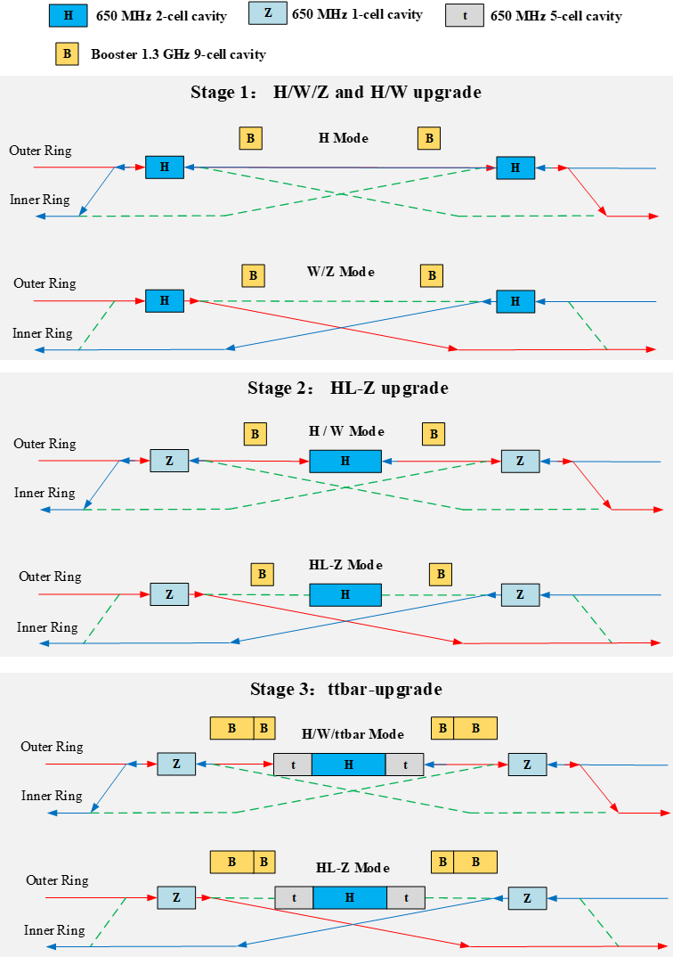
CEPC TDR RF Parameters (Collider Ring)
Version. 2022.01.12. Machine parameters: 2021.11 30 MW SR power per beam for each mode. ttbar and Higgs half fill with common cavities for two rings, W and Z with separate cavities for two rings, Z use high current 1-cell cavity with RF bypass | ttbar |  | Higgs | W | Z
 | Additional 5-cell cavities | Existing 2-cell cavities
Luminosity / IP [10³⁴ cm⁻²s⁻¹] | 0.5 |  | 5 | 16 | 115
RF voltage [GV] | 10 (7.8 + 2.2) |  | 2.2 | 0.7 | 0.12
Beam current / beam [mA] | 3.4 |  | 16.4 | 84 | 803
Bunch charge [nC] | 32 |  | 22 | 21.6 | 22.4
Bunch length [mm] | 2.9 |  | 3.9 | 4.9 | 8.7
650 MHz cavity number | 240 | 240 | 240 | 120/ring | 30/ring
Cell number / cavity | 5 | 2 | 2 | 2 | 1
Gradient [MV/m] | 28.5 | 20 | 20 | 12.7 | 8.7
Q₀ @ 2 K at operating gradient (long term) | 5E10 | 2E10
HOM power / cavity [kW] | 0.4 | 0.16 | 0.45 | 0.93 | 2.9
Input power / cavity [kW] | 194 | 56 | 250 | 250 | 1000
Optimal Q_{L} | 1E7 | 7E6 | 1.6E6 | 6.4E5 | 7.5E4
Optimal detuning [kHz] | 0.01 | 0.02 | 0.1 | 0.9 | 13.3
Cavity number / klystron | 4 | 12 | 2 | 2 | 1
Klystron power [kW] | 1400 | 1400 | 800 | 800 | 1400
Klystron number | 60 | 20 | 120 | 60 | 60
Cavity number / cryomodule | 4 | 6 |  |  | 1
Cryomodule number | 60 | 40 |  |  | 30
Total cavity wall loss @ 2 K [kW] | 9.5 | 4.7 |  | 1.9 | 0.45
RF staging and bypass. Seamless mode switching.
Z lower lumi in Stage 1.
If start from Stage 2: W~1/2 Lumi, Z~1/10 Lumi.
Transfer Higgs/ttbar RF power to high lumi Z.
Klystron power and HOM handling capacity allow for 50 MW upgrade of ttbar, H, W. Add 30 cavities for Z 50 MW upgrade.

Slide 6
CEPC TDR RF Parameters (Booster Ring)
Version. 2022.01.12. Machine parameters: 2021.11 30 MW Collider SR power per beam for each mode. 20 GeV injection. | ttbar | Higgs off/on-axis | W | Z high current
Extraction beam energy [GeV] | 180 | 120 | 80 | 45.5
Extraction average SR power [MW] | 0.087 | 0.09 | 0.01 | 0.004
Bunch charge [nC] | 0.96 | 0.7 | 0.73 | 0.83
Beam current [mA] | 0.11 | 0.5/1 | 2.7 | 14.3
Injection RF voltage [GV] | 0.438 | 0.197 | 0.122 | 0.122
Extraction RF voltage [GV] | 9.3 | 2.05 | 0.59 | 0.28
Extraction bunch length [mm] | 1.9 | 1.9 | 1.6 | 0.9
Cavity number (1.3 GHz 9-cell) | 336 | 96 | 64 | 16
Extraction gradient [MV/m] | 26.7 | 20.6 | 8.9 | 17.1
Q₀ @ 2 K at operating gradient (long term) | 1E10
Q_{L} | 4E7 | 1E7
Cavity bandwidth [Hz] | 33 | 130
Peak HOM power per cavity [W] | 0.4 | 1.2/2.3 | 7.8 | 105
Input peak power per cavity [kW] | 7.5 | 16/21.4 | 15 | 31
SSA peak power [kW] (one cavity per SSA) | 10 | 25 | 25 | 40
Cryomodule number (8 cavities per module) | 42 | 12 | 8 | 2
Higgs and ttbar half fill for injection timing with Collider ring. Transient beam loading tolerable.
Transient beam loading of the booster for Higgs on-axis injection tolerable.
Standard quasi-CW TESLA cryomodules for Higgs, W and ttbar.
Two high current 8x9-cell cryomodules for Z with RF bypass, as well as more SSAs (or RF power transfer and combine from Higgs SSAs?) even for 50 MW upgrade. Not the limit for booster Z beam current ramp up.
High gradient high Q 9-cell cavities for ttbar. Narrow bandwidth high gradient cavity voltage ramping through the multipacting region to be studied.
SR, RF power, HOM power, cryogenic duty factors to be calculated with the real time structures.

Slide 7
CEPC SRF Hardware Specifications
Suitable for 30/50 MW SR per beam | H, W, Z high gradient & high Q | HL-Z high current & power | ttbar very high gradient & high Q
Collider 650 MHz Cavity at 2 K | 2-cell VT 4E10 @ 22 MV/m HT 2E10 @ 20 MV/m OP 1.5E10 @ 20 MV/m | 1-cell 1E10 @ 8.7 MV/m | 5-cell VT 6E10 @ 32 MV/m HT 5E10 @ 32 MV/m OP 5E10 @ 28.3 MV/m
Booster 1.3 GHz 9-cell Cavity at 2 K | VT 3E10 @ 24 MV/m HT 3E10 @ 22 MV/m OP 1E10 @ 20 MV/m | 1E10@17 MV/m | VT 3E10 @ 32 MV/m HT 2E10 @ 32 MV/m OP 1E10 @ 26.7 MV/m
650 MHz Input Coupler variable | 300/500 kW variable | 1000 kW | 300 kW variable
650 MHz HOM Coupler | 1 kW | \ | 1 kW
650 MHz HOM Absorber | 5 kW | 10 kW | \

Slide 8
Outline
CEPC SRF system design
CEPC SRF technology R&D
  650 MHz SRF for CEPC Collider
  1.3 GHz SRF for CEPC Booster
  SRF infrastructure

Slide 9
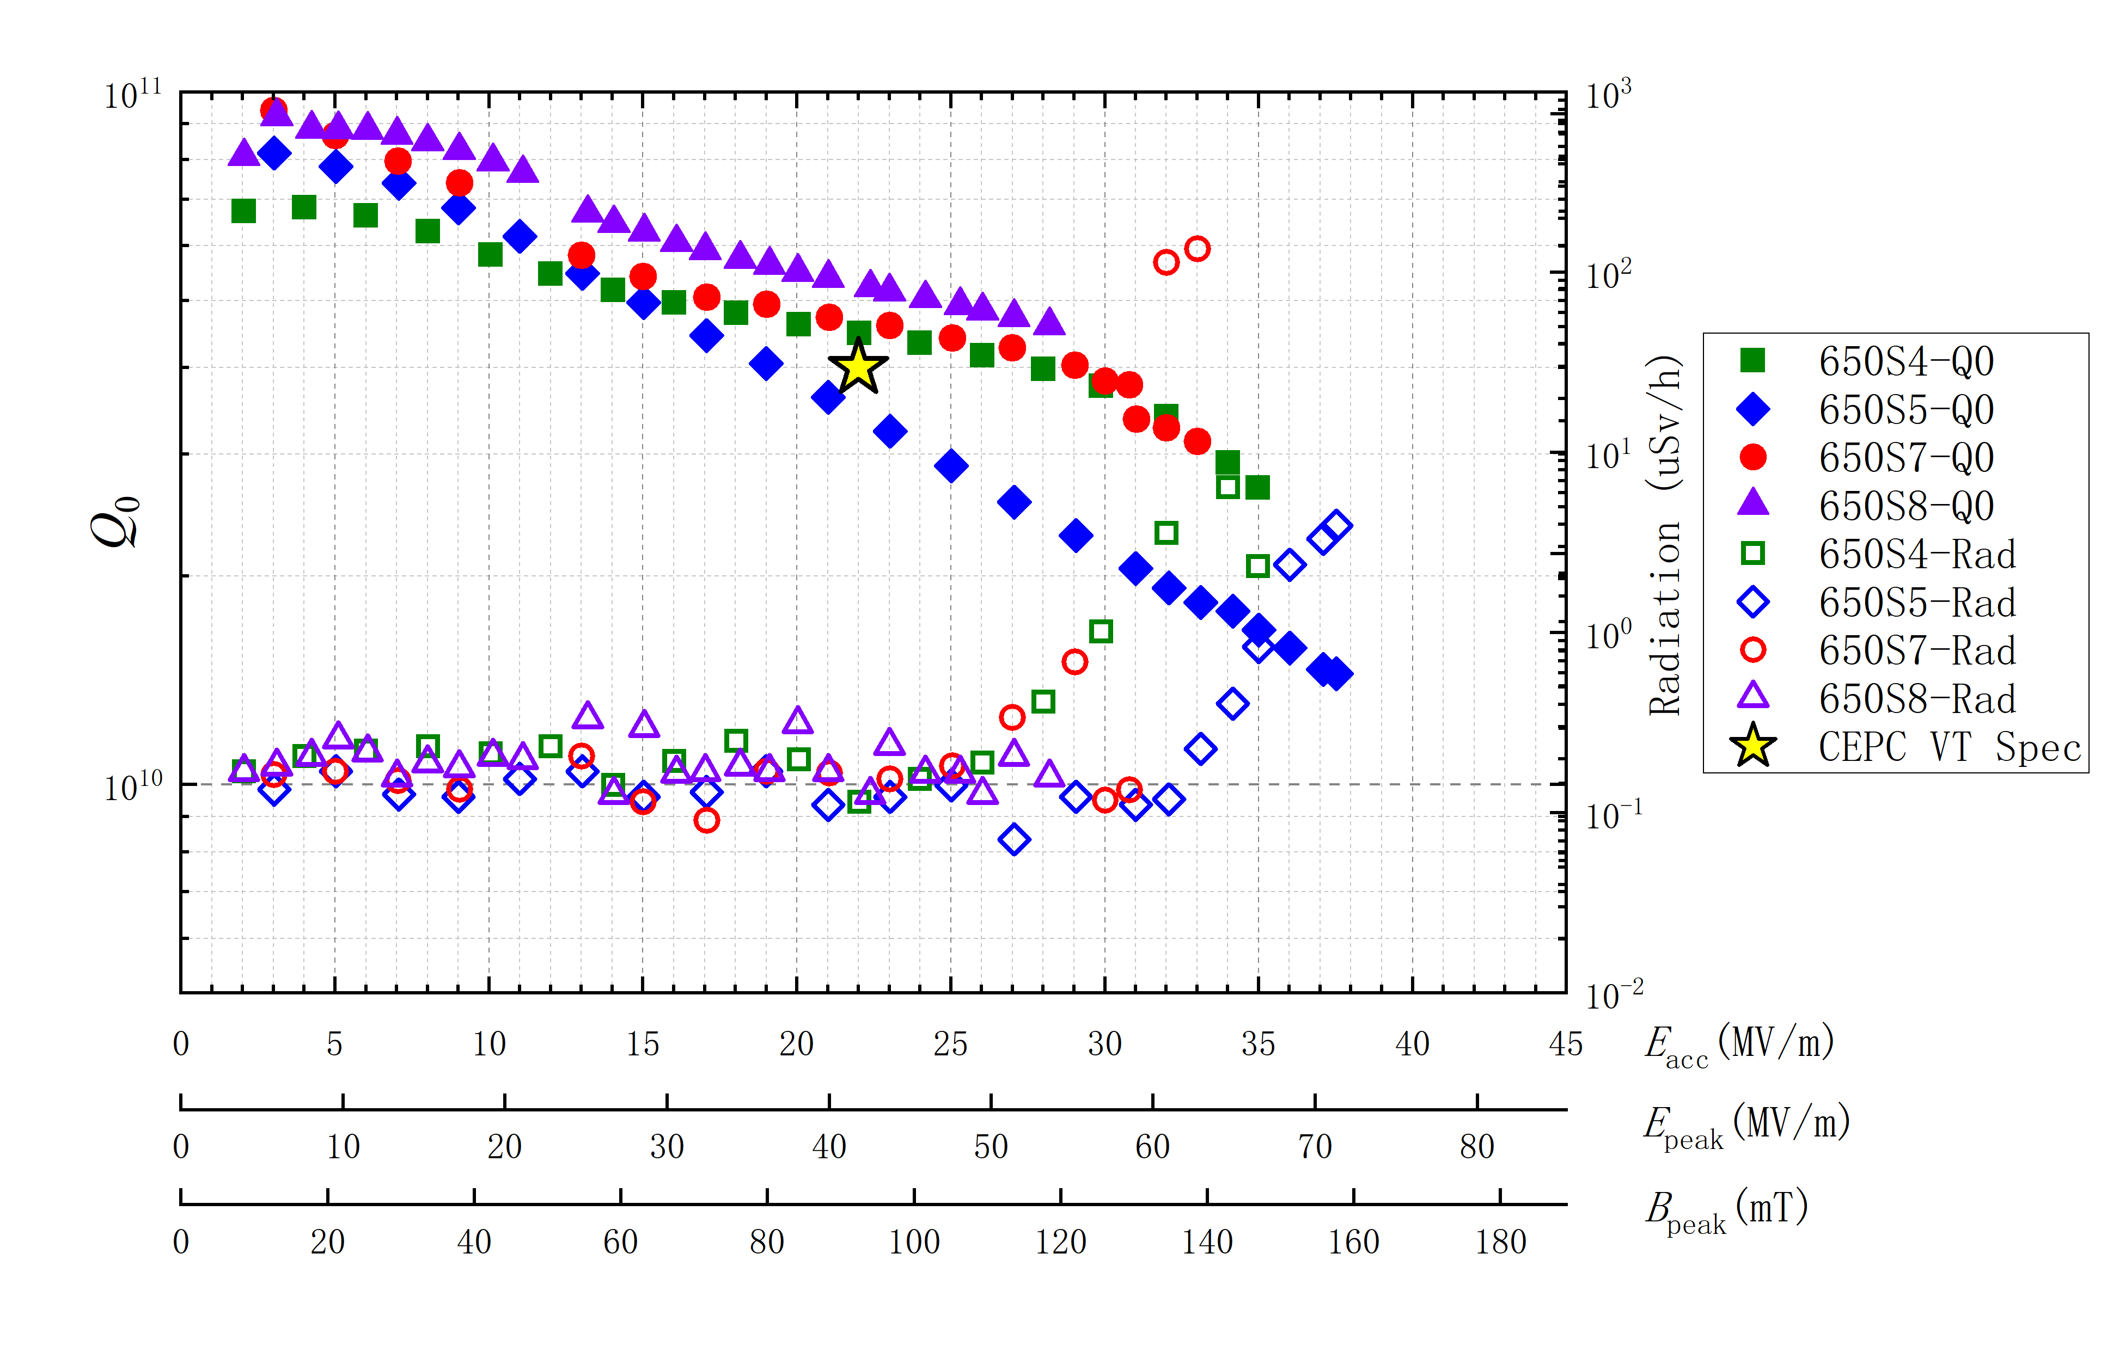
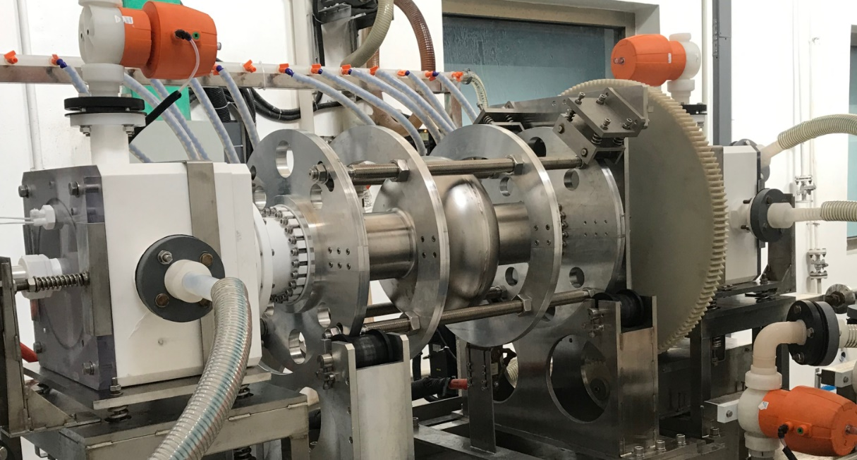
High Gradient 650 MHz Cavity
EP fine grain 1-cell: 3.9E10@30MV/m,1.5E10@37.5MV/m.
State-of-the-art high gradient 650 MHz cavity.
2.0 K
EP of 650 MHz single-cell cavity
Vertical test results of 650 MHz single-cell cavities
S. Jin et al., Materials, 2021, 14(24), 7654

Slide 10
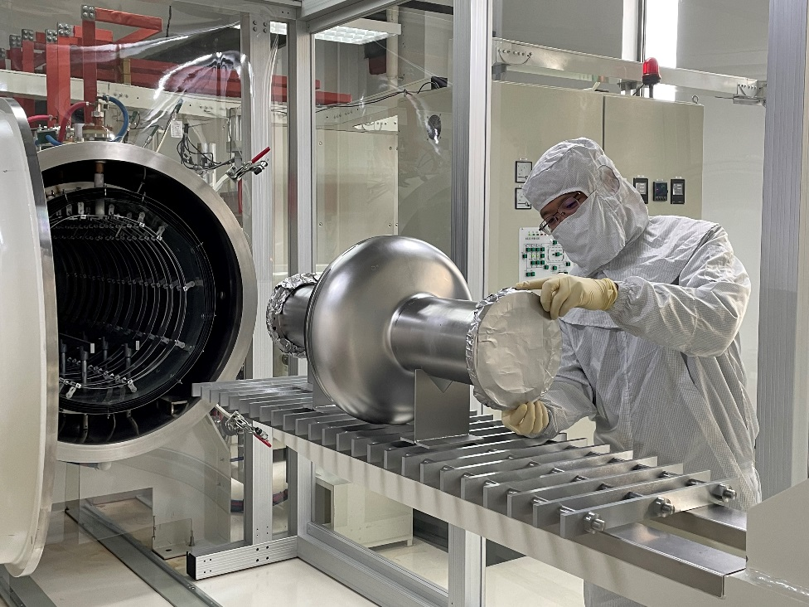
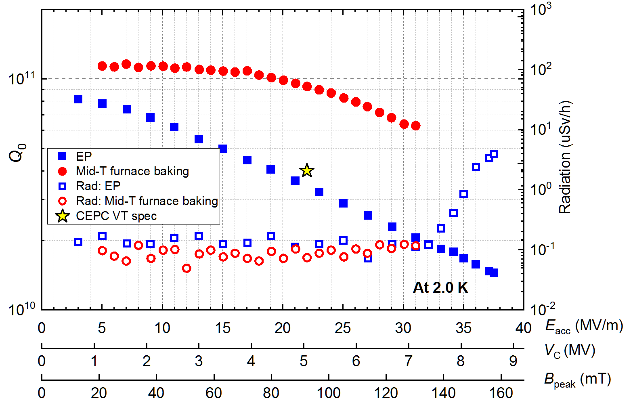
High Q 650 MHz Cavity
After medium-temperature (mid-T) furnace baking, Q reached 6.4E10 at 30 MV/m.
World record high Q at high gradient for 650 MHz cavity.
Mid-T furnace baking of 650 MHz
single-cell cavity
P. Sha et al., Applied Sciences. 2022; 12(2):546.
Vertical test results of 650 MHz single-cell cavity

Slide 11
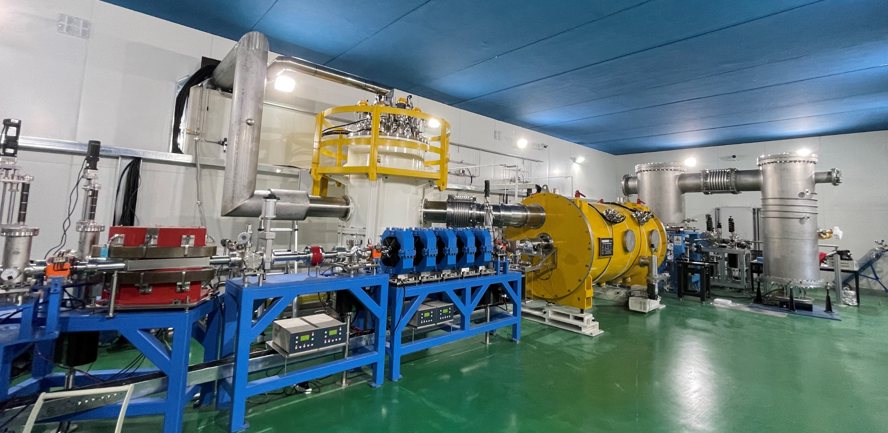
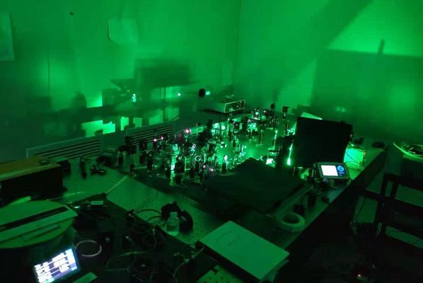
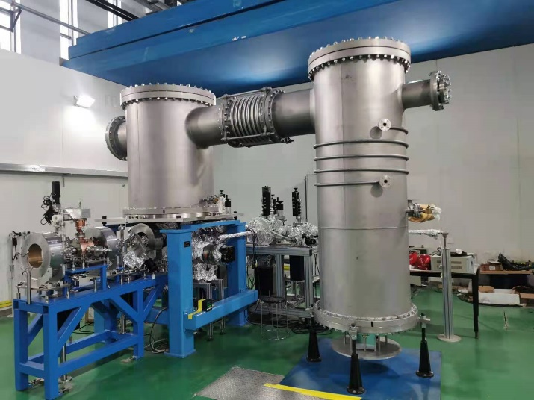
CEPC 650 MHz Test Cryomodule
Cavity string and module assembly. Modul installation in beamline, 2 K cool down test and RT coupler conditioning. Horizontal and beam test soon.
IR laser output to 116 W. Photo-cathode QE to 5 %. DC gun vacuum to 1.5E-10 Pa, voltage to 350 kV. Buncher cavity high power tested.

Slide 12
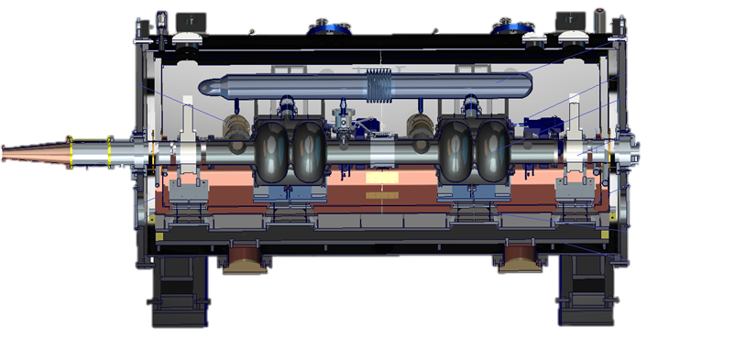
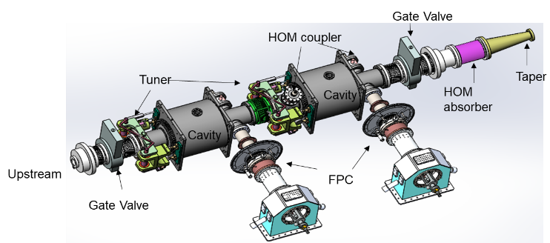
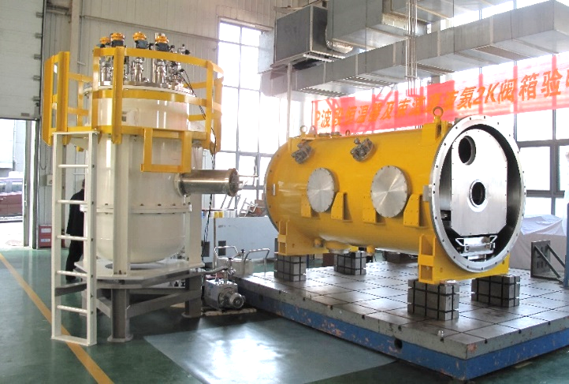
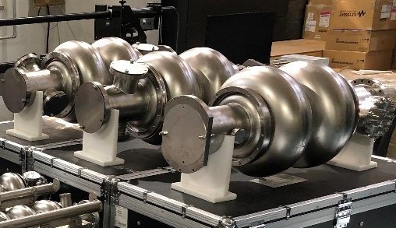
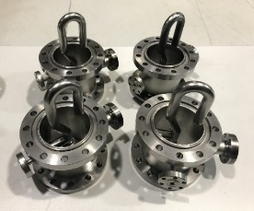
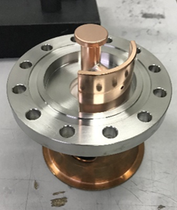
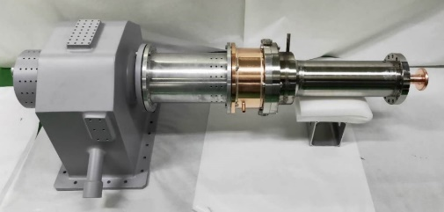
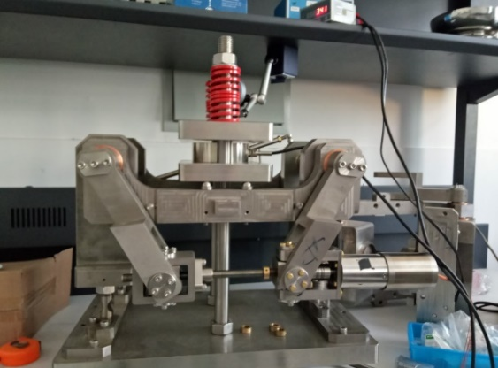
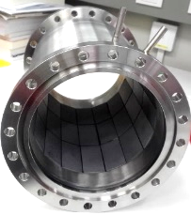
CEPC 650 MHz Test Cryomodule

Slide 13
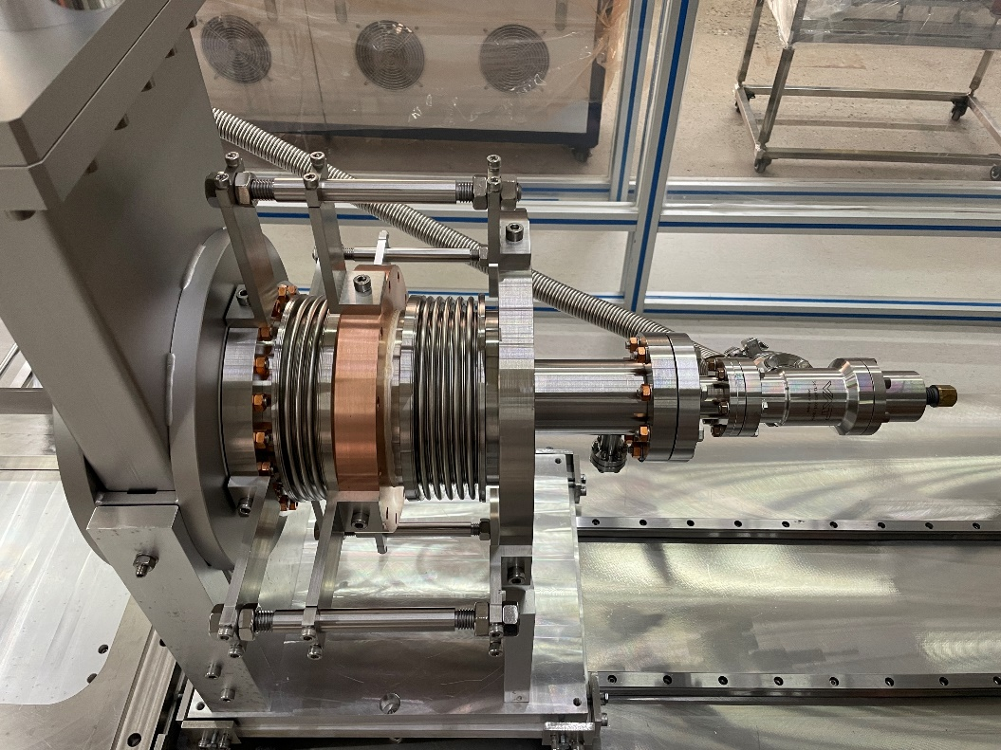
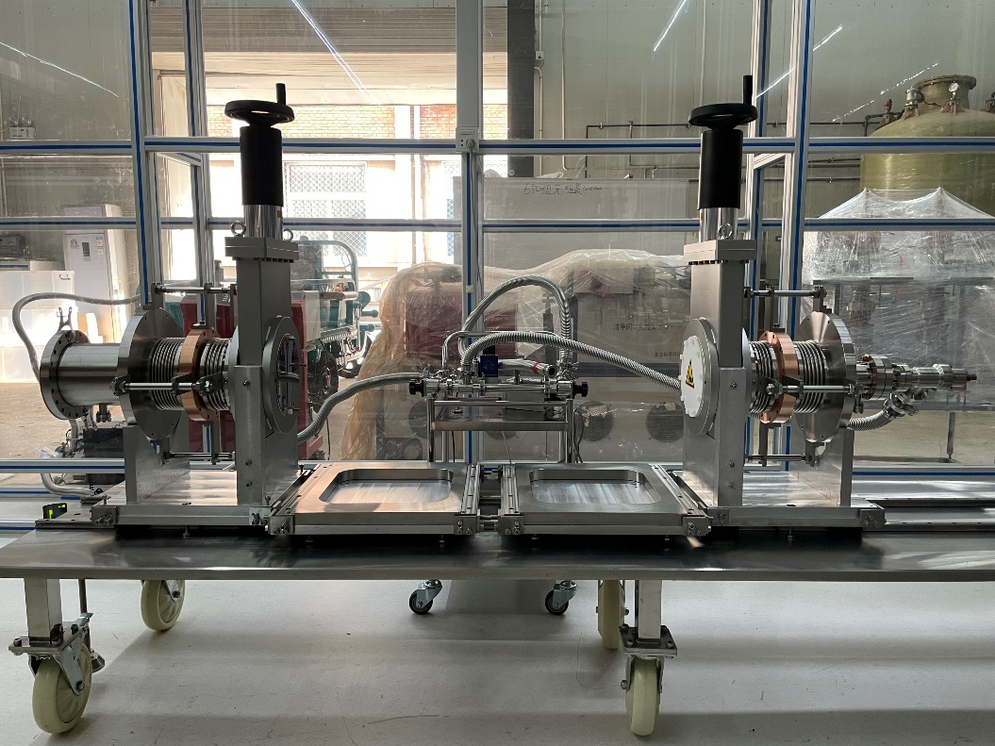
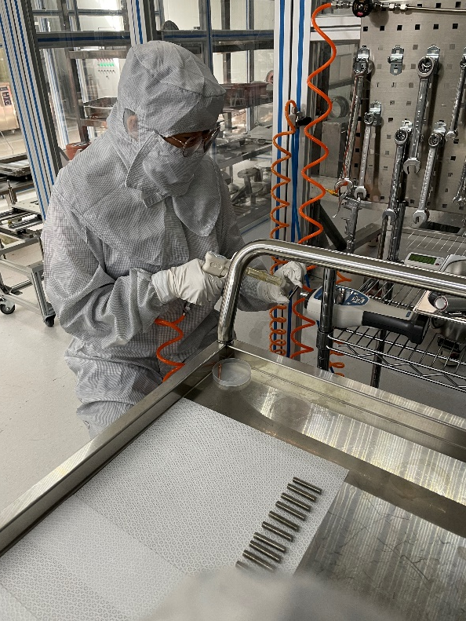
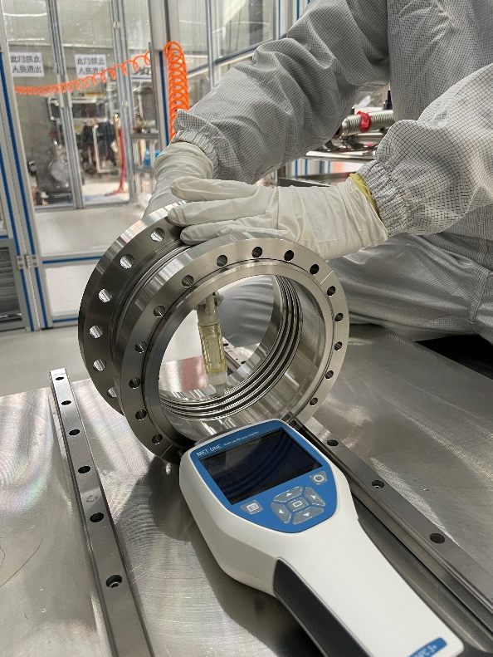
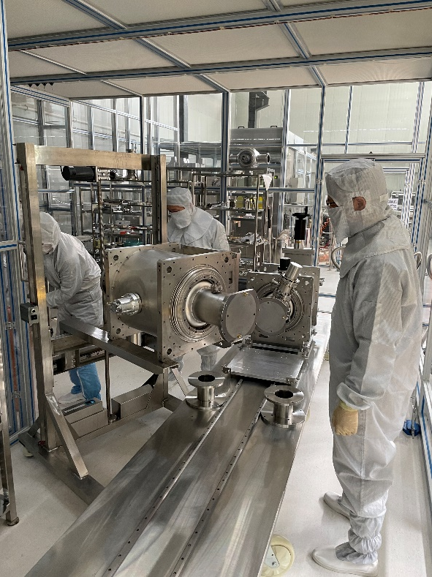
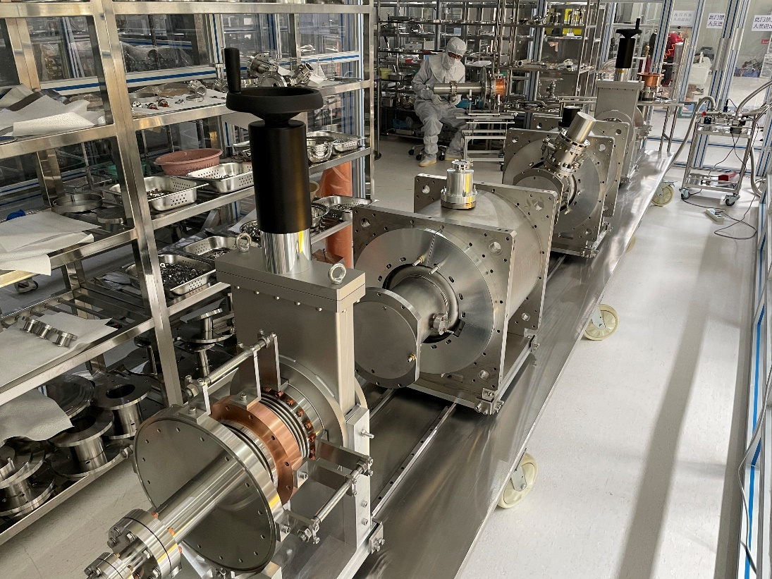
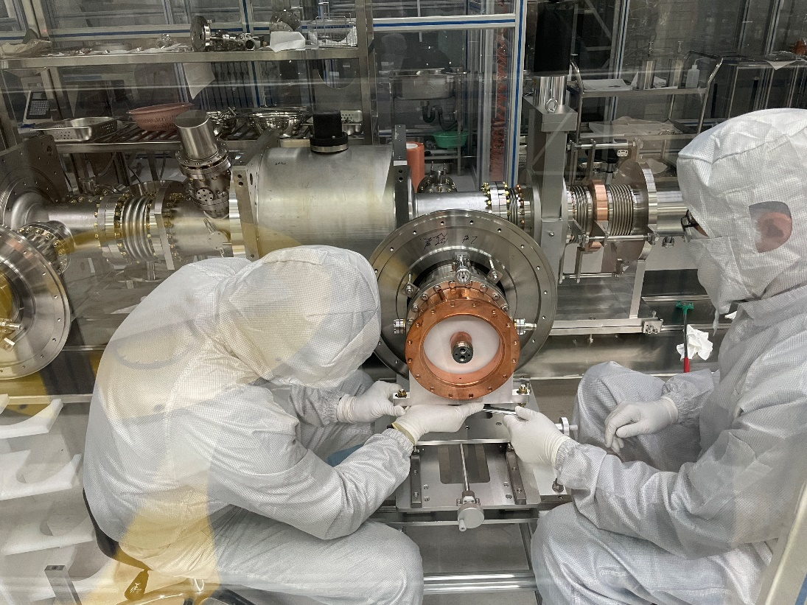
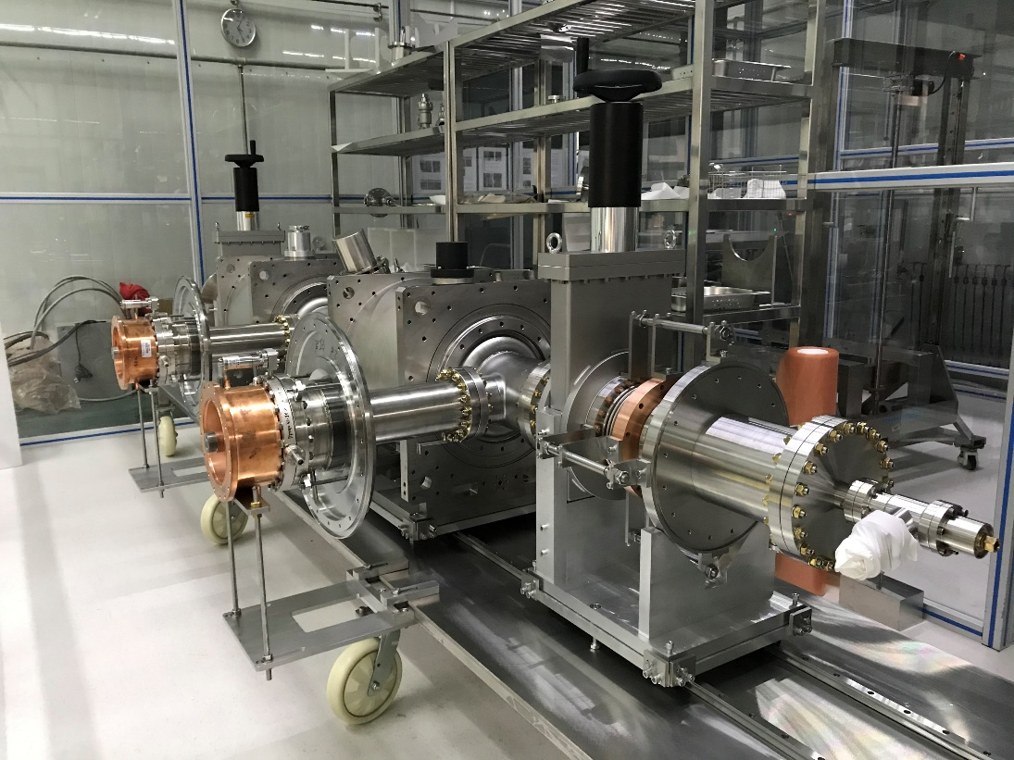
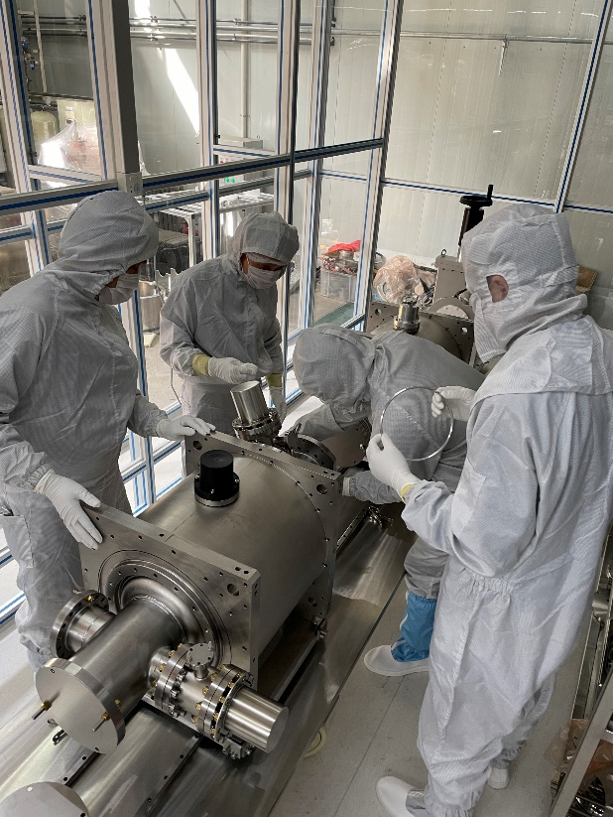
650 MHz 2 x 2-cell Cavity String Assembly

Slide 14
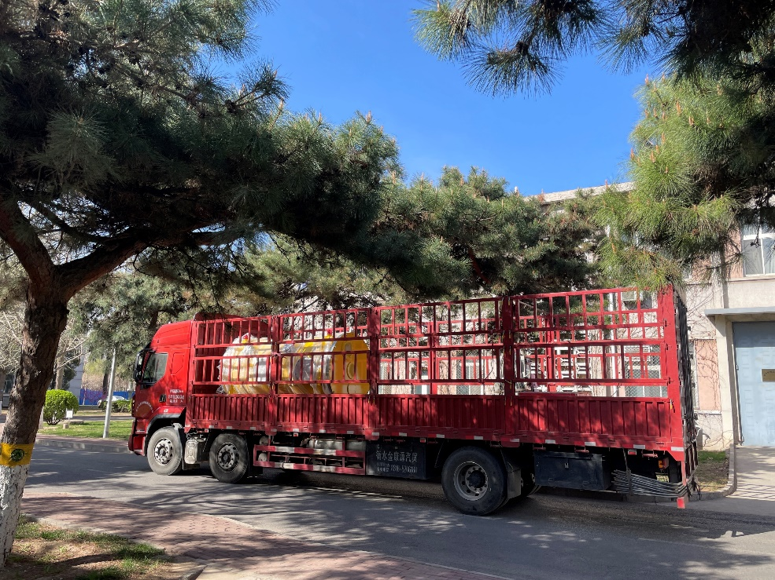
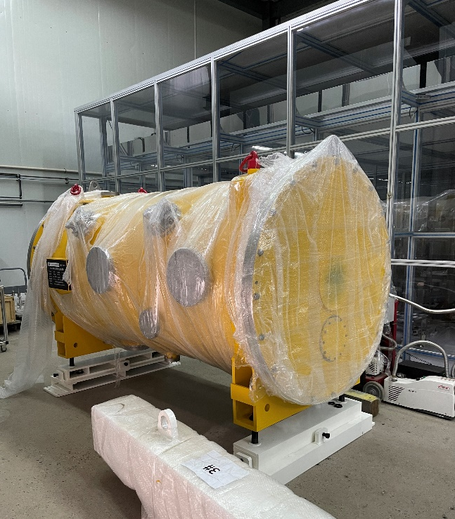
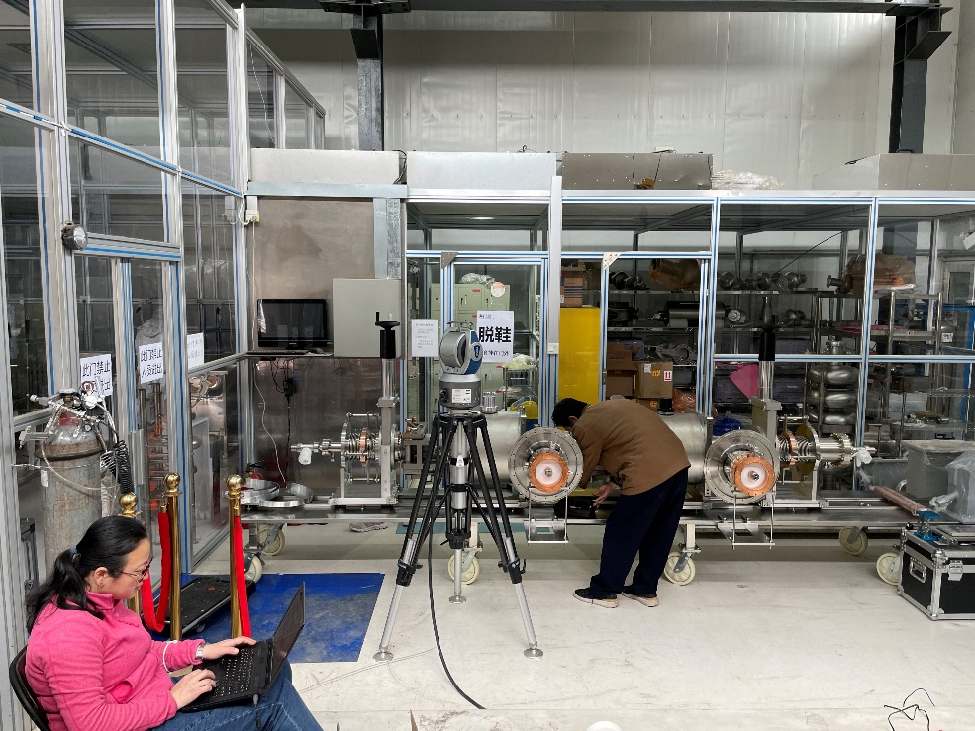
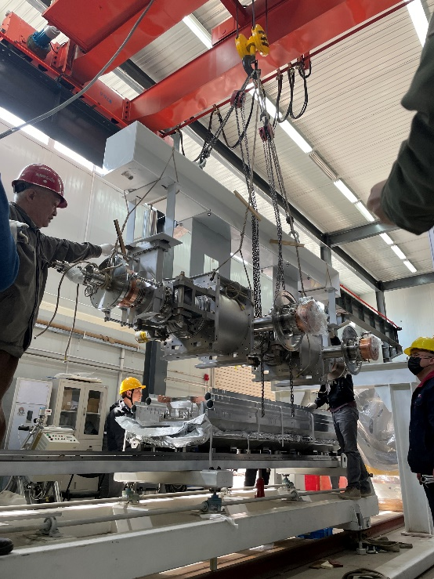
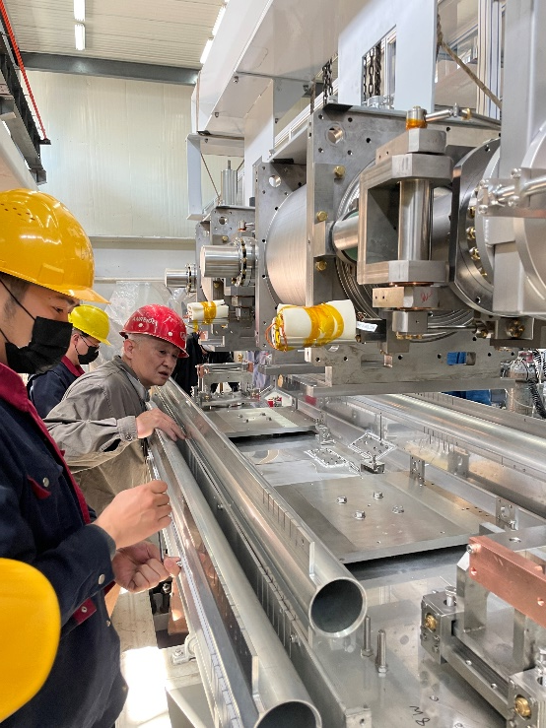
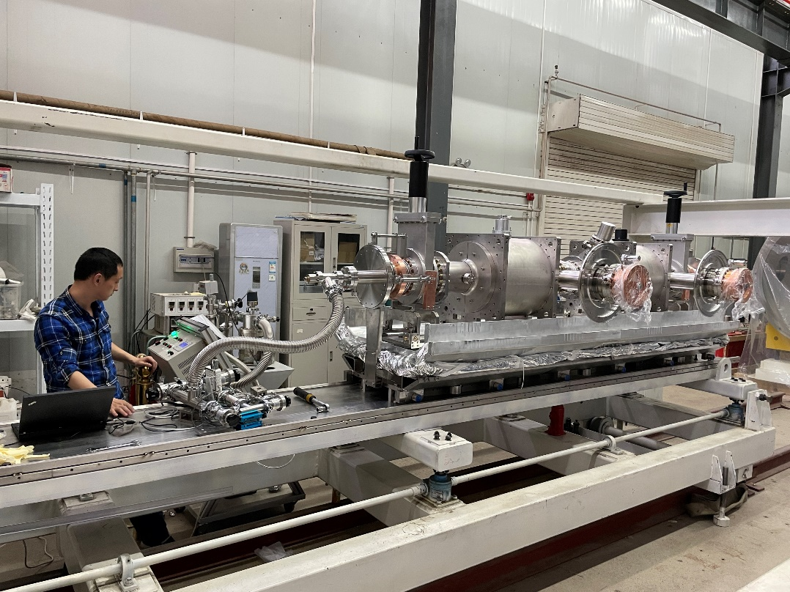
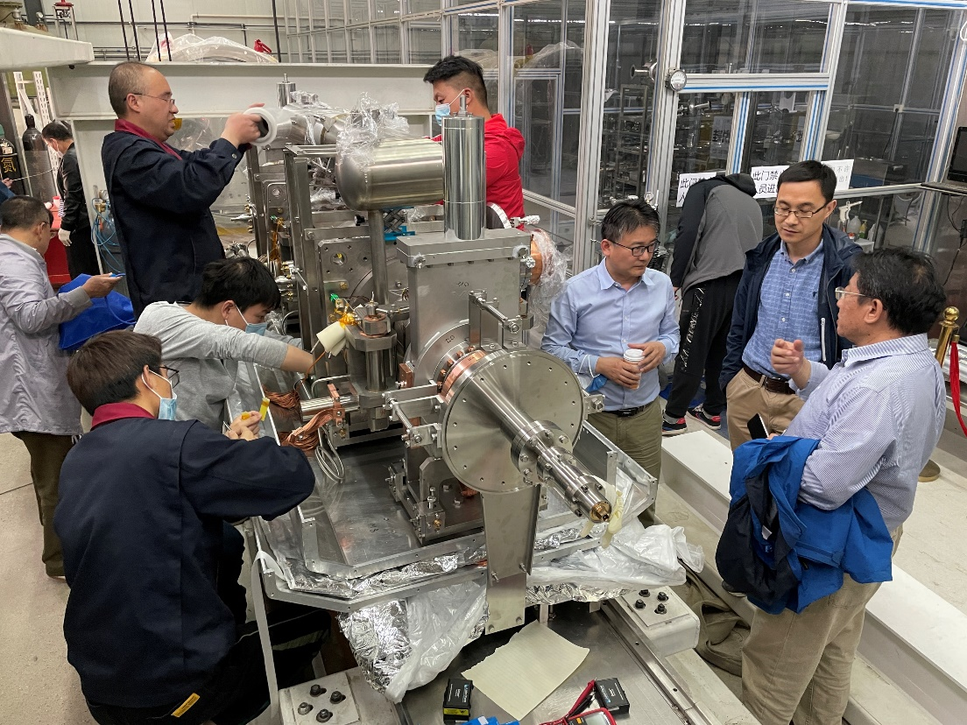
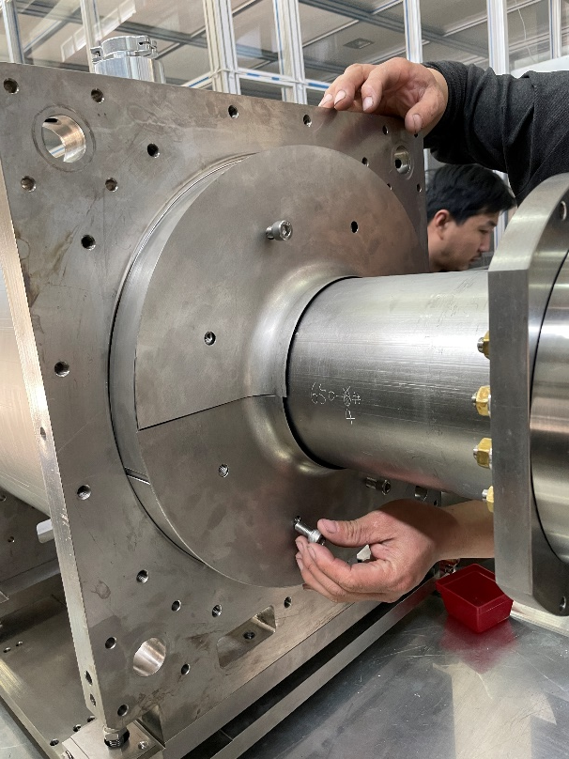
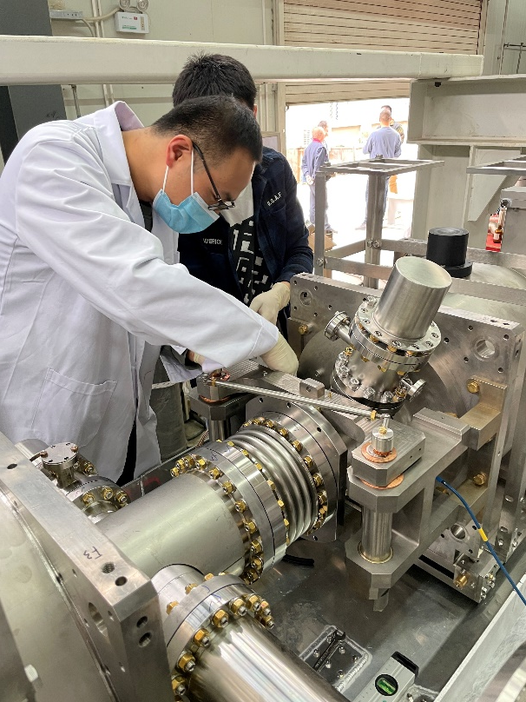
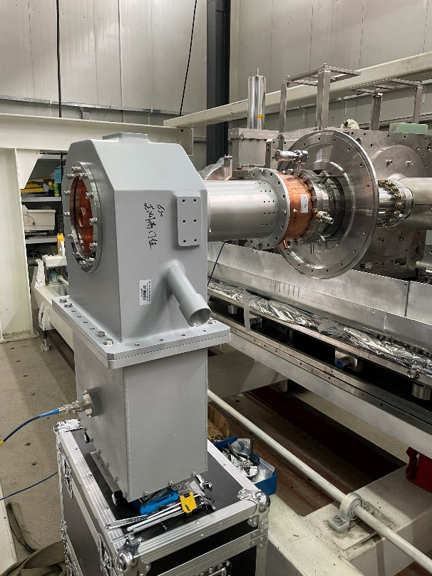
650 MHz Test Cryomodule Assembly

Slide 15
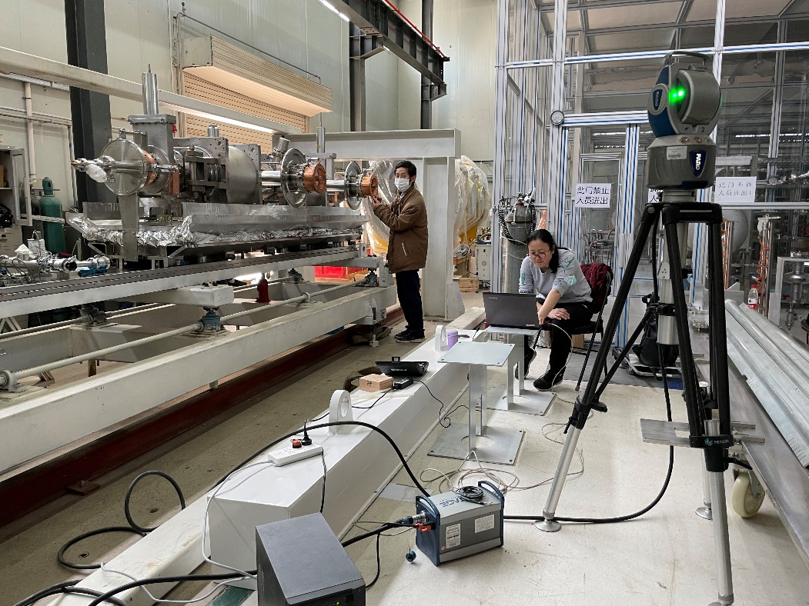
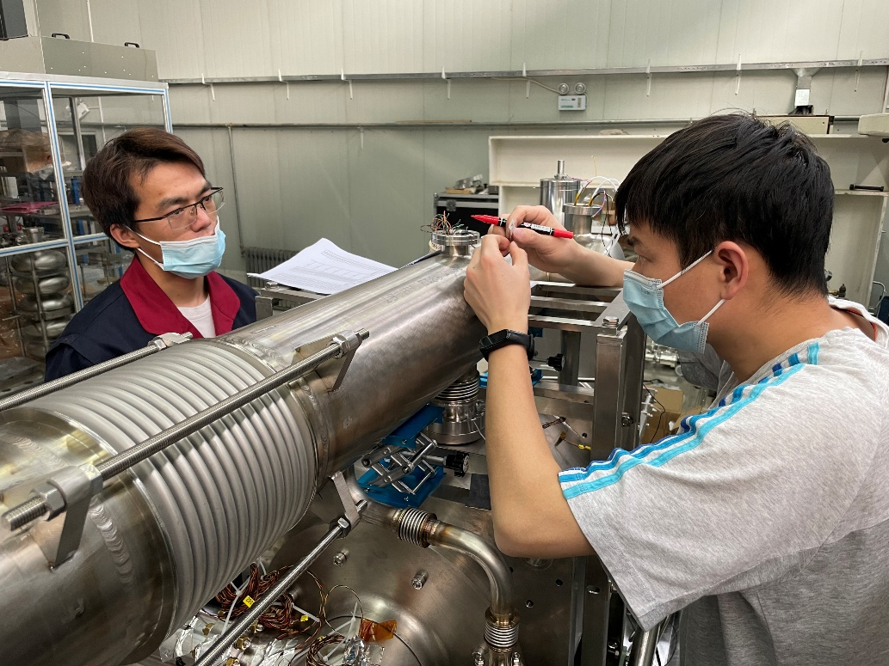
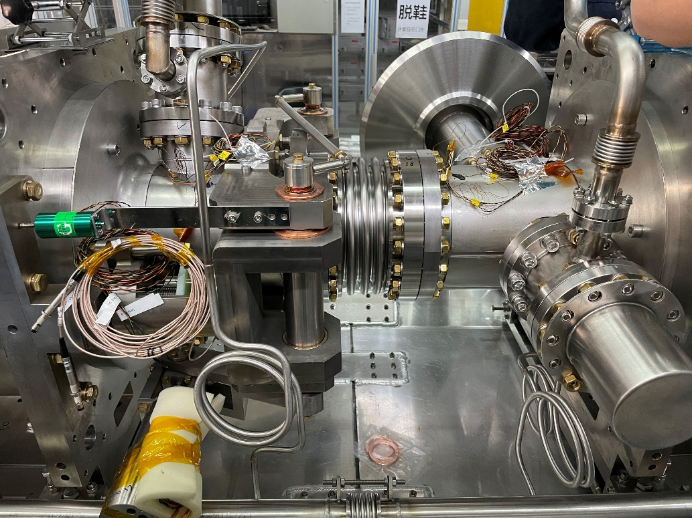
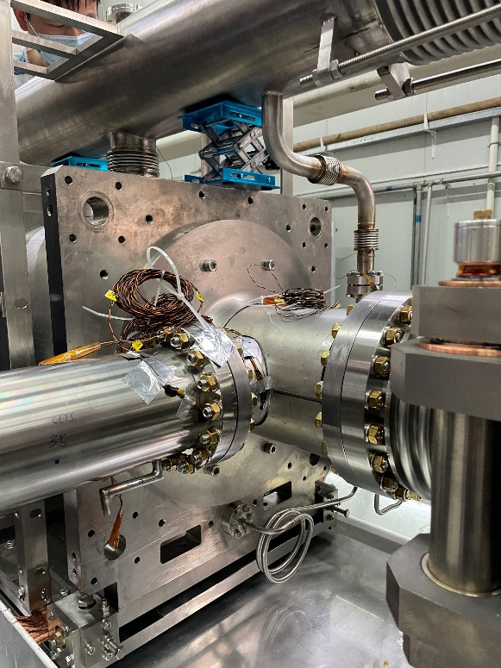
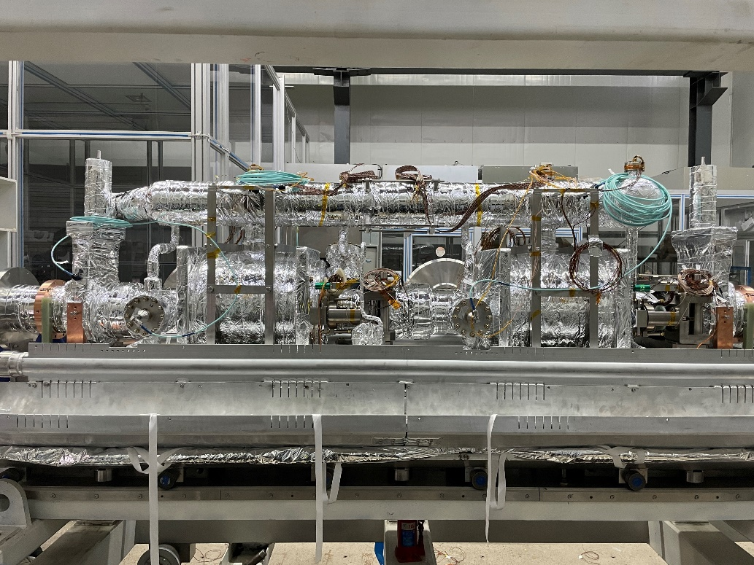
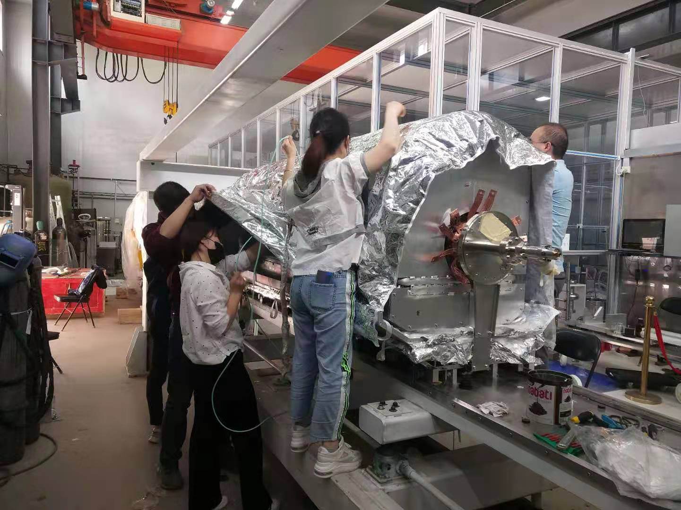
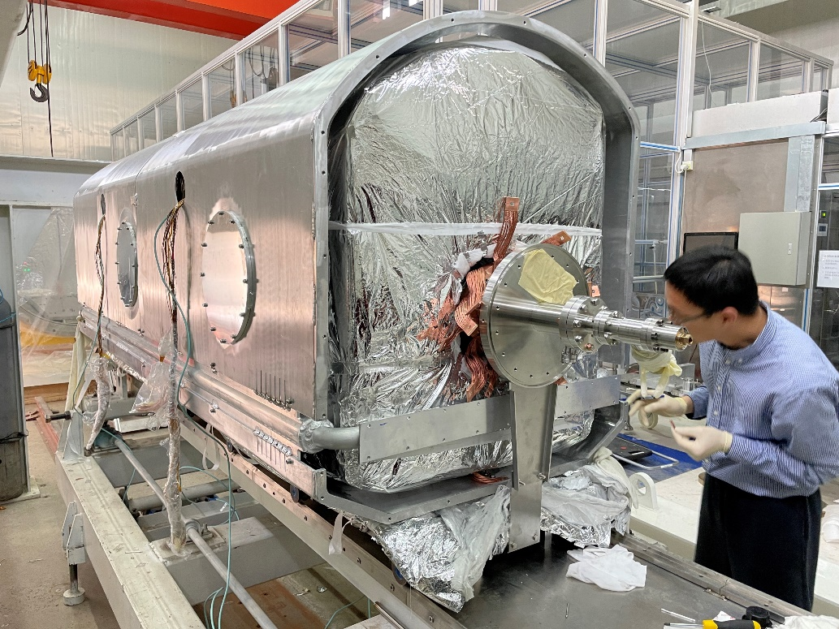
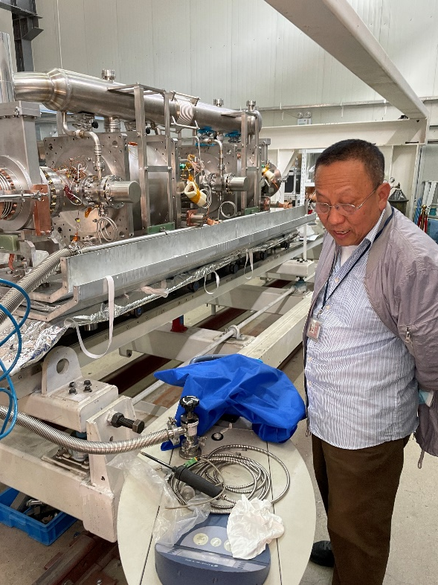
650 MHz Test Cryomodule Assembly

Slide 16
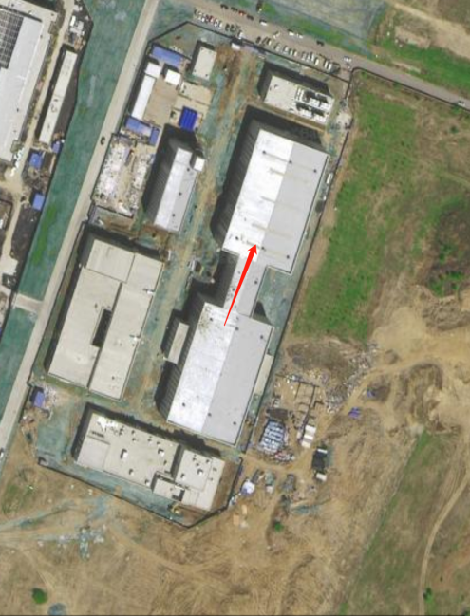
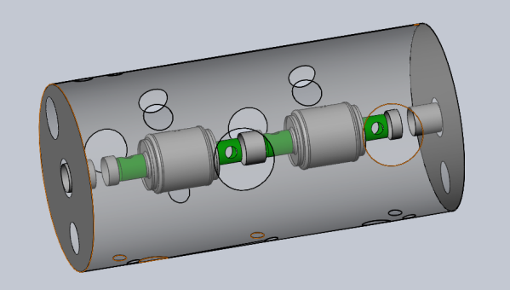
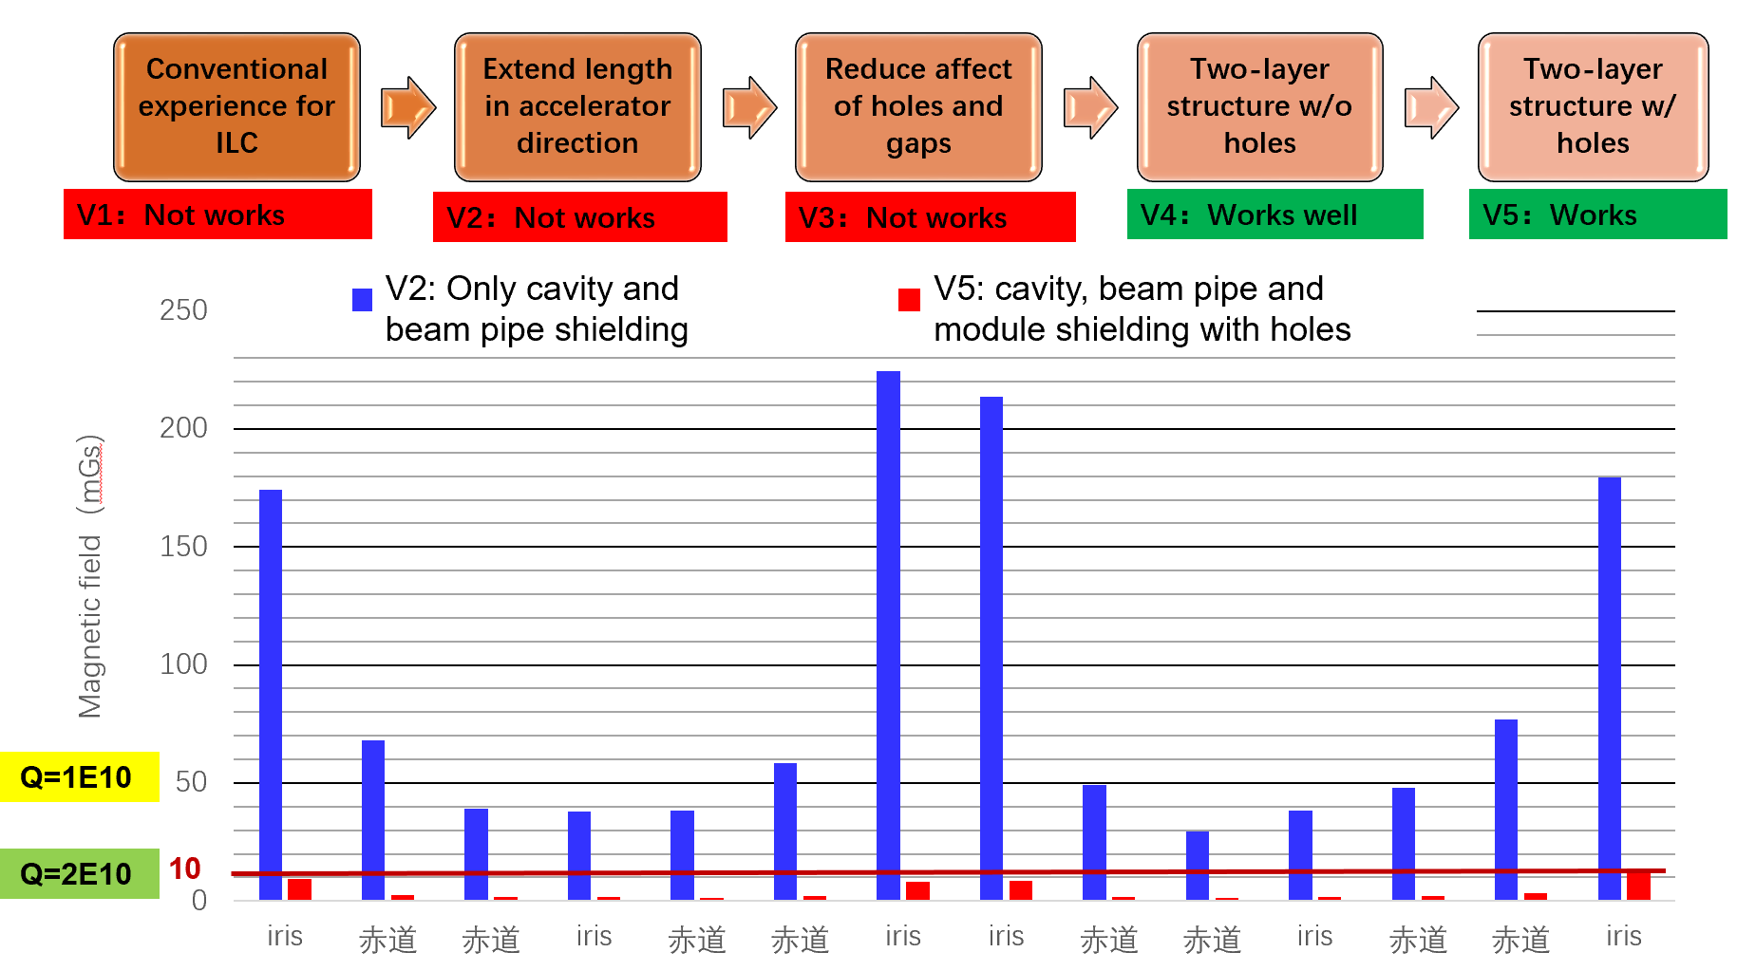
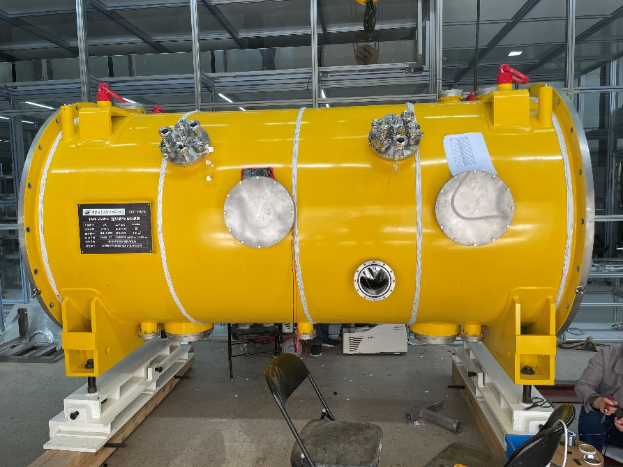
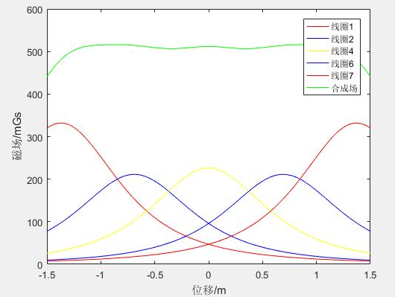

Magnetic Shielding and Compensating
North
Because of beam direction and larger beam pipe than 1.3 GHz, only two shieldings can reach the magnetic field requirement of high Q 650 MHz cavity: cavity (2 K local) shield and module (RT global) shield.
$$R_{mag}=η∙S(l)∙{(B}_{ext}{+B}_{tc})\sqrt{f}$$
Flux trapping ratio: grain size, high-T annealing, fast cold down
Magnetic sensitivity: mean free path and other
Remnant magnetic field: demagnetization, magnetic shield, magnetic compensation
Thermocurrent induced magnetic field
Magnetic compensation with coils

Slide 17
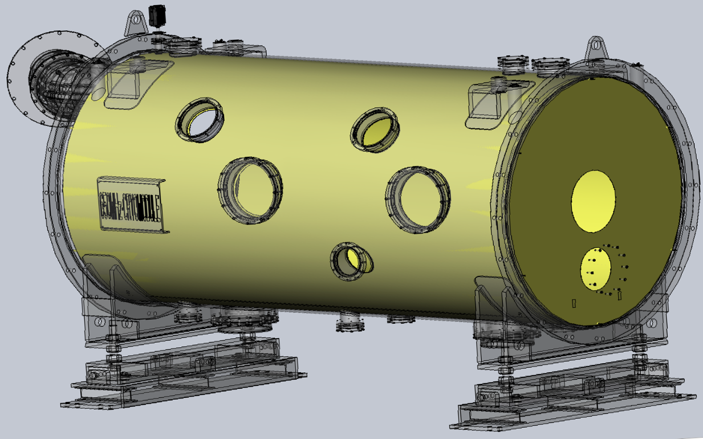




Global Magnetic Shield of the 650 MHz CM

Slide 18



650 MHz Test Cryomodule Assembly

Slide 19




650 MHz Module Transport (IHEP to PAPS 80 km)
Module transport on a frame with isolator springs. Three accelerometers attached.
Max acceleration 0.4 g (average 0.1 g) in the whole process (< 1.5 g spec)
Cavity string vacuum monitored with cold gauge (powered by UPS). No leak.

Slide 20




650 MHz Module Beamline Installation
Upstream gate valve
installation
Downstream HOM absorber, taper, ion pump, gate valve
Upstream beamline
connection
Downstream beamline and valve box connection

Slide 21


650 MHz Module Beamline Installation
Input coupler warm part, doorknob, waveguide
Module in the beamline

Slide 22


650 MHz Module 2 K Cool Down Test
Cavity vacuum @ 2 K: 6E-7 Pa
Cryogenics lines no leak. Most temperatures OK. Input coupler helium gas cooling test (need further optimize).
Frequency: CAV#1 649.856 MHz, CAV#2 649.816 MHz. Tuners stretch the cavities ~150 kHz to 650 MHz.
Input coupler Qin:
  CAV#1: 1.2E6 (HT 35 kW@13 MV/m, Beam Test 49 kW@9.7 MV/m, 10 mA)
  CAV#2: 1.8E6 (HT 35 kW@16 MV/m, Beam Test 76 kW@15 MV/m, 10 mA)
HOM couplers fundamental mode Qe (double notch, tuning not needed): #1 6.8E13, #2 1.9E13. #3 2.1E12.
Flux gates on cavity wall in the helium vessel: < 3 mG (with cavity local and vacuum vessel global shields)
Warm up for couplers RT conditioning (up to 35 kW full reflection limited by the SSA).

Slide 23




650 MHz HLRF and LLRF
150 kW (total) solid state amplifier
LLRF and timing system for 650 MHz module, laser, DC-Gun and buncher.

Slide 24
Outline
CEPC SRF system design
CEPC SRF technology R&D
  650 MHz SRF for CEPC Collider
  1.3 GHz SRF for CEPC Booster
  SRF infrastructure

Slide 25

Word Record high Q 9-cell cavity at high gradient
1300-N11
Mid-T furnace baked
Bulk EP+900C+oxidation in air +300C+HPR
Vertical Test on Dec 31, 2021 at PAPS VTS
4.5E+10 @ 16 MV/m
4.3E+10 @ 31.3 MV/m

Slide 26
1.3 GHz High Q Mid-T Cavity Horizontal Test
Step 1a: Horizontal test with vertical test antenna (self excitation mode) at IHEP campus
  Low Q0 (unknow heat load?) , abnormal HOM notch change (HOM can thermal anchor?)
  Flux gates and thermal sensors on cavity outside wall in helium vessel, double-layer magnetic shield and foils, thermal straps (HOM coupler, beam pipe), fast cool down and flux expulsion
Step 1b: Horizontal test with vertical test antenna (self excitation mode) at PAPS
  Successful, similar Q0 as vertical test, abnormal frequency and field flatness change (bellow support, overpressure)
  Add thermal intercepts for cables, Q0 measurement comparison (mass-flow vs RF), input coupler flange heating
Step 2: Horizontal test with input coupler (self excitation mode) at PAPS
  Ongoing, got high Q0 for four 9-cell cavities but unstable for long time at high gradient (sporadic quench), need long-time conditioning, similar to LCLS-II and LCLS-II-HE cavities.
  Input coupler thermal sensors, interlocks, thermal straps, RT online conditioning, cavity active pumping
Step 3: Horizontal test with input coupler and tuner (GDR mode) at PAPS
  Tuner, LLRF, microphonics …

Slide 27






1.3 GHz High Q Mid-T Cavity Horizontal Test

Slide 28


1.3 GHz High Q Mid-T Cavity Horizontal Test
Horizontal test with high power input coupler (self excitation mode)
IHEP 1.3 GHz 9-cell Cavity Vertical Test

Slide 29

1.3 GHz High Q Cryomodule (8x9-cell)
CEPC booster 1.3 GHz SRF technology R&D and industrialization in synergy with domestic CW FEL projects.
1.3 GHz 8x9-cell high Q cryomodule prototype
Component fabrication in 2021 to mid 2022
Assemble and horizontal test in 2022
Ship to Dalian in 2023

Slide 30
Outline
CEPC SRF system design
CEPC SRF technology R&D
  650 MHz SRF for CEPC Collider
  1.3 GHz SRF for CEPC Booster
  SRF infrastructure

Slide 31








New SRF Facility in Full Operation

Slide 32








New SRF Facility in Full Operation

Slide 33
Summary
CEPC RF system design and parameters are converging towards TDR. Many challenges in system design and technical R&D.
Achieved high Q and high gradient cavity with mid-T baking.
650 MHz and 1.3 GHz module prototyping in progress.
New SRF facility PAPS at IHEP Huairou Campus is supporting these R&D as well as the near term cryomodule mass production practice for the domestic projects.

Slide 34

Thank you

