Slide 1


CEPC Superconducting Quadrupole Magnet R&D
Yingshun Zhu, Xiangchen Yang, Ran Liang, Chuang Shen
Institute of High Energy Physics, Chinese Academy of Sciences
Jan. 13, 2022
Mini-workshop: Accelerator Physics - Key Beam Physics and Technologies Issues for Colliders

Slide 2
Outline
Introduction
Research of CEPC IR superconducting quadrupole magnet
Development status of 0.5m single aperture QD0 short
model magnet
Summary

Slide 3
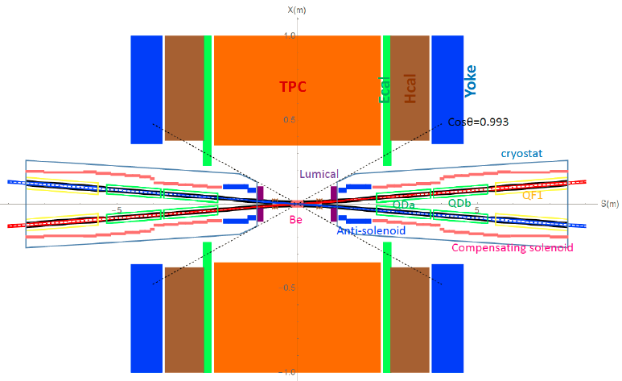
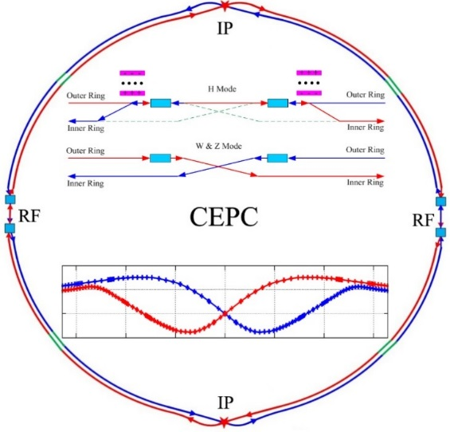
Introduction
To greatly squeeze the beam for high luminosity, compact high gradient final focus quadrupole magnets are required on both sides of IP points.
The CDR requirements of Final Focus quadrupoles (QD0 and QF1) are based on L* of 2.2 m, beam crossing angle of 33 mrad.
Table 1: CDR requirements of Interaction Region quadrupole magnets for Higgs
Magnet | Central field gradient (T/m) | Magnetic length (m) | Width of GFR (mm) | Minimal distance between two aperture beam lines (mm)
QD0 | 136 | 2.0 | 19.6 | 72.6
QF1 | 110 | 1.48 | 27.0 | 146.20
Sketch of CEPC Collider ring
CEPC MDI layout

Slide 4
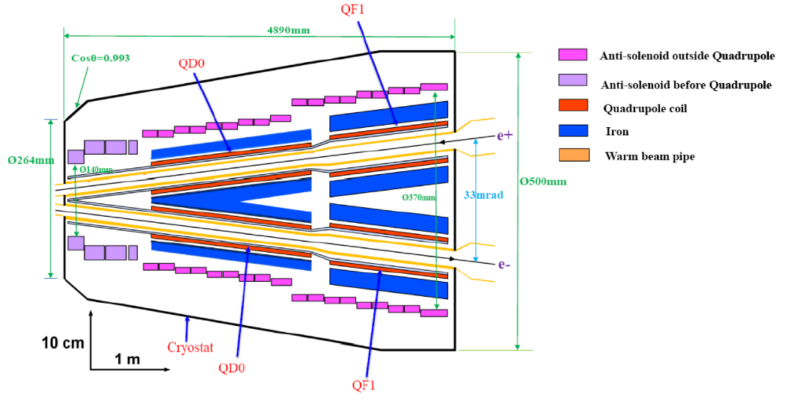
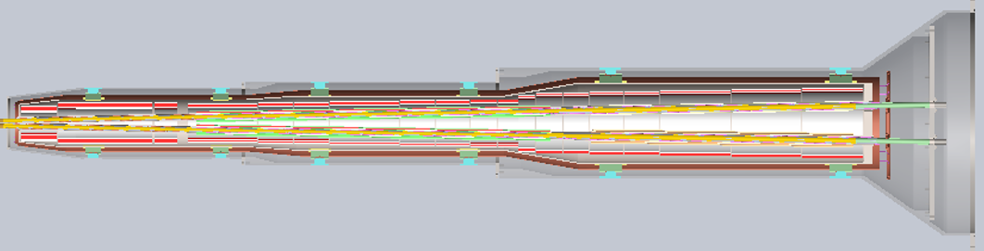
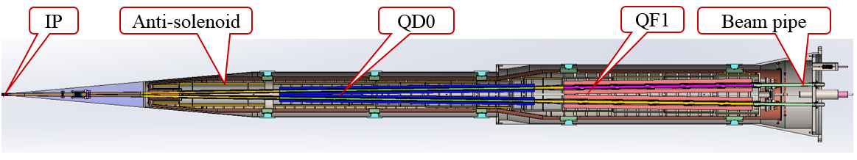
Introduction
QD0 and QF1 magnets are operated inside the field of Detector solenoid magnet with a central field of 3.0 T.
To cancel the effect of the detector solenoid field on the beam, anti-solenoids before QD0, outside QD0 and QF1 are needed.
QD0, QF1, and anti-solenoid coils are in the same cryostat.
CEPC MDI SC Magnets start at z=1.13m, including: superconducting QD0, QF1, anti-solenoid on each side of the IP point.
Schematic layout of QD0, QF1, and anti-solenoid

Slide 5
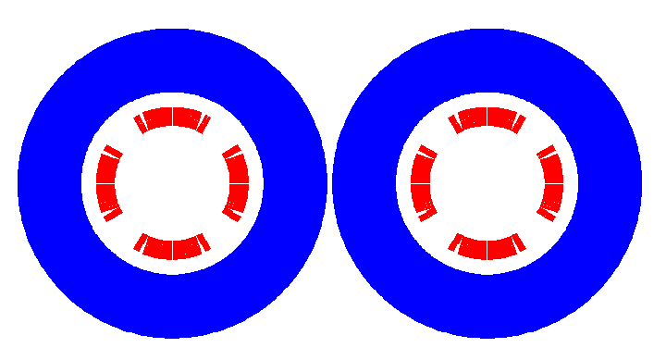
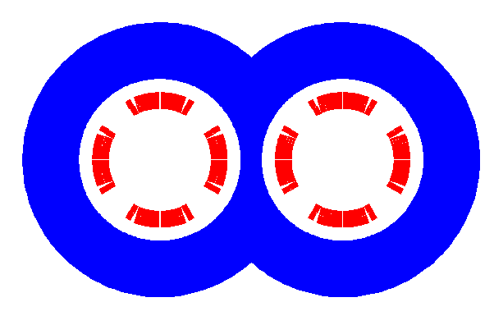
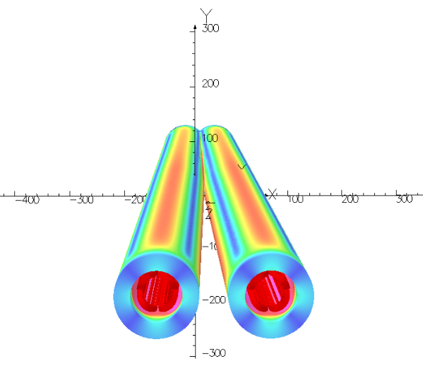

Research of CEPC IR superconducting quadrupole magnet
QD0 CDR: 136T/m, inner diameter 40mm, length 2m.
Two options design: 1) with iron, 2) iron-free Inner radius of beam pipe:10 mm
Baseline: QD0 design with iron option
Iron yoke: enhance field gradient, reduce current, shield field crosstalk.
Not enough space. Iron core in the middle part is shared by two apertures.
cos2θ quadrupole coil. Meet all requirements.

Slide 6
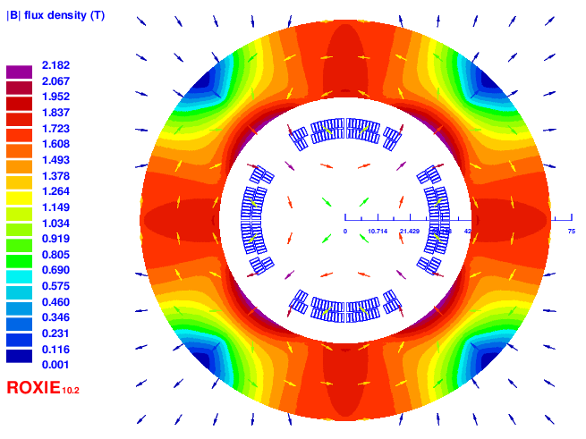
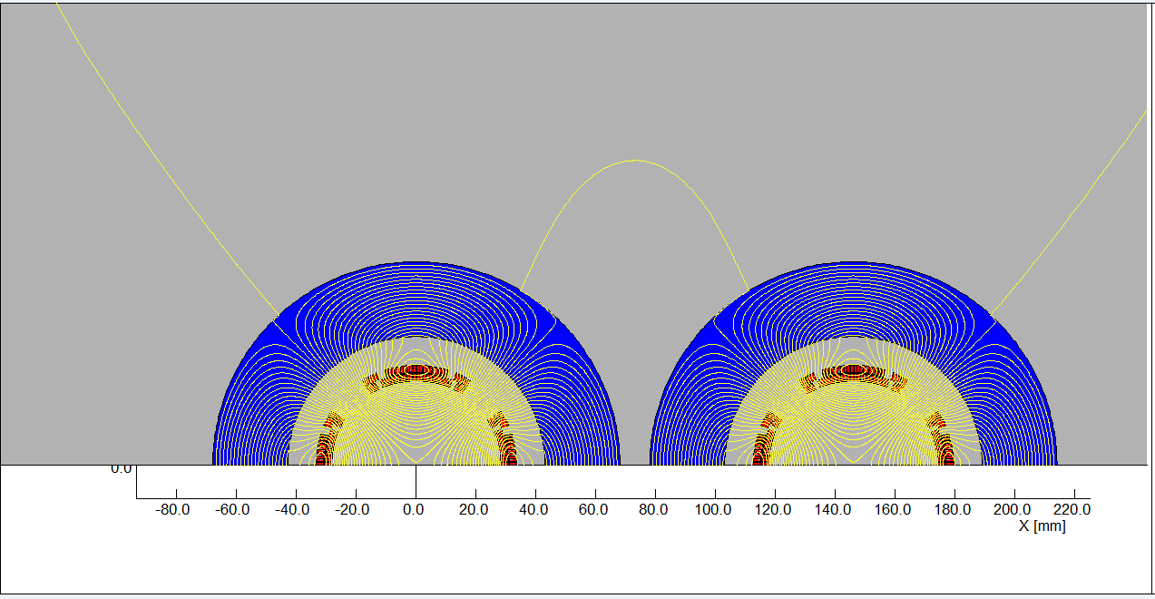
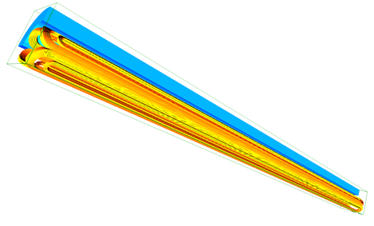
Design of superconducting quadrupole QF1
Since the distance between the two apertures is much larger, the field cross talk between the two apertures of QF1 is not a problem using iron yoke.
After optimization, QF1 coil consists of four coil blocks in two layers separated by wedges, and there are 28 turns in each pole.
Current: 2280A. The field gradient, magnetic length, field harmonics meet the design requirement.
Each systematic field harmonics is smaller than 1 unit (1×10⁻⁴).
Non-systematic field harmonics as a result of field cross talk can be neglected.
Field simulation of QF1

Slide 7
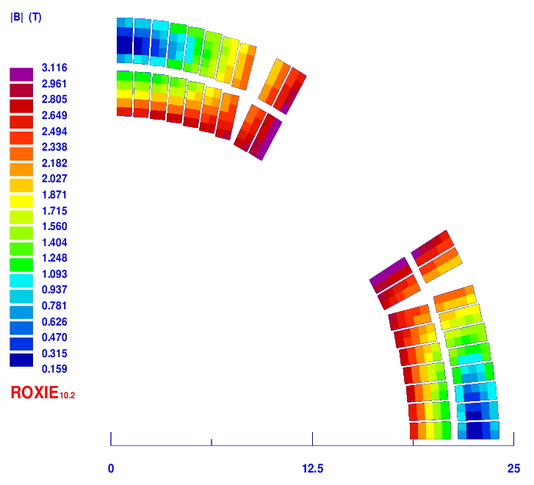
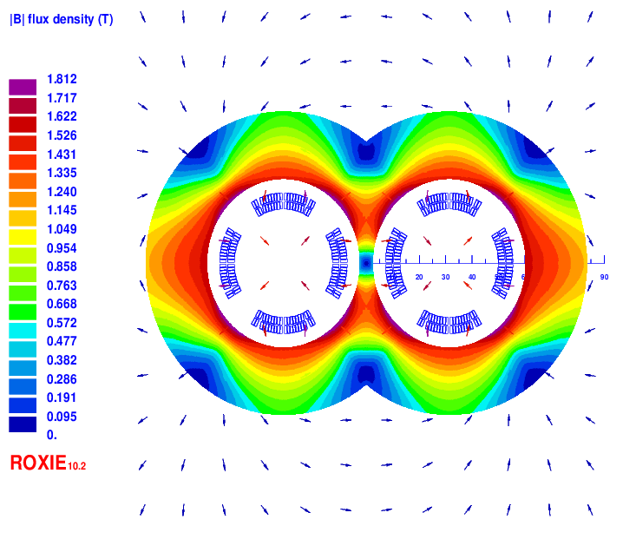
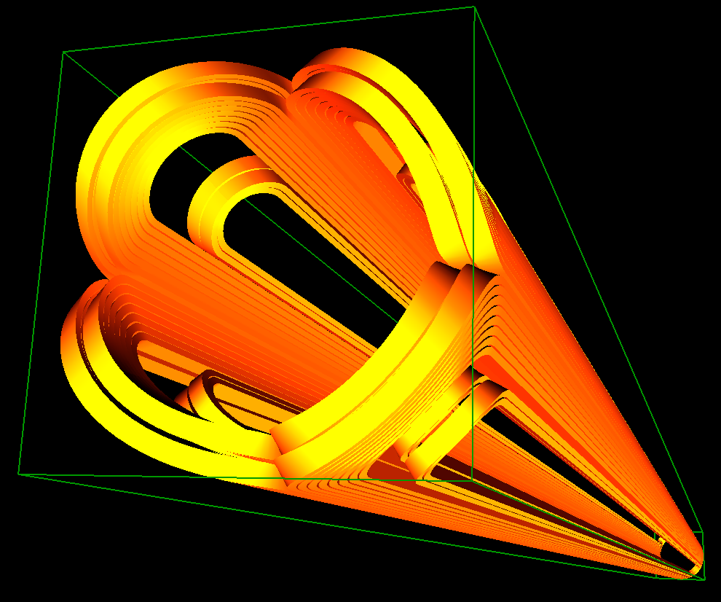
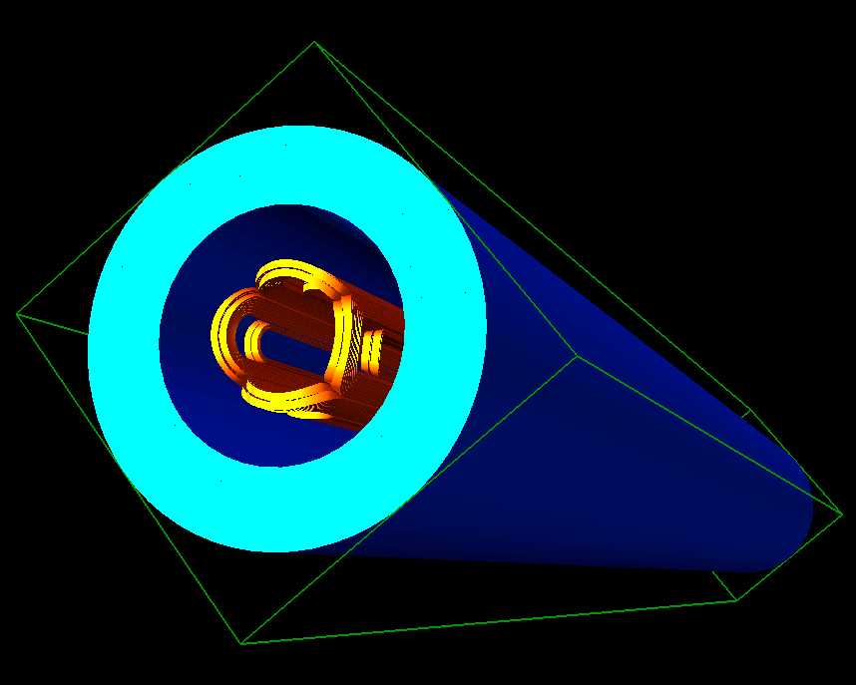
Design of Q1a for high luminosity (L*=1.9m)
1) Cos2θ option of Q1a (141T/m, 1.21m) LTS or HTS
Q1a: two layers cos2θ quadrupole coil using Rutherford cable with iron yoke. The inner diameter of coil: 37mm.
Width of the cable: 2.5mm, excitation current: 1970A.
Magnetic field cross talk between two apertures is negligible.

Slide 8
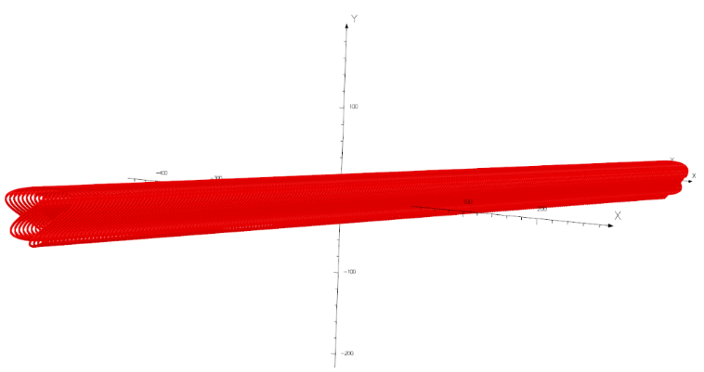
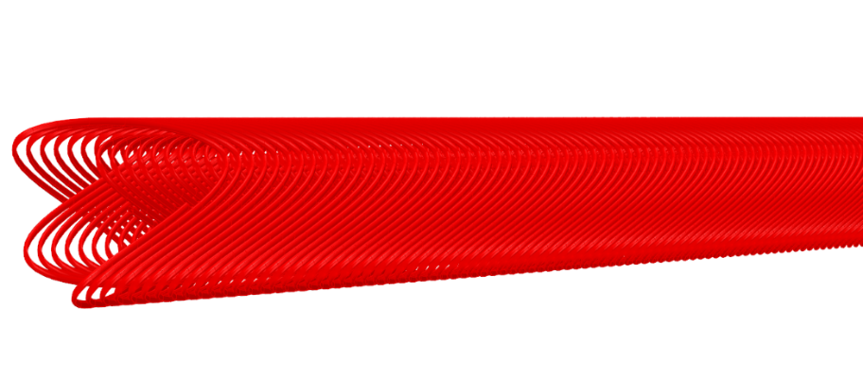
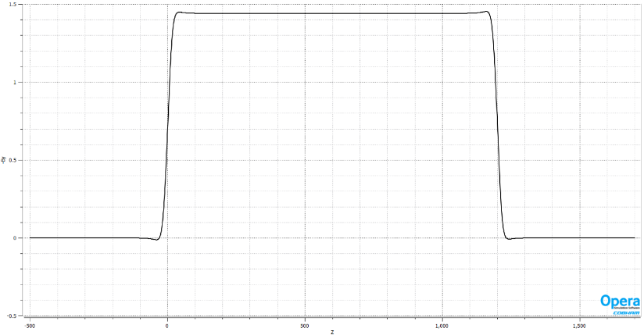
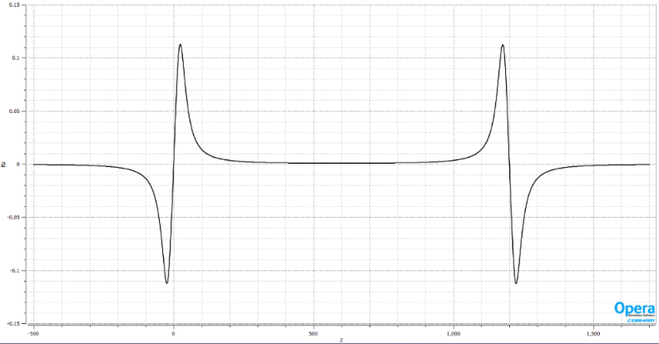
CCT option of Q1a
2) CCT option of Q1a (141T/m) LTS or HTS
HTS or LTS 0.8mm round wire.
Two layers CCT quadrupole coil. Inner radius of the spar is 18.5mm.
Outer radius of single aperture coil: 29mm.
Groove on the spar: 2×3mm; 6 wires in a groove.
Conductor canted angle: 30 deg. Excitation current: 1342A.
Each integrated multipole field in single aperture is smaller than 1×10⁻⁴.

Slide 9
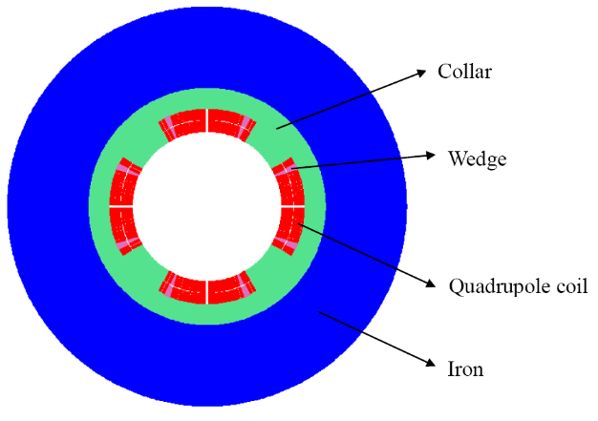

Development status of 0.5m single aperture QD0 short model magnet
So far, there is no cos2θ superconducting quadrupole magnet in China.
In the R&D, the first step is to develop a single aperture QD0 short model magnet with 0.5m length.
The aim of QD0 short model magnet:
Verify magnet design; Exploring magnet manufacturing technology;
Master cryogenic testing Technology;
Lay the foundation for the development of next QD0 prototype.

Slide 10
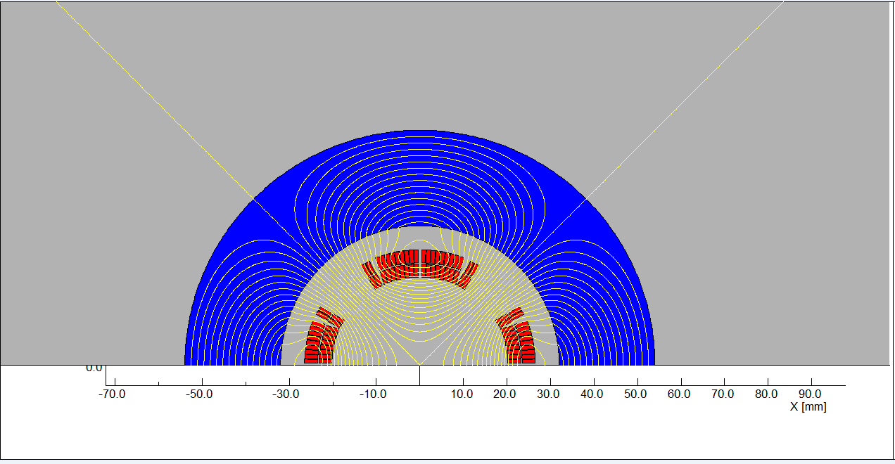
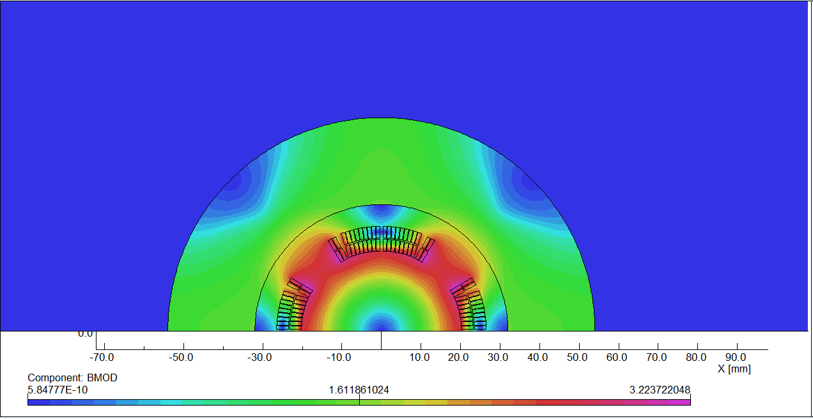
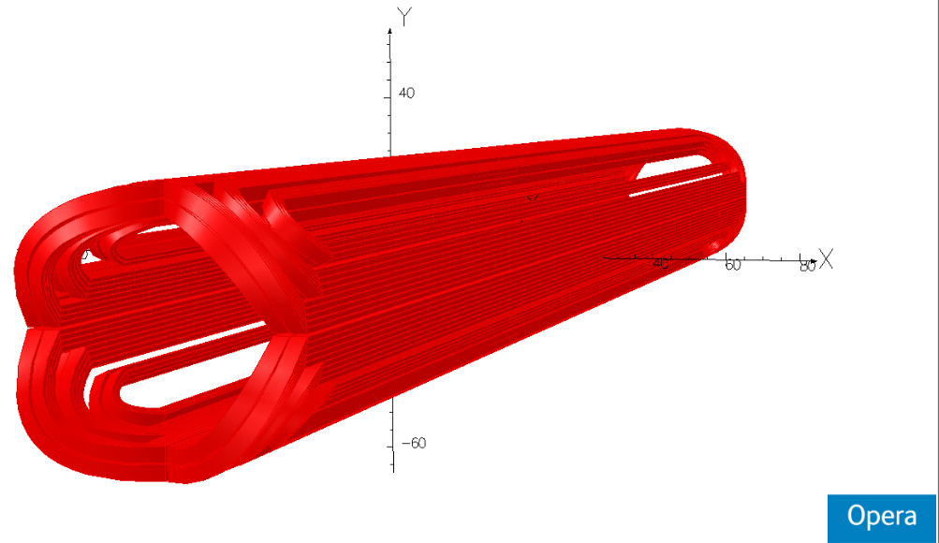
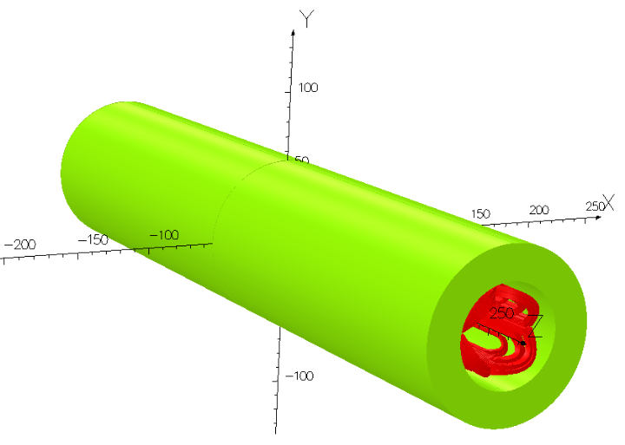
Design of 0.5m single aperture QD0 short model
Magnetic field simulation has been performed.
The magnetic performance meet the requirement: 136T/m, B_{n}/B₂< 3×10⁻⁴.
Excitation current: 2080A.

Slide 11
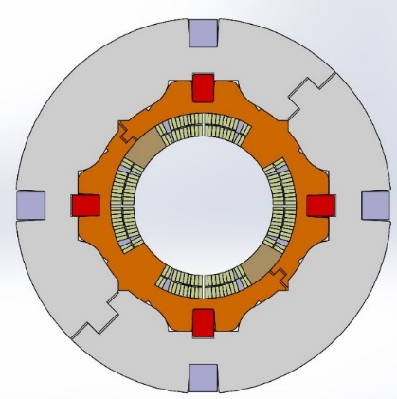
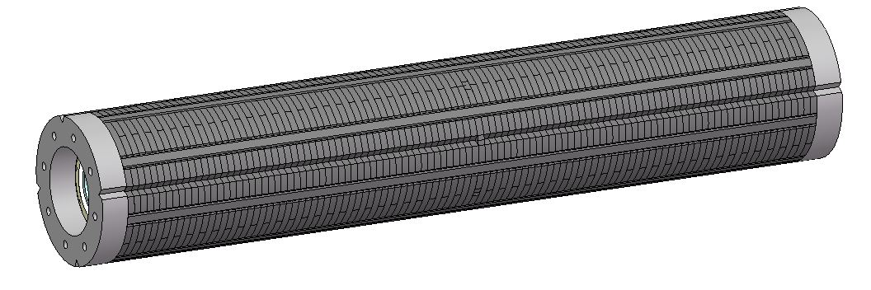
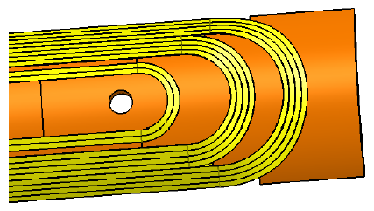

Status of 0.5m single aperture QD0 short model
Research on key technologies of 0.5m single aperture QD0 short model has started (NbTi, 136T/m), in collaboration with HeFei KEYE Company.
Including: quadrupole coil winding technology, fabrication of quadrupole coil with small diameter, stress control, quadrupole magnet assembly, cryogenics vertical test and field measurement technology, etc.

Slide 12
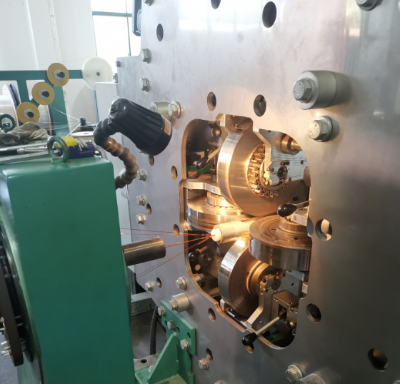
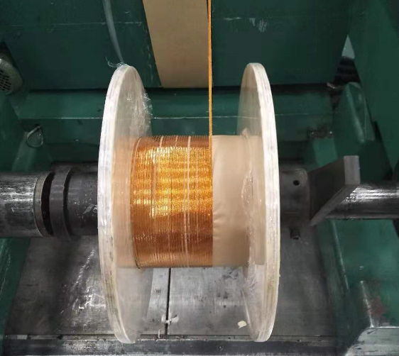
NbTi Rutherford cable
NbTi Strand and keystoned Rutherford Cable have been fabricated:
Strand:
NbTi/Cu, 0.5mm in diameter,
Cu/Sc=1.3, @4.2K, Ic≥340A@3T，Ic≥280A@4T，Ic≥230A@5T.
Rutherford Cable:
Width: 3mm, mid thickness: 0.93 mm, keystone angle: 1.9 deg, No of stands: 12.
NbTi Rutherford cable

Slide 13
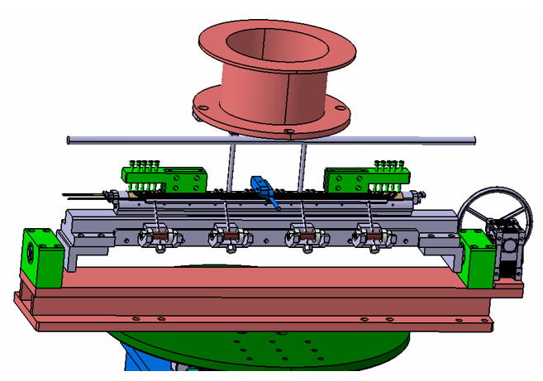
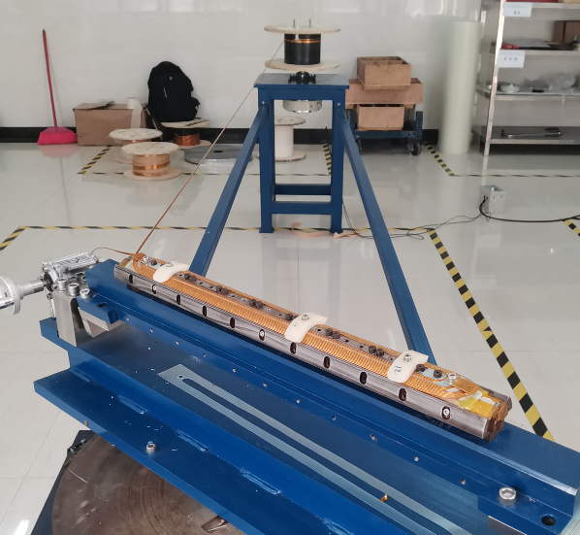
Quadrupole coil winding machine
Quadrupole coil winding machine has two rotating shafts.
Cable tension range during the winding: 100-200N.
The winding machine mainly composes of brackets, turntables, flip brackets, coil bobbins.
Fabrication of quadrupole coil winding machine has been finished.

Slide 14
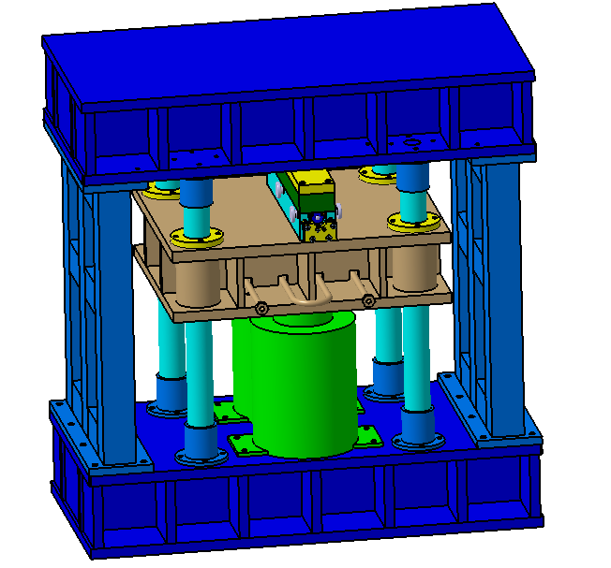
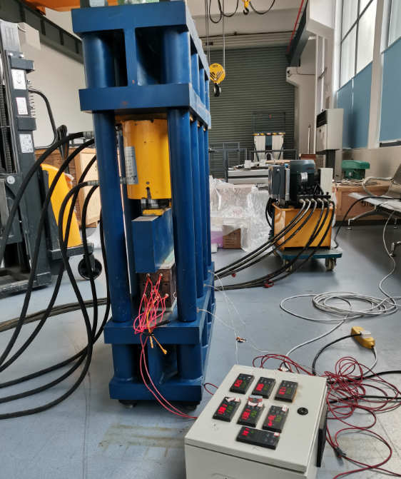
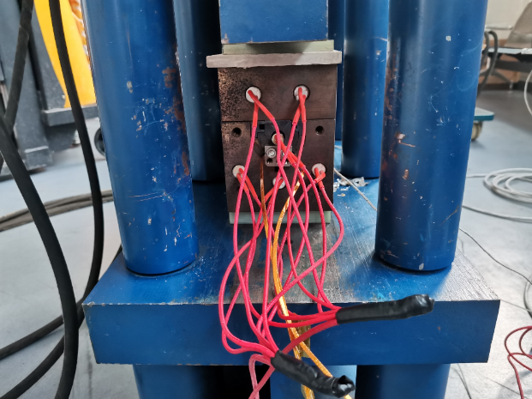
Coil heating and curing system
After the winding process, the coil is heated and cured under a certain temperature and pressure, using coil heating and curing system.
The curing mold defines the outer shape of the coil.
Fabrication of coil heating and curing system has been finished.

Slide 15
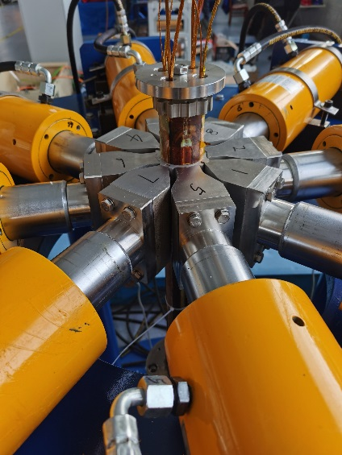
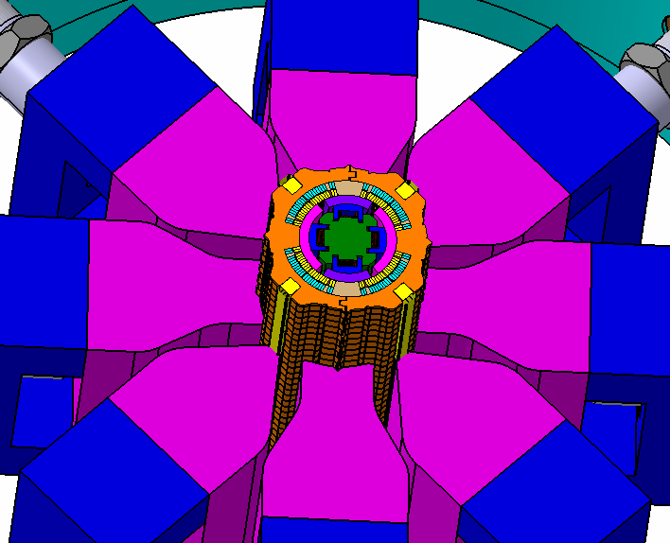
Coils assembly system
Four coils and collar are assembled together using coils assembly system, forming self-supporting structure.
The pre-stress on the quadrupole coils is applied during the assembly, and the keys are inserted to fix the collar and coil.
Fabrication of coils assembly system has been finished.

Slide 16
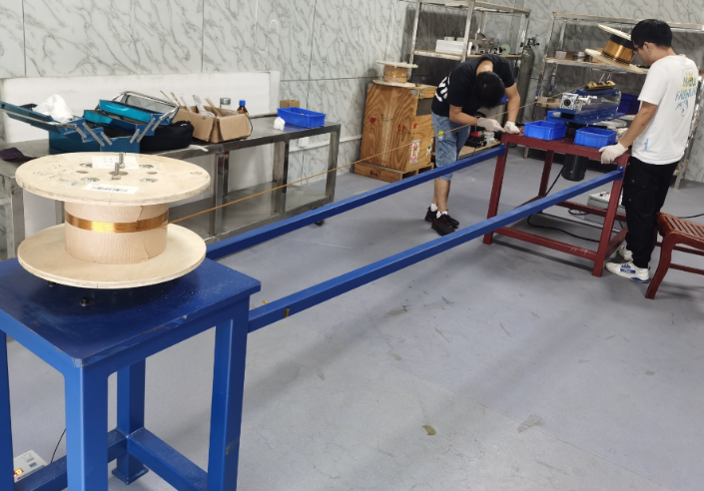
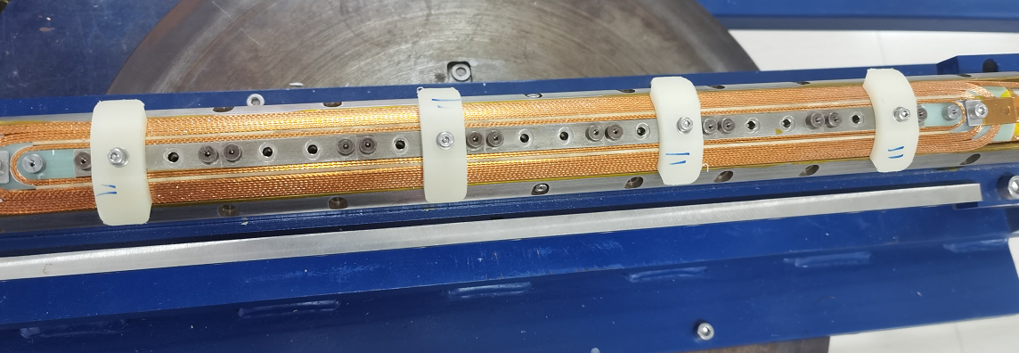
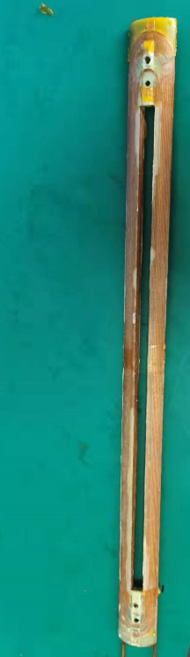
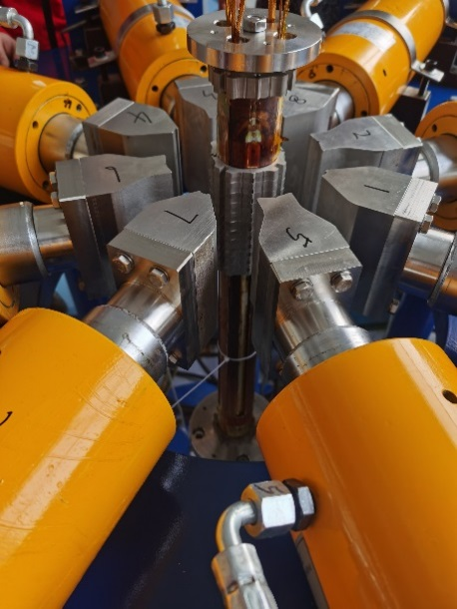
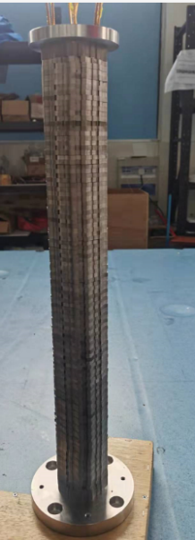
Fabrication of 0.5m single aperture QD0 short model
All the hardware devices achieved the expected function.
Several NbTi quadrupole coils have been wound and cured.
First collared coil has been assembled. Fabrication of 0.5m single aperture QD0 short model is in progress, and will be completed within half a year .

Slide 17
Summary
Superconducting quadrupole magnets are key devices for CEPC.
Different design options are studied.
Despite of limited space, field crosstalk effect between two apertures in QD0 is negligible using iron yoke.
Study and research on key technologies of 0.5m single aperture QD0 short model (LTS 136T/m) is in progress, in collaboration with KEYE Company.
All the hardware devices have been fabricated, and development of 0.5m single aperture QD0 short model is in progress.

Slide 18
Thanks for your attention!
Mini-workshop: Accelerator Physics - Key Beam Physics and Technologies Issues for Colliders

