Slide 1
IR Modelling for FCC-ee
Leon van Riesen-Haupt
Many thanks to:
Rogelio Tomas, Tobias Persson, Katsunobu Oide, Helmut Burkhardt, Frank Zimmermann, Michael Hofer
Notes:
Today I will be talking about our ongoing efforts to model the optics of FCC-ee, in particular, the optics of the experimental insertion regions. None of this work would have been possible without the extensive help and input by experts from both CERN and KEK.

Slide 2
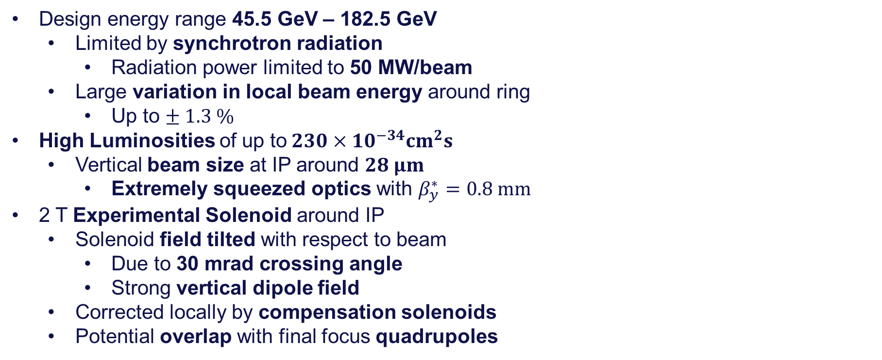
Overview of FCC-ee Optics Challenges
Design energy range 45.5 GeV – 182.5 GeV
  Limited by synchrotron radiation
    Radiation power limited to 50 MW/beam
  Large variation in local beam energy around ring
    Up to $± 1.3 \%$
High Luminosities of up to$230×10^{−34}cm^{2}s$
  Vertical beam size at IP around $28 μm$
    Extremely squeezed optics with $β_{y}^{∗}=0.8 mm$
2 T Experimental Solenoid around IP
  Solenoid field tilted with respect to beam
    Due to 30 mrad crossing angle
    Strong vertical dipole field
  Corrected locally by compensation solenoids
  Potential overlap with final focus quadrupoles
Notes:
I thought it would be best to start with a quick overview of the FCC-ee and some of the key challenges that we face when trying to simulate its optics.
The FCC collider is designed to have a beam energy ranging from 45.5 GeV for Z boson production up to 182.5 GeV for top pair production.
Since it is an electron machine, these high energies result in extremely high synchrotron radiation and the radiation power per beam is one of the key limiting design features for the parameter choices.
This high radiation also means that the beam energy varies by up to 1.3% in the 182 GeV case.
This is extremely challenging from an optics point of view because it requires some form of current compensation to ensure the beam stays on the design orbit.
The FCC also aims to provide a very high luminosity to the experiments, which it will achieve by squeezing the beam to very small sizes at the interaction points.
Depending on the beam energy, the optics required for this foresee a sub millimeter beta function at the collision point, which in turn requires very strong magnets and large beta functions in the final focus.
To make things in the IR more complicated, the experiments require a two Tesla solenoid around the interaction point.
Because the beams collide at an angle, the solenoid field will be tilted with respect to the beam which leads to a non-zero coupled orbit in the solenoid.
A part of this effect can be countered by placing an equal but opposite ant solenoid pair around the experimental solenoid.
The design also foresees a potential overlap between the solenoid field and the final focus quadrupoles in order to get them as close to the interaction point as possible.

Slide 3
Optics Simulations in MADX
Adjust CERN simulation tools to meet FCC-ee demands
  FCC-ee is a CERN accelerator
  A lot of expertise and tools rely on MADX
  Past development often driven by CERN hadron infrastructure
Learn from KEK’s SAD codes
  Driven by electron-positron collider needs
  Simulations often compared to experiment
FCC-ee optics largely designed using SAD (K. Oide)
  Previous MADX translation does not capture all features
Notes:
Whilst the lattice is currently largely designed in SAD, at CERN there is an ongoing effort to adjust CERN’s MADX optics simulation software to be able to meet the challenges set by FCC-ee.
The motivations for doing this include the fact that FCC-ee will be a CERN accelerator and therefore work with CERN tools, also because a lot of expertise and tools at CERN rely on MADX.
In the past decade or so however, the MADX development was focused on CERN’s hadron infrastructure and the Large Hadron Collider so many features specific to electron colliders need to be updated and tested.
One of the strongest tools when doing this, is to compare MADX results to those created by KEK’s SAD code as its development is driven by the needs of the Super KEKB electron positron collider and the simulations have often been compared to real measurements.

Slide 4
Overview of Ongoing CERN Efforts
Extensive comparisons between MADX and SAD
  Linear optics, amplitude and momentum detuning (presentation)
  Emittance (presentation) and radiation integrals (presentation)
  On axis and tilted solenoid
Tapering Implementation in MADX
  Presented during FCC November Week 2020 (presentation)
  Optics in good agreement with SAD results
  Able to get correct emittance from tracking
Analytical equations for emittance estimate
  Quadrupole roll errors and sextupole misalignments (presentation)
Dynamic Aperture Studies
  Computation of dynamic aperture without radiation in PTC (presentation)
Input for future code development at CERN
  Input for MAD-NG development (presentation)

Slide 5







Features Required for IR Modelling
Tilted Solenoid
  Machine geometry defined by beam’s path through solenoid
  Correct optics behaviour whilst passing through solenoid
Finite/thick multipoles
  Including fringe fields
Overlapping of solenoid and other elements
SAD↔MADX converter that produces
  “Standard” CERN/KEK format
  Forward/Backward translation
L
L/2N
L/N
$$k_{n}L/N$$
$$k_{n}L/N$$
$$k_{n}L/N$$
$$k_{n}L/N$$
$$k_{n}L/N$$
$$k_{n}L/N$$
$$k_{n}L/N$$
Notes:
These complex concepts include the tilted solenoid, which defines the machine’s geometry.
Thick or finite multipoles as well as the overlap of solenoids and thick multipoles.
We also aim to make a translator that produces MADX and SAD lattices that meet the norms of the respective institutes and allow for forward and backward translation.

Slide 6
Translator
New translator written that can tackle these requirements
  Written using python
  Takes in file produced using SAD
  Creates MADX files
    CERN/LHC style “sequence”, “optics” files as well as solenoid matching script
    Preserves dependencies and definitions
    Aims to be easily readable
Aims to make it easy to achieve backward translation from MADX to SAD
  Would be very useful for switching between codes for different types of studies and optimisations
Notes:
To achieve all of this we have started work on a new code translator that aims to meet all of these requirements.
The translator is written in python and takes in files generated using SAD and produces MADX lattice and optics files, like we have for LHC.
It preserves all the dependencies of different elements and also includes a matching script to match the tilted solenoid correctly.
The SAD-MADX translator used for FCC-ee is written in SAD, but this translator is written in python which we hope will make it easier to also add a backwards translation feature, which would be very useful for different colleagues that use the different codes for different studies and wish to collaborate.

Slide 7
Reference Orbit in Dipole
Reference orbit defined by orbit through magnet nothing new
  Common in arc dipole magnets
x
x
x
s
s
s
Machine Frame
Dipole Frame
Machine Frame
Notes:
To explain the concept of the tilted solenoid defining the reference orbit, I first want to remind you that magnets changing coordinate systems is not something outlandish and that it is done for example in dipoles, which bend or transform the coordinate system of the beam.
The quadrupoles and other magnets are then placed around and aligned with the reference system defined by the dipoles.

Slide 8
Tilted Solenoid
x
x
x
s
s
s
Machine Frame
Lab Frame
Machine Frame
Notes:
The tiled solenoid does something similar.
The beam’s reference system is defined in a way that it goes through all the magnets before reaching the solenoid but once in the solenoid we switch to the experiments frame of reference, around which the solenoid is aligned but not the beam.
In the example shown here, the two colliding beams are at an angle compared and do not enter at the centre of the solenoid so we have to shift and rotate the coordinate system when we enter.
After we pass through the solenoid we then switch back to a reference system based on the location of the beam.

Slide 9
Tilted Solenoid
More complicated orbits
  Difficult to measure field around this orbit
E.g. vertical orbit through anti-solenoid/solenoid/anti-solenoid (FCC-ee)
x
x
x
s
s
s
-B
B
-B
Machine Frame
Lab Frame
Machine Frame
Notes:
The orbit through the solenoid can get quite complicated and it is difficult to measure the fields around it. For example the horizontal tilt through the solenoid sandwiched between two antisolenoids in FCC-ee causes opposing vertical dipole fields, making the orbit look something like this in the vertical plane.

Slide 10
Tilted Solenoid
More complicated orbits
  Difficult to measure field around this orbit
E.g. vertical orbit through anti-solenoid/solenoid/anti-solenoid (FCC-ee)
y
y
y
s
s
s
Machine Frame
Lab Frame
Machine Frame
Notes:
The orbit through the solenoid can get quite complicated and it is difficult to measure the fields around it. For example the horizontal tilt through the solenoid sandwiched between two antisolenoids in FCC-ee causes opposing vertical dipole fields, making the orbit look something like this in the vertical plane.

Slide 11
Implementation of Tilted Solenoid
Redefine co-ordinate system at entrance and exit of solenoid region
  Known “tilt” at entrance
  Zero orbit at exit
Exact co-ordinate transformation at solenoid exit dependant on closed orbit
  SAD determines this internally during closed orbit search
  In MADX this can be achieved by matching transformations
    Matching scripts written by translator
Features to test:
  Orbit in both planes
  Optics due to solenoid and due to tilt
  Vertical dispersion due to tilted solenoid field
Notes:
Since we are looking at a synchrotron, the reference orbit depends on the closed orbit of the beam and the exact coordinate transformations depend on this closed orbit.
In SAD these transformations are found internally when determining the twiss. In MADX we can do something similar by matching these transformations using the match module.
This was implemented in this new translator and we can test the implementation by looking at the optics and orbit in the FCC-ee with a tilted solenoid.

Slide 12
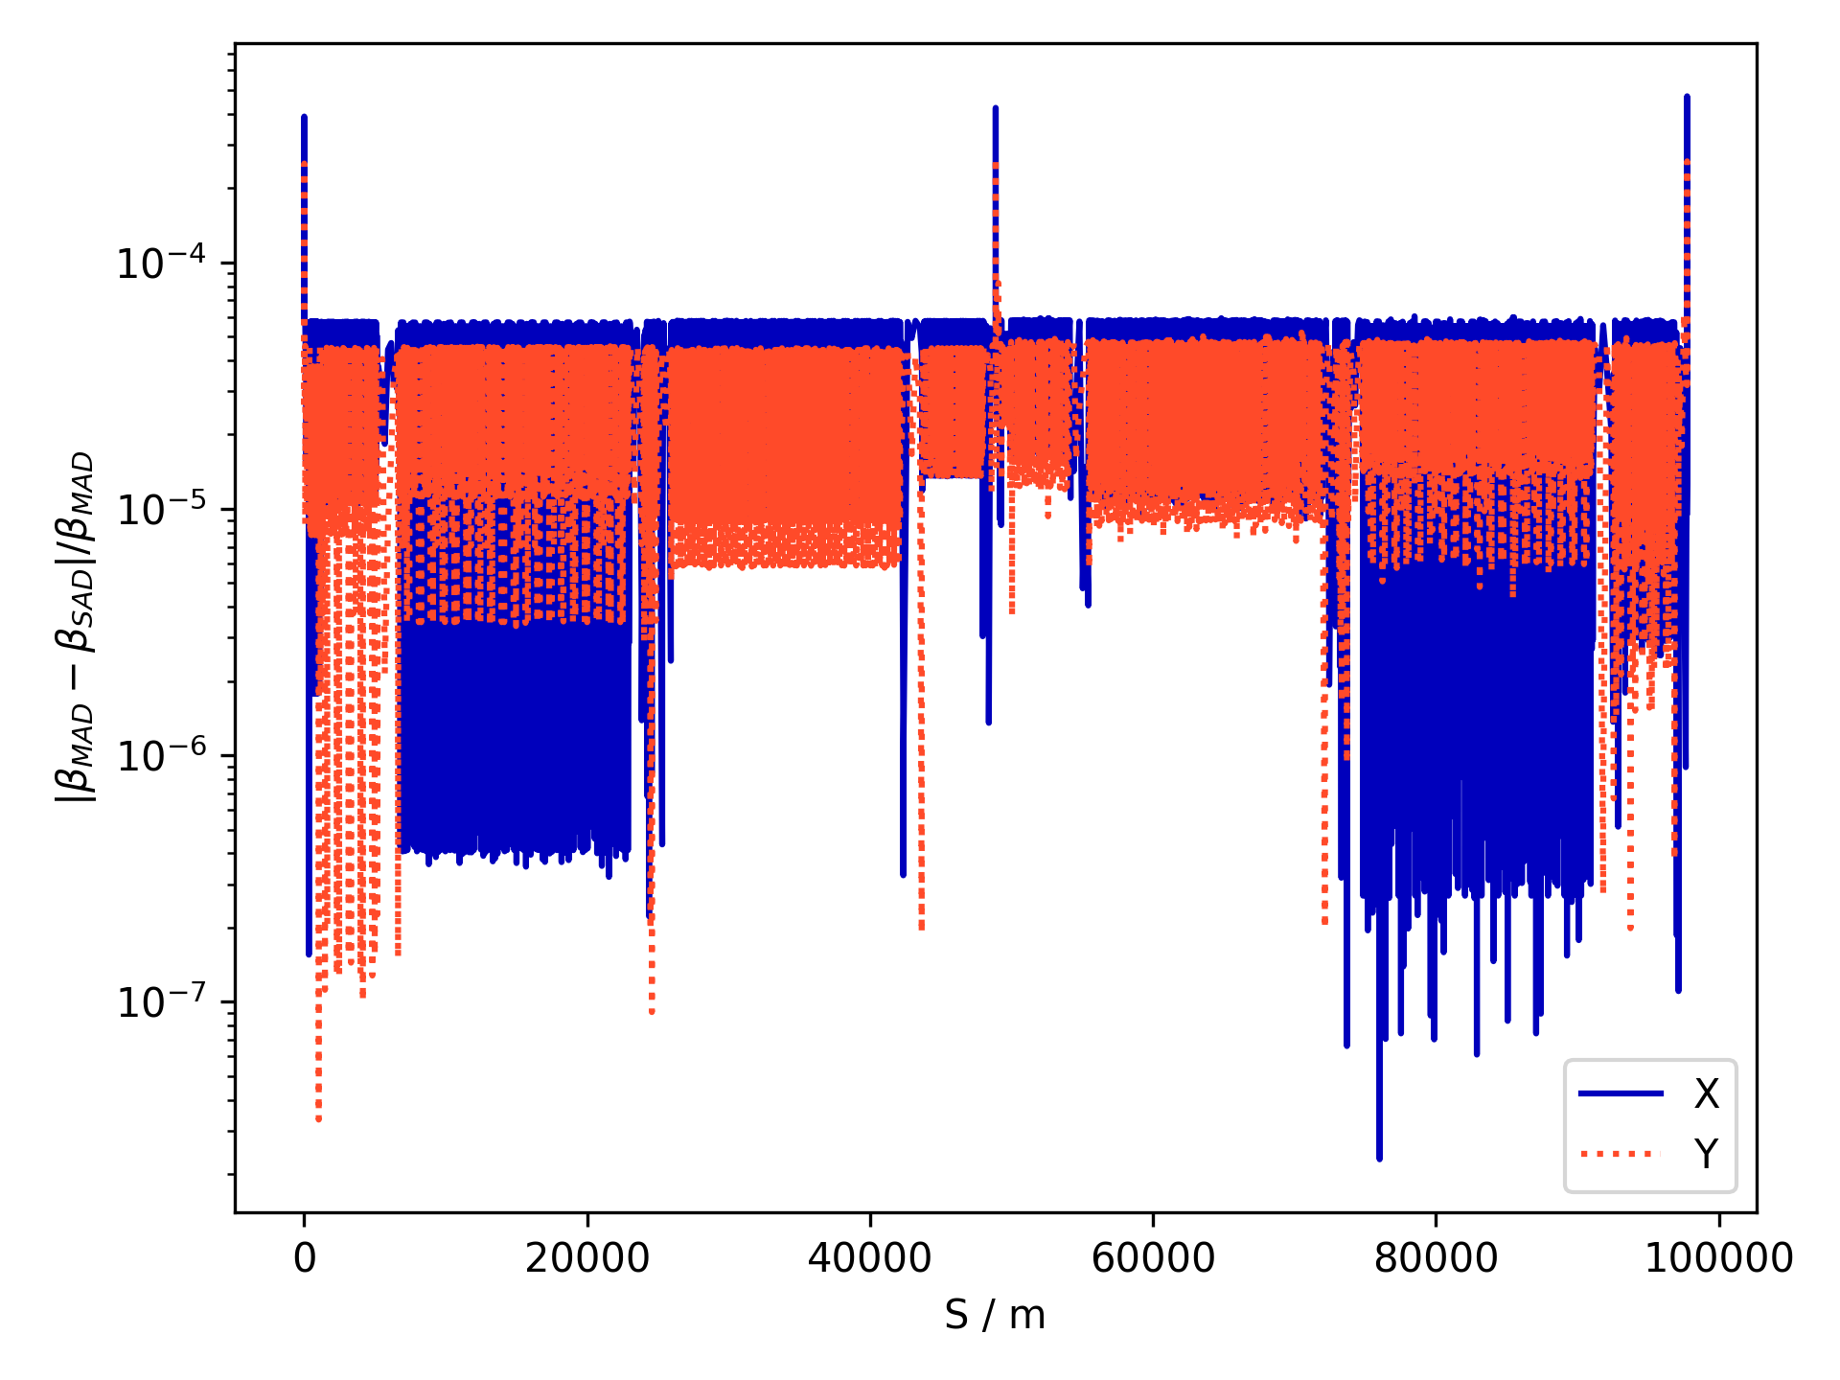
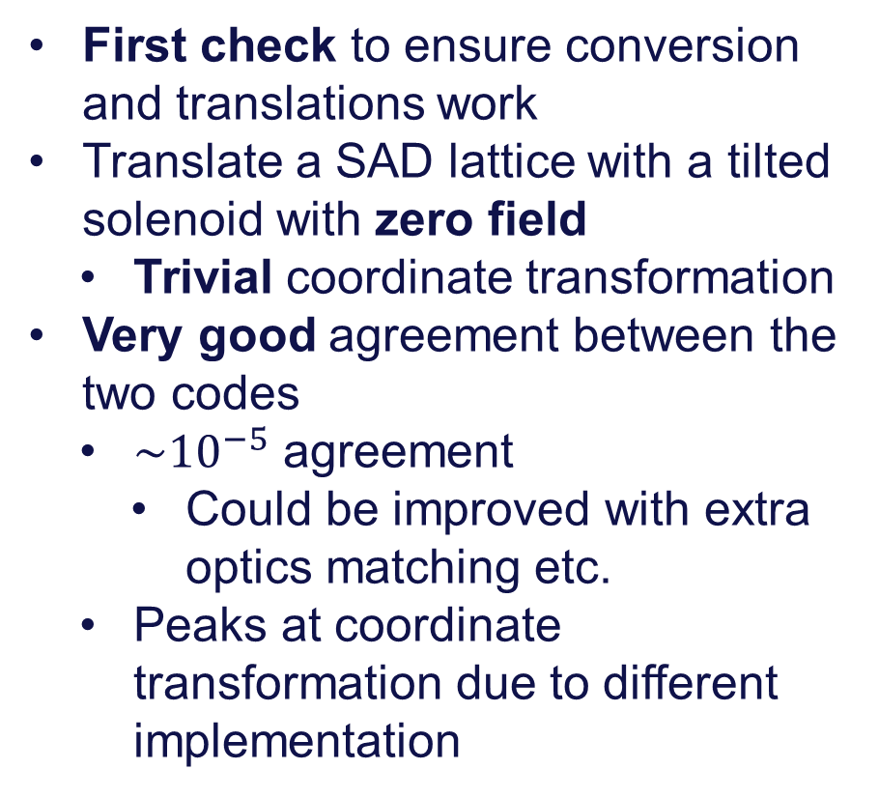
Optics with a “Tilted” Drift (FCC-ee)
First check to ensure conversion and translations work
Translate a SAD lattice with a tilted solenoid with zero field
  Trivial coordinate transformation
Very good agreement between the two codes
  $\sim {10}^{−5}$ agreement
    Could be improved with extra optics matching etc.
  Peaks at coordinate transformation due to different implementation
$β$-beating between SAD and converted MADX for FCC with tilted drift
Notes:
We can first check if the transformation are well defined by looking at the optics through a tilted zero field solenoid as this is a trivial transformation only in the horizontal plane.
On the right we see the beta beating in both planes between MADX and SAD. The beating is very small and there is a very good agreement between the codes.

Slide 13
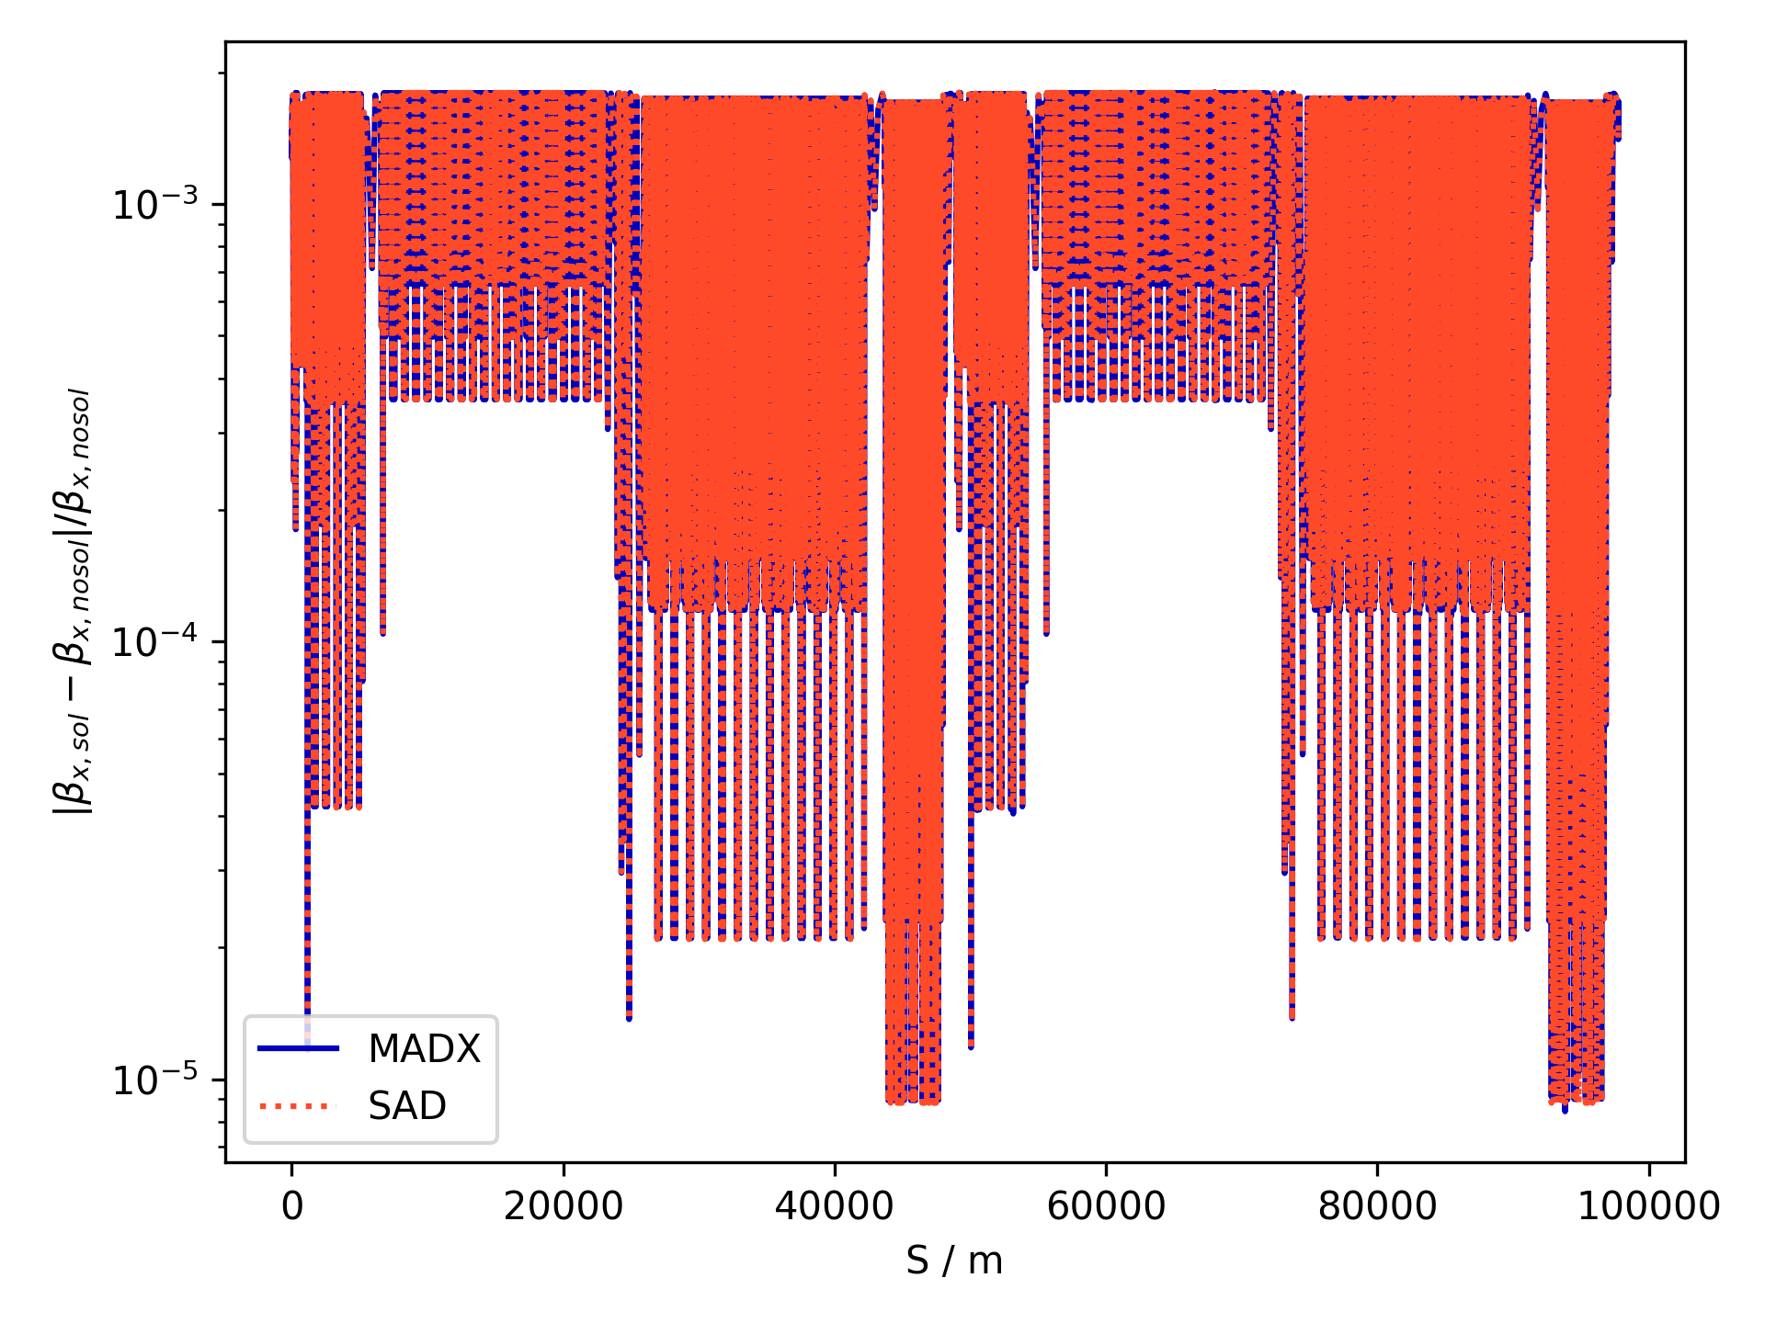
Change in Optics due to Solenoid (FCC-ee)
Solenoid field turned on to 2T
  Causes coupling
  Change in optics
Check if change in optics is the same in both codes
Very good agreement
  Significantly larger beating than due to conversion (previous slide)
$β$-beating due to turning on tilted solenoid obtained using MADX and SAD

Slide 14
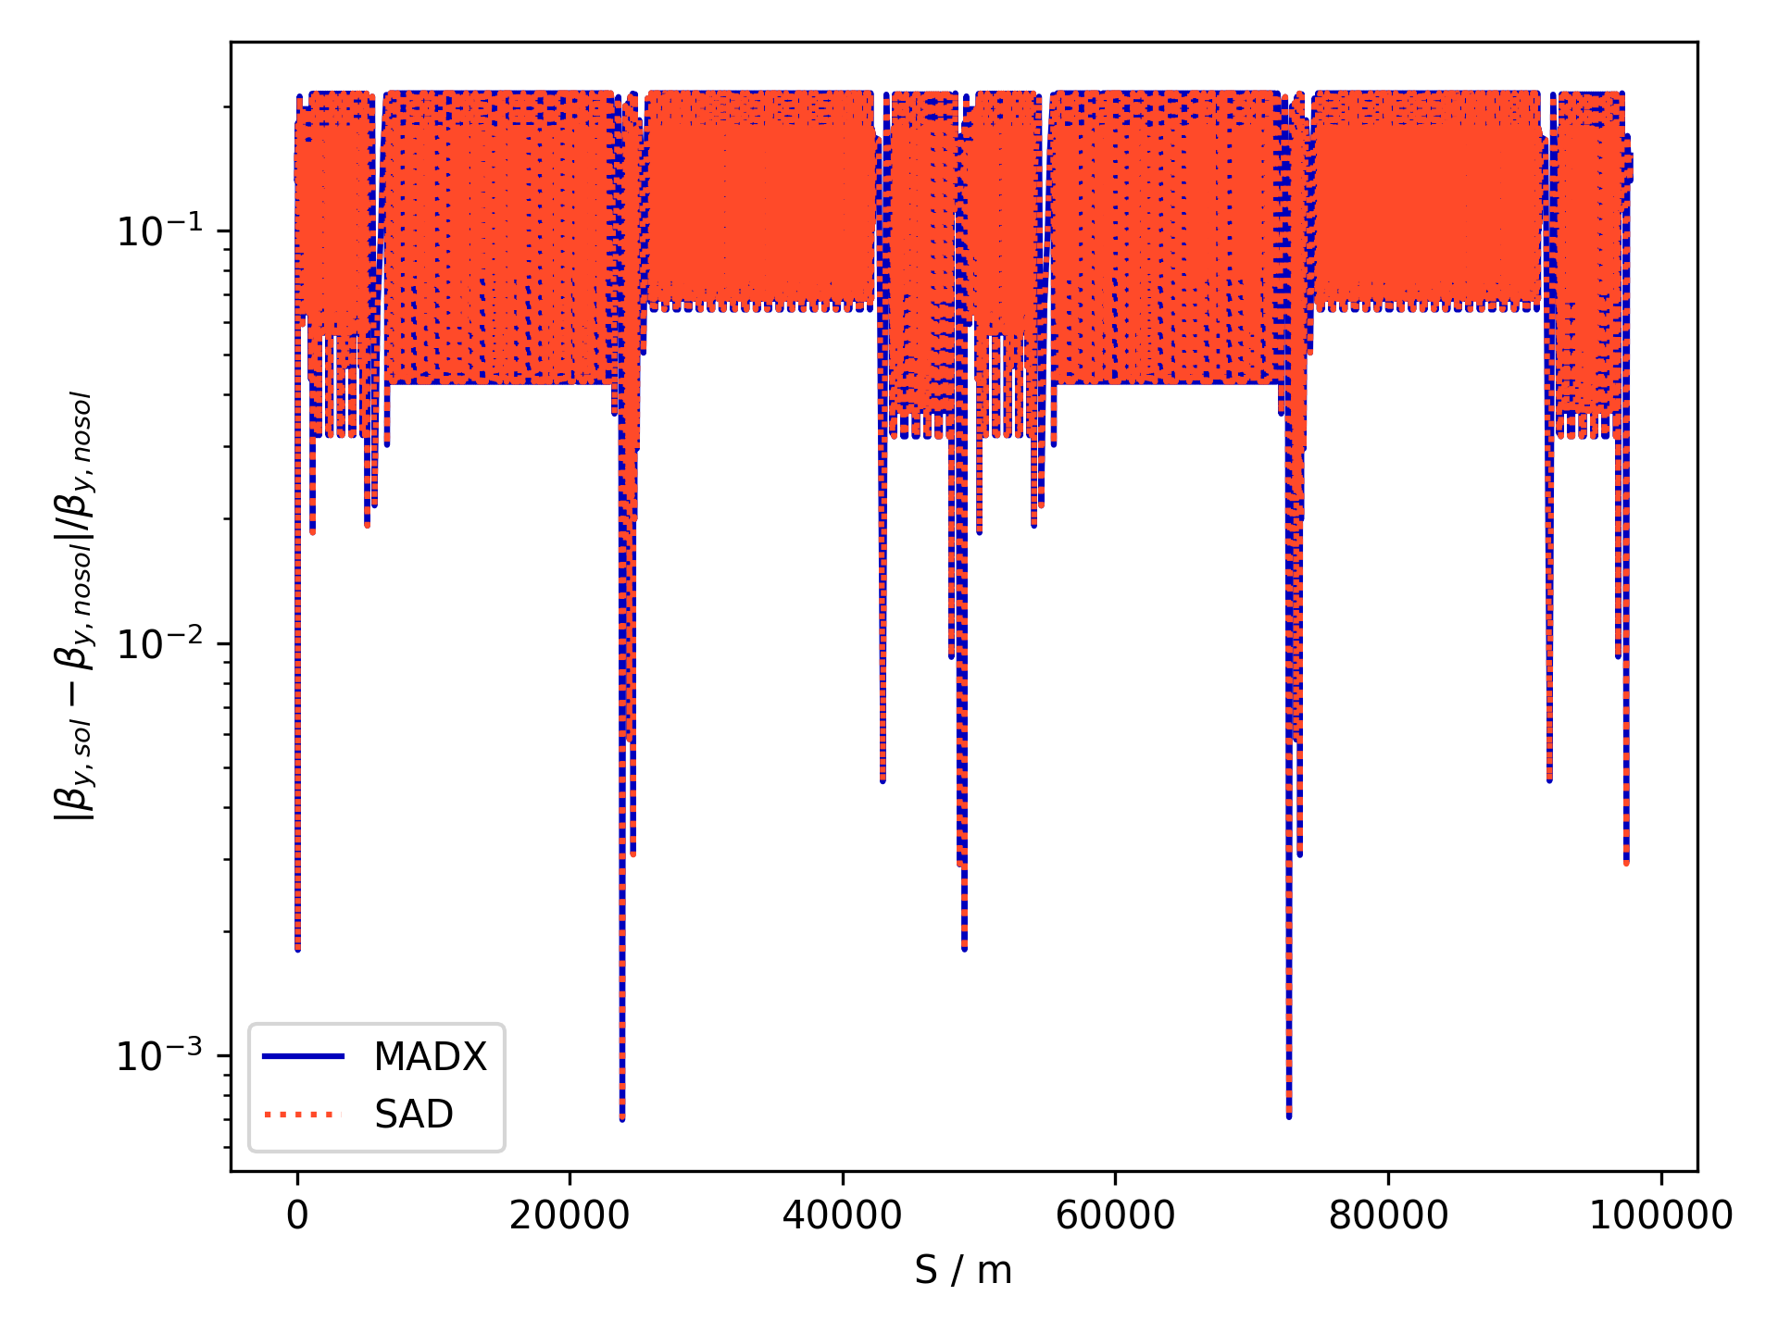
Change in Optics due to Solenoid (FCC-ee)
Solenoid field turned on to 2T
  Causes coupling
  Change in optics
Check if change in optics is the same in both codes
Very good agreement
  Significantly larger beating than due to conversion (previous slide)
  Especially in the y plane
$β$-beating due to turning on tilted solenoid obtained using MADX and SAD
Notes:
Next, we can turn on a 2T solenoid field and look at the change in optics due to the solenoid in both codes.
We can see that the solenoid has a significant impact on the optics and that both codes are in good agreement about the magnitude of this impact.
The effect of the solenoid is largest in the vertical plane plane because the beta function is squeezed more in this plane within the solenoid.

Slide 15
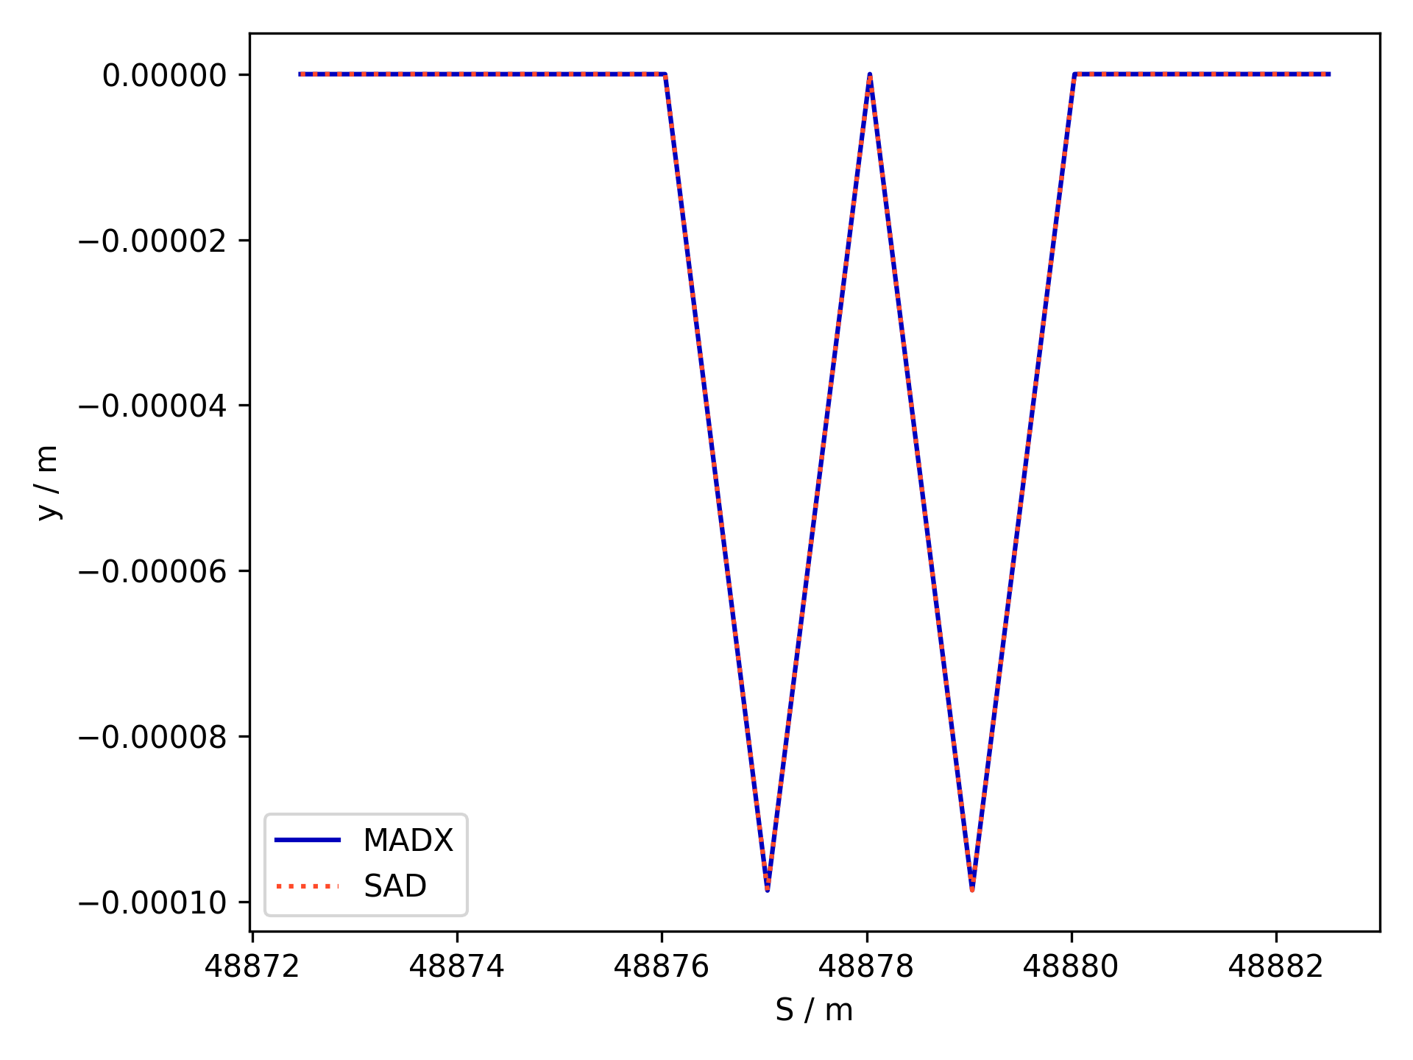
Orbit Bump (FCC-ee)
Check whether the vertical orbit behaves as desired
Zoomed in plot around the second IP (48878 m)
  2 m solenoid and two 1 m anti-solenoid around IP
NOTE:
  Convention is to return to “Machine Frame” at IP
  Hence zero orbit at IP
Very good agreement
Vertical orbit bump due to tilted solenoid in FCC-ee
Notes:
We can also look at the vertical orbit bump in the solenoid, which I spoke about in the previous slides.
On the right we see a plot of the vertical orbit in the solenoid around the second interaction point. Note that it is convention to transform back into the beam frame at the IP so we have a zero orbit there.
Again, the agreement between both codes is excellent, indicating that this implementation of the tilted solenoid is correct.

Slide 16
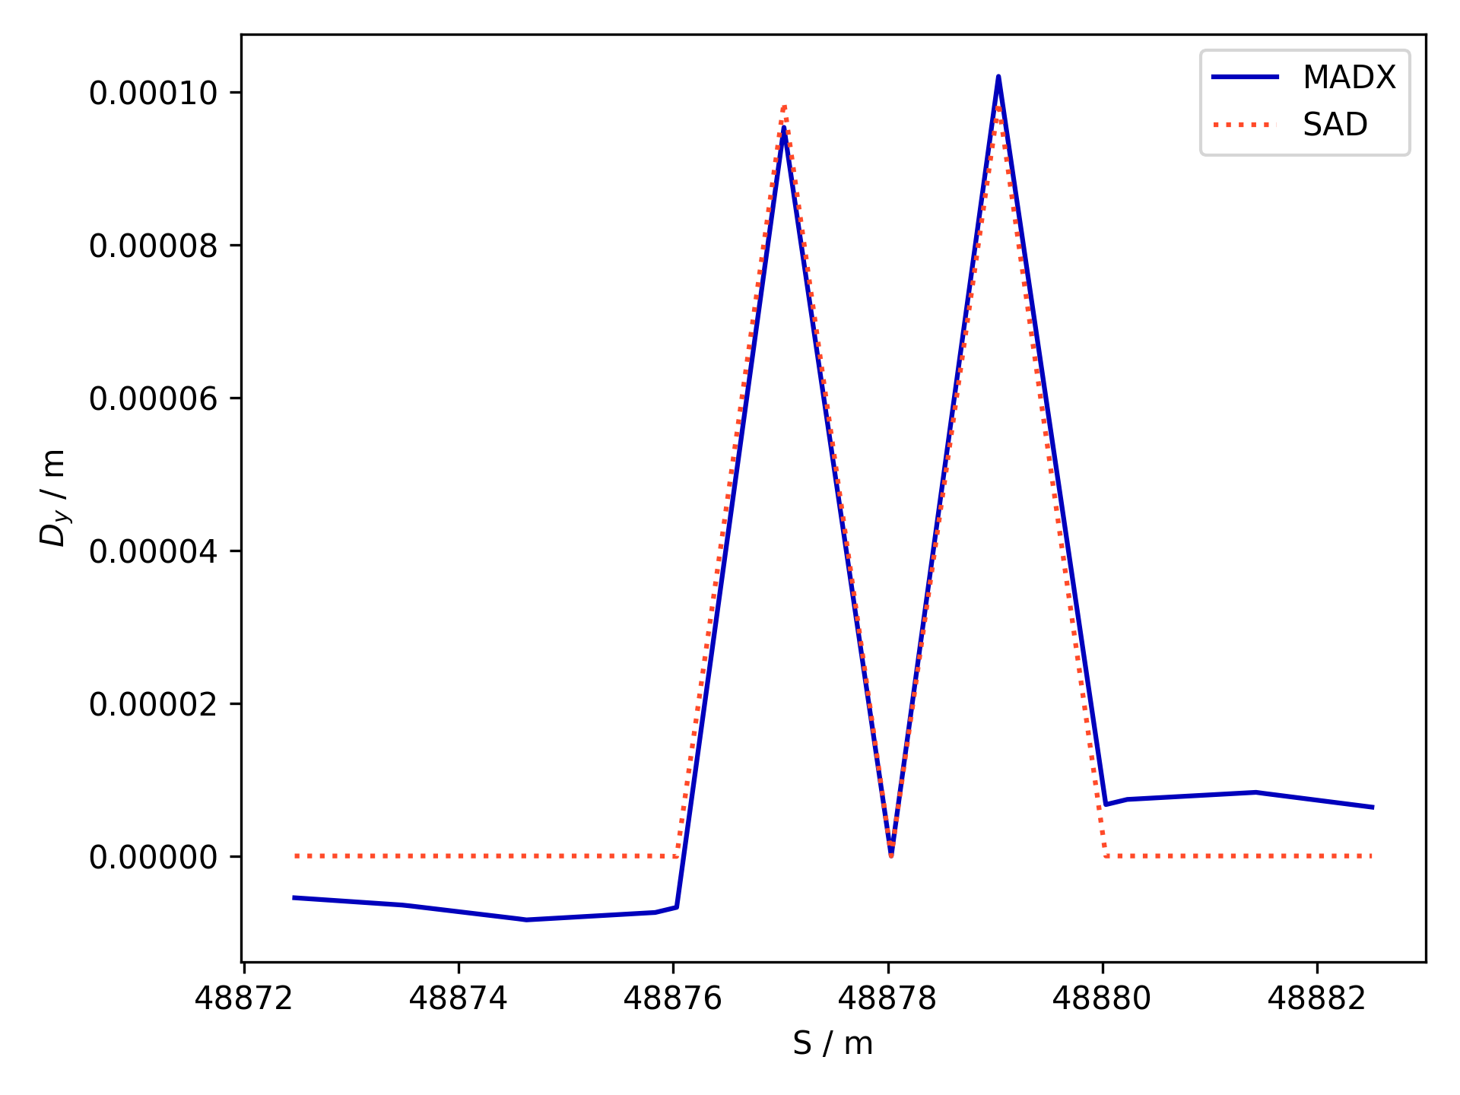
Vertical Dispersion (FCC-ee)
Expect a vertical dispersion bump in solenoid
  Caused by vertical dipolar field due to tilt
  Cancelled by anti-solenoid
  Important for vertical emittance
Currently transformation causes unphysical dispersion in MADX
  Bug under ongoing investigation by MADX team
Vertical dispersion due to solenoid/anti-solenoid pair
Notes:
We also expect a dispersion bump in the vertical plane due to the vertical dipole kicks, that is important for the vertical emittance.
Currently the transformations in MADX cause an unphysical error in the dispersion but we are actively working on this bug and with a fix provided by Tobias Persson we get something that closely resembles this bump.

Slide 17







Thick Multipoles and Overlap
L
SAD model also features thick multipoles
  Potentially overlapping with solenoid field
MADX only has thin multipoles
Thick multipoles “Under the hood”:
  Several thin multipole slices with drifts between them
L/2N
L/N
$$k_{n}L/N$$
$$k_{n}L/N$$
$$k_{n}L/N$$
$$k_{n}L/N$$
$$k_{n}L/N$$
$$k_{n}L/N$$
$$k_{n}L/N$$
Notes:
The other feature that is implemented in SAD and required for a full modelling of the interaction regions are thick multipoles, that can overlap with solenoid fields.
This is important because in the final design the final focus quadrupoles will potentially be overlapping with the antisolenoid
In MADX we only have thin multipoles, but it turns out that under the hood the thick multipoles in SAD are in principle a series of thin multipoles with drifts between them.

Slide 18






Finite Multipoles and Overlap
L
SKEKB SAD model also features finite multipoles
  Potentially overlapping with solenoid field
MADX only has thin multipoles
Finite multipoles “Under the hood”:
  Several thin multipole slices with drifts between them
  Finite quadrupole and solenoids instead of drifts if these fields are non-zero
Many features can be captured using a similar approach in MADX
  Currently cannot simulate thick simultaneous quadrupole/solenoid
L/2N
L/N
$$k_{n}L/N$$
$$k_{n}L/N$$
$$k_{n}L/N$$
$$k_{n}L/N$$
$$k_{n}L/N$$
$$k_{n}L/N$$
$$k_{n}L/N$$
$$\frac{k_{sol}L}{N}$$
$$\frac{k_{sol}L}{N}$$
$$\frac{k_{sol}L}{N}$$
$$\frac{k_{sol}L}{N}$$
$$\frac{k_{sol}L}{N}$$
$$\frac{k_{sol}L}{N}$$
Notes:
If the multipoles are in a solenoid, the drifts between the thin slices can be replaced with thick solenoid pieces.
It is possible to spoof this approach in MADX by translating the thick multipoles as a series of thin slices with drifts or solenoids between them.

Slide 19
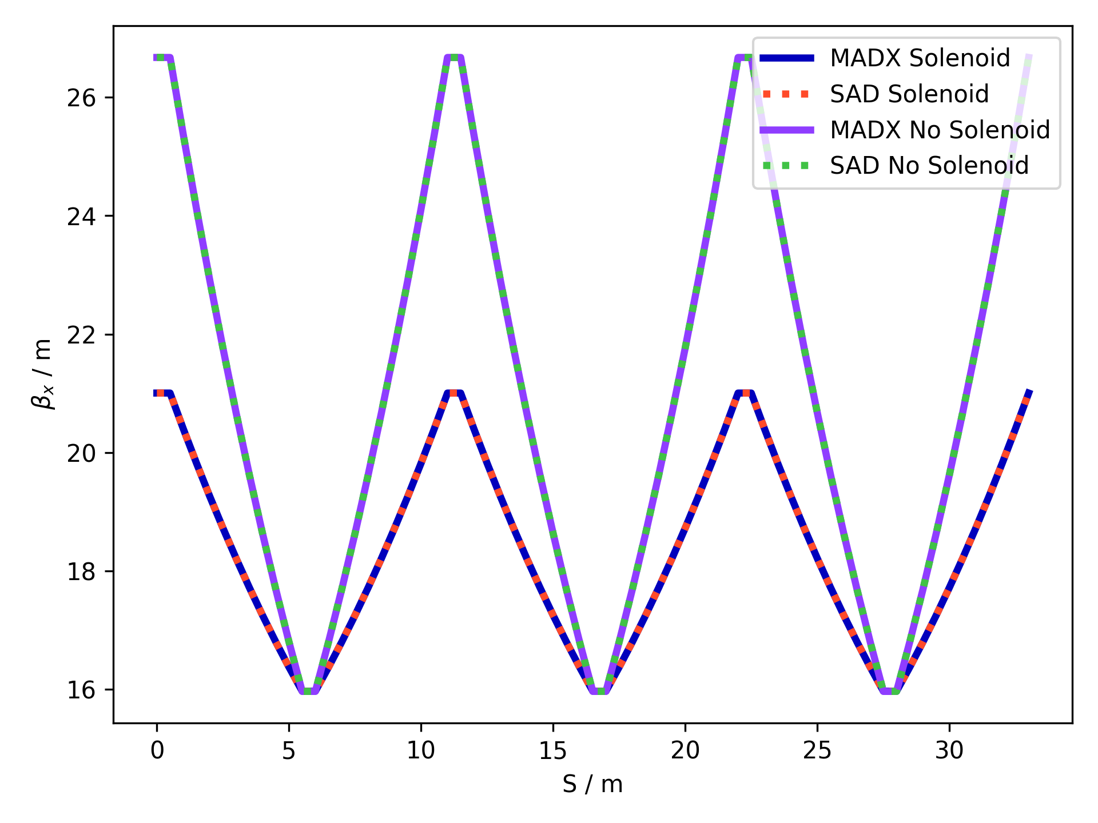
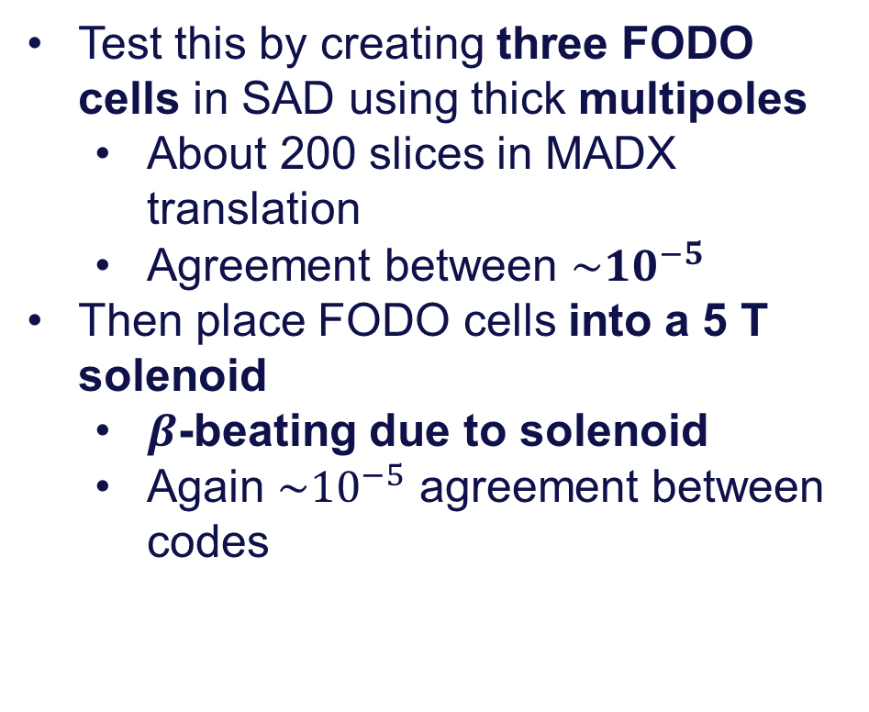
FODO in Solenoid
Test this by creating three FODO cells in SAD using thick multipoles
  About 200 slices in MADX translation
  Agreement between $\sim {10}^{−5}$
Then place FODO cells into a 5 T solenoid
  $β$-beating due to solenoid
  Again $\sim {10}^{−5}$ agreement between codes
Notes:
We can test this by creating a FODO cell in SAD where the quadrupoles are made using thick multipoles and reproduce the optics in MADX using many slices per multipole. Again, we see a very good agreement.
We can check the overlap of multipoles and solenoids by placing the FODO cells in a solenoid field, where MADX will then place solenoids between the thin multipole slices.
The change in optics is significant but again it is identical in both codes showing that this I viable method to simulate thick multipoles and their overlap with solenoid fields.

Slide 20
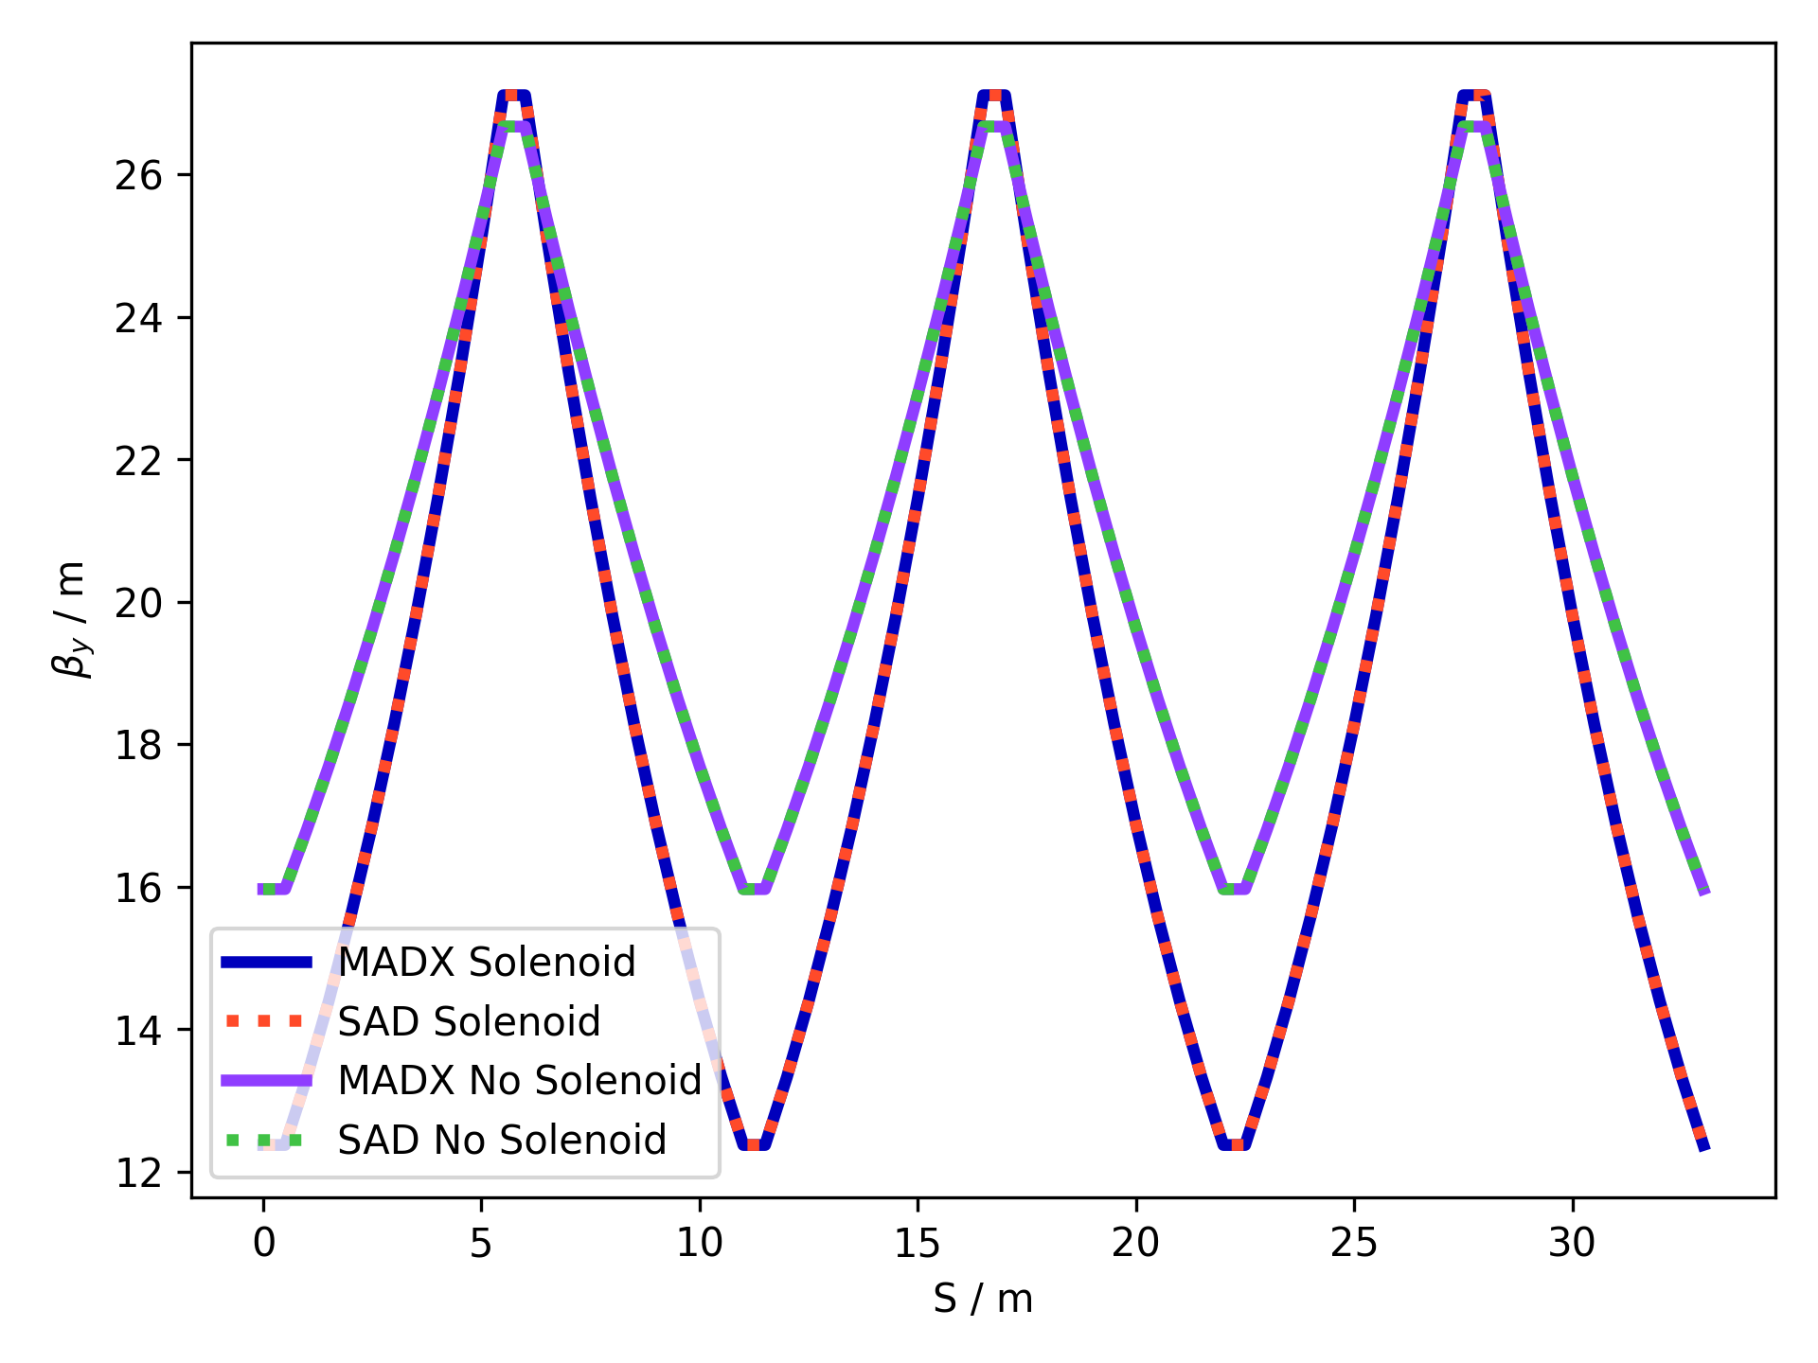
FODO in Solenoid
Test this by creating three FODO cells in SAD using thick multipoles
  About 200 slices in MADX translation
  Agreement between $\sim {10}^{−5}$
Then place FODO cells into a 5 T solenoid
  $β$-beating due to solenoid
  Again $\sim {10}^{−5}$ agreement between codes
Notes:
We can test this by creating a FODO cell in SAD where the quadrupoles are made using thick multipoles and reproduce the optics in MADX using many slices per multipole. Again, we see a very good agreement.
We can check the overlap of multipoles and solenoids by placing the FODO cells in a solenoid field, where MADX will then place solenoids between the thin multipole slices.
The change in optics is significant but again it is identical in both codes showing that this I viable method to simulate thick multipoles and their overlap with solenoid fields.

Slide 21
Conclusions
Extensive study to enable the simulation electron-positron collider experimental insertions regions using CERN tools
  Complementary to previous studies and efforts
  Important for FCC-ee optics simulations at CERN
New translator written in python
Effective method to implement SAD-like tilted solenoid in MADX
  Achieves correct optics and orbits
Strategy for thick multipoles and overlap in MADX
  Demonstrated to work for FODO cells in solenoids
Notes:
In conclusion, we have presented an extensive study showing how we can simulate the experimental insertion regions of electron-positron colliders using MADX.
This work complements previous efforts and is highly relevant to both the SKEK-B task force and FCC-ee efforts at CERN.
We have come up with a way to effectively translate key IR features such as the tilted solenoid, thick multipoles, and their overlap with solenoids.

