Slide 1


Beam-Beam Effects: an Overview
T. Pieloni
EPFL Laboratory of Particle Accelerator Physics
Acknowledgements and material from: W. Herr, D. Shatilov, X. Buffat, K. Ohmi, W. Fisher, S. White, V. Schilzev, Y. Alexahin, A. Valishev, Seemann, A. Chao, D. Sagan, D. Zhou, F. Zimmermann, W. Kozanecki, M. Zobov, P. Raimondi, K. Oide, Yuan Zhang, G. Sterbini, several beam-beam colleagues worldwide.

Slide 2
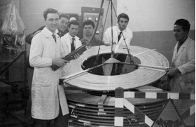
Colliders and Beam-Beam Effects
Since the very first Collider where particle beams are accelerated and smashing one against each other….
Anello di Accumulazione AdA
B. Touschek 1960

Slide 3
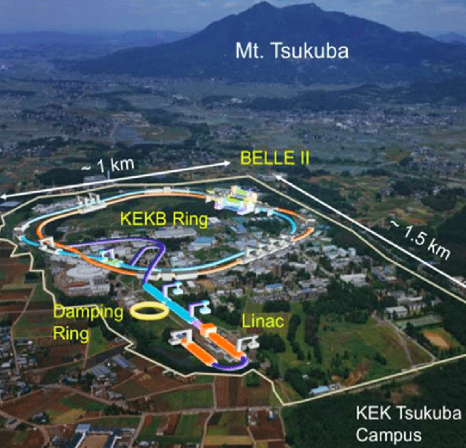

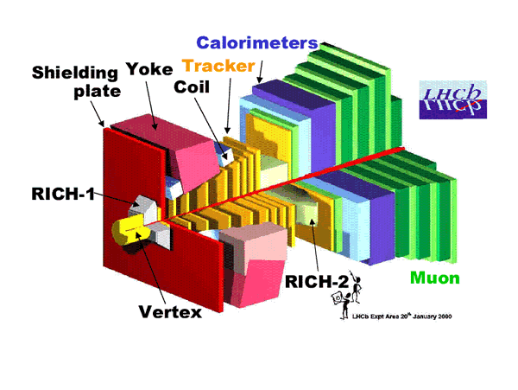

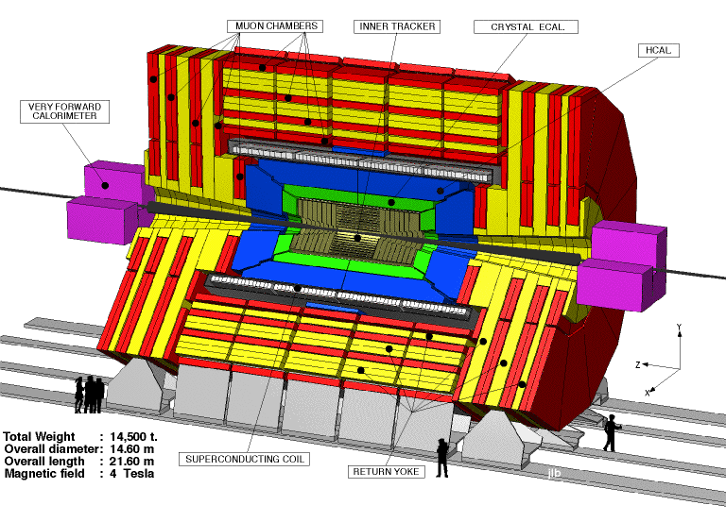
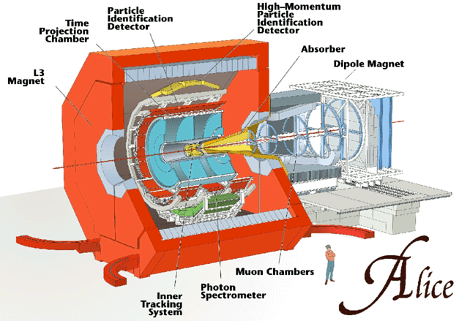
Colliders and Beam-Beam Effects
To today large colliders
SuperKEKB
Large Hadron Collider
LHC
Beam-beam effects have always shown to be present!

Slide 4
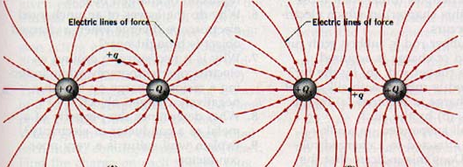


Colliders and Beam-Beam Effects
Every time the two beams collide or get closer to each other in a common beam pipe they electromagnetically interact!
Beam-beam interaction is the electromagnetic interactions of the two beams!
In linear colliders this occurs once at the collision region.
In circular colliders this happens at every turn and at different locations !

Slide 5
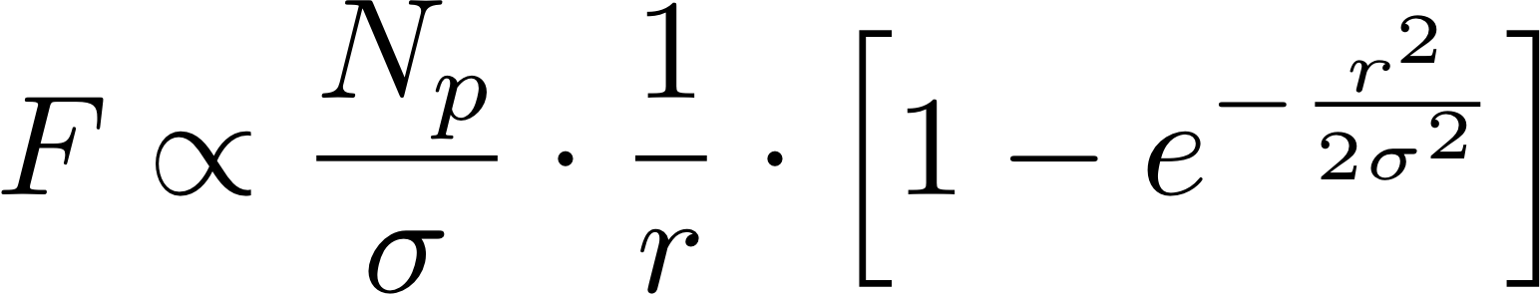
Beam-Beam Force
The electromagnetic force produced by a bunch of charged particles can be expressed with some assumptions (Gaussian particle distributions and ) as:
  N_{p} intensity particles per bunch
  σ transverse beam size
  r the distance respect to
  the distribution center
  Non-linear force
  Pushing for higher luminosity
  means making the force stronger
  Cannot be avoided!

Slide 6
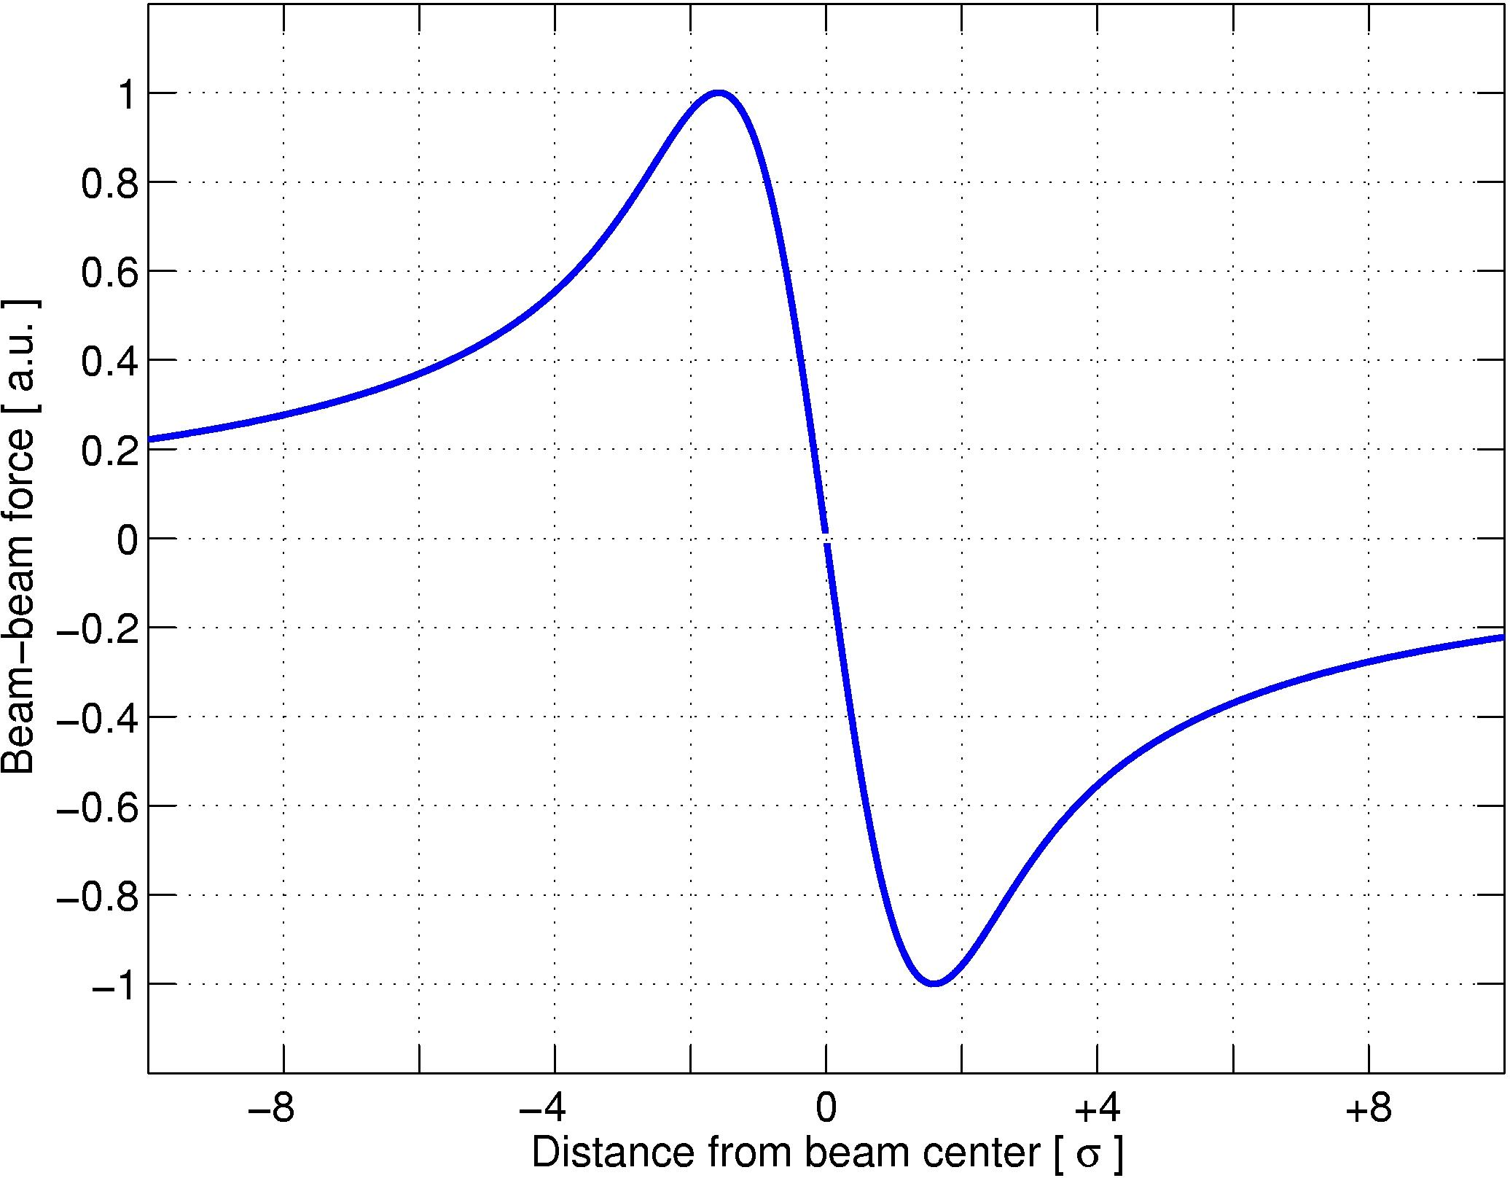
Head-on interactions
Beam-beam force
Second beam passing in the center
HEAD-ON beam-beam interaction

Slide 7
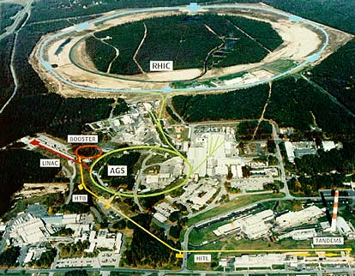
Head-on interactions
Beam-beam force
Relativistic Heavy Ion Collider
Second beam passing in the center
HEAD-ON beam-beam interaction
SuperKEKB

Slide 8
Long range interactions
Beam-beam force
Second beam displaced offset
LONG-RANGE beam-beam interaction
Different particles will see different parts of the force!

Slide 9
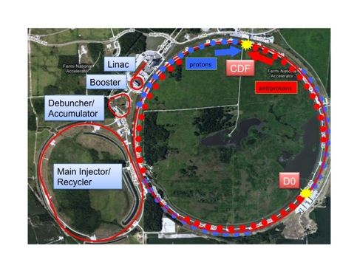
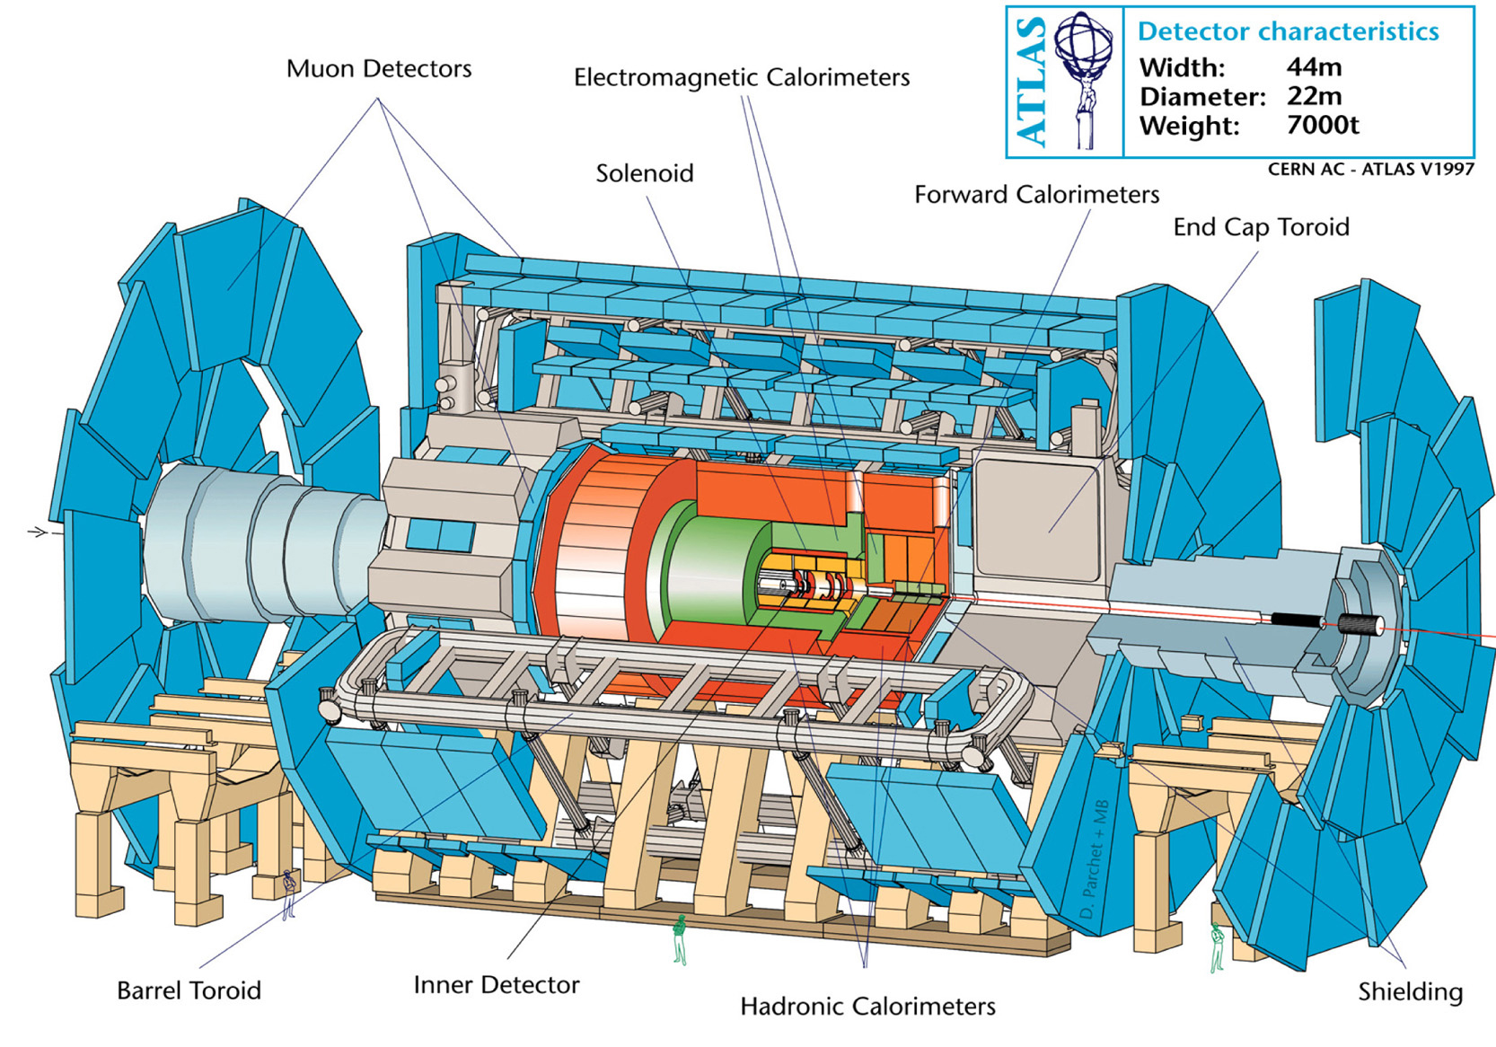
Long range interactions
Beam-beam force
Tevatron
Head-On
Second beam displaced offset
LONG-RANGE beam-beam interaction
Long Range
Different particles will see different parts of the force!

Slide 10
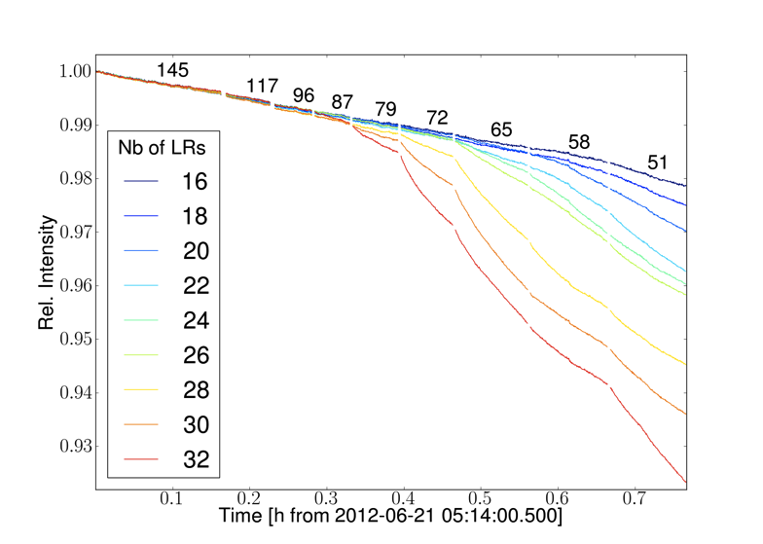
Beam-Beam Incoherent effects
Incoherent Effects: the single particle dynamics is changed due to the force of the opposing beam.
The change depends on the test particle amplitude in the force.
These effects could lead to: emittance blow-up, particle diffusion, bad lifetimes.
Particle losses as a function of the beam-beam long range separation and number of encounters
d_{sep} = 6 σ
d_{sep} Beam-Beam separation at Long range encounters

Slide 11
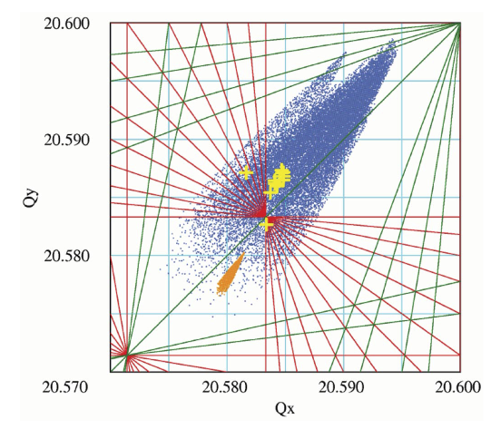
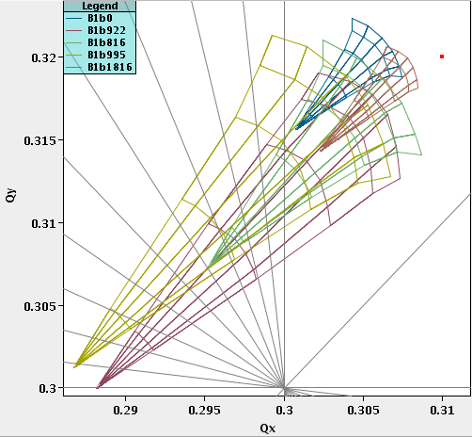
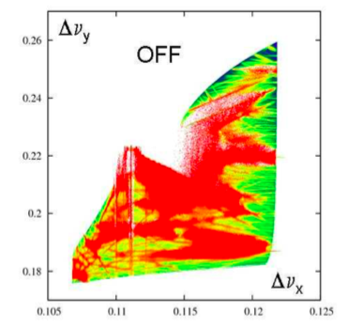
Beam-Beam tune shift and tune-spread
Tune shift and Tune spread
The opposite beam represents a non-linear electromagnetic lens to any charge. This will result in a tune shift and spread since the quadrupolar component will depend on the particle amplitude.
Has been derived analytically for simplified cases.
Numerical simulations are used for complex interactions
Tevatron
Footprints
DAFNE
Footprint
LHC 2012
Footprints
Well understood and reproduced several references.
Overlapping with resonances can lead to several effects: emittance blow up, bad lifetime and particle diffusion.

Slide 12
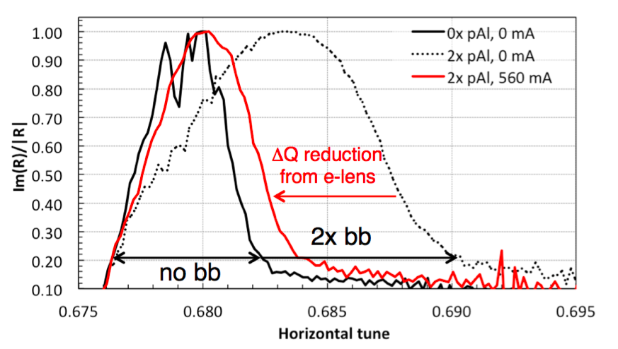
Compensation schemes active and passive
Tune shift and Tune spread suppression
Corrections or reduction of tune shift and spread have triggered development of several active devises and passive schemes to compensate.
Compensating tune shifts and spread is not the whole story.
RHIC
Active and passive compensators have been proved successful in several colliders (electron lenses Tevatron and RHIC, crab cavities KEKB and LHC,passive compensation schemes LHC) others like wires have been at DAFNE and are still under study at LHC together with the suppression of beam-beam or lattice resonances → improve performances!

Slide 13
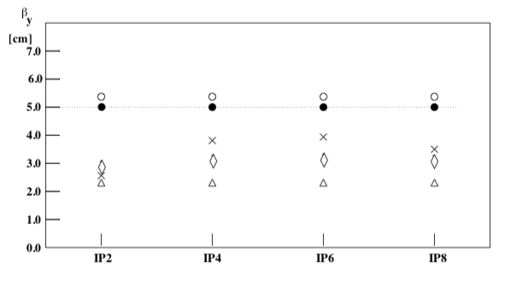
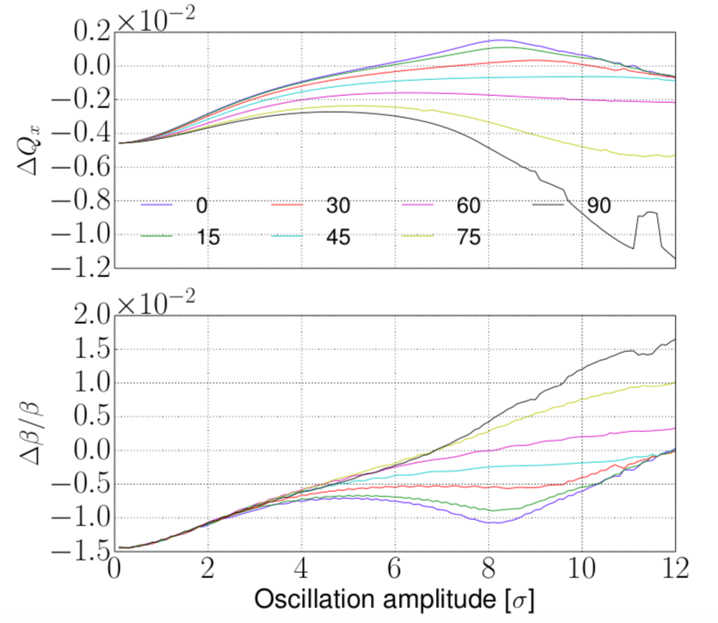
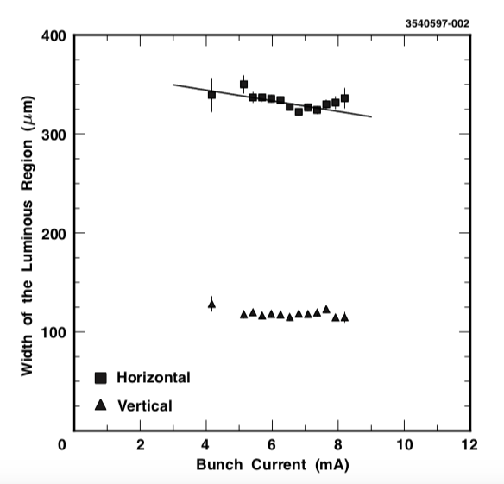
Beam-Beam dynamic beta and beta-spread
Dynamic β and β spread
As for the tune shift and spread, each particle going through the opposite beam fills a different focusing term that depends on the interaction and the relative position of the particle in the force. The beta function is distorted.
LEP dynamic beta
The effects depends on the beam-beam force strength and the phase between interactions.
CSRS
LHC
Can have positive effects enhancing Luminosity or reducing it, needs good phase between IPs.
Changes the beam aperture since it results in a beta-beating along the accelerator.
It is a bias to the visible cross section during luminosity calibration measurements in H colliders.

Slide 14
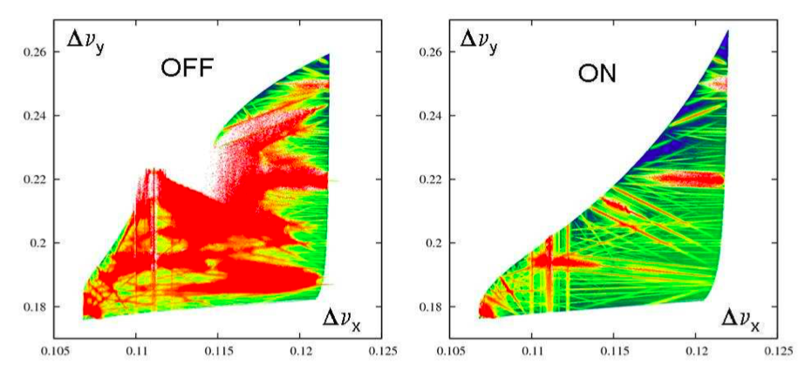
Beam-Beam and resonances
Betatron and synchrotron betatron resonances (due to Piwinski angle, lattice non linearities,…) coherent buildup of these perturbations can lead to the instability of beam motion, resonant condition
Crab Waist Scheme:
for a collider with two flat beams
in collision, one can use large horizontal
crossing angle to reduce parasitic
collision as well as beam-beam tune shift
a sextupole on either side of the
collision point re-distributes the beta
squeeze waist in the overlap area
The beta function at the waist becomes
β(s) = β∗ + (s − x/θ)2 β∗
Suppression of resonances!
DAFNE
Crab Waist Scheme

Slide 15
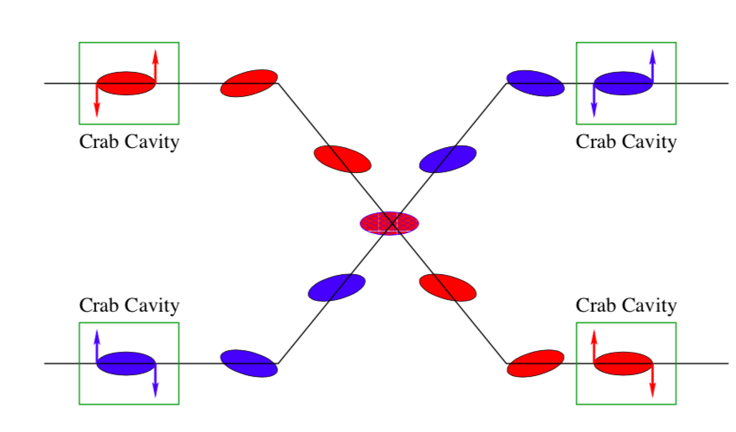
Beam-Beam and resonances
Betatron and synchrotron betatron resonances (due to Piwinski angle, lattice non linearities,…) coherent buildup of these perturbations can lead to the instability of beam motion, resonant condition
HL-LHC Crab Crossing
Crab Crossing scheme
Suppresses crossing angle and reduces long-range interaction effects
Suppresses synchrotron-betatron resonances
Operationally used in KEKB
Baseline for the HL-LHC

Slide 16
Beam-Beam and resonances
Betatron and synchrotron betatron resonances (due to Piwinski angle, lattice non linearities,…) coherent buildup of these perturbations can lead to the instability of beam motion, resonant condition
Beam-beam interactions, lattice non-linearities and other elements in accelerator can excite resonances .
Resonances can drive emittance blow up and particle losses.
Several devices have been developed to suppress BB induced resonances:
Crab Waist scheme
Electron lenses
Crab cavities
Compensating wires…

Slide 17
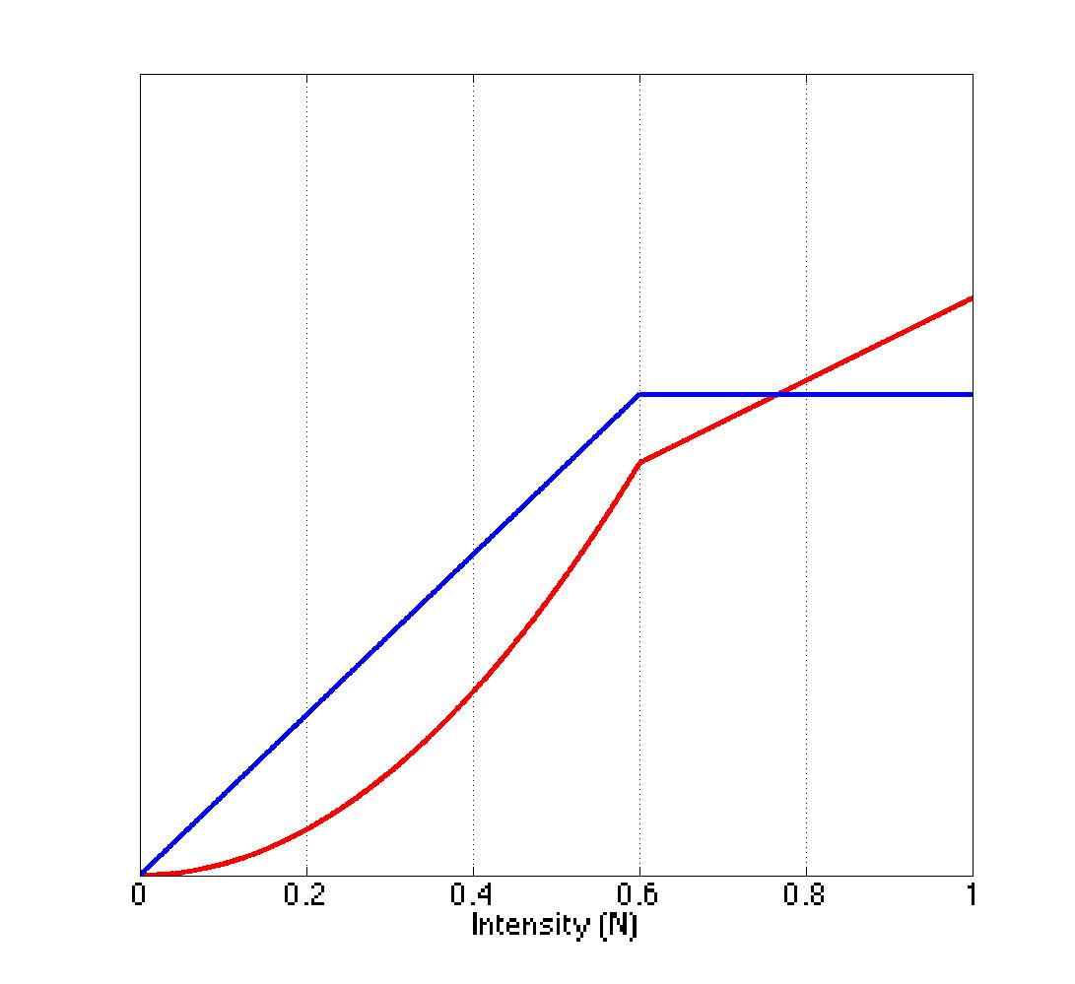
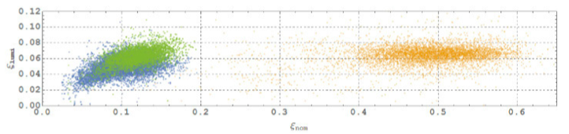
Beam-Beam limit
Beam-beam limit in lepton colliders. Vertical growth is observed due to H-V coupling of the beam-beam force. This will reduce the luminosity increase. Has a threshold effect.
Beam-beam limit
Lepton colliders σ_{x} >> σ_{y}
VEP 2000
Beam-beam H to V coupling defines the beam-beam limit.

Slide 18
Beam-Beam Coherent effects
Coherent Effects: particles organize a collective motion. The whole bunch dynamics is modified. A collective motion is organized as a result.
These effects could lead to: coherent oscillations, dipolar or head-tail type, emittance blow-up and sudden intensity or luminosity loss.

Slide 19
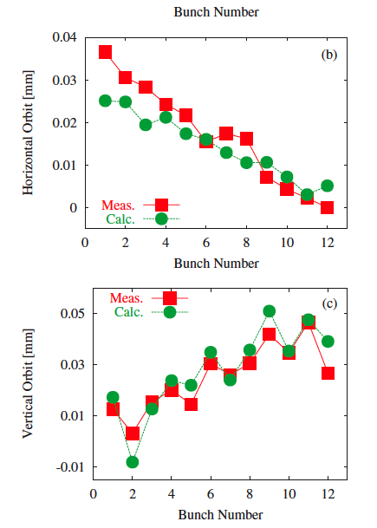

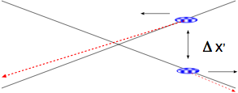
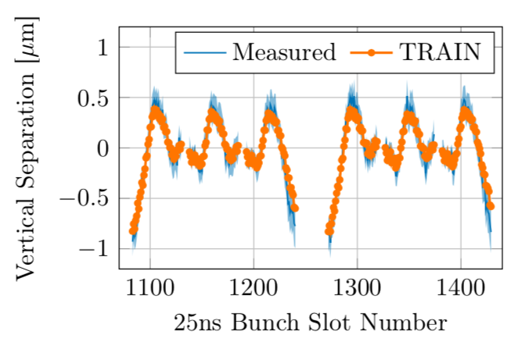
Orbit effects
Tevatron
LHC
Orbit effects can deteriorate beam overlap. Need to be self-consistently computed and reduced. Particularly complex for multi bunch colliders

Slide 20
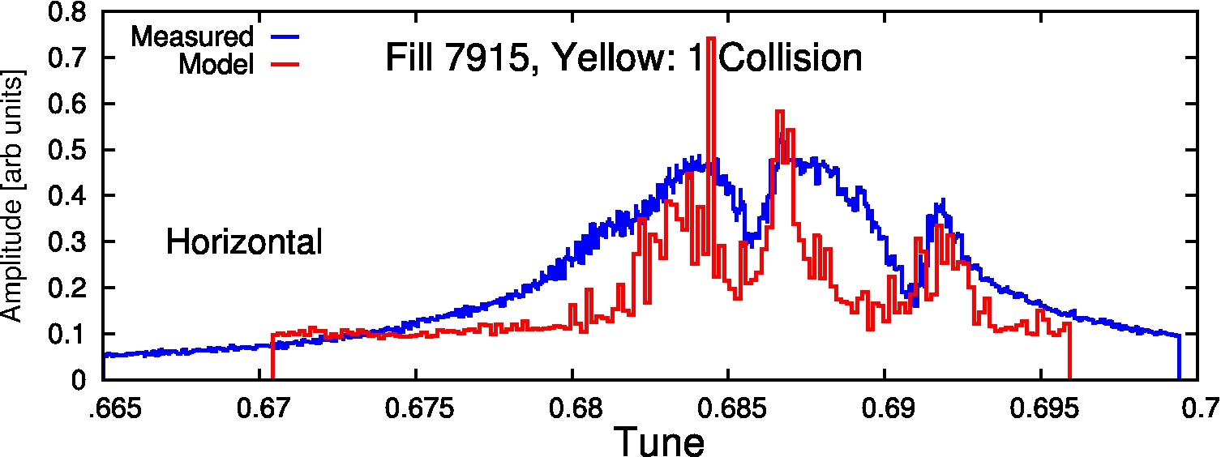
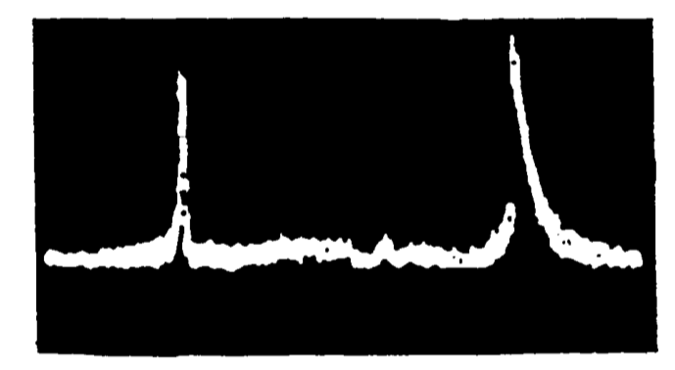
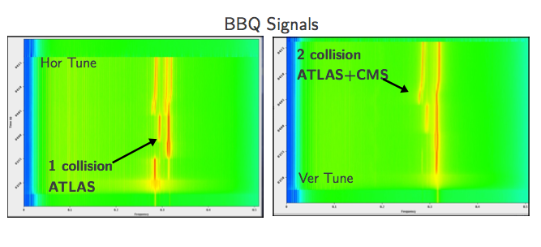
Beam-Beam Coherent modes
Coherent kick of separated beams can excite coherent dipolar oscillations
All bunches couple because each bunch interacts with many opposing bunches: many coherent modes possible!
RHIC
PETRA
LHC
Coherent beam-beam modes have been measured and studied extensively in several colliders. Measurements agree well with expectations. The two beams are locked together in a coherent motion.

Slide 21
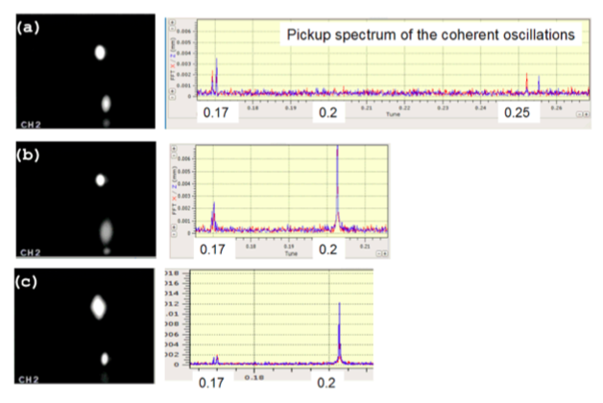
Beam-Beam Flip-Flop effect
3D Flip-flop effects have been observed in several colliders (PEPII, VEP2000, )
The instability mechanism develops due to several ingredients:
Ingredients include:
asymmetry in beam intensities
beamstrahlung
crossing beams
x-y coupling
This flip-flop instability has a beam
intensity threshold.
VEP 2000
FLIP-FLOP
3D Flip-Flop effects triggered by non-linearities of lattice. π-mode on 1/5 resonance. The effect have shown a strong sensitivity to X-Y coupling, beta unbalance and bunch length → main limitation in VEPP 2000.
→ Round beam operation to enhance the beam-beam limit proved to be succesfull!

Slide 22
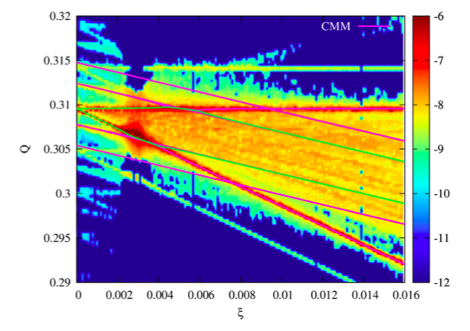
Beam-Beam driven coherent instabilities
Beam-beam instabilities
  BB and impedance mode coupling
Coherent beam beam modes can couple to the transverse impedance modes
LHC case
The interplay of beam-beam coherent modes with other effects i.e. the machine impedance drives coherent instabilities.
Dipolar type are easy to suppress by transverse damper.

Slide 23
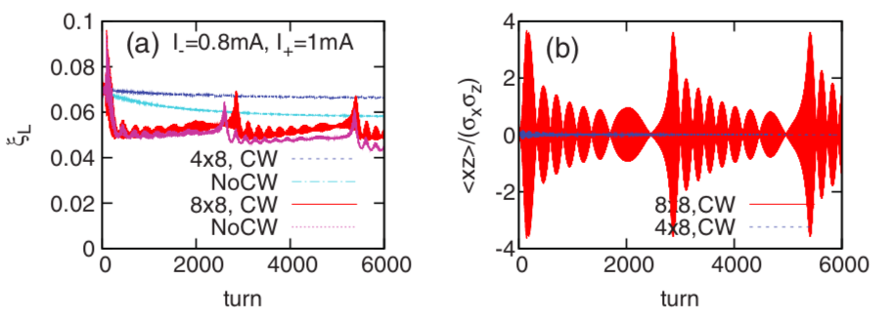
X-Z Instability with CW
Beam-beam instabilities
  BB and impedance mode coupling
  BB X-Z instability
SuperKEKB X-Z instability
Beam-beam driven head-tail type of instability
It depends on Piwinski angle and Crab Waist scheme
Experimental observation possible at SuperKEKB
The head-tail σ-mode is excited. Two beams oscillate in phase. To avoid instabilities modify machine set-up.

Slide 24
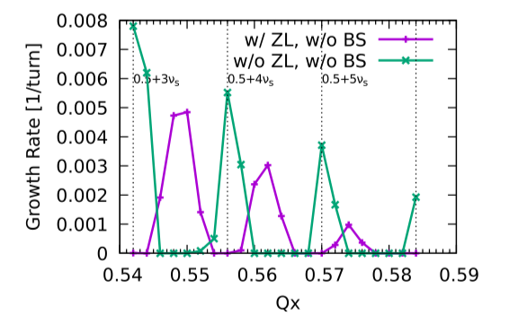
Beam-Beam + longitudinal coupling impedance and beamstrahlung
Beam-beam instabilities
  BB and impedance mode coupling
  BB and CW schemes : X-Z instability
  BB, beamstrahlung and longitudinal coupling impedance
CEPC studies
Large Piwinski angle operation might
suffer of Head-tail like horizontal-synchrotron
(X-Z) coherent instability.
The horizontal oscillation will be affected by the longitudinal dynamics due to the beam-beam force.
The interplay of beam-beam with longitudinal machine impedance drives coherent instabilities.
Several observations for different machines in simulation.

Slide 25
Beam-Beam effects
Incoherent Effects:
Tune shift and Tune spread
β-change and β spread
Betatron and synchrotron betatron resonances (due to angles, BB, lattice)
Beam-beam limit
Noise
Landau damping
Pinch effects + beamstruhlung in linear colliders
Cooherent Effects:
Orbit Effects
Coherent beam-beam modes
Flip-Flop effects
Beam-beam Mode coupling instabilities
Beam-beam X-Z instability with CW schemes
BB X-Z instability longitudinal coupling impedance and beamstruhlung
These effects impact and interplay with machine set-up and other effects gives the real picture of what is happening!

Slide 26
Beam-beam studies in the future?
From the very first collider it was clear beam-beam effects play an important role in the beam dynamics and performance success of colliders
The key in pushing collider performances is always understanding the limitations, interplay of beam-beam effects with other ingredients is the correct way to address problems.
Future colliders should profit of a wide pool of expertise coming from past and present machines all around the world
Today tools (collaborative software packages) and technology (GPU, parallel processing) allow the modelling of complex operational scenario
Benchmarks to operating colliders are fundamental to define models limitations and understand the details of beam-beam effects
Globalization helps! Sharing experts knowledge from hadron to lepton communities, linear to circular machines, CW,CC, e-lenses, impedances helps pushing forward knowledge…
…and certainly more powerful colliders to come!

Slide 27
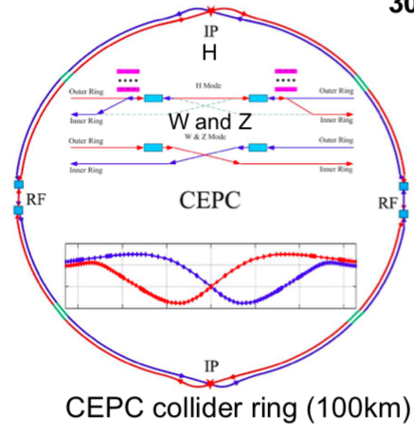
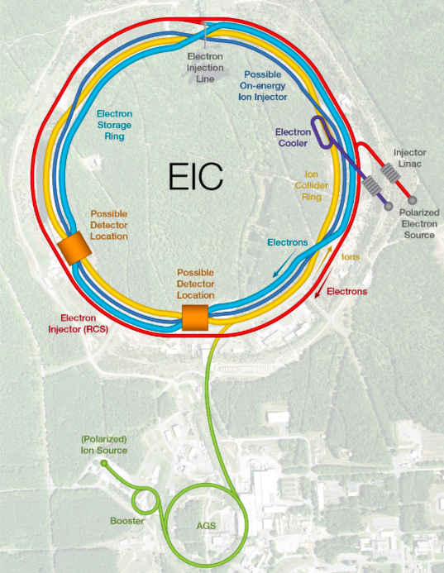
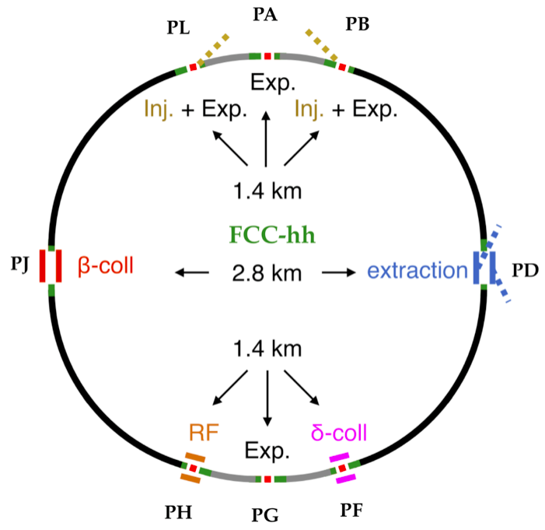
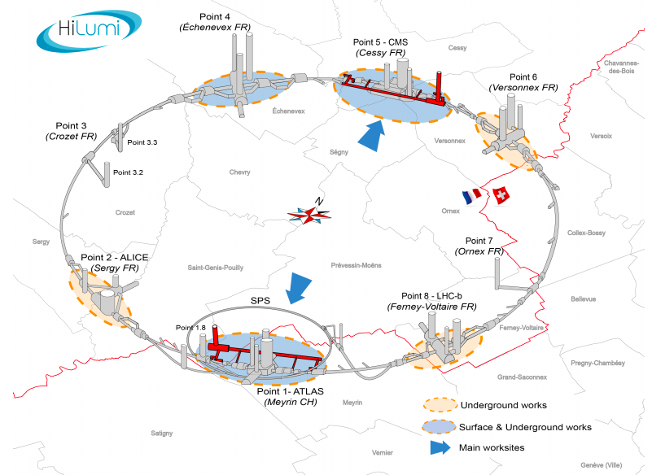
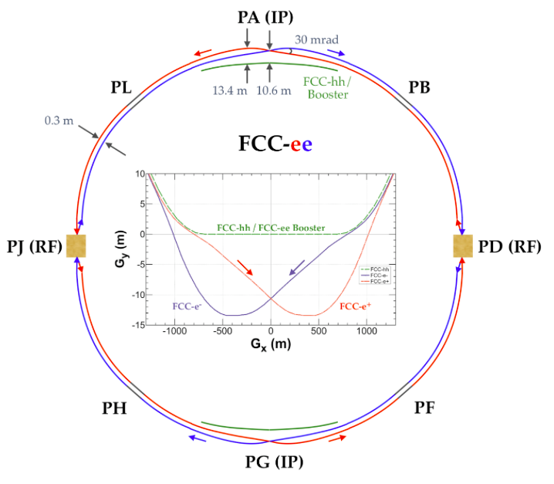
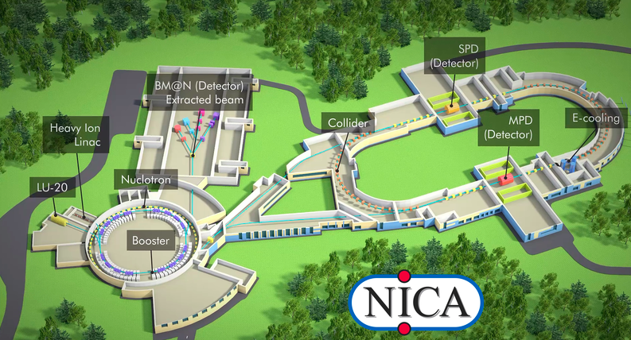
Future beam-beam studies
CEPC
EIC
FCC
HL-LHC
Super-KEKB
Muon Collider
ILC
CLIC

Slide 28
Questions?

