Slide 1
SuperKEKB Accelerators
Current status and Lessons learned
Makoto Tobiyama
KEK Accelerator Laboratory
HKUST IAS Mini Workshop of Accelerator, 13/Jan/2022

Slide 2
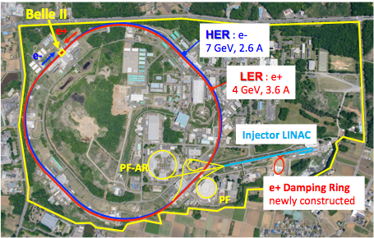
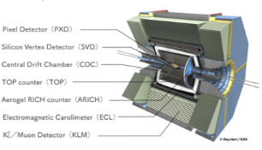

SuperKEKB Accelerators
HER
7 GeV, 2.6 A
IP
IP
LER
4 GeV, 3.6 A
SuperKEKB
3 km
900 m
Linac Injector
Control room
Positron Damping Ring (1.1 GeV)

Slide 3
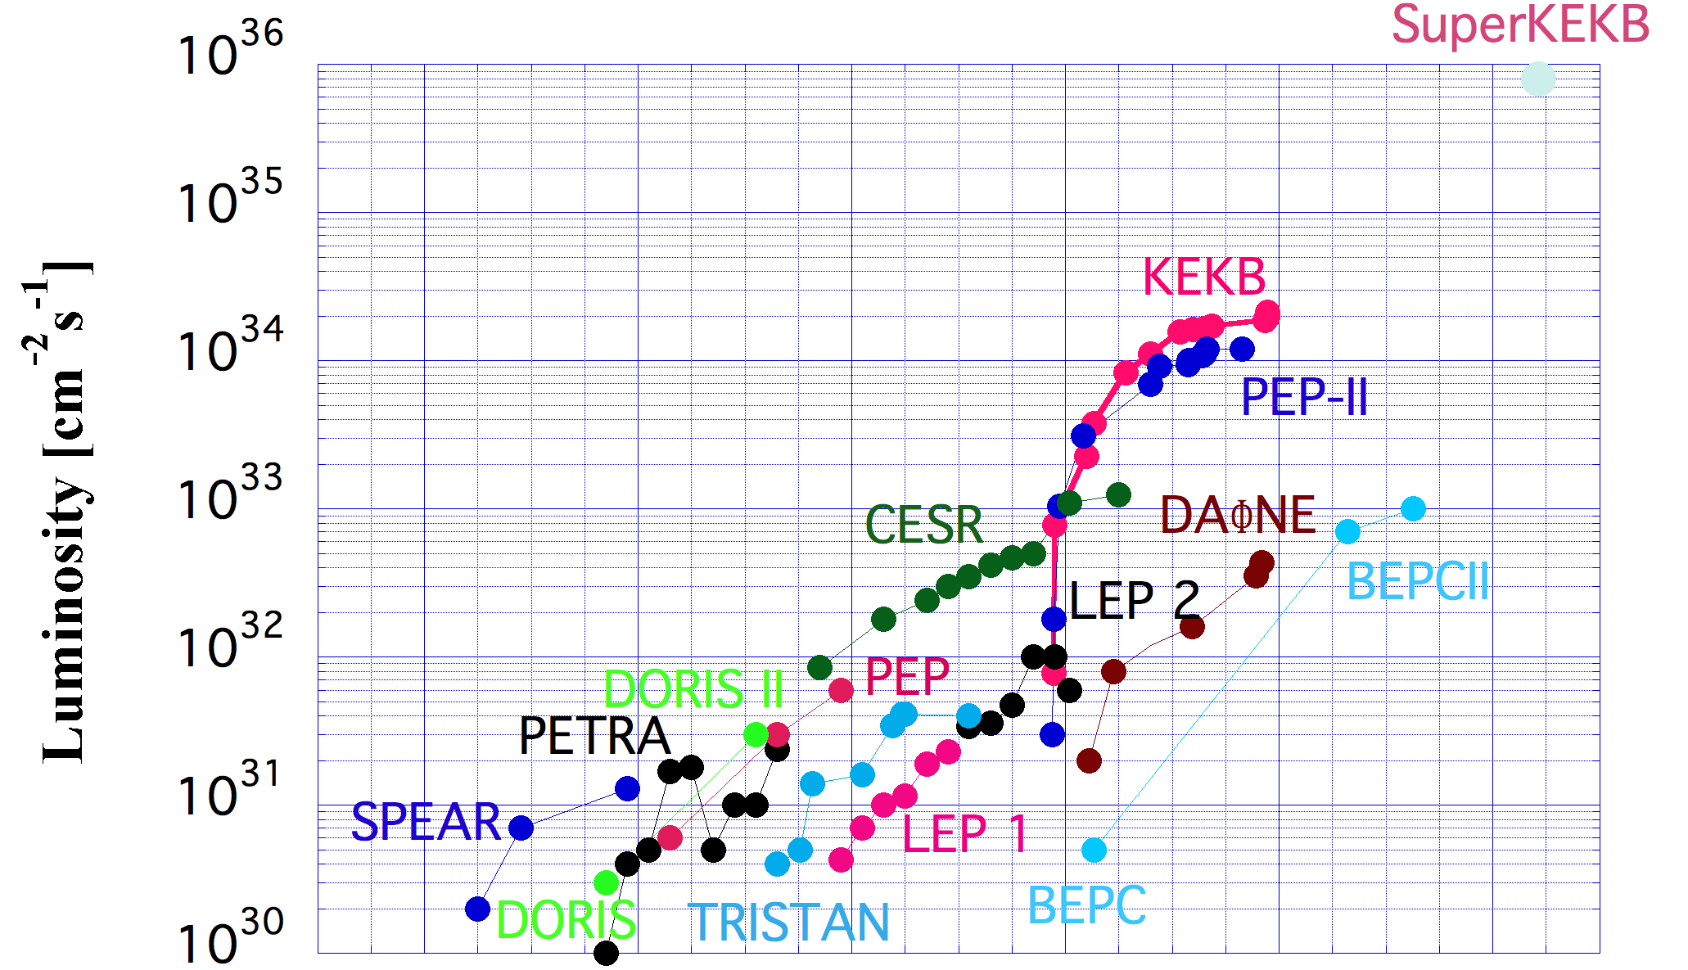
SuperKEKB Luminosity Target
8 x 10³⁵
History of Peak Luminosity (e+/e- colliders)
Target integrated luminosity is 50 ab⁻¹.
(~10 year operation)
2.1 x 10³⁴
x few 10 !!
1970
1980
1990
2000
2010
2020
By Y. Funakoshi

Slide 4
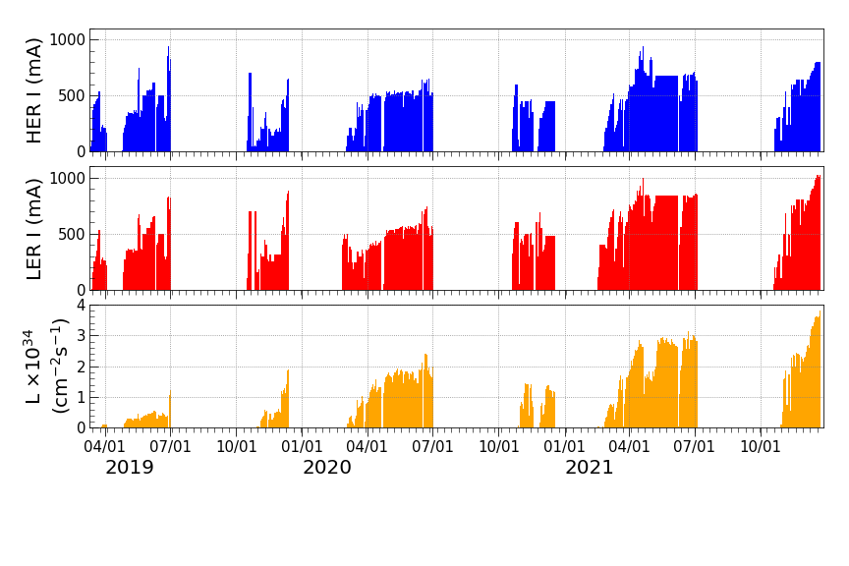
Ｌｕｍｉｎｏｓｉｔｙ Ｈｉｓｔｏｒｙ
by Y. Onishi
Y. Ohnishi, KEKB Accelerator Review

Slide 5
Machine Parameters
Y. Onishi

Slide 6
Luminosity records
Peak luminosity 3.81x10³⁴ cm⁻²s⁻¹
Integrated luminosity 874.7 pb⁻¹ / shift
2215.1 pb⁻¹ /day
12.62 fb⁻¹ /7 days

Slide 7
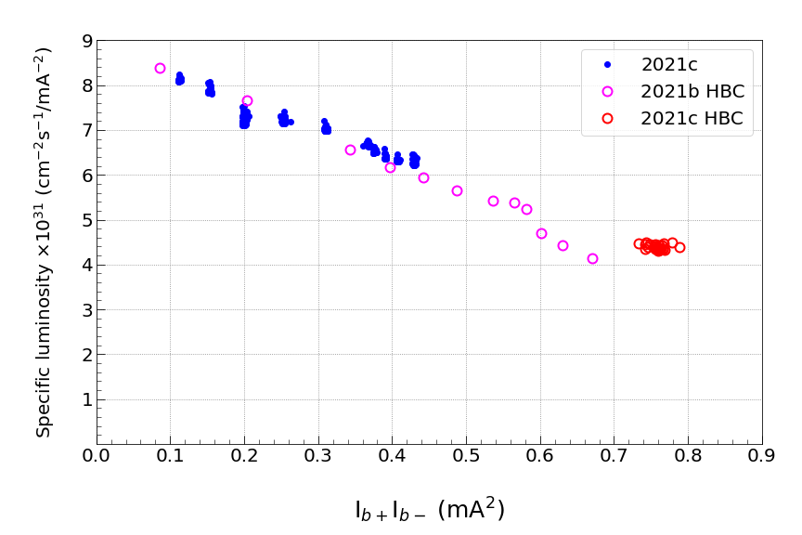
Specific Luminosity
Physics run
HBC:High bunch current study
w/o Belle II data taking
by Y. Onishi

Slide 8
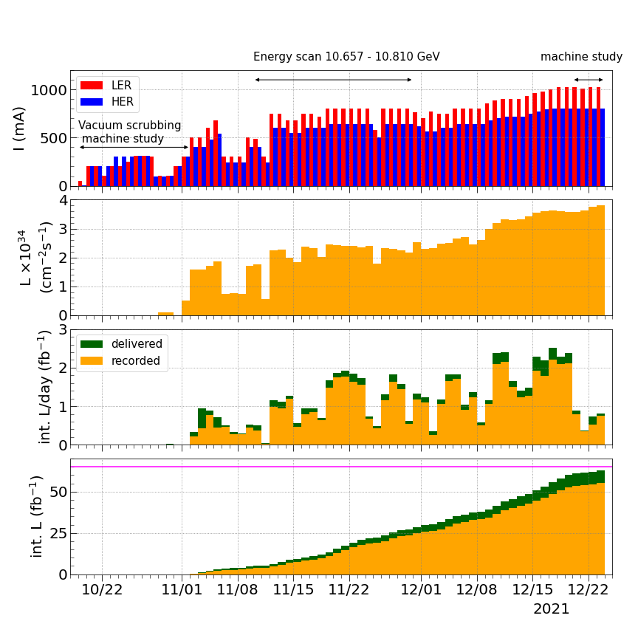
Almost around the baseline plan
by Y. Onishi

Slide 9
Challenges (1) LER QC1
Totally 54 SC magnets

Slide 10
Challenges (1)
LER QC1 without anti-solenoid nor magnetic shield
  Introduces chromatic coupling which might work worse on the point of beam-beam interaction
    Larger stopband on the resonance line
    Increase vertical beam size
    Smaller dynamic aperture
  Rotatable sextupole (to cancel skew sextupole components) might help to cancel the effect.
    Found better settings on the single beam study on 2021c runs

Slide 11
Challenges (2)
Extremely smaller dynamic (and physical) aperture on LER
  Beam lifetime is strongly limited by the dynamic aperture
    Tried several new settings of sextupoles but not successful up to now.
      Still trying to find better sextupole sets under the international task force, of course.
    Physical aperture (vertical) in the QCS limits the physical aperture in some degree
    Very narrow setting of vertical collimators to suppress the beam background (especially in the injection background) also limit the physical aperture (and beam life time).

Slide 12
Challenges (3)
Beam background and beam aborts due to (extremely fast) beam loss.
  Serious radiation dose at collimators, severe damage at collimators, damage on Belle II detector.
  Large risks for increasing beam currents (to achieve higher luminosity).
T. Ishibashi, KEKB Accelerator Review

Slide 13
By H. Nakayama (MDI meeting)

Slide 14
LER
HER

Slide 15
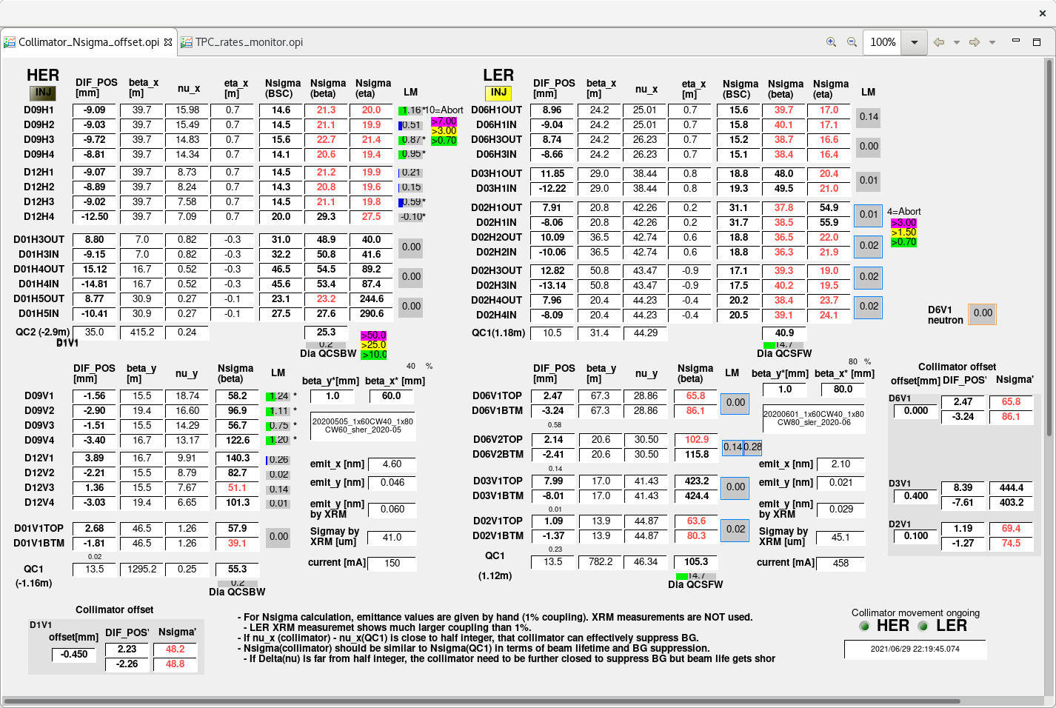

Slide 16
Collimator damage
T. Ishibashi, KEKB Accelerator Review

Slide 17
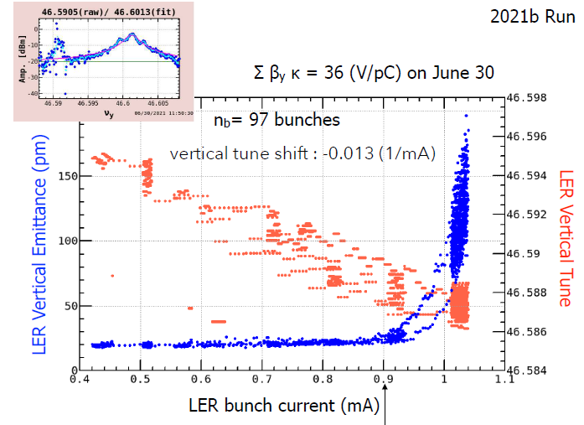
Challenges (4)
Collimator transverse impedance (TMCI threshold)
  Fairly narrow aperture to reduce beam background to Belle II detector.
    Shorter beam lifetime (especially in LER)
    Limit the maximum bunch current due to lower TMCI threshold
    Increasing risks to damage the beam collimators (including residual radiation).

Slide 18
Challenges (5)
Beam-beam blowup (in vertical plane)
  Source of the blowup : Chromatic X-Y coupling?? or other?
  Single bunch blowup or multi bunch effect?
  Contribution from (broadband noise in) transverse bunch-by-bunch feedback?
  Beam-beam head-tail instability?
  Could be cured by the optimization of crab waist?

Slide 19
Challenges (6)
Quality and amount of the injection beam from Linac
  Larger emittance than expected
  Emittance blowup in the beam transport line (due to CSR??)
  Stability of the injector Linac
    Orbit fluctuation
    Change of energy spread

Slide 20
Many challenges remains
Bunch feedback (noise) effect to vertical beam size
Optimization of crab waist
Impedance (bunch lengthening: longitudinal and transverse)
Machine stability (mechanical, power supplies)
Machine protection
RF beam loading, HOM
Aging of the infrastructures, including buildings.

Slide 21
International Task force for SuperKEKB upgrade
Members
  ARC members prepared a list of possible candidates in June, 2021
  Initial members have been identified. More members who have required expertise and strong interest are welcome.
  Should work in close collaboration with KEKB commissioning team.

Slide 22
International Task Force
Charges
  Consider effective ideas to realize luminosity of ~6x10³⁵ cm⁻² s⁻¹ as a result of an intermediate upgrade around 2026, which could include modifications of IR, final focus systems, injectors, but without changing the boundary to the Belle II detectors.
  Find a realistic way before long shutdown 1 (LS1) scheduled to start Jul/2022 in order to achieve luminosity of the order of 10³⁵ cm⁻² s⁻¹ without large modification of accelerator components.
  Consider longer-term alternative idea to achieve ~6x10³⁵ cm⁻² s⁻¹ or more, even by largely modifying the IR and the Belle II detector
Four working groups (sub-groups) organized and their indico sites created
  Optics (contact person: Akio Morita)
  Beam-beam (contact person: Demin Zhou)
  TMCI (contact person: Mauro Migiliorati)
  Linac (contact person: Masanori Satoh)

Slide 23
Please join the sub-group
Anyone can join the group-mail-list by sending an email to {group-name}-request AT ml.post.kek.jp with a subject of “subscribe”
Sub-group
  skb-itf-bb AT ml.post.kek.jp: for Beam-beam
  skb-itf-opt AT ml.post.kek.jp: for Optics
  skb-itf-tmci AT ml.post.kek.jp: for TMCI
  skb-itf-linac AT ml.post.kek.jp: for Injector Linac
We look forward to your participation!

