Slide 1
ILC Political Status
Hitoshi Yamamoto
IAS Panel Discussion
Jan 21, 2021

Slide 2
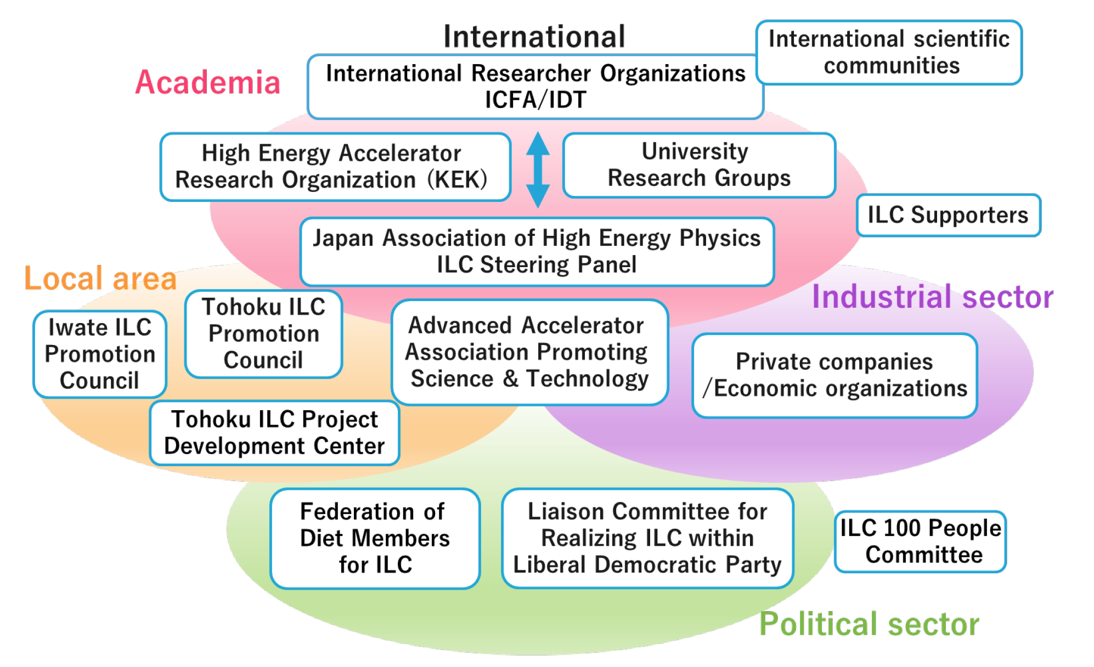
Active Organizations in Japan Promoting ILC
~100 diet members of 700 total
Direct contact with the PM’s office

Slide 3
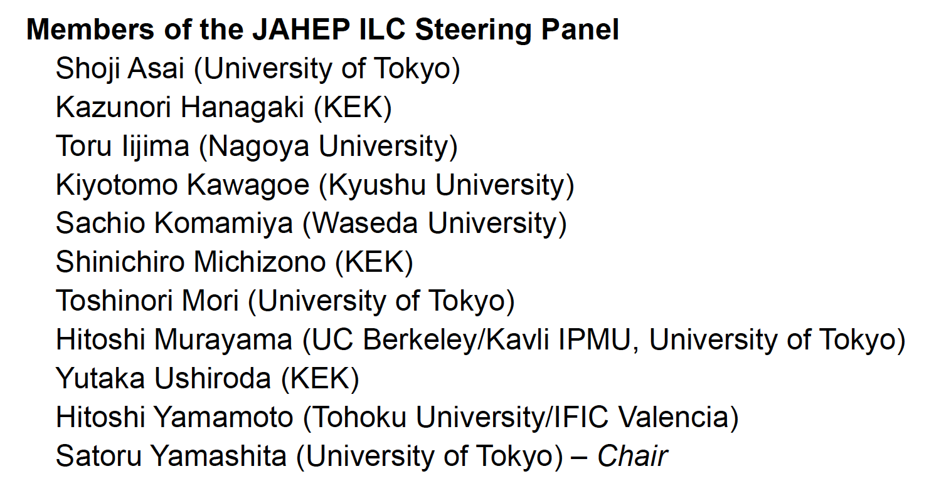
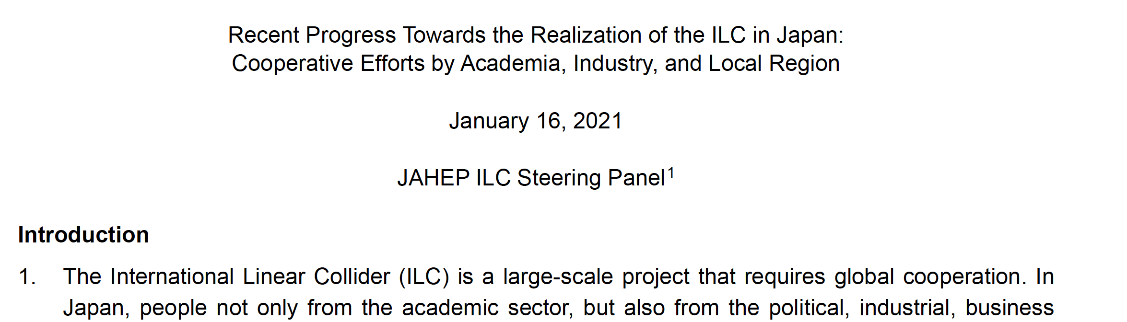
ILC Steering Panel
Established fall 2020
LHC
LHC
Belle
Belle
http://jahep-ilc.org/files/ILC_JP_update_20210116_E.pdf

Slide 4
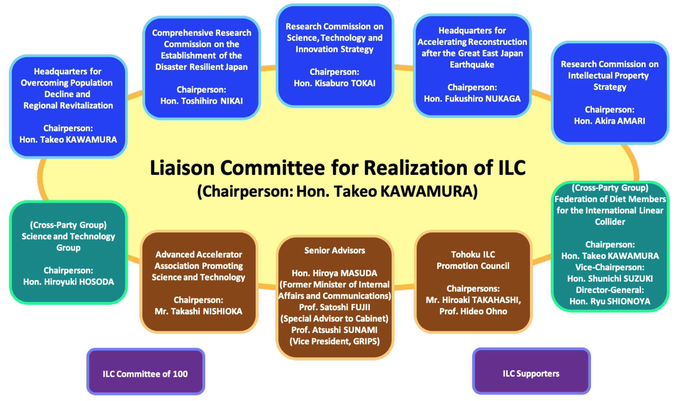
Ruling Party（LDP）’s Coodination Council for Realization of ILC
Established Sep 18,2018
  Goal: realize ILC as a national project addressing cross-policy issues
    Resolutions: ILC budget to be outside of ordinary ‘science’ budget
    Roughly ½ from overseas
  Key members of the LDP are in the group
Nikai: general secretary
Amari: election
Amari: election
LDP Leadership

Slide 5
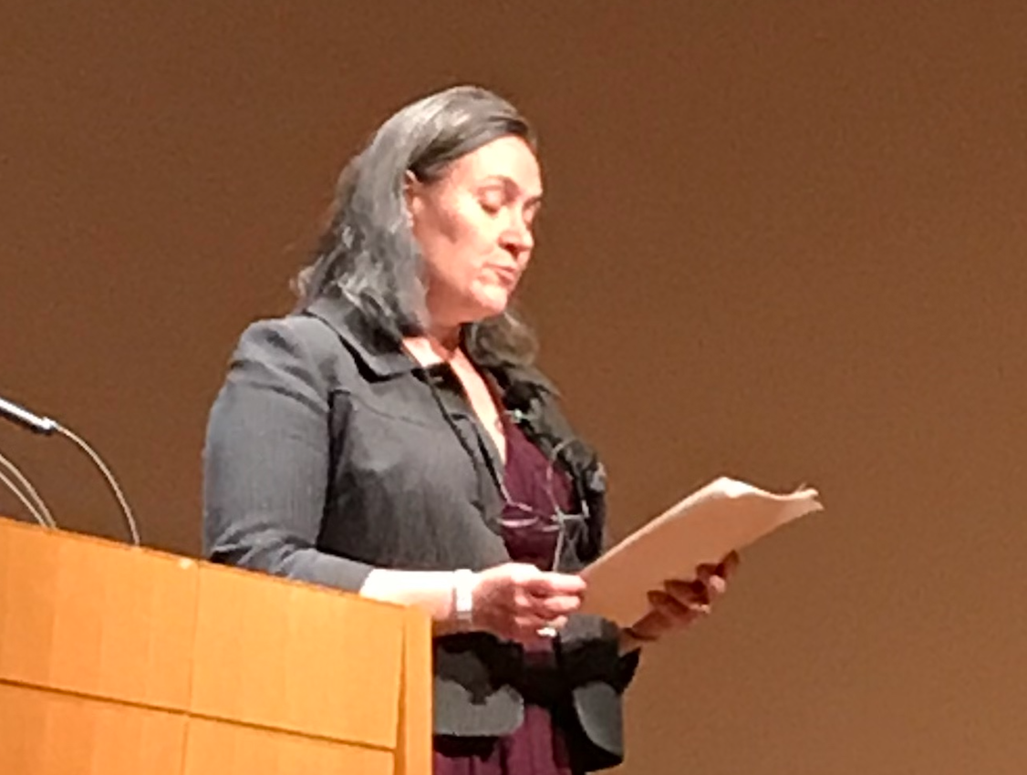
On the US stance toward the ILC:
Address at LCWS2019 by Melinda M. Pavek :
Embassy of the USA, Economic and Scientific Affairs,
Director, Science, Innovation and Development Unit.
… the U.S. Department of State has done our initial due diligence,
and we are ready to assist our partner agencies in moving forward
with the next major particle physics facility in Japan—the International
Linear Collider, also known as the ILC. To be clear, the United States is
not looking for an immediate decision on building, or hosting, the ILC.
Instead, the United States is looking for Japan to signal an intent to
explore hosting the ILC.

Slide 6
The National Diet of Japan passed a bill to extend the Reconstruction Agency (June 5, 2020)
Supplementary Resolution #5 by the House of Representatives (unofficial translation)
In cases where international research and development projects, such as the International Linear Collider which will contribute to the creation of a “New Tohoku”, are to be implemented in Japan, coordination and cooperation should be done with relevant organizations so that the projects can be hosted in the disaster-stricken areas.
Supplementary Resolution #26 by the House of Councillors (unofficial translation)
Since the Tohoku area is the world’s candidate site for the International Linear Collider project, its implementation will contribute, alongside the Fukushima Innovation Coast Framework, to the creation of a “New Tohoku” by becoming a breeding ground for scientific innovation. Therefore, the discussions need to be pushed forward in close coordination with the relevant organizations toward realizing the ILC in Japan.

Slide 7
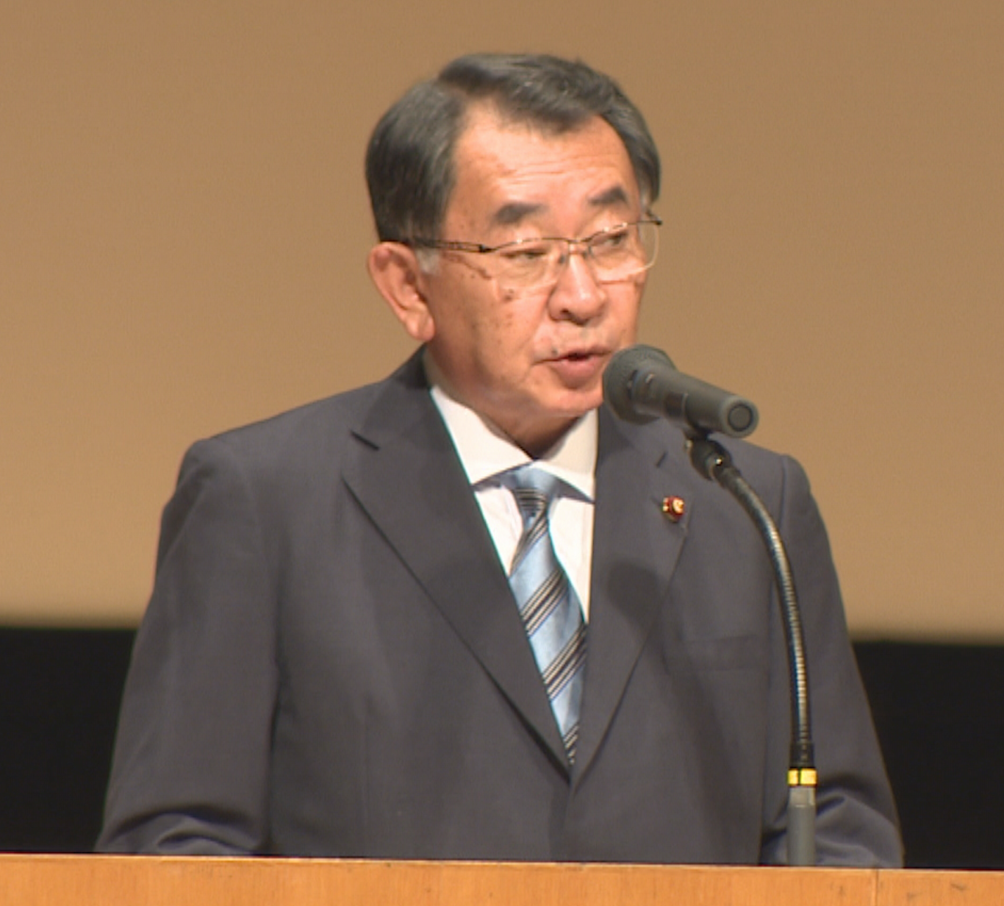
From Key-note Speeches at LCWS2019
On what is happening within Japanese government and legislative body:
’In parallel with the administrative process by the government, we,
as politicians in the legislative branch, will make actions in earnest
toward implementing the preparatory budget and discussing the
financial resources for the construction.’
http://epx.phys.tohoku.ac.jp/LCWS2019/keynote.html
Address at LCWS2019 by Hon. Shionoya:
The Director-General of the Federation of Diet Members supporting the ILC
and ex-MEXT minister
Now intensely working toward the
budget for Pre-LAB.

