Slide 1
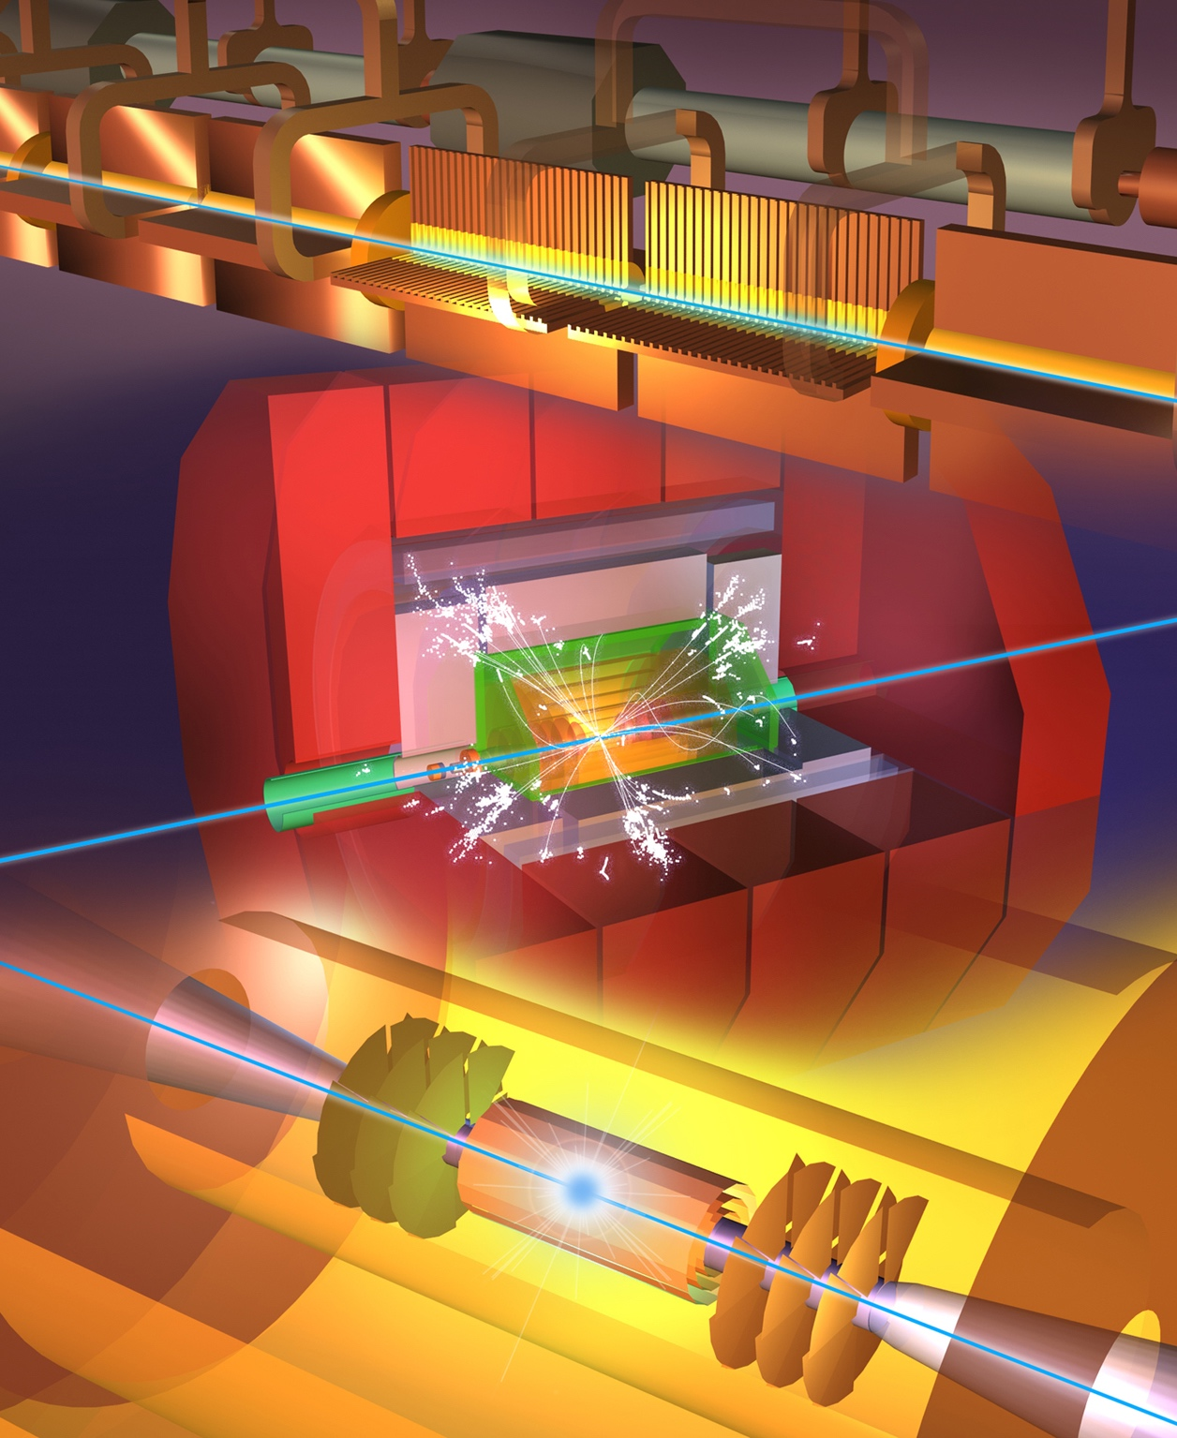
Steinar Stapnes
on behalf of CLIC
The Compact Linear Collider (CLIC)
Outline
CLIC project overview
Technical status and progress
Project implementation
Summary
Hong Kong IAS
January 20th, 2021

Slide 2
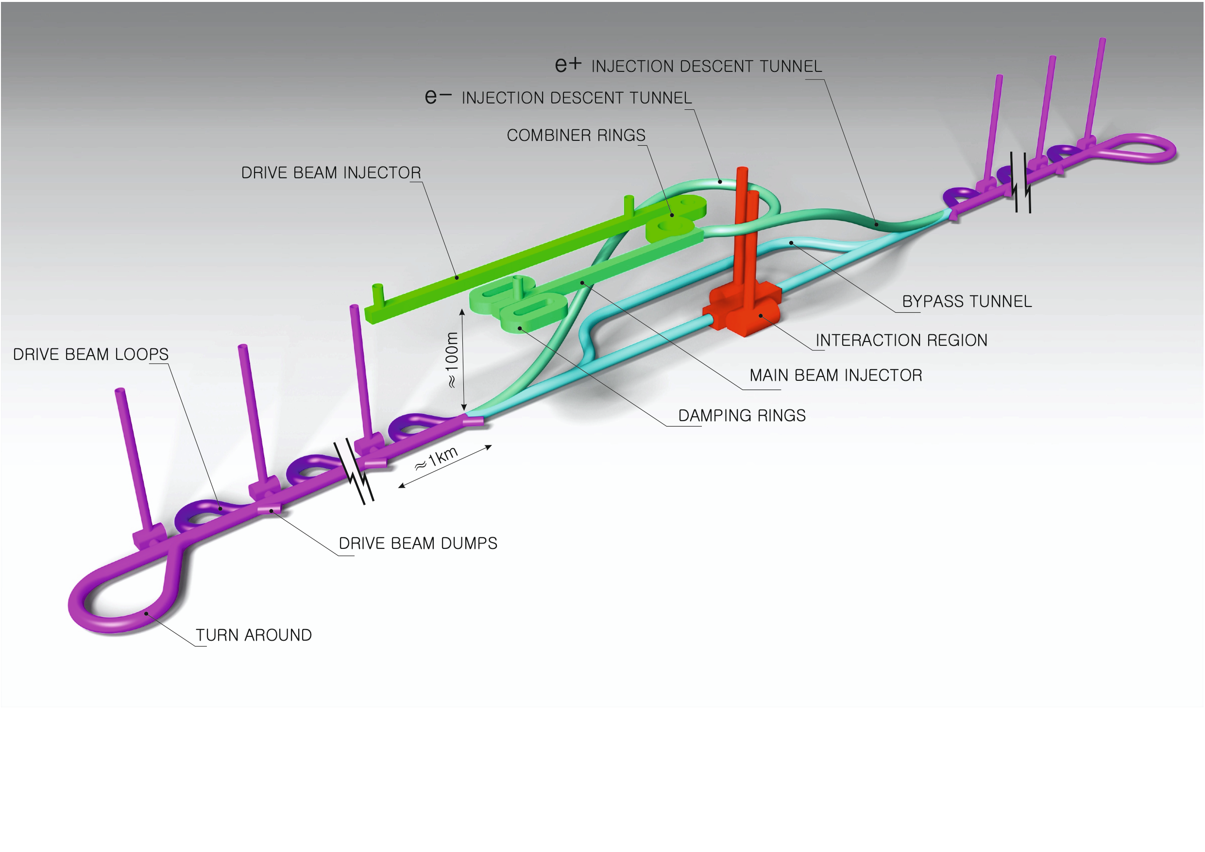
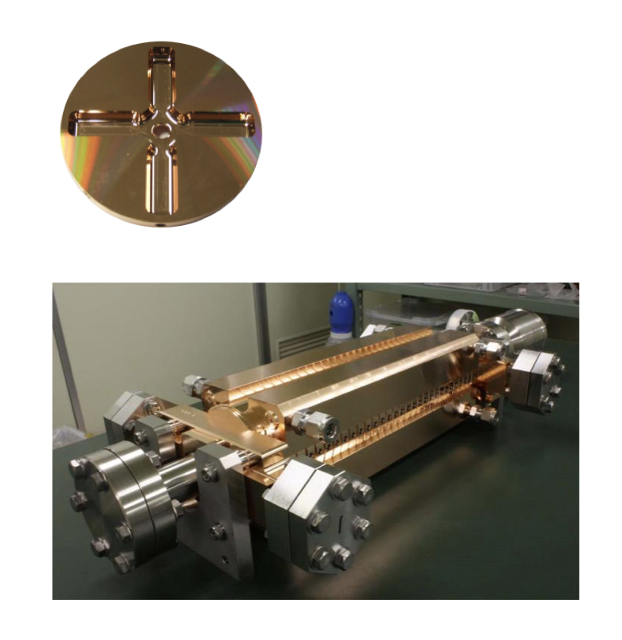
Proposed e⁺e– linear colliders – CLIC
The Compact Linear Collider (CLIC)
  Timeline: Electron-positron linear collider at CERN for the era beyond HL-LHC (~2035 Technical Schedule)
  Compact: Novel and unique two-beam accelerating technique with high-gradient room temperature RF cavities (~20’500 cavities at 380 GeV), ~11km in its initial phase
  Expandable: Staged programme with collision energies from 380 GeV (Higgs/top) up to 3 TeV (Energy Frontier)
  CDR in 2012. Updated project overview documents in 2018 (Project Implementation Plan). See resource slide.
  Cost: 5.9 BCHF for 380 GeV (stable wrt 2012)
  Power: 168 MW at 380 GeV (reduced wrt 2012),
  some further reductions possible
  Comprehensive Detector and Physics studies
Accelerating structure prototype for CLIC:
12 GHz (L~25 cm)

Slide 3
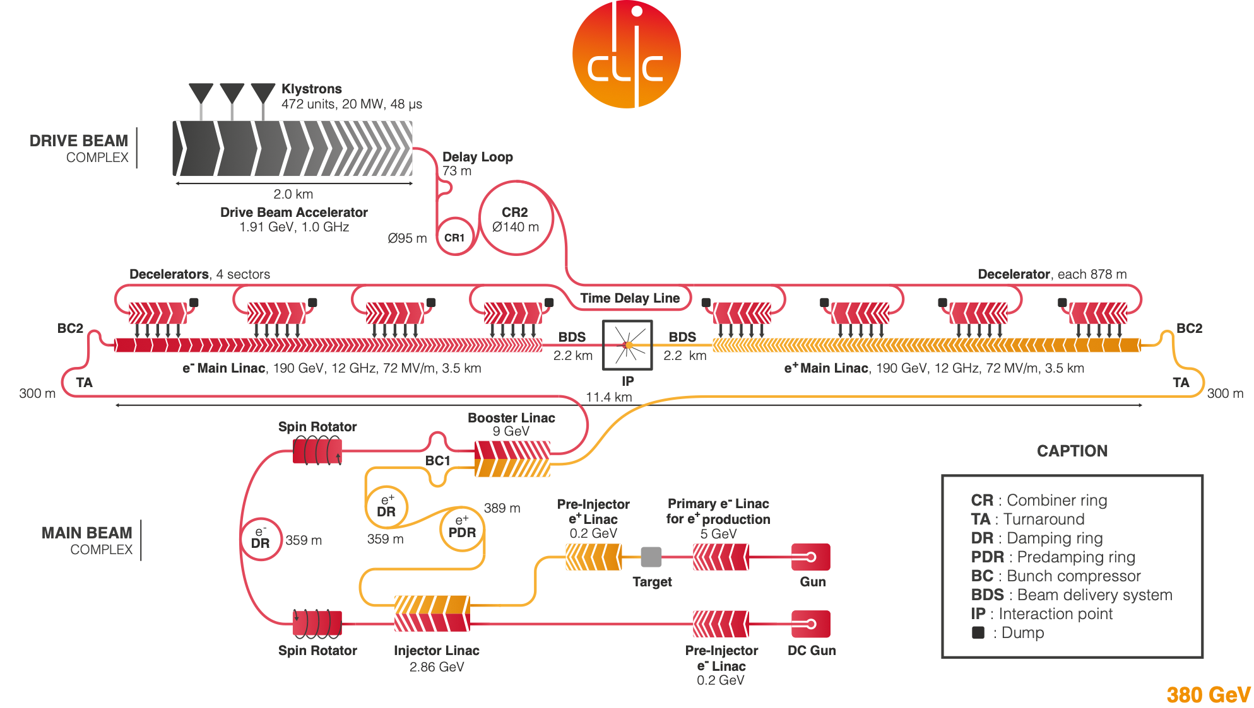
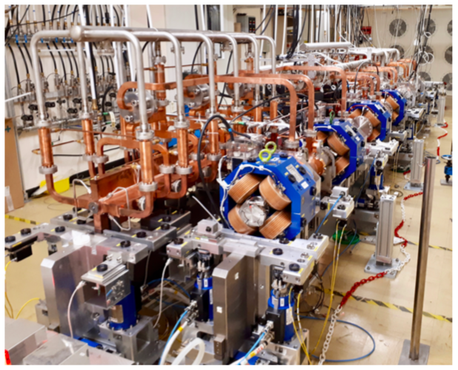
  Drive beam accelerated to ~2 GeV using conventional klystrons
  Intensity increased using a series of delay loops and combiner rings
  Drive beam decelerated and produces high-RF
  Feed high-RF to the less intense main beam using waveguides

Slide 4
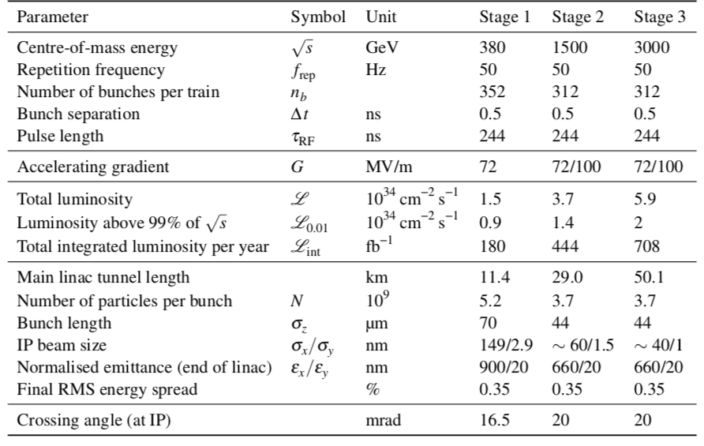
CLIC parameters

Slide 5
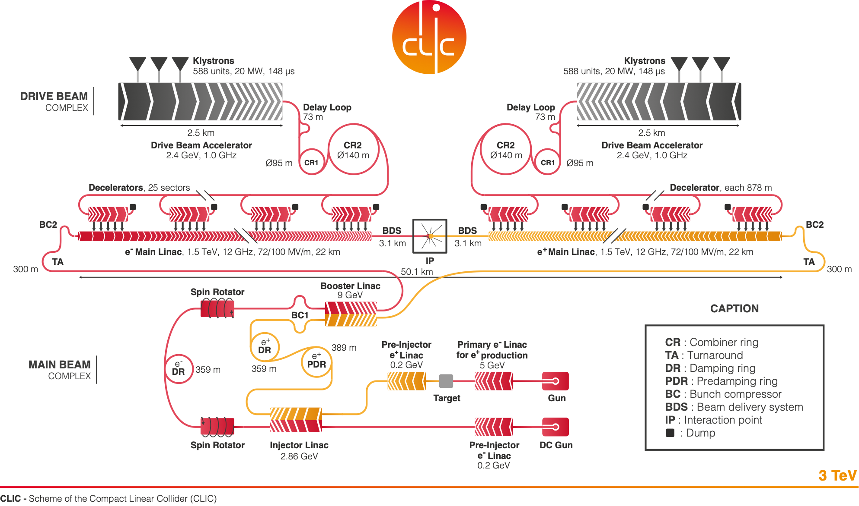

Slide 6
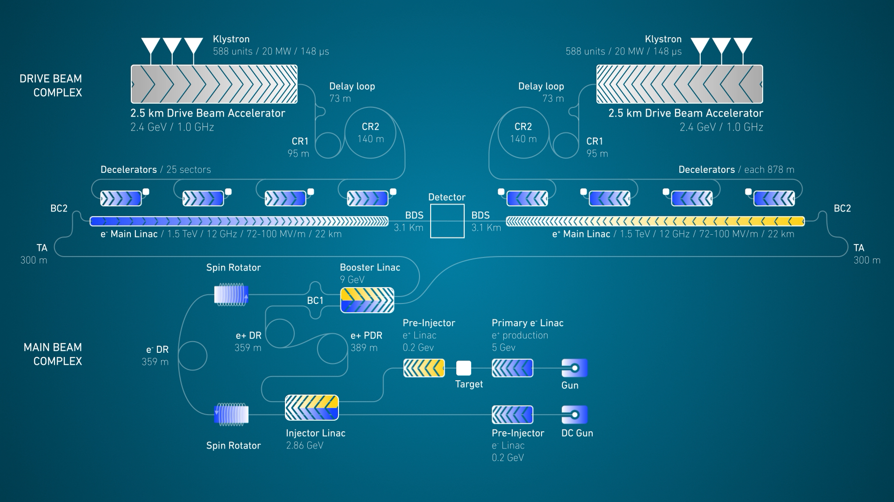

Slide 7
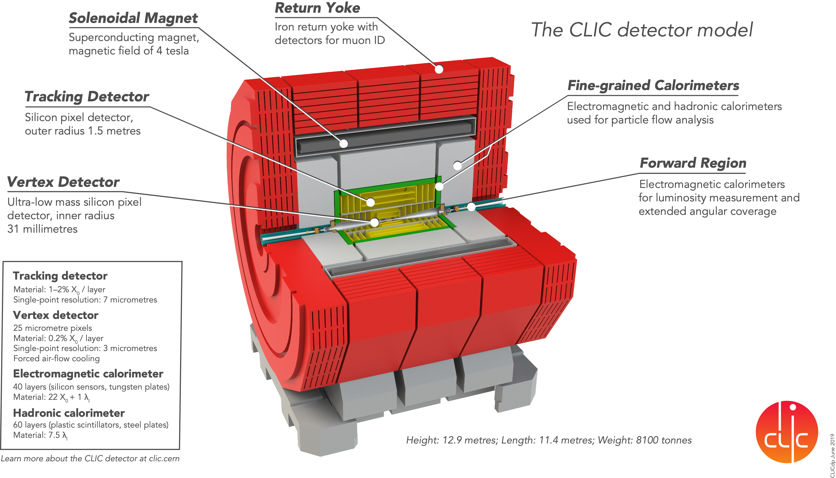
CLIC’s baseline is a single interaction point/single experiment
Two detectors in push-pull mode possible
Two beam-delivery systems and two interaction points possible at 380 GeV

Slide 8
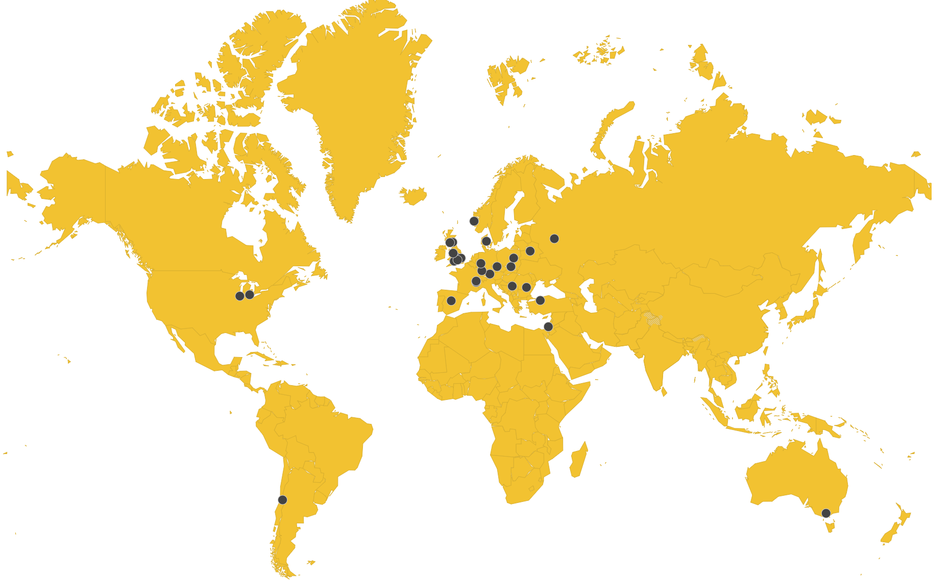
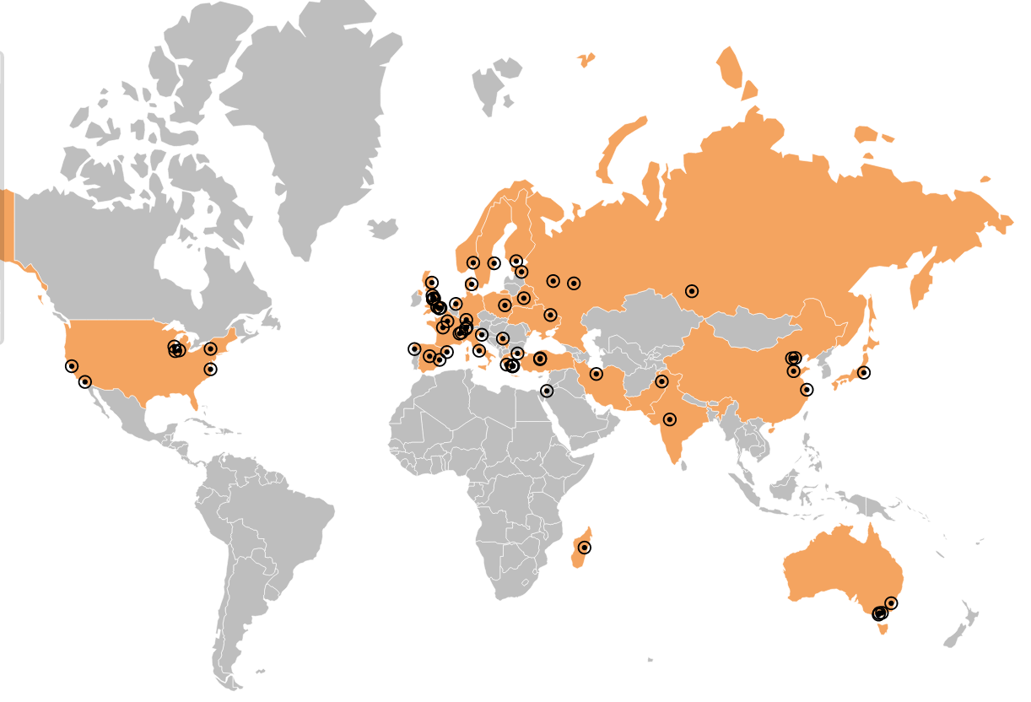
Collaborations
CLIC accelerator
  ~50 institutes from 28 countries
  CLIC accelerator studies
  CLIC accelerator design and development
  Construction and operation of CLIC Test Facility, CTF3
CLIC detector and physics (CLICdp)
  30 institutes from 18 countries
  Physics prospects & simulations studies
  Detector optimisation + R&D for CLIC
+ strong participation in the CALICE and FCAL Collaborations and in AIDA-2020

Slide 9
Steinar Stapnes
on behalf of CLIC
The Compact Linear Collider (CLIC)
Outline
CLIC project overview
Technical status and progress
Project implementation
Summary
Hong Kong IAS
January 20th, 2021

Slide 10
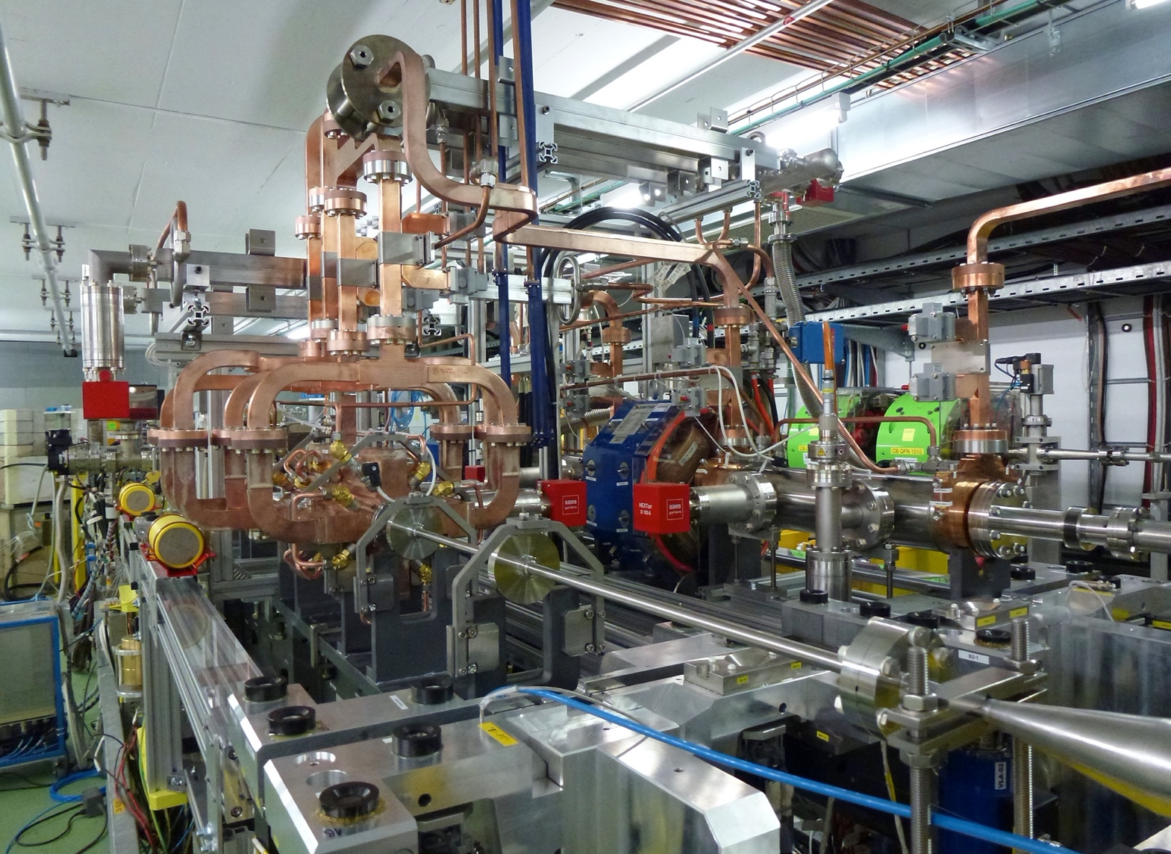
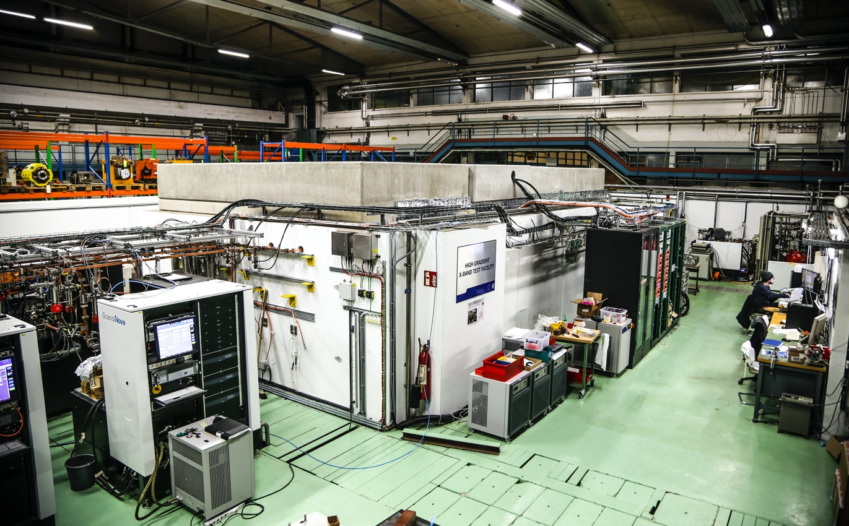
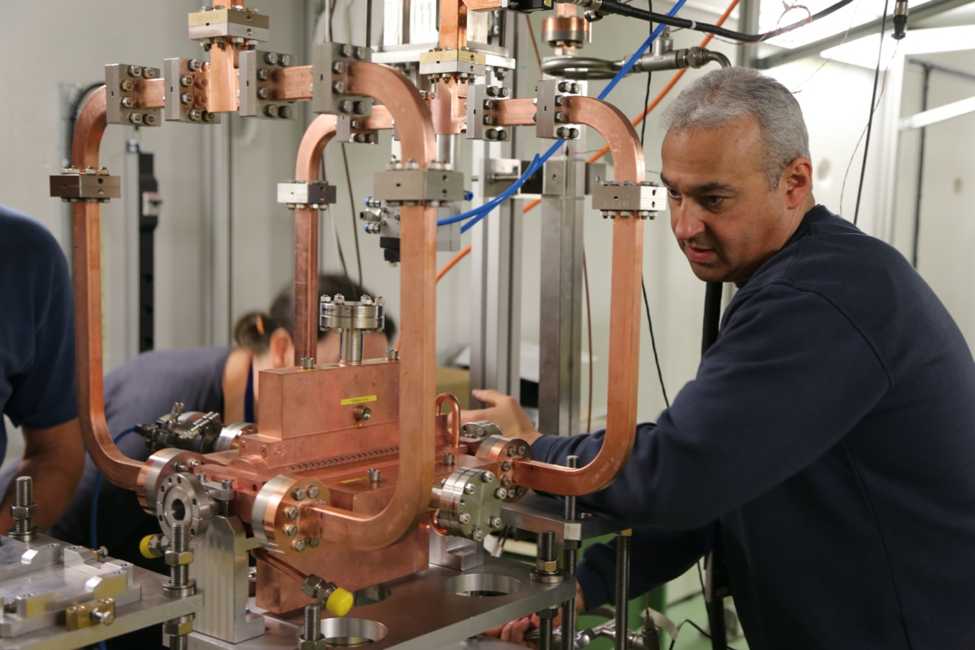
Accelerator challenges
Details in PIP, DOI: http://dx.doi.org/10.23731/CYRM-2018-004
CLIC baseline – a drive-beam based machine with an initial stage at 380 GeV
Four main challenges
  High-current drive beam bunched at 12 GHz
  Power transfer and main-beam acceleration
  Towards 100 MV/m gradient in main-beam cavities
  Alignment and stability (“nano-beams”)
The CTF3 (CLIC Test Facility at CERN) programme addressed all drive-beam production issues
Other critical technical systems (alignment, damping rings, beam delivery, etc.) addressed via design and/or test-facility demonstrations
X-band technology developed and verified with prototyping, test-stands, and use in smaller systems
Two C-band XFELS (SACLA and SwissFEL – the latter particularly relevant) now operational: large-scale demonstrations of normal-conducting, high-frequency, low-emittance linacs

Slide 11
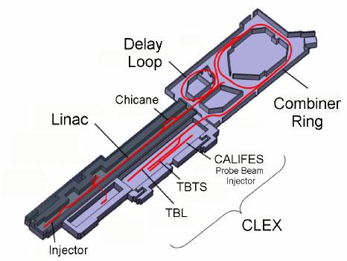
Two beam acceleration
Demonstrated 2-beam acceleration
31MeV = 145MV/m

Slide 12
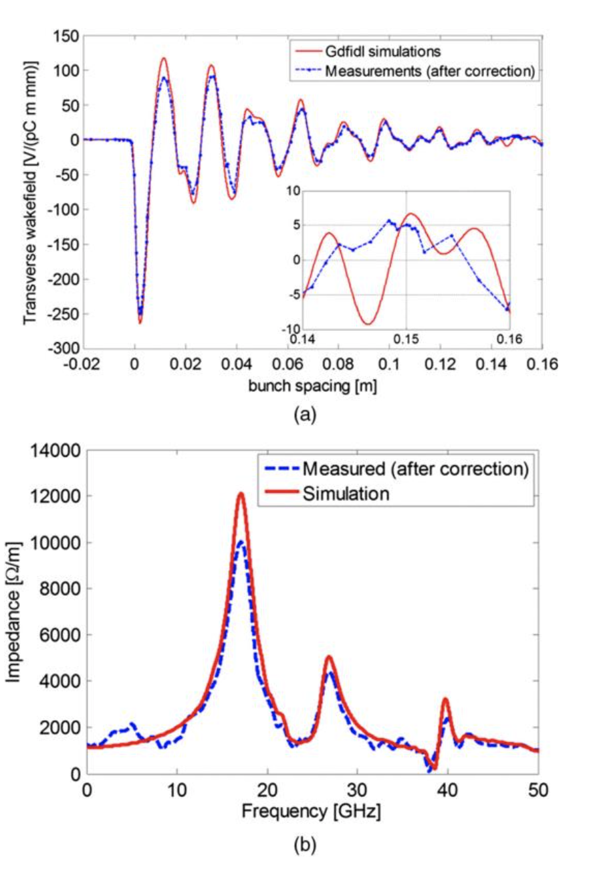
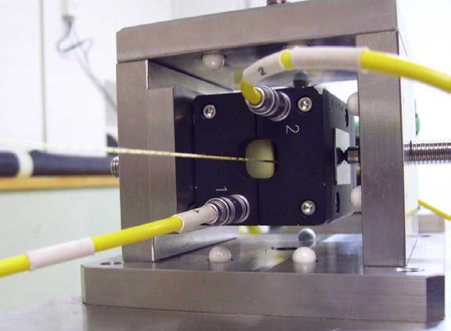
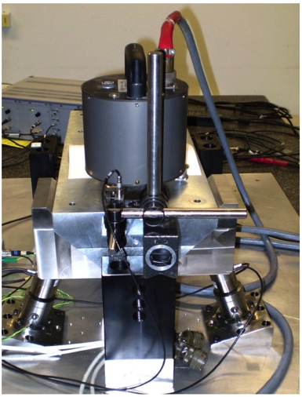
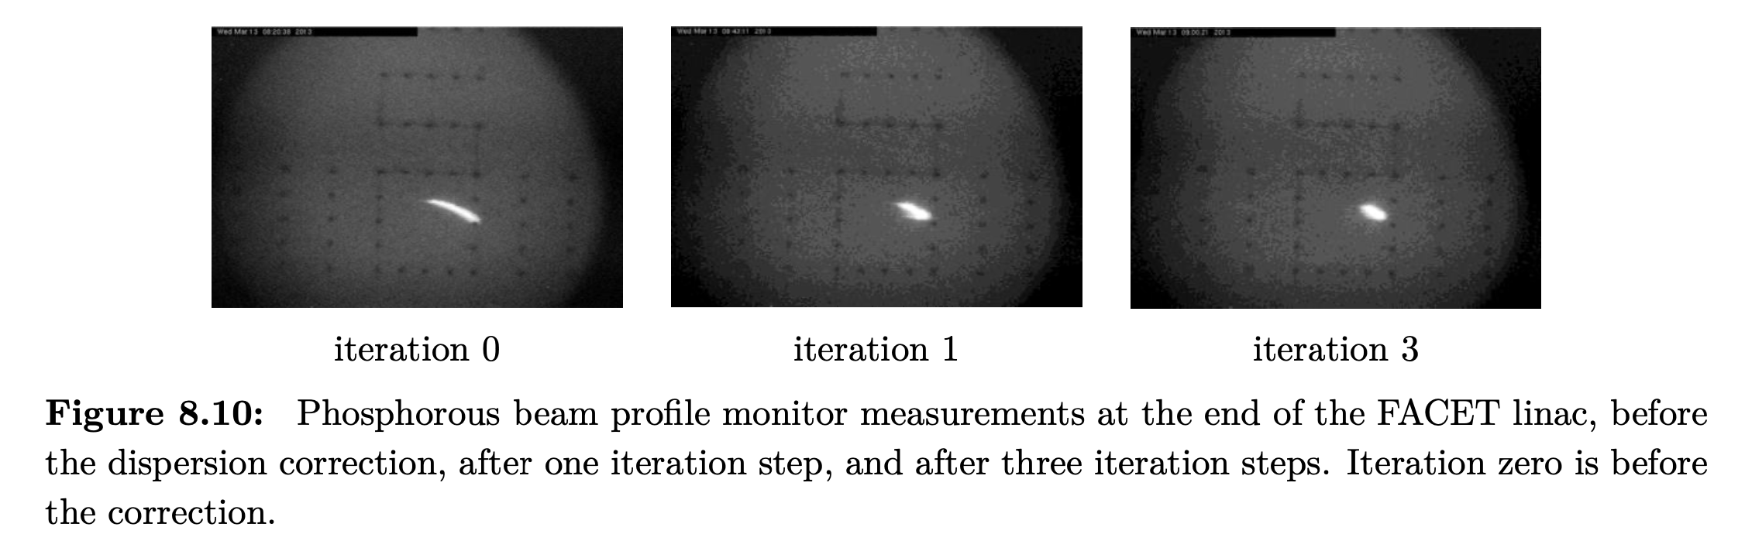
Low emittance generation and preservation
Low emittance damping rings
Preserve by
Align components (10 μm over 200 m)
Control/damp vibrations (from ground to accelerator)
Beam based measurements
– allow to steer beam and optimize positions
Algorithms for measurements, beam and component optimization, feedbacks
Experimental tests in existing accelerators of equipment and algorithms
(FACET at Stanford, ATF2 at KEK, CTF3, Light-sources)
Target and achieved emittance in existing and planned machines
2018
2008
Wake-field measurements in FACET
(a) Wakefield plots compared with numerical simulations.
(b) Spectrum of measured data versus numerical simulation.

Slide 13
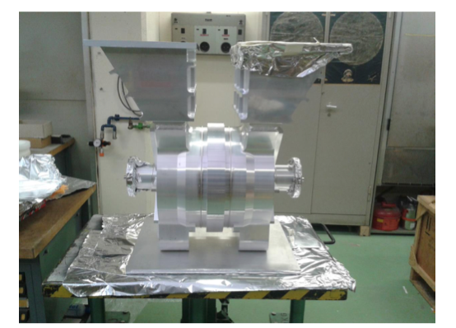
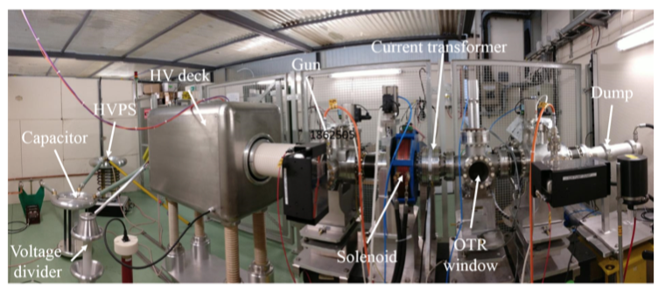
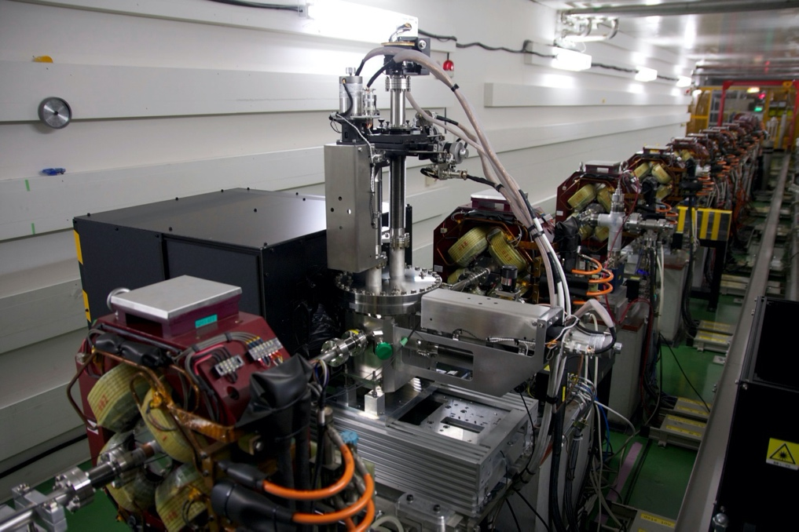
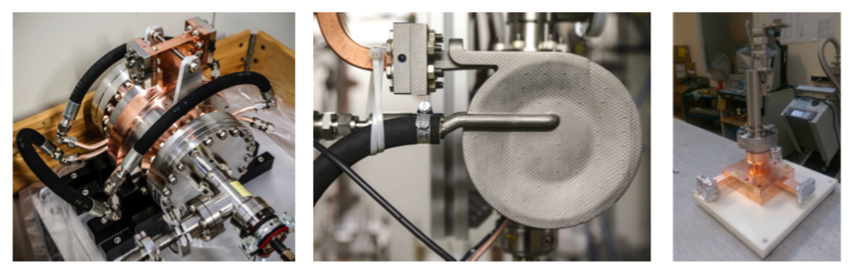
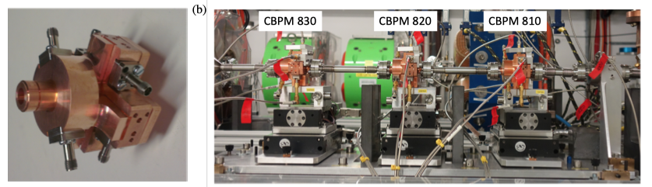
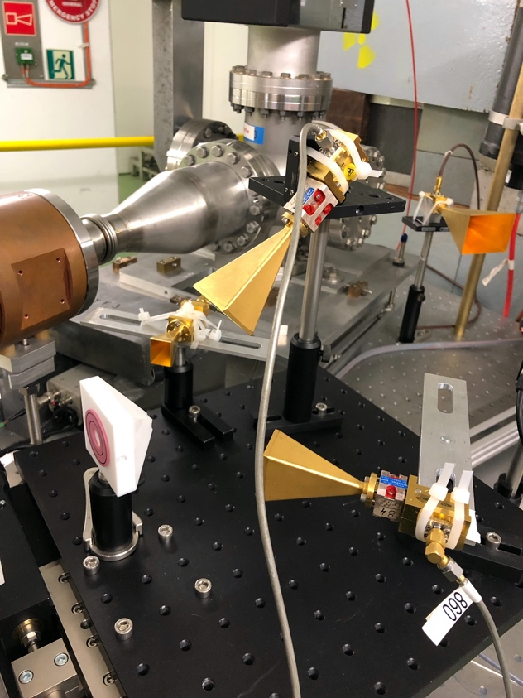
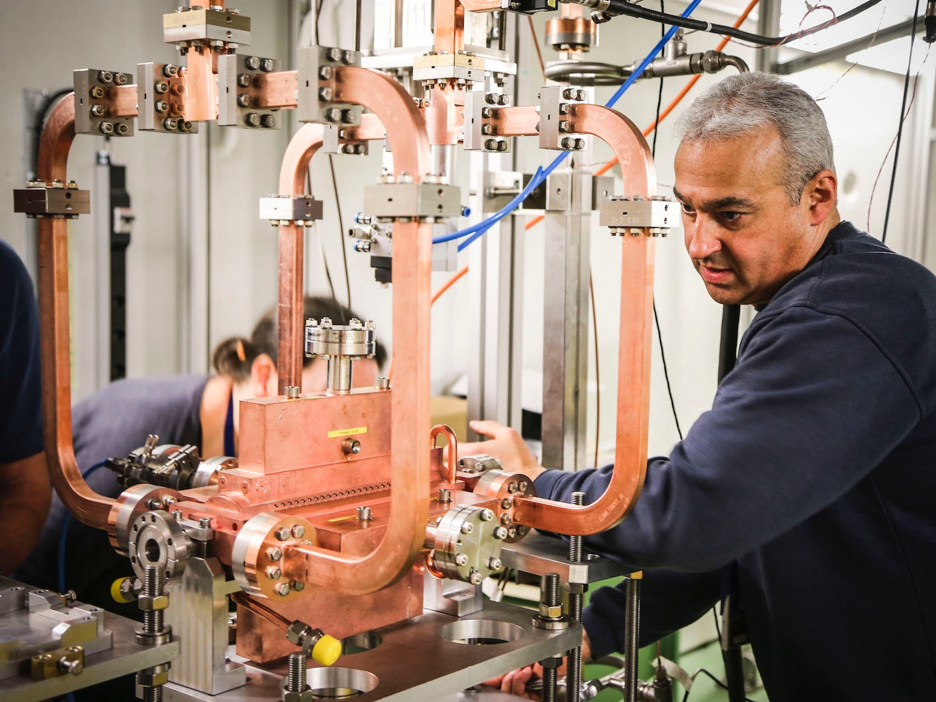
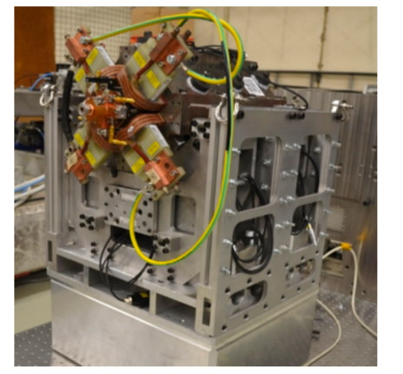
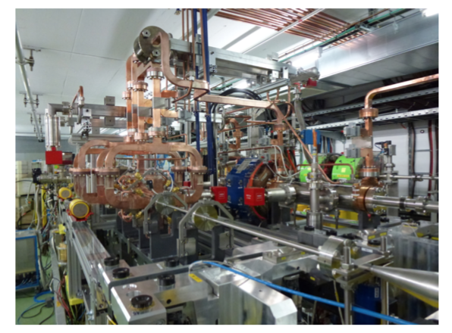
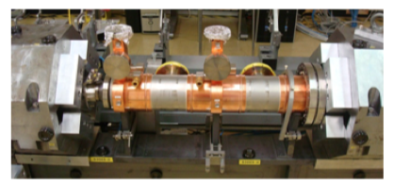
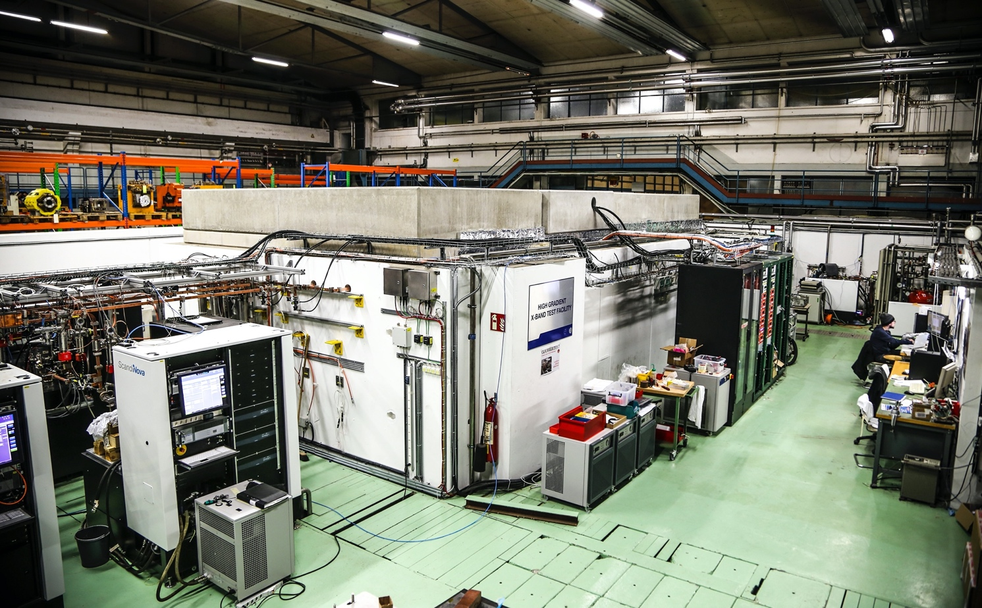
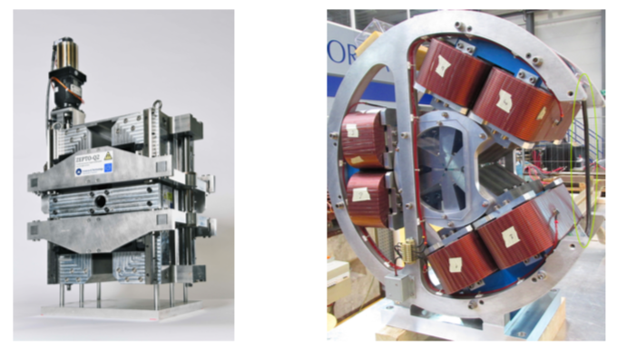
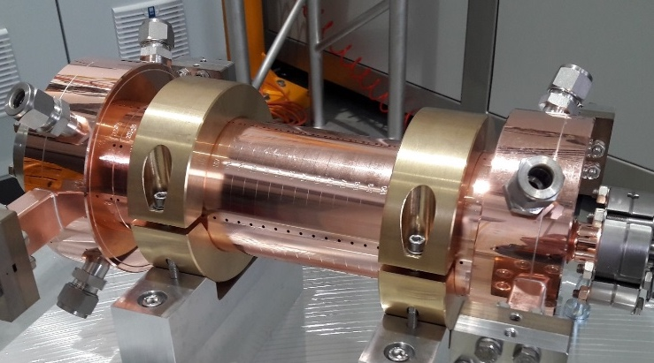
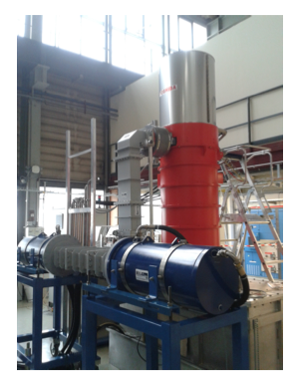
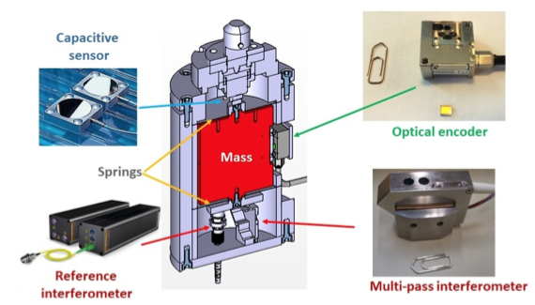
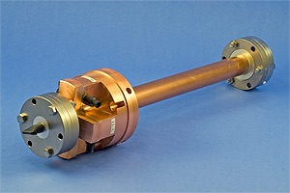
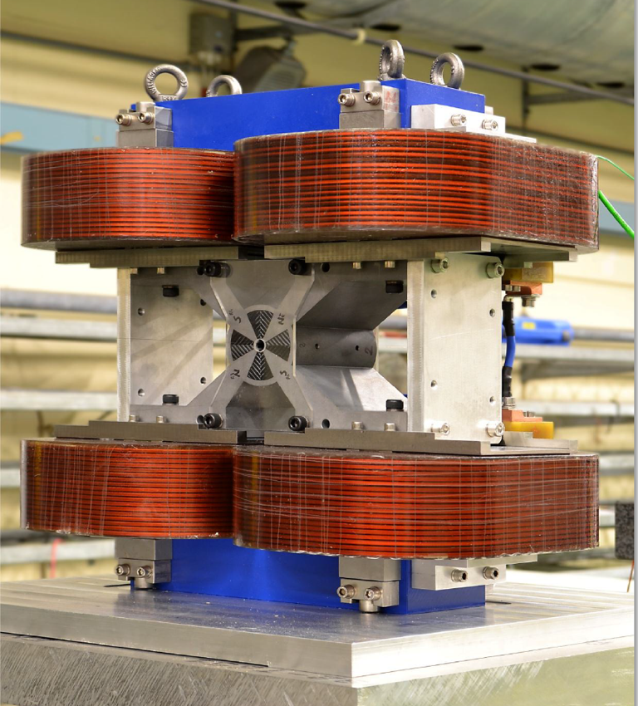
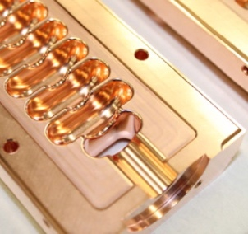
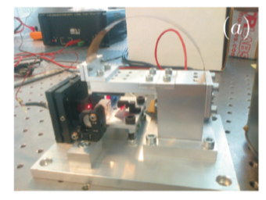
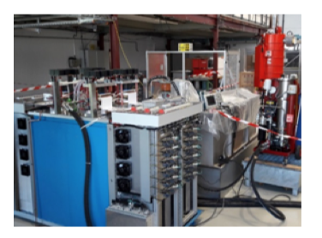
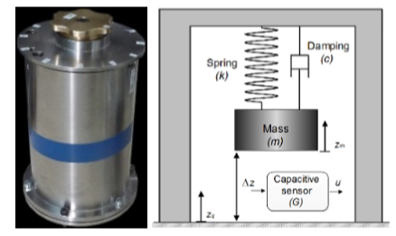
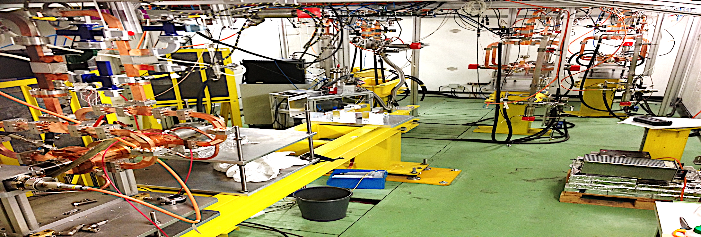
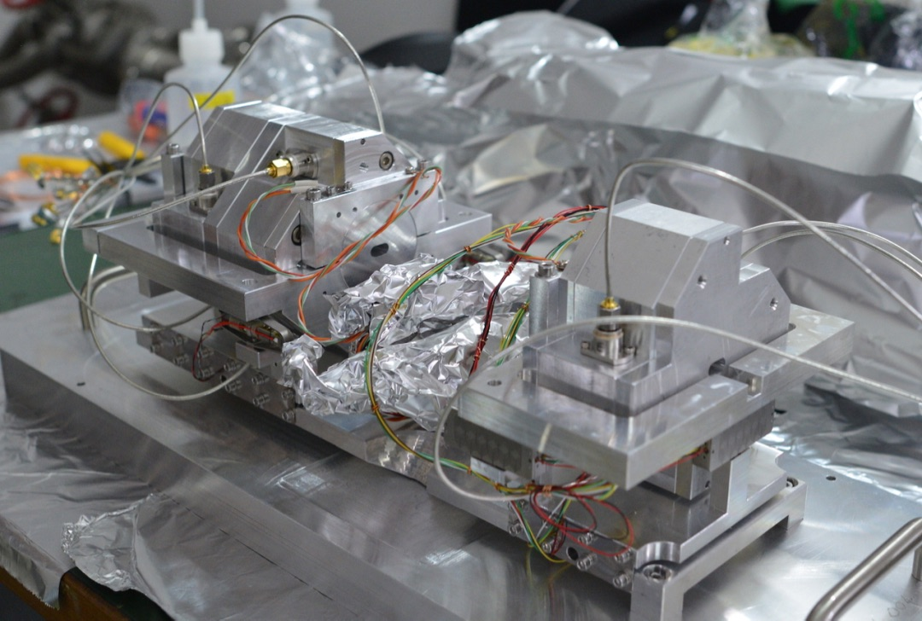
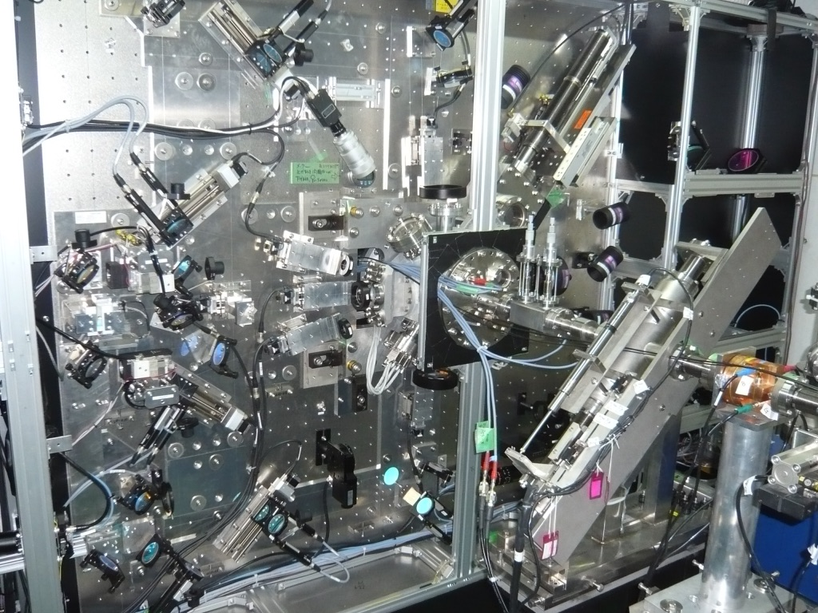
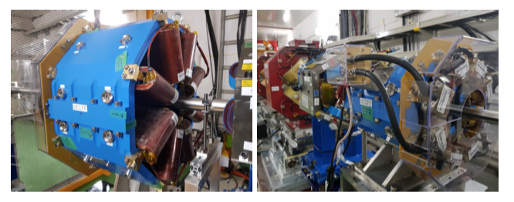
Technical Developments

Slide 14
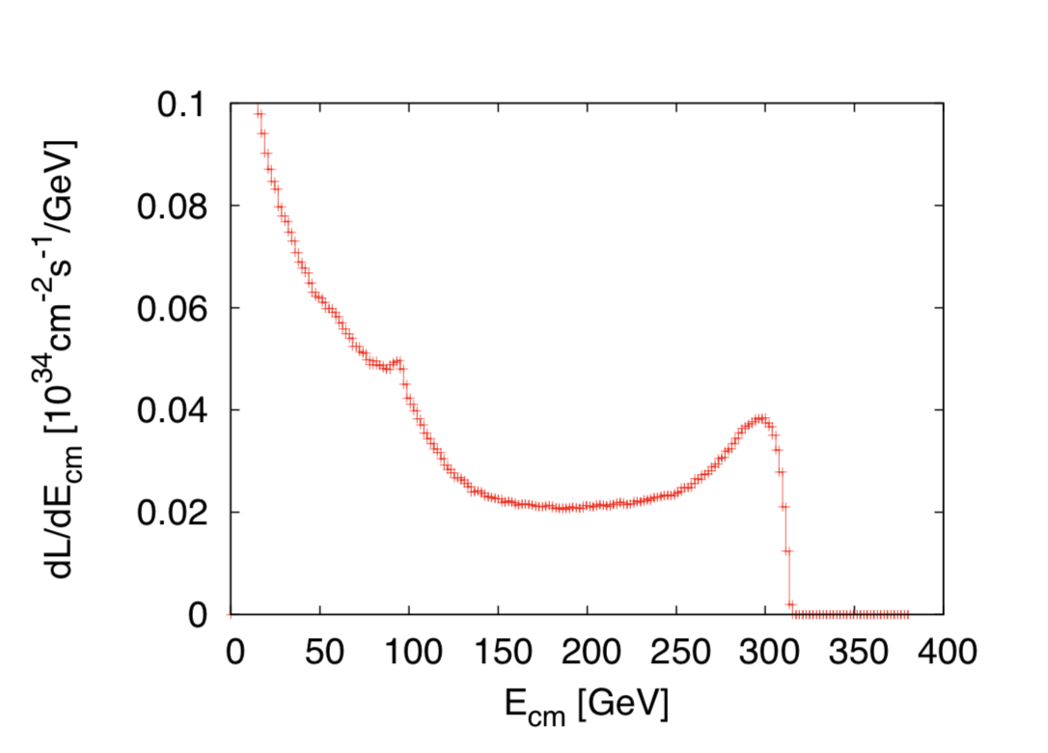
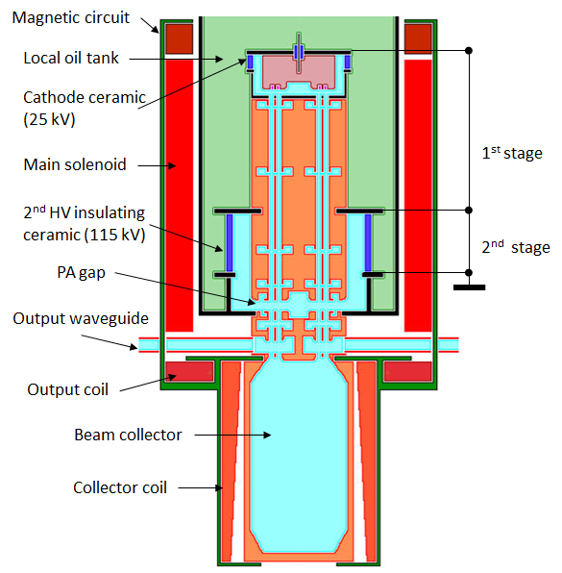
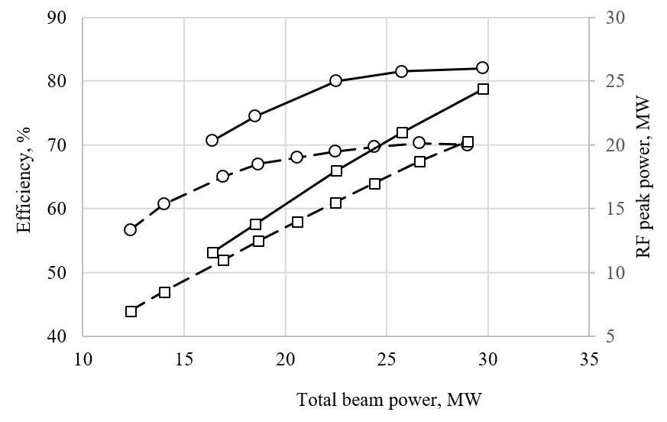
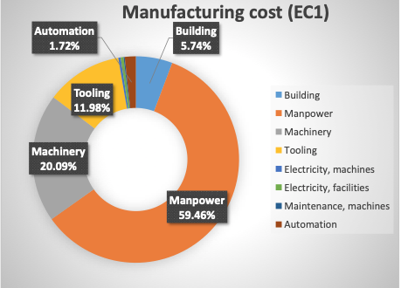
CLIC acc. studies 2019/20 – some examples
Further work on luminosity performance, possible improvements and margins, operation at the Z-pole and gamma-gamma
    Z pole performance, 2.3x10³² – 0.4x10³⁴ cm⁻² s⁻¹
      The latter number when accelerator configured for Z running (e.g. early or end of first stage)
      Gamma – Gamma spectrum (example)
      Luminosity margins and increases
      Baseline includes estimates static and dynamic degradations from damping ring to IP: 1.5 x 10³⁴ cm⁻² s⁻¹, a “perfect” machine will give : 4.3 x 10³⁴ cm⁻² s⁻¹, so significant upside
      In addition: doubling the frequency (50 Hz to 100 Hz) would double the luminosity, at a cost of +50 MW and ~5% cost increase
    CLIC note about these studies
Industrial questionnaire:
Based on the companies feedback, the preparation phase to the mass production could take about five years. Capacity clearly available.
Drivebeam klystron: The klystron efficiency (circles) and the peak RF power (squares) simulated for the CLIC TS MBK (solid lines) and measured for the Canon MBK E37503 (dashed lines) vs total beam power. See more later.
Publication: https://ieeexplore.ieee.org/document/9115885

Slide 15
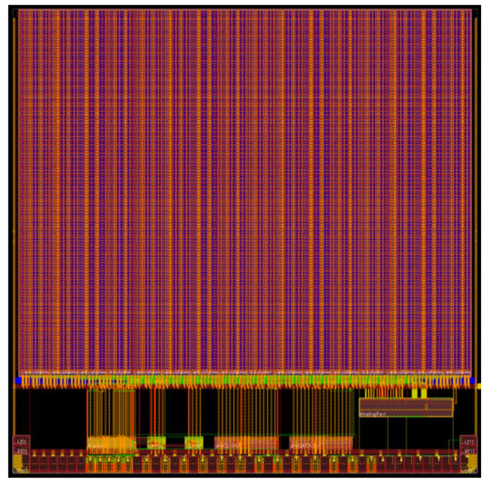
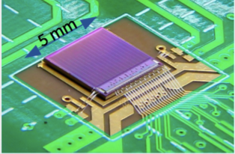





CLIC Detector Technologies R&D highlights
Pursuing various technologies for CLIC vertex and tracking system,
to meet spatial and timing precision requirements, and material budget.
CLICTD chip
CLICTD on test board
CLICpix2 planar assembly
Common tools we have developed are being used increasingly widely:
Allpix² simulation
Allpix² simulation framework
Full Geant4 simulation of charge deposition
Fast charge propagation (drift-diffusion model)
Electric fields from TCAD can be imported
https://cern.ch/allpix-squared
CLICTD: fully integrated small collection electrode HR-CMOS chip
30 x 37.5 μm² pixel size, 30 x 300 μm² readout channel size
Using novel CMOS process modifications for faster charge collection
Designed from detailed TCAD studies JINST 14 (2019) no 5 C05013
Encouraging preliminary performance results from lab measurements and initial testbeams (DESY); close to CLIC tracker requirements
– one testbeam campaign possible in summer 2020
Allpix² validation w/ data
CaRIBOu readout
Universal readout system developed w/ ATLAS
System-on-chip architecture – crucial for new sensor development phase in lab & beam tests
CaRIBOu
CLICpix2: a readout chip from Timepix family for the CLIC vertex detector
25 x 25 μm² pixel size, pixel matrix of 128 x 128
Excellent timing performance
3μm target spatial resolution still challenging with thin sensors.
Corryvreckan testbeam reconstruction
Package for offline event building in complex data-taking environments, combining detectors with different readout architectures
Novel hybrid device assembly techniques: encouraging results from
fine-pitch bump-bonding, and anisotropic conducting film
https://cern.ch/corryvreckan

Slide 16







CLIC Physics Potential recent highlights
Dedicated studies addressed extra questions raised during European Strategy Update to allow direct comparisons with other proposals; studies focusing on the high-energy potential are continuing
Higgs coupling sensitivity:
evaluated under longer first stage scenario
https://arxiv.org/abs/2001.05278
e⁺e⁻→ χ₁⁺ χ₁⁻
with χ₁±→ χ₁⁰ W±
and W⁺W⁻ → qqqq
or W⁺W⁻ → e⁻μ⁺νν
or e⁺μ⁻ν ν
*
Longer first stage 380 GeV
Baseline, 380 GeV + 1.5 TeV
Dark matter:
Searching for simplified
model dark matter scalar mediator using mono-photon signature
Higher mass reach
SUSY signatures:
Scan of parameter space in R-parity conserving scenario
Larger kinematic coverage; difficult to access at LHC
other sensitivities from Briefing Book https://arxiv.org/abs/1910.11775
Publications on:
HH production and self-coupling
EPJC 80 (2020) 1010
Conformal track reconstruction
NIM A956 (2020) 163304
Electroweak precision at the Z:
A dedicated CLIC run at the Z pole could produce ~100fb^{–1} over 2 years –> 4.5 billion Zs
Also considered return-to-Z at 380 GeV
Some significant improvement over current PDG; confirms that electron beam polarisation is equivalent to higher stats for several observables

Slide 17
Steinar Stapnes
on behalf of CLIC
The Compact Linear Collider (CLIC)
Outline
CLIC project overview
Technical status and progress
Project implementation
Summary
Hong Kong IAS
January 20th, 2021

Slide 18




Power and energy
Power estimate bottom up (concentrating on 380 GeV systems)
Very large reductions since CDR, better estimates of nominal settings, much more optimised drivebeam complex and more efficient klystrons, injectors more optimisation, etc
Further savings possible, main target damping ring RF
From running model and power estimates at various states – the energy consumption can be estimated
CERN is currently consuming ~1.2 TWh yearly (~90% in accelerators)
Will look also more closely at 1.5 and 3 TeV numbers next (in blue in figure to illustrate not optimized as for 380 GeV), Hi-Eff L-band klystrons development (see later), damping ring RF as mentioned, include reduction using permanent magnets

Slide 19

Energy studies - I
(Fraunhofer)
Topic 1:
CLIC is normal conduction, single pass, can change off-on-off quickly, at low power when not pulsed
Specify state-change (off-standby-on) times and power uses for each – see if clever scheduling using low cost periods, can reduce the energy bill

Slide 20
Energy studies - II
(Fraunhofer)
Topic 2:
It is possible to fully supply the annual electricity demand of the CLIC-380 by installing local wind and PV generators (this could be e.g. achieved by 330 MW-peak PV and 220 MW-peak wind generators, at a cost of slightly more than 10% of the CLIC 380 GeV cost)
However, self-sufficiency during all times can not be reached and only 54% of the time CLIC could run independently from public electricity supply with the portfolio simulated.
About 1/3 of the generated PV and wind energy will be available to export to the public grid even after adjusting the load schedule of CLIC.
Additional, the renewables are most efficient in summer, when prices are low anyway
Topic 3:
The use of waste heat to generate electricity is technically difficult due to the low temperature of the waste heat. The heat would have to be raised to a significantly higher level and more electricity would be consumed than can be generated again in the later process.
A reasonable option is to use the waste heat to provide space heating. Also for this option, the temperature must be raised via a heat pump and thus additional electricity must be used.
Another possibility would be the research of further innovative concepts for the use of waste heat with very low temperature (for example very low temperature ORCs, thermoelectric generators or the storage of heat in zeolites).
The fact that the maximum energy need locally is during the winter, when it is favourable of energy cost reasons to not run the accelerator, also makes is more difficult today to envisage efficient large scale energy recovery strategies.
More in chapter 7.4.3 of the CLIC project plan (link)

Slide 21



Cost - I
Machine has been re-costed bottom-up in 2017-18
Methods and costings validated at review on 7 November 2018 – similar to LHC, ILC, CLIC CDR
Technical uncertainty and commercial uncertainty estimated

Slide 22

Cost - II
Other cost estimates:
Construction:
From 380 GeV to 1.5 TeV, add 5.1 BCHF (drive-beam RF upgrade and lengthening of ML)
From 1.5 TeV to 3 TeV, add 7.3 BCHF (second drive-beam complex and lengthening of ML)
Labour estimate: ~11500 FTE for the 380 GeV construction
Operation:
116 MCHF (see assumptions in box below)
Energy costs

Slide 23




CLIC timeline
Ramp-up and up-time assumptions: arXiv:1810.13022, Bordry et al.
Technology Driven Schedule from start of construction:
First collisions by ~2035
Baseline scenario of operation ~30 years

Slide 24
CLIC timeline
Ramp-up and up-time assumptions: arXiv:1810.13022, Bordry et al.
Technology Driven Schedule from start of construction shown above.
A preparation phase of ~5 years is needed before (estimated resource need for this phase is ~4% of overall project costs)

Slide 25

Based on detailed breakdown of tasks, rates,
access/zoning/transport, prod. rates, etc

Slide 26






CLIC studies 2021-25
X-band technology:
Design and manufacturing of X-band structures and components
Study structures breakdown limits and optimization, operation and conditioning
Baseline verification and explore new ideas
Assembly and industry qualification
Structures for applications, FELs, medical, etc
Technical and experimental studies, design and parameters:
Module studies (see some targets for development below)
Beamdynamics and parameters: Nanobeams (focus on beam-delivery), pushing multi TeV region (parameters and beam structure vs energy efficiency)
Tests in CLEAR (wakefields, instrumentation) and other facilities (e.g. ATF2)
High efficiency klystrons
Injector studies suitable for X-band linacs (coll. with Frascati)
Application of X-band technology (examples):
A compact FEL (CompactLight: EU Design Study 2018-21)
Compact Medical linacs (proton and electrons)
Inverse Compton Scattering Source (SmartLight)
Linearizers and deflectors in FELs (PSI, DESY, more)
1 GeV X-band linac at LNF
eSPS for light dark matter searches (within the PBC-project)
More information: CLIC mini week (1.10.2020)

Slide 27

Summary
CLIC is a mature project, prepared for a 380 GeV initial stage
There presents a consistent way forward with initial LC at “SM energies”, keeping the options open for future upgrades and/or circular accelerators further on
The cost and implementation time for CLIC 380 are similar to LHC
The physics case is broad and profound, and being further developed
The detector concept and detector technologies R&D are advanced
The full project status has been presented in a series of Yellow Reports and other publications: http://clic.cern/european-strategy ( + Snowmass papers + some more recent results in slides)
Picture from the CLIC week 2019
With thanks to all my CLIC collaborators

Slide 28
Snowmass papers
Several LoIs have been submitted on behalf of CLIC and CLICdp to the Snowmass process:
The CLIC accelerator study: Link
Beam-dynamics focused on very high energies: Link
The physics potential: Link
Detector: Link

Slide 29











Resources
3-volume CDR 2012
Updated Staging Baseline 2016
Available at:
clic.cern/european-strategy
4 CERN Yellow Reports 2018
Two formal submissions to the ESPPU 2018
Details about the accelerator, detector R&D, physics studies for Higgs/top and BSM

