Slide 1
Electron-Ion Collider Status
On behalf of EIC project team:
Andrei Seryi, Jefferson Lab
EIC Associate Director for Accelerator Systems and International Partnership
Institute for Advanced Study, HEP 2021
19 January 2021

Slide 2
Outline
Science case & path to project approval
Project – brief overview
Design overview
  Technical scope
  Energy, Luminosity, Polarization, 2 IRs
Collaboration opportunities
Summary
Acknowledgement: this talk includes materials from presentations of Tim Hallman (Associate Director of the DOE Office of Science for Nuclear Physics), Jim Yeck (EIC Project Director), Ferdinand Willeke (EIC Deputy Project Director and Technical Director), Elke Aschenauer and Rolf Ent (Co-Associate Directors for the Experimental Program) and many other members of EIC project team

Slide 3

EIC in the 2015 Long Range Plan for Nuclear Science
Recommendations:
Capitalize on investments made to maintain U.S. leadership in nuclear science.
Develop and deploy a U.S.-led ton-scale neutrino-less double beta decay experiment.
Construct a high-energy high-luminosity polarized electron-ion collider (EIC) as the highest priority for new construction following the completion of FRIB.
Increase investment in small-scale and mid-scale projects and initiatives that enable forefront research at universities and laboratories.

Slide 4
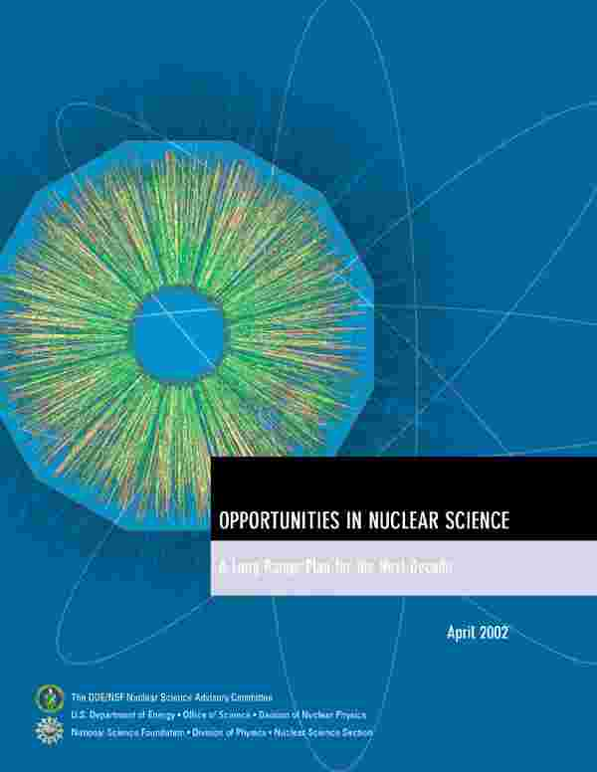
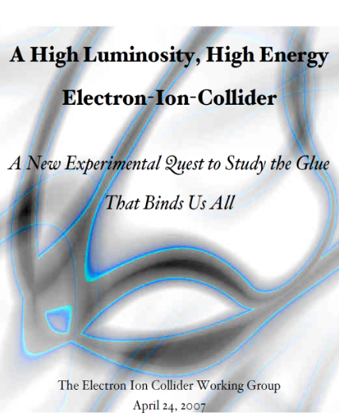


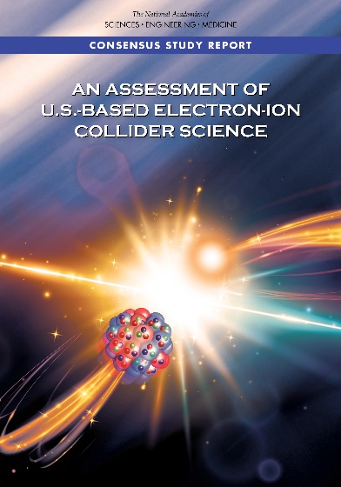
Developing the EIC Science Case
2002
A strong community emphasis on the urgent need for a machine to illuminate the dynamical basis of hadron structure in terms of the fundamental quark and gluon fields has been a persistent message for almost two decades
2007
2009
2010
Gluons and the Quark Sea at High Energies
2012
“a high-energy high-luminosity polarized EIC [is] the highest priority for new facility construction following the completion of FRIB.”
2013
Major Nuclear Physics Facilities for the Next Decade
2015
NSAC
“…essential accelerator and detector R&D [for EIC] should be given very high priority
in the short term.”
“We recommend the allocation of resources …to lay the foundation for a polarized Electron-Ion Collider…”
“..a new dedicated facility will be essential for answering some of the most central questions.”
March 14, 2013
2018
“The quantitative study of matter in this new regime [where abundant gluons dominate] requires a new experimental facility: an Electron Ion Collider.”
Electron-Ion Collider absolutely central to the nuclear science program of the next decade.

Slide 5
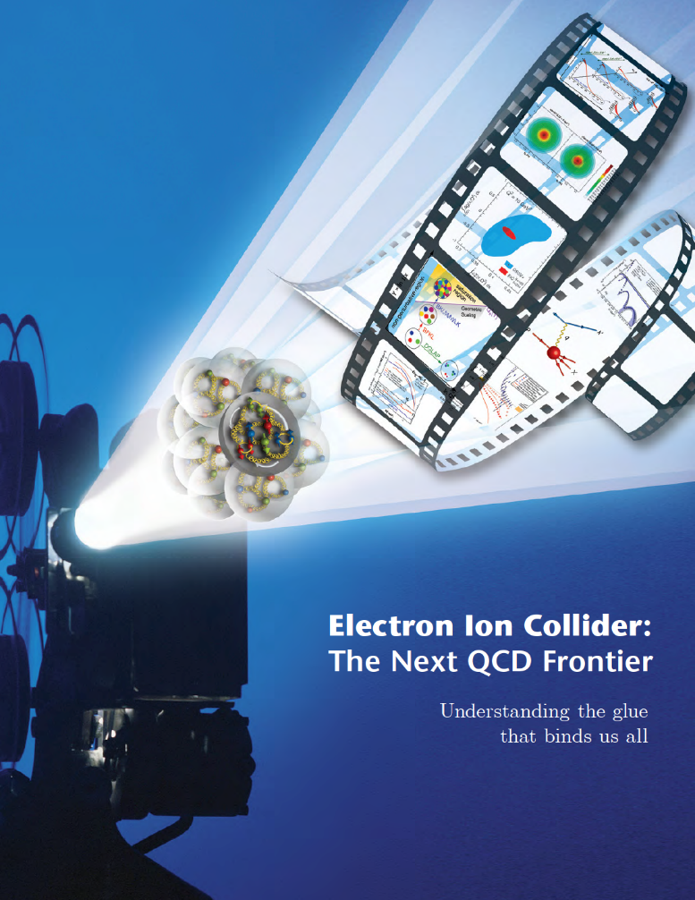
NSAC 2015 LRP Performance Parameters
NSAC Performance Parameters:
A - Polarized e, p, light nuclei
B - Ion beam from deuterons to the heaviest table nuclei
C - Center of Mass energy 20-100 GeV
D - Capable of future Center of Mass upgrade to 140 GeV
E - High collision luminosity ~10³³-10³⁴ cm⁻² S⁻¹
F - More than one Interaction Region
Community and NSAC defined the parameters of machine needed to address the science.

Slide 6
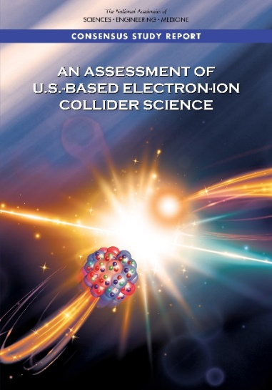
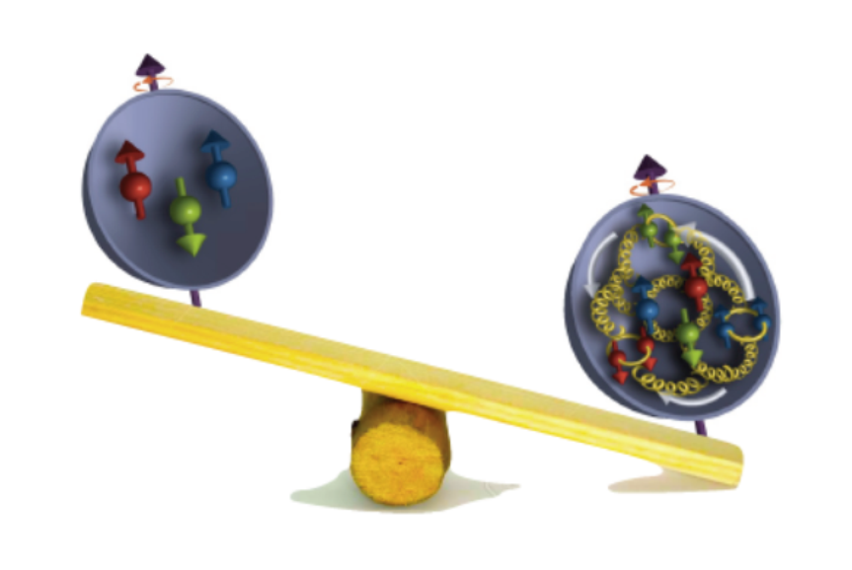
Independent Assessment of the EIC Science Goals
National Academy of Science Report: AN ASSESSMENT OF U.S.-BASED ELECTRON-ION COLLIDER SCIENCE
“An EIC can uniquely address three profound questions
About nucleons—neutrons and protons—and how they
are assembled to form the nuclei of atoms:
• How does the mass of the nucleon arise?
• How does the spin of the nucleon arise?
• What are the emergent properties of dense systems of gluons?”
The EIC would be a unique facility & maintain leadership in nuclear science
The EIC would maintain leadership in the accelerator science and technology of colliders

Slide 7
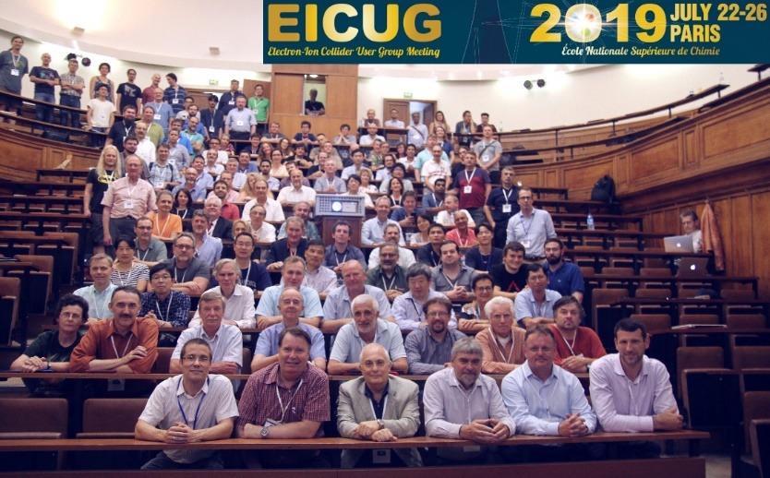

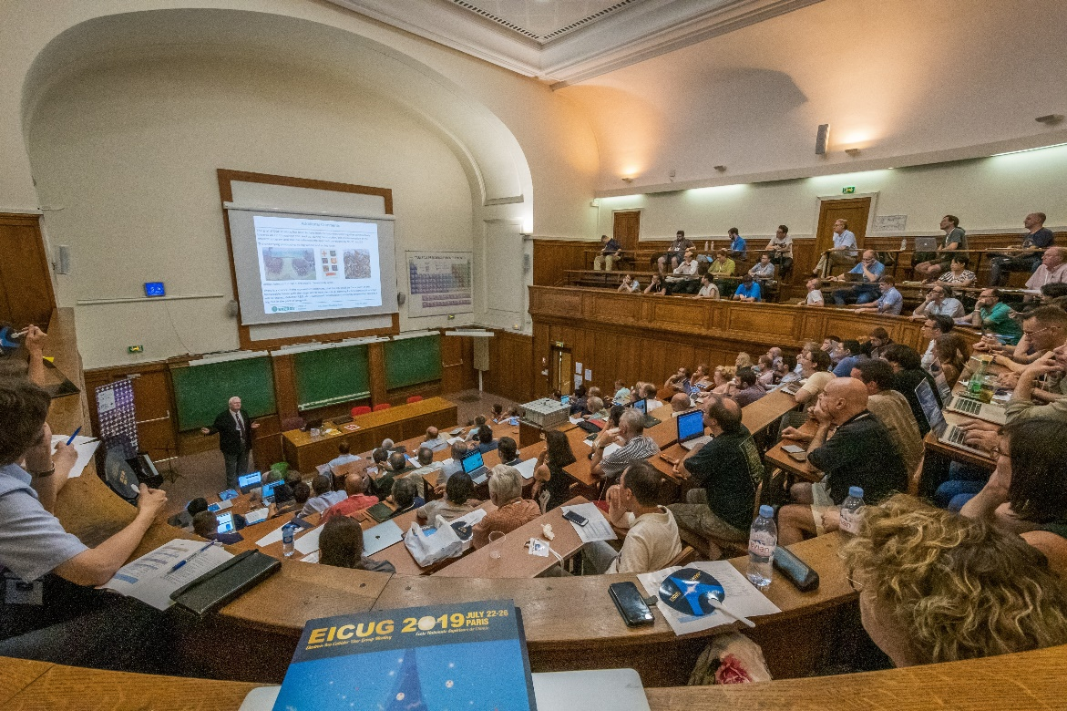

Important Ingredient to Success: EIC International Users Community
July 22, 2019 Paris, France:
EICUG annual meetings alternate between U.S. and Europe

Slide 8
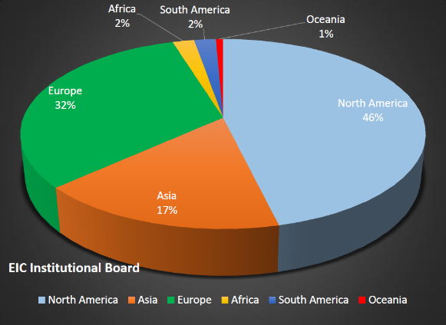
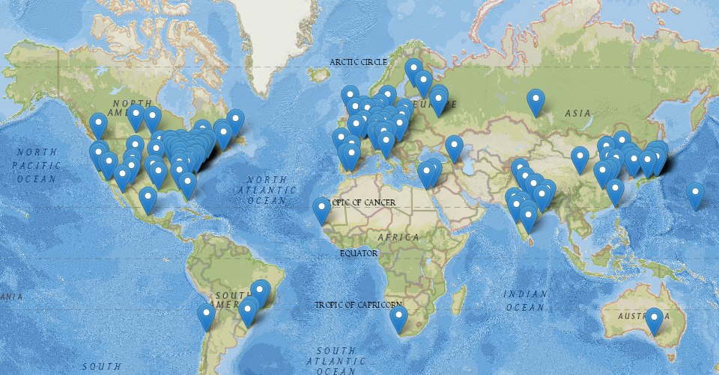
EIC User Community
EIC Users Group Formed in 2016
EICUG.ORG
Status January 2021:
Collaborators 1243
Institutions 250
Countries 34
Annual EICUG Meetings
2016 UC Berkeley
2016 Argonne
2017 Trieste, Italy
2018 Washington, DC
2019 Paris, France
Miami
2021 TBD
2022 Warsaw, Poland
Notes:
230

Slide 9
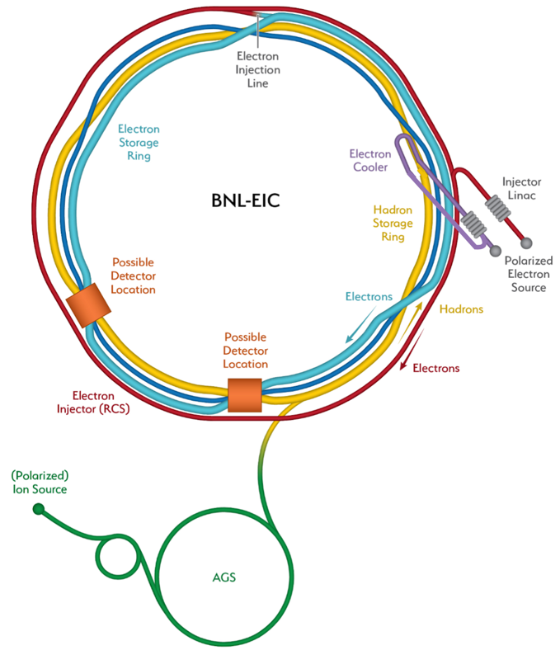
Project – brief overview
Project requirements
BNL-TJNAF Partnership
Project Organization
Project Scope
Project Partnership plans
Plans for the Experimental Program
Schedule
Funding
Project Milestones

Slide 10

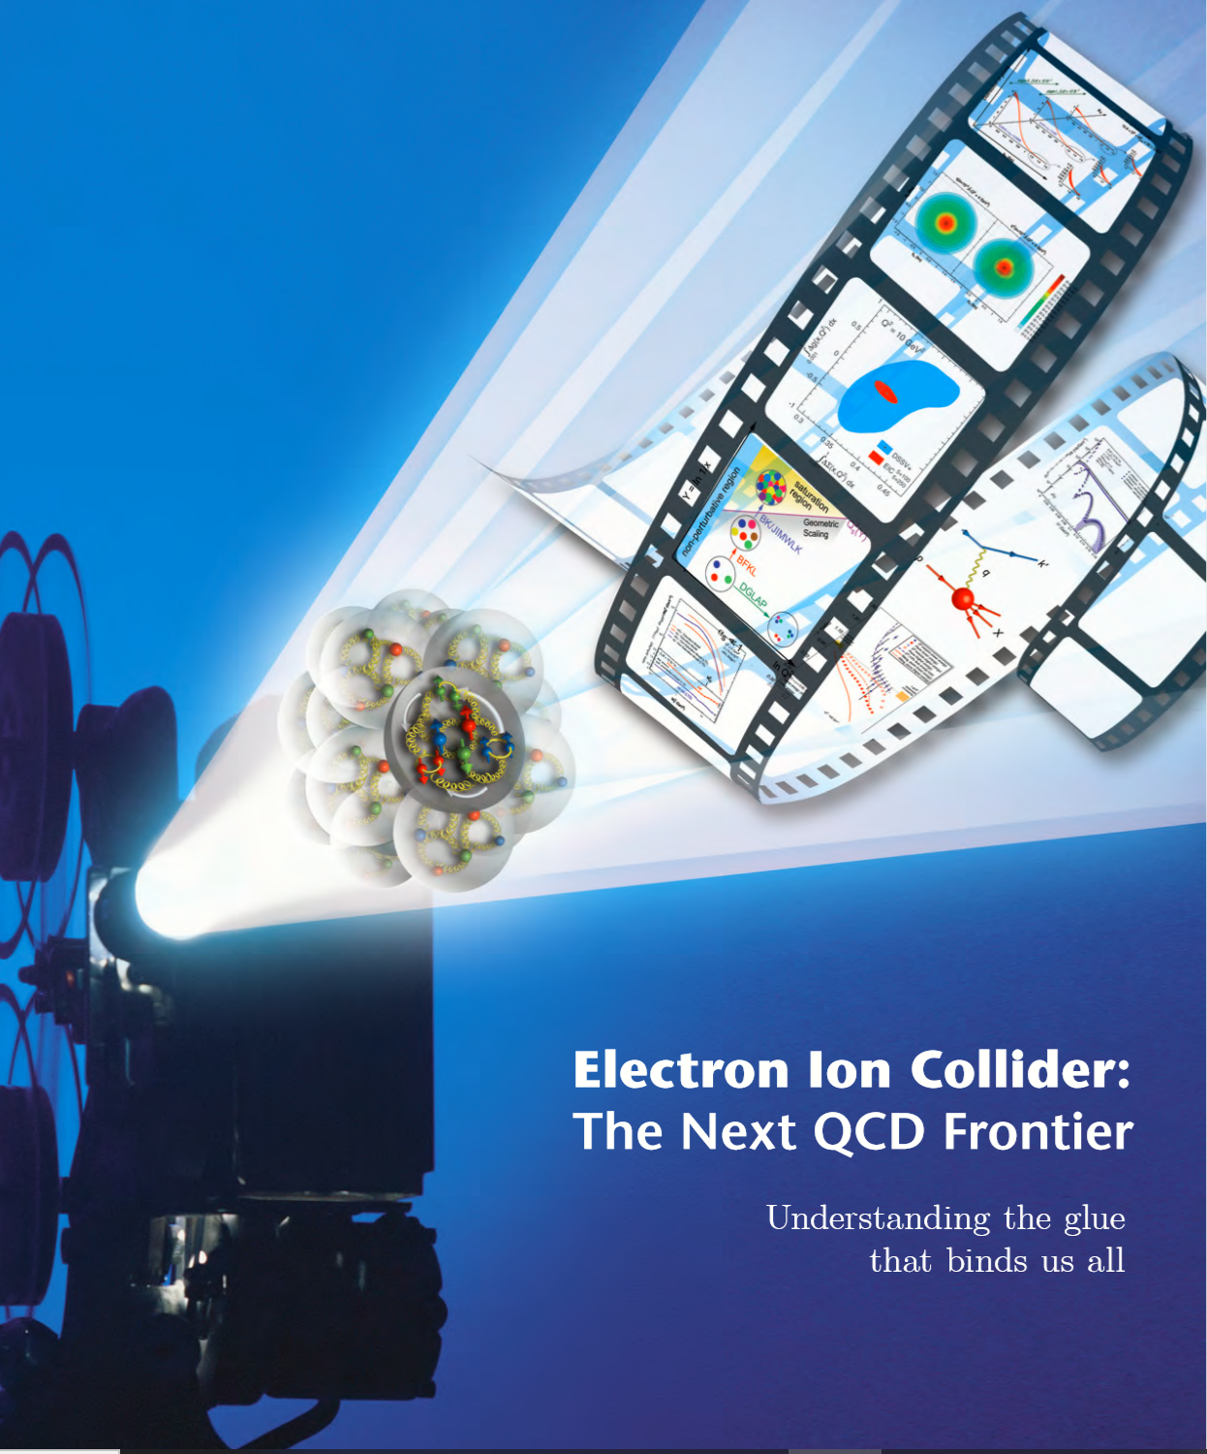
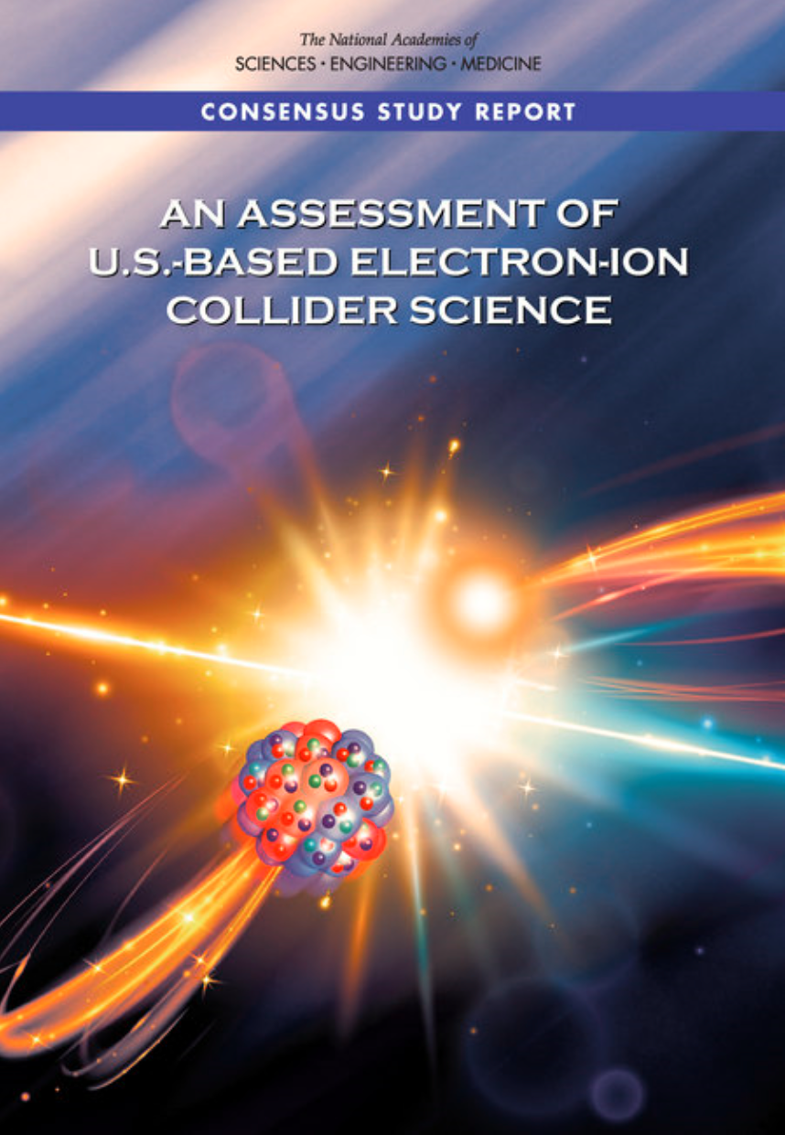
Project Requirements
Project Design Goals
High Luminosity: L= 10³³ – 10³⁴cm⁻²sec⁻¹, 10 – 100 fb⁻¹/year
Highly Polarized Beams: 70%
Large Center of Mass Energy Range: E_{cm} = 20 – 140 GeV
Large Ion Species Range: protons – Uranium
Large Detector Acceptance and
Good Background Conditions
Accommodate a Second Interaction Region (IR)
Conceptual design scope and expected performance meets or exceed NSAC Long Range Plan (2015) and the EIC White Paper requirements endorsed by NAS (2018)

Slide 11
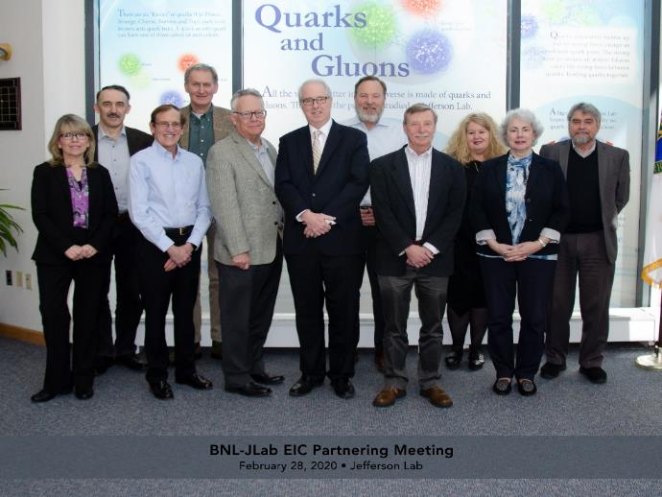
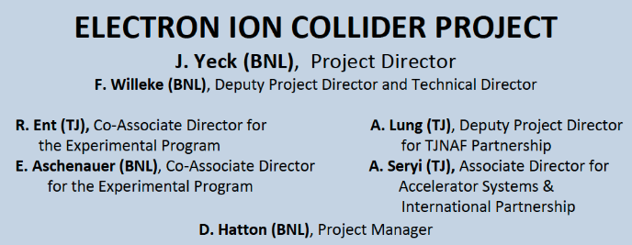
BNL TJNAF Partnership
BNL-TJNAF Partnering Agreement Approved- May 7, 2020
The EIC Project Leadership Team captures project delivery experience from BNL and TJNAF
EIC Project Executive Management Team (EMT) Established:
Elke Aschenauer, Rolf Ent, Diane Hatton, Allison Lung, Andrei Seryi, Ferdinand Willeke, and Jim Yeck
Abhay Deshpande, EIC Science Director, participates in the EMT meeting as an ex-officio member, providing an additional connection to the User community.
BNL Visit to TJNAF – Feb 28, 2020

Slide 12
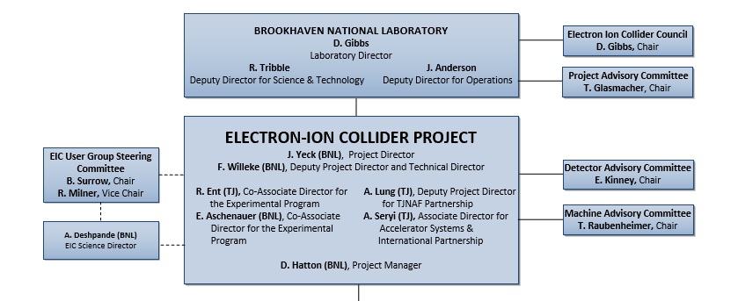
Project Leadership, Committees, and Users

Slide 13
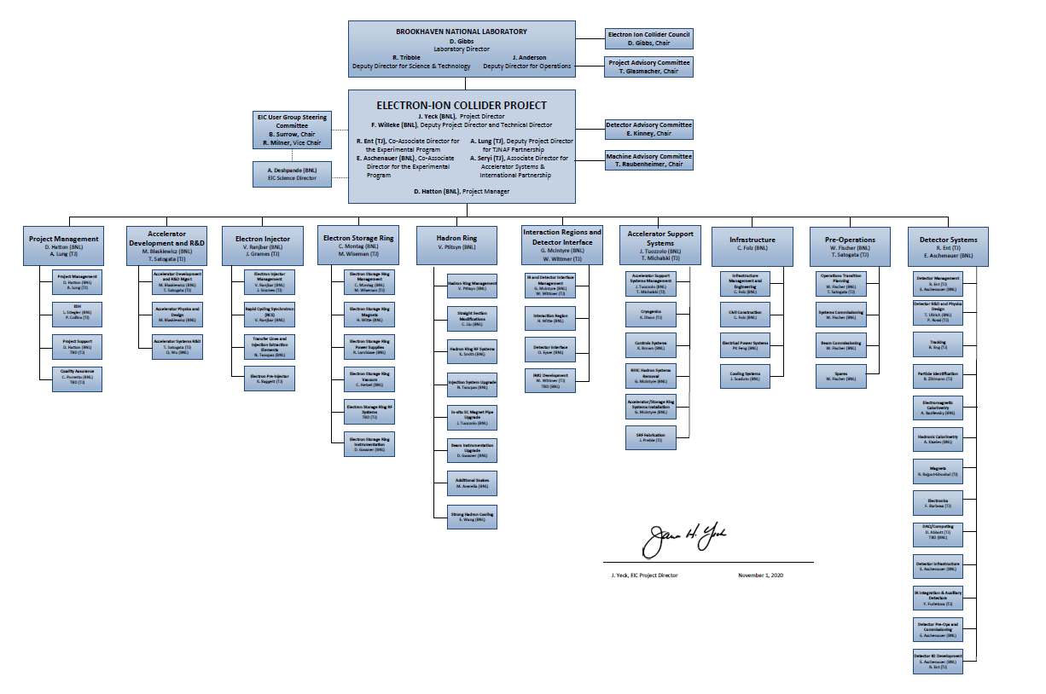
EIC Project Organization

Slide 14
EIC Partnership Plans
Actively promoting a culture of interdisciplinary and multi-institutional collaboration for both the accelerator and experimental program
International and domestic partnership is being pursued and bi-lateral meetings with potential partners are well underway to discuss opportunities in the accelerator and experimental areas
Accelerator Partnership Activities (Assumption of ~5-10% In-kind)
  Workshop October 7-9 Hosted by Cockcroft Institute, UK – Promoting Collaboration on the Electron-Ion Collider
  In-kind contributions to the accelerator design and hardware are being pursued
Detector Partnership Activities (Assumption of ~30% In-kind)
  Expressions of Interest (EoI) for potential cooperation on EIC experimental equipment submitted following a call in May: https://www.bnl.gov/eic/EOI.php
  Call for proposals for detector(s) planned for March 2021
DOE Office of Nuclear Physics organizes regular meetings with international funding agencies (next meeting late February).

Slide 15
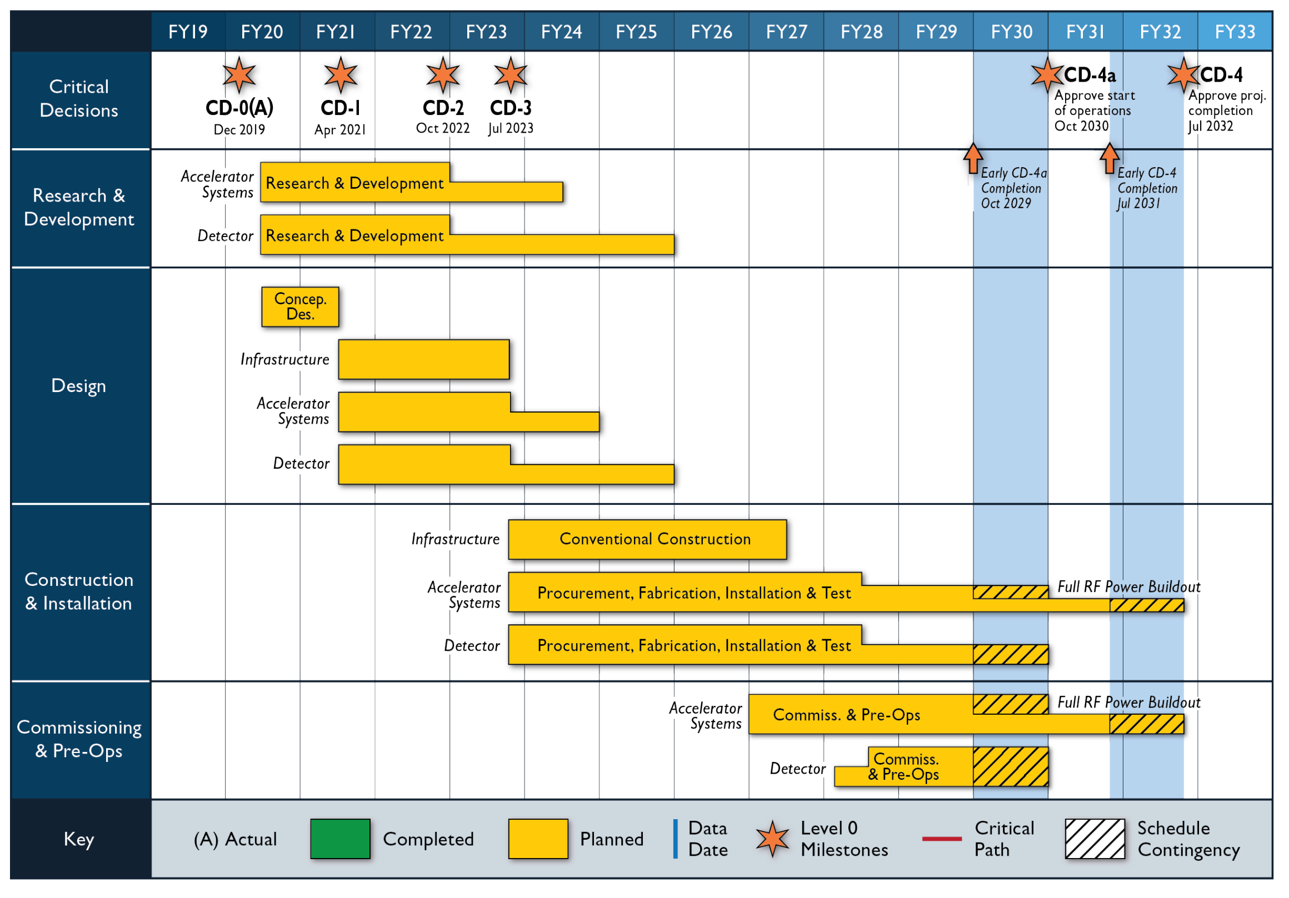
Schedule

Slide 16
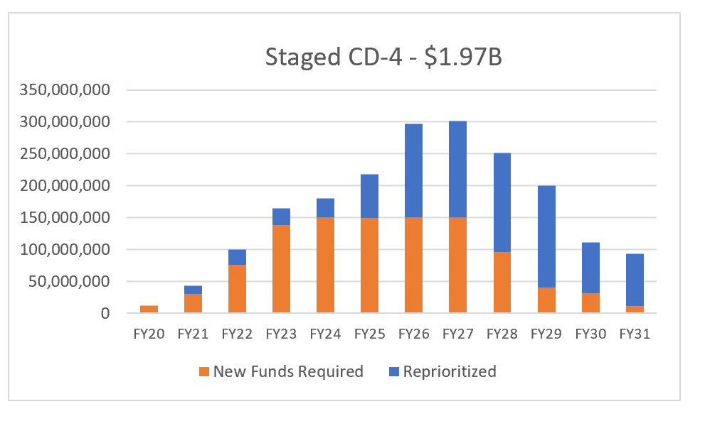
Reference Funding Profile
Reprioritized and New Funding
FY2021 Budget of $30M supports schedule for CD-1
Funding Profile Set prior to CD-2
$100M Investment by New York State for Conventional Construction
16

Slide 17
EIC Project - Recent Milestones
Event | Date
DOE Mission Need Statement Approved | January 22, 2019
DOE Independent Cost Review | July 2019
DOE Electron Ion Collider Site Assessment | October 2019
Critical Decision – 0 (CD-0) Approved | December 19, 2019
DOE Site Selection Announced | January 9, 2020
BNL TJNAF Partnership Agreement | May 7, 2020
DOE Office of Science Status Review | September 9-11, 2020
Independent EIC Conceptual Design Review | November 16-18, 2020
BNL Director’s Review | December 8-10, 2020
DOE OPA CD-1 Review | January 26-29, 2021
CD-1 Approval Target Date | April 2021

Slide 18
Post CD-1 Project Milestones
Accelerator Technical Reviews | Spring/Summer 2021
Call for Detector Proposals | March 2021
Start Preliminary Design | April 2021
Detector Proposals Submitted | December 2021
Selection of Project Detector | March 2022
In-kind Deliverables - Agreements | Summer/Fall 2022
Goal for CD-2 Approval | Q1FY2023
Goal for CD-3 Approval | Q4FY2023

Slide 19
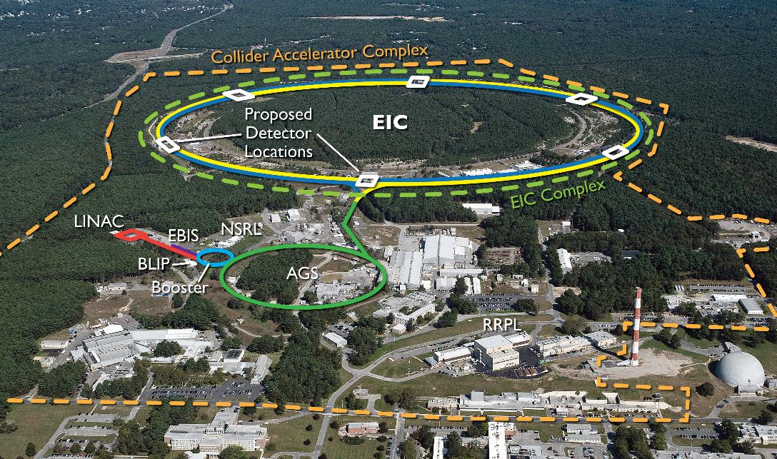
EIC Design Overview

Slide 20
EIC designed to meet NSAC and NAS Requirements
Center of Mass Energies 20 GeV – 140 GeV
Maximum Luminosity 10³⁴ cm⁻²s⁻¹
Hadron Beam Polarization >70%
Electron Beam Polarization >70%
Ion Species Range p to Uranium
Number of interaction regions up to two
NSAC - Department of Energy Nuclear Science Advisory Committee
NAS - National Academies of Sciences, Engineering, and Medicine

Slide 21
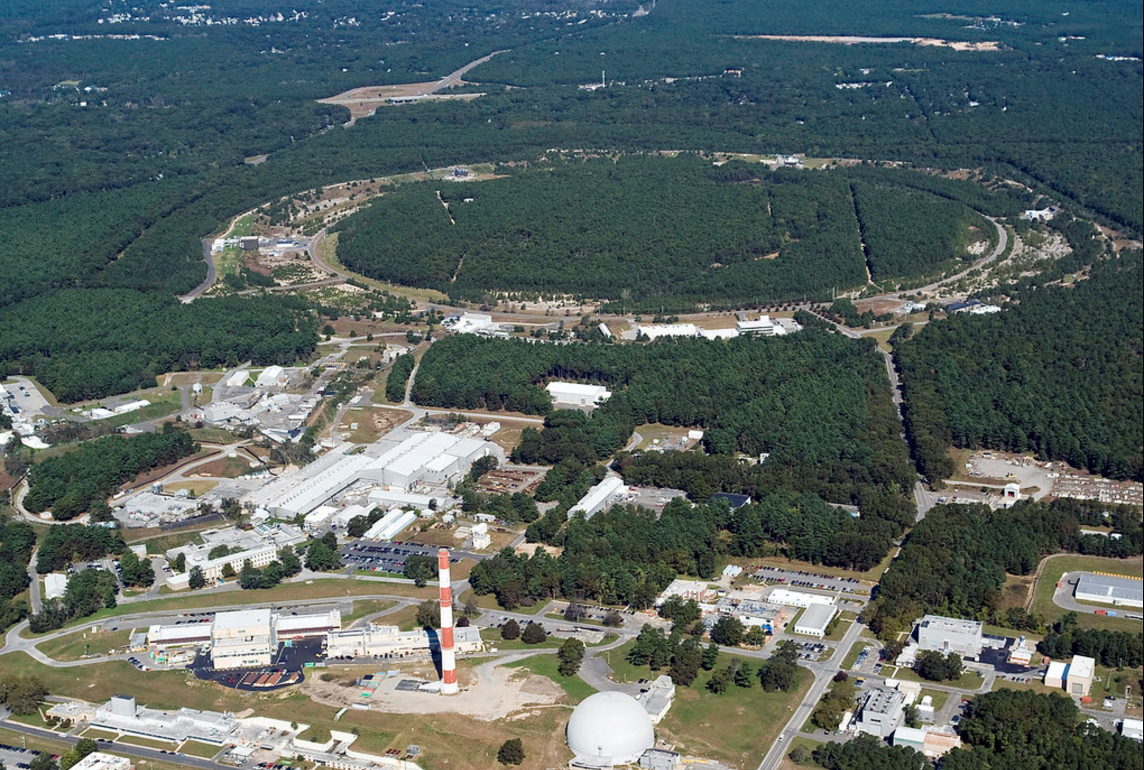
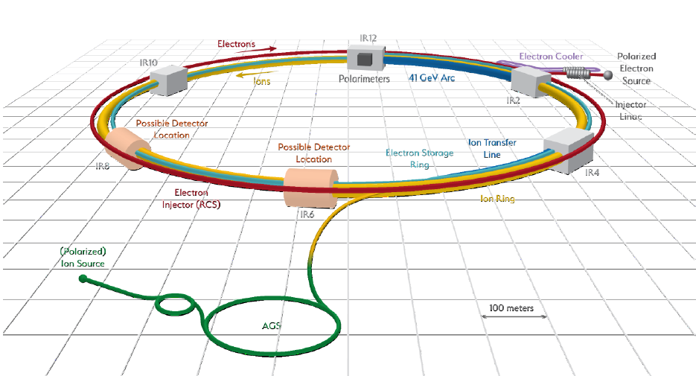
Electron-Ion Collider Concept
Design based on existing RHIC,
RHIC is well maintained, operating at its peak
Hadron storage ring 40-275 GeV (existing)
  Many bunches
  Bright beam emittance
  Need strong cooling or frequent injections
Electron storage ring (2.5–18 GeV (new))
  Many bunches,
  Large beam current (2.5 A) ➔ 10 MW S.R. power
Electron rapid cycling synchrotron (new)
  1-2 Hz
  Spin transparent due to high periodicity
High luminosity interaction region(s) (new)
  L = 10³⁴cm⁻²s⁻¹
  Superconducting magnets
  25 mrad Crossing angle with crab cavities
  Spin Rotators (longitudinal spin)
  Forward hadron instrumentation
EIC

Slide 22
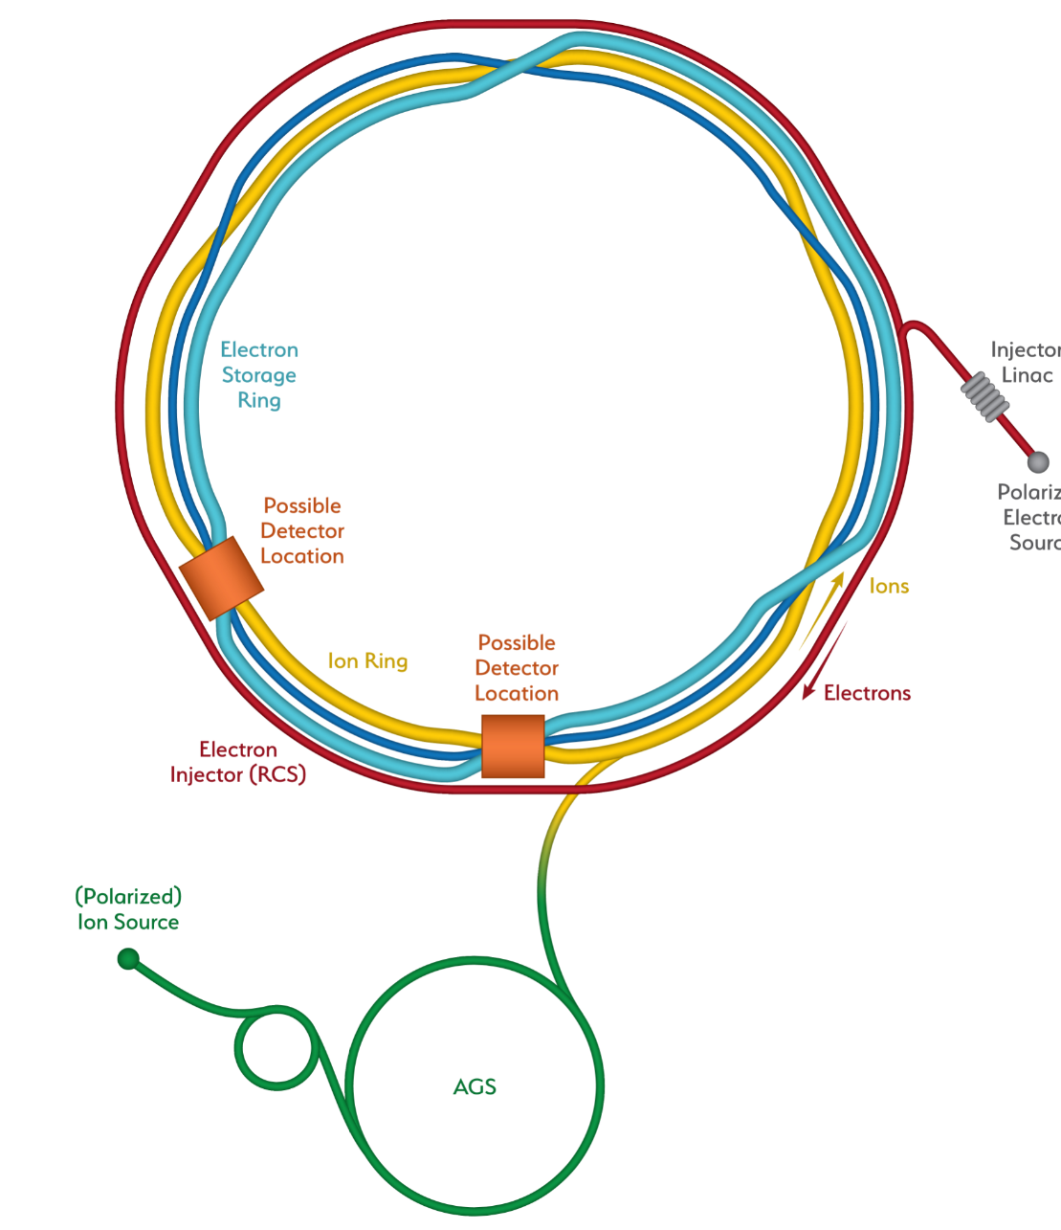
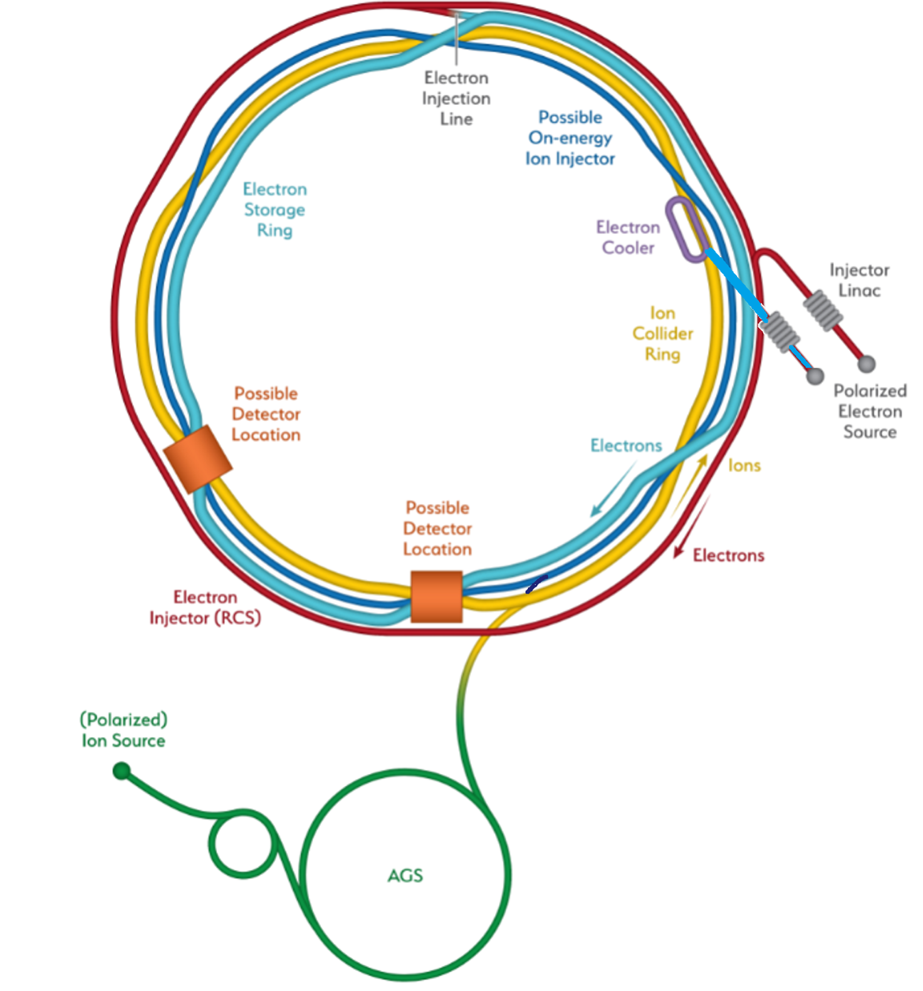
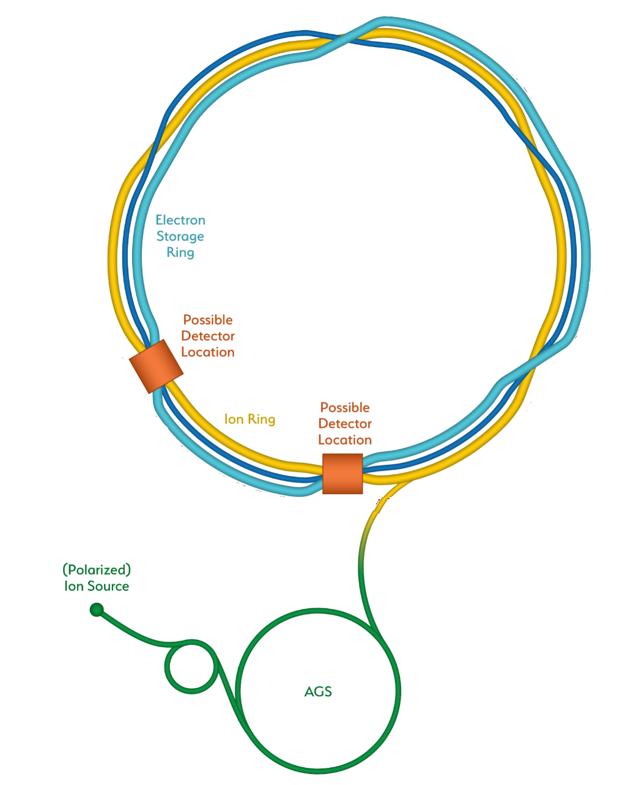
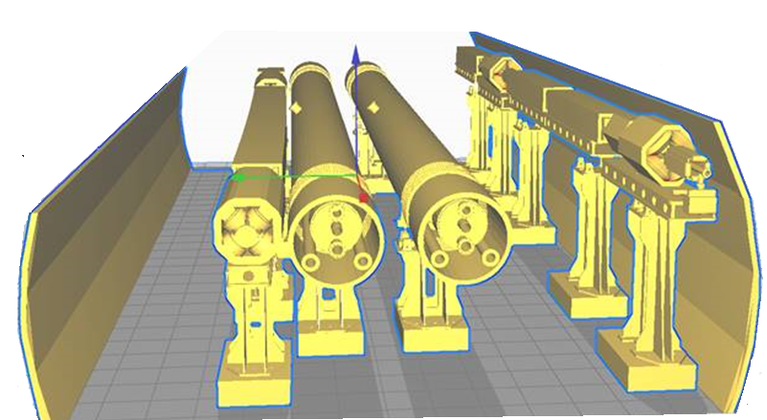
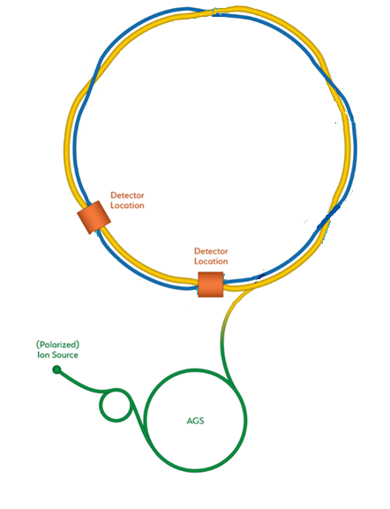
From RHIC to the EIC
EIC
Add electron storage ring
Which holds the electrons which collide with hadrons
We add an electron
Injector complex which delivers full energy electrons to the storage ring
The strong hadron cooling facility completes the facility
Existing RHIC with
Blue and Yellow ring
Hadron Storage Ring
Electron Storage Ring
Electron Injector Synchrotron
Possible on-energy Hadron
injector ring
Hadron injector complex

Slide 23
EIC covers full center of mass energy range of 20 GeV – 140 GeV
Protons up to 275 GeV:
  Existing RHIC with superconducting magnets allow up to E_{p} = 275 GeV and down to E_{p} = 41 GeV
  RHIC beam parameters are close to what is required for EIC
Electrons up to 18 GeV:
Electron storage ring with up to 18 GeV installed RHIC tunnel,
readily achievable with
    large circumference of 3870 m and
    available superconducting RF technology ➔ U_{rf} = 62 MV
low electron energy of 2.5 GeV is easily obtainable

Slide 24
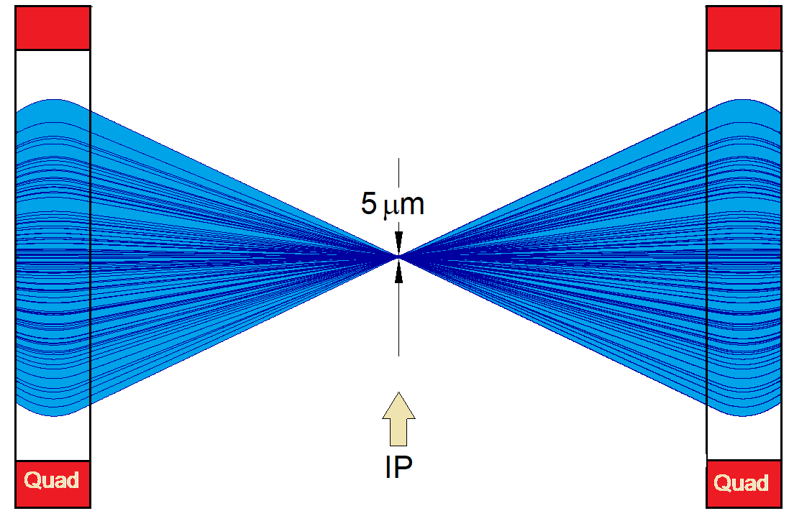
EIC achieves high luminosity L = 10³⁴ cm⁻²s⁻¹
Large bunch charges N_{e} ≤ 1.7·10¹¹, N_{p} ≤ 0.69·10¹¹
Many bunches, n_{b}=1160
  crossing angle collision geometry
  large total beam currents
  limited by installed RF power of 10 MW
Small beam size at collision point achieved by
  small emittance, requiring either:
- strong hadron cooling to prevent emittance growth or
  - frequent hadron injection
  and strong focusing at interaction point (small β_{y})
  flat beams σ_{x}/σ_{y} ≈ 10
Strong, but previously demonstrated beam-beam interaction
Δν_{p} = 0.01 demonstrated in RHIC
Δν_{e} = 0.1 demonstrated in HERA, B-factories
Strong focusing β_{y} =5 cm

Slide 25
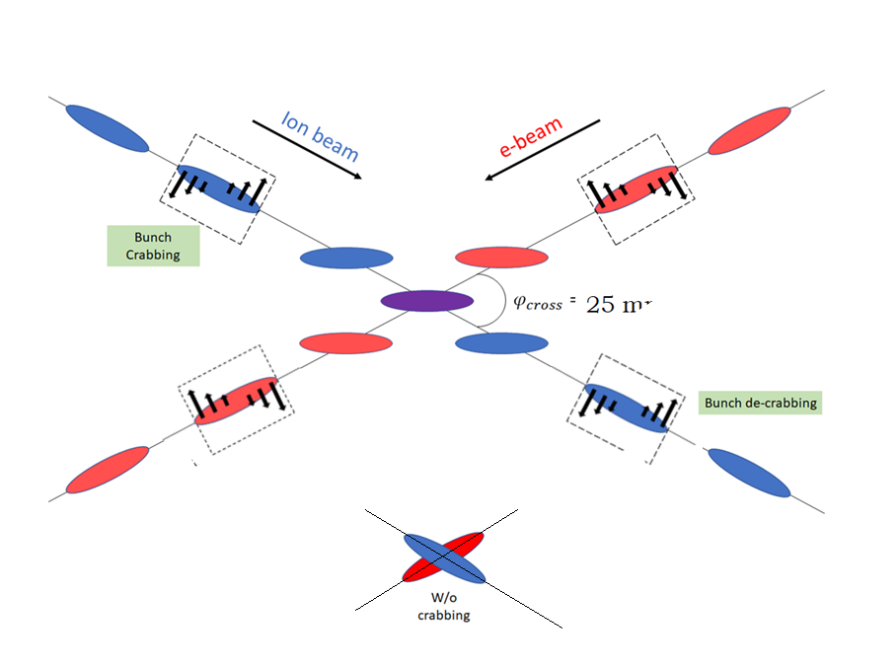
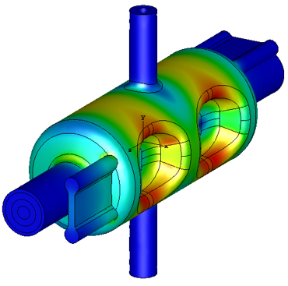
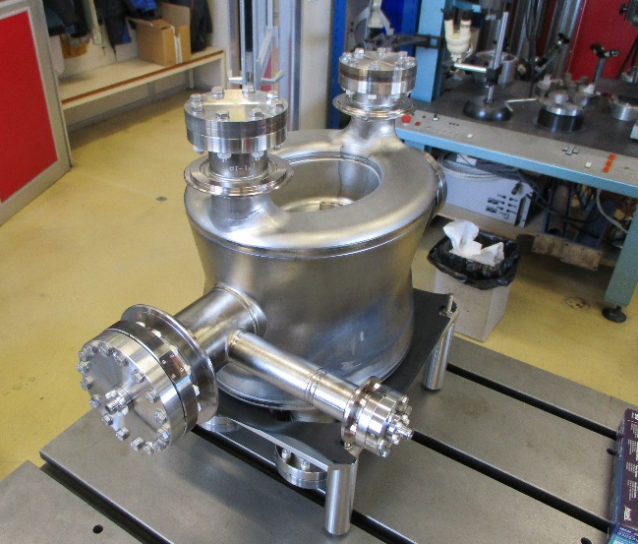
EIC High Luminosity with a Crossing Angle
Modest crossing angle of 25 mrad
  Avoid parasitic collisions due to short bunch spacing
  For machine elements, to improve detection
  Reduce detector background
However, crossing angle causes
  Low luminosity
  Beam dynamics issues
25 mrad
avoided by Crab Crossing
Then :
  Effective head-on collision restored
  Beam dynamic issues resolved
RF resonator (crab-cavity) prototypes built
and tested with proton beam in the CERN-SPS

Slide 26
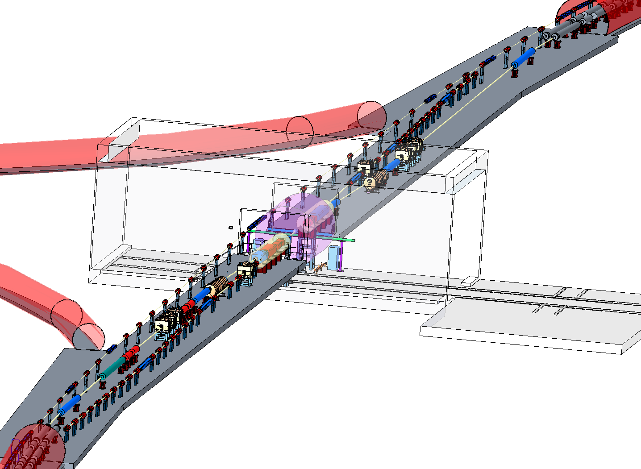
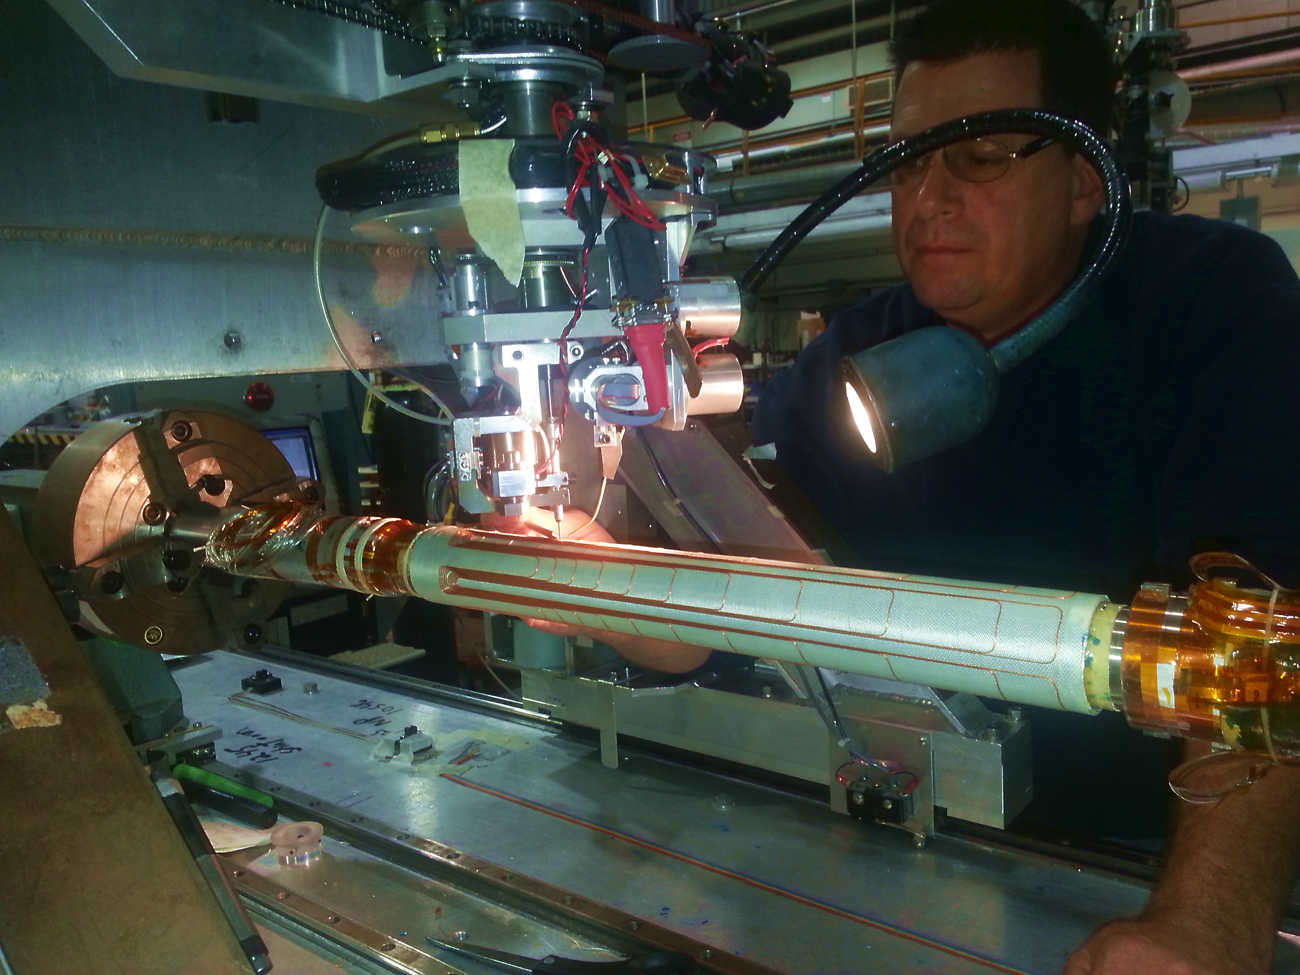
EIC Interaction Region
Beam focused to β_{y} ≤ 5 cm @ σ_{y}= 5 μm, gives L=10³⁴cm⁻²s⁻¹
Manageable IR chromaticity and sufficient dynamic aperture
Full acceptance for the colliding beam detector
Accommodates crab cavities and spin rotators
Synchrotron radiation and impedance manageable
EIC final focus magnets based on conventional NbTi superconducting magnets using collaring and direct wind - technology
Detector hall
Direct wind s.c. coil production in progress

Slide 27
Maintaining high luminosity during a fill
Issue: Dense hadron beam leads to emittance growth due to IBS – causes luminosity decay, would imply reduced average luminosity
eA collisions: existing stochastic cooling system preserves emittance – e-ion luminosity maintained, thus for Ions, straightforward path forward
ep collisions: need to actively prevent p emittance growth with cooling scheme
EIC Strong Hadron Cooling: extension of established stochastic cooling to higher bandwidth: replacing cables @ amplifiers with electron beam and beam dynamical effects: Coherent Electron Cooling (CeC)
Establishing CeC will provide:
  Long un-interrupted luminosity runs
  Significant advance in accelerator science
Active R&D on demonstrating CeC
Has also considered an alternative of frequent on-energy injections using existing Blue Ring that restores average luminosity up to ~ the peak luminosity
Several alternative options are also being studied – an electron storage ring (single or dual energy) for incoherent electron cooling, use of induction accelerators to produce high power electron beam for cooling, etc.

Slide 28
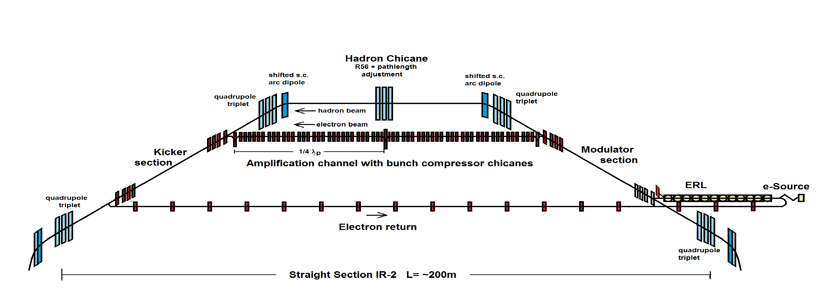
EIC Strong Hadron Cooling
Coherent Electron Cooling with μ-bunching amplification
Design Cooling Rate R_{cool}= 1-2 h⁻¹
Electron beam current I_{e}=100 mA (1nC/bunch), electron emittance ε_{xyN}= 2.5/0.5μm
EIC Strong Hadron Cooling: extension of established stochastic cooling to higher bandwidth: replacing cables @ amplifiers with electron beam and beam dynamical effects: Coherent Electron Cooling (CeC)
Establishing CeC will provide:
  Long un-interrupted luminosity runs
  Significant advance in accelerator science

Slide 29
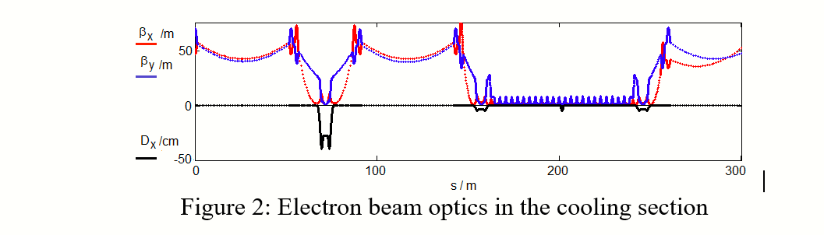
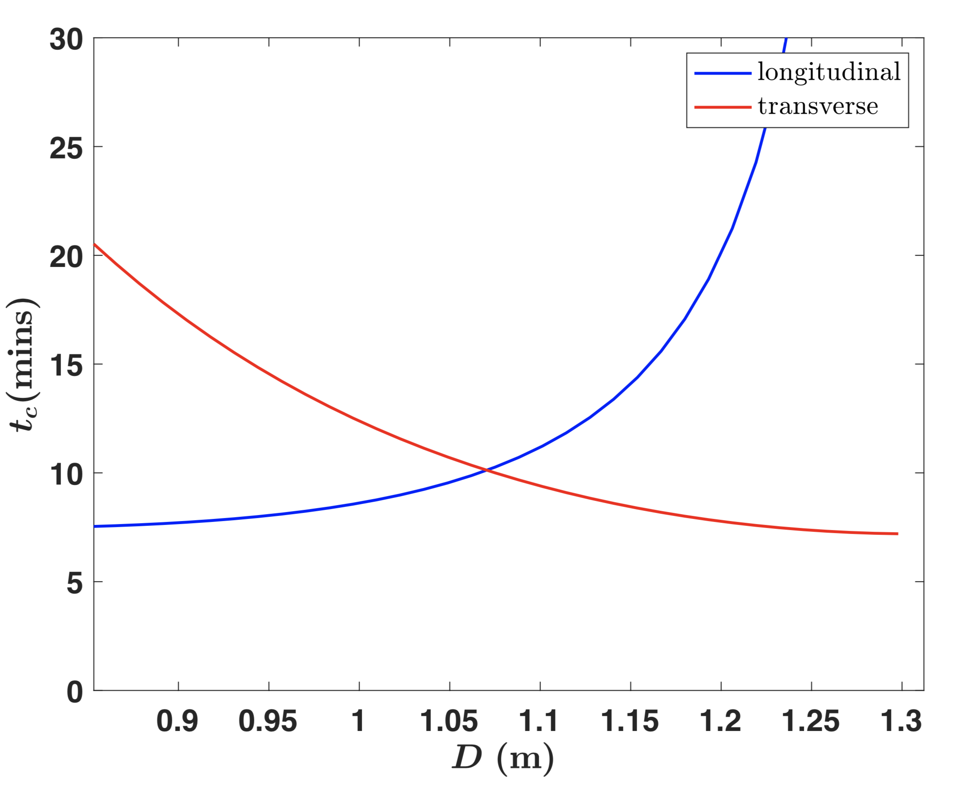
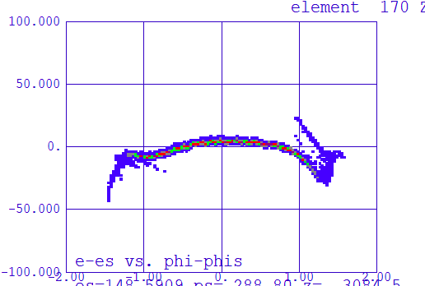
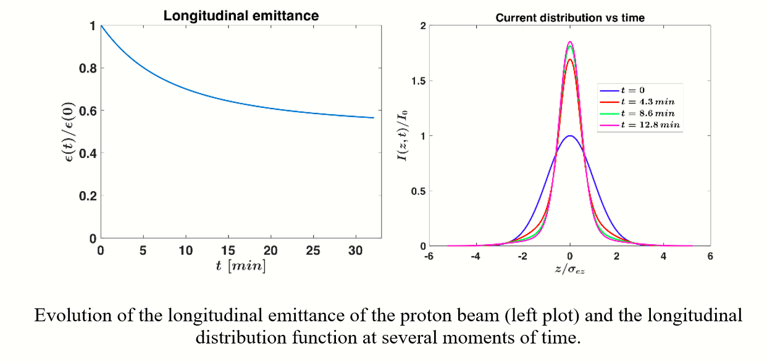
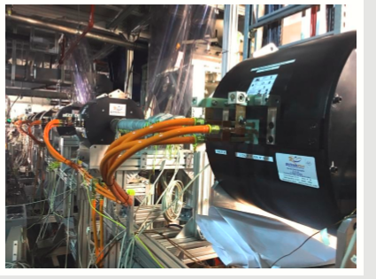
Progress on Strong Hadron Cooling
Optics and Geometry
Optimization of transverse
vs longitudinal cooling
e Return path
kicker
ERL
Amplification
ERL optimization:
Less components, better performance!!
modulator
Cooling Simulation 1h cooling time !!
CeC test set up in RHIC: Plasma cascade amplification section with strong solenoids

Slide 30
Luminosity versus E_{CM} center of mass energy
EIC
Optimization for low E_{cm}
Annual Integrated Luminosity [fb⁻¹]
Peak Luminosity [cm⁻²s⁻¹]
10³⁴
10³³
10³²
EIC
Optimization for high E_{cm}
100
10
1
Tomography (p/A)
Spin and Flavor Structure of
the Nucleon and Nuclei
Internal
Landscape of the Nucleus
QCD at Extreme Parton Densities-
Saturation
150
Center of Mass Energy E_{cm} [GeV]

Slide 31
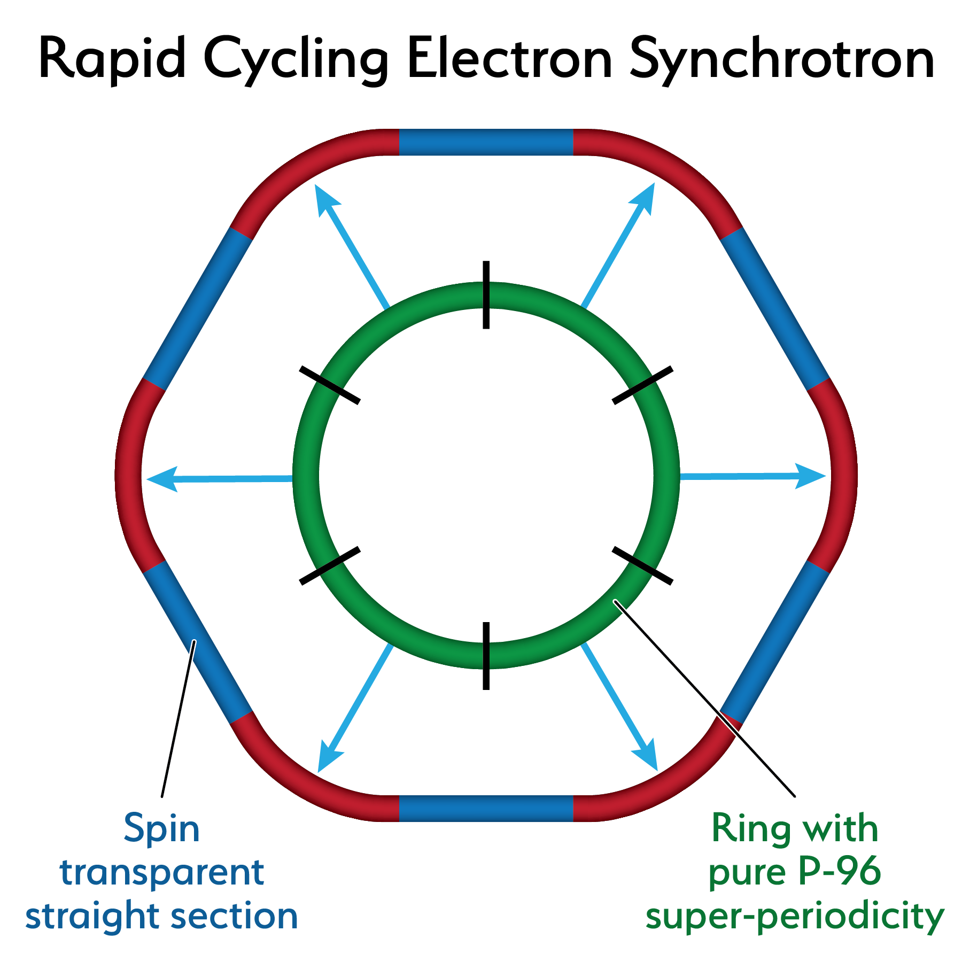
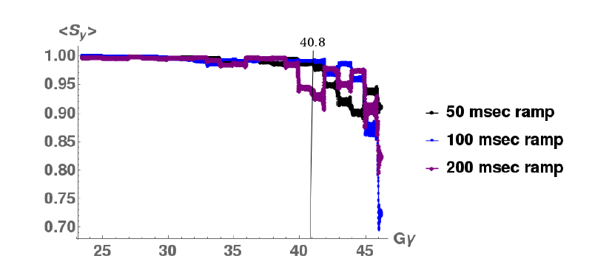
18 GeV Rapid Cycling Synchrotron enables high electron polarization in the electron storage ring
85% polarized electrons from a polarized source and a 400 MeV s-band linac
get injected into the fast cycling synchrotron in the RHIC tunnel
AGS experience confirms depolarization suppressed by lattice periodicity
Ingenious optical design with high quasi-periodicity arcs and unity transformations in the straights suppresses all systematic depolarizing resonances up to E >18 GeV
Good orbit control y_{cl.o.}< 0.5 mm; good reproducibility suppresses depolarization by imperfection resonances
➔ No depolarizing resonances during acceleration 0.4-18 GeV
no loss of polarization on the entire ramp up to 18 GeV (100 ms ramp time, 2 Hz)
RCS Design
RCS Polarization Performance confirmed by extensive simulations

Slide 32
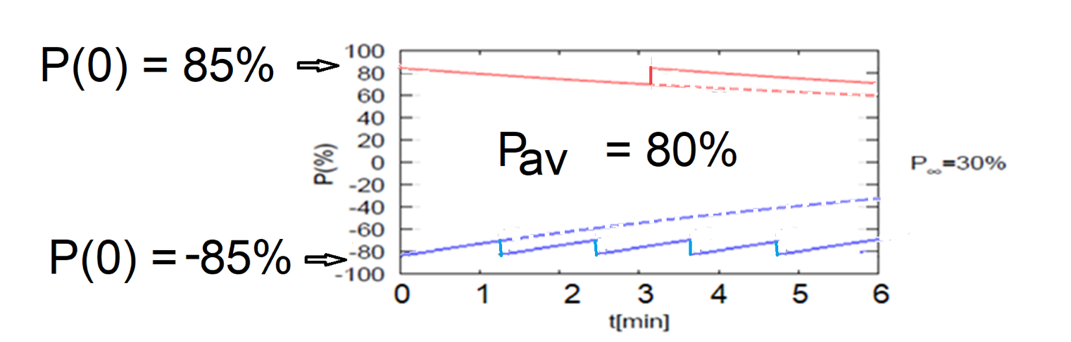
High average polarization at electron storage ring of 80% by
Frequent injection of bunches on energy with high initial polarization of 85%
Initial polarization decays towards P∞ < ~50% (equilibrium of self-polarization and stochastic excitation)
At 18 GeV, every bunch is refreshed within minutes with RCS cycling rate of 2Hz
Need both polarization directions present at the same time
B P
Refilled every 1.2 minutes
B P
Refilled every 3.2 minutes
Re-injection
P_{av}=80%
P∞= 30%
(conservative)
P_{av}=80%
Re-injections

Slide 33
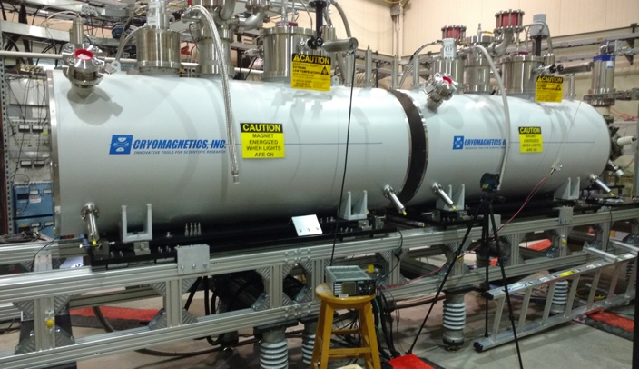
EIC Hadron Polarization
Existing p Polarization in RHIC achieved with “Siberian snakes”
Near term improvements will increase proton polarization in RHIC from 60% to 80%
³He polarization of >80% measured in source
80% polarized ³He in EIC will be achieved with six “snakes”,
Acceleration of polarized Deuterons in EIC 100% spin transparent
Need tune jumps in the hadron booster synchrotron
Electron beam ion source EBIS with polarized ³He extension

Slide 34
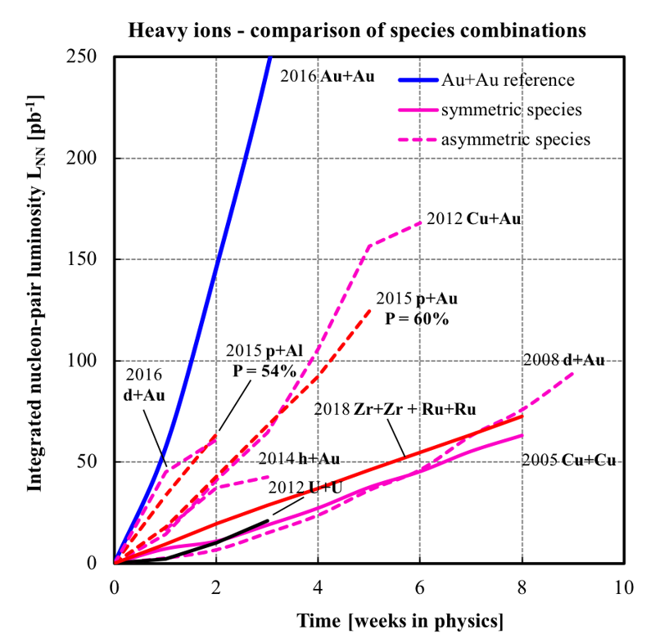
The existing RHIC ion sources & ion acceleration chain provide already today all ions needed for EIC
Ions from He to U have been already generated in the Electron-Beam-Ion-Source ion source (EBIS), accelerated and collided in RHIC
EBIS can generate any ion beam from ³He to U for the BNL EIC
Existing EBIS provides the entire range of ion species from He to U in sufficient quality and quantity for the EIC
Ion Pairs
in the RHIC Complex
Zr-Zr, Ru-Ru (2018)
Au-Au (2016)
d-Au (2016)
p-Al (2015)
h-Au (2015)
p-Au (2015)
Cu-Au (2012)
U-U (2012)
Cu-Cu (2012)
D-Au (2008)
Cu-Cu (2005)
Ion-Ion Luminosity Runs in RHIC 2005-2018
Accumulated Luminosity [pb⁻¹]
Enormous
versatility!
is a unique capability!
Operation Time [weeks]

Slide 35
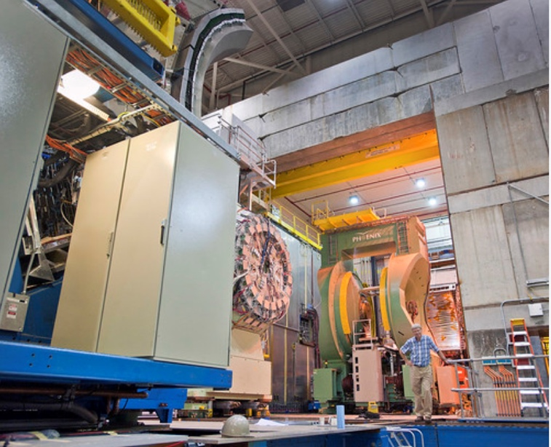
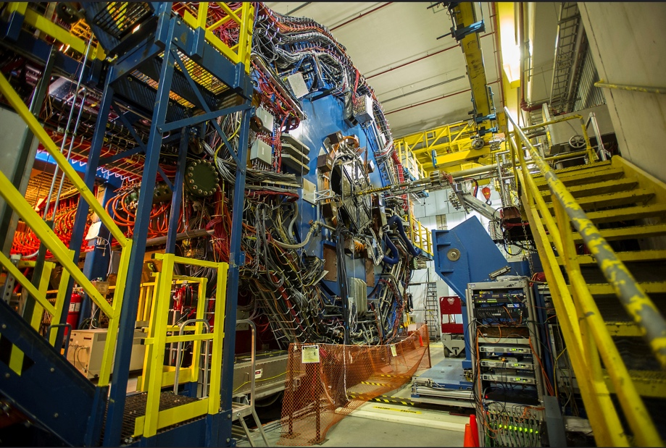
The EIC will benefit from two large existing detector halls in IR 6 and IR 8
Both halls are large and fully equipped with infrastructure such as power, water, overhead crane, ….
35
35
IR 8 detector hall with PHENIX detector (transitioning to sPHENIX)
IR 6 detector hall with STAR detector
Both IRs can be implemented simultaneously in the EIC lattice and be accommodated within beam dynamics envelope
2 IR’s: laid out identically or optimized for maximum luminosity at different E_{CM}

Slide 36
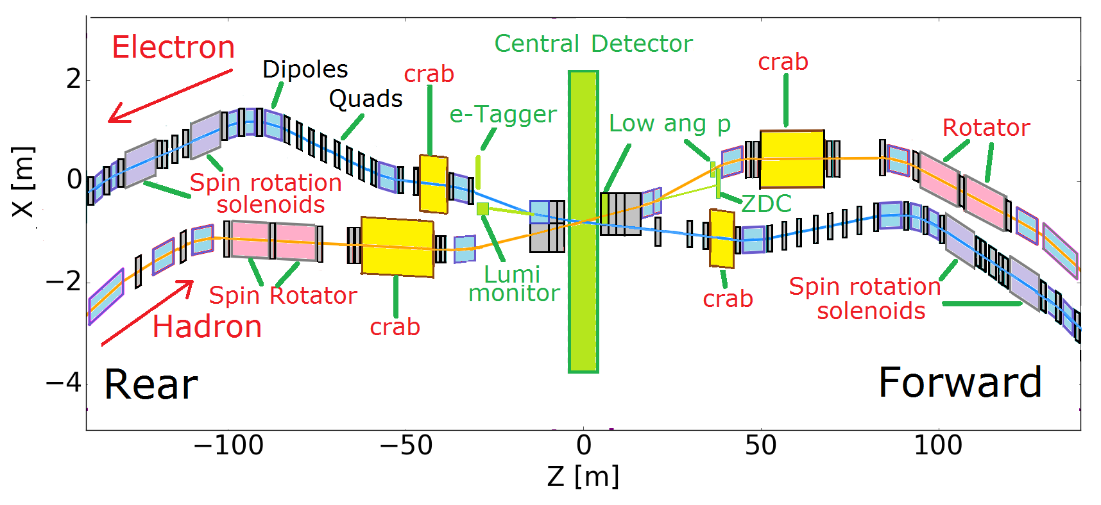
Interaction Region Design
Interaction Region, the accelerator around the colliding beam detector is the most complex and most constrained section of a collider
2nd IR and 2nd detector is not in the project scope but we unanimously agree that the EIC should have 2 detectors (and 2 IR s)
The layout of a second IR is being studied under the assumption that more luminosity can be achieved at lower center of mass energy (60GeV) if more bunches are used in collisions

Slide 37
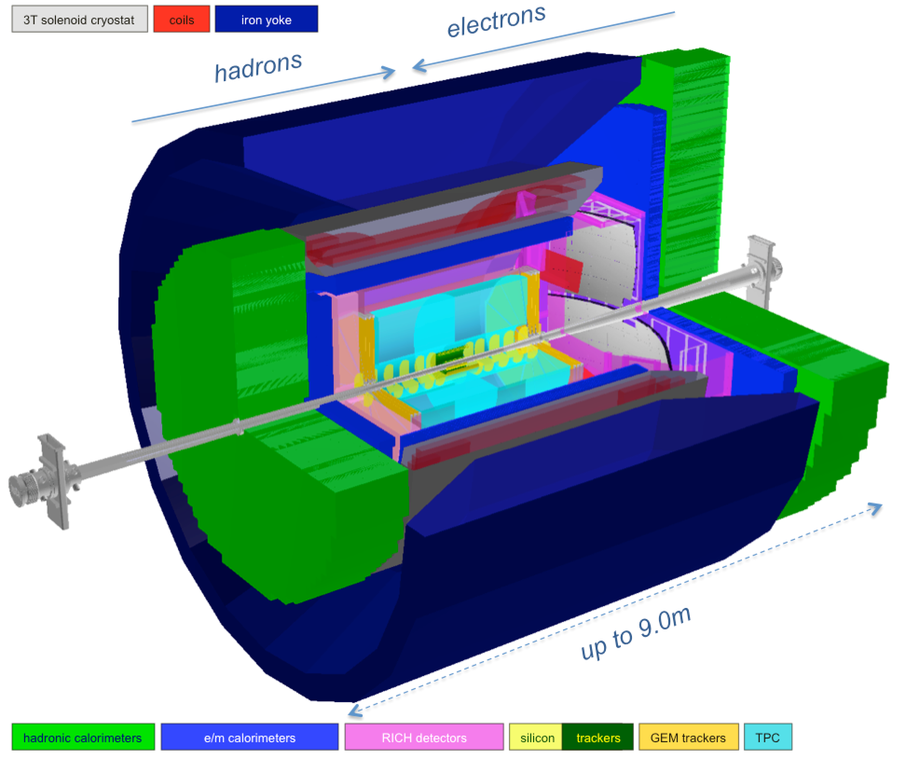
Experimental Program Preparation
EIC User Community Yellow Report – December 2019 Kick Off
4 workshops to prepare physics studies & detector concepts in preparation for realization of the EIC
Final workshop in November 2020. Draft Yellow Report is available
Reference detector
BNL and TJNAF Jointly Leading Process for Defining Detector(s)
Call for Expressions of Interest (EOI) for “Potential Cooperation on the EIC Experimental Program” | May 2020
EOI Responses | November 2020
Assessment of EOI Responses | On-going
Call for Detector Proposals | March 2021
BNL/TJNAF Program Advisory Committee Established | Summer 2021
Detector Proposals Submitted | December 2021
Decision on Detector(s) | Early 2022

Slide 38

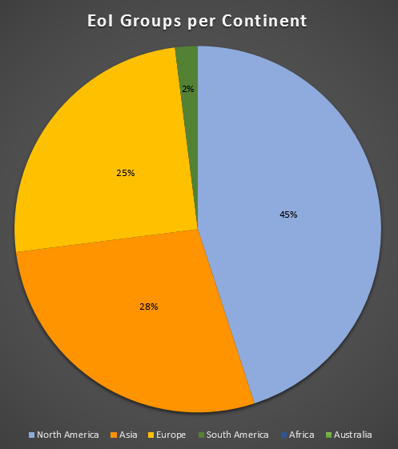
Call was issued May 2020
Deadline: November 1st 2020
Call advertised worldwide
  https://www.bnl.gov/eic/EOI.php
Received 47 EoIs, available at: https://indico.bnl.gov/event/8552/
Dear prospective Electron-Ion Collider users,
Brookhaven National Laboratory (BNL), in association with Thomas Jefferson National Accelerator Facility (TJNAF), would like to invite interested groups to submit an Expression of Interest (EOI) for their potential cooperation on the experimental equipment in support of a broad and successful science program at the Electron-Ion Collider (EIC).
We encourage interested groups to work together within their country, their geographical region, or as a general consortium, to submit such EOIs.
This call focuses on all detector components to facilitate the diverse EIC science program, including those integrated in the interaction region.
Please visit https://www.bnl.gov/eic/EOI.php to see further details about this call and how to submit an Expression of Interest.
Best regards,
Elke Aschenauer and Rolf Ent for the EIC Project Team
Europe
25%
N. America
45%
Asia
28%

Slide 39
EIC Accelerator Collaboration Opportunities
EIC is international from its conception
Collaboration on EIC design and construction –mutually beneficial, providing a gateway to EIC science, advancing accelerator science and technology
Possible contributions to the EIC accelerator could include the full range of accelerator design & hardware
  E.g. IR magnet design and construction, luminosity monitoring, RF R&D and construction, normal conducting magnets, critical vacuum components, feedback systems, polarimetry, contributions to the 2nd IR, beam-dynamics calculations, etc.

Slide 40
Partnership development
Building up and expanding collaboration on EIC accelerator
Two approaches: bi-lateral dialogue & workshops:
  Bi-lateral discussions
    Between EIC project and a specific lab
    Allow for focused discussion on specific scope
  Dedicated partnership workshops
    Wide attendance, 2-3 days workshops
    Hosted by one of key international partners
    Aimed at both domestic and international partners, and for discussion of contribution of any scale

Slide 41
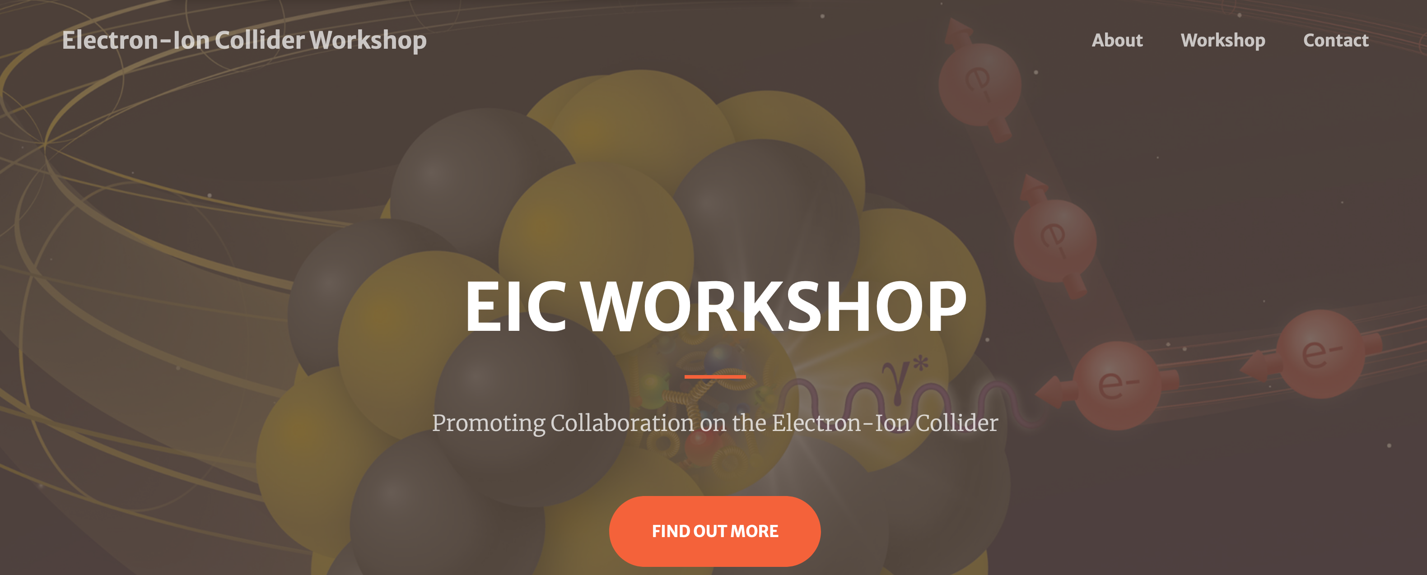


7-9 October 2020
hosted by Cockcroft Institute for accelerator science and technology, UK
https://www.cockcroft.ac.uk/events/eic20/
https://indico.cern.ch/event/949203/

Slide 42

October 7-9, 2020 EIC partnership workshop
  365 invited participants
  26 countries
  6 continents
  A truly global event!
  76 scheduled talks
  33 hours of presentations spread across 16 sessions in a period of 50 hours
From Peter Ratoff’s summary, Cockcroft Institute Director, Workshop co-Chair:

Slide 43
EIC Accelerator Collaboration – path forward
The EIC team making efforts to stay as close as possible to technically driven schedule
With anticipated CD1 in 2021, CD2 in 2022 the time to engage is now
Mechanisms for collaboration developing
  1) Partnership workshops allow to see the broad picture and indicate the areas where project needs and the interests and expertise match
  2) Meetings between the institutional team and EIC project team allow for focused discussion on specific collaboration scope

Slide 44
EIC – the big picture
The EIC will be located at BNL and will be realized with TJNAF as a major partner. The realization of the EIC will be accomplished over the next decade at an estimated cost between $1.6 and $2.6 billion.
Utilize existing operational hadron collider; add electron storage ring, cooling in existing RHIC tunnel and electron injector.
The EIC’s high luminosity and highly
polarized beams will push the frontiers
of accelerator science and technology
and provide unprecedented insights into the building blocks and forces that hold atomic nuclei together.
Working towards CD-1 in Q3 FY 2021
EIC scope includes the machine upgrade to RHIC asset and two interactions regions with one of the interaction regions outfitted with a major detector.
Message from Tim Hallman - Associate Director of the DOE Office of Science for Nuclear Physics:
The EIC will be a game-changing resource for the international nuclear physics community. DOE looks forward to engaging with the international community and the international funding agencies about potential collaborations and contributions to the EIC effort, in nuclear, accelerator and computer science.

Slide 45
Summary
The EIC will be a discovery machine, providing answers to long-elusive mysteries of matter related to our understanding the origin of mass, structure, and binding of atomic nuclei that make up the entire visible universe
EIC project is underway aiming to start physics in about a decade
The EIC project will work closely with domestic and international partners to deliver the EIC construction project and then begin EIC operations
Collaboration in EIC design, construction and scientific exploration is welcome!

