Slide 1

Status of Novosibirsk SCTF
A.Bogomyagkov (BINP)
IAS Program on High Energy Physics
18-21 January 2021
Notes:
call,file="ct_ring-49_6.str; call,file="ct_ring-49_6.seq";

Slide 2
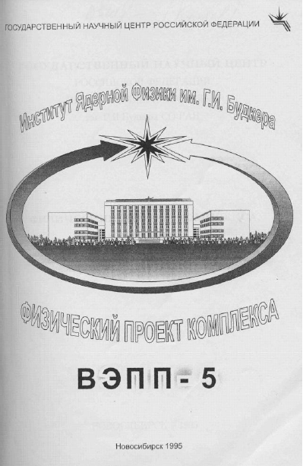
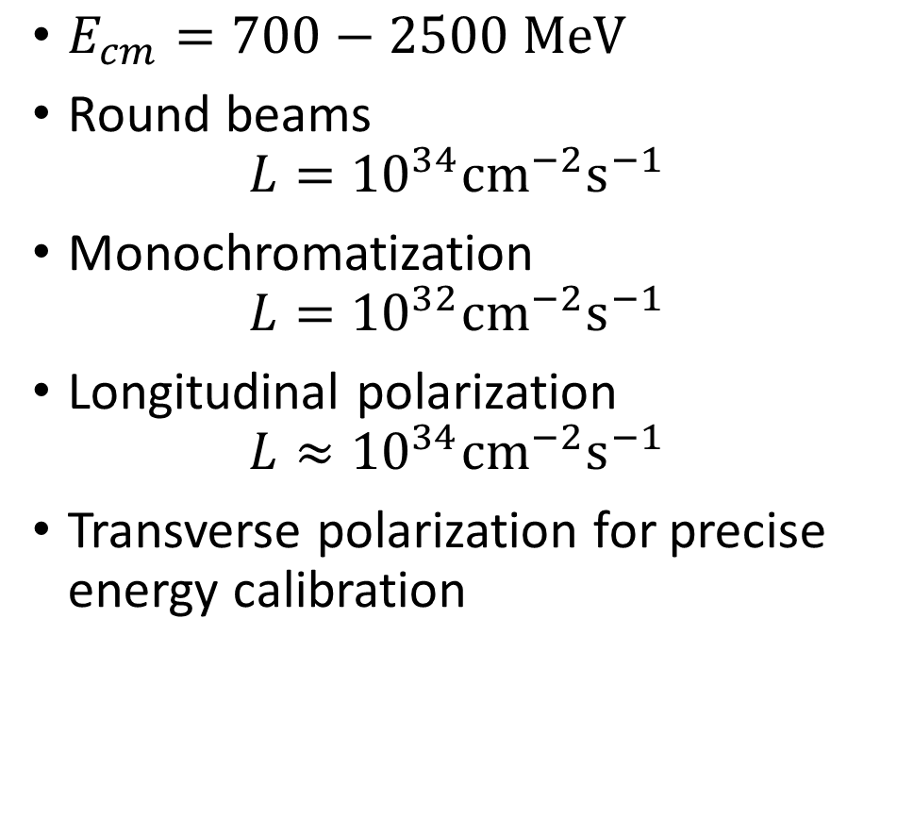
History of SCTF in Novosibirsk: 1995
$E_{cm}=700−2500 \text{MeV}$
Round beams
$$L={10}^{34}{\text{cm}}^{−2}{\text{s}}^{−1}$$
Monochromatization
$$L={10}^{32}{\text{cm}}^{−2}{\text{s}}^{−1}$$
Longitudinal polarization
$$L≈{10}^{34}{\text{cm}}^{−2}{\text{s}}^{−1}$$
Transverse polarization for precise energy calibration

Slide 3
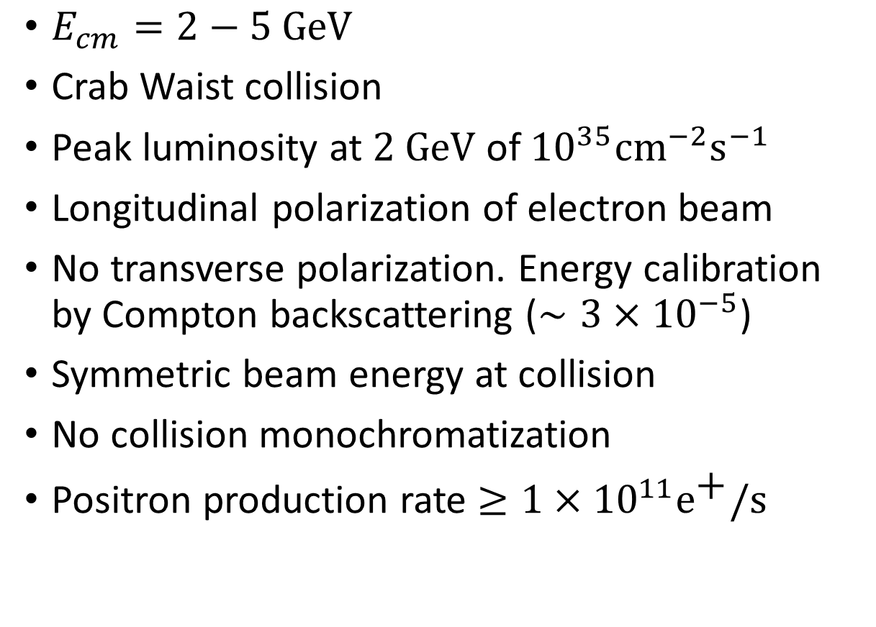
SCTF 2006 - 2011
$E_{cm}=2−5 \text{GeV}$
Crab Waist collision
Peak luminosity at $2 \text{GeV}$ of ${10}^{35}{\text{cm}}^{−2}{\text{s}}^{−1}$
Longitudinal polarization of electron beam
No transverse polarization. Energy calibration by Compton backscattering ($∼3×{10}^{−5}$)
Symmetric beam energy at collision
No collision monochromatization
Positron production rate $≥1×{10}^{11}{\text{e}}^{\text{+}}\text{/}\text{s}$

Slide 4
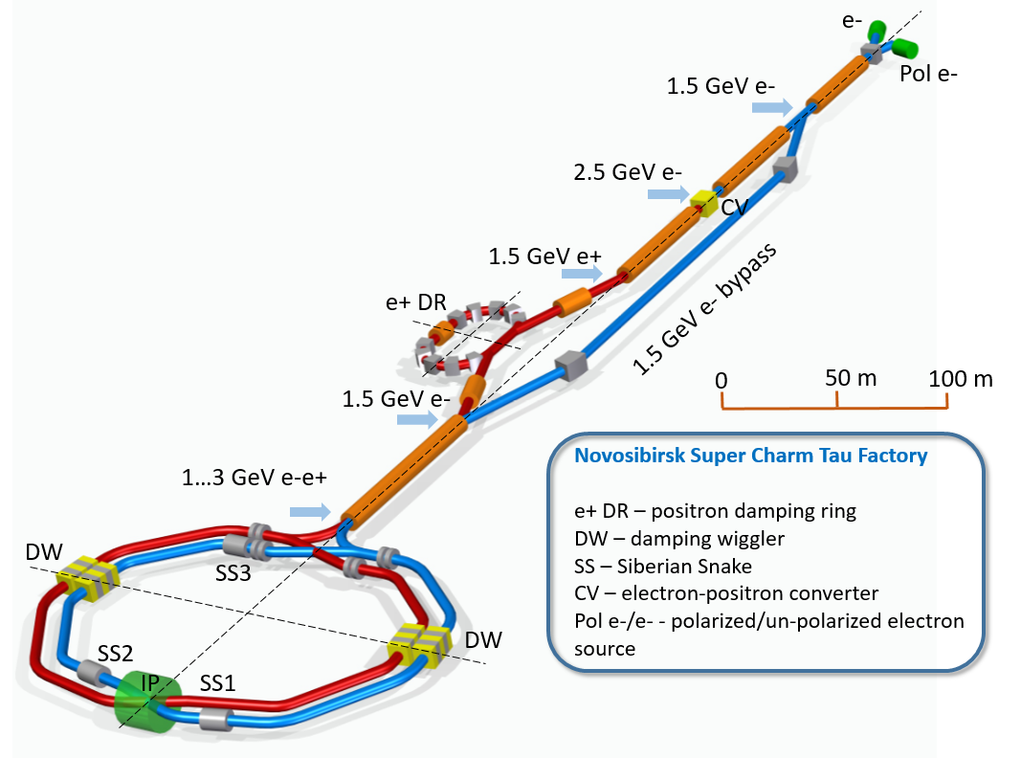
The whole facility

Slide 5
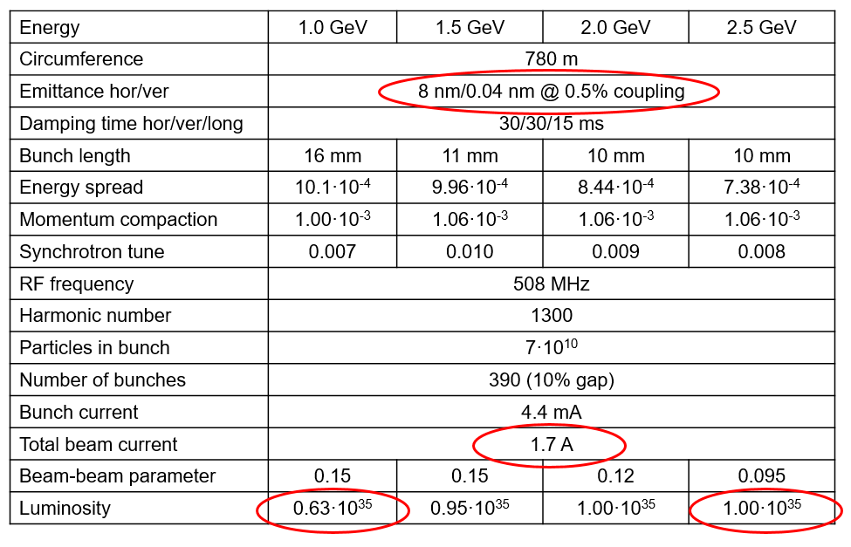
SCTF 2006 - 2011
Unrealisticly strong wigglers
L*=0.6 too smal
Insufficient DA with CRAB sextupole ON
IP: β_{y}=0.8 mm, β_{x}=40 mm

Slide 6
Official Status
SCTF was approved by Russian Government as one of the six mega-science projects.
The Government requested final documents by the end of 2019 for the project financing.
Preliminary Design Report, Conceptual Design Report, Civil Construction Design Report and Road Map are ready.
SCTF officially supported by ECFA.
European Commission Expert Group has supported SCTF (Russian Mega Science projects – evaluation of the potential for cooperation with Europe Experts meeting in Brussels 19 June 2013).
MoUs with CERN, KEK, INFN, JINR, John Adams Institute, etc. are signed.
Never received funding

Slide 7
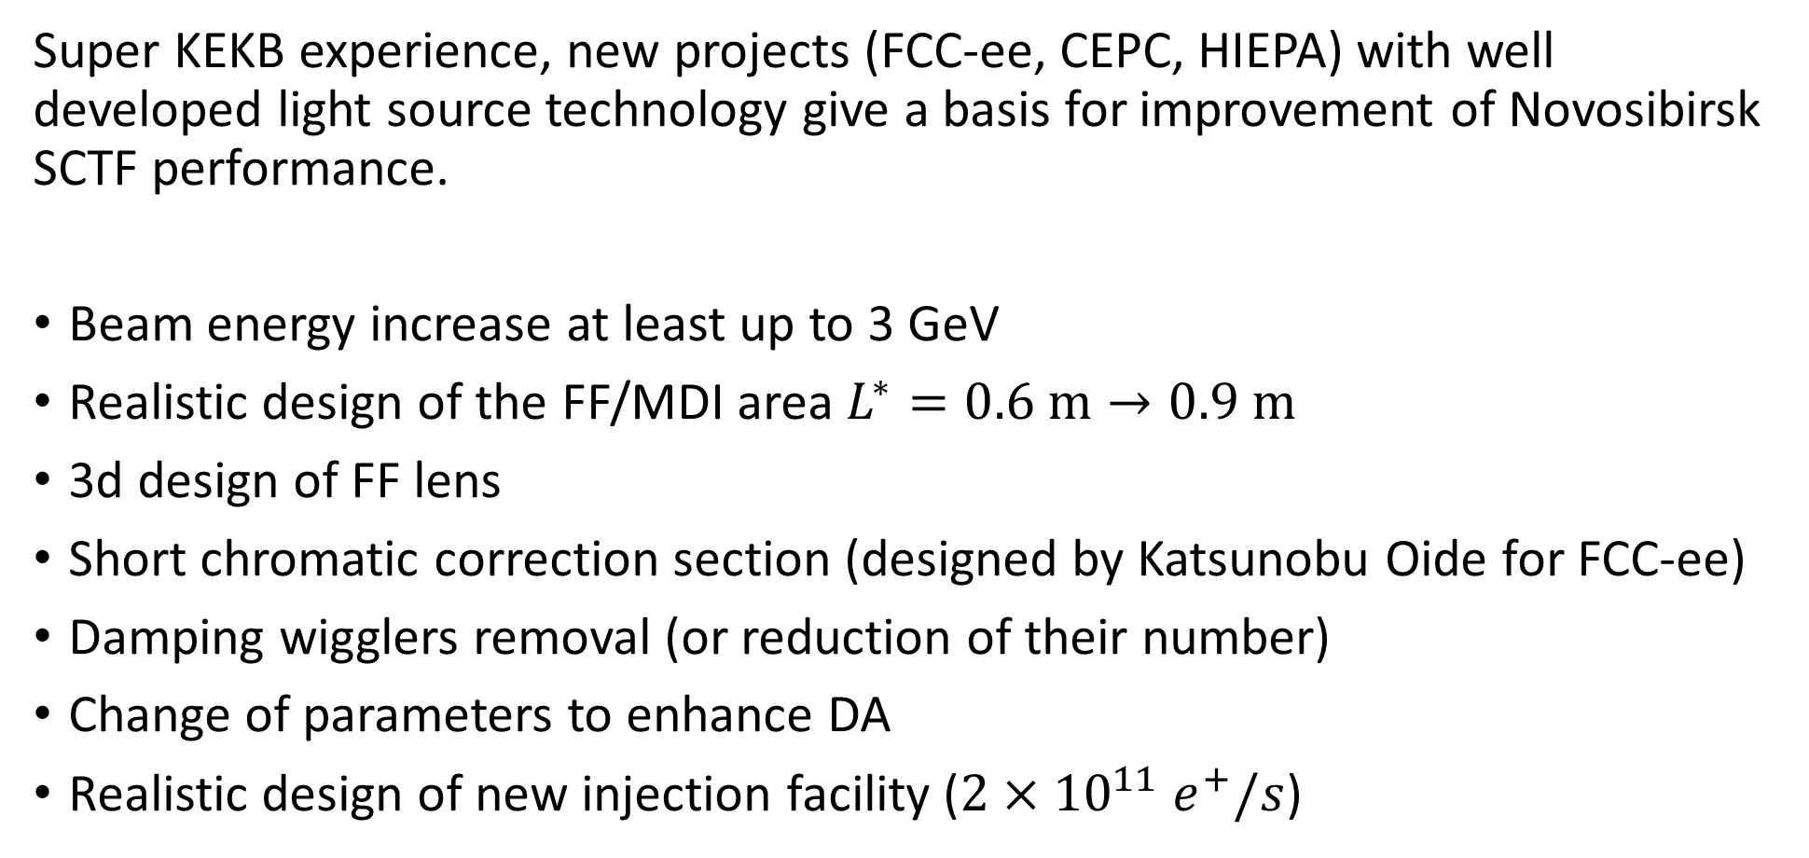
Progress continues
Super KEKB experience, new projects (FCC-ee, CEPC, HIEPA) with well developed light source technology give a basis for improvement of Novosibirsk SCTF performance.
Beam energy increase at least up to 3 GeV
Realistic design of the FF/MDI area $L^{∗}=0.6 \text{m}→0.9 \text{m}$
3d design of FF lens
Short chromatic correction section (designed by Katsunobu Oide for FCC-ee)
Damping wigglers removal (or reduction of their number)
Change of parameters to enhance DA
Realistic design of new injection facility ($2×{10}^{11} e^{+}/s$)

Slide 8
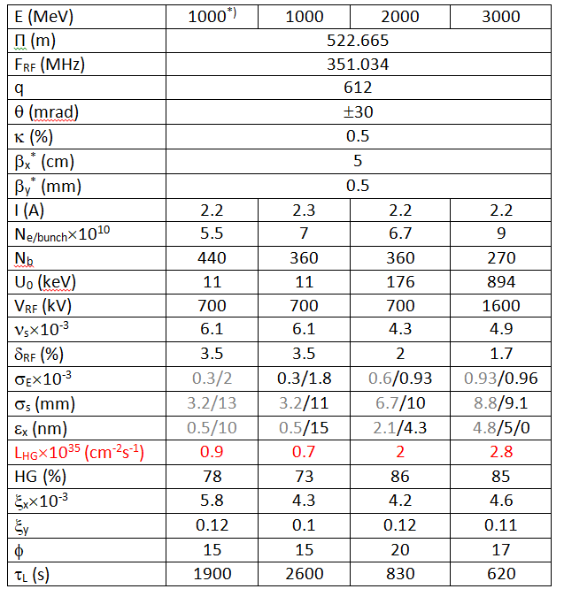
SCTF 2018
Insufficient momentum acceptance with CRAB sextupole ON
K.Oide’s type of Interaction Region
6 HMBA cells in the arcs

Slide 9
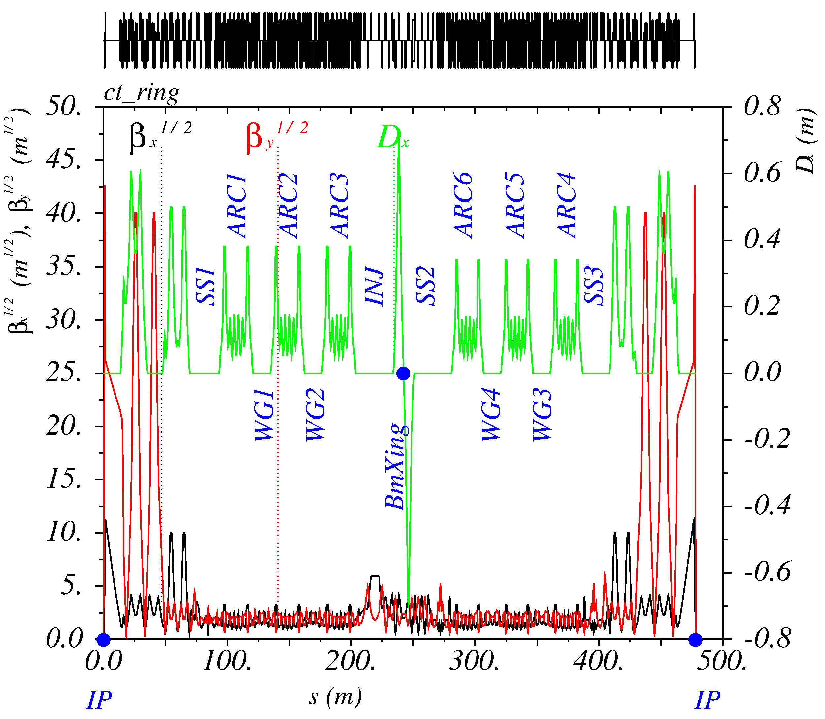
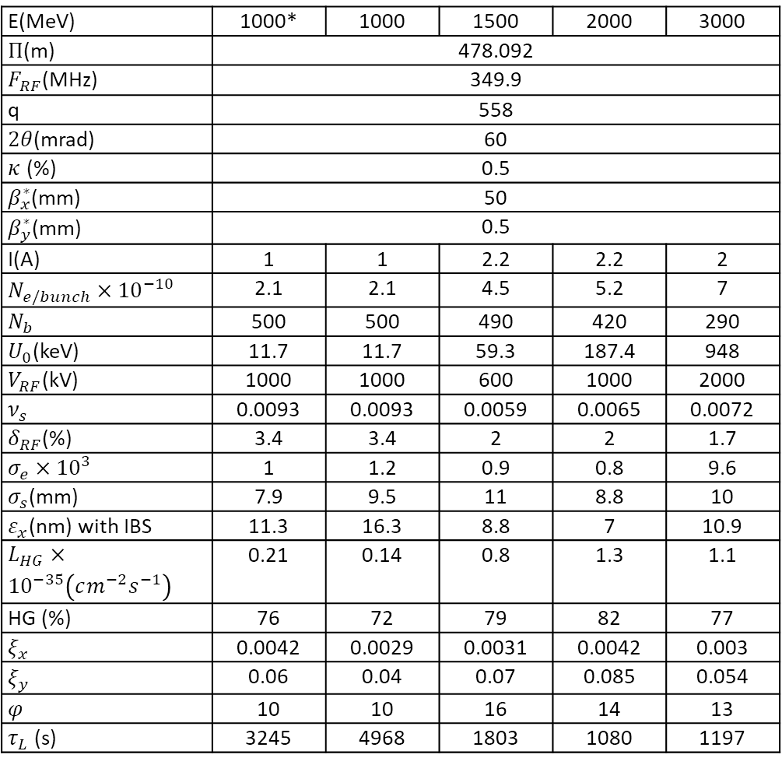
SCTF 2019
E(MeV) | 1000* | 1000 | 1500 | 2000 | 3000
$Π$(m) | 478.092
$F_{RF}$(MHz) | 349.9
q | 558
$2θ$(mrad) | 60
$κ$ (%) | 0.5
$β_{x}^{∗}$(mm) | 50
$β_{y}^{∗}$(mm) | 0.5
I(A) | 1 | 1 | 2.2 | 2.2 | 2
$N_{e/bunch}×{10}^{−10}$ | 2.1 | 2.1 | 4.5 | 5.2 | 7
$N_{b}$ | 500 | 500 | 490 | 420 | 290
$U_{0}$(keV) | 11.7 | 11.7 | 59.3 | 187.4 | 948
$V_{RF}$(kV) | 1000 | 1000 | 600 | 1000 | 2000
$ν_{s}$ | 0.0093 | 0.0093 | 0.0059 | 0.0065 | 0.0072
$δ_{RF}$(%) | 3.4 | 3.4 | 2 | 2 | 1.7
$σ_{e}×{10}^{3}$ | 1 | 1.2 | 0.9 | 0.8 | 9.6
$σ_{s}$(mm) | 7.9 | 9.5 | 11 | 8.8 | 10
$ε_{x}$(nm) with IBS | 11.3 | 16.3 | 8.8 | 7 | 10.9
$L_{HG}×{10}^{−35}\left(cm^{−2}s^{−1}\right)$ | 0.21 | 0.14 | 0.8 | 1.3 | 1.1
HG (%) | 76 | 72 | 79 | 82 | 77
$ξ_{x}$ | 0.0042 | 0.0029 | 0.0031 | 0.0042 | 0.003
$ξ_{y}$ | 0.06 | 0.04 | 0.07 | 0.085 | 0.054
$φ$ | 10 | 10 | 16 | 14 | 13
$τ_{L}$ (s) | 3245 | 4968 | 1803 | 1080 | 1197
K.Oide’s type of Interaction Region + CCSX
6 HMBA cells in the arcs

Slide 10
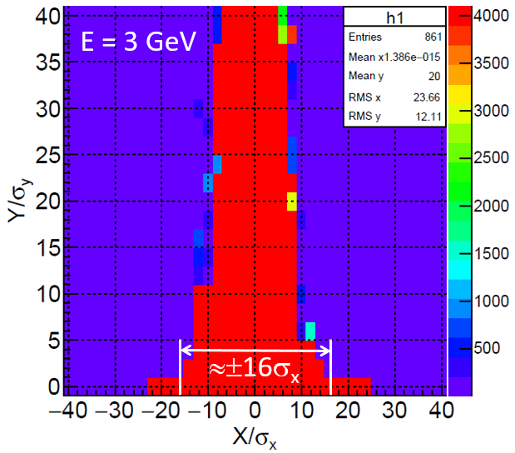
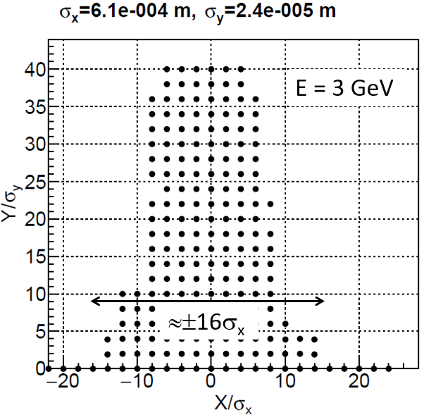
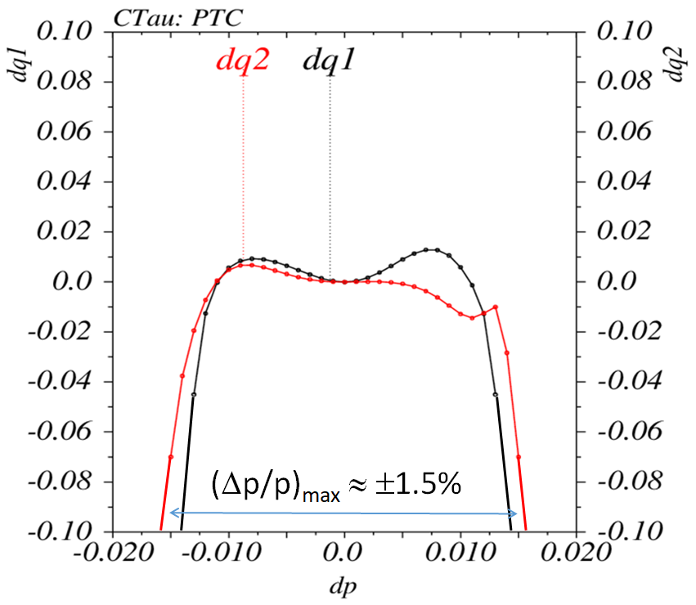

History of SCTF in Novosibirsk: 2019
$ε_{x}=10.7 nm$, $σ_{δ}=1×10^{−3}$
Sufficient on momentum DA with CRAB sextupole ON
Better, but still not enough off momentum DA
Small number of sextupoles
Notes:
27_1-2019.07.10-05.09.43_sextupole_chrom-6_da.str

Slide 11
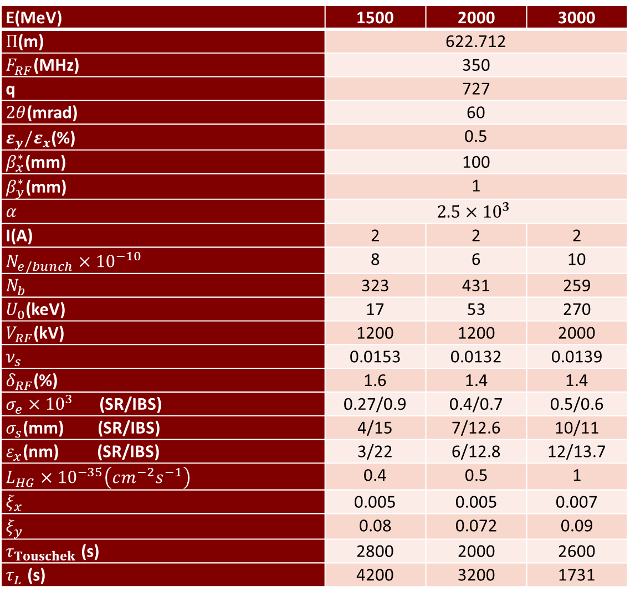
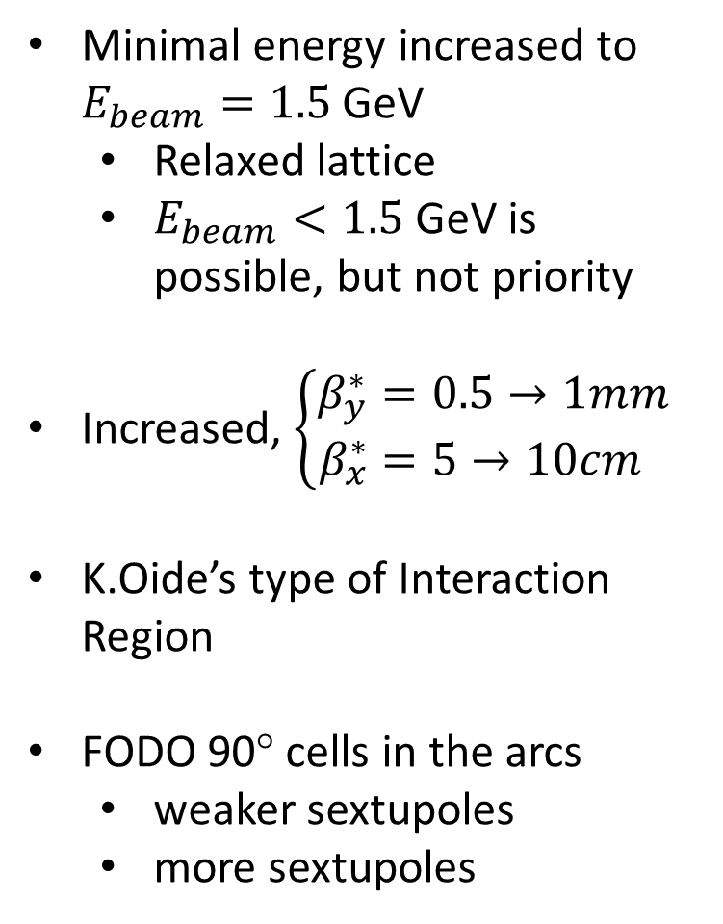
Parameters 2020
E(MeV) | 1500 | 2000 | 3000
$Π$(m) | 622.712
$F_{RF}$(MHz) | 350
q | 727
$2θ$(mrad) | 60
$ε_{y}/ε_{x}$(%) | 0.5
$β_{x}^{∗}$(mm) | 100
$β_{y}^{∗}$(mm) | 1
$α$ | $$2.5×{10}^{3}$$
I(A) | 2 | 2 | 2
$N_{e/bunch}×{10}^{−10}$ | 8 | 6 | 10
$N_{b}$ | 323 | 431 | 259
$U_{0}$(keV) | 17 | 53 | 270
$V_{RF}$(kV) | 1200 | 1200 | 2000
$ν_{s}$ | 0.0153 | 0.0132 | 0.0139
$δ_{RF}$(%) | 1.6 | 1.4 | 1.4
$σ_{e}×{10}^{3}$ (SR/IBS) | 0.27/0.9 | 0.4/0.7 | 0.5/0.6
$σ_{s}$(mm) (SR/IBS) | 4/15 | 7/12.6 | 10/11
$ε_{x}$(nm) (SR/IBS) | 3/22 | 6/12.8 | 12/13.7
$L_{HG}×{10}^{−35}\left(cm^{−2}s^{−1}\right)$ | 0.4 | 0.5 | 1
$ξ_{x}$ | 0.005 | 0.005 | 0.007
$ξ_{y}$ | 0.08 | 0.072 | 0.09
$τ_{Touschek}$ (s) | 2800 | 2000 | 2600
$τ_{L}$ (s) | 4200 | 3200 | 1731
Minimal energy increased to $E_{beam}=1.5$ GeV
  Relaxed lattice
  $E_{beam}<1.5$ GeV is possible, but not priority
Increased, $\left\{\begin{aligned}β_{y}^{∗}&=0.5→1mm \\ β_{x}^{∗}&=5→10cm\end{aligned}\right.$
K.Oide’s type of Interaction Region
FODO 90° cells in the arcs
  weaker sextupoles
  more sextupoles

Slide 12
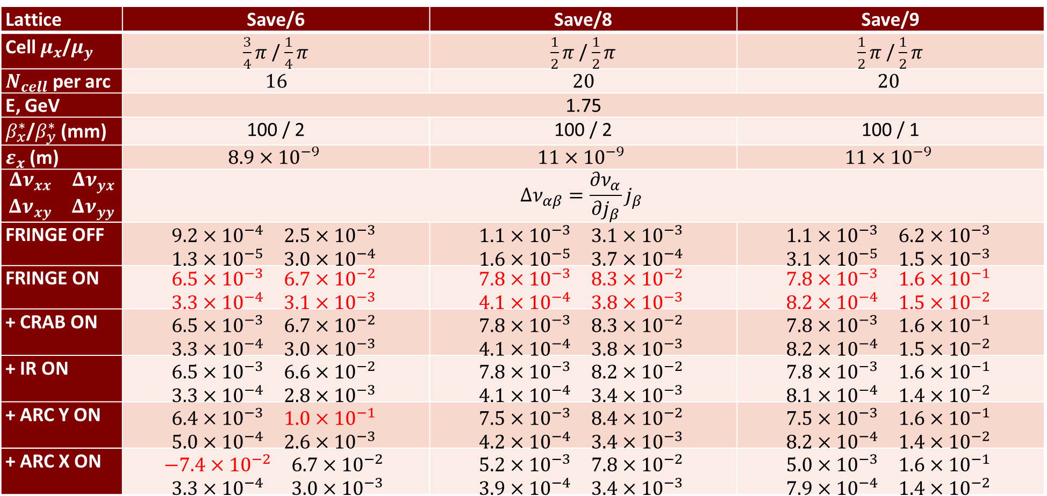
FODO cell comparison by detuning ($x_{0}=20σ_{x}, y_{0}=20σ_{y}$)
Lattice | Save/6 | Save/8 | Save/9
Cell $μ_{x}$/$μ_{y}$ | $\frac{3}{4}π$ / $\frac{1}{4}π$ | $\frac{1}{2}π$ / $\frac{1}{2}π$ | $\frac{1}{2}π$ / $\frac{1}{2}π$
$N_{cell}$ per arc | $$16$$ | $$20$$ | $$20$$
E, GeV | 1.75
$β_{x}^{∗}$/$β_{y}^{∗}$(mm) | 100 / 2 | 100 / 2 | 100 / 1
$ε_{x}$(m) | $$8.9×{10}^{−9}$$ | $$11×{10}^{−9}$$ | $$11×{10}^{−9}$$
$$\begin{matrix}Δν_{xx} & Δν_{yx} \\ Δν_{xy} & Δν_{yy}\end{matrix}$$ | $$Δν_{αβ}=\frac{∂ν_{α}}{∂j_{β}}j_{β}$$
FRINGE OFF | $$\begin{matrix}9.2×{10}^{−4} & 2.5×{10}^{−3} \\ 1.3×{10}^{−5} & 3.0×{10}^{−4}\end{matrix}$$ | $$\begin{matrix}1.1×{10}^{−3} & 3.1×{10}^{−3} \\ 1.6×{10}^{−5} & 3.7×{10}^{−4}\end{matrix}$$ | $$\begin{matrix}1.1×{10}^{−3} & 6.2×{10}^{−3} \\ 3.1×{10}^{−5} & 1.5×{10}^{−3}\end{matrix}$$
FRINGE ON | $$\begin{matrix}6.5×{10}^{−3} & 6.7×{10}^{−2} \\ 3.3×{10}^{−4} & 3.1×{10}^{−3}\end{matrix}$$ | $$\begin{matrix}7.8×{10}^{−3} & 8.3×{10}^{−2} \\ 4.1×{10}^{−4} & 3.8×{10}^{−3}\end{matrix}$$ | $$\begin{matrix}7.8×{10}^{−3} & 1.6×{10}^{−1} \\ 8.2×{10}^{−4} & 1.5×{10}^{−2}\end{matrix}$$
+ CRAB ON | $$\begin{matrix}6.5×{10}^{−3} & 6.7×{10}^{−2} \\ 3.3×{10}^{−4} & 3.0×{10}^{−3}\end{matrix}$$ | $$\begin{matrix}7.8×{10}^{−3} & 8.3×{10}^{−2} \\ 4.1×{10}^{−4} & 3.8×{10}^{−3}\end{matrix}$$ | $$\begin{matrix}7.8×{10}^{−3} & 1.6×{10}^{−1} \\ 8.2×{10}^{−4} & 1.5×{10}^{−2}\end{matrix}$$
+ IR ON | $$\begin{matrix}6.5×{10}^{−3} & 6.6×{10}^{−2} \\ 3.3×{10}^{−4} & 2.8×{10}^{−3}\end{matrix}$$ | $$\begin{matrix}7.8×{10}^{−3} & 8.2×{10}^{−2} \\ 4.1×{10}^{−4} & 3.4×{10}^{−3}\end{matrix}$$ | $$\begin{matrix}7.8×{10}^{−3} & 1.6×{10}^{−1} \\ 8.1×{10}^{−4} & 1.4×{10}^{−2}\end{matrix}$$
+ ARC Y ON | $$\begin{matrix}6.4×{10}^{−3} & 1.0×{10}^{−1} \\ 5.0×{10}^{−4} & 2.6×{10}^{−3}\end{matrix}$$ | $$\begin{matrix}7.5×{10}^{−3} & 8.4×{10}^{−2} \\ 4.2×{10}^{−4} & 3.4×{10}^{−3}\end{matrix}$$ | $$\begin{matrix}7.5×{10}^{−3} & 1.6×{10}^{−1} \\ 8.2×{10}^{−4} & 1.4×{10}^{−2}\end{matrix}$$
+ ARC X ON | $$\begin{matrix}−7.4×{10}^{−2} & 6.7×{10}^{−2} \\ 3.3×{10}^{−4} & 3.0×{10}^{−3}\end{matrix}$$ | $$\begin{matrix}5.2×{10}^{−3} & 7.8×{10}^{−2} \\ 3.9×{10}^{−4} & 3.4×{10}^{−3}\end{matrix}$$ | $$\begin{matrix}5.0×{10}^{−3} & 1.6×{10}^{−1} \\ 7.9×{10}^{−4} & 1.4×{10}^{−2}\end{matrix}$$

Slide 13
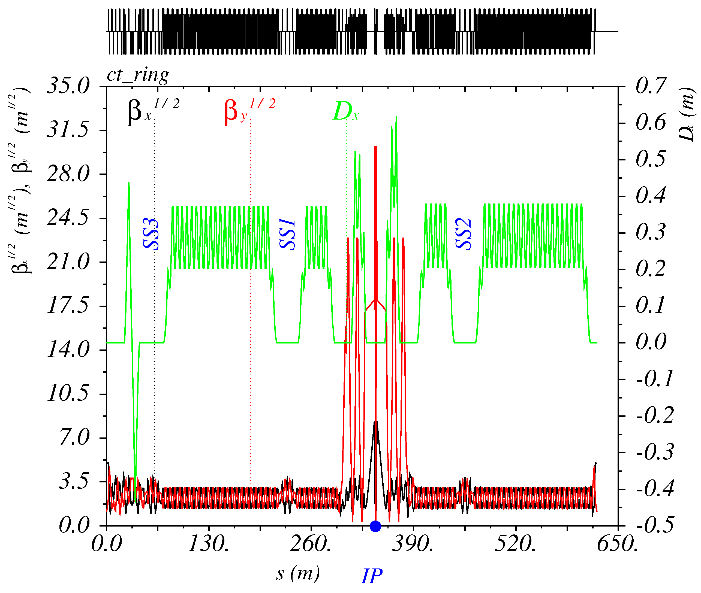
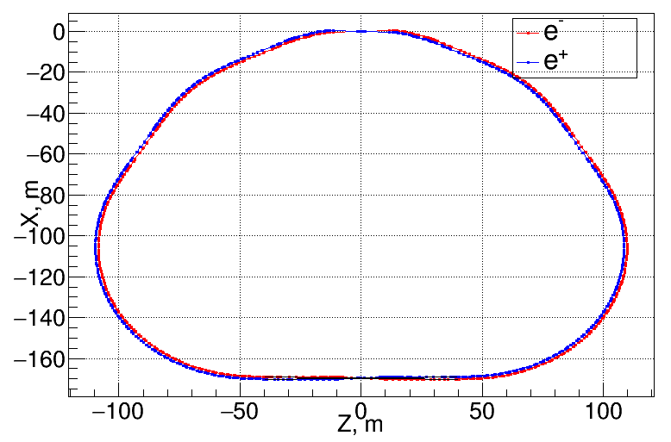
Lattice and layout
IP
Interaction Region
SS
SS
SS
Xing
Inj

Slide 14
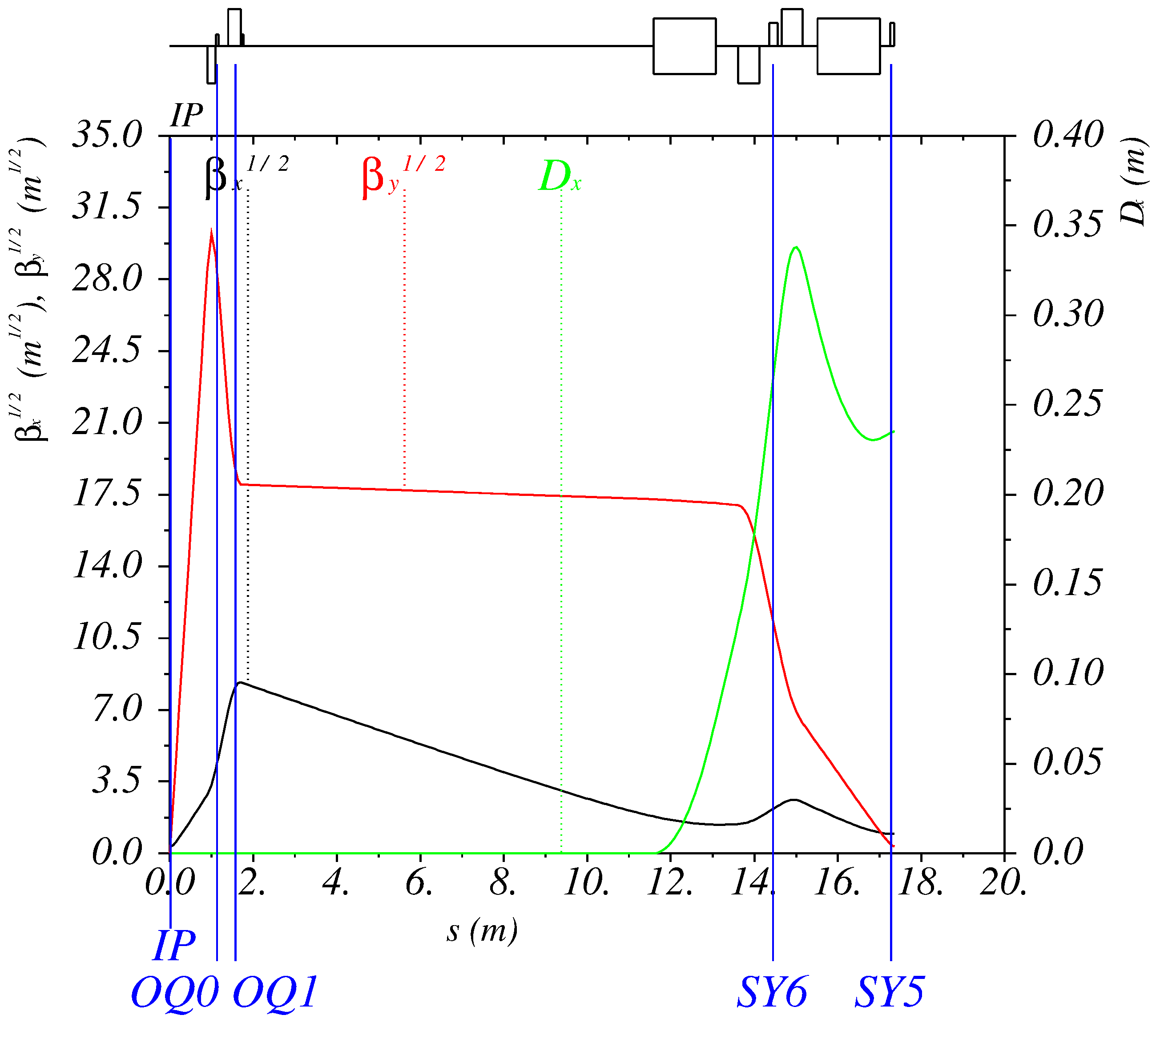
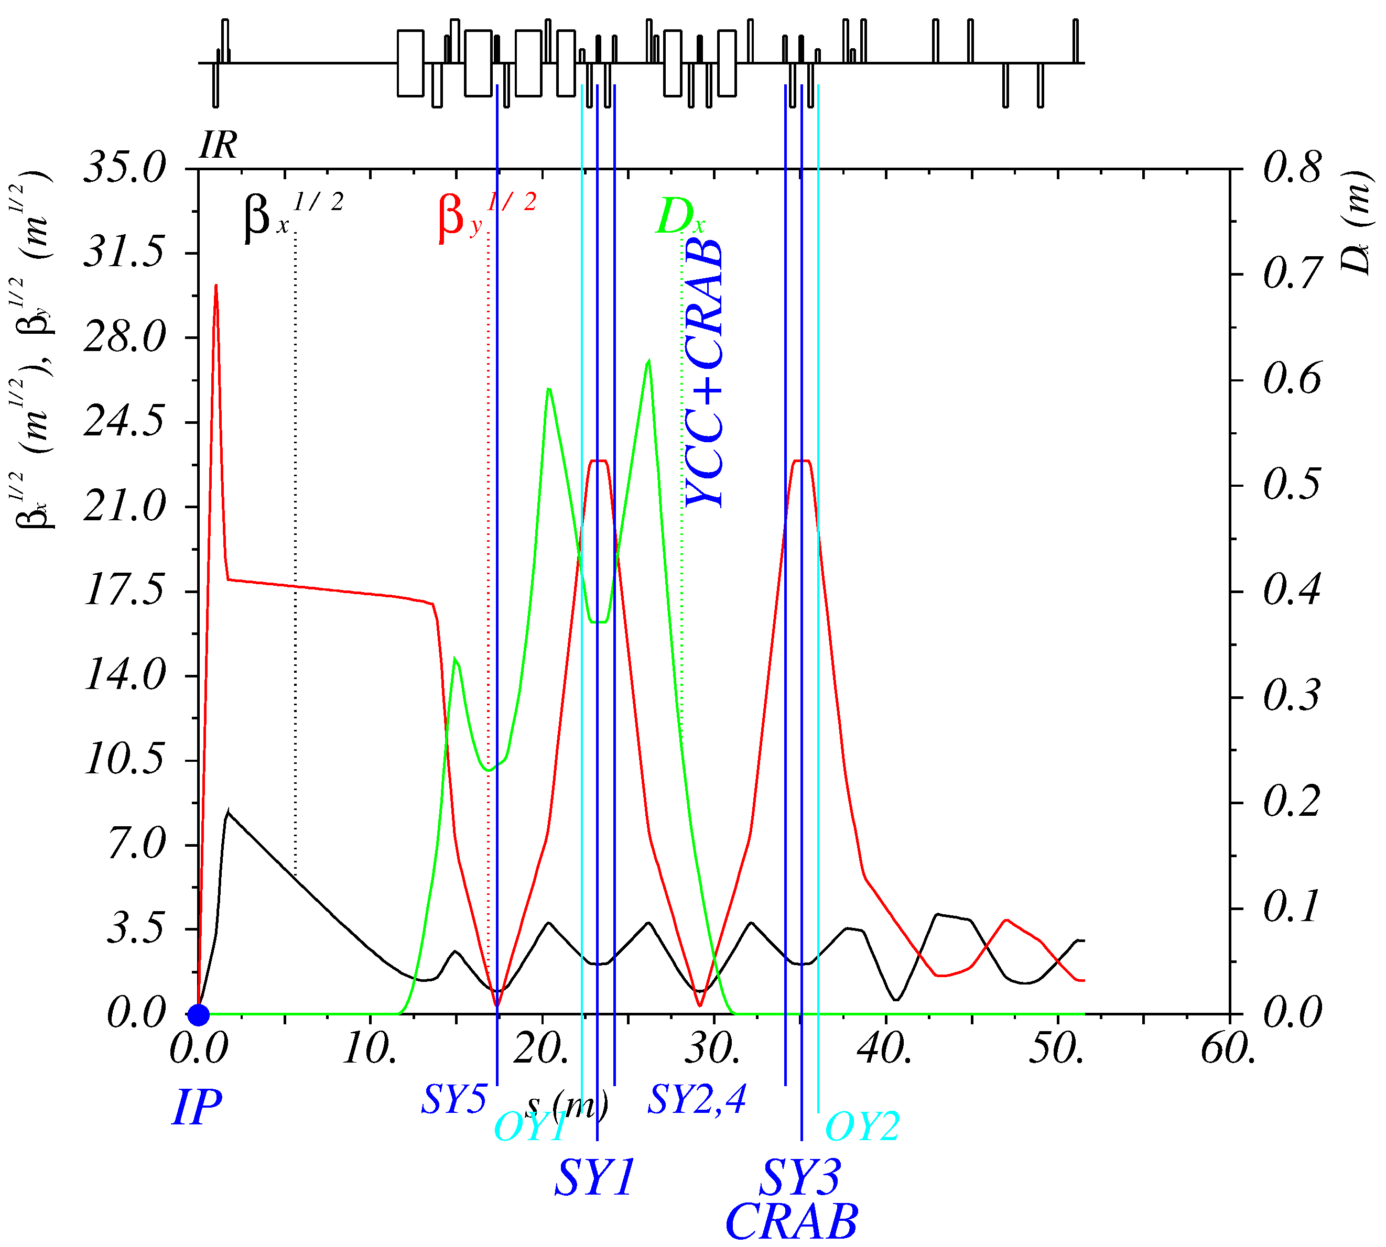
Interaction region

Slide 15
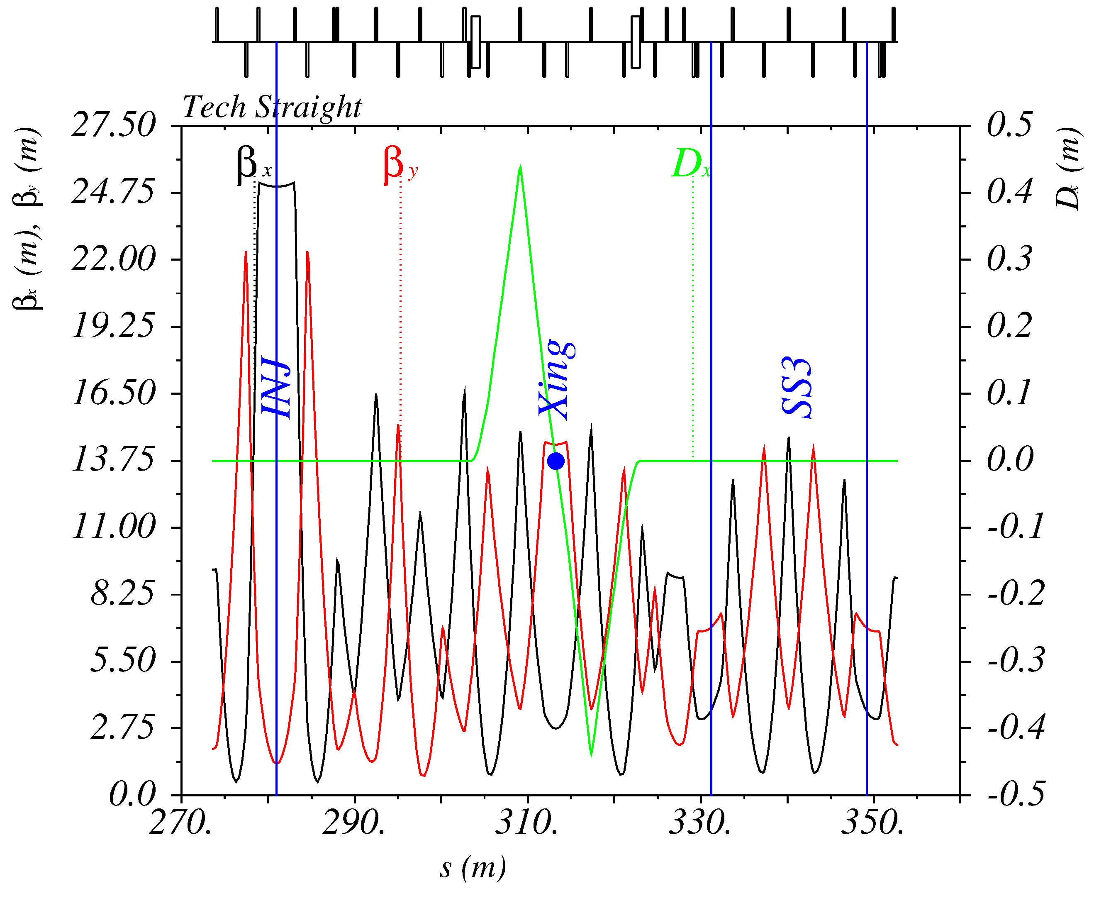
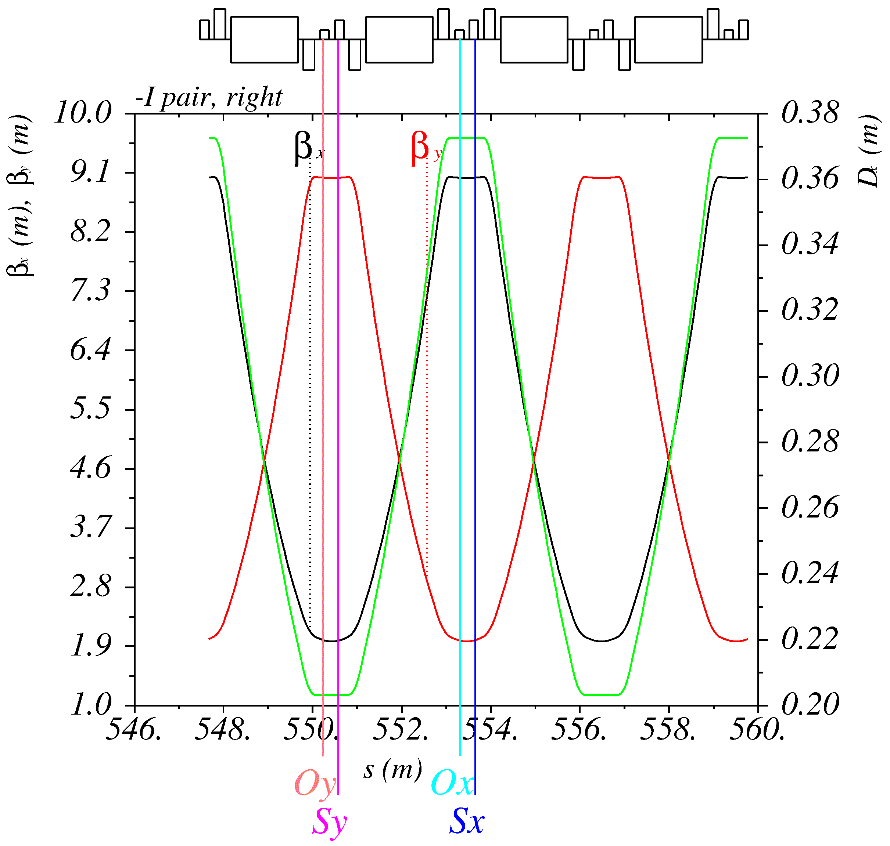
Straight and Arc sections
Straight
Arc: FODO 90° cells

Slide 16
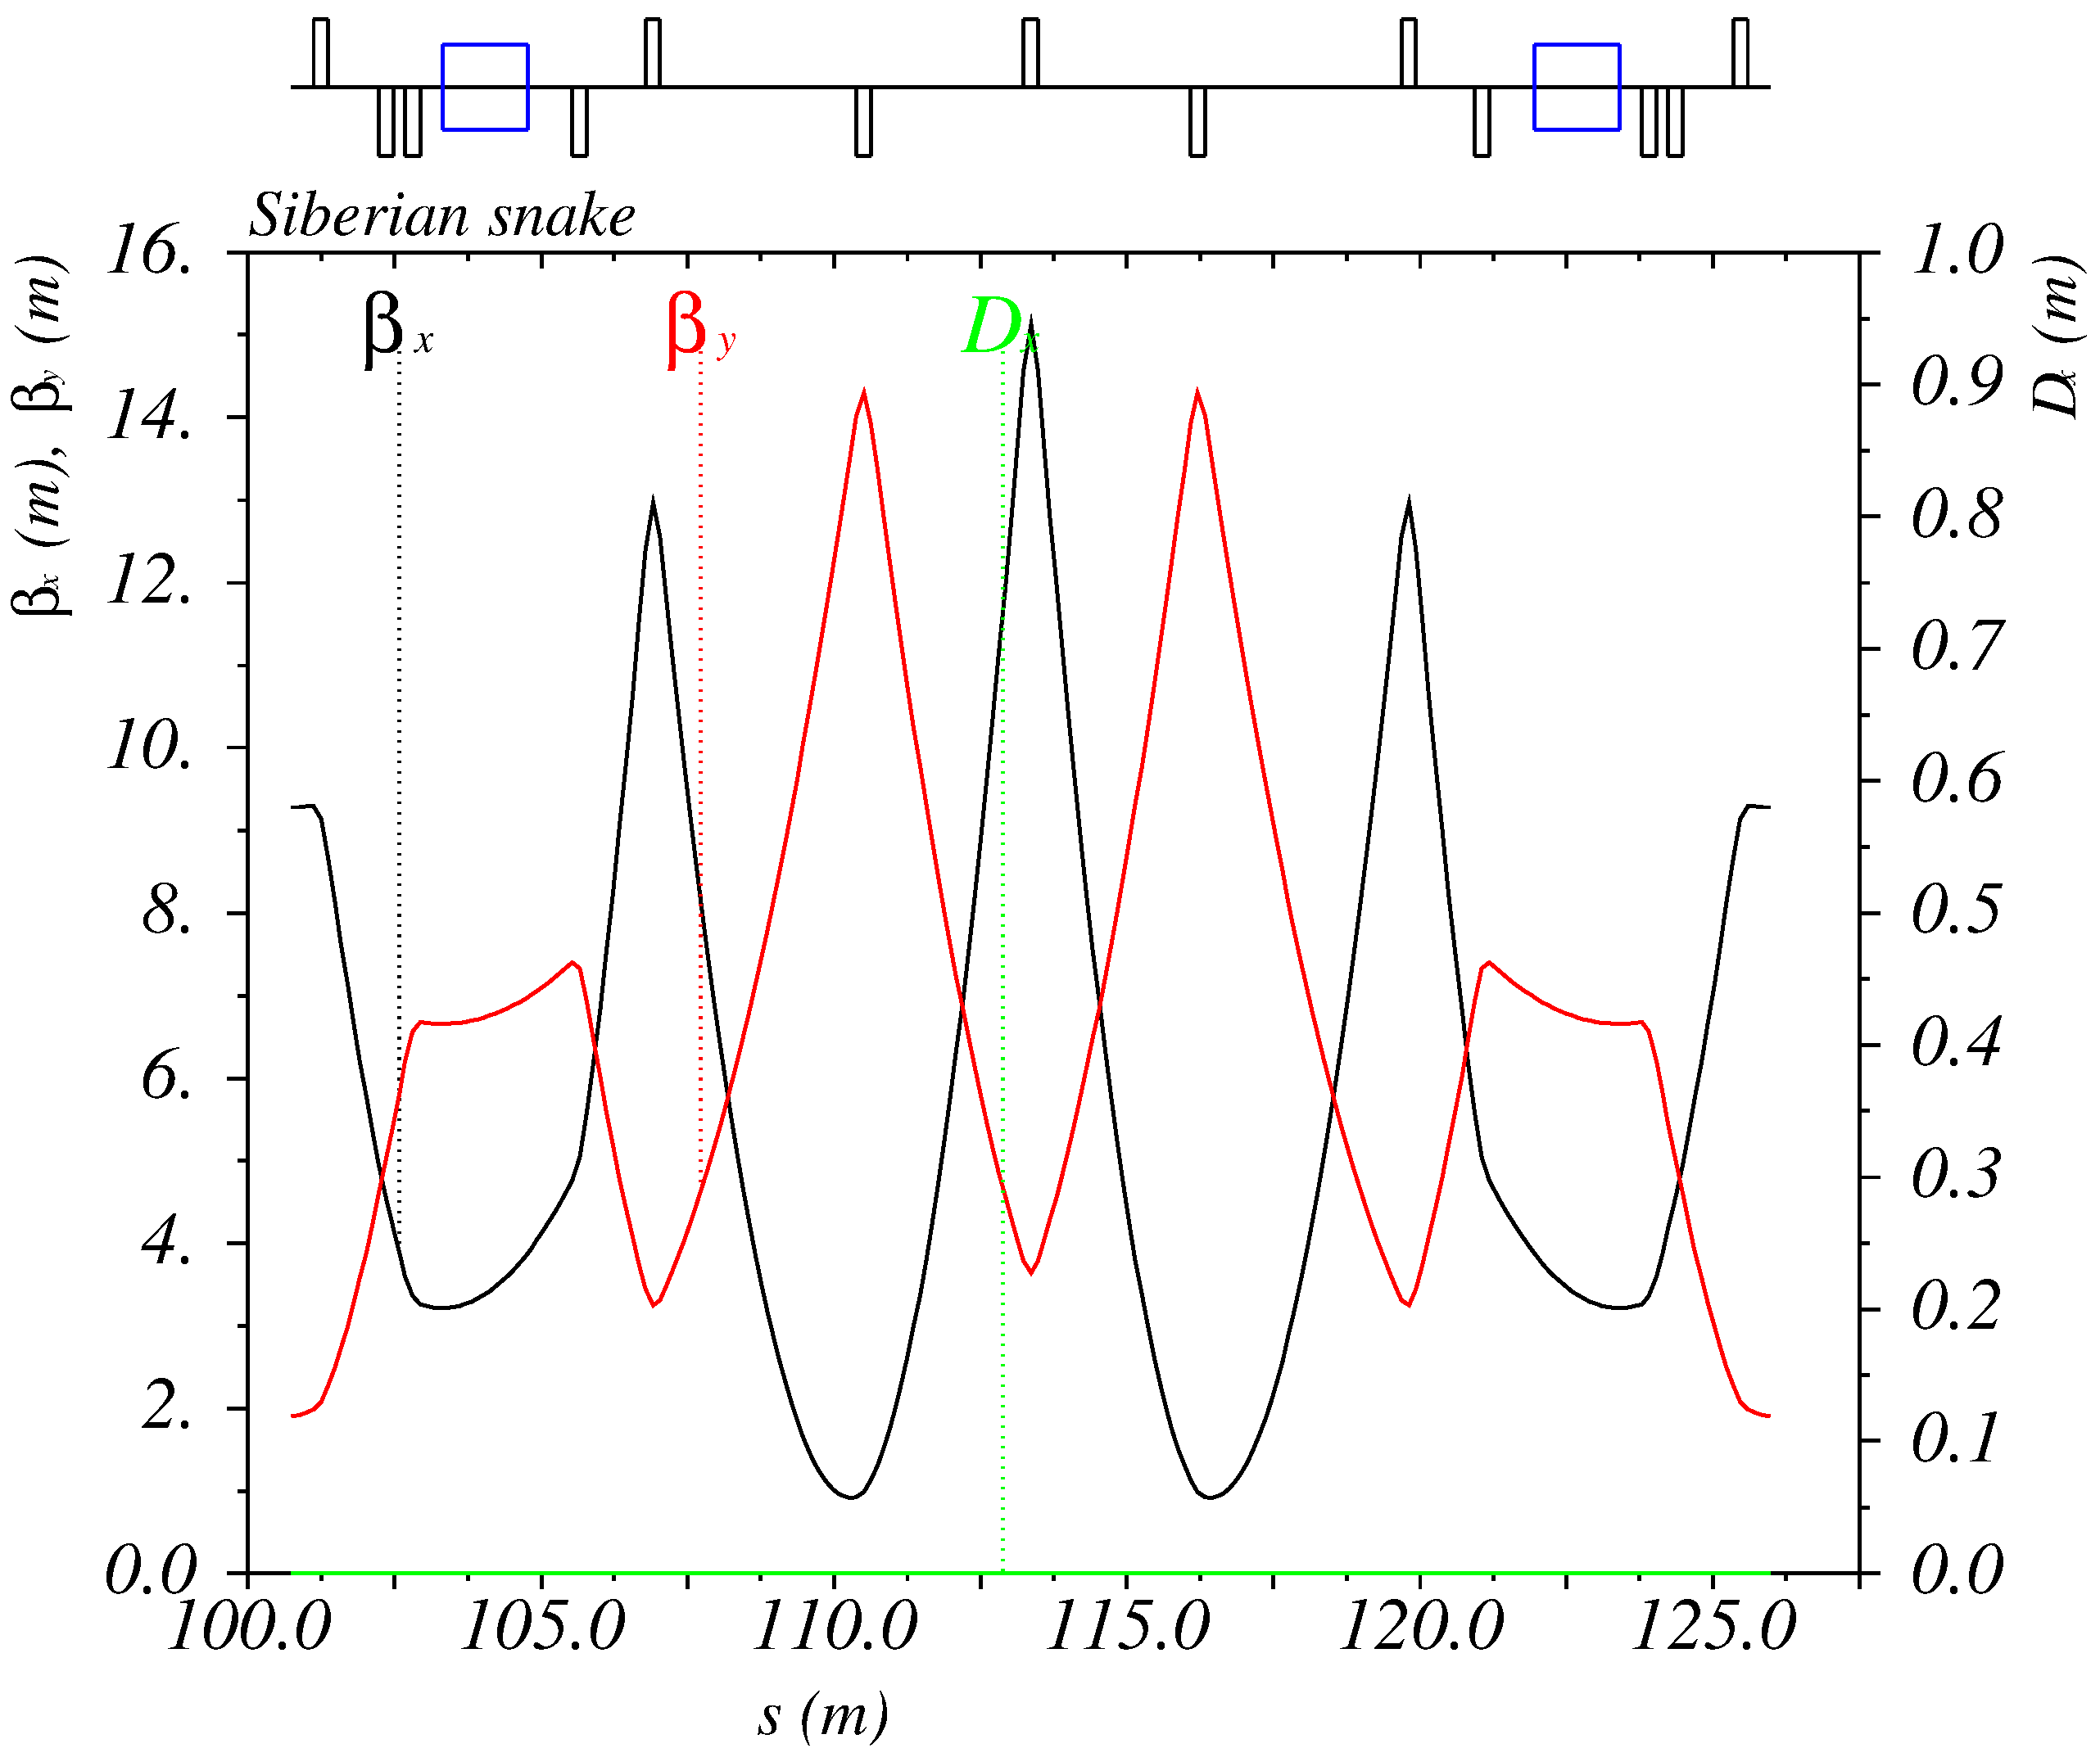
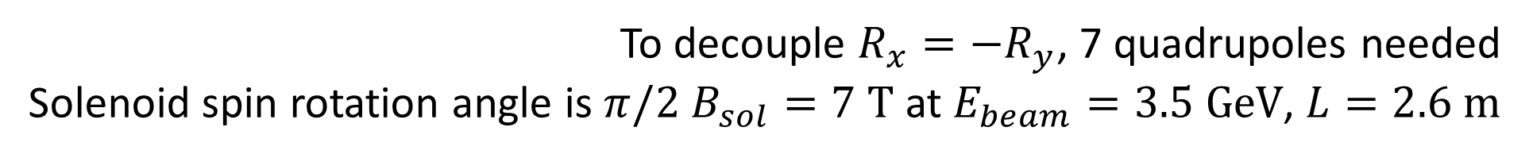
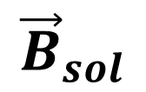
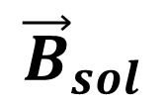
Siberian Snake
The goal is to provide longitudinal polarization at IP
$${\vec{B}}_{sol}$$
$${\vec{B}}_{sol}$$
120°
IP
SS2
SS1
120°
120°
SS3
To decouple $R_{x}=−R_{y}$, 7 quadrupoles needed
Solenoid spin rotation angle is $π/2$ $B_{sol}=7 \text{T}$ at $E_{beam}=3.5 \text{GeV}$, $L=2.6 \text{m}$

Slide 17
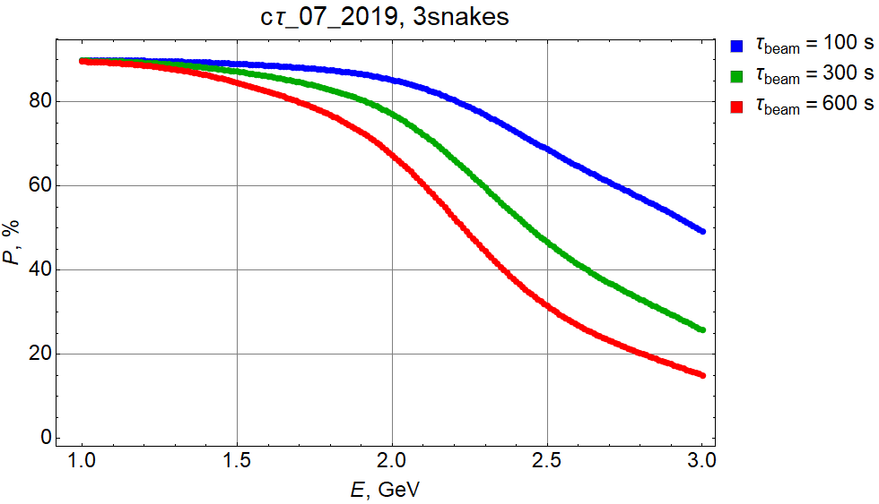
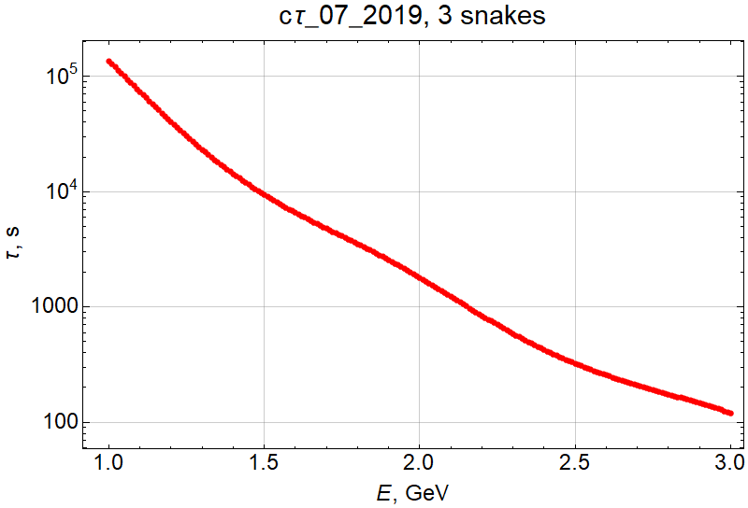
Longitudinal Polarization (number of snakes)
Particle replenishing time

Slide 18
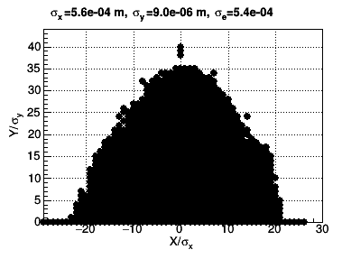
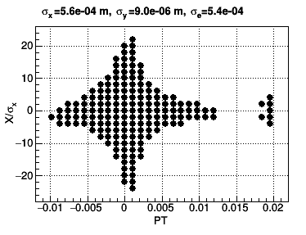
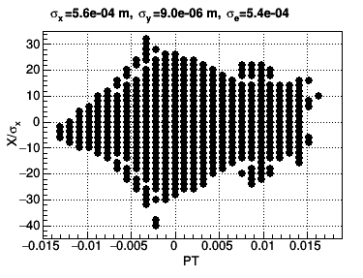
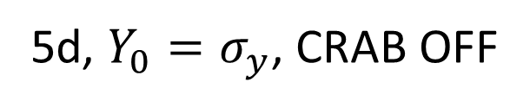


Nonlinear dynamics
4d, on momentum
5d, ${Y_{0}=σ}_{y}$, CRAB ON
5d, ${Y_{0}=σ}_{y}$, CRAB OFF
$ε_{x}=12.4 nm$, $σ_{δ}=0.5×10^{−3}$
Notes:
49-5: 2020.10.11-22.59.05_sextupole_chrom-5.str

Slide 19
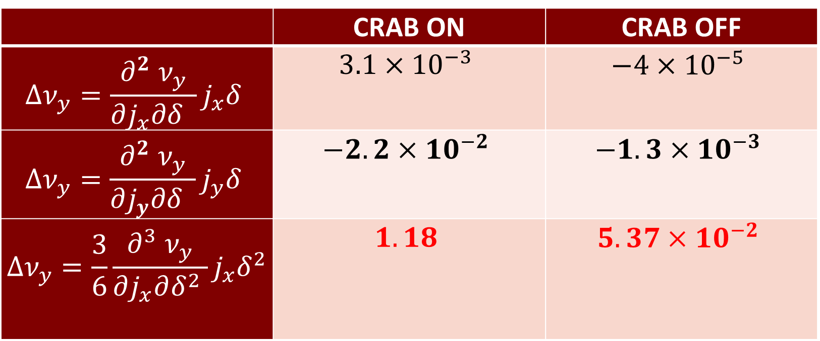
Detuning CRAB ON and OFF ($x_{0}=10σ_{x}, y_{0}=15σ_{y}, δ=1.5\%$)
 | CRAB ON | CRAB OFF
$$Δν_{y}=\frac{∂^{2} ν_{y}}{∂j_{x}∂δ }j_{x}δ$$ | $$3.1×{10}^{−3}$$ | $$−4×{10}^{−5}$$
$$Δν_{y}=\frac{∂^{2} ν_{y}}{∂j_{y}∂δ }j_{y}δ$$ | $$−2.2×{10}^{−2}$$ | $$−1.3×{10}^{−3}$$
$$Δν_{y}=\frac{3}{6}\frac{∂^{3} ν_{y}}{∂j_{x}∂δ^{2} }j_{x}δ^{2}$$ | $$1.18$$ | $$5.37×{10}^{−2}$$
Notes:
call,file="../2020.10.11-22.59.05_sextupole_chrom-5.str";

Slide 20
Final Focus trajectories

Slide 21
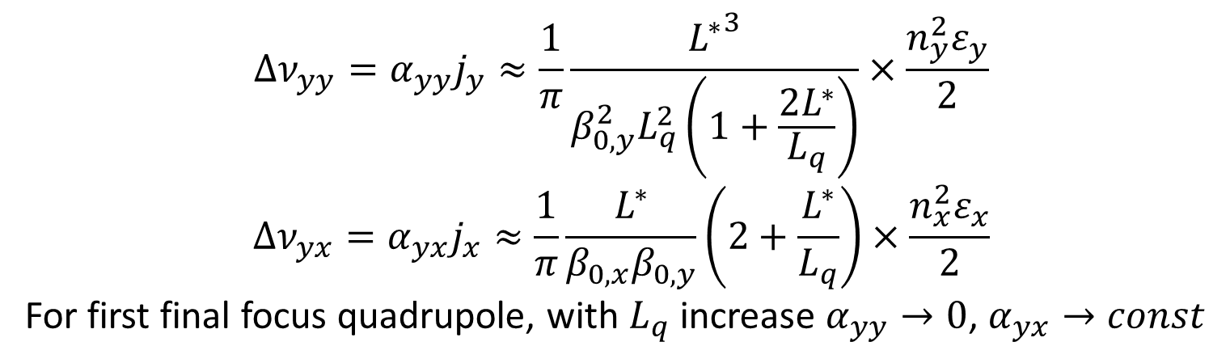
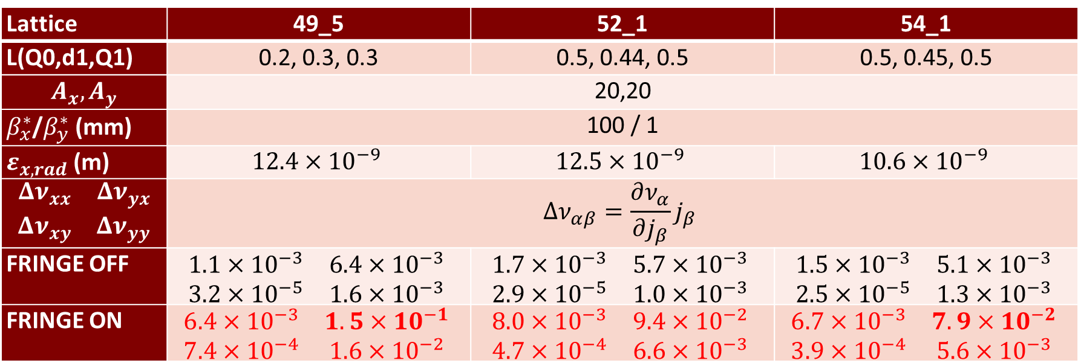
Optimization of the final doublet
$$Δν_{yy}=α_{yy}j_{y}≈\frac{1}{π}\frac{{L^{∗}}^{3}}{{β_{0,y}^{2}L}_{q}^{2}\left(1+\frac{2L^{∗}}{L_{q}}\right)}×\frac{n_{y}^{2}ε_{y}}{2}$$
$$Δν_{yx}=α_{yx}j_{x}≈\frac{1}{π}\frac{L^{∗}}{β_{0,x}β_{0,y}}\left(2+\frac{L^{∗}}{L_{q}}\right)×\frac{n_{x}^{2}ε_{x}}{2}$$
For first final focus quadrupole, with $L_{q}$ increase $α_{yy}→0$, $α_{yx}→const$
IP
L*
d1
Q0
Q1
Lattice | 49_5 | 52_1 | 54_1
L(Q0,d1,Q1) | 0.2, 0.3, 0.3 | 0.5, 0.44, 0.5 | 0.5, 0.45, 0.5
$$A_{x}, A_{y}$$ | 20,20
$β_{x}^{∗}$/$β_{y}^{∗}$(mm) | 100 / 1
$ε_{x, rad}$(m) | $$12.4×{10}^{−9}$$ | $$12.5×{10}^{−9}$$ | $$10.6×{10}^{−9}$$
$$\begin{matrix}Δν_{xx} & Δν_{yx} \\ Δν_{xy} & Δν_{yy}\end{matrix}$$ | $$Δν_{αβ}=\frac{∂ν_{α}}{∂j_{β}}j_{β}$$
FRINGE OFF | $$\begin{matrix}1.1×{10}^{−3} & 6.4×{10}^{−3} \\ 3.2×{10}^{−5} & 1.6×{10}^{−3}\end{matrix}$$ | $$\begin{matrix}1.7×{10}^{−3} & 5.7×{10}^{−3} \\ 2.9×{10}^{−5} & 1.0×{10}^{−3}\end{matrix}$$ | $$\begin{matrix}1.5×{10}^{−3} & 5.1×{10}^{−3} \\ 2.5×{10}^{−5} & 1.3×{10}^{−3}\end{matrix}$$
FRINGE ON | $$\begin{matrix}6.4×{10}^{−3} & 1.5×{10}^{−1} \\ 7.4×{10}^{−4} & 1.6×{10}^{−2}\end{matrix}$$ | $$\begin{matrix}8.0×{10}^{−3} & 9.4×{10}^{−2} \\ 4.7×{10}^{−4} & 6.6×{10}^{−3}\end{matrix}$$ | $$\begin{matrix}6.7×{10}^{−3} & 7.9×{10}^{−2} \\ 3.9×{10}^{−4} & 5.6×{10}^{−3}\end{matrix}$$
Notes:
call,file="../2020.10.11-22.59.05_sextupole_chrom-5.str";

Slide 22
New Final Focus trajectories

Slide 23
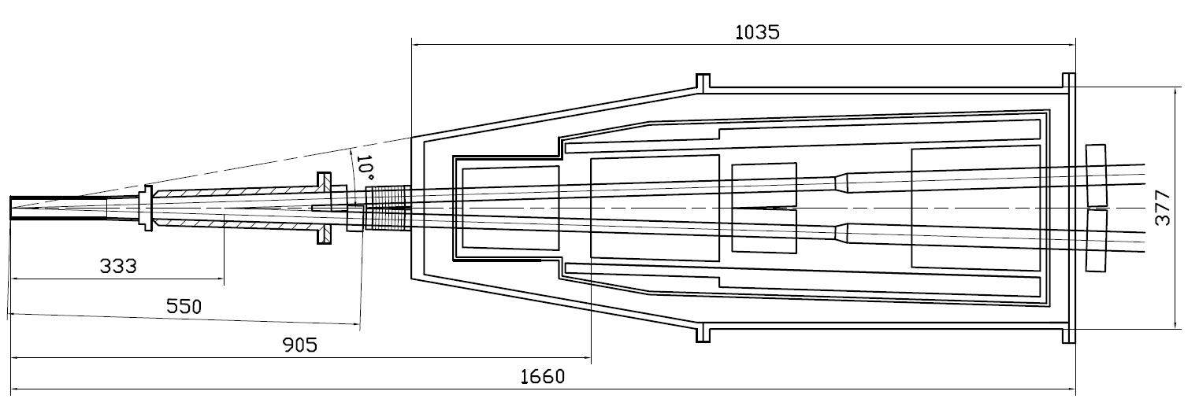
Machine-detector interface
Compensating solenoid
Gradients for 3 GeV
Be-tube ±150 mm,
∅30 mm, cooled
QD0, 200 mm
–100 Т/m
QF1, 200 mm
70 Т/m
Corr. coils
Screening solenoid
BPMs
Y-chamber,
cooled
BPMs
e+
IP
∅ 417
e-
L* =
FF vacuum chamber
Cryostate with FF magnets

Slide 24
Machine-detector interface

Slide 25
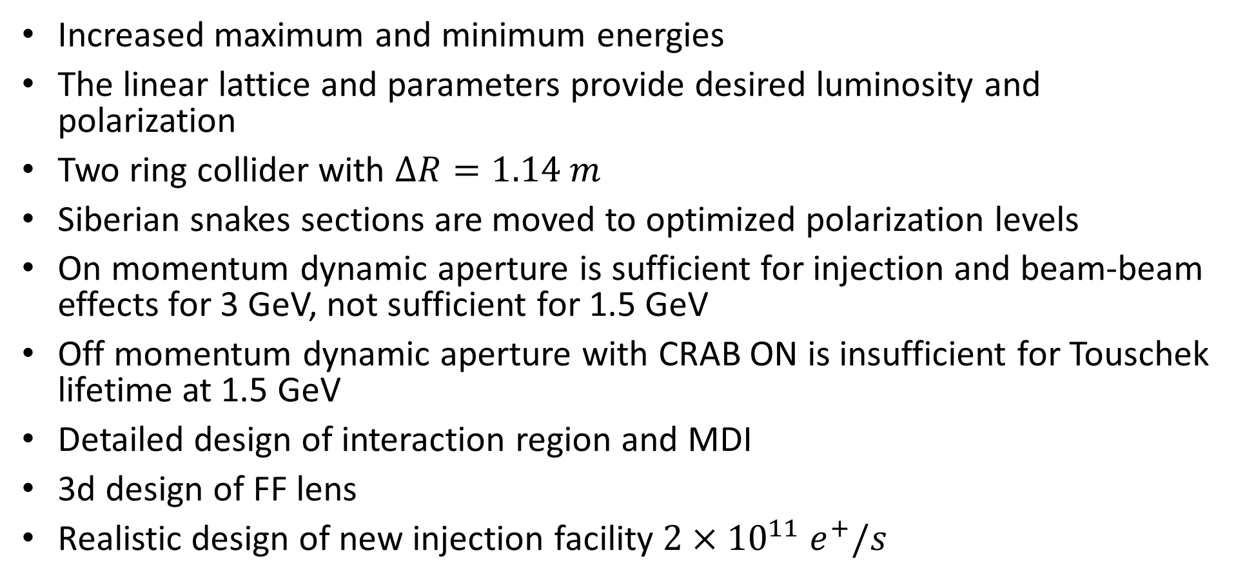
Conclusion
Increased maximum and minimum energies
The linear lattice and parameters provide desired luminosity and polarization
Two ring collider with $ΔR=1.14 m$
Siberian snakes sections are moved to optimized polarization levels
On momentum dynamic aperture is sufficient for injection and beam-beam effects for 3 GeV, not sufficient for 1.5 GeV
Off momentum dynamic aperture with CRAB ON is insufficient for Touschek lifetime at 1.5 GeV
Detailed design of interaction region and MDI
3d design of FF lens
Realistic design of new injection facility $2×{10}^{11} e^{+}/s$

