Slide 1



Mass Unspecific Supervised Tagging (MUST) for boosted jets
João Seabra
Departamento de Física and CFTP, Instituto Superior Técnico, Lisboa
IAS Program on High Energy Physics (HEP 2021)
21st of January 2021
Based on work made in collaboration with: Juan A. Aguilar-Saavedra and Filipe R. Joaquim
arXiv:2008.12792 [hep-ph] (to appear in JHEP)

Slide 2
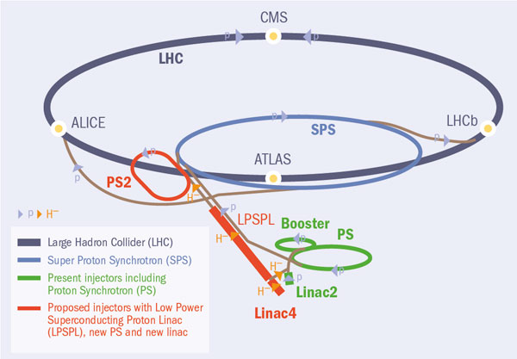

Motivation
In the decades to come, the high-energy frontier of particle physics will continue to be explored at the Large Hadron Collider (LHC);
Most jets stem from Quantum Chromodynamics (QCD) processes...
...but when sufficiently boosted, the hadronic decays of Standard Model (SM) particles like the W, Z and Higgs bosons and the top quark also yield jets;
W/Z/H
Hadronic decays of new particles can produce jets too;
t
W
A lot of theoretical frameworks beyond the SM predict multi-jet signals originated from direct or cascade decays of yet unseen particles.
e.g. J. A. Aguilar-Saavedra, F. R. Joaquim; JHEP 01 (2016) 183
K. S. Agashe et al.; JHEP 05 (2017) 78
A
S
Therefore...
A
2

Slide 3
Motivation
Jet identification tools are crucial for new physics searches at the LHC.
Searches for new gauge-bosons, scalars and spin-2 particles
Searches for vector-like quarks
A. M. Sirunyan et al. [CMS]; JHEP 08 (2017) 29
A. M. Sirunyan et al. [CMS]; JHEP 09 (2018) 148
M. Aaboud et al. [ATLAS]; Phys. Lett. B 781 (2018) 327
M. Aaboud et al. [ATLAS]; Phys. Lett. B 788 (2019) 316
M. Aaboud et al. [ATLAS]; Phys. Lett. B 783 (2018) 392
M. Aaboud et al. [ATLAS]; Phys. Rev. D 98, 3 (2018) 32015
A. M. Sirunyan et al. [CMS]; Phys. Rev. D 99, 1 (2019) 12005
A. M. Sirunyan et al. [CMS]; Eur. Phys. J. C 80, 3 (2020) 237
A. M. Sirunyan et al. [CMS]; Phys. Rev. D 100, 11 (2019) 112007
G. Aad et al. [ATLAS]; Eur. Phys. J. C 80, 12 (2020) 1165
A. M. Sirunyan et al. [CMS]; Phys. Lett. B 781 (2018) 574
A. M. Sirunyan et al. [CMS]; Eur. Phys. J. C 79 (2019) 90
M. Aaboud et al. [ATLAS]; JHEP 05 (2019) 41
A. M. Sirunyan et al. [CMS]; Eur. Phys. J. C 79, 3 (2020) 36
Searches for dark-matter
A. M. Sirunyan et al. [CMS]; Eur. Phys. J. C 79, 3 (2019) 280
3

Slide 4



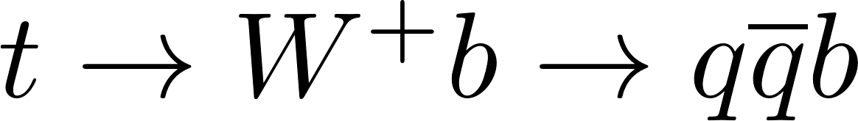
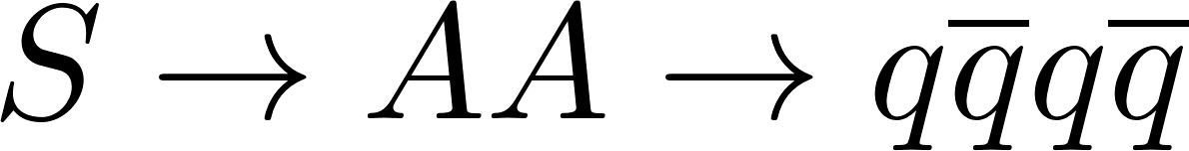
Jet Identification
It requires:
Quantifying its mass, usually after applying some grooming;
Infering the number of quarks and gluons clustered inside it (prongs).
Tagging
Examples:
Processes | Prongness | Classification
QCD | One-pronged (1P) | Background
 | Two-pronged (2P) | Signal
 | Three-pronged (3P)
 | Four-pronged (4P)
Here, this procedure relies on the training of Neural Networks (NNs).
4

Slide 5
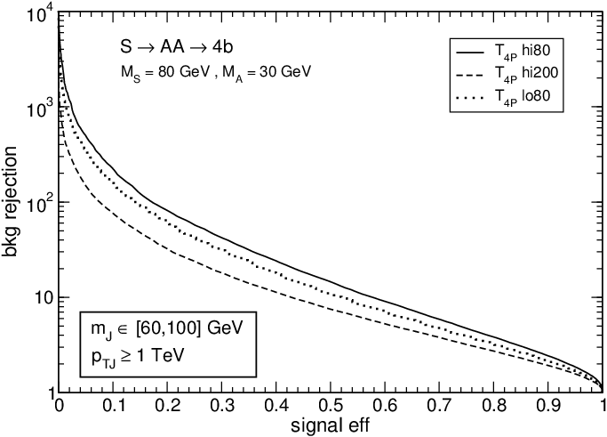

Mass Decorrelation
The mass of a jet and the variables that encode its substructure are usually correlated;
The mass decorrelation methods employed so far in supervised taggers leave a residual dependence of the results on the jet mass and transverse momentum training ranges. Consequently...
Their performance drops when applied to kinematical regions different from those used to train them.
J. A. Aguilar-Saavedra, B. Zaldívar, Eur. Phys. J. C 80, 6 (2020) 530
?
?
Solution
5

Slide 6
Our goals
Build generic taggers, sensitive to any kind of jets
Excellent performance for all jet masses
Mass decorrelation
6

Slide 7
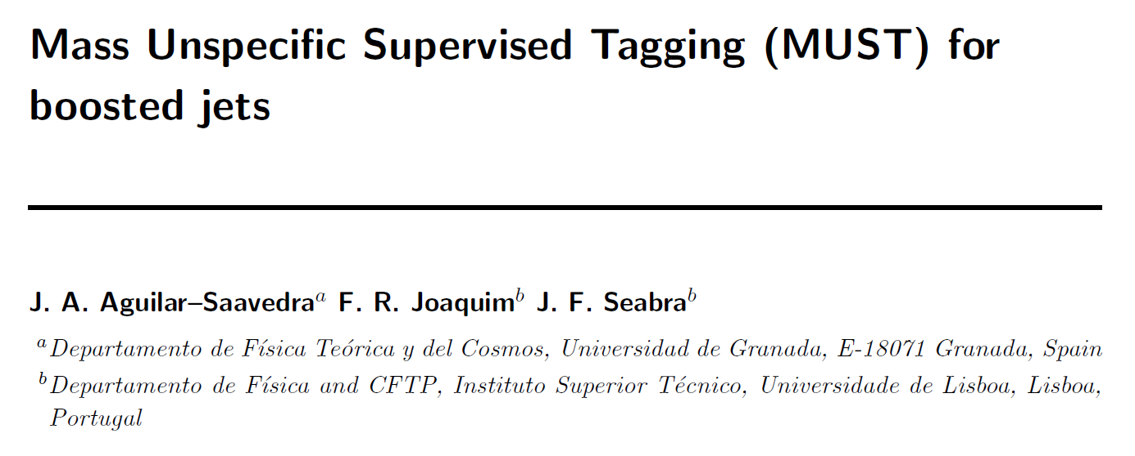
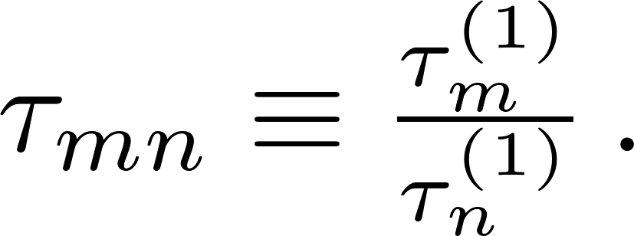
Mass Unspecific Supervised Tagging
Considering the jet mass and its transverse momentum varying over wide ranges, we make them input variables of a multivariate tool, together with jet substructure observables.
Our MUST-inspired jet taggers have 19 input variables:
17 N-subjettiness observables which characterise jet substructure,
Jet’s mass, m_{J} ;
Jet’s transverse momentum, p_{T} .
All those variables should be standardised according to the SM background distributions.
Note:
Ratios of N-subjettiness variables will be denoted as
7

Slide 8
Event Simulation and Reconstruction
Parton-level event generation
MadGraph
(Background samples)
Protos
(Signal samples)
Hadronisation
Pythia
Detector simulation
Delphes
(CMS card)
Jet reconstruction
FastJet
(anti-k_{T} algorithm with R=0.8)
8

Slide 9



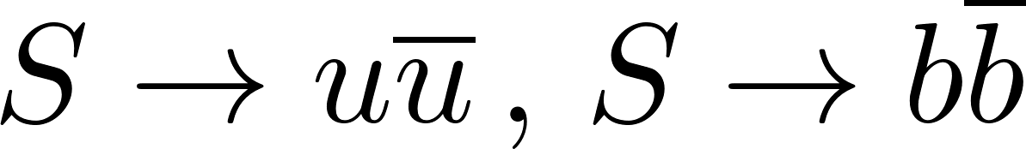
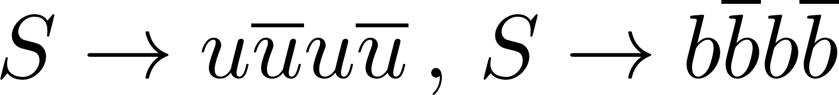
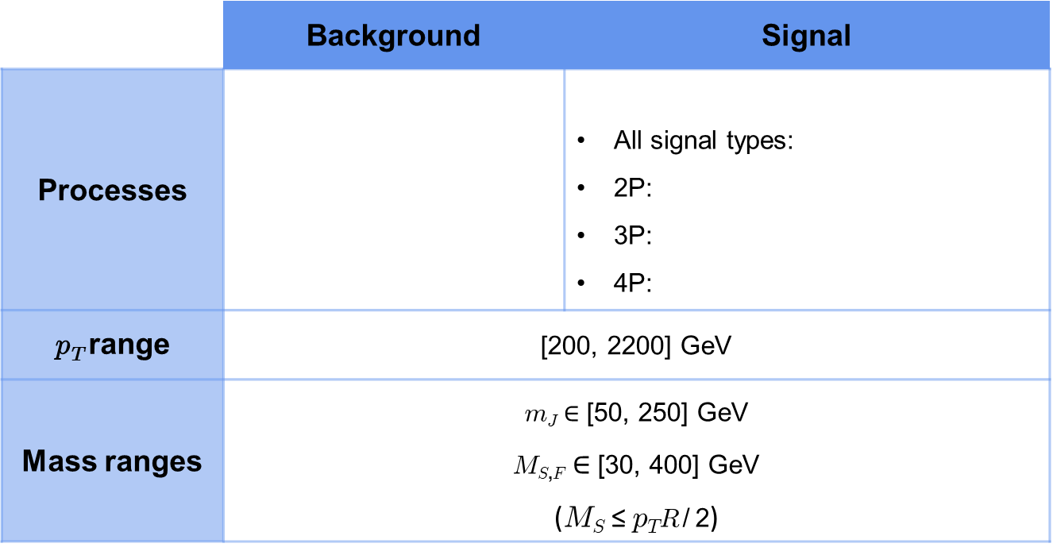
Training set Generation
 | Background | Signal
Processes |  | All signal types: 2P: 3P: 4P:
p_{T} range | [200, 2200] GeV
Mass ranges | m_{J} $∈$ [50, 250] GeV M_{S,F} $∈$ [30, 400] GeV (M_{S} ≤ p_{T} R / 2)
The decays of S and F are implemented with a flat matrix element (to achieve generic taggers).
9

Slide 10
Tagger Properties
Name | Types of events used in training | NN architecture | Output Layer
GenT | Background + 2P + 3P + 4P | 2048 x 128 | Sigmoid
GenT_{2P} | Background + 2P | 1028 x 64 | Sigmoid
GenT_{3P} | Background + 3P | 1028 x 64 | Sigmoid
GenT_{4P} | Background + 4P | 1028 x 64 | Sigmoid
Prongness selection tagger | 2P + 3P + 4P | 2048 x 128 | Softmax
To evaluate the performance of GenT, GenT_{2P}, GenT_{3P} and GenT_{4P} we use the Area Under the ROC curve (AUC) whereas the Prongness selection tagger is evaluated by measuring its accuracy.
All our NNs use the Rectified Linear Unit (ReLU) activation function;
The optimisation of GenT, GenT_{2P}, GenT_{3P} and GenT_{4P} (Prongness selection tagger) rely on the binary (categorical) cross-entropy;
The Adam optimiser is applied to all NNs.
10

Slide 11
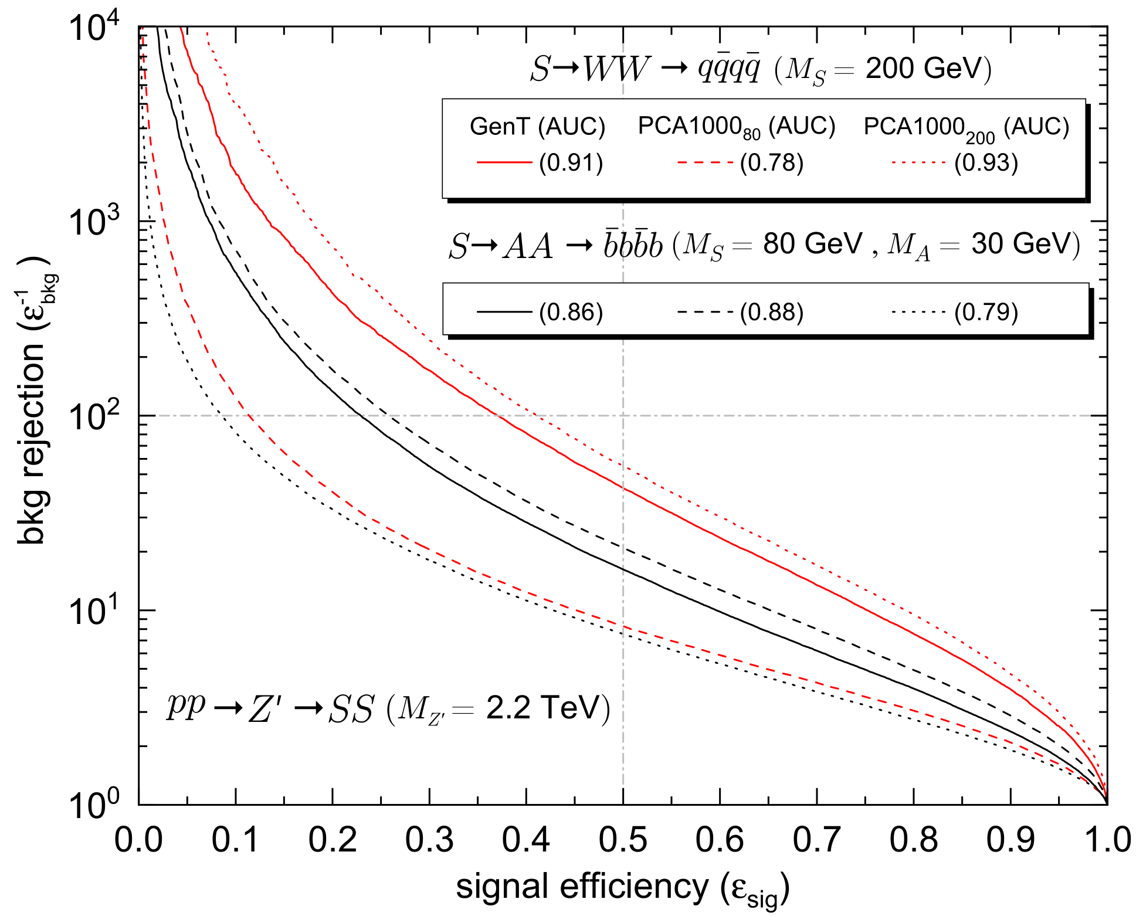
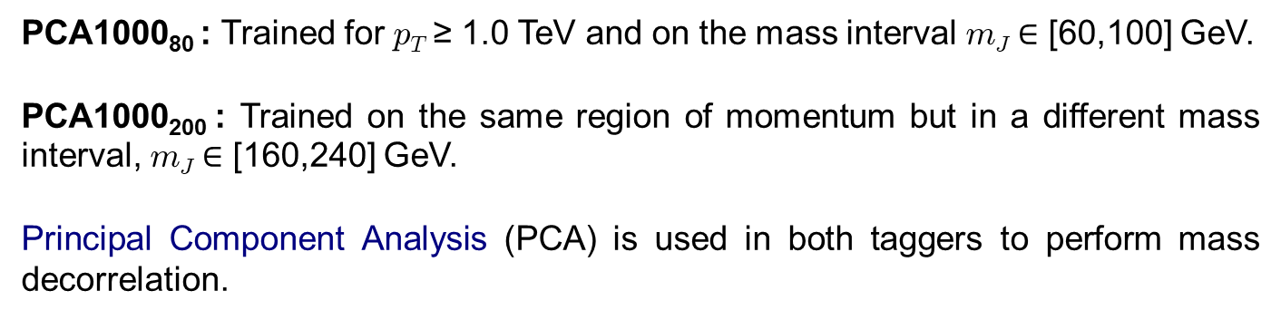


Benefit of MUST taggers
Non-MUST taggers:
PCA1000₈₀ : Trained for p_{T} ≥ 1.0 TeV and on the mass interval m_{J} $∈$ [60,100] GeV.
PCA1000₂₀₀ : Trained on the same region of momentum but in a different mass interval, m_{J} $∈$ [160,240] GeV.
Principal Component Analysis (PCA) is used in both taggers to perform mass decorrelation.
These taggers perform slightly better on a mass region close to the one where they were trained...
... but are much less efficient when applied to masses out of the training region.
11

Slide 12
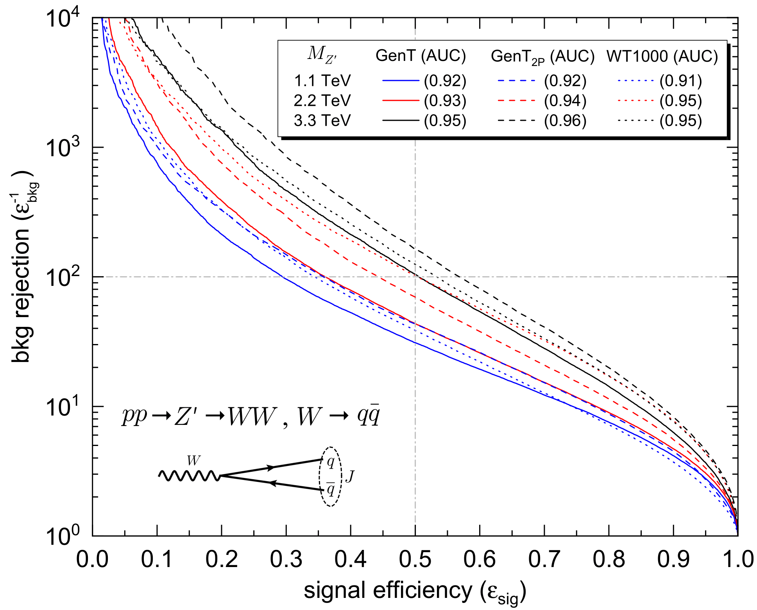
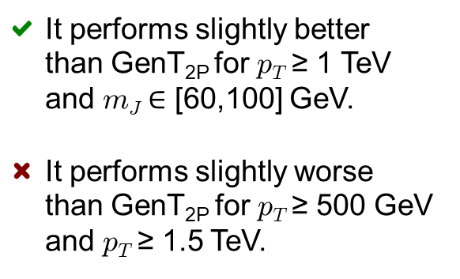
Benefit of MUST taggers
Non-MUST tagger:
WT1000: PCA-decorrelated tagger trained with W jets obtained from Z’ → WW (M_{Z’} = 2.2 TeV) and QCD jets with p_{T} ≥ 1 TeV and m_{J} $∈$ [60,100] GeV.
It performs slightly better than GenT_{2P} for p_{T} ≥ 1 TeV and m_{J} $∈$ [60,100] GeV.
It performs slightly worse than GenT_{2P} for p_{T} ≥ 500 GeV and p_{T} ≥ 1.5 TeV.
GenT_{2P} is nearly optimal for W jets
12

Slide 13
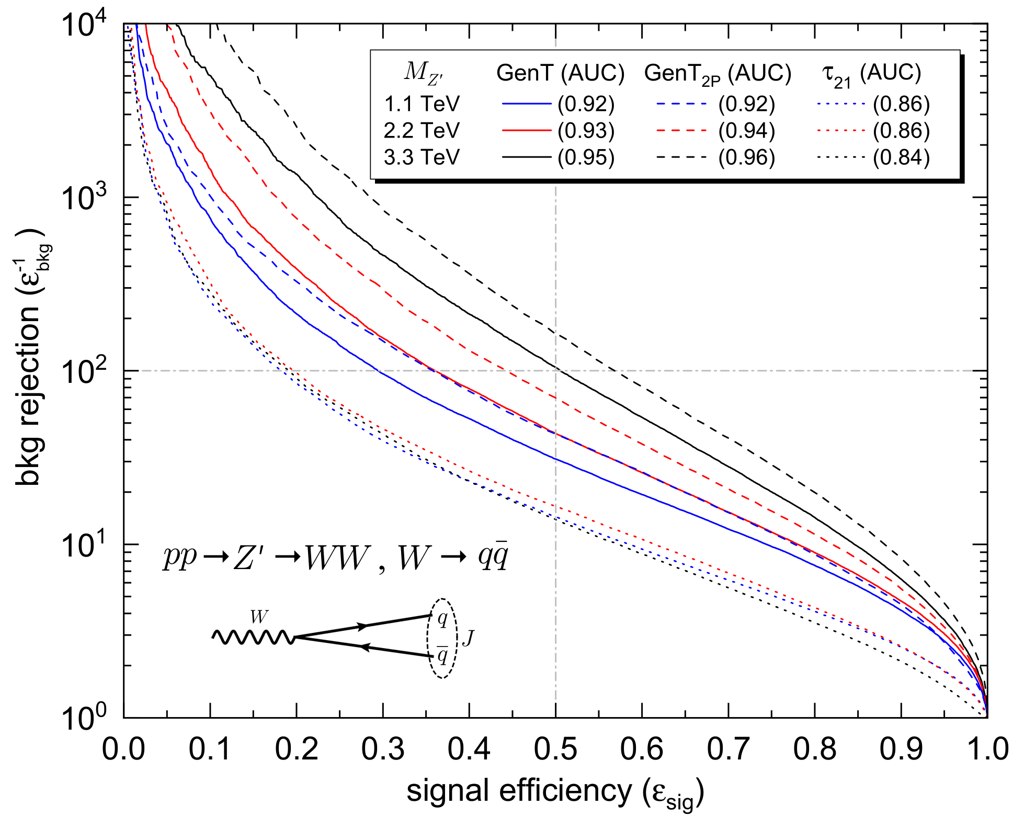
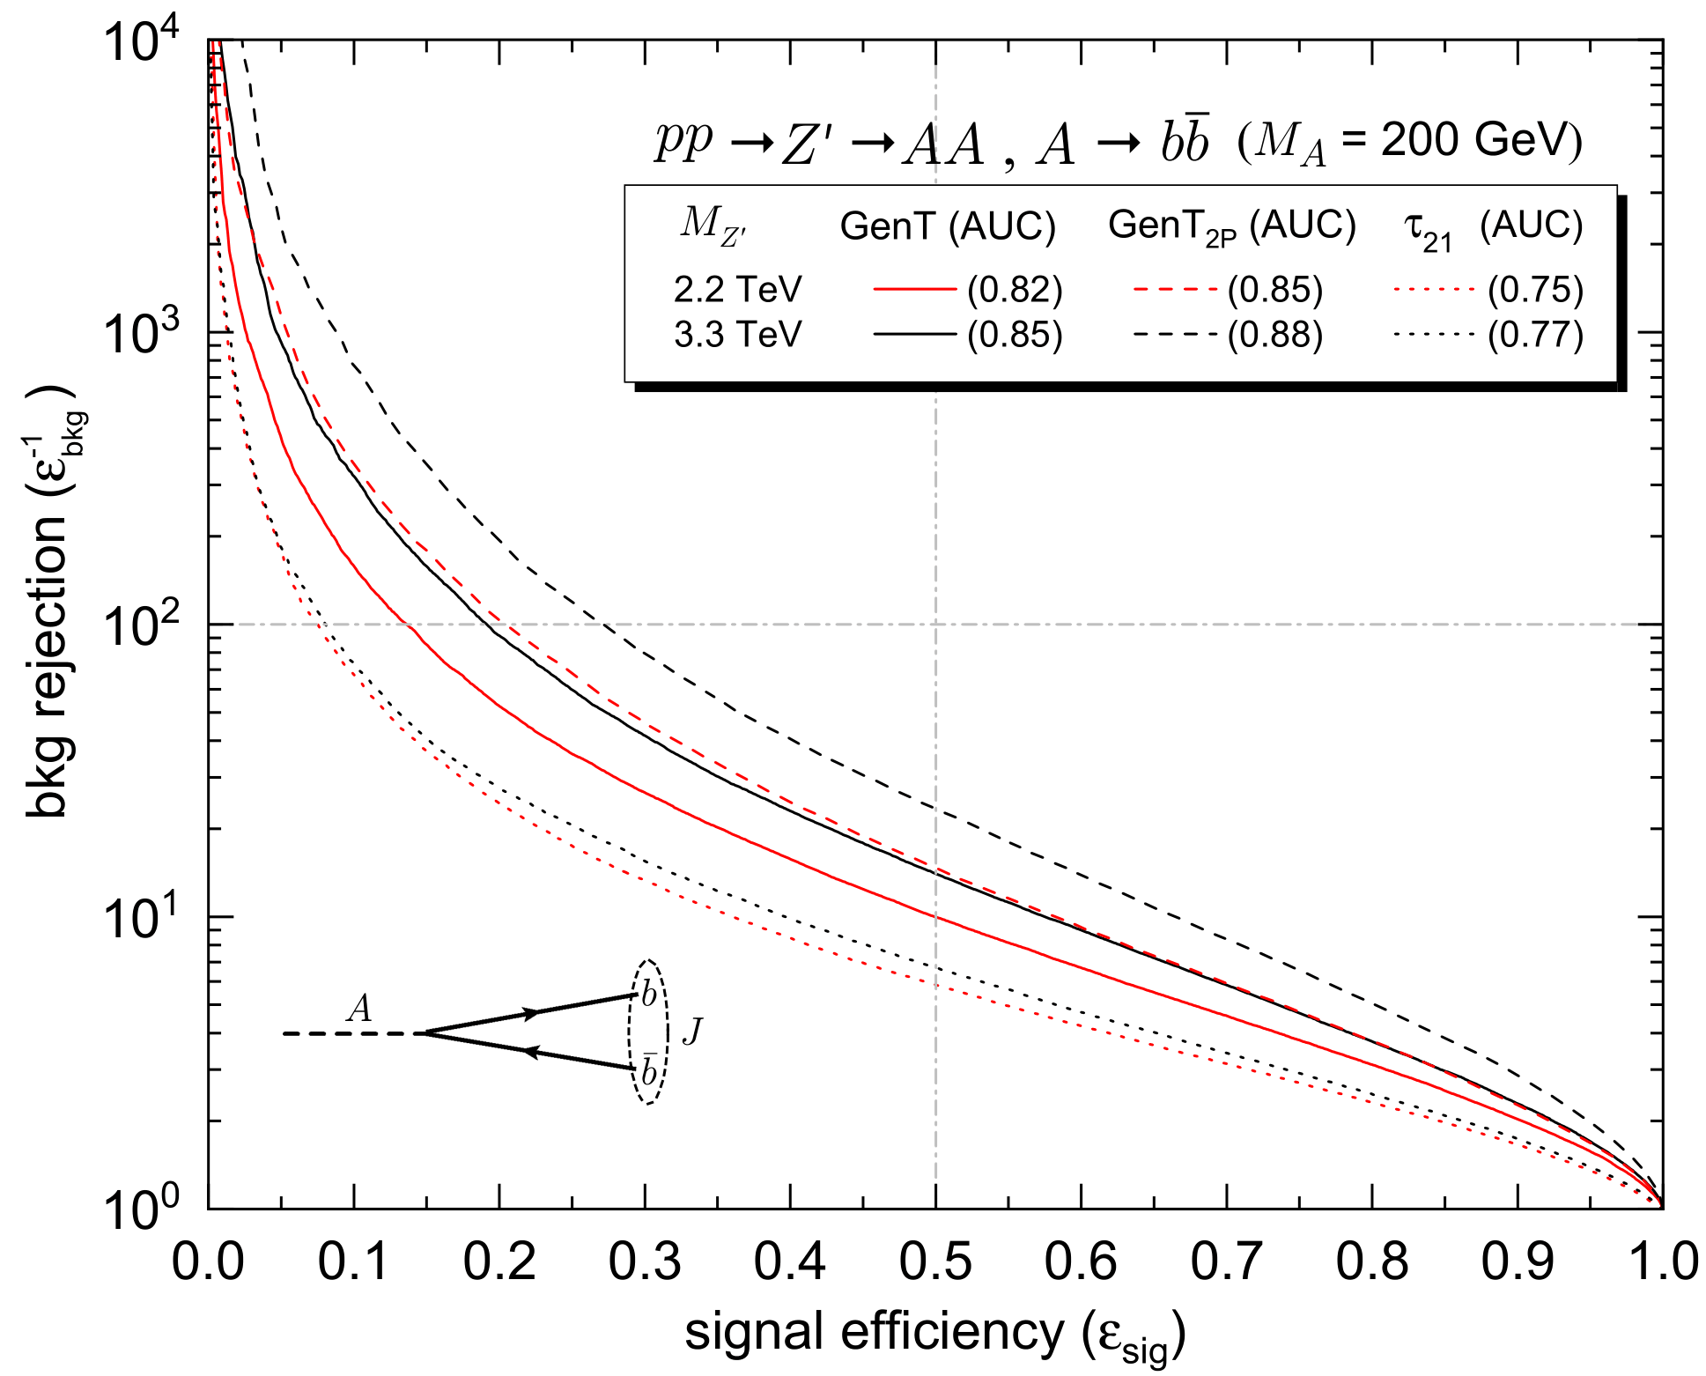
Tagger Performance (2P signals)
Background: Quark and gluon jets generated in pp → Zq, pp → Zg, with Z → νν
p_{T} ≥ 0.5, 1.0, 1.5 TeV for M_{Z’} = 1.1, 2.2, 3.3 TeV, respectively;
In general, GenT and GenT_{2P} perform better than the commonly used ratio τ₂₁;
The performance improves as M_{Z’} increases.
13

Slide 14
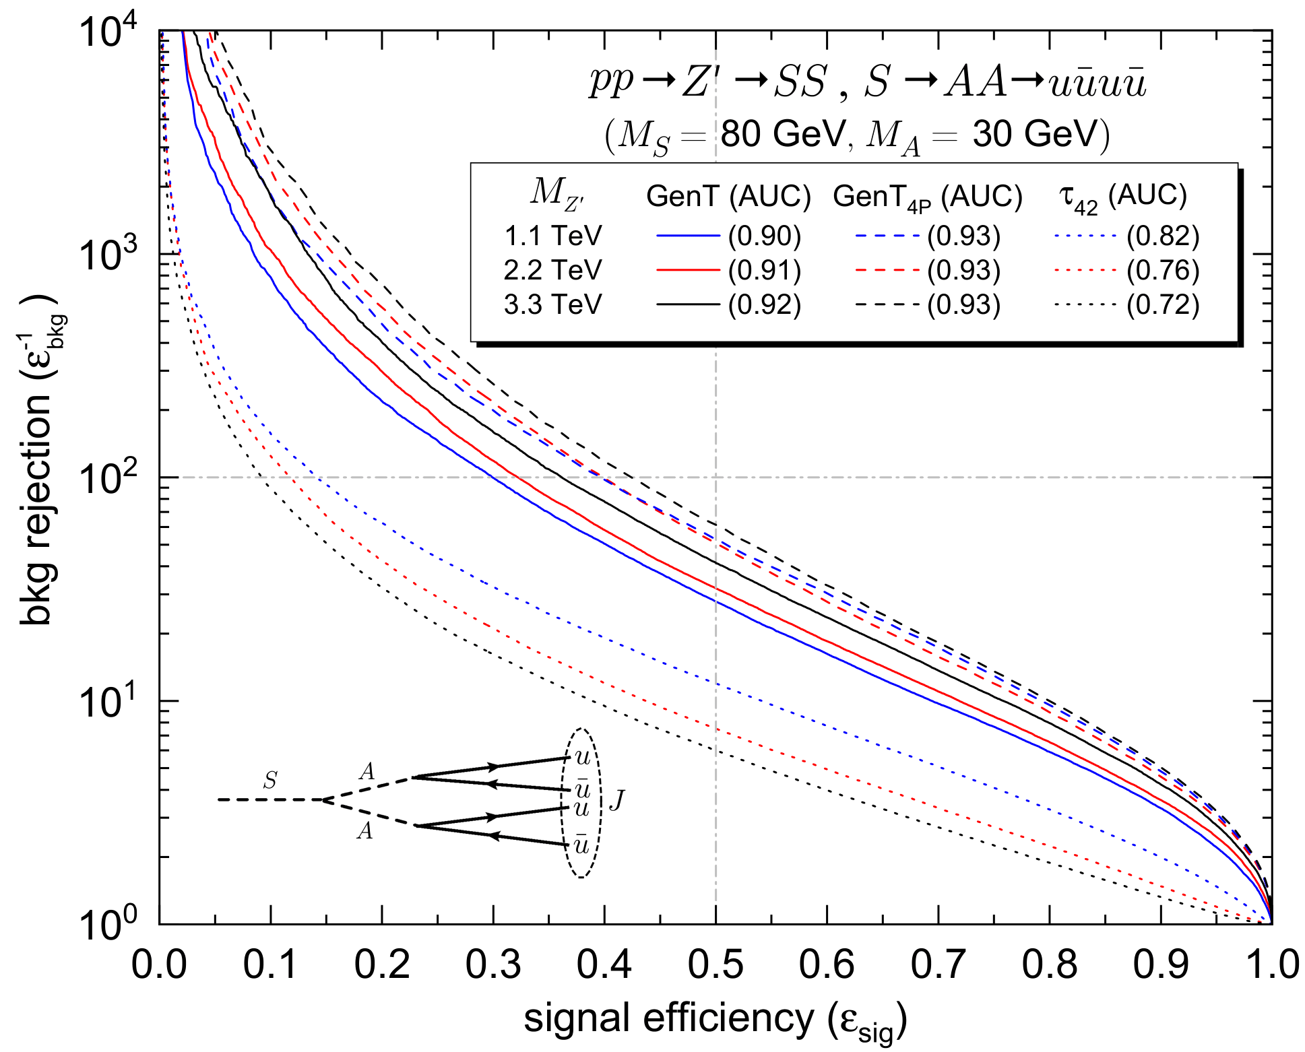
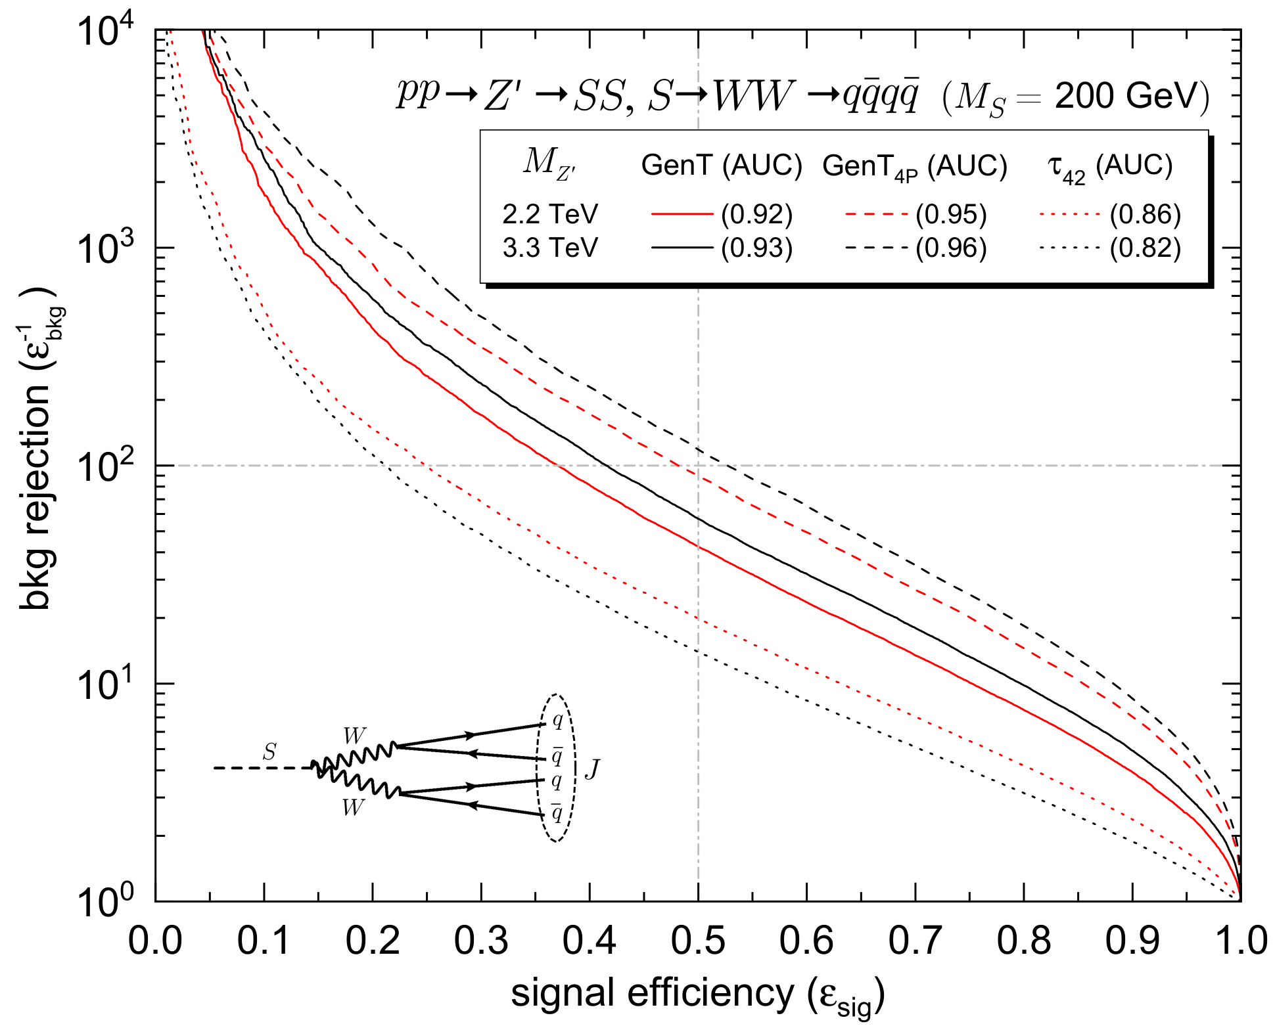
Tagger Performance (4P signals)
The performance of GenT and GenT_{4P} is significantly better than that of τ_{42.}
14

Slide 15
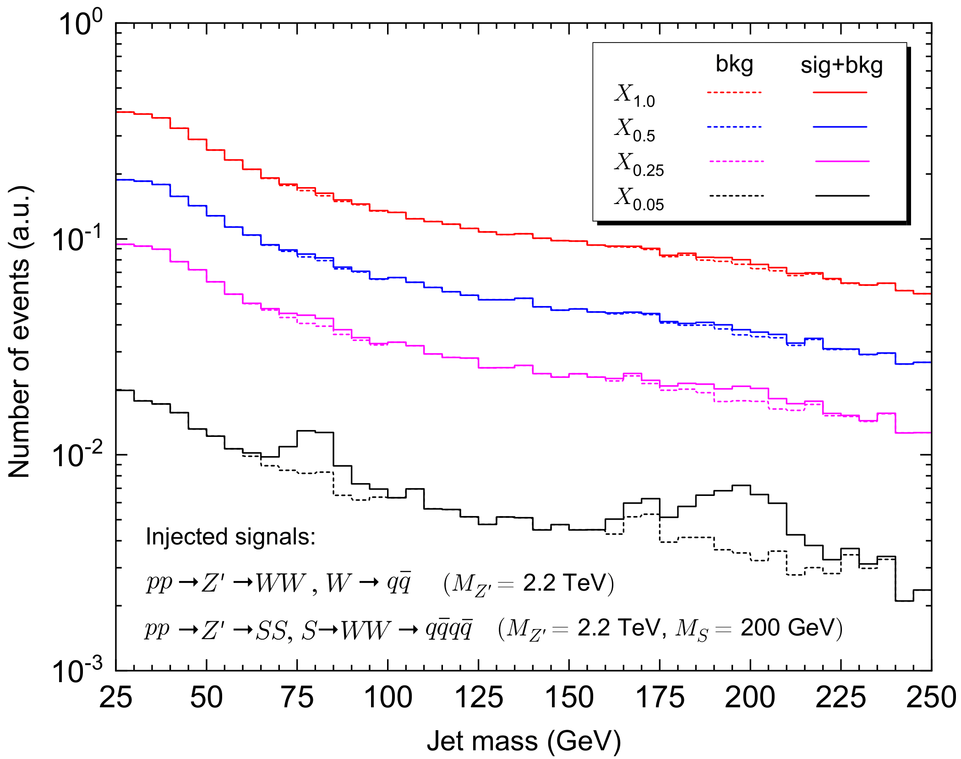
Mass Decorrelation
Defining ρ = 2 log(m_{J} / p_{T}), we compute at each bin of a 2D grid (ρ, p_{T} ) the 5%, 25% and 50% percentiles of the NN score (X_{0.05} , X_{0.25} and X_{0.5} respectively);
2P
4P
This varying threshold preserves the SM background distribution and the injected signals show up when the cut is sufficiently tight.
Our generic taggers also provide a perfect solution to the mass correlation problem.
15

Slide 16
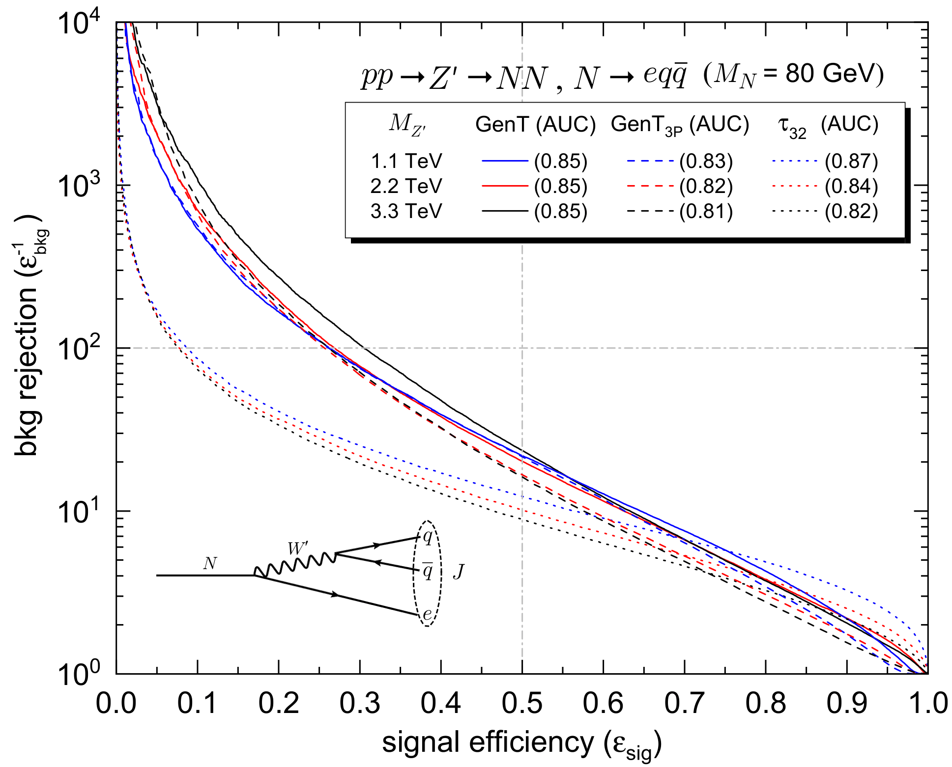
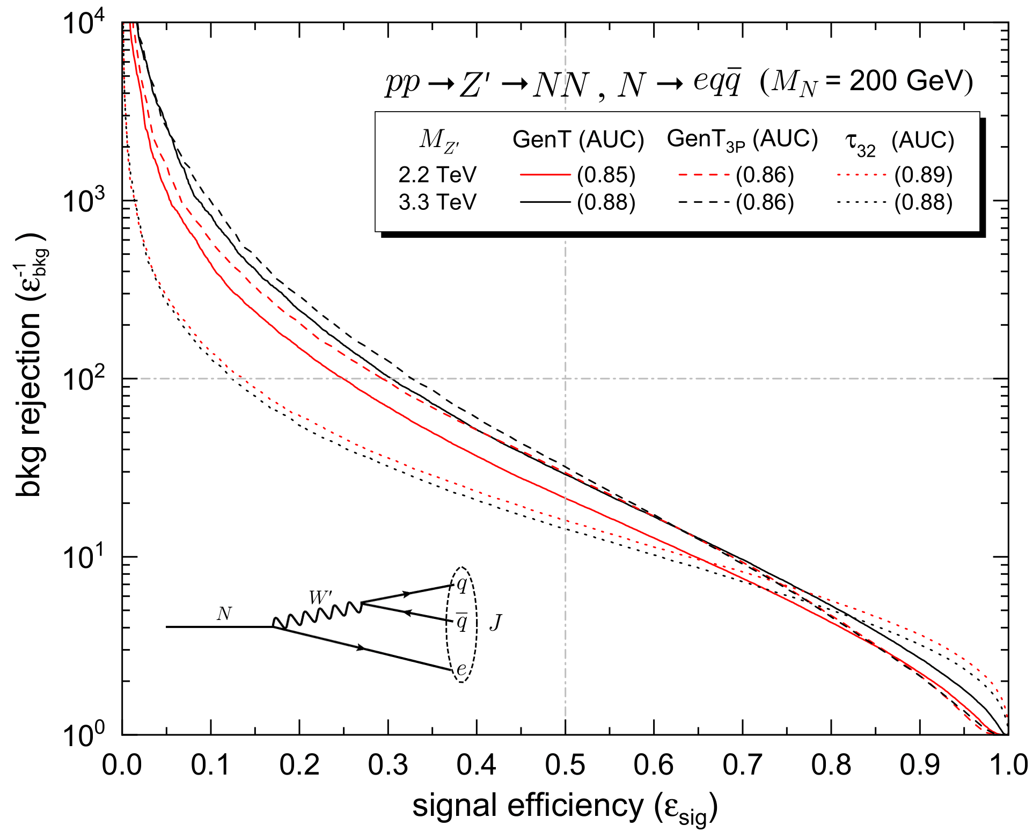
Jets not used to train MUST-taggers
  GenT and GenT_{3P} perform quite well on these jets;
  The AUC is not good to evaluate the performance of taggers in this case (it is dominated in the region with ε_{sig} ~ 1 where τ₃₂ performs slightly better).
16

Slide 17
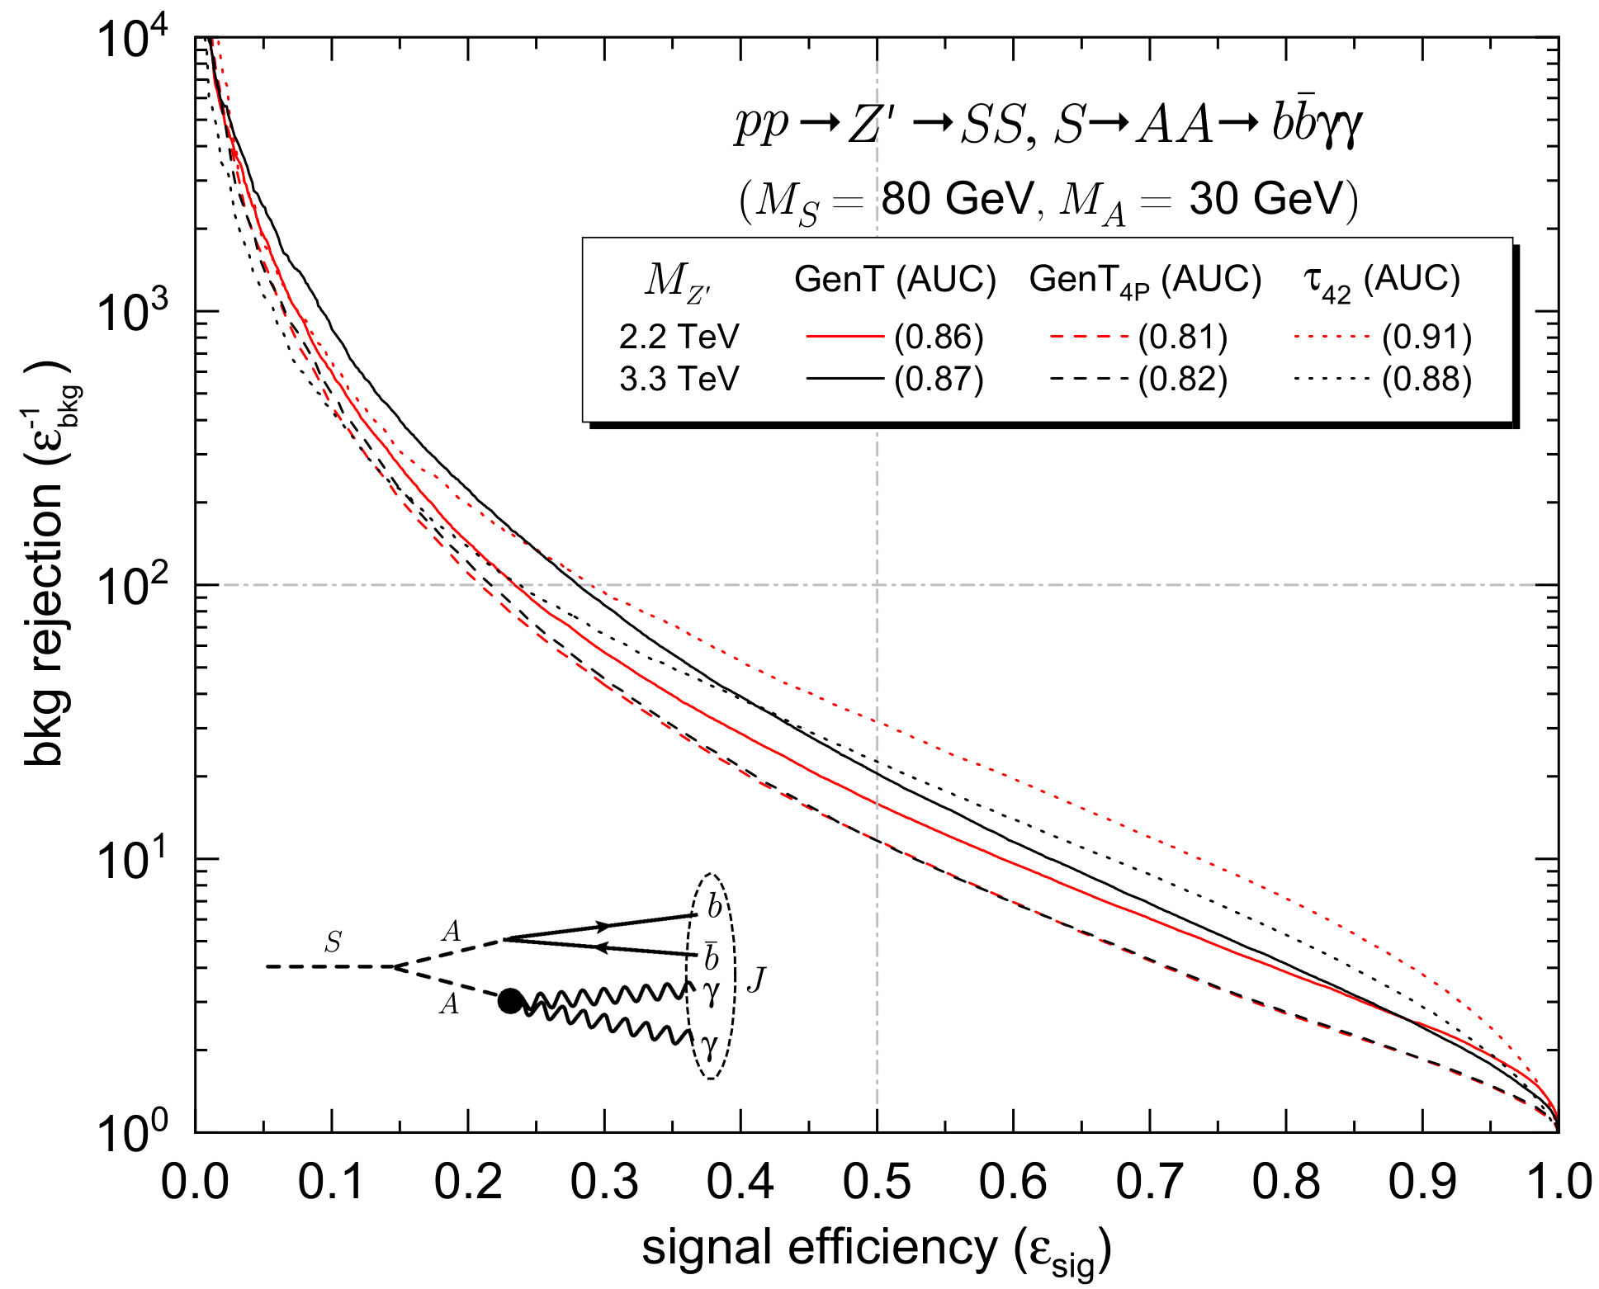
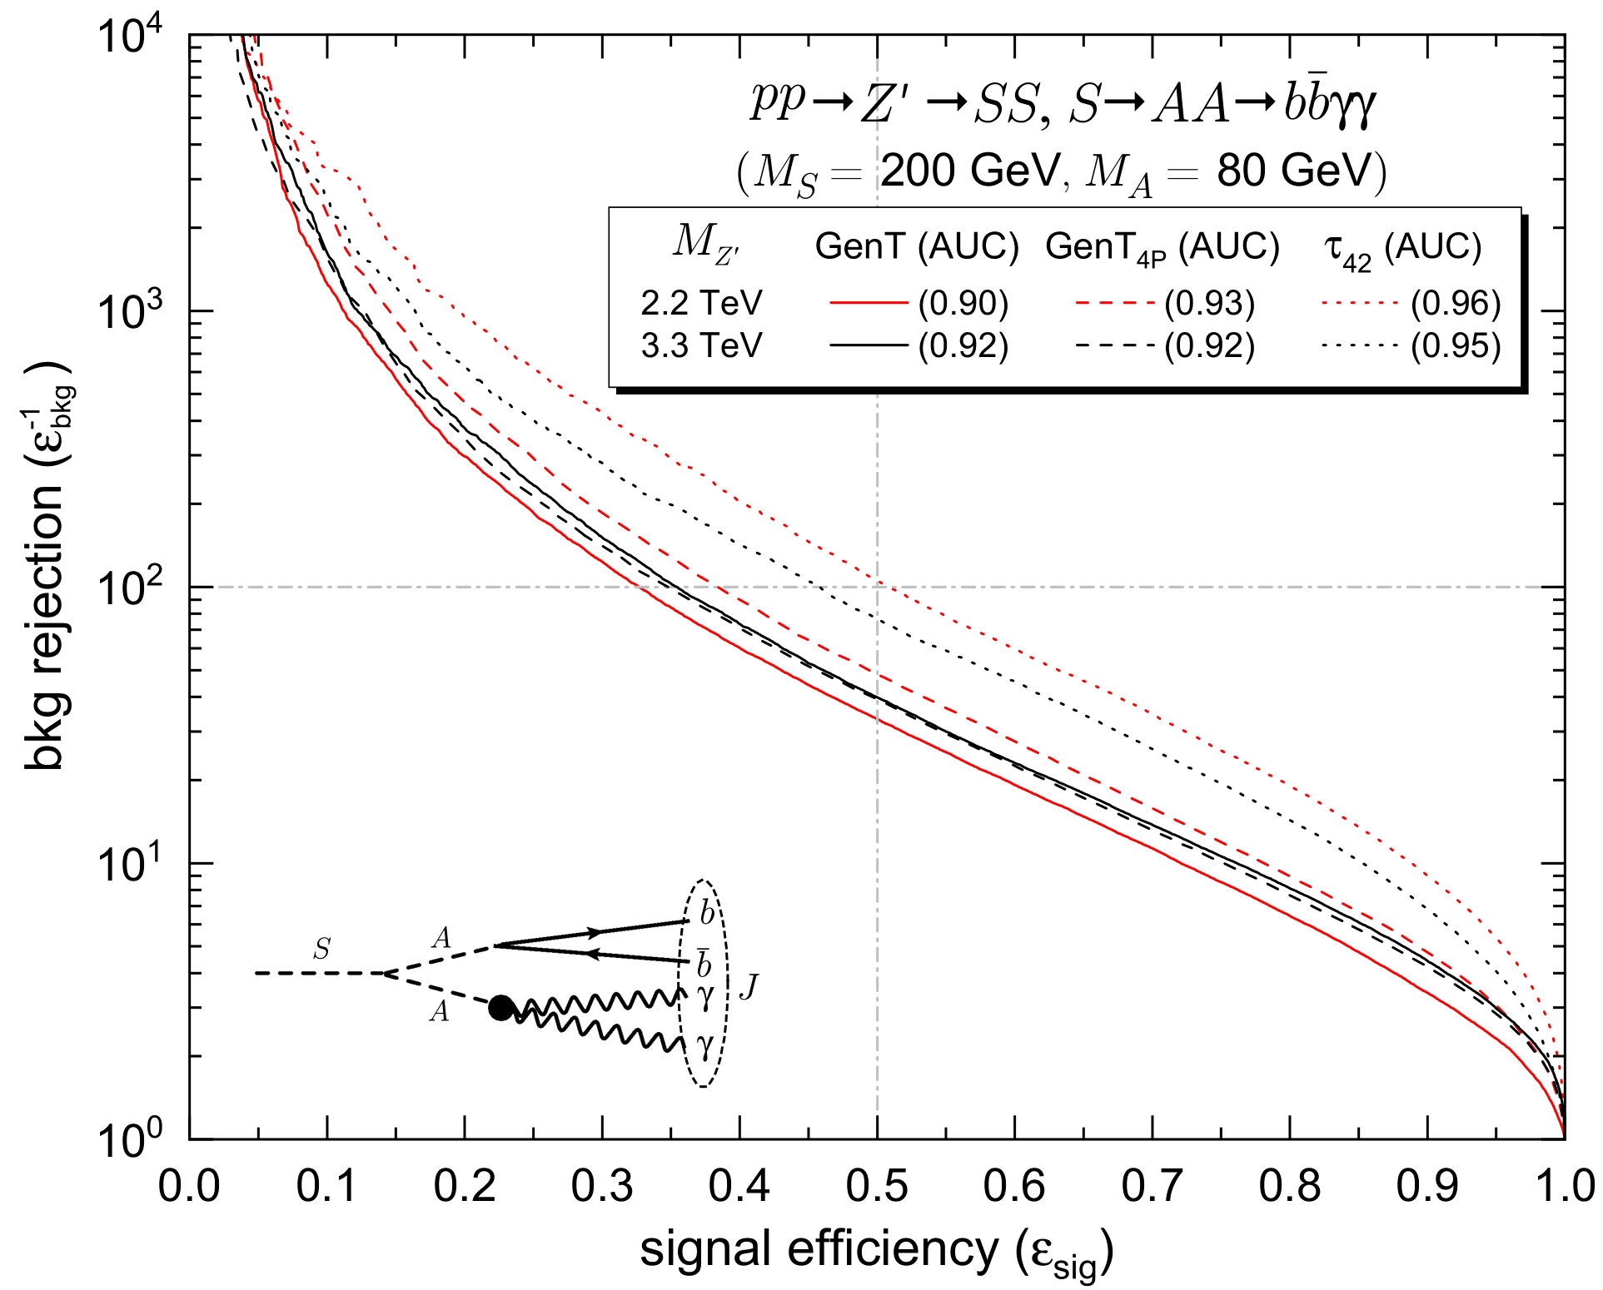
Jets not used to train MUST-taggers
GenT and GenT_{4P} can detect those unseen signals with good efficiency;
Simpler multivariate methods like logistic regression may achieve better performance for this type of jets. J. A. Aguilar-Saavedra, B. Zaldívar; Eur. Phys. J. C 80, 6 (2020) 530
17

Slide 18
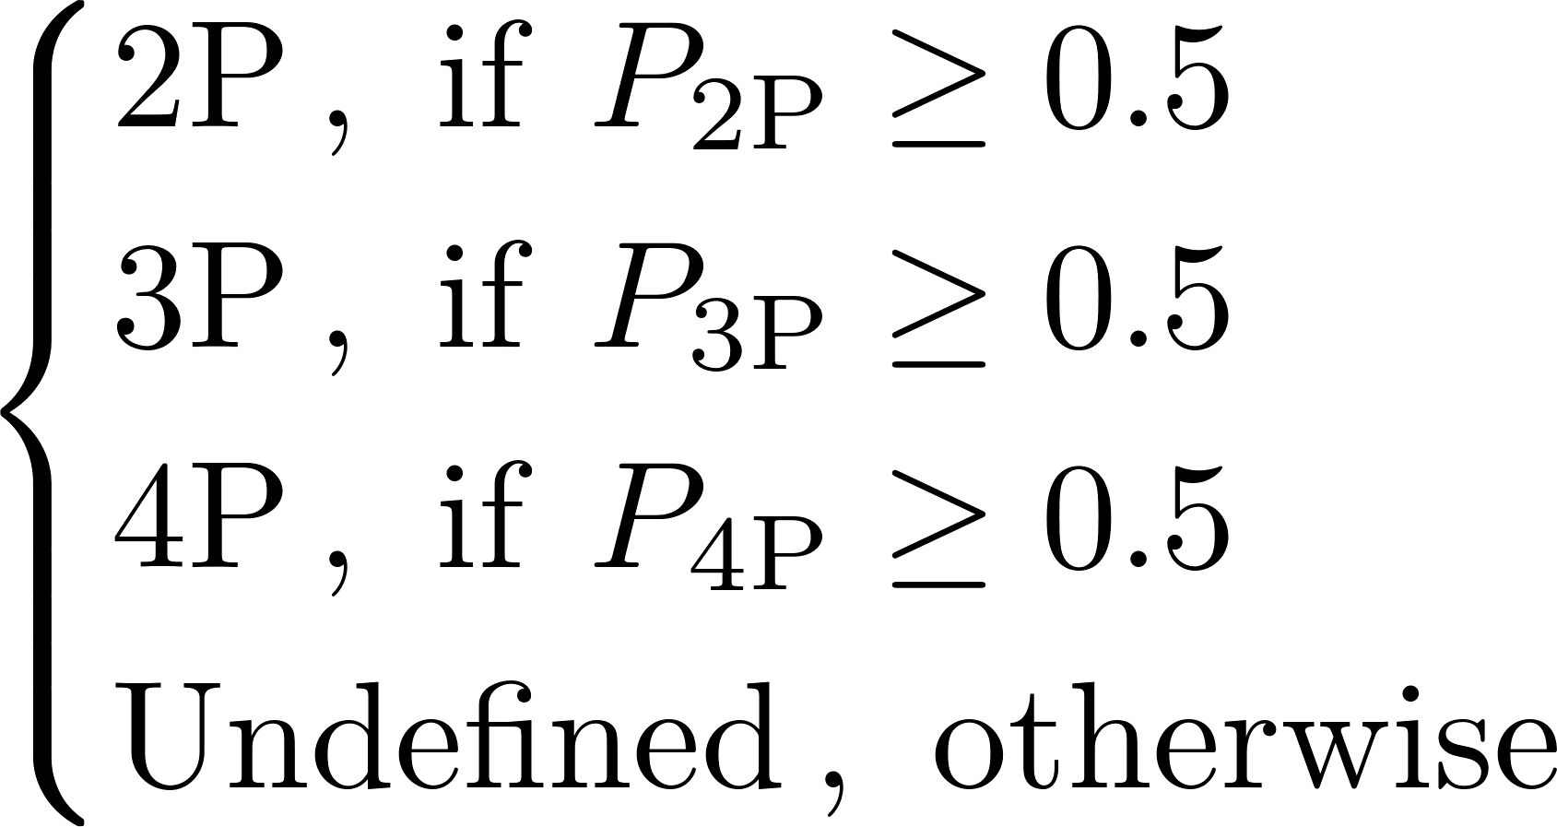

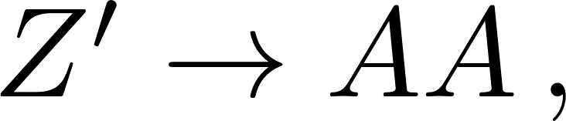
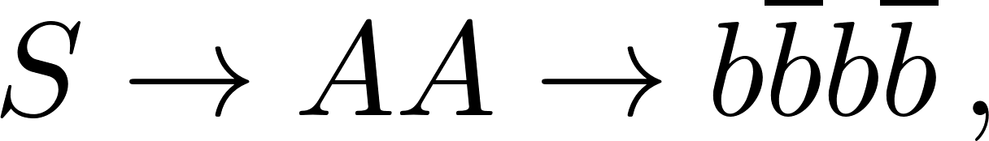
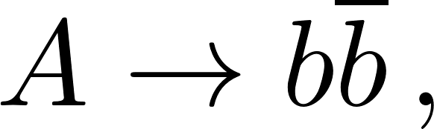
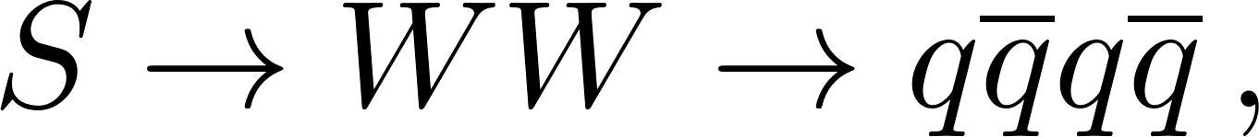
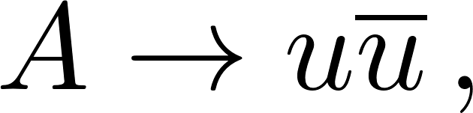







Identification of new physics signals
Using the prongness selection tagger, we apply the following classification criteria in the four benchmark examples below:
Benchmark 1 (4P)
Benchmark 2 (2P)
Benchmark 3 (4P)
Benchmark 4 (2P)
18

Slide 19
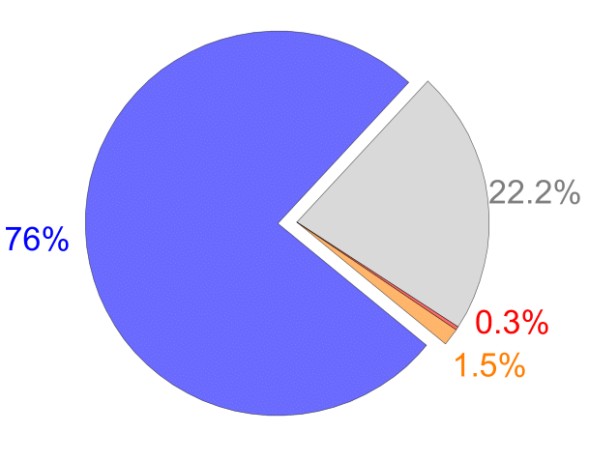
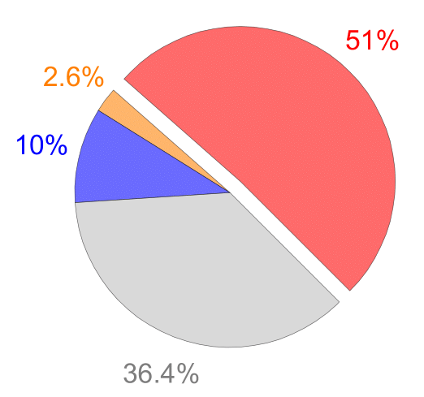
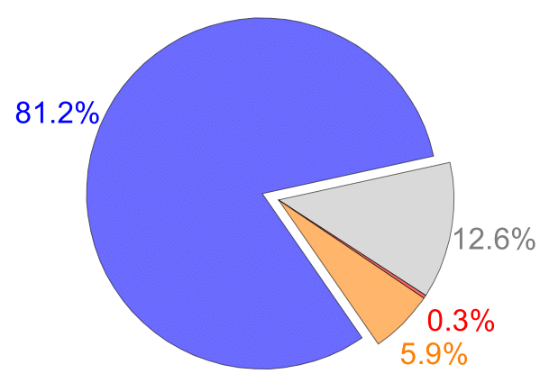
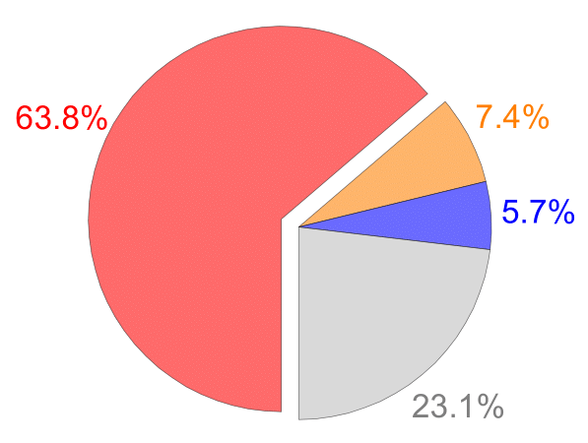
Identification of new physics signals
Using the prongness selection tagger, we apply the following classification criteria in the four benchmark examples below:
Benchmark 1 (4P)
Benchmark 2 (2P)
Benchmark 3 (4P)
Benchmark 4 (2P)
The fraction of correctly identified jets is several times larger than that of misidentified ones;
Mistag rates can be further reduced by raising the value of the threshold that separates undefined jets from the classified ones.
18

Slide 20
Concluding Remarks
We introduced the method of MUST for multi-pronged jets;
Taggers built upon MUST keep an excellent performance across a very wide m_{J} and p_{T} range;
Our taggers are sensitive to any kind of multi-pronged jets, outperforming simple variables;
Mass decorrelation can easily be implemented using the varying threshold method;
MUST-taggers can achieve good performances on signals for which they were not trained;
The MUST concept can also be applied to selection taggers that can determine the prongness of signal jets.
Thank you!
19

Slide 21
Backup slides

Slide 22
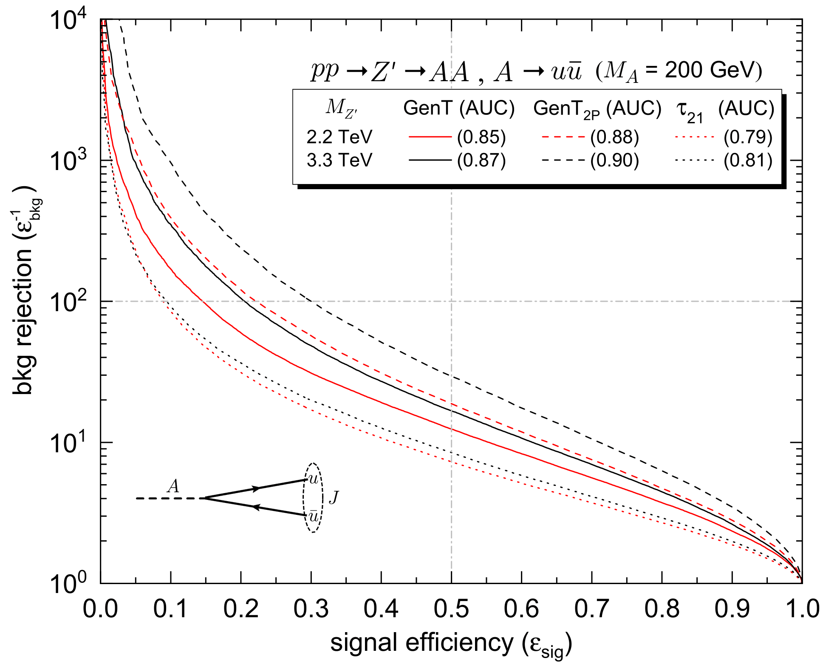
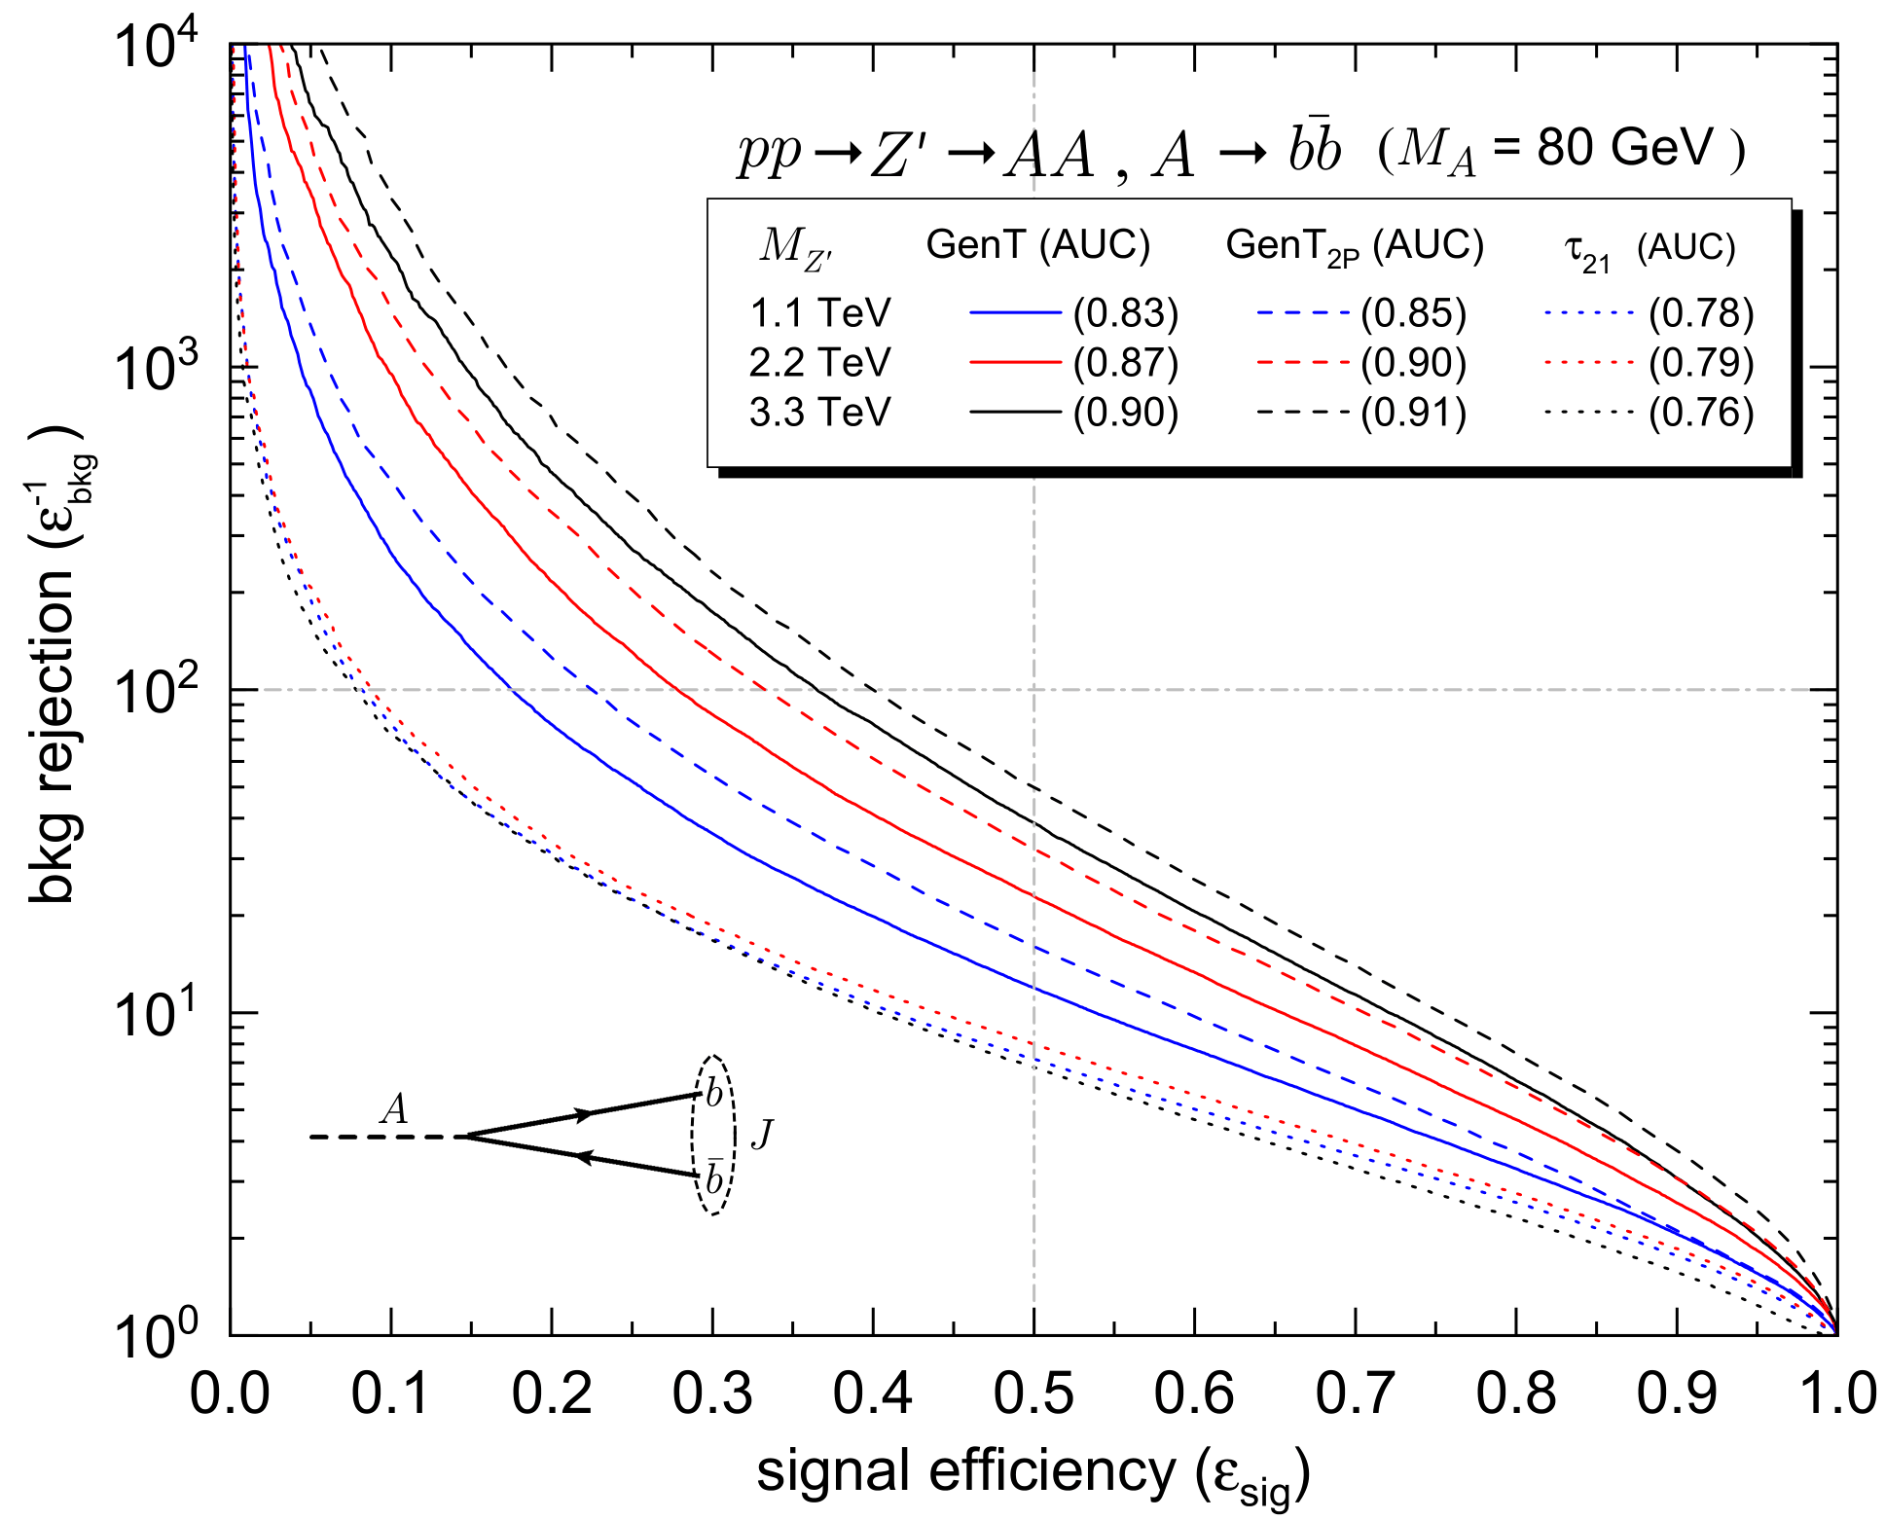
Tagger Performance (2P signals)
11

Slide 23
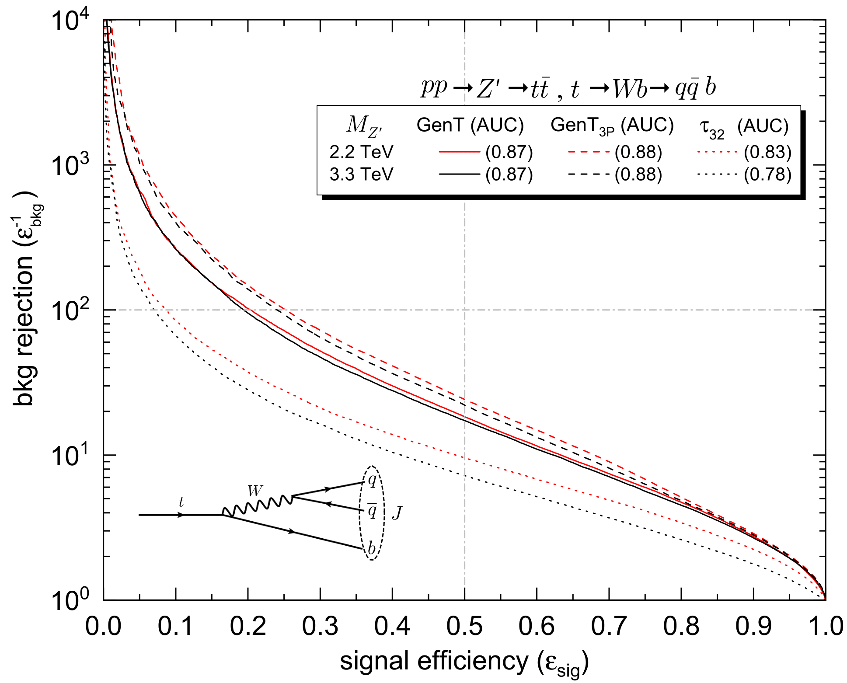
Tagger Performance (3P signal)
Although GenT and GenT_{3P} perform well on top quark jets and would not miss those signals, fully-dedicated top taggers perform better.
e.g. S. Macaluso, D. Shih; JHEP 10 (2018) 121

Slide 24
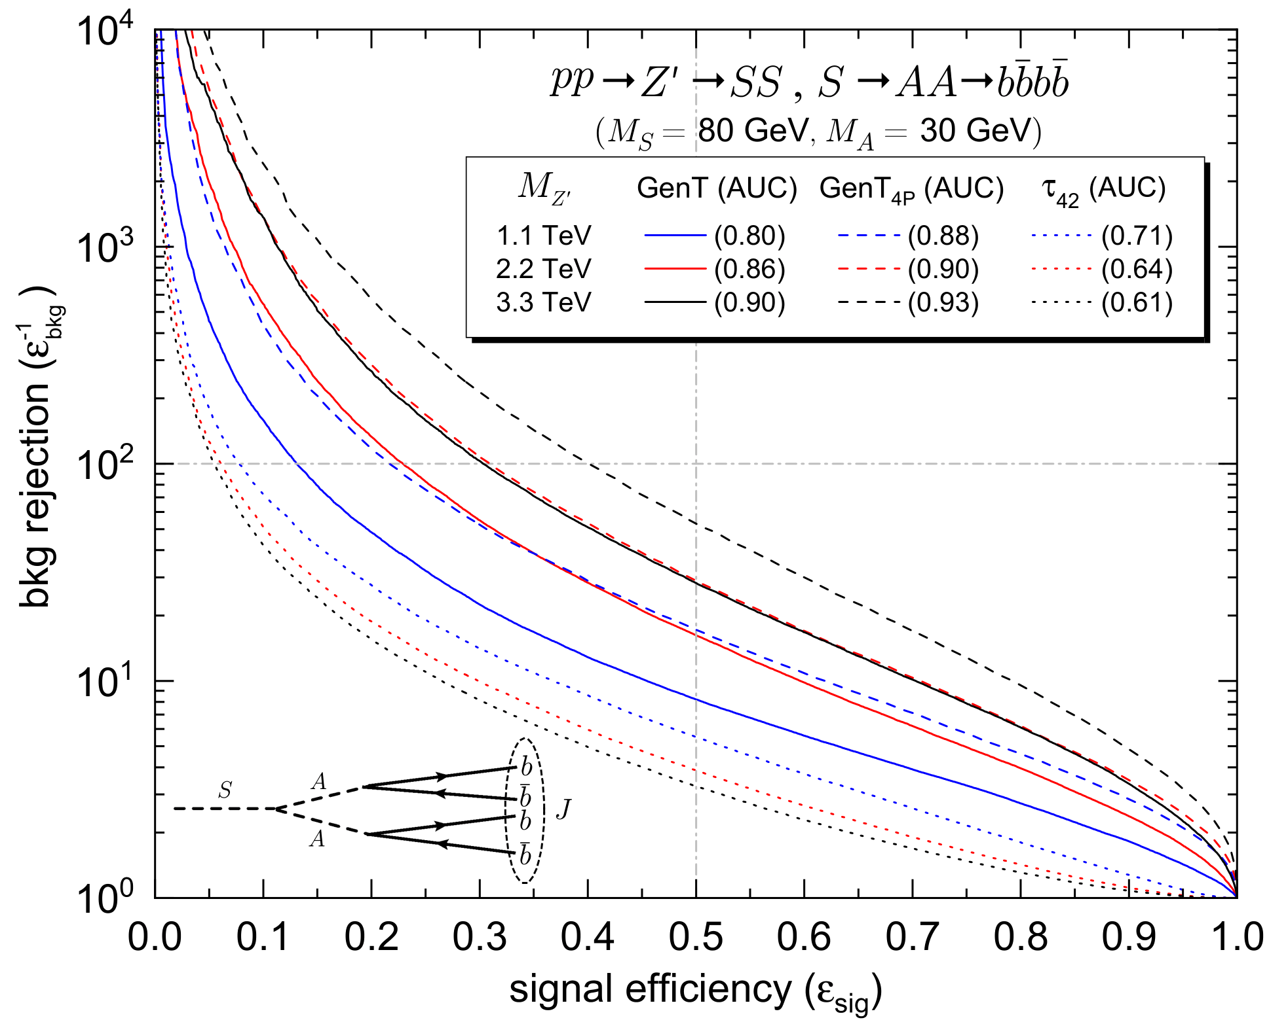
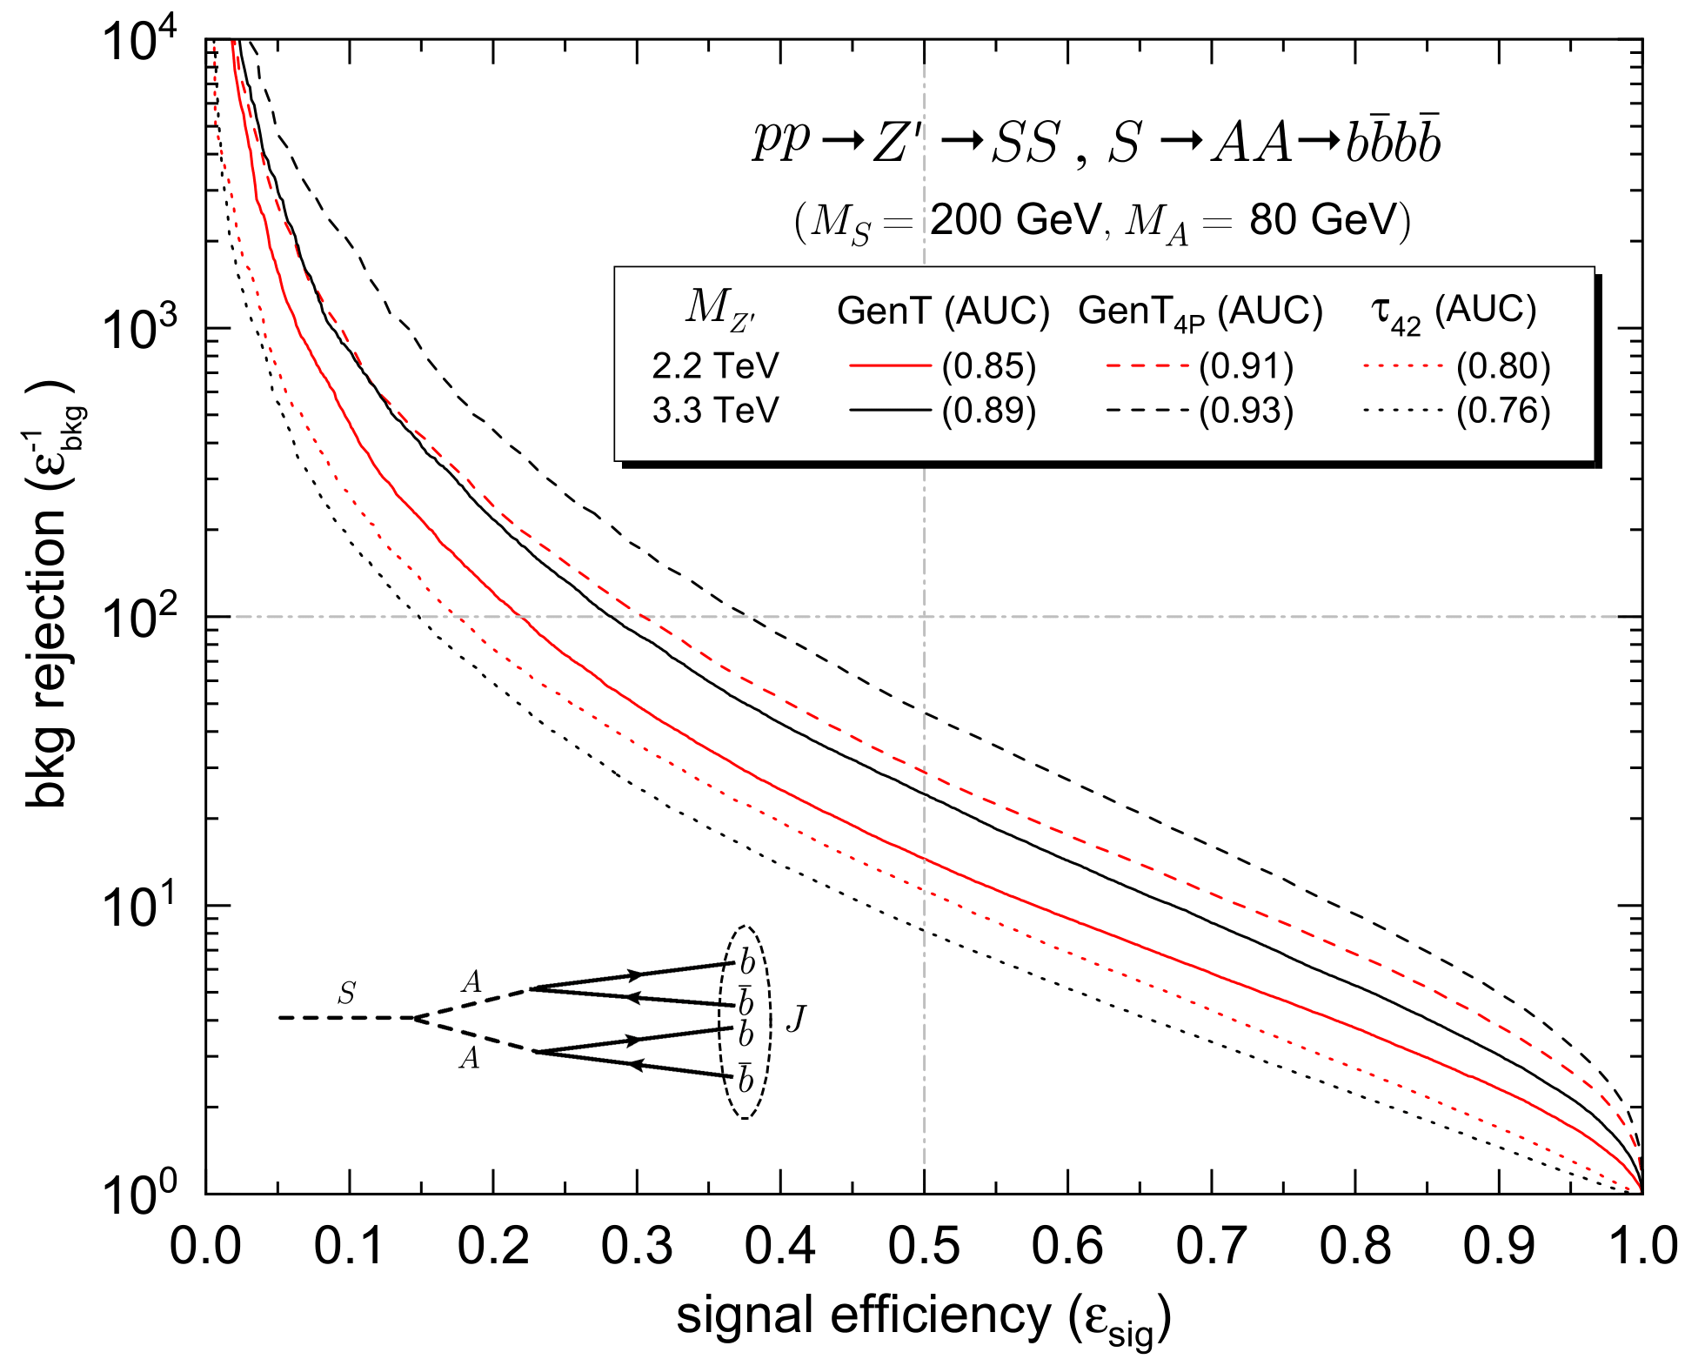
Tagger Performance (4P signals)
14

Slide 25
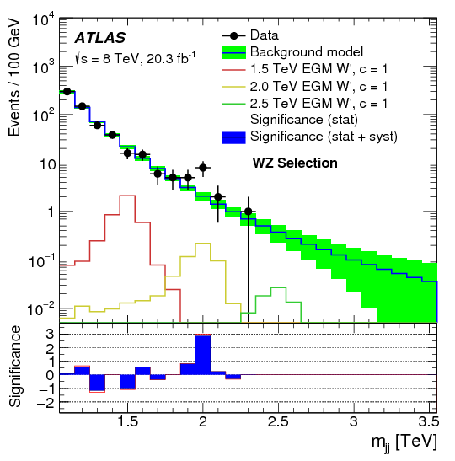
More about Stealth Bosons
Stealth bosons are relatively light boosted particles with a cascade decay:
A particles can be weak bosons W, Z, a Higgs boson or new relatively light (pseudo-)scalars.
Heavy resonances decaying into two such stealth bosons, or one plus a W/Z boson, may offer an explanation for small excesses found in hadronic diboson resonance searches near an invariant mass of 2 TeV (example on the right).
(For more information about this topic, see:
J. A. Aguilar-Saavedra; Eur. Phys. J. C 77, 10 (2017) 703)
G. Aad et al. [ATLAS]; JHEP 12 (2015) 55

Slide 26
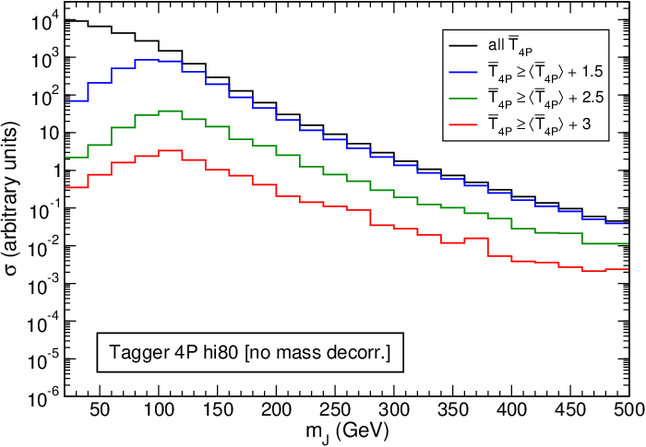
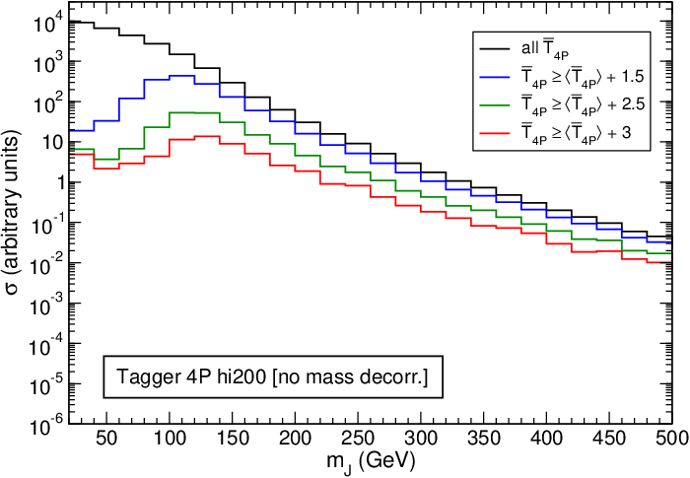
Taggers without Mass Decorrelation
Jet mass spectrum for QCD background produced by 4P taggers with no prior mass decorrelation
J. A. Aguilar-Saavedra, B. Zaldívar, Eur. Phys. J. C 80, 6 (2020) 530
The peak-like structure produced near 100 GeV is not in any case related to the design mass interval.

Slide 27
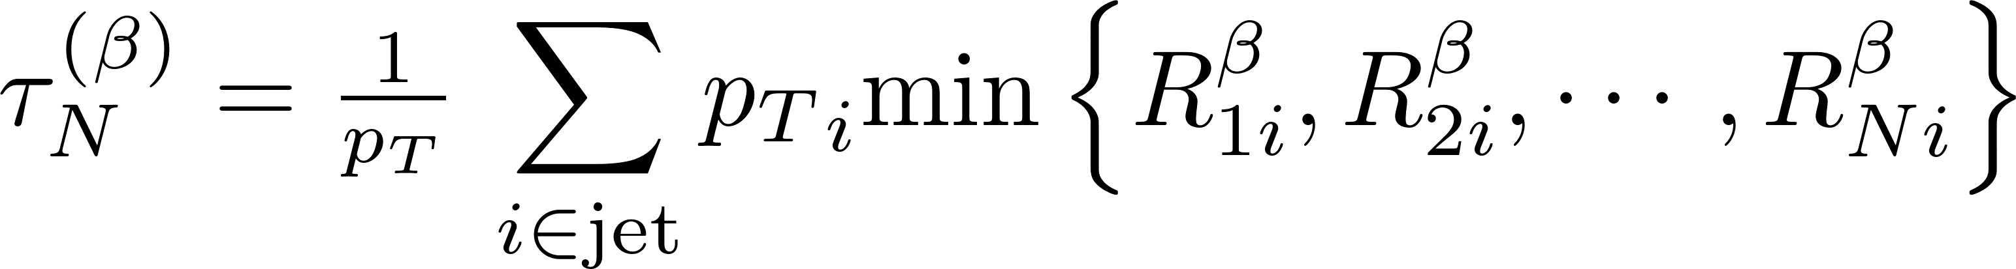
N-subjettiness observables
The N-subjettiness observable τ_{N}^{(β)} is a measure of the radiation about N axes in the jet, specified by an angular exponent β > 0,
Transverse momentum of particle i in the jet
Angular distance between particle i and axis N in the jet
The coordinates of the M-Body phase space can be defined by (M – 1) transverse momentum fractions and (2M – 3) angles, so we need (3M – 4) N-subjettiness observables to completely specify the coordinates of that space:
(For more information about this topic, see K. Datta, A. Larkoski; JHEP 06 (2017) 73)

Slide 28
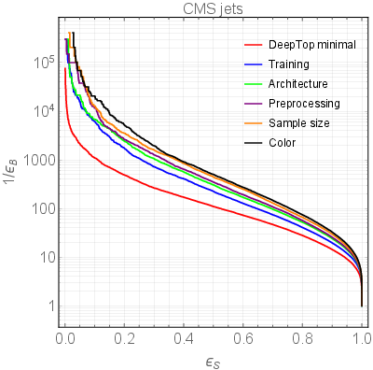
TopDeep Tagger
Performance of DeepTop tagger (after several improvements) discriminating top quark jets
S. Macaluso, D. Shih; JHEP 10 (2018) 121

Slide 29
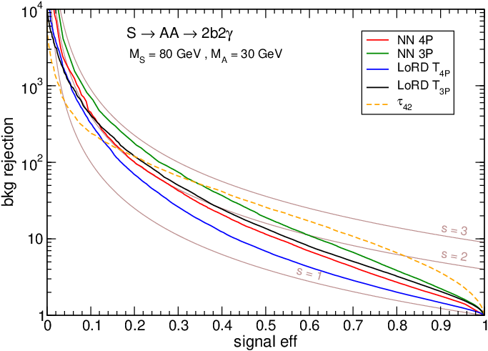
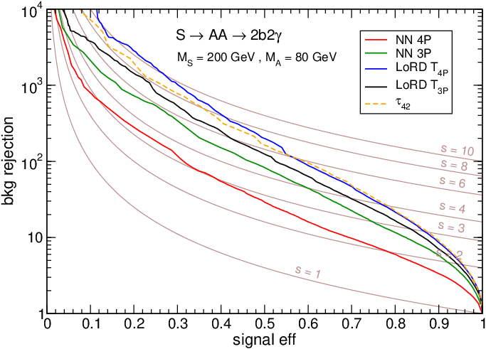
LoRD
Performance of Logistic Regression Design (LoRD) classifying jets with two hard photons
J. A. Aguilar-Saavedra, B. Zaldívar, Eur. Phys. J. C 80, 6 (2020) 530

