Slide 1
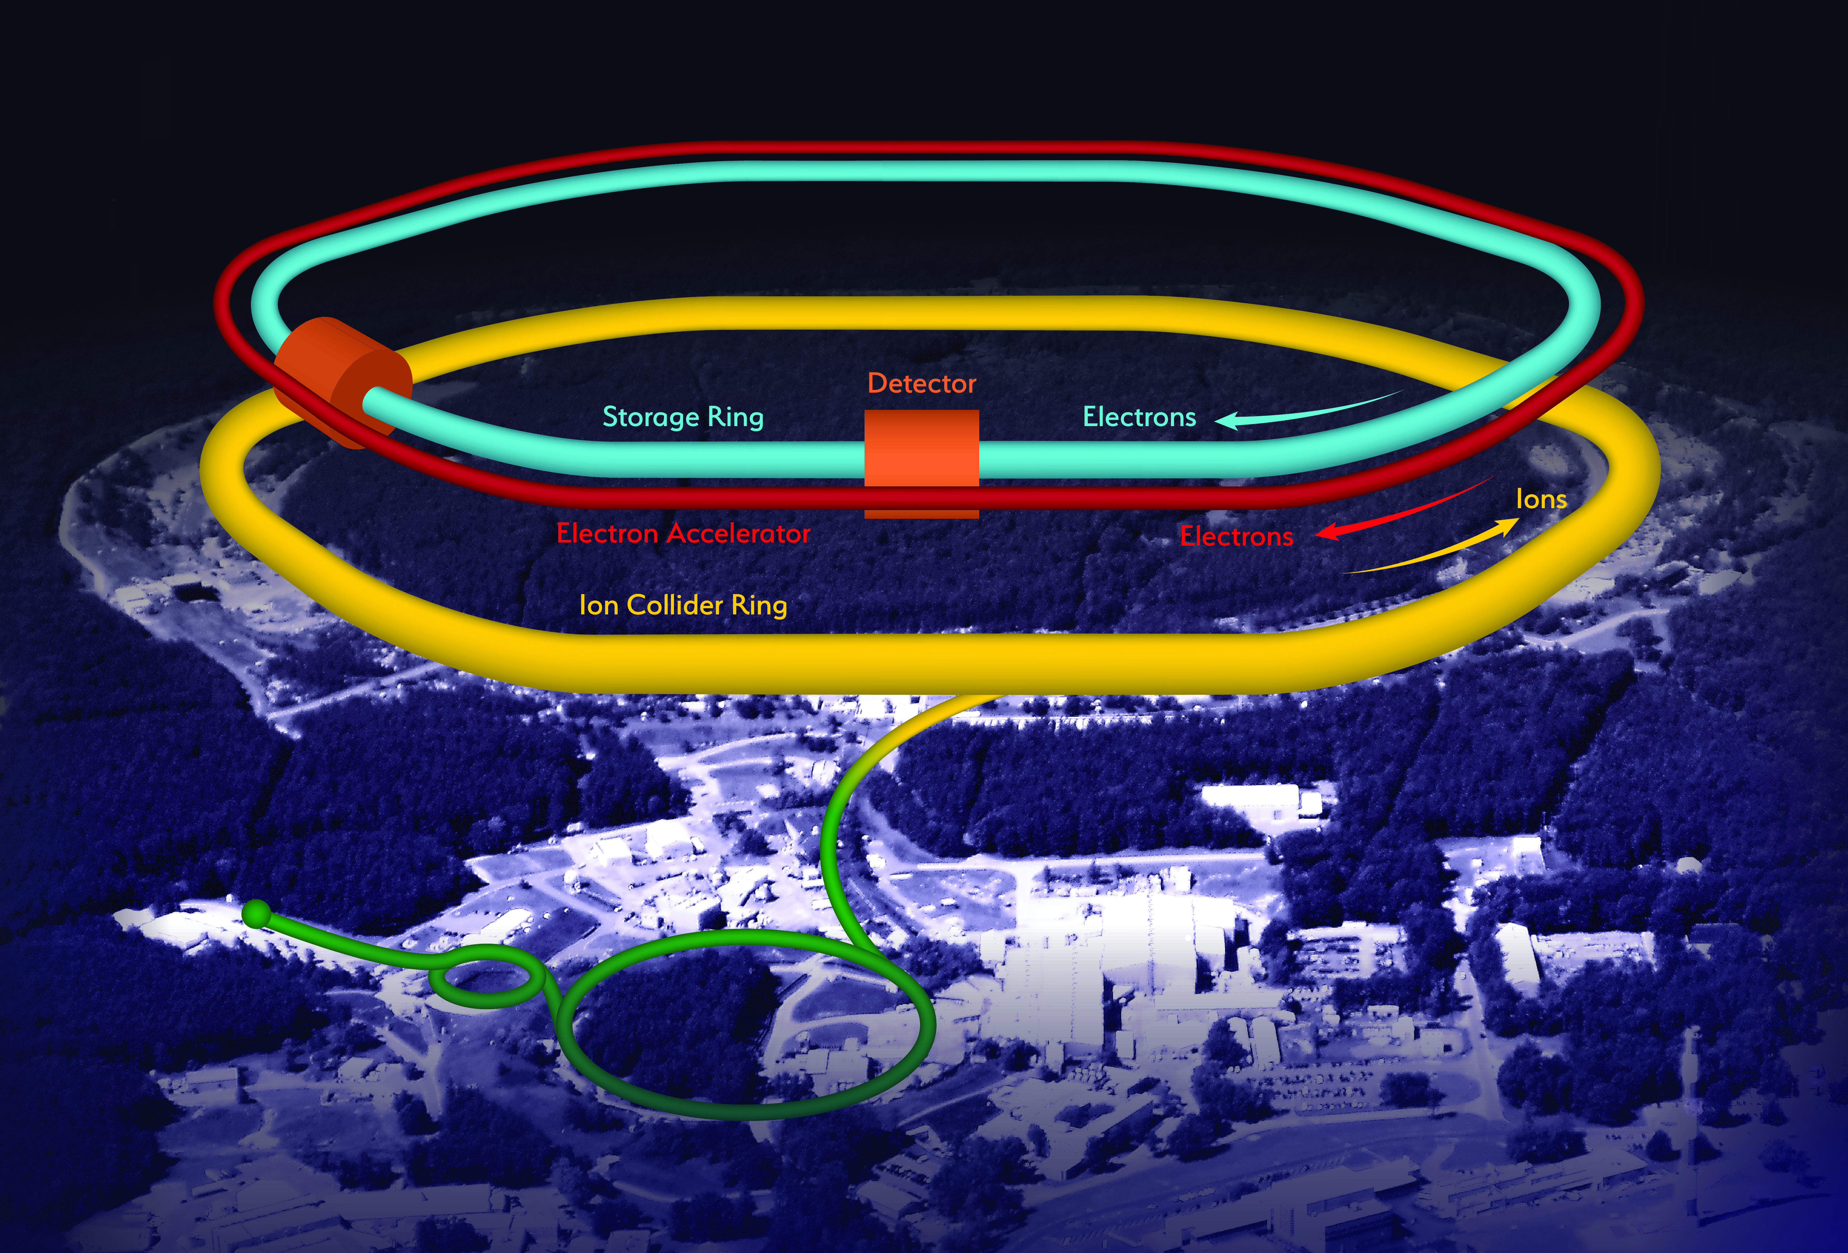
PID at EIC
Thomas K Hemmick

Slide 2


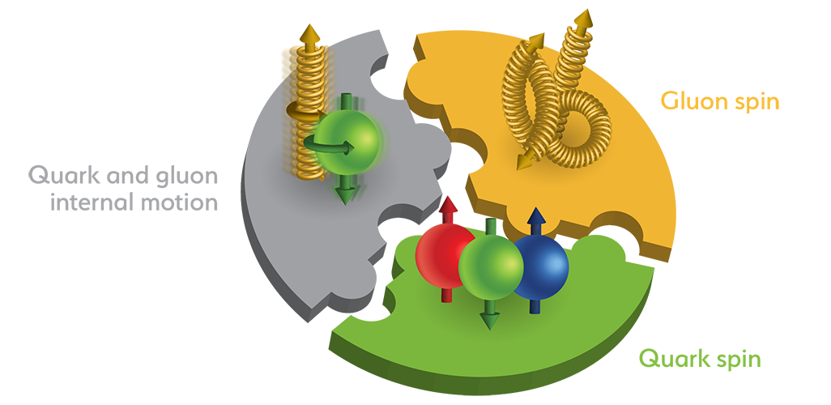

Electron Ion Collider Future Collider
  What is the spatial mapping of quark and gluon fields in the nucleon AND nucleus.
  Is the missing spin to be found via quark orbital momentum?
  Are new phases of matter (Color-Glass Condensate) accessible at low x in nuclei?
Site Selected
BNL !!

Slide 3
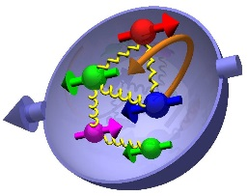

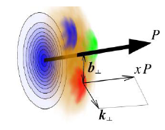
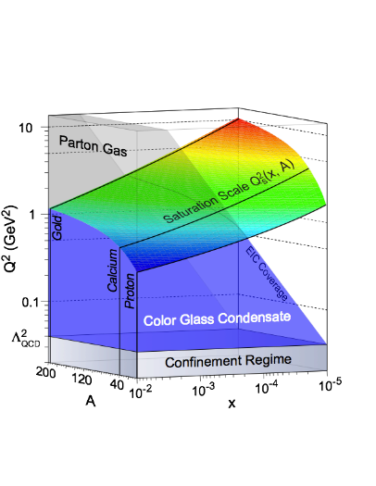
Compelling EIC SCIENCE Questions
How are sea quarks and gluons and their spin distributed
in space and momentum inside the nucleon?
How are these quark and gluon distributions correlated with the
over all nucleon properties, such as spin direction?
What is the role of the motion of sea quarks and gluons
in building the nucleon spin?
How does the nuclear environment affect the distribution
of quarks and gluons and their interaction in nuclei?
How does the transverse spatial distribution of gluons compare to that in the nucleon?
How does matter respond to fast moving color charge passing through it?
Is this response different for light and heavy quarks?
γ*
h
e’
q
e
Where does the saturation of gluon densities set in?
Is there a simple boundary that separates the region from the more dilute quark gluon matter? If so how do the distributions of quarks and gluons change as one crosses the boundary?
Does this saturation produce matter of universal properties in
the nucleon and all nuclei viewed at nearly the speed of light?

Slide 4
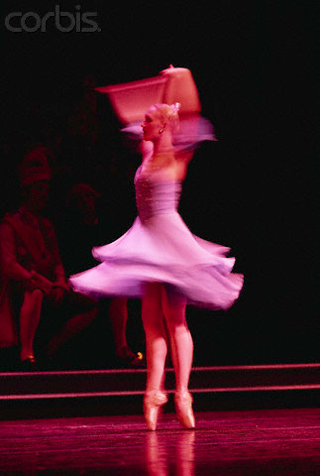
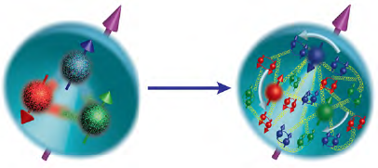
Evolution In Our Understanding Of Nucleon “Spin”
Traditionally we treated proton as a 1D object → What are the quark, gluon intrinsic spin contributions to the nucleon’s spin?
Last 10+ years: Theoretical tools and experiments to view proton as a (2+1)D object became available.
What are the position & momentum correlations amongst partons? Do they contribute to nucleon’s spin?
Notes:
Its not just understanding the nucleon spin sum rule. But a deeper quest to understand the nucleon as a many body object in QCD.

Slide 5
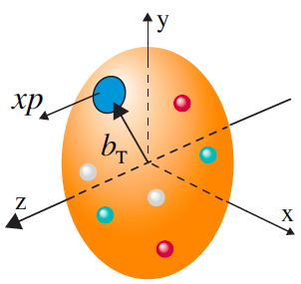
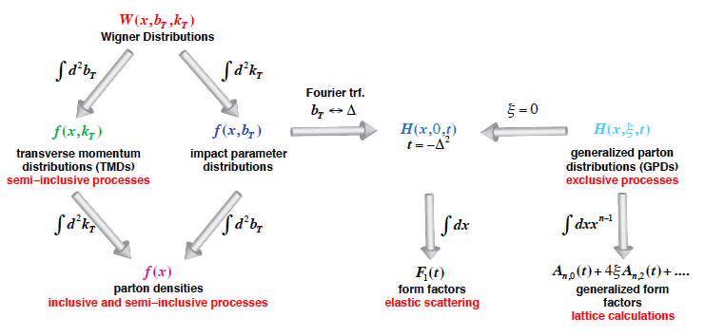
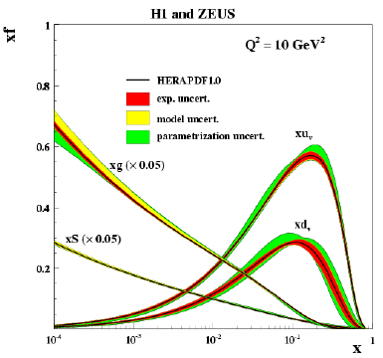
Unified view of the Nucleon Structure
(X. Ji, D. Mueller, A. Radyushkin)
Wigner distributions:
5D
JLab12
COMPASS
for
Valence
HERMES
JLab12
COMPASS
3D
1D
EIC – 3D imaging of partons: Quarks (fixed target) , Gluons (collider)
TMDs – confined motion in a nucleon (semi-inclusive DIS)
GPDs – Spatial imaging of quarks and gluons (exclusive DIS)

Slide 6
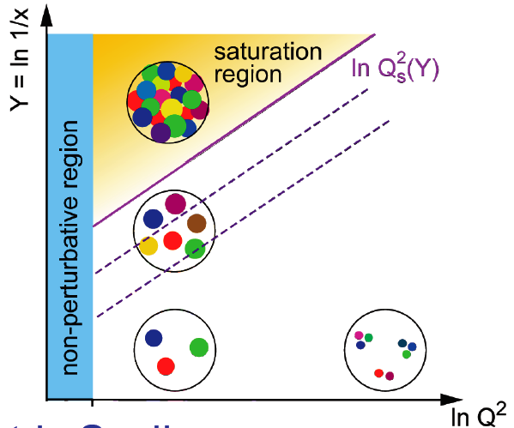
Physics at Low x?
See Ann. Rev. Nucl Part (60) 2010 F. Gelis et al., , arXiv:1002.0333)
Method of including non-linear effects (McLerran, Venugopalan)
Small coupling, high gluon densities
BK/JMWLK equations lead to a Saturation Scale Q_{S}(Y)
BK/JMWLK
Linear QCD
BFKL:
gluon
emission
Nonlinear QCD
BK/JMWLK gluon recombination
BFKL
DGLAP
Need a higher energy e-p collider than HERA?
Large Hadron electron Collider (LHeC)
➔ Nuclei: naturally enhance the densities of partonic matter
Why not use Nuclear DIS at high energy?
At Q_{S} gluon emission balances the recombination
Strongly correlated gluonic system at high energy (low-x)
Universal? Color Glass Condensate ??

Slide 7
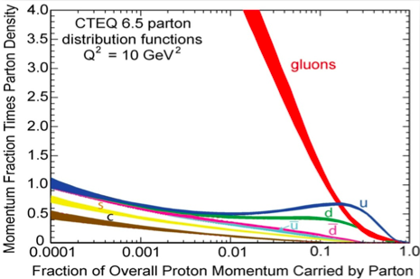
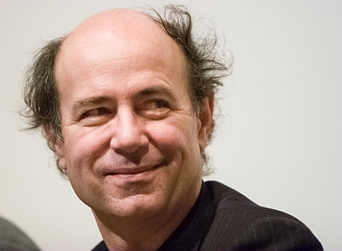
Gluon and the consequences of its properties:
Gluons carry color charge ➔ Can interact with other gluons!
Apparent “indefinite rise” in gluon distribution in proton!
recombination
What could limit this indefinite rise? → saturation of soft gluon densities via gg→g recombination must be responsible.
No unambiguously observation
Fundamental limiting state of matter
“Color Glass Condensate”
McLerran & Venugopalan et al
“…The result is a self catalyzing enhancement that leads to a runaway growth. A small color charge in isolation builds up a big color thundercloud….”
F. Wilczek, in “Origin of Mass”
Nobel Prize, 2004
Notes:
Significant modification and simplification of this slide… may convert in to two….

Slide 8
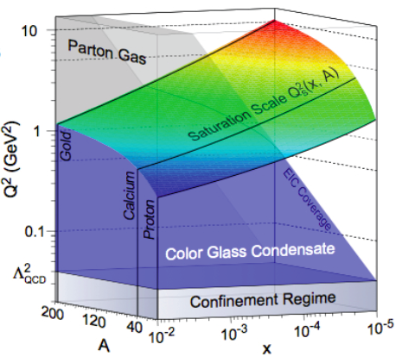
How to reach the high gluon density?
Alternatively,
Probe the nucleons in NUCLEI US Electron Ion Collider (EIC)
Kowalski, Teany
PRD 68:114005
Enhancement of Q_{S} with A, not energy

Slide 9
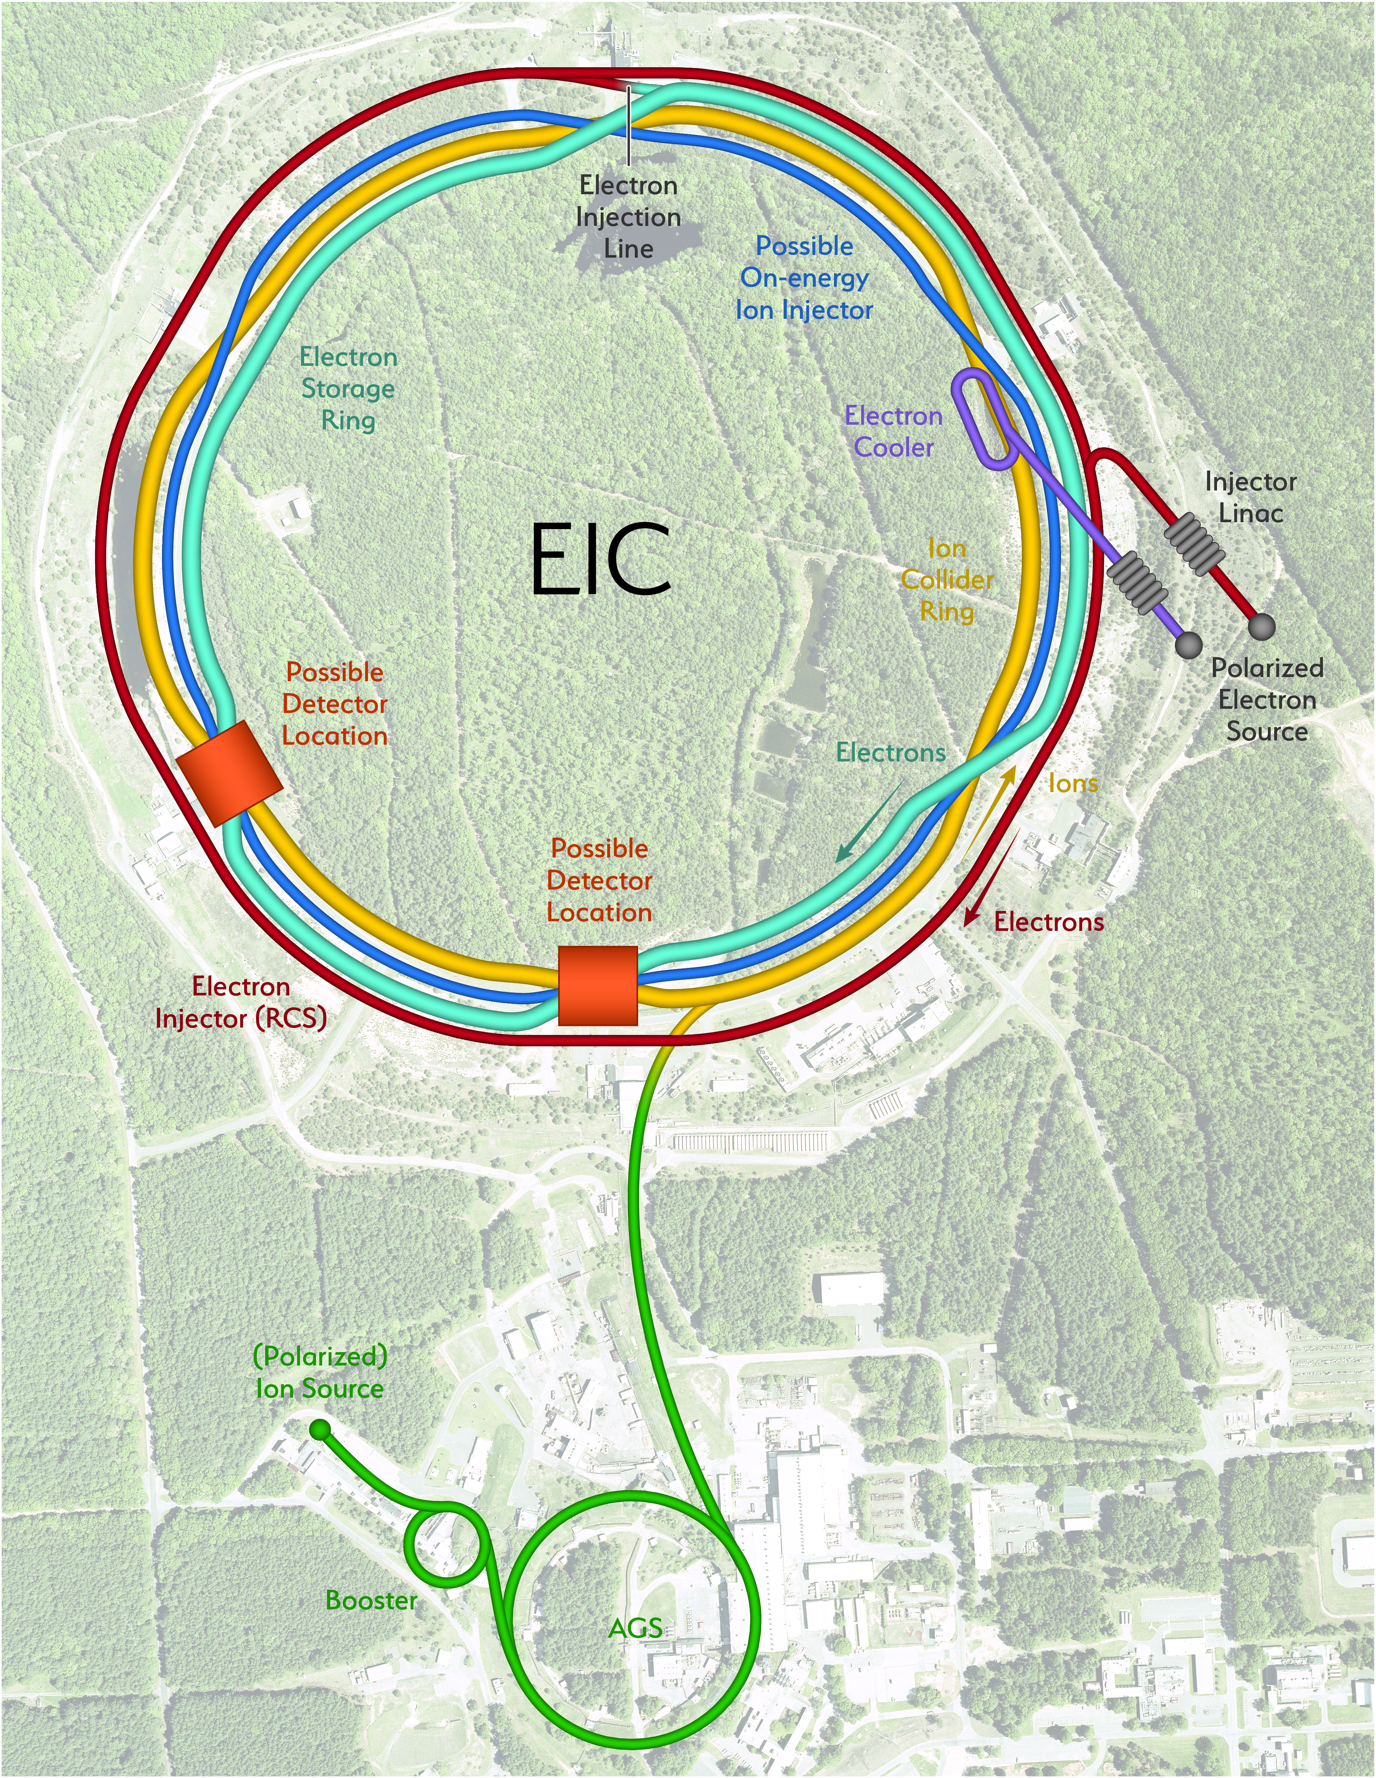
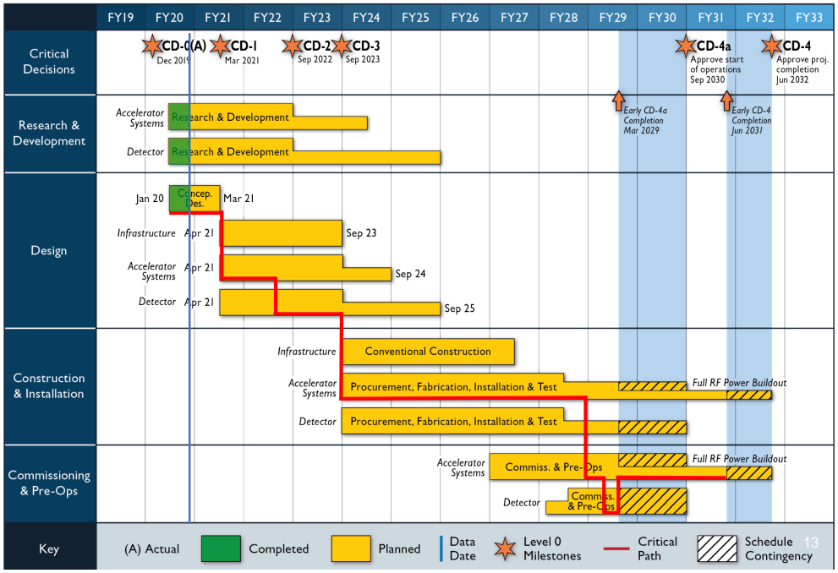
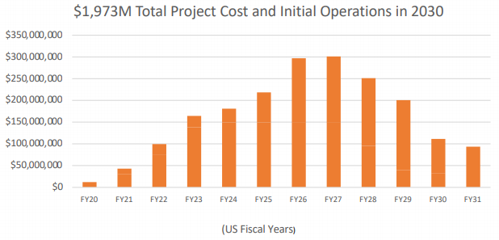
EIC Basics and Timeline
Center of Mass Energies: 20 GeV – 141 GeV
Maximum Luminosity: 10³⁴ cm⁻²s⁻¹
Hadron Beam Polarization: 80%
Electron Beam Polarization: 80%
Ion Species Range: p to Uranium
Interaction regions: up to two

Slide 10
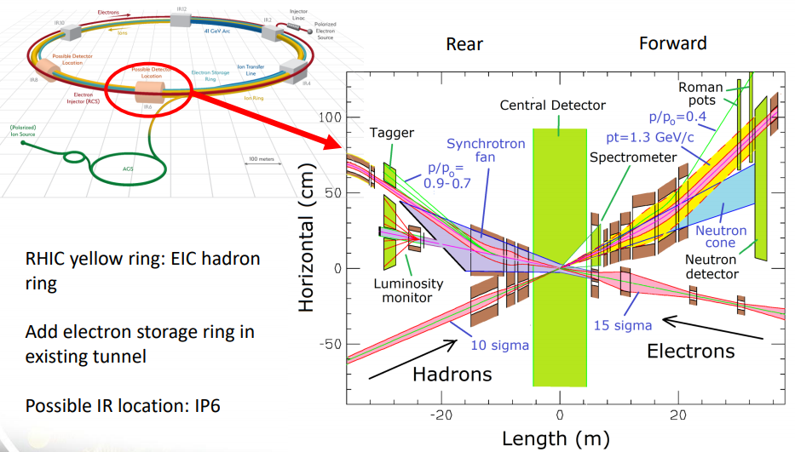
Interaction Region
+/- 4.5 meters for detectors
Limited outside radius

Slide 11
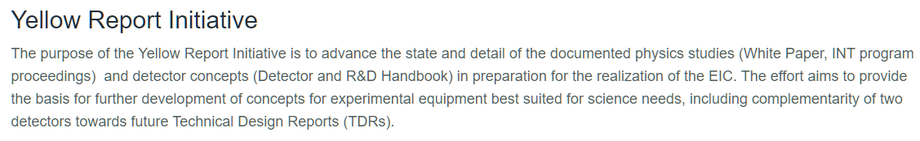
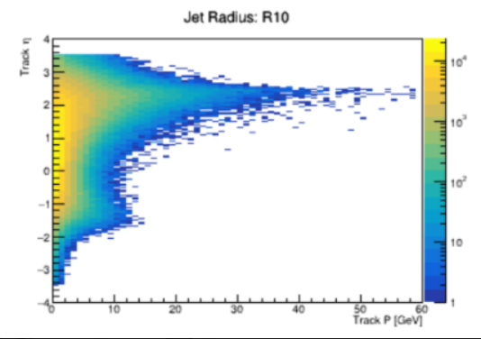
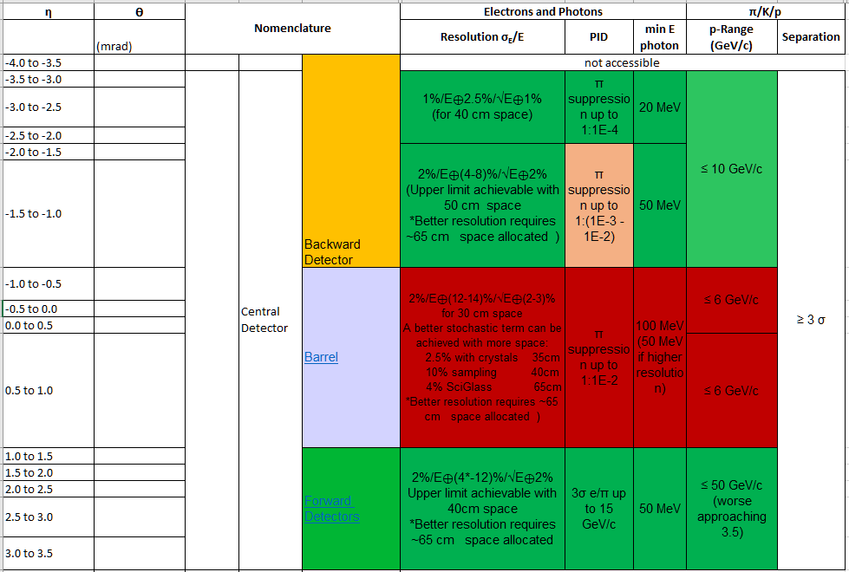
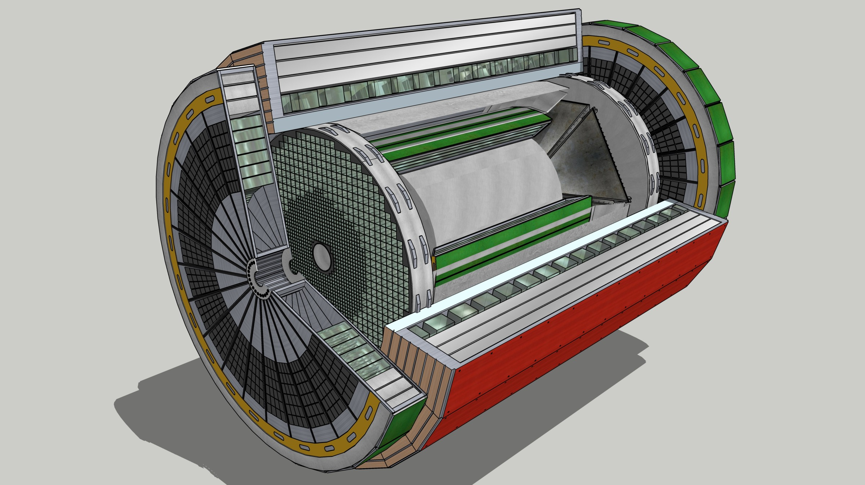
Asymmetric!!
Generic All-purpose Detector

Slide 12
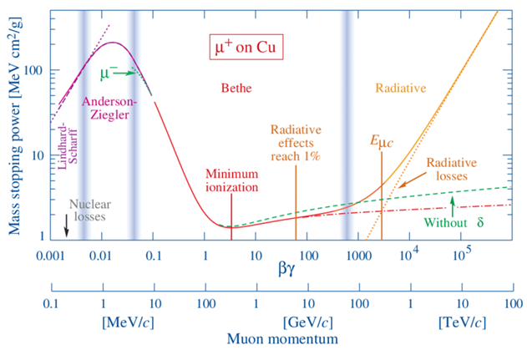
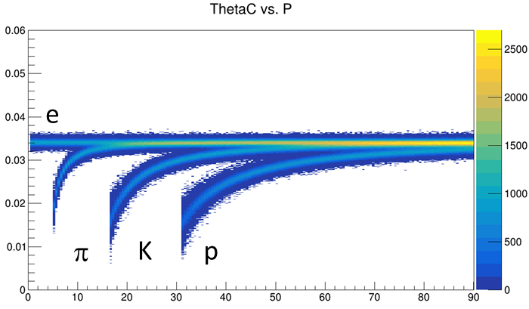
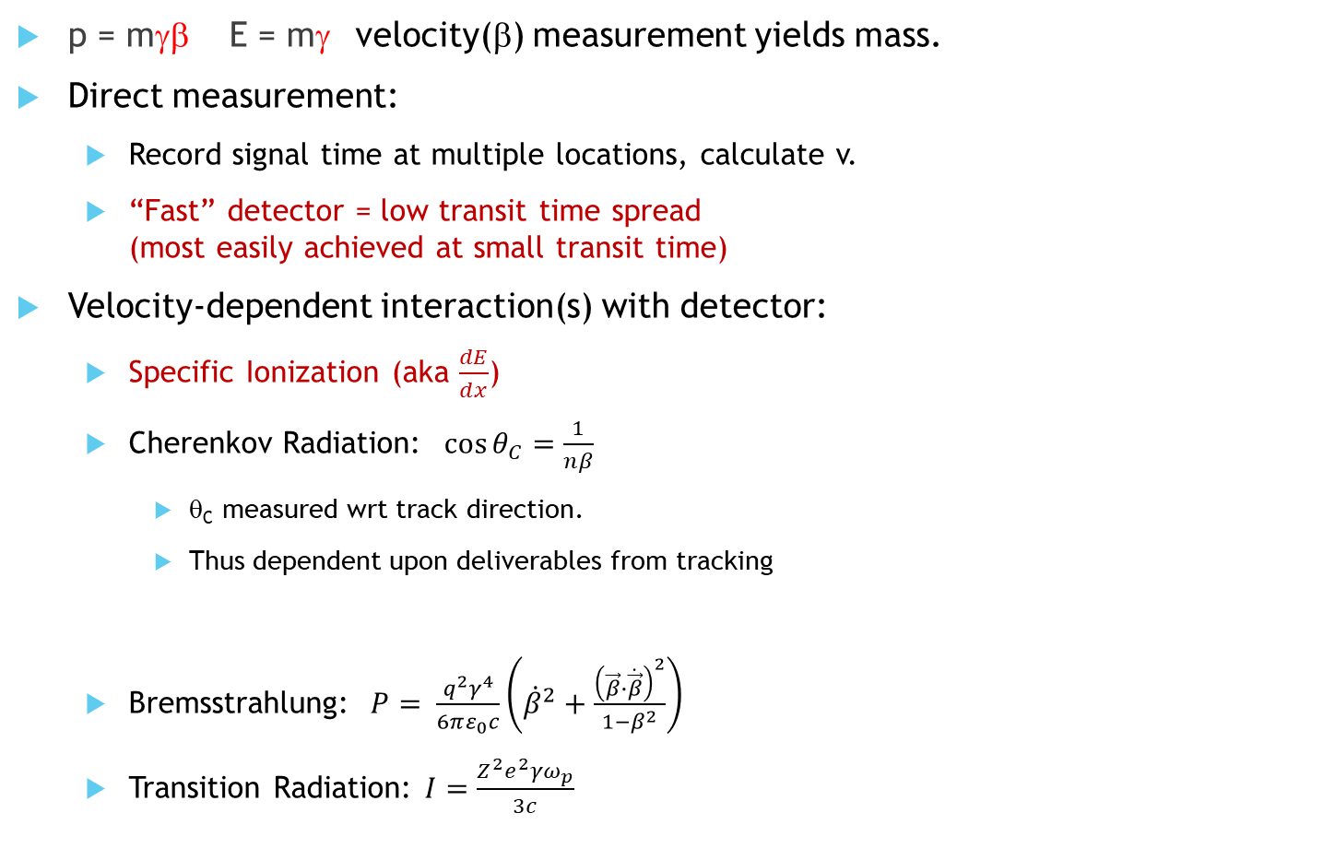
PID ~ Velocity
p = mγβ E = mγ velocity(β) measurement yields mass.
Direct measurement:
  Record signal time at multiple locations, calculate v.
  “Fast” detector = low transit time spread
  (most easily achieved at small transit time)
Velocity-dependent interaction(s) with detector:
  Specific Ionization (aka $\frac{dE}{dx}$)
  Cherenkov Radiation: $\cos{θ_{C}=\frac{1}{nβ}}$
    θ_{C} measured wrt track direction.
    Thus dependent upon deliverables from tracking
  Bremsstrahlung: $P= \frac{q^{2}γ^{4}}{6πε_{0}c}\left({\dot{β}}^{2}+\frac{{\left(\vec{β}∙\dot{\vec{β}}\right)}^{2}}{1−β^{2}}\right)$
  Transition Radiation: $I=\frac{Z^{2}e^{2}γω_{p}}{3c}$
eID mechanisms
TOF covered well in prior presentations, not repeated here

Slide 13
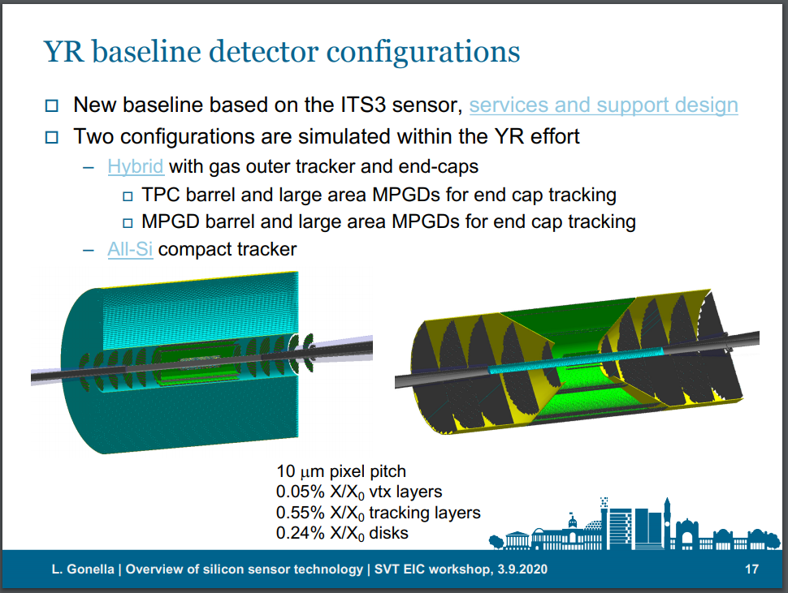
Available Space Depends Upon Tracking Options
Cylindrical defining volume
+/- ~ 1.2 meters
Outer radius:
  ~20 cm for hybrid
  ~50 cm for All-silicon
Hybrid Option allows for dE/dx
MUCH smaller than STAR or ALICE
LAURA GONELLA

Slide 14
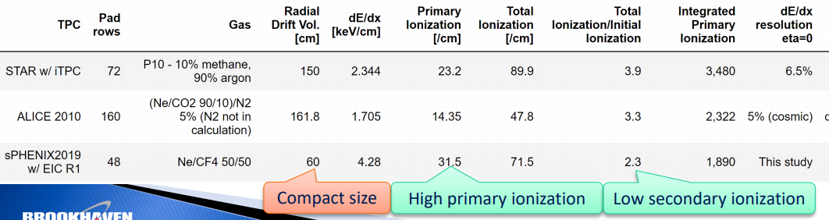
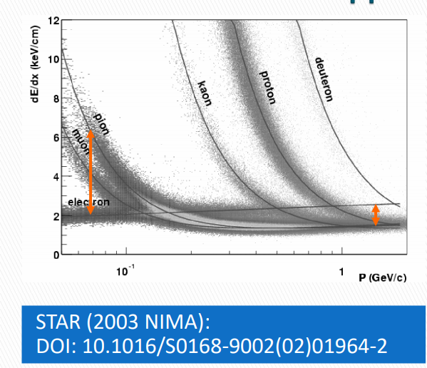
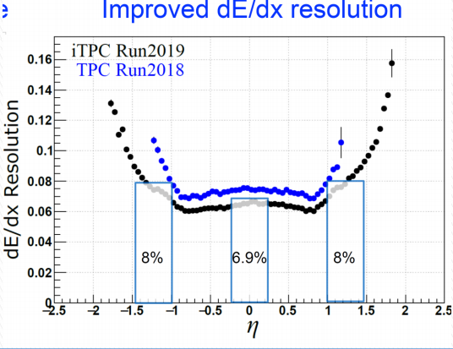
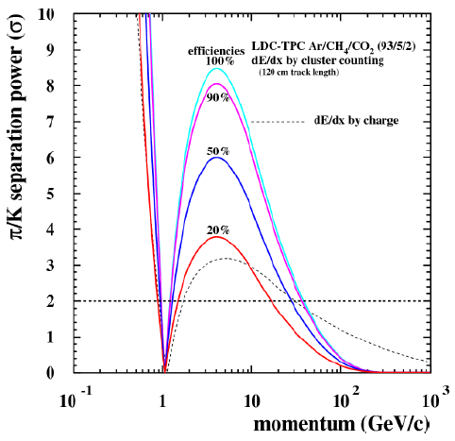
dE/dx w/ hybrid detector
Goal: Achieve dE/dx performance with least gas volume
Specific ionization is a function of β.
PID bands vs momentum.
Crossing ~β = 0.7 (TOF can help)
Limitations from Landau tails:
  Primary ionization Statistics = Poisson
  Total ionization = Landau
  Traditional Approach:
    Lots of gas & lots of samples
  Forward thinking approaches:
    Gas choice to minimize Landau
    “Cluster Counting”
Dots = STAR
Boxes = sPHENIX Test Beam

Slide 15
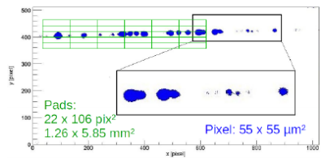
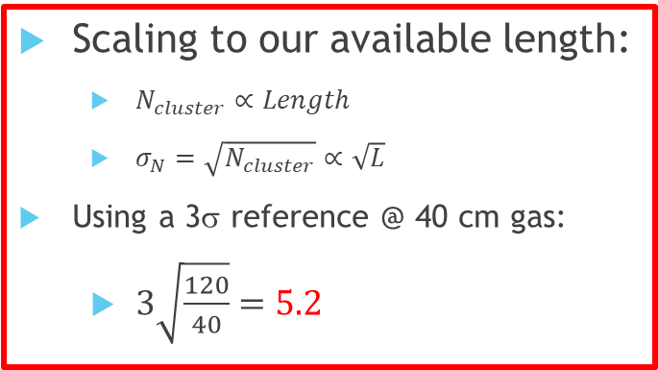
Speculative Cluster Counting Concept
Scaling to our available length:
  $N_{cluster}∝Length$
  $σ_{N}=\sqrt{N_{cluster}}∝\sqrt{L}$
Using a 3σ reference @ 40 cm gas:
  $3\sqrt{\frac{120}{40}}=5.2$
Existing Concept (“Timepix”)
  Avalanche onto Silicon Pixels
  Tiny Pixels (smaller than cluster spacing)
  Sufficient gain for single electron
In principle can work
Expensive for large area.
Can we accomplish with conventional tech?

Slide 16
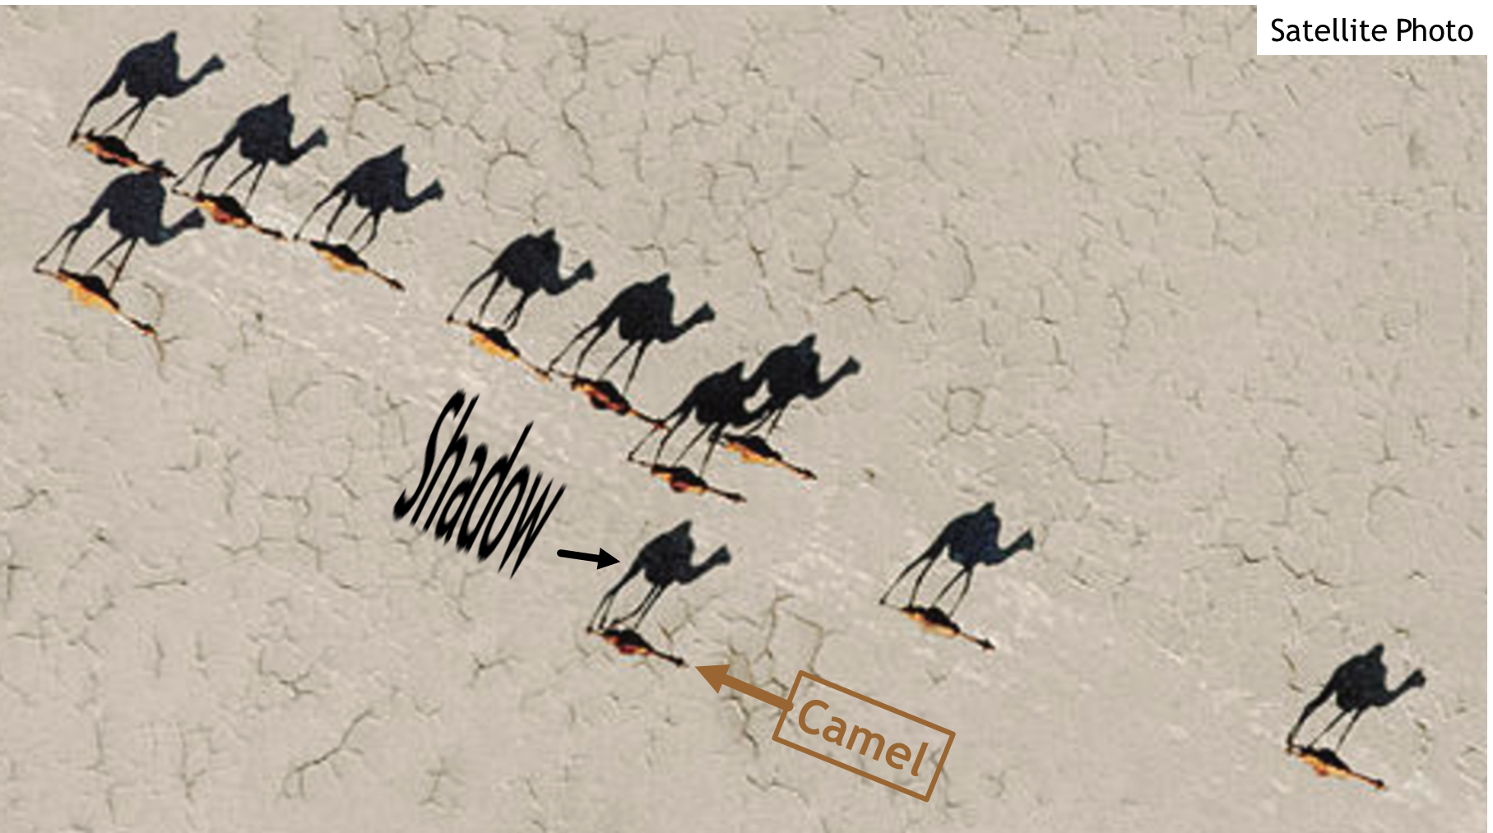
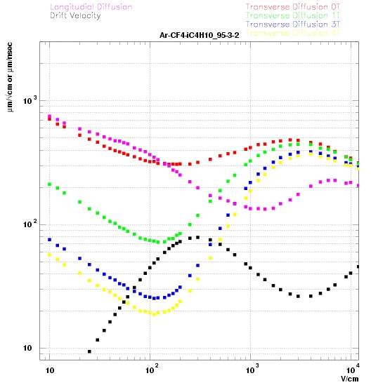
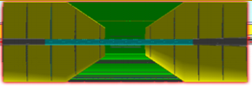
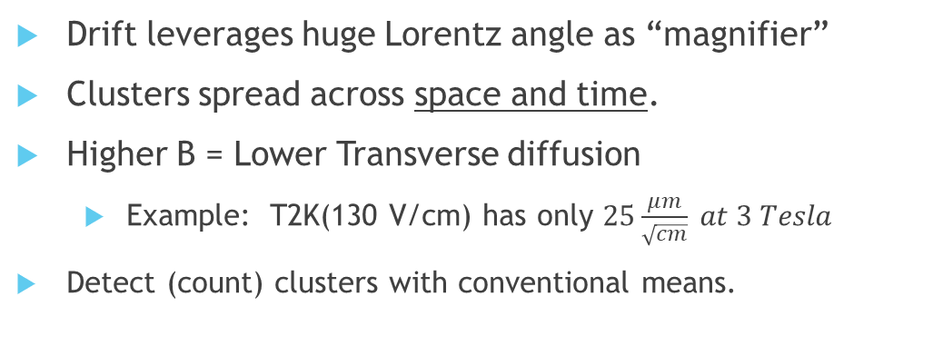
Long Shadow Detector -- LSD
Bad for Tracking
Good for PID
Multiple sections…
New Concept: Like a “Streak Camera”
Sensors
B-field
track
HV-
Silicon Tracker
Drift leverages huge Lorentz angle as “magnifier”
Clusters spread across space and time.
Higher B = Lower Transverse diffusion
  Example: T2K(130 V/cm) has only $25\frac{μm}{\sqrt{cm}} at 3 Tesla$
Detect (count) clusters with conventional means.
Early Conceptual Stage: Requires R&D

Slide 17
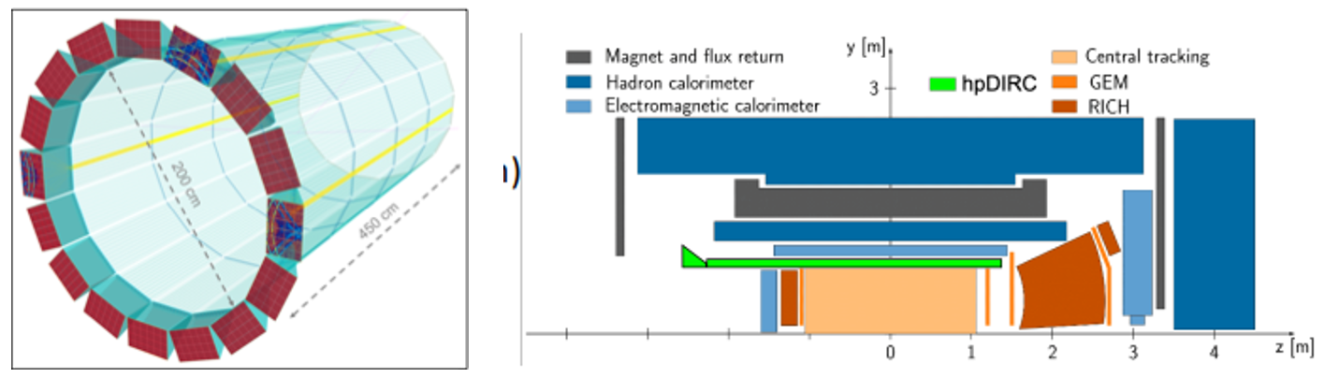
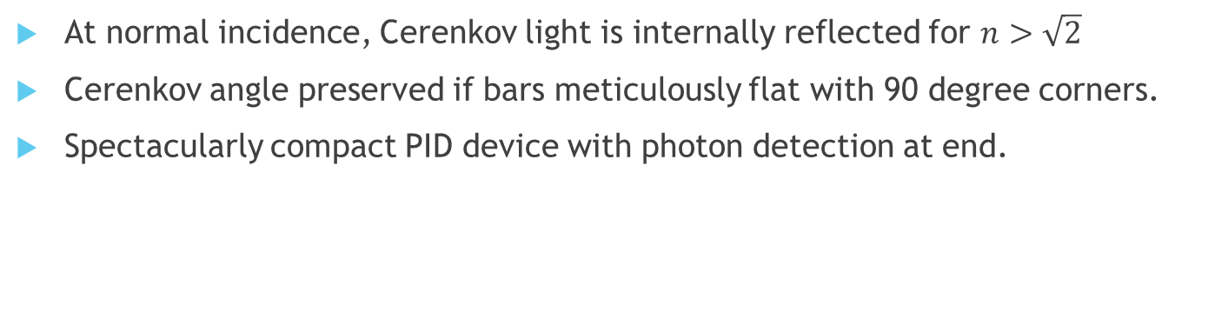
Leading Barrel PID Technology: DIRC
hpDIRC ala eRD14
DIRC in sPHENIX
:
At normal incidence, Cerenkov light is internally reflected for $n>\sqrt{2}$
Cerenkov angle preserved if bars meticulously flat with 90 degree corners.
Spectacularly compact PID device with photon detection at end.
Generic reference design: 1m barrel radius, 16 sectors
176 bars: synthetic fused silica,17mm (T) ´ 32mm (W) ´ 4200mm (L)
Photo sensors: MCP-PMTs -3x3mm2 pixels
17

Slide 18
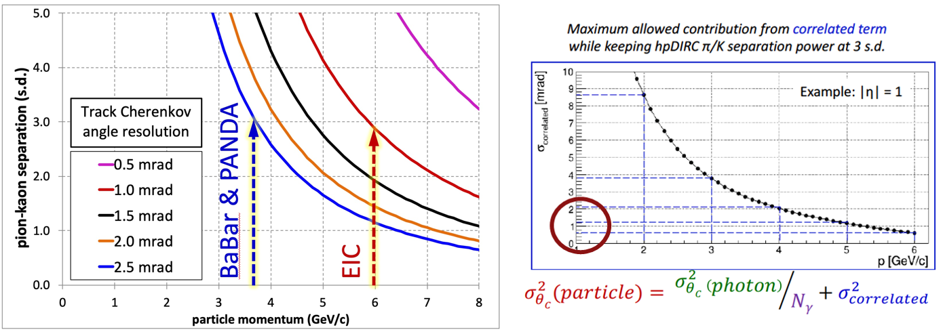
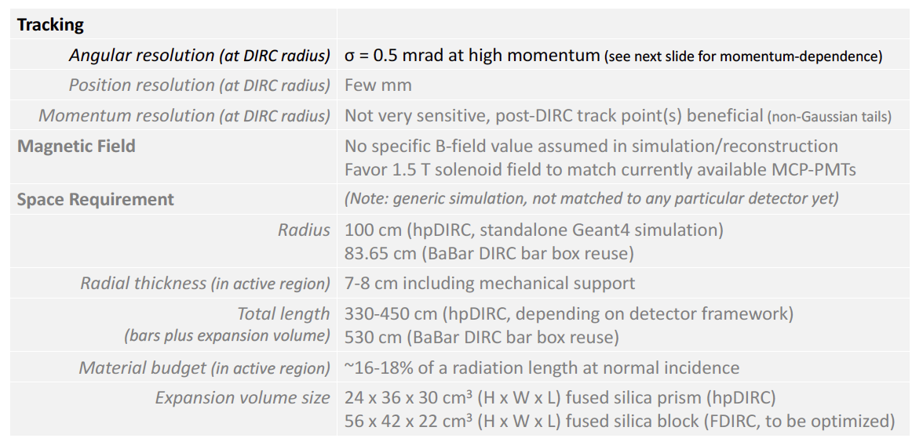
hpDIRC Performance Simulations
Original BaBar DIRC was effectively “proximity focused”
hpDIRC section creates focused ring improving resolution.
Excellent match to EIC needs.
Strict requirements on “correlated terms”,
(e.g. angular resolution of tracking)
Works with either standard tracking solution.

Slide 19
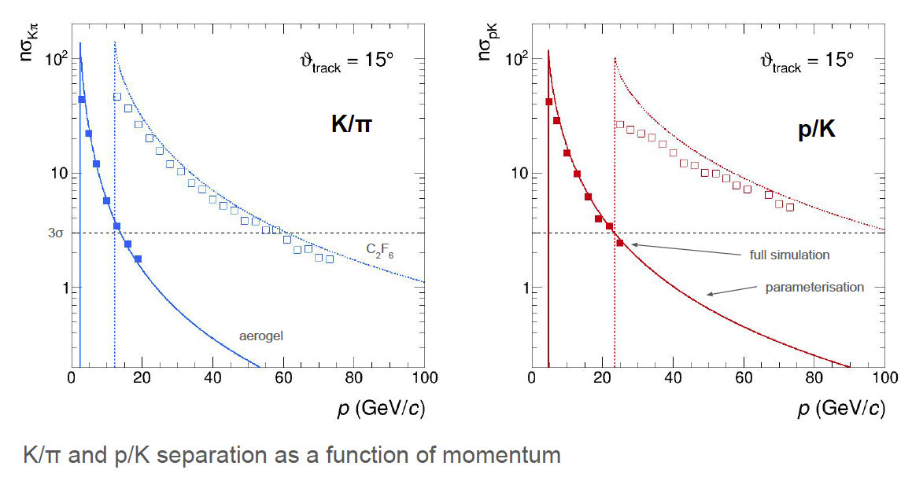
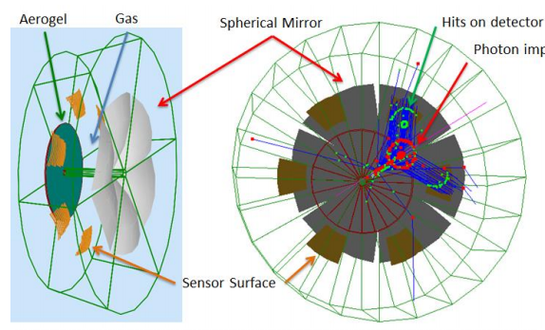
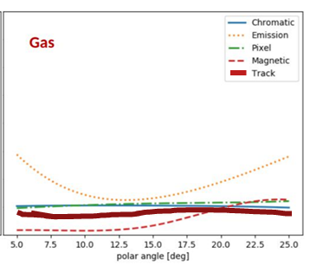
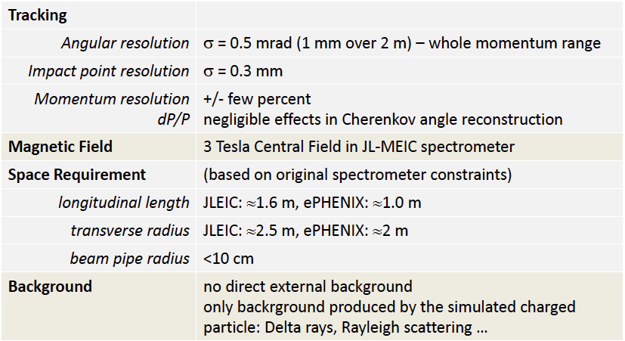

Hadron End: Dual RICH
Cherenkov radiator
○ Refractive Index
n = 1.02 (aerogel) 1.0008 (C₂F₆)
○ Length of the radiator
L = 4 cm (aerogel) , 160 cm (C₂F₆)
Mirrors
Photon Detector
3 mm pixel size; 200-500 nm MAPMT
Particle Generation
Originate from the vertex
Exquisite detail in simulation.
AI-based optimization.
Uses constant external angular resolution assumption.
Similar external constraint assumed as deduced for separate gas & aerogel RICHes
Tracking maybe tolerates ~2X sim
(0.5 – 1.0 mrad)
NOTE: PMTs to the side makes optical aberration (“Emission”) dominant

Slide 20
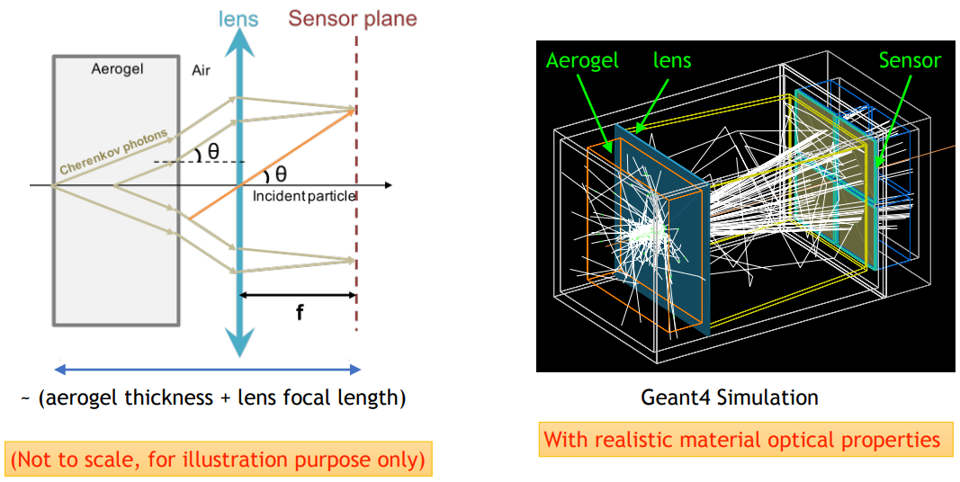
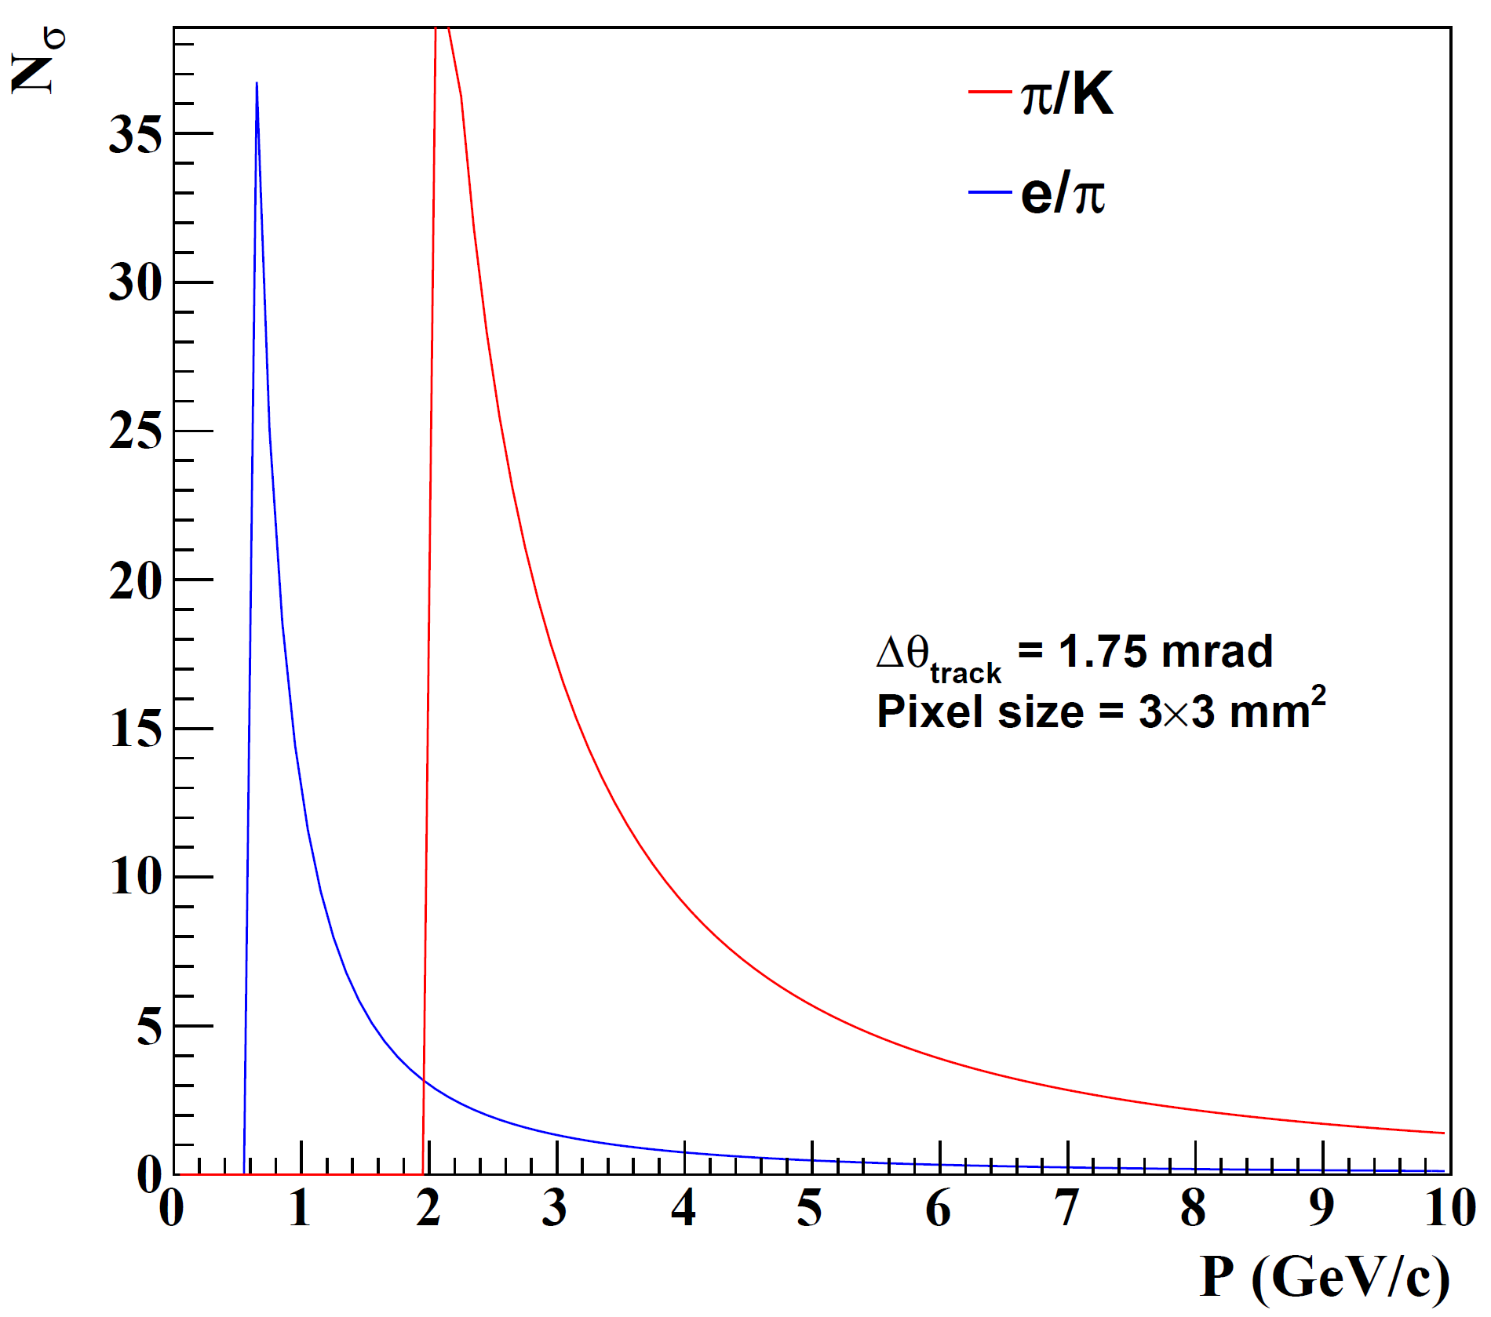
Electron Arm: Modular RICH
Cherenkov radiator
(Aerogel) refractive index, n = 1.03
Length of the radiator, L = 3cm
lens with focal length, 𝑓= 6”
Photon Detector
3 mm pixel size
Hadron ID requirements relaxed…aerogel only
Additionally require eID ~ 4GeV/c
Modular RICH focused by Fresnel Lens
  Sharp image improves resolution.
  Transmission of lens combats dispersion
Provides TOF with suitable readout device (LAPPD)
NOTE: Similar performance to aerogel in dRICH

Slide 21
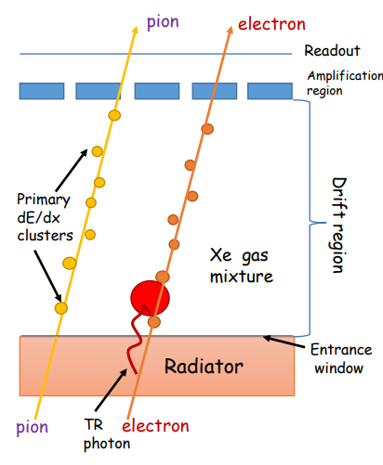
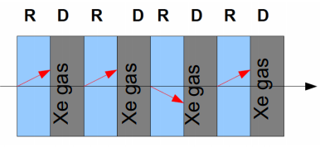
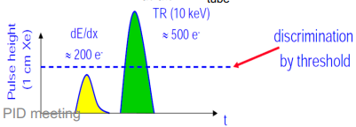
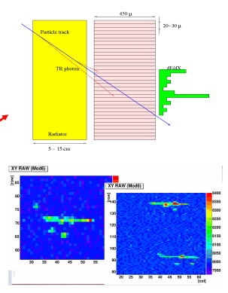

eID by Transition Radiation (TRD)
3: ID TR photons by energy/pos
1: Make TR photons:
Index, n, change
X-ray regime
Film, foam, fleece
2: Layered to get more photons
4: Reject Pions
“Threshold detector” (TR X-rays produced or not)
P_{min} ~ 1 GeV (rejection ~constant at higher momentum)
Balance between X₀ and rejection

Slide 22




eID by Hadron Blind Detector
Unfocused
Threshold
Cherenkov
electron
Limited by 1st Gap
Garfield + Fast Monte Carlo
Pion Signals Simulated
PHENIX HBD optimized for 1e-vs-2e separation.
  20 photoelectrons vs 40 photelectrons
Non-zero hadron response.
Re-optimize for EIC??
1st Gap Dominates!
Fractional Contribution to signal

Slide 23




Speculative HBD++ ??
HBD: Phenix
HBD+: Gem + 1-stage μM gain
HBD++: GEM _ 2-stage μM gain
Conceptual Idea
G
μ₁
μ₂
microMEGAS provide the smallest gas length.
Gain from any or all of three layers:
  Gain from GEM
  Gain from μ₁
  Gain from μ₂
Speculative! Requires R&D

Slide 24



Time-of-Flight
MCP: Micro Channel Plate
Direct measurements of velocity require a fast charge collection device.
The time resolution is automatically helped by small devices:
  LGAD: Low Gain Avalanche Device. Instantly small.
  MCP: Micro Channel Plate ➔ LAPPD (Large Area Picosecond Photon Detector)

Slide 25



TOF @ EIC: Available space
PID from TOF requires:
  Time resolution.
  Maximum path length.
Known ring makes size restrictions!
  Civil construction already there.
  One ring outsize the detector.
Practical Implementation:
  Tempting to assume time resolution scales as $\sqrt{N}$
  Extreme care required to minimize or eliminate correlated errors
  (e.g. “start clock jitter”)

Slide 26

Summary
Electron Ion Collider has passed “CD0” and will be built at BNL.
Detector challenges in PID are exacerbated by limited available space.
Asymmetric collisions lead to asymmetric requirements
Options exist to leverage
  TOF.
  Cherenkov
  dE/dx
Solutions seem to be in hand.
More R&D possible on alternative speculative avenues.

Slide 27
BACKUP SLIDES

Slide 28



Summary
Cherenkov Pointing:
  Parameterizations of gas Cherenkov indicate pointing required at 0.5-1.0 mrad level while inside the radiator.
  Calculations of aerogel devices indicate 0.5 -1.0 mrad level.
  Calculations of DIRC indicate 0.5 mrad level or better.
TOF:
  Path length can influence PID resolution at the best δt.
  Non-trivial influence of “material budget distribution”.
  Need deeper understanding of this issue.
PID requirements toughening with time:
  SIDIS group shown on right. Jets want even more.
  PID requirements are not symmetric in eta, driven by 0.8 → 1.0
  Is a symmetric barrel optimal at our asymmetric collider?
Old
New
Meta-materials: Game changer,
But we can’t assume these will work:

Slide 29


What is the meaning of “Long Shadow”?
Satellite Photo
Camel

Slide 30



Additional Integration Points
Gas RICH at highest momentum (hadron arm) does not enjoy an over-abundance of Cherenkov photons (love to have lots of Zed).
Angular resolutions required for Cherenkov-based PID detectors must be evaluated WITHIN the radiator:
  Services at Zed > 1.2 may scatter particle before hadron arm Cherenkov.
  DIRC bars scatter particles on their own (17 mm quartz)
  Must evaluate needs of a tracking layer behind Cherenkov devices.
Cherenkov detectors require photo-sensors
  Many technologies are sensitive to field strength and orientation.
  1 Tesla at the sensor is fine.
  Easy to achieve with central field = 1.5 Tesla.
  Very challenging but seems doable if central field
  = 3 Tesla…trade off with optical aberration as you
  move sensors back.
  SiPM sensors operate fine in the field, but radiation
  damage can lead to high rate of “false photons”
Need to minimize bending of tracks within the RICH.
Zed
Is this less than
1 mrad scattering

Slide 31


High Momentum GEM RICH
1m of CF₄ radiator at 1.003 bar (slightly overpressure)
CsI Photocathode on top GEM
Mirror in deep UV -> MgF₂ coating
Single Photon Capability ->quintuple GEM stack with APV25-SRS
Particles ~perpendicularly incident on spherical mirror, focused onto a GEM stack directly
hmm
OK
According to the parameterization, tracking is leading error contribution is worse than ~7 mrad, becomes negligible resolution factor around 2 mrad. Between 2 and 7mrad , more detailed investigation is required.
Plot shows viscerally the effect.
More detailed simulation required.
p
p
NOTE: High chromaticity =
loose requirement on tracking
Performance from Parameterized Test Beam Data

Slide 32





Ring Imaging Cherenkov
(RICH) vs. Track Direction
Trivial (just math) Calculation:
  Assume photon measured perfectly.
  Tracker makes fixed error α.
  δθ_{C} depends on both $\frac{\left\langle N_{pe}\right\rangle }{ring}$ and α!
Requirements depend upon performance
  Parameterizations:
    Wide range of assumptions possible.
  Full Monte Carlo
    Robust and Reliable results.
We present both parameterizations and full Monte Carlo calculations

Slide 33




Basic Coupling of Tracking to PID
NOTE: Where PID is excellent, it can contribute to momentum resolution.
$${\left(\frac{dm}{m}\right)}^{2}={\left(γ^{2}\frac{dβ}{β}\right)}^{2}+{\left(\frac{dp}{p}\right)}^{2}$$
NOTE:
N independent TOF measurements,
$δ_{t}→\frac{δ_{t1}}{\sqrt{N}}$
Challenges exist to make independent
  Common clock
  Etc…
Dominant Term
Cherenkov Angle (θ_{C}):
  Centroid from n
  δθ_{c} from:
    N_{photo-electrons}
    chromaticity (aka dispersion; n(λ))
    pixel size
    optical aberration (aka “emission”)
    magnetic field
    Track Pointing
  δp from tracking
Time Of Flight (TOF):
  Calculates m² using p, β.
  δm from:
    δ_{t}
    δ_{p}
    δ_{L}
  $c∙5ps=1.5 mm$
If δ_{t} is tiny,
δ_{L} is significant
Dominant
Strongly reliant upon tracking
Weakly reliant upon tracking…discussed in backup slides

Slide 34








Rey Cruz-Torres
XIN DONG
XUAN LI
SPENCER KLEIN
Håkan WENNLÖF
FRANCOIS-XAVIER GIROD
Many presentations.
Similar themes:
Si as a vertex
All-Silicon
RACHID NOUICER
ASTRID MORREALE

Slide 35


Superb e/π Separation
eRD6 RICH
prototype
eRD14 “dual RICH”
simulation
Focused Gas RICH
Low index gas pushed the e/π out to 15 GeV or beyond.
Compromise parameter is Zed length:
  1-1.5 meters in Zed
  Under study:
    Move Z_{vertex} toward –η exacerbating the space issue.
Notice:
eID needs met w threshold device
Optics maybe unnecessary

Slide 36


psTOF
Several technologies reviewed, no one chosen yet
AC-LGADs could provide a very good tracking layer (~100 um) + timing (20 ps)
External start time provided by forward detectors could be helpful
Study of Self-timing (Internal) using tracks
TOF needs a measurement of p and L
As δt➝5 ps, requires precision path length L ( c*δt~1.5 mm…tracking must exceed this.)
Multiple scattering might be the biggest worry, need to ensure low material budget and/or enough tracking layers to catch scattering.
Depends partly upon the material that does not provide position measurement:
36

Slide 37


Slide 38


More Compact Cherenkov eID Detectors
Modular RICH:
Fresnel-focused compact RICH
eRD14 “hpDIRC”
Close to 4 GeV.
Effective enough alone?
Complementary detector?
  TRD?
  dE/dx?
Useful at the lowest momenta.
Performance limited by Mult. Scattering.
Detailed simulations req’d and underway
Expectation:
  3-4σ @ 1 GeV
eRD14 “mRICH”

