Slide 1
CEPC?
FCC-ee?
2018
Past, present & future of B physics
& role of particle identification
Yuehong Xie
Central China Normal University
IAS program on High Energy Physics, 14-21 Jan 2021

Slide 2
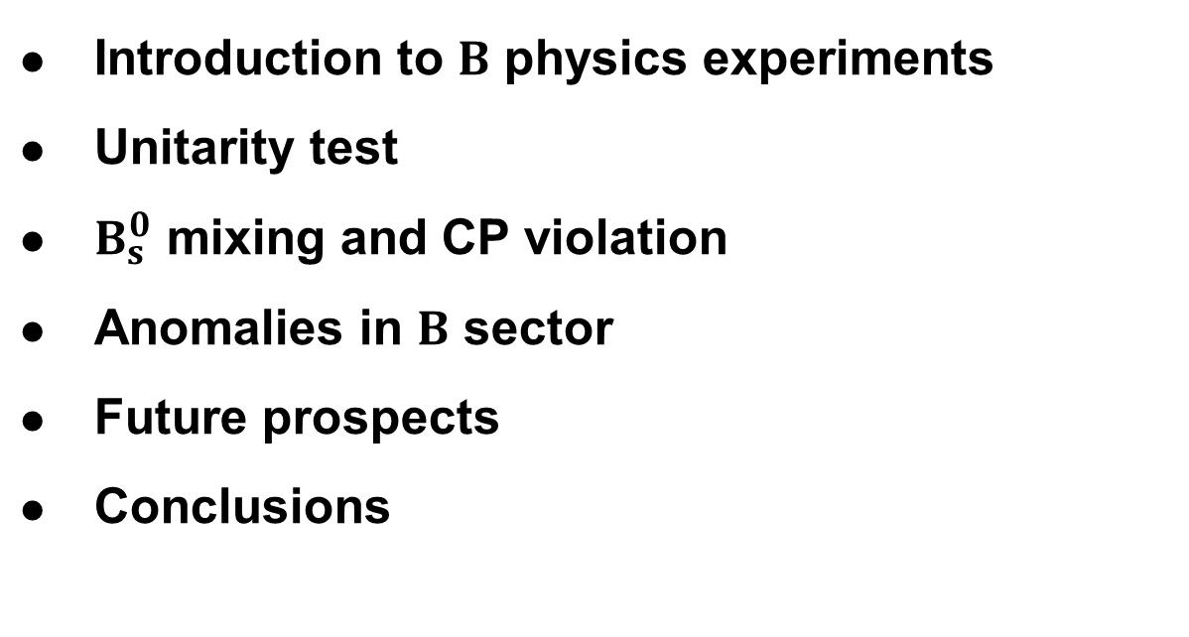
Outline
Introduction to $B$ physics experiments
Unitarity test
$B_{s}^{0}$ mixing and CP violation
Anomalies in $B$ sector
Future prospects
Conclusions
2

Slide 3
Introduction to B physics experiments
3

Slide 4

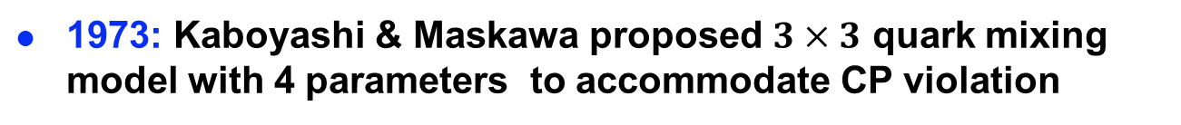
Timeline of B physics
1973: Kaboyashi & Maskawa proposed $3×3$ quark mixing model with 4 parameters to accommodate CP violation
1977: Upsilon ($b\overline{b}$) meson discovered by E288 at Fermilab
1981: I. I. Bigi & A. Santa pointed out the expectation of large CP violation in $B^{0}$ decays according to CKM theory
1987: P. Oddone proposed construction of asymmetric B factories to study CP violation in B decays
1999: BABAR and BELLE started running
New century: Tevatron & LHC experiments entered the game
B physics has played a central role in the advance of particle physics in recent decades
4

Slide 5



Key B physics measurements
Decay rates and mixing frequencies for determination of magnitudes of CKM matrix elements
CP asymmetries for determination of phases of CKM matrix elements
$$B→DK$$
$$B^{0}→J/ψK_{S}^{0}$$
$$B_{s}^{0}→J/ψφ$$
5

Slide 6
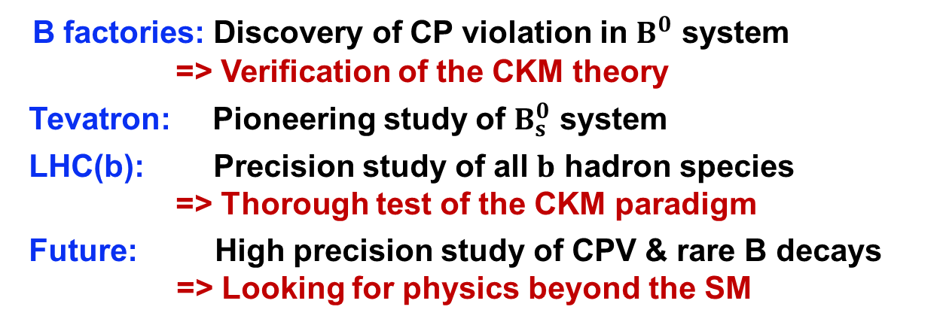
Major players in B physics
CEPC?
FCC-ee?
2018
B factories: Discovery of CP violation in $B^{0}$ system
=> Verification of the CKM theory
Tevatron: Pioneering study of $B_{s}^{0}$ system
LHC(b): Precision study of all $b$ hadron species
=> Thorough test of the CKM paradigm
Future: High precision study of CPV & rare B decays => Looking for physics beyond the SM
6
6

Slide 7
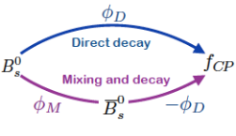


Top goal: CPV in neutral $B$ decays
amplitude ratio
CP eigenvalue
Time-dependent CP asymmetry
Need to determine
  Initial flavor of the $B$meson: kaon and lepton PID essential
  Decay time of the $B$ meson: vertex reconstruction essential
7

Slide 8

Essential requirements on detector
Ability to find signals and suppress background
  Good momentum and mass resolution
  Excellent particle identification
  Flexible and efficient trigger (for hadron colliders)
Ability to identify the initial B flavor
  Excellent particle identification for $e^{±}, μ^{±}, K^{±}$
Precise measurement of proper decay time
  Excellent vertex resolution
=> Very demanding on the capacity of
Track & vertex reconstruction
Hadron & electron identification
8

Slide 9
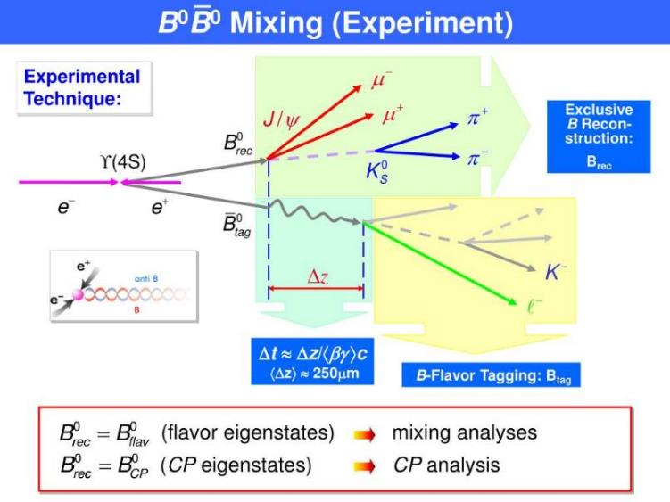
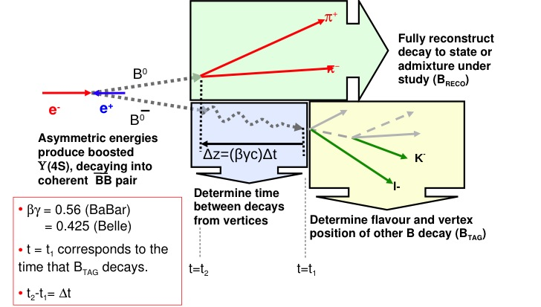
The Babar approach
taggers
Clean environment: only $B$ and $\overline{B}$ are produced in $Υ\left(4S\right)$ decays!
9

Slide 10
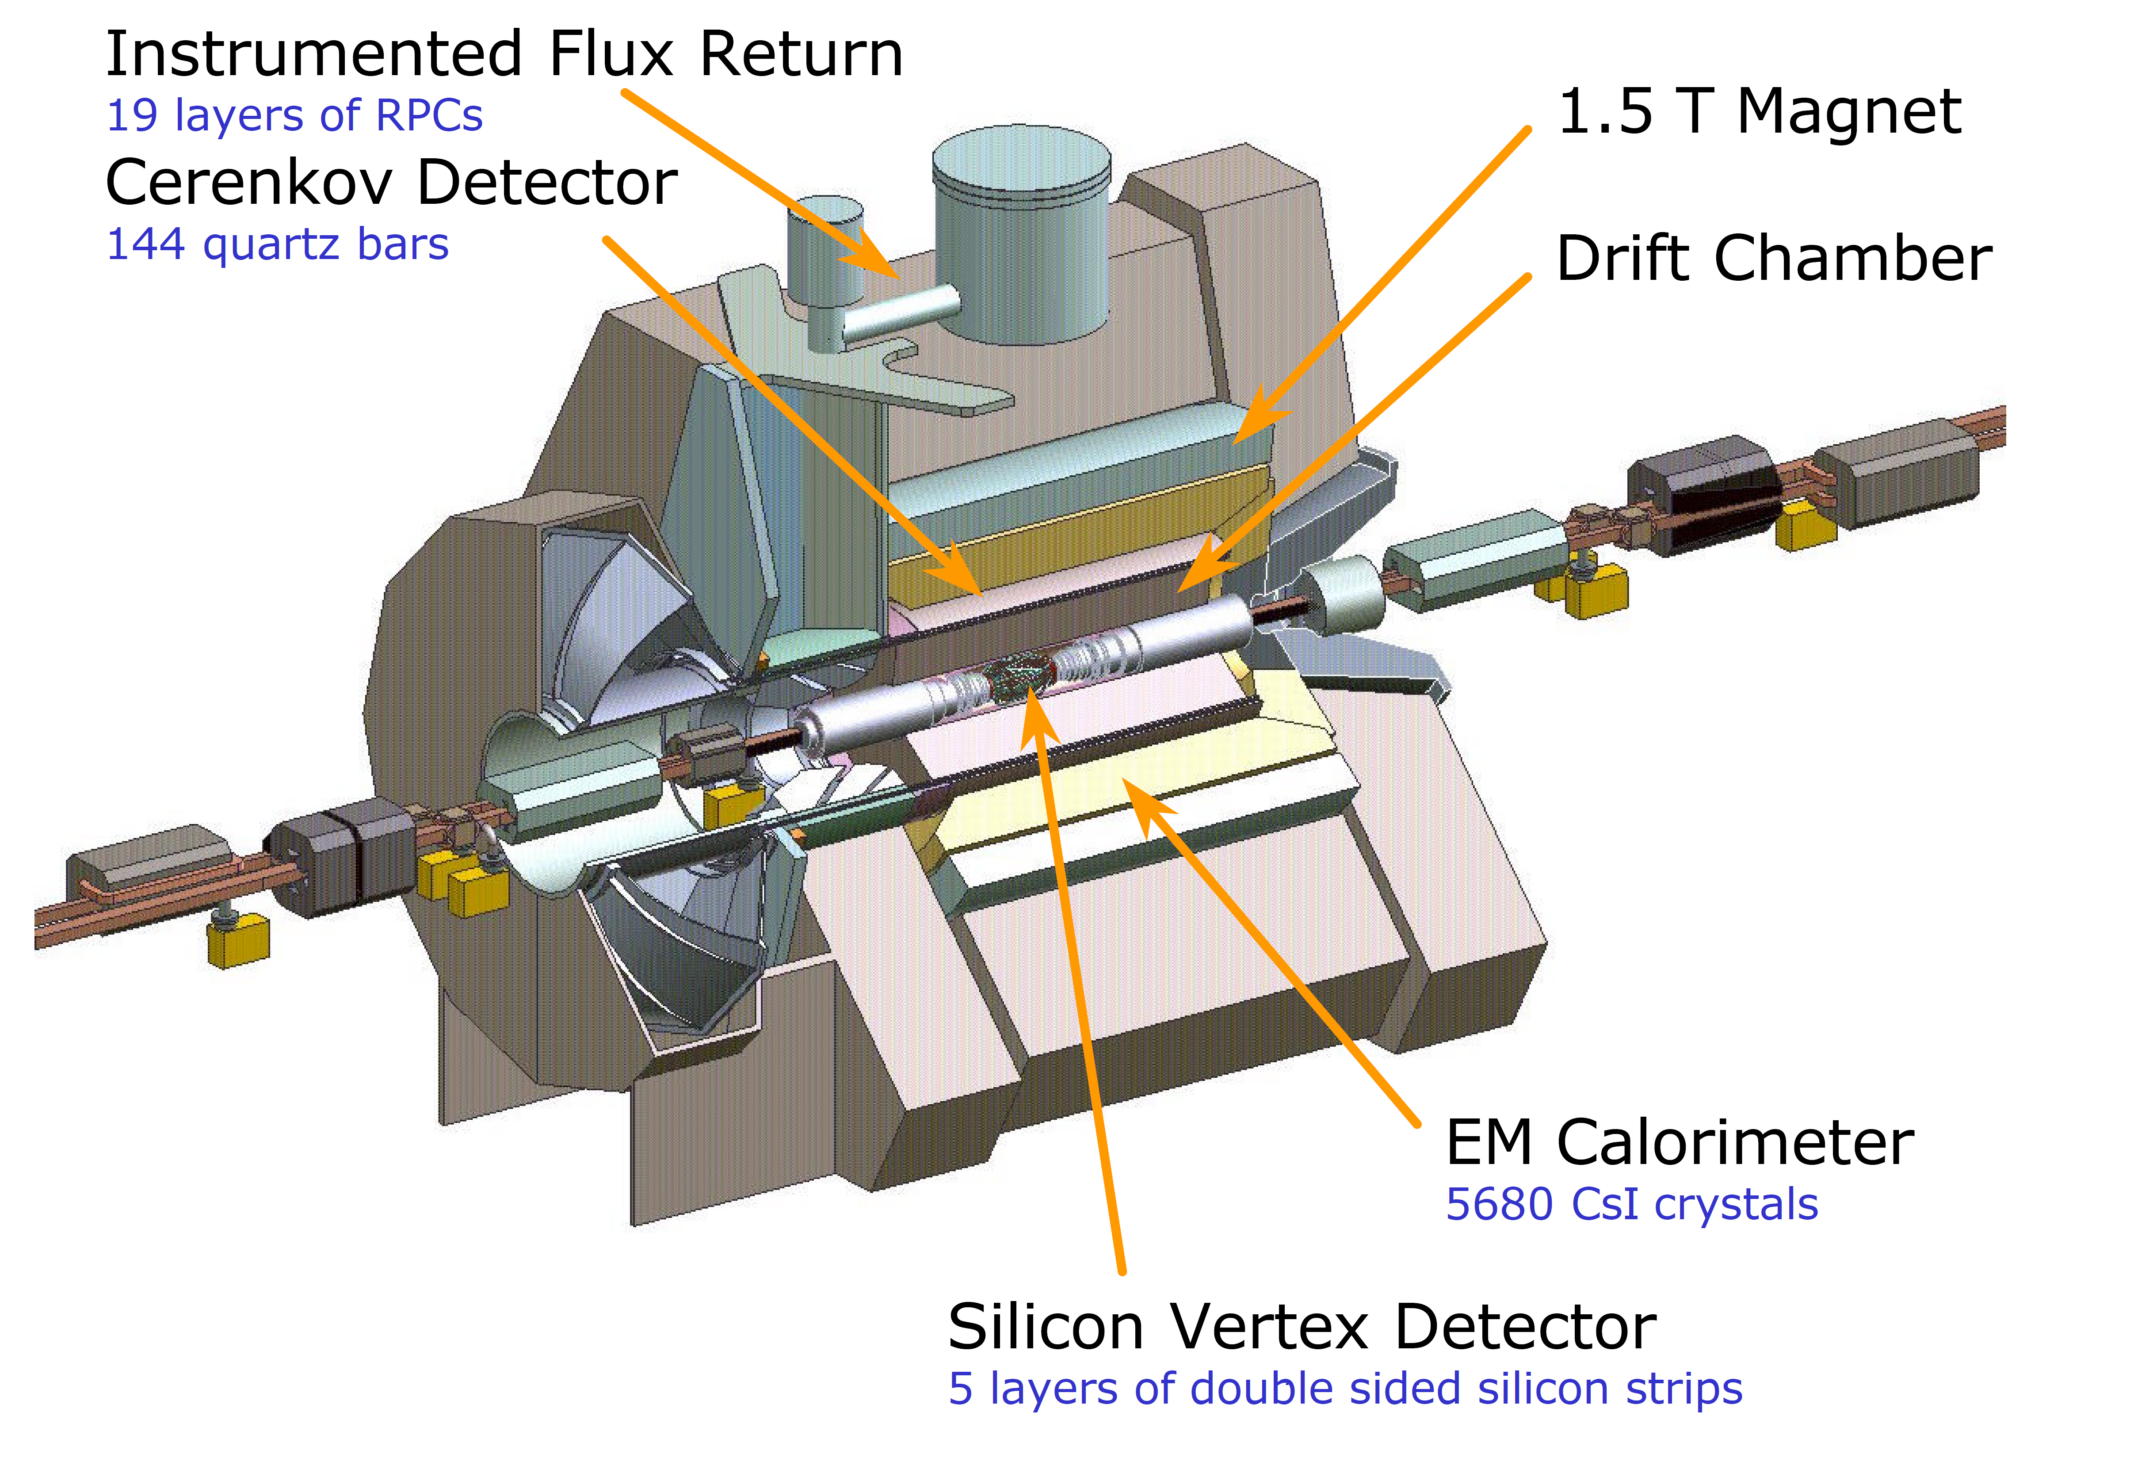

Babar detector
Tagging power $ε{\left(1−2ω\right)}^{2}∼35\%$
Time resolution $∼1.5 ps$, $B^{0}$ oscillation period $∼12 ps$
10

Slide 11
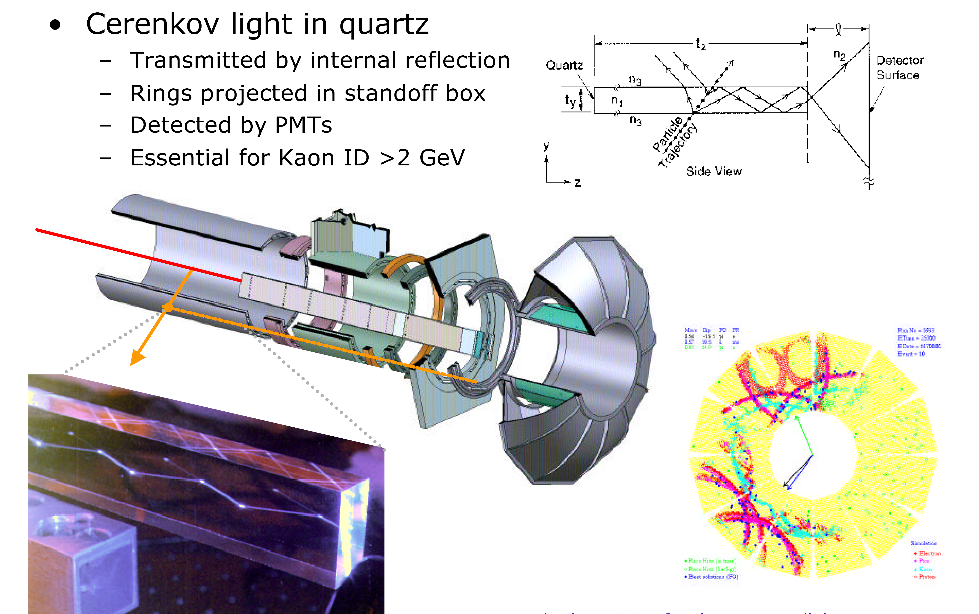
Babar Cherenkov detector
11

Slide 12
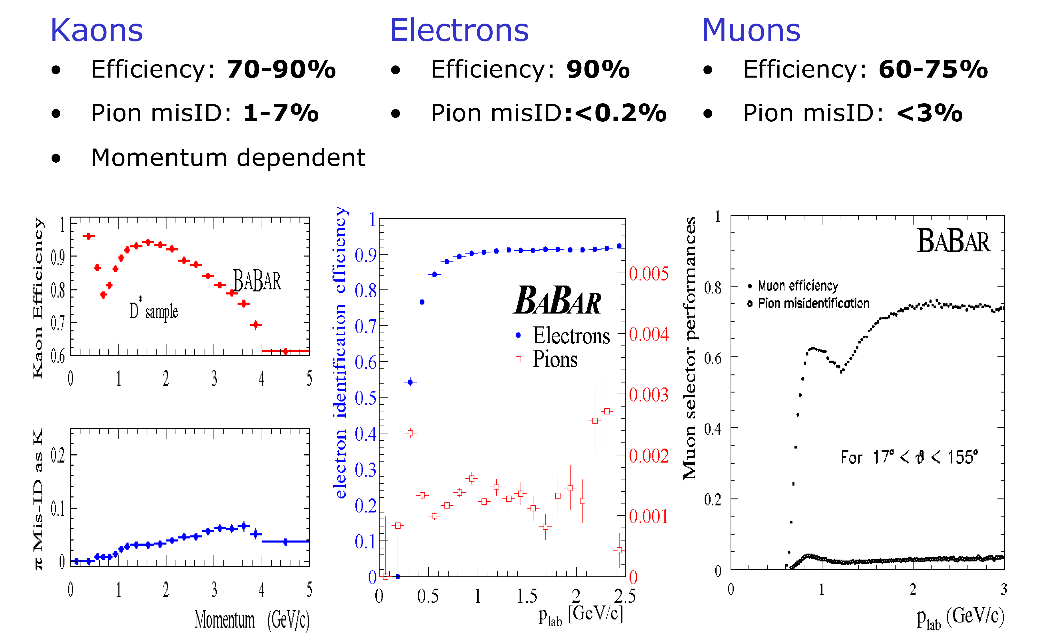
Babar PID performance
12

Slide 13


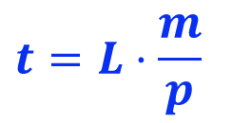
The LHCb approach
$$L$$
$$t=L⋅\frac{m}{p}$$
Prompt particles produced in $pp$ collision facilitate PV reconstruction, but also form a huge background.
13

Slide 14
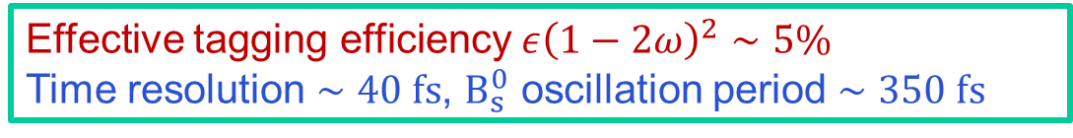
LHCb detector
Effective tagging efficiency $ε{\left(1−2ω\right)}^{2}∼5\%$
Time resolution $∼40 fs$, $B_{s}^{0}$ oscillation period $∼350 fs$
14

Slide 15
LHCb RICH detectors
15

Slide 16
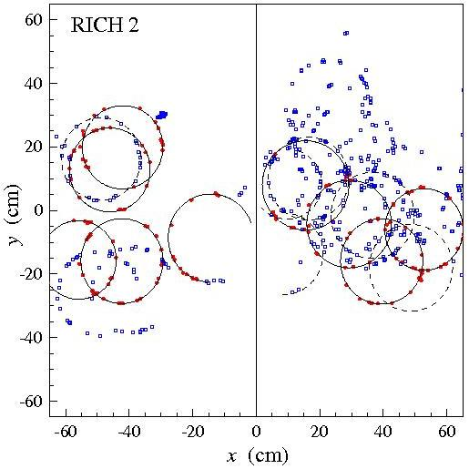
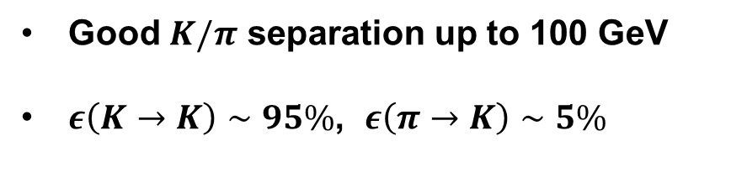
Hadron identification
Good $K/π$ separation up to 100 GeV
$ε\left(K→K\right)∼95\%$, $ε\left(π→K\right)∼5\%$
Two Ring Imaging Cherenkov detectors
16

Slide 17
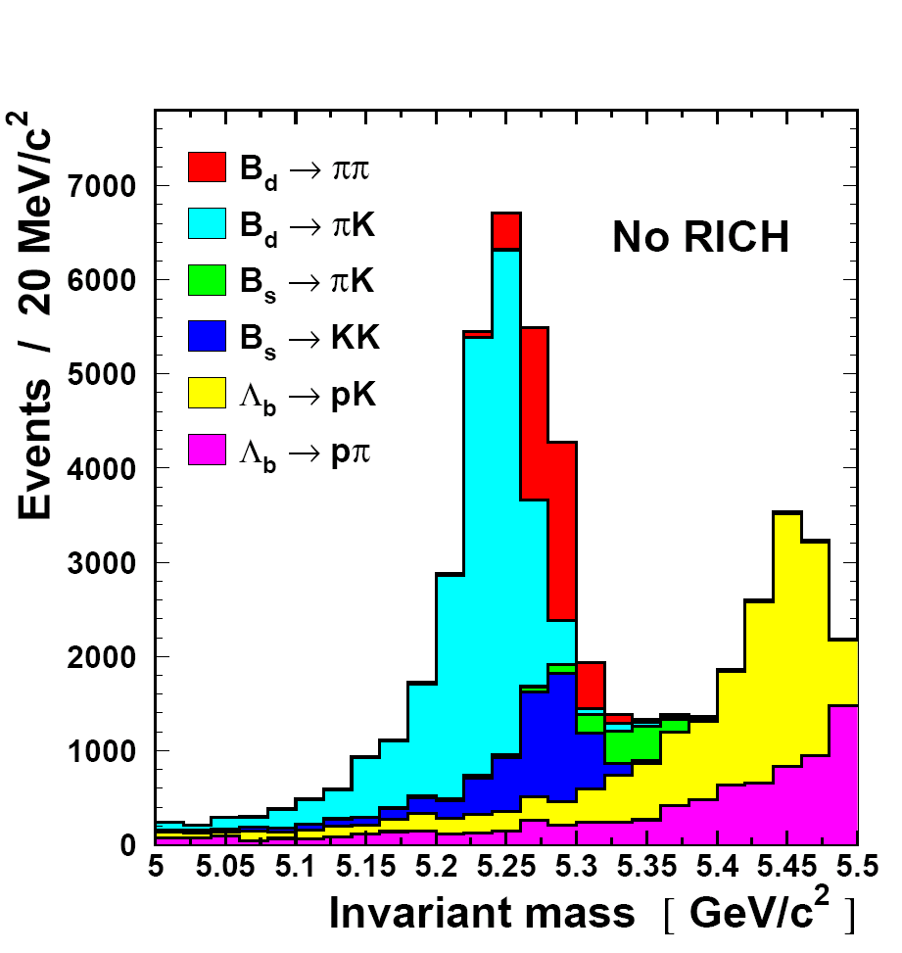
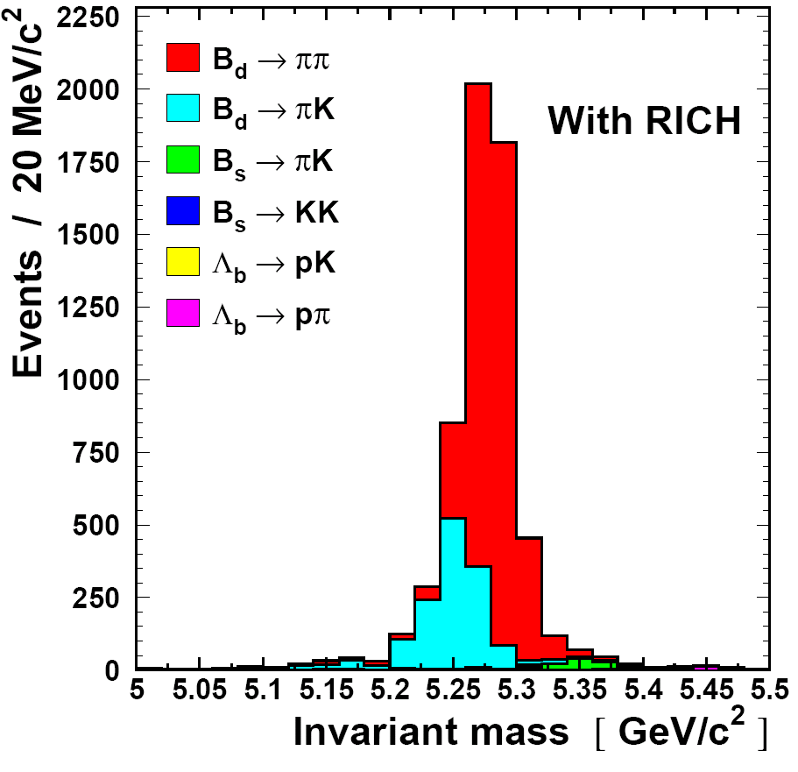
The RICH Magic
Signal decay
Background
Invariant mass distribution of B → ππ decays including background
17

Slide 18
LHCb muon stations
18

Slide 19
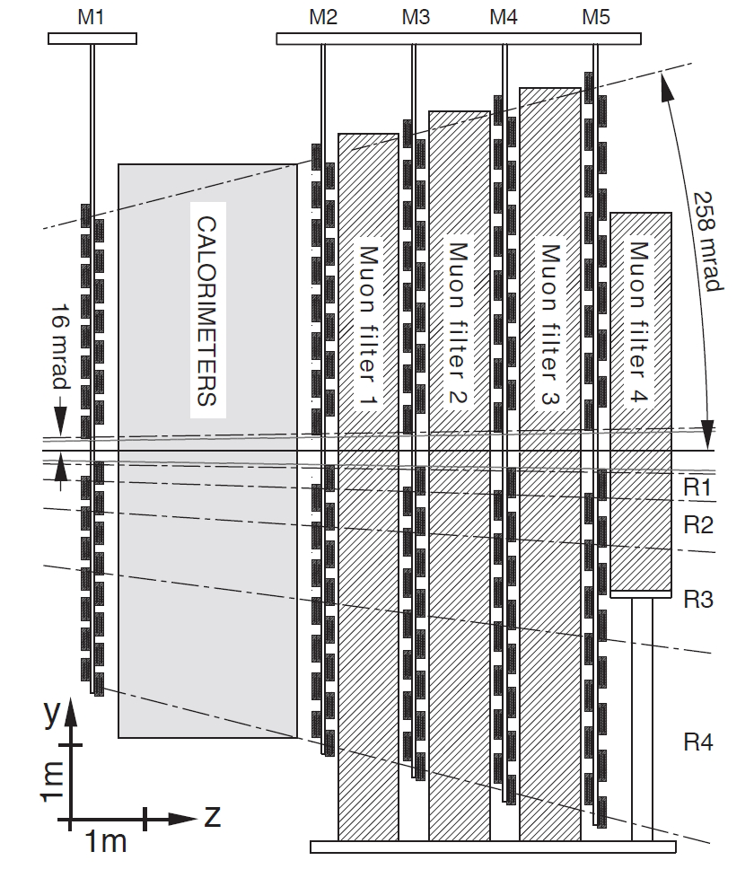
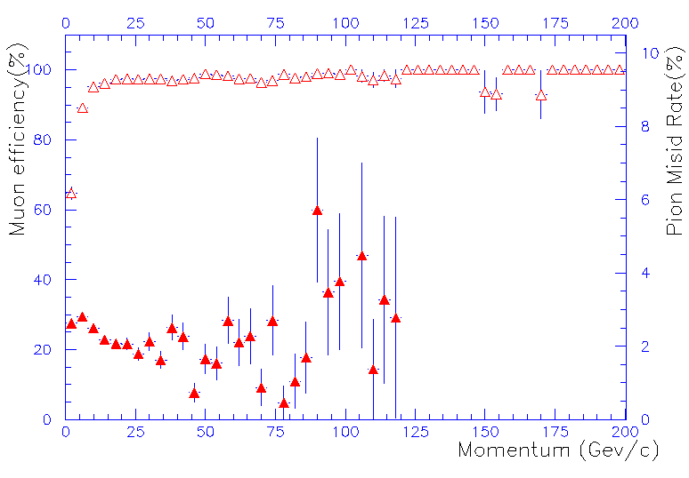
Muon identification
Five MWPC detectors (interleaved with iron walls)
$ε\left(μ→μ\right)∼97\%$ above 3 GeV, $ε(π→μ)∼1−3\%$
19

Slide 20
LHCb CALO system
20

Slide 21
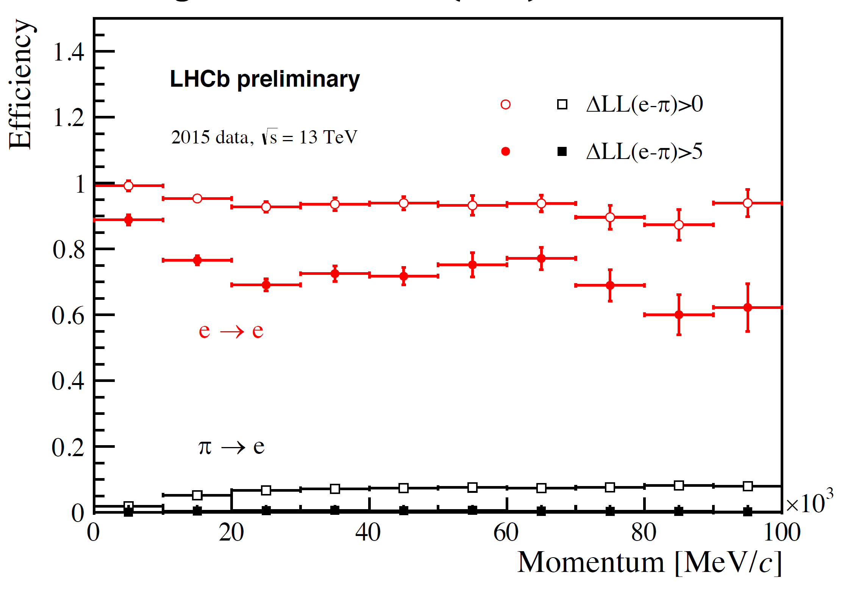
Electron identification
97$ε\left(e→e\right)∼95(75)\%,$ $ε(π→e)∼10(3)\%$
21

Slide 22
Unitarity test
22

Slide 23
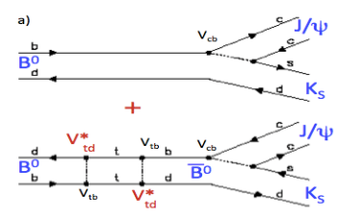


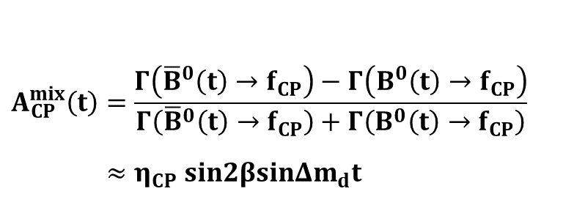

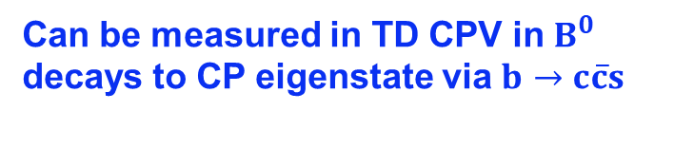
$B^{0}$-${\overline{B}}^{0}$ mixing phase 2$β$
$$β$$
Can be measured in TD CPV in $B^{0}$ decays to CP eigenstate via $b→c\overline{c}s$
Golden mode: $B^{0}→J/ψK_{S}$
$$A_{CP}^{mix}\left(t\right)=\frac{Γ\left({\overline{B}}^{0}\left(t\right)→f_{CP}\right)−Γ\left(B^{0}\left(t\right)→f_{CP}\right)}{Γ\left({\overline{B}}^{0}\left(t\right)→f_{CP}\right)+Γ\left(B^{0}\left(t\right)→f_{CP}\right)}$$
$≈η_{CP} sin2βsinΔm_{d}t$
23

Slide 24
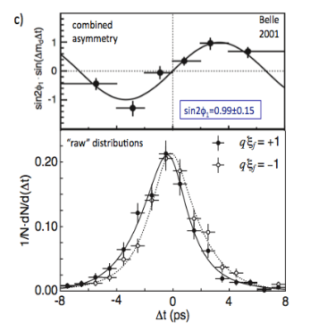

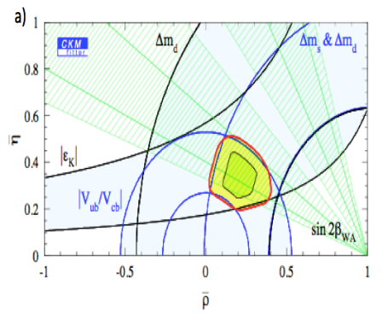


sin2$β$: a milestone in particle physics
First observation of CPV in B decays, powerful verification of the CKM theory!
Babar, PRL 87 (2001) 091801
sin2β = 0.59±0.14±0.05
Belle, PRL 87 (2001) 091802
$φ_{1}$=sin2β = 0.99±0.14±0.06
  （2008年诺贝尔物理奖）
24

Slide 25
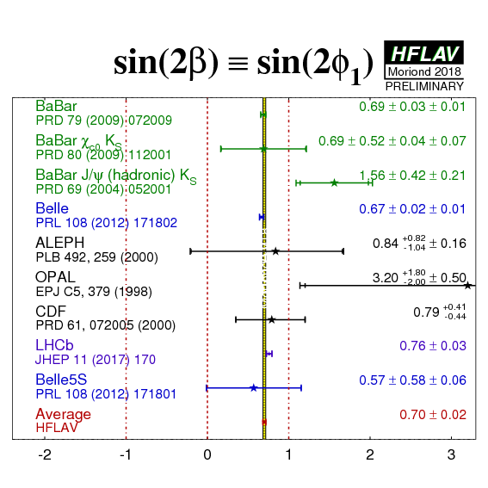
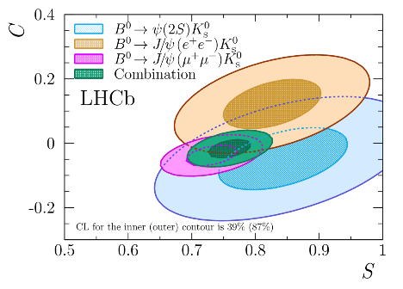
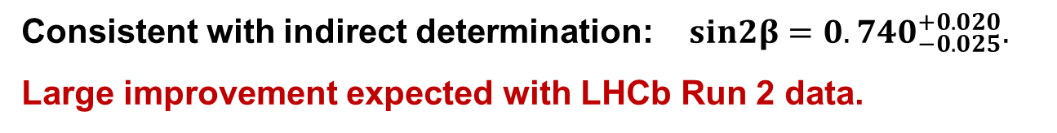


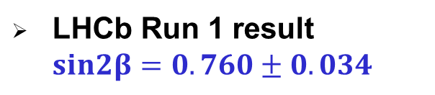
$sin2β$ status
LHCb Run 1 result $sin2β=0.760±0.034$
World average: $sin2β=0.70±0.02$
LHCb, JHEP 11 (2017) 170
Consistent with indirect determination: $sin2β=0.740_{−0.025}^{+0.020}.$
Large improvement expected with LHCb Run 2 data.
25

Slide 26

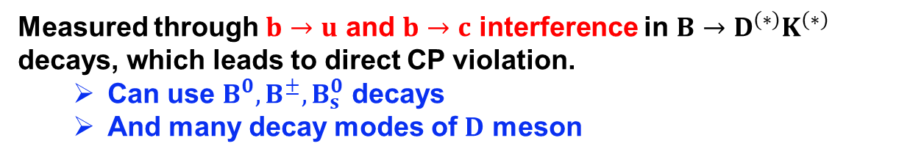

CKM phase $γ$
$$γ$$
Measured through $b→u$ and $b→c$ interference in $B→D^{(∗)}K^{(∗)}$ decays, which leads to direct CP violation.
  Can use $B^{0}, B^{±}, B_{s}^{0}$ decays
  And many decay modes of $D$ meson
26

Slide 27




PID essential for $γ$ measurement
Example: $B^{±}→D^{0}K^{±}$with $D^{0}→K^{+}K^{−}$
$$B^{−}→D_{CP}^{0}(K^{+}K^{−})K^{−}$$
$$B^{+}→D_{CP}^{0}(K^{+}K^{−})K^{+}$$
Without RICH, the mis-identification and partially reconstructed background would be much higher!
27

Slide 28

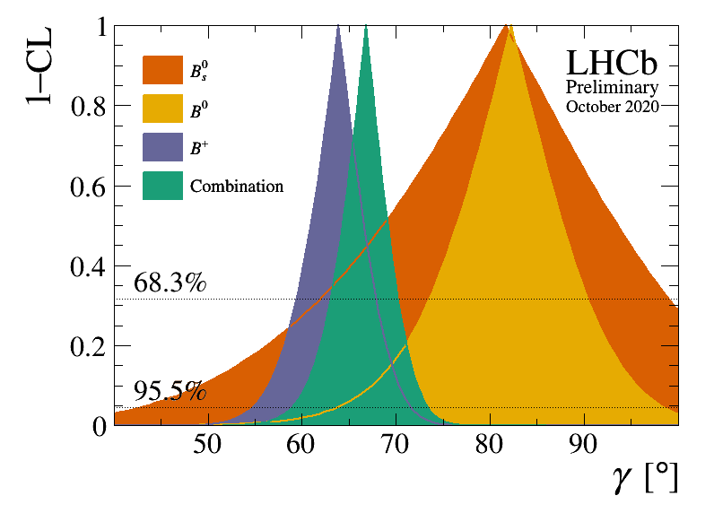

Status of $γ$ measurement
B factories achieved a precision of about $15°$
PRD 87 (2015) 052 015
arXiv: 1301.2033
LHCb combinations of 16 $B^{±}, B^{0}, B_{s}^{0}$ decay modes
LHCb: $γ={\left(67±4 \right)}^{°}$ Indirect determination $γ={\left({65.7}_{−2.7}^{+0.9}\right)}^{°}$
LHCb-CONF-2020-003
Large improvement from LHCb upgrade & BELLEII expected!
28

Slide 29
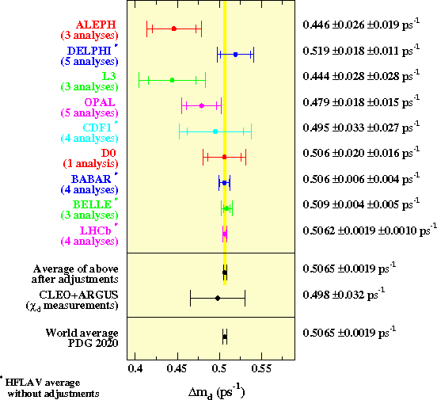
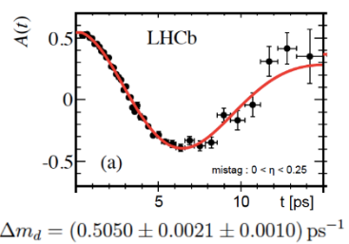



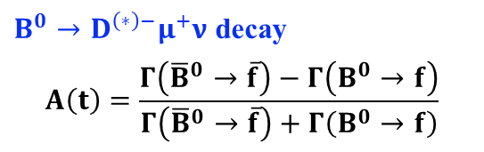
$Δm_{d}$ measurement
$∝Δm_{d}$, theory uncertainty reduced in $Δm_{d}/Δm_{s}$
Very well measured
LHCb, EPJC 76 (2016) 412
$B^{0}→D^{\left(∗\right)−}μ^{+}ν$ decay
$$A\left(t\right)=\frac{Γ\left({\overline{B}}^{0}→\overline{f}\right)−Γ\left(B^{0}→f\right)}{Γ\left({\overline{B}}^{0}→\overline{f}\right)+Γ\left(B^{0}→f\right)}$$
$$Δm_{d}=\left(0.5050±0.0021±0.0010\right) ps^{−1}$$
29

Slide 30
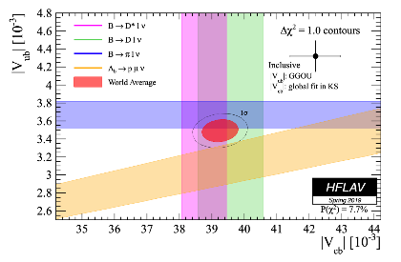


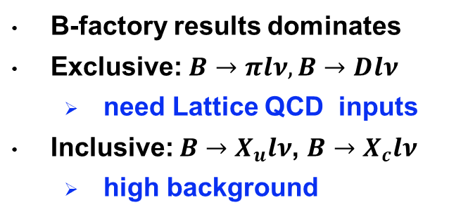

$V_{ub}$and $V_{cb}$
b$→ulν$
b$→clν$
Tension between inclusive and exclusive
B-factory results dominates
Exclusive: $B→πlν, B→Dlν$
  need Lattice QCD inputs
Inclusive: $B→X_{u}lν$, $B→X_{c}lν$
  high background
30

Slide 31






LHCb efforts for $V_{ub}, V_{cb}$
$$B_{s}^{0}→K^{−}μ^{+}ν low q^{2}$$
$$B_{s}^{0}→K^{−}μ^{+}ν high q^{2}$$
$$B_{s}^{0}→D_{s}^{−}μ^{+}ν$$
$$Λ_{b}^{0}→Λ_{c}^{+}μ^{+}ν$$
$$Λ_{b}^{0}→pμ^{+}ν$$
Reconstruction of decay modes with missing neutrinos is challenging but still possible at LHCb
31

Slide 32



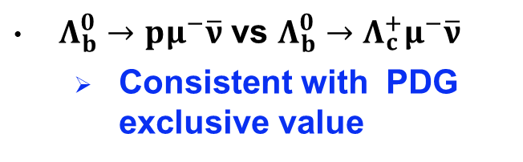

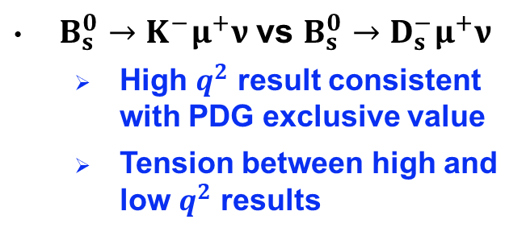


$V_{ub}/V_{cb}$ ratio from LHCb
$$0.061±0.004$$
$$0.095±0.008$$
$$0.079±0.006$$
$$0.090±0.004$$
$$0.101±0.007 (PDG incl.)$$
Nature Physics 11 (2015) 743
LHCb-paper-2020-038
$Λ_{b}^{0}→pμ^{−}\overline{ν}$ vs $Λ_{b}^{0}→Λ_{c}^{+}μ^{−}\overline{ν}$
  Consistent with PDG exclusive value
$B_{s}^{0}→K^{−}μ^{+}ν$ vs $B_{s}^{0}→D_{s}^{−}μ^{+}ν$
  High $q^{2}$ result consistent with PDG exclusive value
  Tension between high and low $q^{2}$ results
Better understanding requires higher measurement precision and new inputs from LQCD
32

Slide 33
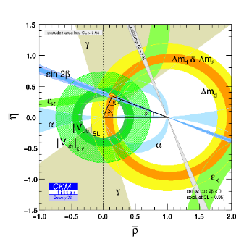
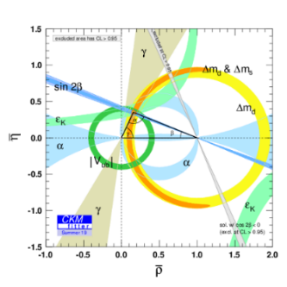

Global test of CKM
In the middle of 1990
When LHC started (2009)
Ten years later (2019)
Still large room for precision improvement, particularly in $γ$.
What will happen with even higher precision?
33

Slide 34
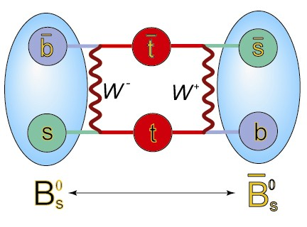

$B_{s}^{0}$ mixing and CP violation
34

Slide 35

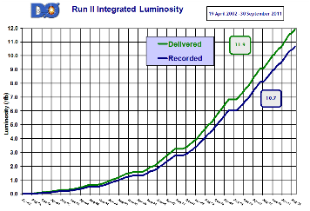
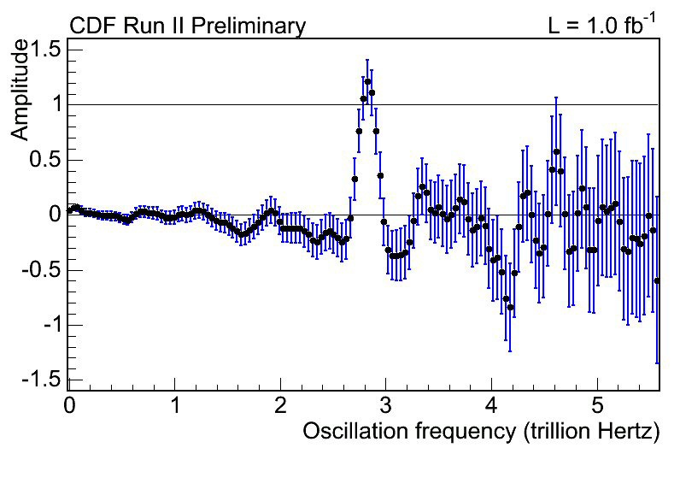
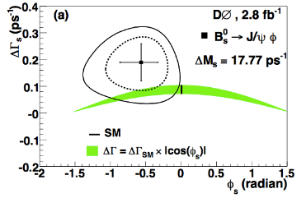

Pioneering work at Tevatron
Run II integrated Luminosity: 9.6/fb
B_{s} oscillation
B_{s} CP violation ($ϕ_{s}$)
CDF, PRL 97 (2006) 242003
D0, PRL 101 (2008) 241801
35

Slide 36

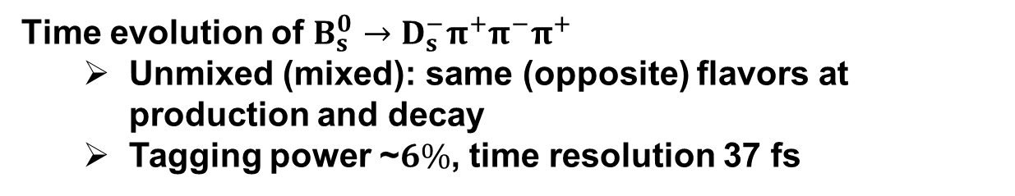
$Δm_{s}$ pinned down by LHCb
unmixed
mixed
Time evolution of $B_{s}^{0}→D_{s}^{−}π^{+}π^{−}π^{+}$
  Unmixed (mixed): same (opposite) flavors at production and decay
  Tagging power ~$6\%$, time resolution 37 fs
$$Δm_{s}=\left(17.757±0.007±0.008\right) ps^{−1}$$
LHCb-paper-2020-030
Demonstration of excellent time resolution at LHCb
36

Slide 37
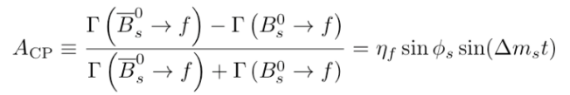
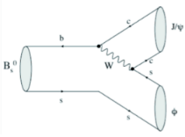



CP violating phase: $φ_{s}≡−2β_{s}$
$$β_{s}$$
Measured through TD CPV in $b→c\overline{c}s$ decays of $B_{s}^{0}$
$$≈$$
Sensitive to new physics in $B_{s}^{0}$ mixing, golden mode $B_{s}^{0}→J/ψφ$
NP?
37

Slide 38

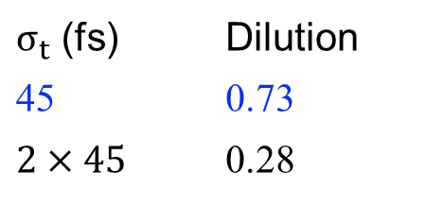
Key ingredients for $φ_{s}$ (LHCb)
Time resolution: 45 fs
$σ_{t}$ (fs) | Dilution
45 | 0.73
$$2×45$$ | 0.28
Tagging power: 4.7%
38

Slide 39


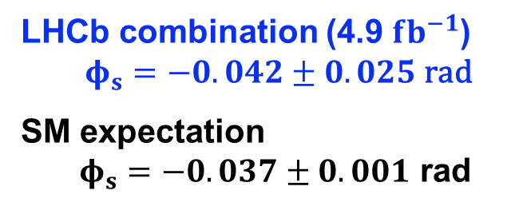

$φ_{s}$ measurements at LHCb
$$B_{s}^{0}→J/ψφ$$
$$B_{s}^{0}→J/ψπ^{+}π^{−}$$
LHCb, EPJC 80 (2020) 601
LHCb combination (4.9 $fb^{−1}$)
$φ_{s}=−0.042±0.025$ rad
SM expectation
$φ_{s}=−0.037±0.001$ rad
39

Slide 40
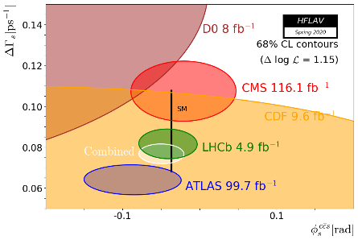


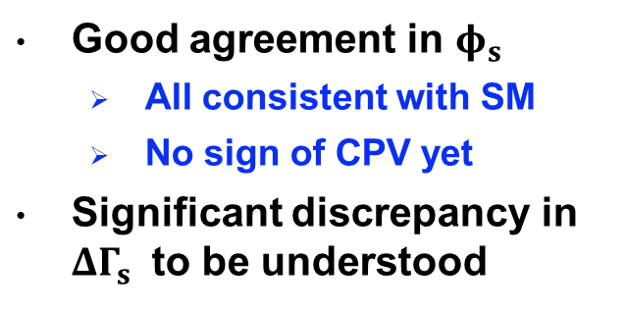

$φ_{s}$ competition at LHC
Exp. | $$φ_{s}$$ | yields | $$σ_{t}$$ | $$ε{\left(1−2ω\right)}^{2}$$
LHCb | $−0.042±0.025$ rad | ~210k | ~45 fs | ~4.7%
ATLAS | $−0.087±0.042$ rad | ~500k | ~70 fs | 1.75%
CMS | $−0.021±0.045$ rad | ~60k | ~130 fs | ~10% (run 2)
SM $−0.037±0.001$ rad
Good agreement in $φ_{s}$
  All consistent with SM
  No sign of CPV yet
Significant discrepancy in $ΔΓ_{s}$ to be understood
Measurement precision ~25-45 mrad, long way to go to approach the precision of SM prediction!
40

Slide 41






CPV in $b→s$ penguins
CP phase $φ_{s}$in $b→s$ decays ~ 0 in SM, sensitive to new particles in loop diagrams
$B_{s}→φφ→K^{+}K^{−}K^{+}K^{−}$: $b→s\overline{s}s$
$φ_{s}=−0.073±0.115±0.027$ rad
(4.9 $fb^{−1}$data)
LHCb, JHEP 12 (2019) 155
$B_{s}→K^{∗0}{\overline{K}}^{∗0}→K^{+}π^{−}K^{−}π^{+}$: $b→s\overline{d}d$
$φ_{s}=−0.10±0.13±0.14$ rad
(3.0 $fb^{−1}$data)
LHCb, JHEP 03 (2018) 140
Kaon identification extremely important for decays to multi-hadron final states
41

Slide 42







Observation of CPV in $B_{s}^{0}$ system
$B_{s/d}^{0}→hh^{′}$ sensitive to New Physics
NP
2013: Direct CPV observed in $B_{s}^{0}→K^{−}π^{+}$ (and $B^{0}→K^{+}π^{−}$ )
$$A_{CP}^{dir}\left(B_{s}^{0}→K^{−}π^{+}\right)=0.27±0.04(stat)±0.01(syst)$$
LHCb, Phys.Rev.Lett. 110 (2013) 221601
Excellent hadron PID makes it happen!
42

Slide 43




Observation of TD CPV in $B_{s}^{0}$ decays
2020: Time-dependent CPV observed in $B_{s}^{0}→K^{+}K^{−}$
$$A_{CP}^{mix}\left(t\right)=\frac{Γ\left({\overline{B}}_{s}^{0}\left(t\right)→hh\right)−Γ\left(B_{s}^{0}\left(t\right)→hh\right)}{Γ\left({\overline{B}}_{s}^{0}\left(t\right)→hh\right)+Γ\left(B_{s}^{0}\left(t\right)→hh\right)}$$
$$≈C⋅cos\left(Δm_{s}t\right)+S⋅sin(Δm_{s}t)$$
$S_{KK}=0.123±0.034(stat)±0.015(syst)$ $C_{KK}=0.164±0.034(stat)±0.014(syst)$
LHCb, arXiv:2012.12789
Excellent hadron PID makes it happen!
43

Slide 44

CP violation milestones
The next
CP violation in baryon decays?
CP violation in $B_{s}^{0}→J/ψφ$ decay?
CP violation phenomena beyond the SM?
44

Slide 45
Anomalies in B sector
45

Slide 46
Anomalies
46

Slide 47





$$b→sl^{+}l^{−}$$
b → sl⁺l⁻ decay rates sensitive to heavy non-SM particles
SM contributions
NP contributions
Cannot compute hadronic matrix elements reliably
Theoretically robust observables
  Carefully chosen angular observables
  Branching fraction ratios between $e$ and $μ$
47

Slide 48

$$B_{s}^{0}→μ^{+}μ^{−}$$
Theoretically very clean!
Roughly $2σ$ below SM predictions
48

Slide 49






$b→sl^{+}l^{−}$ branching fractions
Measured values consistently below SM predictions at low $q^{2}$
SM predictions suffer from large hadronic uncertainties
B⁺ → K⁺ μ⁺ μ–
[JHEP 06(2014)133]
B ⁰ → φ μ⁺ μ–
s
[JHEP 09(2015)179]
B⁰ → K*⁰ μ⁺ μ–
[JHEP 04(2017)142]
Λ → Λμ⁺ μ–
b
[JHEP 06(2015)115]
49

Slide 50










Angular analysis: $B^{0}→K^{∗0}μ^{+}μ^{−}$
θ
_{μ}+
_{K}-
K*
θ
W
2
K
_{μ}-
q
B
_{π}+
8 independent observables
F_{L}: fraction of longitudinal polarization
S₆ = 4/3 A_{FB}: forward-backward asymmetry of the $μ^{+}μ^{−}$ system
S_{3,4,5,7,8,9} : other CP-averaged observables
50

Slide 51

Impact of PID for $B^{0}→K^{∗0}μ^{+}μ^{−}$
LHCb: selecting kaons using RICH information
ATLAS and CMS: no hadron identification, relying on kinematic constraints to choose mass hypothesis
51

Slide 52


Local tension in $P_{5}^{′}$
$P_{5}^{′}=\frac{S_{5}}{\sqrt{F_{L }(1−F_{L})}}$ has reduced dependence on form factor
52

Slide 53



Global fit of $b→sl^{+}l^{−}$
Most relevant Wilson coefficients: $C_{9}$and $C_{10}$
Global fit of $b→sl^{+}l^{−}$ rate and angular observables
  Deviation from SM: 3-5$σ$
Shifting $Re(C_{9})$ can explain data
SM
Eur.Phys.J. C80 (2020) 252
53

Slide 54


LFU in neutral-current decays
$$R_{K^{(∗)}}=\frac{B\left(B→K^{\left(∗\right)}μ^{+}μ^{−} \right)}{B\left(B→K^{\left(∗\right)}e^{+}e^{−}\right)} ≈ 1$$
SM
Free of form factor uncertainties, prediction error O(10⁻³)
Experimental challenge: electron reconstruction
Electron bremsstrahlung
54

Slide 55
$$R_{K}$$
LHCb
[PRL 122(2019)191801]
Babar
[PRD 86(2012)032012]
Belle
[PRL 103(2009)171801]
LHCb: $R_{K}={0.846}_{−0.054}^{+0.060} _{−0.016}^{+0.014}$
$2.5σ$ below SM prediction
PRL 122 (2019) 191801
55

Slide 56

$$R_{K^{∗}}$$
LHCb: JHEP 08 (2017) 055, Babar: PRD 86 (2012) 032012, Belle: PRL 103 (2009) 171801
LHCb: $R_{K^{∗}}={0.66}_{−0.07}^{+0.11}±0.03; 0.045<q^{2}<1.1$GeV²
$R_{K^{∗}}={0.69}_{−0.07}^{+0.11}±0.05; 1.1<q^{2}<6.0$GeV²
$2.1σ$ and $2.4σ$ below SM predictions
JHEP 08 (2017) 055
56

Slide 57







LFU in charged-current decays
Tree-level $b→cl^{−}{\overline{ν}}_{l}$ transitions sensitive to extended Higgs sector or Leptoquarks
$$W^{−},H^{−}$$
$R(D^{(∗)}) =\frac{B(B→D^{(∗)}τ{\overline{ν}}_{τ} )}{B(B→D^{(∗)}μ{\overline{ν}}_{μ})}$ measurements from LHCb, Babar, Belle all above SM predictions
Discrepancy with SM
2$.5σ$ in $R(D^{∗})$
1$.4σ$ in $R(D)$
$3.1σ$combined
SM
57

Slide 58



$R\left(D^{∗}\right)$ and $R\left(D\right)$ summary
World average: R (D∗) =0.295 ± 0.011 ± 0.008
R (D) =0.340 ± 0.017 ± 0.013
SM prediction: R (D∗) =0.258 ± 0.005
R (D) =0.299 ± 0.003
58

Slide 59







Possible explanations
New physics
$$Z^{′}$$
$$Leptoquark$$
Underestimated QCD uncertainties
  $P_{5}^{′}:$ $c\overline{c}$ resonance effect
  $R(D^{(∗)})$: form factors
  $R_{K^{(∗)}}$: more robust
Experimental artefact
  overlooked problem in $e$ and $τ$ reconstruction, awaiting check by another experiment
Fluctuation
  More data will shed light
59

Slide 60
Future prospects
60

Slide 61





LHCb timeline
We are here
HL-LHC
Install Upgrade I
Consolidation and
maintainance
Upgrade II
61

Slide 62


Luminosity vs year
Factor ~13 increase in data compared to pre-HL-LHC era.
Corresponding to a factor of 13^{1/4}$≈$1.9 in discovery reach
Similar to that of direct searches in raising energy from 14 TeV (HL-LHC) to 27 TeV (HE-LHC) !
62

Slide 63



LHCb upgrade2 physics motivation
Greatly improve knowledge of golden and theoretically clean observables
  E.g. $γ, β, φ_{s}, B(B_{s}→μμ)/B(B_{d}→μμ)$, charm CP violation
Widen the set of observables beyond those accessible at Upgrade I
  E.g. additional measurements involving $b→s/d l^{+}l^{−}, b→c/u l$ decays
Fully exploit the HL-LHC for topics beyond flavor physics
63

Slide 64


LHCb upgrade II sensitivities
CKM tests: match precision from indirect determination
$σφ_{s}∼3$ mrad, $σγ∼0.35°$, $σsin2β∼0.003$
LFU: If hints are confirmed, LHCb upgrade II will be needed for discrimination of NP models
64

Slide 65
Evolution of the unitary triangle
LHCb 2018
LHCb 2025
LHCb 2035
65

Slide 66





Lepton universality violation
High precision of LFU observables ($R_{K},R_{K^{∗}}, R_{φ}$) can discriminate different NP models (scenarios with different Wilson coefficients for illustration)
66
$$ΔReC_{9(10)}={ReC}_{9}^{μ} −{ReC}_{9}^{e}$$

Slide 67

BELLE II and Z factories
BELLE II (2020-2025): deeply explore $B^{0}, B^{+}$ systems, with strength in final states with neutrinos, electrons, photons
CEPC (2030-2040) or FCC-ee (2038-2044) at Z pole: can study all b species and all final states with high precision
67

Slide 68
Rare decay prospect at Tera-Z
In the area of rare decay and LFU, CEPC as a Terz-Z factory can not only provide crucial cross checks of the major LHCb measurements but also probe some new decay modes inaccessible at LHCb
68

Slide 69



CPV prospects at Tera-Z
Back of envelop calculation for $φ_{s}$ in $B_{s}^{0}→J/ψφ$
Assumptions for CEPC
  Signal efficiency ~80%: track multiplicity between Babar and LHCb
  Decay time resolution ~40 fs: silicon vertex detector
  Tagging power~20%: hadron and lepton identification performance similar to Babar, achieved with dedicated TOF, DEDX, ECAL, MUON detectors
CEPC sensitivity in time dependent CP violation is expected to be competitive to that of the LHCb phase II upgrade, which aims to accumulate $300 fb^{−1}$ during 2030-2040
$B_{s}^{0}→J/ψφ$ | Signal yield | Time resolution | Tagging power | Effective size | $$σ_{φ_{s}}$$
LHCb (300 $fb^{−1}$) | $$2×{10}^{7}$$ | 45 fs | 5% | 4.5$×{10}^{5}$ | 4 mrad
CEPC (${10}^{12}$ Z) | $$6×{10}^{5}$$ | 40 fs | 20% | 4.5$×{10}^{5}$ | 4 mrad
69

Slide 70
Conclusions
B physics has been and will continue to be a crucial part of particle physics
  B factories and LHCb established a solid foundation
  LHCb upgrade and BELLE II will focus on test of the SM in CP violation, rare B decays and lepton flavor universality in the next 10-20 years
  Tera-Z factories will play a highly competitive and complementary
Excellent capability to identify hadrons and leptons is essential for study of B physics, including but not limited to time-dependent CP violation in B decays
  A dedicated hadron identification system covering the momentum range up to 20 GeV is required for a Tera-Z factory
70

Slide 71
Backup slides
71

Slide 72
DNA test of flavor models
A. Buras, 0909.1333
72

Slide 73
73

Slide 74
74

Slide 75


$φ_{s}$ from LHC
LHCb
ATLAS
CMS
LHCb: EPJC 80 (2020) 601
$φ_{s}=−0.042±0.025$ rad
ATLAS: EPJC 80 (2020) 601
$φ_{s}=−0.087±0.042$ rad
CMS: EPJC 80 (2020) 601
$φ_{s}=−0.021±0.045$ rad
75

Slide 76




$R\left(D^{∗}\right)$ with $τ^{−}→μ^{−}{\overline{ν}}_{μ}ν_{τ}$
PRL115 (2015) 11803
R (D∗) =0.306 ± 0.013 ± 0.007
2$σ$ above SM prediction: RSM (D∗) =0.258 ± 0.005
76

Slide 77





$R\left(D^{∗}\right)$ with $τ^{−}→π^{−}π^{+}π^{−}ν_{τ}$
$$B→D^{∗}τ{\overline{ν}}_{τ}$$
$$B→D^{∗}3π$$
R (D∗) =0.291 ± 0.019 ± 0.029
PRL120 (2018) 171802
1$σ$ above SM prediction
77

Slide 78






$F_{L}$ and $A_{FB}$ in $B^{0}→K^{∗0}μ^{+}μ^{−}$
LHCb
JHEP02(2016)104
CMS
PLB 753 (2016) 424
ATLAS
arXiv:1805.04000
3fb⁻¹
SM predictions
ABSZ: EPJC 75 (2015) 382
LSCR: JHEP 08 (2016) 98
Lattice: arXiv:1501.00367
3fb⁻¹
Measured values agree well with SM predictions
78

Slide 79

Long distance effects
79

Slide 80

form factors
80

