Slide 1

Higgs Alignment and CP Violation in 2HDM
Xiao-Ping Wang
Beihang University
Jan,20,2021
Based on ArXiv:2012.00773, Collaborated with Ian Low, Nausheen R. Shah

Slide 2
SM Mass origin
CMS, CMS-PAS-HIG-17-031
ATLAS, Phys.Rev. D101 (2020) no.1, 012002

Slide 3
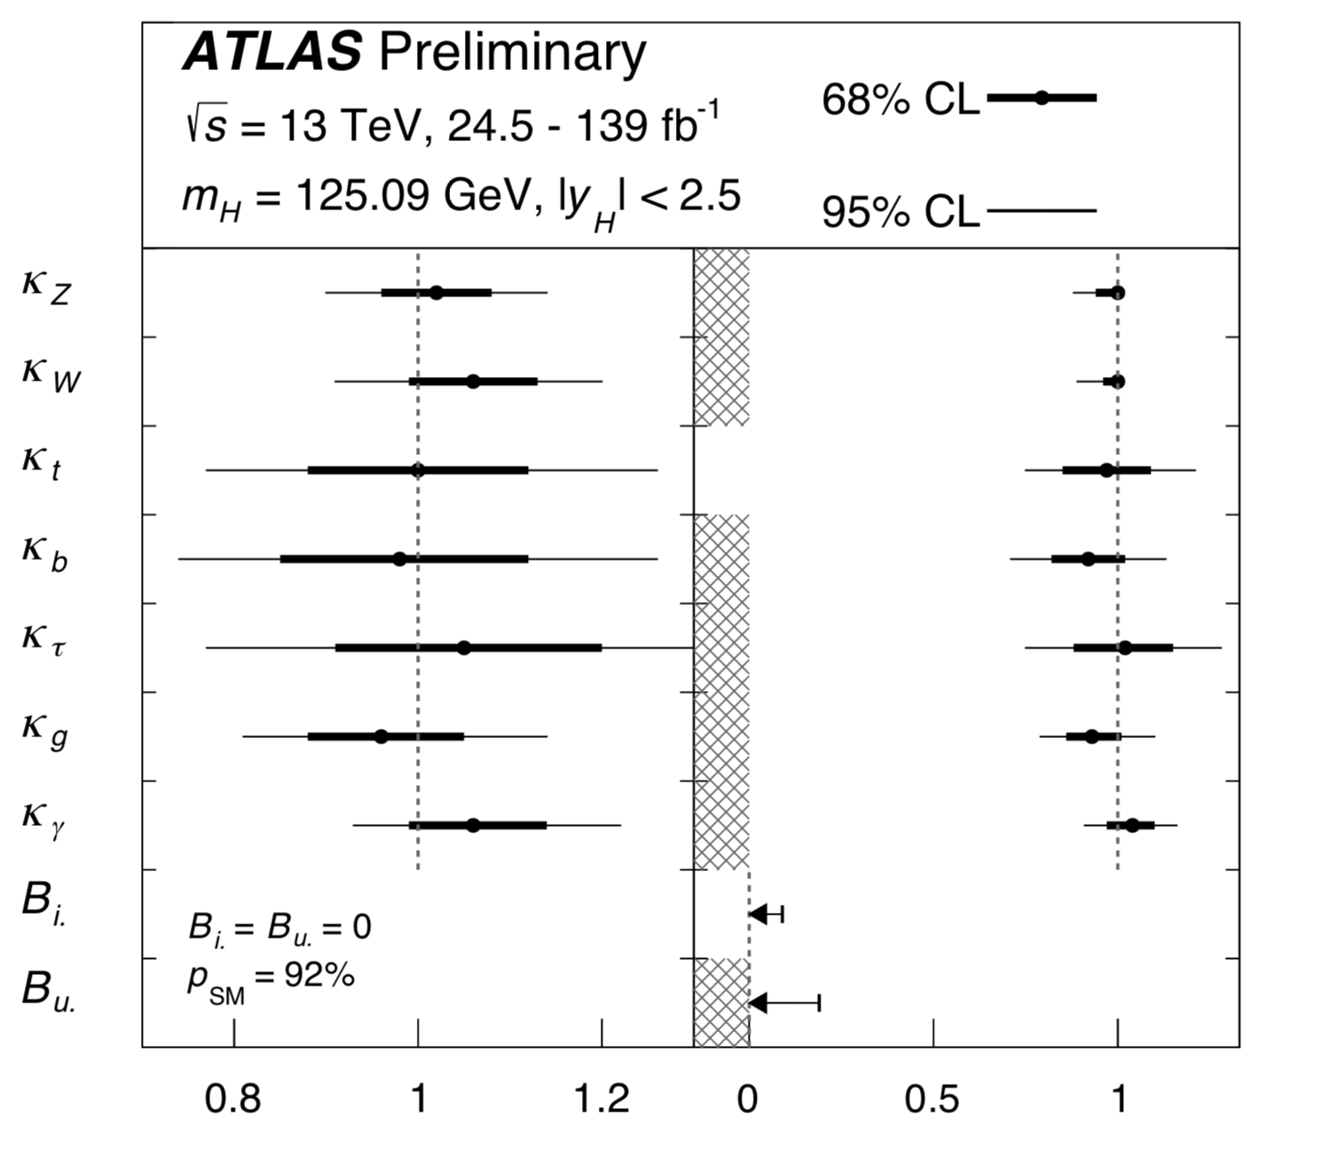
SM Higgs Search

Slide 4
SM Higgs search
SM Higgs self-interaction:
ATLAS, Phys. Lett. B 800 (2020) 135103

Slide 5
Extra Neutral Higgs search
CMS, HIG-13-025-pas
ATLAS, JHEP 1904 (2019) 092

Slide 6
Extra Charged Higgs search
CMS, JHEP07 (2019) 142
ATLAS-CONF-2020-039

Slide 7
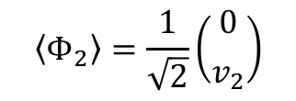

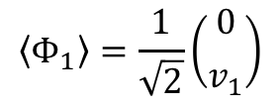
Two Higgs Doublet model
CP conserving 2HDM:
In the basis, all the parameters are real. The VEVs are:
$$\left\langle Φ_{1}\right\rangle =\frac{1}{\sqrt{2}}\left({0 \atop v_{1}}\right)$$
$$\left\langle Φ_{2}\right\rangle =\frac{1}{\sqrt{2}}\left({0 \atop v_{2}}\right)$$
$$v=\sqrt{v_{1}^{2}+v_{2}^{2}}=246 GeV$$
There are 8 real degrees of freedom:
3 eaten Goldstones and 5 physical scalars -- 2 charged Higgs, 1 CP-odd neutral Higgs and 2 CP-even neutral Higgs.

Slide 8
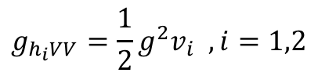
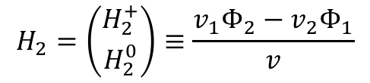
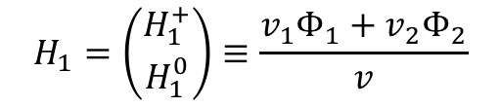
Two Higgs Doublet model
To see how “alignment without decoupling” arises by CP even Higgs couplings:
$$g_{h_{i}VV}=\frac{1}{2}g^{2}v_{i} , i=1,2$$
It is possible to rotate to Higgs basis
$$H_{1}=\left({H_{1}^{+} \atop H_{1}^{0}}\right)≡\frac{v_{1}Φ_{1}+v_{2}Φ_{2}}{v}$$
$$H_{2}=\left({H_{2}^{+} \atop H_{2}^{0}}\right)≡\frac{v_{1}Φ_{2}−v_{2}Φ_{1}}{v}$$

Slide 9
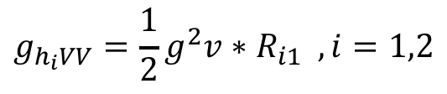
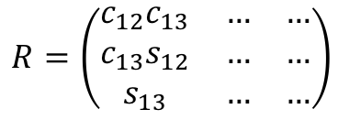
Two Higgs doublet model
Mass matrix:
$$R=\left(\begin{matrix}c_{12}c_{13} & … & … \\ c_{13}s_{12} & … & … \\ s_{13} & … & …\end{matrix}\right)$$
Higgs –V-V couplings:
$$g_{h_{i}VV}=\frac{1}{2}g^{2}v∗R_{i1} , i=1,2$$
“Alignment without decoupling” occurs when Higgs basis = Mass eigen basis

Slide 10
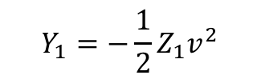

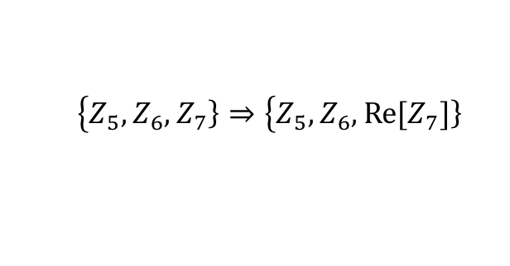
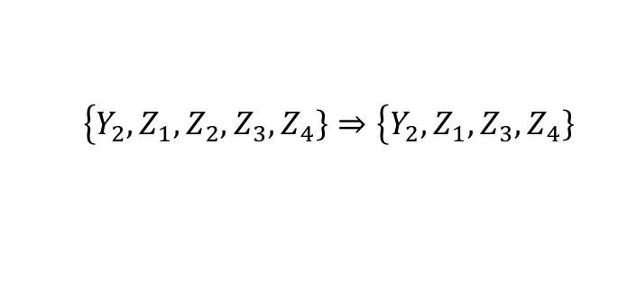
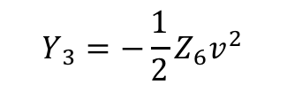
CP violation THDM
Counting the number of d.o.f. in CPX 2HDM
• Minimization condition in the Higgs basis:
$$Y_{1}=−\frac{1}{2}Z_{1}v^{2}$$
$$Y_{ 3}=−\frac{1}{2}Z_{6}v^{2}$$
• $Z_{2}$ Symmetry:
Haber+collaborators: 2001.01430
• Free parameters:
$$\left\{Y_{2}\right.,Z_{1},Z_{2},Z_{3}, \left.Z_{4}\right\}⇒\left\{Y_{2}\right.,Z_{1}, Z_{3}, \left.Z_{4}\right\}$$
9 real free parameters!
$$\left\{Z_{5},Z_{6}\right., \left.Z_{7}\right\}⇒\left\{Z_{5},Z_{6}\right., \left.{Re[Z}_{7}]\right\}$$

Slide 11
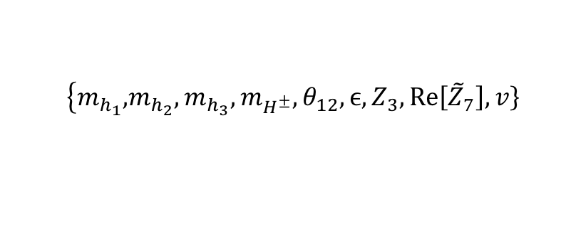
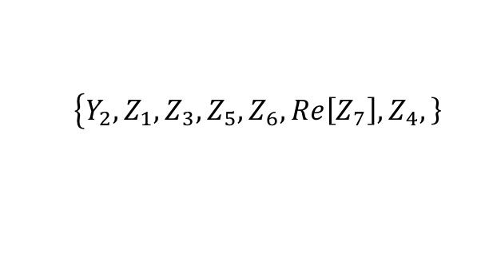
Free parameters in CTHDM
Diagonalize the mass matrix
Redefine the mass matrix
Alignment Limit:
Free parameters:
$$\left\{Y_{2}\right.,Z_{1}, Z_{3}, Z_{5},Z_{6},Re\left[Z_{7}\right],\left.Z_{4},\right\}$$
$$\left\{m_{h_{1}},\right.m_{h_{2}},m_{h_{3}},m_{H^{±}},θ_{12},ϵ,Z_{3},Re\left[{\tilde{Z}}_{7}\right],\left.v\right\}$$

Slide 12

CP conservative Limit
Higgs mixing:
Relationships between $Z_{i}$and mixing angles:
Case I:
Case 2:

Slide 13
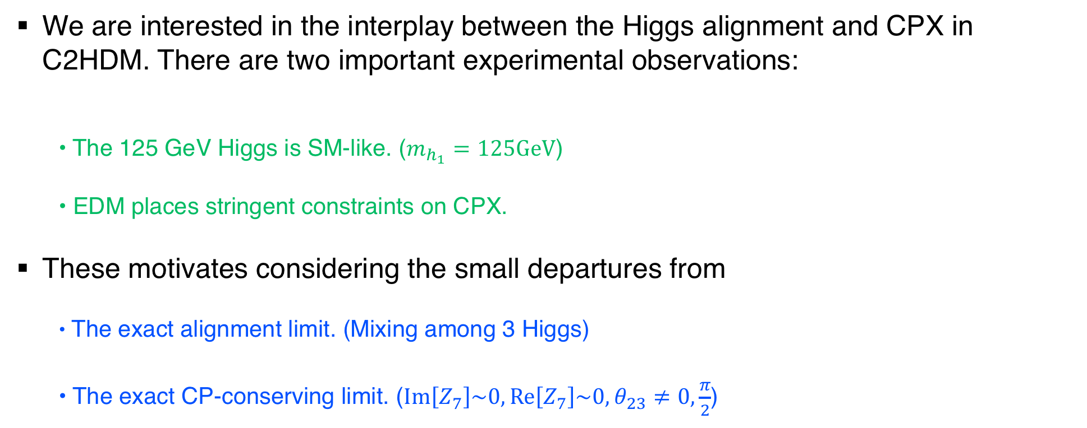
CP conservative and Alignment Limit CTHDM
We are interested in the interplay between the Higgs alignment and CPX in C2HDM. There are two important experimental observations:
  • The 125 GeV Higgs is SM-like. ($m_{h_{1}}=125GeV$)
  • EDM places stringent constraints on CPX.
These motivates considering the small departures from
  • The exact alignment limit. (Mixing among 3 Higgs)
  • The exact CP-conserving limit. ($Im\left[Z_{7}\right]\sim 0,Re\left[Z_{7}\right]\sim 0,θ_{23}≠0,\frac{π}{2}$)

Slide 14
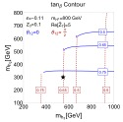
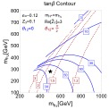
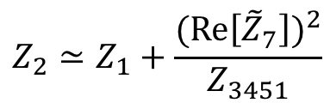
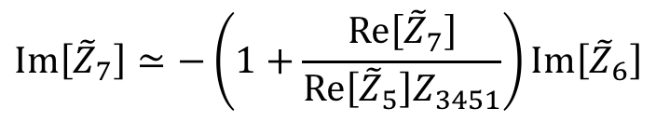
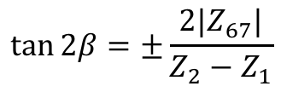
Other parameters dependence
$$Z_{2}≃Z_{1}+\frac{{(Re\left[{\tilde{Z}}_{7}\right])}^{2}}{Z_{3451}}$$
$$Im\left[{\tilde{Z}}_{7}\right]≃−\left(1+\frac{Re\left[{\tilde{Z}}_{7}\right]}{Re\left[{\tilde{Z}}_{5}\right]Z_{3451}}\right)Im\left[{\tilde{Z}}_{6}\right]$$
$$\tan{2β}=±\frac{2|Z_{67}|}{Z_{2}−Z_{1}}$$

Slide 15

Charged Higgs Search
CMS, JHEP 2001 (2020) 096
We choose $\tan{β}>1$

Slide 16
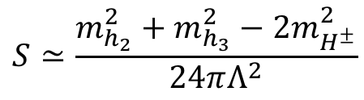

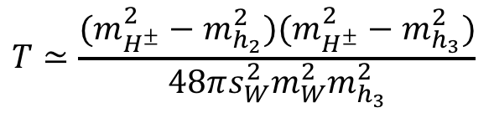
oblique parameters
The analysis of precision electroweak data get:
In the alignment Limit:
$$S≃\frac{m_{h_{2}}^{2}+m_{h_{3}}^{2}−2m_{H^{±}}^{2}}{24πΛ^{2}}$$
$$T≃\frac{(m_{H^{±}}^{2}−m_{h_{2}}^{2})(m_{H^{±}}^{2}−m_{h_{3}}^{2})}{48πs_{W}^{2}m_{W}^{2}m_{h_{3}}^{2}}$$
H.Haber, D.O’Neil Phys.Rev. D83 (2011) 055017
We choose $m_{H^{±}}^{2}\sim m_{h_{2}}^{2}$

Slide 17

Electron EDM constraint
Fermion contributions:
$$∝$$
Higgs boson-loop contributions:
gauge-loop contributions

Slide 18

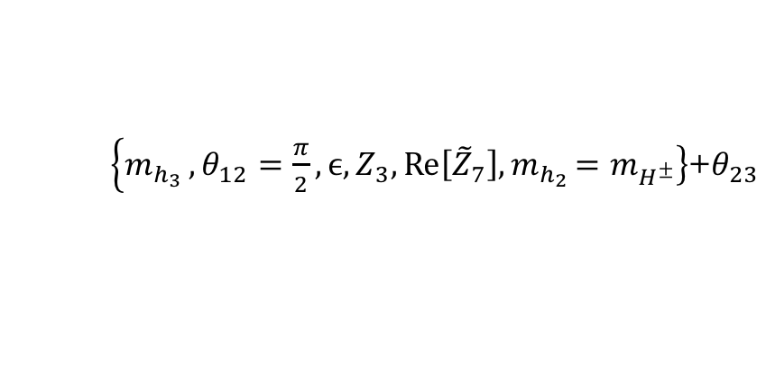
Electron EDM constraint
$\left\{m_{h_{3}}\right.,θ_{12}=\frac{π}{2},ϵ,Z_{3}, \left.Re\left[{\tilde{Z}}_{7}\right]{,m}_{h_{2}}=m_{H^{±}}\right\}$+$θ_{23}$

Slide 19
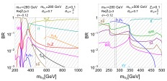
Collider Phenomenology
Branching ratios for benchmark points:

Slide 20
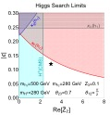
Other Constraints
CMS, PhysRevLett.122.121803

Slide 21
Summary
There is an interesting interplay between alignment limit and Cp conserving limit in C2HDM. In one case, the alignment limit is identical with the CP-limit, while in the other case they are independent.
There is a smoking-gun signal for CP violation at the LHC in C2HDM, without recourse to angular distributions, by searching for
Thank you

