Slide 1
Driving positron beam acceleration with coherent transition radiation
Baifei Shen
Shanghai Normal University
Shanghai Institute of Optics and Fine Mechanics

Slide 2
Outline
1.Background
2. positron beam acceleration with coherent transition radiation

Slide 3
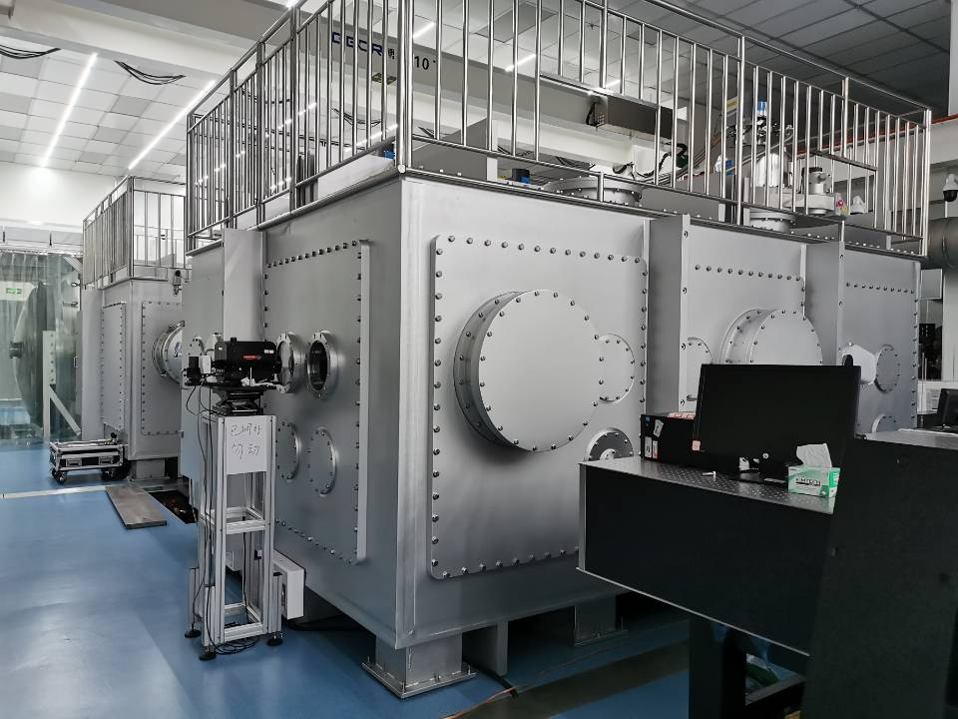
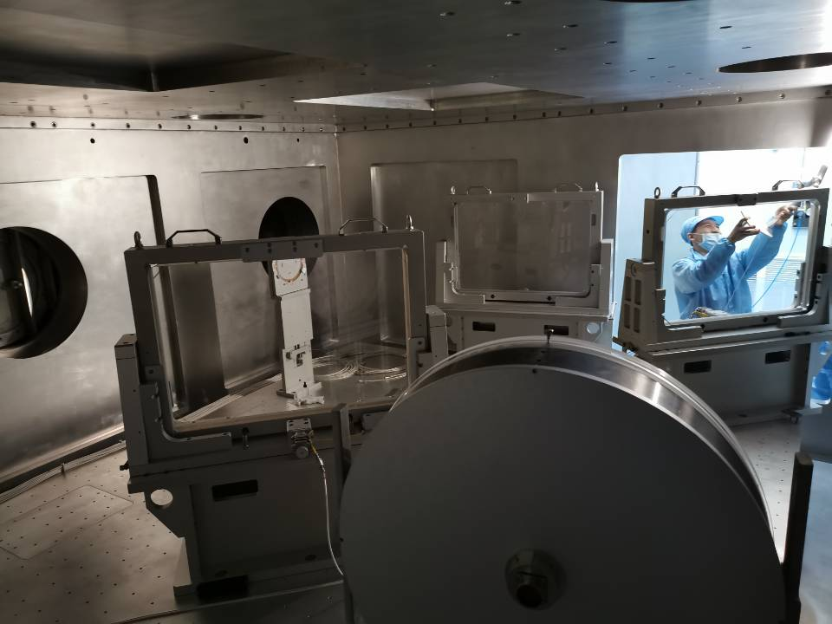
The experiment platform for “Ultrafast Sub-atomic Physics” at SULF is now in operation, where 10 PW laser is used.

Slide 4
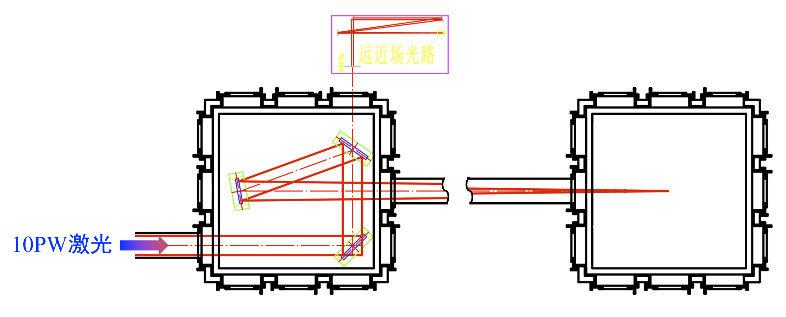
We are preparing for the experiment of electron acceleration, hoping to produce the electron beam of energy more than 10GeV.
target
…
Large Chamber
Small chamber

Slide 5
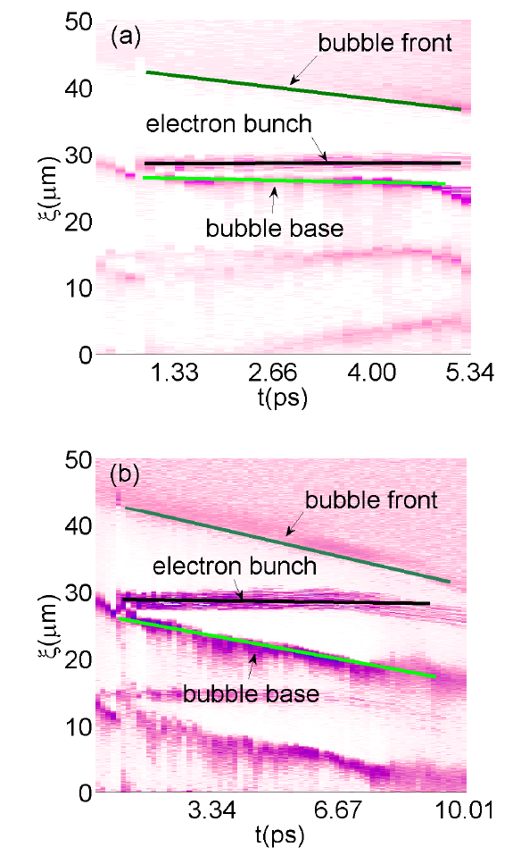
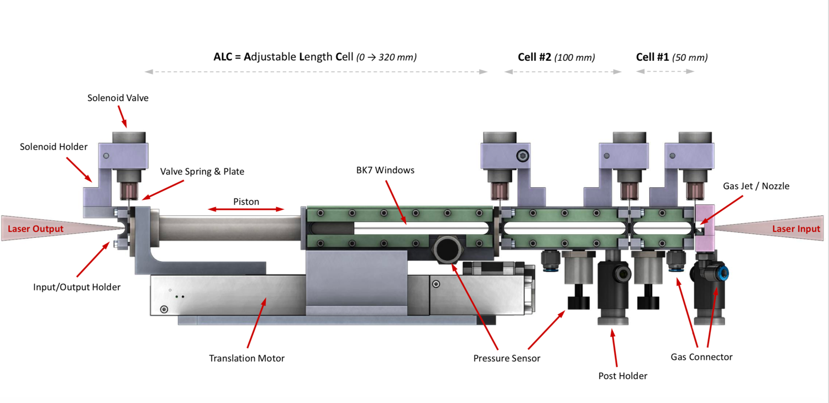
We are preparing for the experiment of electron acceleration, hoping to produce the electron beam of energy more than 10GeV.
We use a gas cell with several sections to change the plasma density along the laser propagation.
探测光靶室
物理实验靶室

Slide 6
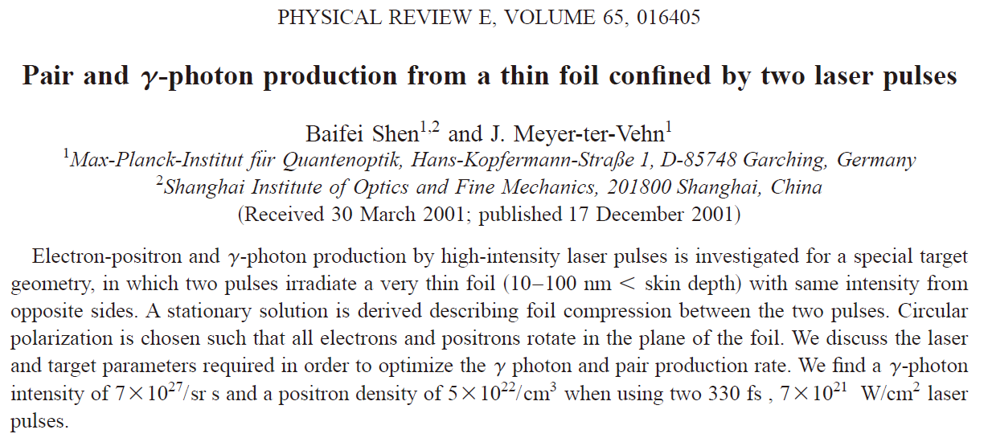
In 2001, we studied positron production by laser foil interaction.

Slide 7
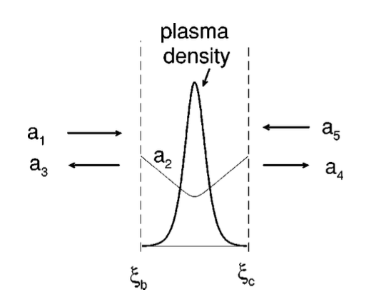
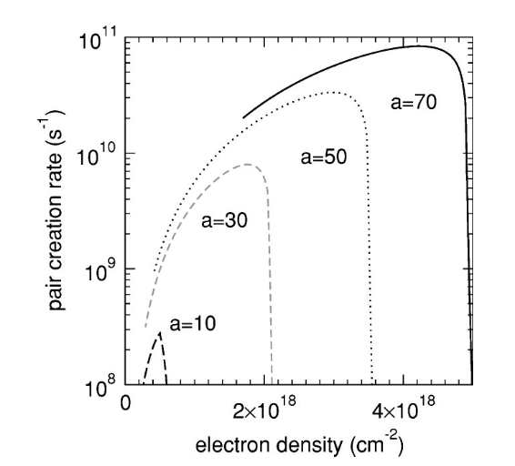
Due to the compression of two intense laser pulses, the plasma density could be very high. Therefore, here the main scheme of positron production is the trident process.
Baifei Shen et al., PHYSICAL REVIEW E 65, 016405(2001)

Slide 8
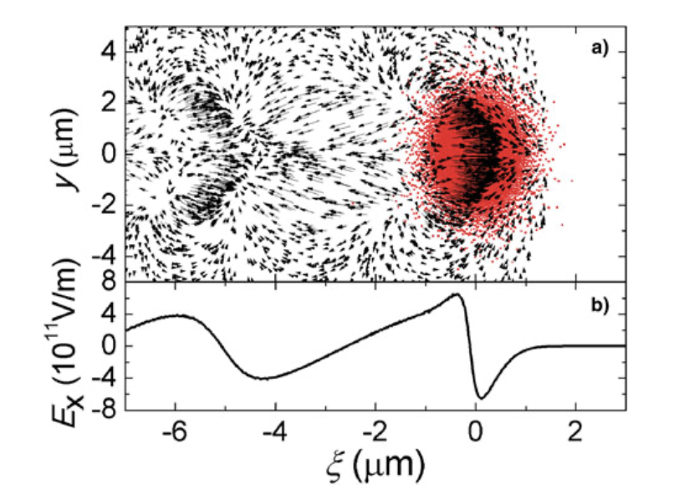
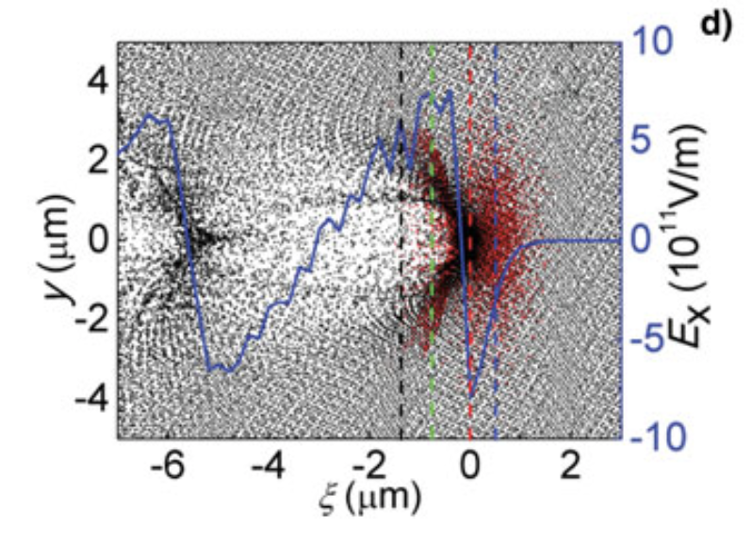
Positron acceleration driven by proton beam
Proton beam could drive a wake field for positron acceleration. But the defocusing field in transverse prevents the positron acceleration in a long distance 。
Laser and Particle Beams, 2013. doi:10.1017/S0263034613000293

Slide 9
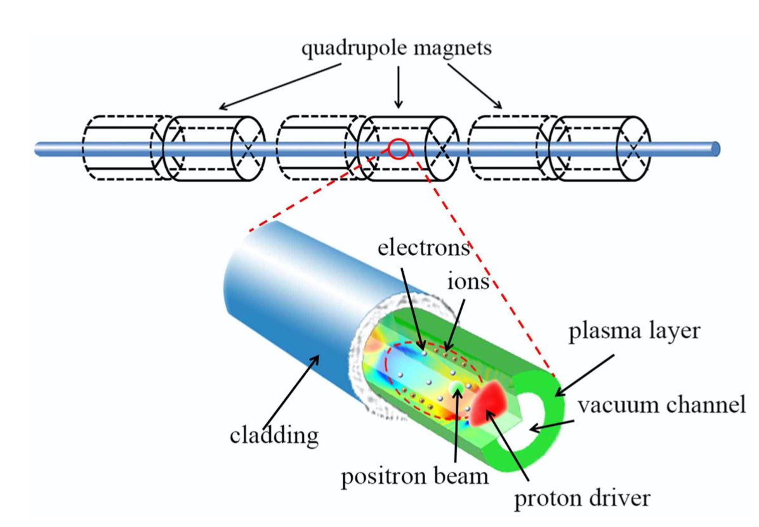
Positron acceleration in a hollow channel driven by proton beam
PHYSICAL REVIEW SPECIAL TOPICS - ACCELERATORS AND BEAMS 16, 071301 (2013)
SCIENTIFIC REPORTS | 4 ， 4171 （2014）

Slide 10
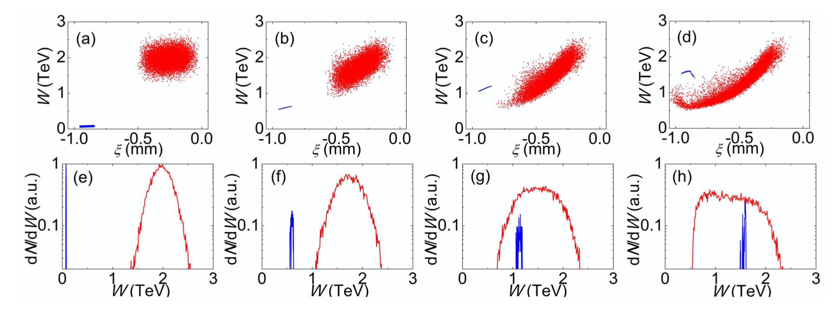
Positron acceleration in a hollow channel driven by proton beam
The positron beam can be well accelerated in the proton driven wake field. There is a weak focusing field near the channel wall, but no transversal field in the middle of the channel. Therefore, the radiation loss of the positron is quite small.

Slide 11
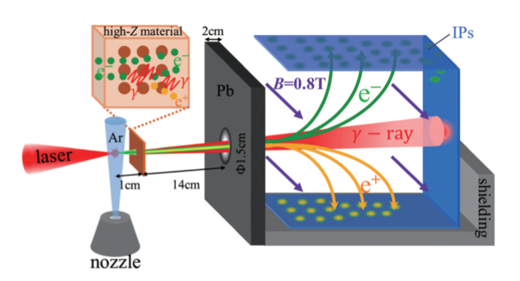
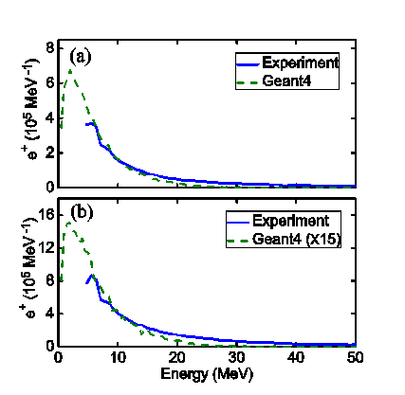
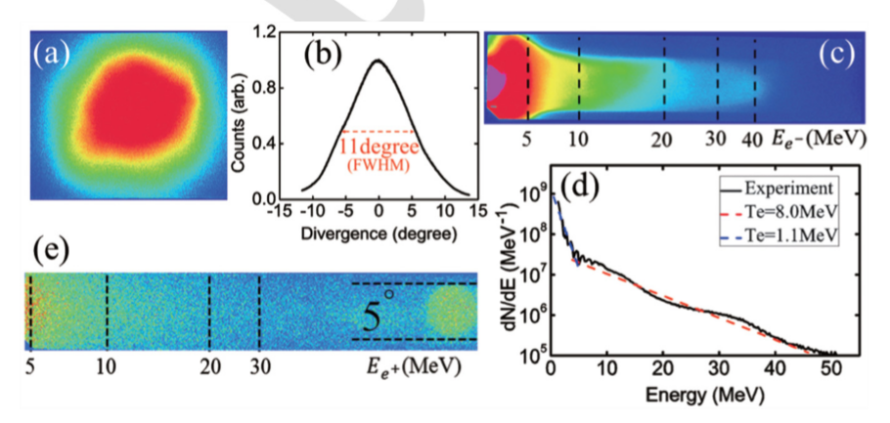
In 2016，we succeeded to produce positrons with femtosecond laser. At first, we accelerated electrons with laser gas interaction. Then the energetic electrons produced gamma photons with bremstrahlung. The gamma photons produced the positrons with the BH process.
Tongjun Xu，Baifei Shen et al.，Phys. Plasmas 23, 033109 (2016)

Slide 12
Outline
1.Background
2. positron beam acceleration with coherent transition radiation

Slide 13
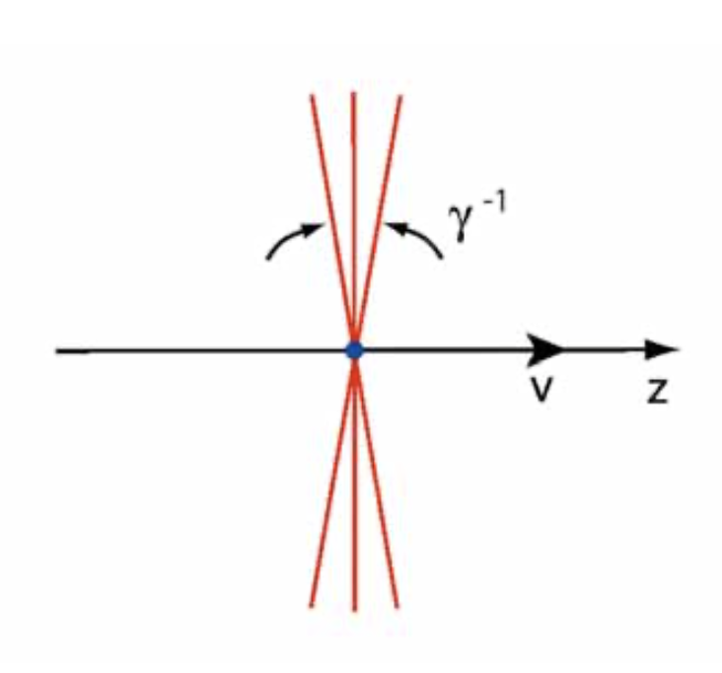
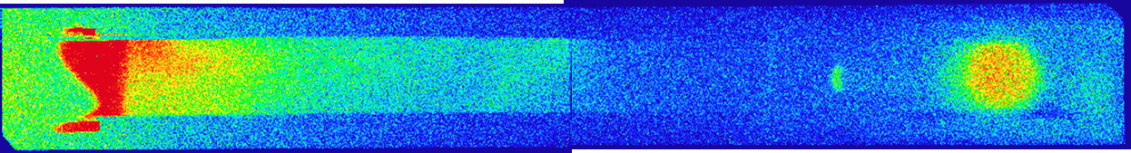
In our experiments, we fond there was a mono energetic positron peak when the charge number of the driving electron beam is high(>1nC).
shot20
Divergence angle 20mrad
Charge 5pC
（>1.5MeV）
4.4% @82.43MeV
(36.2 fC)
The positrons move together with the electrons. Due to relativistic effect, the longitudinal field of the electron beam becomes small, not enough to accelerate the positron.

Slide 14





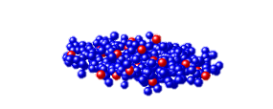


When the electron beam goes through the back surface, strong coherent transition radiation of frequency several THz is generated, due the the small size and large charge number of the electron beam.
positrons
electrons
1mm Cu
longitudinal electricfield
Laser
v
Gas jet
Ⅰ
z
B_{x} = 30T
Ⅱ
External magnetic field
y
x
Ⅲ
Phys. Plasmas 23, 033109 (2016).
Communication Physics 3，191 (2020)

Slide 15
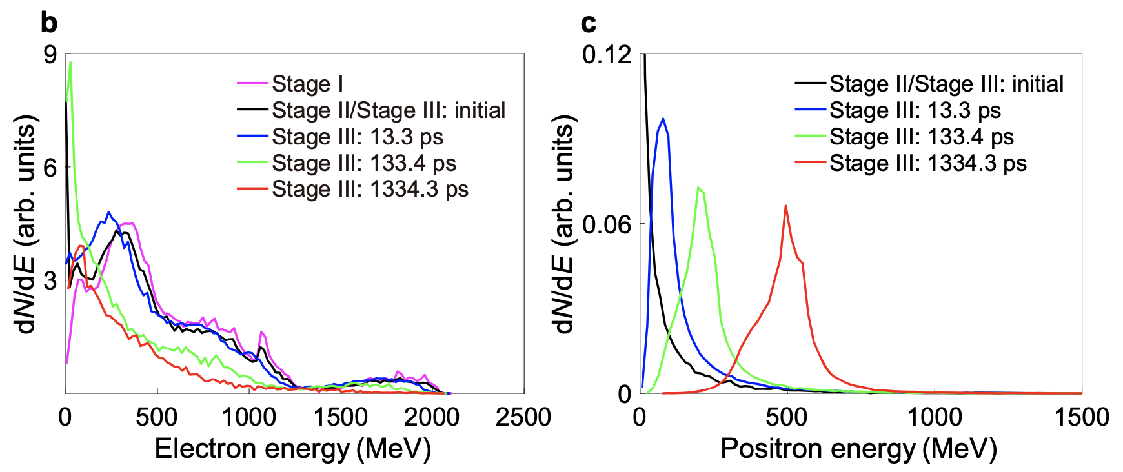
In simulation, with a 5 PW 45 fs laser, a positron beam of 10 pC is acceleration from 25 MeV to 500 MeV within a distance of 40 cm.

Slide 16
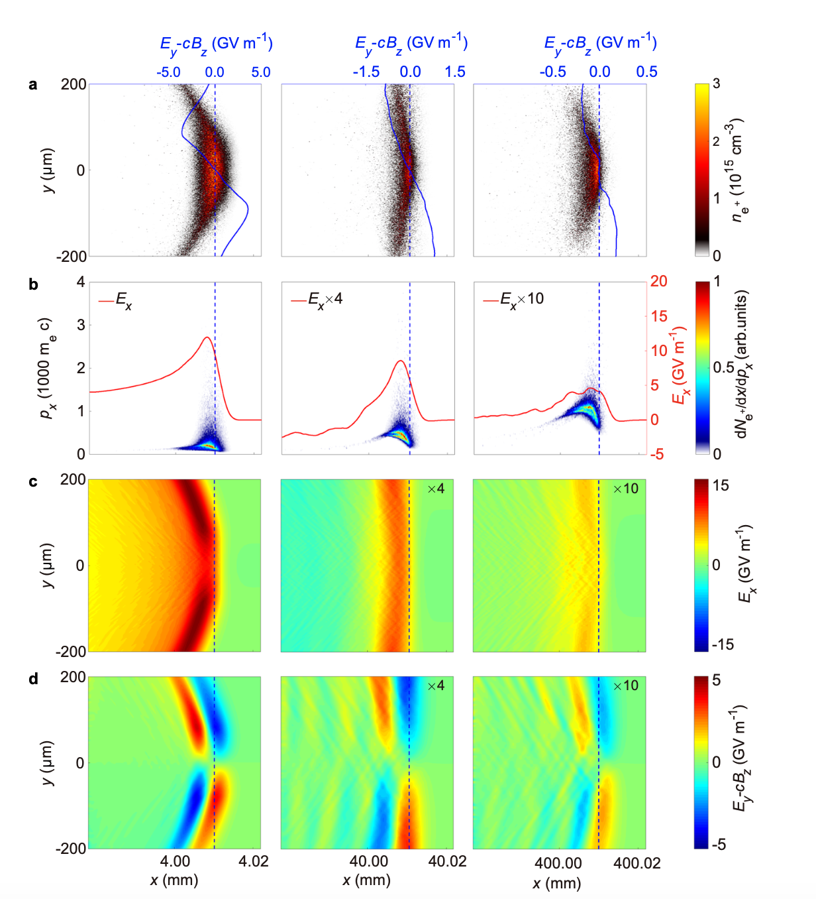
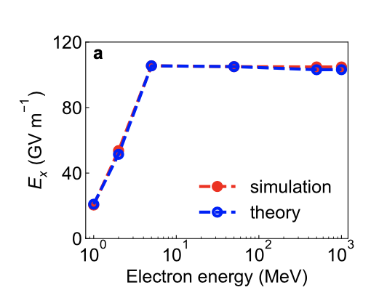
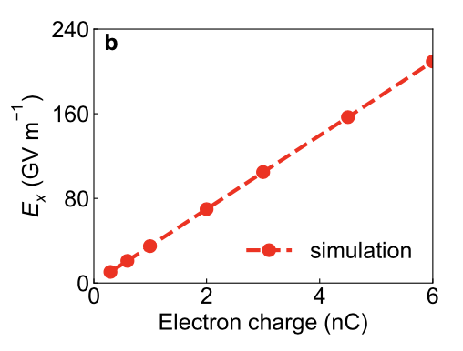
External magnetic field
Simulation shows that it is good for positron acceleration.
The magnetic field suppresses the spread of the electron which may guide the propagation the THz wave.
Positron density and focusing force in transverse.
Acceleration field and positron distribution in phase space.
Two dimensional acceleration field.
Two dimensional transversal force
The THz radiation is of radial polarization.

Slide 17
The efficiency of the acceleration
During the propagation of particles and the radiation, the positrons get energy while the electrons lose energy. Therefor, in principle the radiation energy could keep unchanged. And the electron energy is gradually transferred to the positron energy. The efficiency could be high.
At present, the main limitation is the diffraction of the Thz radiation and the spreading of the electron beam.

Slide 18
Positron beam acceleration with coherent transition radiation driven by conventional electron beam
positrons
electrons
1mm Cu
longitudinal electricfield
Laser
v
Gas jet
Ⅰ
z
B_{x} = 30T
Ⅱ
External magnetic field
y
x
Ⅲ
The most important thing is that the electron beam should be compressed in time and in transversal size. Since the good collimation of the electron beam, the external magnetic field may not be required.

Slide 19
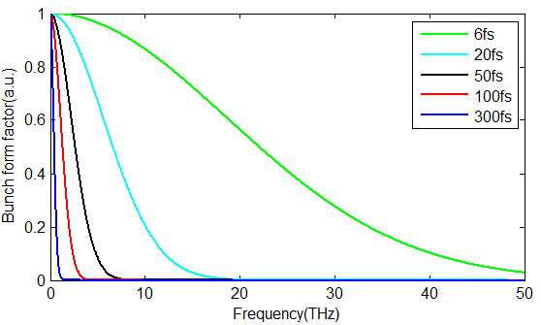
Positron beam acceleration with coherent transition radiation driven by conventional electron beam
Short electron beam produce coherent transition radiation of high frequency short pulse duration and high intensity.
The charge of the electron beam is important to the intensity of the acceleration field.

Slide 20
Conclusions
In experiment, we observed monoenergetic positron peak.
We proposed the new scheme to accelerate positrons with coherent transition radiation.
We discussed the possibility to use the new scheme for conventional accelerator.
Many more things should be done for the new scheme.

Slide 21
Thank you for your attention！

