Slide 1
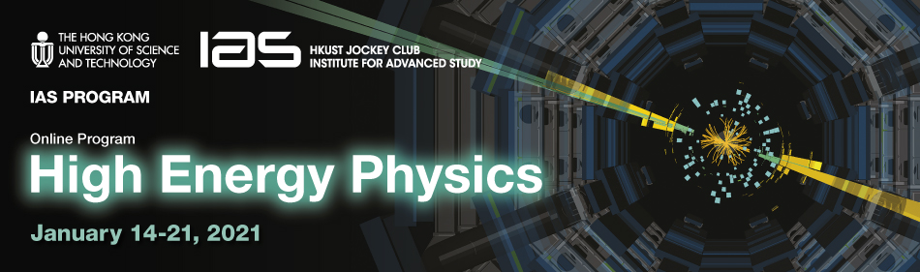

High Energy Physics 2021, January 14-15, 2021
Laser Plasma Acceleration and Its Applications
Jiansheng Liu
Shanghai Normal University
Shanghai Institute of Optics and Fine Mechanics (SIOM), CAS

Slide 2
Outline
1. Background and motivations
2. High-quality e-beam generation from a sophisticated laser wakefield accelerator (LWFA)
Generation of x- and γ-ray sources based on a LWFA
Summary

Slide 3
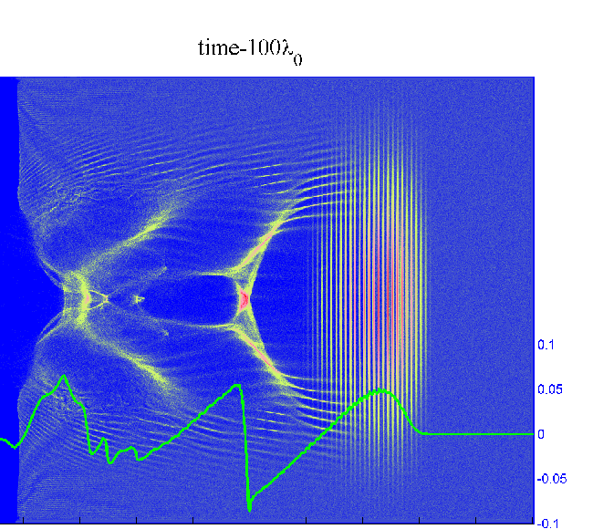
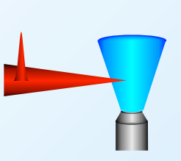

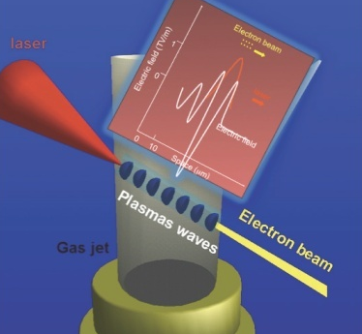
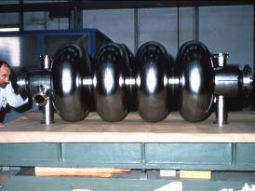
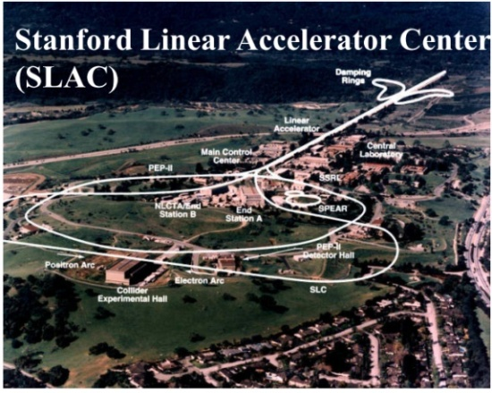
Motivations: LWFAs are compact accelerators
Laser wakefield accelerators—Compact particle accelerators
Gas jet
Driving laser
LWFA: Accelerating gradient
~100 GV/m‏
Stanford LINAC, 2 miles long
RF cavity (1 m-long)
(gradient= 10⁷⁻⁸ V/m)
RF accelerator
Laser Pulse Phenomena and Applications
Notes:
3

Slide 4
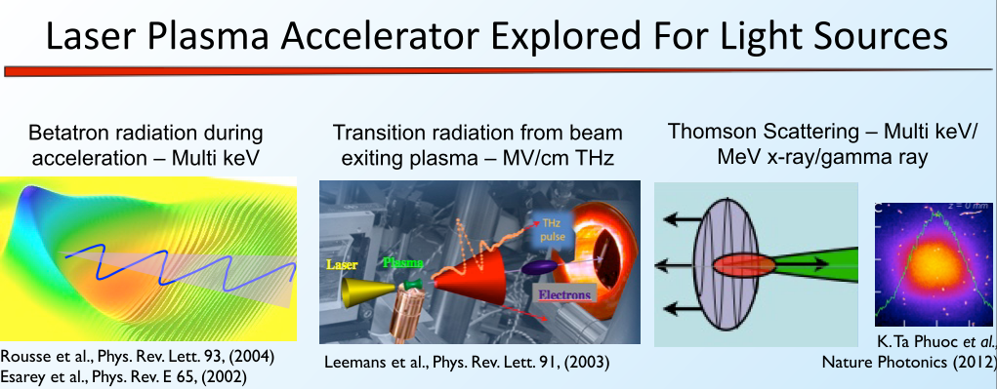
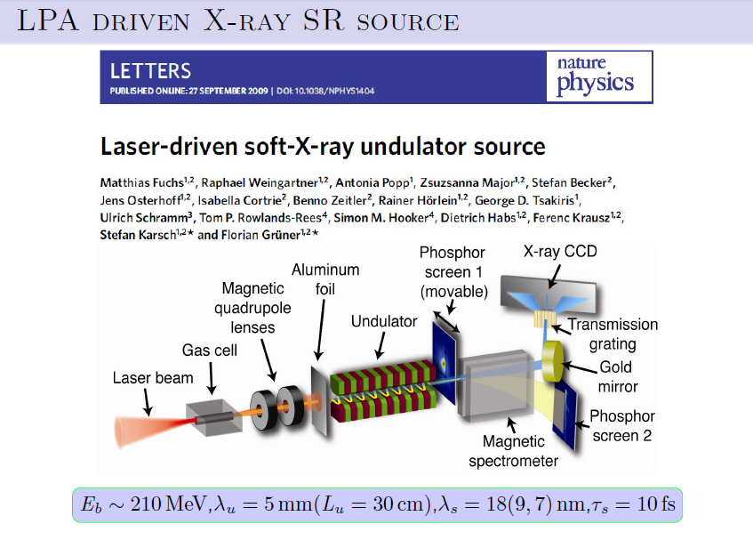
Compact light sources based on a LWFA
However, high-brightness light sources rely on the generation of stable and high-brightness electron beams from a LWFA
FEL
Nature Physics 2009

Slide 5
Outline
1. Background and motivations
2. High-quality e-beam generation from a sophisticated laser wakefield accelerator (LWFA)
3. Generation of x- and γ-ray source based on a LWFA
4. Summary

Slide 6
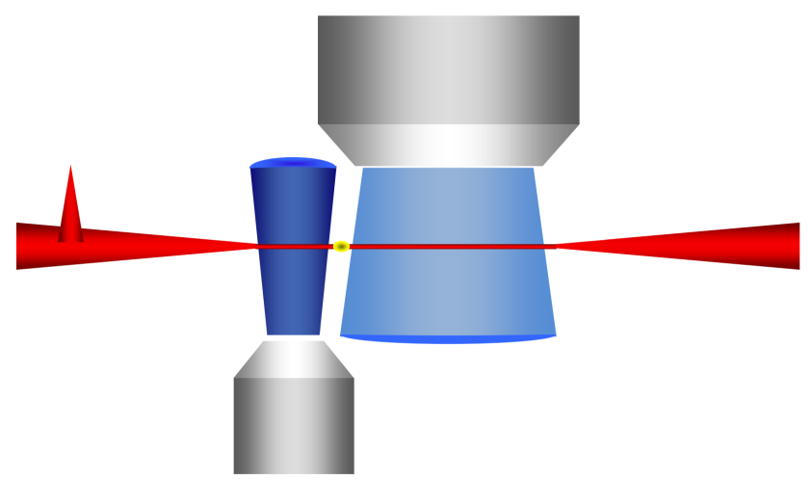
Generation of controllable high-quality high-energy e-beam:
decoupling electron injection and acceleration, and energy control
Single-Stage LWFAs
Single-stage LWFAs
Gas jet
Electron injection
Electron acceleration
High density
Strong nonlinear
Low density
Quasi linear
Driving laser
contradiction
Cascaded/Staged LWFAs
Cascaded LWFAs
3 major issues
Electron injector
Energy chirp control
Efficient acceleration
Electron injection and acceleration are decoupled
Controllable high-quality high-energy e-beams

Slide 7
Minimization of energy spread in a cascaded LWFA via velocity bunching (e-beam compression)
Evolution of energy spread and energy chirp in a LWFA
Δε_{z0} = Δε_{z0}
l_{z} > l_{z}
Δε_{z}=ε_{back}−ε_{front}

Slide 8
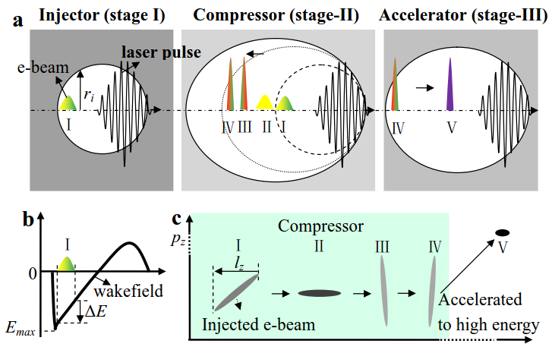
Minimization of energy spread in a cascaded LWFA via velocity bunching (e-beam compression)
Zhijun Zhang et al., Phys. Plasmas 23, 053106 (2016)

Slide 9
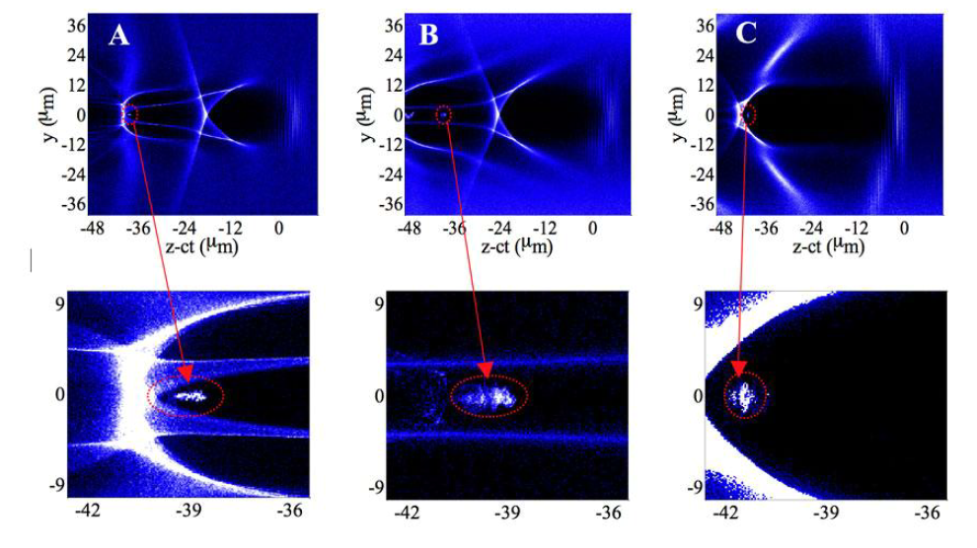
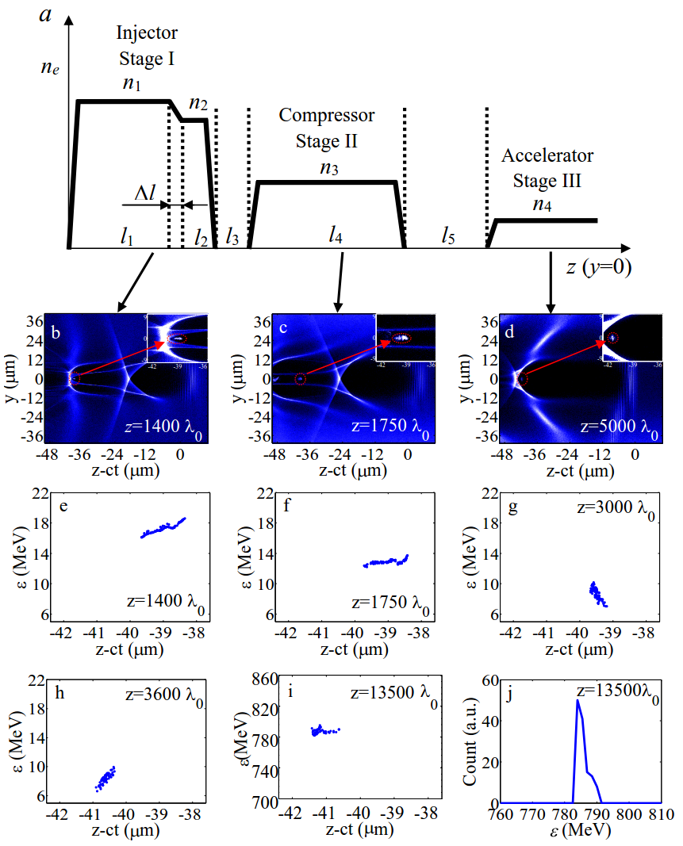
PIC模拟
Minimization of energy spread in a cascaded LWFA
via velocity bunching (e-beam compression)
Δε_{z0}= -0.53 MeV
l_{z}=0.43 μm
Δε‘_{z0}= -1.23 MeV/μm
Δε_{z} =0.86 MeV l_{z}=0.15 μm
Δε‘_{z0}= 5.63 MeV/μm
I
II
III
I
II
Ⅳ → Ⅴ
Ⅳ
Ⅴ
l₁=1300λ₀、l₄=1400λ₀、l₅=6l₂=6l₃=600λ₀、Δl=6λ₀、
n₁=5.2×10¹⁸cm⁻³、n₂=0.94n₁、n₃=0.42n₂、n₄=0.36n₃
ε_{p}：784.0 MeV
Δε=1.6 MeV l_{z}=0.18 μm
rms ES：0.20%
Zhijun Zhang et al., Phys. Plasmas 23, 053106 (2016)

Slide 10
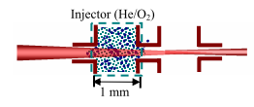
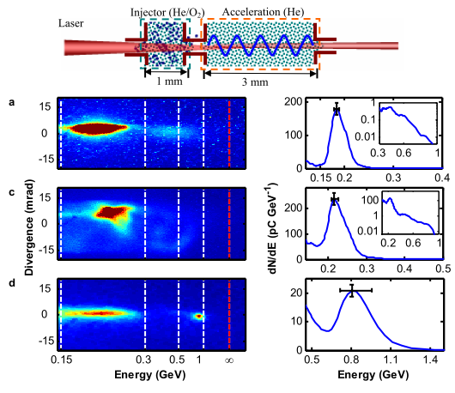
Design of a cascaded LWFA using ionization injection
Electron injector
Acceleration stage
Advantages of using ionization-induced injection for the electron injector
Self-injection requires a high input power P/P c > 4
Ionization-induced injection works at lower laser power. a 0 < 2
Ionization-induced injection can be operated at lower plasma density
nonlinear instability can be minimized
phase matching for the electron seeding between the two-stage plasmas can
be satisfied easily.
Notes:
10

Slide 11
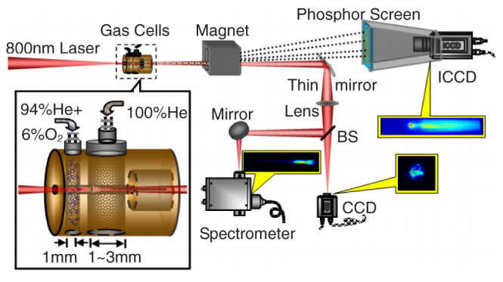
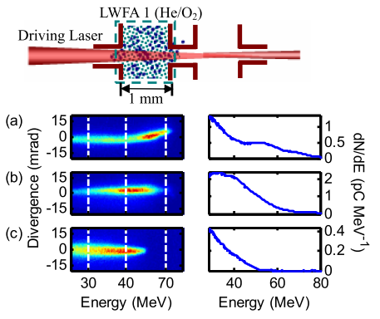
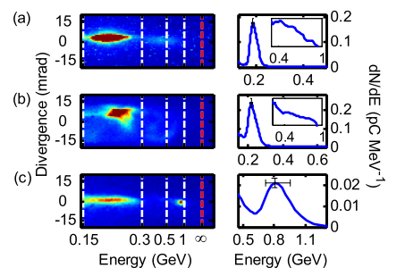
级联尾场电子加速机制的提出
100 TW
Jiansheng Liu et al PRL, 107, 035001 (2011)

Slide 12
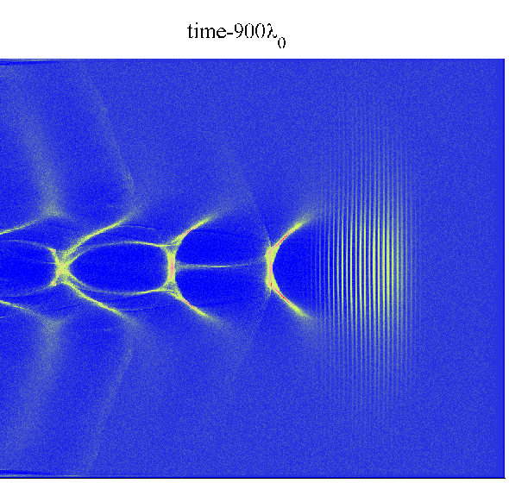
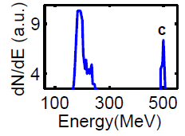
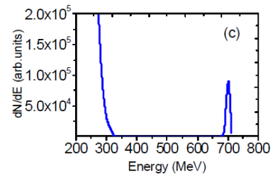
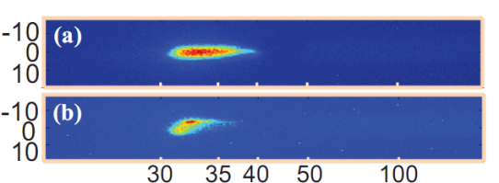
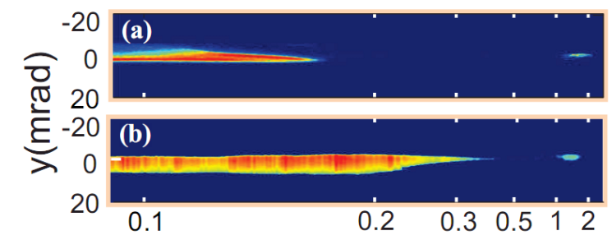
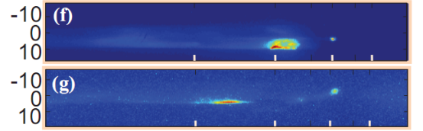


Demonstration of a cascaded LWFA using self injection
By optimizing the seeding phase of electrons into the second stage, electron beams beyond 0.5 GeV with a 3% rms energy spread were produced over 2 mm. Peak was further extended beyond 1 GeV by lengthening the second acceleration stage to 5 mm.[ Appl. Phys. Lett.103, 243501(2013), Phys. Plasmas 19,023105(2012)]。
Cascaded LWFA
(Gradient injection)
ΔE/E = 0.7%
2-5 mm
Experimental realization
Electron injector
~32 MeV
Cascaded LWFA (1+2 mm)
530 MeV, ΔE/E ~ 3%
Cascaded LWFA (1+5 mm)
~1.3 GeV

Slide 13
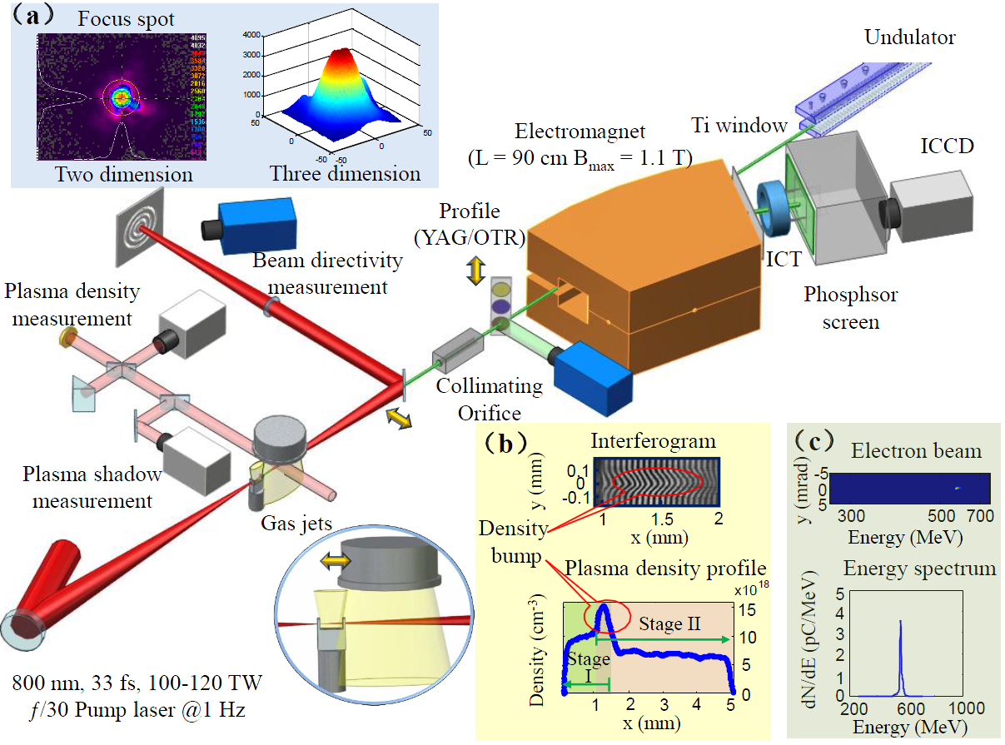
High-Brightness High-Energy Electron Beams from a Laser Wakefield Accelerator via Energy Chirp Control
W. Wang et al., PRL 117,124801(2016)

Slide 14
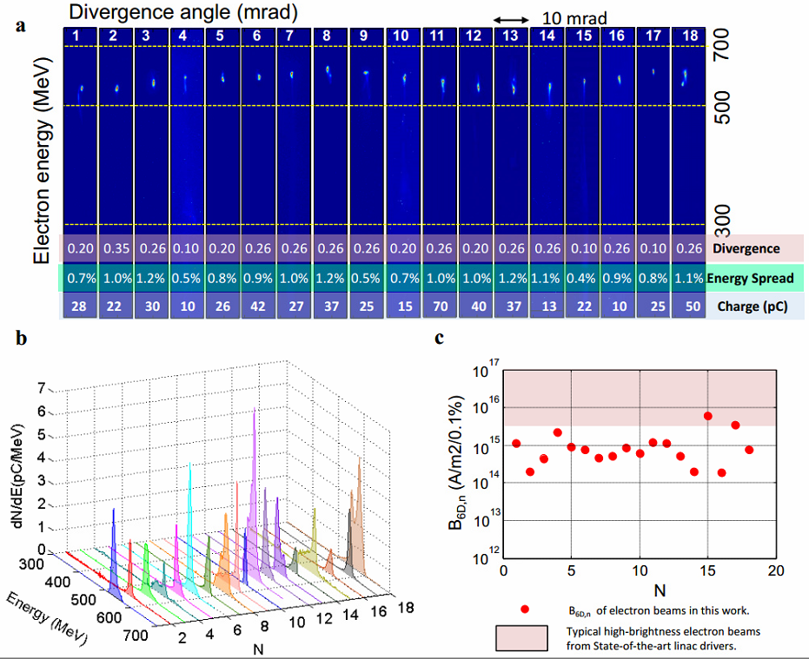
High-quality high-energy electron beams from a cascaded LWFA
Energy chirp control
Peak energy: 0.4-0.8 GeV
Energy spread: <1%
Beam charge : up to 80 pC
Divergence: <0.3 mrad
Stability: >90%
Energy fluctuation: <5%
Wentao Wang et al., Phys. Rev. Lett. 117, 124801(2016)

Slide 15
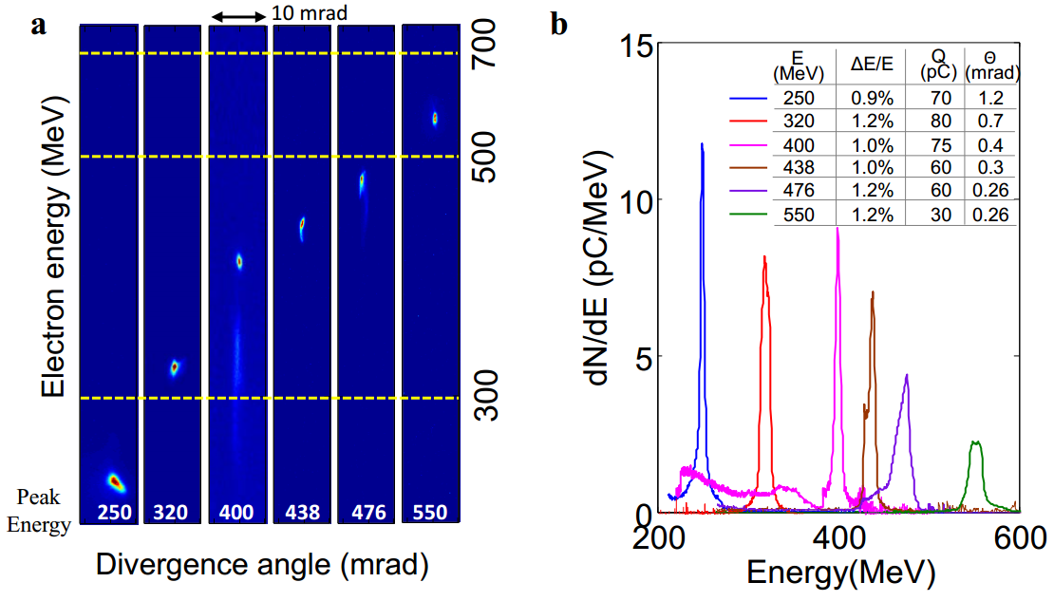
High-quality high-energy electron beams from a cascaded LWFA
Wentao Wang et al., Phys. Rev. Lett. 117, 124801(2016)

Slide 16
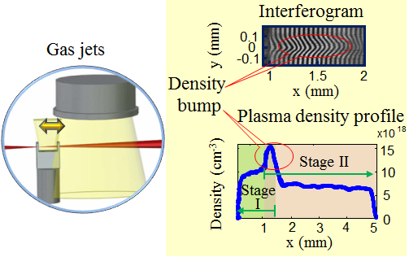
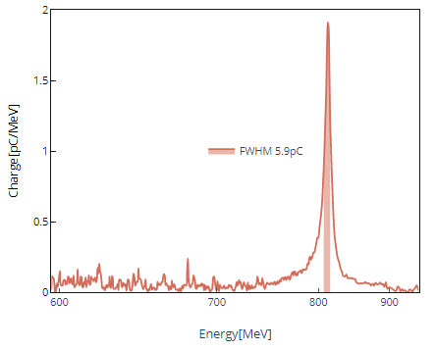
High-quality high-energy electron beams from a cascaded LWFA
Compression of energy spread via energy chirp control and beam loading
Wentao Wang et al., Phys. Rev. Lett. 117, 124801(2016)

Slide 17
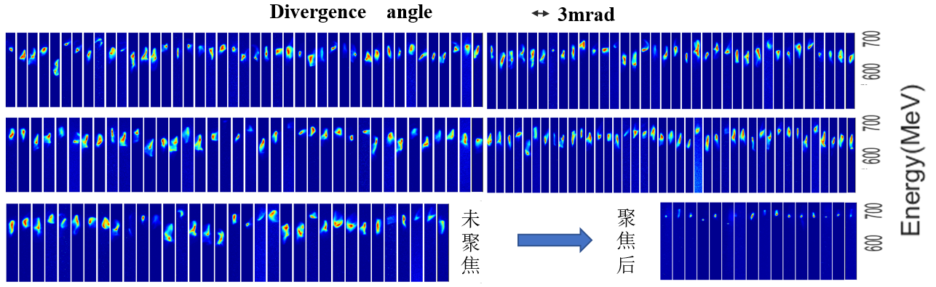
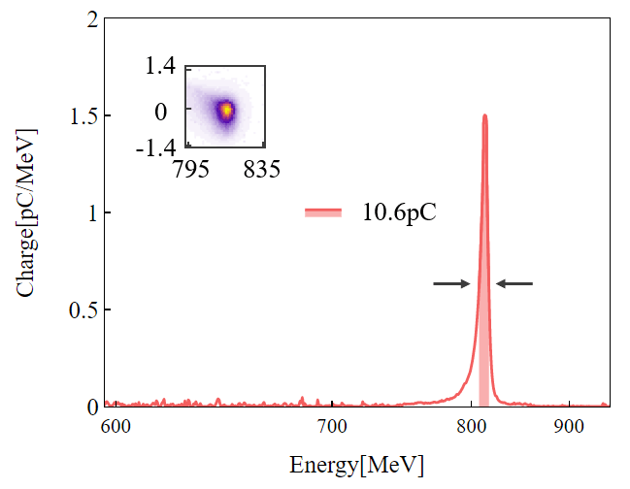

Stable Near-GeV electron beams at a few-thousandth level
1
~ 100% Monoenergetic
Energy spread 0.4-3%
Energy fluctuation 4% (rms)
Pointing stability 0.5mrad (rms)
Beam charge 10-80 pC
Consecutive shots
$$3.3‰$$
A big step from laser acceleration to accelerators！

Slide 18
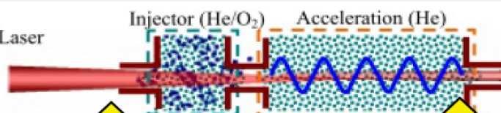
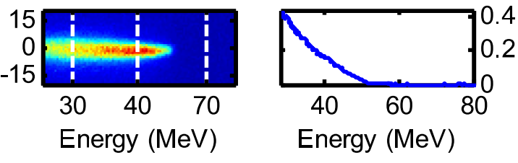
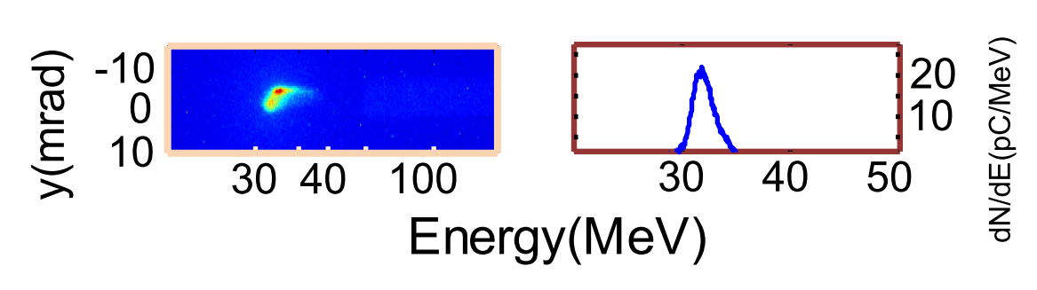
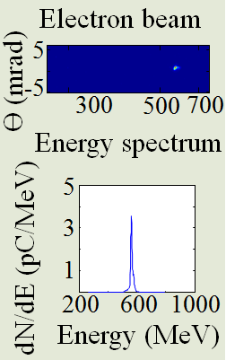
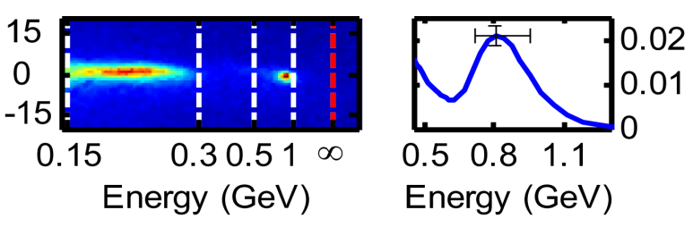
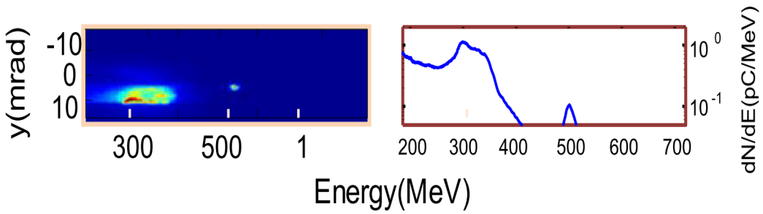
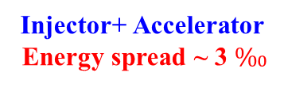
Progress in generating high-quality electron beams via developing high-quality LWFAs
Ionization-induced injection
self injection
Energy chirp control
5.7×10¹⁹ cm⁻³
2.5×10¹⁸ cm⁻³
7-9×10¹⁸ cm⁻³
~3×10¹⁸ cm⁻³
1.1×10¹⁹ cm⁻³
6×10¹⁸ cm⁻³
Injector: Energy spread 100％
Injector: Energy spread 10％
Injector+ Accelerator
Energy spread <25％
Injector+ Accelerator
Energy spread ~ 3％
Injector+ Accelerator
Energy spread ~ 3 $‰$
Phys. Rev. Lett. 107, 035001 (2011).
Appl. Phys. Lett. 103, 243501(2013).
Phys. Rev. Lett. 117, 124801(2016)

Slide 19
Outline
1. Background and motivations
2. High-quality e-beam generation from a sophisticated laser wakefield accelerator
Generation of x- and γ-ray source based on a LWFA
Summary

Slide 20
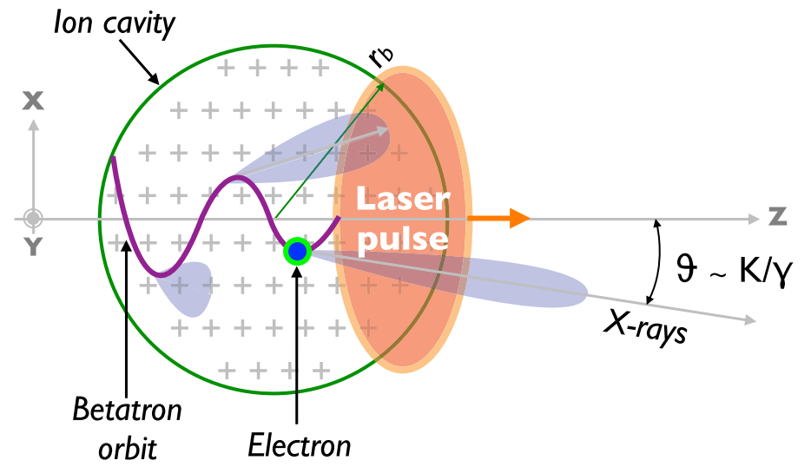
I. Betatron radiation enhancement by steering a laser-driven wakefield with a titled shock front
High-quality electron beams
? High yield radiation

Slide 21
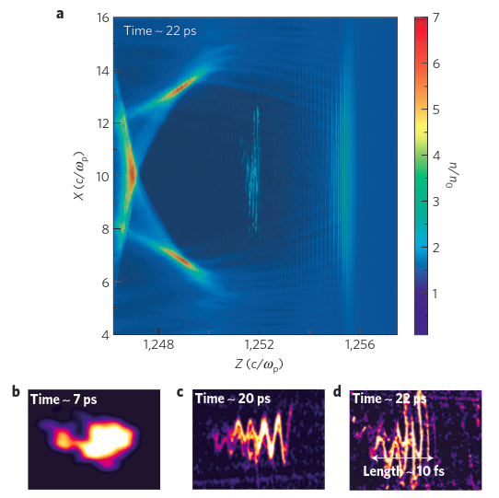
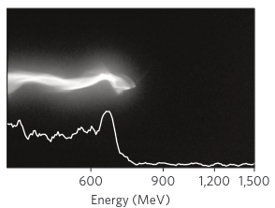
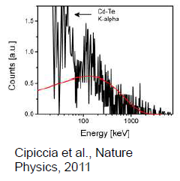
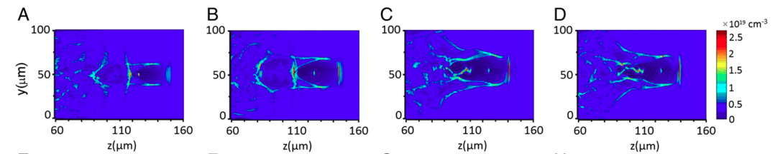
Enhanced betatron radiation via manipulation
Betatron radiation during acceleration---resonant enhancement (100 keV)
Peak brightness
10²³ phs/s/mm²/mrad²/0.1%BW
Betatron radiation during acceleration---injection control and bubble evolution
Peak brightness: 4x10²³ phs/s/mm²/mrad²/0.1%BW
IOP, PNAS 111, 5825 (2014)

Slide 22
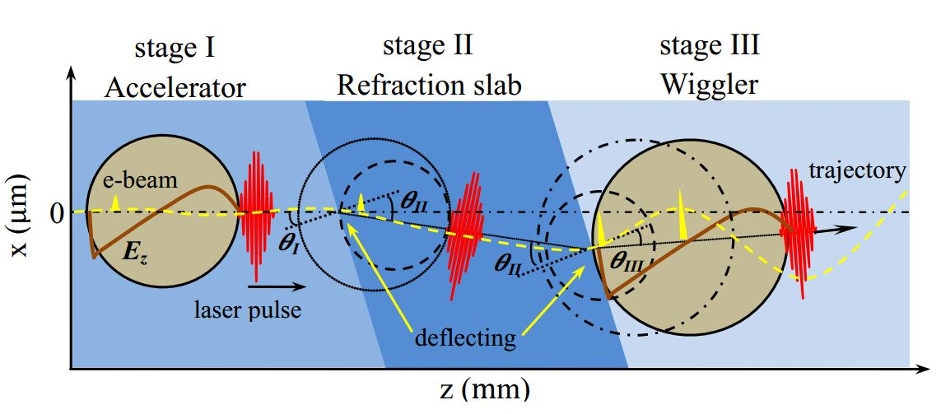
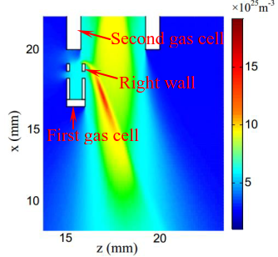
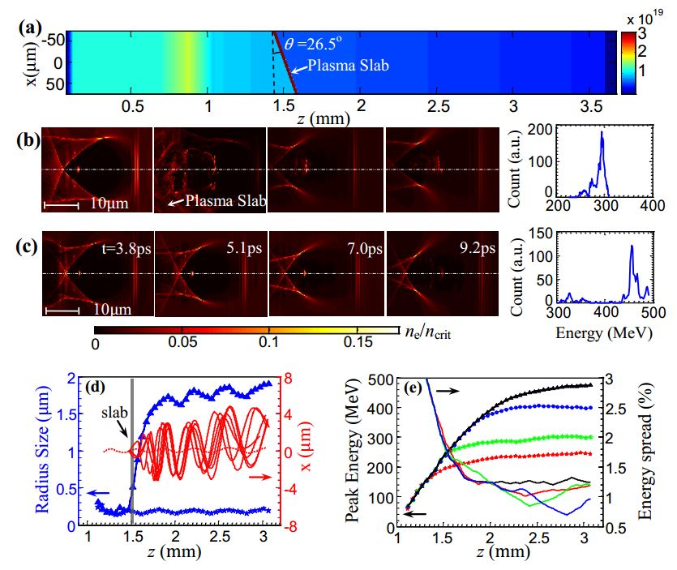
Betatron radiation enhancement by steering a laser-driven wakefield with a titled shock front
Applied Physics Letters 112, 133503 (2018)

Slide 23
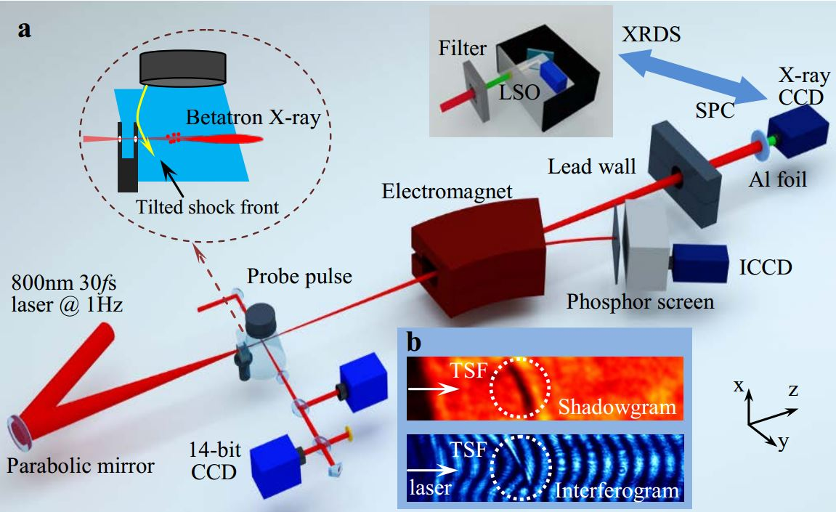
Betatron radiation enhancement by steering a laser-driven wakefield with a titled shock front

Slide 24
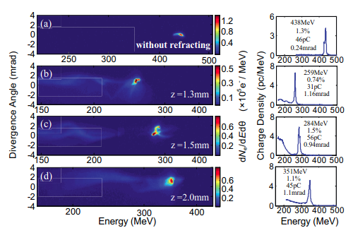
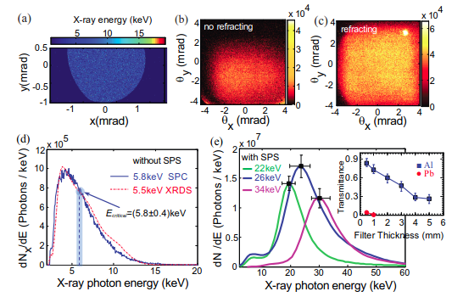
Betatron radiation enhancement by steering a laser-driven wakefield with a titled shock front
Total x-ray numbers : 2 ×10⁷.
Total x-ray numbers :3 ×10⁸.
Peak brilliance ~10²³ photons s⁻¹ mm⁻² mrad⁻² 0.1% BW.
Applied Physics Letters 112, 133503 (2018)

Slide 25
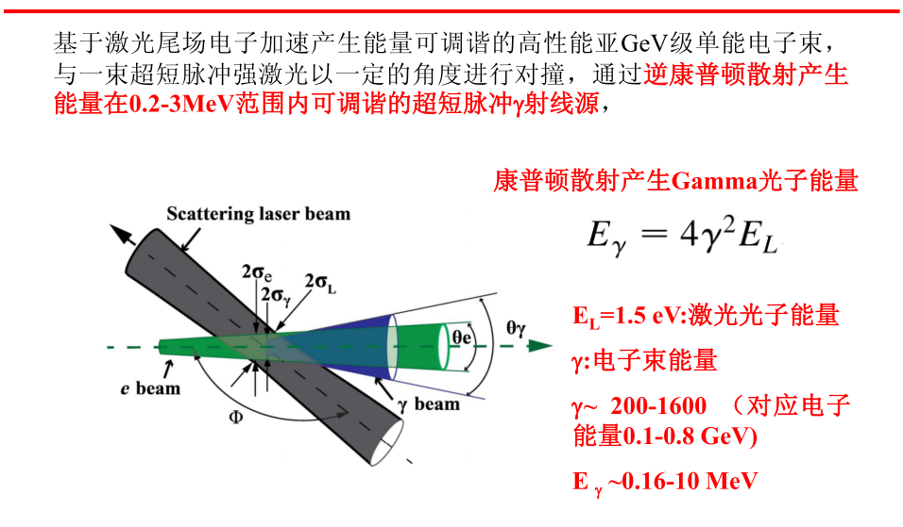
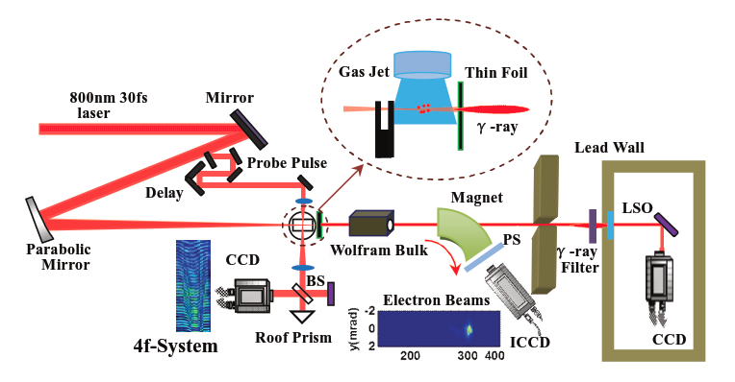
II. Generation of γ-ray sources via inverse Compton scattering

Slide 26

Peak energy: 204 MeV
rms energy spread: 1.2%
Charge：44 pC
Divergence：0.48 mrad
Peak energy: 266 MeV
rms energy spread: 1.1%
Charge：48 pC
Divergence：0.75 mrad
Peak energy: 347 MeV
rms energy spread: 1.7%
Charge：39 pC
Divergence：0.71 mrad

Slide 27







(1.5mm)
(1mm)
(0.5mm)
Pb(2.5mm)
Empty
(2mm)
Pb(1mm)
(0.5mm)
(2mm)
(5mm)
(4mm)
(3mm)
(1.5mm)
Empty
(2.5mm)
γ-ray
yield ： 5× 10⁷ photons/shot
Divergence：
3.8 mrad×4.1mrad
γ-ray duration ：
Photons in :
6.5×10⁴ photons
Peak brilliance
~3×10²² photons s⁻¹ mm⁻² mrad⁻² 0.1% BW
[C. Yu et al., Scientific Reports, 6, 29518 (2016)]

Slide 28


III. X-ray radiation based on a LWFA and an undulator has been demonstrated

Slide 29


III. X-ray radiation based on a LWFA and an undulator has been demonstrated
Long-distance transport of e beams from the LWFA into the undulator
Beam center
Beam size
Beam size can be less than 100 μm；
Beam center jitter ~200 μrad。

Slide 30


III. X-ray radiation based on a LWFA and an undulator has been demonstrated
1-10 MW
0.1-1MW
~100 kW
Measured undulator radiation
Radiation photons : 10⁹⁻¹⁰@27 nm

Slide 31
Summary
A two-stage LWFA for generating high-quality electron beams has been experimentally realized. By optimizing the seeding-phase and energy chirp control, high-quality electron beams with an energy spread of few thousandth, small divergence and high stability were produced.
Enhanced betatron radiation was produced by steering a low-energy-spread electron beam in a laser-driven plasma wiggler.
Tunable MeV Gamma-ray Source from Compton Backscattering with ultrahigh brilliance of 3×10²² photons s⁻¹ mm⁻² mrad⁻² 0.1% BW has been experimentally demonstrated.
A XFEL platform based on the LWFA electron-beams and an undulator has been installed and tested. X-ray radiation at 27 nm has been observed.

Slide 32

Thank you for your attention!

