Slide 1


Positron Acceleration in a Hollow Channel Plasma Wakefield Accelerator
Shiyu Zhou
Tsinghua University
January 14, 2021

Slide 2


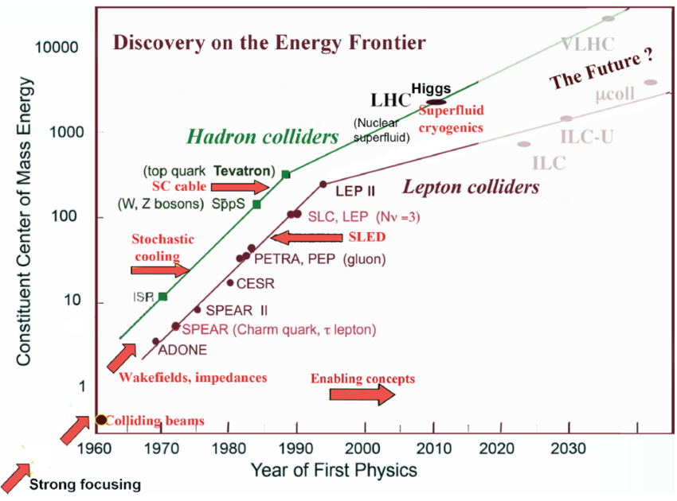
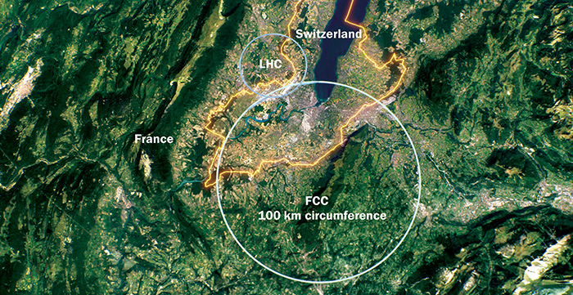
Why wakefield acceleration?
(GeV)
CEPC / FCC ?
Livingston plot
Notes:
对撞机取得重大成就。梯度限制。装置巨大。我们需要更高梯度的加速机制。

Slide 3
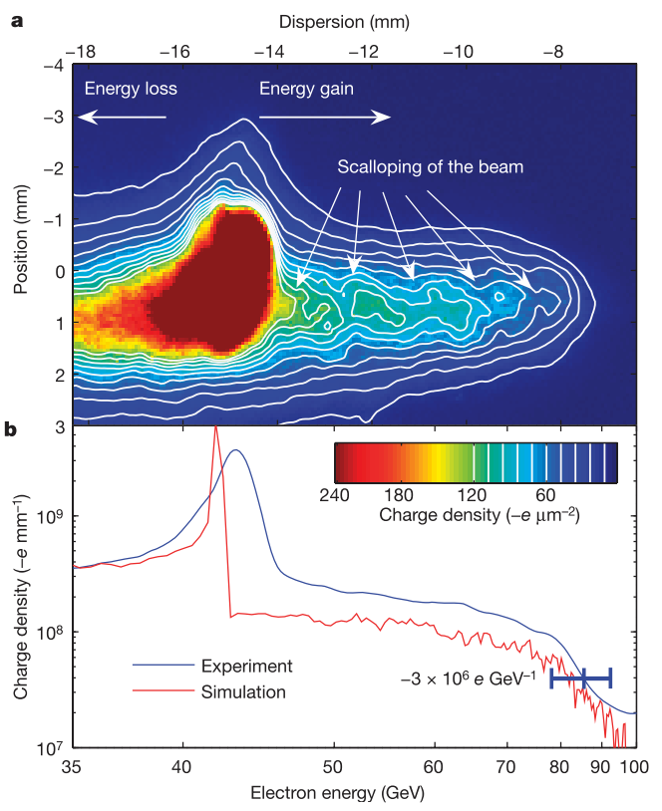
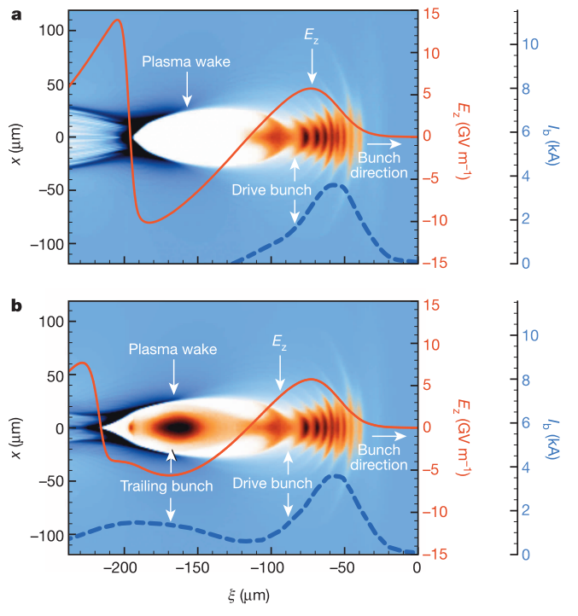
Plasma based wakefield acceleration
Plasma based wakefield acceleration
Over 42GeV acceleration in an 85cm plasma
Efficient and uniform acceleration
Gradient 1-100GeV/m
T. Tajima and J.M. Dawson, PRL (1979) LWFA
P. Chen, J.M. Dawson et al., PRL (1983) PWFA
Ian Blumenfeld et al., Nature 445 (2007)
M. Litos et al., Nature 515 (2014)
Notes:
Dielectric，原理，梯度。Plasma成功。

Slide 4
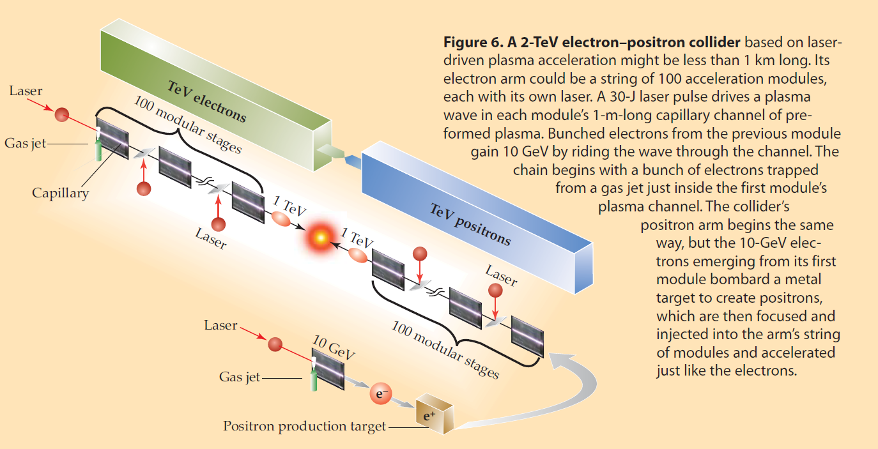
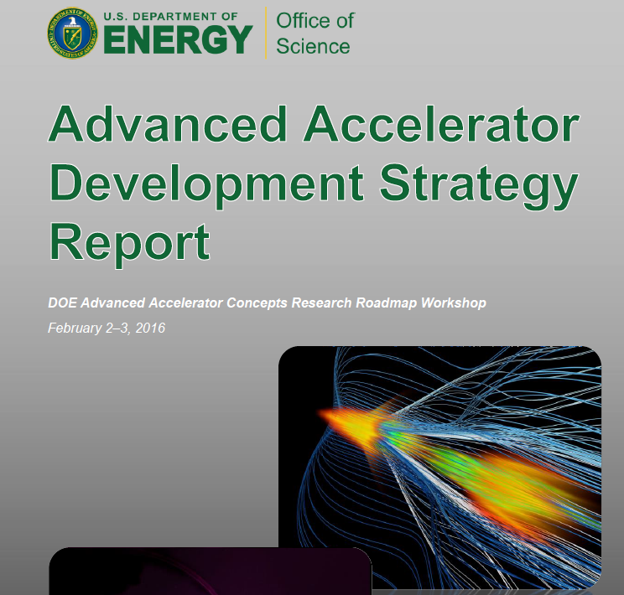
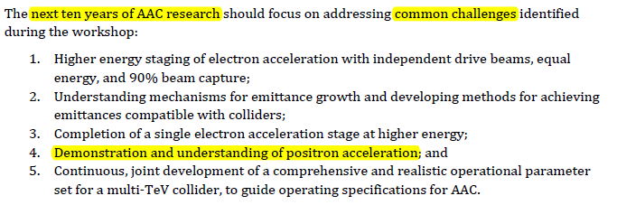
Plasma acceleration based collider
LWFA based
PWFA based
Leemans & Esarey, Physics Today, March 2009
Mark Hogan, SLAC-PUB-15426, 2013
Notes:
成功，挑战。优势。但是如何加速正电子是个问题。

Slide 5

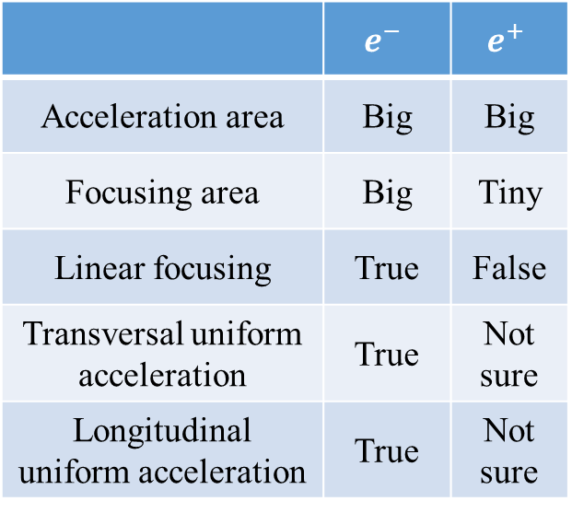



Plasma wakefield $e^{−}/e^{+}$ acceleration
In blowout regime：
Requirements for high quality beam acceleration
 | $$e^{−}$$ | $$e^{+}$$
Acceleration area | Big | Big
Focusing area | Big | Tiny
Linear focusing | True | False
Transversal uniform acceleration | True | Not sure
Longitudinal uniform acceleration | True | Not sure
$$E^{+}$$
$$E^{−}$$
$e^{−}$ beam load
Notes:
介绍blowout regime。

Slide 6
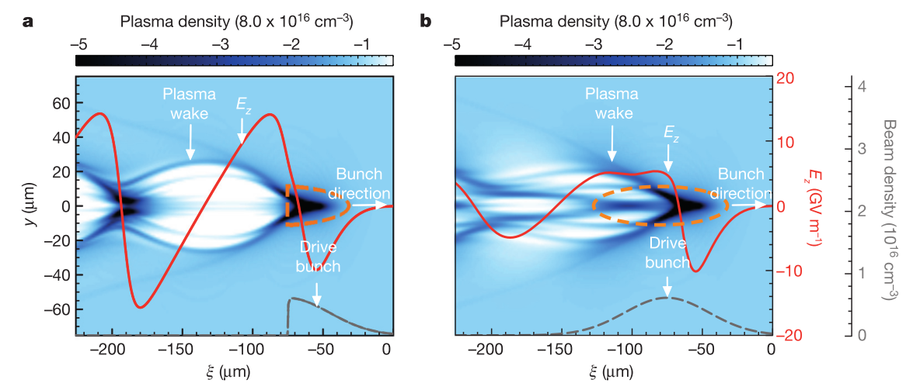
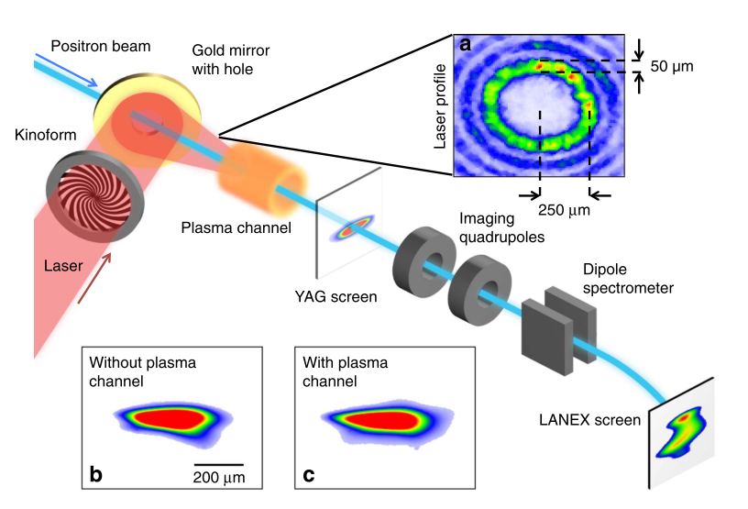
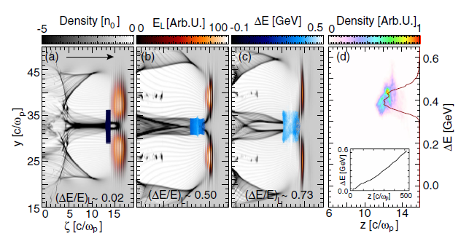
Positron acceleration schemes
Self-loaded wakefield
Hollow laser or electron driver
Hollow plasma channel
Stable, efficient uniform acceleration?
Spencer Gessner, et al., Nature Comms.(2015)
J. Vieira and J. T. Mendonca, Phys. Rev. Lett. 112, 215001 (2014)
Neeraj Jain, et al., Phys. Rev. Lett. 115, 195001 (2015)
S. Corde et al. Nature(2015)

Slide 7
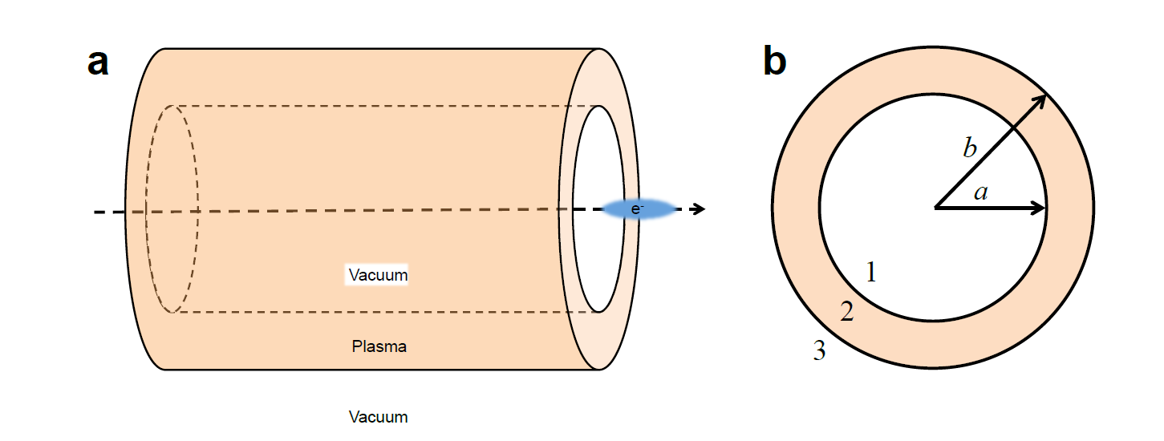
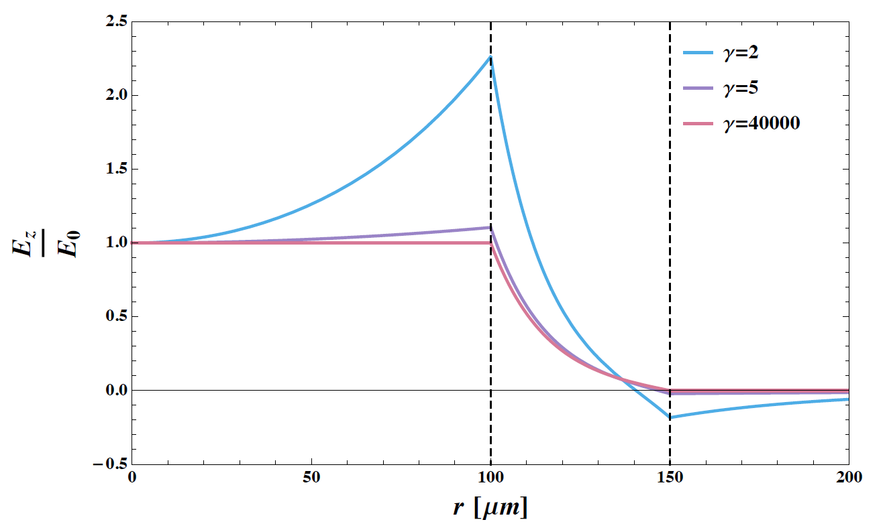
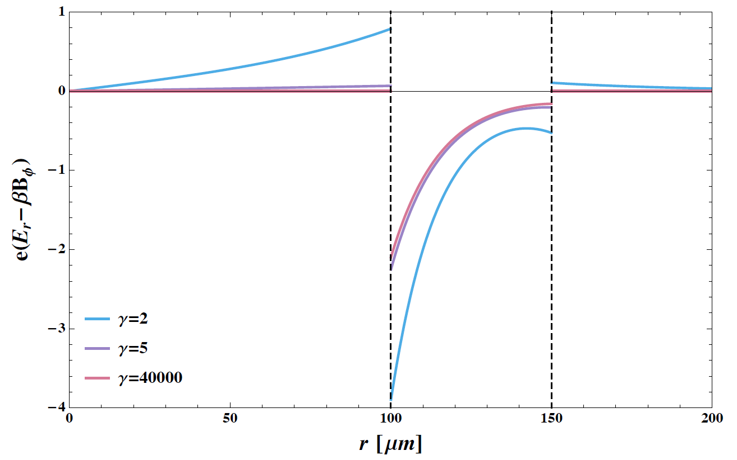
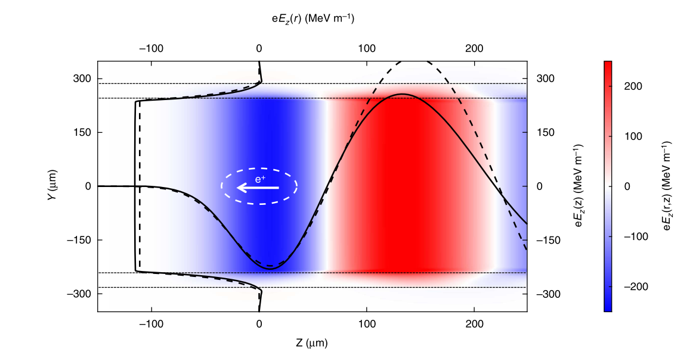
Properties of hollow plasma channel
The advantages of hollow plasma channel:
Accelerating field is uniform in transverse direction
Transverse force is almost 0
Spencer J. Gessner, thesis (2016)

Slide 8
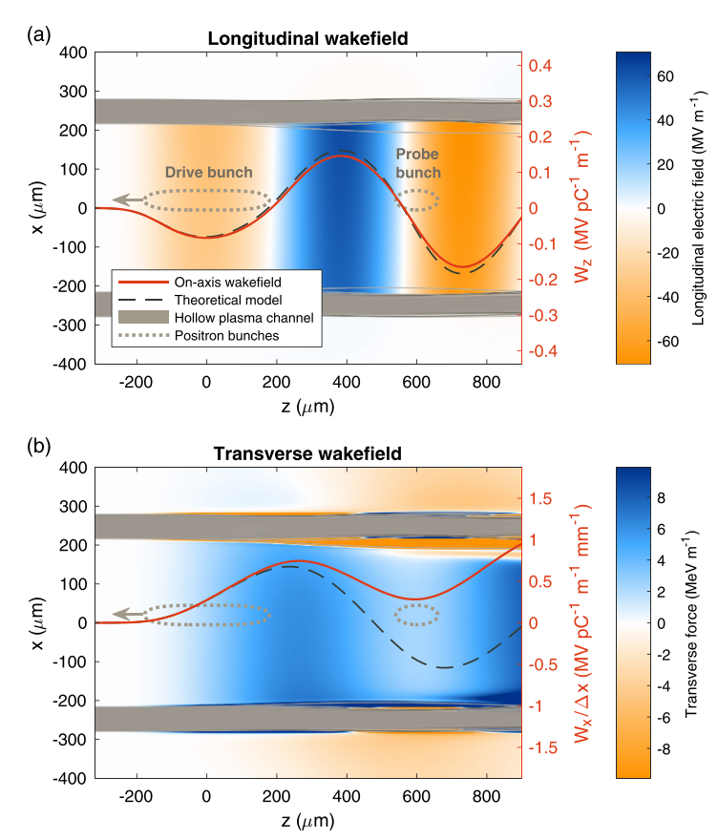
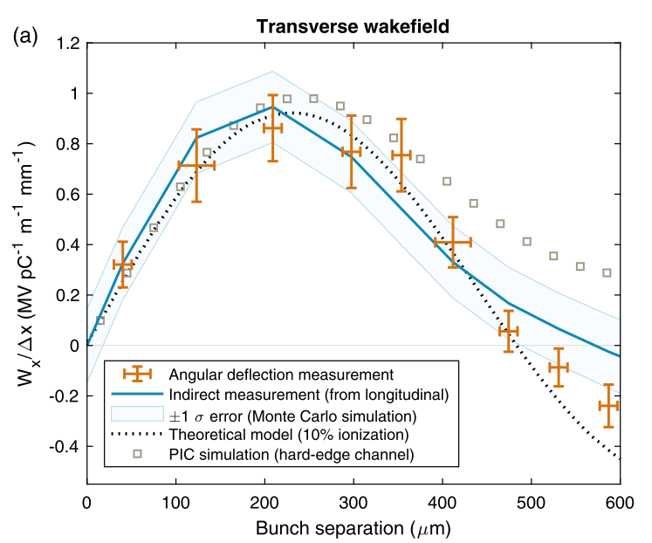

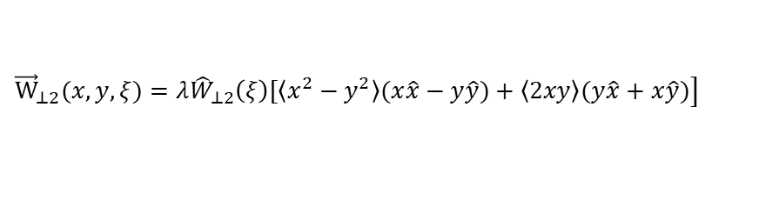
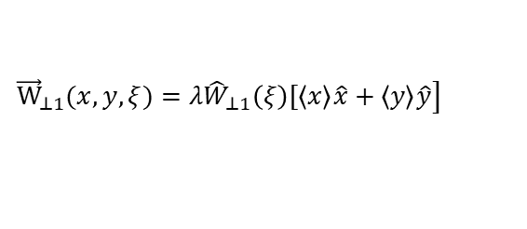
Stability issue in hollow plasma channel
Transverse wakefields in hollow plasma channel:
$${\vec{W}}_{⊥0}(x,y, ξ)=0$$
$$\left.{\vec{W}}_{⊥1}(x,y,ξ)=λ{\hat{W}}_{⊥1}\left(ξ\right)[〈x〉\hat{x}+〈y〉\hat{y}\right]$$
$$\left.{\vec{W}}_{⊥2}(x,y,ξ)=λ{\hat{W}}_{⊥2}\left(ξ\right)[〈x^{2}−y^{2}〉(x\hat{x}−y\hat{y})+〈2xy〉(y\hat{x}+x\hat{y})\right]$$
Only when the beam is exactly on-axis and with axial symmetry, there is no transverse wakefields.
C. A. Lindstrøm et al., PRL 120, 124802 (2018)

Slide 9
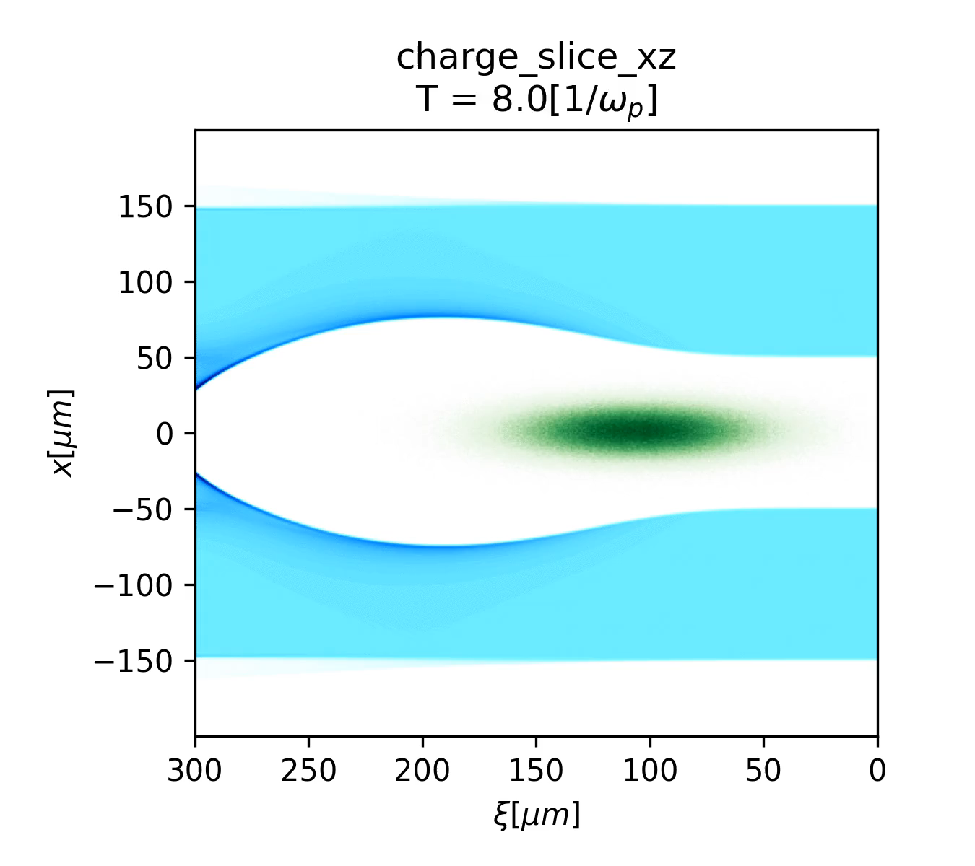
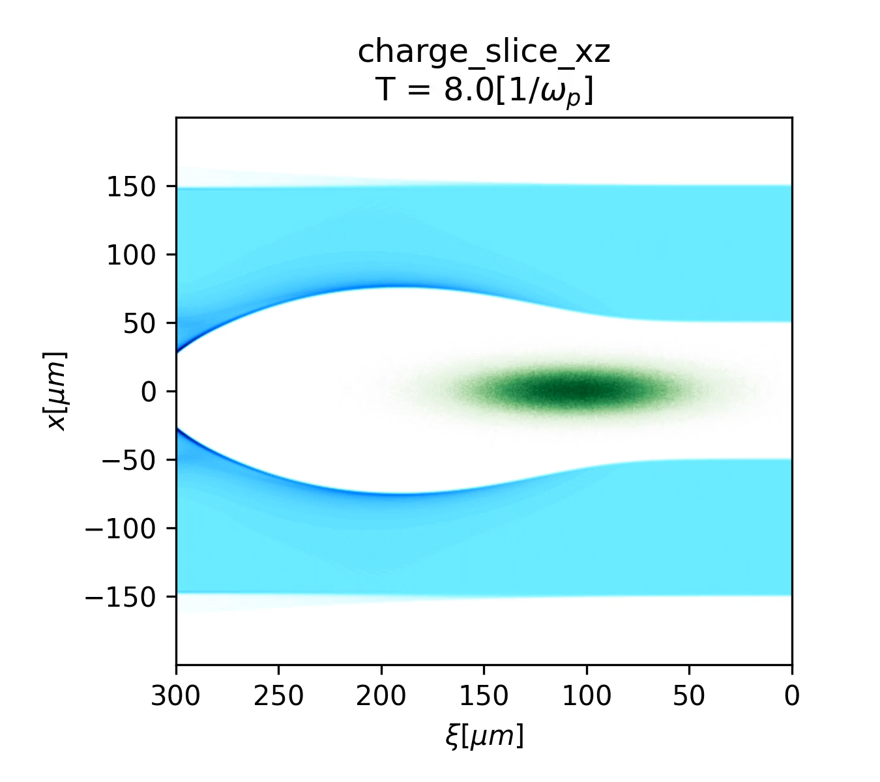
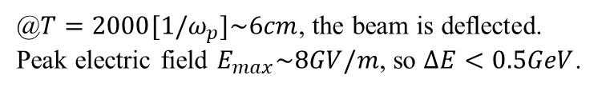
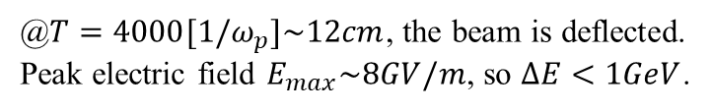
Electron transportation with misalignment
@$T=2000[1/ω_{p}]\sim 6cm$, the beam is deflected.
Peak electric field $E_{max}\sim 8GV/m$, so $ΔE<0.5GeV$.
@$T=4000[1/ω_{p}]\sim 12cm$, the beam is deflected.
Peak electric field $E_{max}\sim 8GV/m$, so $ΔE<1GeV$.

Slide 10
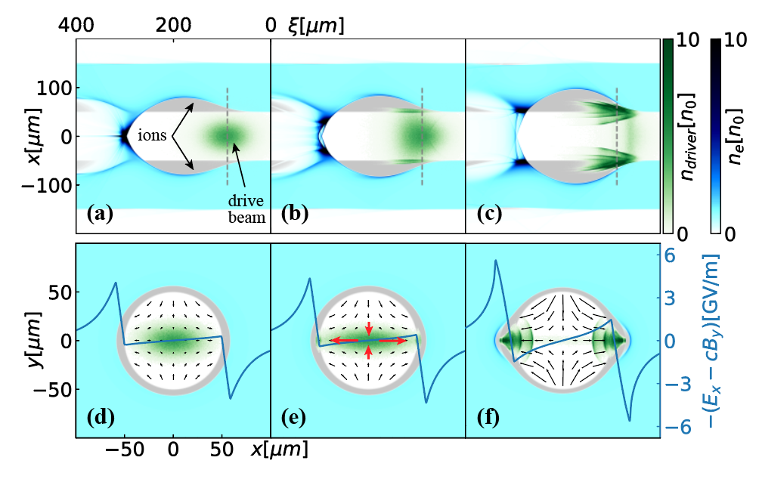
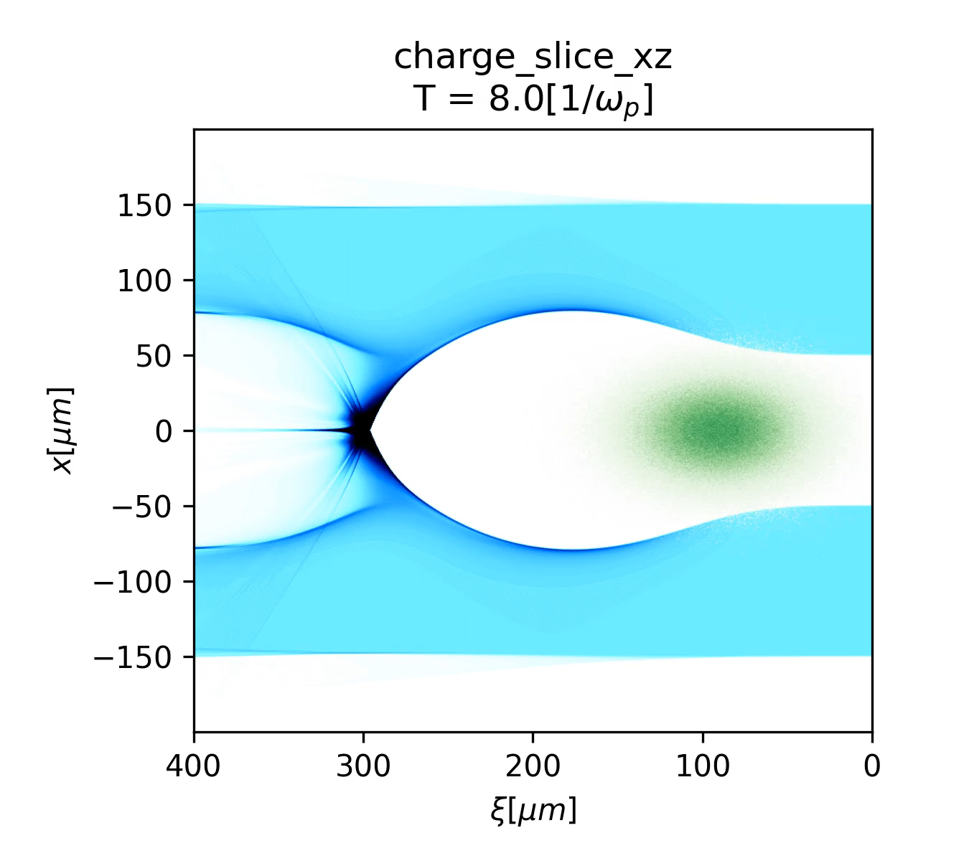

Stable transportation
Evolution of an asymmetric beam
$${\vec{W}}_{⊥1}(x,y,ξ)=0$$
$${\vec{W}}_{⊥2}\left(x,y,ξ\right)=λ{\hat{W}}_{⊥2}\left(ξ\right)[(σ_{x}^{2}−σ_{y}^{2})(x\hat{x}−y\hat{y})$$
Notes:
unique

Slide 11
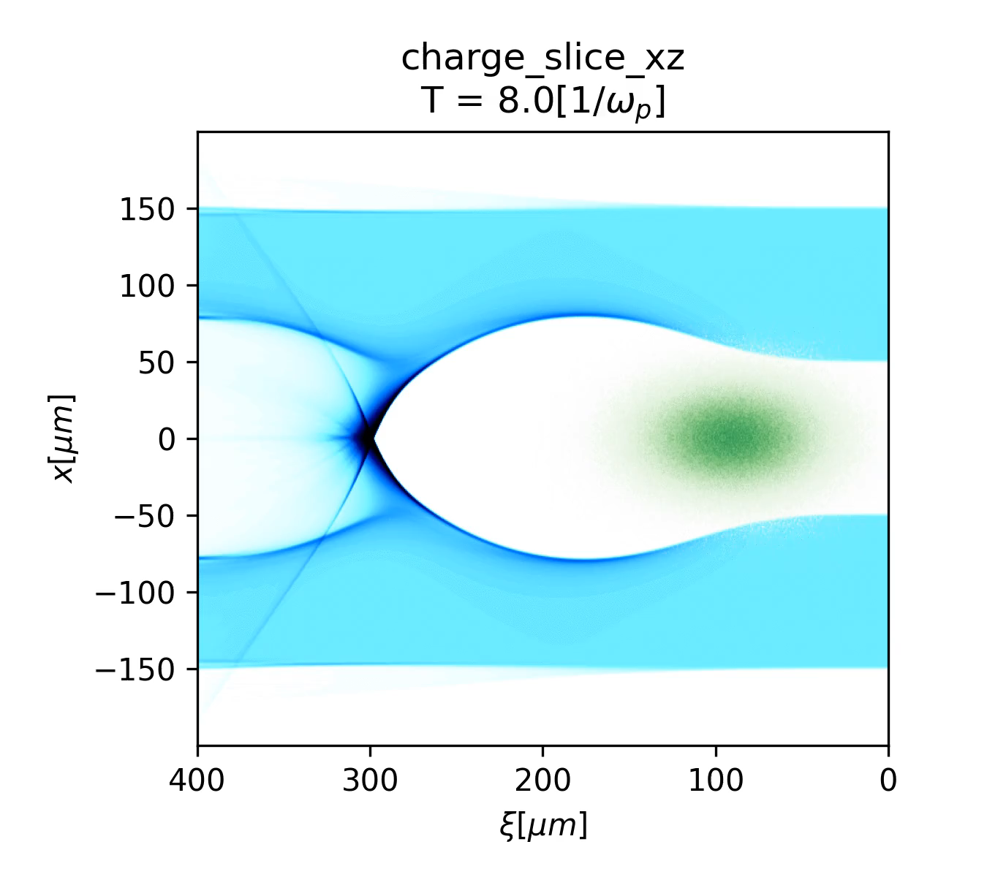
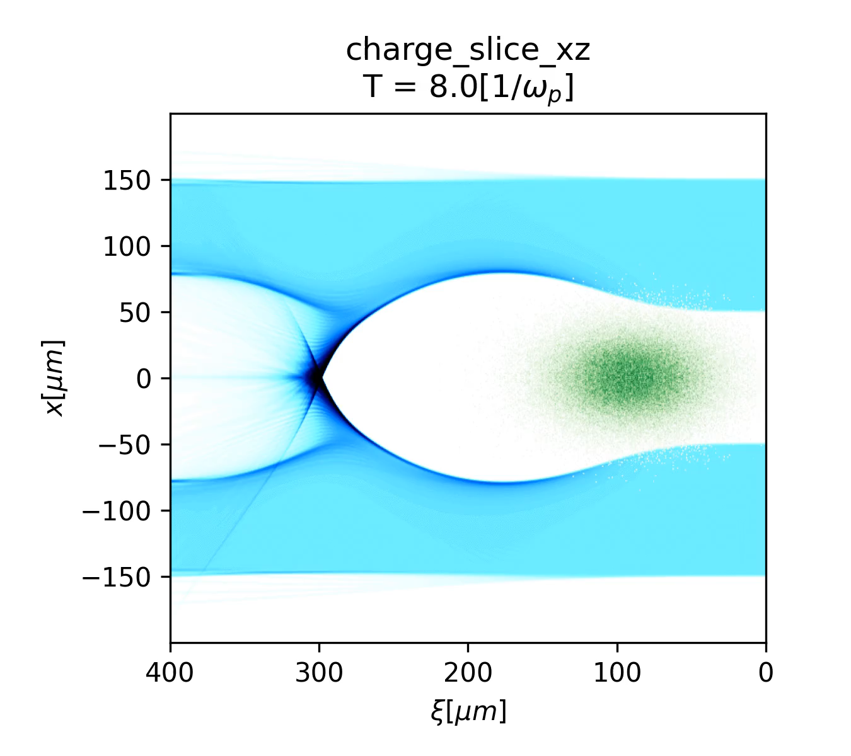
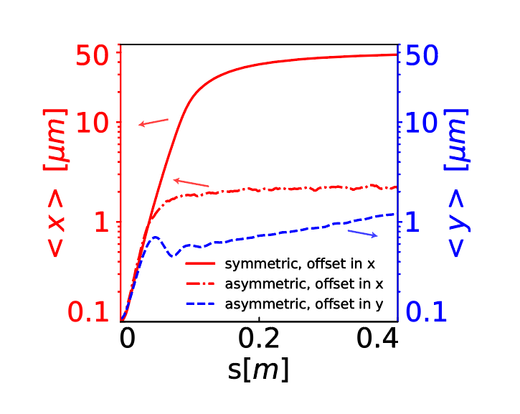
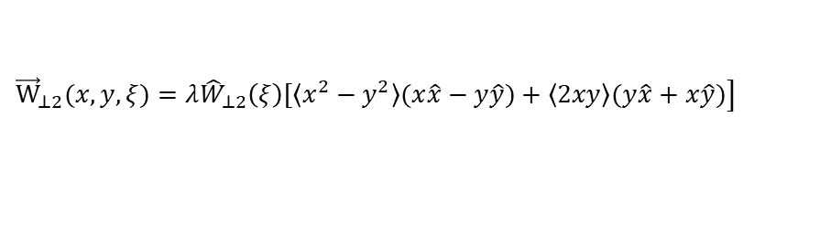

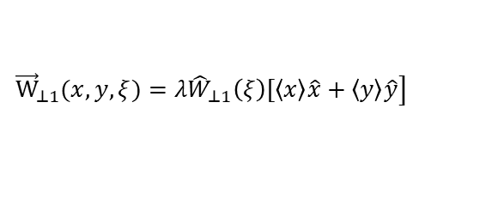

Tolerance analysis
$$x_{offset}=0.1um$$
$$y_{offset}=0.1um$$
Beam center evolution
$$\left.{\vec{W}}_{⊥1}(x,y,ξ)=λ{\hat{W}}_{⊥1}\left(ξ\right)[〈x〉\hat{x}+〈y〉\hat{y}\right]$$
$$\left.{\vec{W}}_{⊥2}(x,y,ξ)=λ{\hat{W}}_{⊥2}\left(ξ\right)[〈x^{2}−y^{2}〉(x\hat{x}−y\hat{y})+〈2xy〉(y\hat{x}+x\hat{y})\right]$$

Slide 12
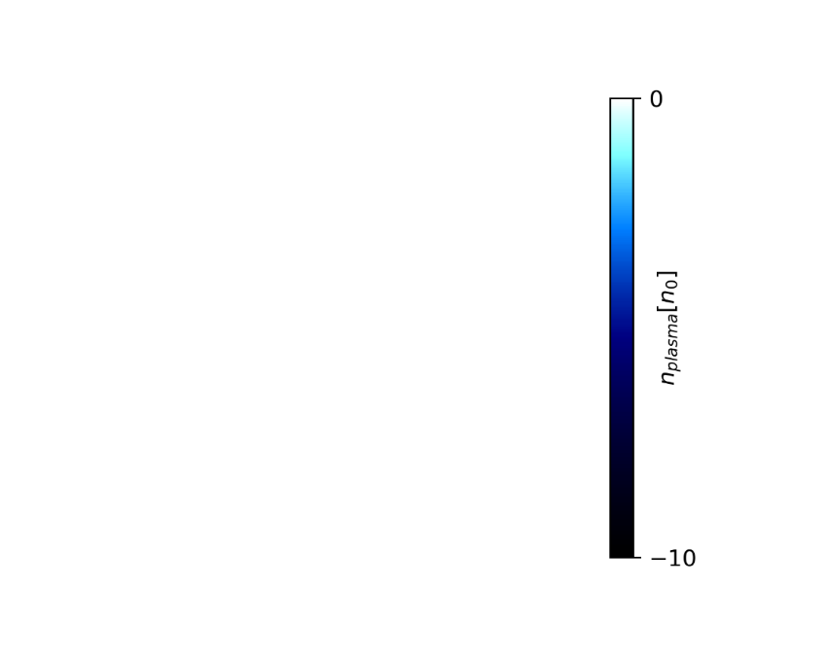
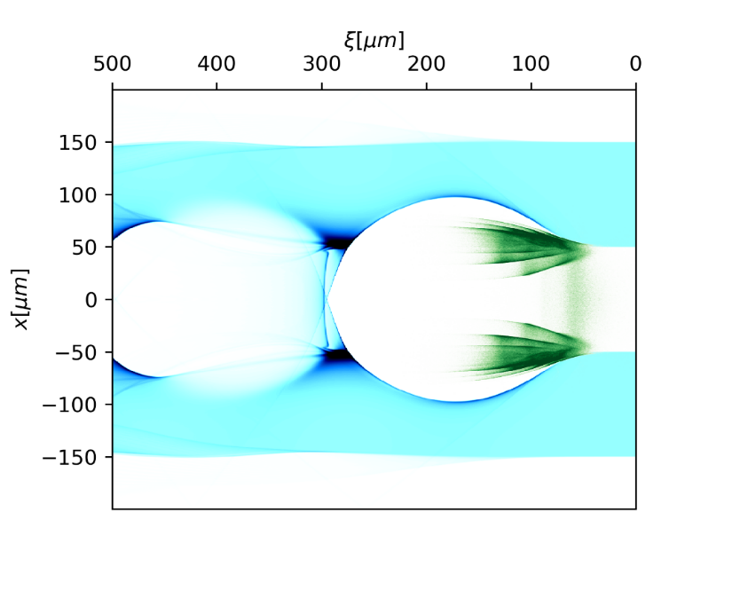
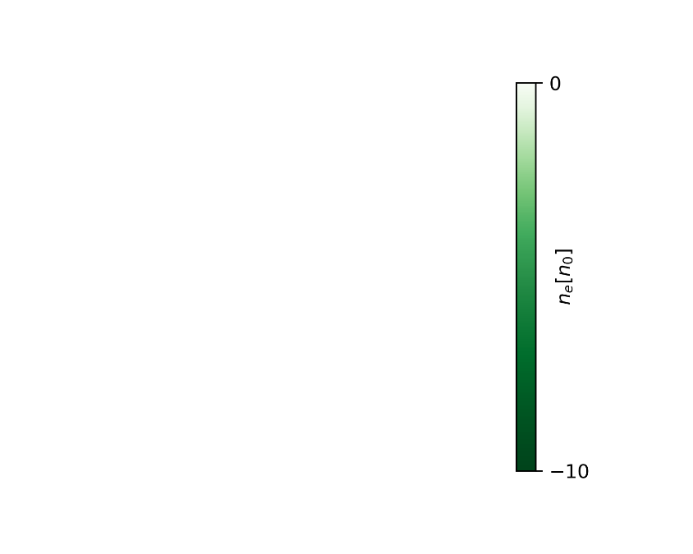
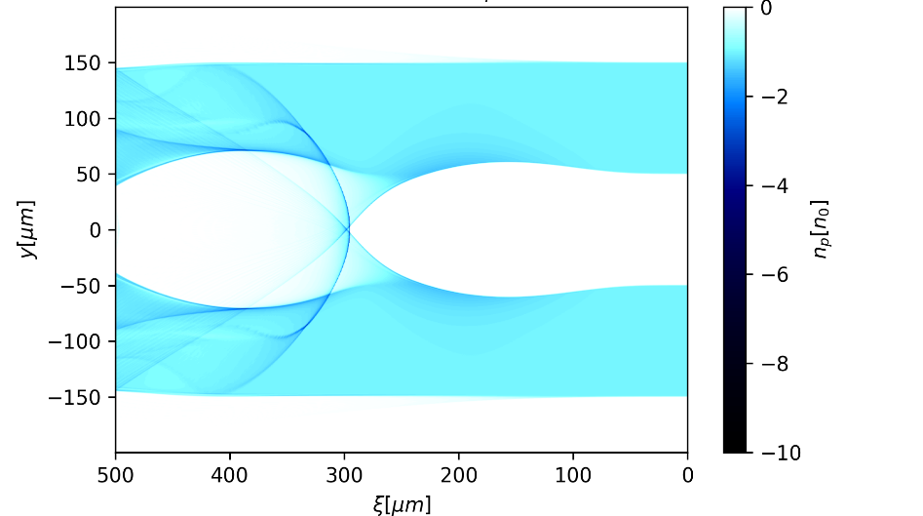
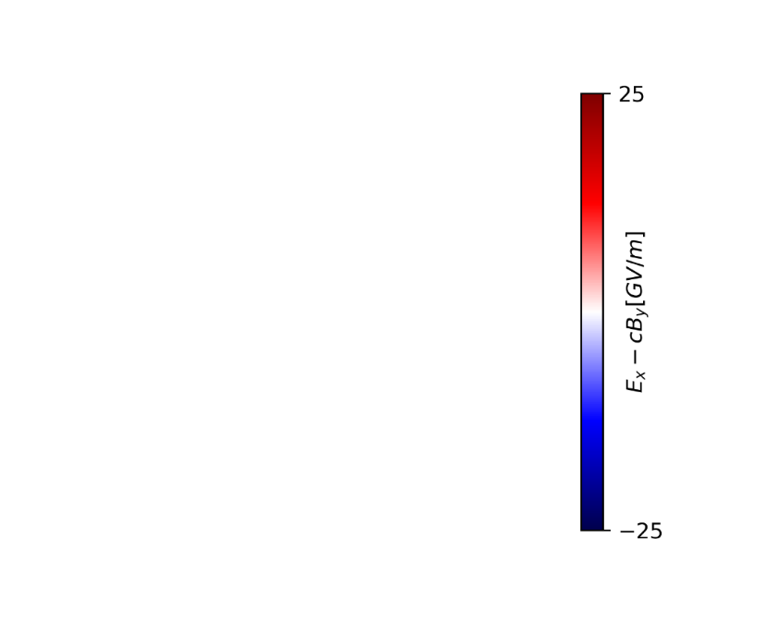
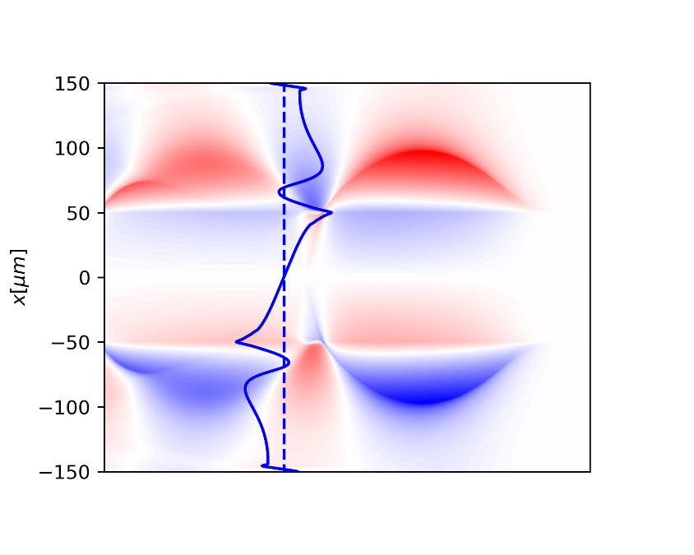

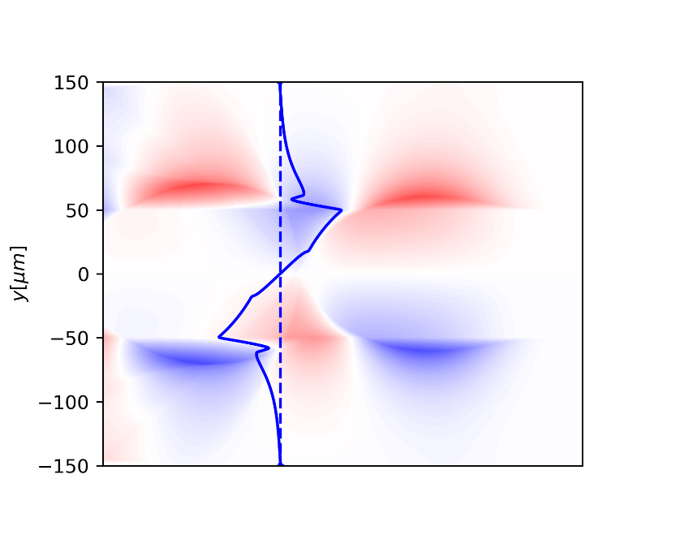
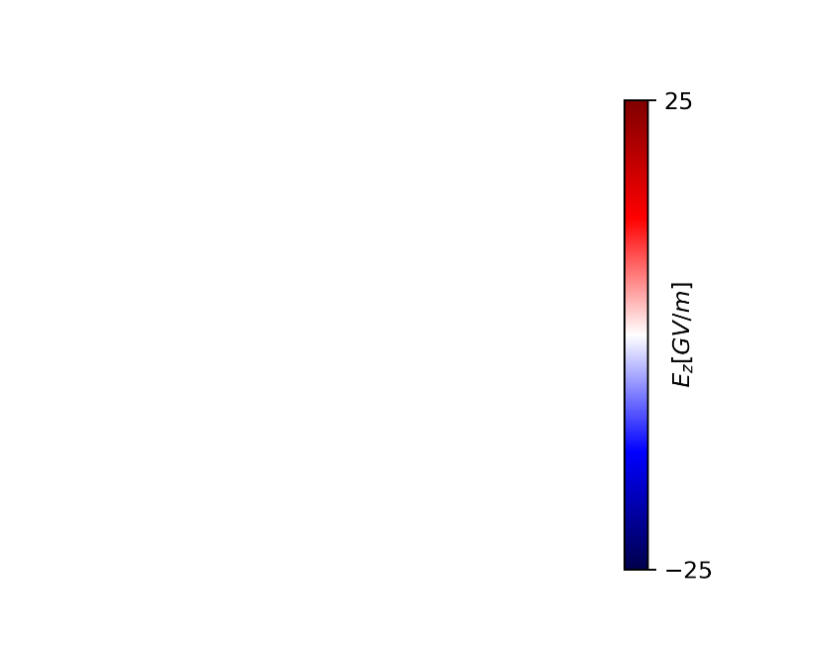
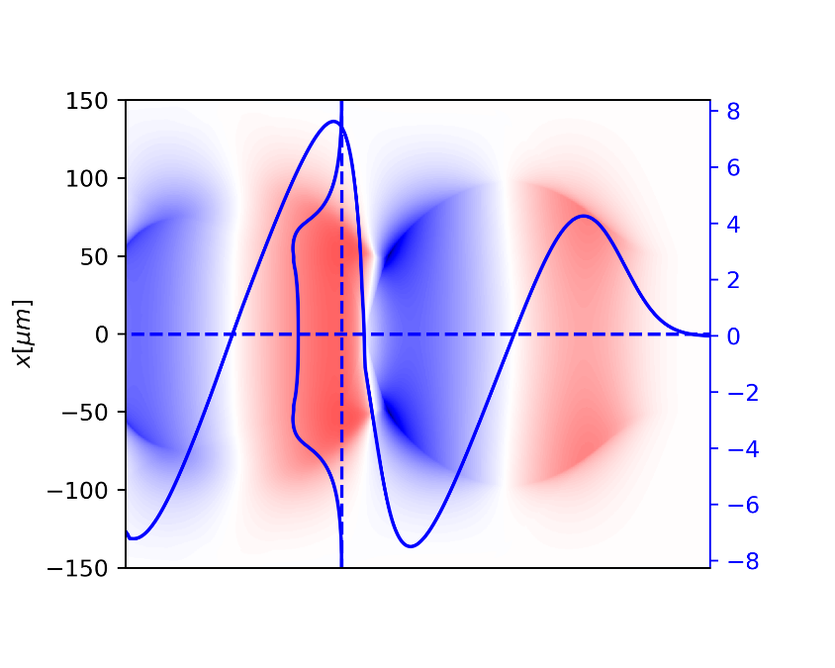
Wakefield structure
Focusing on both directions
Accelerating and focusing at the same location.
Notes:
电子响应。

Slide 13
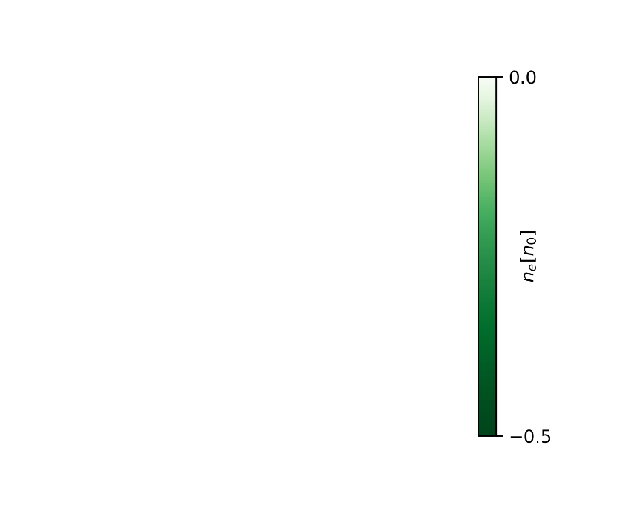
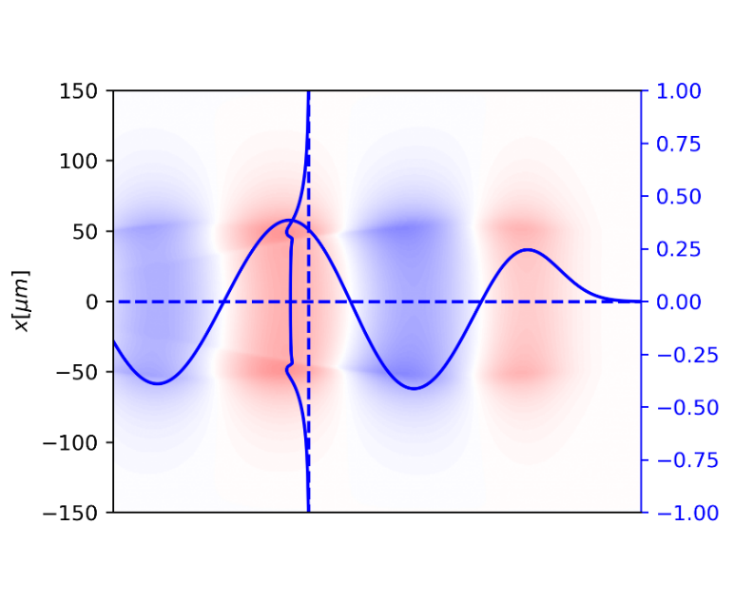


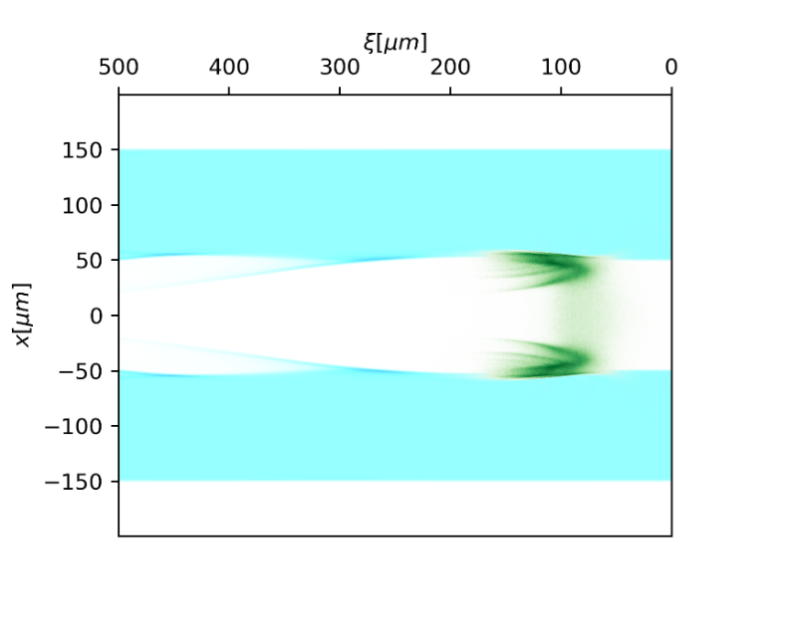
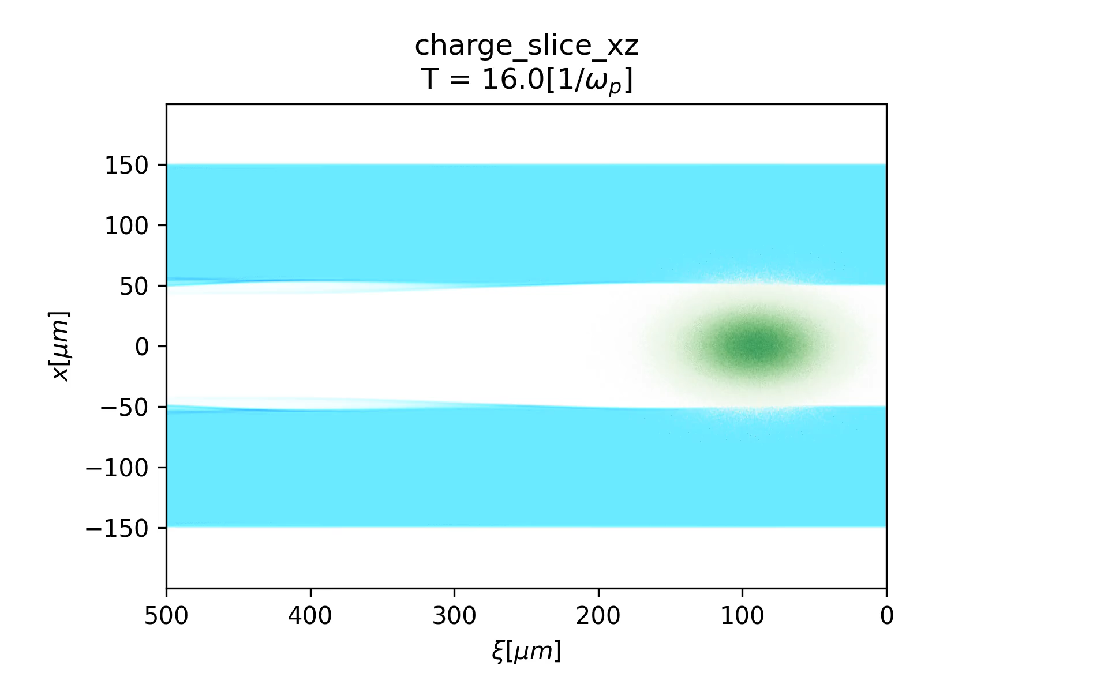
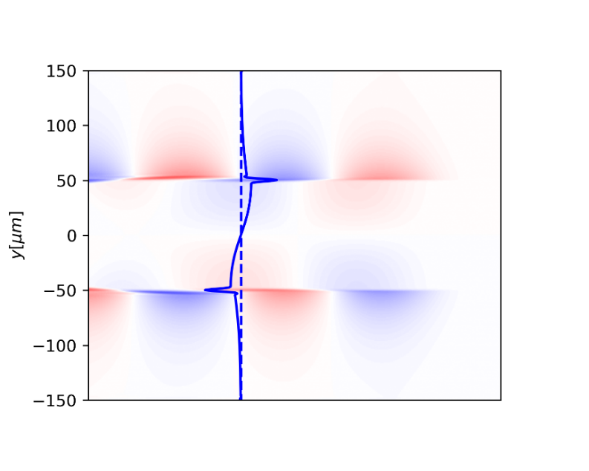
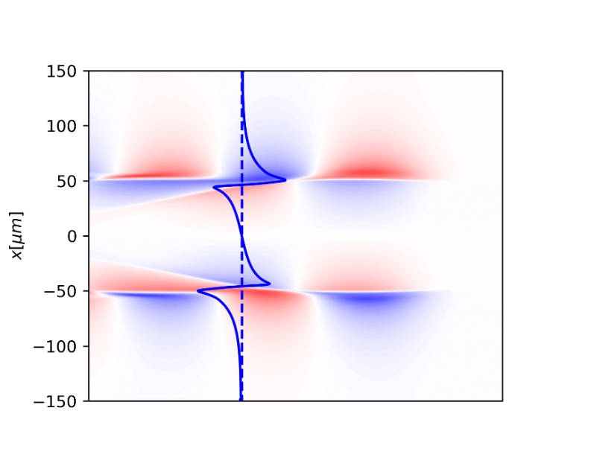


With a weak driver
Inside channel, it’s focusing at one direction and defocusing at the other.

Slide 14


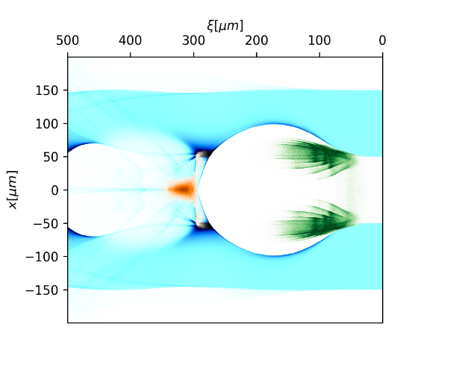
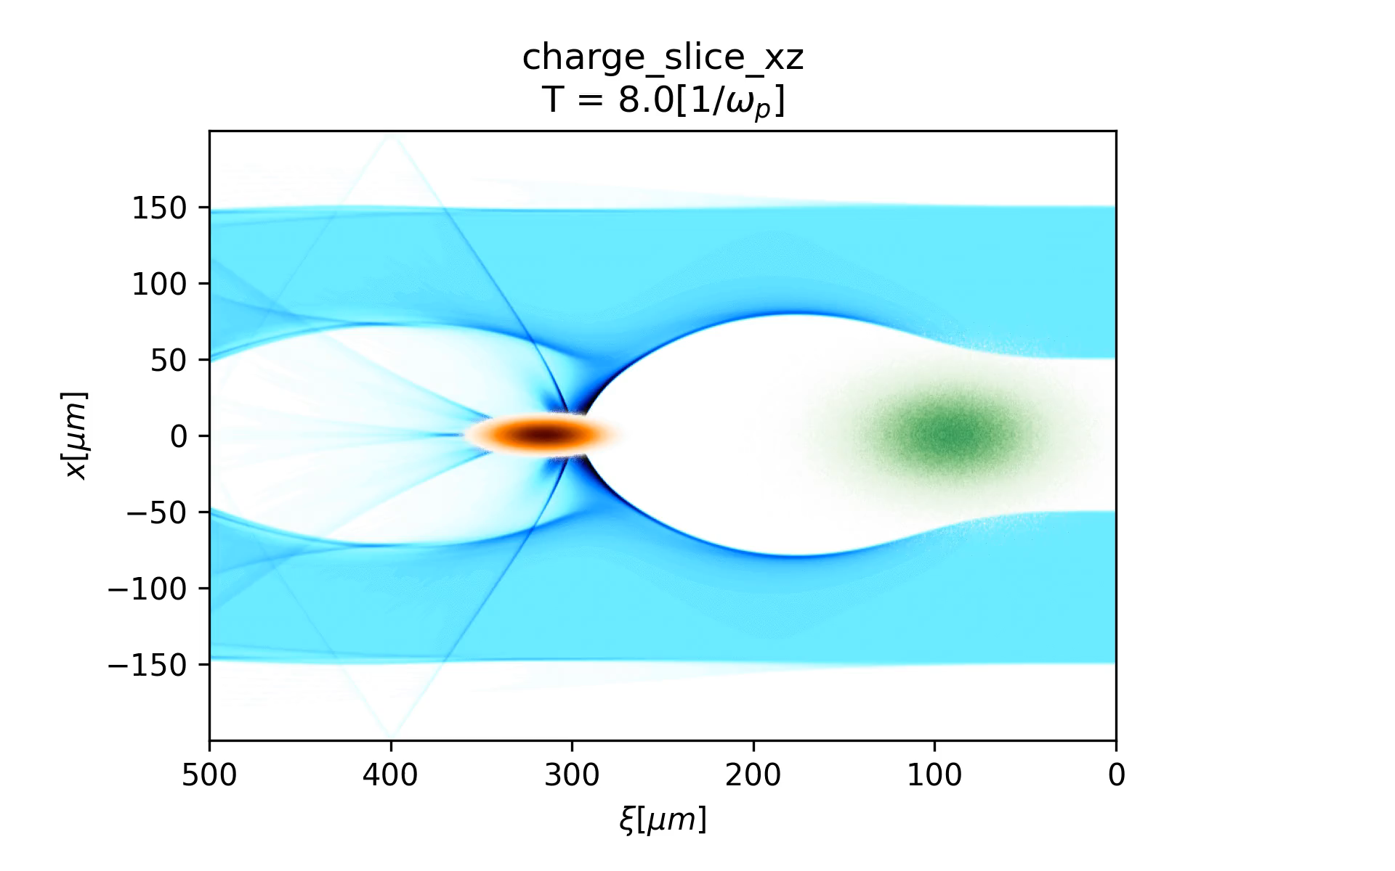
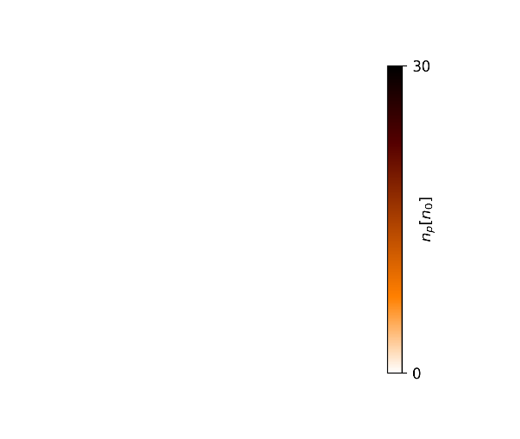
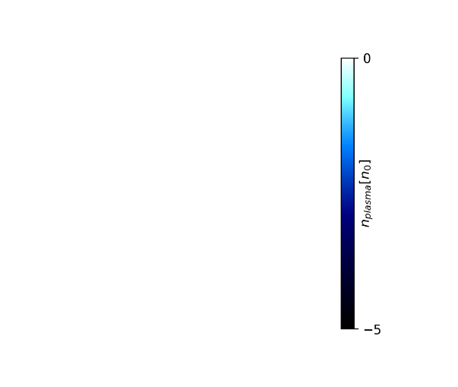
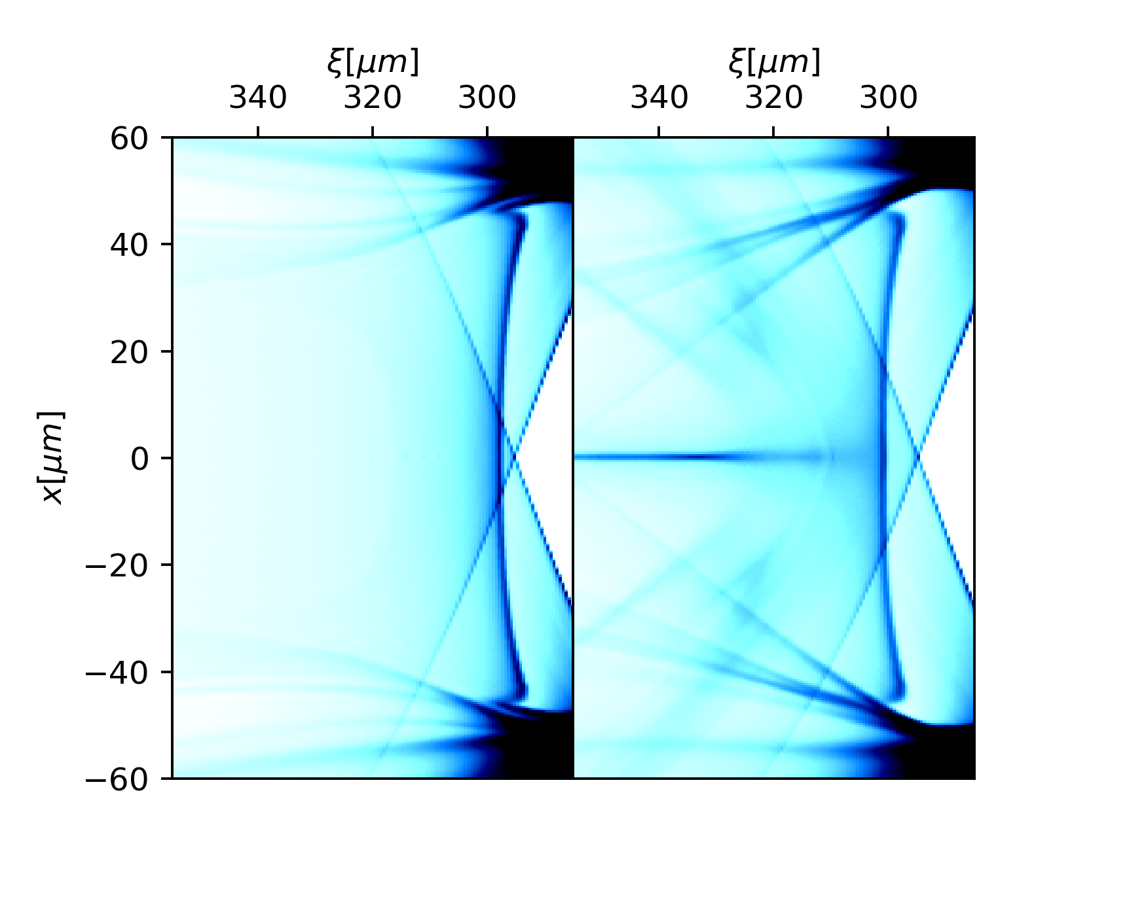
Beam loading effect

Slide 15









Beam loading effect
~90cm
  Focusing region extends
  Ez is flattened
>30% beam loading efficiency
~1.5% energy spread
Gradient $\sim$5GeV/m

Slide 16




Two-bunch driver
$$\left.{\vec{W}}_{⊥1}(x,y,ξ)=λ{\hat{W}}_{⊥1}\left(ξ\right)[〈x〉\hat{x}+〈y〉\hat{y}\right]$$
$$\left.{\vec{W}}_{⊥2}(x,y,ξ)=λ{\hat{W}}_{⊥2}\left(ξ\right)[〈x^{2}−y^{2}〉(x\hat{x}−y\hat{y})+〈2xy〉(y\hat{x}+x\hat{y})\right]$$

Slide 17
Summary
There is stable propagation mode in hollow plasma channel.
Positron beam can be accelerated and focusing in this regime.
A lot to be explored and optimized.

Slide 18
Thanks for your attention!

