Slide 1



Polarized Beams from Plasma Accelerators
HKIAS mini workshop on plasma acceleration
Markus Büscher | 14 January 2021

Slide 2
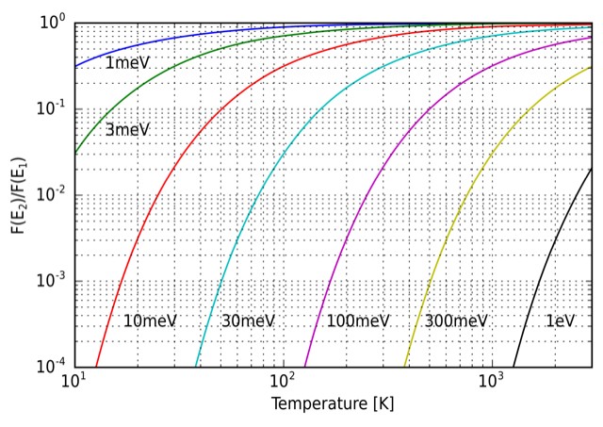

Polarization in plasmas???
Boltzmann factor as a function of temperature for several energy differences ΔE (taken from Wikipedia)
Typical energy of (proton) spin states:
$E_{spin,p}=μ∙B=6∙{10}^{−8}\frac{eV}{T}∙1000 T ≈1 meV$
Typical temperature of the plasma:
10⁸ K $≈$ 10 keV
occupation probability of both spin states
(almost) equal in thermal equilibrium
no polarization (in thermal equilibrium)

Slide 3
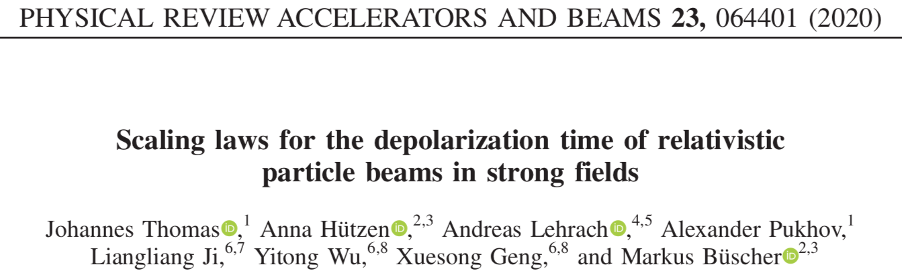
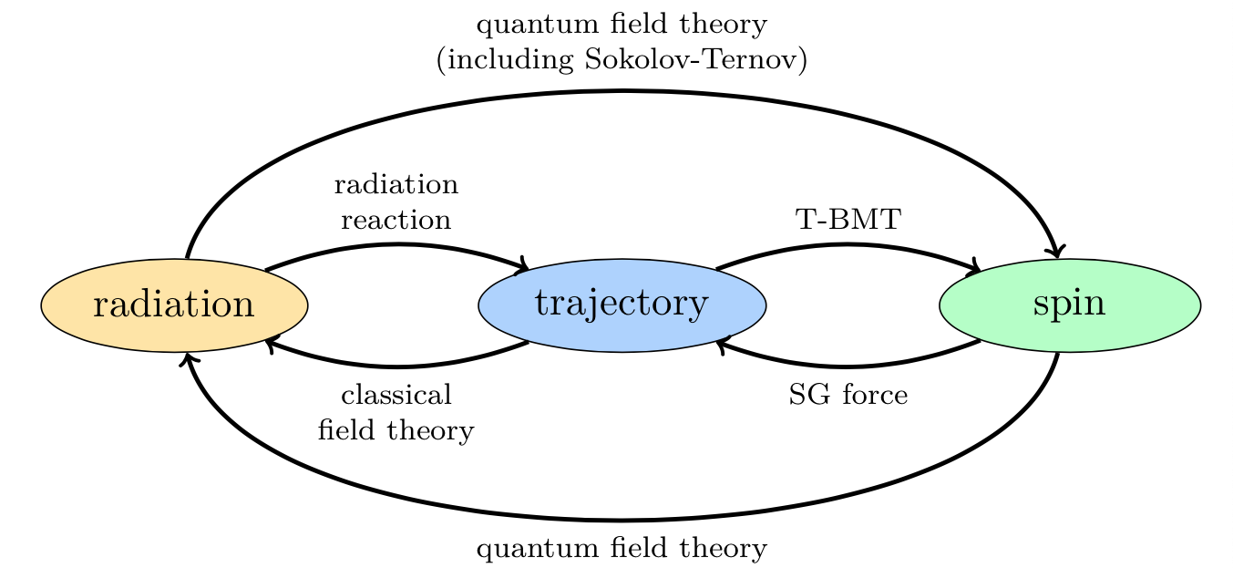
Interactions involving Spins
Relevant processes for e⁻, p, ions:
T-BMT
Sokolov-Ternov
Stern-Gerlach
(Radiation reaction only for ultra-relativistic particles)
Notes:
Thomas-Bargmann-Telegdi-Michel

Slide 4
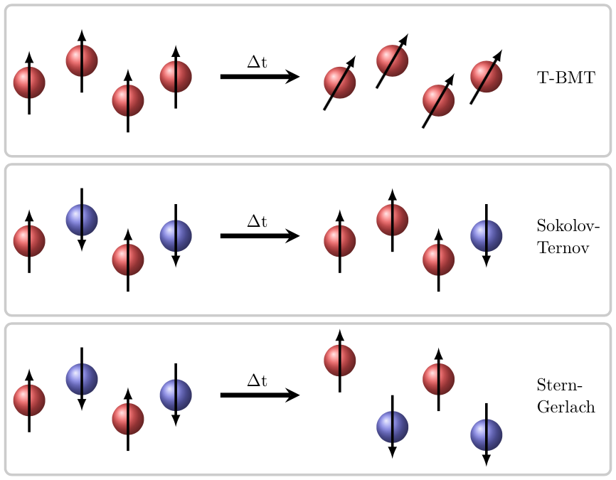
Possible (De-)Polarization effects
Conservation of polarization for times
< 1 ps in a 10³ T field
→ Dominant effect
Polarization time ~ 5 ms for a 100 GeV proton beam in a 1000 T field
Time scale too long
Separation distances are in the nm-range for e⁻ & sub pm-range for protons
→ Spatial separation too small

Slide 5
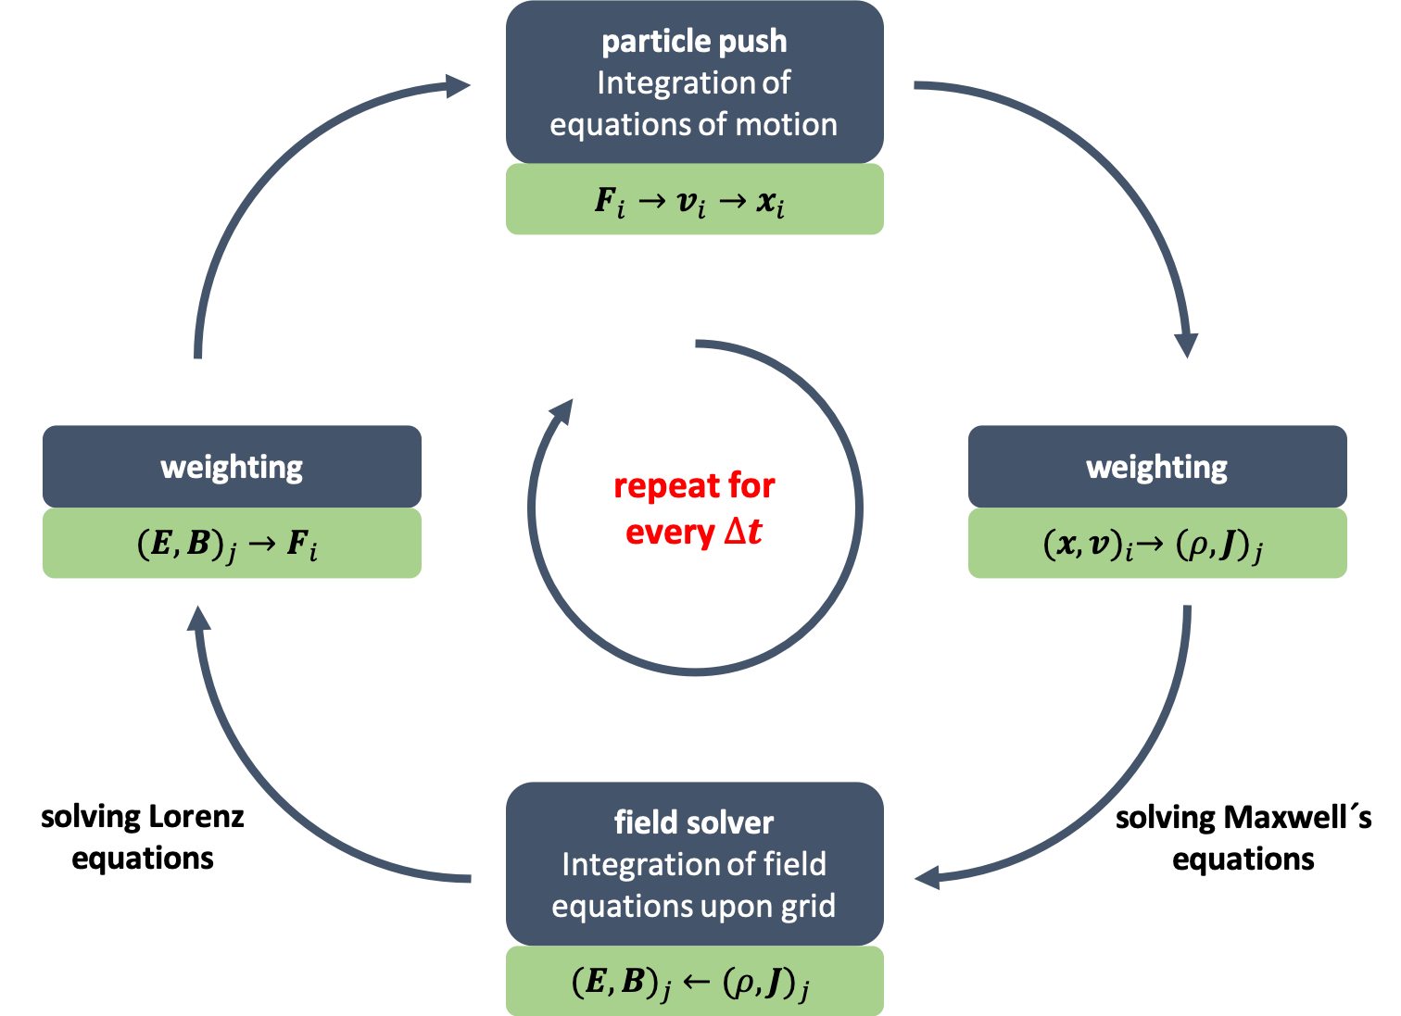
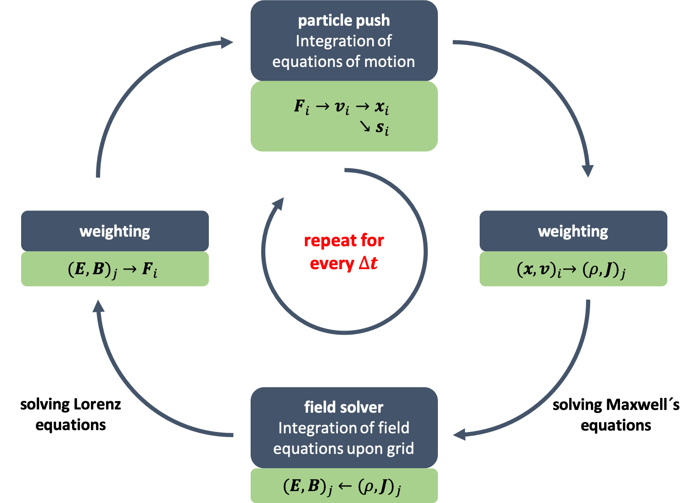
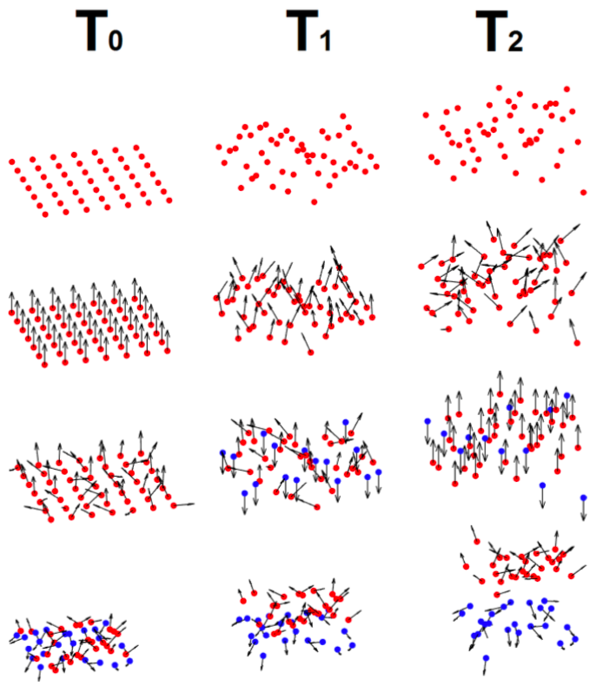

Spin dynamics in the vlpl code
Implementation into already existing code
Spin precession described by the Thomas-BMT equation
$∆$t

Slide 6

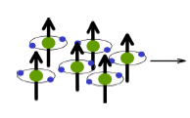


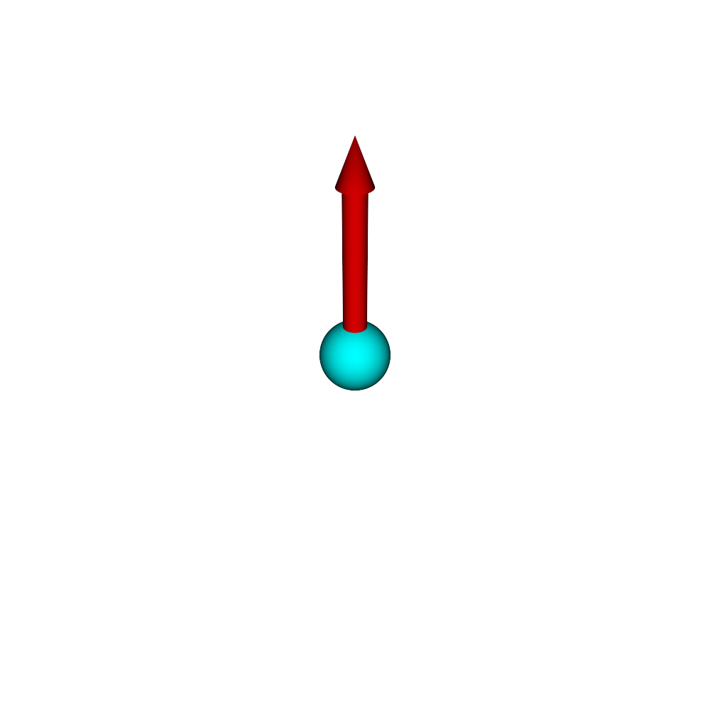
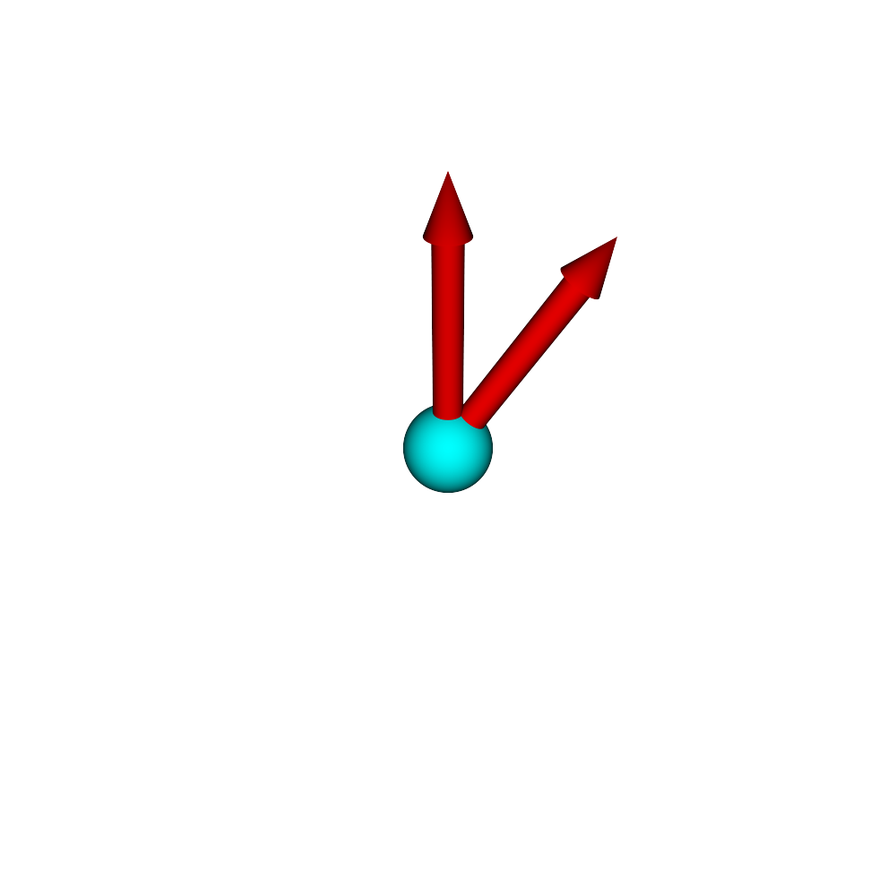
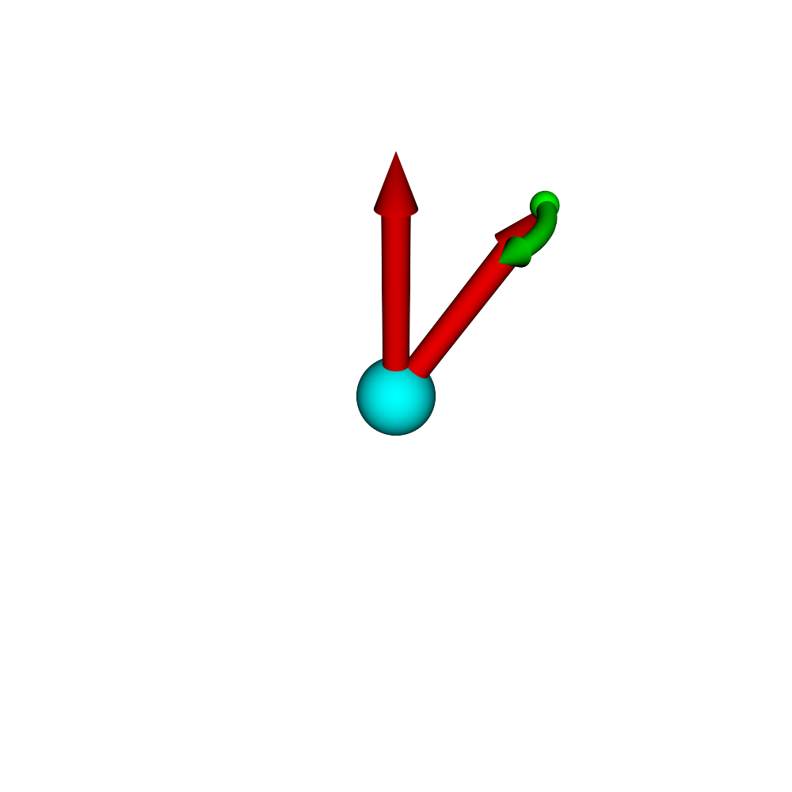
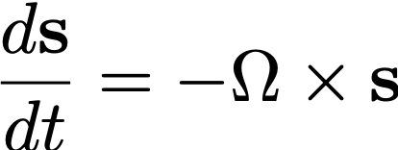
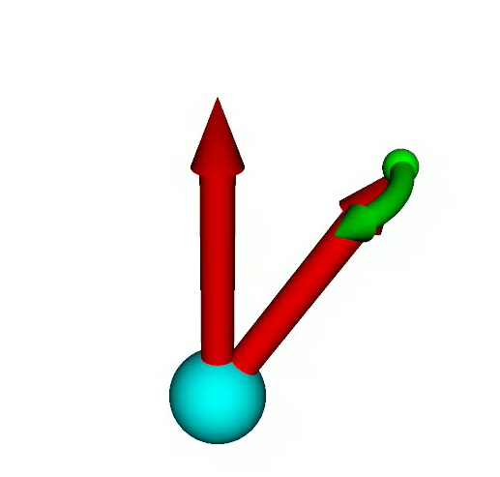
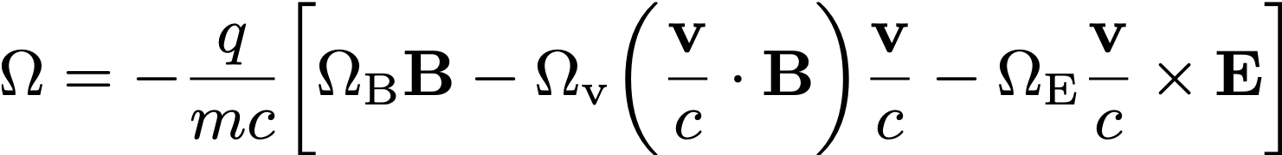



Modelling of Spins in laser-induced plasmas
Implementation of particle spins into a simulation code (in collaboration with A. Pukhov, )
Thomas-BMT equation
PIC Code (VLPL, recently EPOCH)
Description of spin motion in arbitrary electric and magnetic fields for the semi-classical approach
$$\overset{⃑}{B}$$
$$\overset{⃑}{s}$$
$$\overset{⃑}{Ω}$$
Thomas-BMT equation
Rotation frequency in cgs units
with
Notes:
Paul Ehrenfest: under certain conditions the classical equations of motion apply to the mean values of quantum mechanics; classical mechanics is thus to a certain extent contained in quantum mechanics (principle of correspondence).

Slide 7
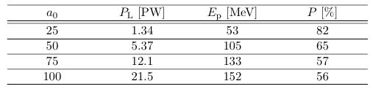
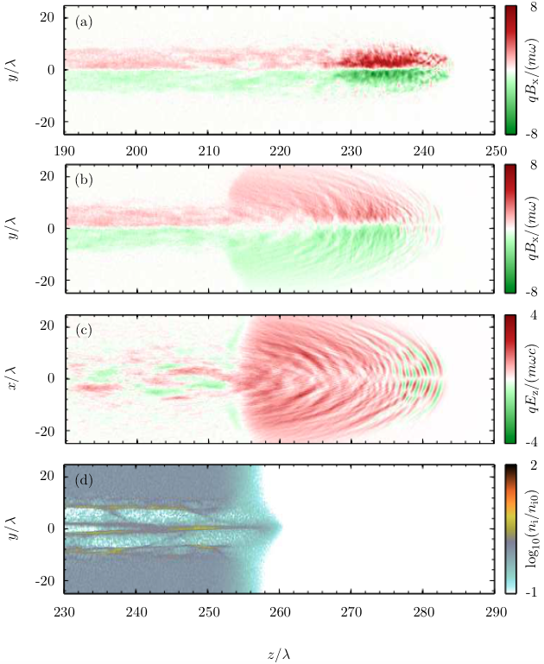
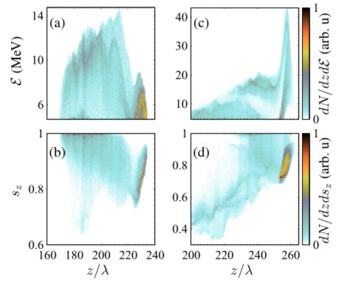
Spin-polarized proton beams from hCL gas
a₀ | P_{L} [PW] | E_{p} [MeV] | P [%]
25 | 1.34 | 53 | 82
50 | 5.37 | 105 | 65
75 | 12.1 | 133 | 57
100 | 21.5 | 152 | 56
Proton beam polarization driven by PW lasers is mostly maintained
L. Jin et al., Phys. Rev. E 102, 011201(R) (2020)
Notes:
3D EPOCH simulation of proton beam generation from a gas-jet target using a multi petawatt laser: (a) azimuthal magnetic field at t\,=\,250\,$\lambda$/c, (b) azimuthal magnetic field, (c) longitudinal electric field, (d) proton density at t\,=\,290\,$\lambda$/c
The laser pulse for proton acceleration (green) with a bi-Gaussian envelope
laser amplitude a0 = 25, focal radius w0 = 10λ, wavelength λ = 800 nm, and temporal duration τ0 = 10λ/c.
The length of the target is l = z2 − z1 = 200λ.
np = n0/(ZH + ZCl ) ≈ 3.48 × 10¹⁹ cm⁻³
the protons are accelerated in forward and transverse directions under the actions of the electrons in front and the chlorine nuclei behind.
second effect at the rear end of the gas jet, which enhances the proton energies even more significantly (MVA)
Two stage acceleration
The 3D-PIC simulations are performed with a moving box of size 100λ × 80λ × 80λ represented by a 1000 × 400 × 400 grid at the speed of light c and a total pseudoparticle number of 8 × 10⁸. The laser pulse for proton acceleration (green) with a bi-Gaussian envelope a = exa0 exp[−(t − z/c + z0/c)2/τ02 − r2/w02] and a focal position z0 propagates along the z axis, where the laser amplitude a0 = 25, focal radius w0 = 10λ, wavelength λ = 800 nm, and temporal duration τ0 = 10λ/c. To reach a high acceleration efficiency, the laser pulse is focused to the left boundary of the gas target z0 = z1 = 50λ.
The target is assumed to be a fully ionized plasma of HCl gas, with all protons initially polarized along the z axis η0 = ⟨s0⟩ · ez = 1. Its density profile, is a uniform plateau with steep edges. The length of the target is l = z2 − z1 = 200λ. The density gradient at the edge is expressed asn=n0exp[−(z−zi)2/δl2]withδl =5λ,wherei=1and 2 correspond to the left and right boundaries of the target, respectively. In the following simulations, gas jets with electron density n0 = 0.36nc are applied where nc = ε0mω2/e2 is the critical plasma density, ε0 is the vacuum permittivity, and ω = 2πc/λ is the laser frequency. One should note that the proton density np is lower than the plasma density, i.e., np = n0/(ZH + ZCl ) ≈ 3.48 × 1019 cm−3, with charge numbers of hydrogen ZH = 1 and chlorine ZCl = 17.
More specifically, the electron filament appears inside the laser fields, while the proton filament forms behind the laser pulse but in front of the chlorine nuclei filament.

Slide 8



Polarization of electrons vs protons
Targets
Pre-pol.
Un-pol.
Theoretically studied
Protons
(ions)
Experiments ongoing
Electrons
not feasible

Slide 9
Polarized target Options for protons
solid targets
gas targets
cluster
pellets
foil
…
static polarization
Targets suitable for laser acceleration not available yet
Experimental realization extremely challenging
Established technique and easy in handling
E.g. ³He

Slide 10

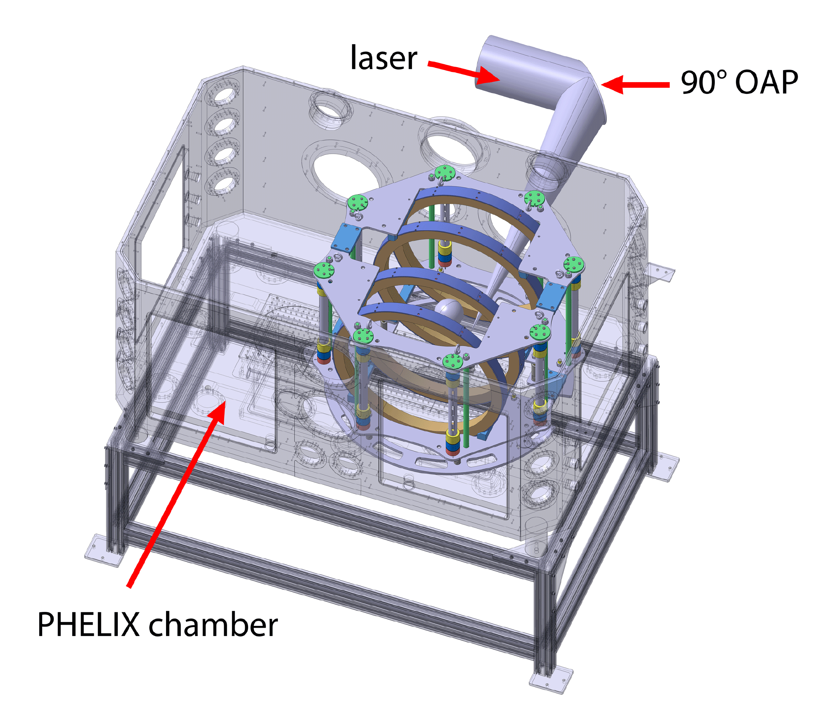
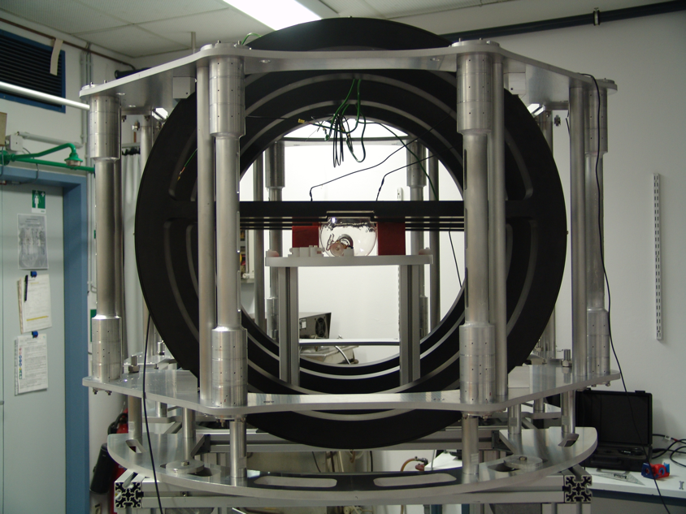
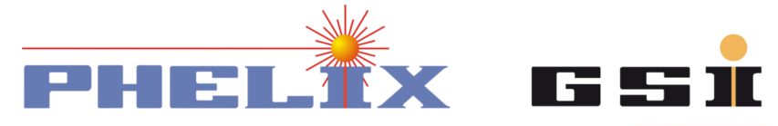
Hyperpolarized ³He gas-jet
magnetic holding field
for storing pre-polarized
³He gas
non-magnetic nozzle for providing the desired gas-jet target
P. Fedorets, C. Zheng
Measurements @ : 2021
I. Engin et al., Plasma Physics and Controlled Fusion 61(11) (2019)

Slide 11
Polarized target Options for protons
solid targets
gas targets
cluster
pellets
foil
…
static polarization
dynamic polarization
Targets suitable for laser acceleration not available yet
Experimental realization extremely challenging
Established technique and easy in handling
E.g. ³He
Novel approach & synchronization with accelerating laser needed
E.g. HCl, HBr, HI, …

Slide 12

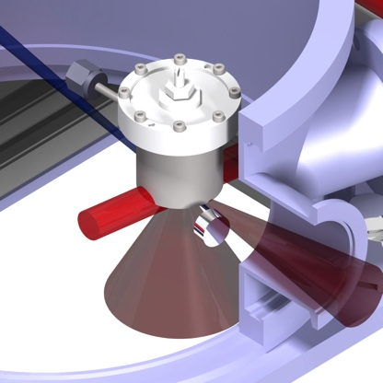


Polarized Hydrogen gas target @ FZJ
Nozzle
For HCl gas jet
Method described in:
T. P. Rakitzis,
Chem.Phys.Chem. 5, 1489 (2004)
IR/UV Laser
For photo-dissociation & polarization of H atoms,
100 mJ @ 1064 nm,
20 mJ @ 213 nm,
5 Hz, 170 ps
Lamb-Shift polarimeter
For measurement of nuclear polarization
R. Engels et al., Rev.Sci.Instrum. 74, 4607 (2003)
Notes:
LSP measures the relative HFS occupation number after Stark quenching

Slide 13
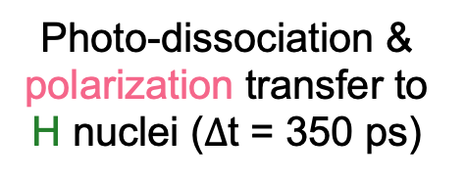
Production of nuclear polarized hydrogen
Alignment of
HCl bonds
100 mJ @ 1064 nm
Photo-dissociation & polarization transfer to H nuclei ($∆$t = 350 ps)
20 mJ @ 213 nm
~ c
Acceleration of the protons in gas jet
300 J @ 800 nm
A. Hützen et al., High Power Laser Sci. Eng. 7, E16 (2019)
Notes:
For production of polarized proton beams (photodissociation to take place), two-atom gas must be used. We chose HCl because the polarizability is comparatively high and the handling is acceptable
1024 nm: linear pol., 213 nm: circular pol.

Slide 14
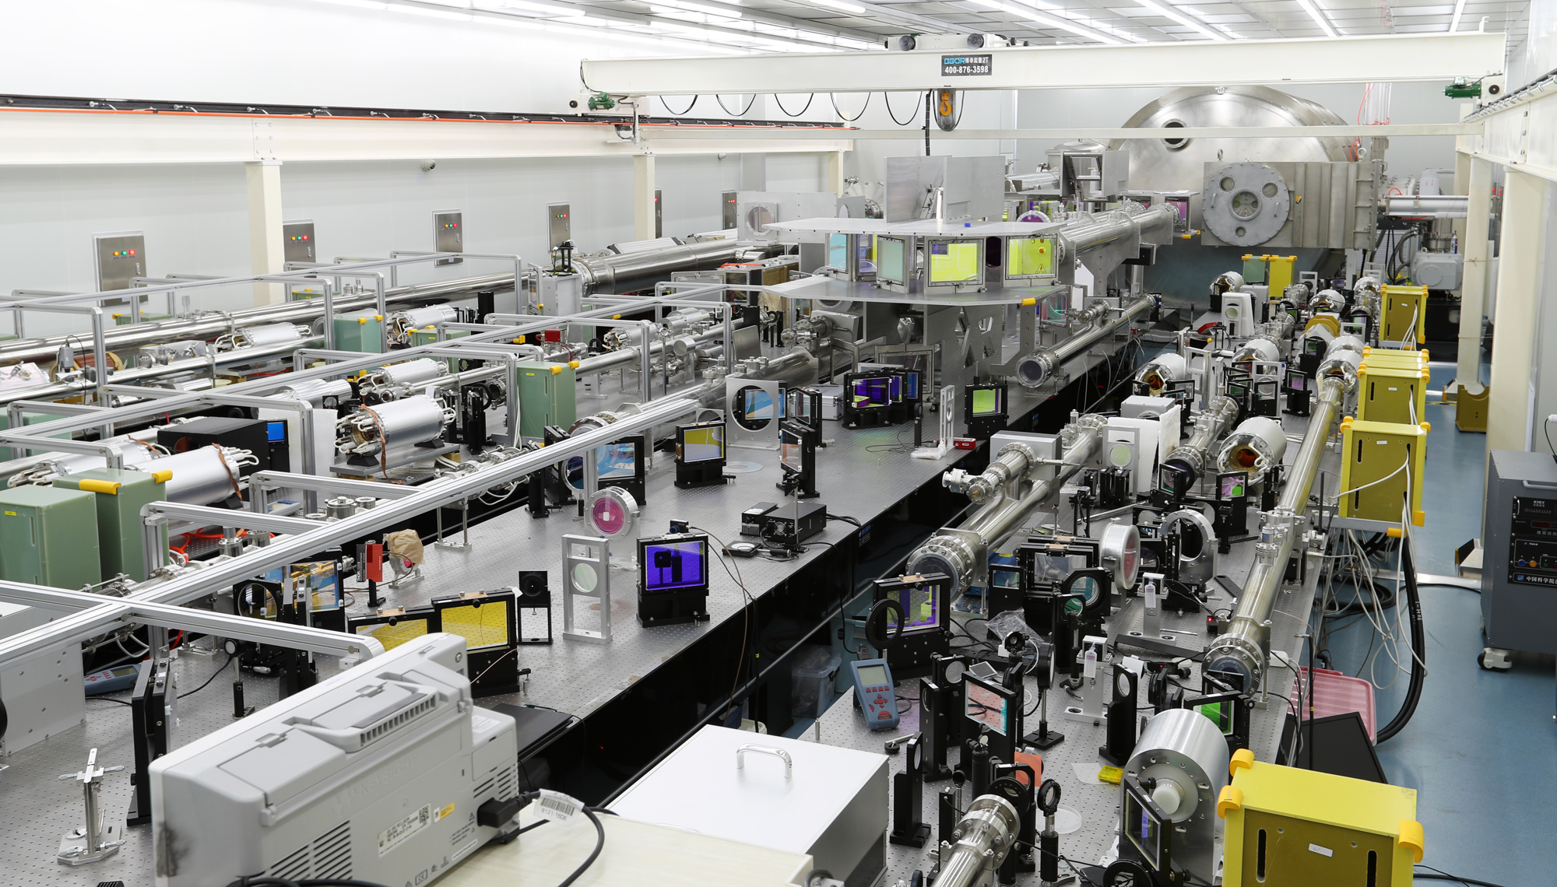
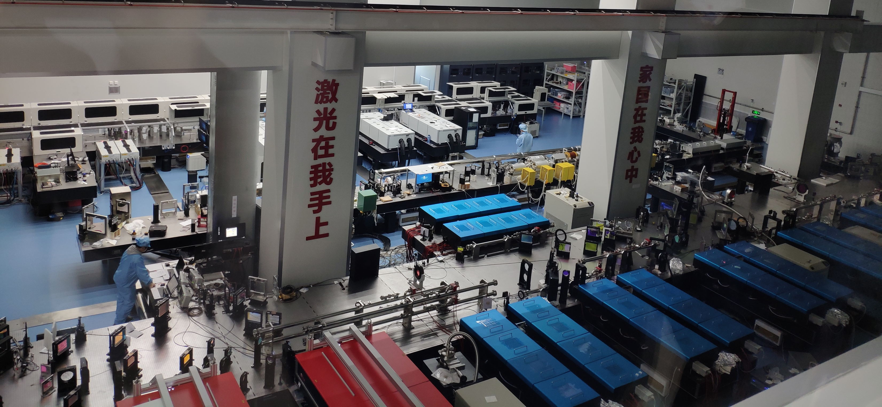
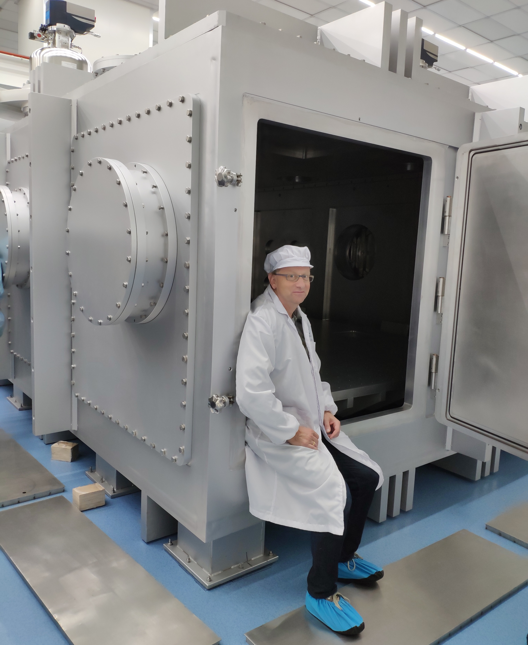
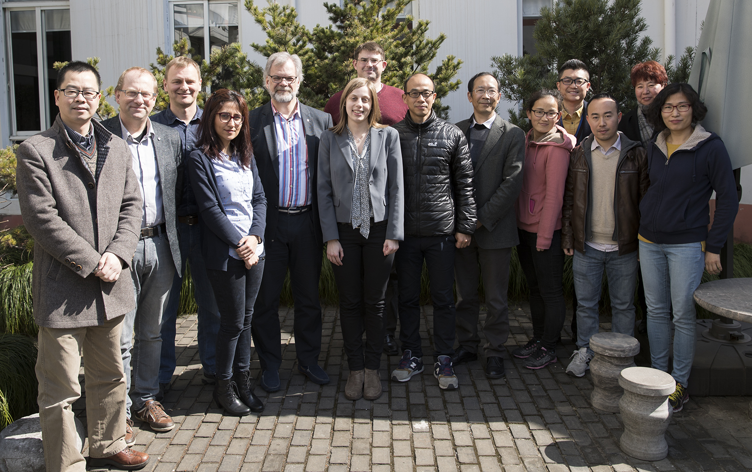
Superintense Ultrafast Laser Facility
@ SHANGHAI
Common simulation work and publications on polarized particle beams
First common experiments on proton acceleration in 2021 (@1 PW)
Laser parameter for SULF
Central wavelength: ~ 800 nm
• Pulse energy: ~ 300 J
• Pulse duration: ~ 30 fs
• Contrast ratio: ~ 10¹¹
• Focused intensity: > 10²² W/cm²

Slide 15
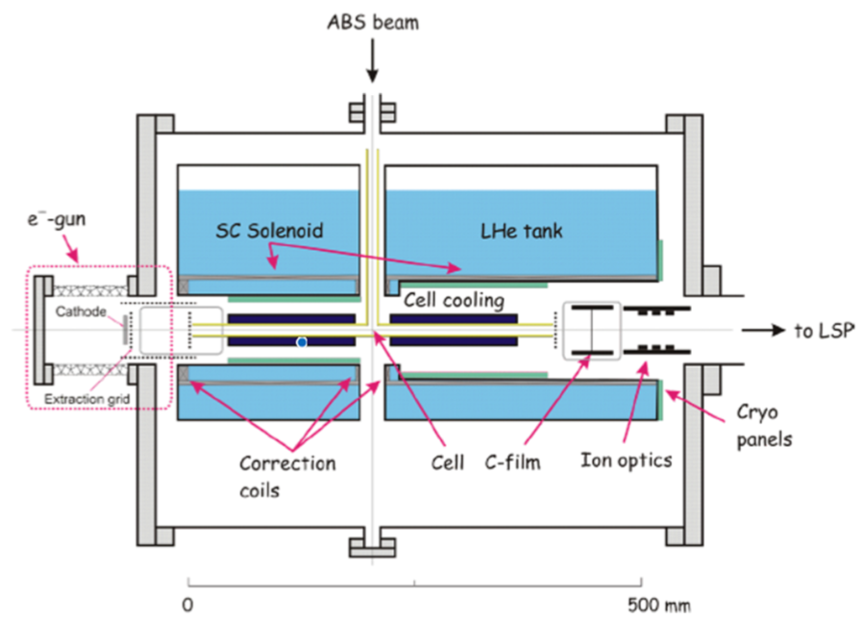
NEW IDEA: HYPERPOLARIZED CRYOGENIC TARGETS ew idea: Hyperpolarized cryogenic targets
Production of selected nuclear and electron spin orientations
Generation of strong magnetic field focussing the e⁻ beam
Freezing of molecules while maintaining their polarization
Production of e⁻ beam at energies of a few 100 eV
Measurement of nuclear polarization
R. Engels et al.,
Production of HD Molecules in Definite Hyperfine Substates,
PRL 124, 113003 (2020)
Interaction of polarized atoms and evaporated molecules with e⁻ beam leads to ionization process
Recombination of atoms into molecules on the surface of the cell
Freezing the molecules to polarized foil target

Slide 16
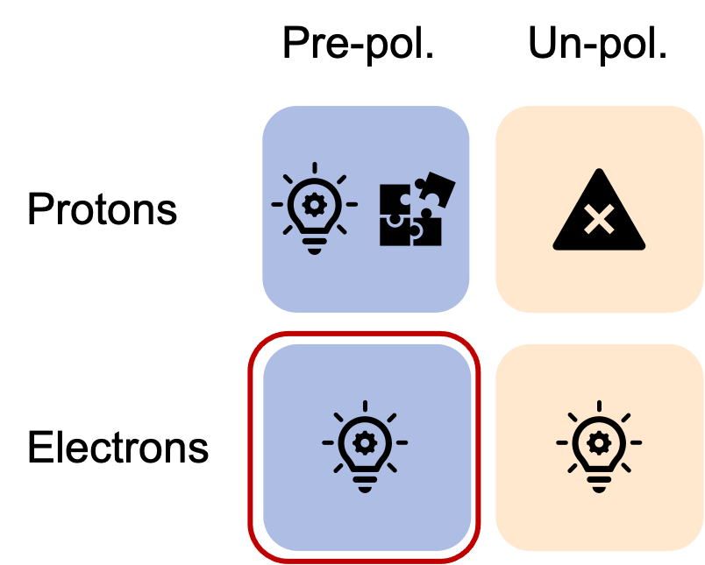
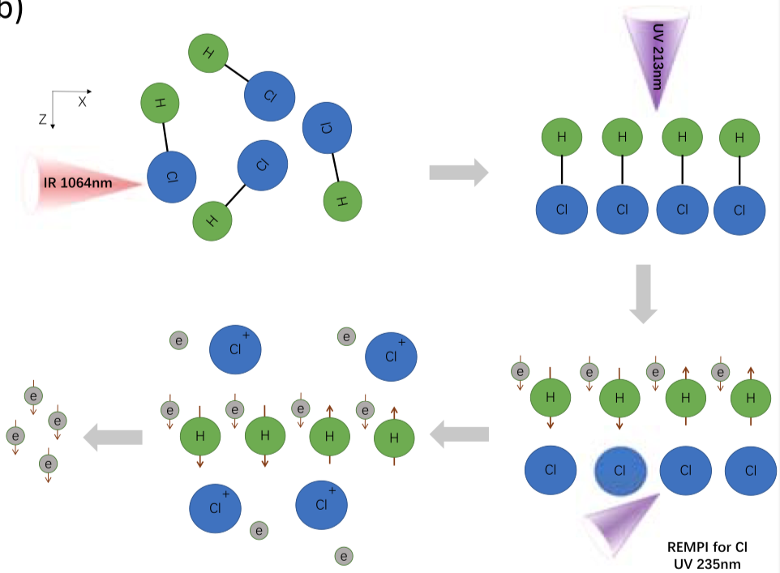

Generation of Polarized electrons
Polarized electron target: Based on the pre-polarized HCl gas target
Pre-pol.
Un-pol.
1st beam at 1064 nm:
Alignment of HCl bonds
2nd beam at 213 nm:
Photo-dissociation & polarization transfer to H nuclei
3rd beam at 235 nm:
Ionization of Cl atoms &
Expulsion of Cl ions
Protons
Electrons
Wu et al., New J. Phys. 21, 073052 (2019)

Slide 17
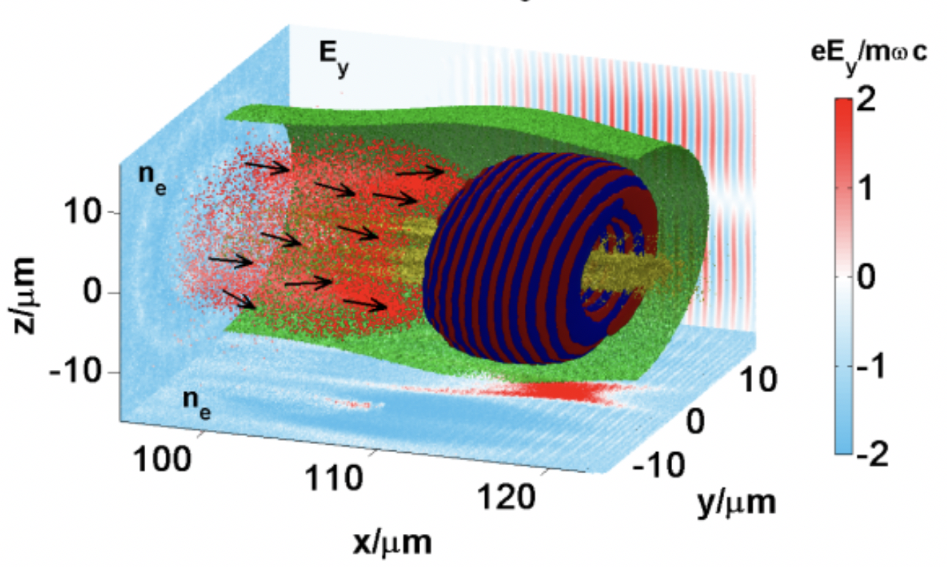

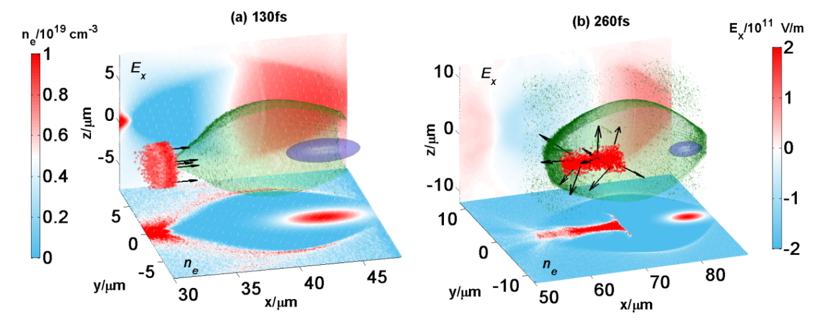
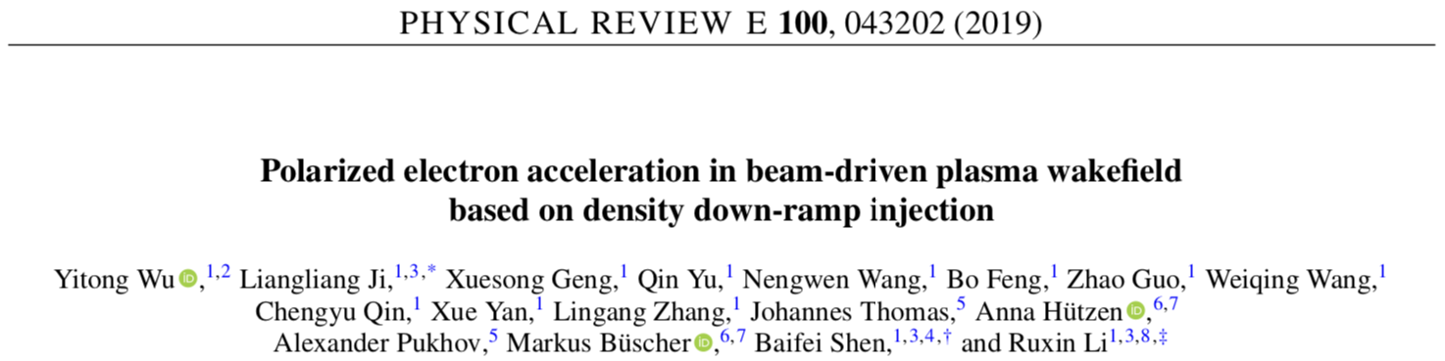
Pre-Polarized electron beams
Notes:
Most critical is the injection process which was studied for the two individual cases.
We could show that we need some special laser pulse shaping, the so-called vortex pulses

Slide 18
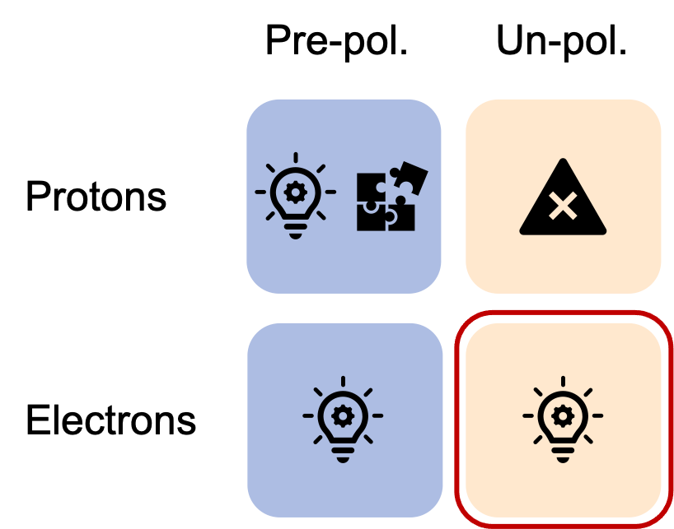
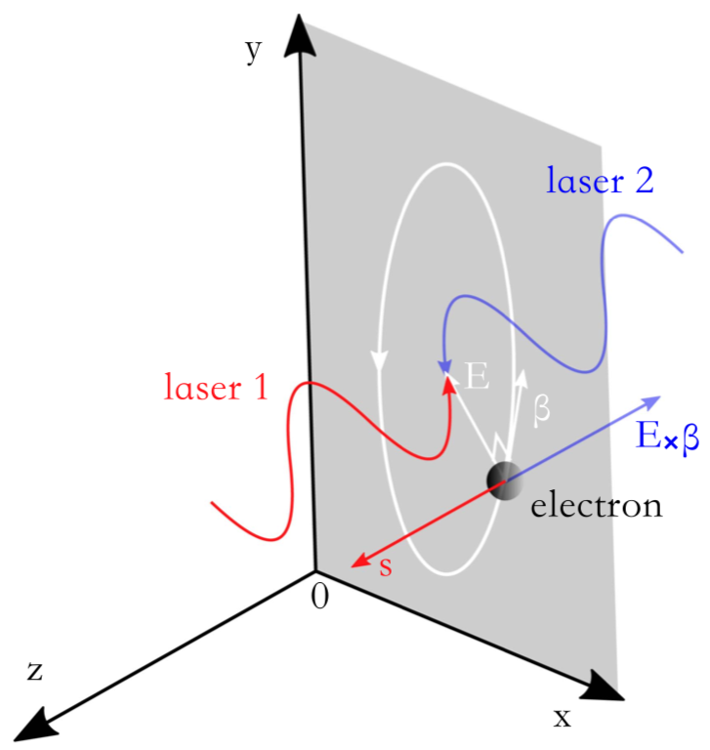
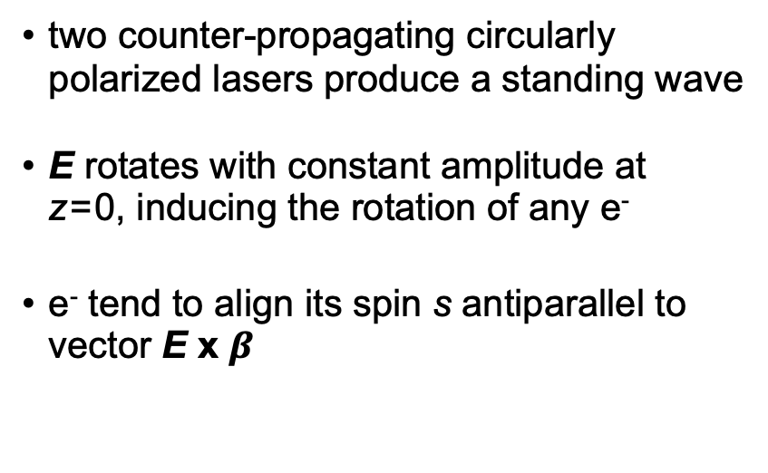
Polarized electrons by lasers
Pre-pol.
Un-pol.
two counter-propagating circularly polarized lasers produce a standing wave
E rotates with constant amplitude at
z = 0, inducing the rotation of any e⁻
e⁻ tend to align its spin s antiparallel to vector E x $β$
Protons
Electrons
Del Sorbo et al., Plasma Phys. Control. Fusion 60, 064003 (2018)
Notes:
Atraktiv, weil man damit auch Positronen polarisieren könnte
Fernziel: Elektronen-Positronen-Collider
Electrons follow the laser field
Strong-field quantum electrodynamics (QED) processes – like nonlinear Compton scattering and radiation reactions – can strongly modify the dynamics of light charged particles, such as electrons or positrons. Analogous to the Sokolov– Ternov effect in a strong magnetic field, electrons can rapidly spin-polarize in ultra-strong laser fields due to an asymmetry in the rate of spin-flip transitions, i.e., interactions where the spin changes sign during the emission of a γ-ray photon.
Needs pre-accelelerated (unpoloarized) electron beams

Slide 19
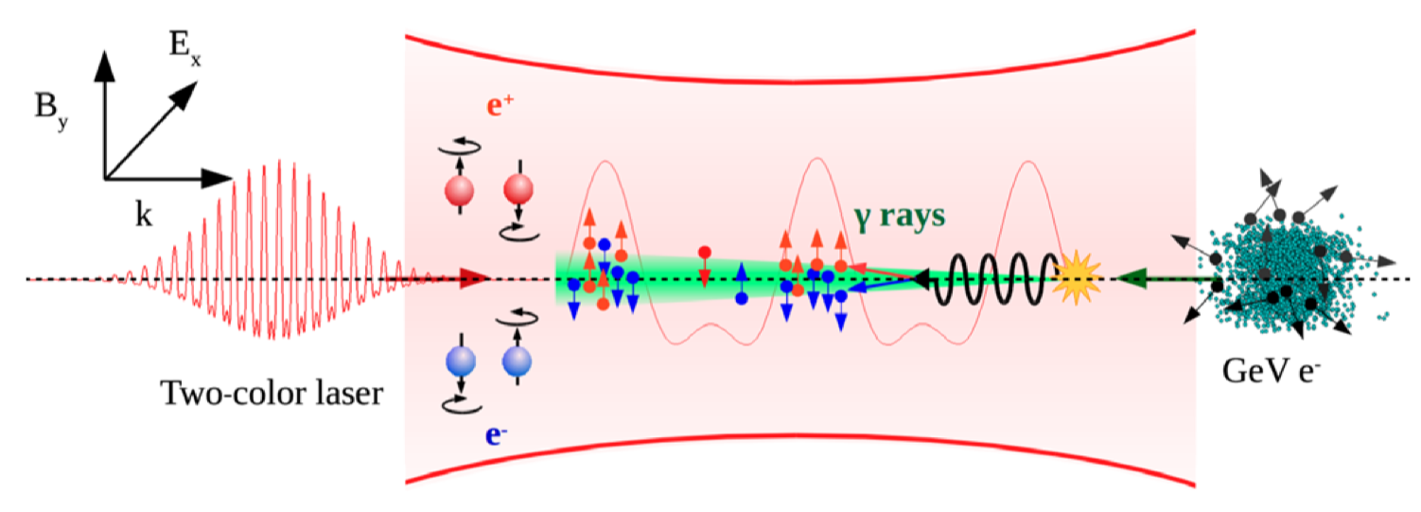
Polarized Positrons by lasers
Chen et al., Phys. Phys. Rev. Lett. 123, 174801 (2019)
intense linearly polarized two-color laser pulse collides head-on with unpolarized relativistic e⁻ beam
emission of photons in the forward direction decaying into polarized e⁺/e⁻ pairs
spins parallel & antiparallel to laser’s magnetic field direction
small divergence angle in propagation direction

Slide 20



Shanghai Institute of Optics and Fine Mechanics
Baifei Shen
Jiancai Xu
Liangliang Ji
Lingang Zhang
Yitong Wu
Xuesong Geng
Group at
Markus Büscher
Anna Hützen
Andreas Lehrach
Claus M. Schneider
Paul Gibbon
Ralf Engels
Pavel Fedorets
Chuan Zheng
Chrysovalantis Kannis
Institut für Theoretische Physik I
Alexander Pukhov
Johannes Thomas
Lars Reichwein
University of Crete
T. Peter Rakitzis
Dimitrios Sofikitis

Slide 21
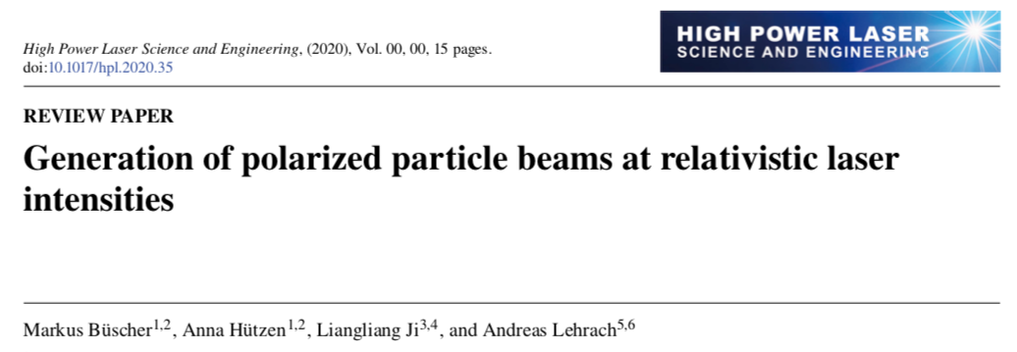

Further reading …
Polarized particle beams
  Polarized e⁺/e⁻ collider
Polarized nuclear fusion
  Enhanced yield of fusion reactors

Slide 23
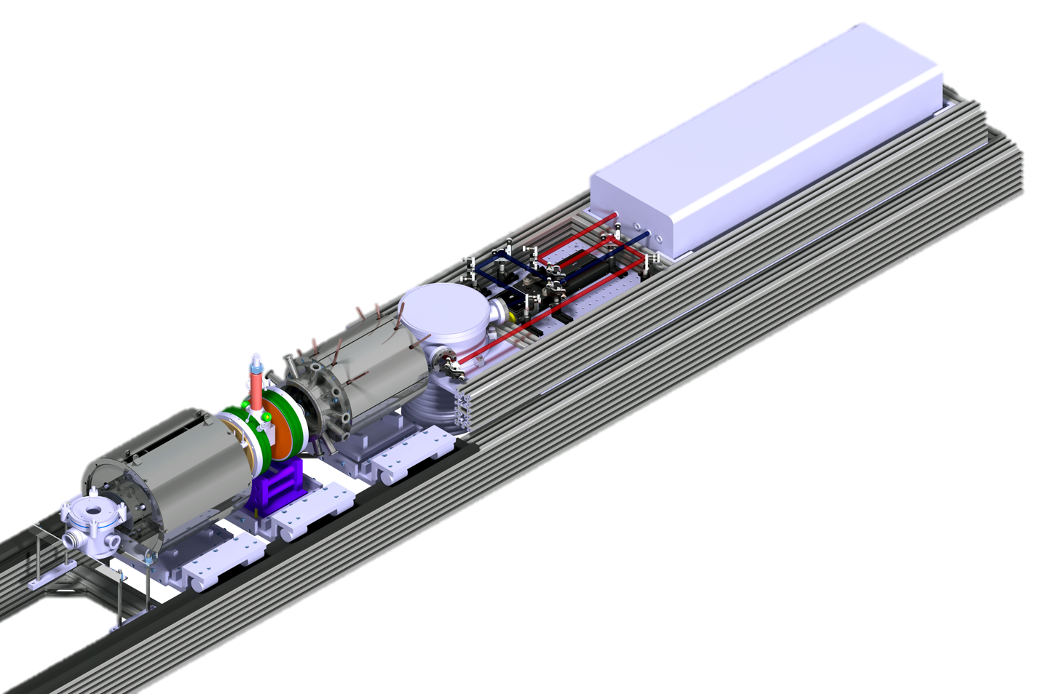
polarized HCl Target @ FZJ
IR/UV Laser
For photo-dissociation & polarization of H atoms,
100 mJ @ 1064 nm,
20 mJ @ 213 nm,
5 Hz, 170 ps
Nozzle
For HCl gas jet
Method described in:
T. P. Rakitzis,
Chem.Phys.Chem. 5, 1489 (2004)
Lamb-Shift polarimeter
For measurement of nuclear polarization
R. Engels et al., Rev.Sci.Instrum. 74, 4607 (2003)
Notes:
Wir beschleunigen keine Teilchen, daher LSP
This is a complicated device but is a well-known working horse that is in use for more than 10 years

Slide 24

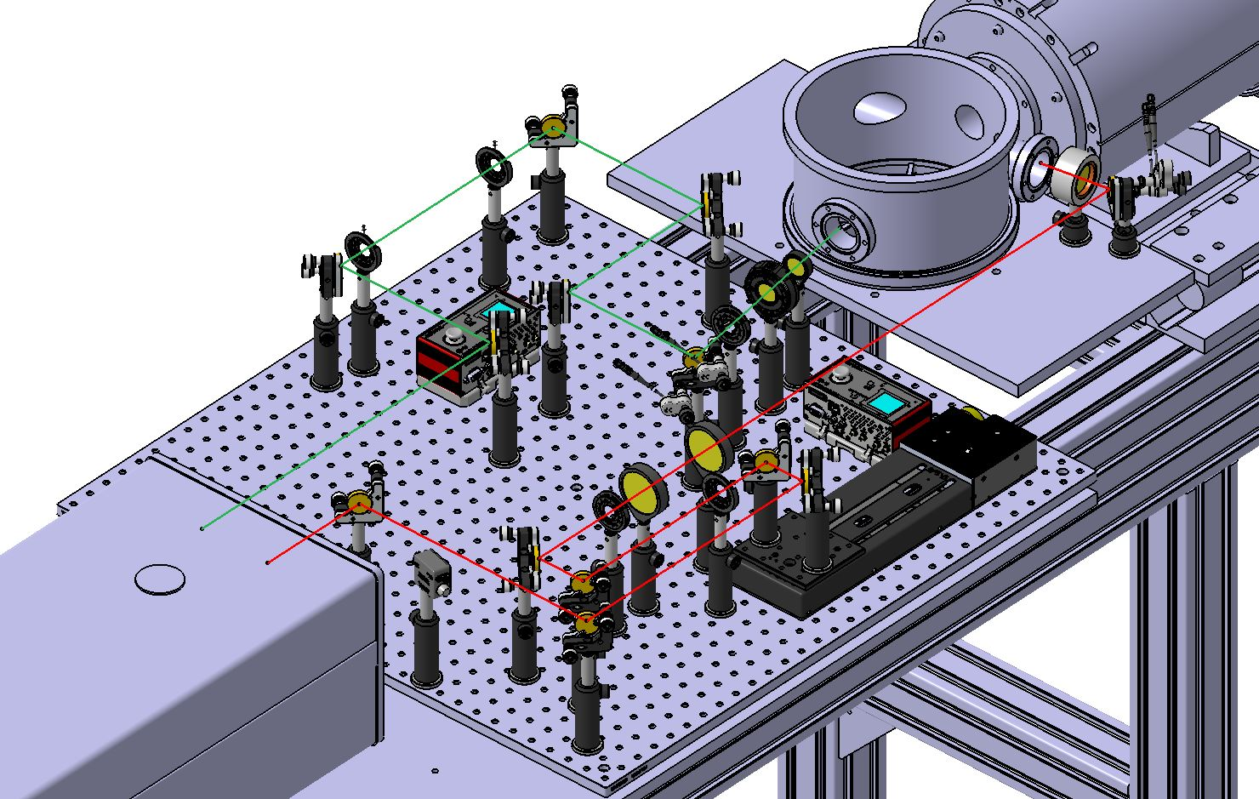
Setup of optical elements
Circularly polarized beam @ 213 nm
Linearly polarized beam @ 1064 nm

Slide 25
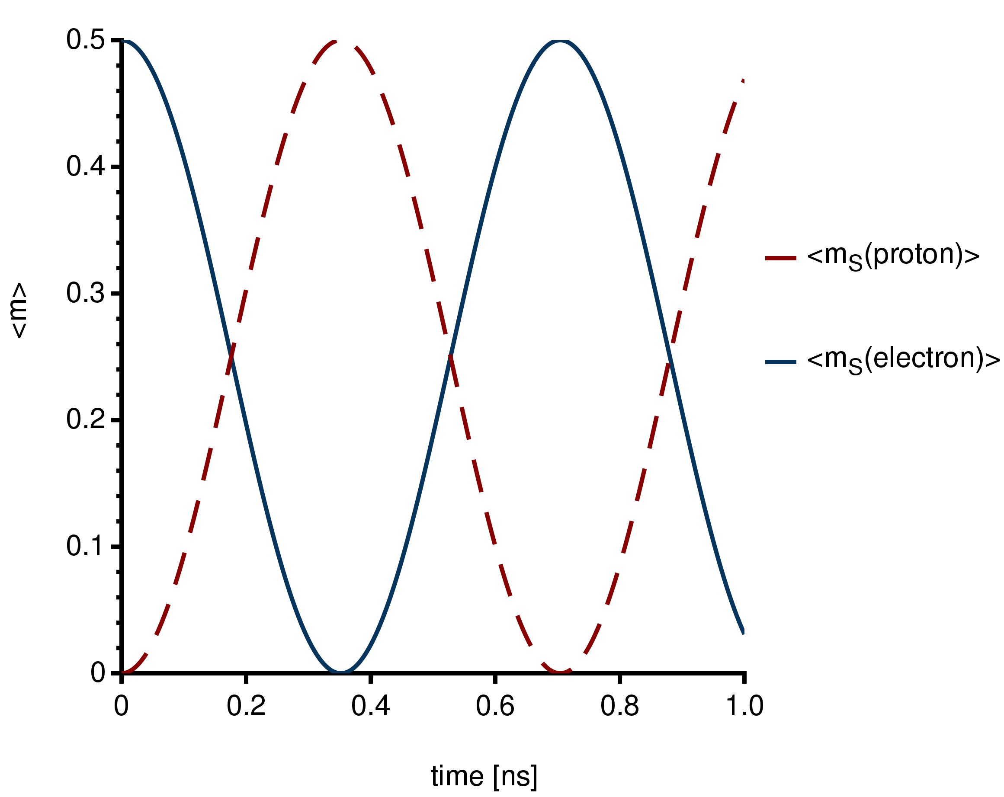
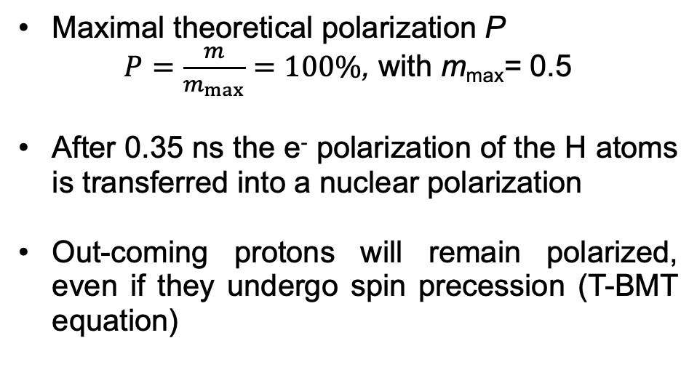
Polarization of the h nucleus
Maximal theoretical polarization P
$P=\frac{m}{m_{max}}=100\%$, with m_{max}= 0.5
After 0.35 ns the e⁻ polarization of the H atoms is transferred into a nuclear polarization
Out-coming protons will remain polarized, even if they undergo spin precession (T-BMT equation)
Notes:
Oscillation between electron and nucleus
Accelerating laser has to hit the tarhet where m_S<proton> is fully polarized

Slide 26
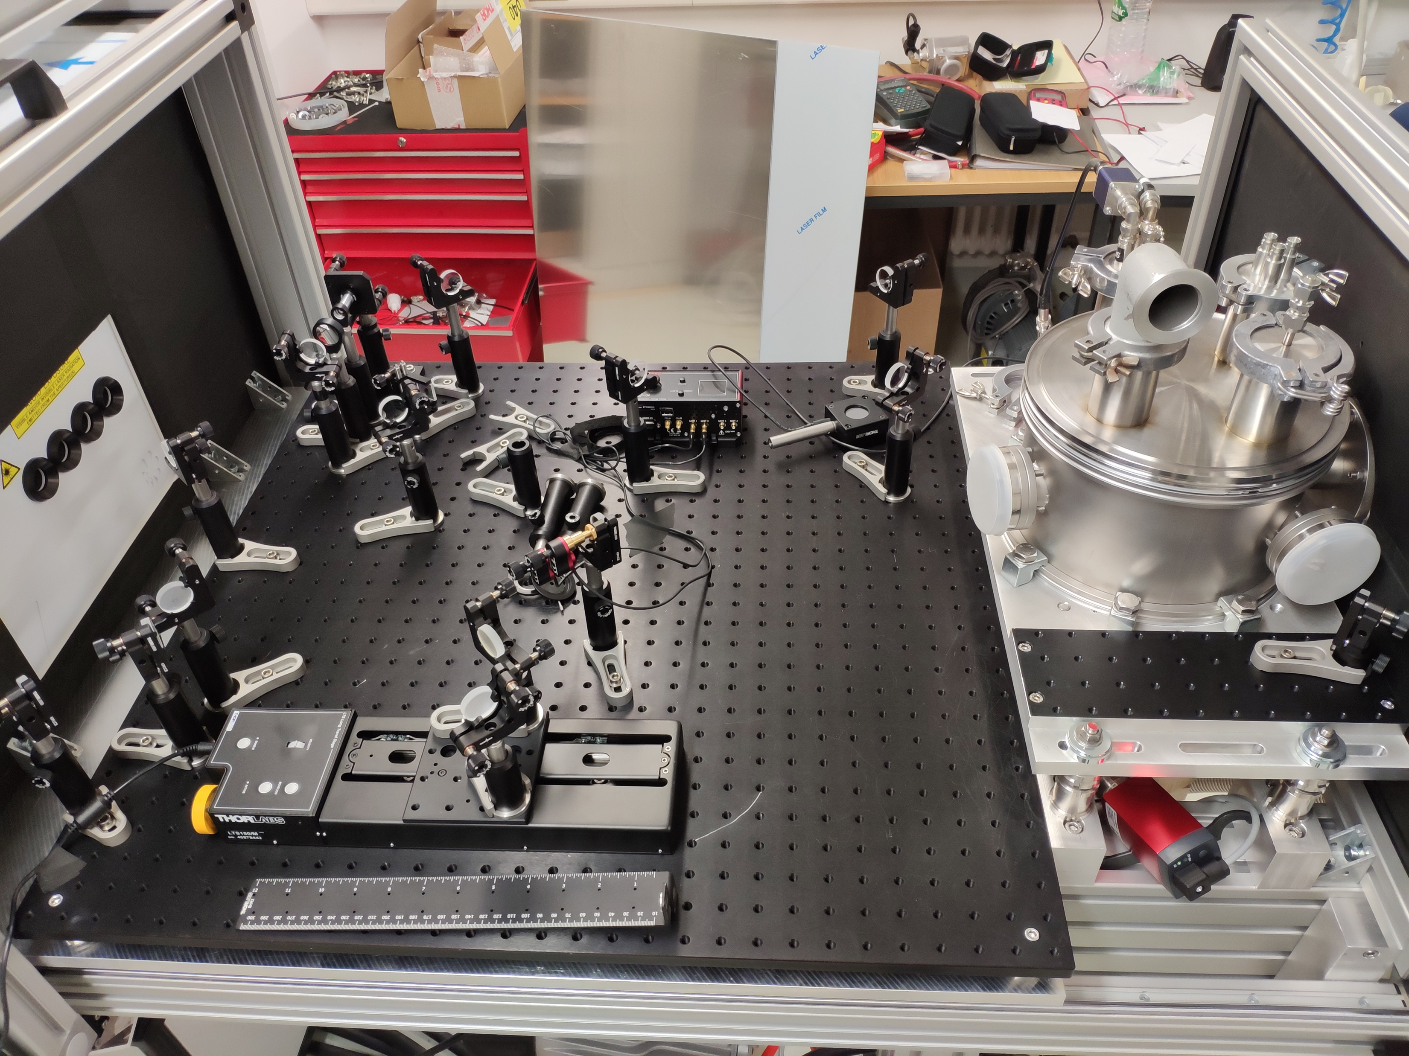
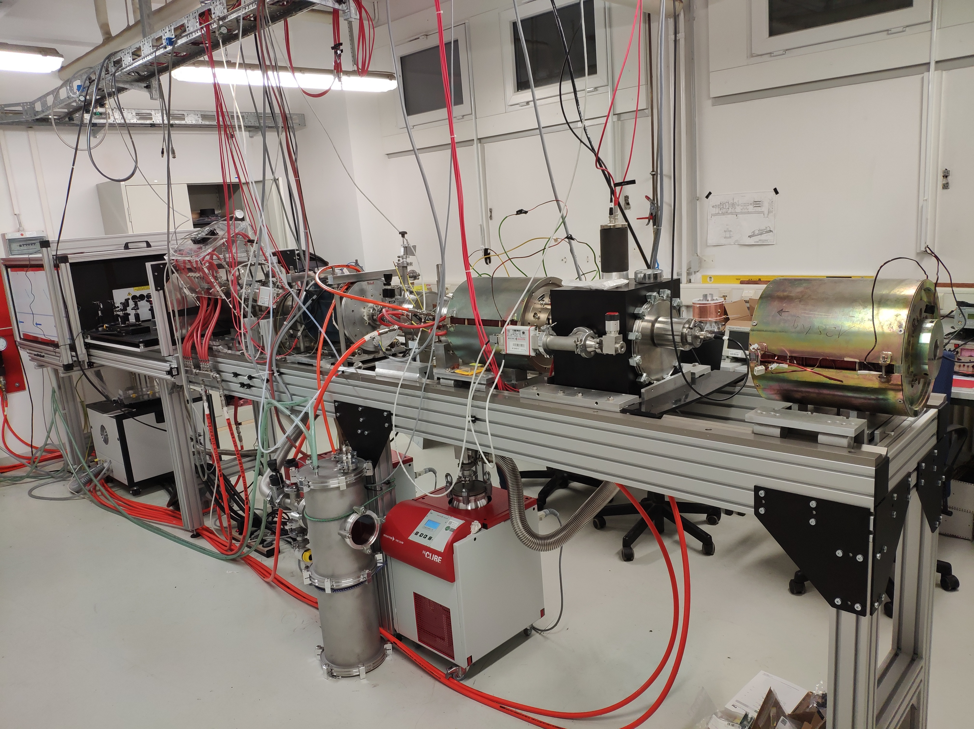
Current status of the experiment
Circularly polarized 213 nm beam
Wien filter
Cs cell
Glavish ionizer
Linearly polarized 1064 nm beam
Spin filter

Slide 27
Notes:
Das machen wir mit dem leistungsstärksten Laser der Welt in Shanghai.
Das ganze System passt in einen Raum.

Slide 28

Commissioning of polarized HCl target
Additional signal from nuclear polarized Hydrogen expected
Clear detection of proton signal from diffusive HCl into ionizer after ~ 4 ms.
Laser-generated atoms should produce additional proton signal
→ not yet detected
https://www.researchgate.net/publication/340460224
Notes:
we are in the commission phase
we have not yet observed the polarization but we see an effect of the incomming gas in the LSP

Slide 29
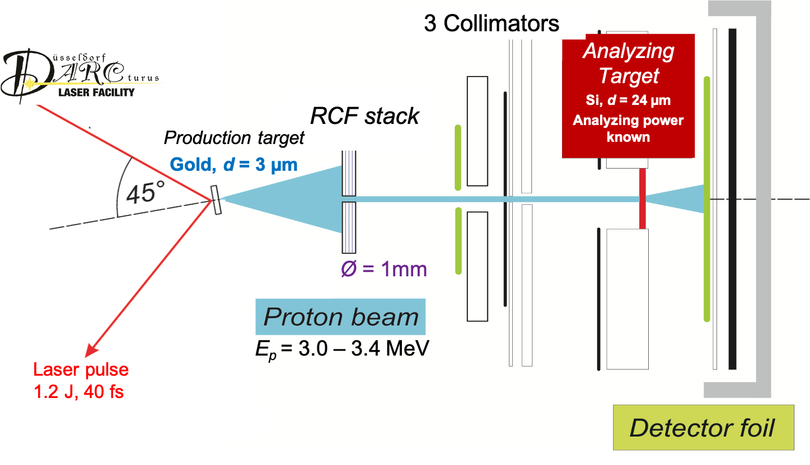
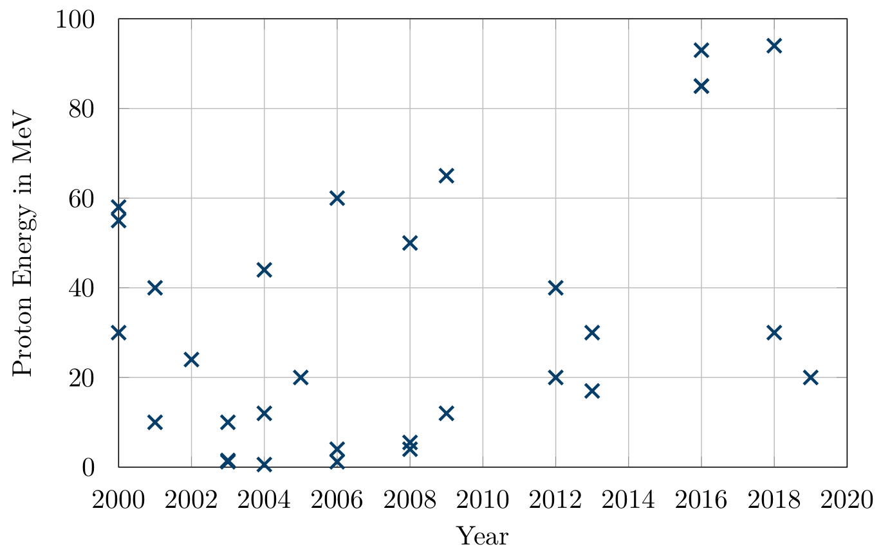
Why polarization of protons?
Our group already has expertise in polarized proton acceleration
Stagnation in the (unpolarized)
proton acceleration
Polarimetry developed
New target concepts needed
Raab et al., Phys. Plasmas 21, 023104 (2014)
Notes:
We performed the first and only experiment on laser-induced ion acceleration at ARCturus Laser System in Dusseldorf.
Here, we used an unpolarized foil target und the ions were accelerated according to TNSA mechanism towards a Silicon target with a thickness of 24 μm elastic scattering takes place.
Behind this scattering target, CR-39 detectors are placed, covering scattering angles θ of up to 68◦ as well as the complete azimuthal range φ.
Hence, the number of protons impinging on the Silicon target is analysed shot-by-shot from the dose on the calibrated RCF detectors.
For the measurements a 100 TW Ti:Sa laser system with a typical pulse duration of 25 fs and a repetition rate of 10 Hz was used producing an intensity of several 10²⁰ Wcm⁻² when being focused on the target.
Impinging the laser pulse in a 45◦ angle on an unpolarized gold foil of 3 μm thickness, protons with an energy of typically a few MeV are produced.
Side aspect, mostly with foil target, Maybe with our polalrized gas targets we can improve here.

Slide 30



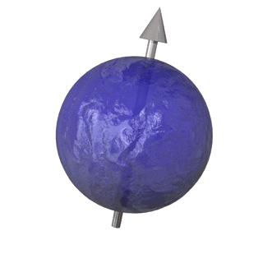
Spin as a particle property
“Everything in the universe, including light and gravity,
can be described in terms of particles. These particles have a property called spin. [...]
What the spin of a particle really tells us is what the particle looks like from
different directions.”
A Brief History of Time –
Stephen Hawking - Chapter 5
mass
charge
spin
S
spin = intrinsic angular momentum
polarization
N
Notes:
polarization = spin of an ensemble, looks like an intrinsic angular momentum
If the particle ensemble is brought into a magnetic field, therefore, the energy of the individual state changes depending on its position relative to the field direction, the degeneration is cancelled.
Thus, the spin density is transferred into a energy difference, which is measurable.
Spin= looks like an intrinsic angular momentum, Es hat viele Eigenschaften eines Drehimplses (Erhaltungssatz, Spinalgrebra), ist aber qm gesehen nichts

Slide 31
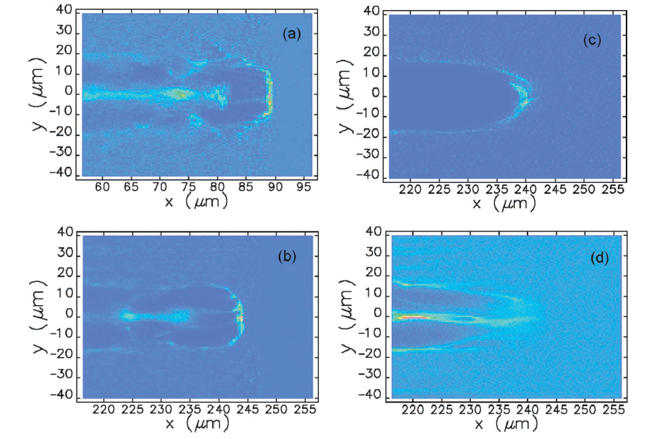
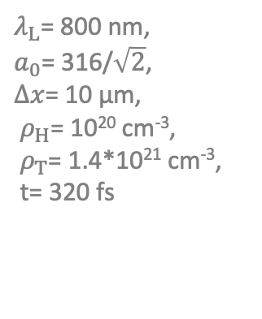
Predicted acceleration scheme for protons
$λ_{L}$= 800 nm,
$a_{0}$= 316/$\sqrt{2}$,
$∆x$= 10 µm,
${ ρ}_{H}$= 10²⁰ cm⁻³,
${ ρ}_{T}$= 1.4*10²¹ cm⁻³,
t= 320 fs
Electrons
Protons!!
Acceleration in electron bubble-channel structure: e⁻ at the rear of the bubble, ions at the front
  Gas mixtures required (protons & heavier nuclei)
  High Laser powers required (>10 PW)
Observation of a up to GeV polarized proton beam.
B. Shen et al., Phys. Rev. E 76, 055402 (2007)
Notes:
The trapped ions, surfing on the field, can be accelerated over a long distance and achieve a very large energy gain
Predicted more than 10 years ago
A more recent simulation

Slide 32
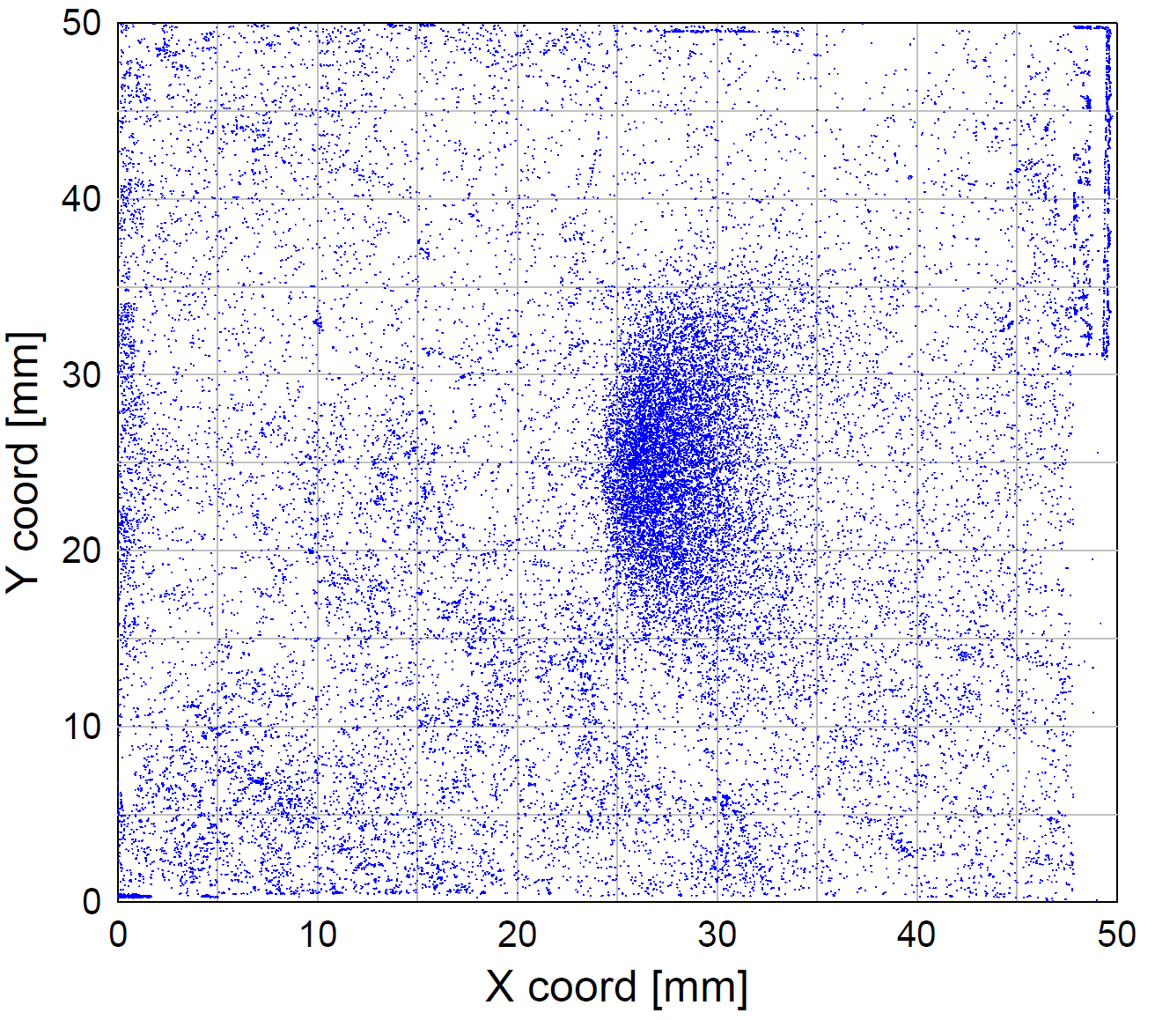


Polarimetry for ³He ions
Test beam time at Jülich Tandetron
with unpolarized ³He beam
CR-39 stack
³He beam
CD₂ foil:
$$D\left({}_{ }^{3}{He},p\right){}_{ }^{4}{He}$$
Analysis by: C. Zheng
Notes:
Fusionsreaktion mit Deuterium with unpolarized 3He
We employ this fusion reation with transplates the degree of polarization into a measuble angluar asymmetry
The degree of polariztion is tranferred into a spatical asymmetry, the so-called analysing power
Ersatz für pol. Neutronenstrahlen, da hier die Polarisation sitzt
Of course 3He is a bit special, in generall proton acceleration would be adventageous

Slide 33

Polarimetry for protons
Stack of SSNTDs
Polarized protons
proton
CH₂ foil target
Based on elastic pp and pC scattering
Test beam time @COSY: Feb. 2020
Data under analysis
Analysis by: C. Zheng
Notes:
carbon
Based on the polarimeter used for the Dudo experiment, we have optimised our polarimeter with polarized beams only available in Jülich
Scan of one of the CR-39 plates where we could clearly identify the eleastically scattered protons

