Slide 1
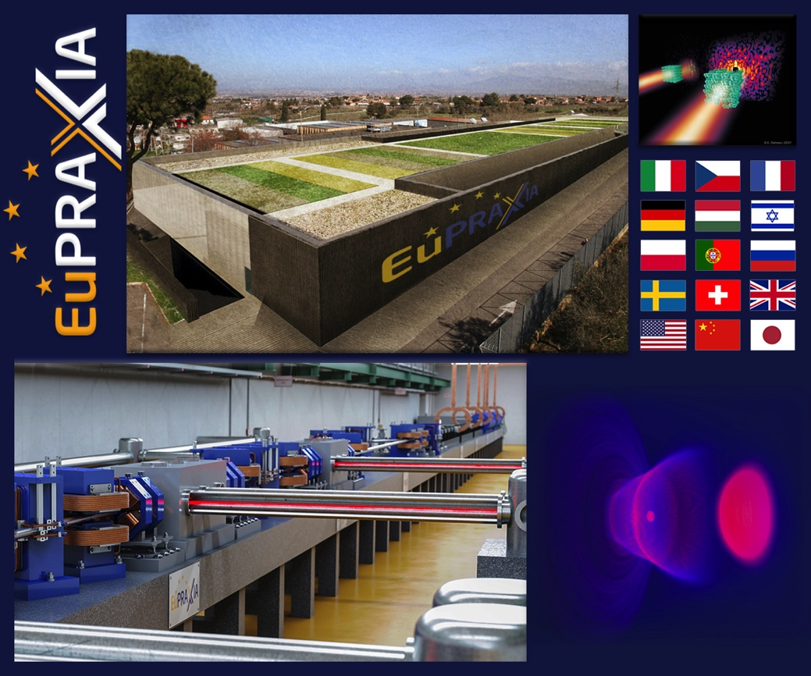
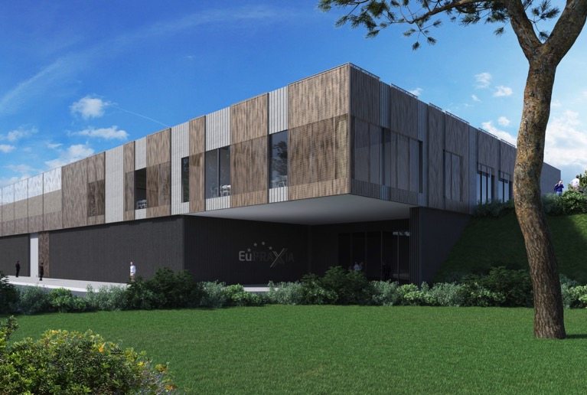
The EuPRAXIA Project for a European Research Infrastructure
Ralph Assmann (DESY & INFN)
IAS High Energy Physics (HEP 2021) Conference, Plasma Mini-Workshop
Hongkong, China (Virtual)
14.01.2021

Slide 2
Pioneering Accelerators for Advancing Human Knowledge
The history of science exhibits an intimate interplay between ideas, new technology, scientific advance and progress in human knowledge.
In 2021 we will celebrate Bruno Touschek, one of our heroes in accelerator science.
  Bruno Touschek had a central role in proposing and realizing colliders, in particular the 1st e+e- collider 60 years ago.
  We note: Progress always starts with an idea and colliders were very small initially!
  A long and hard road to the modern colliders as masterpieces of science and human technology.
Important to look at new ideas and to find out whether they work! Needs brains, time and money...
shifted

Slide 3
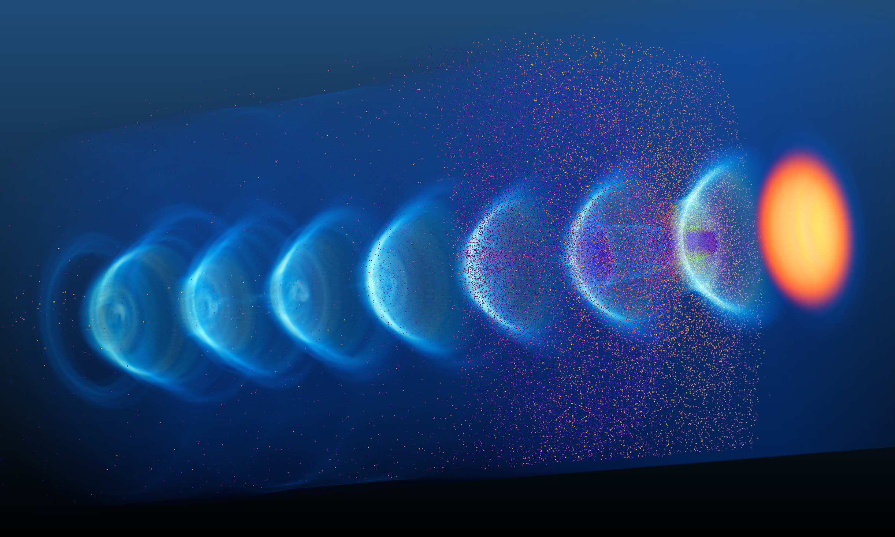
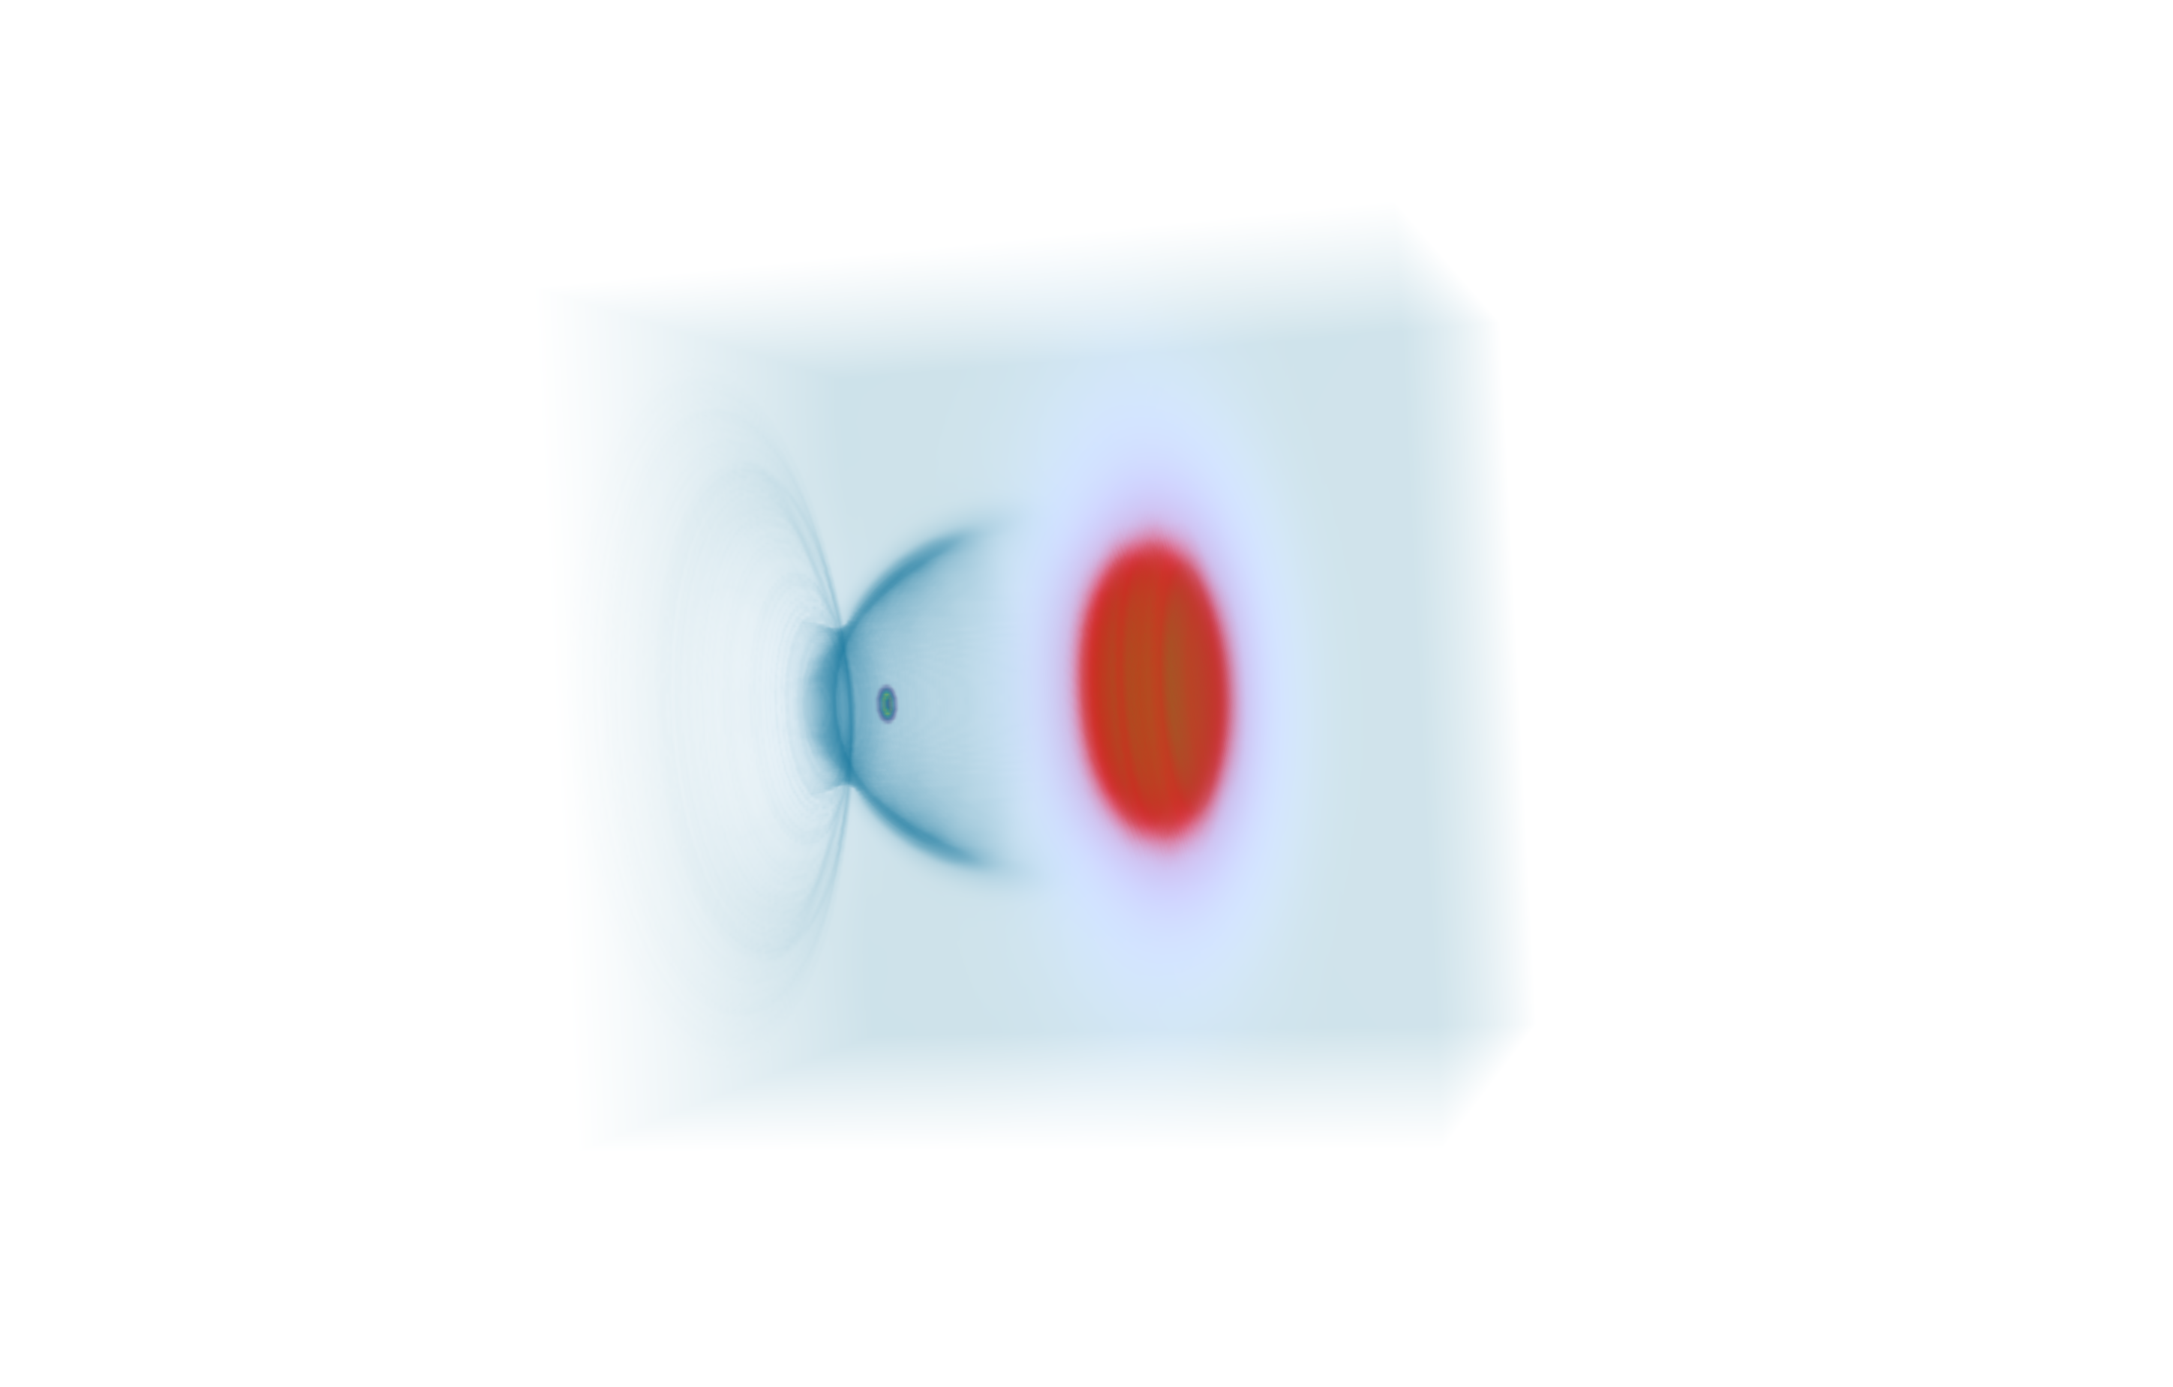

The Plasma Accelerator: The Next Step?
Wakefield due to space charge oscillation inside plasma → 10 – 100 GV/m
Laser or beam driver
Electron beam
Illustrations from A. Ferran Pousa
$\sim 100$µm
Very strong fields can be produced in plasmas and we know how to construct a particle accelerator with them (idea of Tajima & Dawson 1979). A 1 TeV collider in 10-100 meters? Not so easy...

Slide 4
The EuPRAXIA Project
First ever international design of a plasma accelerator facility.
Challenges addressed by EuPRAXIA since 2015:
  How can plasma accelerators produce usable electron beams?
  For what can we use those beams while we increase the beam energy towards HEP and collider usages?
CDR for a distributed research infrastructure funded by EU Horizon2020 program. Completed by 16+25 institutes end 2019.
Formed next phase consortium with 40 partners, 10 observers.
Applied to ESFRI roadmap update 2021 with government support in Sep 2020.
Judged as eligible and has entered the ESFRI review.
653 page CDR
240 scientists contributed
http://www.eupraxia-project.eu/

Slide 5
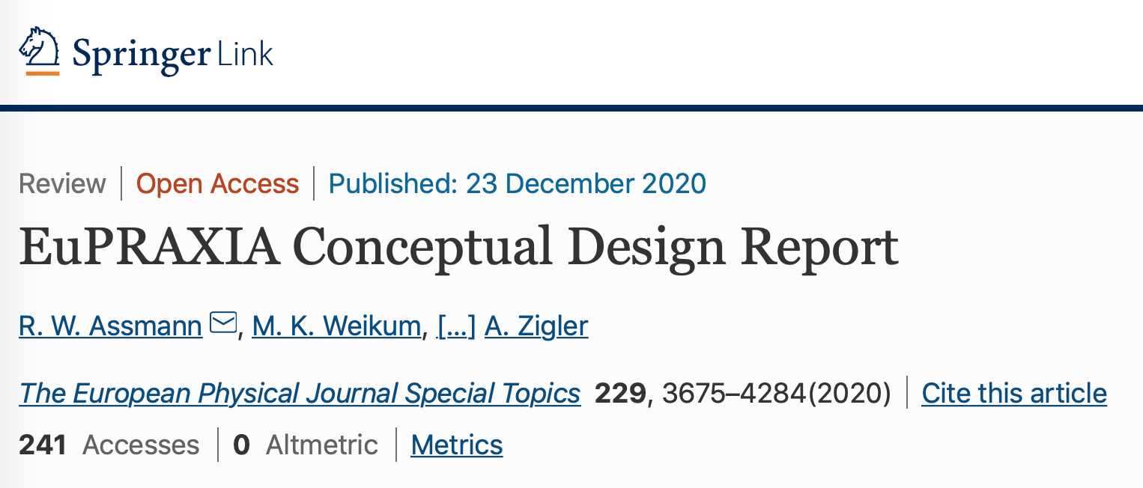
The Reference: EuPRAXIA CDR
First ever international design of a plasma accelerator facility
CDR completed on time and submitted to European Union on Oct 30th, 2019
Published in peer-reviewed European Physical Journal – Special Topics. Now in print.

Slide 6
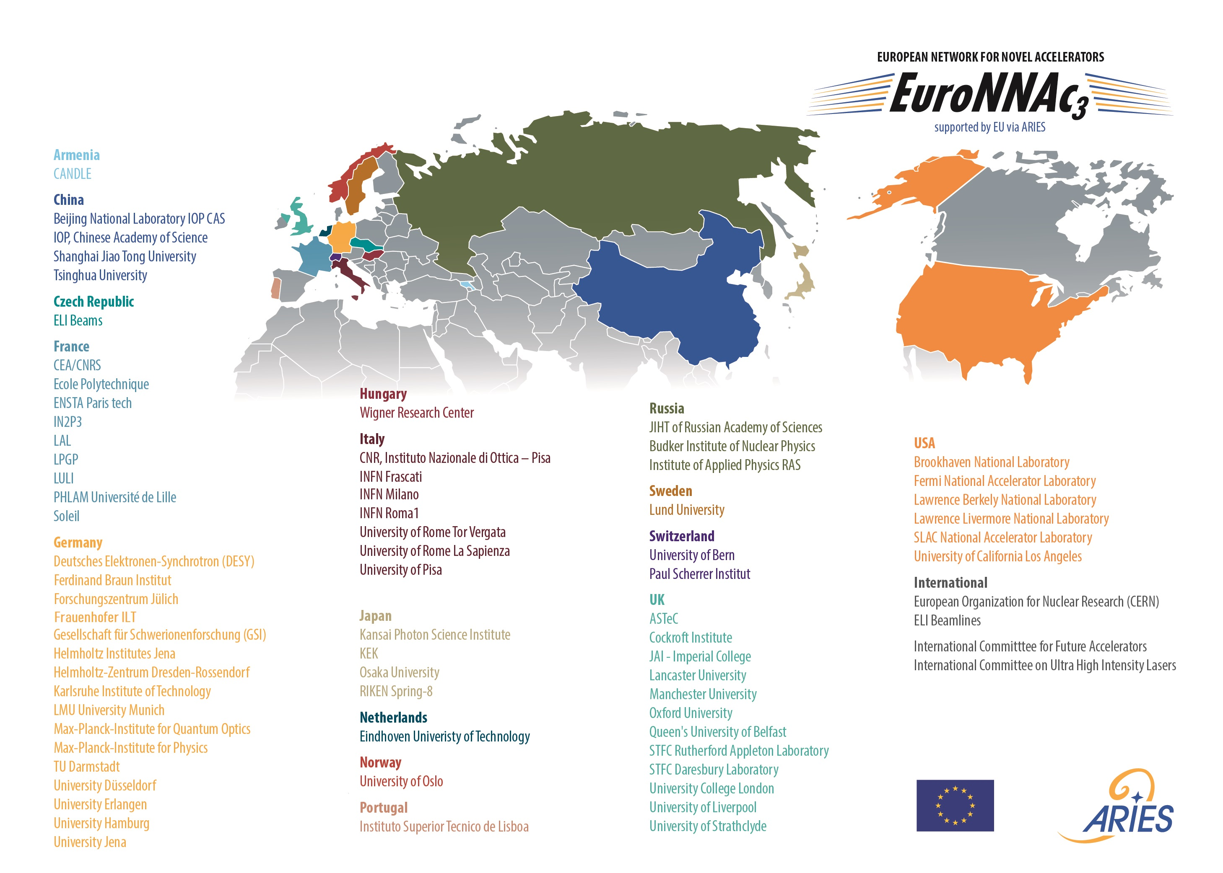
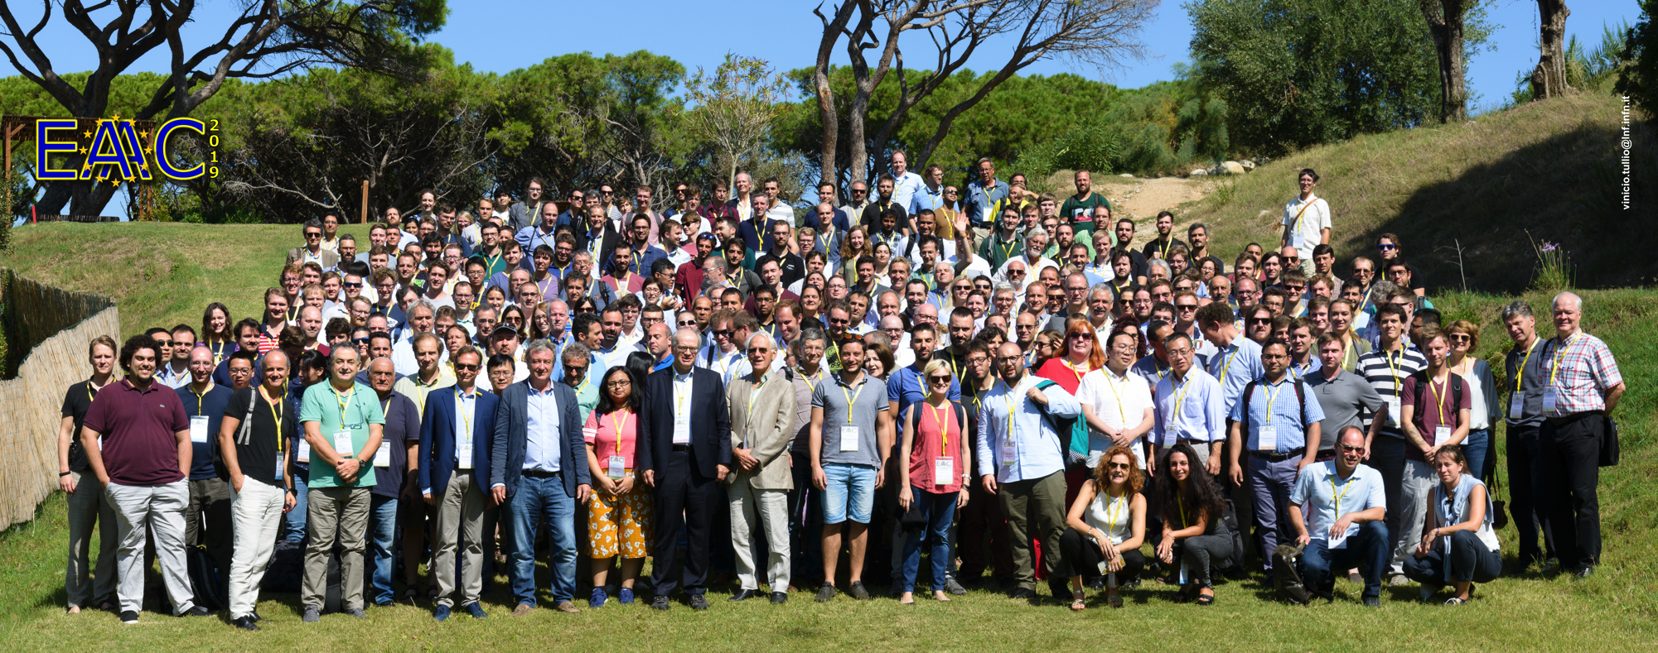
EuPRAXIA is a Community-Driven Project
European Network for Novel Accelerators (EuroNNAc)
65 institutes
Founded by RA in 2011 at CERN
EU support secured until 2025
Provided input to last two European Strategies in Particle Physics
Founded EAAC workshop series
Initiated EuPRAXIA
Supported ALEGRO
Bi-Annual European Advanced Accelerator Concepts Workshop EAAC
Founded by RA, MF and EuroNNAc steering group in 2013, EU support secured until 2025 (ARIES → IFAST)
267 participants in 2019 (limited by space)

Slide 7
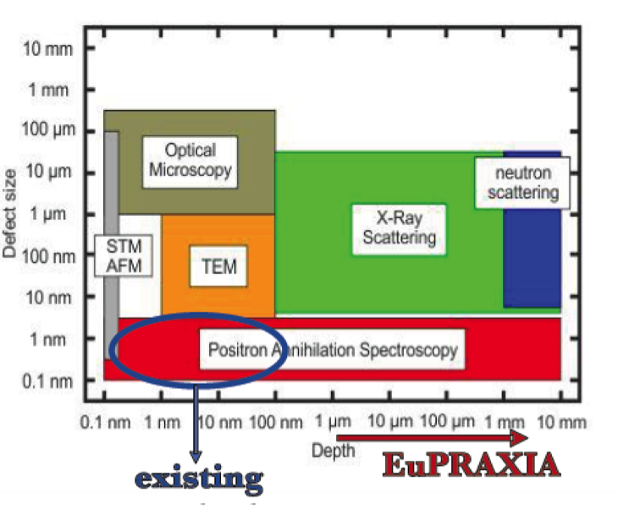
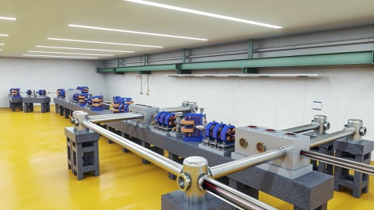
The EuPRAXIA “Philosophy”
Building links across labs, communities, technologies
Bringing together established excellence from RF accelerators, new innovative plasma accelerator concepts and laser technology
Building on existing infrastructure with realistic intermediate goals for plasma accelerators:
  150 MeV → 1 GeV → 5 GeV (FEL + other applications)
  1 plasma stage → 2 plasma stages → multiple
  factor 3 facility size reduction → factor 10 → ...
  Low charge, 10 Hz apps of electrons (+ positron generation)
  → high charge, 10 Hz applications (FEL) → 100 Hz
  Includes RF injectors, transfer lines, undulator lines, shielding, ...
EuPRAXIA Positron Annihilation Spectroscopy in a new regime:
Courtesy M. Butterling, HZDR

Slide 8
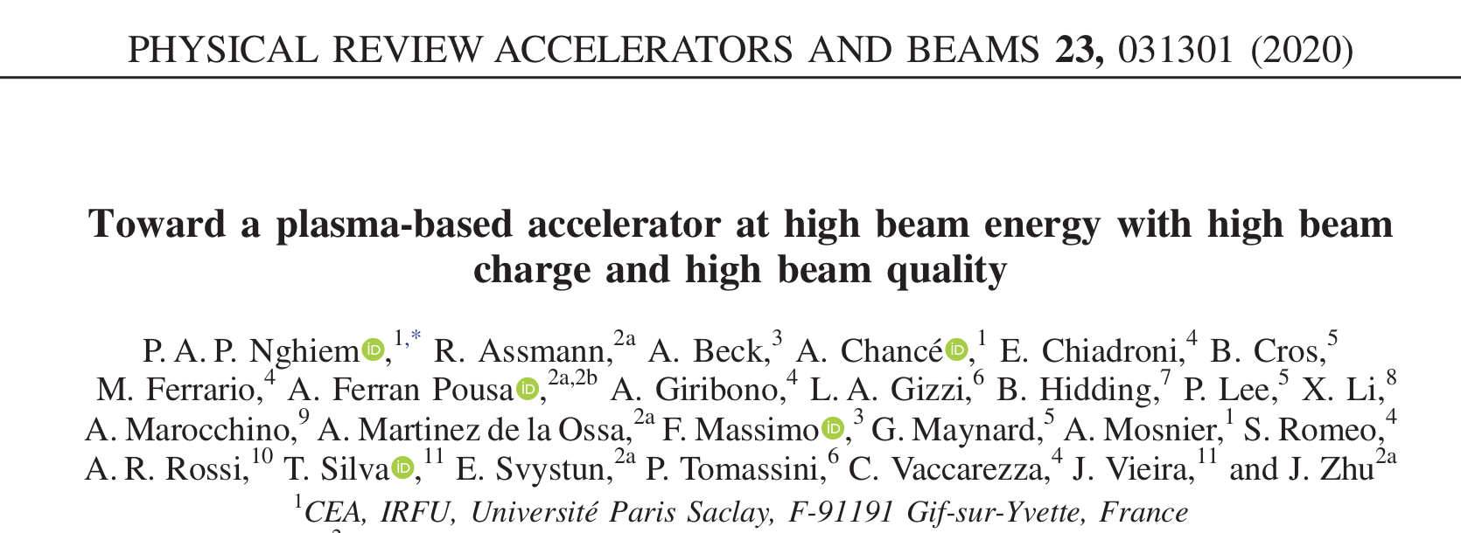
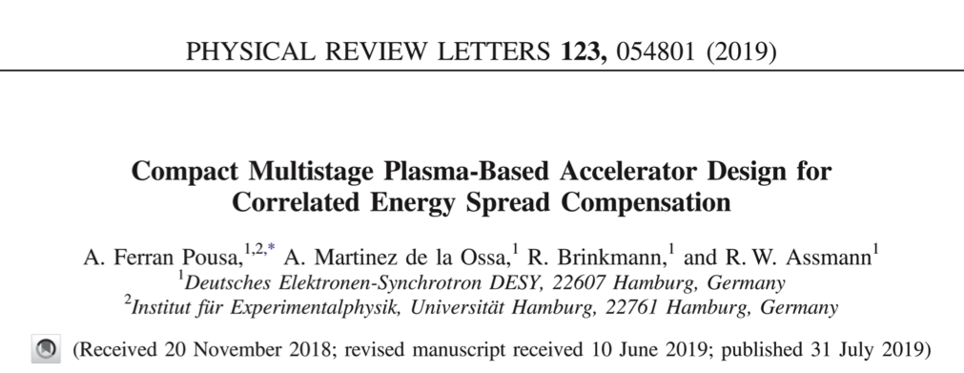
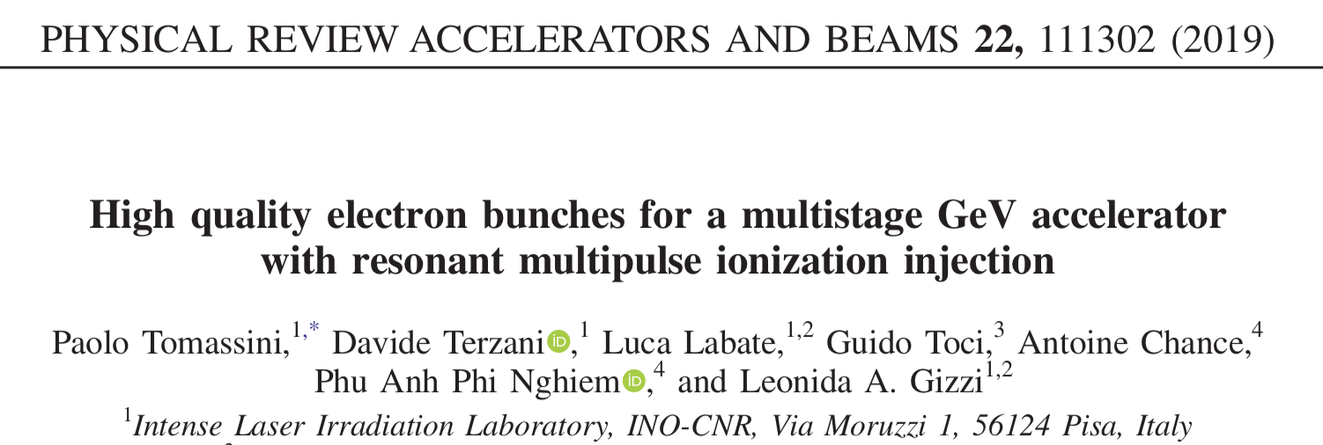
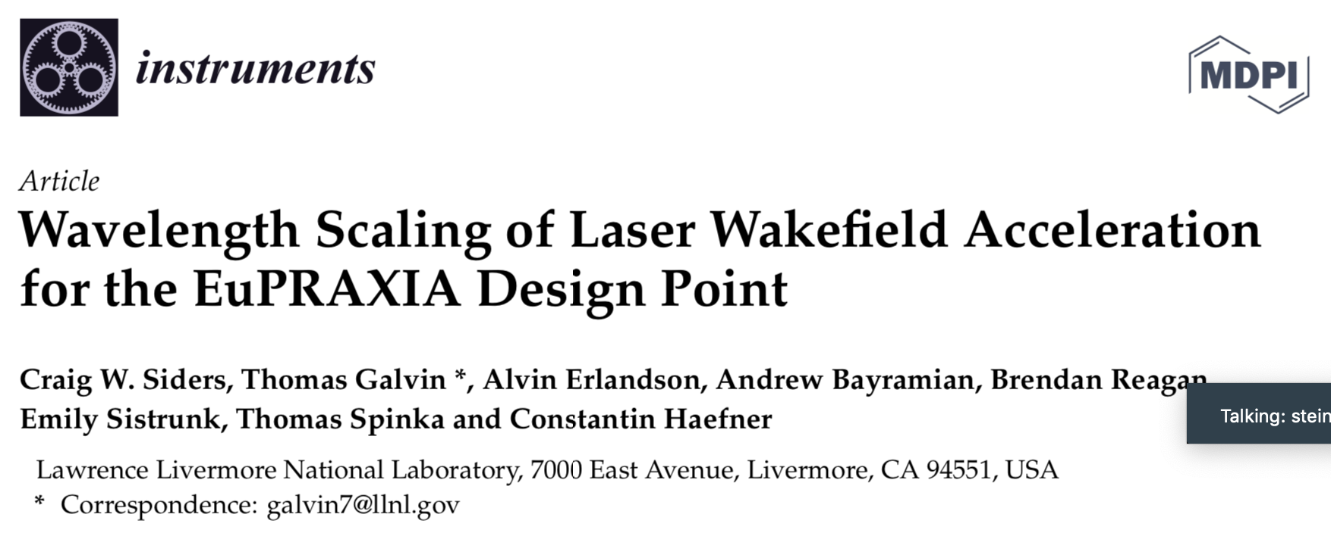
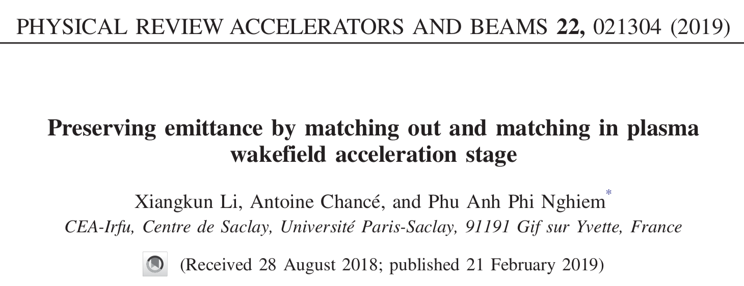
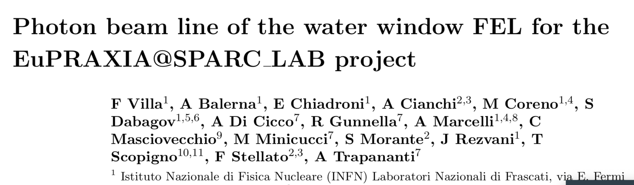
Examples of EuPRAXIA Ideas and Innovation

Slide 9
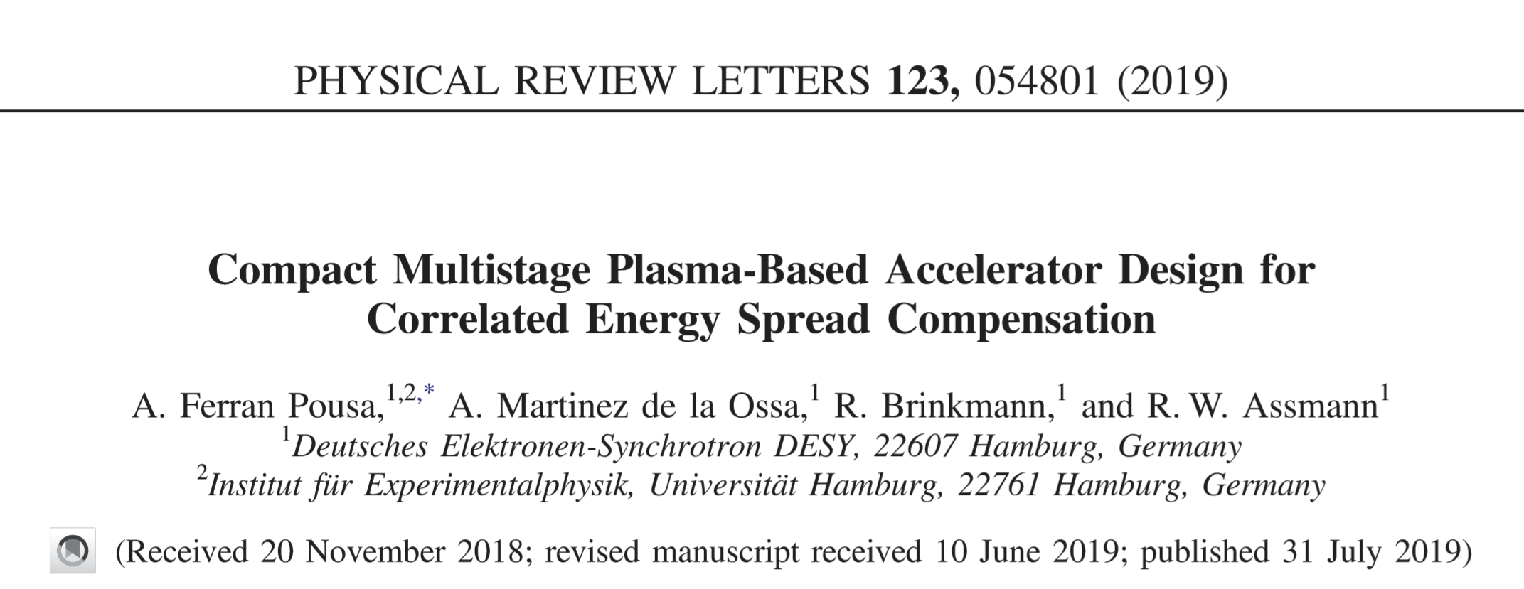
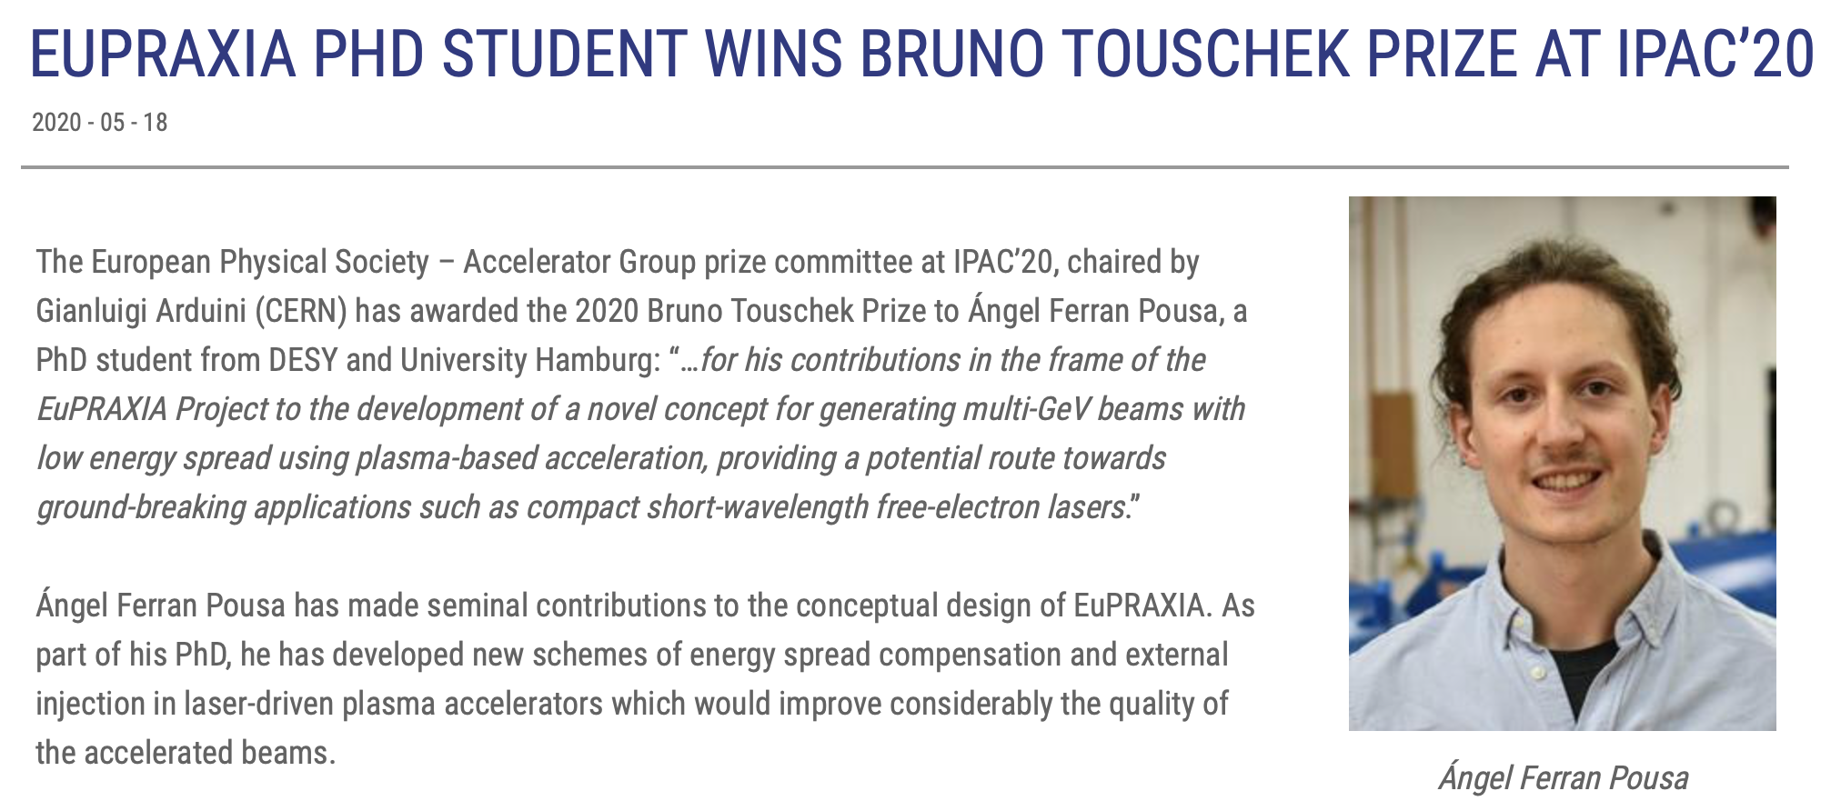
Examples of EuPRAXIA Ideas and Innovation

Slide 10
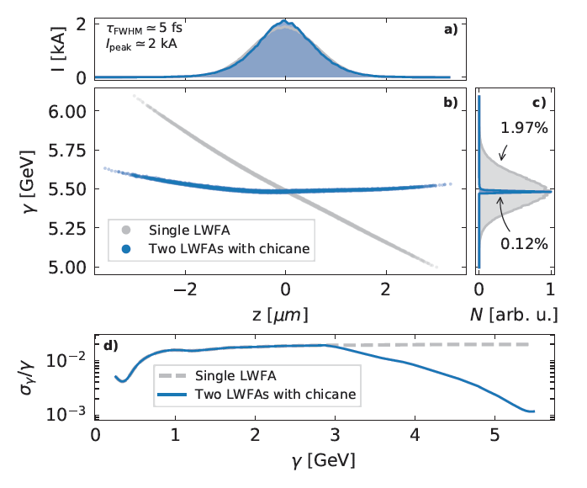
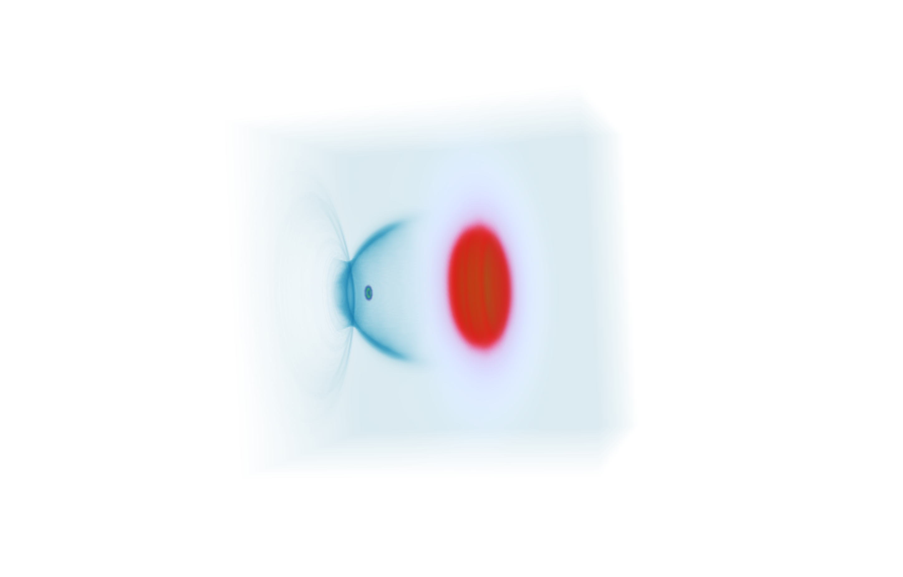






Example of EuPRAXIA Idea and Innovation
Electron beam
Ref.: Ferran Pousa, Martinez de la Ossa, Brinkmann, Assmann
PRL 123, 054801 (2019)
Not to scale. Compact setup 1.5 m.
Laser 1
Coherent Synchrotron Radiation (CSR) and Space-Charge checked
Plasma mirror
(coupling of laser 2)
Plasma accel. stage 2
Plasma mirror
(laser 1 removal)
Active plasma lens
Magnetic chicane
Plasma accel. stage 1
Active plasma lens
Laser 2
Accelerating in a plasma stage and...
... flipping phase space in the middle before second plasma stage

Slide 11
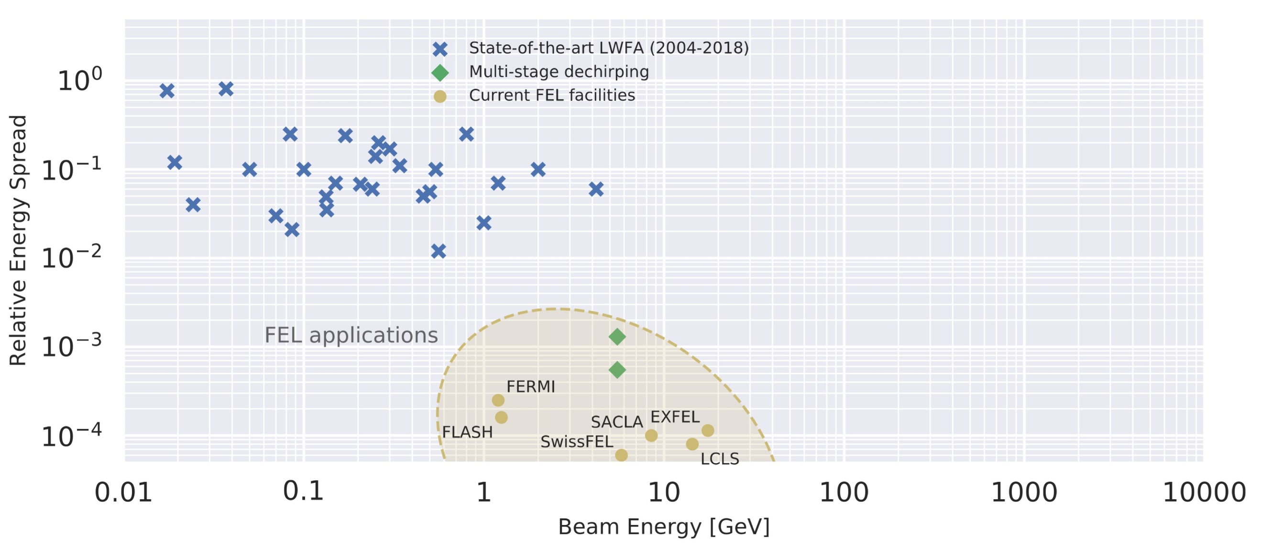

Example of EuPRAXIA Idea and Innovation
EuPRAXIA developed solutions for high beam quality in plasma accelerators, approaching performance of established RF accelerators!
STATE OF THE ART PLASMA ACCELERATORS
STATE OF THE ART COLLIDER
CLIC
CDR Vol. 1
EuPRAXIA
Design
ILC
TDR Vol. 1
STATE OF THE ART FEL

Slide 12
Example of EuPRAXIA Idea and Innovation
EuPRAXIA developed solutions for high beam quality in plasma accelerators, approaching performance of established RF accelerators!
STATE OF THE ART PLASMA ACCELERATORS
STEP 1
STATE OF THE ART COLLIDER
CLIC
CDR Vol. 1
EuPRAXIA
Design
ILC
TDR Vol. 1
STATE OF THE ART FEL

Slide 13
Example of EuPRAXIA Idea and Innovation
EuPRAXIA developed solutions for high beam quality in plasma accelerators, approaching performance of established RF accelerators!
STATE OF THE ART PLASMA ACCELERATORS
STEP 1
STATE OF THE ART COLLIDER
CLIC
CDR Vol. 1
STEP 2
ILC
TDR Vol. 1
EuPRAXIA
Design
STATE OF THE ART FEL

Slide 14
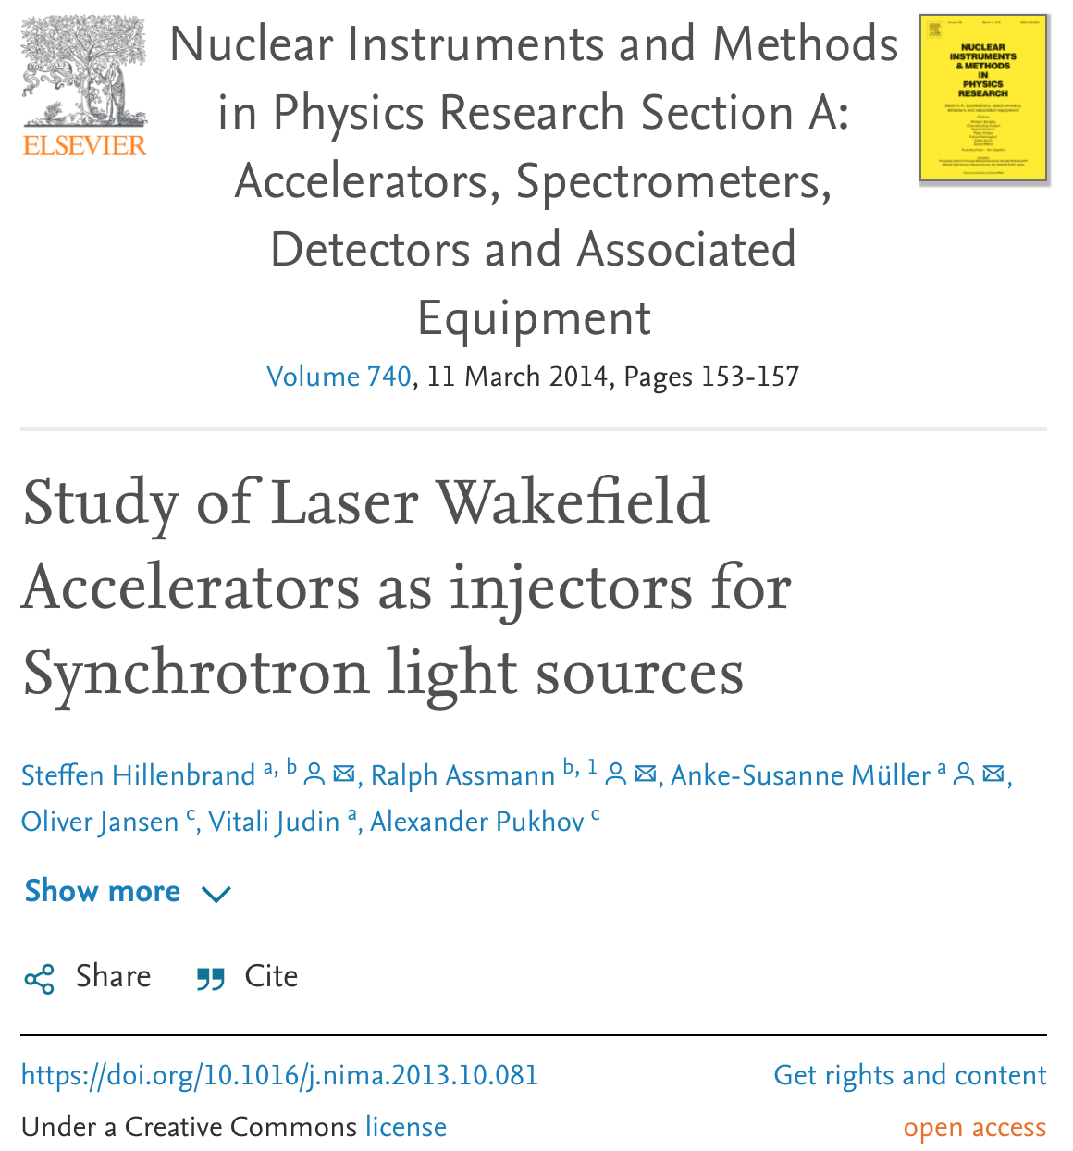
Plasma Accelerators as Injectors for Rings I
First study in 2014 in context of PhD study S. Hillenbrand at KIT and CERN.
Published by S. Hillenbrand, R. Assmann, A.-S. Müller, O. Hansen, V. Judin and A. Pukhov in NIM A 740 (2014) 153–157.
Idea: Damping in storage ring “forgets” about the injected quality.
However, critical roles of short bunch length and high energy spread for acceptance and intensity transfer.
EuPRAXIA will help establishing methods for suitable performance of plasma accelerator (see staging scheme).
Applications of plasma accelerators of injectors for ring-based storage rings open fascinating possibilities for photon science and colliders → major cost savings?
Idea pursued inside the ATHENA project in Helmholtz (KIT experiment CSTART) and recently for PETRA-IV at DESY.

Slide 15
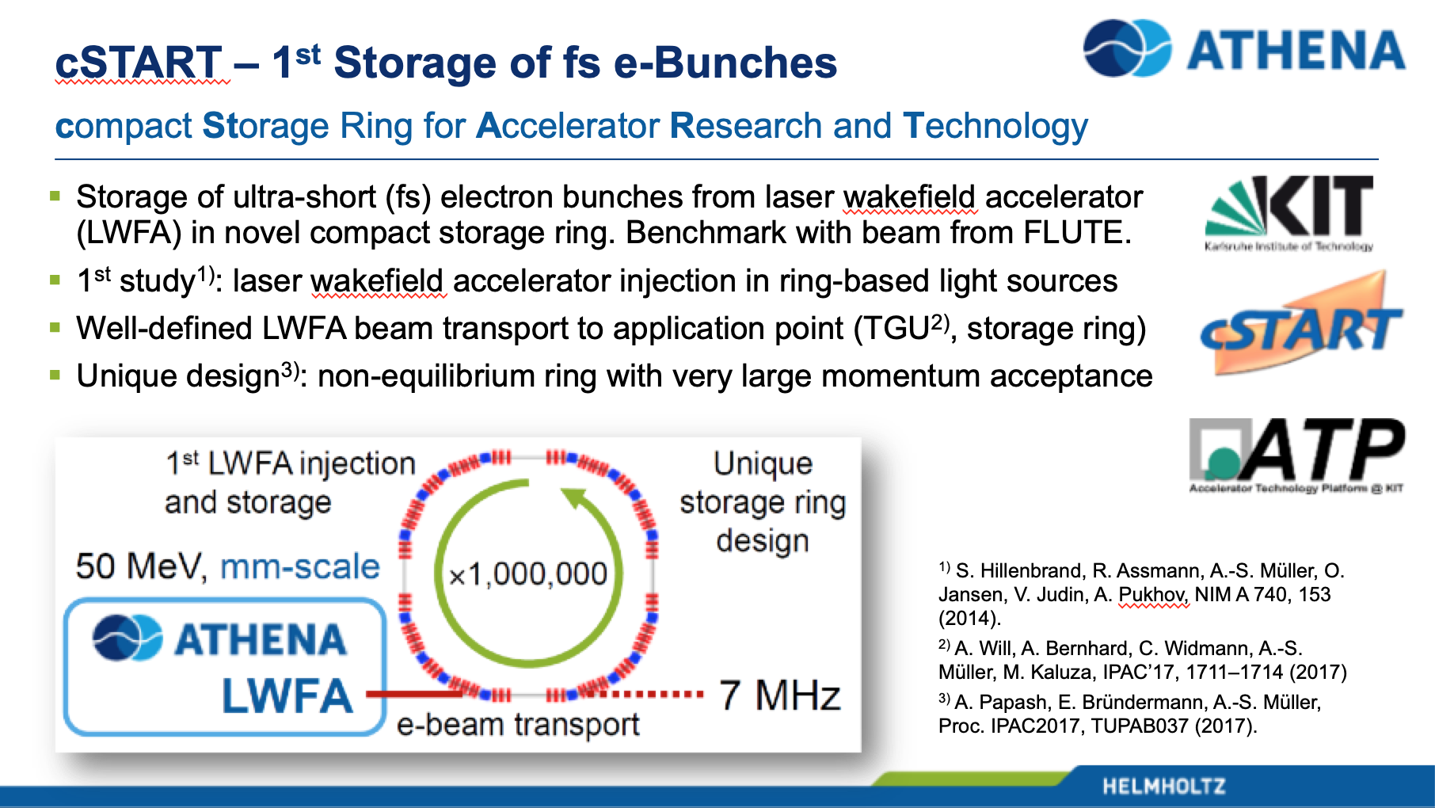
Plasma Accelerators as Injectors for Rings II
Slide from
R. Assmann et al, “The ATHENA project”, Helmholtz- MML Meeting,
15 Feb 2019

Slide 16
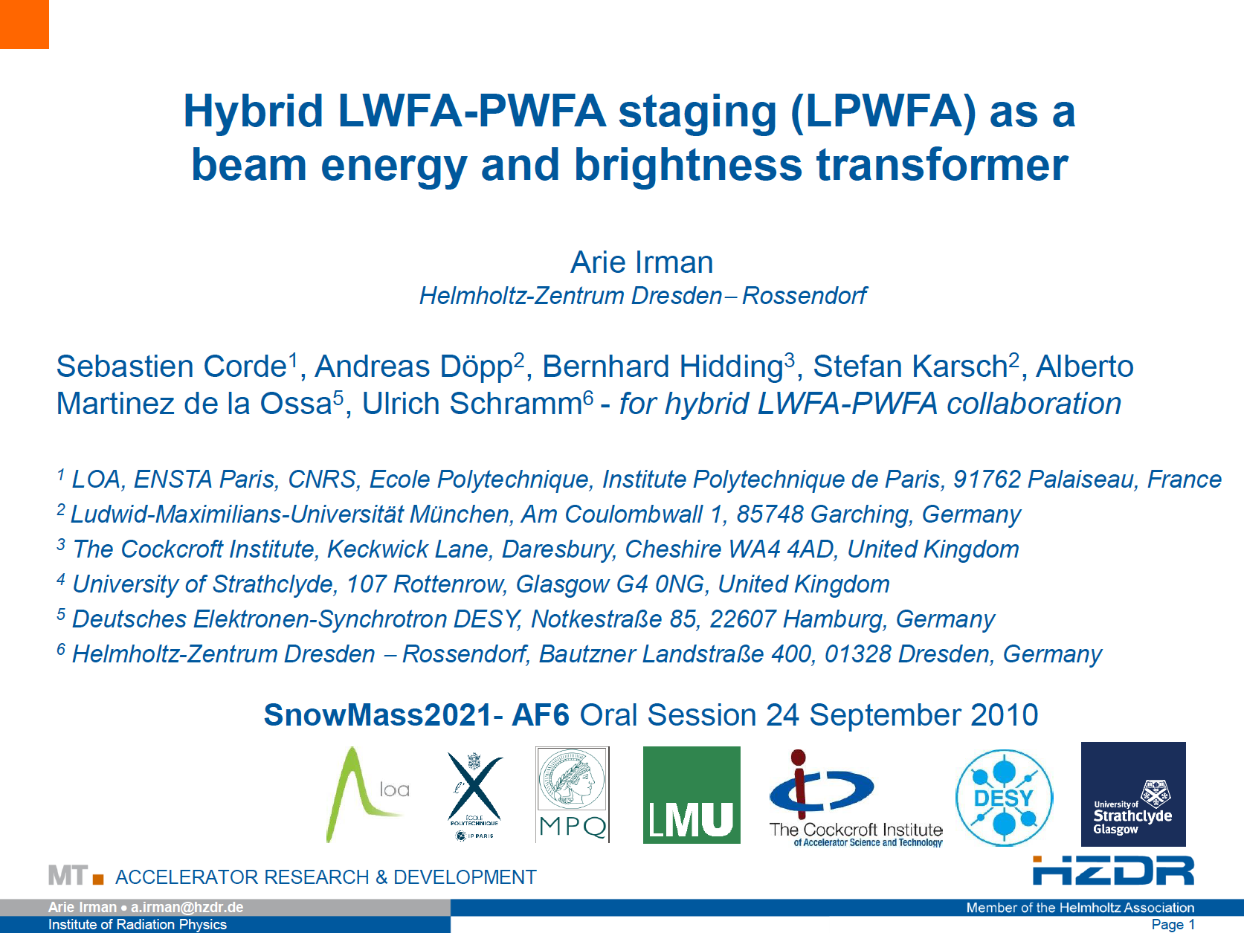
Advancing Spin Polarization and Hybrid Plasma Accelerators
e+e- colliders and physics reach enhanced by spin polarized beams
International Partners: Germany, Greece, China, and USA → facilities involved at FZJ, Shanghai, ...
Use a laser-generated electron beam for driving plasma wakefields in a second stage → HQ electron beam from ultra-compact setup
Several facilities involved at HZDR, Strathclyde, ...
See talk by M. Büscher

Slide 17
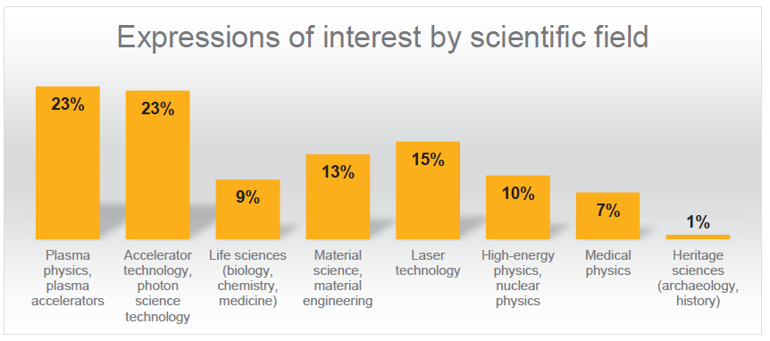
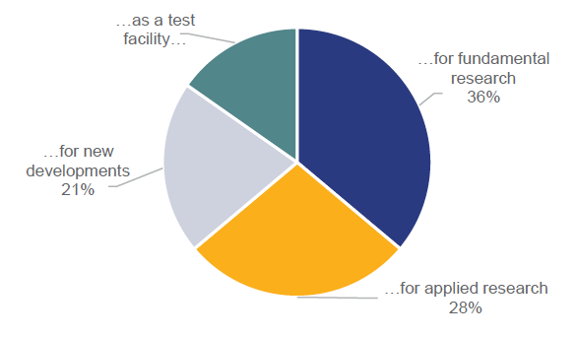
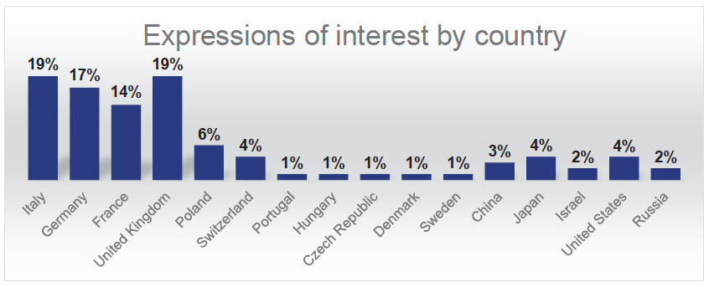
EuPRAXIA Deliverables and User Interests
EuPRAXIA is designed to deliver at 10-100 Hz ultra-short pulses of
Electrons (0.1-5 GeV, 30 pC)
Positrons (0.5-10 MeV, 10⁶)
Positrons (GeV source)
Lasers (100 J, 50 fs, 10-100 Hz)
Betatron X rays (5-18 keV, 10¹⁰)
FEL light (0.2-36 nm, 10⁹-10¹³)
Expressions of interest from 95 research groups representing several thousand scientists in total.

Slide 18
Targeted User Communities
EuPRAXIA provides particle and photon beams with exceptionally short duration and small size – ideal for the study of complex systems and ultrafast processes:
Biology structural biology, research on understanding molecular structures and biochemical processes
Chemistry crystallography, research on understanding molecular structures and chemical processes
Medicine pharmacological developments, research on understanding underlying mechanisms of drug
operating modes and delivery, diseases, etc.
Material science crystallography, research on understanding molecular structures and processes, e-beam machining, material analysis
Physics crystallography, research on understanding structures and processes
Archaeology & history non-destructive testing, material analysis
Beyond those applications various use cases of co-development including accelerator R&D, photon science technologies, compact and industrial applications, plasma-based acceleration and secondary sources for high-energy physics.

Slide 19
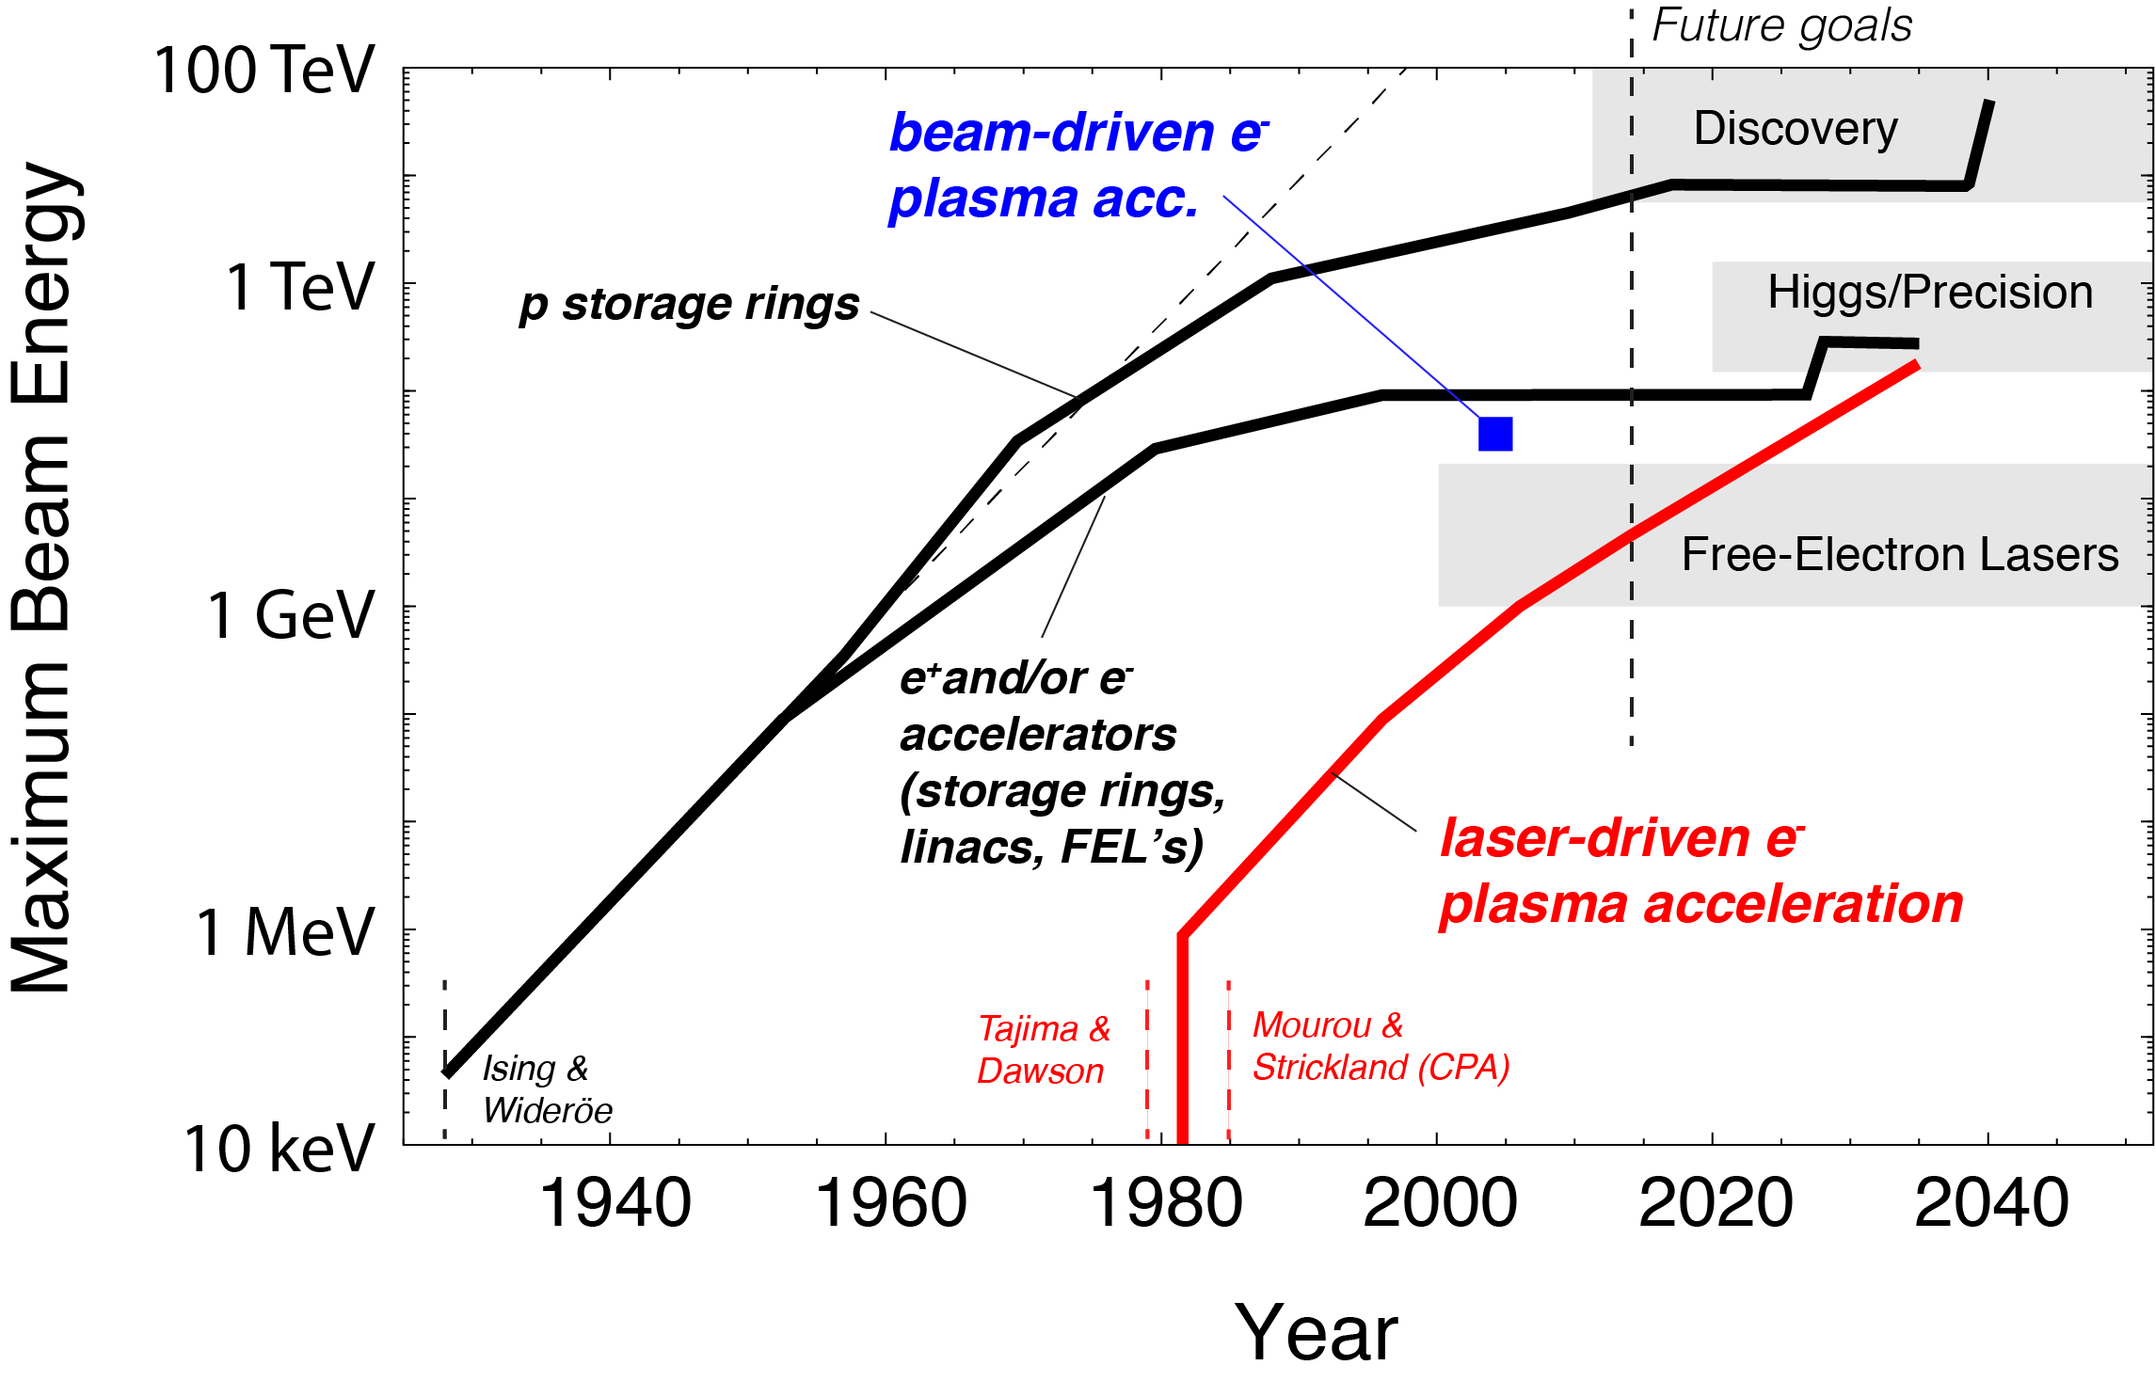
Compact Accelerators for HEP?
100 km
27 km
100 m

Slide 20
Compact Accelerators for HEP?
100 km
Shows potential of plasma acceleration for very high energies → HEP
27 km
100 m

Slide 21
Compact Accelerators for HEP?
100 km
Shows potential of plasma acceleration for very high energies → HEP
27 km
100 m
Plasma acc. today in regime required for FEL’s
→ Photon Science!

Slide 22
Compact Accelerators for HEP?
100 km
Shows potential of plasma acceleration for very high energies → HEP
27 km
100 m → 9 cm
Plasma acc. today in regime required for FEL’s
→ Photon Science!
Acceleration length (new versus conventional):
9 cm versus 100 m

Slide 23
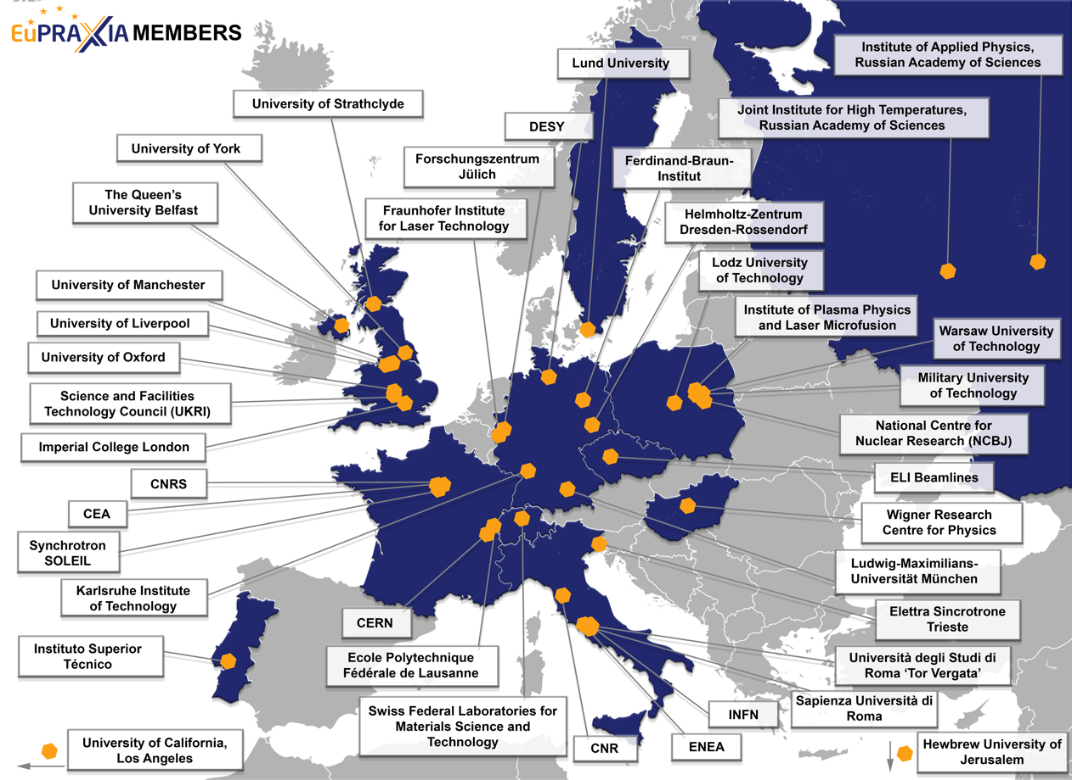
The Consortium Members for the Next Phase
(from 16 to 40)
40 Member institutions in:
Italy (INFN, CNR, Elettra, ENEA, Sapienza Università di Roma, Università degli Studi di Roma “Tor Vergata”)
France (CEA, SOLEIL, CNRS)
Switzerland (EMPA, Ecole Polytechnique Fédérale de Lausanne)
Germany (DESY, Ferdinand-Braun-Institut, Fraunhofer Institute for Laser Technology, Forschungszentrum Jülich, HZDR, KIT, LMU München)
United Kingdom (Imperial College London, Queen’s University of Belfast, STFC, University of Liverpool, University of Manchester, University of Oxford, University of Strathclyde, University of York)
Poland (Institute of Plasma Physics and Laser Microfusion, Lodz University of Technology, Military University of Technology, NCBJ, Warsaw University of Technology)
Portugal (IST)
Hungary (Wigner Research Centre for Physics)
Sweden (Lund University)
Israel (Hebrew University of Jerusalem)
Russia (Institute of Applied Physics, Joint Institute for High Temperatures)
United States (UCLA)
CERN
ELI Beamlines
pending
pending

Slide 24
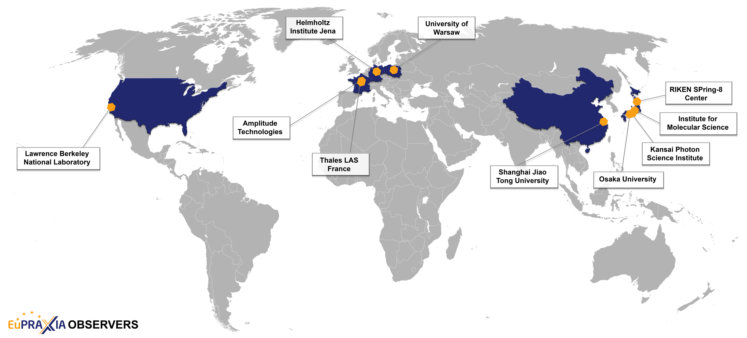
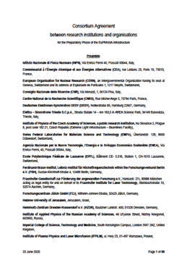
The Consortium Observers for the Next Phase
(from 25 to 10, Consortium Agreement signed)
10 Observer institutions in:
France (Amplitude Technologies, Thales LAS France SAS)
Germany (Helmholtz-Institut Jena)
Poland (University of Warsaw)
United States (LBNL)
China (Shanghai Jiao Tong University)
Japan (Institute for Molecular Science, Osaka University, Kansai Photon Science Institute, RIKEN SPring-8 Center)

Slide 25
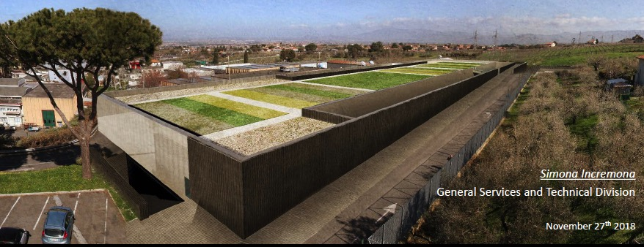
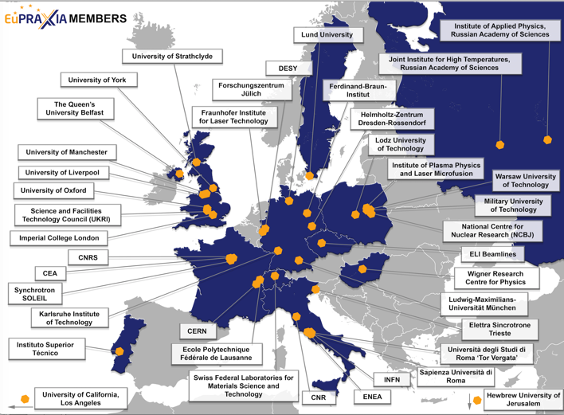
ESFRI Proposal: Financial and Political Support
EuPRAXIA strongly supported in European research landscape, it is timely, it offers highly attractive opportunities for innovation with industry, novel applications and pilot users.
Lead Country: Italy (LNF/INFN)
Political and financial support letter sent to ESFRI by Italian Ministry
Political support letters (at least two needed from countries):
  Hungary
  Portugal
  Czech Republic (ELI beamlines)
  UK
Note: All operational costs covered by host countries.
From political + scientific landscape it is seen that both Czech Republic and UK would be excellent sites for the second leg of EuPRAXIA, connecting to existing facilities with laser expertise, users and few 100 million € pre-invest.

Slide 26
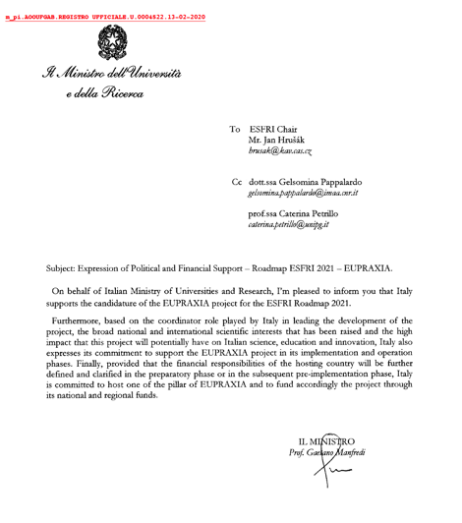
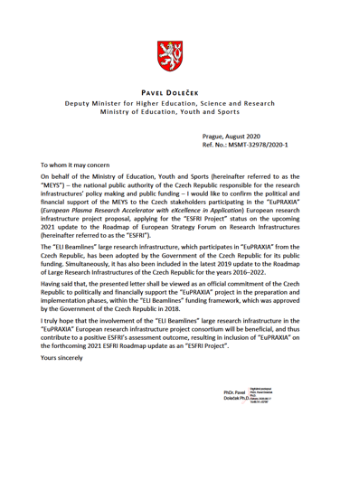
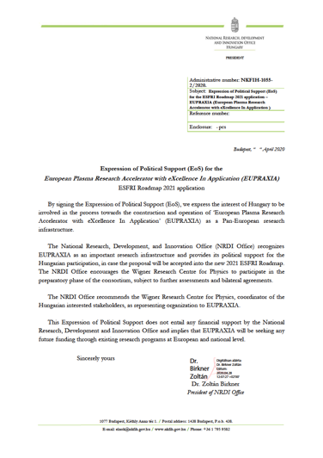

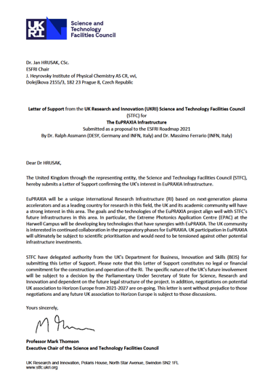
Government Support Letters
Italy Czech Republic Hungary Portugal United Kingdom
plus 32 non-governmental support letters

Slide 27
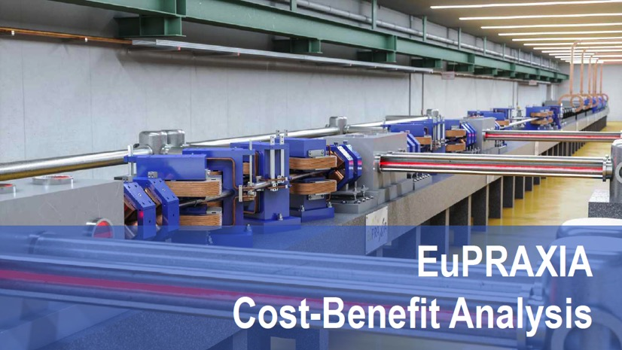
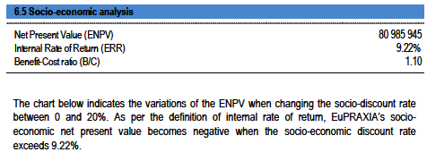
Budget Overview and Cost-Benefit Analysis
(all prepared according to ESFRI and EU rules)
Project duration | 10 years
Full cost (including manpower, past CDR cost and termination cost) | 569 M€
Cost of Phase I (including manpower and past CDR cost) | 388 M€
Operational cost | 30 M€/y
Internal rate of return | 9.22 %
Start of pilot operation | 2028
Funding secured (status 11/2020) | 118 M€ (21 % of full cost)
OP budget secured (status 11/2020) | 9 M€/y (30 %)
89 pages
Return rate found in cost-benefit analysis shows the expected gain of the sustained EuPRAXIA investment also in economical terms. Credits to our consultant F. Brottrier.

Slide 28
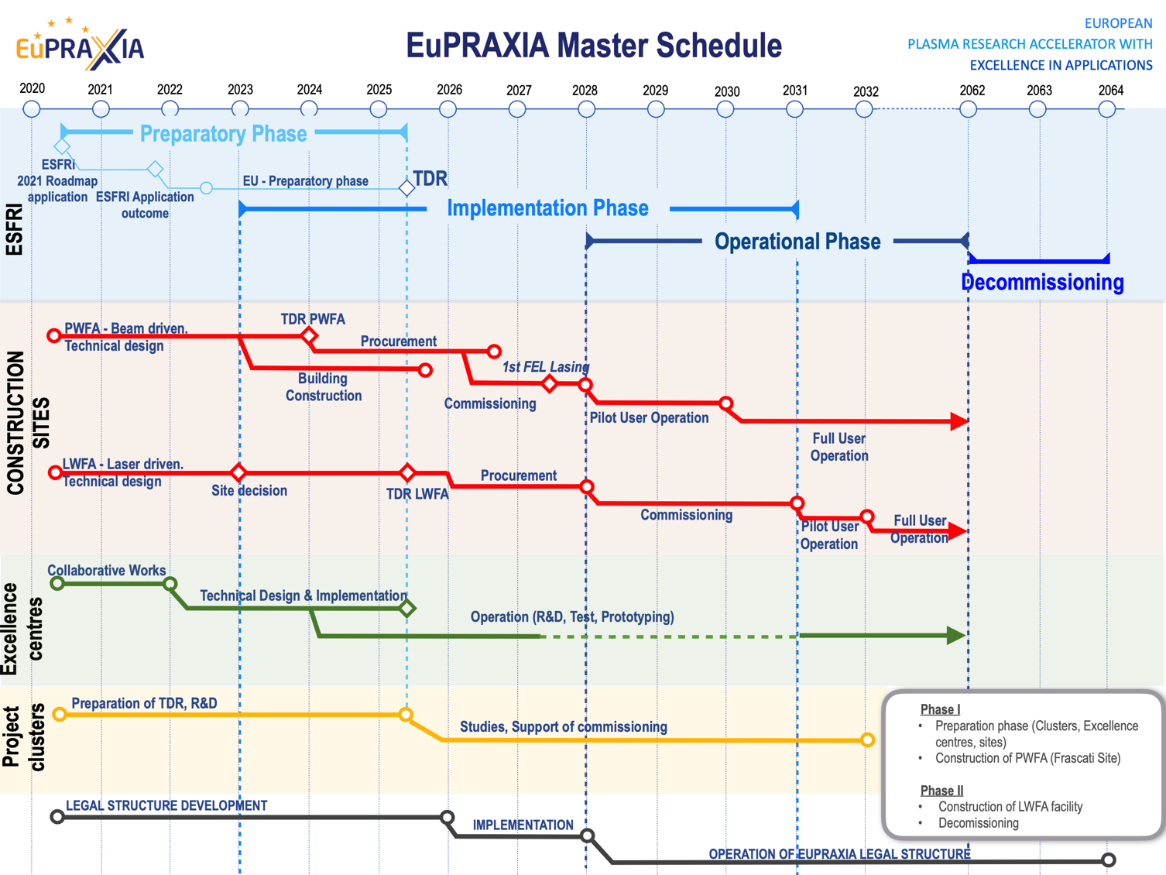
EuPRAXIA Schedule
European World-Class RI on compact accelerators for the end of the 2020‘s to the beginning of the 2060‘s
More detail in Master Schedule

Slide 29
Organization

Slide 30
Concept Distributed Research Infrastructure

Slide 31
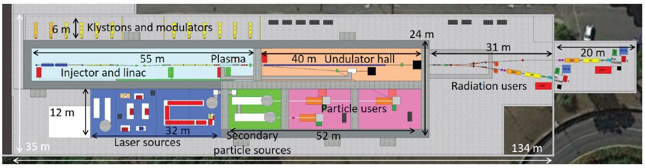
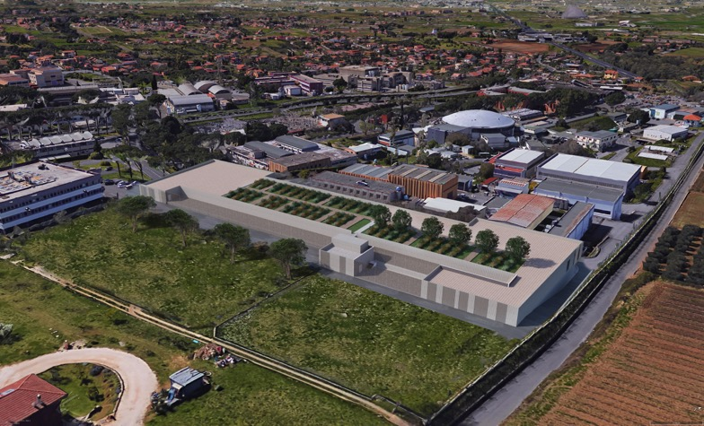
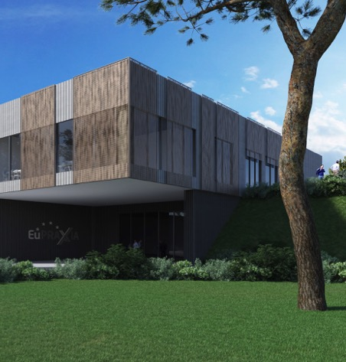

Started: Setup of EuPRAXIA Facility (EuPRAXIA@SPARC_lab) at Frascati
EuPRAXIA will combines compact X band RF technology from CLIC (see talk S. Stapnes) and the plasma accelerator at its Frascati construction site (see talk M. Ferrario)! Brings confidence and excellent synergy with international linear collider efforts!
The executive design of the building has officially started few weeks ago, the delivery of the design is expected in November 2020.
Multiple users from different fields:
studying and understanding bacteria, viruses, materials, ...
using intense bursts of photons, electrons, positrons resolving time-dependent processes in ultra-fast science
co-developing novel technologies for accelerators, users, ...

Slide 32
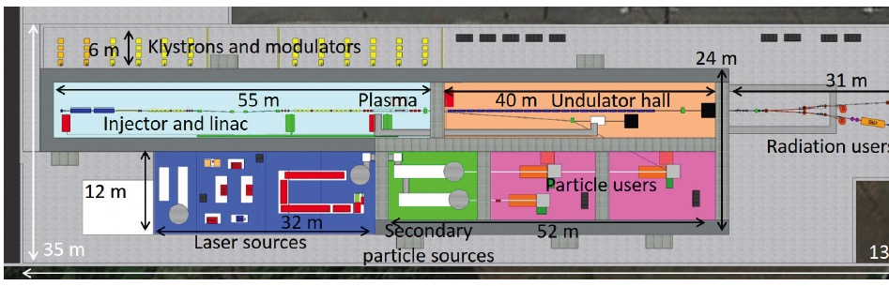
The EuPRAXIA Construction Site at Frascati
Multiple users from different fields: studying and understanding bacteria, viruses, materials, ...
using intense bursts of photons, electrons, positrons
resolving time-dependent processes in ultra-fast science
co-developing novel technologies for accelerators, users, ...

Slide 33
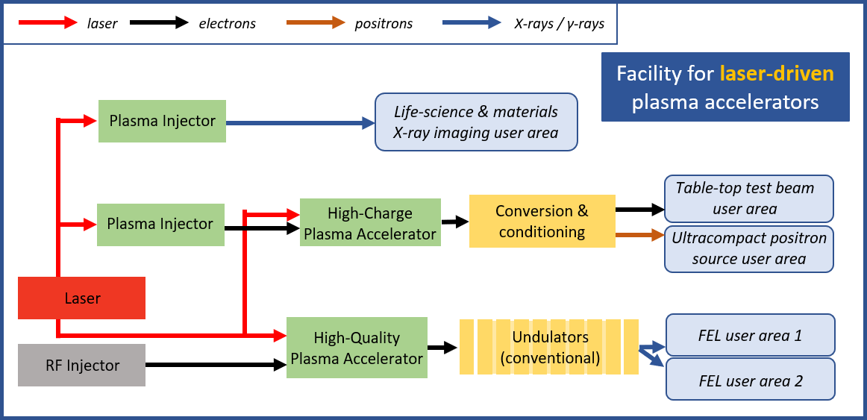
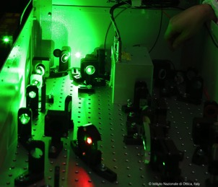
The Laser-Driven EuPRAXIA Construction Site (to be decided in Technical Design Phase)
Free-electron laser
Life-science & materials X-ray imaging (betatron source)
Ultracompact positron source
Table-top test beams
THREE HIGH-POWER LASER SYSTEMS
Wavelength | Energy on target | Pulse duration | Repetition rate
800 nm | 5 – 100 J | ≥ 20 – 60 fs | 20 – 100 Hz

Slide 34
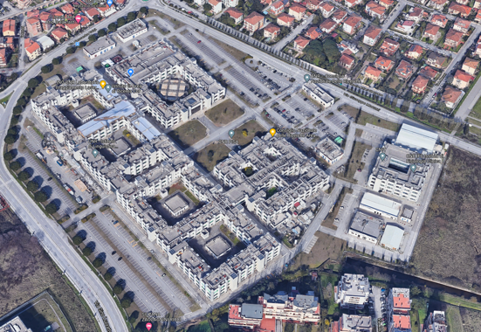
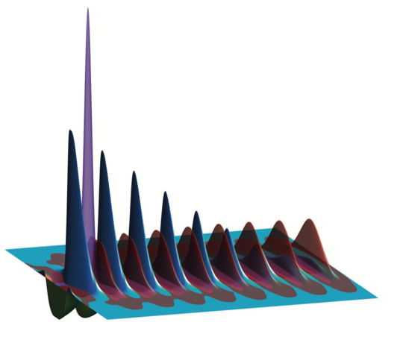




EuPRAXIA Laser-Driven Site Option CNR
Preparation of the EuPRAXIA laser-driven site option at the CNR Campus in Pisa
Builds on experience running the existing facility including a >200 TW laser driver for electron and proton beamlines currently active;
Part of the National roadmap for Extreme Light Infrastructure, and founding participant to ELI along with INFN and Elettra ST;
Currently engaging R&D on key EuPRAXIA pillars:
  High average power laser development as efficient and reliable drivers
  Validation of novel schemes for FEL quality laser-driven acceleration
  Multi-disciplinary user operation at beamlines
Currently promoting EuPRAXIA laser-driven site option at National and Regional levels;
Strong focus on bio-medical uses of laser-driven sources for pre-clinical and clinical studies are motivating growing collaborations.
ESFRI listing of EuPRAXIA will boost all related developments and innovation.

Slide 35
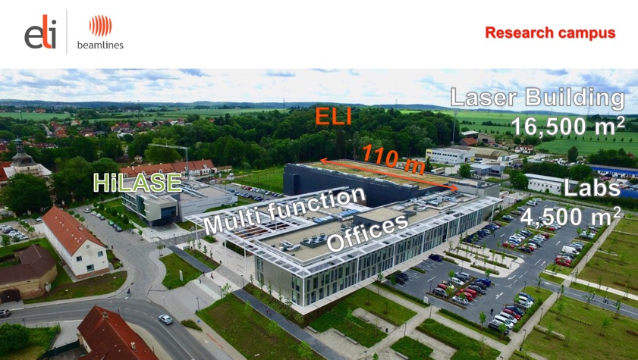
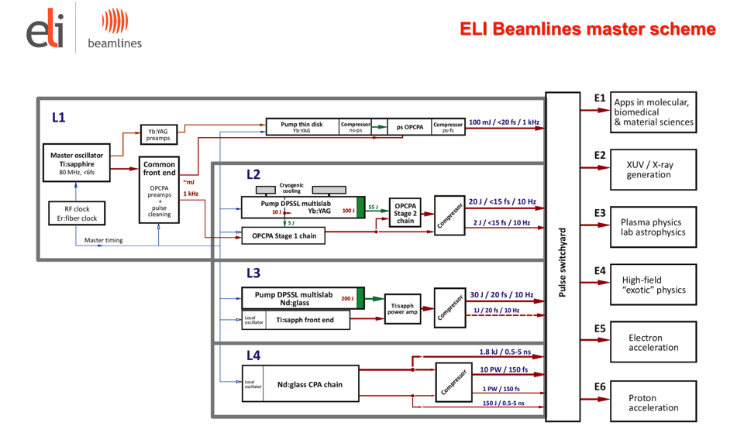
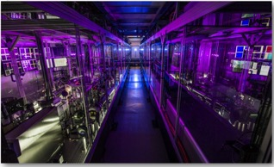


ELI-Beamlines
L3 in ELI-Beamlines

Slide 36





ELI-Beamlines: Compact X-FEL Development
From incoherent to coherent undulator X-ray source
for users
Under preparation in E5 experimental hall
‘First L3-laser light’ in E5-LUIS → March 2021
‘Swiss-FEL’ type of undulator

Slide 37













Excellence Center for Laser Acceleration and FEL
3 French institutions have signed the EuPRAXIA Consortium Agreement : CNRS, CEA and Soleil
French contribution is structured around 2 main facilities and projects
LAPLACE
development of LPA and their applications
  high repetition rate (≥100Hz) LPA sources development
  FEL LPA-driven development, robust high quality beam LPA development (SOLEIL/LOA)
PALLAS
10 Hz, 150 MeV laser-plasma injector (LPI) test facility devoted to:
  advanced online control of LPI
  plasma target development for high beam beam quality
  beam transport for staging
In addition the following CNRS labs contribute to EuPRAXIA clusters
: multi-PW driven LPA experimental demonstration at APOLLON, applications to HEP and other field, beam diagnostics
and compact beam transport, and theory simulations and continuous development of PIC code
: new advanced laser technology development : Compressor, intensity stabilization, focal spot alignment stabilization, amplification stage, beam transport + bring benefit from its close links with the laser industrials partners to ensure the economic feasibility.
: R&D of optimised LPI in tailored plasma density profile and of specific plasma components,
based on novel discharge schemes or laser ionised plasmas, suitable for laser guiding over large propagation distances and experimental tests.

Slide 38






Participations to EuPRAXIA:
Theory and simulations
Integrated laser-plasma experiments on UHI 100
Design and fabrication of transport lines
Design and fabrication of laser and particle diagnostics

Slide 39


Plasma theory and simulations excellence center
Long tradition in developing plasma simulation tools in Portugal
Instituto Superior Técnico (IST) is the largest science&engineering school in Portugal
Concept: collaboratorium
  Platform for coordination, collaboration, scientific and technical exchange.
  Lead coordination efforts for code development and integration
  Front end for the EU exascale initiatives in plasma accelerators
  Hub for new and disruptive ideas, to explore future directions of facility.
Main goals
  Simulation and theory support for EuPRAXIA teams involved in computing
  Coordinate virtual interactions in EuPRAXIA in theory and simulations
  Visiting/workshop program on plasma accelerators (advanced
  trainning, convene PhD students, Post-Docs and senior researchers.
ZPIC
Osiris in the world

Slide 40

Main goals
Portugal has a long tradition in developing plasma computing tools
  Osiris – flagship plasma accelerator simulation tool
  Zpic – open source, plasma simulation educational toolkit
Instituto Superior Técnico
  Largest science&engineering school in Portugal (11500 students, 850 staff, 3 campii)
  Attracts top students in science and engineering
Excellence center - structure
  Site director, 1-2 admin, 3-5 computational scientists, inc.visualisation experts, 1 outreach/communication officer
  Strong connection with national and Iberian supercomputing infrastructures
  Visiting/workshop program on plasma accelerators (advanced trainning, convene students and researchers)
Osiris runs in the largest supercomputers worldwide. Above is Sequoia supercompter (LLNL) > 1 million cores.

Slide 41
Excellence Center for Laser Acceleration and FEL
3 French institutions have signed the EuPRAXIA Consortium Agreement : CNRS, CEA and Soleil
French contribution is structured around 2 main facilities and projects
LAPLACE
development of LPA and their applications
  high repetition rate (≥100Hz) LPA sources development
  FEL LPA-driven development, robust high quality beam LPA development (SOLEIL/LOA)
PALLAS
10 Hz, 150 MeV laser-plasma injector (LPI) test facility devoted to:
  advanced online control of LPI
  plasma target development for high beam beam quality
  beam transport for staging
In addition the following CNRS labs contribute to EuPRAXIA clusters
: multi-PW driven LPA experimental demonstration at APOLLON, applications to HEP and other field, beam diagnostics
and compact beam transport, and theory simulations and continuous development of PIC code
: new advanced laser technology development : Compressor, intensity stabilization, focal spot alignment stabilization, amplification stage, beam transport + bring benefit from its close links with the laser industrials partners to ensure the economic feasibility.
: R&D of optimised LPI in tailored plasma density profile and of specific plasma components,
based on novel discharge schemes or laser ionised plasmas, suitable for laser guiding over large propagation distances and experimental tests.

Slide 42
Participations to EuPRAXIA:
Theory and simulations
Integrated laser-plasma experiments on UHI 100
Design and fabrication of transport lines
Design and fabrication of laser and particle diagnostics

Slide 43















UK contributions to EuPRAXIA
Primary contribution through Excellence Centre (in CDR)
Prototyping & Delivery of Application Beamlines (Betatron, high-& low-energy positrons, Gamma, Compton..): 91,570 k€
Individual contributions from institutions to different clusters
Coordinated by UK’s Plasma Wakefield Accelerator Steering Committee (PWASC)
PWASC
Potential Additional Contributions from the UK (through additional funding)
Part 1: A LWFA-based user facility in EPAC for applications in 2024
Part 2: A EuPRAXIA-driven technology development programme towards plasma-based X-FEL-ready beams
High-rep rate (>100Hz), high-brightness, high-quality beams for plasma-based X-FELs

Slide 44













@ EPAC
See talk on EPAC project by R. Pattahil
A potential flagship international research facility for propelling laser-driven plasma accelerators to transformative real-world applications
A distributed Infrastructure Proposal to combine EPAC with EuPRAXIA, for establishing the laser-driven arm of EuPRAXIA in the UK
First phase: developing EuPRAXIA-beamlines in collaboration with Universities and Accelerator institutes: £59M
Develop a 100Hz laser driver (technology development program exists already)
In the second phase (post-2024), expand the EPAC building to house the additional beamlines for EuPRAXIA
TIFR-EPIC
PWASC
Infrastructure proposal submitted to UKRI
Slide from R. Pattahil et al

Slide 45



EuPRAXIA @ EPAC
See talk on EPAC project by R. Pattahil
EPAC’s spec (PW@10Hz) is very close to EuPRAXIA baseline (PW@20Hz)
A dedicated facility for LWFA applications – hitting several EuPRAXIA milestones
EPAC will be operational in 2024 – during EuPRAXIA construction period
With EU funding, this could be a de-risking option for EuPRAXIA: technological & facility operations

Slide 46


Excellence Centre for Plasma Accelerators and High Repetition Rate Developments at DESY
Plasma accelerators at DESY are progressing toward
high beam quality, high average power, and applications
Ongoing technology R&D will be important
for integration at EuPRAXIA
Key DESY facilities involved
  FLASHForward‣‣: 10 kW, 1.2 GeV FEL-quality electron drive beam, user-facility-grade feedbacks, and advanced diagnostics
  KALDERA: kHz, kW drive laser and laser-plasma accelerator, accelerator-grade control-system integration, and stability systems
Research targeted at beam-quality conservation, high efficiency, high avg. power, stability, intelligent controls,
and applicability
10-year development roadmap in place
Wakefield Sampling
S.Schröder et al., accepted, Nat. Commun. (2020)
24-hour Operation
A.R.Maier et al., Phys. Rev. X 10, 031039 (2020)
See talk by C. Lindstrom
For further information, please contact jens.osterhoff@desy.de

Slide 47


Hungarian user’s interests
Institute of Physics:
The group has leading role in the high-field THz generation by optical rectification. Near single cycle THz pulses with well controlled waveform can be generated at the 0.3-0.7 THz frequency range. The pulses have excellent focusability and around 0.5 MV/cm field strength is available. Using the setups newly proposed by the group, even higher ~10 MV/cm electric field will be available in the near future. These pulses could be used for streaking and other dynamic manipulation of electrons. The group owns US patents for manipulating charged particles with terahertz radiation.
J. Hebling et al., Opt. Express 10(21), 1161–1166 (2002), L. Pálfalvi et al., Opt. Express 25(24), 29560–29573 (2017), Gy. Tóth et al., Opt. Express 27(21), 30681-30691 (2019)
Interest: Carrier-envelope-phase (CEP) stable attosecond pulse generation:
Generation of extreme ultraviolet pulses with attosecond duration is nowadays routinely possible by high-order harmonic generation. However, a precise waveform control is difficult with this technique. Therefore, we proposed a device for producing CEP controlled single-cycle attosecond pulses in the EUV–VUV spectral range, which utilizes a LINAC or laser-plasma-based electron accelerator (the optimum electron energy is 1-2 GeV), a modulator undulator, and a radiator undulator. The waveform of the attosecond pulses can be engineered by the choice of the magnetic field distribution in the radiator undulator. Generation of both linearly and circularly polarized single-cycle attosecond pulses with up to 60 nJ energy and 90–400 attosecond duration in the 30–120 nm wavelength range are predicted by numerical simulation. We would like to perform proof-of-principle experiment in the EuPraxia project.
Z. Tibai et al., Phys. Rev. Lett. 113, 104801 (2014) (basic consideration)
Z. Tibai et al., Frontiers in Phys., 6, 140, (2018) (detailed numerical investigation)
Gy Tóth et al., JOSA B, 35(5), A103 (2018) (extension of the technique for producing
circularly polarized pulses)
Z. Tibai et al., Applied Physics B, 124, 113 (2018) (laser plasma accelerator based electron source)
Slide from I. Barna et al

Slide 48

Hungarian user’s interests
University of Szeged, Department of Oncotherapy:
The department has gained expertise in cancer treatment based on different types of radiation therapies, including novel approaches under clinical evaluations, e.g. hadron therapy, mixed energy radiotherapy or immuno-radiotherapy. It is also committed in testing and developing novel approaches under preclinical evaluations, like FLASH-Radiotherapy (FLASH-RT), Microbeam Radiation Therapy (MRT) for example, shows promising results in minimizing the side effects of radiotherapy, i. e. it lets the applied dose to be increased drastically without the patient having post-treatment complications. A 17 Gy conventional irradiation induced pulmonary fibrosis in 100% of the animals 24-36 weeks post-treatment, whereas no animal developed complications below 23 Gy flash RT. The FAST-01 (FeAsibility Study of FLASH Radiotherapy for the Treatment of Symptomatic Bone Metastases) clinical study was launched 12. Oct 2020.
Synchrotron-based MRT composed of spatially fractionated, planar x-ray (50-600keV) 25-75 micron-wide beams, with a very sharp penumbra, separated by a distance several times of their beam width. These microbeams create unique dose profiles of alternating peaks and valleys with high peak-to-valley-dose-ratios (PVDR). They can be produced in highly brilliant synchrotron sources and are characterised with very small beam divergence and extremely high dose rate, >100 Gy/s.
Favaudon V, Fouillade C, Vozenin MC Ultrahigh dose-rate, "flash" irradiation minimizes the side-effects of radiotherapy] Cancer Radiother. 2015 Oct;19(6-7):526-31
M.-C. Vozenin, P. De Fornel, K. Petersson, V. Favaudon, et al The advantage of FLASH radiotherapy confirmed in mini-pig and cat-cancer patients Clin Cancer Res 2018
Bourhis J, Sozzi WJ, Jorge PG, Gaide O, Bailat C, Duclos F, et al. Treatment of a first patient with FLASH-radiotherapy. Radiother Oncol 2019; 139: 18–22.
Zhang et al. Expert Rev Anticancer Ther. 2015 December
Interests:
Laser driven VHEE (Very High Energy Electron beams) can produce compton and betatron photons that are feasible for MRT. Ultraintense beam and ultrashort dose delivery results in short treatment time, and in general, in a treatment without increased entrance (skin) dose. There is no need for internal organ motion management. Since the EuPRAXIA electron beams make accessible high temporal and spatial resolution, the instrument would be ideal to perform immuno-RT, FLASH-RT and MRT treatments. In vivo an in vitro proof-of-principle experiments in MRT therapy.
Slide from I. Barna et al

Slide 49


2020 Update of European Strategy for Particle Physics
Update had input from the European Network for Novel Accelerators (EuroNNAc), EuPRAXIA, ALEGRO, AWAKE, ... on novel accelerators.
EuPRAXIA is a Europe-wide coordinated project and in itself is a deliverable for this decade.

Slide 50
First Feedback from EU
We are glad to inform you that, following ESFRI internal procedures, the proposal “European Plasma Research Accelerator with Excellence in Applications - EuPRAXIA” has been considered eligible and can now be assessed for entering the ESFRI Roadmap 2021.
The evaluation exercise has just started and below you can find the next steps with an indicative timeframe:
Invitation for the hearing with list of critical questions: February-March 2021
Hearing: April-May 2021

Slide 51
Some Quotes from Support Letters
(from 32 non-governmental support letters)
“...a fantastic opportunity for the regional scientific development as it would provide state-of-the-art facilities for education and training of the young community...” (TIARA)
“...truly European project that realizes a major competitive advantage, strong scientific impact, and important societal benefits.” (LEAPS)
“...is timely and has an extremely high potential for strengthening the European position in a world-wide highly competitive landscape.” (Thales)
“...tackles the need for compact and cost-effective particle and radiation sources for research and industry, as not yet addressed elsewhere at a European level.” (AVS)
Many thanks to all our supporters from local government, interest organizations, industry, universities and research organizations! This is extremely encouraging and valuable support!
It supports our view that there can be a very strong societal impact of such a European infrastructure on compact plasma accelerators!

Slide 52

Thank you
Many thanks to I. Barna, P. Campana, K. Cassou, B. Cros, A. Falone, A. Ferran Pousa, M. Ferrario, L. Gizzi, A.Molodozhentsev, P. Nghie, J. Osterhoff, R. Pattahil, A. Specka, J. Viera for help with the preparation of this talk, provision of slides and material..
Many apologies to my colleagues and the many outstanding results, contributions and infrastructures I could not mention today!
Many thanks to our consortium members and involved management for their untiring support to EuPRAXIA and help to form the new consortium!
Special thanks to P. Campana, A. Zoccoli, L. Silva, J. Viera, G. Korn, R. Hvezda, P. Levai, R. Pattahil, M. Thomson for help on obtaining the governmental support letters .
Special thanks to Maria Weikum, Massimo Ferrario, Pierluigi Campana, Antonio Falone and Franck Brottier for the ESFRI roadmap application support.

Slide 53
Reserve Slides

Slide 55









EuPRAXIA Parameter & Performance Tables
http://www.eupraxia-project.eu/

Slide 56

EuPRAXIA as European Open Innovation Facility

Slide 57


EuPRAXIA User Survey (before Corona)
Survey with responses from 30 groups with a total of more than 1,000 researchers, expressing interest in performing research at the EuPRAXIA facility.

Slide 58

Result EuPRAXIA User Survey (before Corona)

Slide 59
EuPRAXIA Deliverables and User Interests
EuPRAXIA is designed to deliver at 10-100 Hz ultra-short pulses of
Electrons (0.1-5 GeV, 30 pC)
Positrons (0.5-10 MeV, 10⁶)
Positrons (GeV source)
Lasers (100 J, 50 fs, 10-100 Hz)
Betatron X rays (5-18 keV, 10¹⁰)
FEL light (0.2-36 nm, 10⁹-10¹³)
Expressions of interest from 95 research groups representing several thousand scientists in total.

Slide 60

Backup: Invest Cost Split for ESFRI
Cost Breakdown for Preparation & Implementation | Investment cost (excl. contingencies, payroll)
Laser-driven plasma acceleration site | 148 M€
Beam-driven plasma acceleration site | 141 M€
Excellence Centres | 41.5 M€
Laser prototyping (Clusters) | 38.5 M€
Plasma prototyping (Clusters) | 7.3 M€
Applications prototyping (Clusters) | 25.7 M€
Other prototyping (Clusters) | 26.7 M€
Central EU Project Office | 0.8 M€
Total | 429.5 M€

Slide 61



Estimated Full Costs (2015 – 2031)
Estimated costs include the CDR cost, the termination costs and operating costs. See above.
Those are full costs, as required for the ESFRI application!

Slide 62


Coverage Real and Estimated Costs (2015 – 2031)
Presently funded: 21 % of the full project cost, mainly through Italy.
Supporting documents (government budget decree and INFN letter) submitted to ESFRI.

Slide 63

Budget + Schedule → Cost – Benefits Analysis (89 Pages)
Credits to F. Brottier who led this analysis.

Slide 64
Planning
Next steps:
Pushing ahead with implementation of 1st phase of EuPRAXIA at LNF (EuPRAXIA@SPARC_lab)
Answer ESFRI committee questions
Defend in ESFRI hearing
Outcome: Summer 2021?!
If successful: Apply for PP EU Project
In parallel: Moving EuPRAXIA coordination from DESY to INFN

Slide 65






LASER DRIVER TECHNOLOGY
Laser-driven plasma acceleration needs ultrashort, high power lasers with high average power
Available solution: ≈ kW/PW/kHz rep. rate with Ti:Sa technology, pumped by diode-pumped solid state (DPSSL)
  major industrial and research endeavour in place;
  3-5 years to go to first LWFA demonstrator (e.g. Eupraxia)
New technology for higher efficiency and rep. rate beyond kHz stability;
  Fiber lasers with coherent combination;
  Direct Chirped Pulse Amplification with novel lasing media;
    E.g. Thulium based materials, promising;
  5-10 yrs for first efficient, multi-kW-scale demonstrator,
  A strategy is needed to steer effort.
  IFAST project just funded:
    Task on “Lasers for Plasma Acceleration (LASPLA)”
      Roadmap to foster delivery of advanced industrial laser drivers with high-repetition rate and higher efficiency, for the first user plasma-based accelerator.
      Coordination activity with networking and training of main laser labs, focused on laser-driver R&D.

