Slide 1
An Update on
High Energy Plasma Based Injector for CEPC
Wei Lu
Tsinghua University
On behalf the IHEP-THU-BNU AARG team
Jan 14, 2021
Mini-workshop on Accelerator: Plasma Acceleration
IAS Program on High Energy Physics 2021

Slide 2
Outline
Background: CEPC/CEPC plasma injector
Preliminary Design v2
Current status: Physics and experiments
Outlook: Future experiments

Slide 3
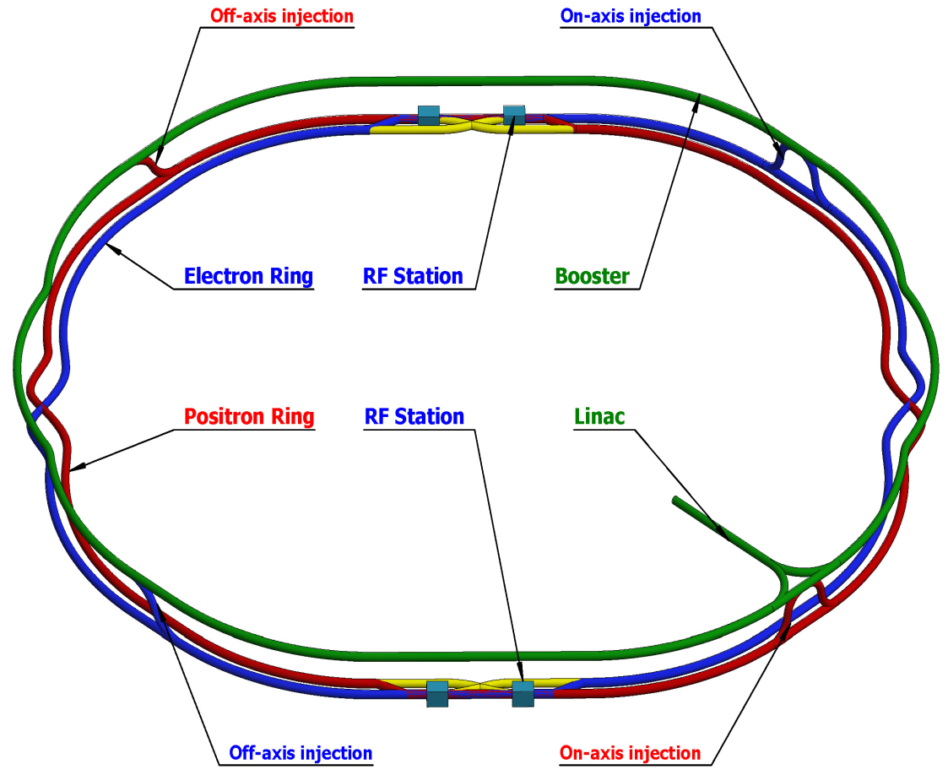
Background: CEPC
CDR (Acc.) International Review @ 2018.6.28-6.30 & Final Released @ 2018.9.2
3

Slide 4
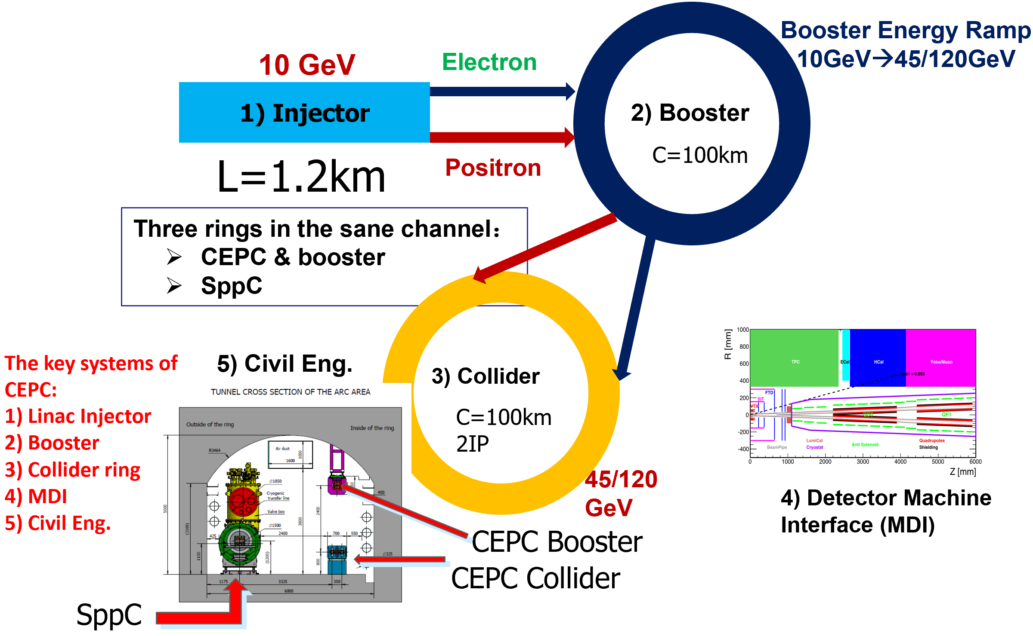
CEPC Accelerator System
LOW FIELD DIPOLE PROBLEM!！
4

Slide 5
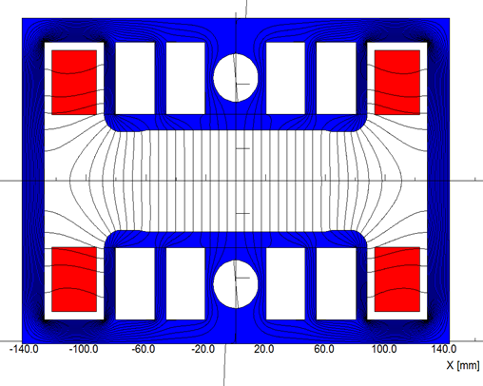
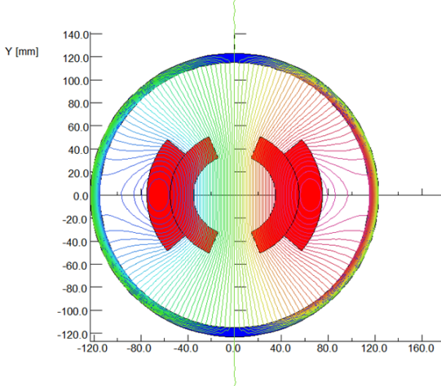
CEPC Low field Dipole in Booster Ring
Can we using a 10m scale plasma accelerator to boost the energy of the injector to about 45GeV?
Challenges:
Solutions in CDR
With magnetic core (better material)
Without magnetic core
(Twice excitation current)
Field error <29Gs*0.1%=0.029Gs → how to design
Field reproducibility <29Gs*0.05%=0.015Gs → how to measure
The Earth field ~0.2-0.5 Gs, the remnant field of silicon steel lamination ~ 4-6 Gs.
Thinking beyond CDR
Nominal field error: ~0.1%
Uniformity requirement: ~0.05%
Eddy current effect
- Sextupole coils outside vacuum chamber
5

Slide 6
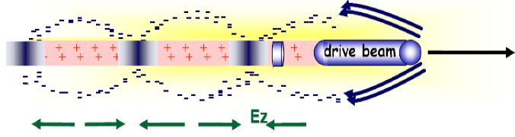
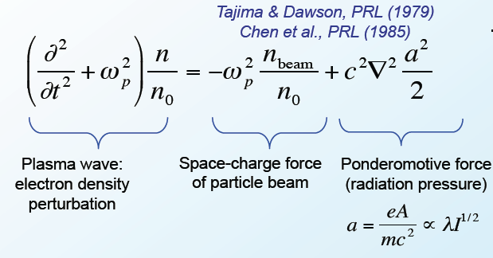
Plasma-based wakefield acceleration
Drive Beam:
laser pulse
e- bunch
proton beam
…………
Plasma wave excitation
>10GeV/m acceleration
6

Slide 7
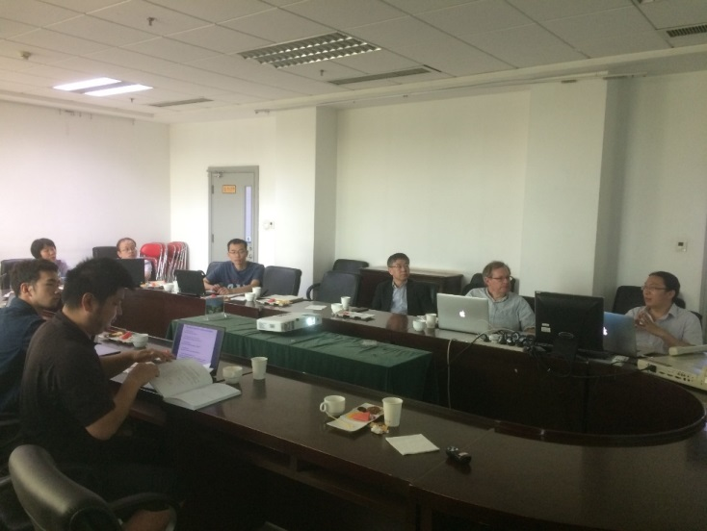
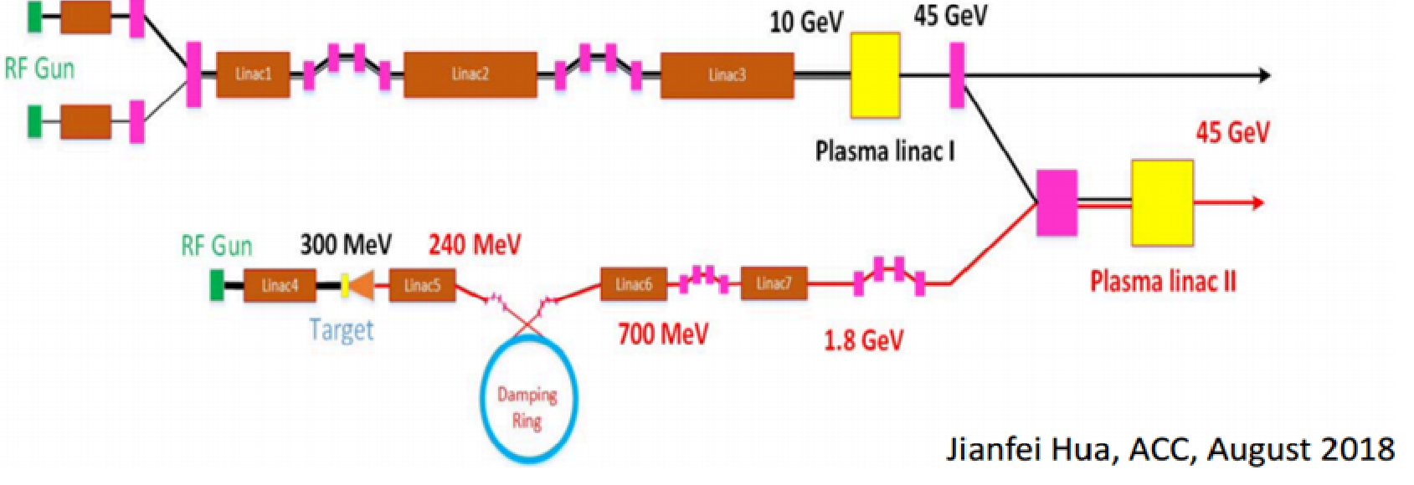
CEPC plasma injector & THU-IHEP AARG
IHEP-THU joint group on Advanced Accelerator Research
  Foundation：March 2017
  THU Member：Wei Lu, Jianfei Hua, Shiyu Zhou, Yue Ma, Shuang Liu, Bo Peng, ……
  IHEP Member：Jie Gao, Dazhang Li, Guan Shu, Cai Meng, Dou Wang, Jingru Zhang, Xiaoning Wang ……
CEPC Plasma Injector V1.0
7

Slide 8
Outline
Background: CEPC/CEPC plasma injector
Preliminary Design v2
Current status: Physics and experiments
Outlook: Future experiments

Slide 9
CEPC Plasma Injector/Overall Goal
Working out a conclusion on the feasibility of plasma injector for 45GeV energy.
If feasible, presenting a technology design with as much as possible details.
Meantime, also working on the feasibility study of a full energy plasma injector at 120-180GeV
Key Issue to address：
  Driver/ Trailer design：large charge(10+ nC) shaped bunch generation
  Plasma source：meter-10meter scale uniform/hollow plasma source
  High transformer ratio high efficiency electron acceleration
  Stable high efficiency positron acceleration in electron beam driven PWFA
  Staging between different accelerators
9

Slide 10
CEPC Project timelines
10

Slide 11
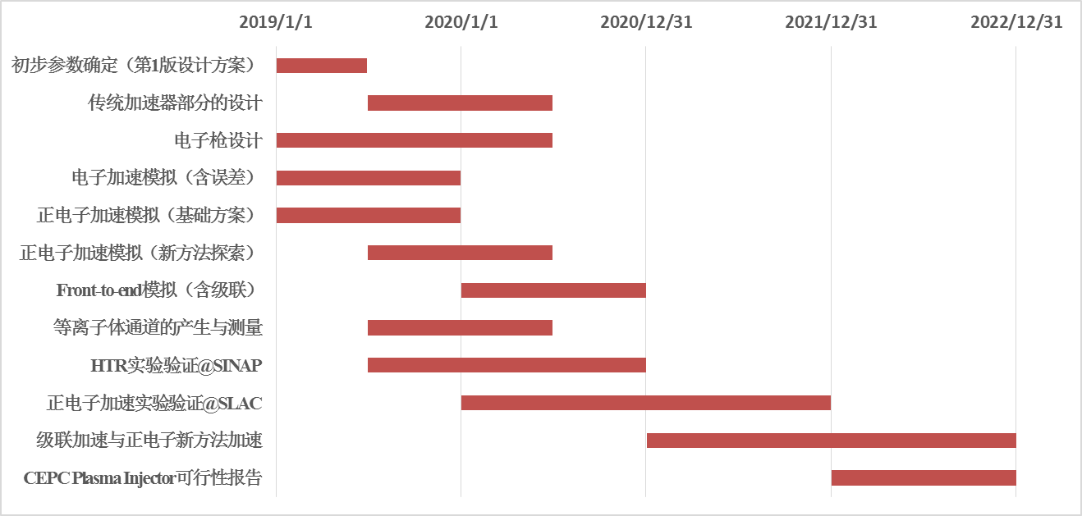
CEPC plasma injector timeline
11

Slide 12
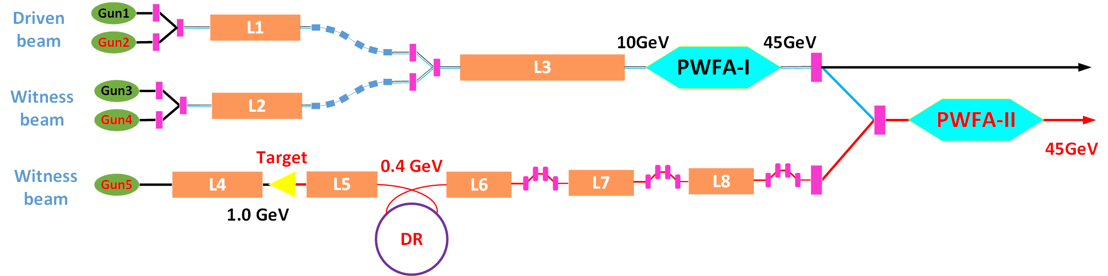
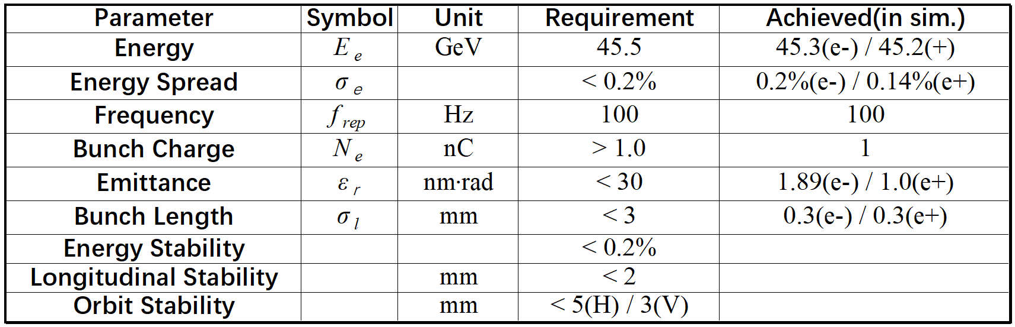
CEPC plasma injector concept design（V2.0）
12

Slide 13
Outline
Background: CEPC/CEPC plasma injector
Preliminary Design v2
Current status: Physics and Technology
Outlook: Future experiments

Slide 14
Key Physics and Technology
Electron Acceleration
  High transformer Ratio，High efficiency, Stability
Positron Acceleration
  Stable acceleration (different schemes)，energy spread control，efficiency enhancement……
Conventional Accelerator design and optimization
  Photon-guns、Linac、Positron generation and damping ring……
Beam manipulations:
  dechirper，external injection，staging and cascading ……
14

Slide 15
I. Electron Acceleration
Goal：Stable High Transformer ratio Acceleration ( 3-4)
To Do：more realistic simulations, experimental demonstration, scaling verification
Tech：
  High fidelity 3D simulations with real parameters, tolerance analysis
  Cross-checking between different codes, combining PIC with beam line dynamics simulations
  Experimental verification on Tsinghua and SXFEL facilities, and scaling test
  FACET-II high charge experimental test
How to Check：
  Finishing front-to-end simulations, code cross-checking, tolerance analysis
  Preliminary experimental results from Tsinghua and SXFEL facilities
  Collaboration on FACET-II High energy High charge experiments
Expecting timeline：1）2021.12；2）2021.12；3）2022.12？
15

Slide 16
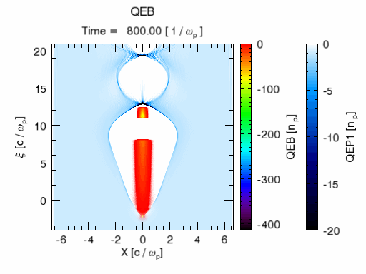
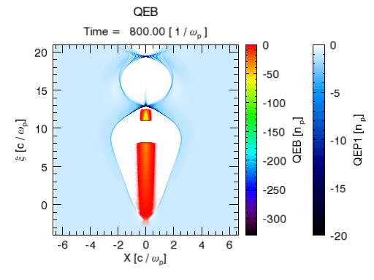
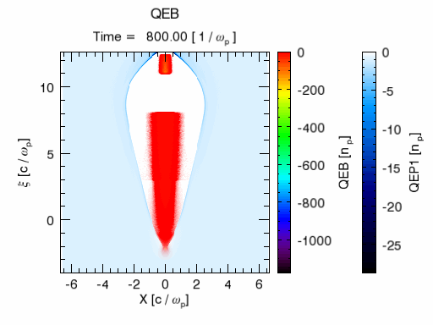
High TR Electron Acceleration:
tolerance check
Without tilt, perfect injection
With 1μm tilt
With 1μm tilt, wide beam
16

Slide 17
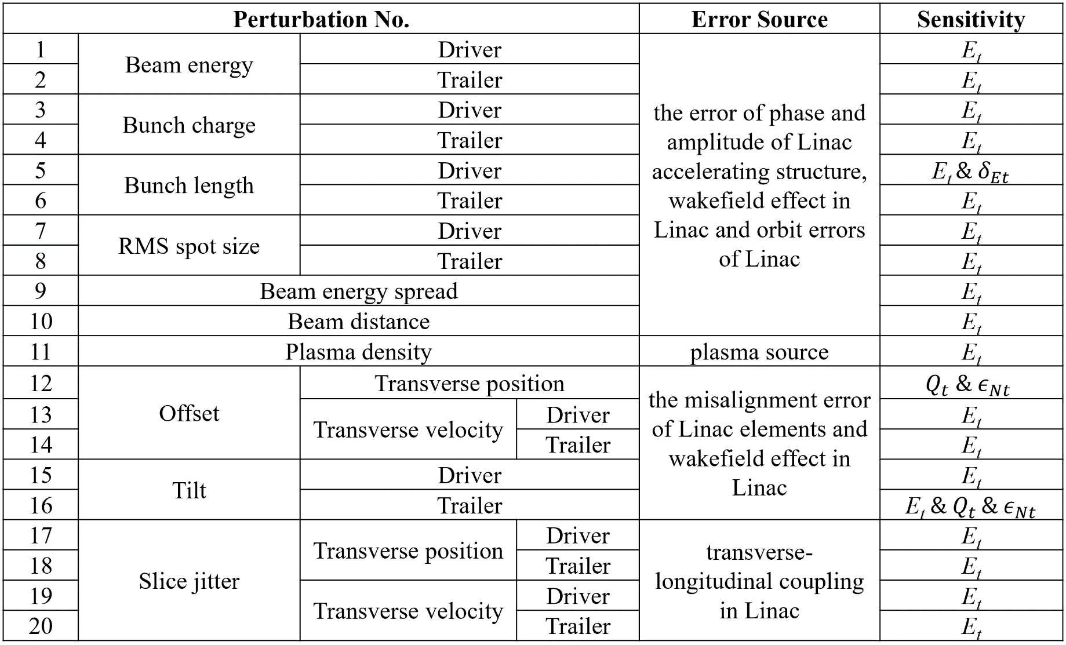
Tolerance analysis for HTR e- acc.
17

Slide 18
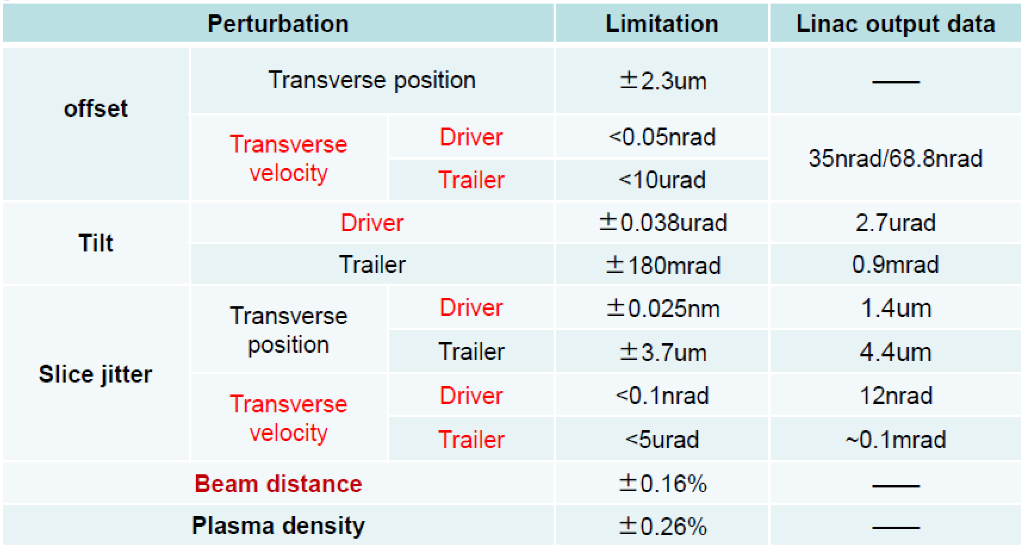
Error analysis for HTR e- acc.
On going process
See Dr. Xiaoning Wang’s talk
18

Slide 19
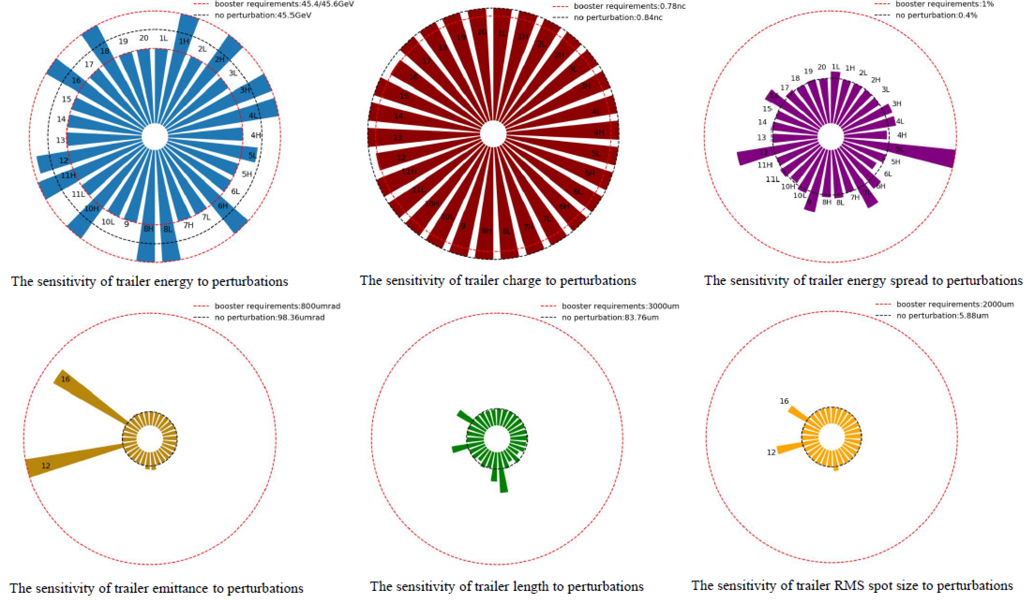
Error analysis for HTR e- acc.
19

Slide 20
II. Positron Acceleration
Goal：Stable high efficiency positron acceleration in an electron beam driven PWFA ( with low energy spread)
To Do：check the feasibility of three (or more) possible schemes, stability and parameter tolerance
Tech：
  High fidelity 3D simulations with real parameters for three schemes, tolerance analysis
  Explore new possible schemes
  Experimental verification on Tsinghua and SXFEL facilities for stable possible acceleration modes
  Collaboration on FACET-II positron experiments
How to Check：
  Finishing front-to-end simulations, code cross-checking, tolerance analysis
  Preliminary experimental results from Tsinghua and SXFEL facilities
  Collaboration on FACET-II positron experiments
Expecting timeline：1）2021.12；2）2022.06；3）2022.12？
20

Slide 21
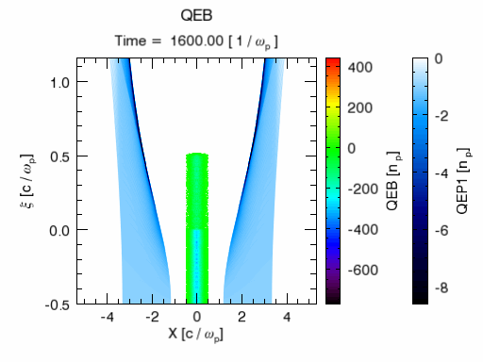
Positron Acceleration Scheme 1 (in CDR)
e-, shaped
2nC, 45GeV
Hollow Plasma Channel
e+
1nC, 45GeV
e+
1.2nC, 2/4GeV
High efficiency 60%
Low energy spread ~0.5%
Small emmitance growth
Tight tolerance on injection parameters to control transverse instability （beam tilt or offset ~ 0.1μm）
21

Slide 22
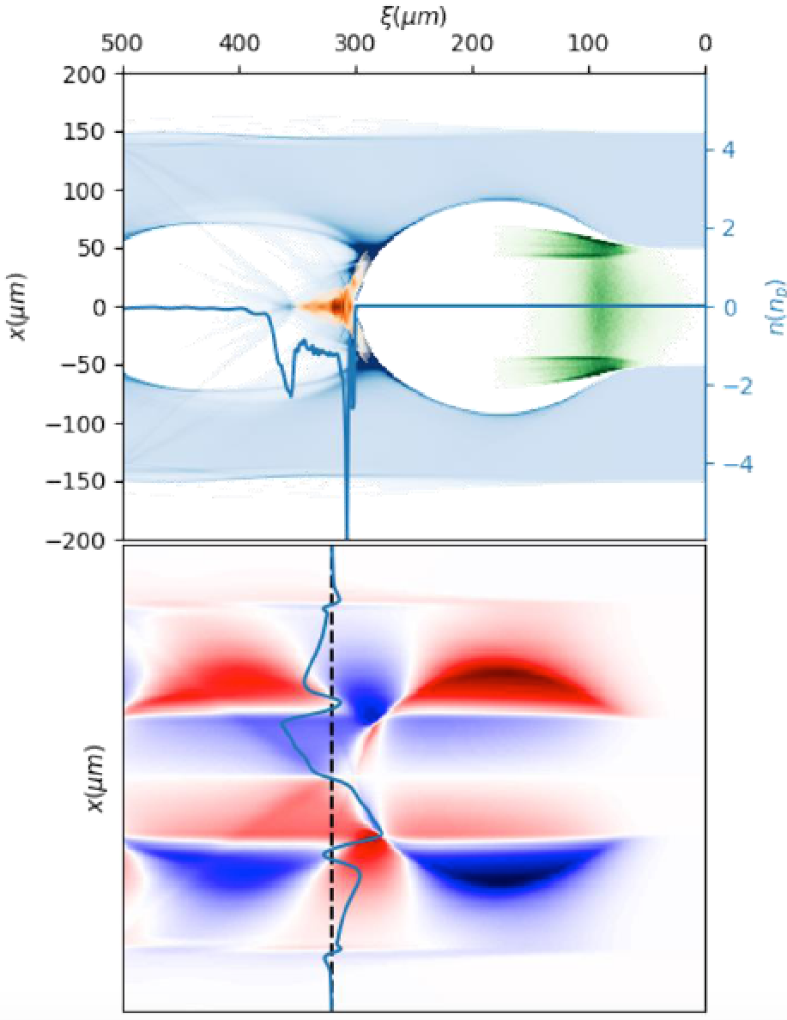
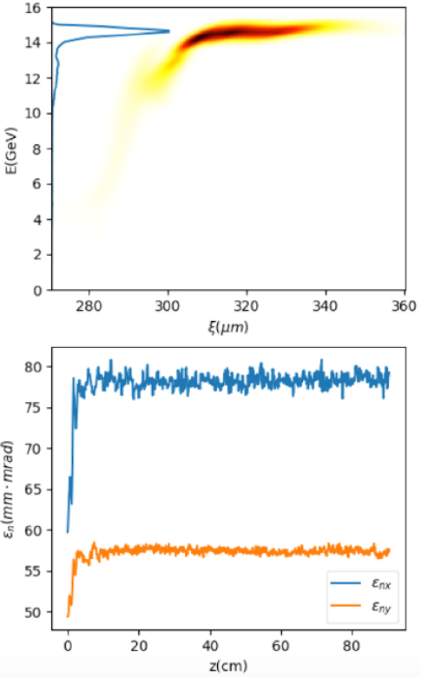
Positron Acceleration Scheme 2 (Stable mode)
e-, shaped & evolved
3-4nC, 45GeV
Hollow Plasma Channel
e+
1nC, 45GeV
e+
1.2nC, 2/4GeV
Energy efficiency ~ 40%
Slice energy spread ~1%（to be optimized）
Tolerable emittance growth
High tolerance on beam tilt and offset
debuncher + dechirper to reduce energy spread down to 0.2%
22

Slide 23
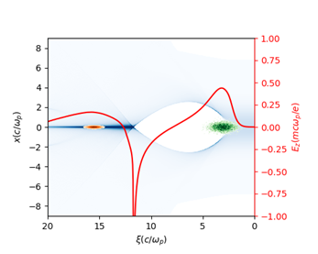
Positron Acceleration Scheme 3
e-, shaped
10nC, 45GeV
Transverse non-uniform
Plasma column
e+
1nC, 45GeV
e+
1.2nC, 2/4GeV
Relative low efficiency ~10% (to be optimized)
Slice energy spread ~0.2%
Tolerable emittance growth
High tolerance on beam tilt and offset
23

Slide 24
III. Accelerator design and optimization
Goal：Generation of 15nC (or more) 10GeV shaped bunches for driving HTR PWFA; Generation of positron beam with 1nC charge, 10mm mrad or less normalized emittance, short bunch ( ~100fs)
To Do：to determine the beam and accelerator parameters, design of gun, Linac, and positron beam line
Tech：
  Detailed beam line simulations with tolerance check
  Iteration loop: Booster→plasma injector→Linac→gun
  Collaboration with FACET-II design
How to Check：
  Giving detailed design of gun, Linac and positron beam line with tolerance check.
Expecting timeline：1）2019.12 (V1) ；2）2021.12 (V2, final)
24

Slide 25
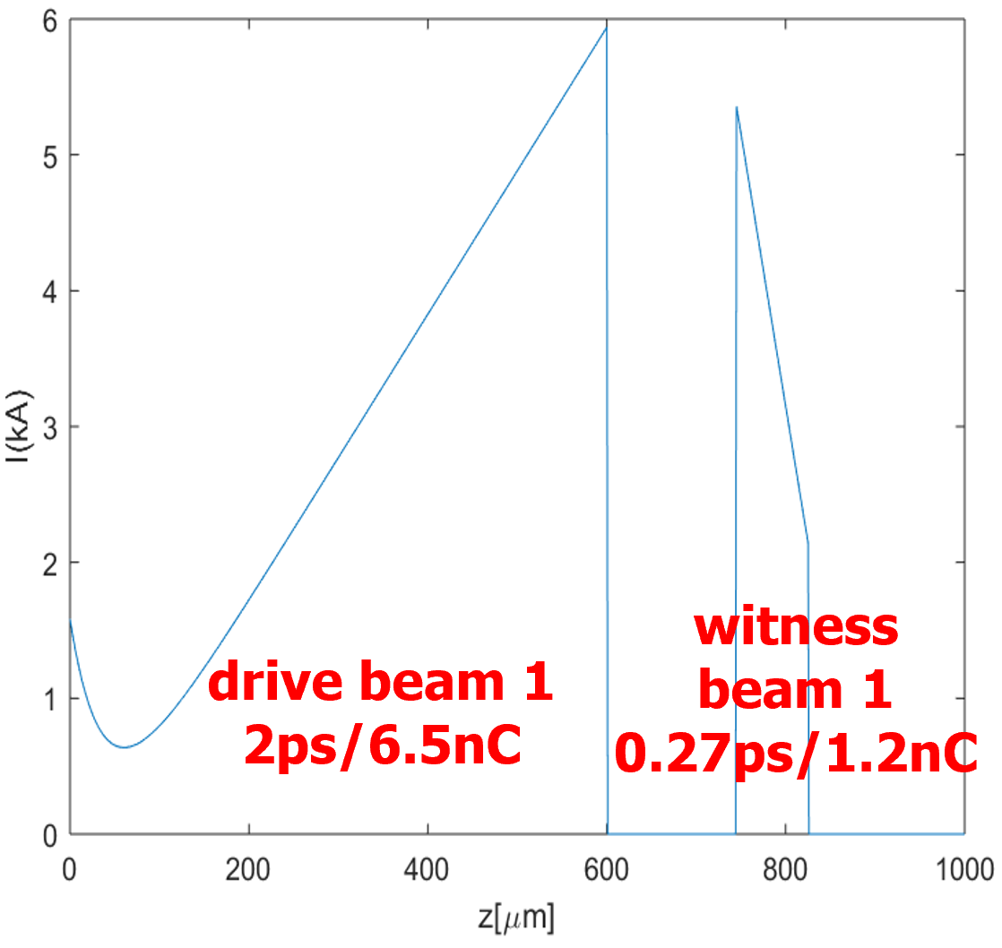
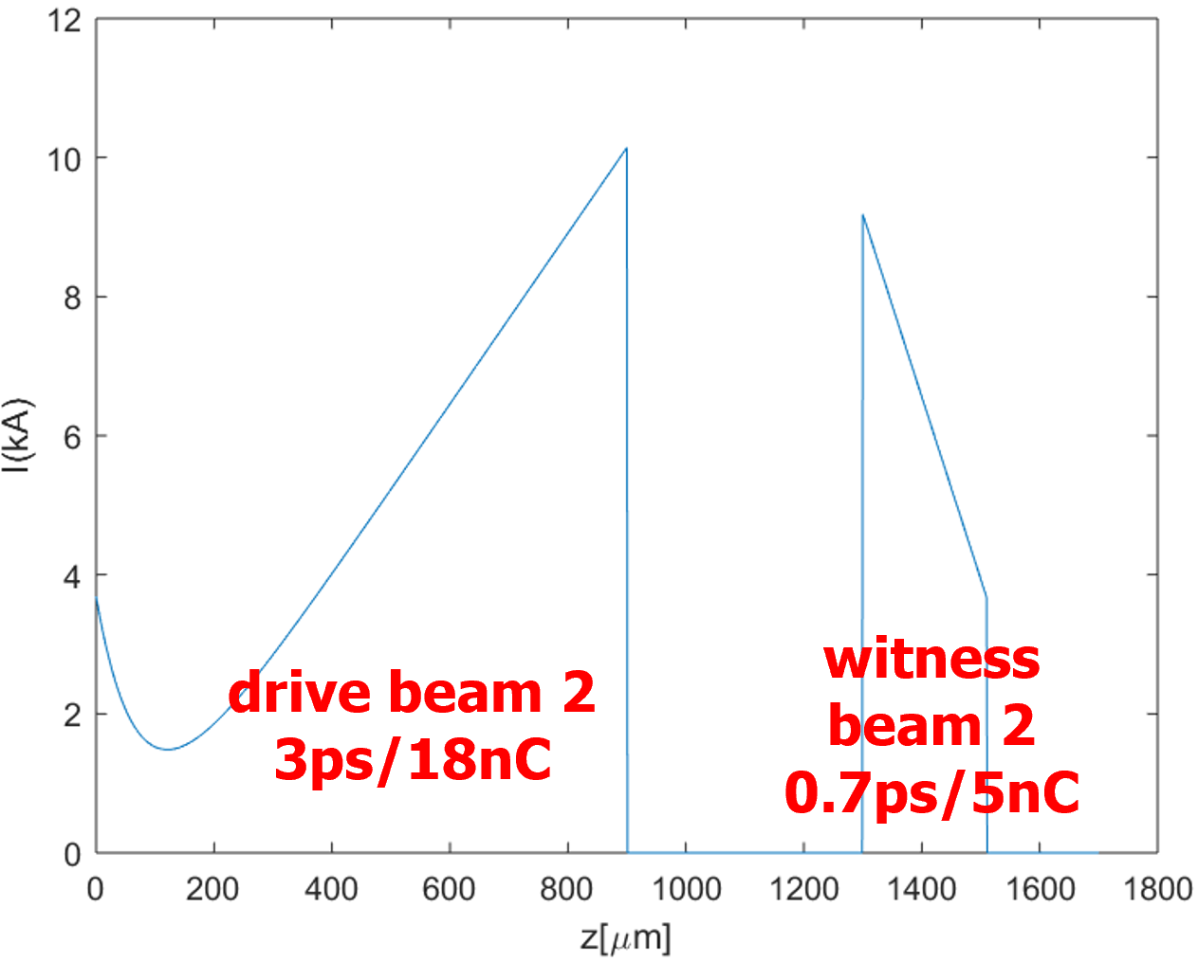
CEPC Plasma Injector beam requirements
e- Gun Main Factor:
High bunch charge
Longitudinal shaping
Low emittance
25

Slide 26
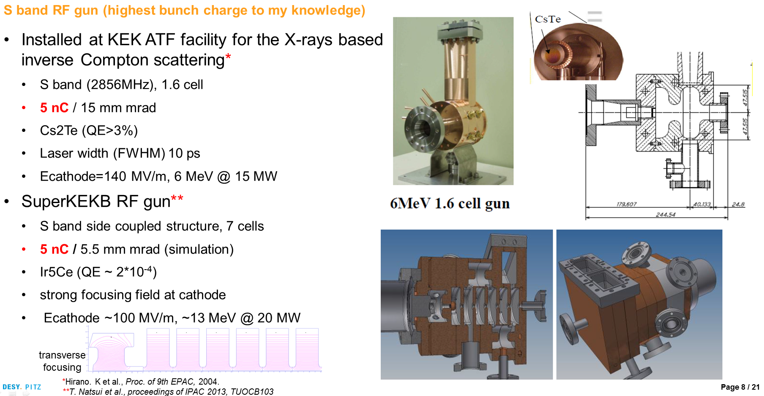

Large Charge Photon gun —KEKB, S-band
26

Slide 27
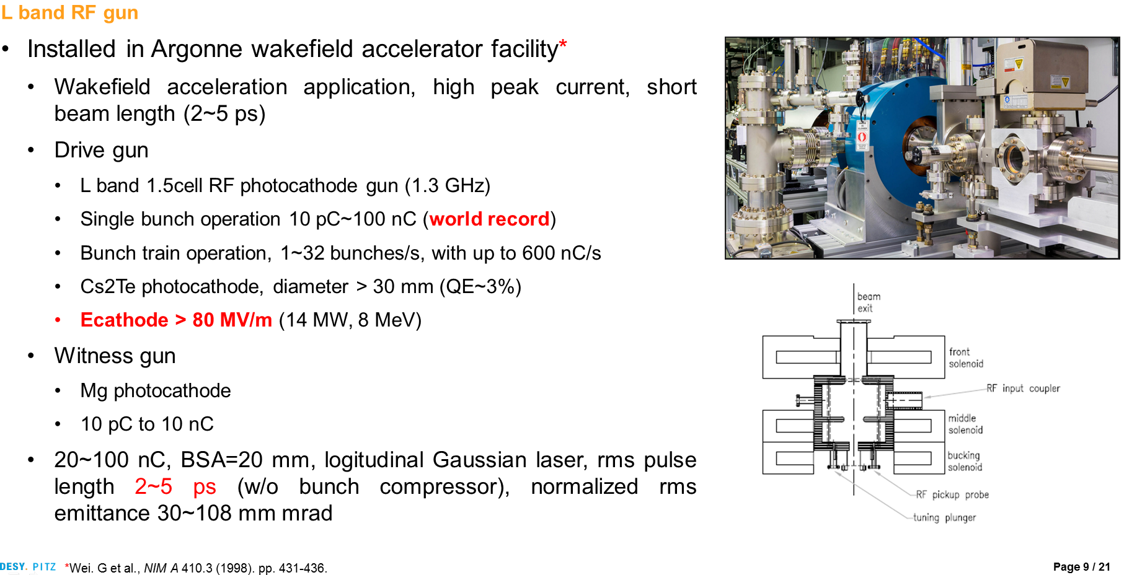
Large Charge Photon gun:Argonne, L-band（√）
27

Slide 28
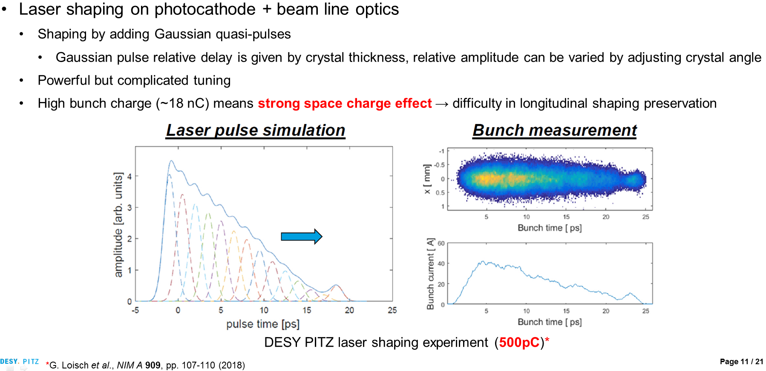
Shaped bunch —Laser Shaping（√）
28

Slide 29
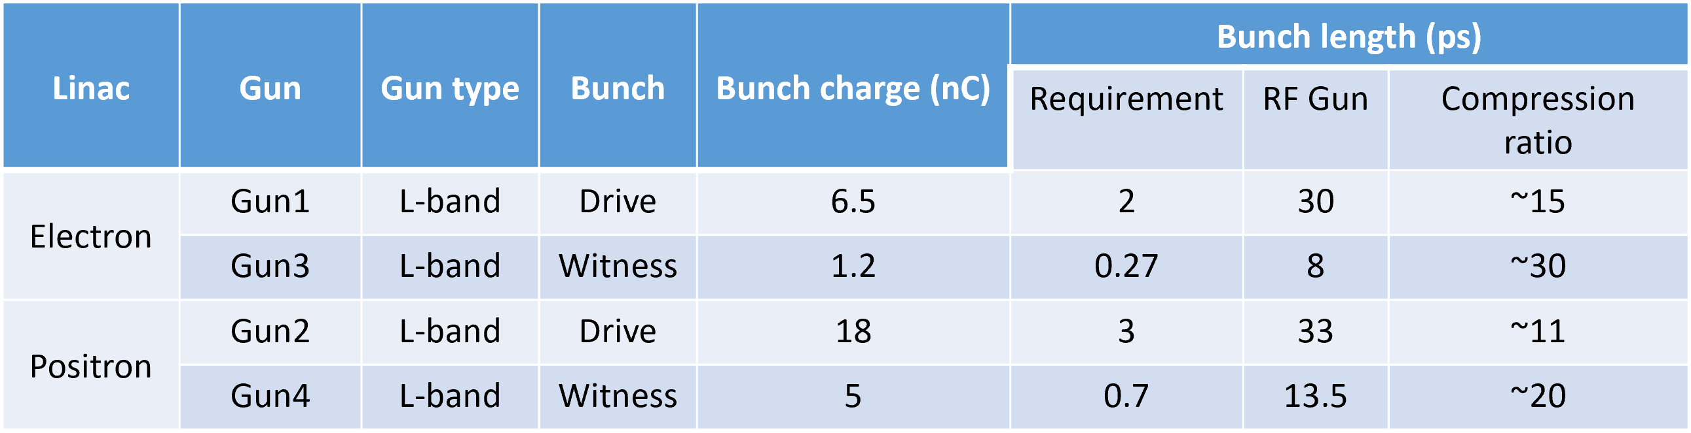
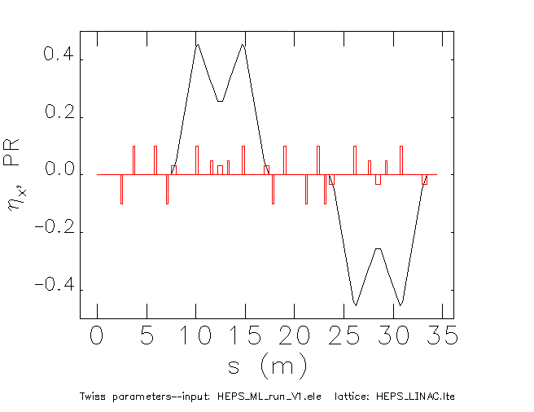
e- Gun requirement and preliminary design
Bunch compressor lattice before main linac
Required (red) and simulated (blue) beam profile
29

Slide 30
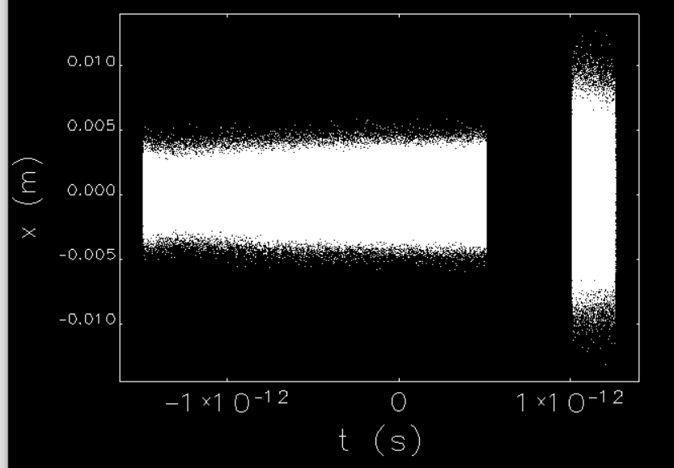
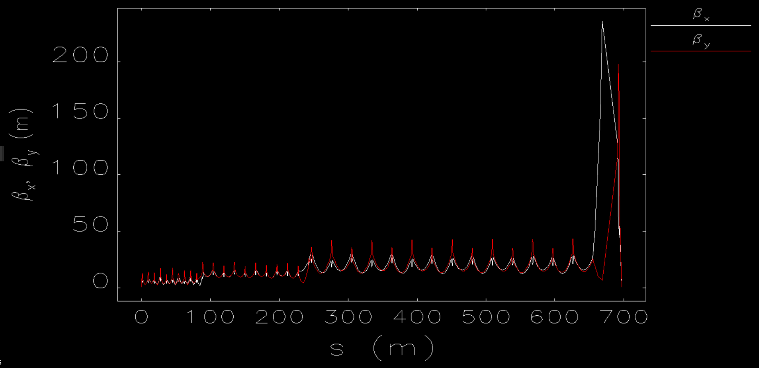
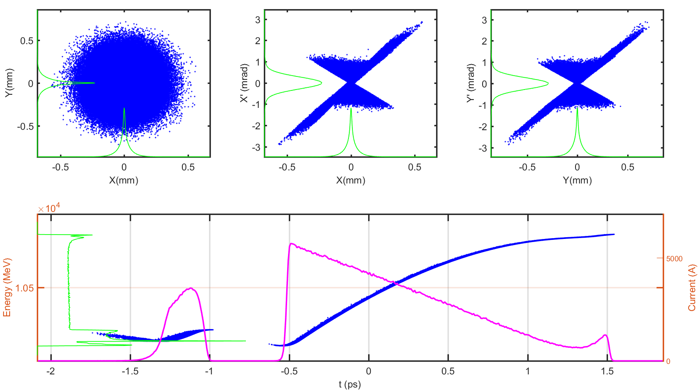
Linac optimization for ideal beams
$$Assuming no coupilng between x−y direction$$
$$β_{∗}=156mm \left(V1.0\right)→14.6 mm (V2.0)$$
L-band photocathode rf gun under design.
Finished the preliminary linac design and the end-to-end simulation (e- gun → FFS). Beam distribution improved but can not meet the requirements yet.
NEED MORE OPTIMIZATIONS
Optimized by Dr. Cai Meng (2020)
30

Slide 31
Preliminary design for e+ damping ring
 | DR V2.0 | current
Energy (MeV) | 400 | 400
Circumference （m） | 20 | 29.62
Bunch number | 2 | 2
Bending radius (m) | 1.5 | 1.375
B0 (T) | 0.89 | 0.97
U0 (keV/turn) | 5.0 | 1.65
Damping time x/y/z (ms) | 10.7/10.7/5.3 | 47.7/48.0/24.1
δ0 (%) | 0.05
ε0 (mm.mrad) | 5
Nature σz (mm) | 4.4
Extract σz (mm) | 4.4
εinj (mm.mrad) | 2400
εext x/y (mm.mrad) | 62/57
δinj /δext (%) | 0.6 /0.05
Storage time (ms) | 20
Wiggler parameters
Dipole strength (T) | 4.8
Magnetic period (m) | 0.2
Total length (m) | 1.5
average βx (m) | 1.3
RF parameters
RF frequency (MHz) | 500
RF voltage (MV) | 1.5
Energy acceptance by RF(%) | 2.1
harmonic | 33
  Conceptual design was finished, further lattice optimization is ongoing. Error study and correction are needed. Impedance and stability study are also required.
31

Slide 32
IV. Beam Manipulations
Goal：Carry out dechirper, hollow plasma channel generation, external injection experiments on Tsinghua and SXFEL facilities, verify their feasibilities
To Do：Prepare and perform systematic experiments on dechirper, hollow plasma channel, and external injection to verify their feasibilities for plasma injector
Tech：
  Plasma dechirper experiments with uniform and hollow channel plasma
  External injection from Linac to wakefield accelerator
How to Check：
  Generating long uniform hollow plasma channel
  performing dechirper experiments to reach 0.1% level energy spread
  External injection experiments to show the feasibility of high efficiency high quality staging
Expecting timeline：1）2020.6；2）2020.12; 3) 2021.12
32

Slide 33
Outline
Background: CEPC/CEPC plasma injector
Preliminary Design v2
Current status: Physics and Technology
Outlook: Future experiments

Slide 34
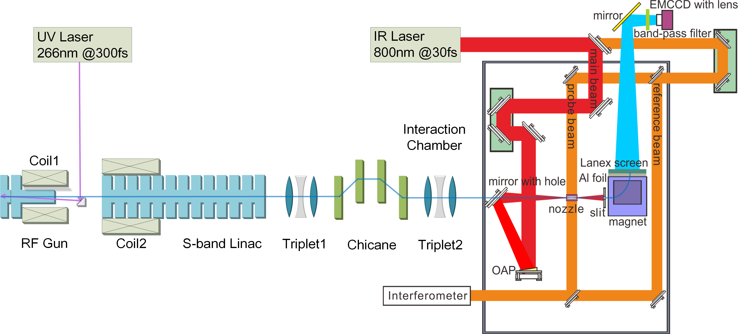
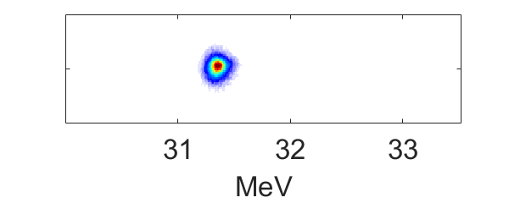
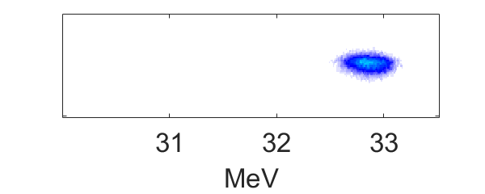
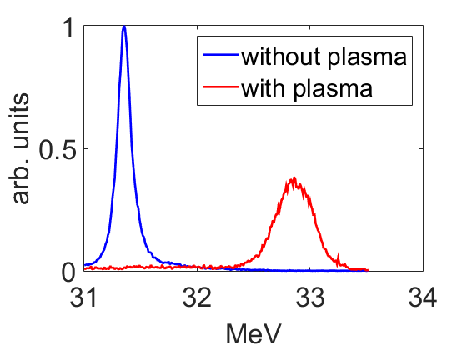
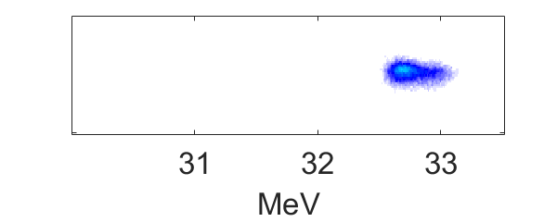
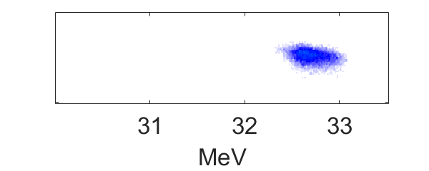
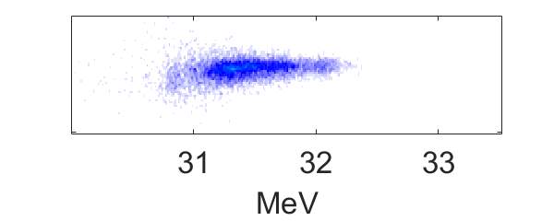
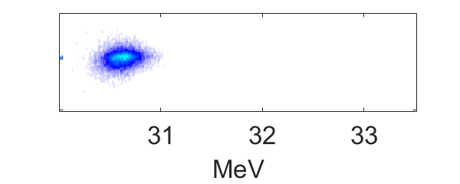
Current External Injection Experiment
external injection with ~100% capture efficiency
AAC 2018, Plenary
34

Slide 35
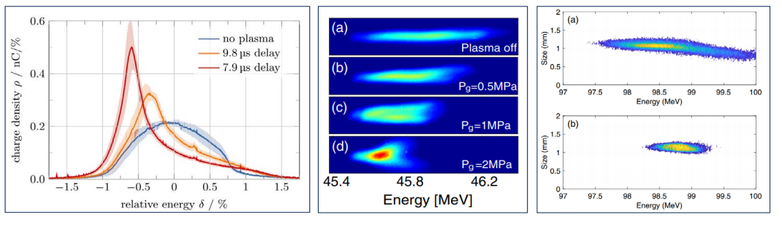
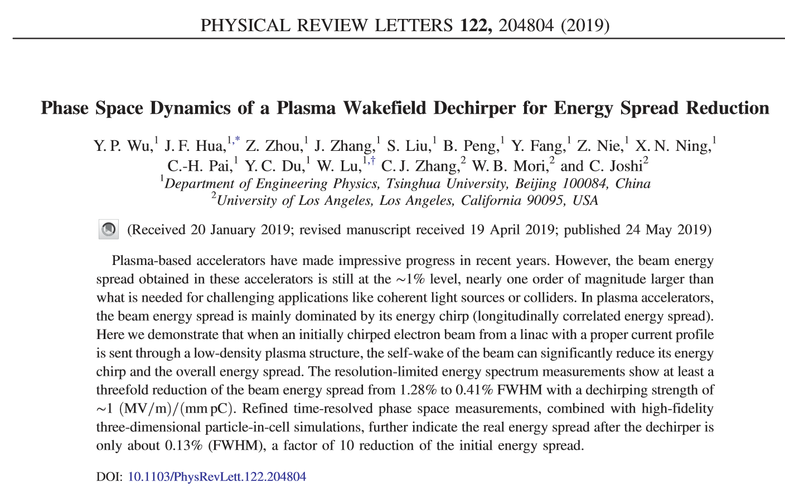
Current Plasma dechirper @ THU lab
Energy spread reduction down to 0.2% level
AAC 2018, Plenary
The experimental resolution on energy spread is limited， refined experiments is planned
The effects on emmittance and slice energy spread needs to be quantified
Hollow channel dechriper seems to be a better solution
35

Slide 36
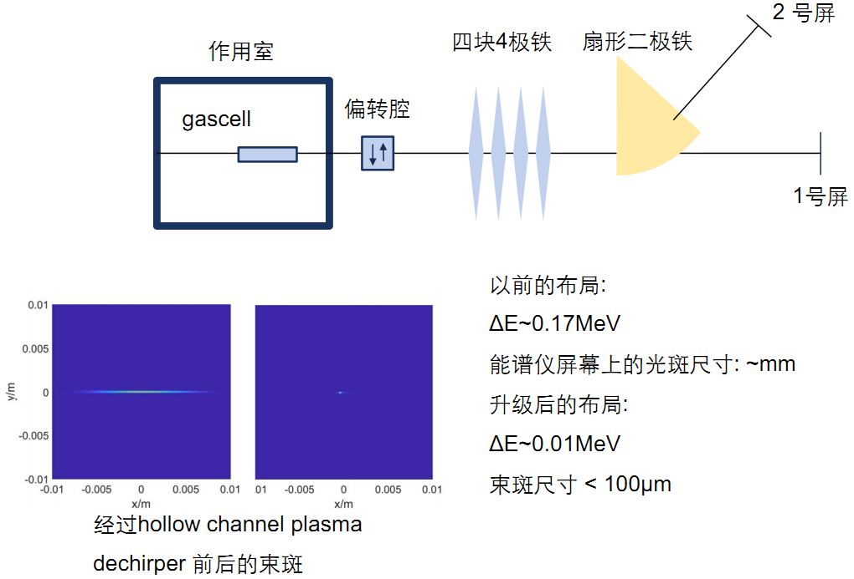
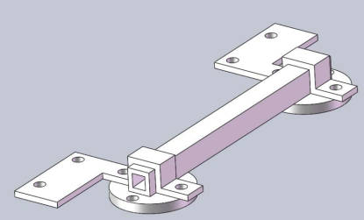
2nd round plasma dechirper experiment
之前实验的不足之处：
对能散的分辨率不够，没有从1%到0.1%的直接测量结果
对发射度的负面影响研究不够
对切片能散的负面影响研究不够
36

Slide 37
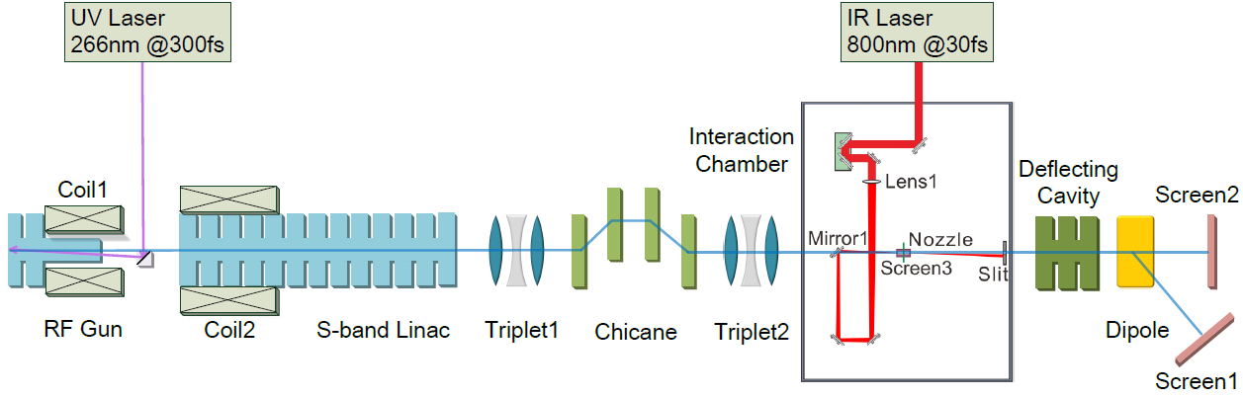
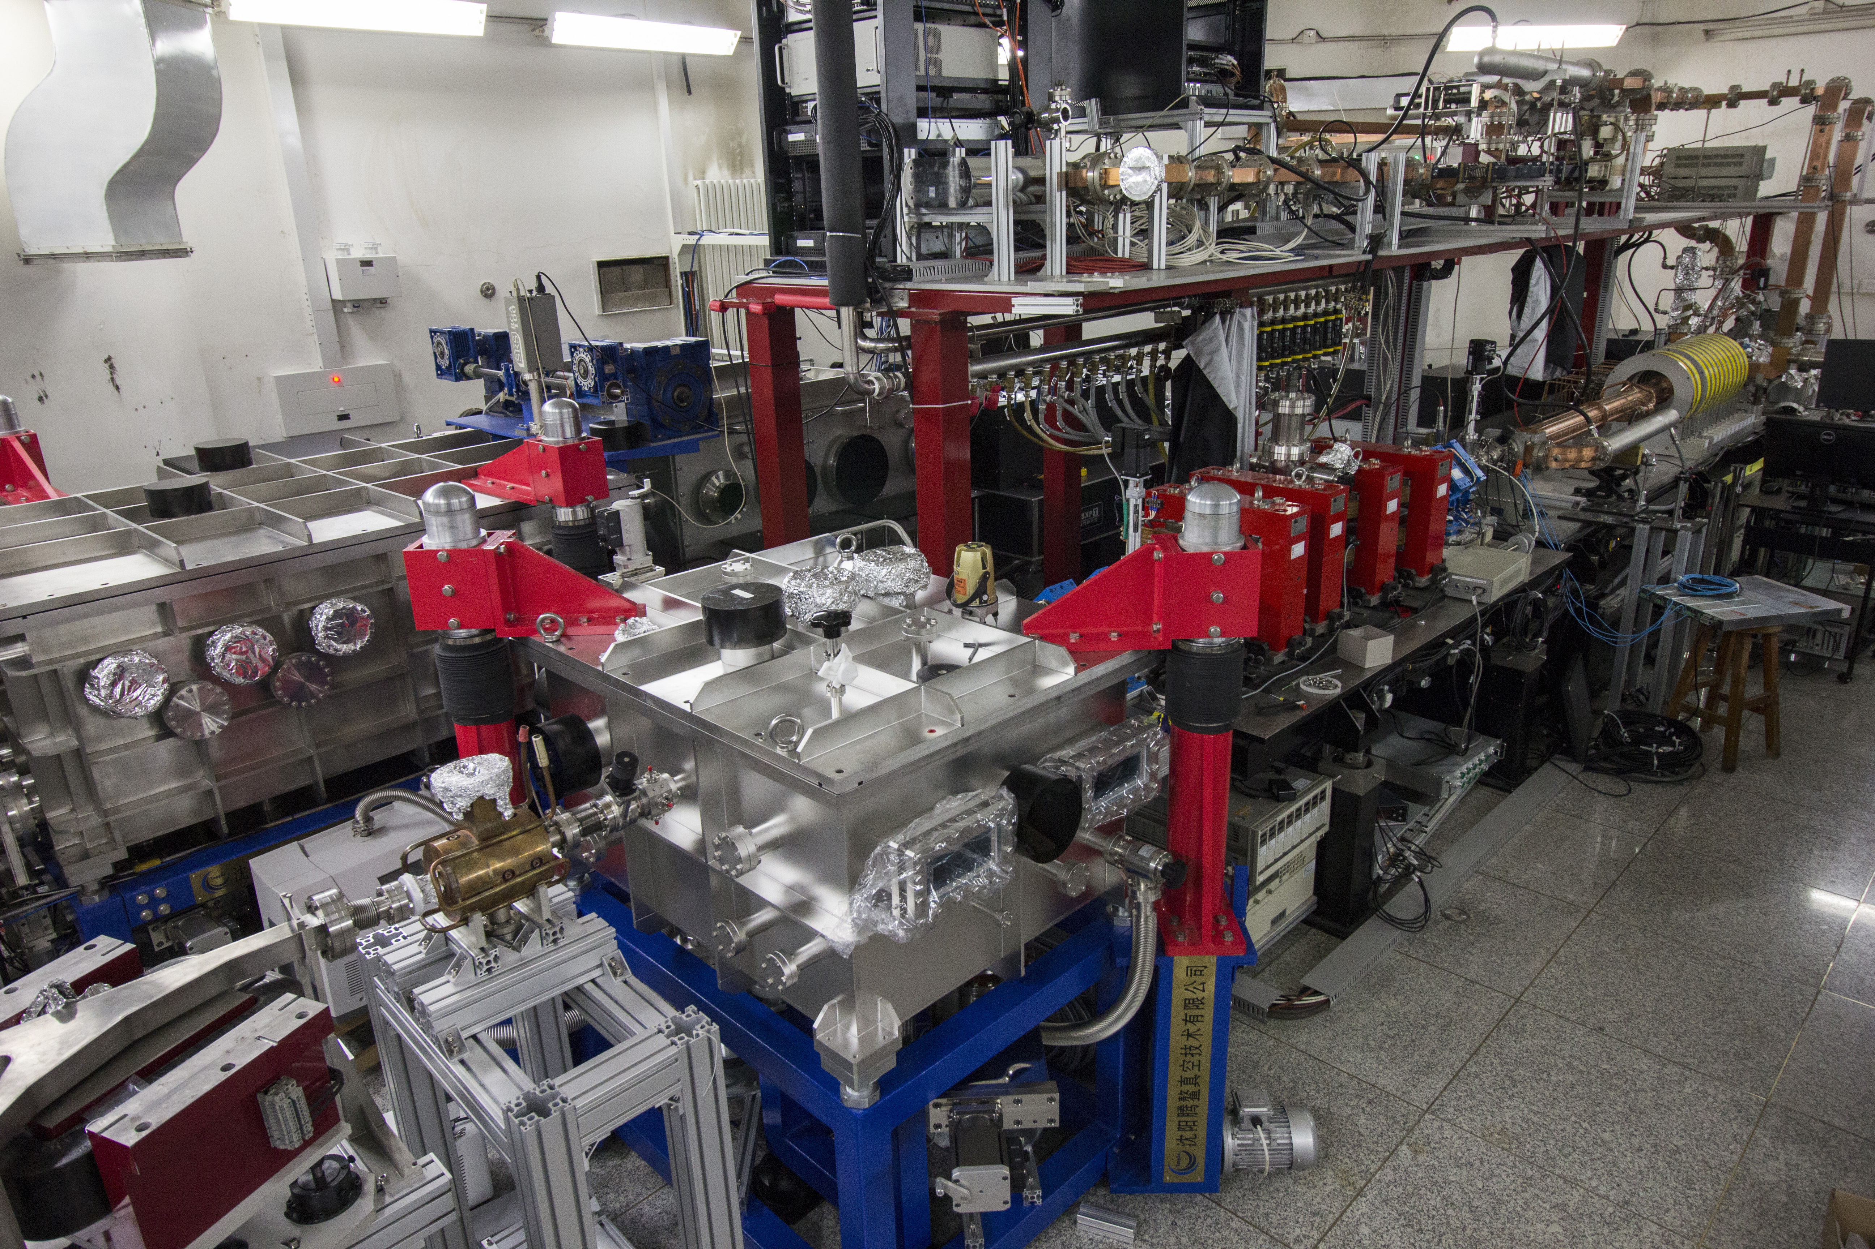
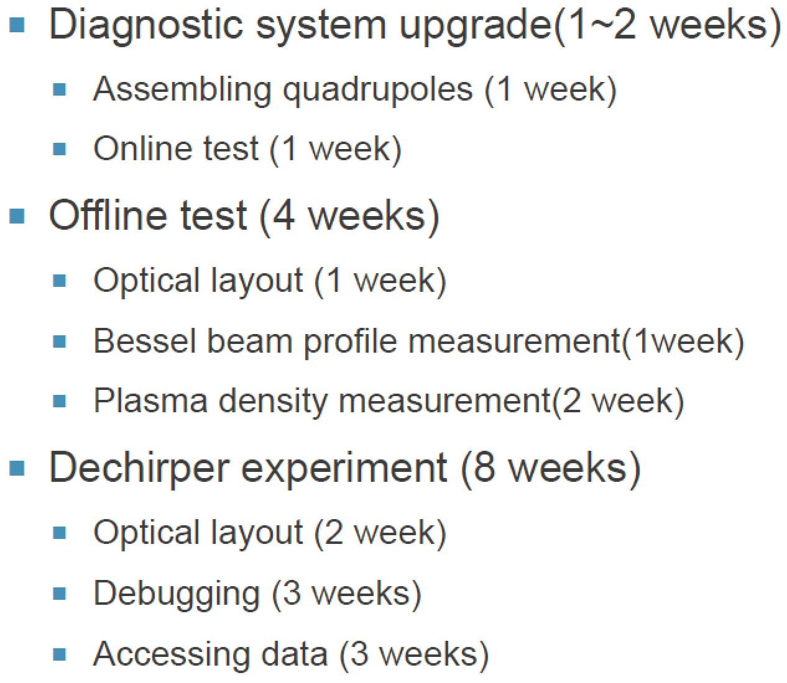
Hollow Channel experiment preparation at THU Lab
Estimated Start Time: 2019.12
RF gun
Chicane
S-band
linac
Compressor
beam
Interaction
chamber
Deflecting
cavity
Dipole

Slide 38
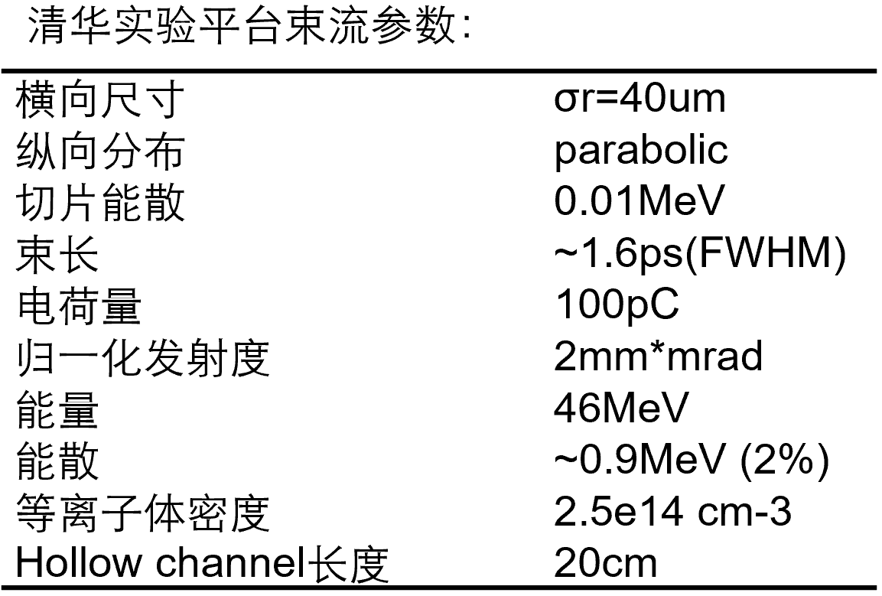
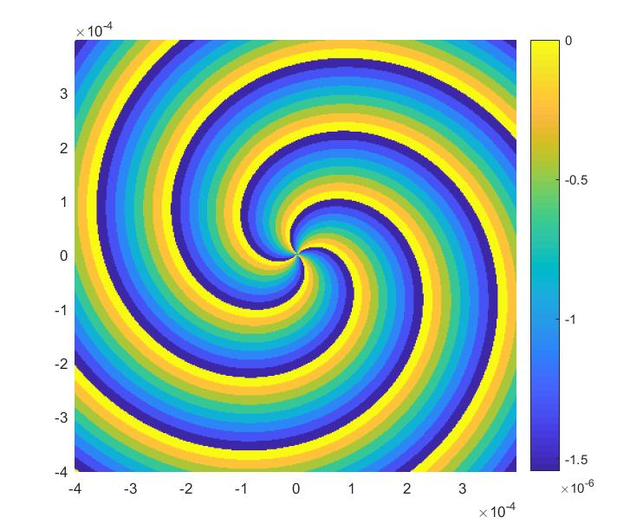
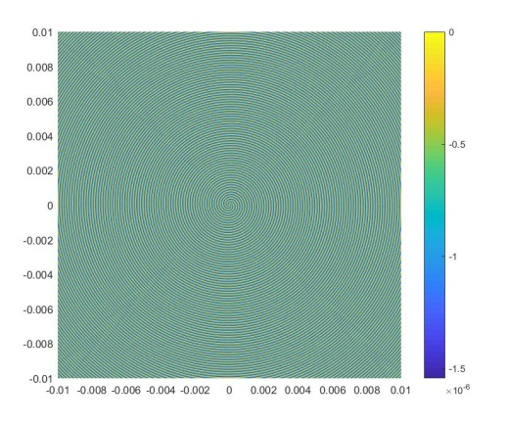
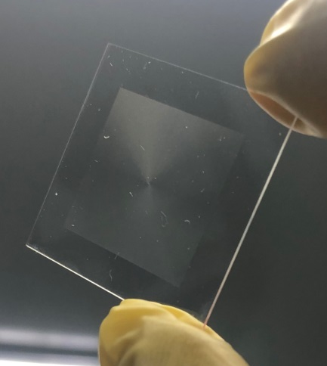





Hollow Channel experiment preparation at THU Lab
Kinoform Plate
Simulation
Simulation
Gas cell for hollow channel experiment
Experiment
Experiment

Slide 39


Energy spread measure: ~1%→~0.1%
39

Slide 40


Plasma dechirper & HTR experiment Preparation@ SXFEL
Parameter | Value
Energy | 0.8GeV
Charge | 50pC
Emittance | 0.8μm
Beam size | 10μm
Peak current | 2.4kA
Energy Chirp | ~8MeV
Plasma Section
Dechirper experiment schedule
First step: Obtaining a stable positively-chirped beam with few percent energy spread
Second step: Post-processing the beam using a passive dechirper

Slide 41




Experiment preparation @ SXFEL
束测室
主作用室
压缩池
束测室
主作用室
压缩池
Slides from Dr. Bo Peng (2020)
41

Slide 42





Experiment preparation → laser system
Amplifier energy performance
Amplifier output profile before expander
Pulse compressor efficiency: 72%
Pulse duration
Slides from Dr. Bo Peng (2020)
42

Slide 43


Experiment preparation → gas loop
Requirement：
200 ~ 10⁵ pa (Negative pressure)
43

Slide 44
Summary
CEPC Plasma Injector is a possible innovative solution to address the low field issue in CEPC booster ring
A preliminary design for CEPC plasma injector at 45GeV has been carried out, and a step by step plan to verify its feasibility has also been mapped out
Key experiments are planned to be carried out in future on several available facilities
It is expected that a conclusion on the feasibilities of CEPC plasma injector should be reached in about 5 years study period
44

