Slide 1
Progress of CEPC Magnet R&D
Wen Kang, Mei Yang
IAS 2021
Beijing, Jan. 21, 2021

Slide 2
Contents
Progress of CEPC booster dipole magnet R&D
Specifications and subscale prototype dipole magnets
Modification of the subscale prototype magnet with iron cores
Design of the full-scale prototype CT coil dipole magnet
Progress of CEPC collider magnet R&D
Overview of the collider magnets
The short prototype DAD and DAQ magnets
Design of the long DAD magnet
A new design of DAQ magnet

Slide 3
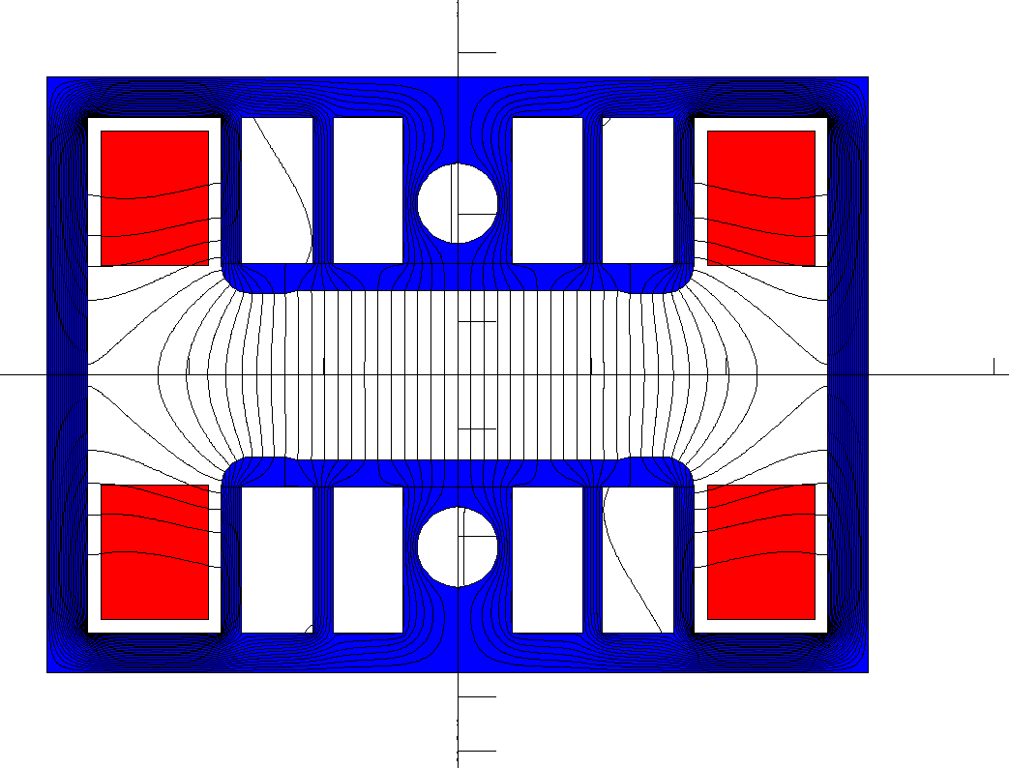
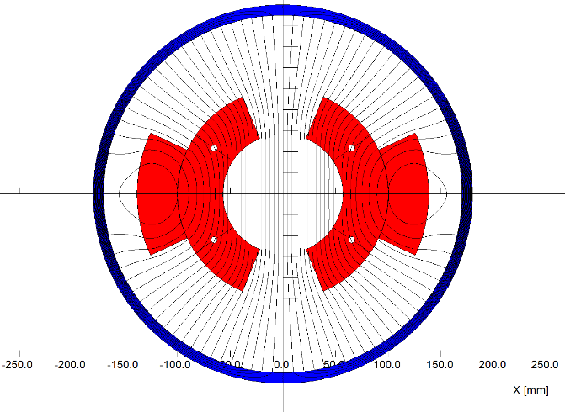
Specifications and subscale prototype magnets
Main Specifications of CEPCB dipole magnets
Quantity | 16320 | Magnetic Length (mm) | 4700
Minimum field (Gs) | 28 | Good field region (mm) | 55
Maximum field (Gs) | 338 | Field uniformity | 0.1%
Gap (mm) | 63 | Field reproducibility | 0.05%
In the past years, two kinds of the subscale prototype magnet with and without iron cores have been designed and developed. The low field performance of the magnet without iron cores could meet the requirements whereas the magnet with iron cores could not due to remnant field.

Slide 4
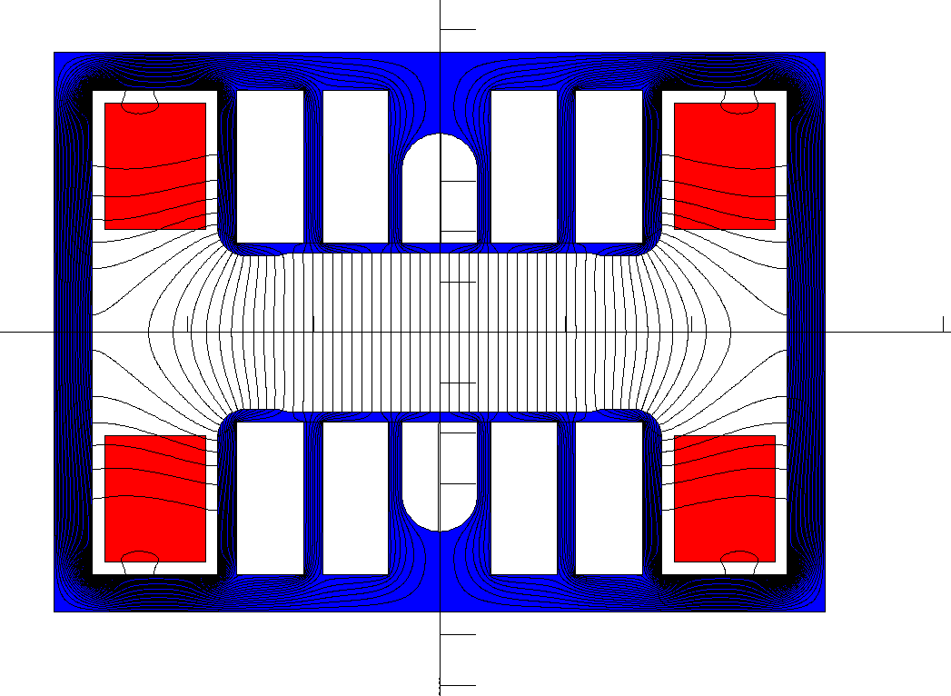
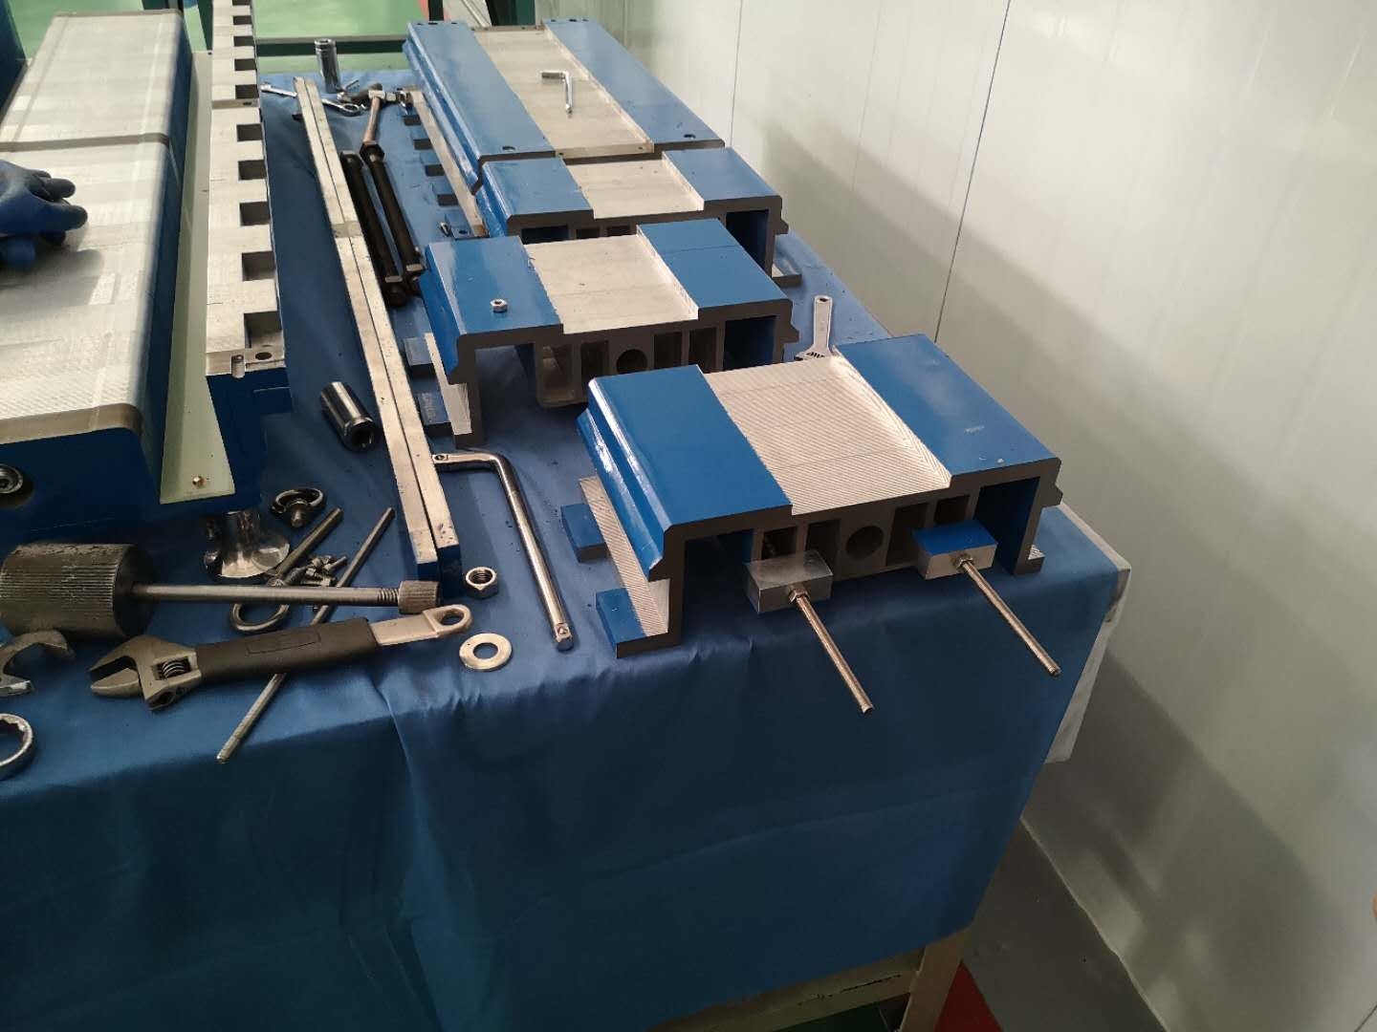
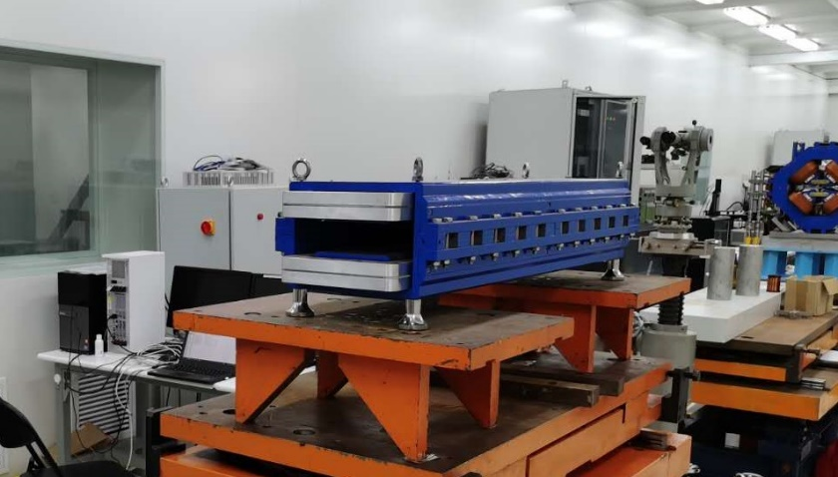
Modification of the subscale prototype magnet with iron cores
In order to reduce the influence of the remnant field on the field quality, the subscale prototype dipole magnet with iron cores was de-assembled and the holes of its laminations were reproduced. It was expected that the remnant field in the pole areas could be made uniform.

Slide 5
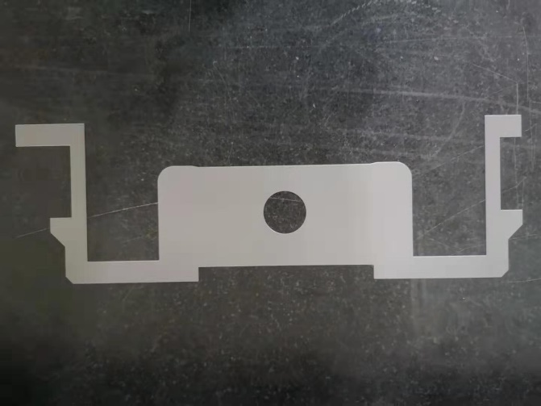
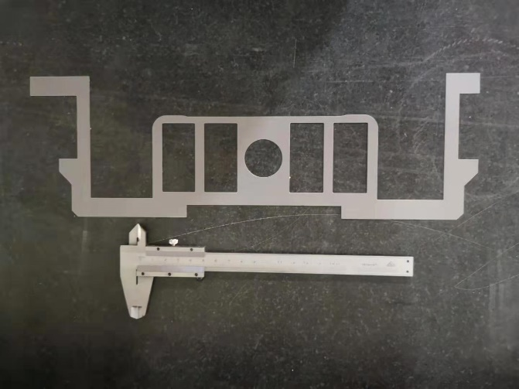
Modification of the subscale prototype magnet with iron cores
For comparison, one half magnet is made by the lamination with pole square holes, the other half is made by the lamination without square holes. When the magnet was modified, the half magnet without square holes did not change.

Slide 6
Modification of the subscale prototype magnet with iron cores
The field measurement results show that the obvious modification of the magnet does not cause an obvious improvement on the low field quality.
The uniformity of low field of 28 Gs for the half magnet with square holes becomes a little better, from 0.35% to 0.25%.

Slide 7
Modification of the subscale prototype magnet with iron cores
Meanwhile, the uniformity of the low field for the half magnet without square holes also becomes a little better, from 0.35% to 0.28%. It means that improvement of the low field performance may come from the fabrication precision.
Conclusion: The magnets with iron cores could not meet the precision requirement of 0.1% at low field of 28Gs due to the influence of the remnant field in the iron cores.

Slide 8
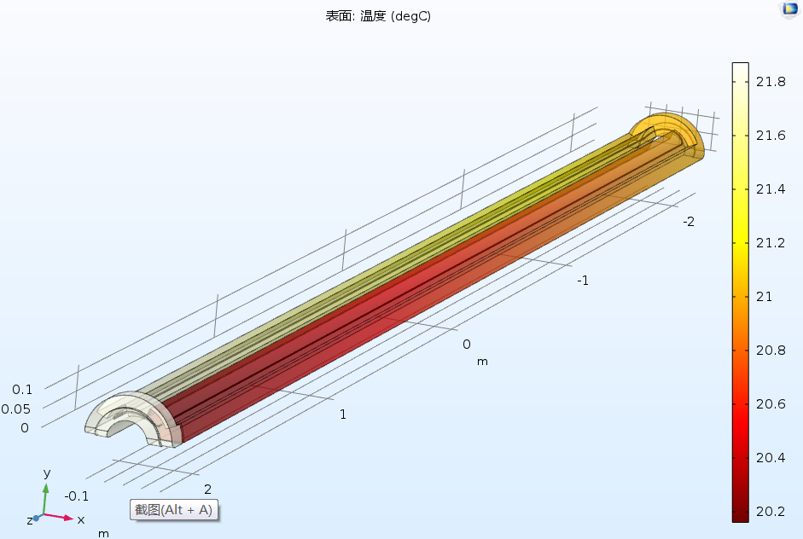
Design of the full-scale prototype CT coil dipole magnet
On the base of good performance for the subscale prototype CT dipole magnet, the mechanical design of a full scale prototype CT dipole magnet was finished. The production of the magnet will begin in the coming month.
The total length of the magnet including the shielding tube is 5.1m.
The coil conductors will be made from pure aluminum, the cooling tubes will be inserted between the inner conductors to decrease temperature rise.
The touch resistance of the contacted surfaces of the conductors will be reduced by coated silver films.

Slide 9
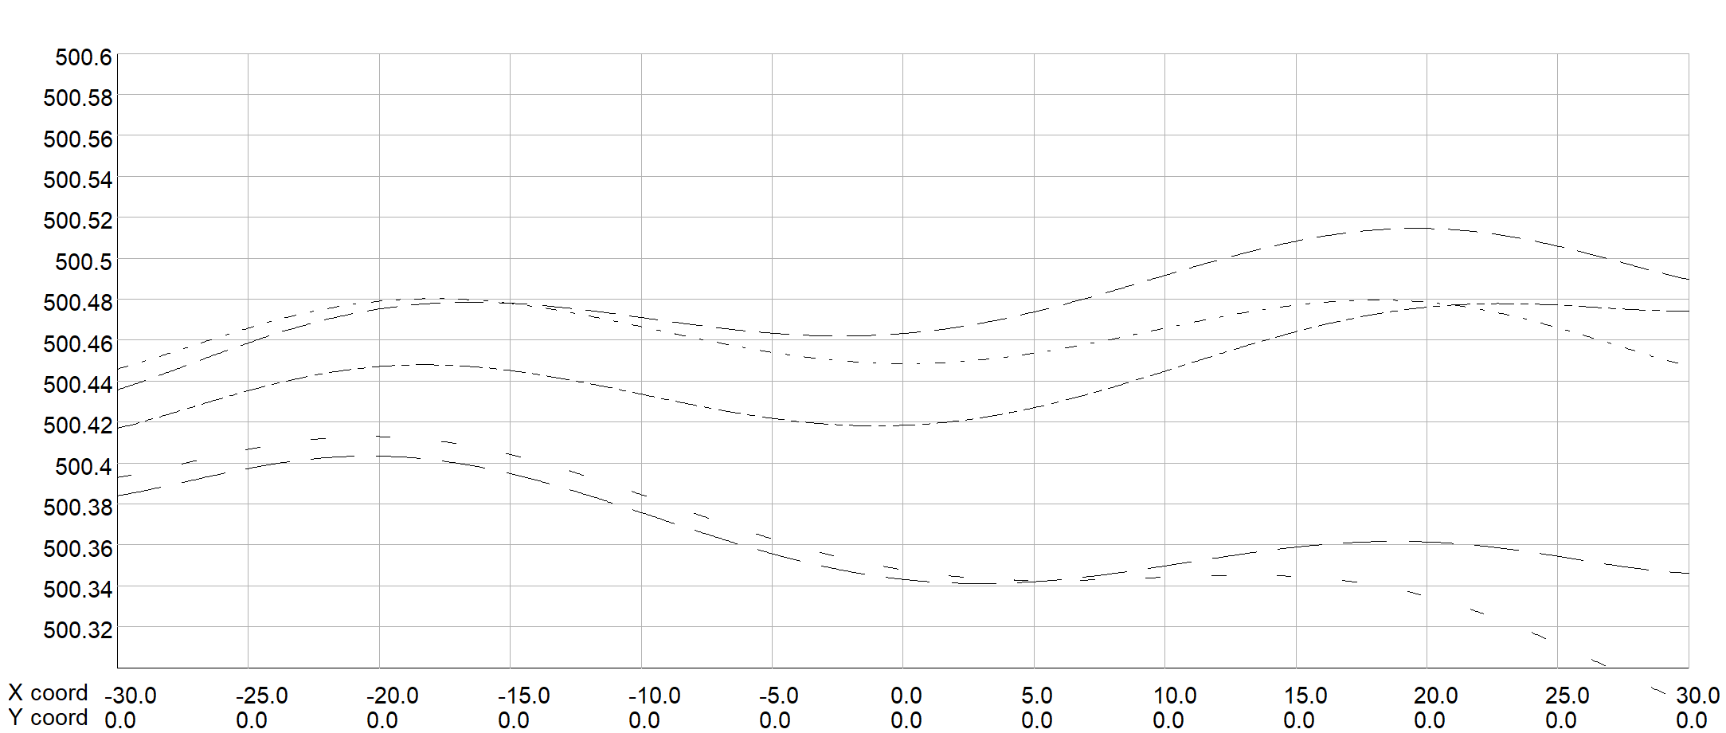
Design of the full-scale prototype CT coil dipole magnet
The CT coil magnet is composed of the upper and lower coils, each coil is formed by three conductors. The size and position tolerance of the conductors are the key factors for the precision of the field.
The field simulation shows,
The tolerance of size dimension for all conductors should be less than 0.05mm.
The position tolerance of the conductors should be less than 0.1mm in 4.7m longitudinal direction.

Slide 10
Design of the full-scale prototype CT coil dipole magnet
Each conductor is 4.7m long, it is designed to be directly fabricated from a long aluminum bar, which will need large machining and surface anodizing facility. In order to reduce the production cost, it is considered to be divided into 3 or more parts for convenient fabrication and then assembled together.

Slide 11
Design of the full-scale prototype CT coil dipole magnet
To control the size and position precision of the conductors, the supporters every 415mm in longitudinal direction are fabricated and assembled in the shielding tube.

Slide 12
Design of the full-scale prototype CT coil dipole magnet
After the coil conductors are produced, the whole assembly of the magnet will be done in the shielding tube, which can be opened into upper and lower parts. The positions of the shielding tube that support the supporters of the CT coils will be carefully and precisely machined.

Slide 13
Design of the full-scale prototype CT coil dipole magnet
The lower coil can be directly assembled in the lower half of the shielding tube, but the upper half coil should be assembled in the assembling tooling firstly, then be rotated 180 degree and put on the lower coil. At last, the upper half of the shielding tube will be assembled with the lower one by the same assembling tooling.

Slide 14
Design of the full-scale prototype CT coil dipole magnet
The designed parameters of the full-scale CT coil dipole magnet
Max. field (Gs) | 492 | Inner radius of inner coil(mm) | 57
Min. field (Gs) | 28 | Outer radius of inner coil (mm) | 100
Gap (mm) | 63 | Outer radius of outer coil (mm) | 138.46
Magnetic length (mm) | 4700 | Angle of inner coil(°) | 67.5
GFR (mm) | 55 | Angle of outer coil(°) | 24.8
Max. NI/pole(A) | 5160 | Resistance(mΩ) | 0.95
Min. NI/pole (A) | 288 | Max. power loss(W) | 2800
Turns/pole | 3 | Avg. power loss(W) | 1120
Max. current(A) | 1720 | Diameter of tube(mm) | 340/360
Min. current(A) | 96 | Weight of magnet(ton) | 1.4

Slide 15
Overview of collider magnets
Over 80% of collider ring is covered by conventional magnets. All these magnets work at DC mode.
 | Dipole | Quad. | Sext. | Corrector | Total
Dual aperture | 2384 | 2392 | - | - | 13742
Single aperture | 80*2+2 | 480*2+172 | 932*2 | 2904*2
Total length [km] | 71.5 | 5.9 | 1.0 | 2.5 | 80.8
Power [MW] | 7.0 | 20.2 | 4.6 | 2.2 | 34

Slide 16
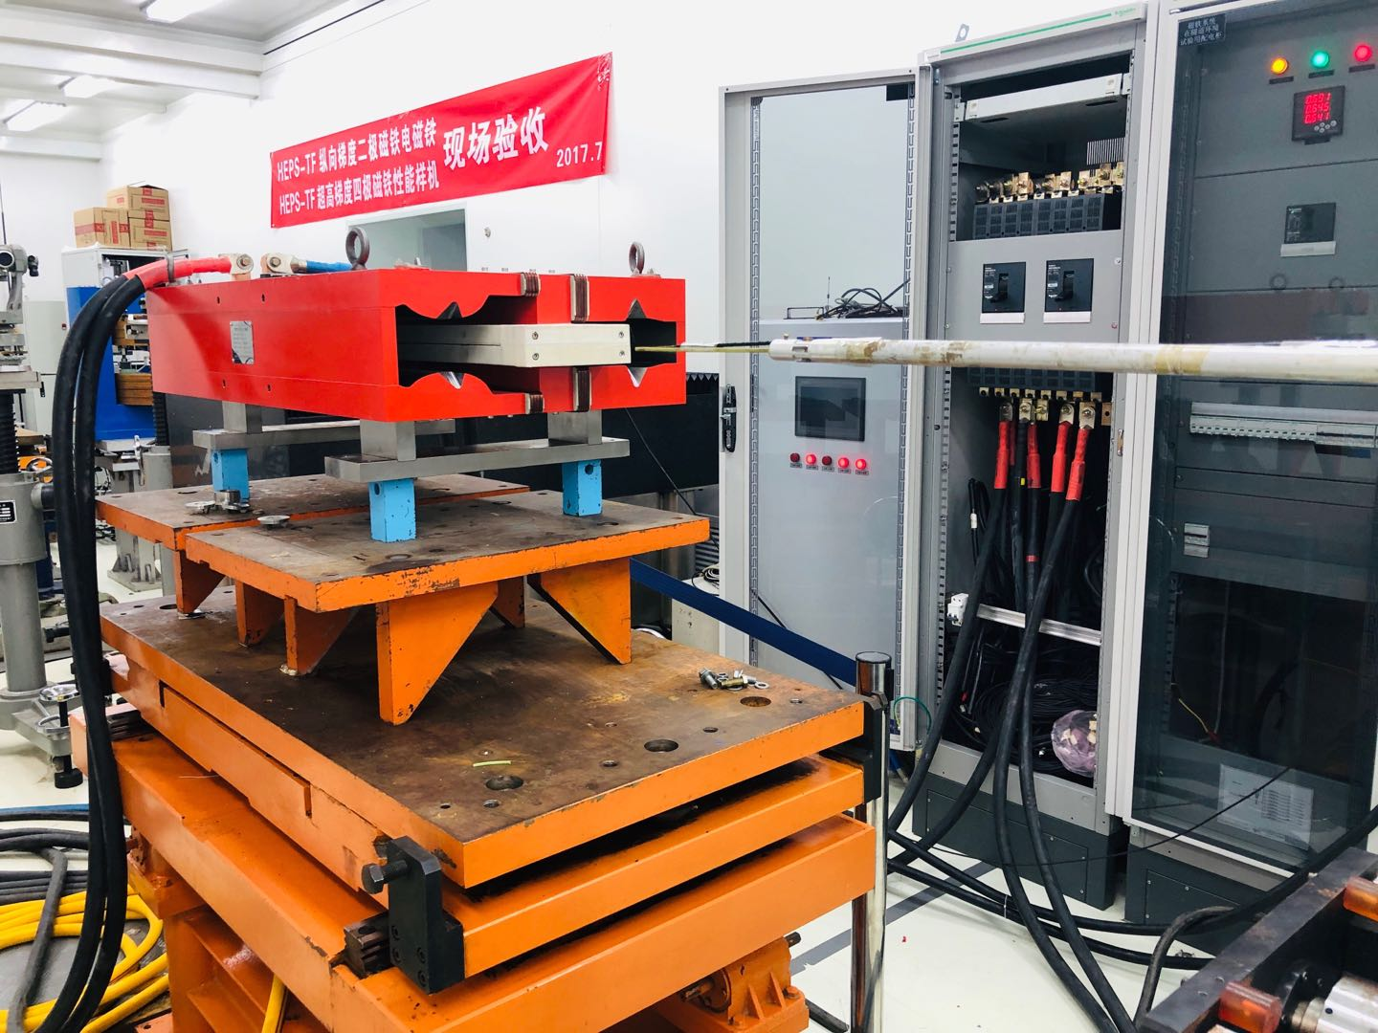
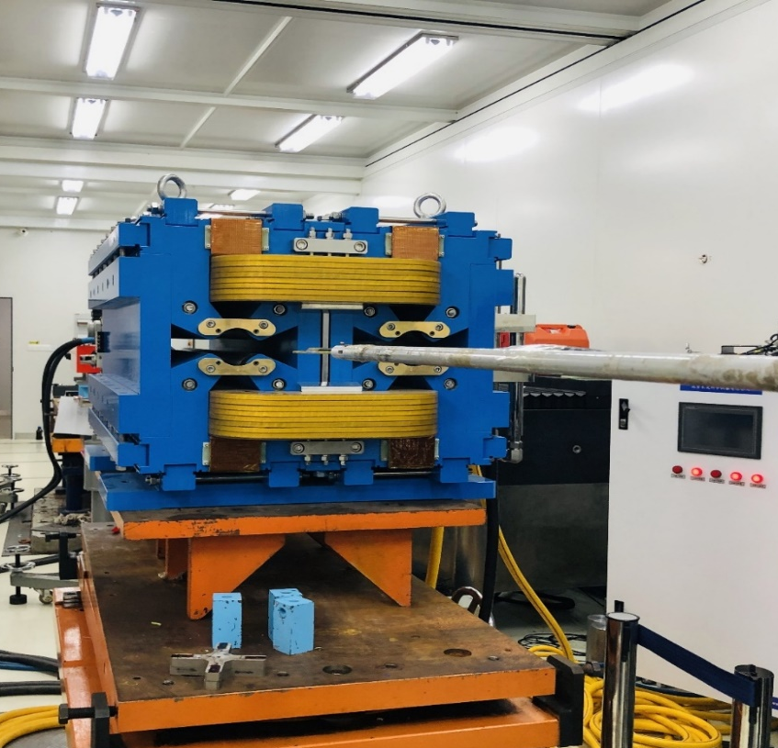
The short prototype DAD and DAQ magnets
Ap2
Ap1
In past years, a short prototype DAD magnet and a short prototype DAQ magnet were also developed and tested.
The field performance of DAD can meet the requirements. The magnetic field coupling between the two apertures can be ignored in the case of existing trim coils.
Since the strong cross talk effect between two apertures, the field performance of DAQ can not meet the requirements.
  The field components and magnetic center changes with the beam energy changing from 45.5GeV to 182.5GeV.
  When trim coils are excited, the field in two apertures has different changes for its asymmetric magnetic structure.
A
B

Slide 17
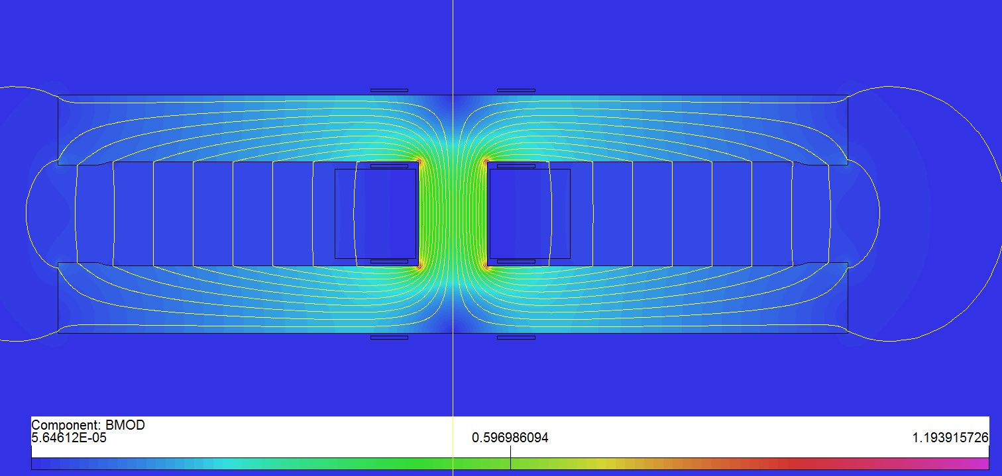
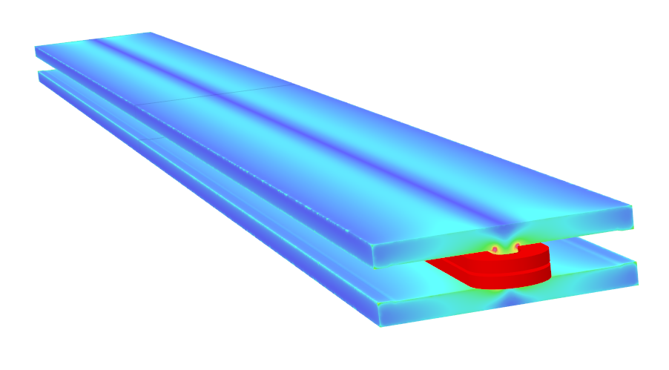
Design of long DAD magnet
As the magnetic length is up to 28.7m, the 5.7m pure dipole model will be built to check the field quality, mechanical strength and deformation.
Basic parameters and design considerations
  Beam center separation is 350mm;
  Solid iron with DT4;
  Two turns of aluminum busbars with cooling hole;
  Anodizing treated insulation coil;
  Silvered contact face to reduce contact resistance.
 | Item
Center field (Gs) | 141.6@45.5GeV，373@120GeV，568@182.5GeV
Gap (mm) | 66
Magnetic Length (m) | 5.737
Good field region (mm) | ±13.5
Field harmonics | <0.05%
Field adjustability | ±1.5%
Field difference between two apertures | <0.5%
Cross section of long DAD

Slide 18
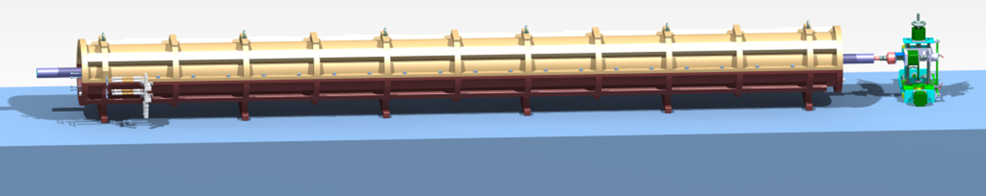
Design of long DAD magnet
The mechanical design of the long DAD has been completed. The physical and mechanical design review was performed in July 2020.
The magnetic field will be measured by a rotating coil measurement system
  Shared with the booster dipole magnet.

Slide 19
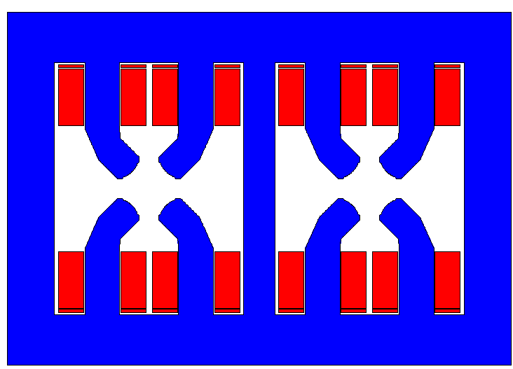
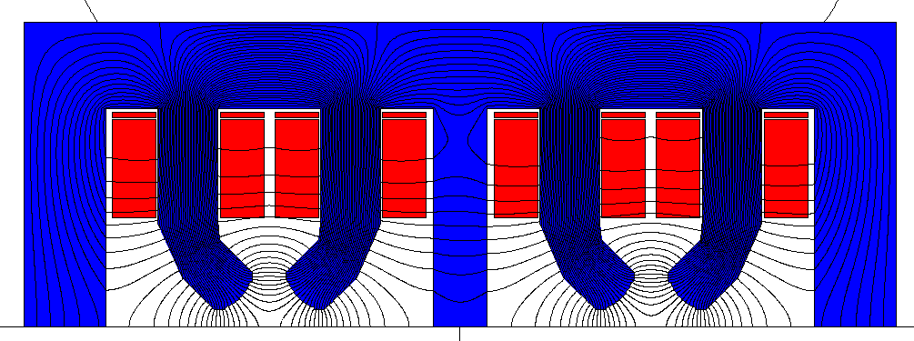
A new design of DAQ magnet
To solve the cross talk problems between two apertures of the DAQ magnet, a new design was proposed.
Two quadrupole magnets locate side by side
  With same polarities in two apertures(QF/QF)
  Beam center separation is 350mm
  Main coils: 8 aluminum coils instead of 2 coils
  Trim coils: 8 coils instead of 4 coils.
Features:
  For strict space, the middle yoke is shared.
  The power consumption has doubled.
  Nearly no cross talk effect between the two apertures.
Primary design: QF/QF

Slide 20
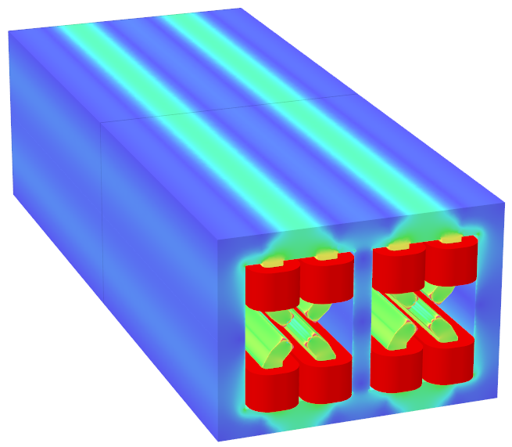
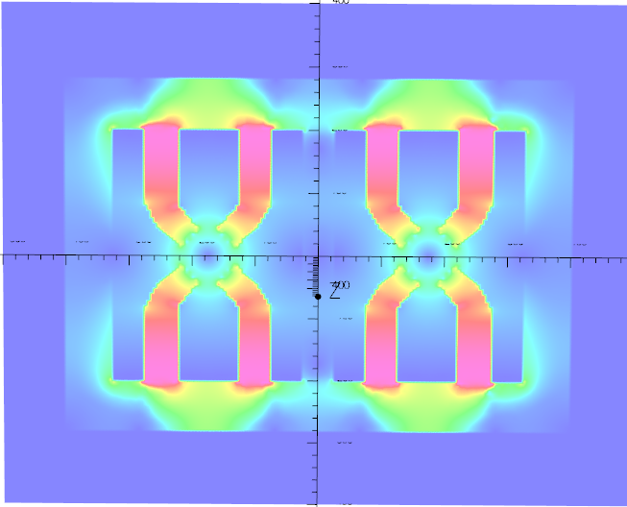
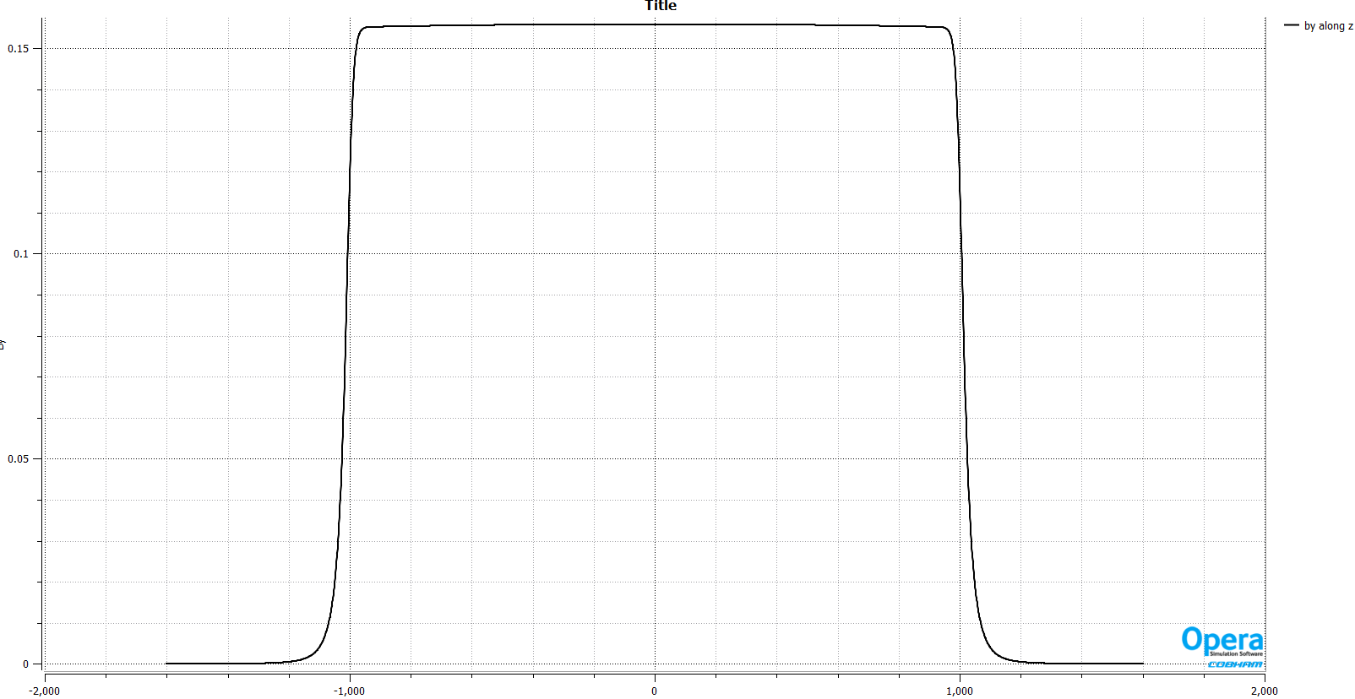
A new design of DAQ magnet
3D simulation (2m long iron)
  The iron weight is about 4 ton, the coils’ weight is about 270kg .
  The power consumption 9kW @120GeV.
Bmod@182.5GeV
Bmod@182.5GeV, @center plane
By along z @r=12.2mm in Ap2

Slide 21
A new design of DAQ magnet
3D simulation results:
  The results show that it can meet the requirement.
  The field harmonics change are acceptable when the beam energy changes.
  3D end field has little effect on the integral field harmonics.
The design can meet the requirements, the power consumption increases 60%,compared to the previous QF/QD design.
 | 45GeV | 45GeV+tr | 120GeV+tr | 182GeV | 182.5GeV+tr
 | right-bn | Right-bn | Right-bn | Right-bn | Left-bn | Right-bn
1 | -7.43 | -7.35 | -3.78 | 0.69 | 0.38 | 1.84
2 | 10000 | 10000 | 10000 | 10000 | 10000 | 10000
3 | -0.91 | -0.89 | -0.60 | -0.25 | 0.59 | -0.15
4 | -0.25 | -0.25 | -0.21 | -0.20 | -0.20 | -0.20
5 | -0.28 | -0.28 | -0.28 | -0.27 | -0.18 | -0.27
6 | -0.25 | -0.26 | -0.26 | -0.27 | -0.20 | -0.27
10 | -0.03 | -0.03 | -0.03 | -0.03 | -0.02 | -0.03

Slide 22
Summary
Two kinds of subscale prototype dipole magnets with and without iron cores for the booster were fabricated and tested.
The magnets with iron cores could not meet the precision requirement of 0.1% at low field of 28Gs due to the remnant field in the iron cores.
The performance of the CT coil dipole magnet without iron cores is satisfied with the requirements. So the full-scale CT dipole magnet has been designed and will be fabricated in this year.
The short prototype DAD and DAQ magnets for the collider were also fabricated and tested. The DAD magnet could meet the requirements whereas the DAQ magnet could not due to the strong cross talk between two apertures.
A long DAD magnet is designed and will be fabricated, a new design of DAQ magnet was proposed.

Slide 23
Thank you for your attention！

