Slide 1



CEPC MDI Issues
Sha Bai
for CEPC MDI group
IAS Program on High Energy Physics,
Hong Kong, Jan 19-21, 2021.
2021-01-21

Slide 2
Outline
MDI design for High Luminosity Higgs
CDR → TDR optimization for MDI
MDI mechanics and integration
Summary

Slide 3
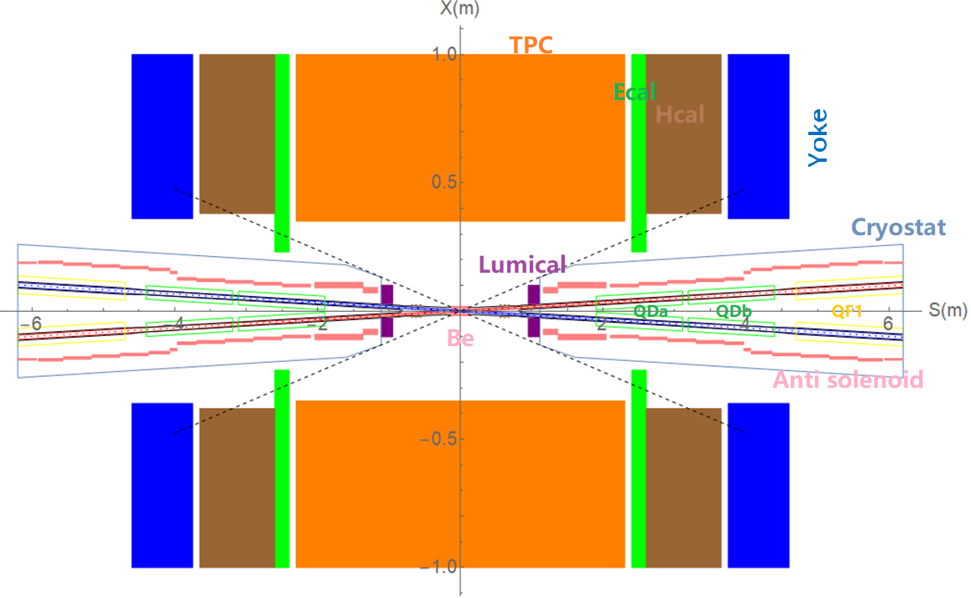
MDI layout and IR design
The Machine Detector Interface (MDI) of CEPC double ring scheme is about ±7m long from the IP.
The CEPC detector superconducting solenoid with 3T magnetic field and the length of 7.6m.
The accelerator components inside the detector without shielding are within a conical space with an opening angle of cosθ=0.993.
The e+e- beams collide at the IP with a horizontal angle of 33mrad and the final focusing length is 1.9m.

Slide 4
MDI parameters
 | range | Peak filed in coil | Central filed gradient | Bending angle | length | Beam stay clear region | Minimal distance between two aperture | Inner diameter | Outer diameter | Critical energy (Horizontal) | Critical energy (Vertical) | SR power (Horizontal) | SR power (Vertical)
L* | 0~1.9m |  |  |  | 1.9m
Crossing angle | 33mrad
MDI length | ±7m
Detector requirement of accelerator components in opening angle | 8.11˚
QDa/QDb |  | 3.2/2.8T | 141/84.7T/m |  | 1.21m | 15.2/17.9mm | 62.71/105.28mm | 48mm | 59mm | 724.7/663.1keV | 396.3/263keV | 212.2/239.23W | 99.9/42.8W
QF1 |  | 3.3T | 94.8T/m |  | 1.5m | 24.14mm | 155.11mm | 56mm | 69mm | 675.2keV | 499.4keV | 472.9W | 135.1W
Lumical | 0.95~1.11m |  |  |  | 0.16m |  |  | 57mm | 200mm
Anti-solenoid before QD0 |  | 8.2T |  |  | 1.1m |  |  | 120mm | 390mm
Anti-solenoid QD0 |  | 3T |  |  | 2.5m |  |  | 120mm | 390mm
Anti-solenoid QF1 |  | 3T |  |  | 1.5m |  |  | 120mm | 390mm
Beryllium pipe |  |  |  |  | ±120mm |  |  | 28mm
Last B upstream | 64.97~153.5m |  |  | 0.77mrad | 88.5m |  |  |  |  | 33.3keV
First B downstream | 44.4~102m |  |  | 1.17mrad | 57.6m |  |  |  |  | 77.9keV
Beampipe within QDa/QDb |  |  |  |  | 1.21m |  |  |  |  |  |  | 1.19/1.31W
Beampipe within QF1 |  |  |  |  | 1.5m |  |  |  |  |  |  | 2.39W
Beampipe between QD0/QF1 |  |  |  |  | 0.3m |  |  |  |  |  |  | 26.5W

Slide 5
QDa/QDb, QF1 physics design parameters β_{y}*=1mm, β_{x}*=0.33m
QDa/QDb | Horizontal BSC 2（18σ_{x}+3） | Vertical BSC 2（22σ_{y}+3） | e+e- beam center distance
Entrance | 9.15/12.41 mm | 12.89/15.22 mm | 62.71/105.28mm
Middle | 10.37/14.84 mm | 14.61/14.88 mm | 82.84/125.41mm
Exit | 12.13/17.92 mm | 15.21/13.87 mm | 102.64/145.21mm
Good field region | Horizontal 12.13/17.92 mm; Vertical 15.21/15.22 mm
Effective length | 1.21 m
Distance from IP | 1.9/3.19 m
Gradient | 141/84.7 T/m
QF1 | Horizontal BSC 2（18σ_{x}+3） | Vertical BSC 2（22σ_{y}+3） | e+e- beam center distance
Entrance | 19.66 mm | 13.21 mm | 155.11 mm
Middle | 23.02 mm | 12.00 mm | 179.87 mm
Exit | 24.14 mm | 11.60 mm | 204.62 mm
Good field region | Horizontal 24.14 mm; Vertical 13.21 mm
Effective length | 1.5 m
Distance from IP | 4.7 m
Gradient | 94.8 T/m

Slide 6
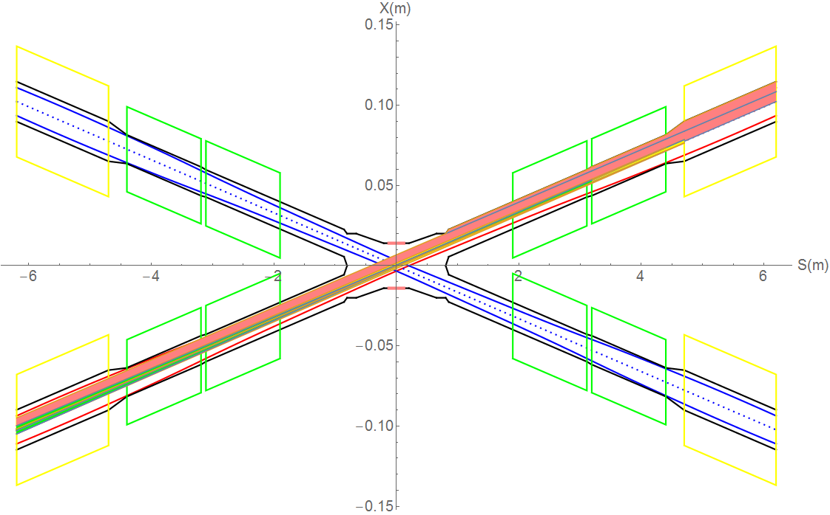
SR on IR beam pipe from last bend upstream and Final Doublet
There is no SR photons hitting the central beam pipe in normal conditions.
Single layer beam pipe with water cooling, SR heat load is not a problem.
QF1
Region | SR heat load | SR average power density
0~805mm | 0 | 0
805mm~855mm | 12.5W | 69.4W/cm²
855mm~1.9m(QDa entrance） | 1.06W | 0.28W/cm²
QDa | 1.19W | 0.27W/cm²
QDa~QDb | 3.73W | 12.95W/cm²
QDb | 1.31W | 0.3W/cm²
QDb~QF1 | 26.5W | 4.9W/cm²
QF1 | 2.39W | 0.44W/cm²
QDb
QDa

Slide 7
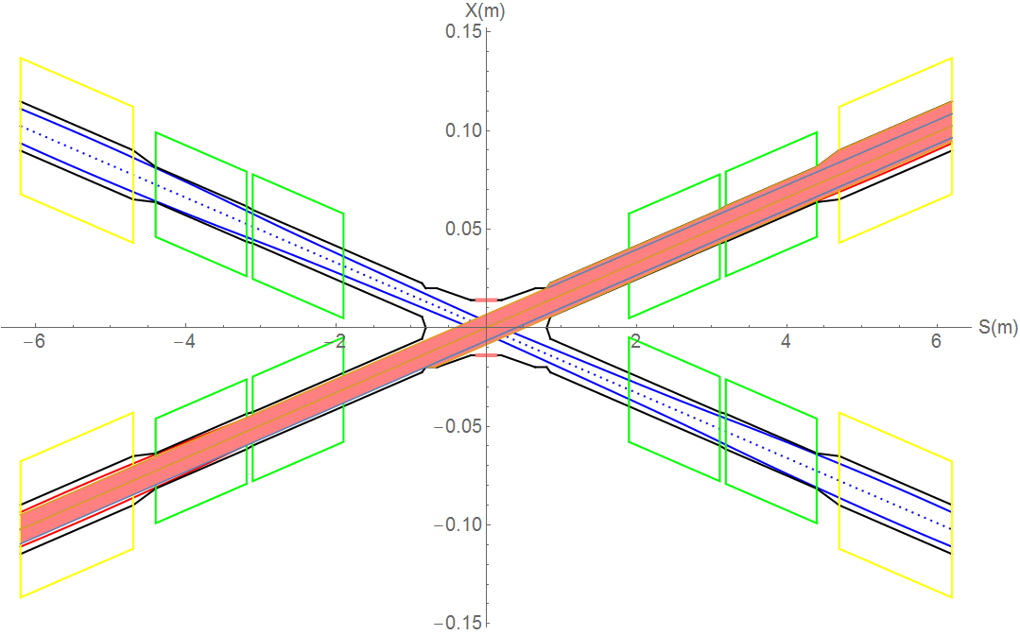
SR from last bending magnet upstream of IP
Abnormal condition
SR photons hitting the bellows under the extreme beam conditions, temperature rise ~1⁰C
Extreme condition, eg, if a magnet power is lost, a large distortion will appear immediately for the whole ring orbit. The beam will be lost when exceeded.
In extreme cases ~ at least 10 times per day. The beam will be stopped within 0.5ms when abnormal. It is not afraid of this 0.5ms for other material beam pipe except beryllium pipe.
The background of the detector should not be considered under abnormal conditions.
It is not necessary to care about whether the beam orbit deviation will affect detector operation, since the high background part will be removed when data analysis is carried out.
SR will enter into the bellows (no cooling):
IP~677mm, no SR heat load.
-677~-805mm beam pipe, SR power ~14.65W, APD~ 31.8W/cm².
-805~855mm beam pipe, SR power~12.96W, APD~72W/cm².
Temperature rise ~1⁰C

Slide 8
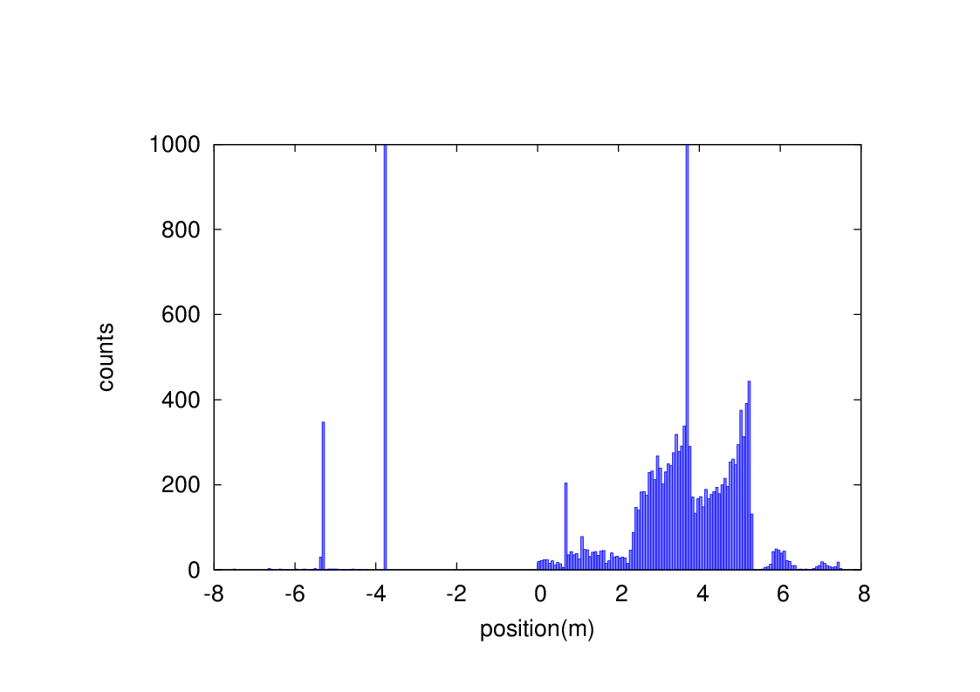
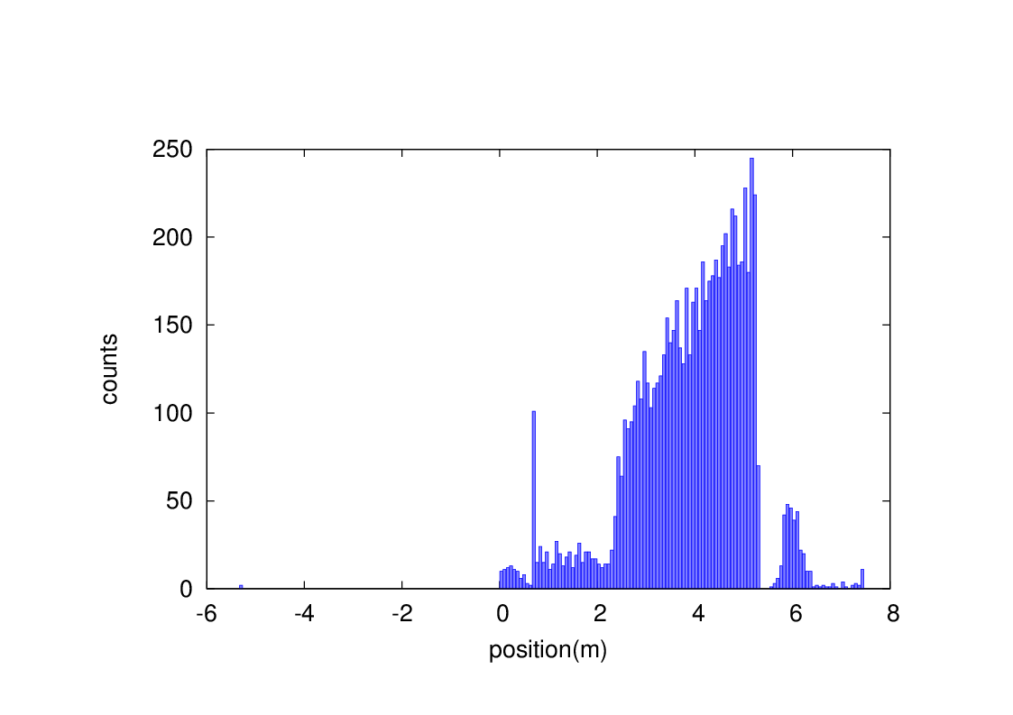
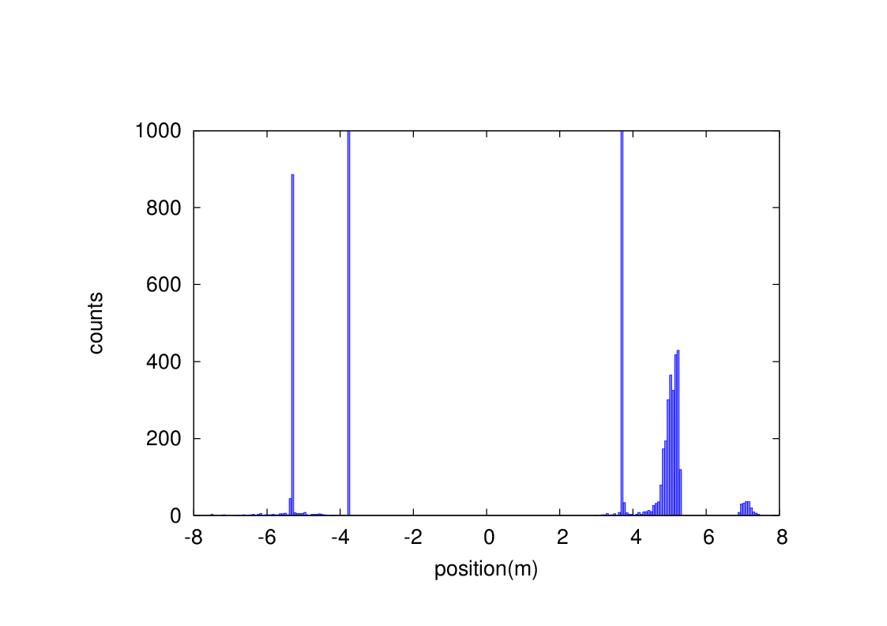
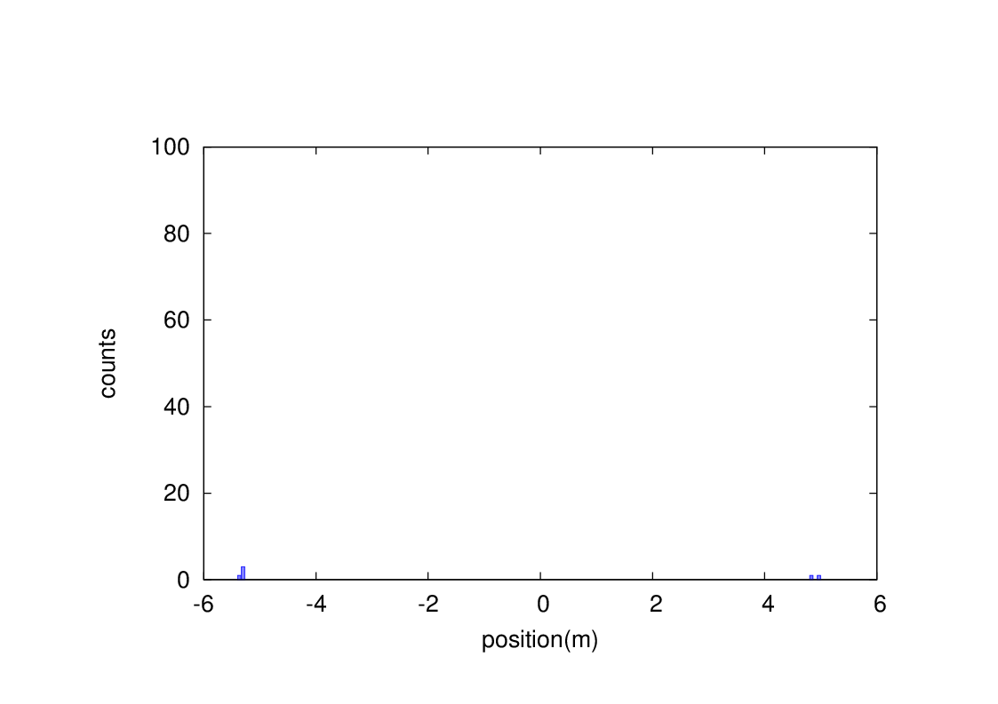
Beam loss from RBB and BS
Without collimator
With collimator
Radiative Bhabha scattering
Without collimator
With collimator
Beamstrahlung

Slide 9
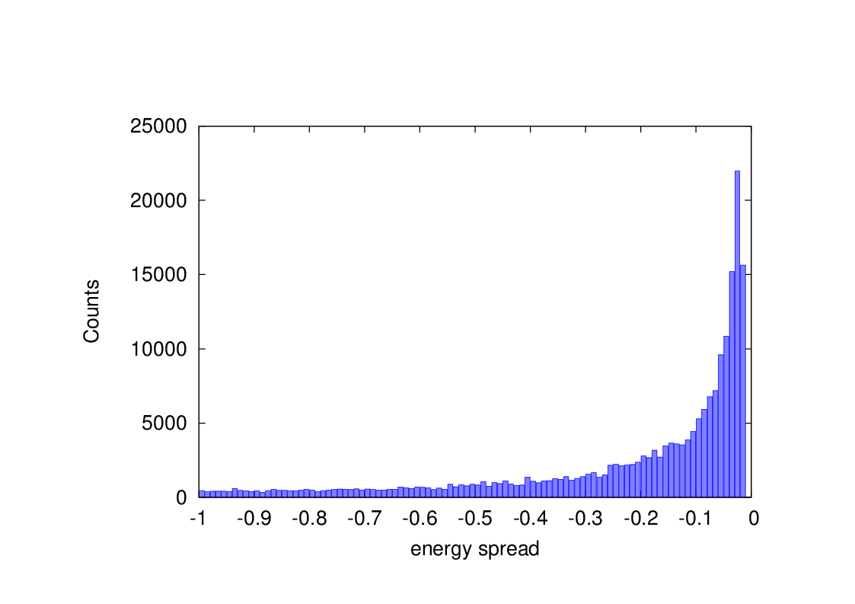
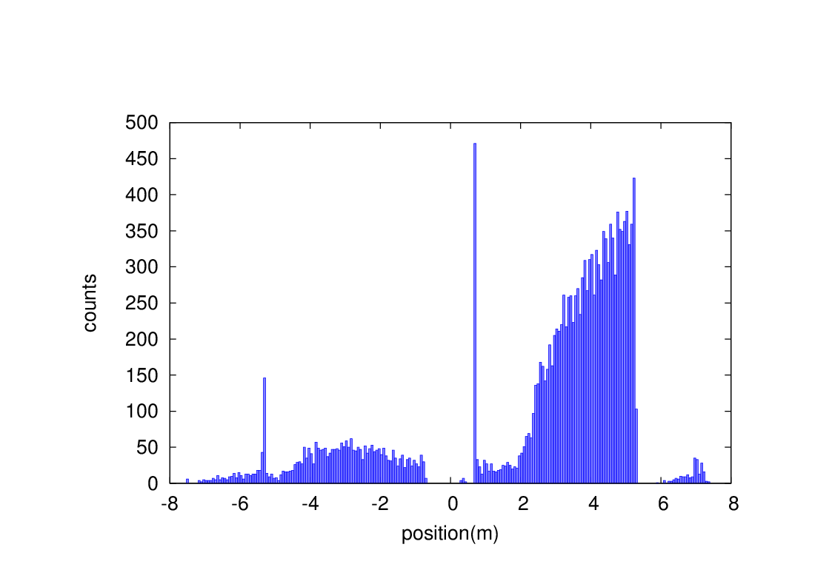
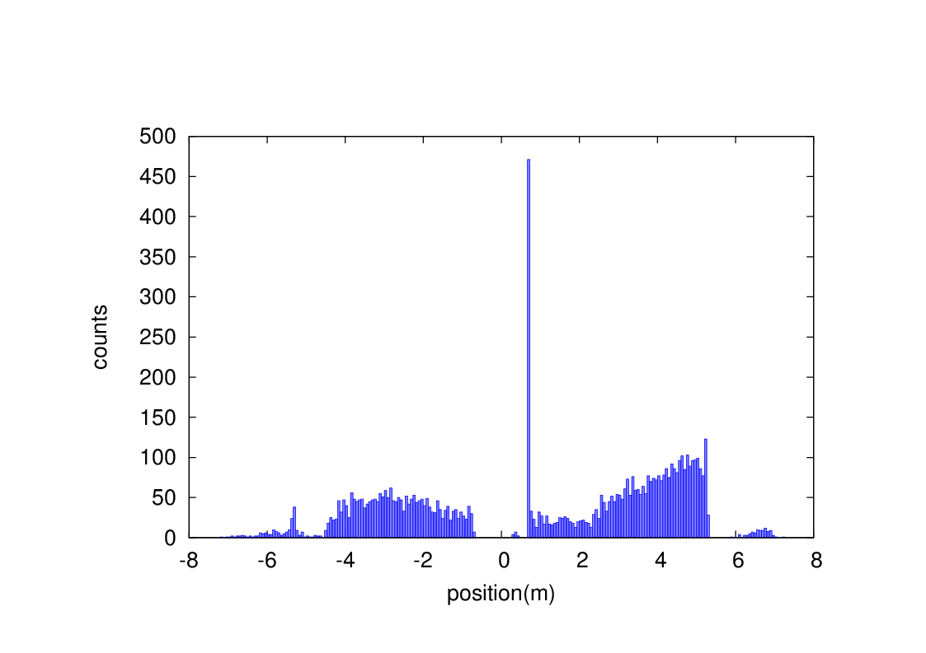
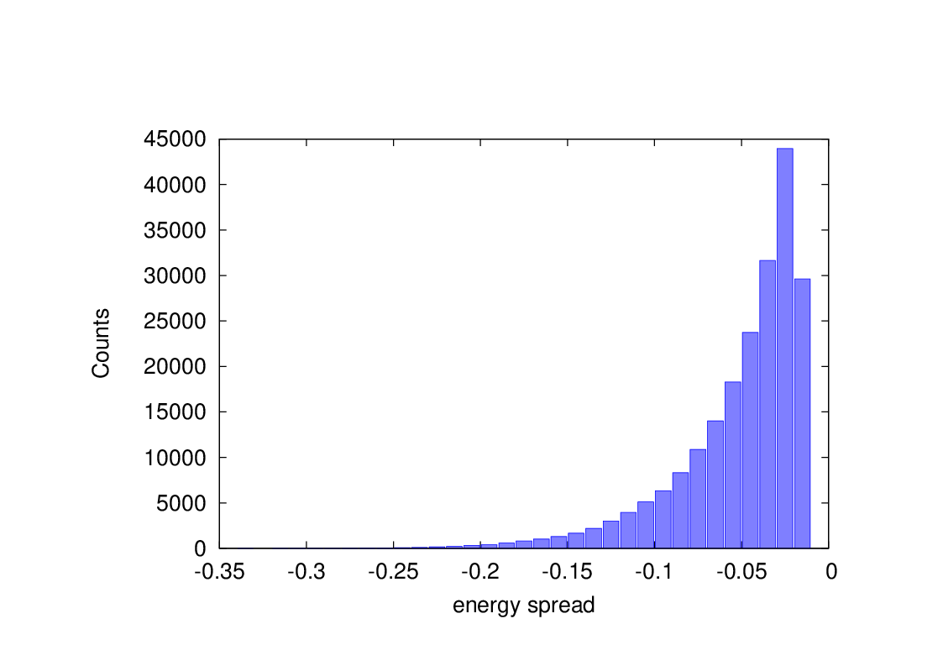
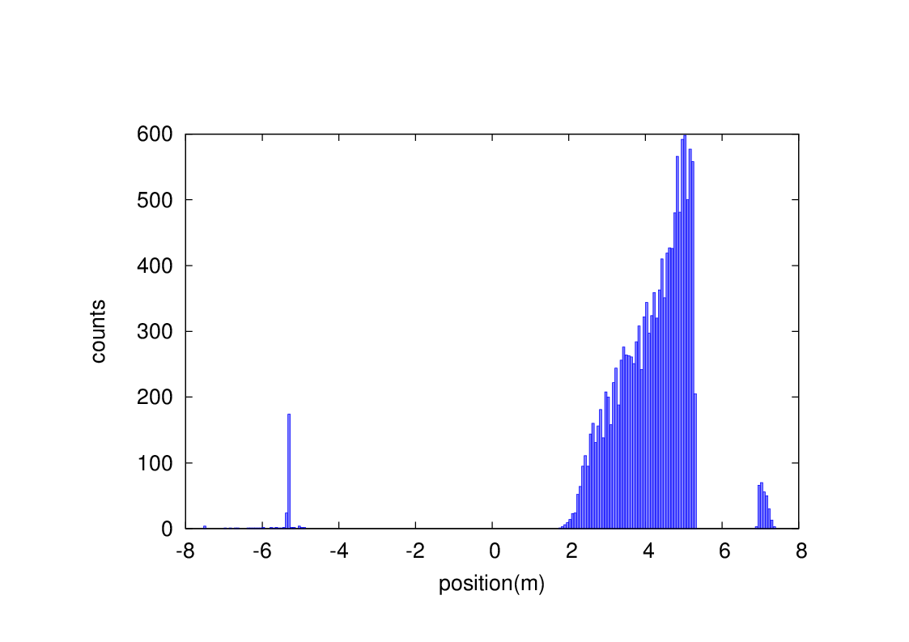
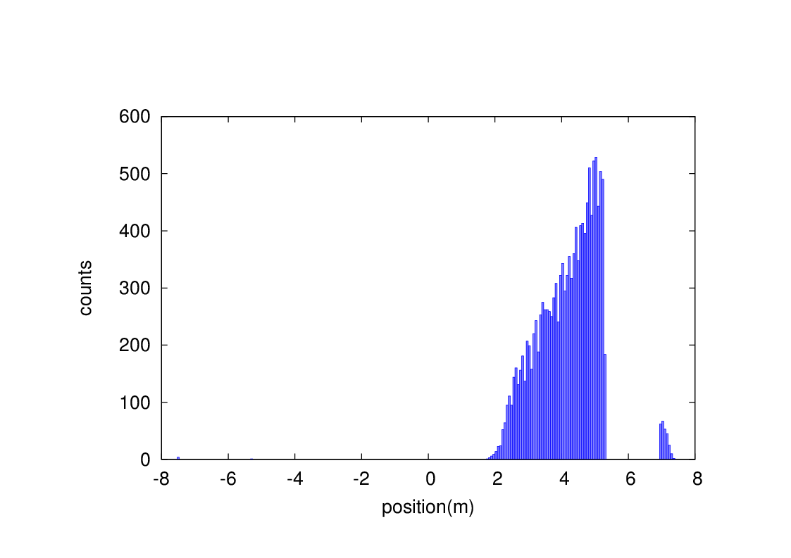
Beam loss from Beam-gas bremsstrahlung and Beam thermal photon scattering
events
Without collimator
With collimator
BG
events
Without collimator
With collimator
BTH

Slide 10
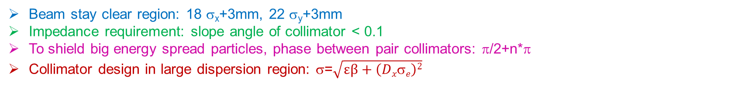
Collimator design
Beam stay clear region: 18 σ_{x}+3mm, 22 σ_{y}+3mm
Impedance requirement: slope angle of collimator < 0.1
To shield big energy spread particles, phase between pair collimators: π/2+n*π
Collimator design in large dispersion region: σ=$\sqrt{εβ+\left(Dxσe\right)2}$
name | Position | Distance to IP/m | Beta function/m | Horizontal Dispersion/m | Phase | BSC/2/m | Range of half width allowed/mm
APTX1 | D1I.785 | 2388.31 | 100.99 | 0.2 | 384.11 | 0.00181 | 1.81~8.42
APTX2 | D1I.787 | 2325.75 | 100.99 | 0.2 | 384.36 | 0.00181 | 1.81~8.42
APTY1 | D1I.791 | 2075.48 | 19.52 | 0.1995 | 387.46 | 0.003348 | 0.079~3.3
APTY2 | D1I.793 | 2012.92 | 19.52 | 0.1995 | 387.71 | 0.003348 | 0.079~3.3
APTX3 | D1O.5 | 1856.35 | 101.95 | 0.20 | 6.877 | 0.00182 | 1.82~8.45
APTX4 | D1O.7 | 1918.92 | 101.95 | 0.20 | 7.127 | 0.00182 | 1.82~8.45
APTY3 | D1O.10 | 2075.33 | 101.95 | 0.1 | 7.75 | 0.00182 | 0.182~3.67
APTY4 | D1O.16 | 2388.17 | 101.95 | 0.1 | 9.00 | 0.00182 | 0.182~3.67
horizontal collimator half width 4mm(13σ_{x}), Vertical collimator half width 3mm (22σ_{y})
The collimators will not have effect on the beam quantum lifetime.

Slide 11
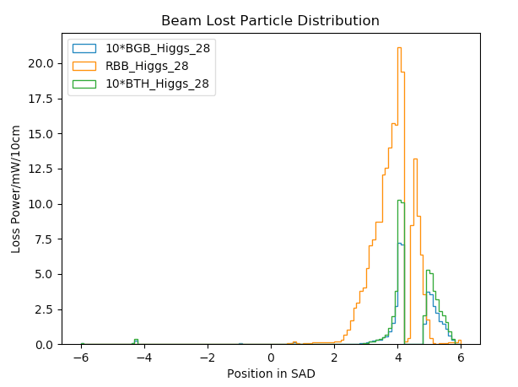
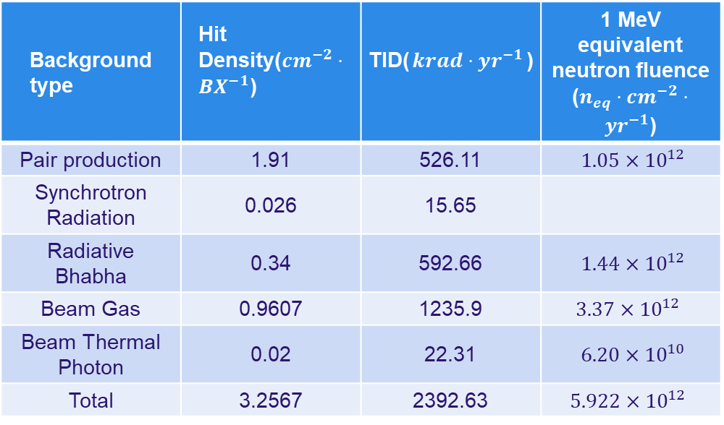
Radiation background
Including Radiative Bhabha, Beam-Gas, Beam Thermal Photon. Almost No Beamstrahlung.
Normalized to loss power in mW(one beam).
Higgs mode in CDR.
Higgs Backgrounds on 1st layer of Vertex.
With a safety factor of 10.
Background type | Hit Density($cm^{−2}⋅BX^{−1}$) | TID($krad⋅yr^{−1}$) | 1 MeV equivalent neutron fluence ($n_{eq}⋅cm^{−2}⋅yr^{−1}$)
Pair production | 1.91 | 526.11 | $1.05×{10}^{12}$
Synchrotron Radiation | 0.026 | 15.65
Radiative Bhabha | 0.34 | 592.66 | $1.44×{10}^{12}$
Beam Gas | 0.9607 | 1235.9 | $$3.37×{10}^{12}$$
Beam Thermal Photon | 0.02 | 22.31 | $6.20×{10}^{10}$
Total | 3.2567 | 2392.63 | $$5.922×{10}^{12}$$

Slide 12
Heat load in IR from beam loss
Region | SR heat load from RBB | SR heat load from BS | SR heat load from BG | SR heat load from BTH
Berryllium pipe | 6.7mW | 0 | 0 | 0
Detector beam pipe | 0.024W | 0 | 4.8uW | 1.2uW
Accelerator beam pipe before QDa | 0.17W | 0 | 4.2uW | 1.2uW
QDa~QDb | 2.13W | 3.8uW | 5.9uW | 1.8uW
QDb~QF1 | 0.01W | 3.8uW | 0.5uW | 0.6uW
QF1 | 0.26mW | 0 | 3.7uW | 0.66uW
Heat load in IR from beam loss background is so small, compared to synchrotron radiation and HOM.

Slide 13
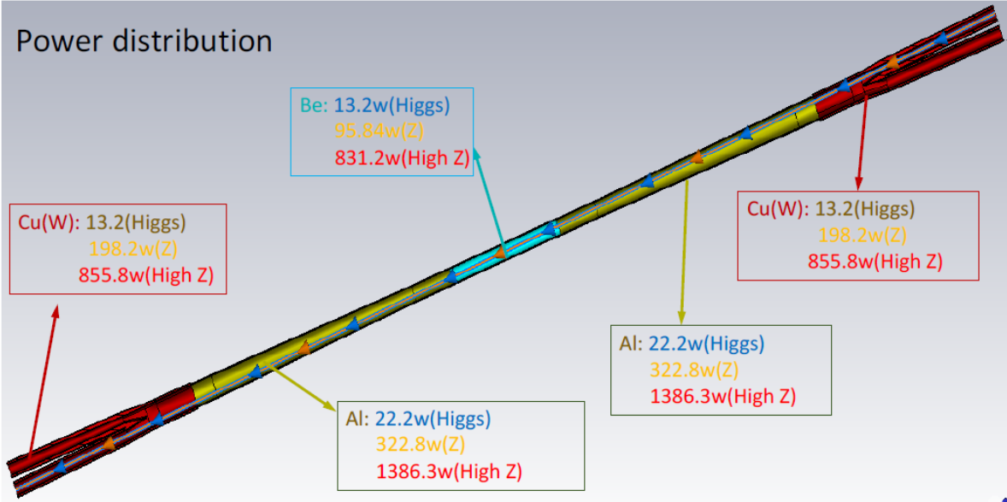
HOM power distribution

Slide 14
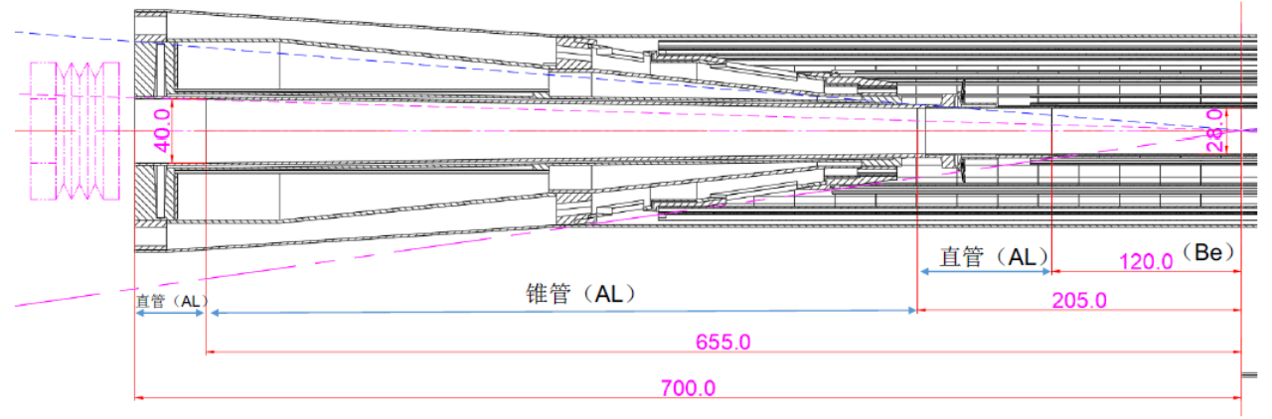
Beam pipe structure
Berryllium (central) and Aluminum(forward) beam pipes
From IP(mm) | Shape | Inner diameter(mm) | Material | Inner surface area(mm²) | Marker
0-120 | Circular | 28 | Be | 10556
120~205 | Circular | 28 | Al | 7477
205~655 | Cone | 28~40 | Al | 48071 | Taper: 1.75
655~700 | Circular | 40 | Al | 5655

Slide 15
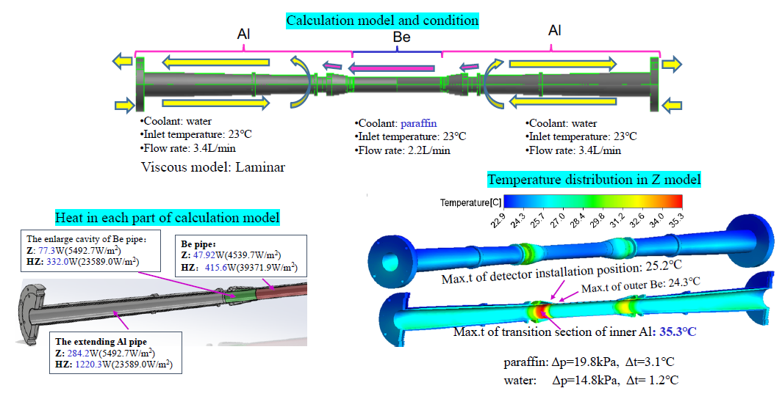
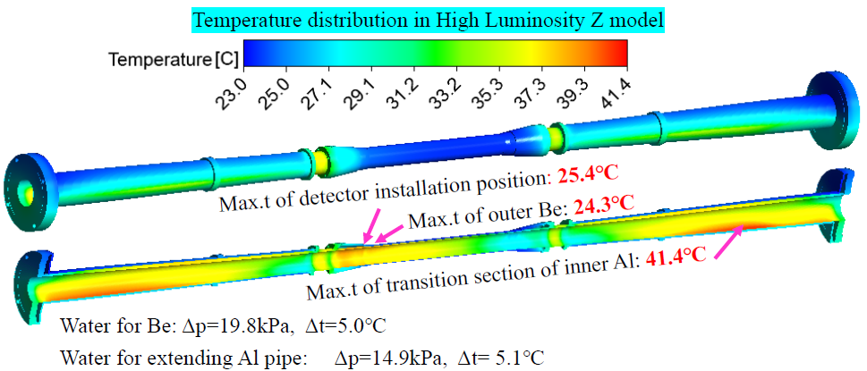
Beam pipe thermal analysis
With the heat deposition in High Luminosity Z mode, it becomes impossible to cool the Be beam pipe with oil. Water is chosen as the coolant for the demonstration purpose.
Water flow rate for Be: 3.4L/min
Water inlet temperature: 23⁰C
Other calculation condition is the same as before
High Lumi Z parameters
CDR Z parameters

Slide 16
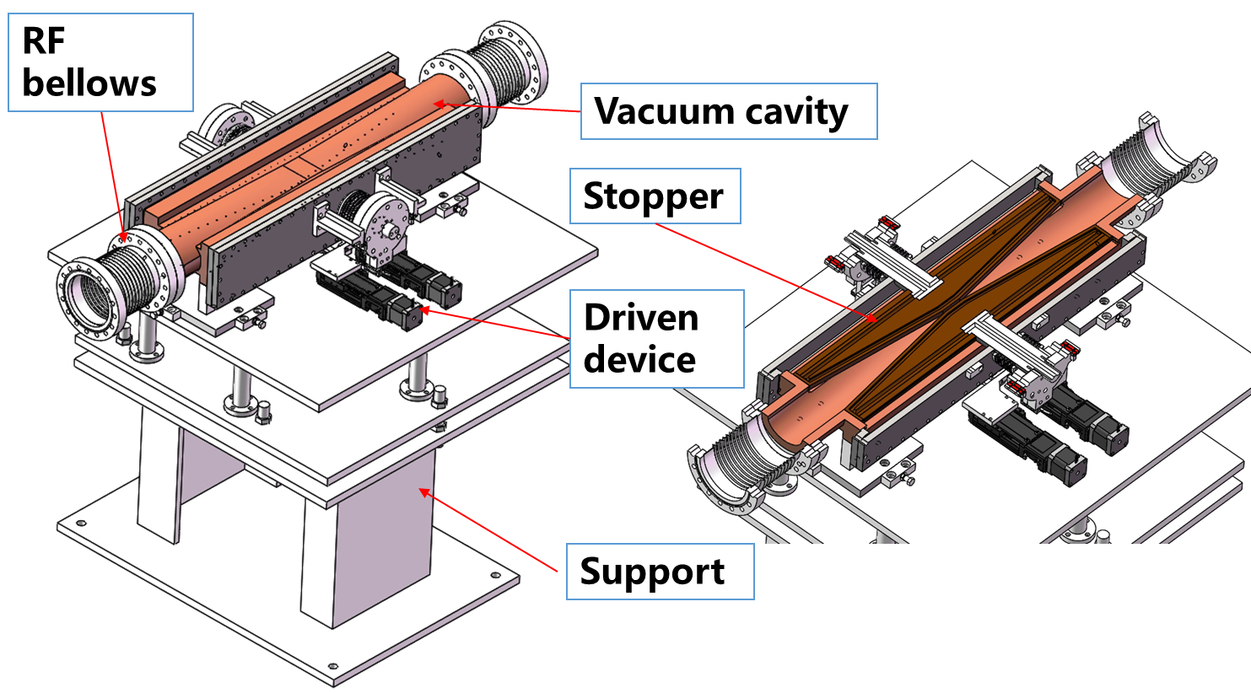
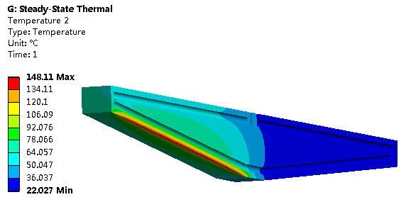
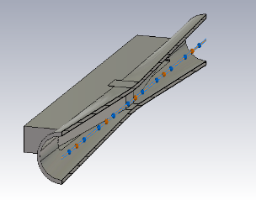
Movable collimators
Located in straight section between two dipoles, the length is 800 mm.
SR power: 7700W @120GeV, 30MW
Highest temperature: 148 ℃
Loss-Factor: 0.045V/pC
P_{loss}: 18.8w(Higgs)/76.1w(W)/265.8w(Z)

Slide 17
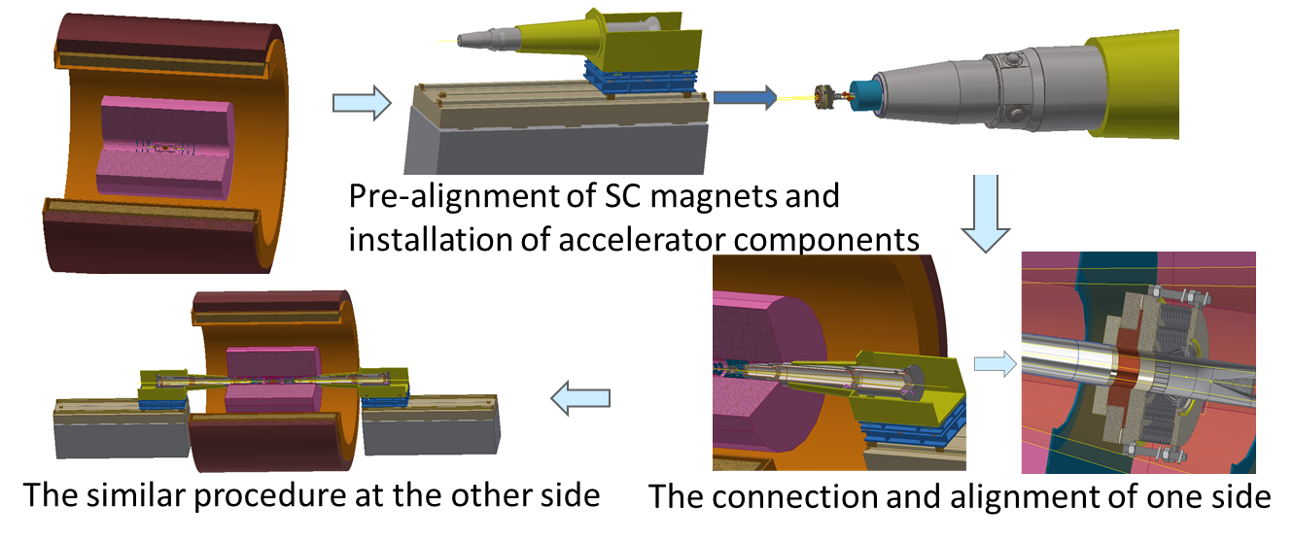
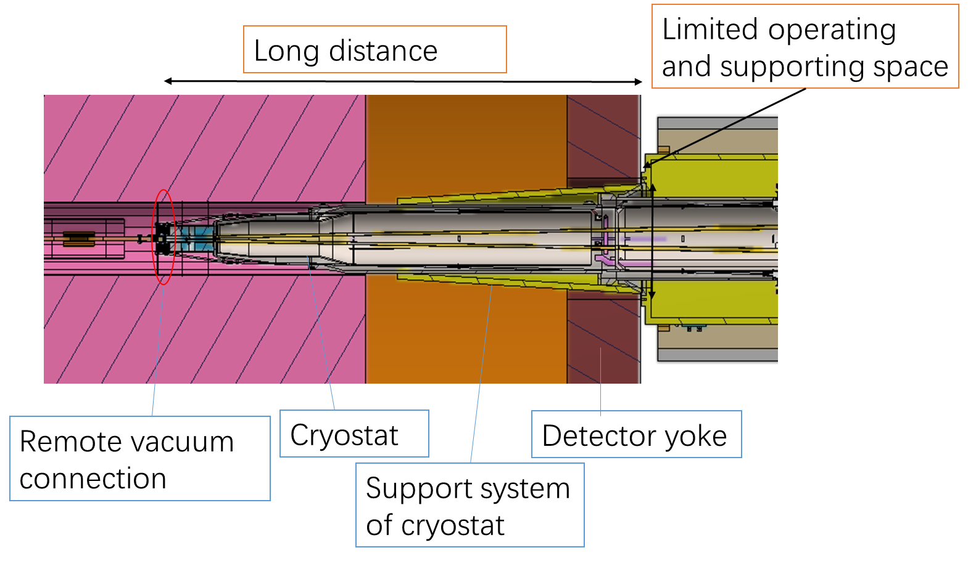
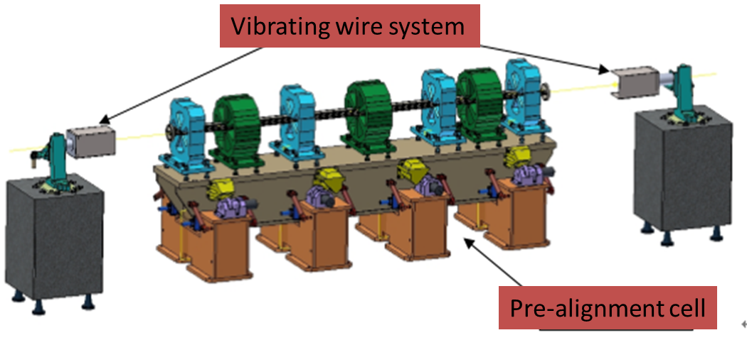
MDI integration and alignment
Alignment scenario:
  Pre-align the SC magnets using vibrating wire system to “certain location” to compensate the effect of loads.
  Align the SC magnets in two cryostats using optical system.
  Measure misalignment using SSW and adjust by corrector magnets meet the alignment requirements.
VWS is a candidate pre-alignment method, accuracy of magnet centers: ≤10 μm

Slide 18
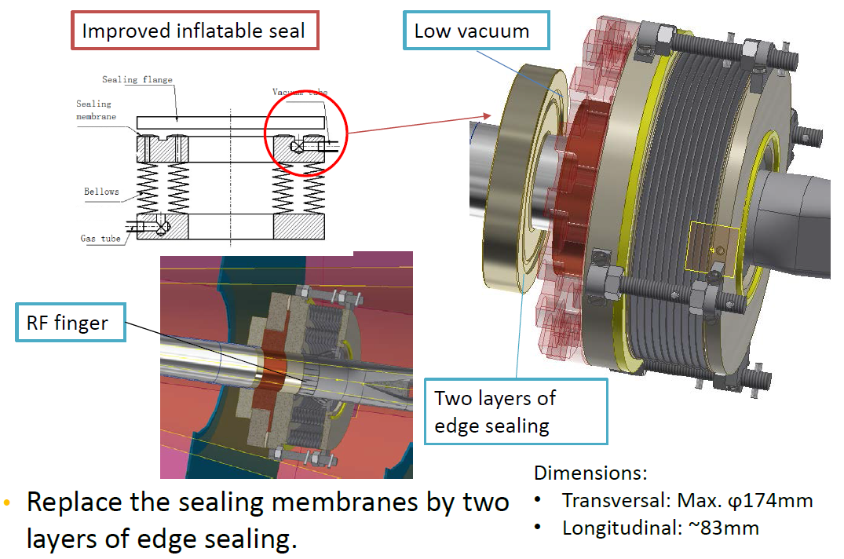
Remote vacuum connector
Difficulties:
  Transversal space: All the structure should be within detection angle.
  Leak rate requirement: Ultra-high vacuum. Leak rate requirement: ≤2.7e-11Pa.m3/s
  Longitudinal space: Bellows should absorb deformation when baking. →Add Z-direction support, length has been decreased to 83mm.
  Minimize thermal loads: The thermal loads mainly includes SR power and HOM power.→ Avoid SR power by layout design, and decrease HOM power by RF finger.
  Cooling: It is hard to dissipate the heat at RF finger which is thin, low thermal conductivity and far from the coolant.→ FEA

Slide 19
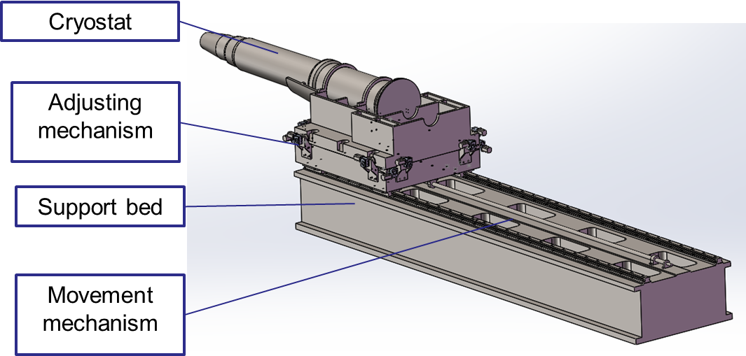
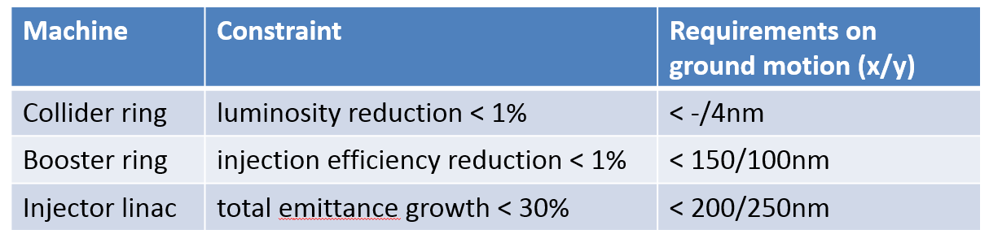
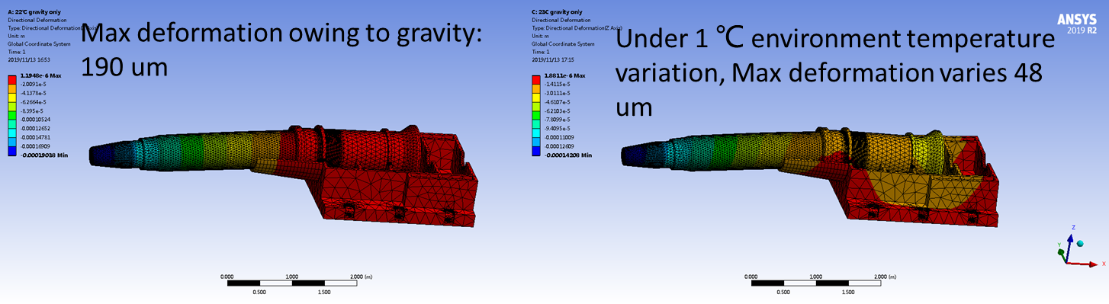
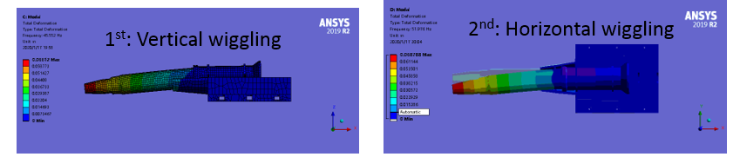
SC magnet supports
Key points
  Stability (static and modal)
  Accuracy
  Easy-operating
  Dimensions
conflict
High stiffness for stability Flexibility for high accuracy.
Studies on support stiffness is on-going.
Motor driven wedges jacks for high stiffness and accuracy.
Auxiliary support, high damping material/structure are also in consideration

Slide 20
Summary
The final focusing length has changed from 2.2m to 1.9m in High Luminosity Higgs.
There is no SR photons hitting the central beam pipe in normal conditions.
Single layer beam pipe with water cooling, SR heat load is not a problem.
SR photons hitting the bellows under the extreme beam conditions, temperature rise ~1⁰C
Beam loss background in High luminosity Higgs with collimators can be reduced to the same level in CDR.
Hit density on first layer of vertex detector is low from radiation background.
Heat load in IR is mainly from HOM, especially in High luminosity Z mode.
With the heat deposition in High Luminosity Z mode, it becomes impossible to cool the Be beam pipe with oil. Water is chosen as the coolant for the demonstration purpose.
Highest temperature on collimators from SR and HOM is 148 ℃
MDI alignment system is preliminary considered and designed.
Replace the sealing membranes by two layers of edge sealing.

Slide 21
Thanks

