Slide 1
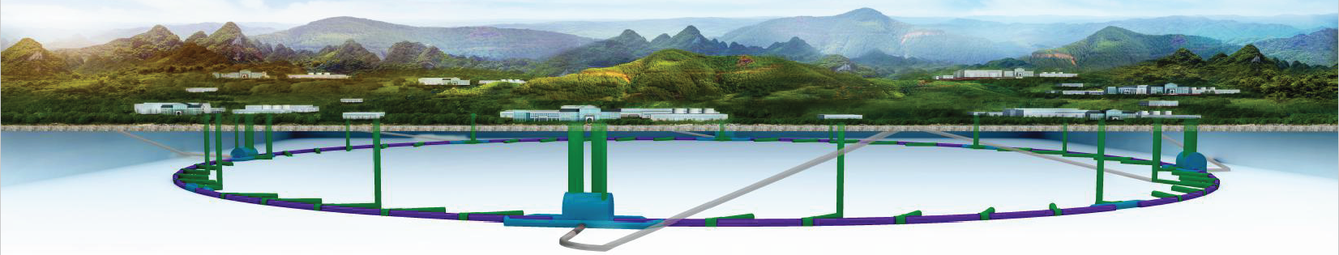
CEPC Injection/Extraction
Hardware Design Towards TDR
The IAS Program on High Energy Physics 2021 , Jan. 19-21, 2021 , Online
Jinhui Chen, Lihua Huo , Yuwen Wu, Hua Shi , Guanjian Wu, Zilin Chen, Guanwen Wang, Lei Wang, X.H. Cui, D. Wang, Yiwei Wang
Injection group
2021-1-20

Slide 2
Outline
1
Overview of CEPC Inj./Ext. systems
2
DR Inj./Ext. system hardware design towards TDR
3
BST LE inj. system hardware design towards TDR
4
BST HE ext. system hardware design towards TDR
5
Summary

Slide 3
Overview of the CEPC injection and extraction systems

Slide 4
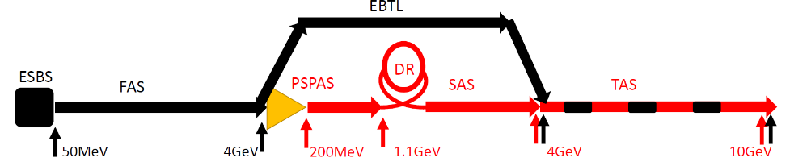
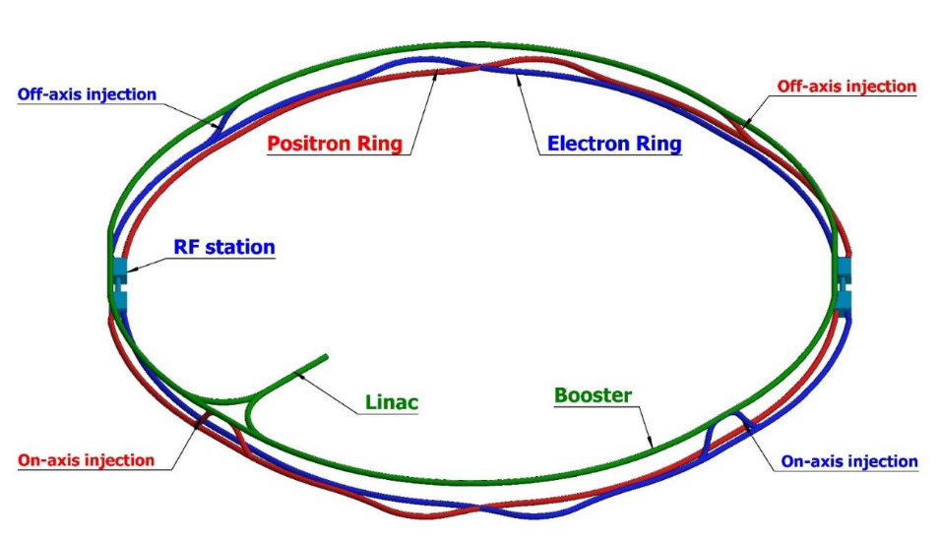
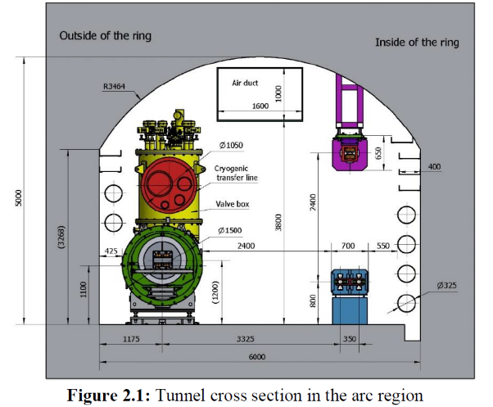
Layout of the accelerator complex
The CEPC accelerator complex consists of a Linac, which including a small damping ring for positron beams, several transport lines, a booster ring and 2 storage rings, all of which are in a single tunnel.
1.2km
120GeV
120GeV
100km
Dump
Damping ring
Dump
e+
e-
10-120GeV

Slide 5
CEPC injection and extraction systems
There are 9 injection and extraction sub-systems in CEPC accelerator complex, including:
DR injection and Extraction system(e+)
Booster LE injection system (e+,e-)
Booster Extraction system1 (e+,e-)
Collider off-axis injection system (e+,e-)
Booster Extraction system2 (e+,e-)
Booster HE injection system (e+,e-)
Collider swap out injection system (e+,e-)
Collider swap out extraction system (e+,e-)
Collider beam dump system(e+,e-)
Off-axis injection
(in W and Z mode)
On-axis injection
(only in Higgs mode)
③
④
⑤
⑦
①
②
Linac
Booster
⑥
⑧
Collider
⑨
dump
1.1GeV
10~120GeV
120GeV
DR

Slide 6
Main types of inj.&ext. hardware
 | Sub-system | Kicker Type | Kicker waveform | Septa Type | Thickness of septum
1 | Damping ring inj./ext. | Slotted-pipe kicker | Half-sine/250ns | Horizontal LMS | ф22/3.5mm
2 | Booster LE inj. | Strip-line kicker | Half-sine/50ns | Horizontal LMS | ф55/5.5mm
3 | Booster ext. for CR off-axis inj. | Delay-line dipole kicker | Trapezoid /440-2420ns | Vertical LMS | Ф55/6mm
4 | Collider off-axis inj. | Delay-line NLK kicker | Trapezoid /440-2420ns | Vertical LMS | Ф75x56/2mm
5 | Booster ext. for CR on-axis inj. | Ferrite core dipole kicker | Half-sine/1360ns | Vertical LMS | Ф55/6mm
6 | Booster HE inj. | NLK or Pulsed sextupole | Half-sine/0.333ms | Vertical LMS | Ф55/6mm
7 | Collider swap out inj. | Ferrite core dipole kicker | Half-sine/1360ns | Vertical LMS | Ф75x56/6mm
8 | Collider swap out ext. | Ferrite core dipole kicker | Half-sine/1360ns | Vertical LMS | Ф75x56/6mm
9 | Collider beam dump | Delay-line dipole kicker | Trapezoid /440-2420ns | Vertical LMS | Ф75x56/6mm
10 | RF region beam separating | Delay-line dipole kicker | CW square / 165us,50% | Horizontal Copper septa | Ф75x56/10mm

Slide 7
DR Inj./Ext. system hardware design towards TDR

Slide 8
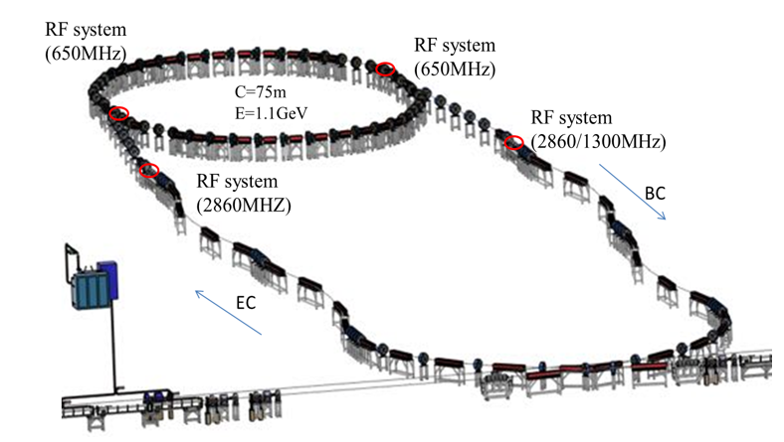
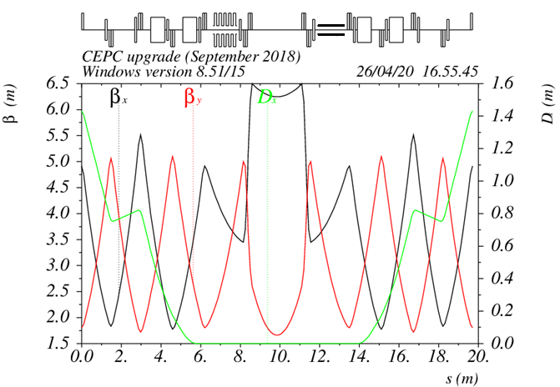
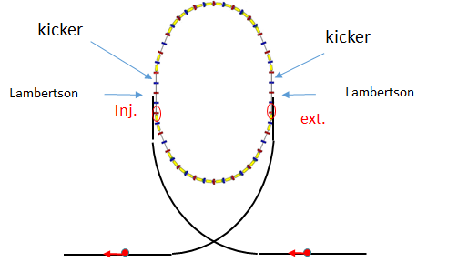
Damping ring injection and extraction system
Damping ring is dedicated to decrease emittance of positron beams
Double bunches are stored at the same time
On-axis bunch-by-bunch injection
Hardware：Vertical slotted-pipe kicker 、horizontal LSM
240mm
120mrad
1.1GeV，75.4m
250ns
125ns
10ms

Slide 9
LSM requirements for DR
Parameters | Unit | DR-LSM
Quantity | - | 2
Energy | GeV | 1.1
Horizontal deflection angle | mrad | 120
Insertion length | m | 0.5
Magnetic field strength for injected/extracted beam | T | 0.883
Min. Septum thickness（including septum board, inj./ext. beam pipe wall, installation gap) | mm | 3.5
Field uniformity | - | <±0.05%
Leakage field | - | ≤1×10⁻³
Clearance of stored beam at lambertson（H×V） （refer to stored beam orbit） | mm | 36.4×22
Clearance of inj.&ext. beam at lambertson（H×V）（refer to inj.&ext. beam orbit） | mm | 22×11
Physical aperture of stored beam vacuum chamber | mm | 22×22
Septum=3.5mm
Inj. beam
Stored beam
11mm
5.5mm
11mm
x
y
Top view
（mm）
Side view
（mm）
Injected beam | X(mm) | Y(mm) | Z(mm)
LSM in | -30.0 | -23.75 | -500.0
LSM out | 0 | -20 | 0
Stored
beam
Stored
beam
z
septum
z
Stored beam | X(mm) | Y(mm) | Z(mm)
LSM in | 0 | 0 | -500.0
LSM out | 0 | 0 | 0
Injected
beam
Injected
beam
-30.0

Slide 10
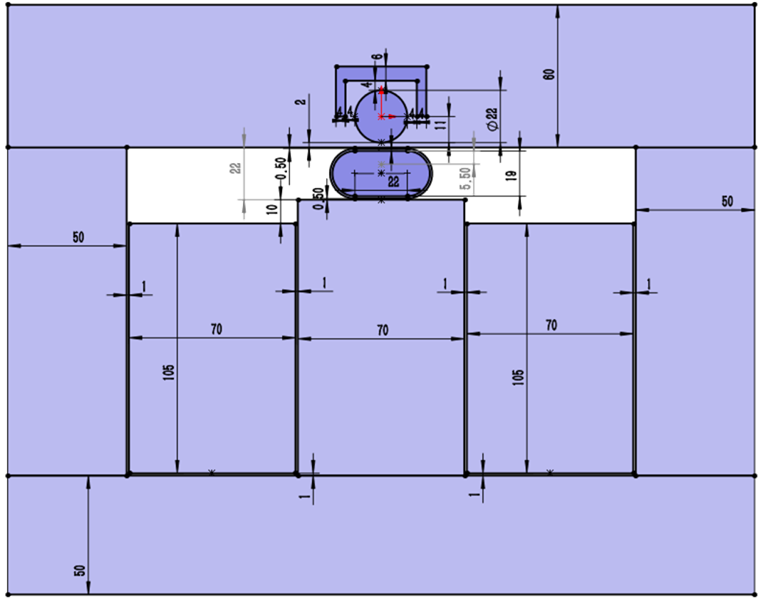
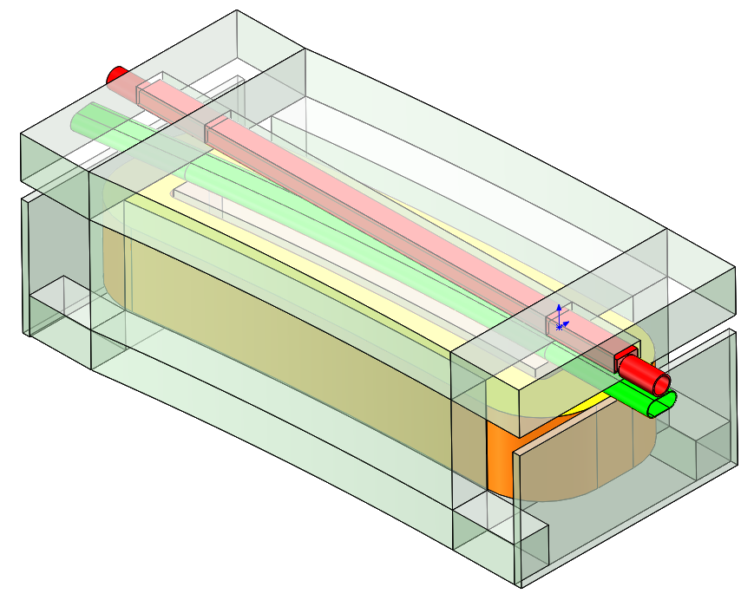
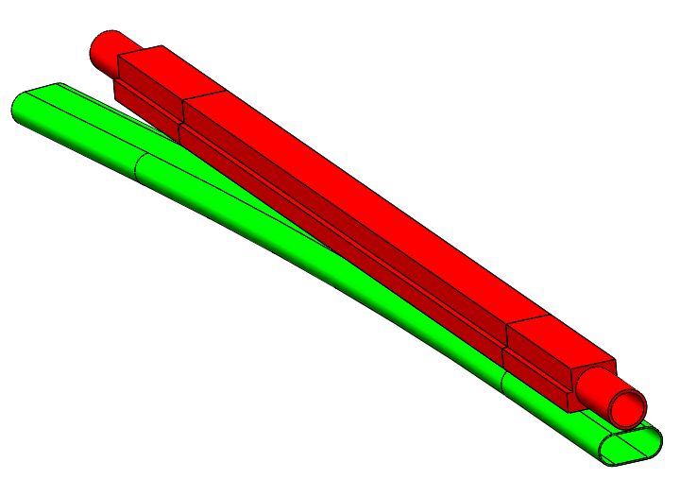
LSM physics design
Stored beam
Φ22mm
Stored beam pipe(VP) inner
diameter= ø22mm,
Thickness=2mm
Injected beam pipe (SS):
W=41mm, H=19mm,
Thickness=1mm
Septum
Thickness=2+1+0.5=3.5mm
Magnet gap: 22mm
Winding:
W=70mm,H=105mm,T=96
Exciting current=166A
Inductance=0.0228H
Yoke
1J22
2mm
0.5mm
1mm
316L
Injected beam
41×19mm
3.5mm
Installation margin
Exit of LSM
Magnet pole
Stored beam
Stored beam chamber
(VP,FeCoV,1J22)
Inj. beam
700×344×268mm
Injected beam chamber
(SS, 316L)
Yoke (DT4)
Winding (96T)
Contributed By Yuwen Wu

Slide 11
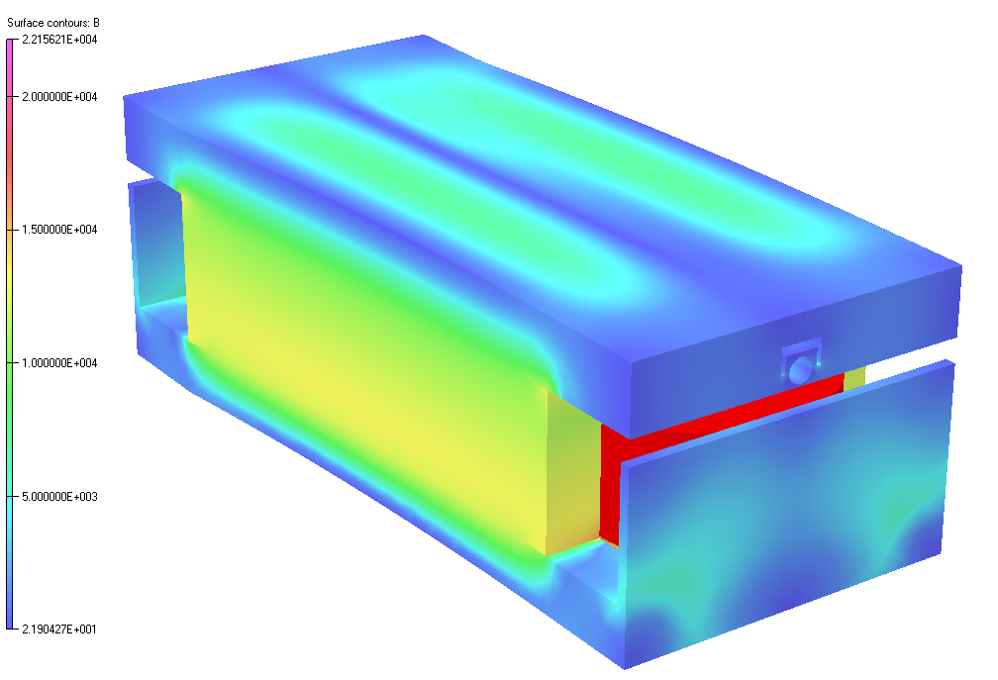
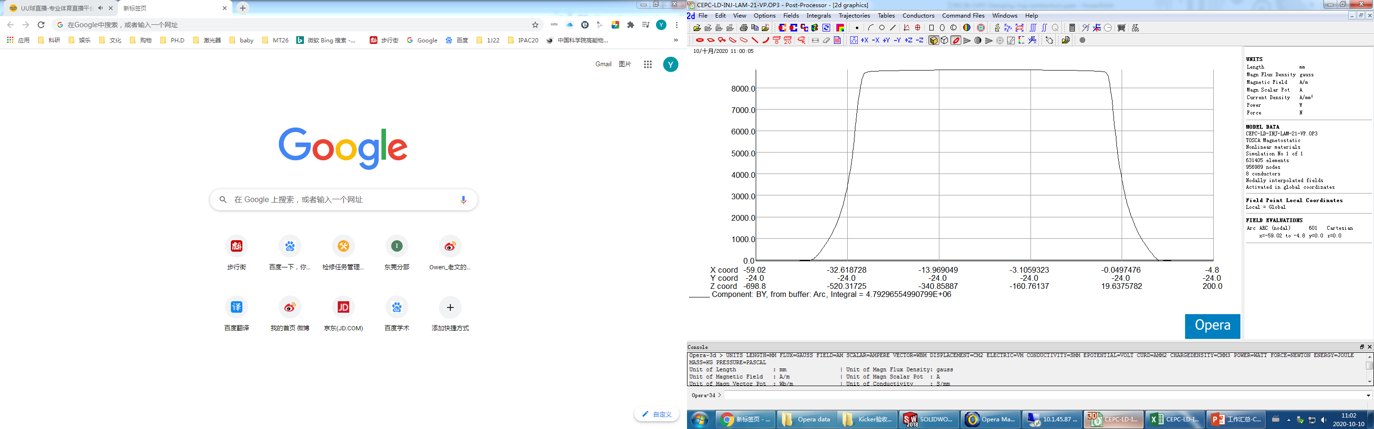
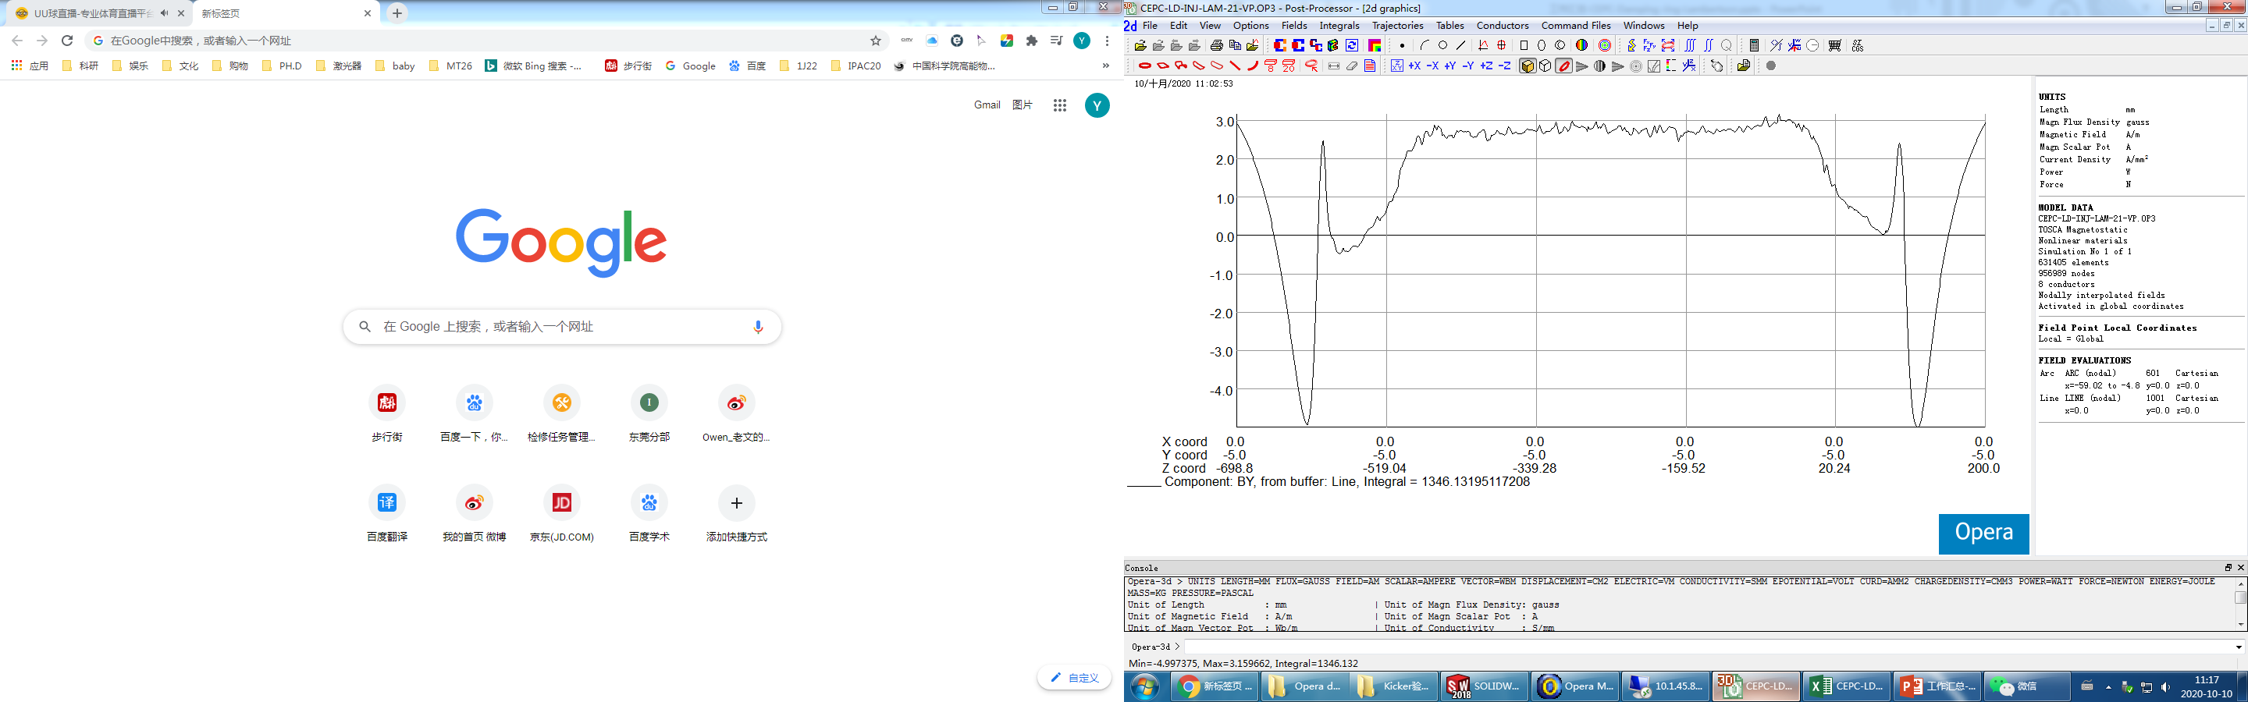
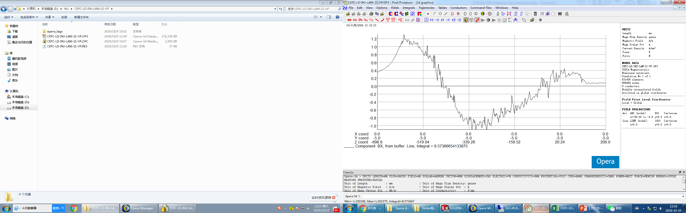
3D simulation
Stored beam vacuum chamber:1J22
Center magnetic field intensity：8836Gauss
Magnet effective length：542mm
Horizontal Leakage field：1.79E-06
Vertical Leakage field：2.81E-04

Slide 12
DR inj./ext. kicker design parameters
parameter | Unit | DR-kicker
Quantity | - | 2
Type | - | Slotted-pipe kicker
Deflect direction | - | Vertical
Beam Energy | GeV | 1.1
Deflect angle | mrad | 10.7
Magnetic effective length | m | 1.4
Magnetic strength | T | 0.0281
Integral magnetic strength | T·m | 0.03934
Clearance region(H×V) | mm | 32.8×26.6
Good field region(H×V) | mm | 19.8×16
Field uniformity in good field region | - | ±1.5%
Repetition rate | Hz | 100
Amplitude repeatability | - | ±0.5%
Pulse jitter | ns | ≤5
Bottom width of half sine pulse(5%-5%) | ns | < 250

Slide 13
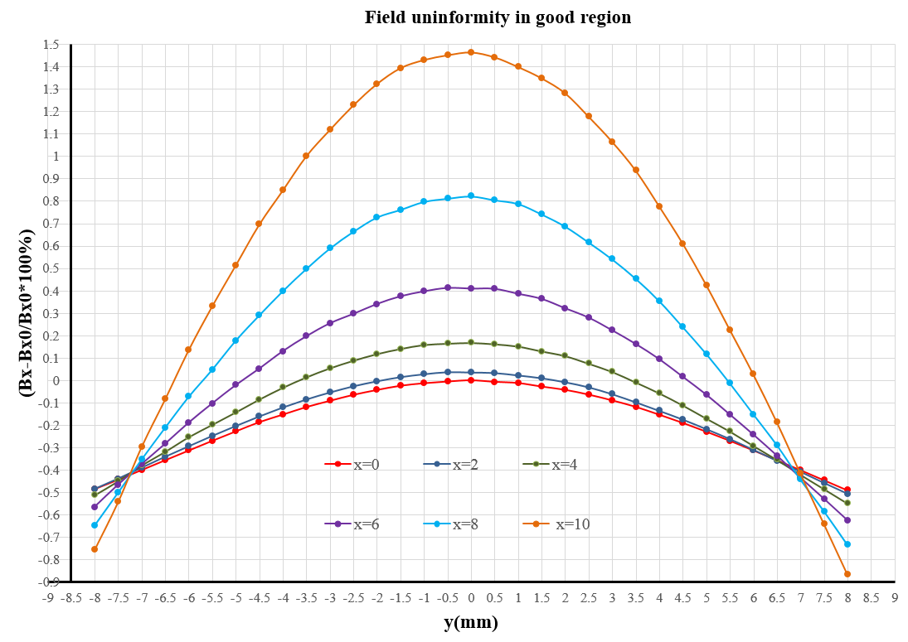
Magnet physics design
2D simulation model
Max. voltage of coil: Umax=10622V
Max. exciting current: Imax=2400A
Magnet coil inductance=387nH
Good field region: 19.8×16mm
Field uniformity: -0.9%~1.5%
x=±10, y=±8
Un.= -0.9%~1.5%
Good field region
19.8×16mm
Contributed By Lihua Huo,Lei Wang

Slide 14
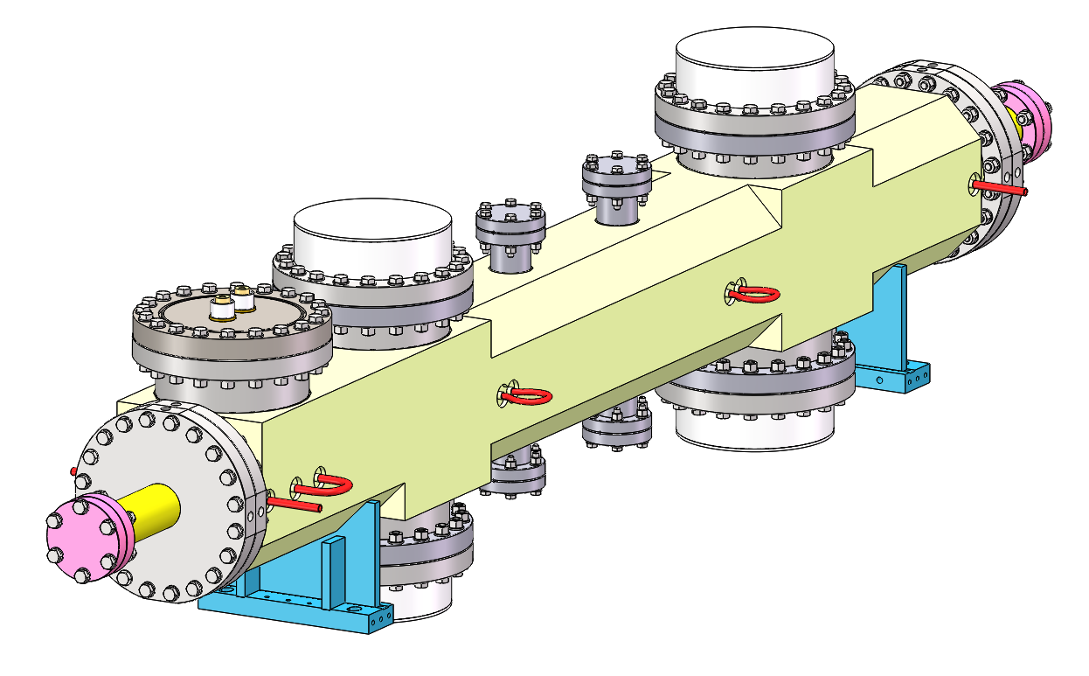
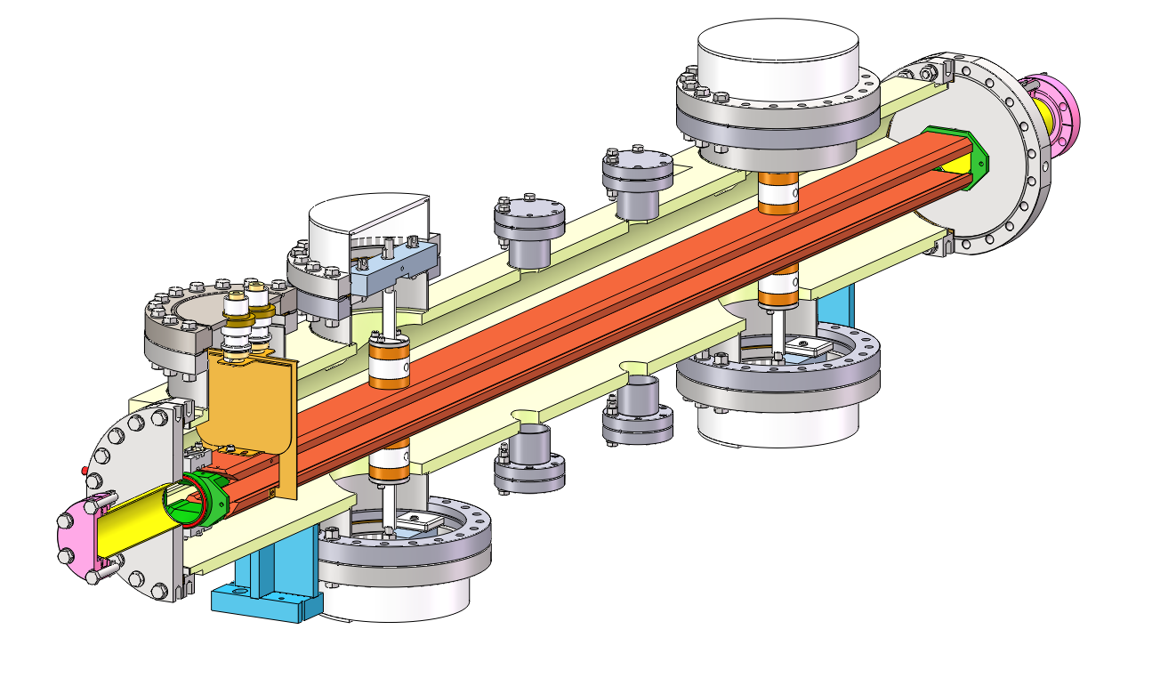
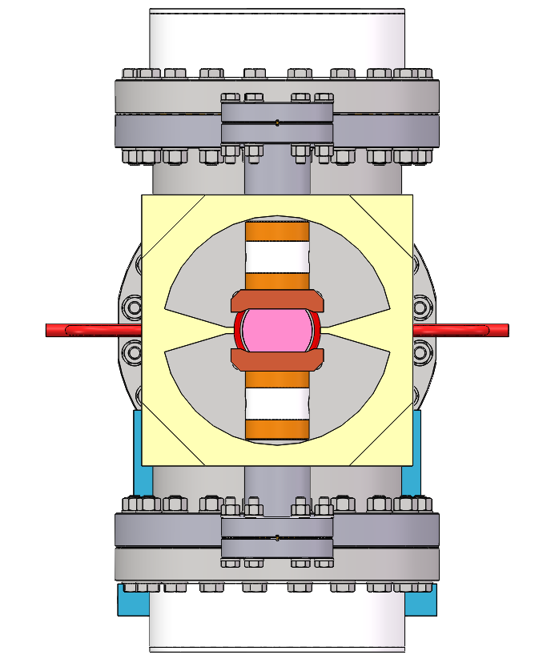
Slotted-pipe kicker engineer design
Outer body (316L)
Cooling water pipe
HV feedthrough
-
+
Busses (FOC)
insulation support (ceramic)
To vacuum pump

Slide 15
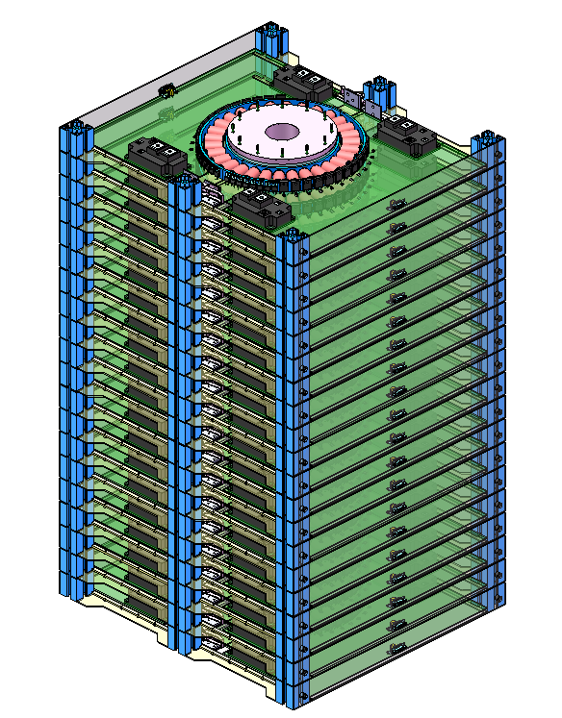
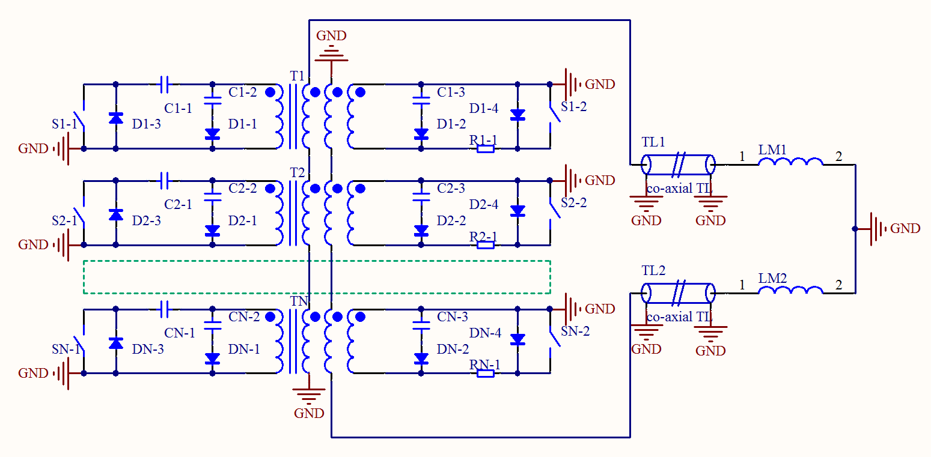
250ns-fast kicker pulser design
Scheme: 20-stage inductive adder based on SiC-MOSFETs.
The co-axial transformer is configured as bipolar output.
The pulser is located outside tunnel and 10 cables with length of 30m are applied to connect to kicker.
Due to short end of the slotted-pipe kicker, the reflection energy should be return to the pulser.
A proper absorption circuit must be designed at pulser end.
920mm
564mm
510mm
20-stage inductive adder

Slide 16
BST LE Inj. system hardware design towards TDR

Slide 17
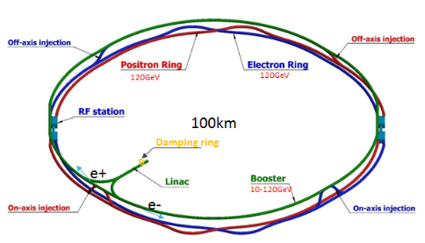
Booster LE injection system
On-axis bunch-by-bunch injection
Hardware：
  Kicker: vertical strip-line kicker driven by fast pulser
  Septa: horizontal Lambertson magnet
Side view
ϴ_{V}=0.11mrad
30.22mm
50mm
0.055mm
Q
Q
50ns,100Hz
22.5m
1m
454m
1m
Top view
478.5m
22mm
517mm
Q
ϴ_{H}=22mrad
Q
Q
Q
Q
Lambertson
kicker

Slide 18
LSM requirements for BST LE inj. system
Parameters | Unit | DR-LSM
Quantity | - | 2
Energy | GeV | 10
Horizontal deflection angle | mrad | 22
Insertion length | m | 0.8
Magnetic field strength for injected/extracted beam | T | 0.9175
Min. Septum thickness（including septum board, inj./ext. beam pipe wall, installation gap) | mm | 5.5
Field uniformity | - | <±0.02%
Leakage field | - | ≤1×10⁻³
Clearance of stored beam at lambertson（H×V） （refer to stored beam orbit） | mm | 30×50
Clearance of inj.&ext. beam at lambertson（H×V）（refer to inj.&ext. beam orbit） | mm | 18×29
Physical aperture of stored beam vacuum chamber | mm | 55×55
Inj. beam
14mm
Septum=5.5mm
27.5mm
Stored beam
27.5mm
x
y
Top view
（mm）
Side view
（mm）
Injected beam | X(mm) | Y(mm) | Z(mm)
LSM in | -22.0 | -50 | -800.0
LSM out | 0 | -50 | 0
Stored
beam
Stored
beam
z
septum
z
Stored beam | X(mm) | Y(mm) | Z(mm)
LSM in | 0 | 0 | -800.0
LSM out | 0 | 0 | 0
Injected
beam
Injected
beam
-22.0
-50.0

Slide 19
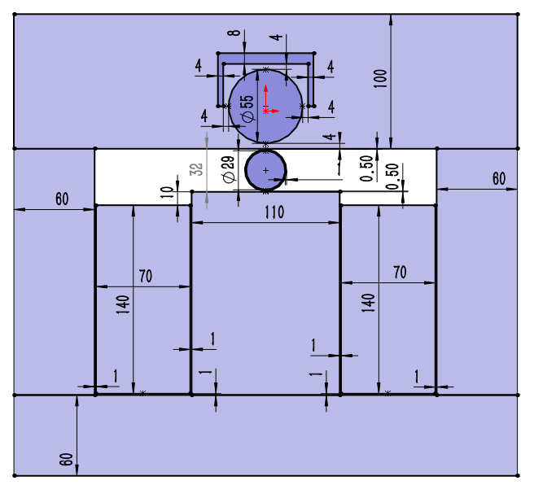
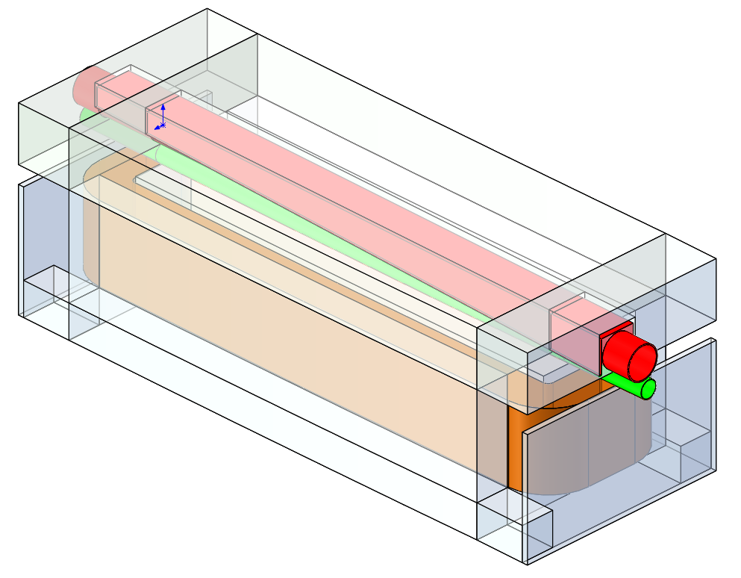
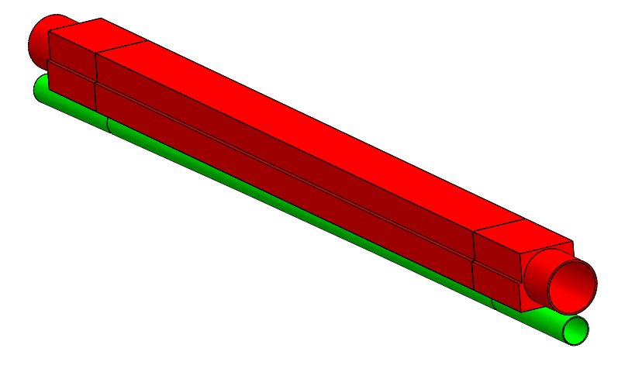
LSM physics design
Stored beam
Φ55mm
Stored beam pipe(VP) inner
diameter= ø55mm,
Thickness=4mm
Injected beam pipe (SS):
inner diameter=ø29mm,
Thickness=1mm
Septum
Thickness=4+1+0.5=5.5mm
Magnet gap: 32mm
Winding:
W=70mm,H=140mm,T=128
Exciting current=188A
Inductance=0.0682H
Yoke
1J22
4mm
0.5mm
1mm
316L
Φ29mm
5.5mm
Installation margin
Magnet pole
Exit of LSM
Injected beam
Stored beam
Stored beam chamber
(VP,FeCoV,1J22)
Inj. beam
1000×383×343mm
Injected beam chamber
(SS, 316L)
Yoke (DT4)
Winding (96T)
Contributed By Yuwen Wu

Slide 20
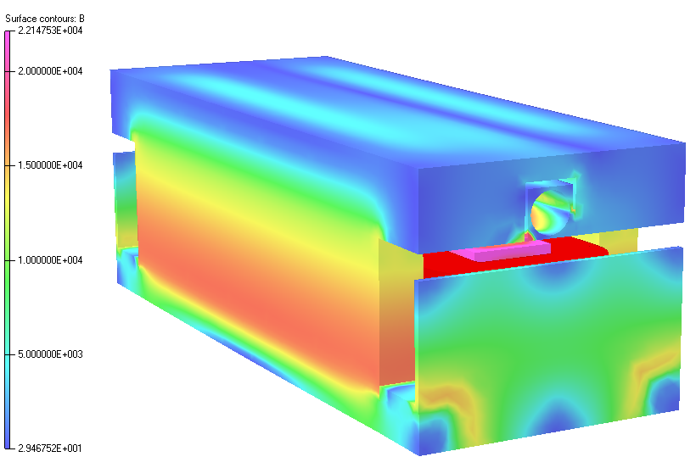
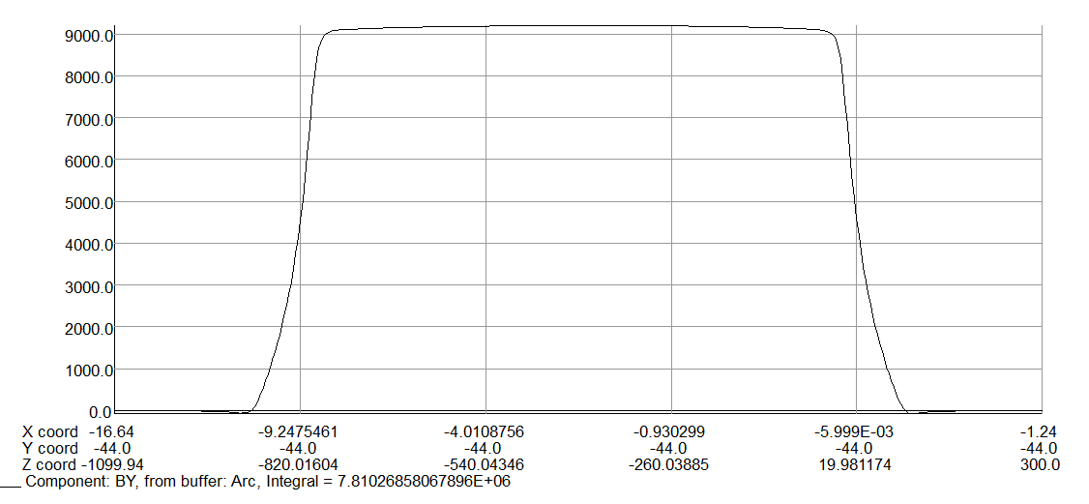
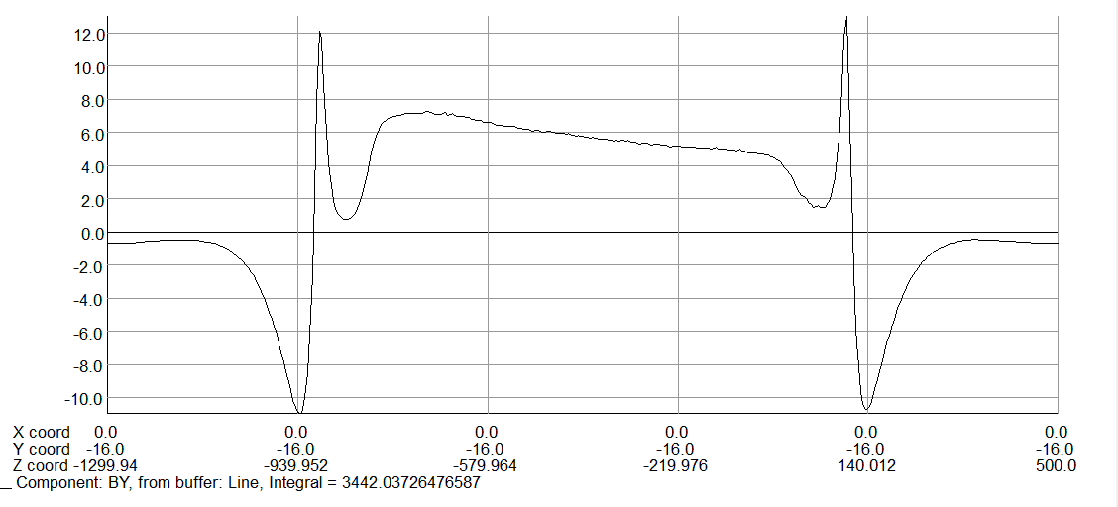
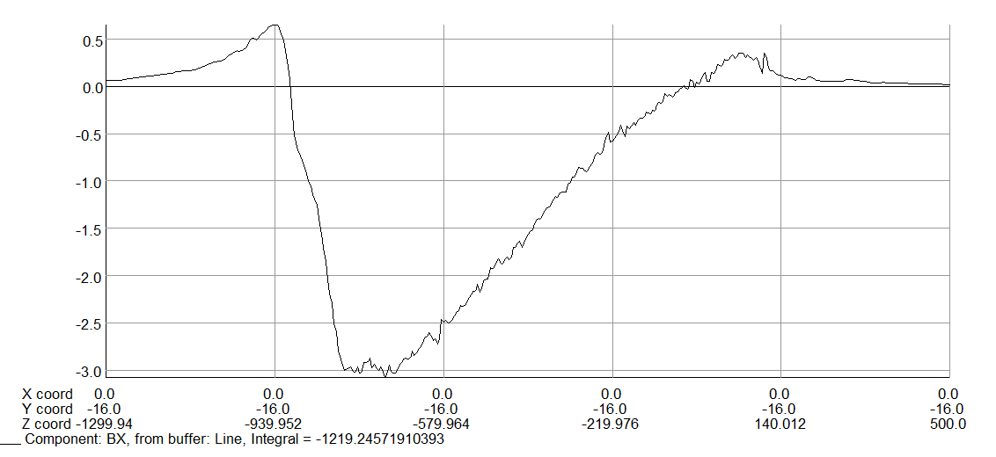
3D simulation
Stored beam vacuum chamber:1J22
Center magnetic field intensity：9200Gauss
Magnet effective length：849mm
Horizontal Leakage field： 1.56E-04
Vertical Leakage field： 4.41E-04

Slide 21
BST LE inj. kicker design parameters
parameter | Unit | Booster Low Energy injection kicker
name | - | BSTLEIK
Quantity | - | 2
Type | - | Strip-line kicker
Deflect direction | - | Vertical
Beam Energy | GeV | 10
Deflect angle | mrad | 0.11
Length of Strip-line kicker electrode | mm | 1000
Gap between two electrodes | mm | 44
Odd mode impedance | Ω | 50±1
Even mode impedance | Ω | <65
Clearance region(H×V) | mm | 22×44
Good field region(H×V) | mm | 12×22.6
Integral field uniformity | - | ±2.5%
Amplitude of electrical pulse（into 50Ω） | kV | ±12.25
Repetition rate | Hz | 100
Amplitude repeatability | - | <2% (RMS)
Pulse jitter | ns | ≤1
Bottom width of electrical pulse（3%-3%） | ns | < 50

Slide 22
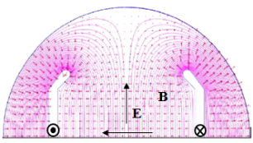
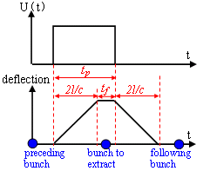
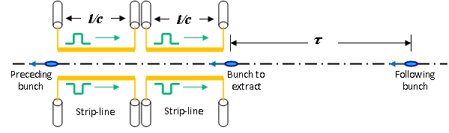
Strip-line kicker design for booster LE inj.
Kick strength
  Total kick angle: θ=0.11mrad
  E=10GeV, d=44mm, g=1 =>U*L>24.2kV∙m
  Total strip-line kicker electrode length L=1m =>U>24.2kV(or ±12.1kV)
50ns,100Hz
Here, θ is kick angle(rad)；E is beam energy(eV)；U is applied pulse voltage for both electrodes(V)；l is strip-line length；d is the distance between the electrodes，g is the geometry factor, determined by the shape of the electrode. w is the strip-line width.
Kick speed
  Min bunch spacing - τ=25ns
    Electrode length l<3.75m => l= 1m
    Electrical pulse Width 6.7ns< t_{p} <43.3ns =>Flat-top t_{top} >6.7ns, Rise/fall Time t_{r}/t_{f} <18.3ns

Slide 23
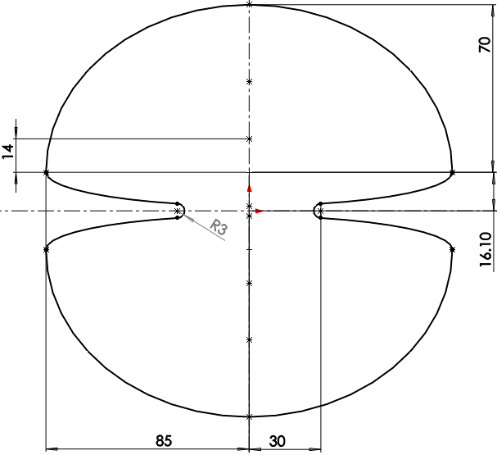
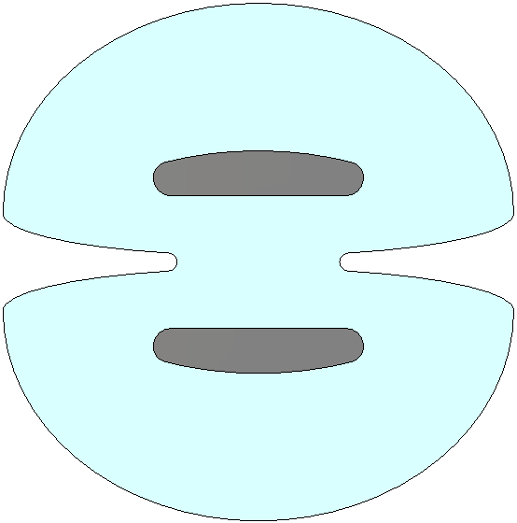
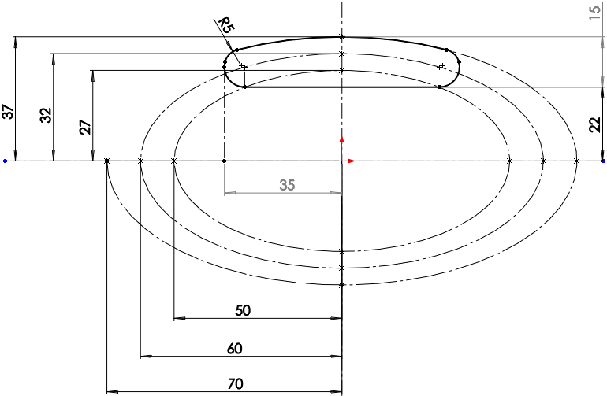
Kicker physics design
To achieve highest geometric factor(g=0.9866) the blade width should be w=70mm, when d=44mm.
Blade length=1m，thickness=10mm
Voltage between blades=24.5kV
Outer body: distance between vanes=60mm
Odd mode impedance Zodd=50Ω, even mode impedance Zeven=60.5Ω
blade
Outer body
2D-geometry
Contributed By Hua Shi

Slide 24
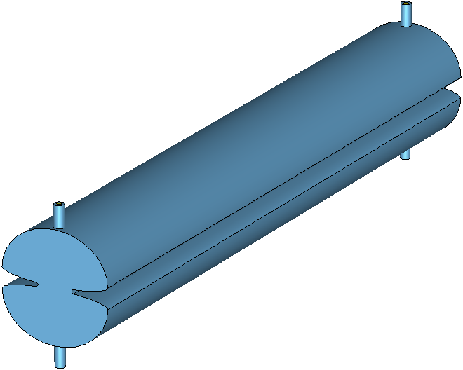
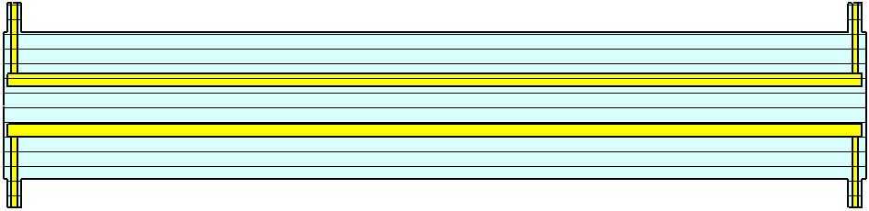
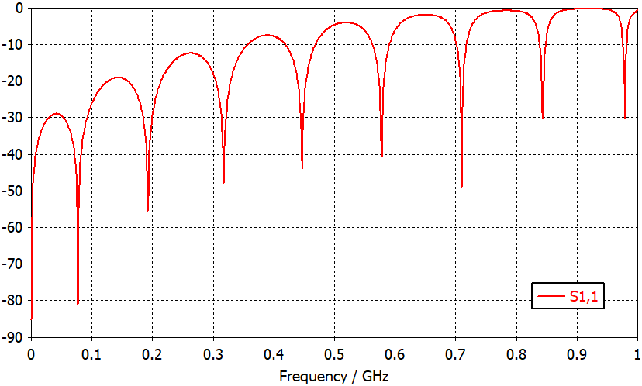
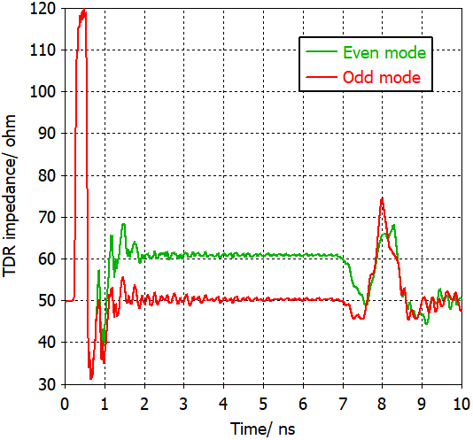
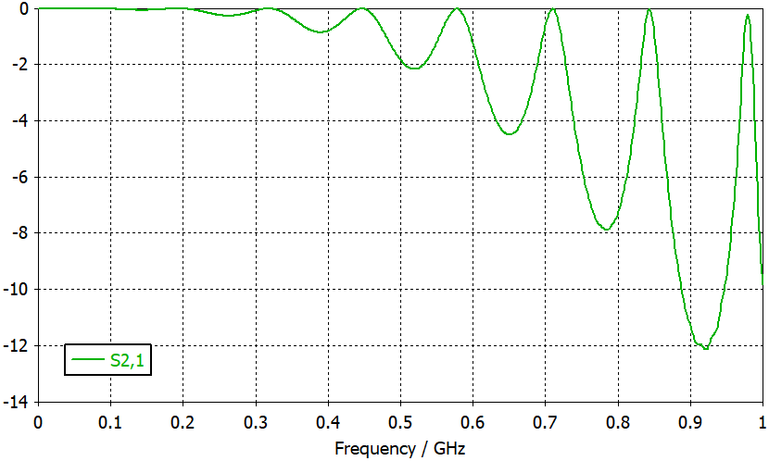
3D simulations
50Ω co-axis feedthrough，d/D=7/16mm
7mm
16mm
1000mm
8mm
1010mm
S-parameter
TDR
Impedance mismatching
（from feedthrough to blade）
Pulse bandwidth：300MHz

Slide 25
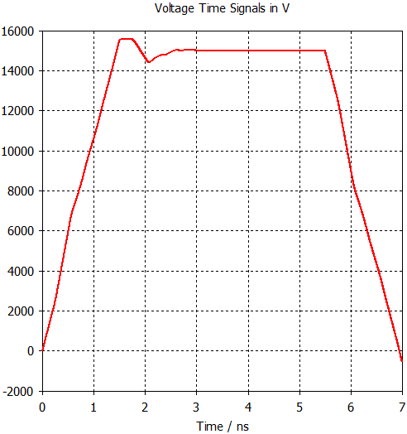
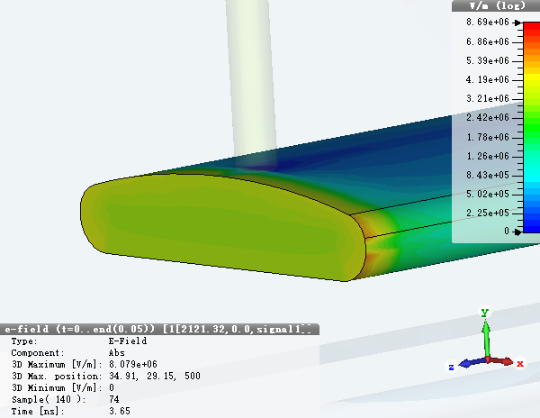
3D simulations
Field uniformity: ~0.52% in x=(-6, 6) mm, ~1.35% in y=(-11.3, 11.3)
Emax=9MV/m @ excited pulse peak=±15kV
Emax=9MV/m

Slide 26
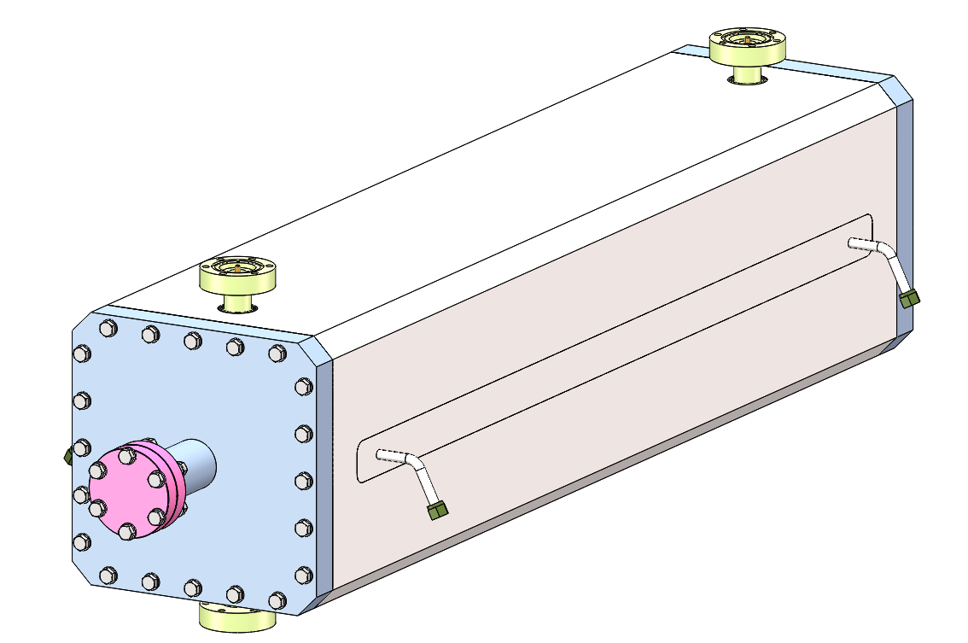
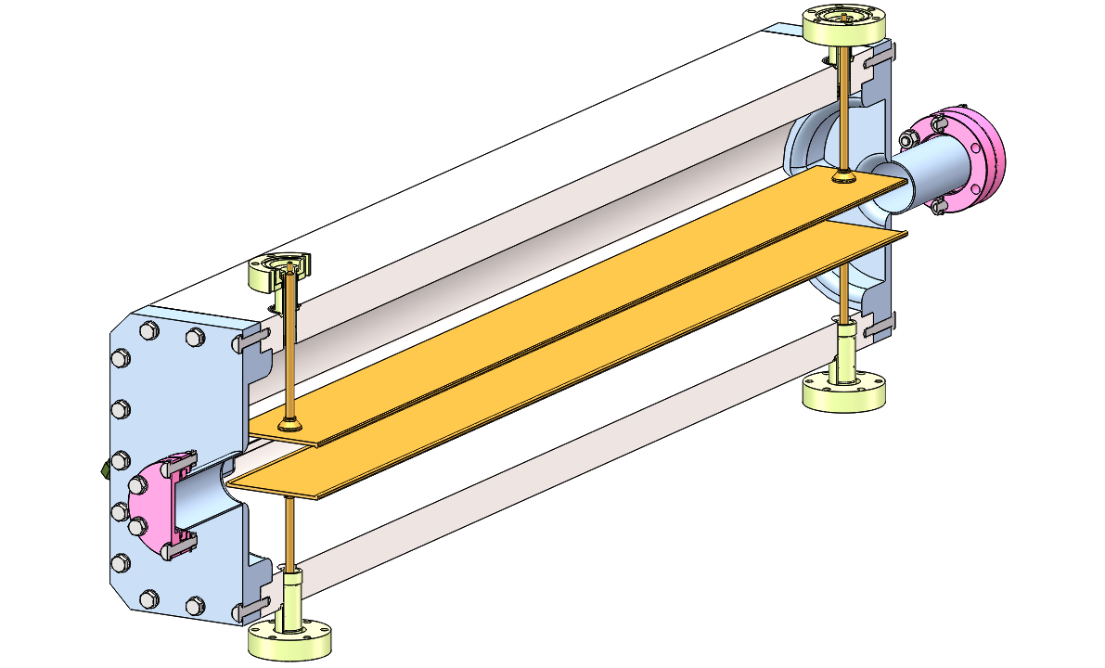
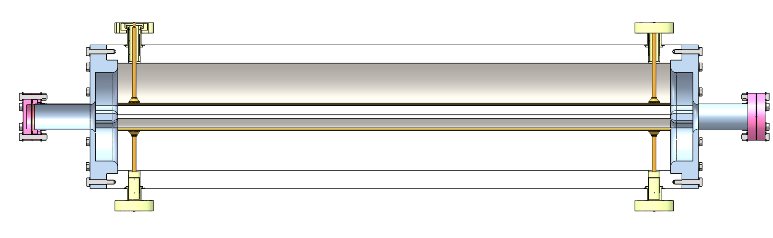
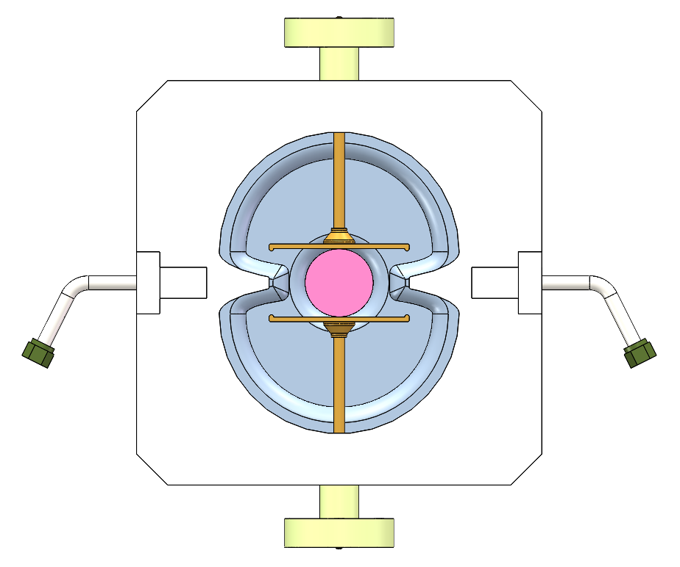
Strip-line kicker engineer design
Outer body (316L)
HV feedthrough
electrodes(FOC)
Contributed By Lihua Huo,Lei Wang

Slide 27
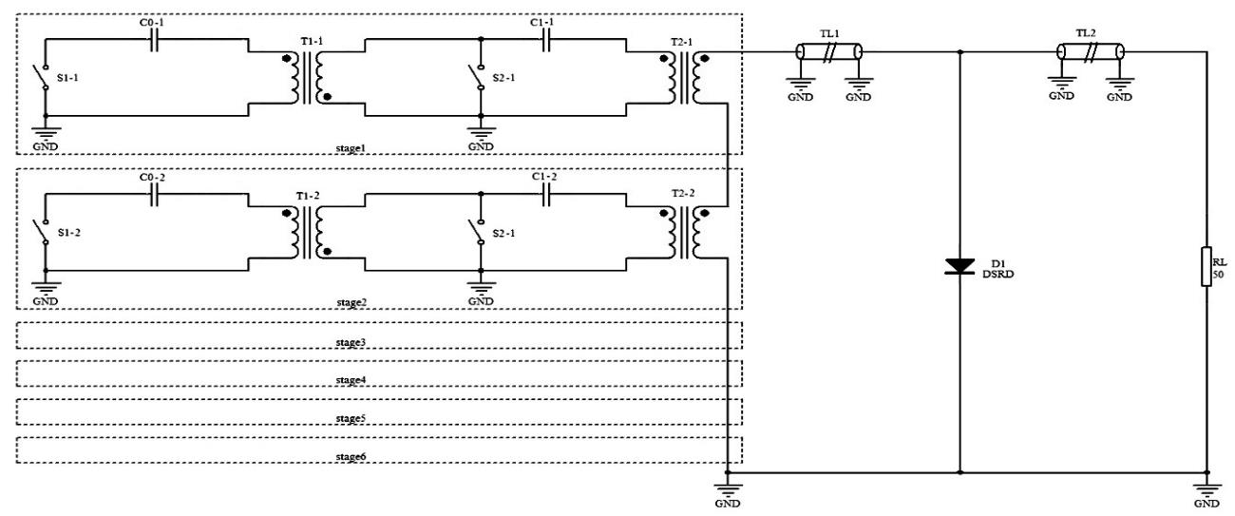
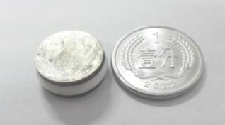
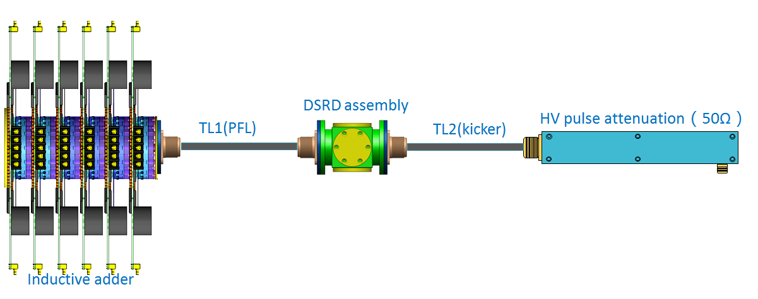
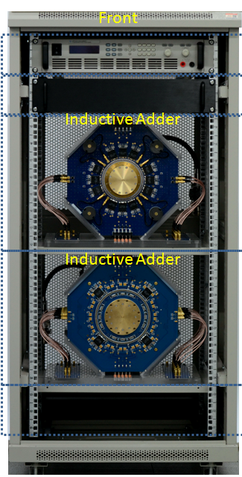
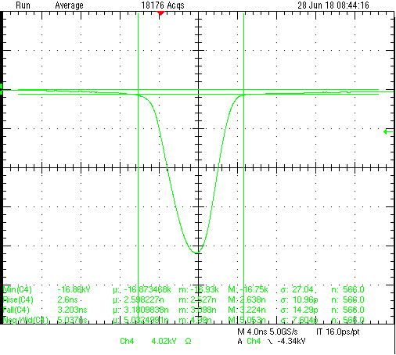


50ns-fast puler design
Scheme: pulser based on DSRDs driven by 6-stage inductive adder;
The similar hardware was developed in HEPS-TF project.
Drift Step Recovery Diode
DSRDs circuit with 6-stage inductive adder driven
PFL=0.3m
4ns
V=17kV,
FWHM=5ns,
T_{r}(10-90%)<2.6ns,
T_{f}(90-10%)<3.2ns,
Bottom width(3%-3%)<10ns
J.H. Chen, Strip-line kicker and fast pulser R&D for the HEPS on-axis injection system, NIMA 920(2019)1-6

Slide 28
BST HE Ext. systems hardware design towards TDR

Slide 29
BST-HE-Ext. for CR off-axis injection
Train by train or bunch-by-bunch extraction
Kicker: horizontal out-vacuum delay-line dipole kicker(coating ceramic vacuum chamber) driven by PFN-based solid-state pulser
Septa: vertical Lambertson magnet
LMS
Kicker
1kHz
Booster
40~2000ns
Side view
down
200ns
200ns
NLK
up
E- CR
LMS
Kicker
Booster
Septum Plate 6mm
Top view
LMS
in
out
E- CR
LMS
NLK
1kHz
Septum Plate 2mm
40~2000ns
200ns
200ns

Slide 30

BST-HE-Ext. for CR on-axis swap-out injection
Bunch-by-bunch extraction
Dipole kicker: horizontal ferrite core out-vacuum kicker+coating ceramic chamber+LC resonance pulser
Inj. NLK: horizontal NLK or Pulsed sextupole+coating ceramic chamber+LC resonance pulser
Septa: Vertical Lambertson magnet
0.333ms,1kHz
1360ns,1kHz
NLK
LMS
LMS
Kicker
Booster
Side view
down
up
down
Kicker
up
E- CR
LMS
LMS
NLK
Kicker
Booster
Septum Plate 6mm
Top view
LMS
1360ns,1kHz
LMS
out
in
out
E- CR
LMS
LMS
Septum Plate 6mm
Kicker

Slide 31
BST EXT kicker design parameters
parameter | Unit | BST-EXT-kicker1 （for CR off-axis inj.） | BST-EXT-kicker2 （for CR on-axis inj.）
Quantity | - | 2 | 2
Type | - | In-air delay-line dipole kicker | In-air lumped parameter dipole kicker
Deflect direction | - | Horizontal | Horizontal
Beam Energy | GeV | 120 | 120
Deflect angle | mrad | 0.2 | 0.1
Magnetic effective length | m | 1.4 | 0.7
Magnetic strength | T | 0.06 | 0.06
Integral magnetic strength | T·m | 0.08 | 0.04
Clearance region(H×V) | mm | 55×55 | 55×55
Good field region(H×V) | mm | ? | ?
Field uniformity in good field region | - | ±1.5%？ | ±1.5%？
Repetition rate | Hz | 1k | 1k
Amplitude repeatability | - | ±0.5% | ±0.5%
Pulse jitter | ns | ≤5 | ≤5
Bottom width of pulse(5%-5%) | ns | Trapezoid：440~2420 | Half-sine：1360
Tr/Tf(5%-95%) | ns | <200 | <680
40~2000ns
1kHz
200ns
200ns
1360ns,1kHz

Slide 32





Kicker magnet physics design
W=68mm
L=$μ_{0}\frac{w}{h}l=4π×{10}^{7}×\frac{68}{64}×1.4=1.8683μH$
4mm
I=$\frac{B}{μ_{0}}h=\frac{0.06}{4π×{10}^{−7}}×0.064=3.056kA$
h=64mm
55mm
$$Z=10Ω$$
U=I$∙Z=3000×10=30kV$
$$τ=\frac{L}{R}=\frac{1.87×{10}^{−6}}{10}=187ns$$
Lumped parameter kicker with shorted end : Tr（5%-95%）=3τ=561ns
Lumped parameter kicker with matched resistor : Tr（5%-95%）=3τ/2=280.5ns
Delay-line kicker with matched resistor : Tr（5%-95%）=τ=187ns
1360ns,1kHz
40~2000ns
1kHz
200ns
200ns

Slide 33



Lumped parameter dipole kicker magnet
Features:
Out-vacuum kicker with metallic coating ceramic vacuum chamber
Pulser: Inductive adder based on IGBTs.
<1360ns,1kHz

Slide 34




Distributed parameter (delay-line) dipole kicker
Features:
The structure of delay-line kicker is complicated, but helps to achieve ideal trapezoid waveform.
ceramic vacuum chamber with special pattern metallic coating
Pulser: adjustable pulse width inductive adder or Marx generator based on SiC MOSFET
40~2000ns
1kHz
200ns
200ns
challenges
C-type
Dual C-type
Solid-state switches（SIC MOSFET）
Delay-line kicker magnet
PFN
Or
Cap.
Marx generator

Slide 35
Summary
There are 9 injection and extraction sub-systems in CEPC accelerator complex. The types of all inj./ext. components are figured out.
The hardware designs towards TDR are being carried out.
So far，the kickers and the Lambertson septas preliminary designs for the damping ring ， the booster low energy inj. system are completed. The kickers for high energy ext. sub-systems are being designed.

Slide 36
END
Thank you for attentions!!!

Slide 37
Backup slides

Slide 38
Booster Ring
Booster operating mode | Higgs |  |  | W |  | Z
Beam energy（GeV） | 10 | 120 |  | 10 | 80 | 10 | 45.5
Function | Injection （both） | Extraction （off-axis） | Inj./Ext. （on-axis） | Injection （off-axis） | Extraction （off-axis） | Injection （off-axis） | Extraction （off-axis）
Bunch number | 242（in half ring） |  | 7（in half ring） | 1524（uniform） |  | 6000
Min. bunch spacing （ns） | 680 |  | 23800 | 220 |  | 25
Bunch number per train× train number | - |  | - | - | - | 80×75
Train spacing （ns） | - |  | - | - | - | 2460
Injection（extraction）mode | Bunch by bunch |  |  | Bunch by bunch |  | Bunch by bunch | Train by train
Kicker repetition rate (Hz) | 100 | 1000 |  | 100 | 1000 | 100 | 1000
Kicker pulse width (ns) | 1360 |  |  | 440 |  | 50 | <6900
Kicker flat top（ns） | - |  |  | - |  | - | >1980
Kicker rise（fall）time (ns) | <680 |  |  | <220 |  | <25 | <2460
Timing delay(ns) | <680 |  | <23800 | <220 |  | <2460 | <4400
injection（extraction）period (s) | 2.42 | 0.242 | 0.007 | 15.24 | 1.5 | 60 | 0.075
Kick angle (mrad) | 0.11 | 0.2 | 0.1 | 0.11 | 0.2 | 0.11 | 0.2
Kick Integral field strength (Tm) | 0.004 | 0.08 | 0.04 | 0.004 | 0.05 | 0.004 | 0.03
Beam pipe aperture Φ（mm） | 55
Considering the compatibility of three operating modes:
Function | LE-Injection （both） | HE-Extraction （off-axis） | HE-Inj./Ext. （on-axis）
Kicker repetition rate (Hz) | 100 | 1000 | 1000
Kicker pulse width (ns) | 50 | 440~2420(Adjustable) | 1360
Kicker flat top（ns） | - | 0~1980(Adjustable) | -
Kicker rise（fall）time(ns) | <25 | <220 | <680
injection（extraction）period (s) | 60 | 1.5 | 0.007
Kick angle (mrad) | 0.11 | 0.2 | 0.1
Kick Integral field strength (Tm) | 0.004 | 0.08 | 0.04
Beam pipe aperture Φ（mm） | 55 | 55 | 55
40~2000ns
1kHz
50ns,100Hz
200ns
200ns
1360ns,1kHz

Slide 39
Collider ring
Booster operating mode | Higgs |  |  | W |  | Z
Beam energy（GeV） | 120 |  |  | 80 |  | 45.5
Function | Injection （off-axis） | Injection （on-axis） | Extraction （dump） | Injection （off-axis） | Extraction （dump） | Injection （off-axis） | Extraction （dump）
Bunch number | 242（in half ring）- 7 |  |  | 1524（uniform） |  | 12000
Min. bunch spacing （ns） | 680 |  |  | 220 |  | 25
Bunch number per train× train number | - |  |  | - |  | 80×150
Train spacing （ns） | - |  |  | - |  | 245
Injection（extraction）mode | Bunch by bunch |  |  | Bunch by bunch |  | Train by train
Kicker repetition rate (Hz) | 1000 |  |  | 1000 |  | 1000
Kicker pulse width (ns) | 1360 |  |  | 440 |  | <2460
Kicker flat top（ns） | - |  |  | - |  | >1980
Kicker rise（fall）time (ns) | <680 |  |  | <220 |  | <245
Timing delay(ns) | <680 | <23800 | <680 | <220 |  | <4400
injection（extraction）period (s) | 0.242 | 0.007 | 0.242 | 1.5 |  | 0.15
Kick angle (mrad) | 0.1 | 0.2 | 0.2 | 0.1 | 0.2 | 0.1 | 0.2
Kick Integral field strength (Tm) | 0.04 | 0.08 | 0.08 | 0.027 | 0.05 | 0.015 | 0.03
Beam pipe aperture HxV（mm） | 75×56
Considering the compatibility of three operating modes:
Function | Injection （on-axis） | Injection （off-axis） | Extraction （dump）
Kicker repetition rate (Hz) | 1000 | 1000 | 1000
Kicker pulse width (ns) | 1360 | 440~2420(Adjustable) | 440~2420(Adjustable)
Kicker flat top（ns） | - | 0~1980(Adjustable) | 0~1980(Adjustable)
Kicker rise（fall）time(ns) | <680 | <220 | <220
injection（extraction）period (s) | 0.007 | 1.5 | 1.5
Kick angle (mrad) | 0.2 | 0.1 | 0.2
Kick Integral field strength (Tm) | 0.08 | 0.04 | 0.08
Beam pipe aperture HxV（mm） | 75×56 | 75×56 | 75×56
40~2000ns
1kHz
40~2000ns
1kHz
1360ns,1kHz
200ns
200ns
200ns
200ns

