Slide 1

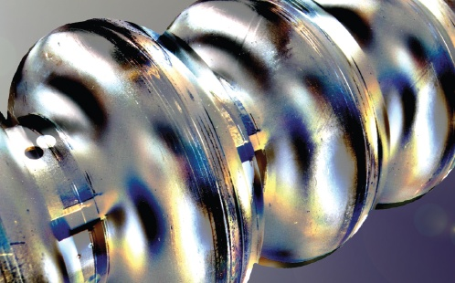
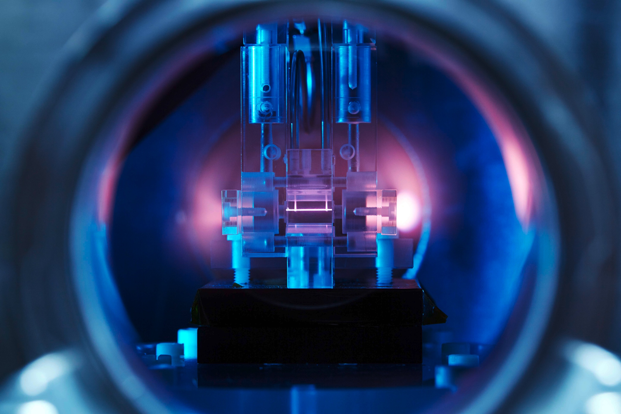
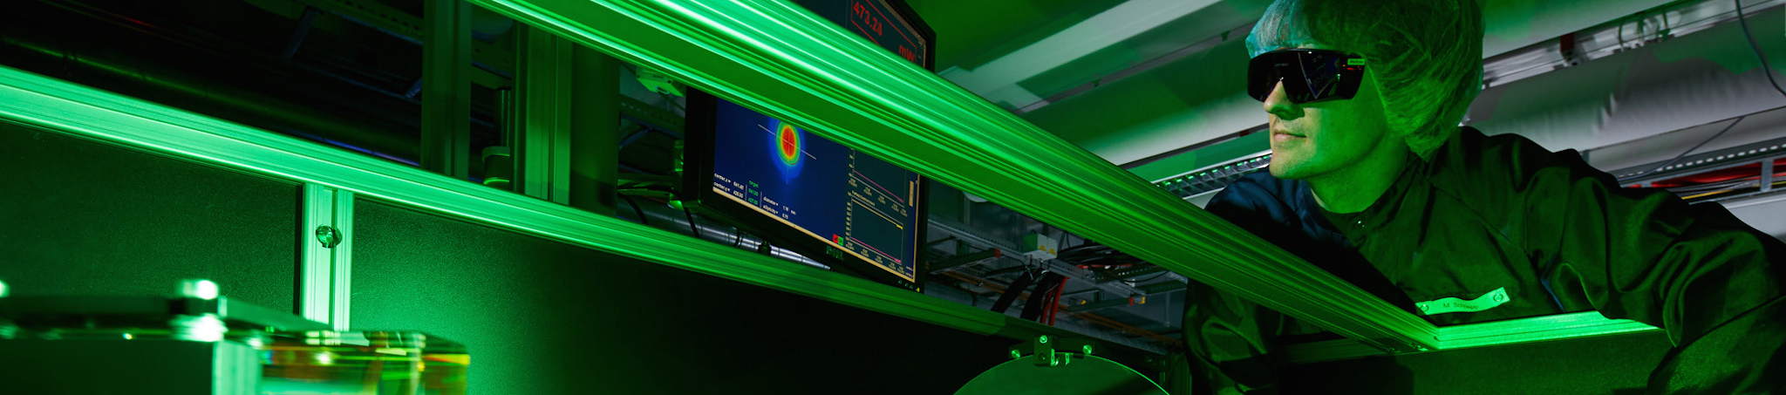
New Accelerator Physics and Technology Trends
An 18 Minute Glimpse at a Very Rich Topic
IHEP 2021
Virtual, Hongkong, China
20 January 2020
Ralph W. Aßmann, DESY

Slide 2
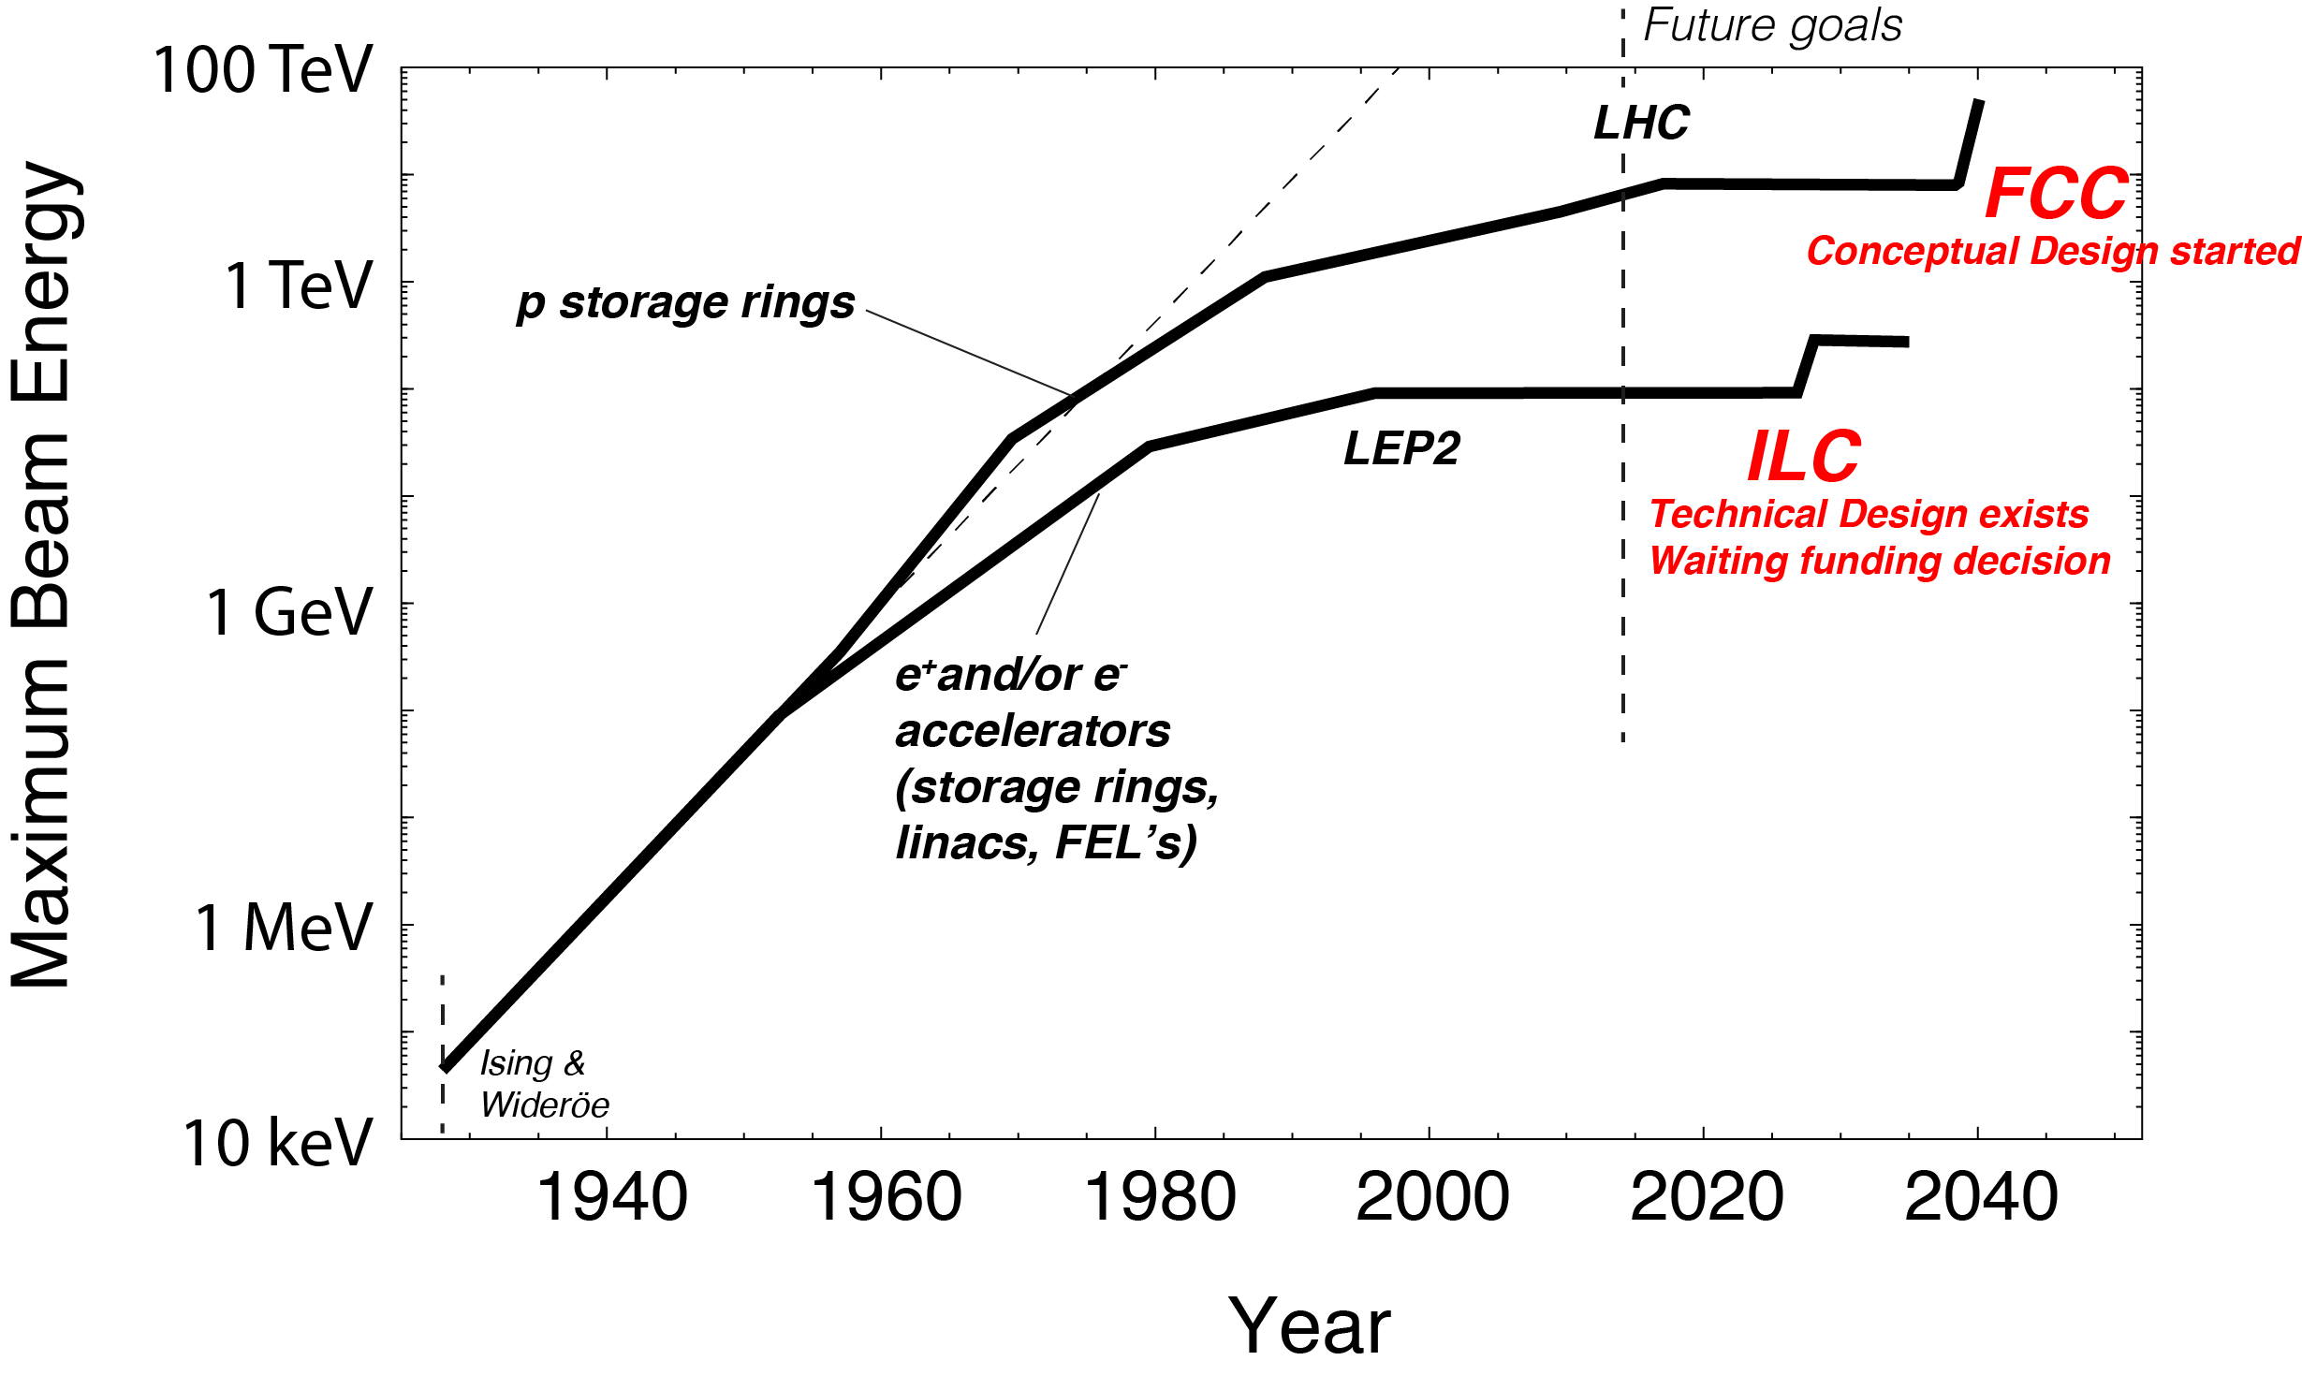
Slow-down in Energy Increase of Frontier Accelerators
Livingston plot leveling off – here our version, giving beam energy versus time
Hadron acc. project
HiLumi
Hadron acc. proposal
FCC-ee
CEPC
Lepton acc. project
Lepton acc. proposal
Advance of new colliders limited by practical constraints on required resources (budget, manpower) and size (does it fit on site?)

Slide 3
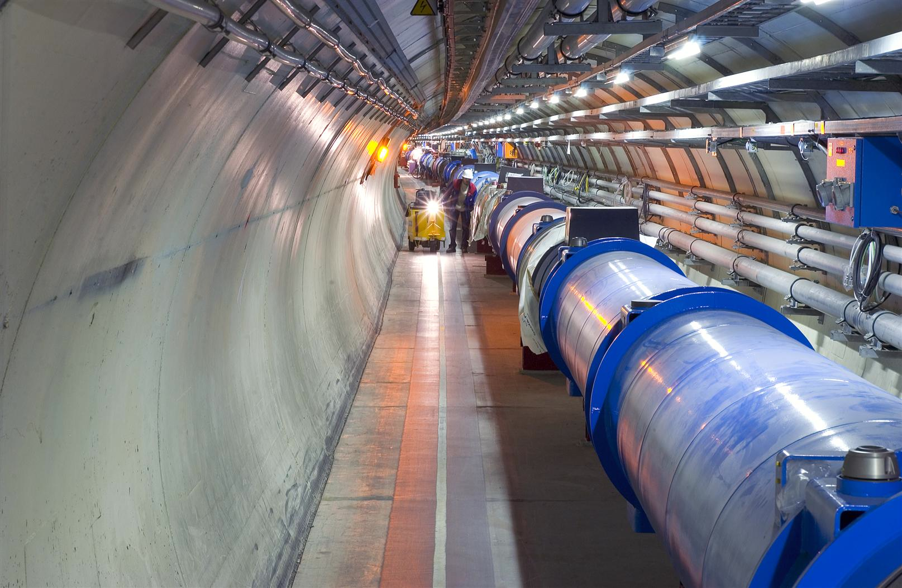
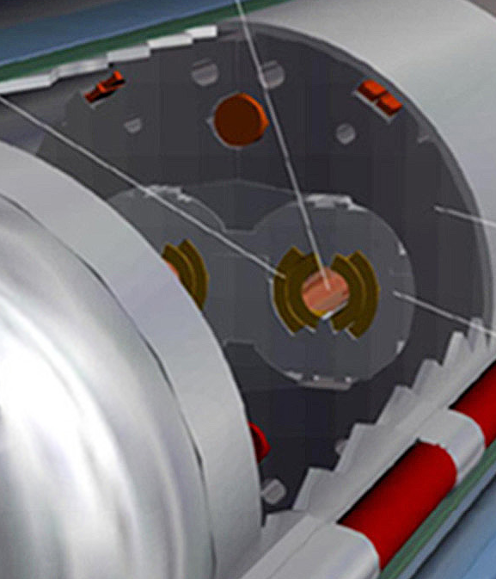
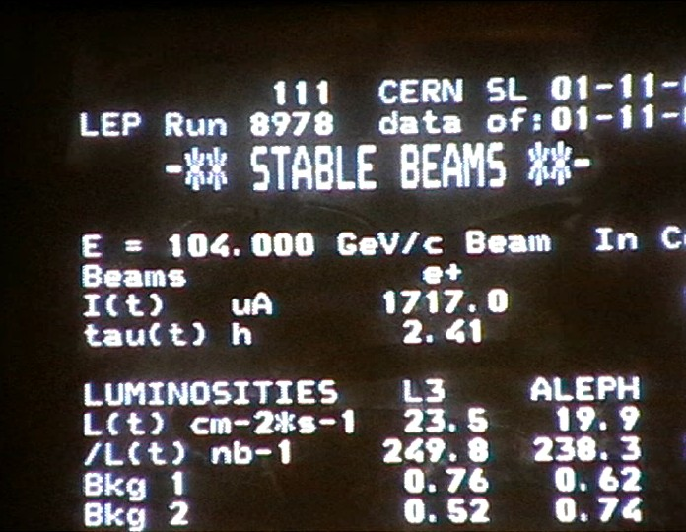
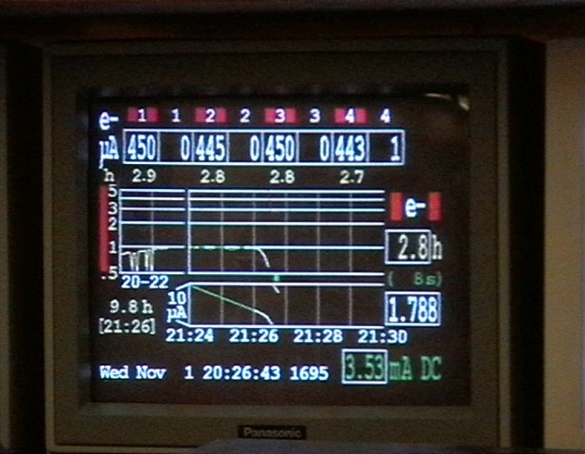
Why this slow-down? Part 1
Technical limitations in highly advanced and mature technologies
Hadron (p) circular collider
Limited by available bending field strength B_{y} (even super-conducting):
Increase momentum p by increasing radius R times bending field B_{y}
Lepton (e-,e+) circular collider
Limited by synchrotron radiation losses U₀, to be fed back by RF voltage V_{RF}:
Increase momentum p by increasing radius R and lowering bending field B_{y}
E.g. LEP2: 3% of energy lost per turn, 10,000 turns/second

Slide 4
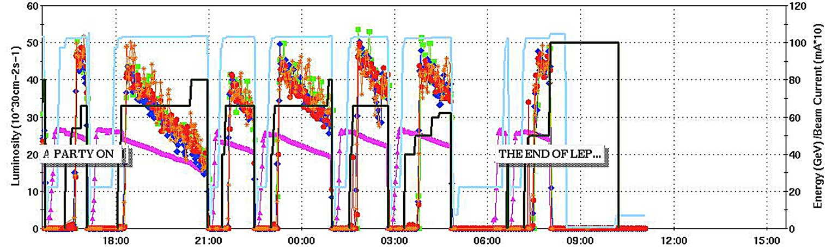
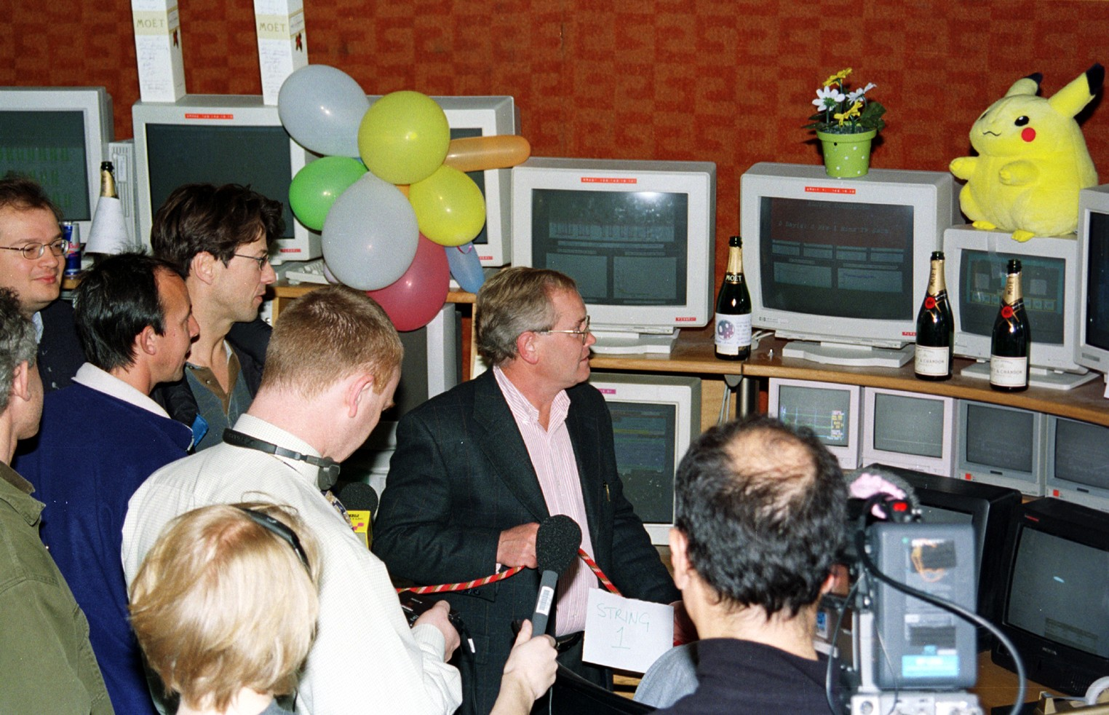
The End of LEP2
November 2nd, 2000, 7am
When we shut down LEP2 in 2000 we thought that it was the last e+e- circular collider due to synchrotron radiation limit!
Larger facility with innovative high luminosity design (realizing new ideas) will allow pushing the e+e- energy frontier (FCC-ee, CEPC).
Alternatively: going linear. This avoids synchrotron radiation limitation! But comes with its own challenges.

Slide 5
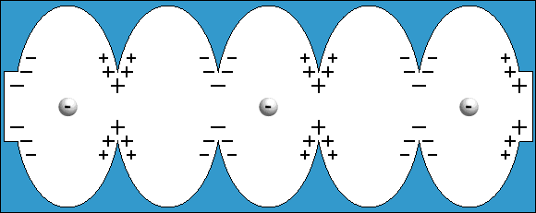
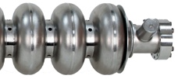

Why this slow-down? Part 2
Technical limitations in highly advanced and mature technologies
Lepton (e-,e+) linear collider
Limited by achievable accelerating gradient (energy gain per length)
Increase momentum p by increasing gradient G_{acc} or length L
Achievable accelerating gradient limited by
peak surface field, flashovers, surface
damage and breakdown rate
Example shows a result from CLIC at
a high RF frequency of 30 GHz
By now, some important progress made
but gradients limited to 100 MV/m at max
presently
Flashover at too high voltages
Sketch Padamse, Tigner
“Runzelröhre”
20 MV per Meter
CLIC, W. Wuensch
Damaged location
30 GHz, 16 ns,
66 MV/meter
W. Wuensch

Slide 6
How to advance?
Looking for solutions
Hadron (p) circular collider
Increase bending field
SC bend magnet work (FCC-hh)
Increase radius = size (FCC-hh)
Lepton (e-,e+) circular collider
Increase supplied RF voltage
(FCC-ee, CEPC)
Increase mass of acc. particle (muon)
Increase radius = size (FCC-ee, CEPC)
Lepton (e-,e+) linear collider
Increase accelerating gradient
Pushing existing technology (ILC, CLIC)
New regime of ultra-high gradients (plasma, dielectric accelerators)
Increase length (ILC, CLIC)

Slide 7
Many high tech activities ongoing in the big collider projects, pioneering new solutions, advancing technology and opening new possibilities!
No time to go through in detail. Apologies!
See the many talks on R&D and results presented at this conference!
Affordability is a critical issue: cost of components, energy efficiency, OP costs!
Here, just a few remarks on trends...

Slide 8
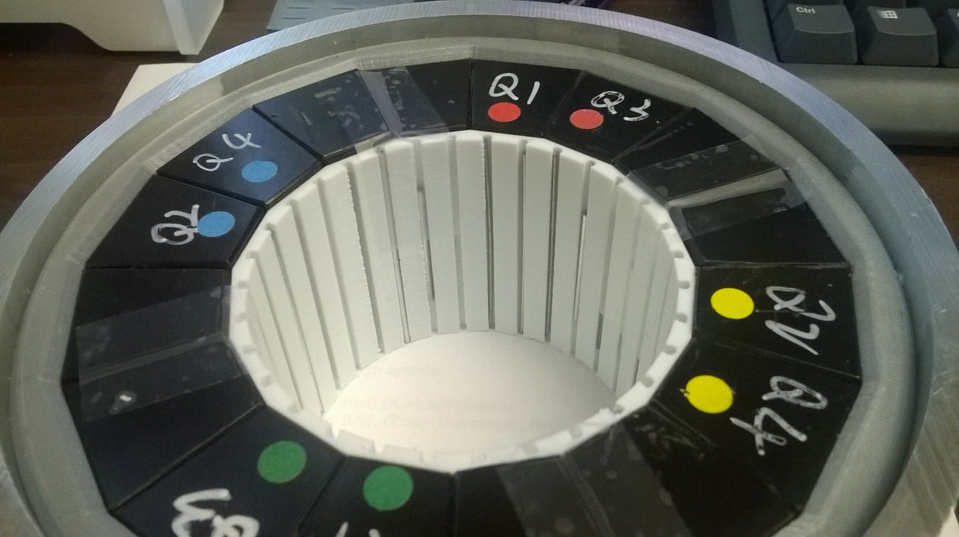
Trend: Smart Manufacturing and Assembly
Can we bring down cost per meter of accelerator by a factor 2 – 10?
Picture courtesy S. Brooks, BNL
Smart manufacturing and assembly (optimized as industrial process):
Factory: Instead of highly accurate pieces of permanent magnets (very expensive) accept non-perfect pieces with larger tolerances (cheap).
Measurement Lab: Measure those pieces accurately.
Computer: Solve for adequate positioning of pieces such required field on beam is achieved.
Computer: Calculate required mechanical custom support for pieces.
Factory: 3D print the optimized custom support.
Factory: Assemble permanent magnet that provides required fields.
Halbach quadrupole using NdFeB, 3D printed, 23.6 T/m, R=34.7mm bore (0.82T max), 10⁻⁴ errors at R=10mm
Material cost: $1100. No alignment better than 0.25 mm required anywhere. Assembled with mallet.

Slide 9
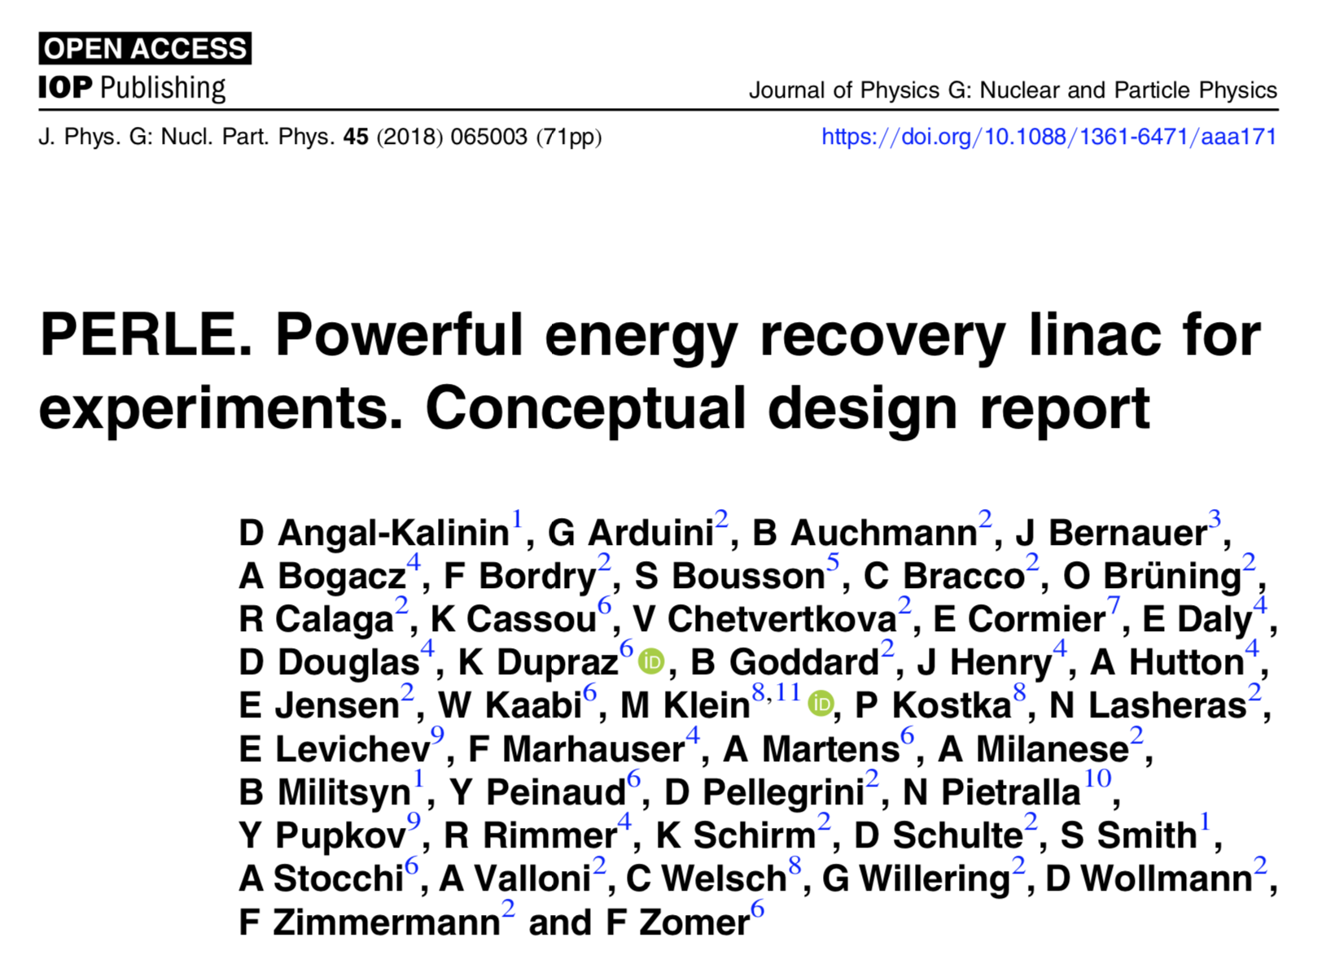
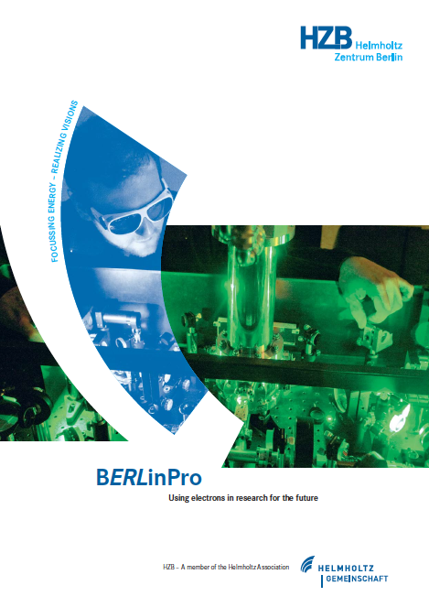
Trend: Energy Efficiency and Green Accelerators
Reduce energy consumption
For example, ERL (CBETA, PERLE, bERLinPro, ...), permanent magnets, novel klystrons:
ERL concept proposed in 1965: M. Tigner, “A possible apparatus for electron clashing-beam experiments”. Nuovo Cim 37, 1228–1231 (1965).
Re-use the energy stored in the beam – RF cavities for pumping energy into beam and for extracting it
PERLE: 1 GeV energy recovery demonstration of a recirculating SC linear accelerator.
We heard about CEPC related work on klystrons with improved efficiency, see also impressive CERN-driven advances on klystron efficiency → mature technologies but still considerable room for improvement!

Slide 10
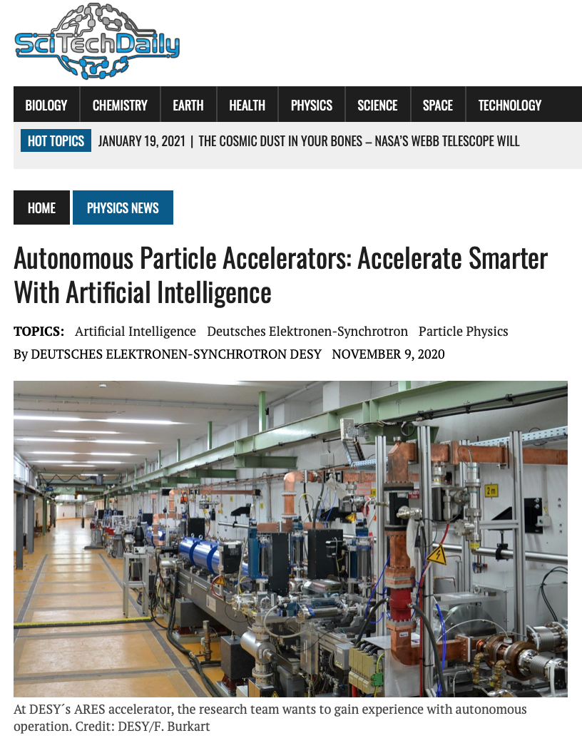
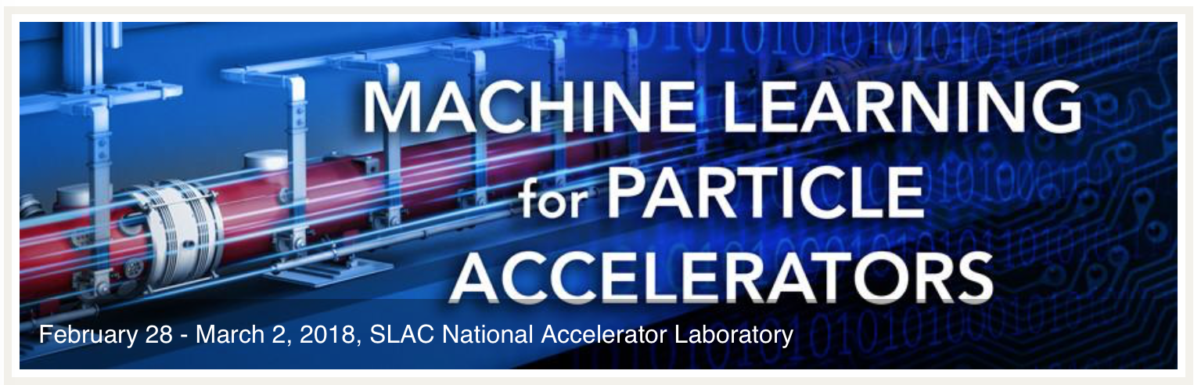
Trend: Machine Learning and Artificial Intelligence
Reduce energy consumption
https://scitechdaily.com/
Machine learning (SLAC, PSI, CERN), automated commissioning (ANL), and autonomous accelerators (DESY):
At DESY in the SINBAD/ARES accelerator a team from DESY & KIT is testing methods towards an autonomous accelerator
Exploits highly non-linear regime of ARES with limited number of degrees of freedom

Slide 11
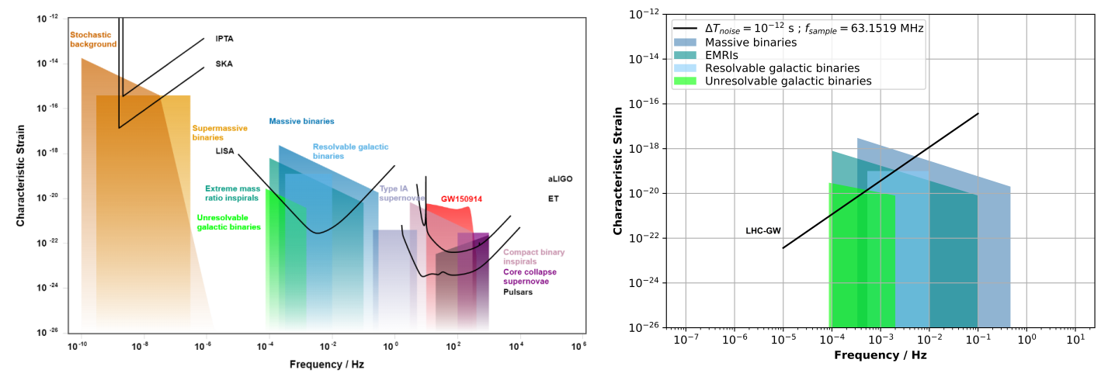
Trend: Accelerators and Gravity
https://journals.aps.org/prd/abstract/10.1103/PhysRevD.102.122006
New territory for large colliders
https://arxiv.org/pdf/2012.00529.pdf
Can a large storage ring like LHC detect gravitational waves?
Thanks to Frank Zimmermann
Rao et al, PRD 2020

Slide 12
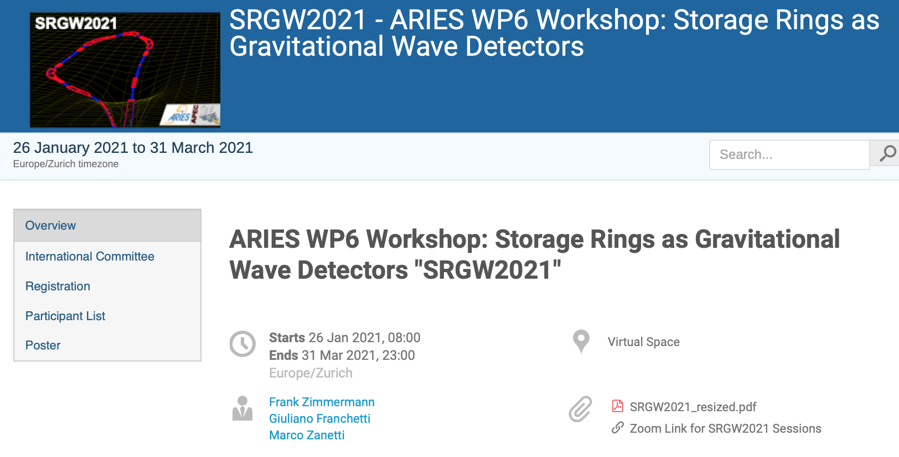
Trend: Accelerators and Gravity
https://indico.cern.ch/event/982987/
New territory for large colliders
Thanks to Frank Zimmermann

Slide 13
Trend: The R&D on Compact Accelerators
BIG factors → Novel concepts pursue transformative concepts that can open new horizons in energy reach for HEP research
Looking for solutions
Hadron (p) circular collider
Increase bending field
SC bend magnet work (FCC-hh)
Increase radius = size (FCC-hh)
Factor 206.8 higher mass muon versus electron
Lepton (e-,e+) circular collider
Increase supplied RF voltage
(FCC-ee)
Increase mass of acc. particle (muon)
Increase radius = size (FCC-ee)
Lepton (e-,e+) linear collider
Increase accelerating gradient
Pushing existing technology (ILC, CLIC)
New regime of ultra-high gradients (plasma, dielectric accelerators)
Increase length (ILC, CLIC)

Slide 14
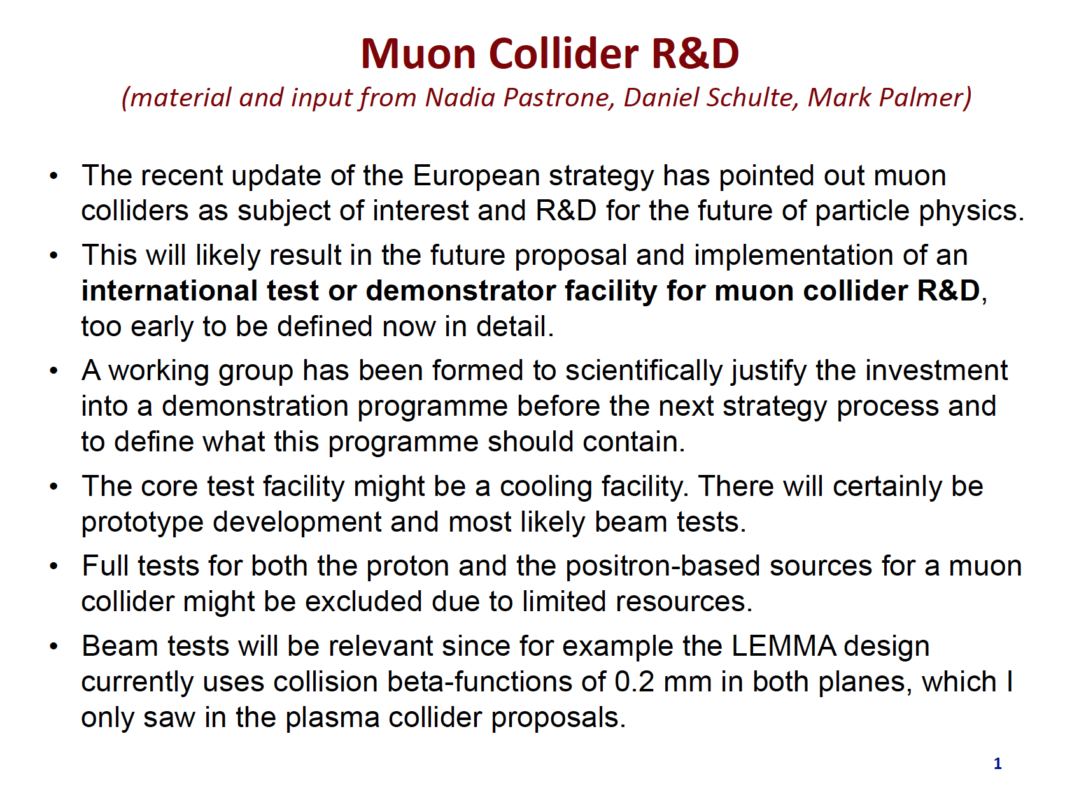
Trend:

Slide 15
Trend: R&D on Compact Accelerators
BIG factors → Novel concepts pursue transformative concepts that can open new horizons in energy reach for HEP research
Looking for solutions
Hadron (p) circular collider
Increase bending field
SC bend magnet work (FCC-hh)
Increase radius = size (FCC-hh)
Factor 206.8 higher mass muon versus electron
Lepton (e-,e+) circular collider
Increase supplied RF voltage
(FCC-ee)
Increase mass of acc. particle (muon)
Factor 100 – 1000 higher accelerating gradient
Increase radius = size (FCC-ee)
Lepton (e-,e+) linear collider
Increase accelerating gradient
Pushing existing technology (ILC, CLIC)
New regime of ultra-high gradients (plasma, dielectric accelerators)
Increase length (ILC, CLIC)

Slide 16
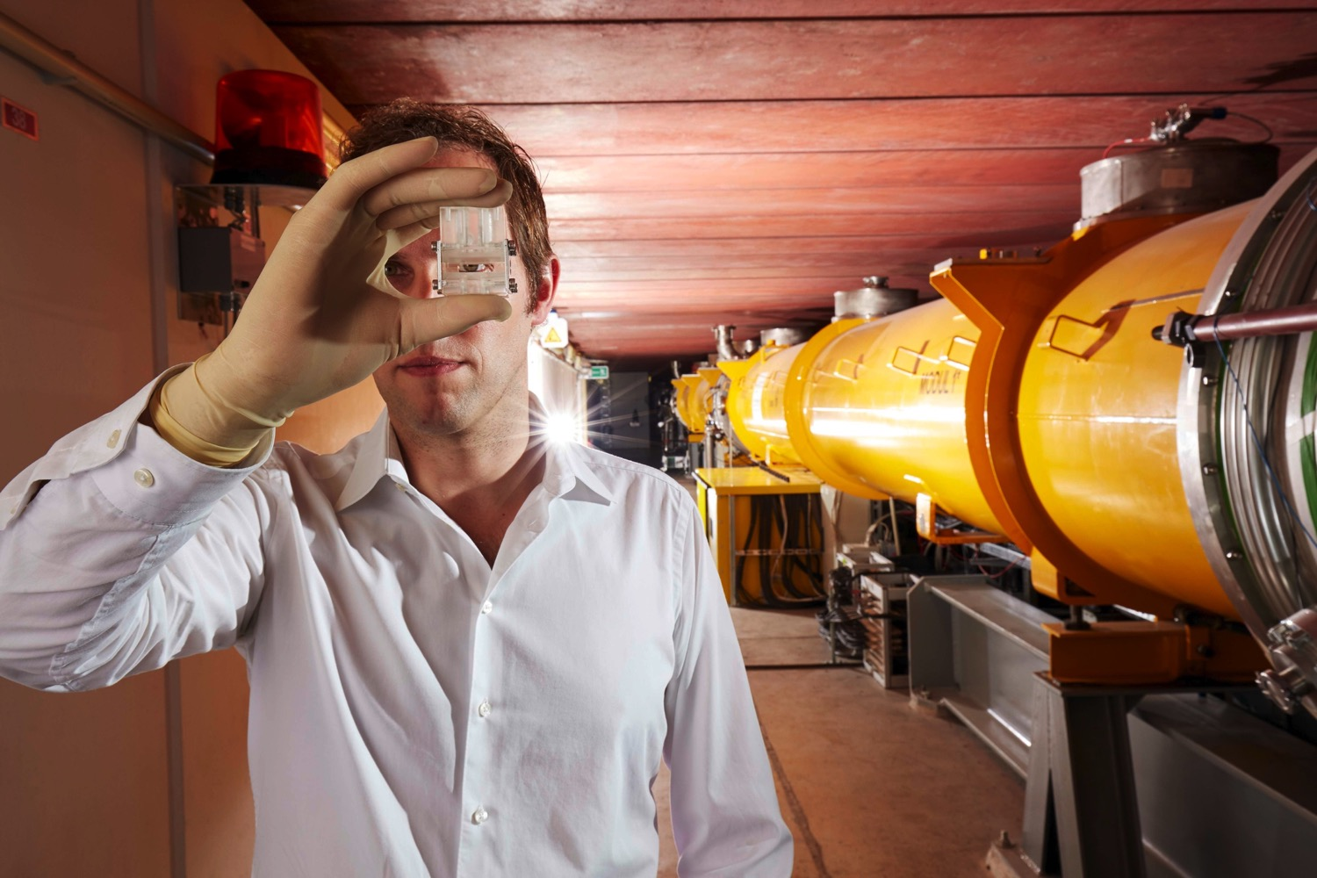
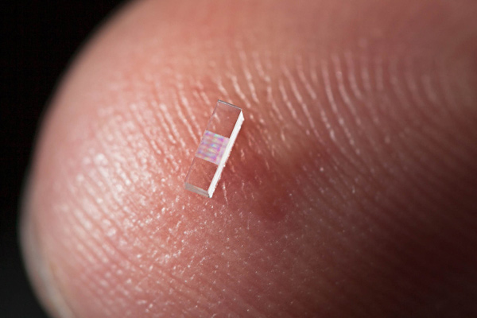
Trend: High Gradient – High Frequency – Small Dimensions
Powering novel accelerators
High → High → Small
Gradients Frequencies Dimensions
(1 – 100 GV/m) (> 100 GHz) (< 1 mm)
No klystrons for high frequencies!
Use particle bunches or laser pulses as drivers.
Material limitations solved through “new cavities”: dielectric materials,
plasma cavities, …
Two main directions:
1
2
Microstructure
Accelerator Laser- or beam driven
Vacuum accelerators
Conventional field design
Plasma
Accelerator
Laser- or beam driven
Dynamic Plasma Structure
Plasma field calculations

Slide 17
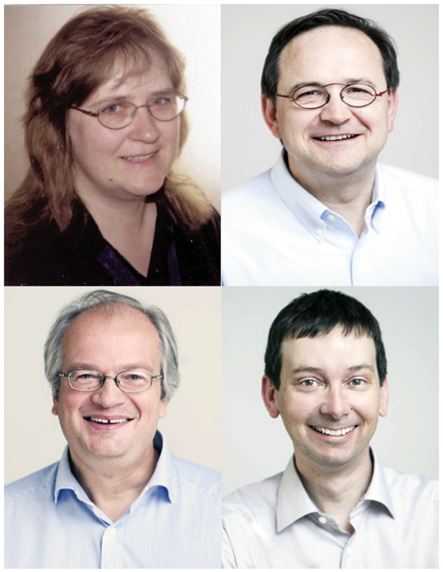
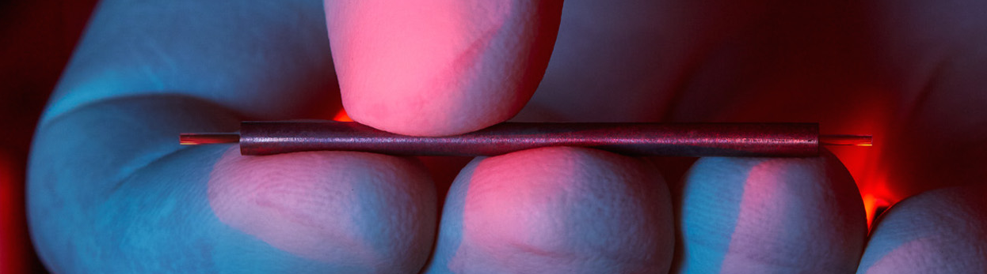

Laser-Driven Micro Structures (Vacuum) – 1
Vacuum dielectric accelerator
1 GeV/m possible but low absolute energies achieved so far
AXSIS project (ERC synergy grant) at DESY/
Uni Hamburg: THz laser-driven accelerator with
atto-second science → Kärtner/Fromme/Chapman/Assmann

Slide 18

Laser-Driven Micro Structures (Vacuum) – 2
Vacuum dielectric accelerator
“Accelerator on a Chip” grant from Moore foundation for work by/at Stanford, SLAC, University Erlangen, DESY, University Hamburg, PSI, EPFL, University Darmstadt, CST, UCLA
Lasers drive structures
that are engraved on
microchips (e.g. Silicium)
Major breakthroughs can
be envisaged:
  Mass production
  Implantable accelerators
  for in-body irradiation of tumors
  Accelerators for outer space

Slide 19
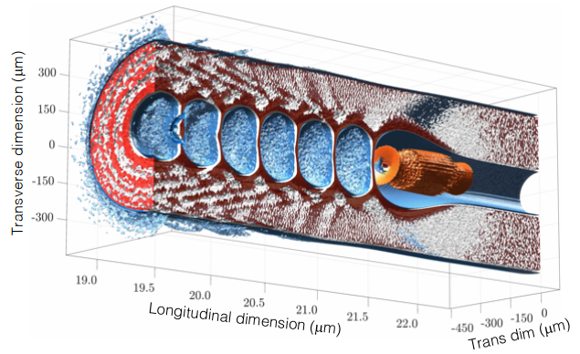
Nano Structures...
Figure from Akash Sahai
Small dimensions with particular promises and challenges

Slide 20
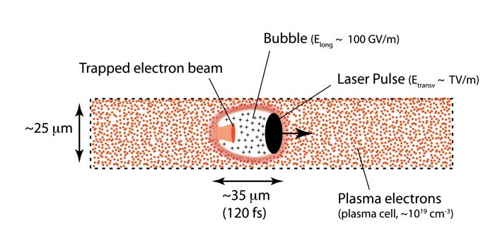
Trend: Laser Plasma-Acceleration
Internal injection

Slide 21
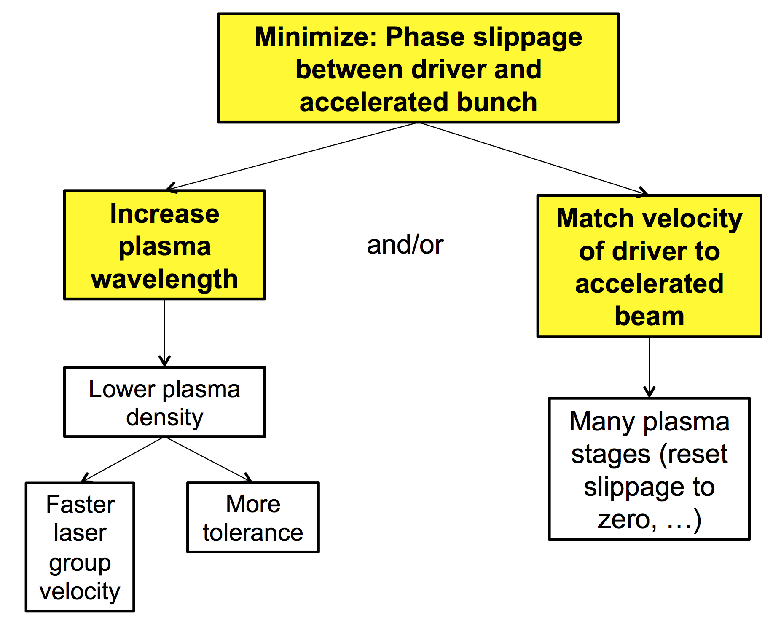
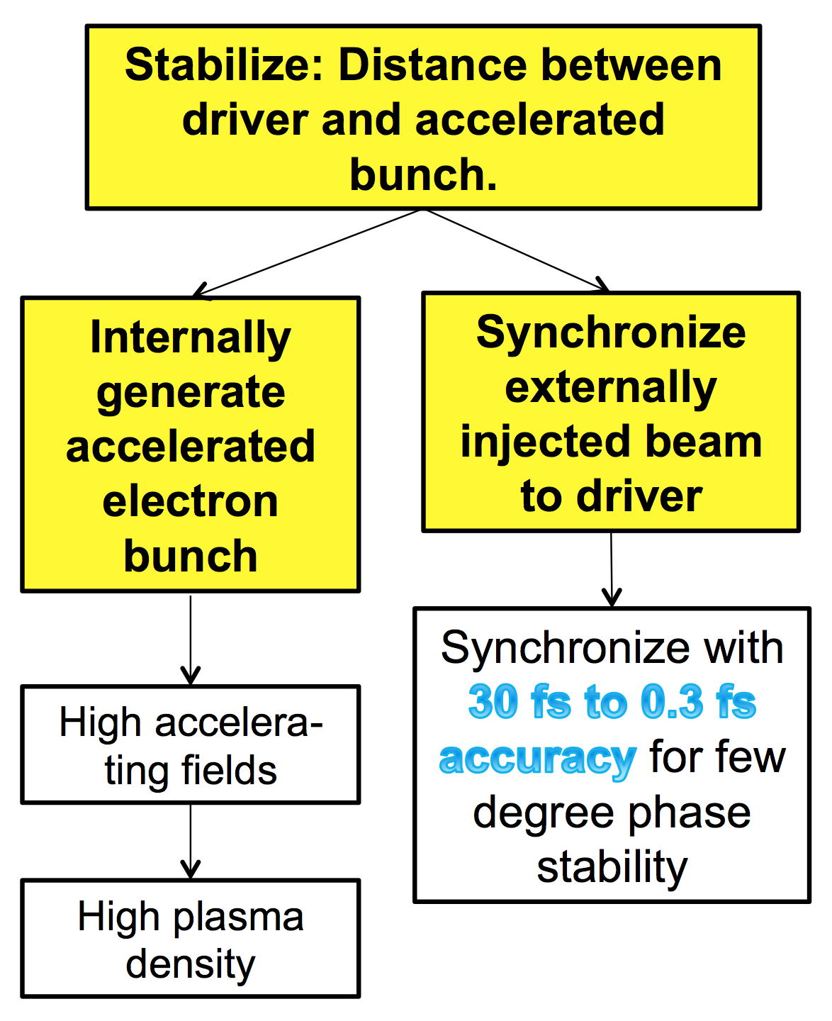
Optimization: Phase Slippage Stability/Reproducibility
Maximize distances over which we can accelerate Hit the same phase every time

Slide 22
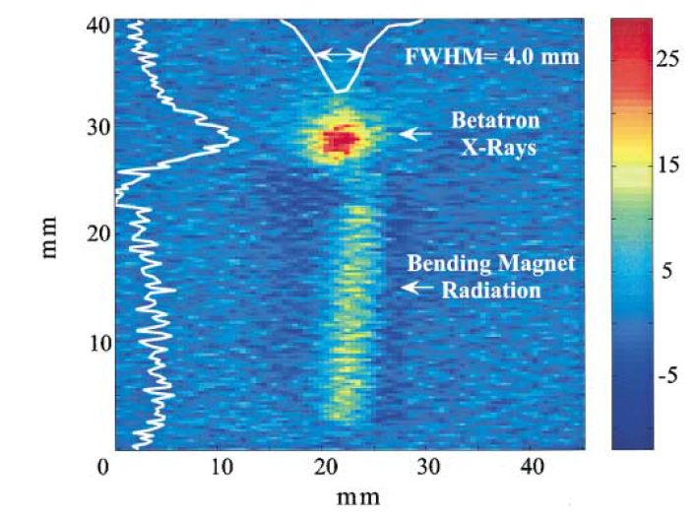
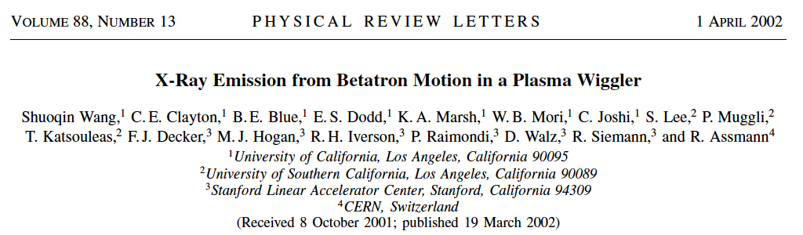
Strong plasma focusing: Betatron motion and X rays
Wiggling electrons emit X rays → a plasma accelerator as accelerator and undulator at once
If an electron beam is injected mis-matched into a plasma, we expect strong beta mismatch oscillations of the beam size.
The oscillating electrons should radiate X rays.
This was seen in a SLAC experiment in 2001.
Plasma acts as undulator!

Slide 23
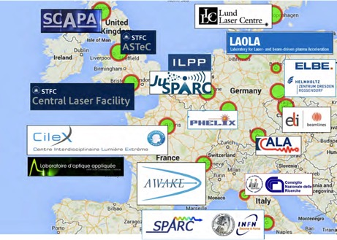





Novel Acceleration R&D in Europe → Towards International Projects
How can we develop plasma accelerators towards usability?
Independent national projects*, funded by national states. About 16 major facilities for novel plasma acceleration R&D in Europe.
European novel accelerator projects with international involvement
CERN experiment collaboration under leadership of MPI (A. Caldwell)
Funded by EU Horizon2020 as EU Design Study
ERC Synergy Grant
* See note on ELI

Slide 24
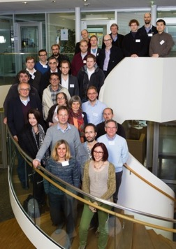
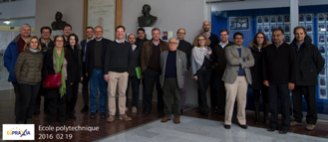


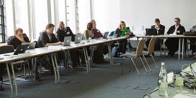
EuPRAXIA: A European Strategy for Accelerator Innovation
Do the required intermediate step between proof of principle and production facility – make one acc. unit!
PRESENT EXPERIMENTS
Demonstrating
100 GV/m routinely
Demonstrating GeV electron beams
Demonstrating basic quality
EuPRAXIA INFRASTRUCTURE
Engineering a high quality, compact plasma accelerator
5 GeV electron beam for the 2020’s
Demonstrating user readiness
Pilot users from FEL, HEP, medicine, ...
PRODUCTION FACILITIES
Plasma-based linear collider in 2040’s
Plasma-based FEL in 2030’s
Medical, industrial
applications soon

Slide 25
Conclusions
Long-term future
The long-term future is bright: there will be plenty of opportunities as technology advances!
Larger e+e- colliders are a future path, requiring affordable technology and good energy efficiency, both if circular or linear.
Advanced e+e- colliders (plasma/dielectric/laser) are another possible path forward. Energy very promising but beam quality insufficient:
  There are now near future science applications outside HEP, e.g. FEL. This can be the stepping stone towards a plasma linear collider.
  Major projects going on, all including HEP aspects.
Muon colliders and future ep machines are subject of intensifying R&D.
In Europe experts panels are being set up to propose accelerator R&D roadmaps in follow-up to European strategy of particle physics. Stay tuned...

Slide 26
Thank you for your attention

