Slide 1


  CEPC collider ring design
Yiwei Wang
for the CEPC Accelerator Physics Group
The Institute of High Energy Physics, Chinese Academy of Sciences
Conference of the IAS HEP program 2021, HKUST
18-21 January, 2021

Slide 2


Outline
  High luminosity Higgs scheme for CEPC collider ring
  Compatible ttbar, W and Z modes
  Summary

Slide 3
  Key parameters of high luminosity scheme
by C. Yu, Y. Wang, Y. Zhang, S. Bai, Y. Zhu, D. Wang et al
Key parameters of CDR scheme for Higgs
L*=2.2m, θc=33mrad, βx*=0.36m, βy*=1.5mm, Emittance=1.2nm
  Strength requirements of anti-solenoids B_{z}~7.2T
  Two-in-one type SC quadrupole coils (Peak field 3.8T & 136T/m)
Key parameters of high luminosity scheme for Higgs
L*=1.9m, θc=33mrad, βx*=0.33m, βy*=1.0mm, Emittance=0.68nm
  Strength requirements of anti-solenoids B_{z}~7.2T
  Two-in-one type SC quadrupole coils (Peak field 3.8T & 141T/m) with room temperature vacuum chamber & Iron yoke
Reduction of the length from IP to 1st quadrupole without changing the front-end position of the FD cryo-module
To make the lattice robust and provide good start point for DA

Slide 4
Overall parameters for Higgs mode
by D. Wang
 | Higgs (CDR) | Higgs (high)
Number of IPs | 2 | 2
Beam energy (GeV) | 120 | 120
Circumference (km) | 100 | 100
Synchrotron radiation loss/turn (GeV) | 1.73 | 1.8 | Luminosity can be increased 4% if reducing the length of straight sections.
Crossing angle at IP (mrad) | 16.5×2 | 16.5
Piwinski angle | 3.48 | 4.87
Number of particles/bunch N_{e} (10¹⁰) | 15.0 | 16.3
Bunch number (bunch spacing) | 242 (0.68μs) | 214
Beam current (mA) | 17.4 | 16.8
Synchrotron radiation power /beam (MW) | 30 | 30
Bending radius (km) | 10.7 | 10.2
Momentum compact (10⁻⁵) | 1.11 | 7.34
β function at IP β_{x}* / β_{y}* (m) | 0.36/0.0015 | 0.33/0.001 | Much larger natural chromaticity. A smaller emittance from the booster is necessary.
Emittance e_{x}/e_{y} (nm) | 1.21/0.0024 | 0.68/0.0014
Beam size at IP s_{x} /s_{y} (μm) | 20.9/0.06 | 15.0/0.037
Beam-beam parameters ξ_{x}/ξ_{y} | 0.018/0.109 | 0.018/0.115
RF voltage V_{RF} (GV) | 2.17 | 2.27
RF frequency f _{RF} (MHz) (harmonic) | 650 (216816) | 650 (217500)
Natural bunch length σ_{z} (mm) | 2.72 | 2.25
Bunch length σ_{z} (mm) | 4.4 | 4.42
HOM power/cavity (2 cell) (kw) | 0.46 | 0.48
Energy spread (%) | 0.134 | 0.19
Energy acceptance requirement (%) | 1.35 | 1.7 | larger momentum acceptance required
Energy acceptance by RF (%) | 2.06 | 2.5
Beamstruhlung lifetime (min) | 80 | 41
Lifetime (hour) | 0.43 | 0.34
F (hour glass) | 0.89 | 0.88
Luminosity/IP L (10³⁴cm⁻²s⁻¹) | 2.93 | 5.0

Slide 5
  Design of high luminosity lattice
Shorter cell length to squeeze the emittance from CDR 1.2nm to 0.68nm
Maximization of bend filling factor to minimize the synchrotron radiation
Optimization of the quadrupole radiation effect
Better correction of energy dependent aberration
Reduction of dynamic aperture requirement from injection
Reduction of the length from IP to 1st quadrupole without changing the front-end position of the FD cryo-module (2.2m to 1.9m)

Slide 6
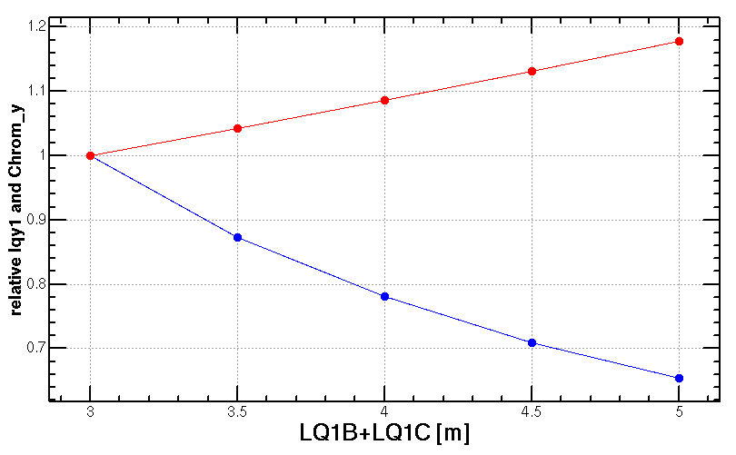
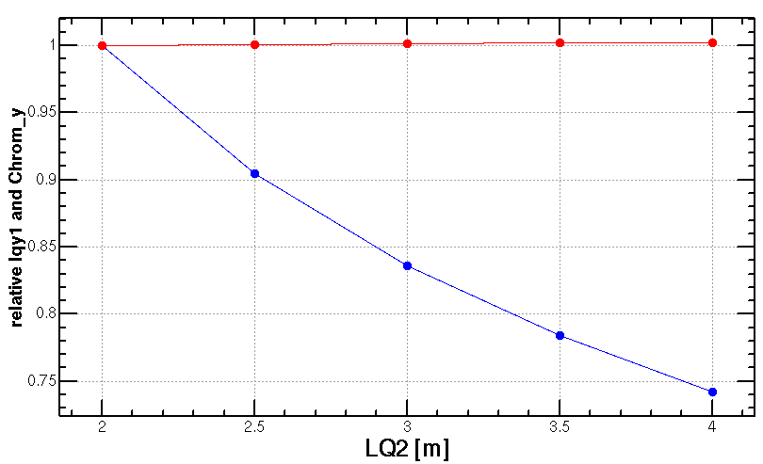
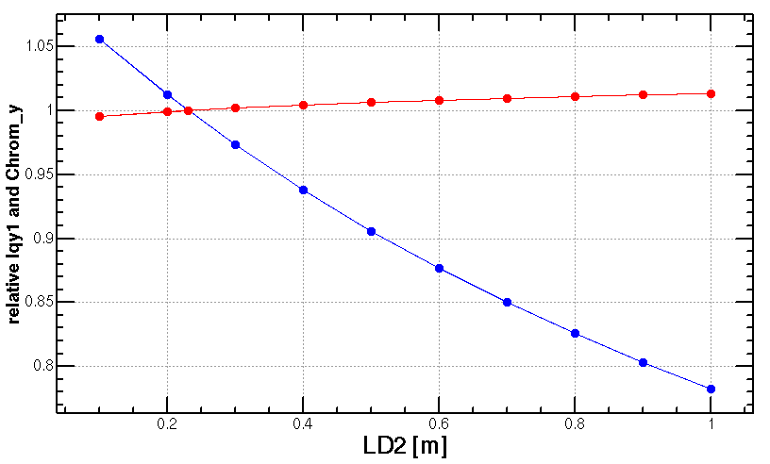
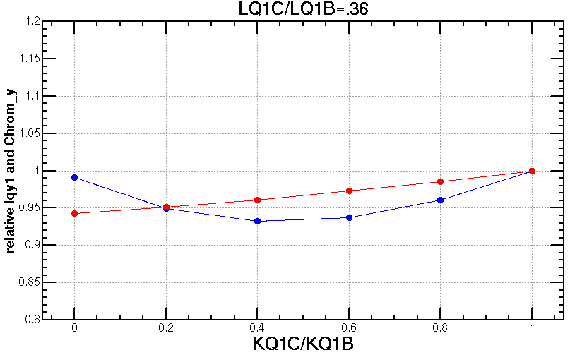
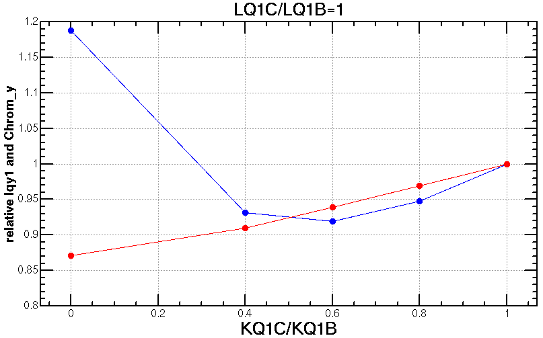
Optimization of final doublet design
Length of Q1
Length of Q2
Distance of Q1 and Q2
—Chromaticity on y plane
—Radiation power on y plane
Different strength ratio of Q1A and Q1B
Different length ratio of Q1A and Q1B when keep total length of Q1A+Q1B
CDR: L*=2.2m, LQ1=2.0m, LQ2=1.5m, d=0.3m, GQ1=136T/m, GQ2 =111T/m
High lumi: L*=1.9m, LQ1A=1.22m, LQ1B=1.22m, LQ2=1.5m, d=0.3m, GQ1A=142T/m, GQ1B=96T/m, GQ2=56T/m

Slide 7
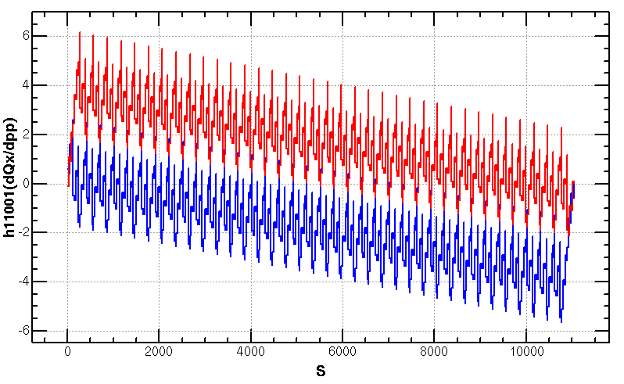
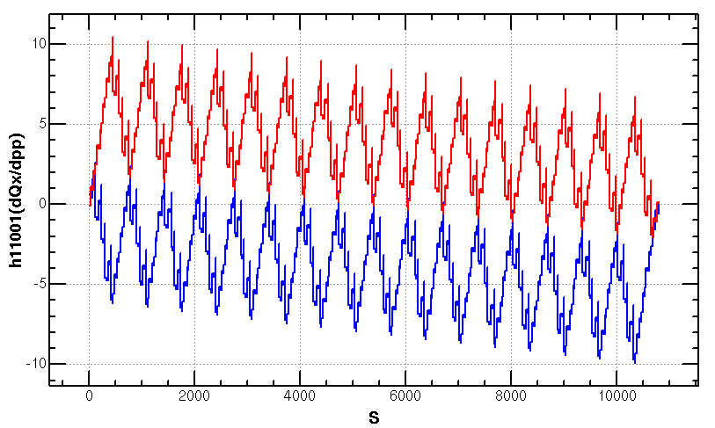
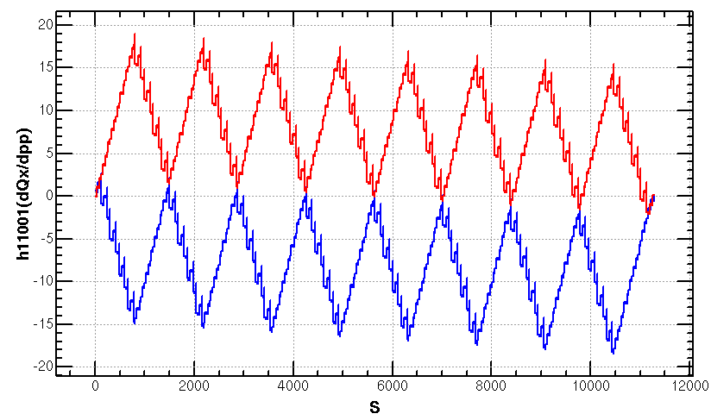
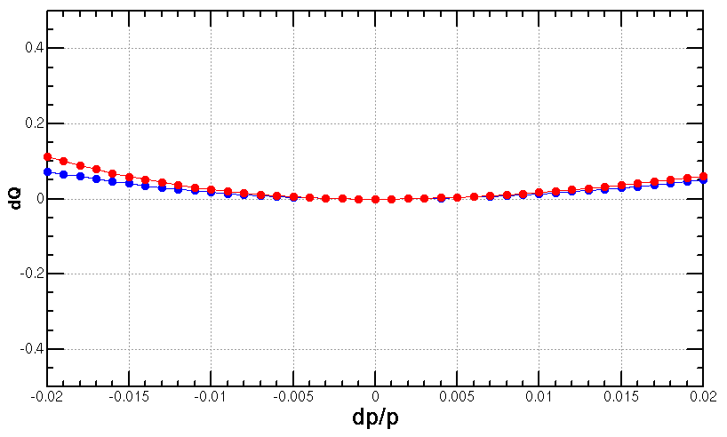
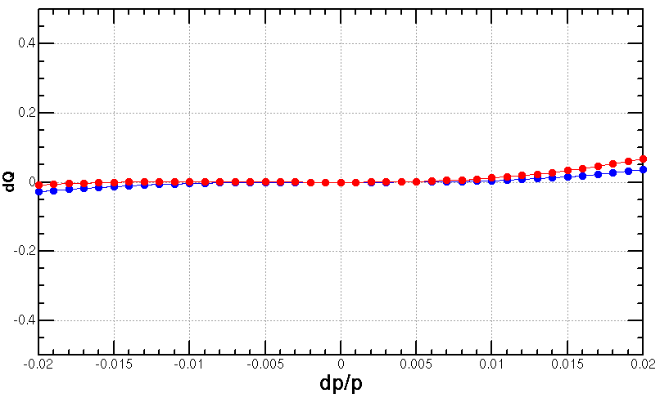
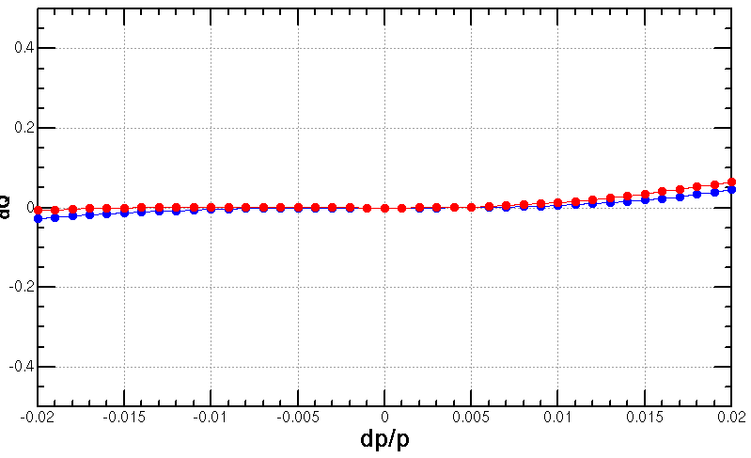
Optimization of the ARC aberration
2nd order chromaticity is a main aberration for the optimization of momentum acceptance with 2-repeated sextupole scheme.
  In previous versions, 2nd order chromaticity generated in the ARC region are corrected with IR knobs (phase advance or K1).
  However, the IR knobs will generate distortions at IP (beta, alfa and dispersion) especially for the horizontal plane.
A lattice with 4-repeated sextupoles
  much less 2nd order chromaticity for the horizontal plane
  not too sensitive to the errors
Q’’=313, 410
Q’’=8, 139
Q’’=9, 145
Scheme with 2 repeated sextupoles
Proposed by K. Oide
Scheme with 4 repeated sextupoles
Proposed by Yiwei Wang
Scheme with 8 repeated sextupoles
Proposed by Tianjian Bian

Slide 8
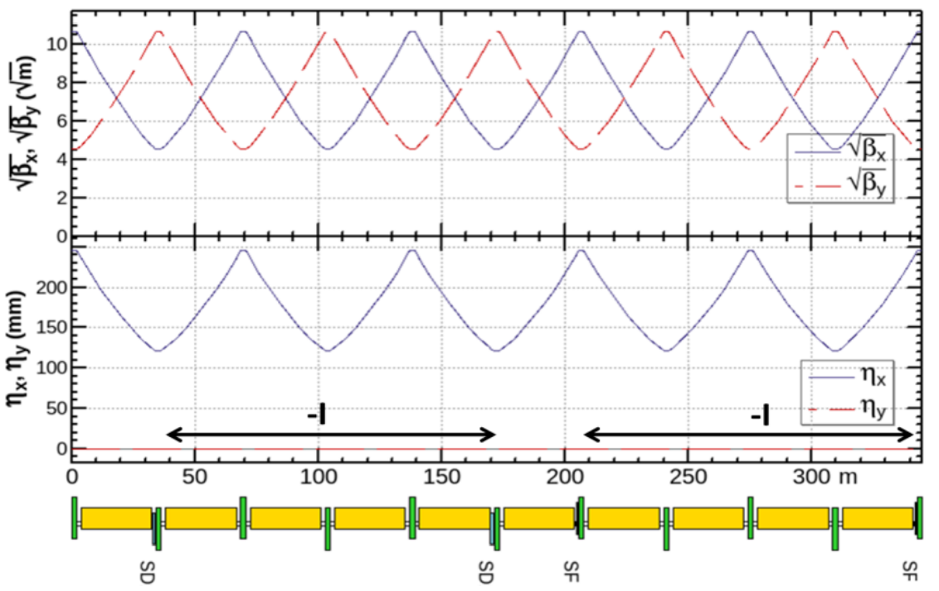
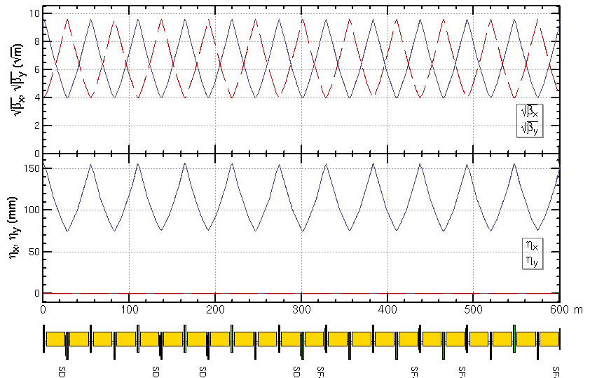
ARC period
ARC period (CDR)
345m, 5cells, 10bends, 10 quads, 4 sextupoles,
staggered sextupoles in two rings
ARC period (High lumi)
600m, 11cells, 22bends, 22 quads, 8 sextupoles,
parallel sextupoles in two rings, more sensitive to alignment error

Slide 9
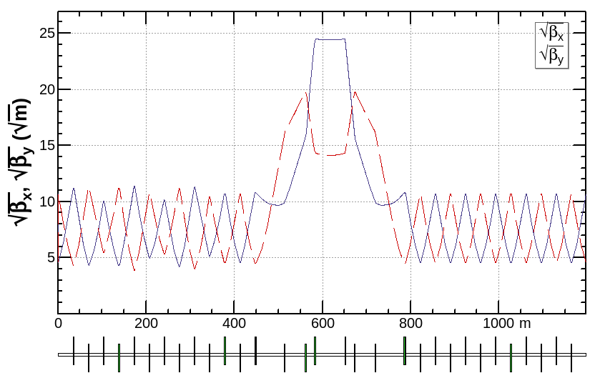
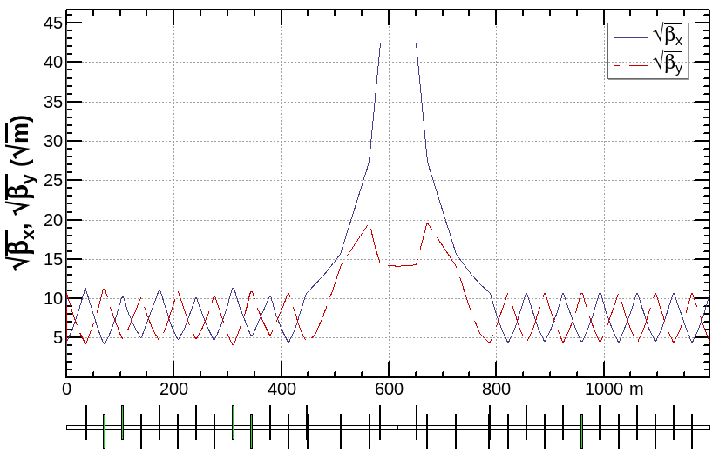
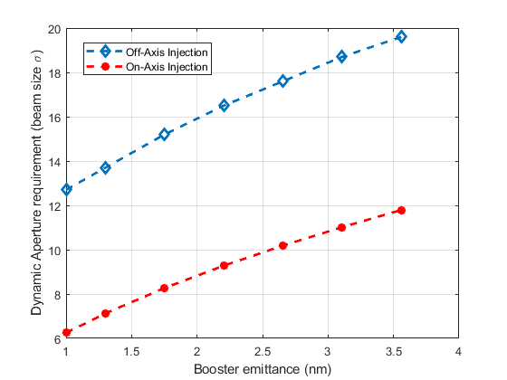
Injection region
Trying to relax the dynamic aperture requirement from injection
  Larger βx at injection point of collider ring (600m to 1800m)
  Smaller injected emittance from booster ring (3.6nm to 1.5nm)
Emittance of accelerators | CDR (nm) | High lumi. (nm)
Collider | 1.2 | 0.68
Booster | 3.6 | 1.5
Linac | 40 | 10
X. H. Cui
Horizontal DA requirement from injection
for the high luminosity collider ring

Slide 10
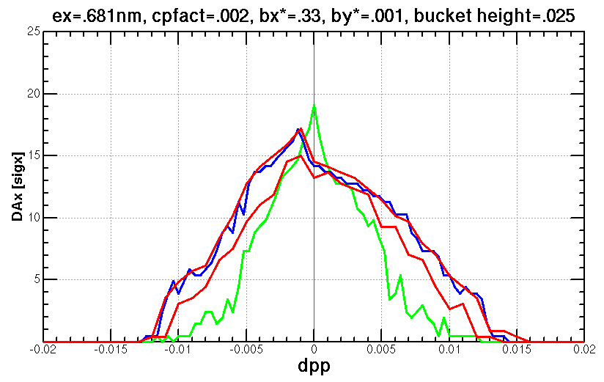
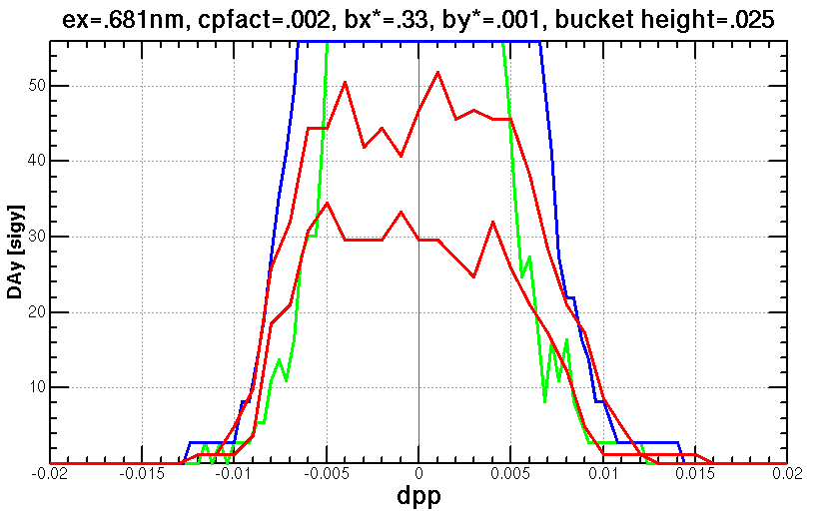
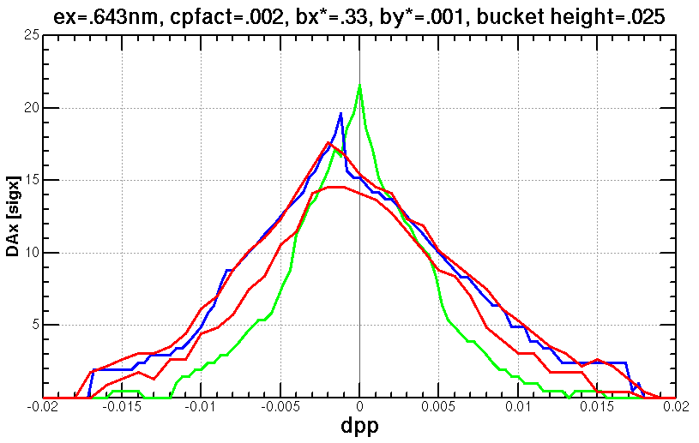
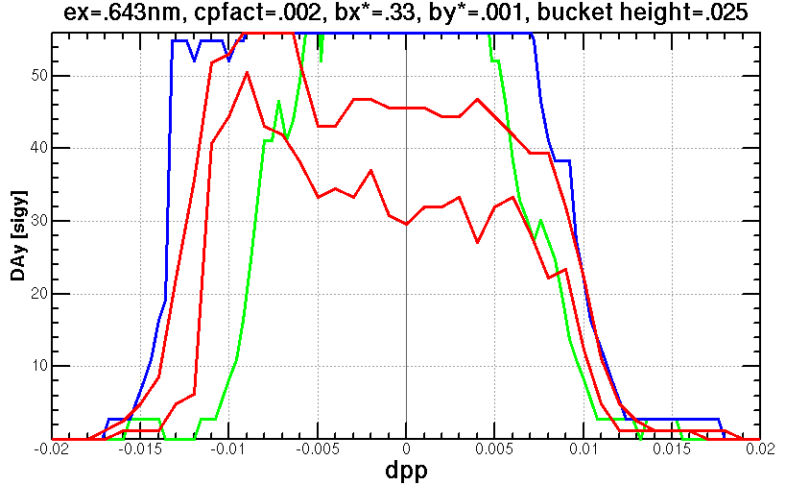
DA after aberration correction
of term by term
w/o rad
w/ damp
w/ damp+fluc (max, min)
145 turns
Initial phase=0

Slide 11
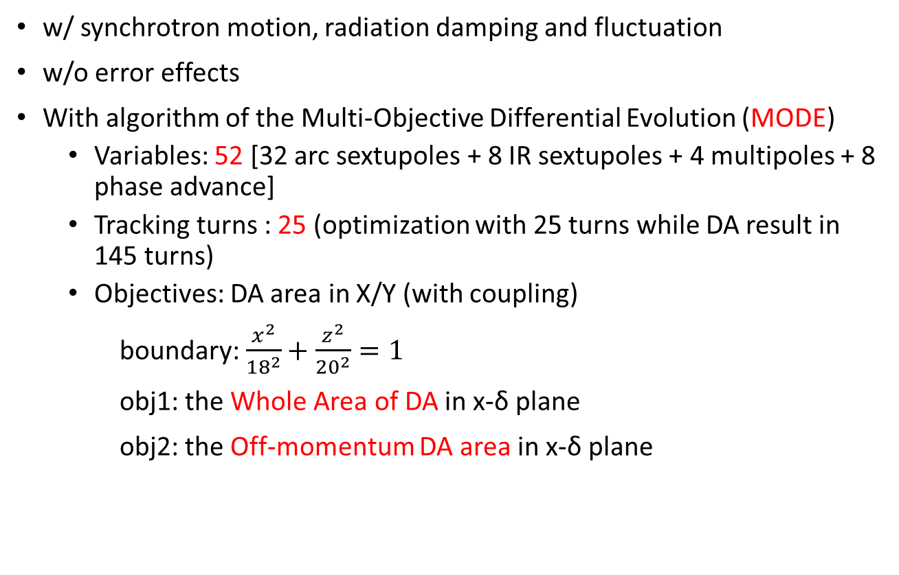
Dynamic aperture optimization
w/ synchrotron motion, radiation damping and fluctuation
w/o error effects
With algorithm of the Multi-Objective Differential Evolution (MODE)
  Variables: 52 [32 arc sextupoles + 8 IR sextupoles + 4 multipoles + 8 phase advance]
  Tracking turns : 25 (optimization with 25 turns while DA result in 145 turns)
  Objectives: DA area in X/Y (with coupling)
boundary: $\frac{x^{2}}{{18}^{2}}+\frac{z^{2}}{{20}^{2}}=1$
obj1: the Whole Area of DA in x-δ plane
obj2: the Off-momentum DA area in x-δ plane
obj2
obj1

Slide 12
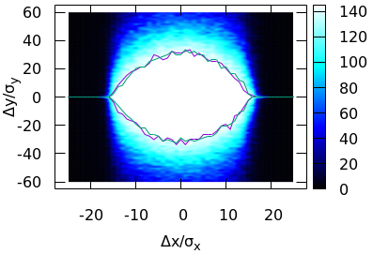
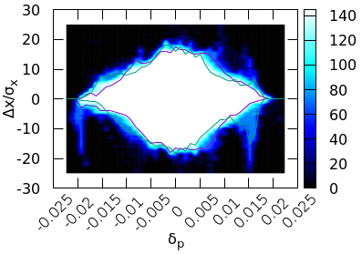


Dynamic aperture optimization
With better correction of energy dependent aberration and shorter L* (without changing the front-end position of the final doublet cryo-module)
Jin Wu, Yuan Zhang, Yiwei Wang
Achieved (w/o error): $16σ_{x}×32σ_{y}×1.9\%$
Goal (w/ error): $8σ_{x}×15σ_{y}×1.7\%$
Notes:
$11?σ_{x}×15σ_{y}×1.7\%(booster 3.6nm)$

Slide 13
Parameters for compatible modes
by D. Wang
 | tt | Higgs | W | Z
Number of IPs | 2 | 2 | 2 | 2
Energy (GeV) | 180 | 120 | 80 | 45.5
Circumference (km) | 100 | 100 | 100 | 100
SR loss/turn (GeV) | 8.53 | 1.73 | 0.33 | 0.036
Half crossing angle (mrad) | 16.5 | 16.5 | 16.5 | 16.5
Piwinski angle | 1.16 | 4.87 | 9.12 | 24.9
N_{e}/bunch (10¹⁰) | 20.1 | 16.3 | 11.6 | 15.2
Bunch number (bunch spacing) | 37 (4.45μs) | 214 (0.7us) | 1588 (0.2μs) | 3816 (86ns) | 11498 (26ns)
Beam current (mA) | 3.5 | 16.8 | 88.5 | 278.8 | 839.9
SR power /beam (MW) | 30 | 30 | 30 | 10 | 30
Bending radius (km) | 10.7 | 10.7 | 10.7 | 10.7
Phase advance of arc cell | 90°/90° | 90°/90° | 90°/90° | 60°/60°
Momentum compaction (10⁻⁵) | 0.73 | 0.73 | 0.73 | 1.48
β_{IP} x/y (m) | 1.0/0.0027 | 0.33/0.001 | 0.33/0.001 | 0.15/0.001
Emittance x/y (nm) | 1.45/0.0047 | 0.68/0.0014 | 0.28/0.00084 | 0.27/0.00135
Transverse σ_{IP} (um) | 37.9/0.11 | 15.0/0.037 | 9.6/0.029 | 6.36/0.037
ξ_{x}/ξ_{y}/IP | 0.076/0.106 | 0.018/0.115 | 0.014/0.13 | 0.0046/0.131
V_{RF} (GV) | 9.52 | 2.27 | 0.47 | 0.1
f _{RF} (MHz) (harmonic) | 650 (216816) | 650 (216816) | 650 (216816) | 650 (216816)
Nature bunch length σ_{z} (mm) | 2.23 | 2.25 | 2.4 | 2.75
Bunch length σ_{z} (mm) | 2.66 | 4.42 | 5.3 | 9.6
HOM power/cavity (kw) | 0.45 (5cell) | 0.48 (2cell) | 0.79 (2cell) | 2.0 (2cell) | 3.02 (1cell)
Energy spread (%) | 0.17 | 0.19 | 0.11 | 0.12
Energy acceptance requirement (DA) (%) | 2.0 | 1.7 | 1.2 | 1.3
Energy acceptance by RF (%) | 2.61 | 2.5 | 1.83 | 1.48
Lifetime (hour) | 0.59 | 0.35 | 1.3 | 1.7 | 1.4
L_{max}/IP (10³⁴cm⁻²s⁻¹) | 0.5 | 5.0 | 18.7 | 35.0 | 105.5

Slide 14
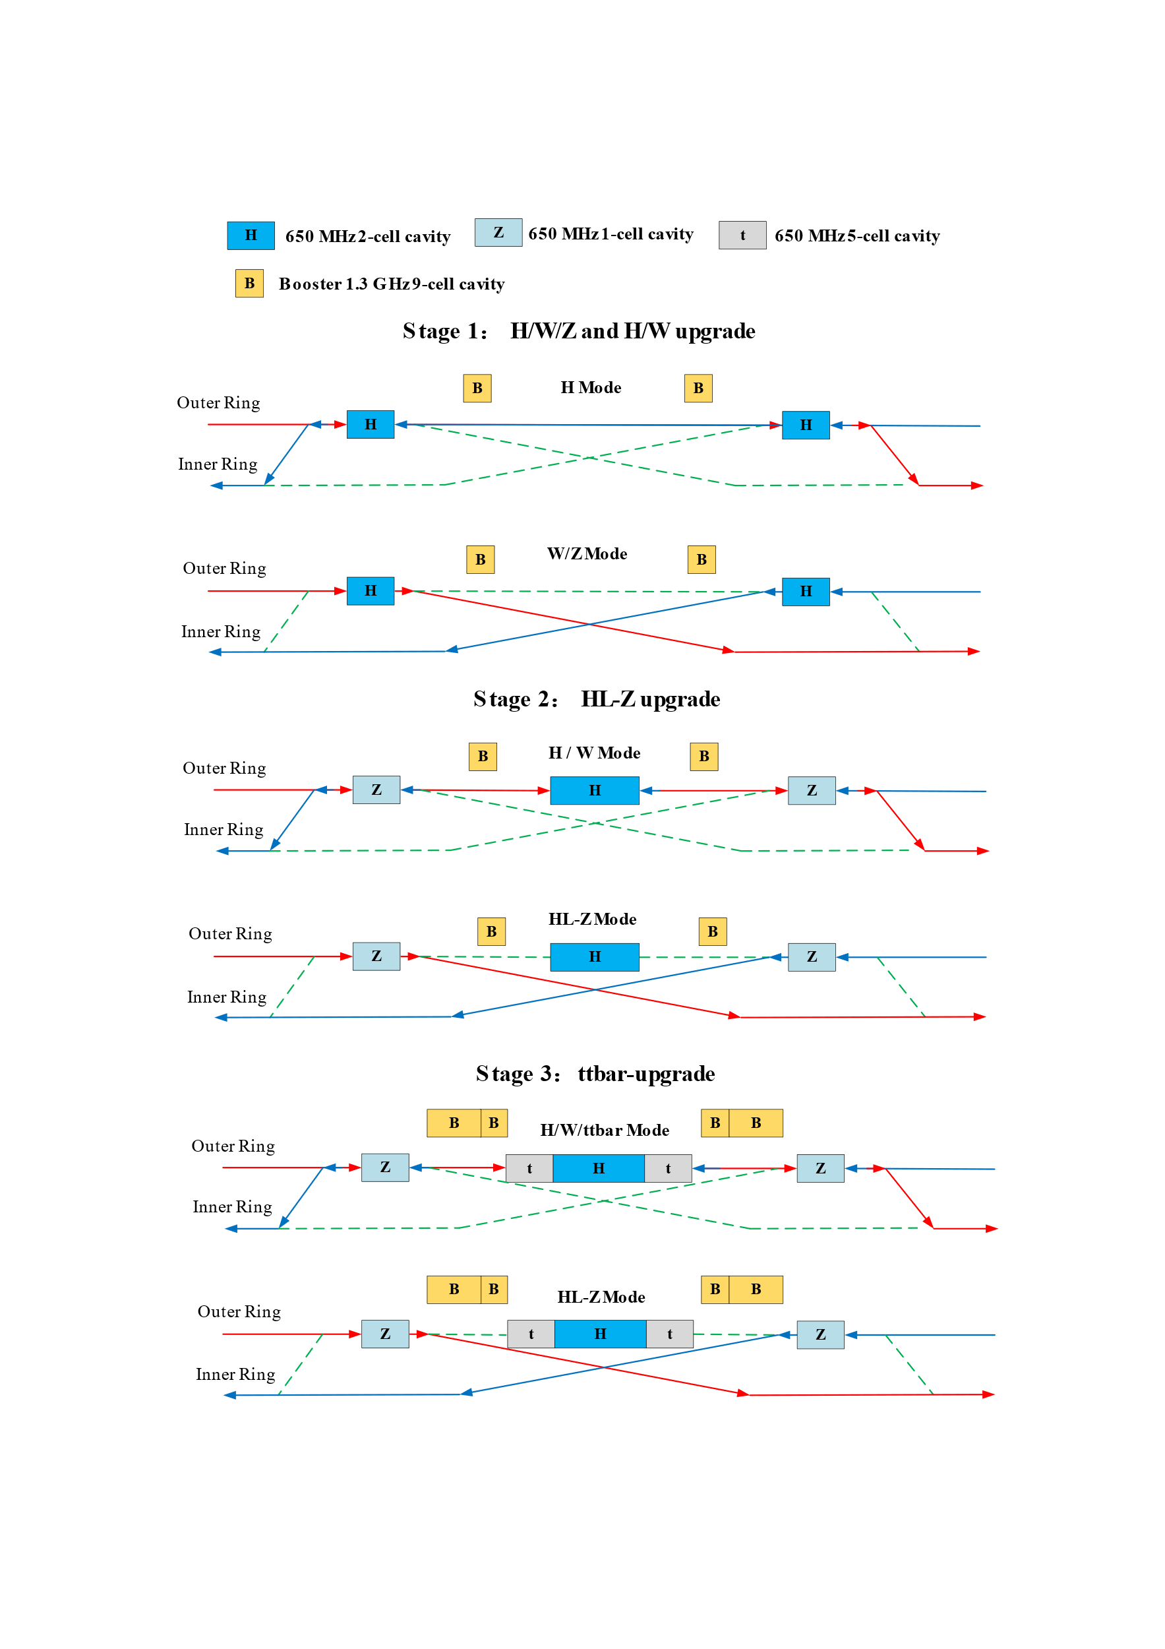
  RF staging for compatible modes
1st piroity of the Higgs running and flexible switching
Low cost at early stage
Get high luminosity for all modes
Stage 1 (H/W run)
Layout and parameters are same with CDR except longer central part
Medium or low luminosity at Z
Stage 2 (HL-Z upgrade)
Move Higgs cavities to center and add high current Z cavities.
By-pass low current H cavities.
Stage 3(ttbar upgrade)：
Add ttbar cavities (low current, high gradient, high Q)
Nb3Sn@4.2 K or others to significant reducing the cost of cryo-system and AC power.
by Jiyuan Zhai, Yiwei Wang

Slide 15
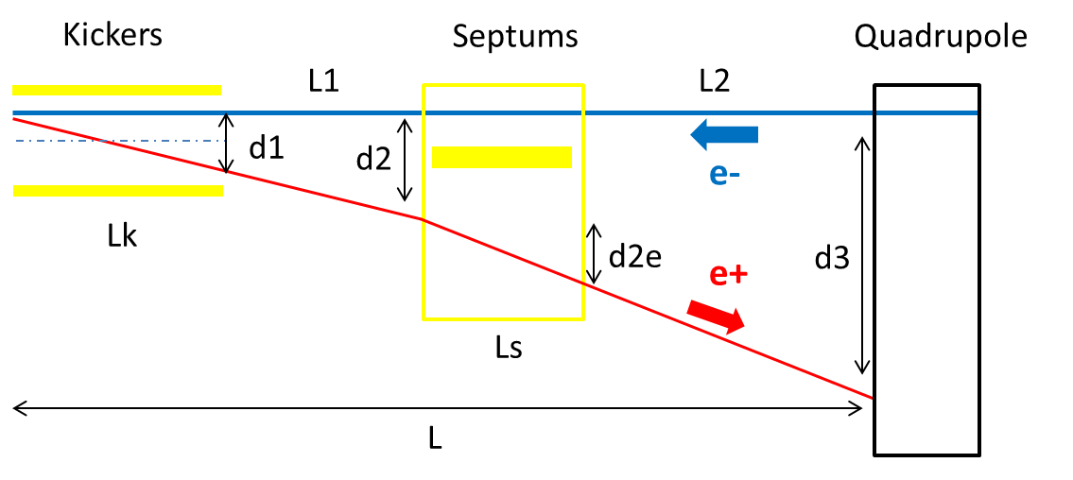
Alternative separation scheme at RF region
With kicker instead of electro-static separator to reduce the impedance
(Proposed by Jinhui Chen)
 | Kicker | Septum
Integrated strength BL [T*m] | 0.1624 | 1.4
Strength B [Guass] | 203 | 1000 | Field for up to 182.5GeV. Septum is weak to suppress emittance growth.
Effective length Leff [m] | 8 | 14
Half width of good field region Hgf/Vgf [mm] | 10.1/3.8 @ 5E-4 | 18.9/3.8 @ 5E-4 | Kicker: 18σx+3mm+d1/2, 18σy+3mm Septum: 18σx+3mm+d2e/2, 18σy+3mm
Half width of beam stay clear Hbsc/Vbsc [mm] | 9.6/3.6 | 9.2/3.6 | 18σx+3mm, 18σy+3mm
Septum width width [mm] | - | 5

Slide 16
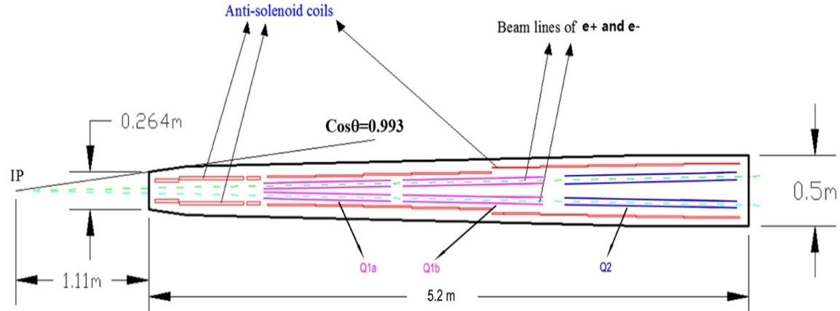
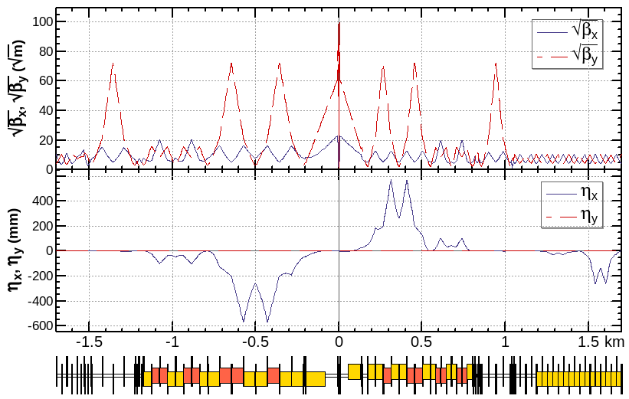
  Interaction region for other modes
  For the interaction region, the IP beta functions are refitted with the different combination of final doulets and the matching quadruples.
 | QD | QF
Z | Q1a | Q1b+Q2
W/H | Q1a+Q1b | Q2
ttbar | Q1a+Q1b+Q1c | add quads
By Y. Zhu, S. Bai
ref: FCC-ee CDR
beam
matching section
Final doublet

Slide 17
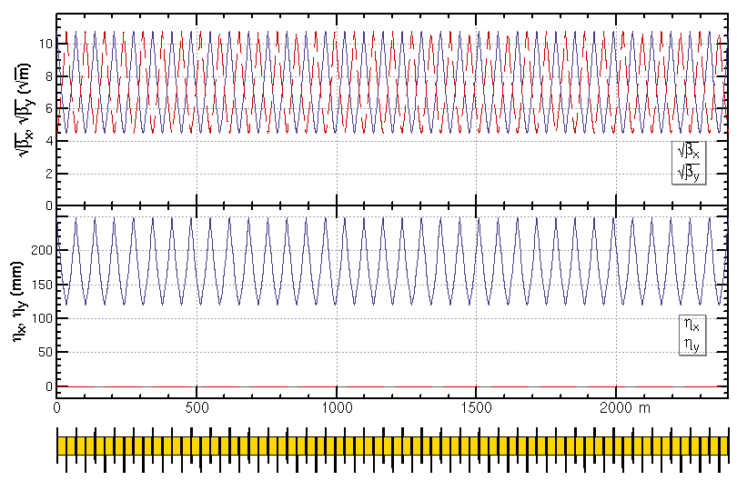
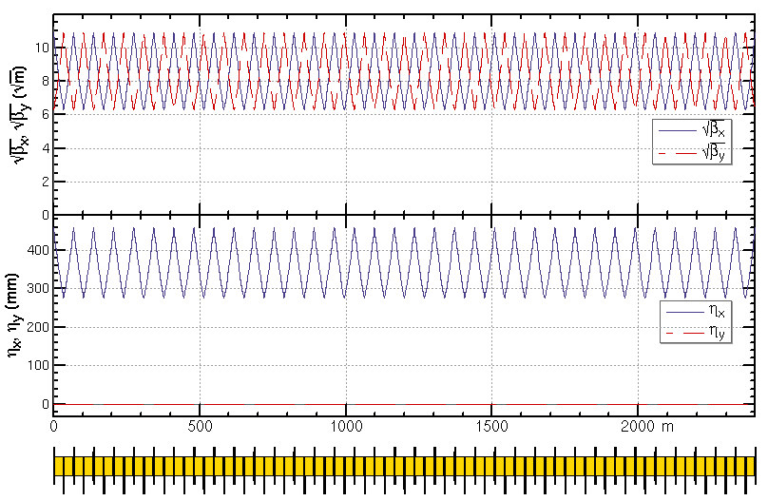
  ARC region for other modes
  For the arc region, the phase advance of each cell will be changed from 90/90 to 60/60 and the additional sextupoles need to be installed for the Z mode (Ref: FCC-ee CDR).
    H/W/tt modes: 5 cells/period, 42 sextupoles in 35 cells
    Z mode: 7 cells/period, 12 additional sextupoles (+29%) in 35 cells
    35 cells of H/W/tt mode
    35 cells of Z mode

Slide 18
Magnets comparison
SC magnet in IR | Higgs (CDR) | Higgs (high lumi.)
SC QD0 and QF1 | L*=2.2m, d=0.6m, QD0: 2.0m, 136T/m QF1: 1.48m, 111T/m | L*=1.9m, d=0.3m, QD0: 2.5m, 142T/m, 96T/m QF1=1.5m, 56T/m
SC anti-solenoids | maximum 7.2T | maximum 7.2T
SC sextupoles | VSIRD: 0.6m, 1308 T/m^2 HSIRD: 0.8m, 1506 T/m^2 VSIRU: 0.6m, 1250 T/m^2 HSIRU: 0.6m, 1600 T/m^2 | VSIRD: 0.6m, 1209 T/m^2 HSIRD: 0.8m, 1679 T/m^2 VSIRU: 0.6m, 1548 T/m^2 HSIRU: 0.6m, 1130 T/m^2 (safety factor 20% for strength )
Main magnets in ARC | Higgs (CDR) Quantity, length and field | Higgs (high lumi.) Quantity, length and field
Dipoles (dual aperture) | 2320, 28.686 m, 373 Gs | 2944, 21.7 m, 390 Gs (Quant +27%, total length -4%)
Quadpoles (dual aperture) | 2320, 2 m, 8.4 T/m | 2944, 3 m, 10.6 T/m (Quant +27%, total length +90%)
Sextupoles (single aperture) | SF: 896, 0.7 m, 506 T/m^2 SD: 896, 0.7 m*2, 506 T/m^2 | SF: 1024, 0.7 m, 1100 T/m^2 SD: 1024, 0.7 m*2, 1129 T/m^2 (Quant +14%, total length +14%)

Slide 19
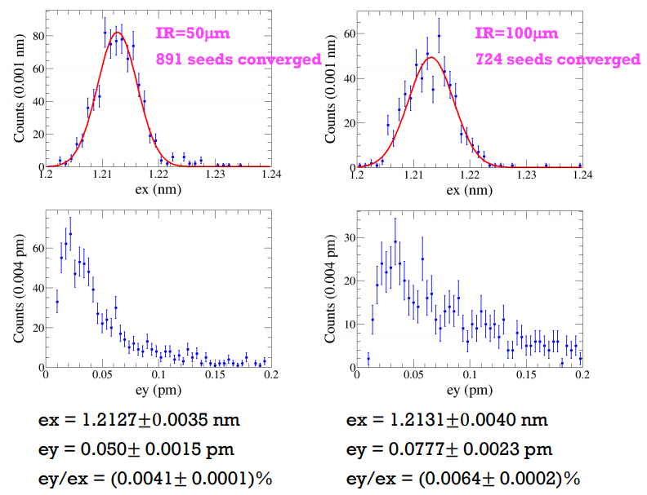
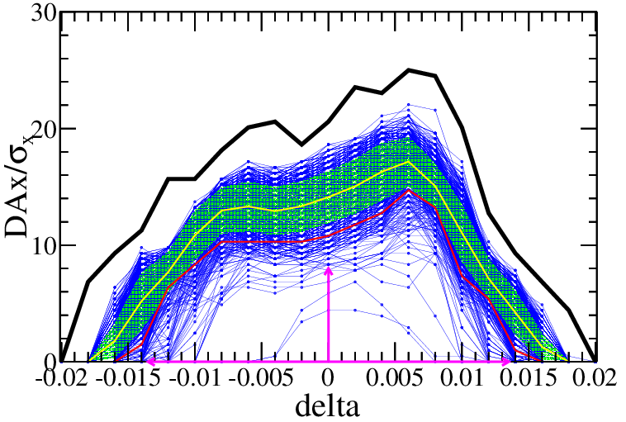
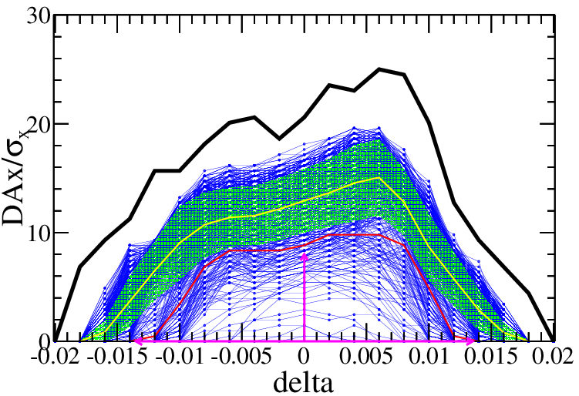
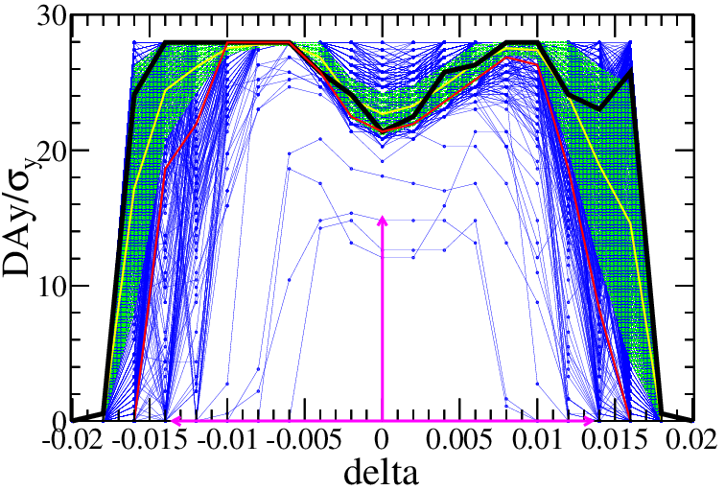
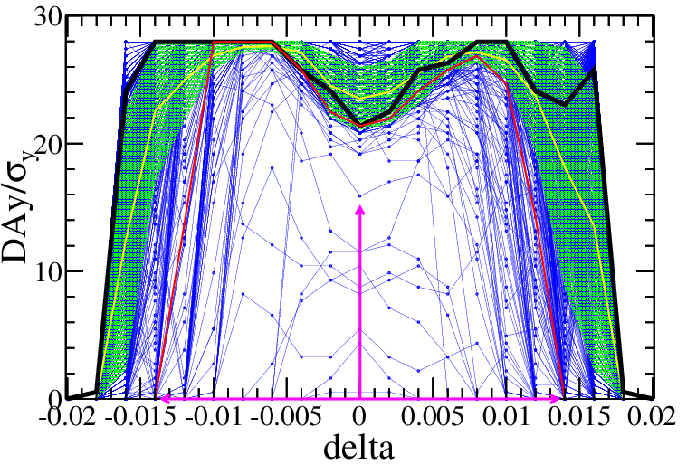
  Dynamic aperture with errors
More robust correction of error effects
by B. Wang, Y. Wei
IR=50μm
IR=100μm
Component | Δx (mm) | Δy (mm) | Δθ_{z} (mrad) | Field error
Dipole | 0.10 | 0.10 | 0.1 | 0.01%
Arc Quadrupole | 0.10 | 0.10 | 0.1 | 0.02%
IR Quadrupole | 0.05 | 0.05 | 0.05
Sextupole | 0.10 | 0.10 | 0.1
Component | Δx (mm) | Δy (mm) | Δθ_{z} (mrad) | Field error
Dipole | 0.10 | 0.10 | 0.1 | 0.01%
Arc Quadrupole | 0.10 | 0.10 | 0.1 | 0.02%
IR Quadrupole | 0.10 | 0.10 | 0.10
Sextupole | 0.10 | 0.10 | 0.1
89% seeds survival
72% seeds survival
—DA of bare lattice
—DA of each seed
—mean value
—statistic errors
—lower limits at 90%
Results based on the CDR lattice
The error corrections based on the high luminosity lattice is under going.

Slide 20
Summary
  The high luminosity scheme of CEPC collider ring with 5×10³⁴cm⁻²s⁻¹ & 30MW has been designed by squeezing the βy* and emittance.
    New aberration correction scheme in ARC region
    Compatible final doublets for all modes
    New RF staging scheme
    Alternative separation scheme at RF region
    Lower injection emittance from booster
  More work to be done for high luminosity scheme
    DA optimization and exploring even higher luminosity for ttbar, W, and Z modes
    Error correction
    Detector background evaluation
    …

