Slide 1
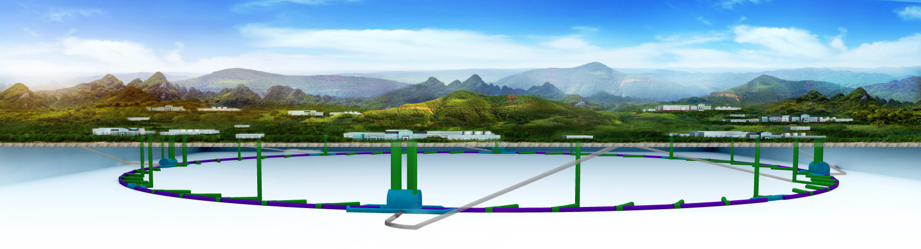
CEPC Beam Physics Issues
Chenghui Yu
for the CEPC accelerator team
Jan. 19, 2021

Slide 2
Outline
Overview of CEPC collider ring
The DA optimization progress based on CDR
High luminosity scheme of CEPC
Summary

Slide 3
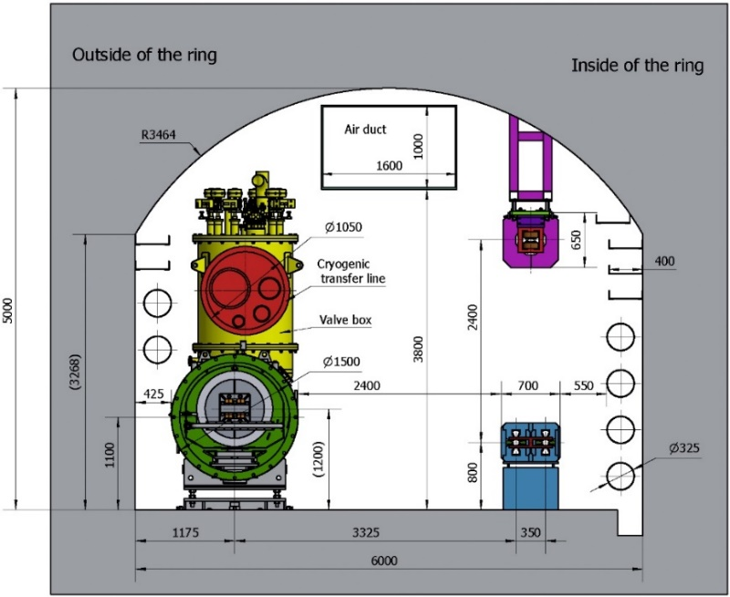
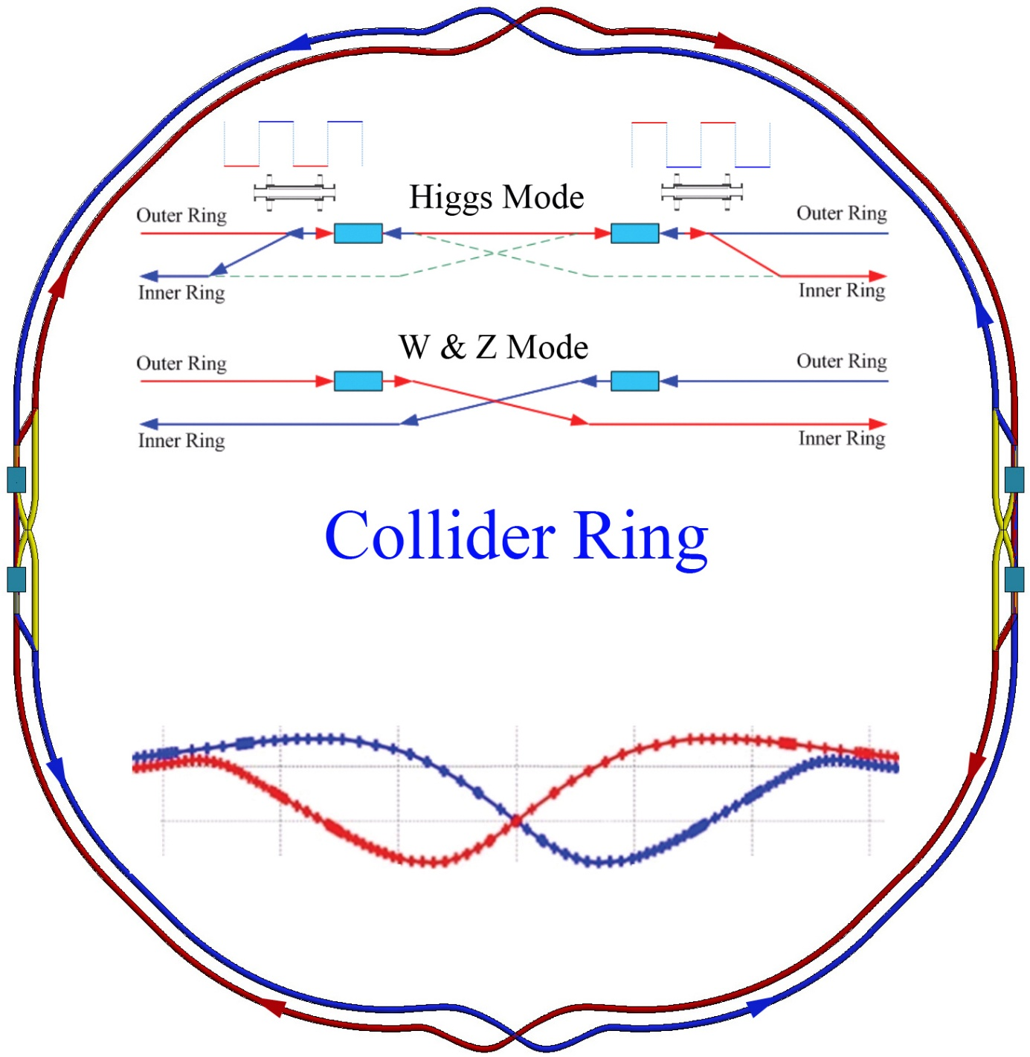
Overview of CEPC collider ring
Double ring collider with 2 IPs
Compatible with the geometry of SPPC

Slide 4
CDR beam parameters of collider ring
 | Higgs | W | Z
Number of IPs | 2
Beam energy (GeV) | 120 | 80 | 45.5
Circumference (km) | 100
Synchrotron radiation loss/turn (GeV) | 1.73 | 0.34 | 0.036
Crossing angle at IP (mrad) | 16.5×2
Piwinski angle | 3.48 | 7.0 | 23.8
Number of particles/bunch N_{e} (10¹⁰) | 15.0 | 12.0 | 8.0
Bunch number (bunch spacing) | 242 (0.68μs) | 1524 (0.21μs) | 12000 (25ns+10%gap)
Beam current (mA) | 17.4 | 87.9 | 461.0
Synchrotron radiation power /beam (MW) | 30 | 30 | 16.5
Bending radius (km) | 10.7
Momentum compact (10⁻⁵) | 1.11
β function at IP β_{x}* / β_{y}* (m) | 0.36/0.0015 | 0.36/0.0015 | 0.2/0.001
Emittance ε_{x}/ε_{y} (nm) | 1.21/0.0024 | 0.54/0.0016 | 0.18/0.0016
Beam size at IP σ_{x} /σ_{y} (μm) | 20.9/0.06 | 13.9/0.049 | 6.0/0.04
Beam-beam parameters ξ_{x}/ξ_{y} | 0.018/0.109 | 0.013/0.123 | 0.004/0.079
RF voltage V_{RF} (GV) | 2.17 | 0.47 | 0.10
RF frequency f _{RF} (MHz) (harmonic) | 650 (216816)
Natural bunch length σ_{z} (mm) | 2.72 | 2.98 | 2.42
Bunch length σ_{z} (mm) | 4.4 | 5.9 | 8.5
HOM power/cavity (2 cell) (kw) | 0.46 | 0.75 | 1.94
Energy spread (%) | 0.134 | 0.098 | 0.080
Energy acceptance requirement (%) | 1.35 | 0.90 | 0.49
Energy acceptance by RF (%) | 2.06 | 1.47 | 1.7
Photon number due to beamstrahlung | 0.082 | 0.050 | 0.023
Beamstruhlung lifetime /quantum lifetime* (min) | 80/80 | >400
Lifetime (hour) | 0.43 | 1.4 | 2.5
F (hour glass) | 0.89 | 0.94 | 0.99
Luminosity/IP L (10³⁴cm⁻²s⁻¹) | 3 | 10 | 32
Physics goals
Performance
Construction cost
Operation cost
Fluctuation
Beamstruhlung
Flexibility
Robust
……

Slide 5
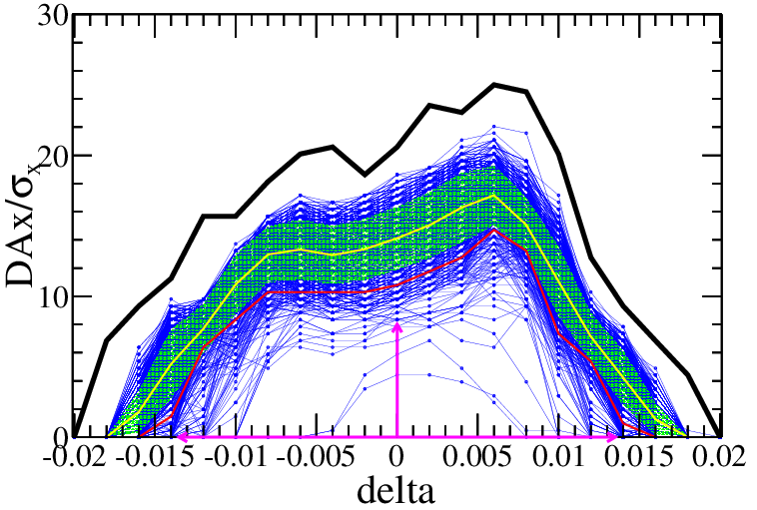
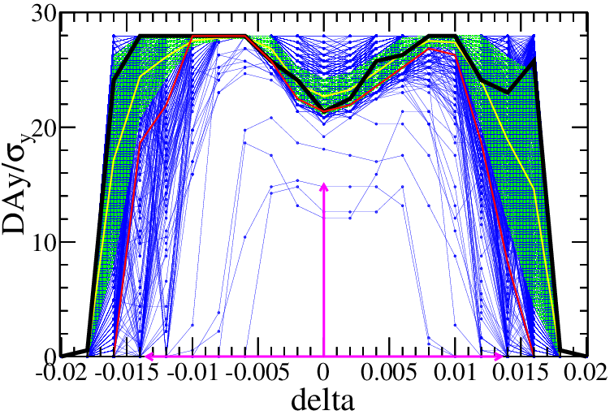
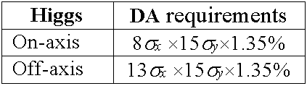
The DA optimization progress base on CDR
Crab waist=100%
KEK
SAD is used
145 turns tracked
1000 samples
IR sextupoles + 32 arc sextupoles
(Max. free various=254)
Damping at each element
RF ON
Radiation fluctuation ON
Sawtooth on with tapering
Higgs
$$10σ_{x}×21σ_{y} \& 0.014$$
89.1% of 1000 seeds
Component | Δx (mm) | Δy (mm) | Δz (mm) | Δθ_{x} (mrad) | Δθ_{y} (mrad) | Δθ_{z} (mrad) | Field error
Dipole | 0.10 | 0.10 | 0.10 | 0.1 | 0.1 | 0.1 | 0.01%
Arc Quadrupole | 0.10 | 0.10 | 0.10 | 0.1 | 0.1 | 0.1 | 0.02%
FF Quadrupole | 0.05 | 0.05 | 0.05 | 0.05 | 0.05 | 0.05
Sextupole | 0.10 | 0.10 | 0.10 | 0.1 | 0.1 | 0.1
Dipole | Quadrupole | Sextupole
B₂/B₀≤4×10⁻⁴ B₃/B₀≤0.8×10⁻⁴ B₄/B₀≤0.2×10⁻⁴ B_{n}(n>4)/B₀≤0.8×10⁻⁴ | B₂/B₁≤4×10⁻⁴ B₃/B₁≤4×10⁻⁴ B₄/B₁≤2×10⁻⁴ B_{n}(n>4)/B₁≤1×10⁻⁴ | B₃/B₂≤20×10⁻⁴ B₄/B₂≤3×10⁻⁴ B₅/B₂≤20×10⁻⁴ B_{n}(n>5)/B₂≤10×10⁻⁴
Including FF
RMS
R=12mm
RMS close orbit distortions are smaller than 30 µm and 50 um in horizontal and vertical plane. Beta beatings < 7% , Coupling < 0.2%

Slide 6
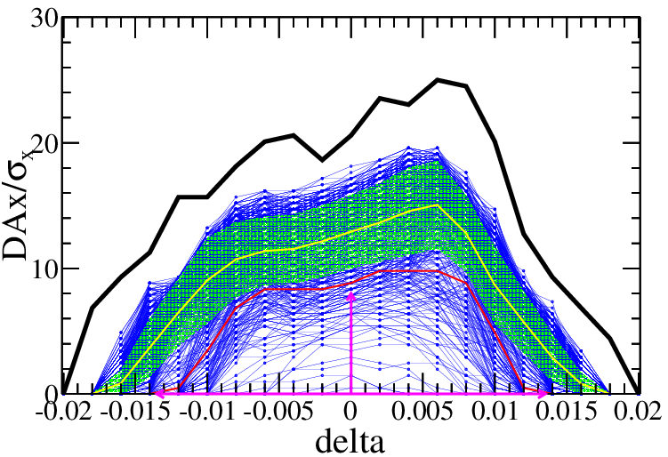
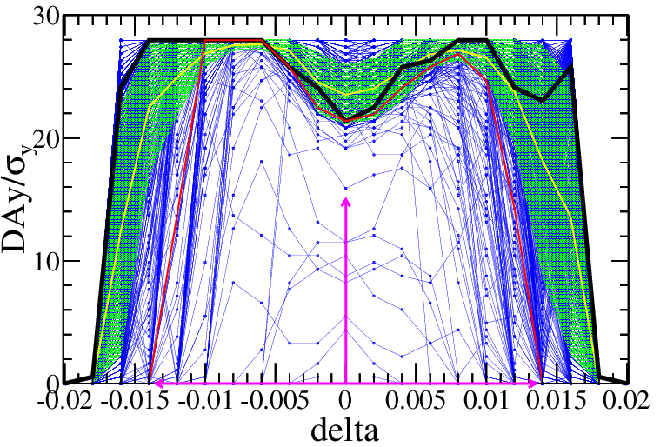
The DA optimization progress base on CDR
Crab waist=100%
KEK
SAD is used
145 turns tracked
1000 samples
IR sextupoles + 32 arc sextupoles
(Max. free various=254)
Damping at each element
RF ON
Radiation fluctuation ON
Sawtooth on with tapering
Higgs
$$9σ_{x}×20σ_{y} \& 0.014$$
72.4% of 1000 seeds
Component | Δx (mm) | Δy (mm) | Δz (mm) | Δθ_{x} (mrad) | Δθ_{y} (mrad) | Δθ_{z} (mrad) | Field error
Dipole | 0.10 | 0.10 | 0.10 | 0.1 | 0.1 | 0.1 | 0.01%
Arc Quadrupole | 0.10 | 0.10 | 0.10 | 0.1 | 0.1 | 0.1 | 0.02%
FF Quadrupole | 0.10 | 0.10 | 0.10 | 0.10 | 0.10 | 0.10
Sextupole | 0.10 | 0.10 | 0.10 | 0.1 | 0.1 | 0.1
Dipole | Quadrupole | Sextupole
B₂/B₀≤4×10⁻⁴ B₃/B₀≤0.8×10⁻⁴ B₄/B₀≤0.2×10⁻⁴ B_{n}(n>4)/B₀≤0.8×10⁻⁴ | B₂/B₁≤4×10⁻⁴ B₃/B₁≤4×10⁻⁴ B₄/B₁≤2×10⁻⁴ B_{n}(n>4)/B₁≤1×10⁻⁴ | B₃/B₂≤20×10⁻⁴ B₄/B₂≤3×10⁻⁴ B₅/B₂≤20×10⁻⁴ B_{n}(n>5)/B₂≤10×10⁻⁴
RMS
R=12mm
The DA margin shows we can expect more aggressive scheme for higher luminosity

Slide 7
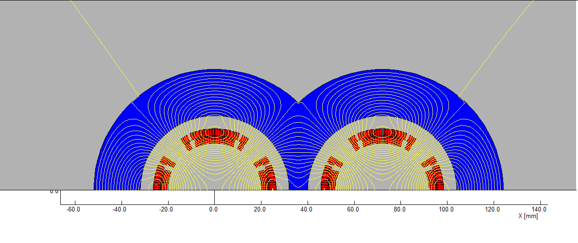
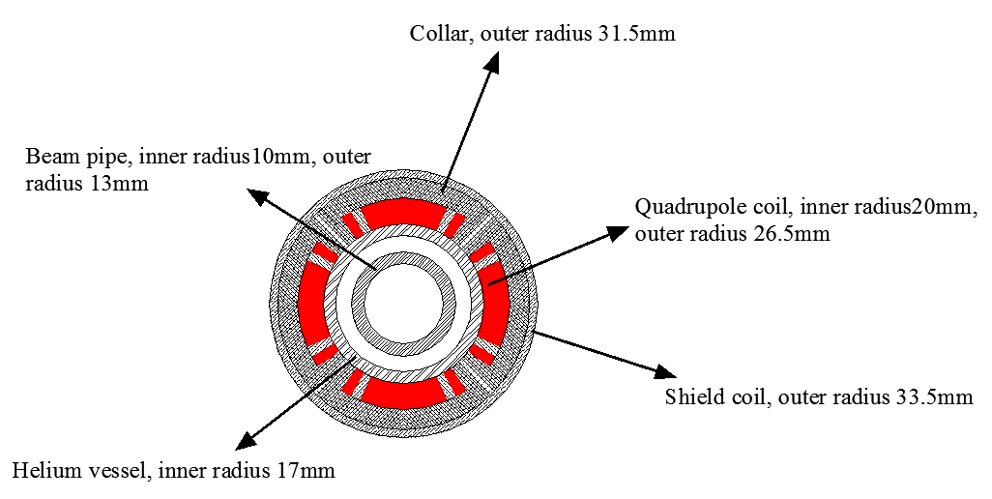
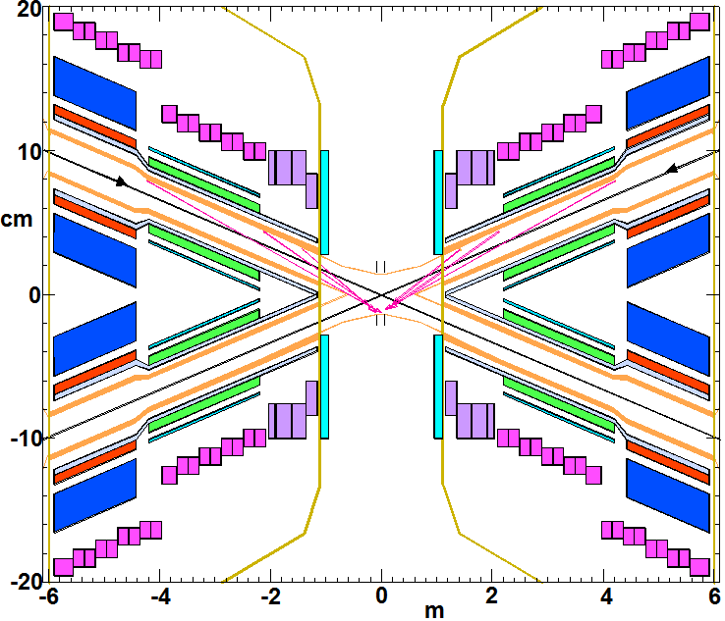
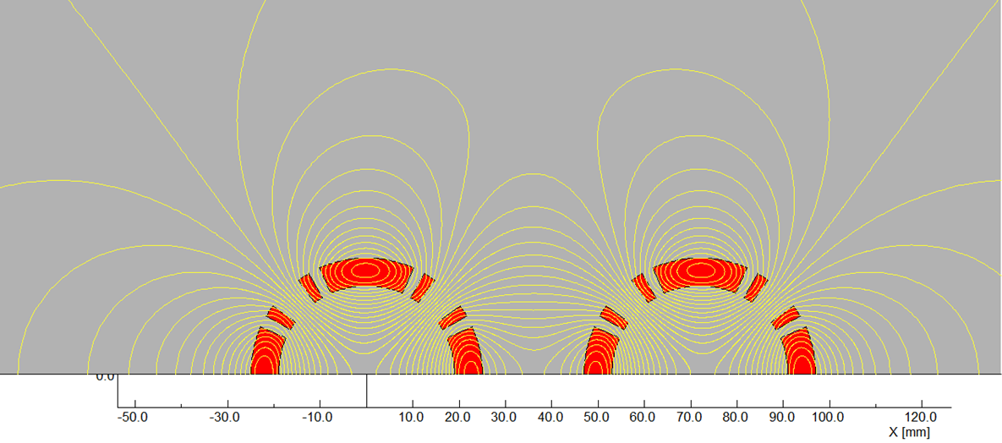
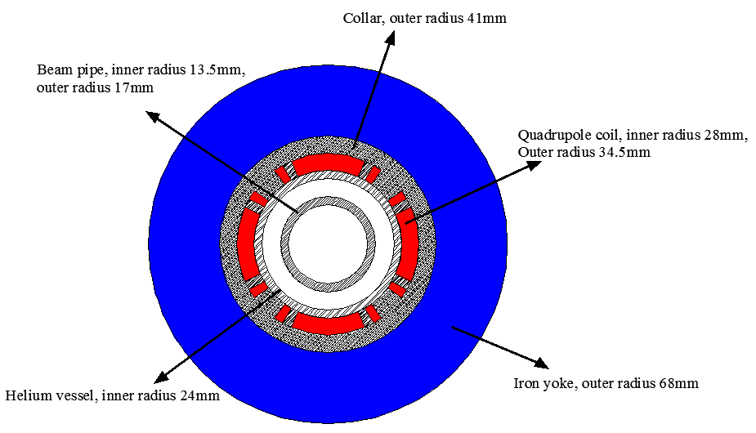
High luminosity scheme at Higgs energy
Key parameters of CDR Higgs scheme
✓ L*=2.2m, θc=33mrad, βx*=0.36m, βy*=1.5mm, Emittance=1.2nm
  Strength requirements of anti-solenoids B_{z}~7.2T
  Enough space for the SC quadrupole coils in two-in-one type (Peak field 3.8T & 136T/m) with room temperature vacuum chamber & Iron yoke

Slide 8
High luminosity scheme at Higgs energy
✓ L*=2.2m, θc=33mrad, βx*=0.36m, βy*=1.5mm, Emittance=1.2nm
  Strength requirements of anti-solenoids B_{z}~7.2T
  Two-in-one type SC quadrupole coils (Peak field 3.8T & 136T/m)
✗ L*=2.2m, θc=33mrad, βx*=0.33m, βy*=1.0mm, Emittance=0.9nm
Key parameters of high luminosity scheme
✓ L*=1.9m, θc=33mrad, βx*=0.33m, βy*=1.0mm, Emittance=0.68nm
  Strength requirements of anti-solenoids B_{z}~7.2T
  Two-in-one type SC quadrupole coils (Peak field 3.8T & 141T/m) with room temperature vacuum chamber & Iron yoke
Lower emittance and smaller beam pipe aperture within the region of SCQ

Slide 9
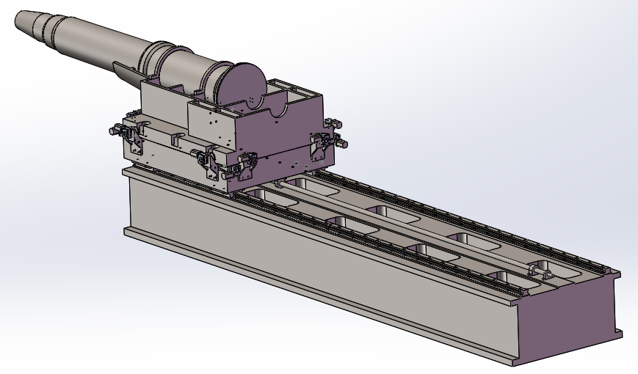
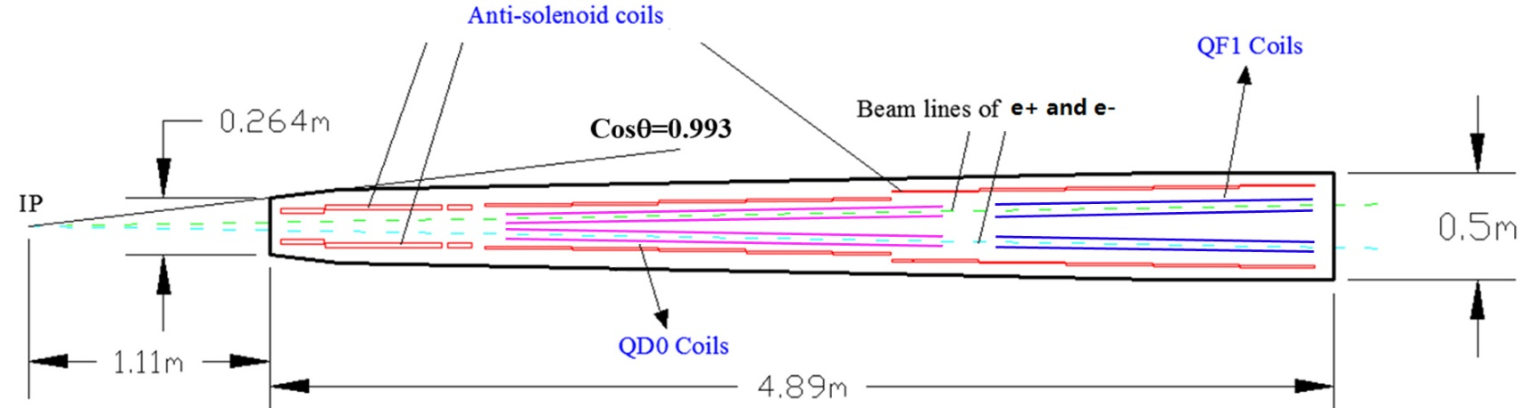
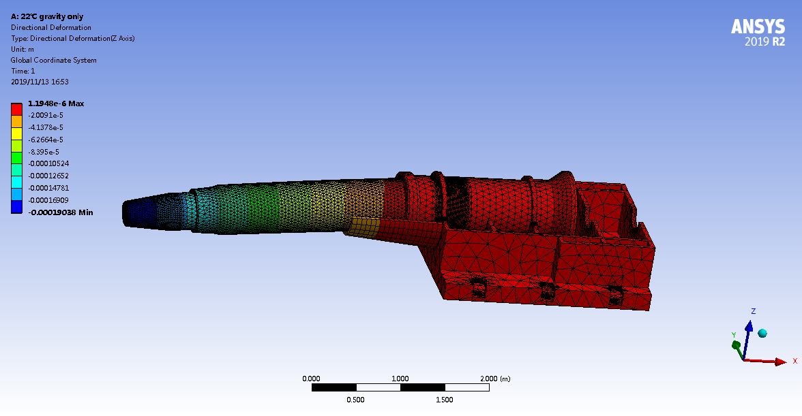
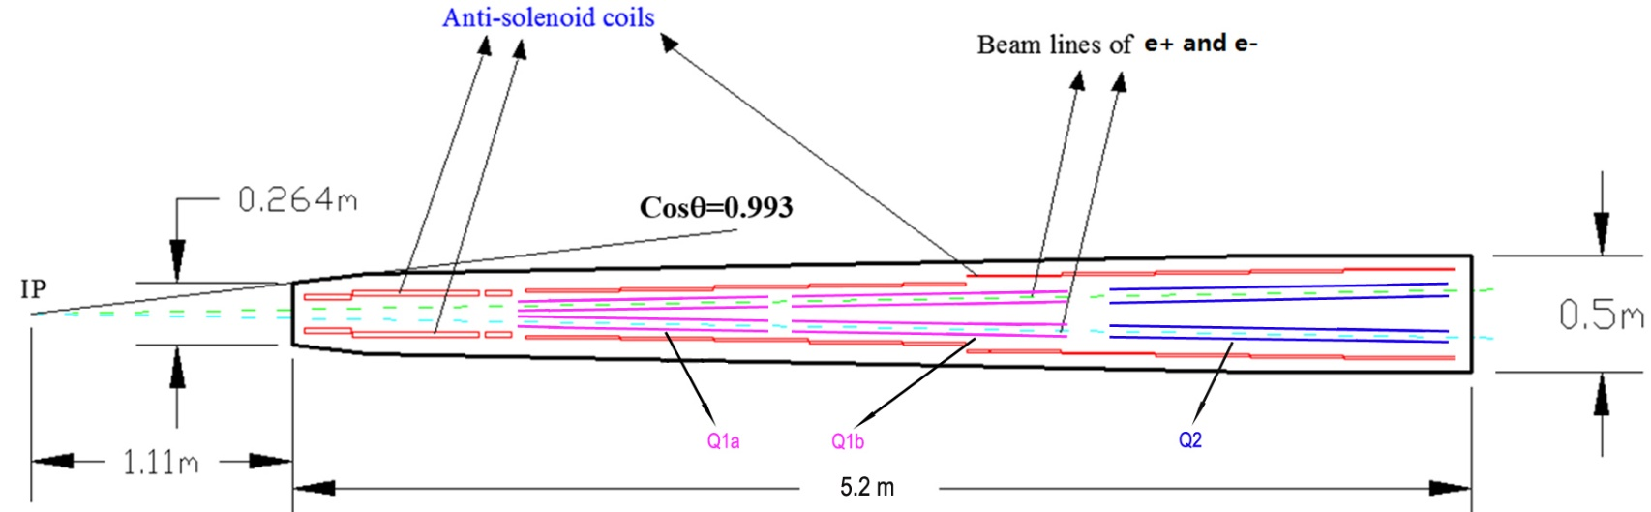
High luminosity scheme at Higgs energy
Change of cryostat
CDR
For the part of cryostat inside the detector, the shape and size stay the same as CDR.
The design of detector won’t be affected.
We hope the length of cryostat can be as shorter as possible.
High luminosity
Under gravity, deformation=190μm
Installation
Vacuum situation at the IP

Slide 10
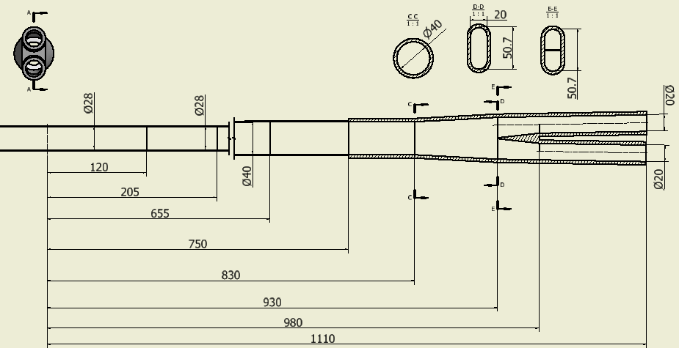
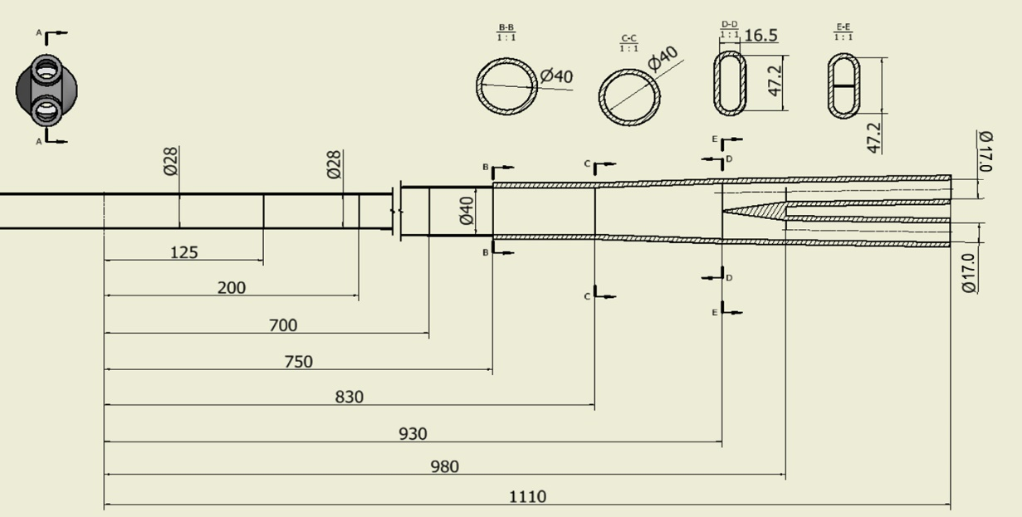
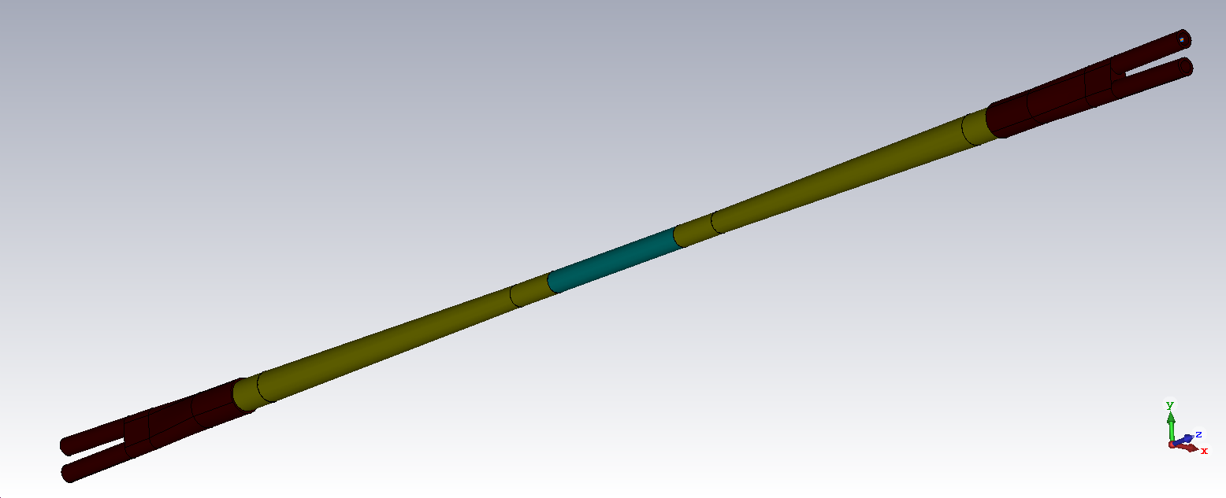
High luminosity scheme at Higgs energy
CDR
Change of IP chamber
High luminosity
Be pipe: 28mm, SCQ Beam pipe:20mm
Be pipe: 28mm, Beam pipe:17mm
Be: φ28mm
Al: φ28mm-> φ40mm
Cu: φ17mm

Slide 11
High luminosity scheme at Higgs energy
Change of HOM deposition nearby the IP
HOM Power distribution | High luminosity Be pipe: 28mm SCQ Pipe:17mm |  | CDR Be pipe: 28mm SCQ Pipe:20mm
 | Higgs | Z | Higgs | Z
Be pipe | 3.46w | 52.1w | 2.66w | 40.74 w
Al | 22.62w | 335.4w | 21.32w | 317.2w
Y-shape crotch | 13.4w | 199w | 12.9w | 191.5w
Total power | 39.48w | 586.5w | 36.88w | 549.5w
Shrinking the SCQ pipe aperture from 20mm to 17mm, the power deposition will increase 10% which is acceptable.

Slide 12

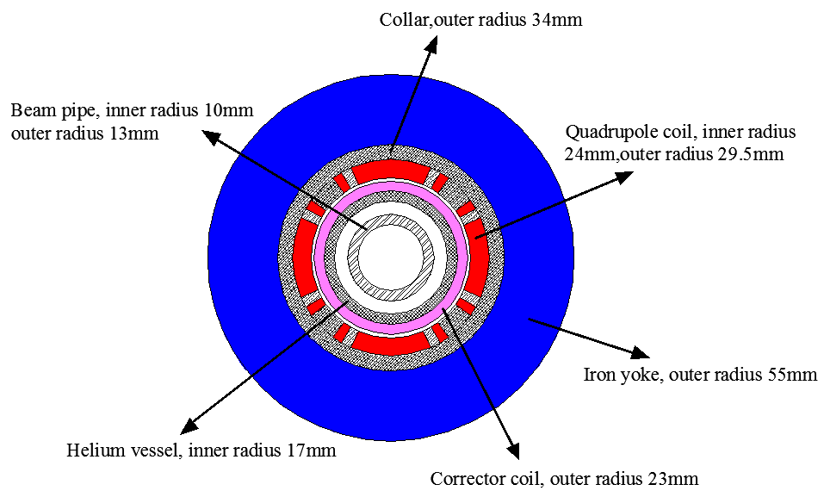
High luminosity scheme at Higgs energy
Change of final focusing quadrupole coils
Coil | Central field gradient (T/m) | Magnetic length (m) | Width of GFR (mm) | Minimal distance between two aperture beam lines (mm)
Q1a | 141 | 1.21 | 15.21 | 62.71
Q1b | 84.7 | 1.21 | 17.92 | 105.28
Q2 | 94.8 | 1.5 | 24.14 | 155.11
Q1a is the most challenging.
The design of quadrupoles and anti-solenoid is similar to that in CDR.
Iron yoke is adopted to eliminate the field crosstalk between the two apertures.

Slide 13
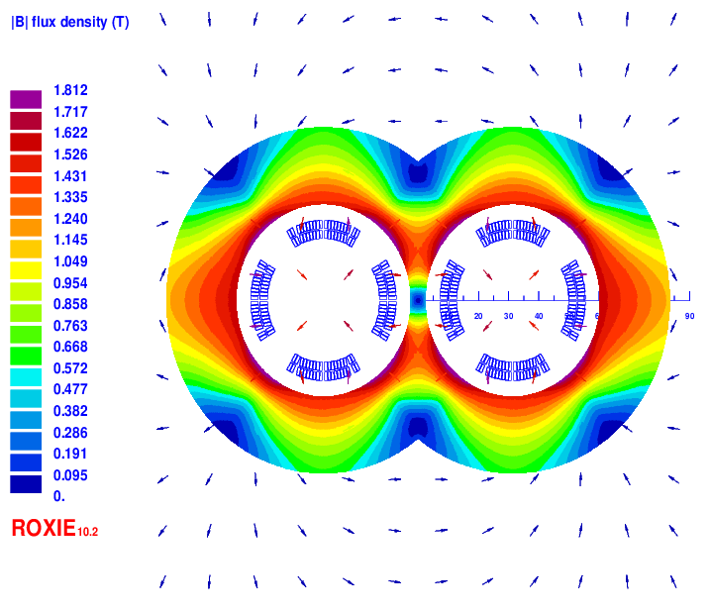
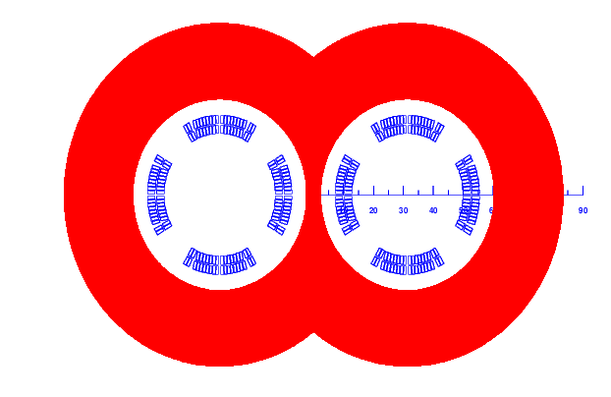
High luminosity scheme at Higgs energy
Change of final focusing quadrupole coils
Two layers cos2θ quadrupole coil using Rutherford cable with iron yoke. The inner diameter of the coil is 37mm. The width of the cable is 2.5mm, and there are 19 turns in each pole.
Each multipole field in single aperture is smaller than 1×10⁻⁴. The field crosstalk is smaller than 0.5×10⁻⁴. The dipole field in each single aperture as a result of field crosstalk is smaller than 5 Gs.
2D model
Magnetic flux density distribution

Slide 14
High luminosity scheme at Higgs energy
Change of ARC region
Shorter cell length to control the emittance from CDR 1.2nm to 0.7nm
Optimization of the quadrupole radiation effect
  Interaction region: longer FF quadrupoles
  ARC region: longer quadrupoles
  Reduction of dynamic aperture requirement from injection
  Straight section region: larger βx at injection point
Optimization of high order chromaticity for arc region
Better correction of energy dependent aberration

Slide 15
High luminosity scheme at Higgs energy
 | Higgs (CDR) | Higgs (high luminosity)
Number of IPs | 2 | 2
Beam energy (GeV) | 120 | 120
Circumference (km) | 100 | 100
Synchrotron radiation loss/turn (GeV) | 1.73 | 1.73
Crossing angle at IP (mrad) | 16.5×2 | 16.5
Piwinski angle | 3.48 | 4.87
Number of particles/bunch N_{e} (10¹⁰) | 15.0 | 16.3
Bunch number (bunch spacing) | 242 (0.68μs) | 214 (0.70μs)
Beam current (mA) | 17.4 | 16.8
Synchrotron radiation power /beam (MW) | 30 | 30
Bending radius (km) | 10.7 | 10.7
Momentum compact (10⁻⁵) | 1.11 | 0.73
β function at IP β_{x}* / β_{y}* (m) | 0.36/0.0015 | 0.33/0.001
Emittance e_{x}/e_{y} (nm) | 1.21/0.0024 | 0.68/0.0014
Beam size at IP s_{x} /s_{y} (μm) | 20.9/0.06 | 15.0/0.037
Beam-beam parameters ξ_{x}/ξ_{y} | 0.018/0.109 | 0.018/0.115
RF voltage V_{RF} (GV) | 2.17 | 2.27
RF frequency f _{RF} (MHz) (harmonic) | 650 (216816) | 650 (216816)
Natural bunch length σ_{z} (mm) | 2.72 | 2.25
Bunch length σ_{z} (mm) | 4.4 | 4.42
HOM power/cavity (2 cell) (kw) | 0.46 | 0.48
Energy spread (%) | 0.134 | 0.19
Energy acceptance requirement (%) | 1.35 | 1.7
Energy acceptance by RF (%) | 2.06 | 2.5
Lifetime (hour) | 0.43 | 0.35
F (hour glass) | 0.89 | 0.88
Luminosity/IP L (10³⁴cm⁻²s⁻¹) | 2.93 | 5.0

Slide 16
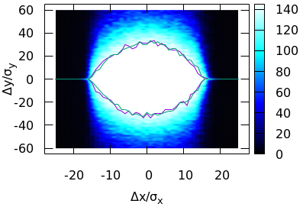
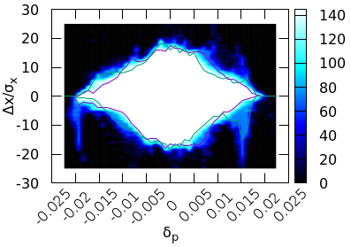

High luminosity scheme at Higgs energy
Dynamic aperture
We are developing more powerful methods for the DA optimization
Achieved (without errors): $16σ_{x}×32σ_{y}×1.9\%$
Goal (with errors): $8σ_{x}×15σ_{y}×1.7\%$
Notes:
$11?σ_{x}×15σ_{y}×1.7\%(booster 3.6nm)$

Slide 17
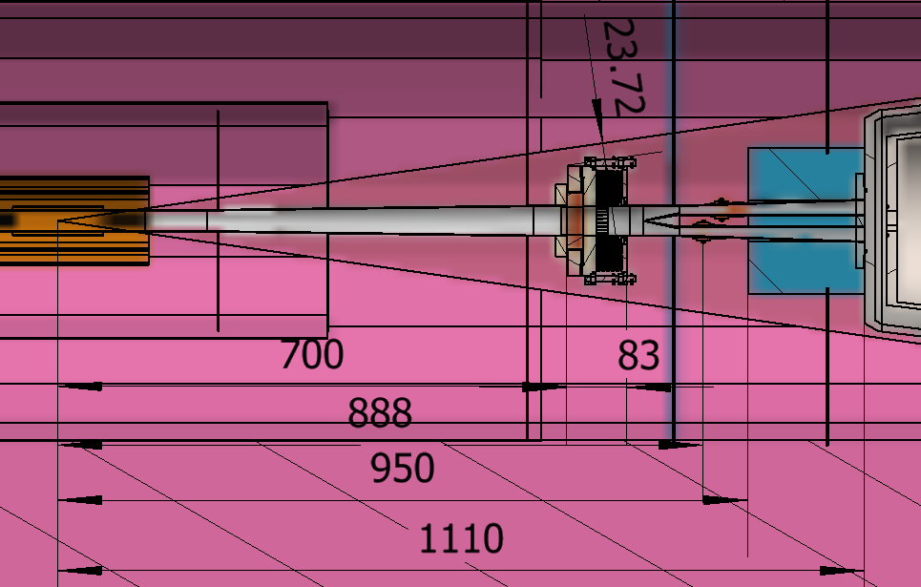
High luminosity scheme at Higgs energy
IR Mechanical Design
Difficulties:
  Vacuum chamber connection
    Longitudinal space: bellows should absorb deformation when baking. →Add Z-direction support, length has been decreased to 83mm.
    Transversal space: all the structure should be within detection angle.
  Hardware protection
    Avoid SR

Slide 18
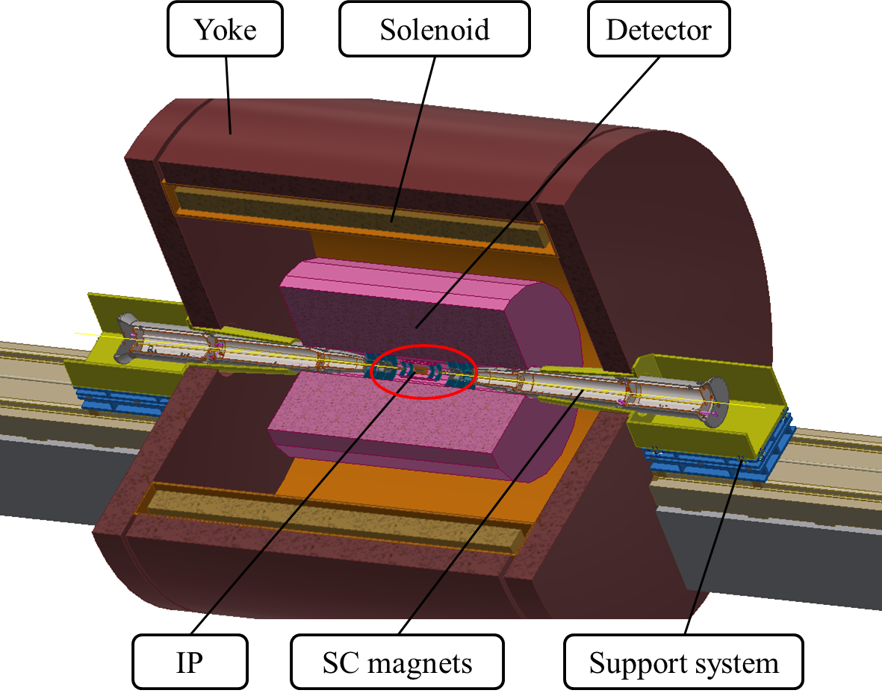
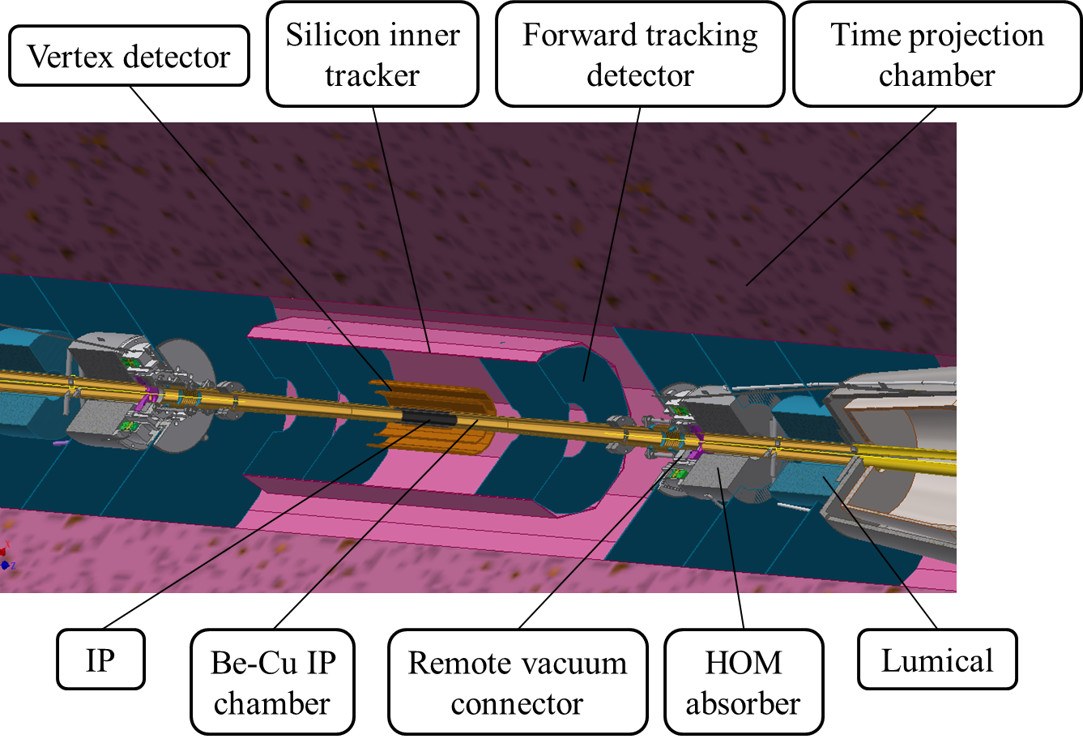
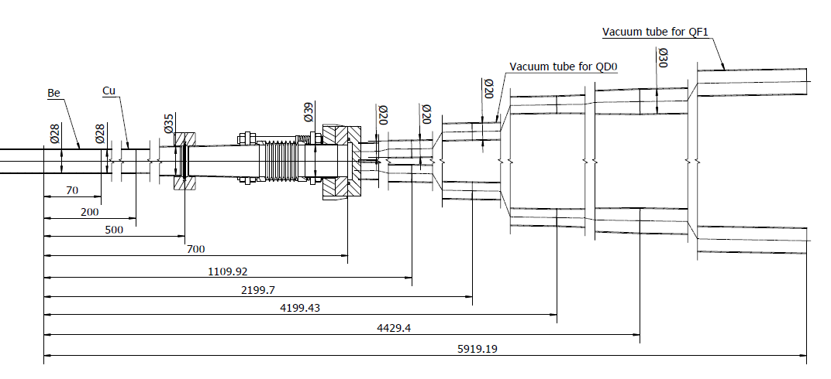
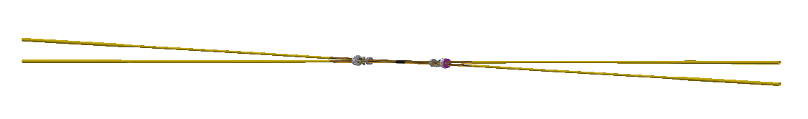
High luminosity scheme at Higgs energy
IR assembly
The installation design nearby the IP

Slide 19
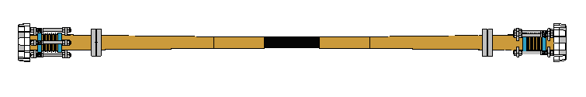
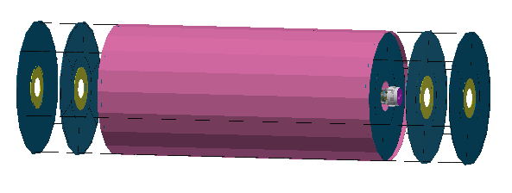
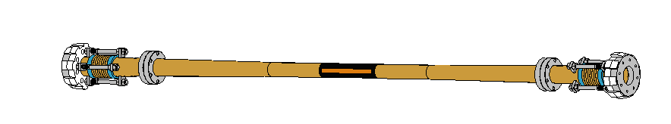
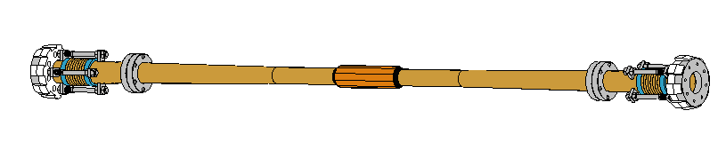
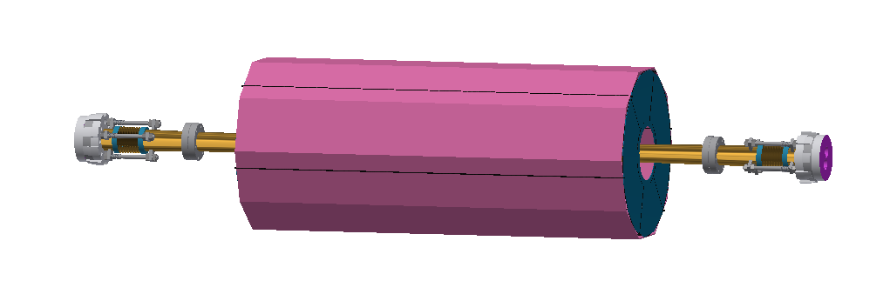
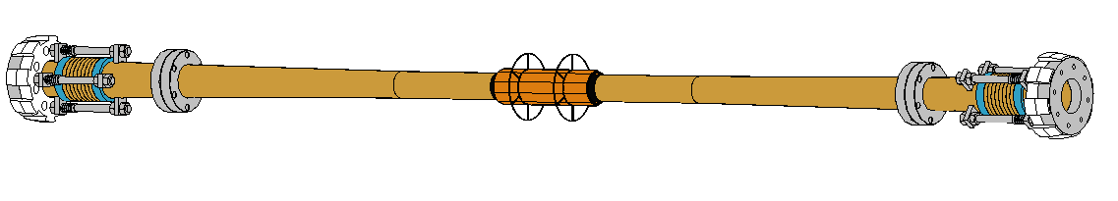
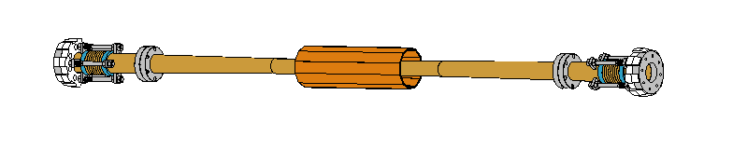
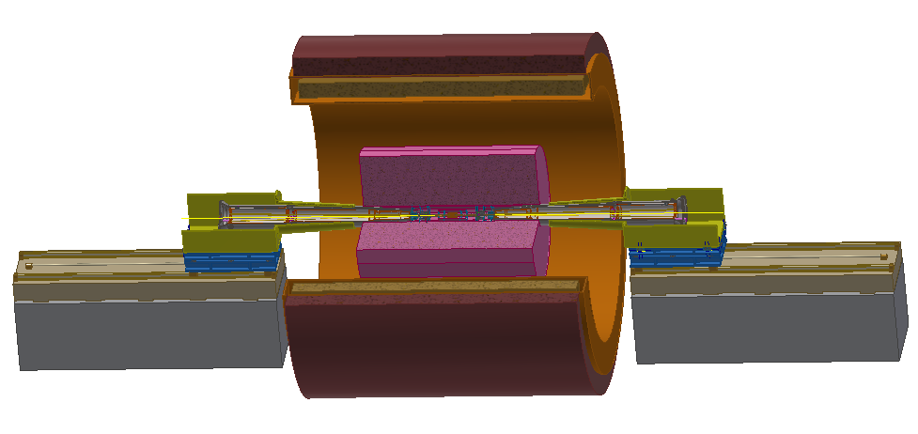
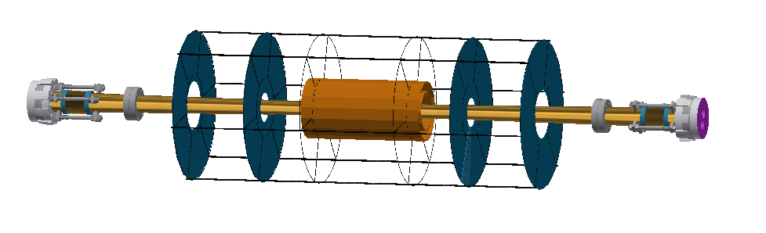
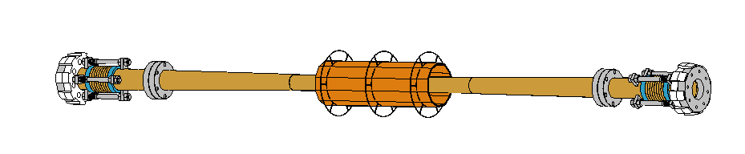
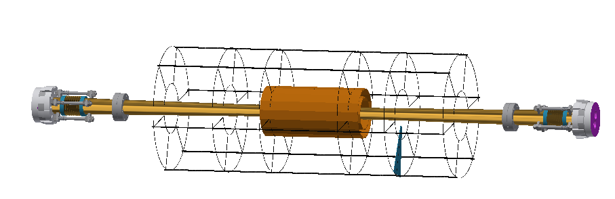
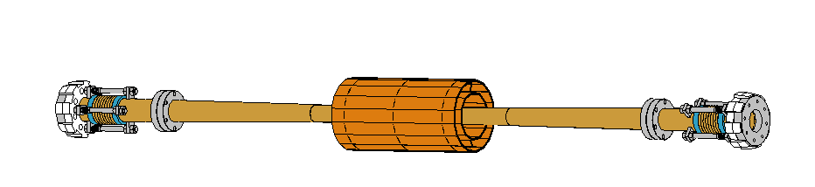
High luminosity scheme at Higgs energy
IR assembly

Slide 20
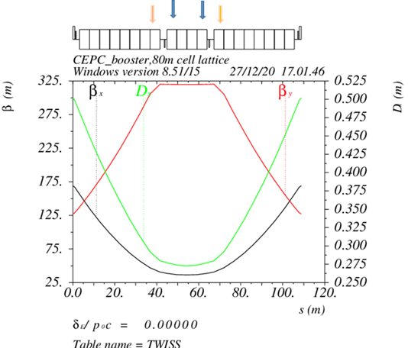
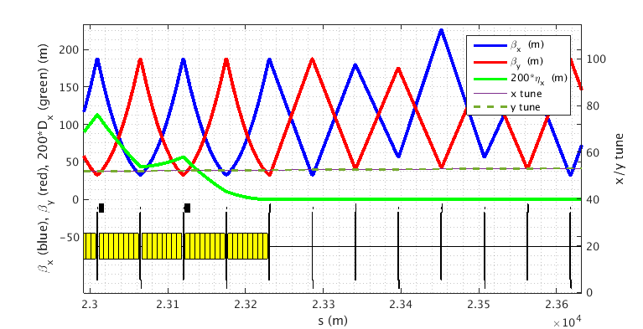
High luminosity scheme at Higgs energy
Booster ring
Standard TME cells are chosen for lower booster emittance to relax the DA requirement of collider ring.
1.4nm is expected. (CDR: 3.6nm)
Uniform distribution of quadrupoles
Combined magnet: B+Q, B+S

Slide 21
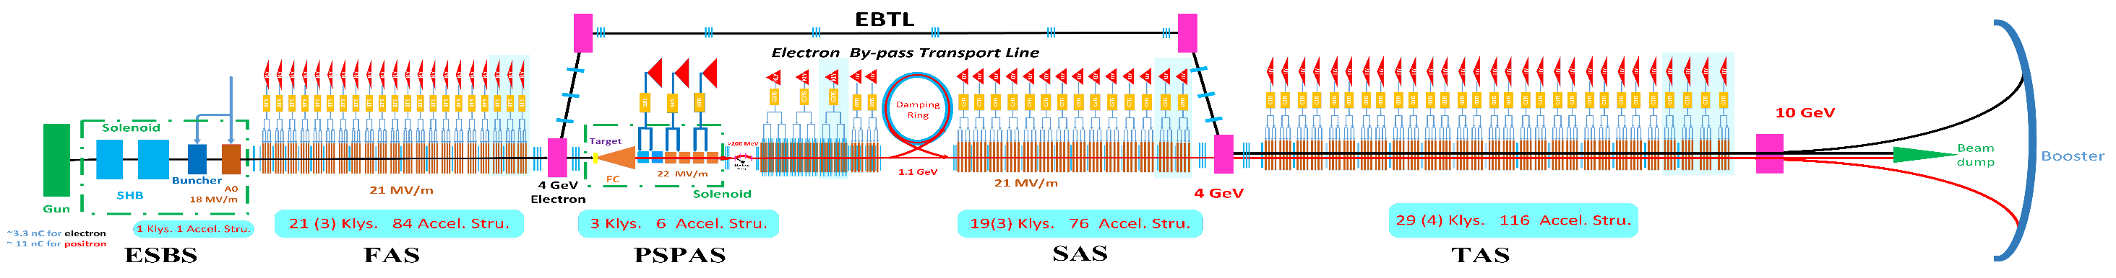
High luminosity scheme at Higgs energy
LINAC
1.1GeV
1200m
Parameter | Symbol | Unit | Designed
e⁻ /e⁺ beam energy | E_{e-}/E_{e+} | GeV | 10
Repetition rate | f_{rep} | Hz | 100
e⁻ /e⁺ bunch population | N_{e-}/N_{e+} |  | > 9.4×10⁹ / >9.4×10⁹
 |  | nC | > 1.5
Energy spread (e⁻ /e⁺ ) | σ_{e} |  | < 2×10⁻³ / < 2×10⁻³
Emittance (e⁻ /e⁺ ) | ε_{r} | nm⋅ rad | 10
Bunch length (e⁻ /e⁺ ) | σ_{l} | mm | 1 / 1
e⁻ beam energy on Target |  | GeV | 4
e⁻ bunch charge on Target |  | nC | 10
In order to relax the DA reqirement of booster the beam emittance of Linac should be controlled as 10 nm with the damping ring of energy 1.1GeV. (CDR: 40nm)

Slide 22
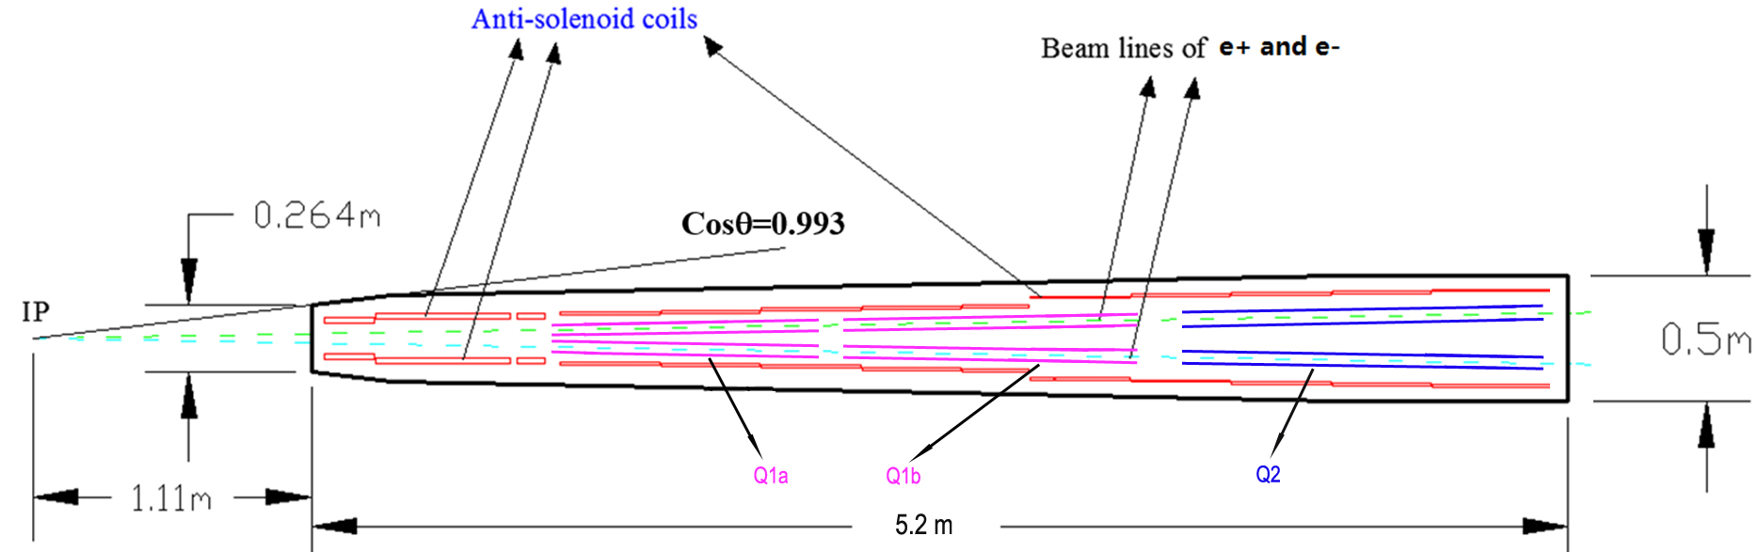
The possibility of other energies base on high luminosity Higgs scheme
Normal Z mode: Q1a=Vertical focusing quadrupole, Q1b+Q2=Horizontal focusing quadrupole
W & H mode: Q1a+Q1b=Vertical focusing quadrupole, Q2=Horizontal focusing quadrupole
Higher than Higgs energy: Q1a+Q1b+Q2=Vertical focusing quadrupole
High luminosity Z: HOM at SCQ Pipe will be one of the dominant constraint. Replacing the whole cryostat is the best option. The shape and size of cryostat stay the same and the inner aperture of SCQ beam pipe can be made large enough since Z beam energy is low enough.

Slide 23
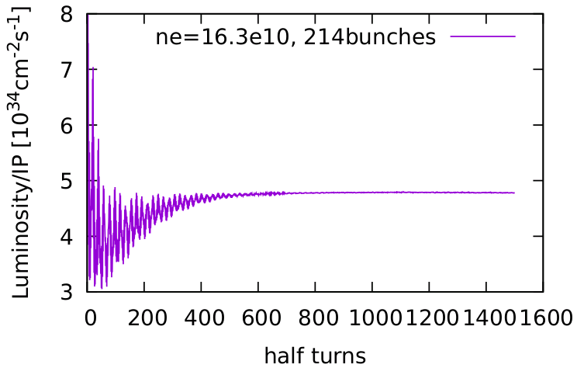
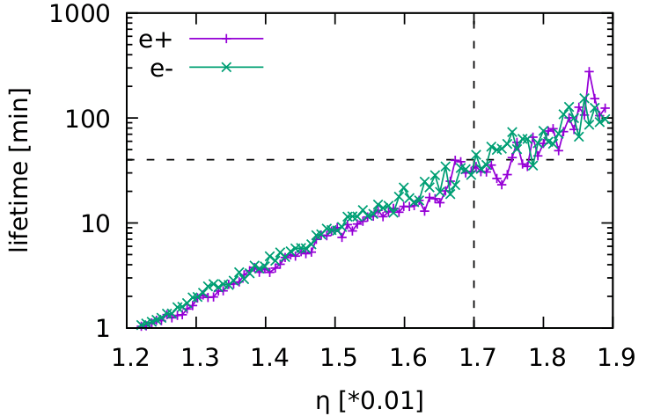
CEPC high luminosity Parameters
 | tt | Higgs | W | Z
Number of IPs | 2 | 2 | 2 | 2
Energy (GeV) | 180 | 120 | 80 | 45.5
Circumference (km) | 100 | 100 | 100 | 100
SR loss/turn (GeV) | 8.53 | 1.73 | 0.33 | 0.036
Half crossing angle (mrad) | 16.5 | 16.5 | 16.5 | 16.5
Piwinski angle | 1.16 | 4.87 | 9.12 | 24.9
N_{e}/bunch (10¹⁰) | 20.1 | 16.3 | 11.6 | 15.2
Bunch number (bunch spacing) | 37 (4.45μs) | 214 (0.7us) | 1588 (0.2μs) | 3816 (86ns) | 11498 (26ns)
Beam current (mA) | 3.5 | 16.8 | 88.5 | 278.8 | 839.9
SR power /beam (MW) | 30 | 30 | 30 | 10 | 30
Bending radius (km) | 10.7 | 10.7 | 10.7 | 10.7
Phase advance of arc cell | 90°/90° | 90°/90° | 90°/90° | 60°/60°
Momentum compaction (10⁻⁵) | 0.73 | 0.73 | 0.73 | 1.48
β_{IP} x/y (m) | 1.0/0.0027 | 0.33/0.001 | 0.33/0.001 | 0.15/0.001
Emittance x/y (nm) | 1.45/0.0047 | 0.68/0.0014 | 0.28/0.00084 | 0.27/0.00135
Transverse σ_{IP} (um) | 37.9/0.11 | 15.0/0.037 | 9.6/0.029 | 6.36/0.037
ξ_{x}/ξ_{y}/IP | 0.076/0.106 | 0.018/0.115 | 0.014/0.13 | 0.0046/0.131
V_{RF} (GV) | 9.52 | 2.27 | 0.47 | 0.1
f _{RF} (MHz) (harmonic) | 650 (216816) | 650 (216816) | 650 (216816) | 650 (216816)
Nature bunch length σ_{z} (mm) | 2.23 | 2.25 | 2.4 | 2.75
Bunch length σ_{z} (mm) | 2.66 | 4.42 | 5.3 | 9.6
HOM power/cavity (kw) | 0.45 (5cell) | 0.48 (2cell) | 0.79 (2cell) | 2.0 (2cell) | 3.02 (1cell)
Energy spread (%) | 0.17 | 0.19 | 0.11 | 0.12
Energy acceptance requirement (DA) (%) | 2.0 | 1.7 | 1.2 | 1.3
Energy acceptance by RF (%) | 2.61 | 2.5 | 1.83 | 1.48
Lifetime (hour) | 0.59 | 0.35 | 1.3 | 1.7 | 1.4
L_{max}/IP (10³⁴cm⁻²s⁻¹) | 0.5 | 5.0 | 18.7 | 35.0 | 105.5
Beam-beam simulation
Beamstrahlung Lifetime

Slide 24
Summary
The design of high luminosity scheme with 5×10³⁴cm⁻²s⁻¹ & 30MW has been designed. It doesn’t meet strong limitation and also won’t affect the current mechanical design of detector.
The L* can be set as 1.9m from IP with lower emittance and smaller beam pipe within the region of SCQ.
For the consideration of high luminosity Z, if it’s a strong limitation from local HOM heating problem due to the narrow SCQ beam pipe, replacing the whole cryostat is the best option. The shape and size of cryostat stay the same and the inner aperture of SCQ beam pipe can be made large enough.
More detailed studies will be done. Such as DA optimization with errors, detector background evaluation, etc.

