Slide 1
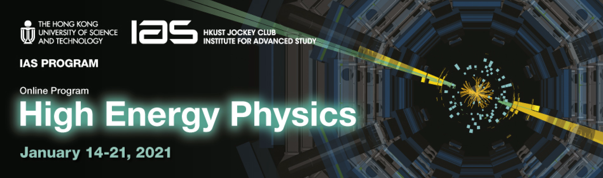




FCC-ee & hh R&D issues and status
Frank Zimmermann, CERN
HKUST IAS HEP, 19 January 2021
LHC
HE-LHC
PS
SPS
FCC
Work supported by the European Commission under the HORIZON 2020 projects ARIES, grant agreement 730871,
and FCCIS, grant agreement
photo: J. Wenninger

Slide 2
FCC-ee issues requiring further studies (Z, W, H factory)
Design for maximum energy efficiency.
Attainable vertical emittance in presence of various errors and with colliding beams, and further luminosity optimization. Alignment tolerances and alignment system.
Complete impedance model, with an evaluation of transverse multibunch resistive-wall instability and single-bunch longitudinal microwave instability. Ion and electron-cloud instabilities with mitigation measures. Design and performance of a bunch-by-bunch feedback system. Interplay of impedance and beam-beam effects.
Finalisation & completion of beam optics, incl. collimation, tuning flexibility, injection & extraction systems. Design for different # of collision points. Dynamic aperture optimizing.
Software tool for e⁺e⁻ optics with IR crossing angle, SR, beam-beam & beamstrahlung.
Collimation system ; collimation / masking and machine protection strategy.
Specification of beam instrumentation and required measurement precision/accuracy.
Optimization of the injector complex (higher-energy linac versus pre-booster, linac pulse)

Slide 3
layout of the FCC-ee injector 6 GeV (20 GeV)
25-162.5 GeV plasma e⁺/e⁻ linac
could replace PBR & FEB !
CEPC, Z. Y. Xu et al.,
PRAB 23, 091301 (2020)
PBR (BR)
e- source
Injector linac
Linac 2 (+ Linac4)
E2
Linac 1
E1
e+ DR
E1
e+
target
capture
linac
Alexej Grudiev, Paolo Craievich, Hans Braun, et al.

Slide 4
FCC-ee issues requiring further studies (top factory)
Interaction region optimization and shielding of the hard synchrotron radiation including radiation from the final quadrupoles.
Beam-tail collimation for background control.
Further off-momentum dynamic aperture optimisation to maximize beamstrahlung lifetime.
Operational scenarios supporting higher luminosity and shorter beam lifetimes with more frequent injections.
Single-bunch beam instabilities with highest bunch charge.
RF system changes for collider and booster, with associated modified optics configuration.
Maximum energy efficiency.
Machine protection and radioprotection.

Slide 5
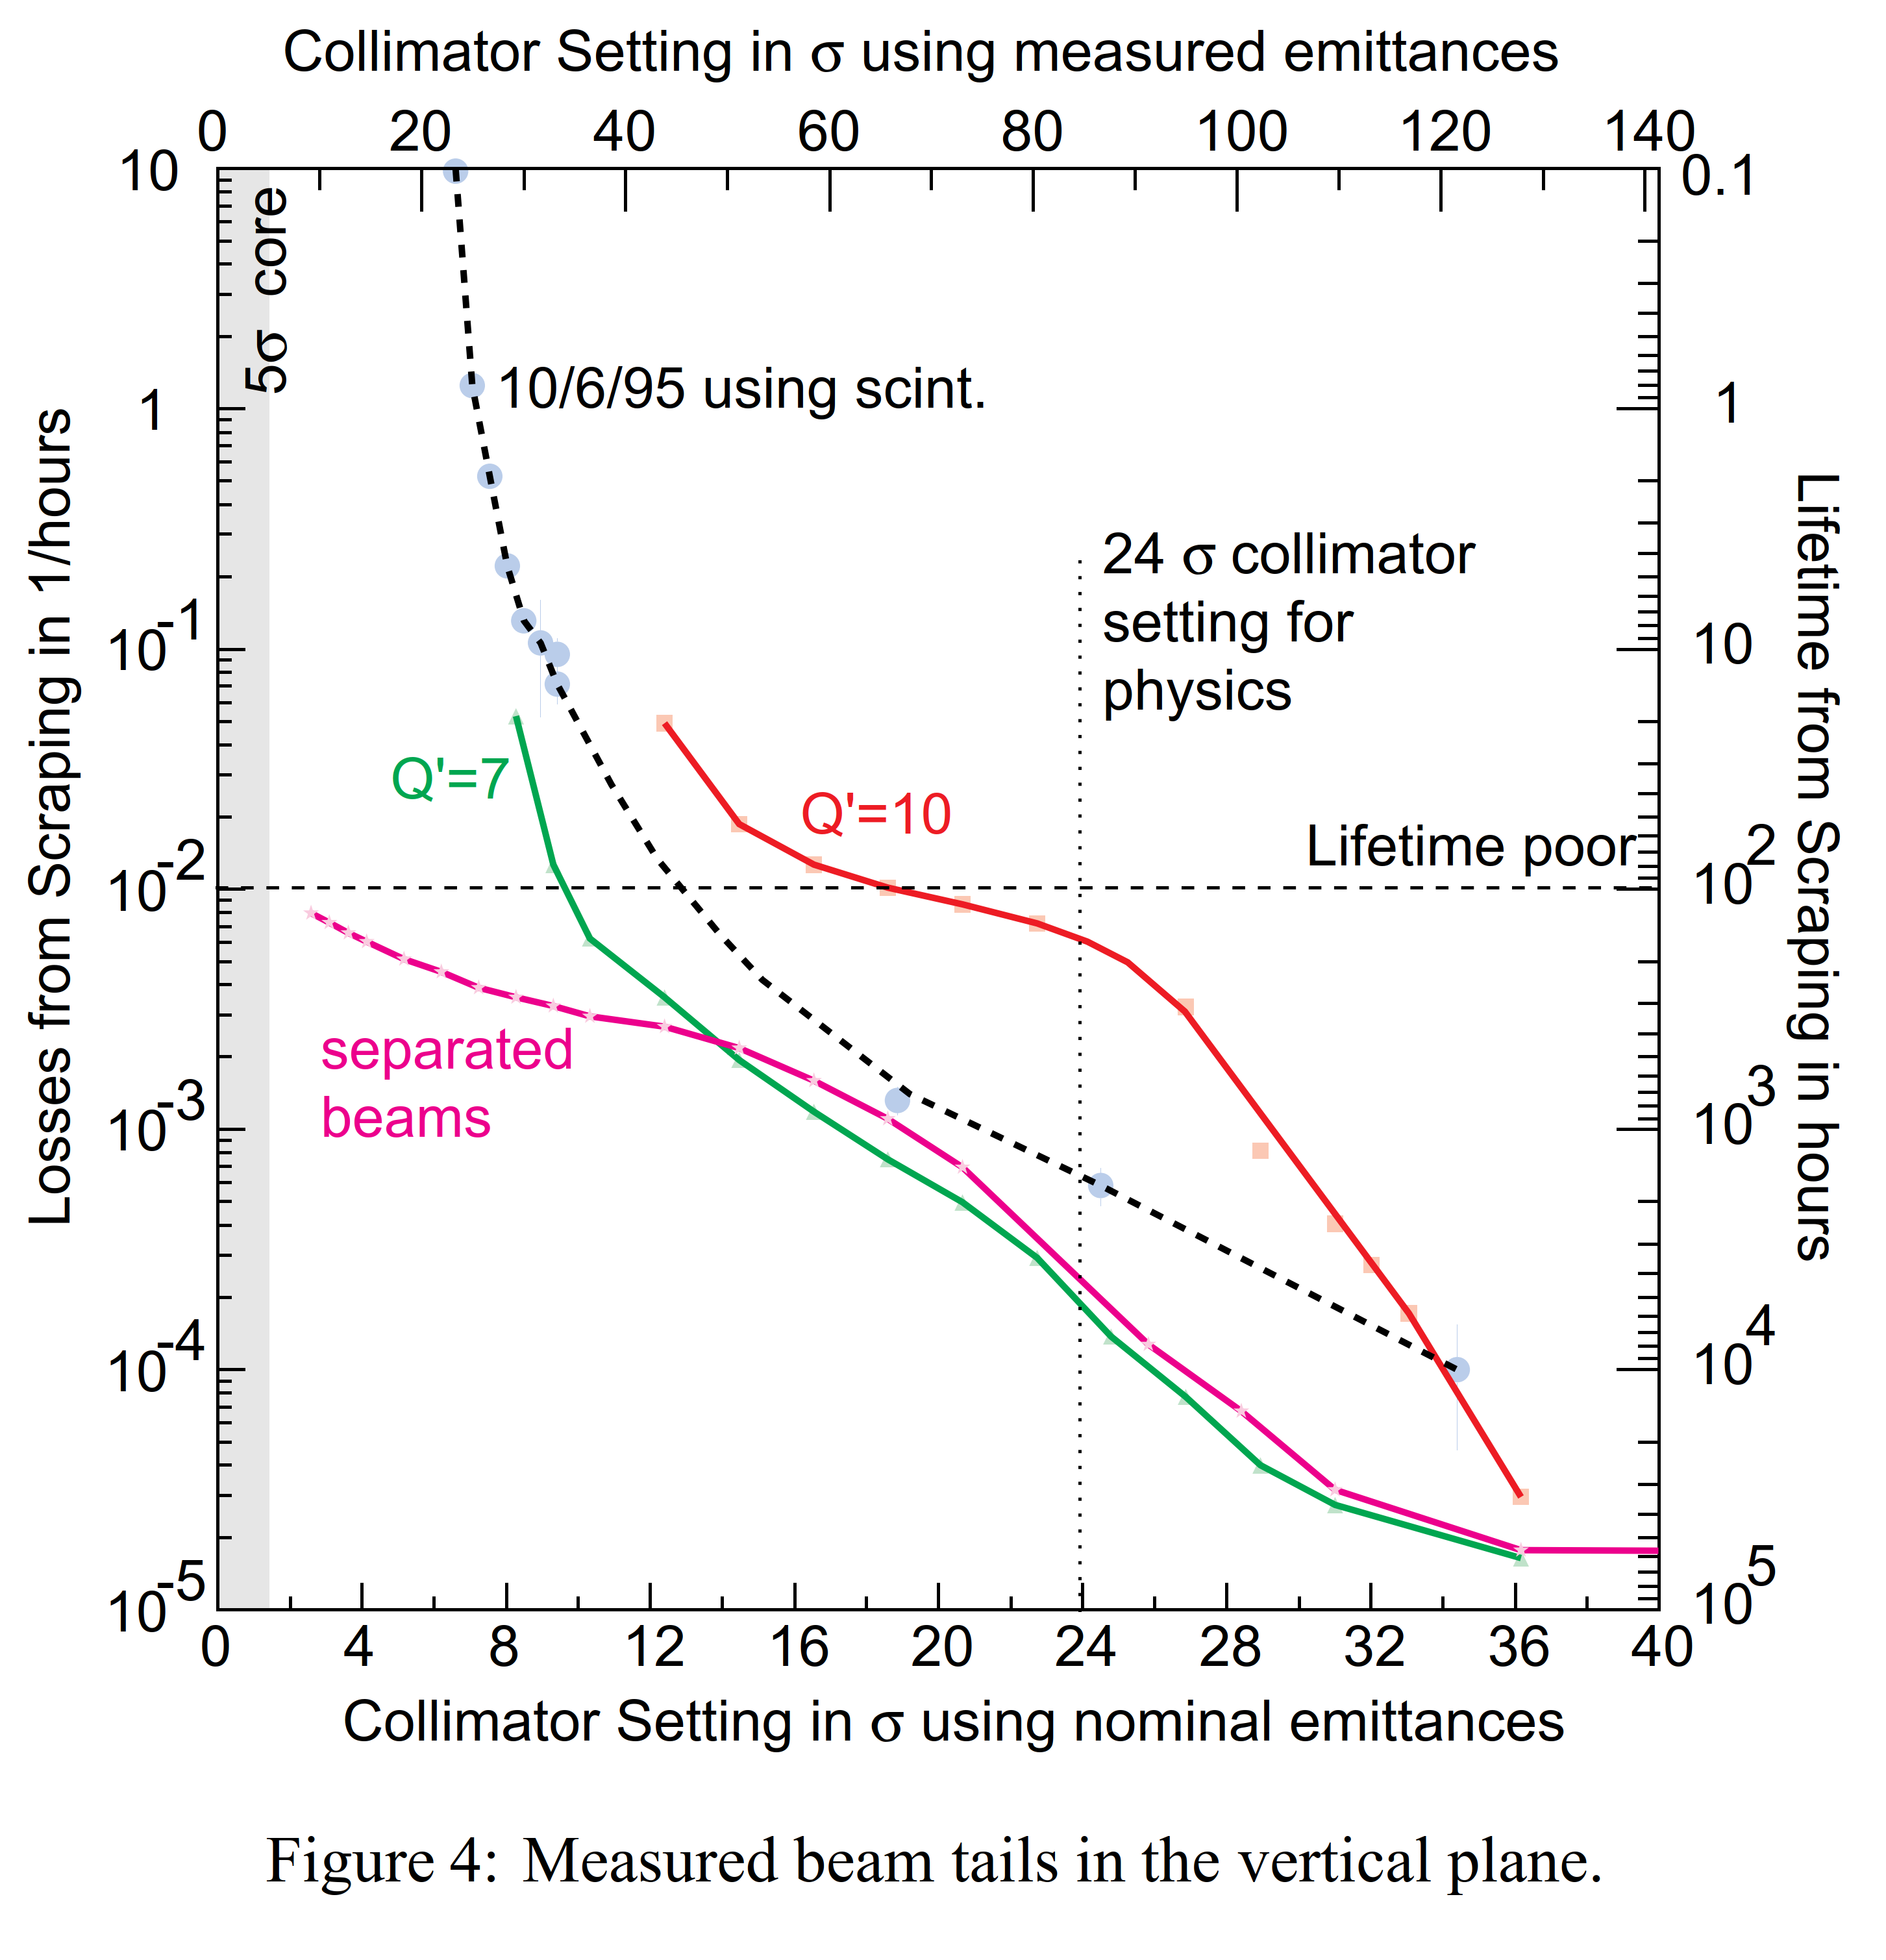
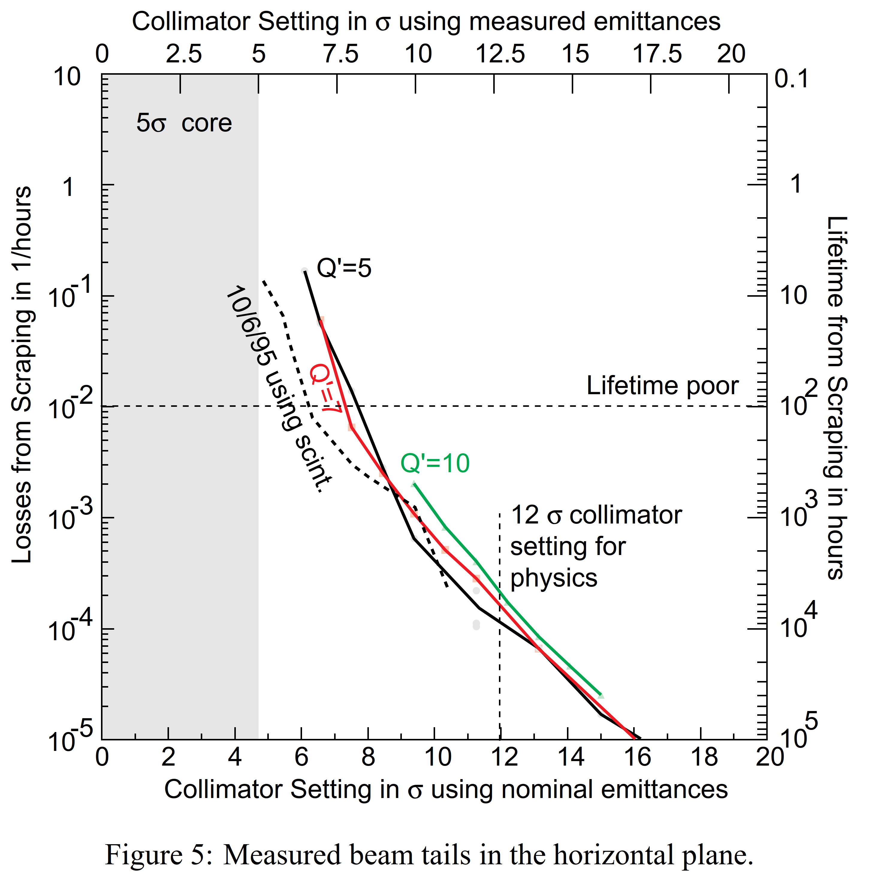
beam lifetime in collision versus collimator settings in LEP
H. Burkhardt, 1995

Slide 6
FCC-ee issues requiring further studies (energy calibration)
Develop & integrate tools for simulating orbit + optics correction processes plus simultaneous optimization of luminosity and polarization, including spin matching. Essential for confirming feasibility and operability of proposed data taking scheme.
Design of diagnostics allowing control of beam-beam offsets and measurement of IP residual dispersion. This diagnostics will help reduce centre-of-mass energy shifts; it should also benefit luminosity optimization.
Explore resonant depolarization process and its sensitivity to energy spread and synchrotron tune to optimize procedures and machine settings.
Detailed design of polarisation wigglers including proper management of the radiation.
Scrutinize and integrate the polarimeter design. Explore its use for Compton-backscattering based measurements precision & stability of momentum measurement.
Thoroughly assess and possible further reduce energy-point-to-energy-point systematic uncertainties. This involves, amongst others, development of energy model and thorough design of monitoring devices.

Slide 7
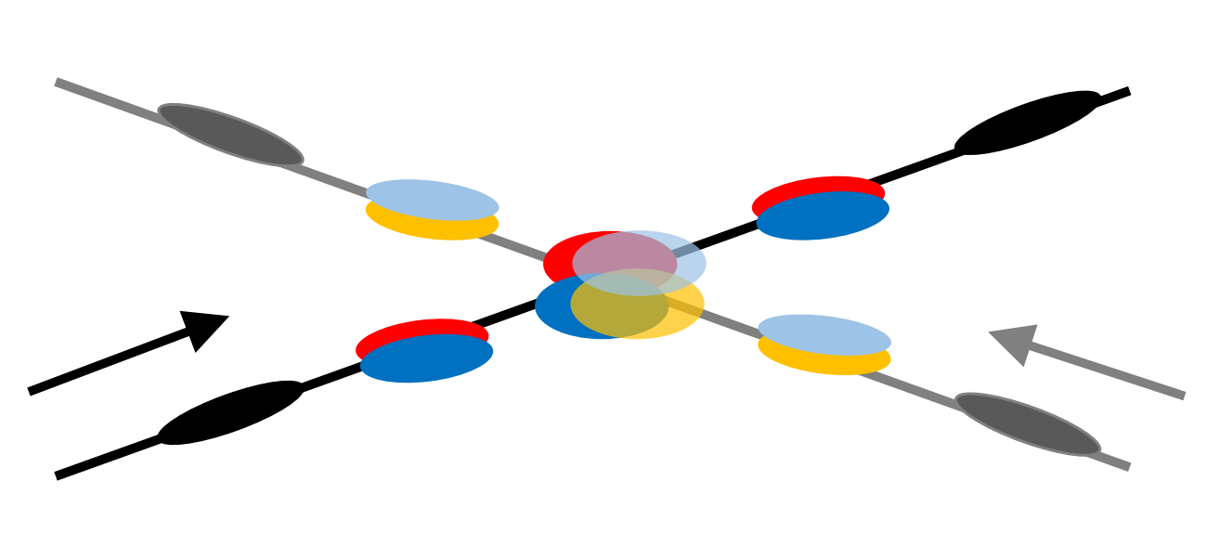
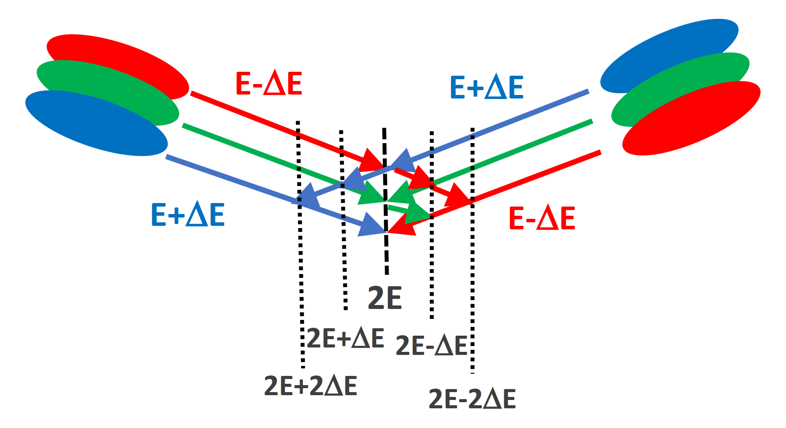
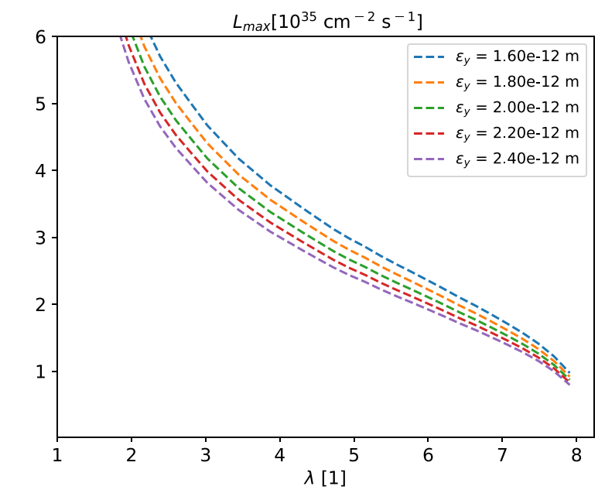
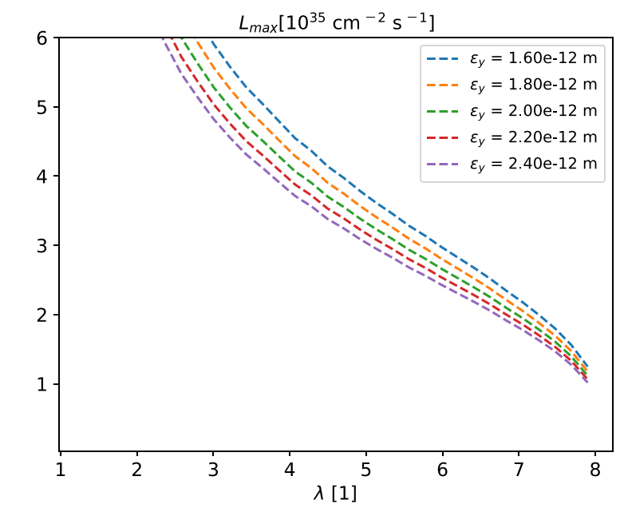
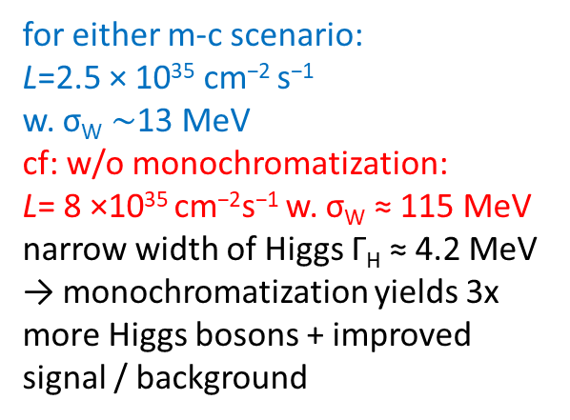
monochromatization scenarios for s-channel H production
with crab cavities
w/o crab cavities
A. Bogomyagkov, E. Levichev
PRAB 20, 051001 (2017)
for either m-c scenario:
L=2.5 × 10³⁵ cm⁻² s⁻¹
w. σ_{W} $\sim$13 MeV
cf: w/o monochromatization:
L= 8 ×10³⁵ cm⁻²s⁻¹ w. σ_{W} ≈ 115 MeV
narrow width of Higgs Γ_{H} ≈ 4.2 MeV → monochromatization yields 3x more Higgs bosons + improved signal / background
M.A. Valdivia, F.Z., 2020

Slide 8
FCC-ee issues requiring further studies (monochromatization)
Elaborate optimum set of IP parameters and optimum choice of monochromatization scheme – compare proposals with and crab cavities etc.
Develop optical lattices producing required large D_{x}∗, along with target values for β_{x}∗ and β_{y}∗.
Devise running mode, including the continuous monitoring of the collision energy and of its spread, at the 10⁻⁵ level, the operation procedures, and the diagnostics, provided both by the accelerator instrumentation and by the particle physics detectors.
Further improve data analyses for s-channel Higgs event selection and background reduction, as well as for few-MeV Higgs mass precision required beforehand.

Slide 9
FCC-hh issues requiring further studies and accelerator optimization
Shortening the length of the betatron collimation system (presently 2.8 km). In parallel also the beam extraction section should be shortened (e.g. by installing a longer extraction septum, and more extraction kickers).
Layout/geometry modifications to reduce transverse distance between the FCC-hh and FCC-ee collision points; studies of the importance of mirror symmetry or super-periodicity and the associated tolerances.
Development of cost-efficient 16 T dipole magnets with acceptable field errors.
Studies and developments of alternative injector scenarios, e.g. injection from a superconducting SPS and elaboration of all the implications. Optimization and review of the injector complex.
Machine protection and radiation issues (further optimisation of the interaction region; shortening of extraction section; failure scenarios; etc.)
Further RF system design and development of FCC-hh crab cavities.
Design for maximum energy efficiency.

Slide 10
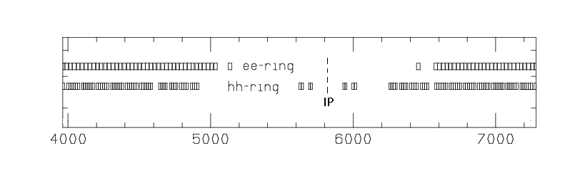
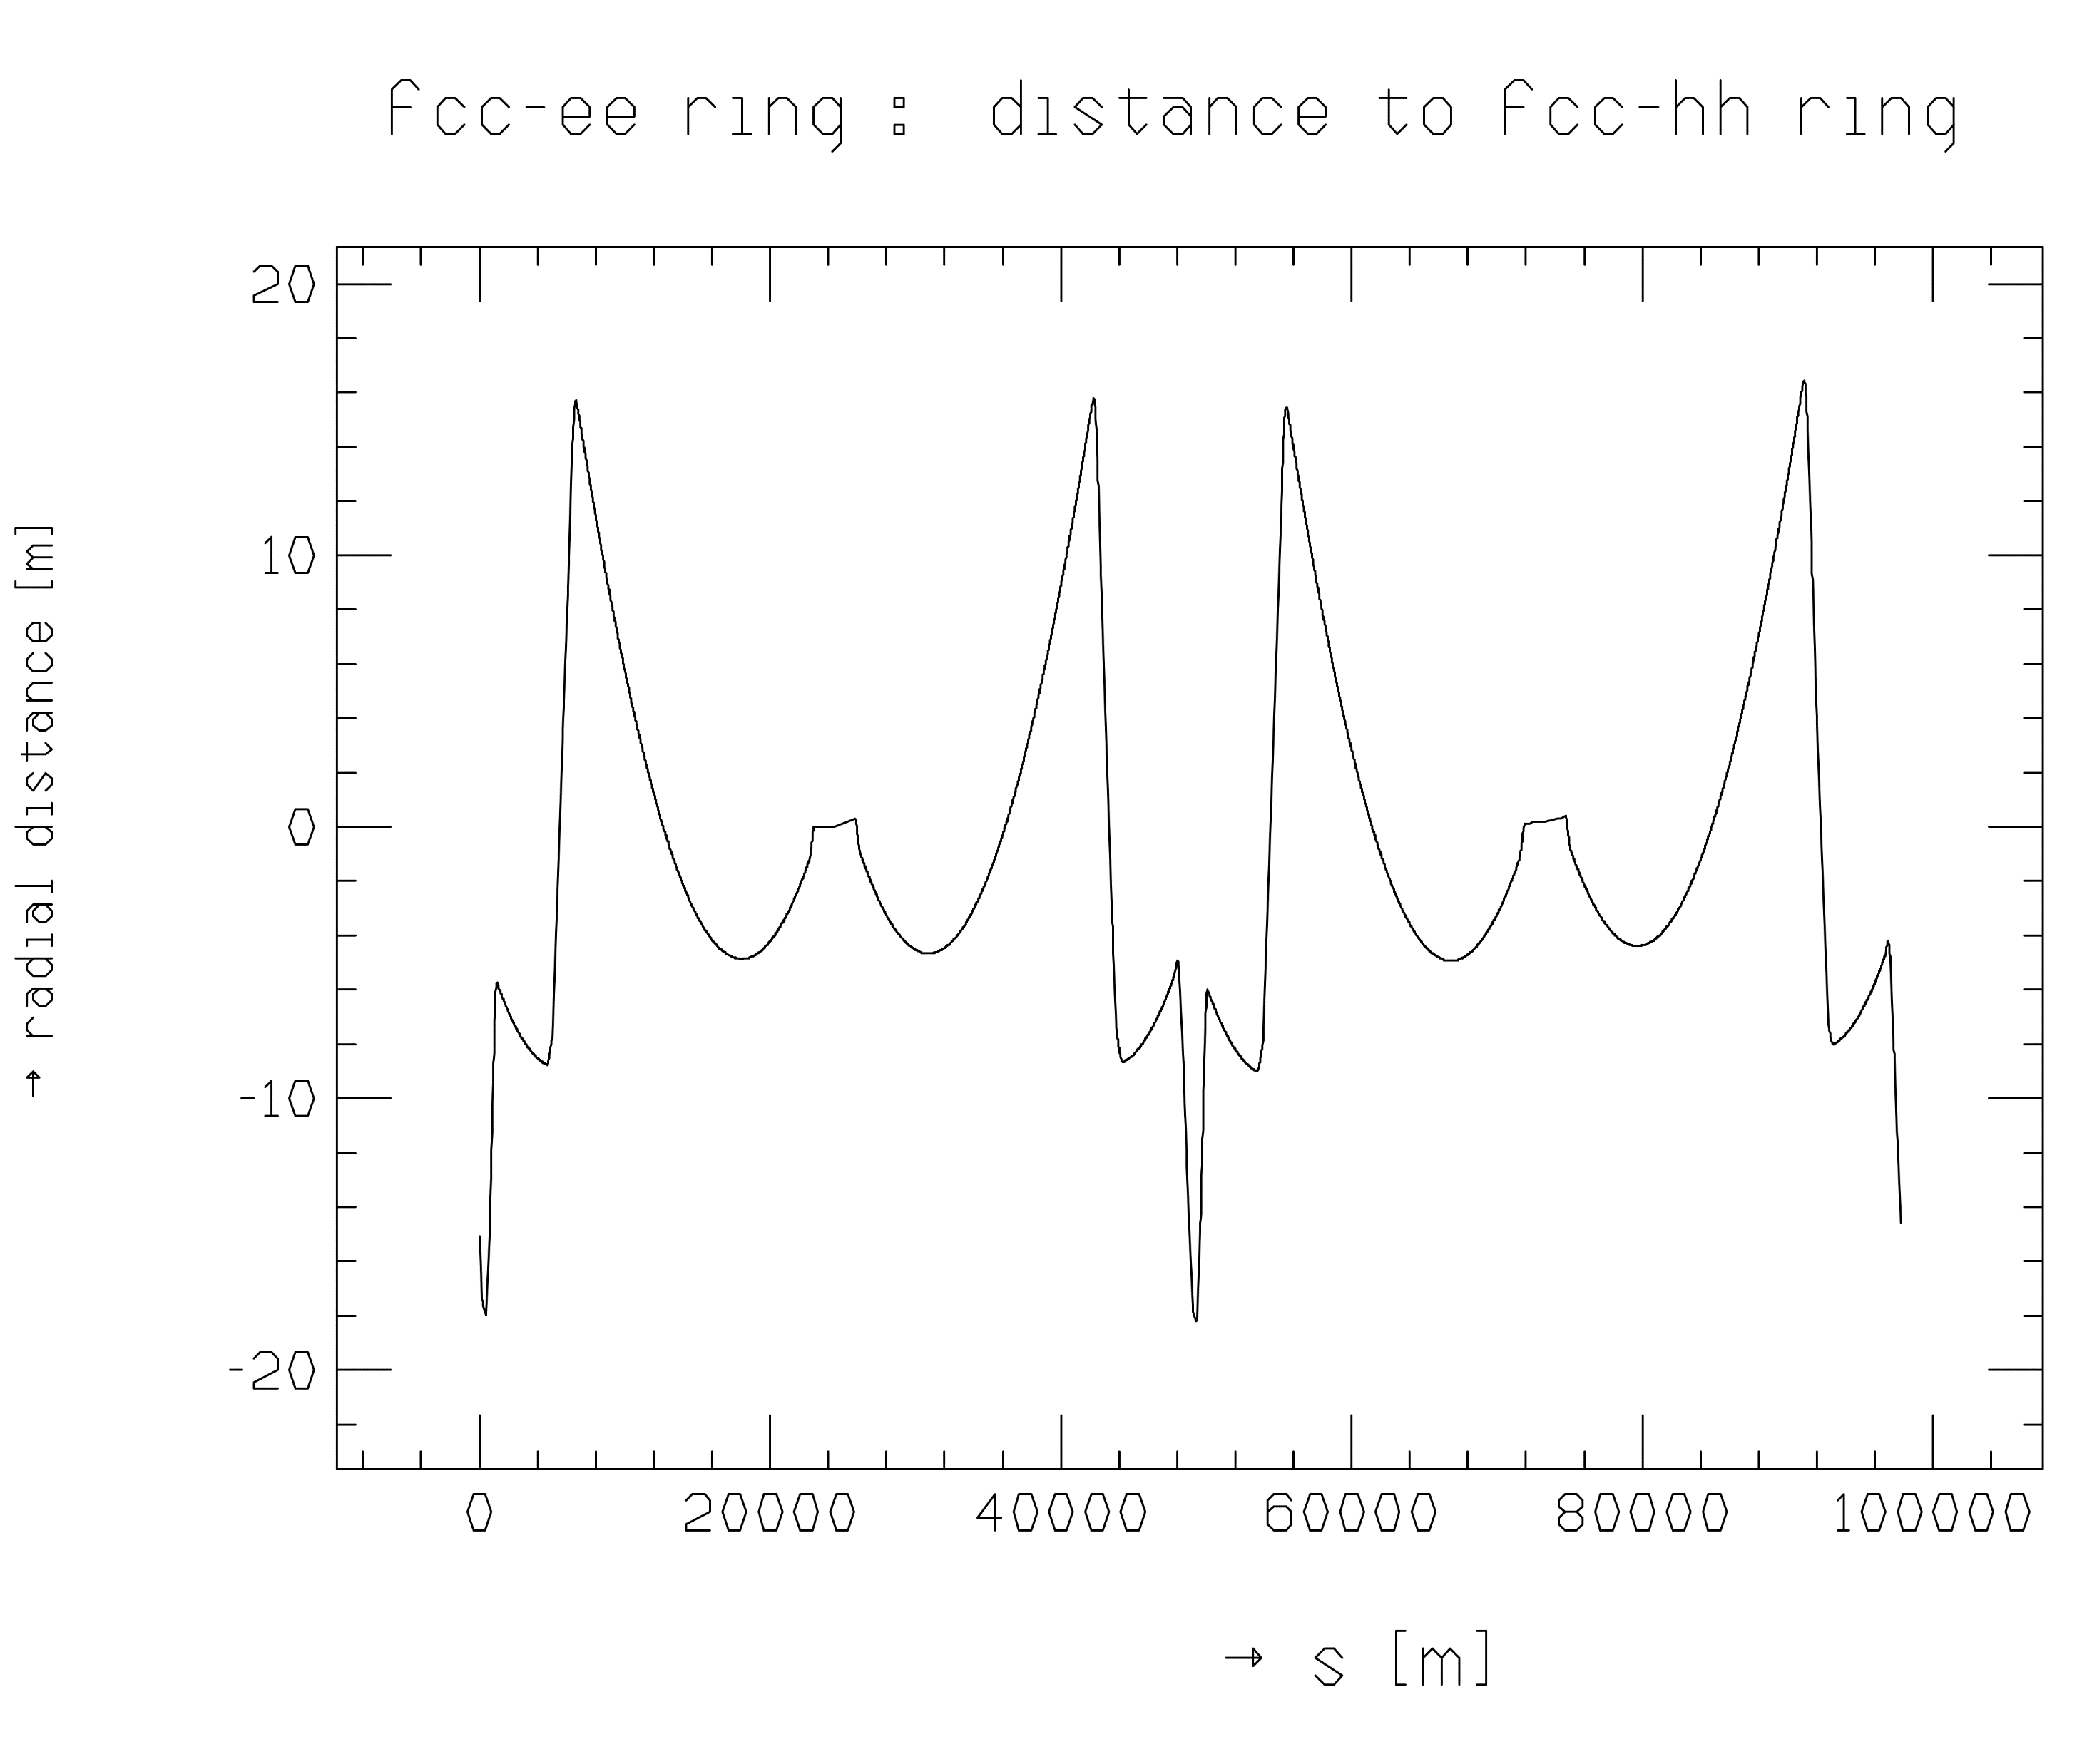
FCC-ee offset from FCC-hh at present
displacement in points B & L
Thys Risselada, M. Giovannozzi,
work in progress

Slide 11
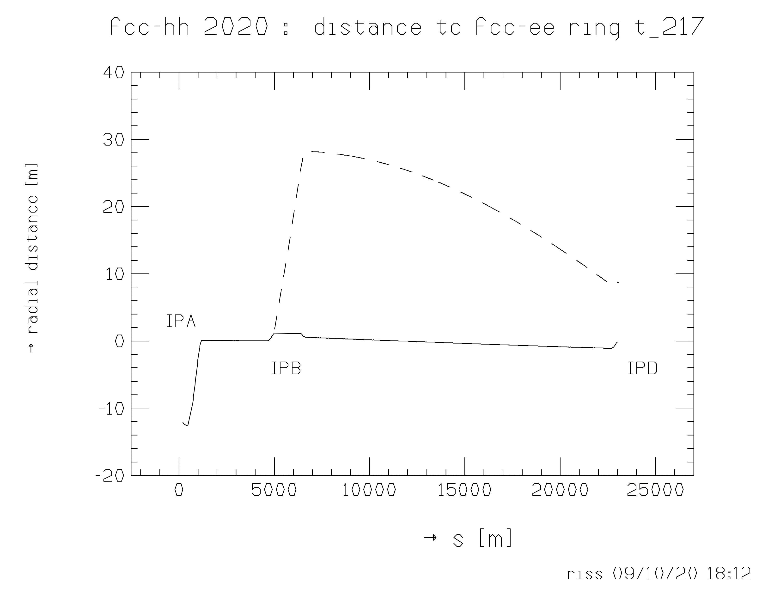
FCC-ee footprint rematched to new FCC-hh footprint
“hacked”
offset only
around IP
Thys Risselada, M. Giovannozzi, work in progress

Slide 12
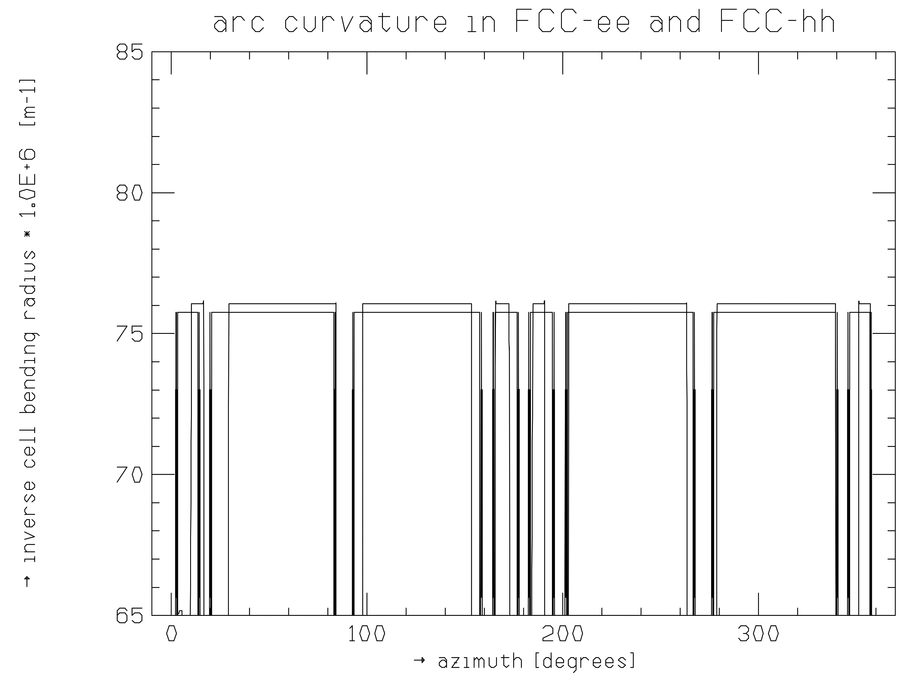
FCC-hh and FCC-ee arc curvatures
The bending radius of the hh ring is slightly larger than in the ee ring; the inverse bending radii are 75.75E-6/m and
76.06E-6/m respectively.
Thys Risselada, M. Giovannozzi

Slide 13
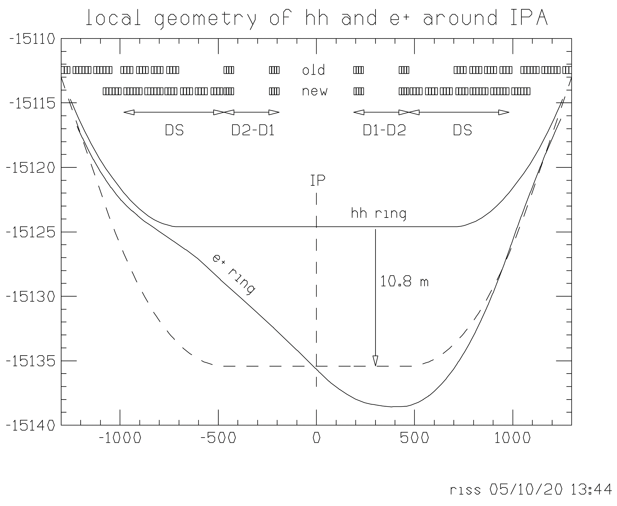
FCC-hh IR geometry with IP at same location as FCC-ee’s
Adjusted bend strengths in the hh ring.; to compensate I decided to lower by 7 % the bending angles in the hh DS.
Working on a machine containing only bends and drifts, pushed the magnets around in order to move the hh IP towards the ee IP.
Moving all 4-bend groups of the DS, plus the adjacent 3 groups of 6-bend half cells, as close as possible to the D2 magnet, brings together the IPs of hh and ee.
Thys Risselada, M. Giovannozzi,
work in progress

Slide 14
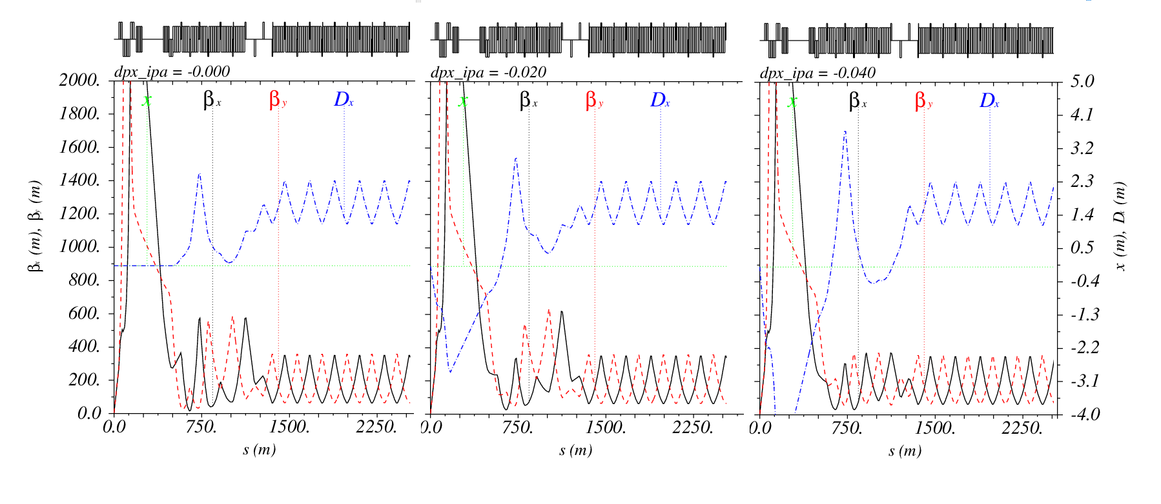
FCC-hh IR optics with IP at FCC-ee location
Thys Risselada, M. Giovannozzi, work in progress

Slide 15
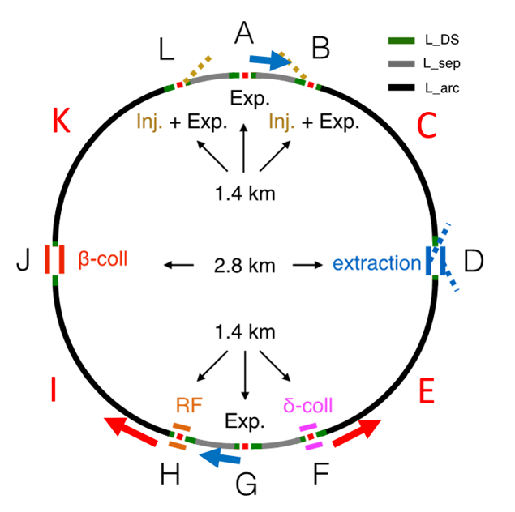
site optimization proceeding in parallel and might further
change layout and footprint(s)
superperiodicity
probably important for FCC-ee but not relevant for FCC-hh
- no merit for hadrons ?
mirror symmetry
ensures equal circumference for beam 1 and beam 2 , but beams could stay in the same aperture on both sides of points L and B (parasitic crossing?)
might potentially help for FCC-ee if choosing 4 IPs
V. Mertens, D. Schulte, K. Oide, J. Gutleber

Slide 16
question of mirror symmetry
beam 1 and beam 2 should each spend half circumference in outer and inner aperture
A
A
A
B
L
B
L
G
G
G
OK for 2 IPs, OK for 4 IPs with mirror symmetry also OK for 4 IPs if no change aperture in L & B

Slide 17
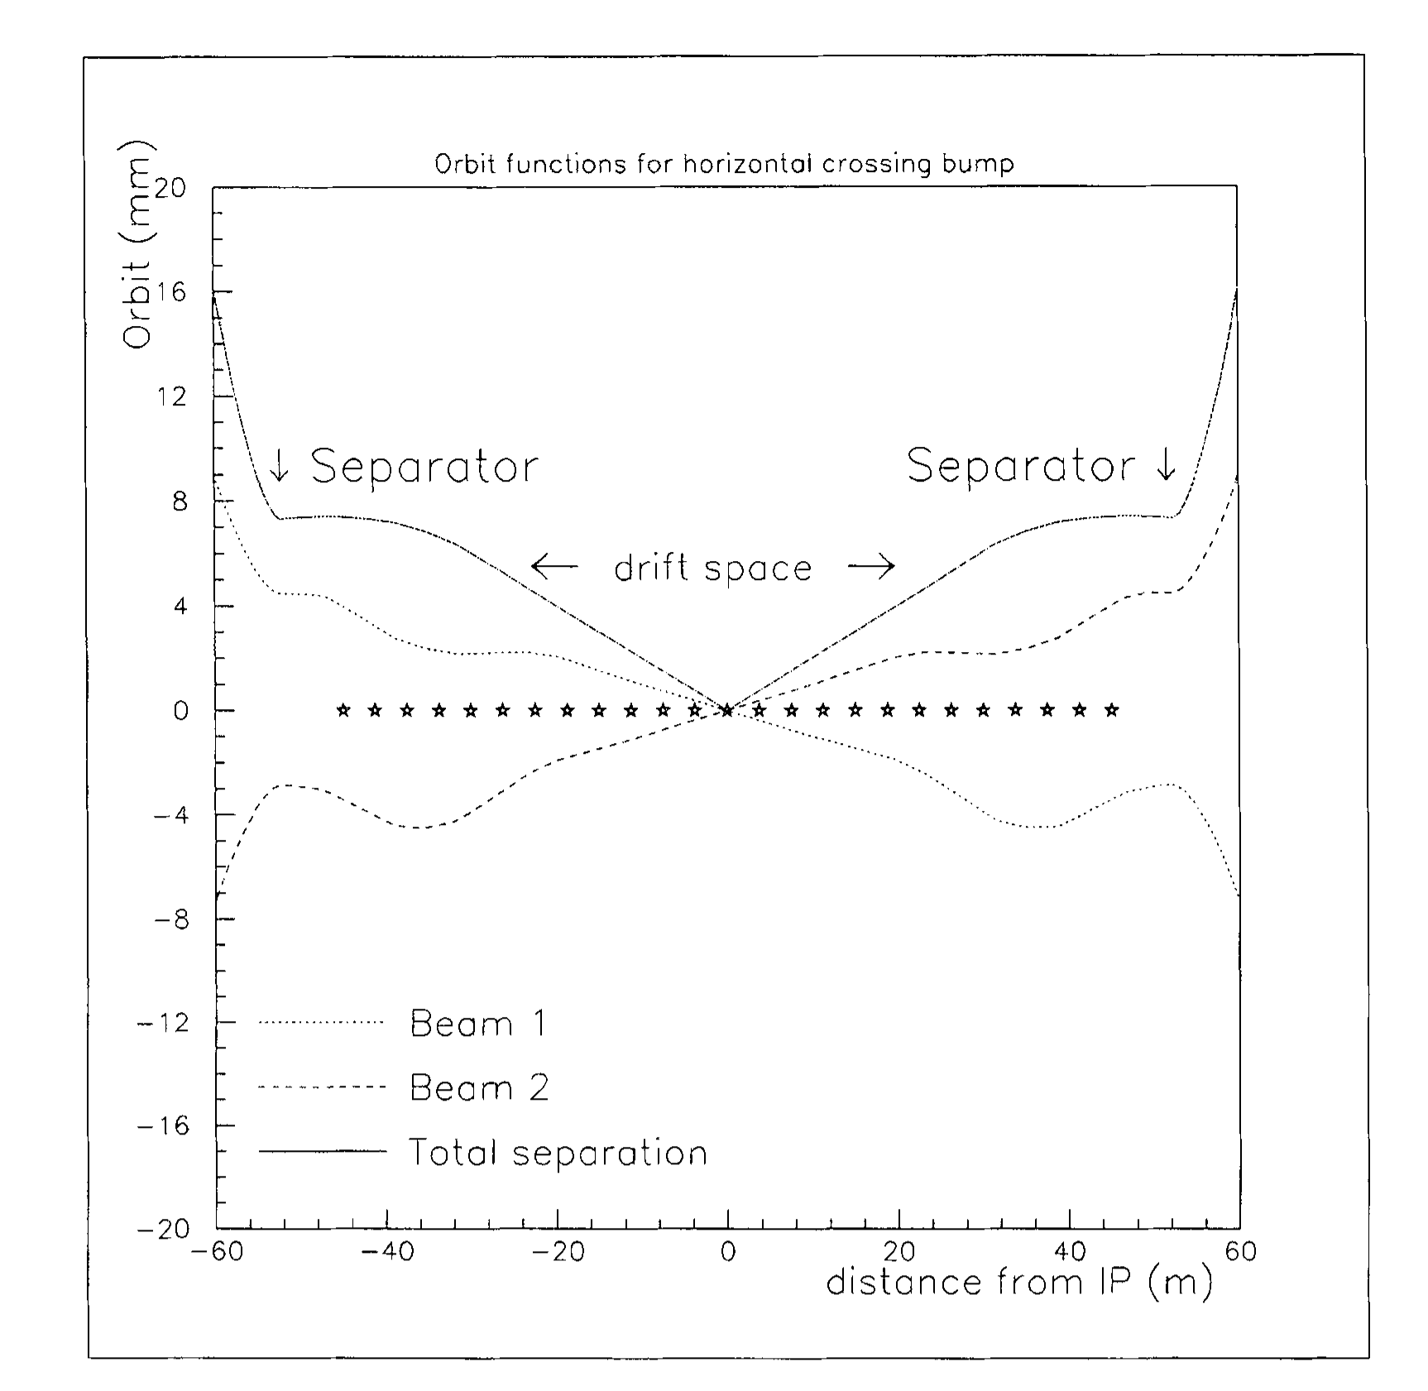
standard x crossing
no problem for vertical crossing (e.g. point B)
issue is secondary IP with horizontal crossing (i.e. point L)
X
W. Herr, 1995

Slide 18
same aperture x crossing (concept)
no problem for vertical crossing (e.g. point B)
issue is secondary IP with horizontal crossing (i.e. point L)
X
X1
→ avoid collision at X1 (separation in vertical direction)

Slide 19



important for e⁺e⁻
question of superperiodicity
example 4 IPs
K. Oide
A
B
A
B
A
L
SP=1
SP=1
SP=2
L
SP=4
B
L
G
G
G
$$mQ_{x}+nQ_{y}=p$$
$$mQ_{x}+nQ_{y}=2p$$
$$mQ_{x}+nQ_{y}=4p$$
resonance condition for lattice errors (DA) and for beam-beam

Slide 20
conclusions
several tantalizing questions
lots of work still ahead of us
excellent synergies between CEPC and FCC studies
relevant Snowmass 2021 LOIs:
FCC-ee as Z, W and H factory, LOI #146
FCC-ee upgrade to top factory, LOI #147
Precision Energy Calibration for a Future Circular Electron-Positron Collider, LOI #148
Monochromatized direct s-channel Higgs production in e+e - at √s=125 GeV, LOI #149
Optimizing the FCC-hh Hadron Collider, LOI #153

Slide 21
spare slides

Slide 22
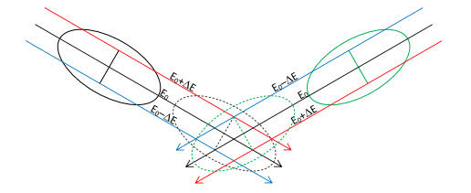
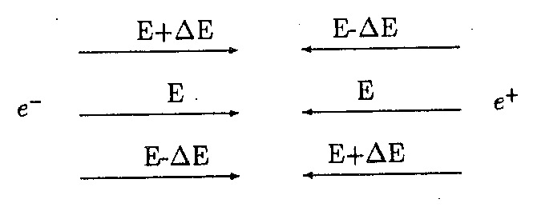
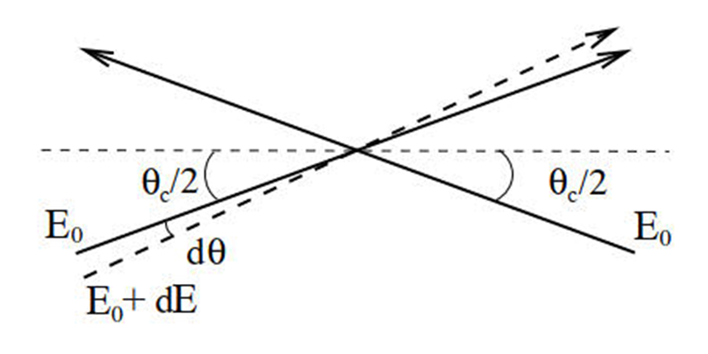
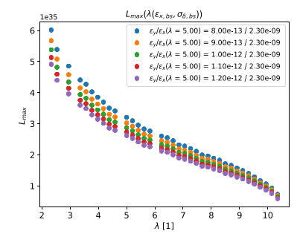
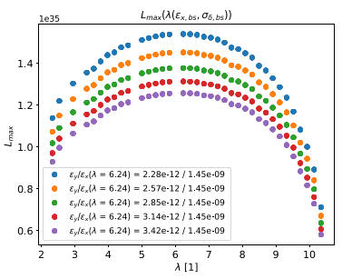
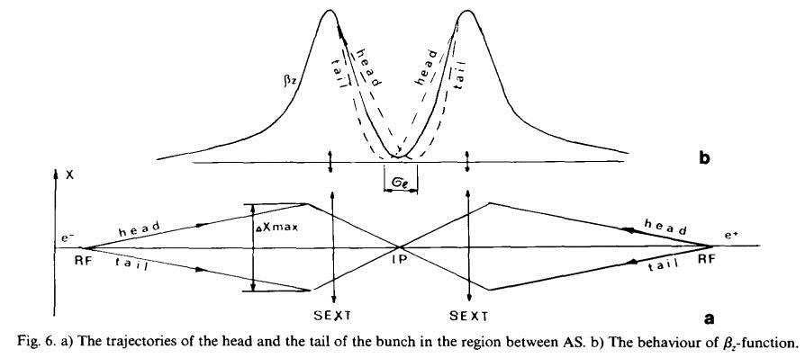
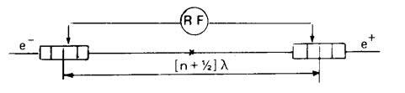



monochromatization for s-channel H production
A. Bogomyagkov,
B. Levichev, 2017
V. Telnov, 2020
A. Renieri, 1975; A. Faus-Golfe, 1996
A. Zholents,
1988
$$ε_{y }=\text{const}.$$
$$ε_{y}=κ_{ε}ε_{x}$$
M.A. Valdivia, F.Z., 2019

