Slide 1

Representation Learning of Collider Events
Jack Collins
IAS Program on High Energy Physics 2021

Slide 2
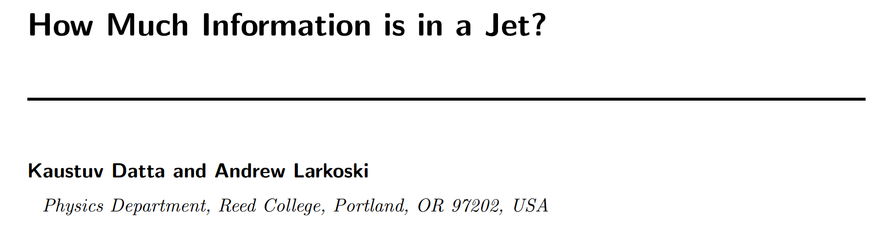

Slide 3
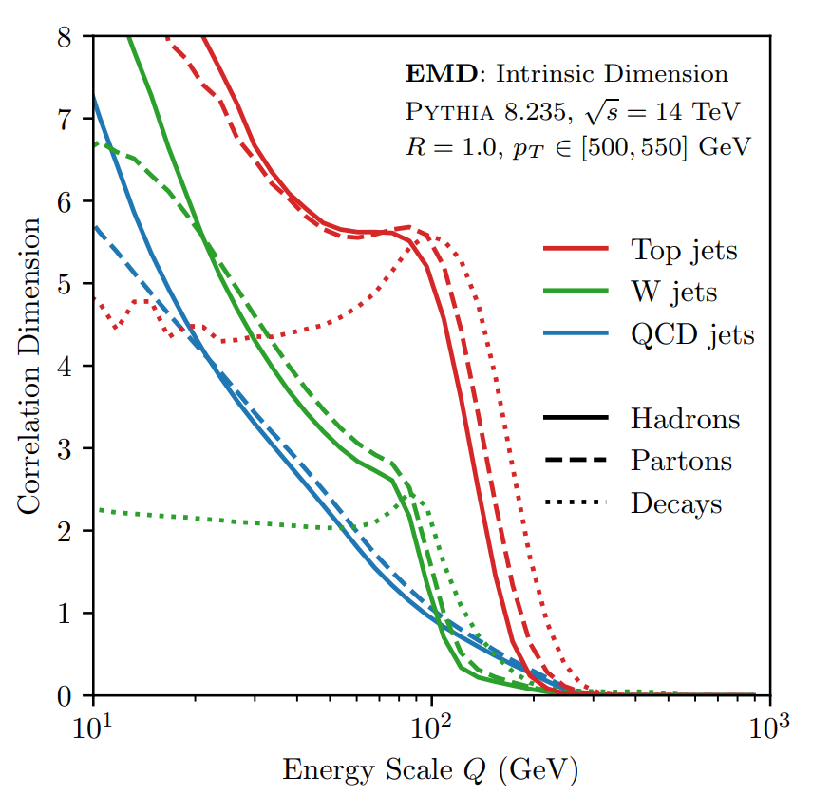
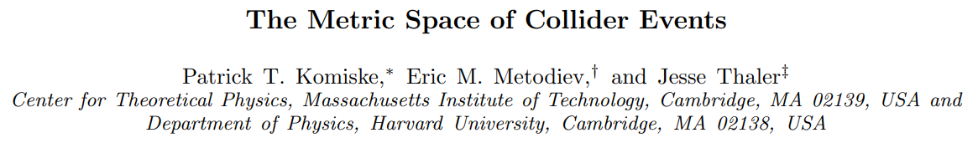

Slide 4
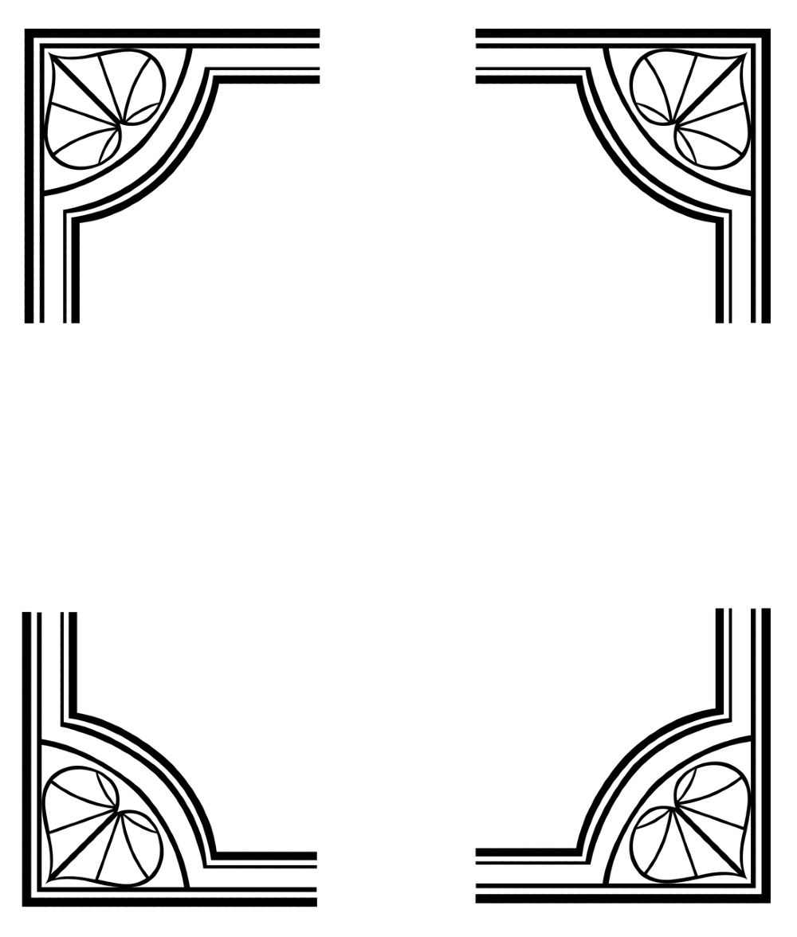
Conclusions
I have been training Variational Autoencoders to reconstruct jets or collider events using Earth Movers Distance as the reconstruction metric.
The learnt representation:
Is scale dependent
Is orthogonalized
Is hierarchically organized by scale
Has fractal dimension which relates to that of the data manifold
This is because:
The VAE is trained to be parsimonious with information
The metric space is physically meaningful and structured

Slide 5
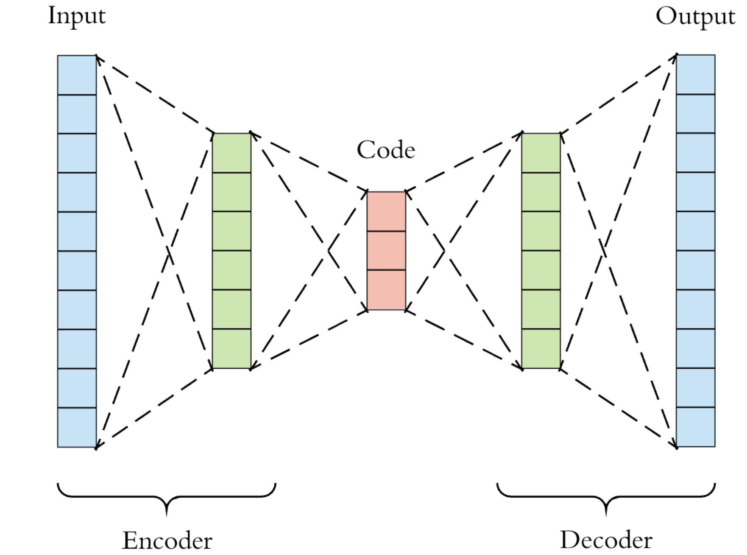
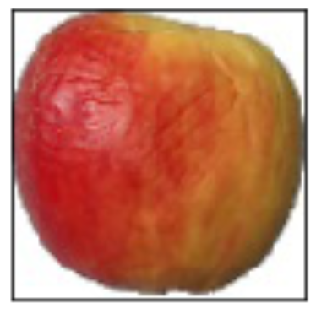
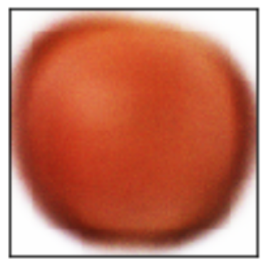
The Plain Autoencoder
Loss = |Output – Input| (what is this for jets?)

Slide 6
The Plain Autoencoder
Latent space =?= Learnt representation

Slide 7
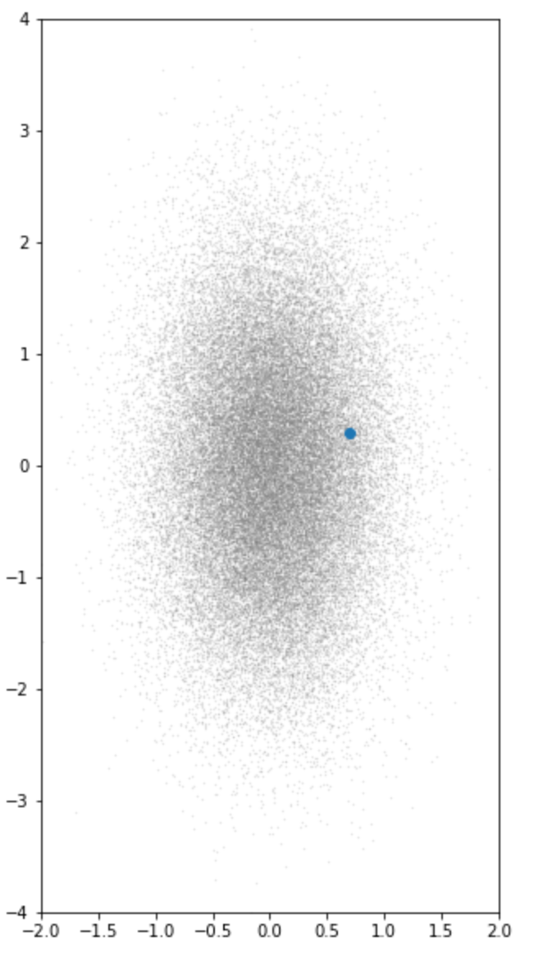
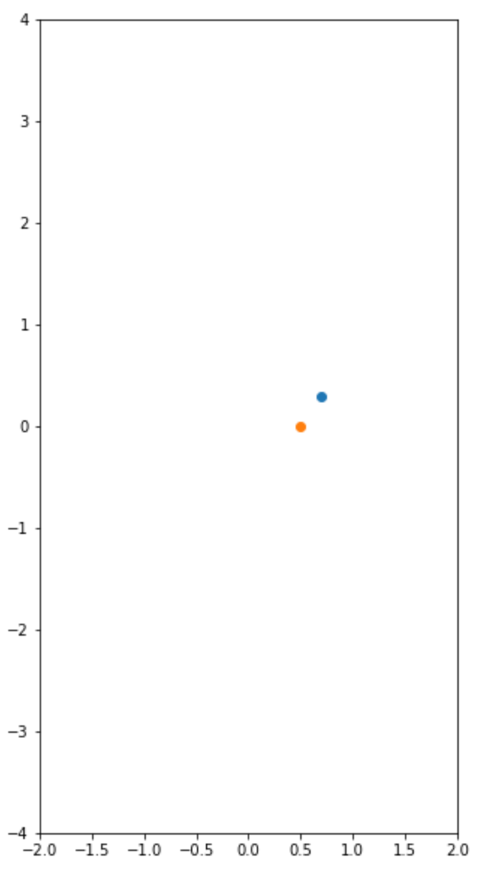
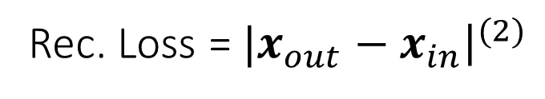
The Plain Autoencoder: a toy example
AE
(1D latent space)
Rec. Loss =${|x}_{out}−x_{in}{\left.​\right|}^{(2)}$

Slide 8
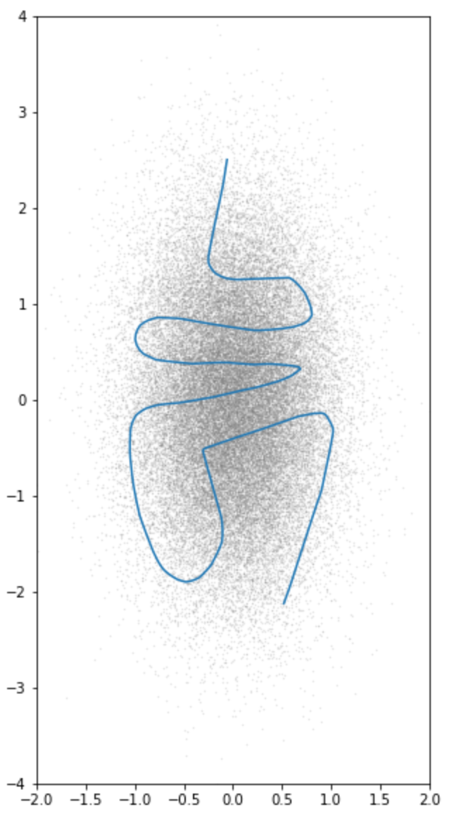
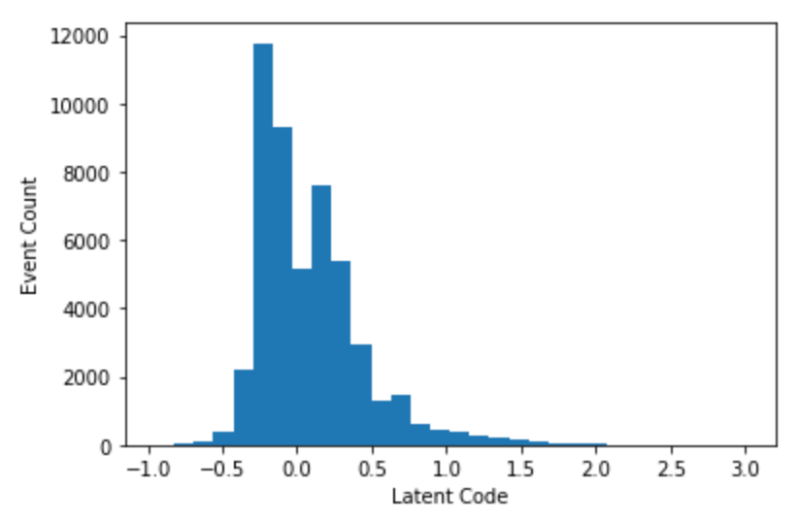
The Plain Autoencoder: a toy example
Latent Space

Slide 9
The Plain Autoencoder: a toy example
The AE learns some dense packing of the data space
The latent representation is highly coupled with the expressiveness of the network architecture of the encoder and decoder

Slide 10
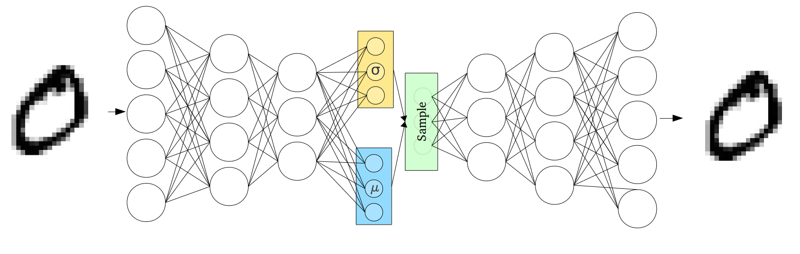
The Variational Autoencoder
Loss = ${{\left|x_{out}−x_{in}\right|}^{2}}/{{2β}^{2} }−\sum_{i}{\frac{1}{2}\left(1+ \log{σ_{i}^{2}}− μ_{i}^{2}− σ_{i}^{2}\right)}$
Reconstruction error
KL(q(z|x)||p(z)) ~ “Information cost”

Slide 11
The Variational Autoencoder:
Information and the loss function
Loss = ${{\left|x_{out}−x_{in}\right|}^{2}}/{{2β}^{2} }−\sum_{i}{\frac{1}{2}\left(1+ \log{σ_{i}^{2}}− μ_{i}^{2}− σ_{i}^{2}\right)}$
Loss = ${ \left|x_{out}−x_{in}\right|}^{2} −{ 2β}^{2}\sum_{i}{\frac{1}{2}\left(1+ \log{σ_{i}^{2}}− μ_{i}^{2}− σ_{i}^{2}\right)}$

Slide 12
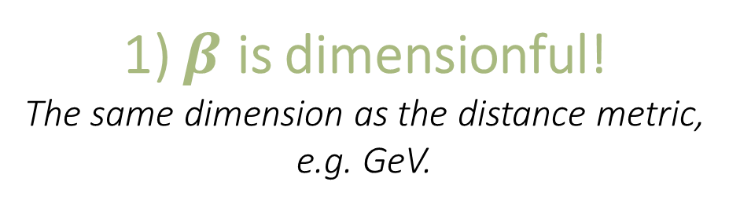
The Variational Autoencoder:
Information and the loss function
Loss = ${{\left|x_{out}−x_{in}\right|}^{2}}/{2β^{2} }−\sum_{i}{\frac{1}{2}\left(1+ \log{σ_{i}^{2}}− μ_{i}^{2}− σ_{i}^{2}\right)}$
1) $β$ is dimensionful!
The same dimension as the distance metric,
e.g. GeV.
Loss = ${\left|x_{out}−x_{in}\right|}^{2}−{2β}^{2}\sum_{i}{\frac{1}{2}\left(1+ \log{σ_{i}^{2}}− μ_{i}^{2}− σ_{i}^{2}\right)}$

Slide 13
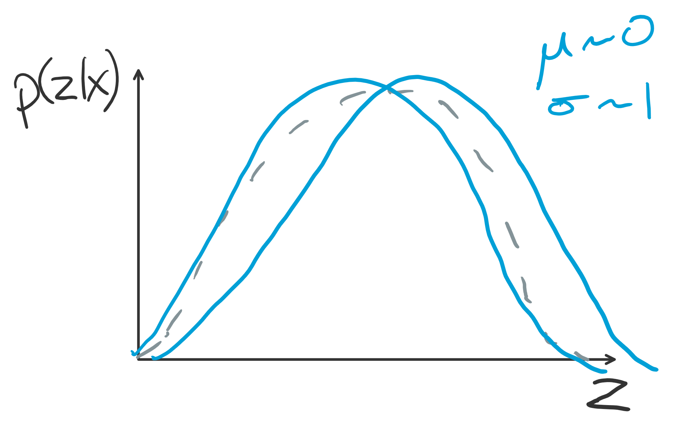
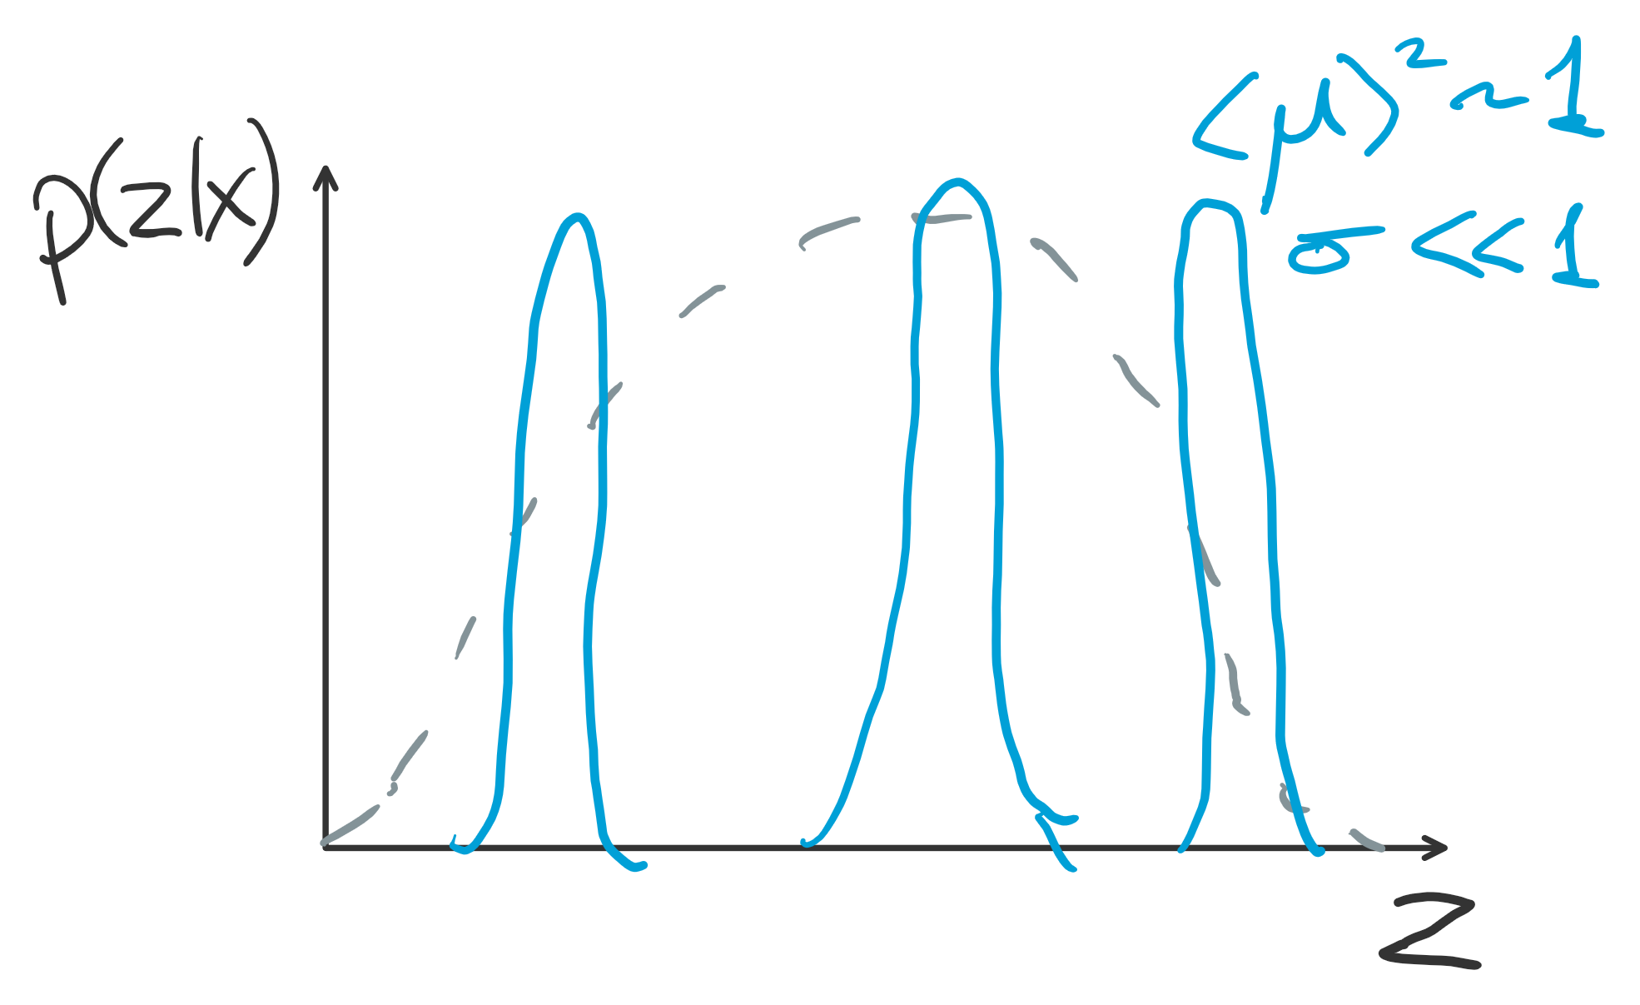
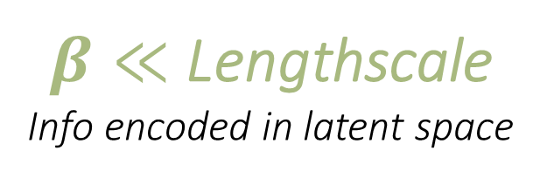
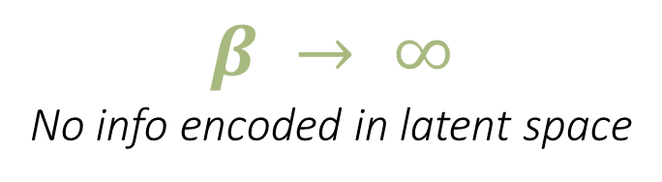
The Variational Autoencoder:
Information and the loss function
$$β → ∞$$
No info encoded in latent space
$β≪$ Lengthscale
Info encoded in latent space
Loss = ${\left|x_{out}−x_{in}\right|}^{2}−{2β}^{2}\sum_{i}{\frac{1}{2}\left(1+ \log{σ_{i}^{2}}− μ_{i}^{2}− σ_{i}^{2}\right)}$

Slide 14
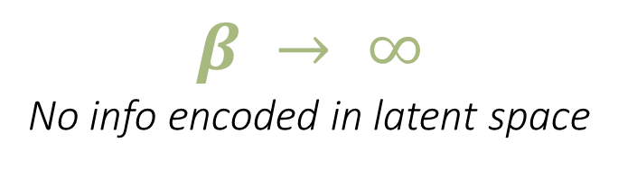
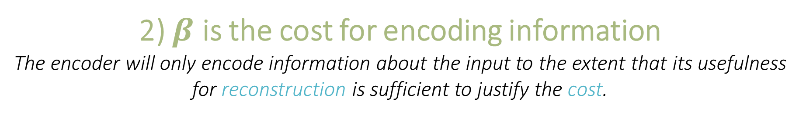
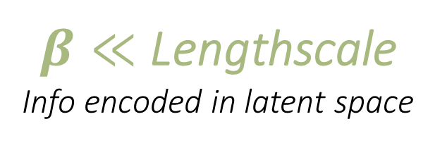
The Variational Autoencoder:
Information and the loss function
$$β → ∞$$
No info encoded in latent space
$β≪$ Lengthscale
Info encoded in latent space
2) $β$ is the cost for encoding information
The encoder will only encode information about the input to the extent that its usefulness for reconstruction is sufficient to justify the cost.
Loss = ${\left|x_{out}−x_{in}\right|}^{2}−{2β}^{2}\sum_{i}{\frac{1}{2}\left(1+ \log{σ_{i}^{2}}− μ_{i}^{2}− σ_{i}^{2}\right)}$

Slide 15
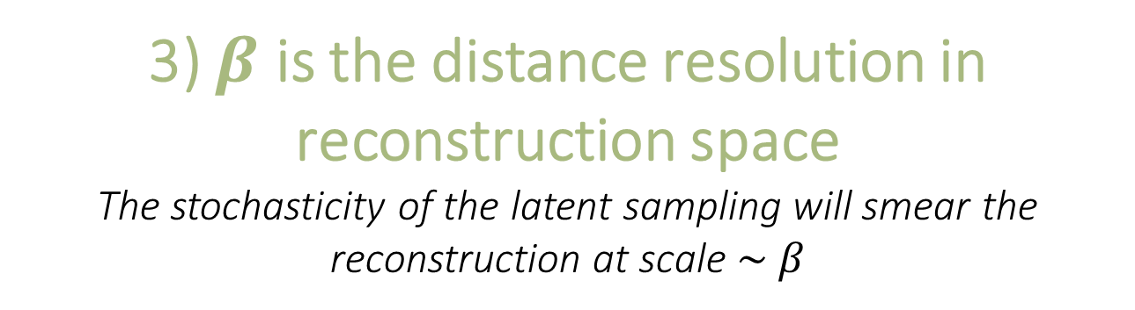
The Variational Autoencoder:
Information and the loss function
Loss = ${{\left|x_{out}−x_{in}\right|}^{2}}/{{2β}^{2} }−\sum_{i}{\frac{1}{2}\left(1+ \log{σ_{i}^{2}}− μ_{i}^{2}− σ_{i}^{2}\right)}$
3) $β$ is the distance resolution in reconstruction space
The stochasticity of the latent sampling will smear the reconstruction at scale $\sim β$

Slide 16
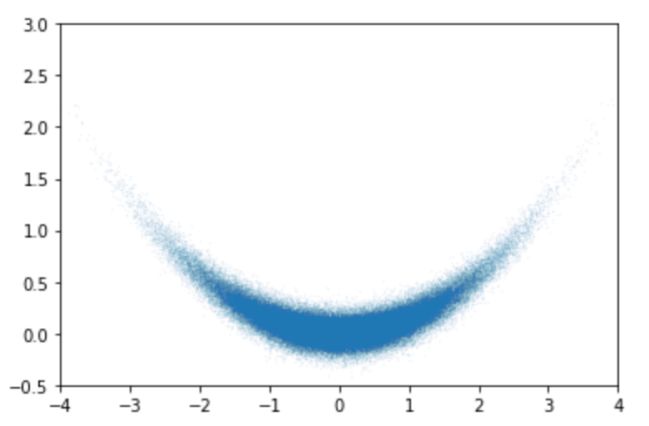
The Variational Autoencoder:
Bananas
Train VAE with a 10 dim latent space on this 2D dataset

Slide 17
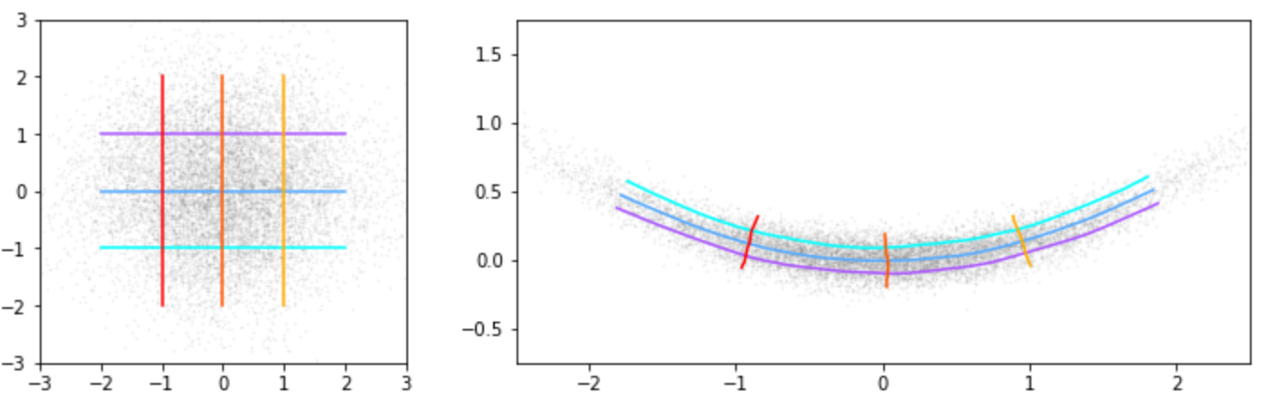
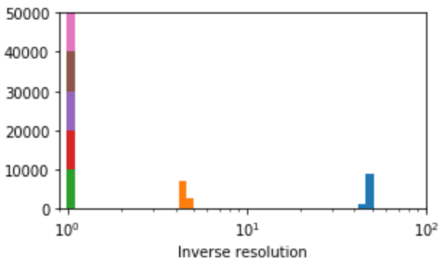

The Variational Autoencoder:
Bananas
Latent Space
Reconstruction Space
$$β<0.1$$
Exp[KL] ~ 1/σ

Slide 18
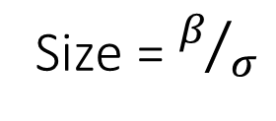
The Variational Autoencoder:
Bananas
Latent Space
Reconstruction Space
$$β<0.1$$
Exp[KL] ~ 1/σ
Size = $β/σ$
The VAE is doing non-linear PCA

Slide 19
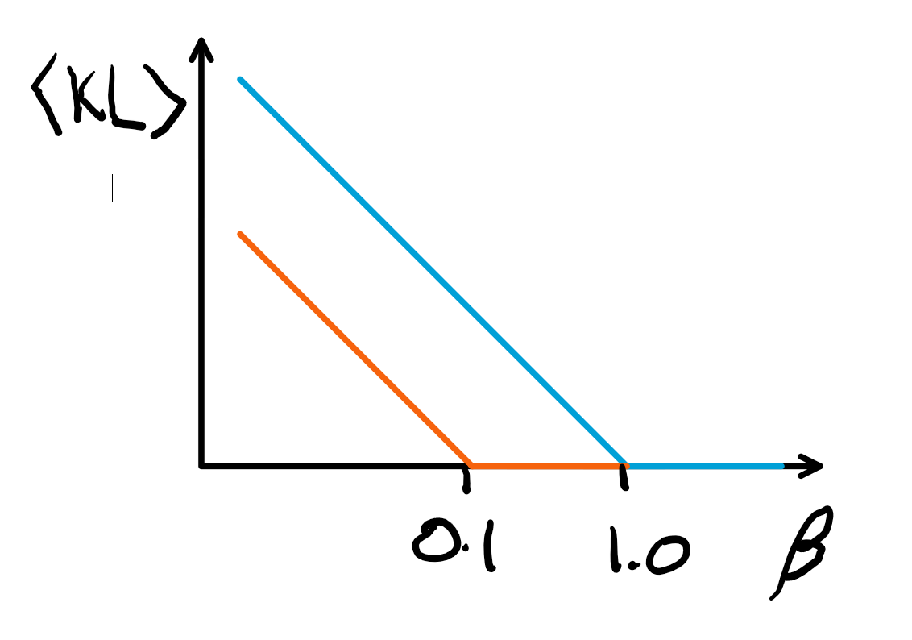
The Variational Autoencoder:
Bananas
Latent Space
Reconstruction Space
$$β<0.1$$
Exp[KL] ~ 1/σ
Size = $β/σ$
The VAE is doing non-linear PCA

Slide 20
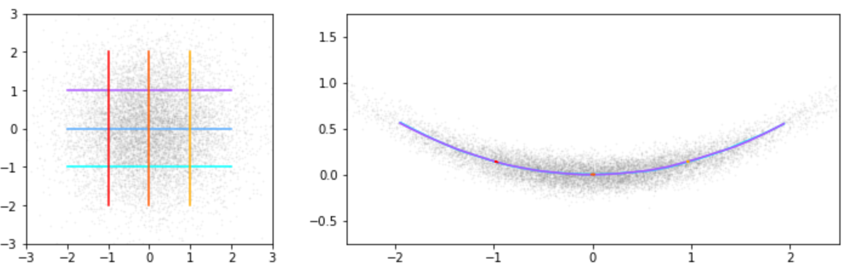
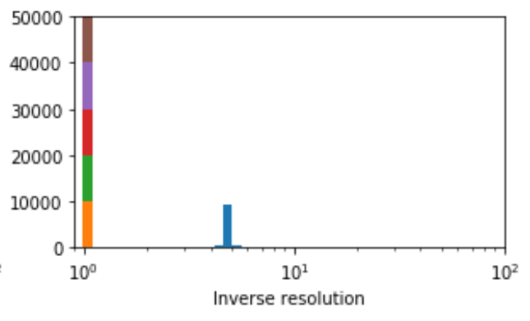

The Variational Autoencoder:
Bananas
Latent Space
Reconstruction Space
$$0.1<β<1.0$$
Exp[KL] ~ 1/σ

Slide 21
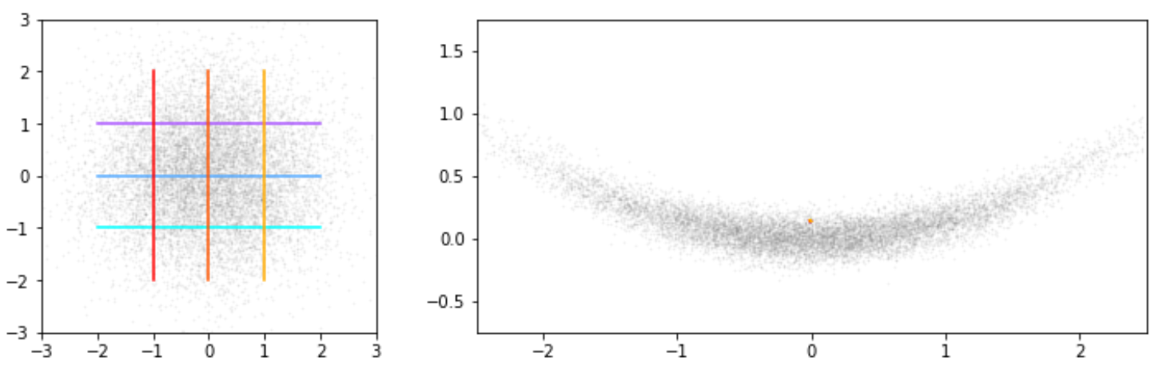
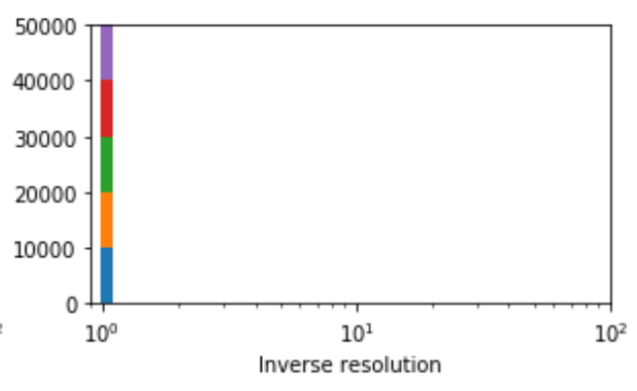

The Variational Autoencoder:
Bananas
Latent Space
Reconstruction Space
Exp[KL] ~ 1/σ
$$β≫1$$

Slide 22
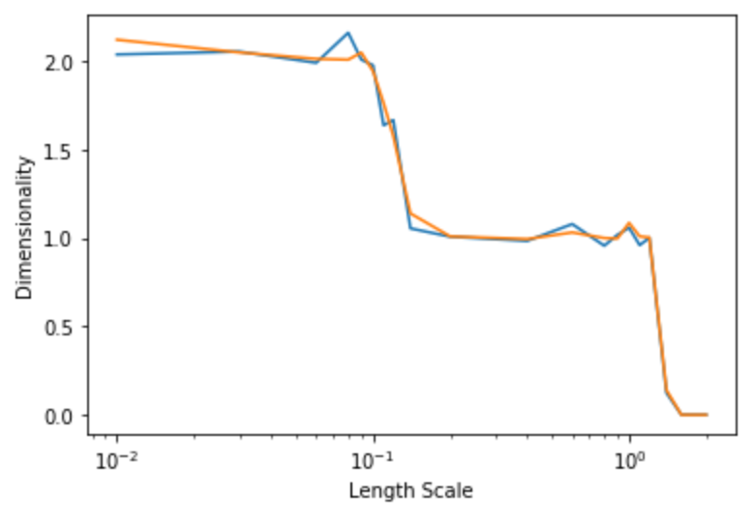
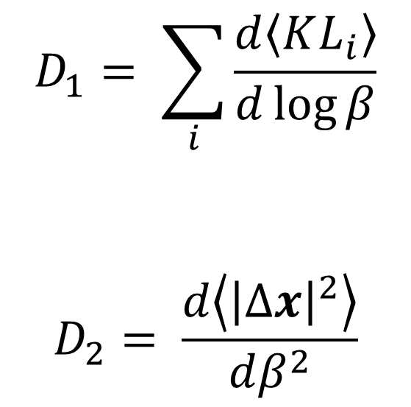
The Variational Autoencoder:
Dimensionality
The scaling of KL with beta suggests a notion of dimensionality, that relates to how tightly small gaussians are being packed into the latent space.
$$D_{1}= \sum_{i}{\frac{d\left\langle KL_{i}\right\rangle }{d\log{β}}}$$
$$D_{2}= \frac{d\left\langle {\left|∆x\right|}^{2}\right\rangle }{dβ^{2}}$$
A similar notion of dimensionality can be derived from the packing of gaussians into the data-space.
β

Slide 23
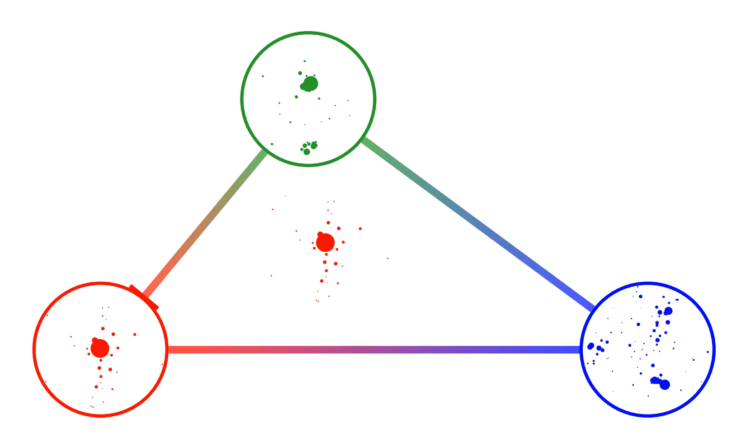
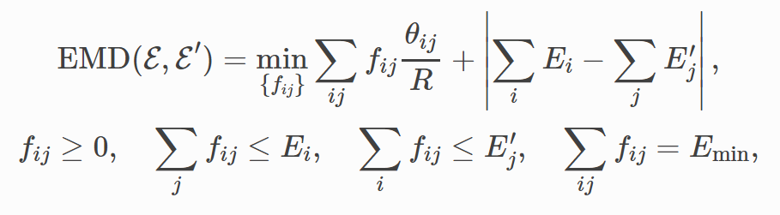
Distance between Jets:
EMD: Cost to transform one jet into another = Energy * distance
Defines a metric space in which jets or collider events form a geometric manifold.
In practice I use a tractable approximation to EMD called Sinkhorn distance
arXiv:1306.0895 [stat.ML] M. Cuturi
arXiv:1902.02346
Video taken from https://energyflow.network/docs/emd/, Eric Metediov, Patrick Komiske III, Jesse Thaler

Slide 24


Jet VAE
Large
Latent space
PFN
Dense
$$\{p_{T i}, y_{i}, φ_{i}\}$$
$$\{p_{T i}, y_{i}, φ_{i}\}$$
1-100 particles
50 particles
Sinkhorn distance ≈ EMD

Slide 25
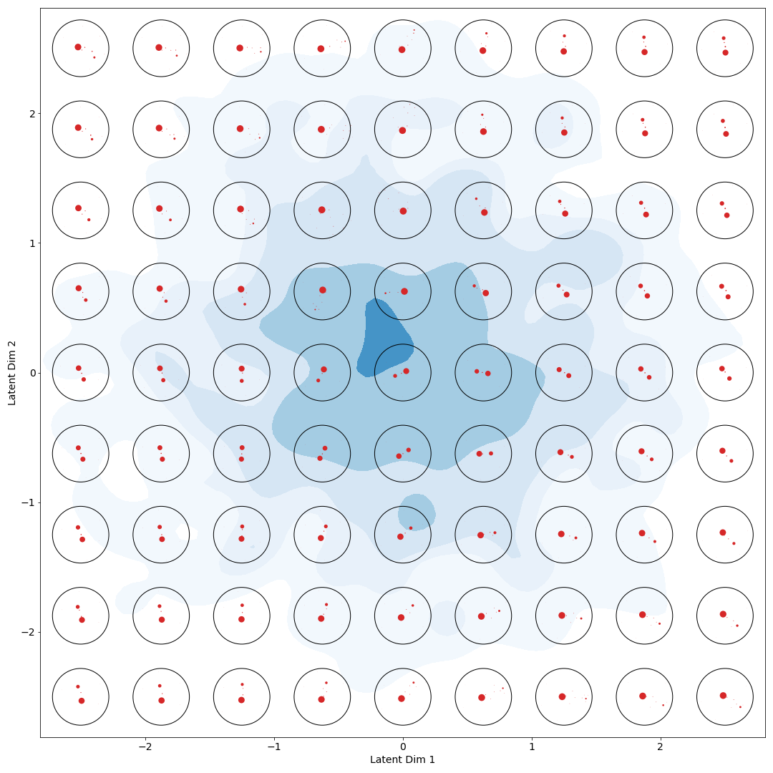
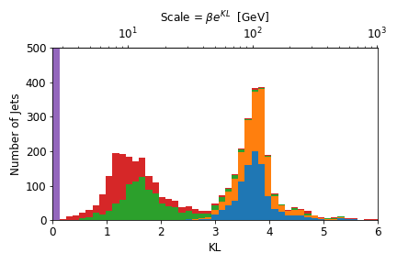

W Jets
$$β=2.5 GeV$$

Slide 26





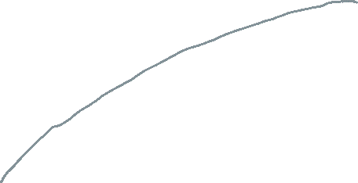



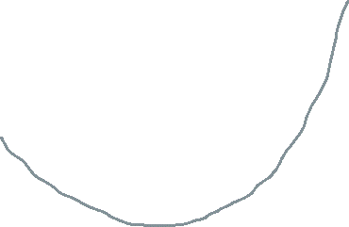
W Jets
Boosted Frame:

Slide 27
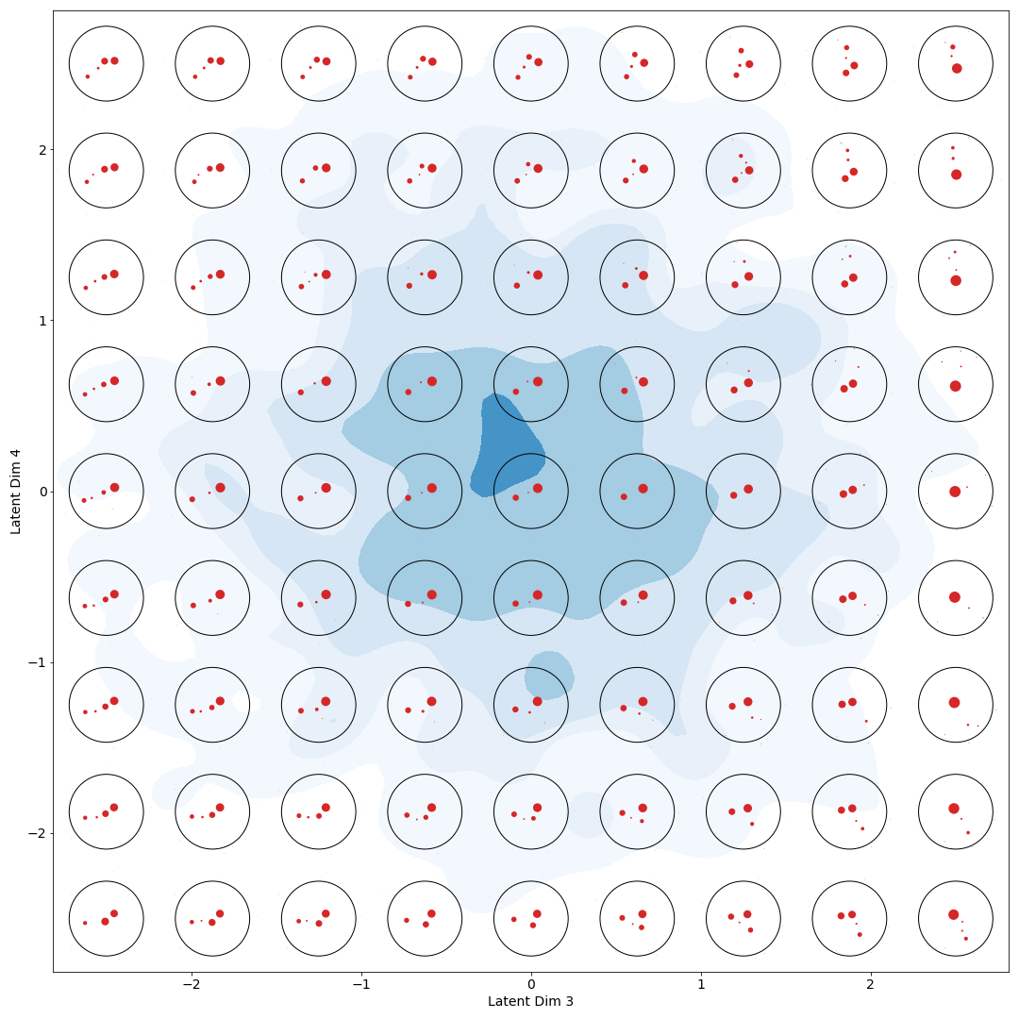
W Jets
$$β=2.5 GeV$$

Slide 28
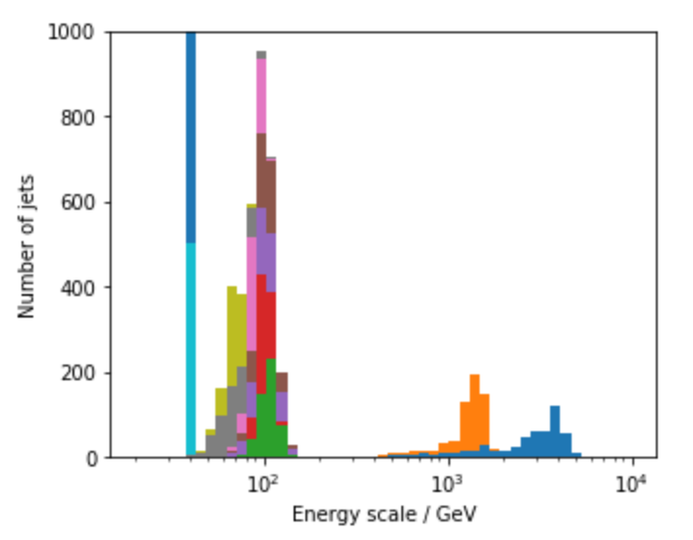
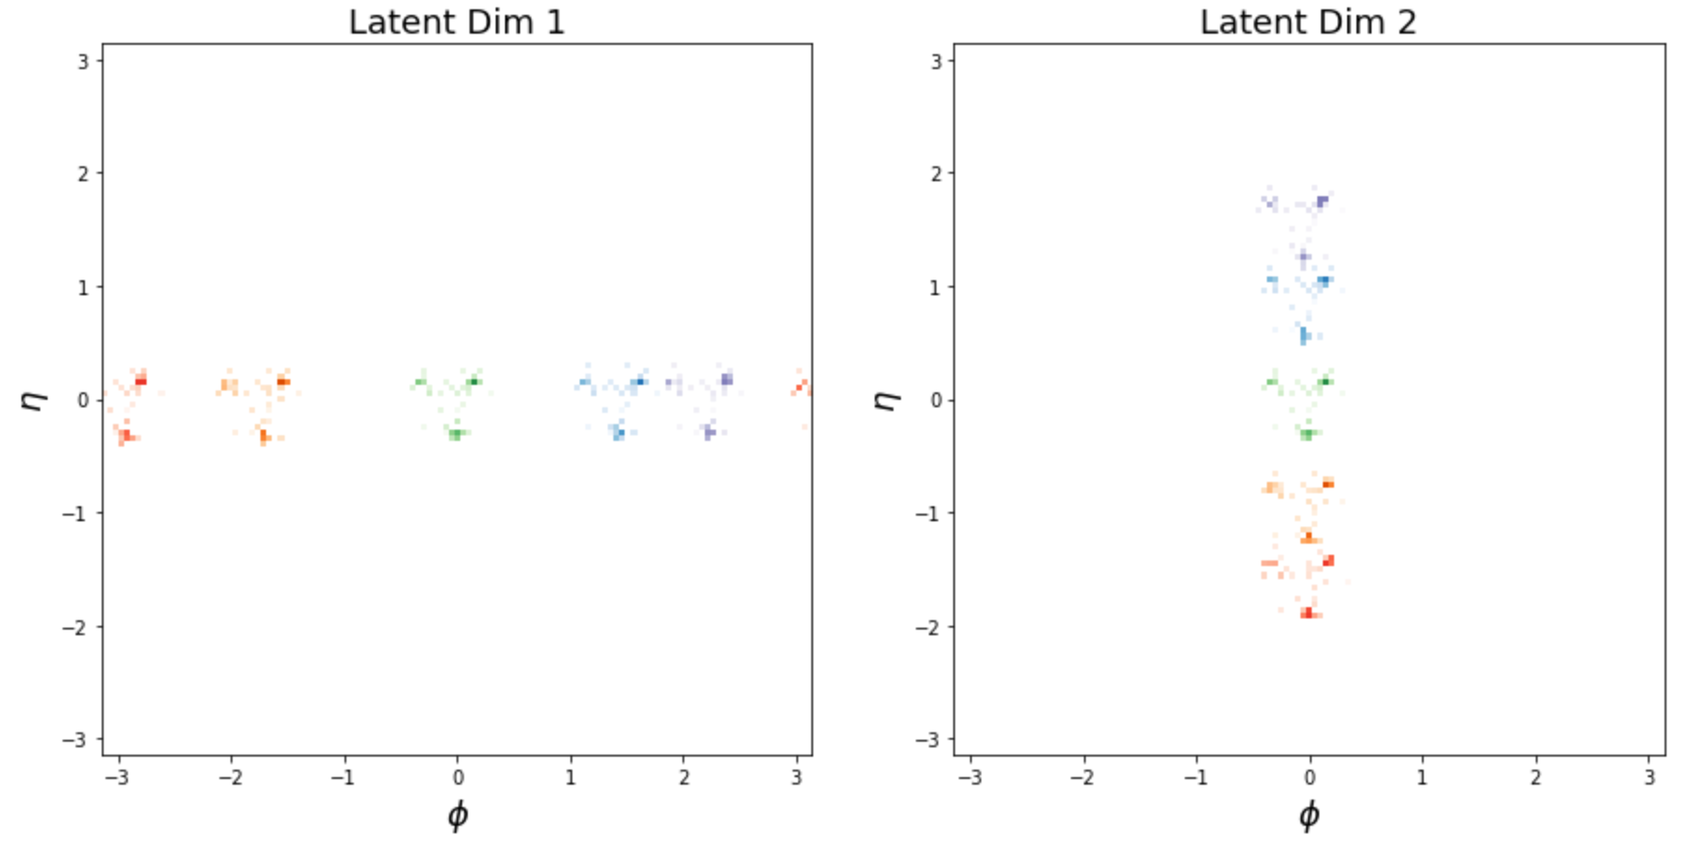

Exploring the Learnt Representation:
Top Jets
$$β=40 GeV$$

Slide 29
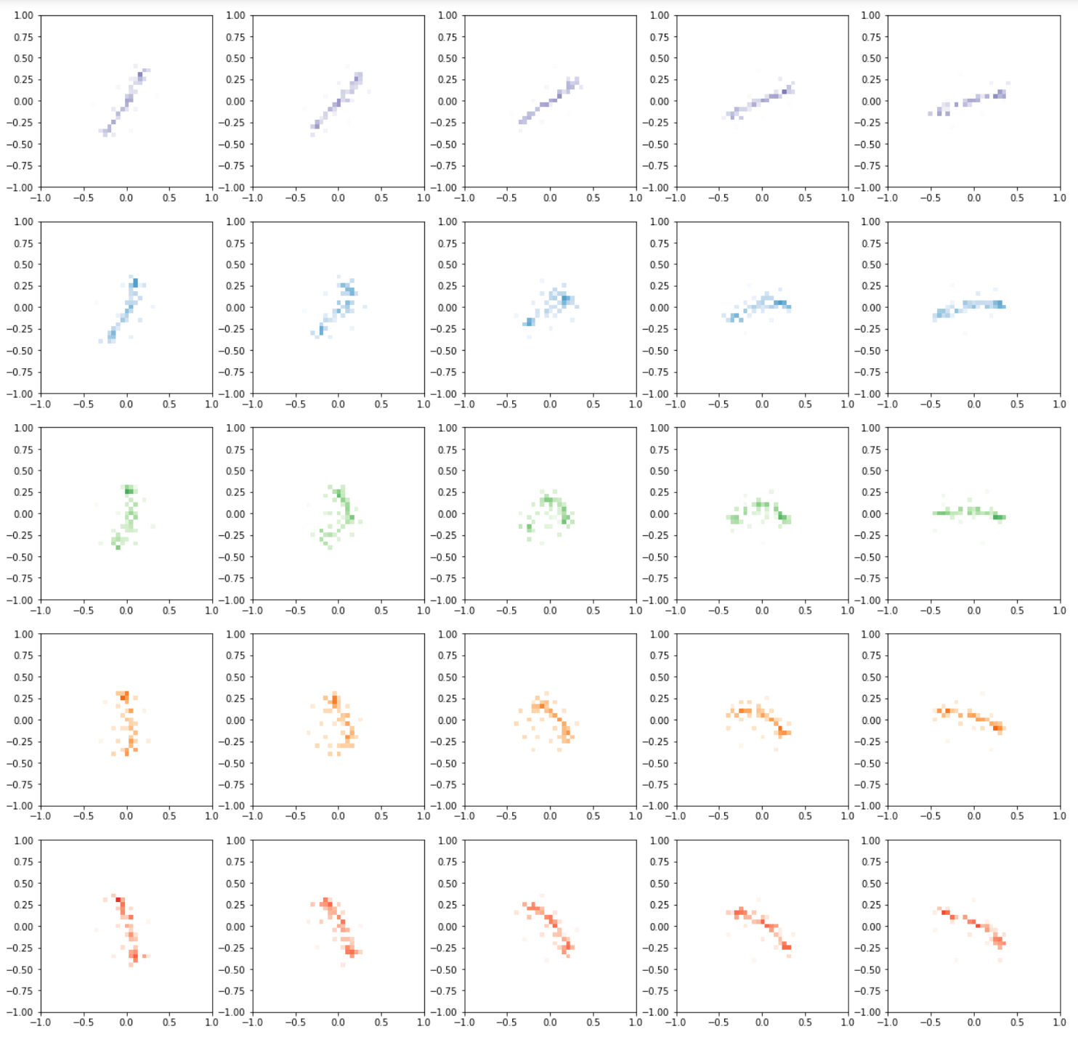
Exploring the Learnt Representation:
Top Jets
$$β=40 GeV$$
Latent Dimension 4
Latent Dimension 3

Slide 30
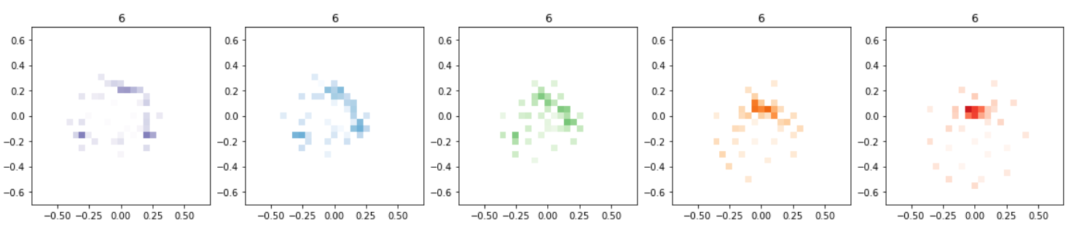
Exploring the Learnt Representation:
Top Jets
$$β=40 GeV$$

Slide 31
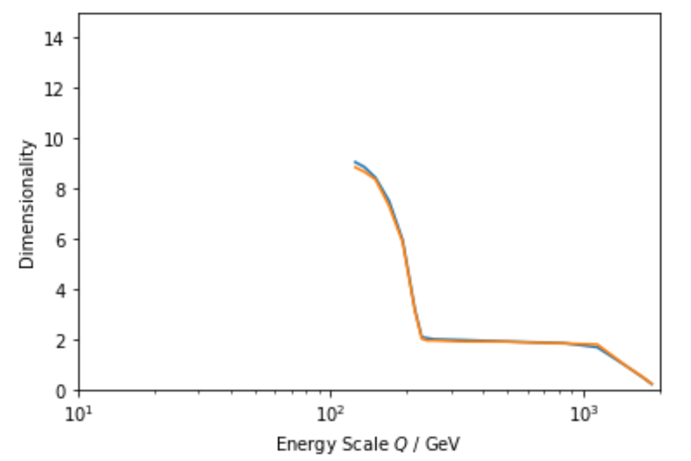
Exploring the Learnt Representation:
Dimensionality
?

Slide 32
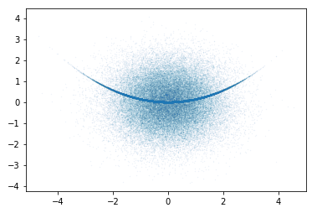
A Mixed Sample

Slide 33

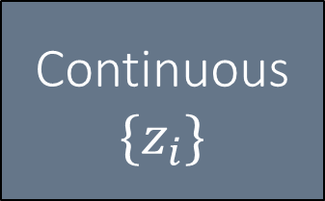



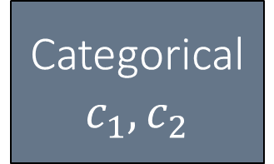

A Mixed Sample
VAE structure
Continuous
$$\{z_{i}\}$$
Dense
Dense
Dense
$$x, y$$
$$x, y$$
Categorical
$$c_{1}, c_{2}$$
$$P(x|c,z)$$
$$P(z|x,c)$$
$$P(c|x)$$

Slide 34
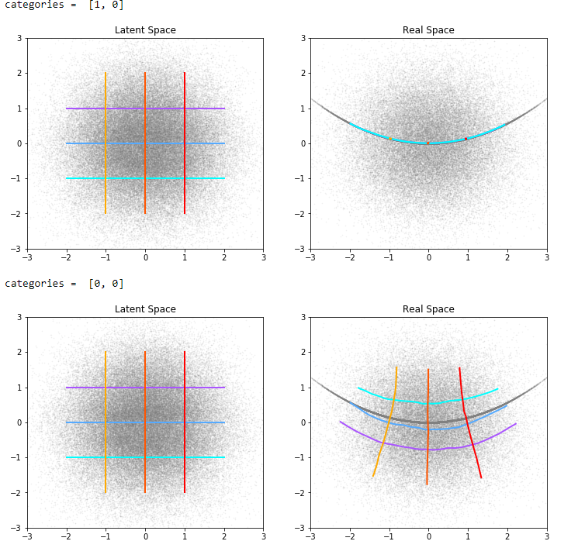
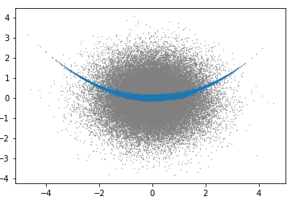
A Mixed Sample
VAE structure
Learnt Classifier
Category 1
Category 2

Slide 35
Conclusions
VAE latent spaces learn concrete representations of the manifolds on which they are trained.
A meaningful distance metric which encodes interesting physics at different scales leads to a meaningful learnt representation which encodes interesting physics at different scales.
For a sufficiently simple manifold, the VAE learnt representation is:
Orthogonalized
Hierarchically organized
Has a scale-dependent fractal dimension which directly relates to that of the true data manifold
These properties are due to the demand to be parsimonious with information.

Slide 36


The Variational Autoencoder:
Orthogonalization and Organization is Information-Efficient
Orthogonalization:
vs
Organization:
vs

Slide 37



Exploring the Learnt Representation:
Top Jets
$$β=400 GeV$$

