Slide 1
Hadron Spectroscopy in Lattice QCD
Ying Chen
Institute of High Energy Physics,
Chinese Academy of Sciences, China
SCNU, Guangzhou, Nov. 24, 2019

Slide 2
Outline
I. Introduction
II. Present status of hadron spectroscopy from
lattice QCD
III. Lattice hadron spectroscopy in China
IV Summary

Slide 3
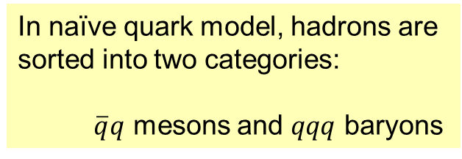

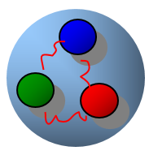
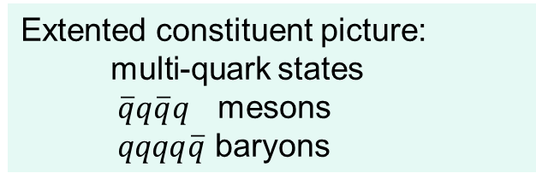
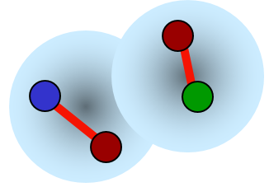
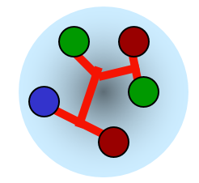
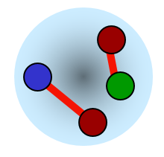
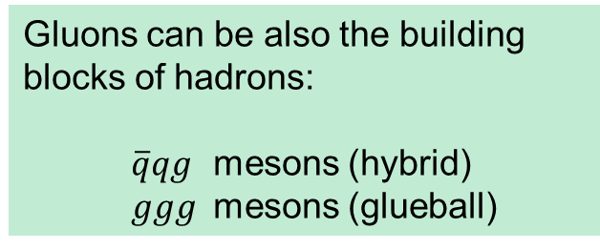
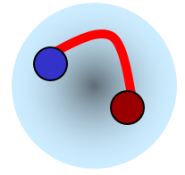

I. Introduction
meson
baryon
hadron molecule
tetraquark
pentaquark
hybrid
glueball
Exotic hadrons

Slide 4
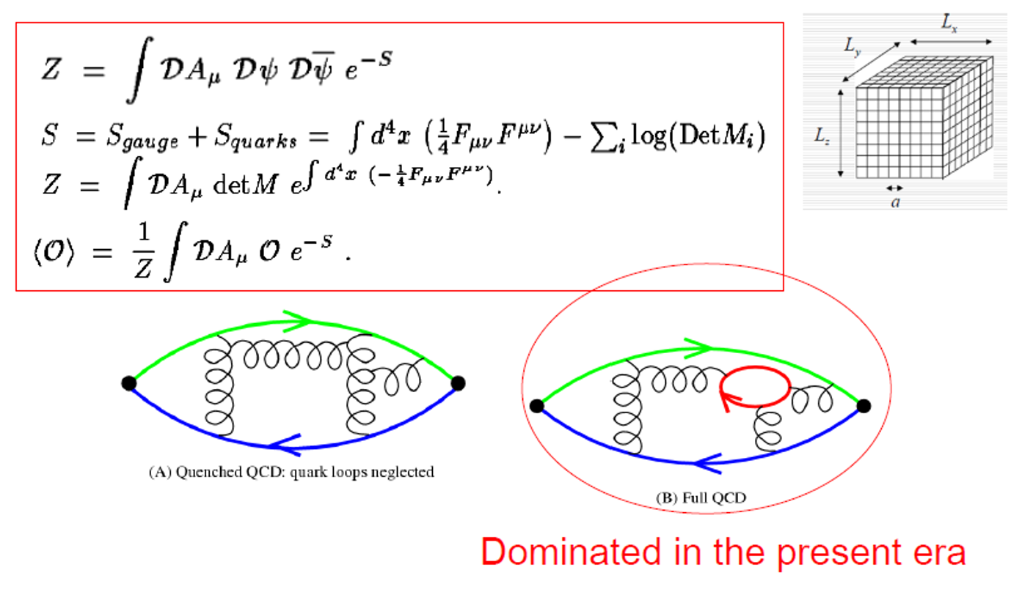

Slide 5
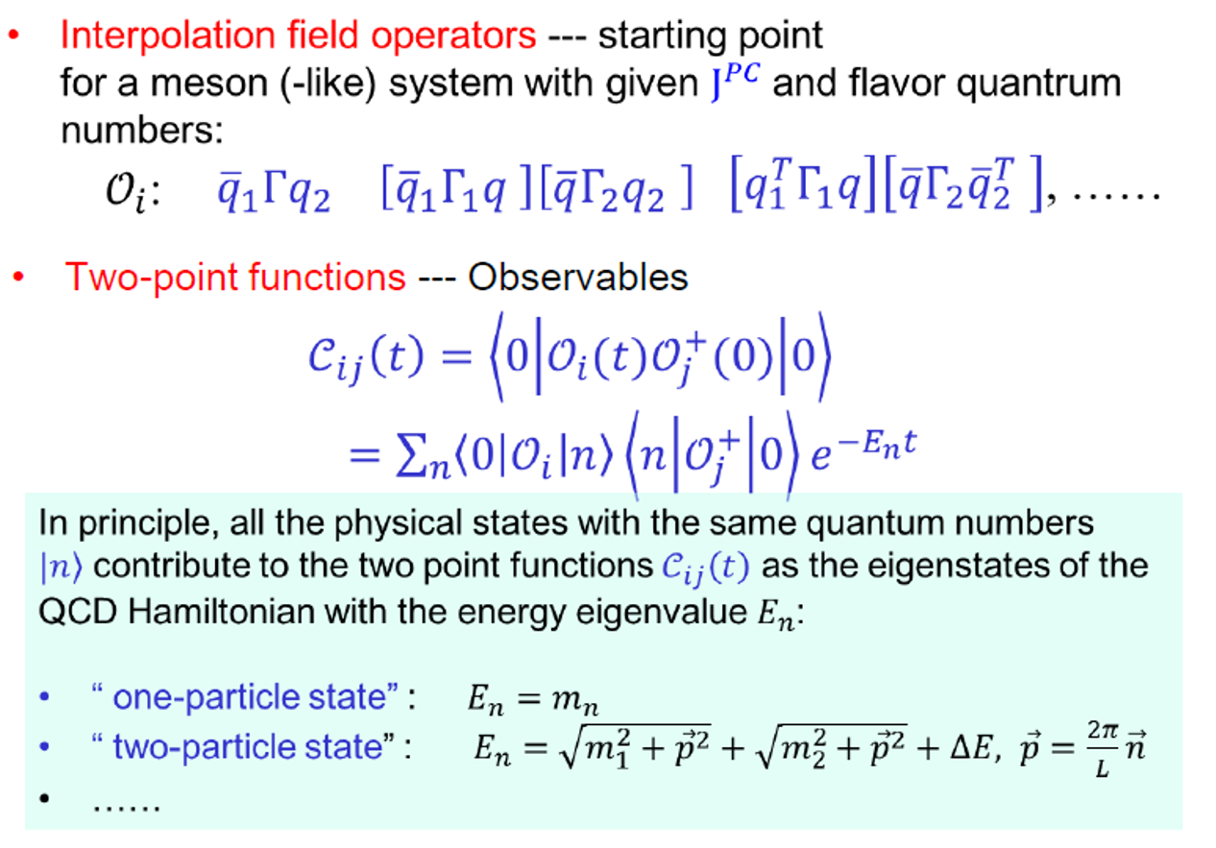

Slide 6
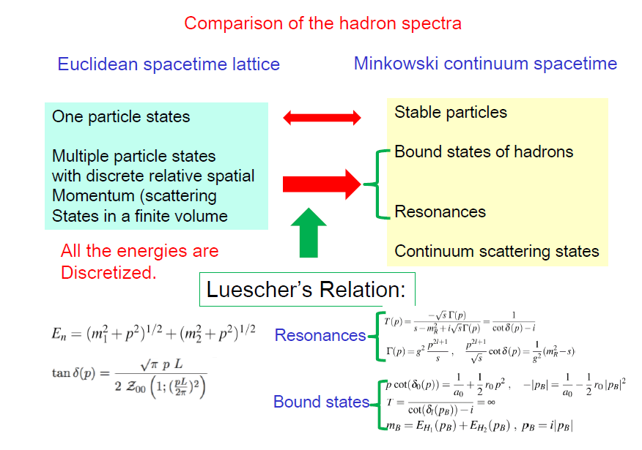

Slide 7
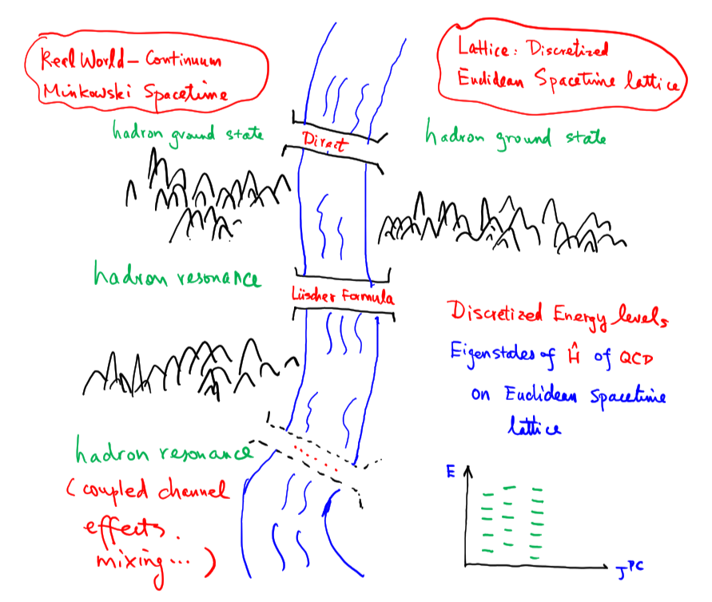
Present status of lattice QCD study on hadron spectroscopy

Slide 8
II. Present status of lattice HS
Quark masses
Masses of ground state hadrons
Hadron resonances
CKM matrix elements relevant

Slide 9
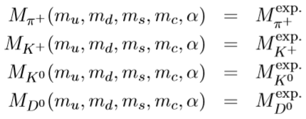
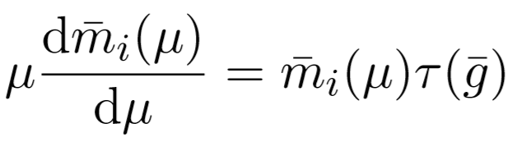
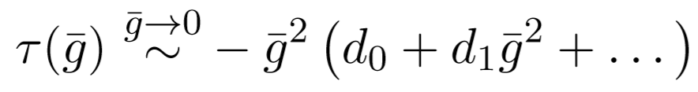
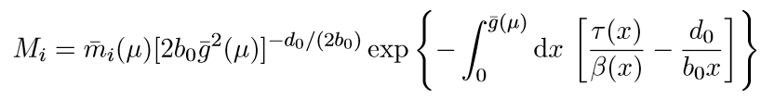
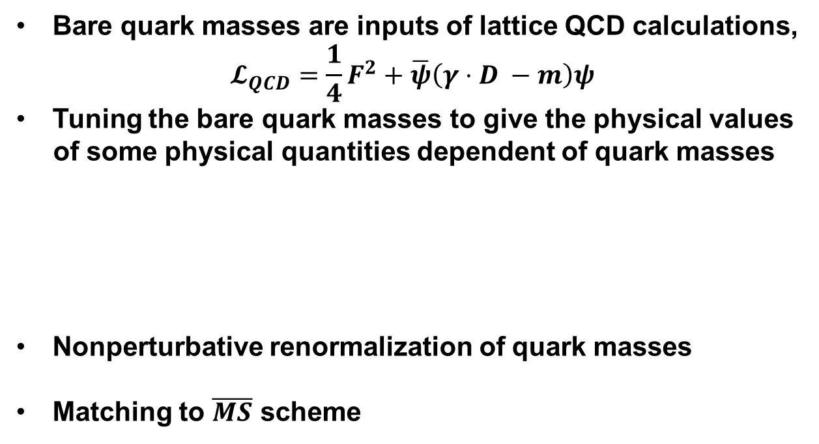
Quark masses
Bare quark masses are inputs of lattice QCD calculations,
$$𝓛_{QCD}=\frac{1}{4}F^{2}+\overline{ψ}\left(γ⋅D −m\right)ψ$$
Tuning the bare quark masses to give the physical values
of some physical quantities dependent of quark masses
Nonperturbative renormalization of quark masses
Matching to $\overline{MS}$ scheme
RGI masses

Slide 10
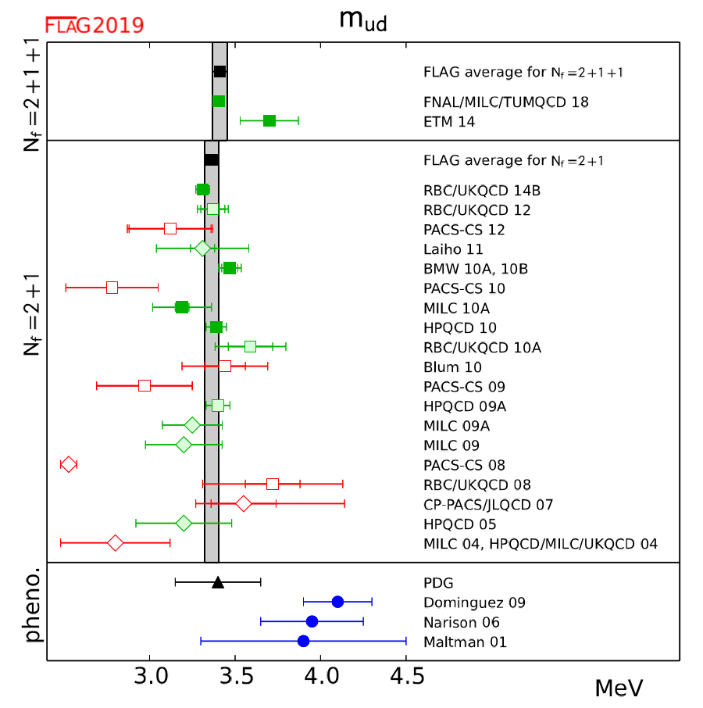
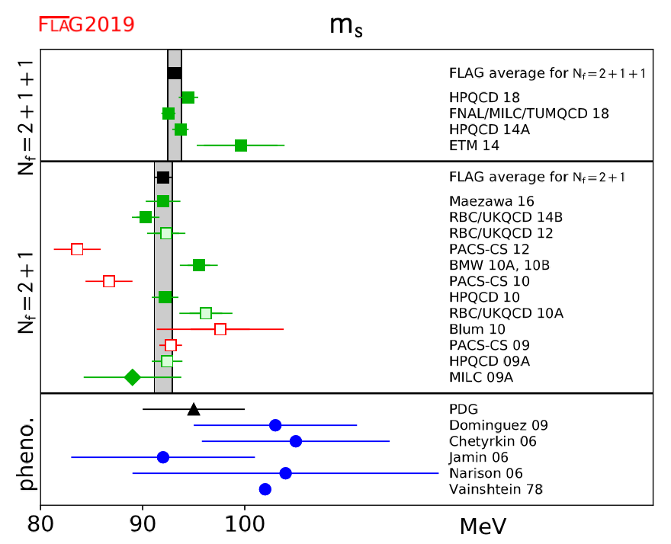
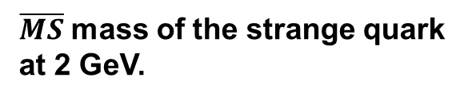
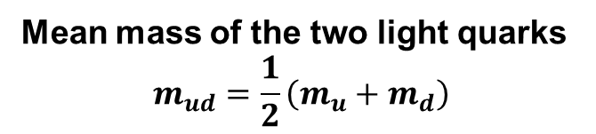
Flavour Lattice Averaging Group (http://flag.unibe.ch/2019/)
Mean mass of the two light quarks
$$m_{ud}=\frac{1}{2}\left(m_{u}+m_{d}\right)$$
$\overline{MS}$ mass of the strange quark
at 2 GeV.

Slide 11
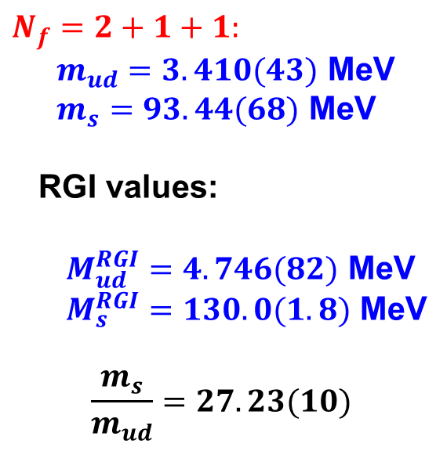
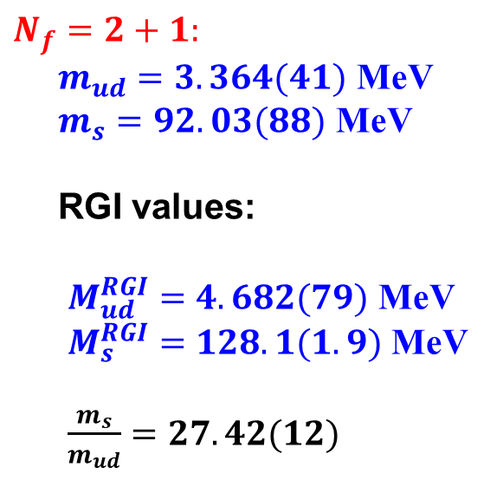
$N_{f}=2+1:$
$m_{ud}=3.364(41)$ MeV
$m_{s}=92.03(88)$ MeV
RGI values:
$M_{ud}^{RGI}=4.682(79)$ MeV
$M_{s}^{RGI}=128.1(1.9)$ MeV
$\frac{m_{s}}{m_{ud}}=27.42(12)$
$N_{f}=2+1+1:$
$m_{ud}=3.410(43)$ MeV
$m_{s}=93.44(68)$ MeV
RGI values:
$M_{ud}^{RGI}=4.746(82)$ MeV
$M_{s}^{RGI}=130.0(1.8)$ MeV
$$\frac{m_{s}}{m_{ud}}=27.23(10)$$

Slide 12
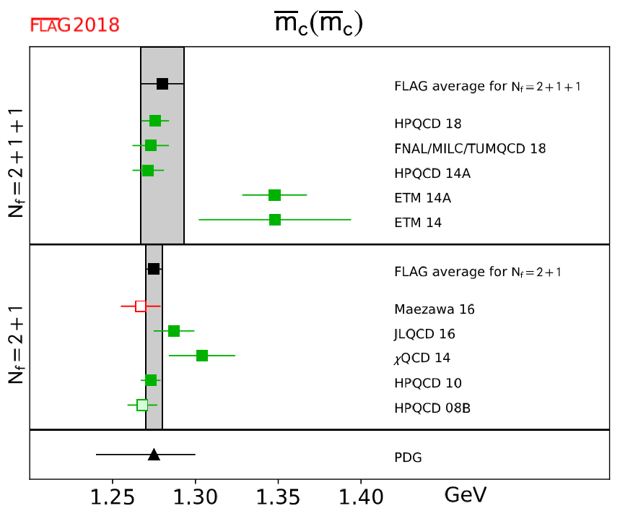
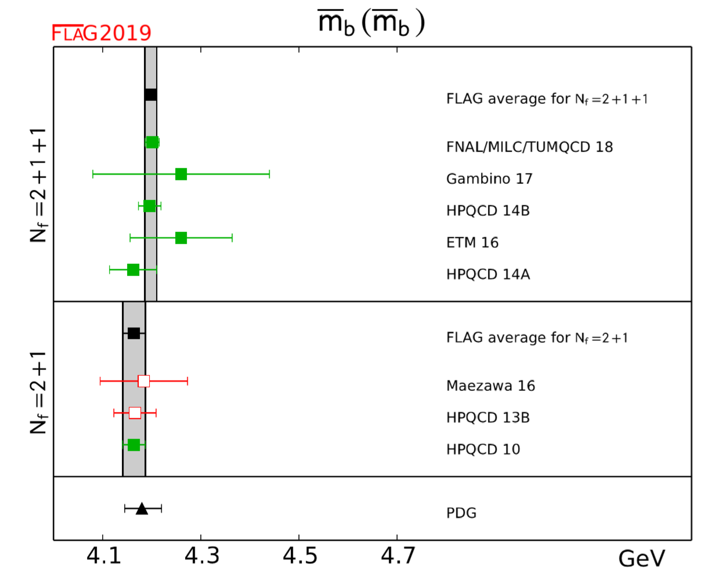
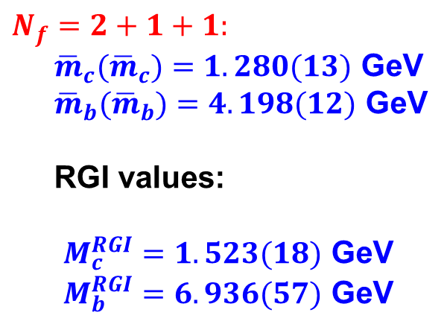
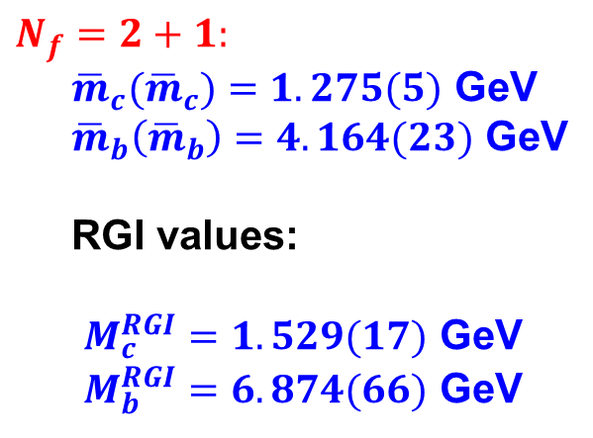
$N_{f}=2+1:$
${\overline{m}}_{c}({\overline{m}}_{c})=1.275(5)$ GeV
${\overline{m}}_{b}\left({\overline{m}}_{b}\right)=4.164(23)$ GeV
RGI values:
$M_{c}^{RGI}=1.529(17)$ GeV
$M_{b}^{RGI}=6.874(66)$ GeV
$N_{f}=2+1+1:$
${\overline{m}}_{c}({\overline{m}}_{c})=1.280(13)$ GeV
${\overline{m}}_{b}({\overline{m}}_{b})=4.198(12)$ GeV
RGI values:
$M_{c}^{RGI}=1.523(18)$ GeV
$M_{b}^{RGI}=6.936(57)$ GeV

Slide 13
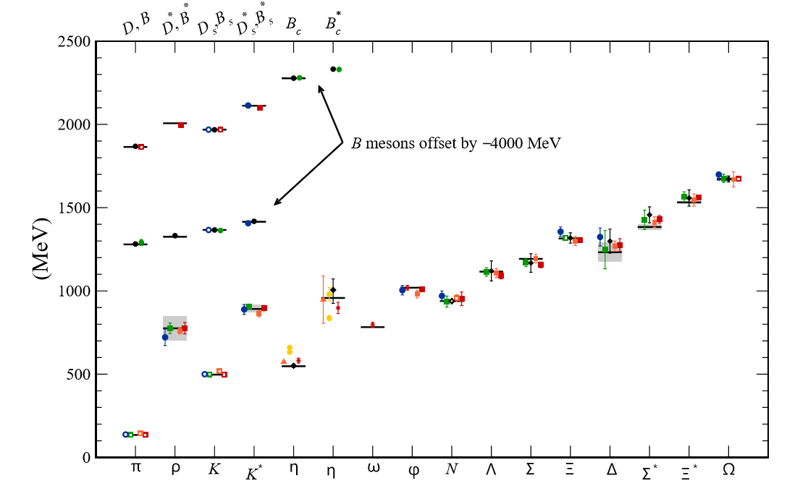
Masses of ground state hadrons
（http://pdg.lbl.gov/2019/reviews/rpp2018-rev-quark-model.pd）
Hadron spectrum from lattice QCD:
MILC (USA), PACS-CS(JAN), BMW(EU), QCDSF(EU),
ETM (EU), RBC&UKQCD(US&UK), HSC(US)

Slide 14
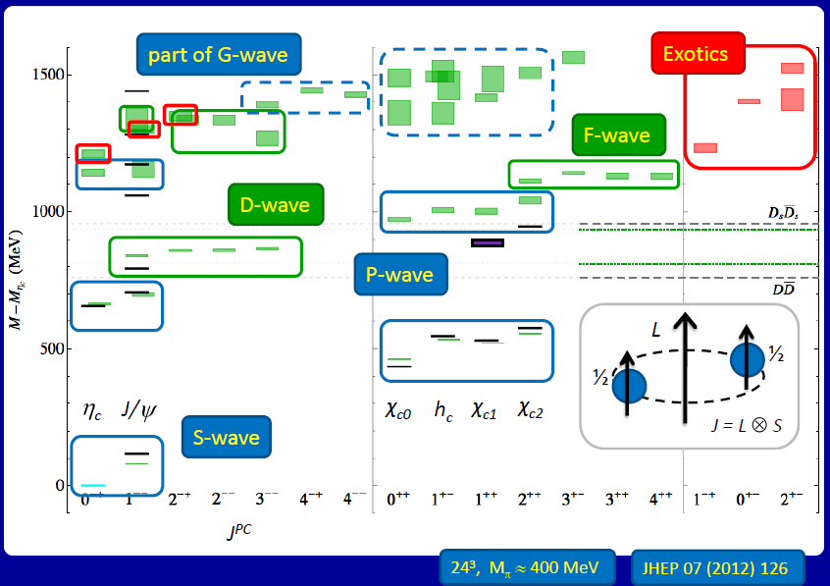
Latest charmonium spectrum from lattice QCD (L. Liu et al.)

Slide 15
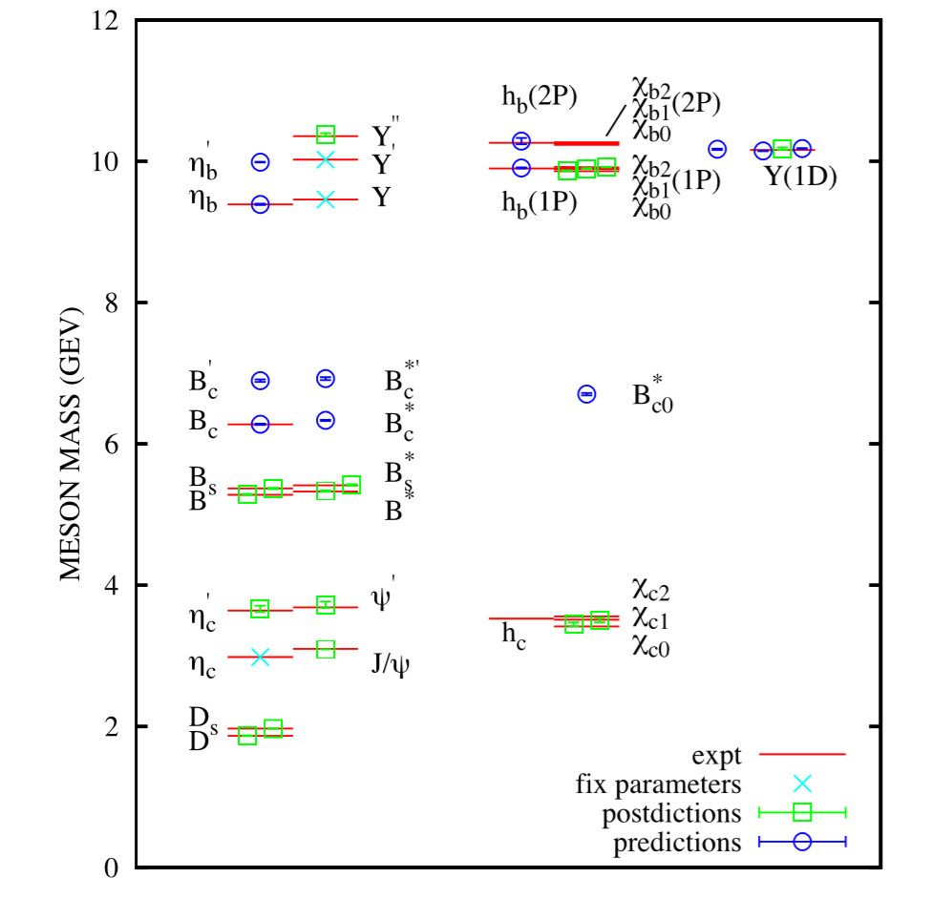
Spectroscopy for mesonic systems with one or two heavy
quarks .

Slide 16
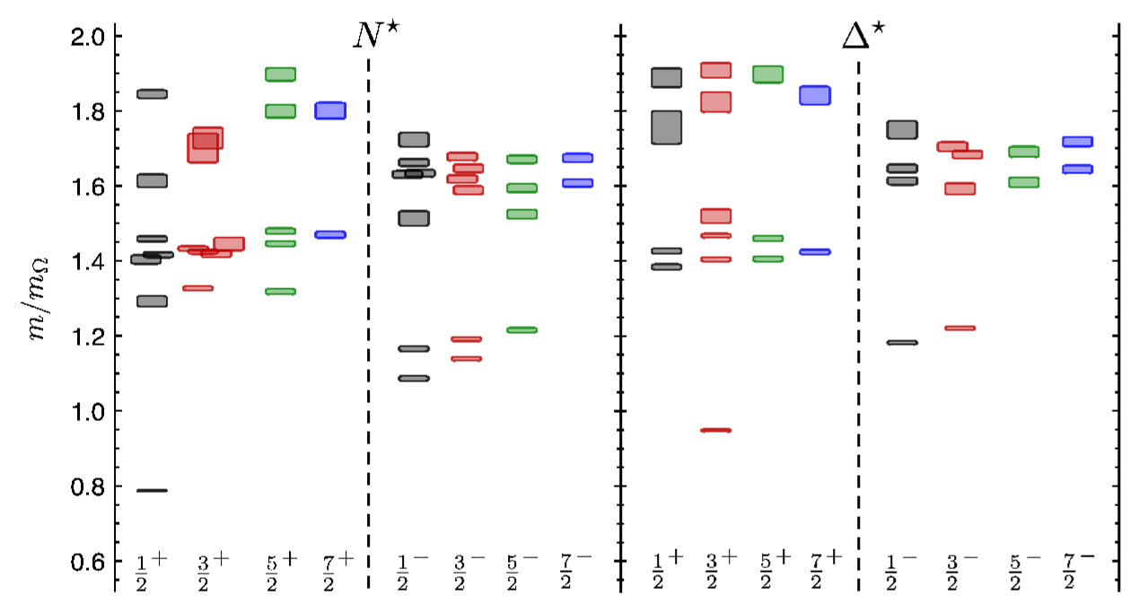
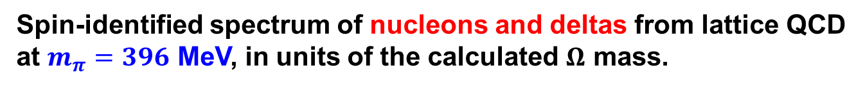
Spin-identified spectrum of nucleons and deltas from lattice QCD
at $m_{π}=396$ MeV, in units of the calculated $Ω$ mass.

Slide 17
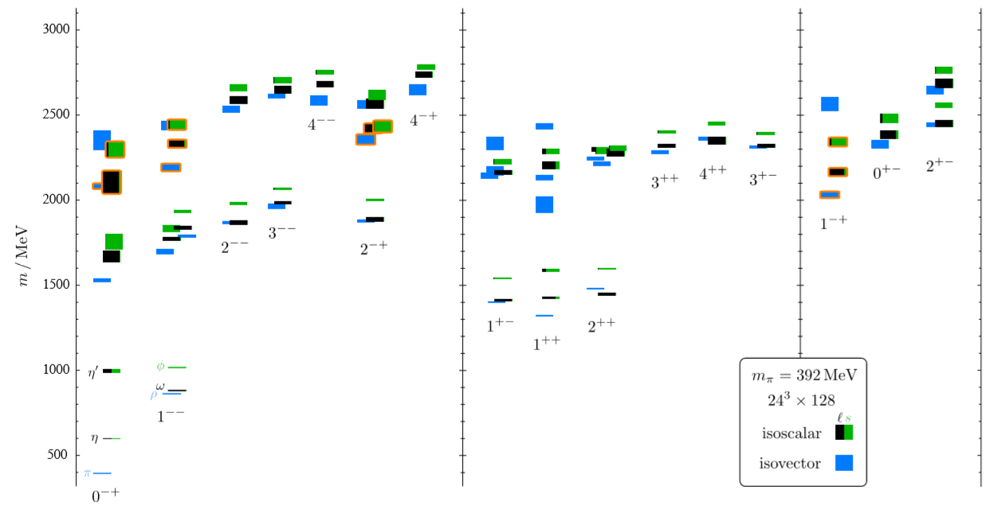
Isoscalar and isovector meson spectrum at $m_{π}=392$ MeV.

Slide 18
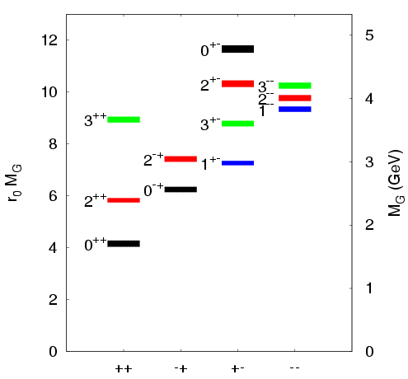
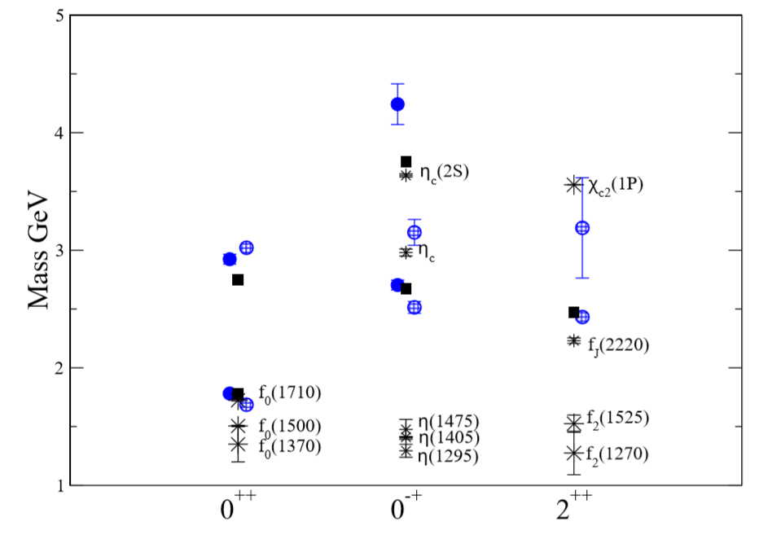
LQCD predictions for glueball masses.
Y. Chen et al,
Phys. Rev. D 73, 014516 (2006)
Open and closed circles:
full QCD calculation.
Squares: the quenched results.
Bursts: experimental states

Slide 19
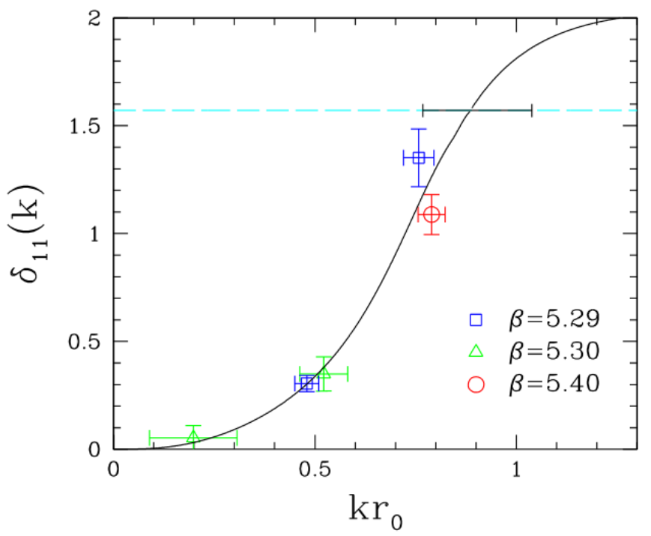
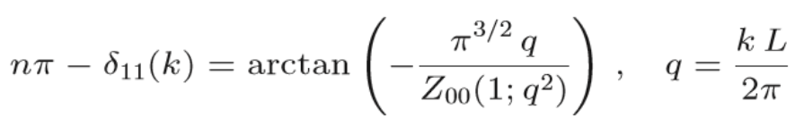

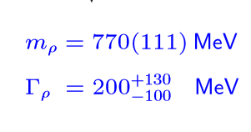
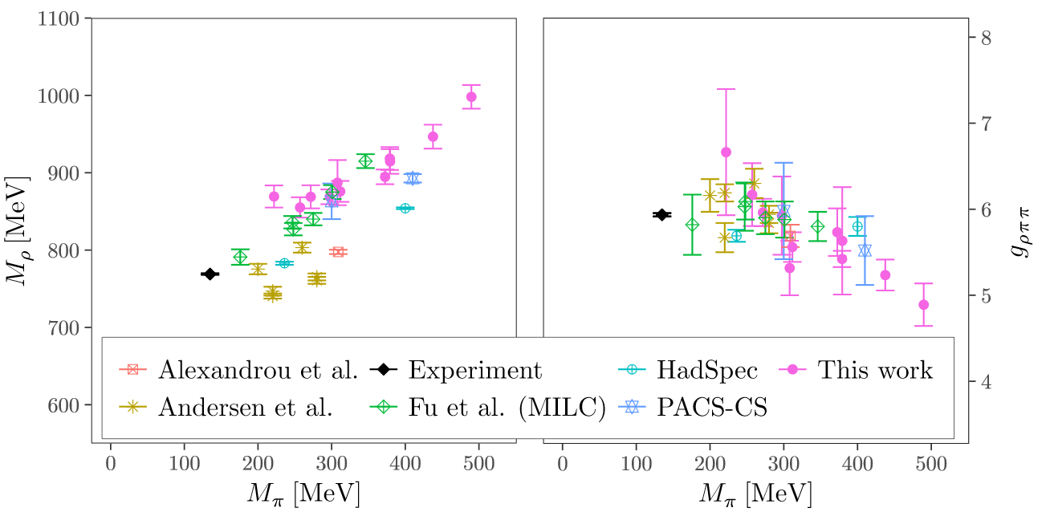

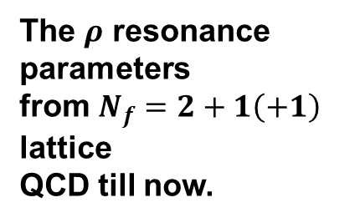
3. Hadron resonances
1) $ρ$ resonance on the lattice
The $ρ$ resonance
parameters
from $N_{f}=2+1\left(+1\right)$
lattice
QCD till now.

Slide 20
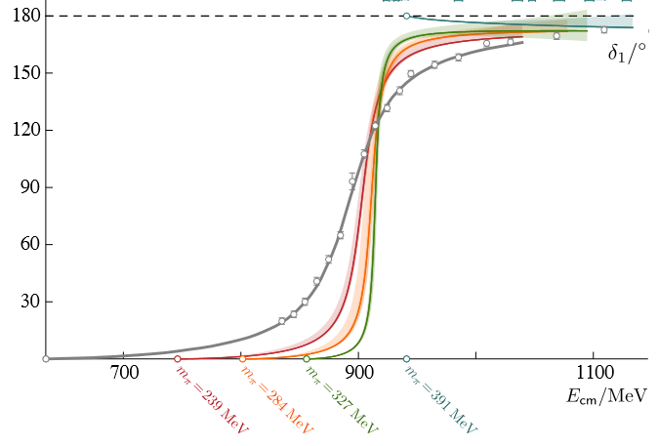
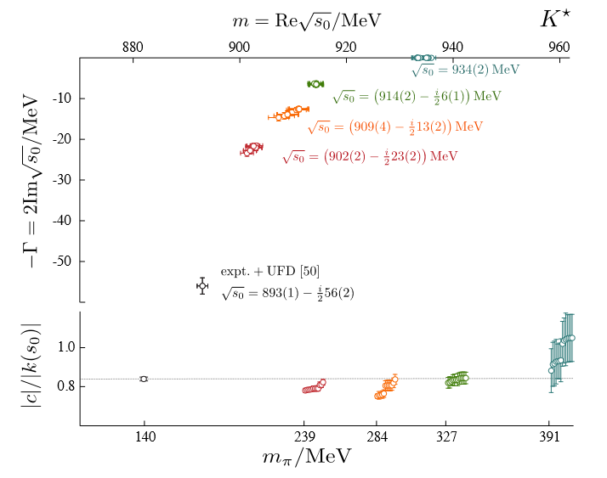


2) $K^{∗}$ Resonance
D.J. Wilson et al (HSC Collab.), Phys. Rev. Lett. 123, 042002 (2019)
arXiv: 1904.03188 (hep-lat)
The pole of the amplitude approaches smoothly towards the experimental value when $m_{π}$ goes to the physical point.

Slide 21
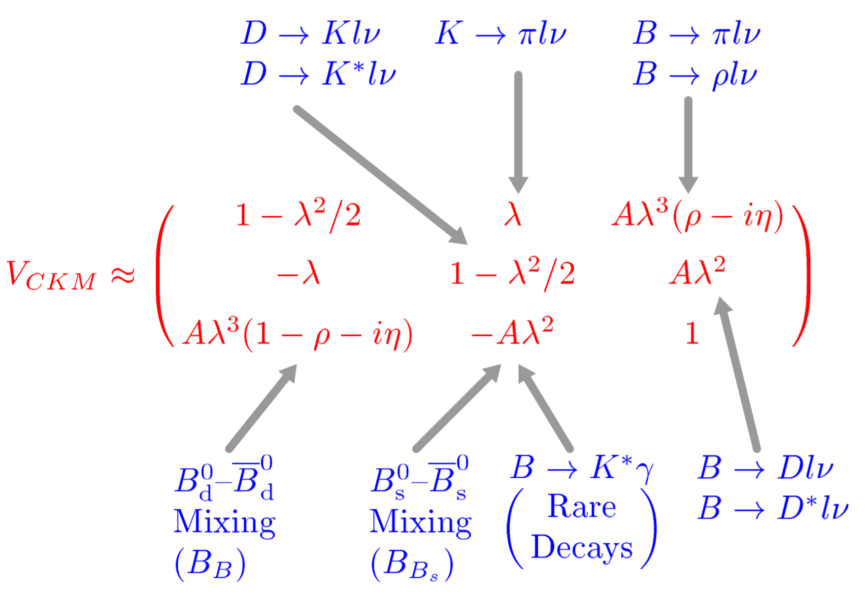
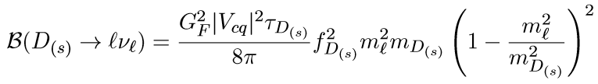
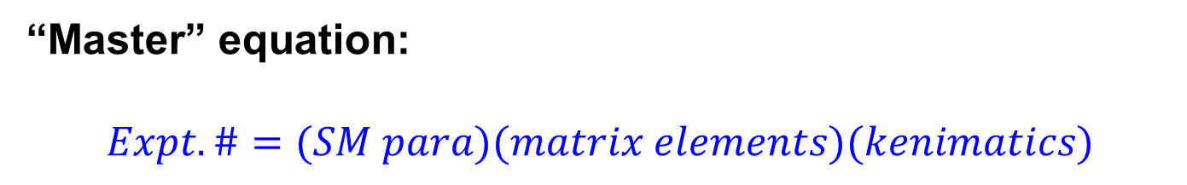
4. CKM matrix elements relevant
“Master” equation:
$$Expt.\#=(SM para)(matrix elements)(kenimatics)$$

Slide 22
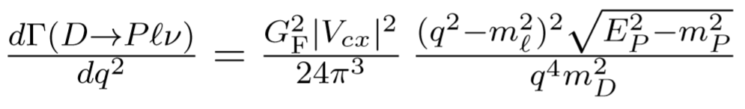
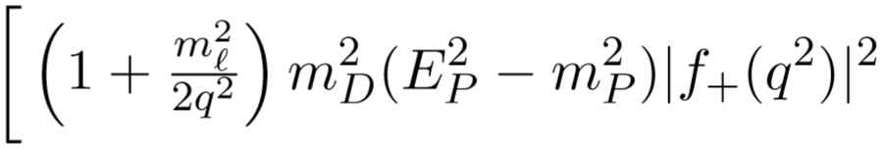
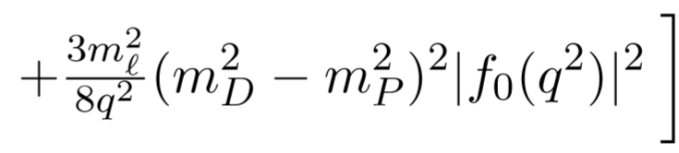
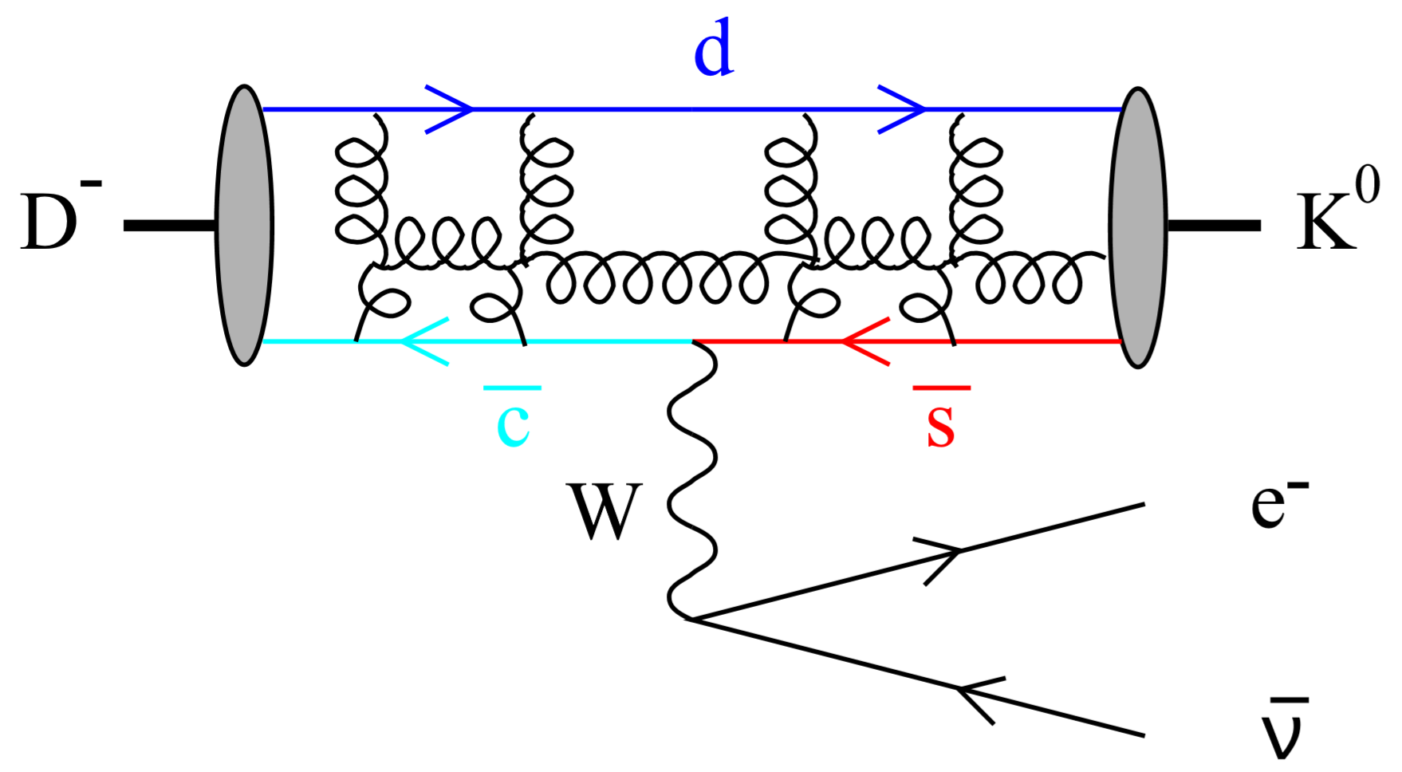
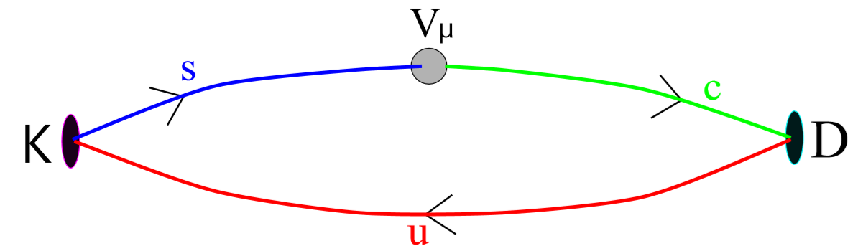

For example, $V_{cx}$ relevant processes $D→Plν$
On the lattice, one can calculate the three-point functions

Slide 23



Present CKM determination
Unitary triangle: $α+β+γ={180}^{∘}±7^{∘}$

Slide 24

III. Lattice HS in China
密切结合BEPCII/BESIII上相关物理进行格点QCD理论研究

Slide 25



1 Glueball relevant
Scalar mesons
Pseudoscalar glueball candidate
$η(1295)/η(1405)/η(1475)$???
If only two states, there is unnecessarily a glueball
candidate here.
Tensor glueball candidate ???
Previous $ξ\left(2230\right)$ observed by BES, but not confirmed by
BESII and BESIII

Slide 26

未来BESIII
新结果
胶球研究
格点QCD
QCD
唯象学

Slide 27



The production rates of glueballs in the J/psi radiative decays
Radiative decay width:
Transition amplitudes:
Multipole decomposition:
Decay width expressed in terms of the form factors
So the major task is to calculate the matrix elements, which can be
derived from the three-point functions

Slide 28



A). J/psi radiatively decaying to the scalar glueball
(L.Gui, et al. (CLQCD Collaboration), Phys. Rev. Lett. 110, 021601 (2013))
Interpolated on-shell form factor E1(0) and its continuum limit
The predicted width and the branch ratio

Slide 29
Lattice prediction:
Experimental results for J/psi radiatively decaying to scalars
C. Amsler et al. (Particle Data Group), Phy. Rev. D 86, 010001 (2012)
BESIII results (PRD87, 092009)
Using Br(f₀(1710)→ KK)=0.36 ⇒ Br(J/ψ→γf₀(1710))= 2.4×10⁻³
Br(f₀(1710)→ ππ)= 0.15 ⇒ Br(J/ψ→γf₀(1710))= 2.7×10⁻³
This result support f0(1710) as the candidate for the scalar glueball

Slide 30


Slide 31


B). J/psi radiatively decaying to the tensor glueball
(Y.B. Yang ,et al .(CLQCD Collaboration), Phys. Rev. Lett. 111, 091601 (2013))
The form factors we obtained from the
lattice QCD
We also carry out a similar lattice study on
the tensor glueball production rate in J/psi
radiative decay.

Slide 32





$$Γ(J/ψ→γG_{2^{+}})=1.01(22)keV \\ Γ(J/ψ→γG_{2^{+}})/Γ_{tot}=1.1(2)×10^{−2}$$
$$J/ψ→γX→γηη$$
BESIII, PRD87(2013)092009
$$Br(J/ψ→γf_{2}(2340)→γηη)\text{=}\left({5.60}_{−0.65−2.07}^{+0.62+2.37}\right)×10^{−5}$$
$$J/ψ→γX→γK_{s}K_{s}$$
BESIII, arXiv:1808.06946 (hep-ex)
$$Br(J/ψ→γf_{2}(2340)→γK_{s}K_{s})\text{ = }\left({5.54}_{−0.40−1.49}^{+0.34+3.82}\right)×10^{−5}$$
$$J/ψ→γX→γφφ$$
BESIII, PRD93(2016)112011
$$Br(J/ψ→γf_{2}(2340)→γφφ)\text{=}\left({1.91±0.14}_{−0.73}^{+0.72}\right)×10^{−4}$$
It is desirable to do a systematic analysis of decay modes
$$J/ψ→γVV$$

Slide 33



BESIII, PRD93(2016)112011
BESIII, PRL117(2016)042002
arXiv:1603.09653

Slide 34
BESIII new results for

Slide 35

BESIII new results for
(M. Ablikim et al. (BES Collaboration),
Phys. Rev. D 87, 092009 (2013) (arXiv:1301.0053)
In this analysis, the best fit favors the presence of f2(2340) with a mass
of 2362(30)MeV and a width of 334(60) MeV. No evident narrow peak around
2.2GeV over the broad bump is observed in the eta-eta mass specturm.

Slide 36





C. Pseudoscalar glueball relevant
The production rate of the pseudoscalar glueball in $J/ψ$ radiative decays
from LQCD
(L.-C. Gui, et al, Phys. Rev. D 100, 054511(2019))
$Br(J/ψ→γX(2395))$=2.3(7)$×{10}^{−4}$
The effective couplings are comparable for glueball and mesons.
The $U_{A}\left(1\right)$ anomaly may play an important role here.

Slide 37


Pseudoscalar glueball candidate ( $0^{−+}$)
BESIII new results for
$$J/ψ→γφφ$$
BESIII, PRL117(2016)042002
arXiv:1603.09653
BESIII, PRD93(2016)112011

Slide 38







Lattice QCD result:
$Br(J/ψ→γG_{ps})$=6.8(2.3)$×{10}^{−5}$
$Br(J/ψ→γX(2370))$=1.5(5)$×{10}^{−4}$
$$J/ψ→γX(2370)→γK^{+}K^{−}η′$$
$$\left(1.86±0.39±0.29\right)×10^{−5}$$
$$J/ψ→γX(2370)→γK_{S}^{0}K_{S}^{0}η′$$
$$\left(1.19±0.37±0.18\right)×10^{−5}$$
V. Prasad (for BESIII) , arXiv:1810.00180 (hep-ex)

Slide 39


2. XYZ particles on the lattice
A. Zc States
Zc(3900) : first observed as a structure in $J/ψπ^{+}$ invariant mass
spectrum, its “mass” is close to the $D\overline{D^{∗}}$ threshold
Zc(4025) : first observed as a structure in $h_{c}π^{+}$ invariant mass spectrum,
its “mass” is close to the $D^{∗}\overline{D^{∗}}$ threshold.
Lattice studies from three aspects:
a. $D\overline{D}$ scattering (Y. Chen et al., PRD89(2014)094506, PRD92(2015)054507 )
b. Spectroscopy study (S. Prelovsek et al., PRD91(2015)014504)
c. Potential matrix and scattering amplitudes
(Y. Ikeda et al (HAL Collab.), PRL117(2016) 242001)
Notes:
054

Slide 40



a. Scattering:
Calculation procedure:
i) The masses of D mesons
ii) The energies of DD*bar system
iii) Define the scattering momenta of D mesons in the
DD*bar system
iv) Use the Leuscher formular to get the scattering phase shift
v) For near threshold scattering, one can use the effective range
expansion to parameterize the phase shift versus q.

Slide 41




In the J^P=1^+ channel, the scattering lengths are negative, indicating a weak repulsive interaction between D(D*) and D*bar. These results does not support a bound state in this channel. However, since the pion mass is still much higher than the physical pion mass, we cannot rule out the possible appearance of a bound state. A more systematic lattice study is demanding.

Slide 42



B. Y(4260) relevant study from quenched lattice QCD
CLEO-III,PRD74,
091104(R)(2006)
BaBar,PRL95,142001(05)
Belle,PRL99,182004(07)
1. Observed in the initial state radiation process
2. The resonance parameter (PDG2012)
3. The leptonic decay width

Slide 43


A. 1– hybrid-like interpolation field operator
Y. Chen, W. Chiu et al., Chin. Phys. C40, 081002 (2016)
Nonrelativistic decomposition
c-cbar spin singlet
c-cbar spin triplet

Slide 44
B. Spatially extended interpolation field operator for
the vector charmonium-like state
In the Coulomb gauge,
This is equivalent to giave a c-cbar center of mass motion, which describes the recoil of the c-cbar
against additional degrees of freedom.
Intuitively, the coupling of this kind of operators to conventional
vector charmonia can be suppressed from two aspects:
a) spin states of the c-cbar (spin flipping is suppressed by the
heavy quark mass.
b) center-of-mass motion ( to the leading order of NR, there is
no cneter-of-mass motions for conventional charmonia.)

Slide 45

This kind of operator does couple strongly to a state with mass
near 4.3 GeV, as seen in the effective mass plateau

Slide 46
IV) The leptonic decay width of the exotic vector charnomium
The leptonic decay width of this exotic vector chamonium
is an important quantity, which can shed light on the
nature of Y(4260).
2. The leptonic decay constant of the exotic state can be
calculated directly in lattice QCD.
The decay constant of a vector meson is defined as
where the matrix element on the left can be derived
by calculate the two point function

Slide 47

Using the formula
One can predict
“Halo charmonium”:
A relatively localized kernal of color octet ccbar surrounded by a
gluonic cloud.
The glounic cloud can be easily hadronized into light hadrons
by emitting or absorbing a soft gluon.
Consequently halo charmonium has large branching ratios to
decay into a conventional charmoium by emitting light hadrons.

Slide 48




$$e^{+}e^{−}→J/ψπ^{+}π^{−}$$
BESIII, PRL118(2017)092001 [arXiv: 1611.01317(hep-ex)]

Slide 49











$$e^{+}e^{−}→h_{c}π^{+}π^{−}$$
BESIII, PRL118(2017)092002
arXiv: 1610.07044(hep-ex)
$$e^{+}e^{−}→χ_{c0}ω$$

Slide 50




mode: relative S-wave between $J/ψ$ and
mode: relative S-wave between and
mode: relative P-wave between $h_{c}$ and
The $c\overline{c}$ in the halo charmonium is spin singlet (S=0),
$J/ψπ^{+}π^{−}$ mode: $J/ψ$ (S=1), spin flipping, $m_{c}$ suppressed,
no refugal barrier
$χ_{c0}ω$ mode: $χ_{c0}$ (S=1), spin flipping, $m_{c}$ suppressed,
no refugal barrier
$h_{c}π^{+}π^{−}$ mode: $h_{c}$ (S=0), no spin flipping,
but suppressed by the refugal barrier .
In this picture, it is understandable that the above three
modes have similar cross section at $\sqrt{s}∼4.22 GeV$

Slide 51
IV. 小结
格点强子谱学研究内容很广泛；
基态强子性质可以高精度计算；
简单的强子共振态能够通过格点上的强子-强子
散射来研究；
衰变性质复杂的强子的格点研究还有挑战；
中国的格点谱学研究一直并将继续结合国内的
重要物理实验 （BESIII, EicC, STCF 等）开展。

Slide 52
Thanks!

