Slide 1
Master Integrals for Higher Order QCD Corrections to Heavy-Quarks Production and Decay
Based on
JHEP 1802 066
Phys.Lett. B786 453
Phys.Lett. B792 50
Long-Bin Chen(陈龙斌)
2019.12.01

Slide 2
Heavy quark (Top quark)
1. The heaviest particle in standard model
2. Suitable for QCD perturbative calculations
3. Huge samples of top quarks at the LHC
4. Study of CKM matrix element
5. Search for new physics beyond standard model
………………………….

Slide 3
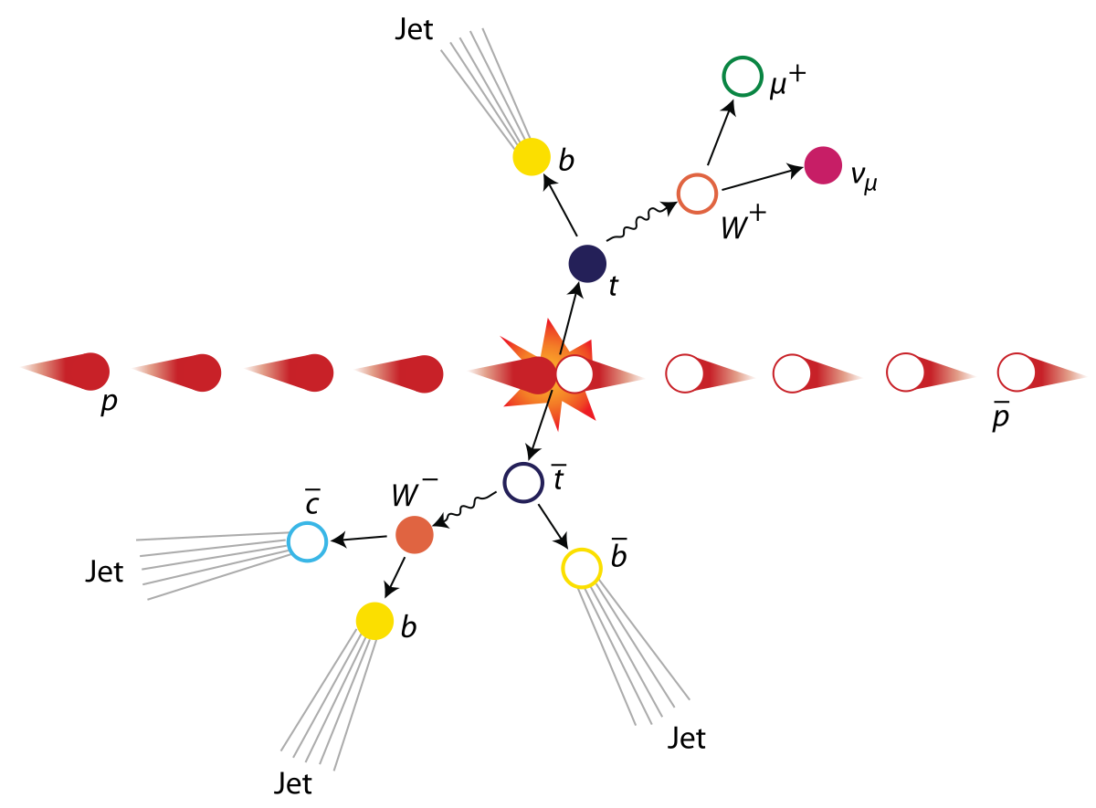
Top pairs production at hadron colliders

Slide 4

The need for higher order QCD corrections
QED $α\sim O\left(0.01\right)$
QCD $α_{s}\sim O(0.1)$ ($μ≫∧_{QCD}$)
QED are more convergence
in perturbation expansion than QCD
For higher order corrections, the most difficult part is the calculation of loop-integrals.

Slide 5
1. Two-loop master integrals for heavy-to-light form factors of two different massive fermions
Massive quark decays to massive quark

Slide 6
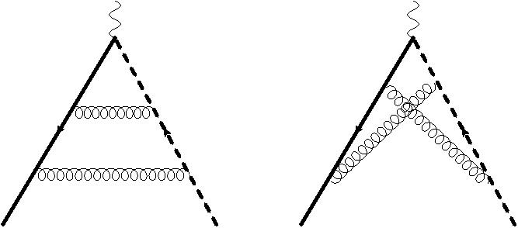
Sample of Two-loop Feynman diagrams

Slide 7
Tensor integrals are reduced by IBP (integrate-by-parts) method.
40 Master Integrals
Solid: Heavy; Dash solid: Light;
Thick: massless.

Slide 8
Three scales: s,m1,m2

Slide 9
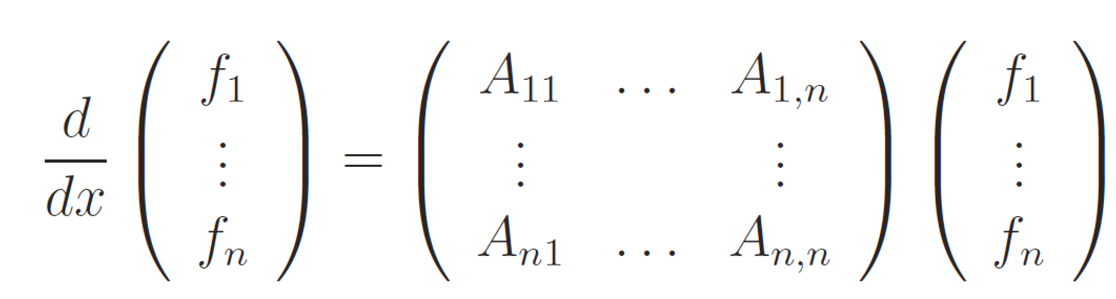
Method: Differential Equations (DE)
x are Lorentz invariant kinematics

Slide 10
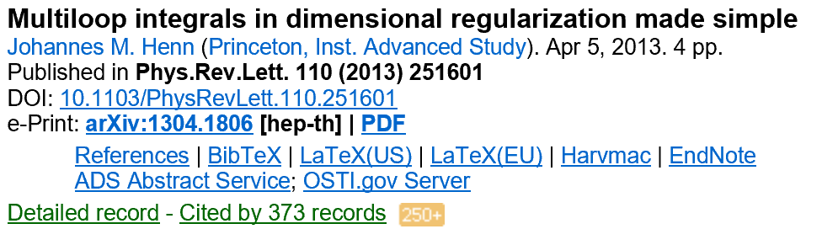
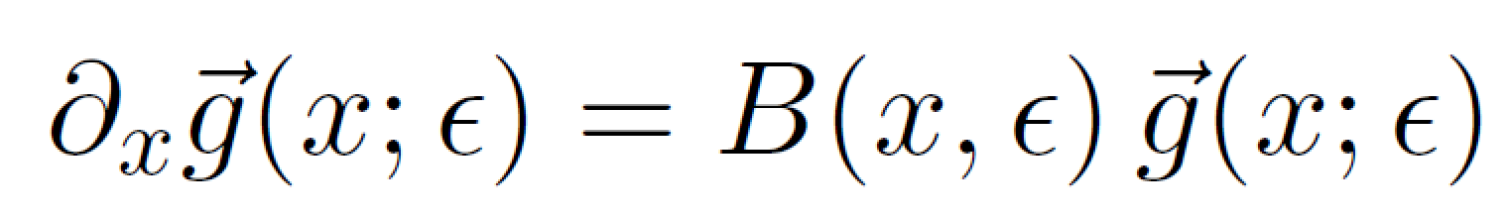
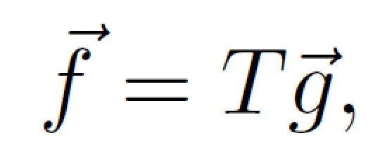
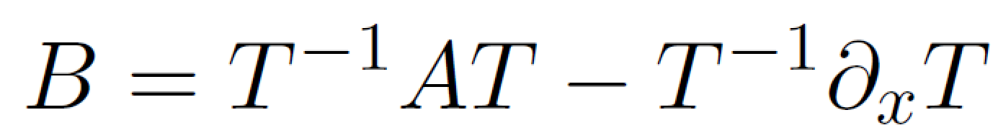

A suitable choice of basis (canonical basis)
arXiv:1304.1806
New Strategy
d=4-2$∈$

Slide 11
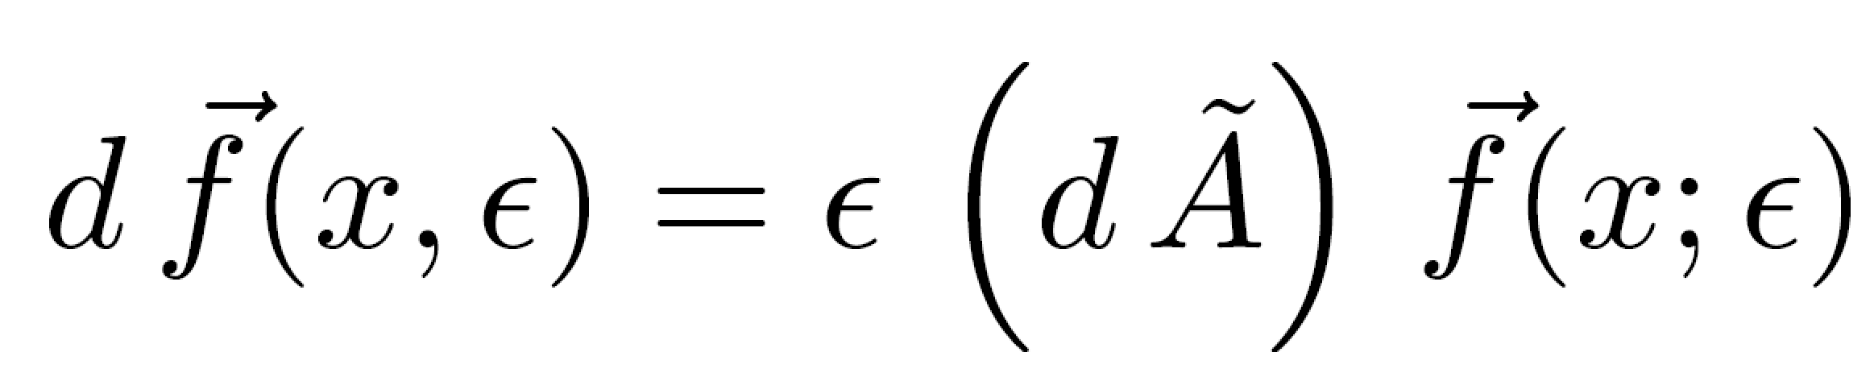

Slide 12
Canonical Basis

Slide 13
Differential Equations In Canonical Form:
A_i are rational matrices

Slide 14
Determination of Boundary Conditions

Slide 15
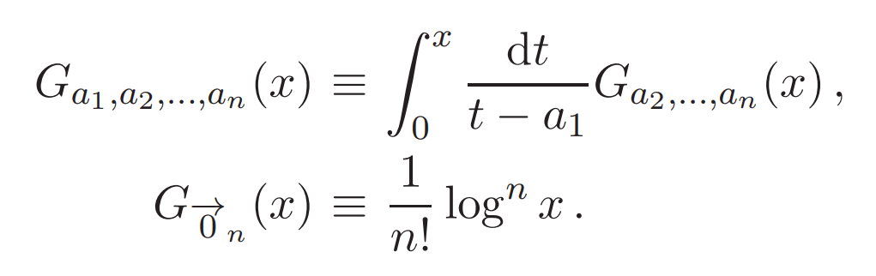
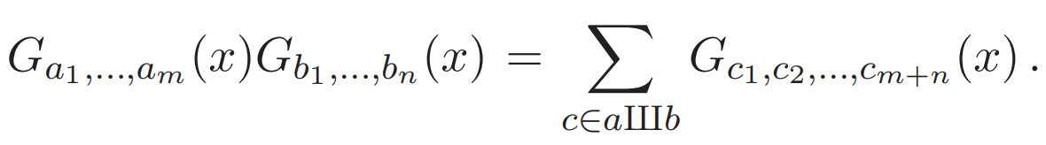
Goncharov Polylogarithms
GINAC

Slide 16
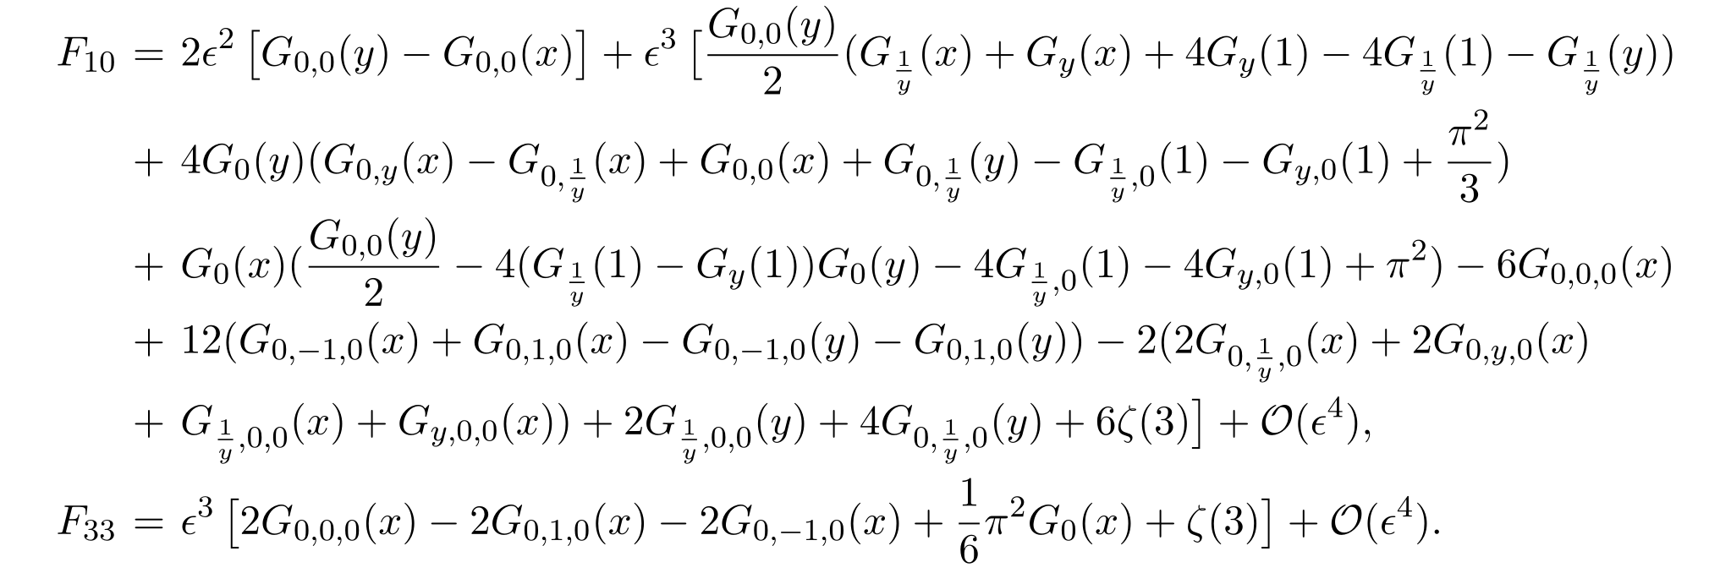
Results:
Goncharov Polylogarithms
Check:

Slide 17
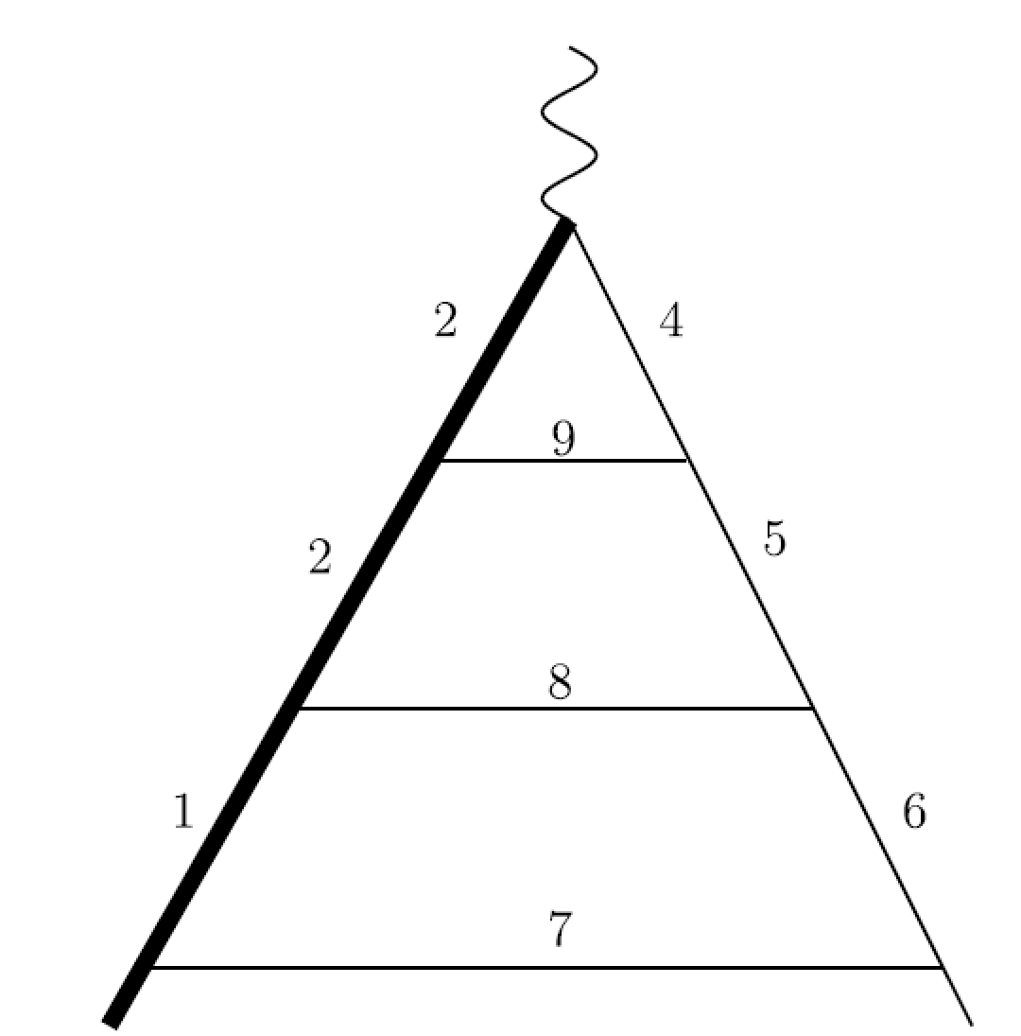
2. Three-Loop Heavy-to-light Form factors
W
t
b

Slide 18
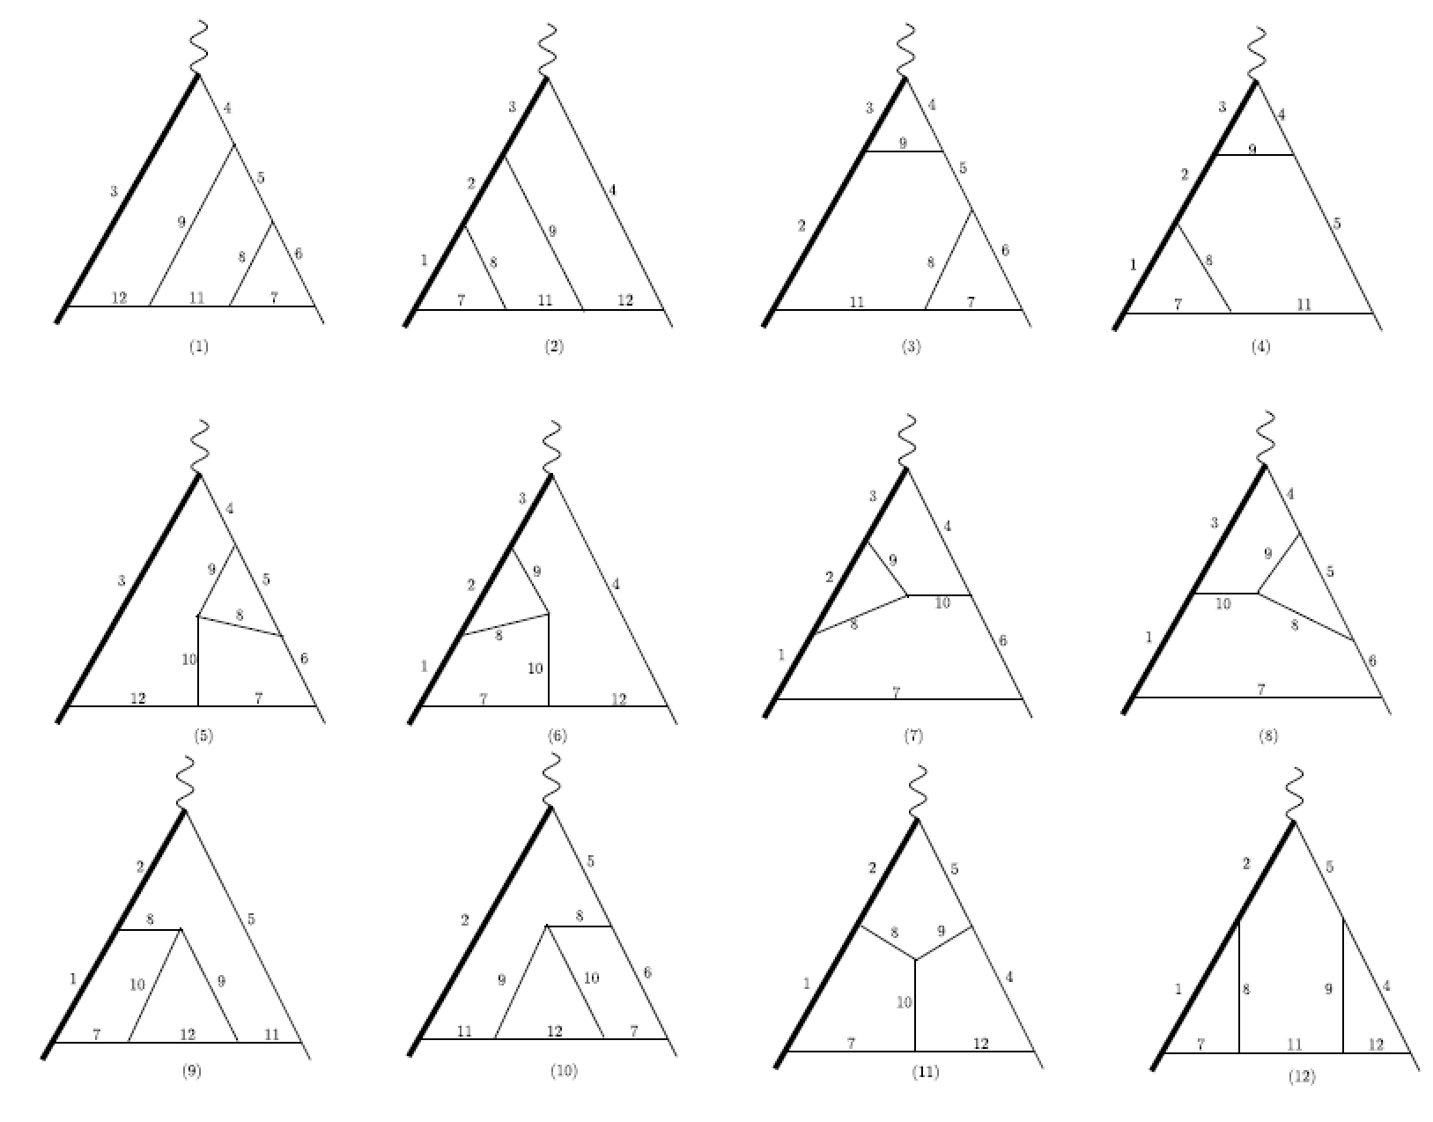
Color-planar diagrams
（Leading Color Contribution）

Slide 19
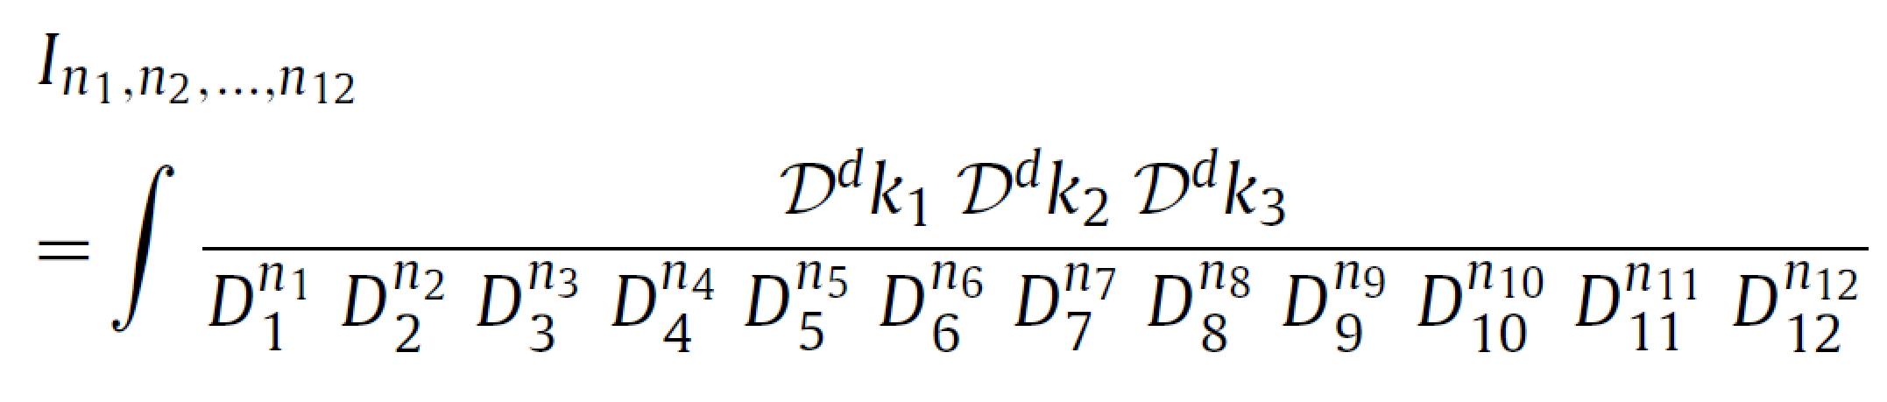
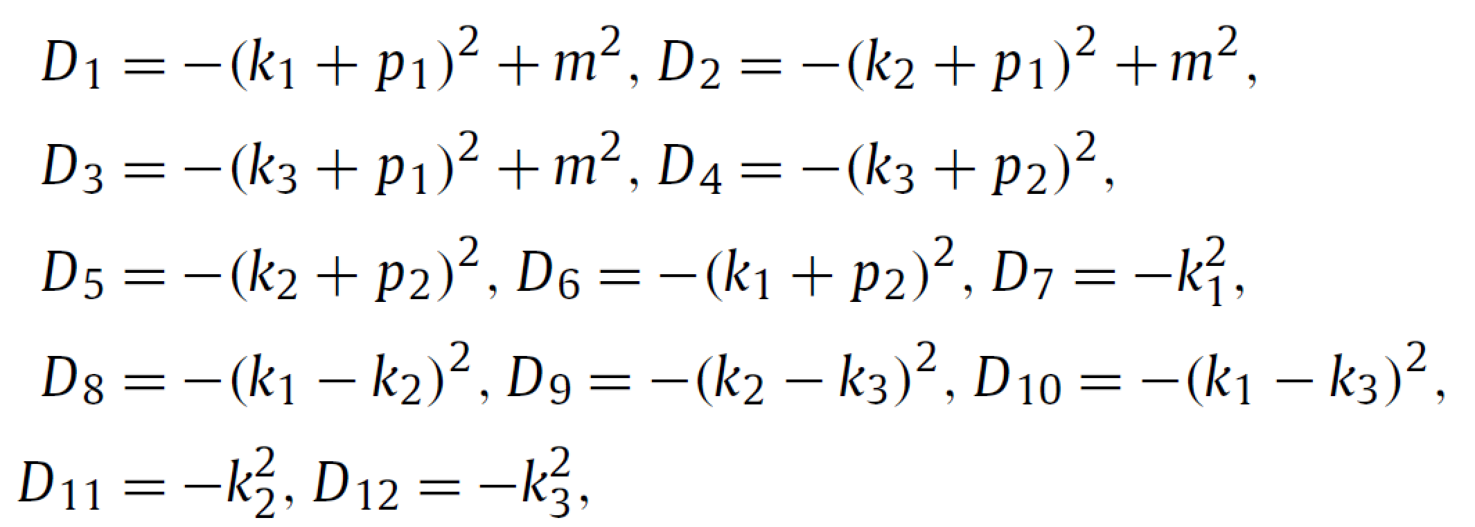

Integrals can be parameterized by
d=4-2$∈$
All integrals can be reduced to 71 Master Integrals

Slide 20
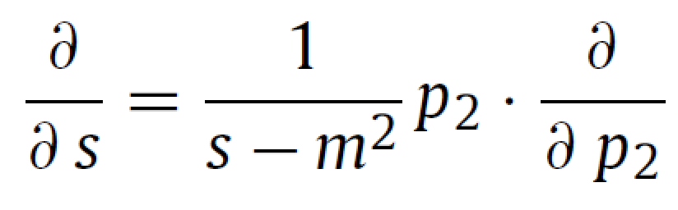
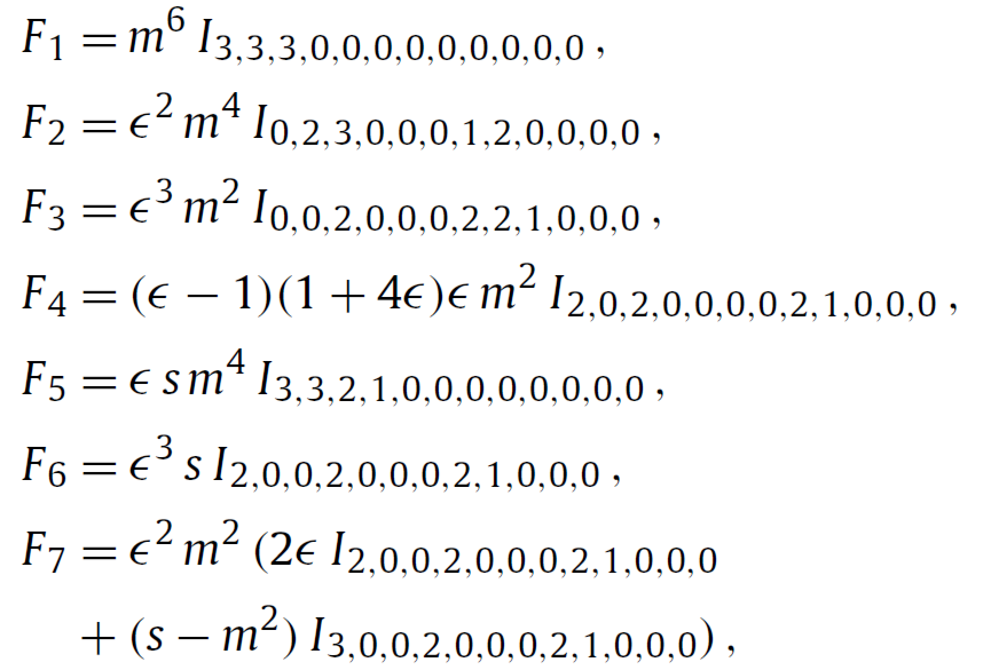
Canonical Basis:
………………………………………………………………

Slide 21
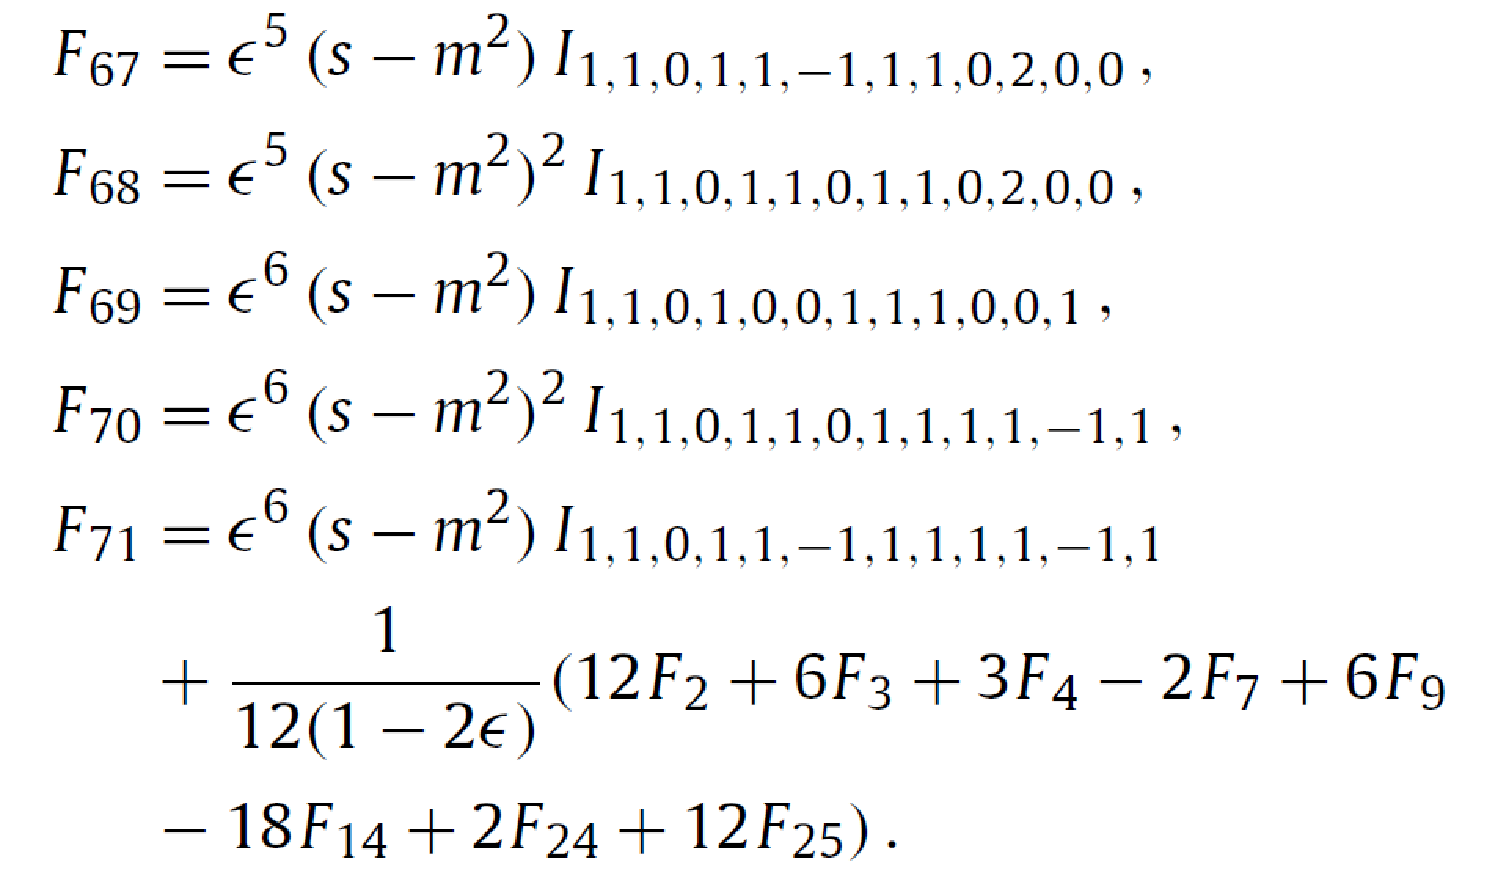

Slide 22
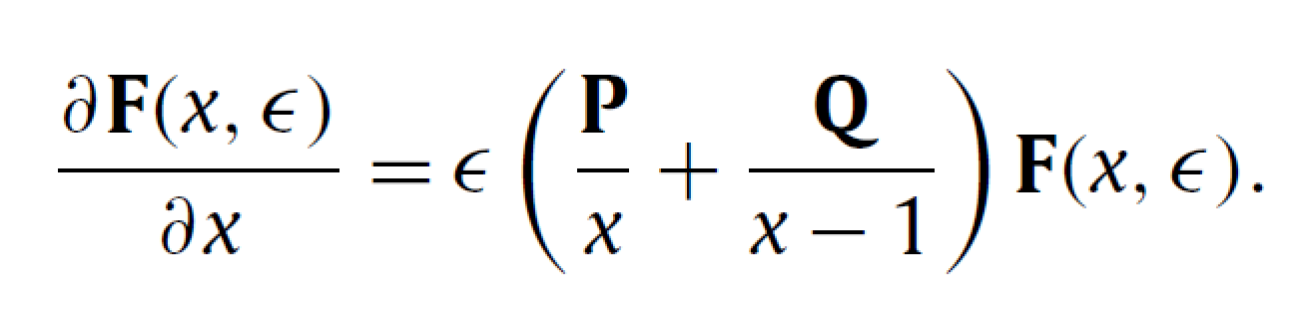
P and Q are 71*71 rational matrices

Slide 23
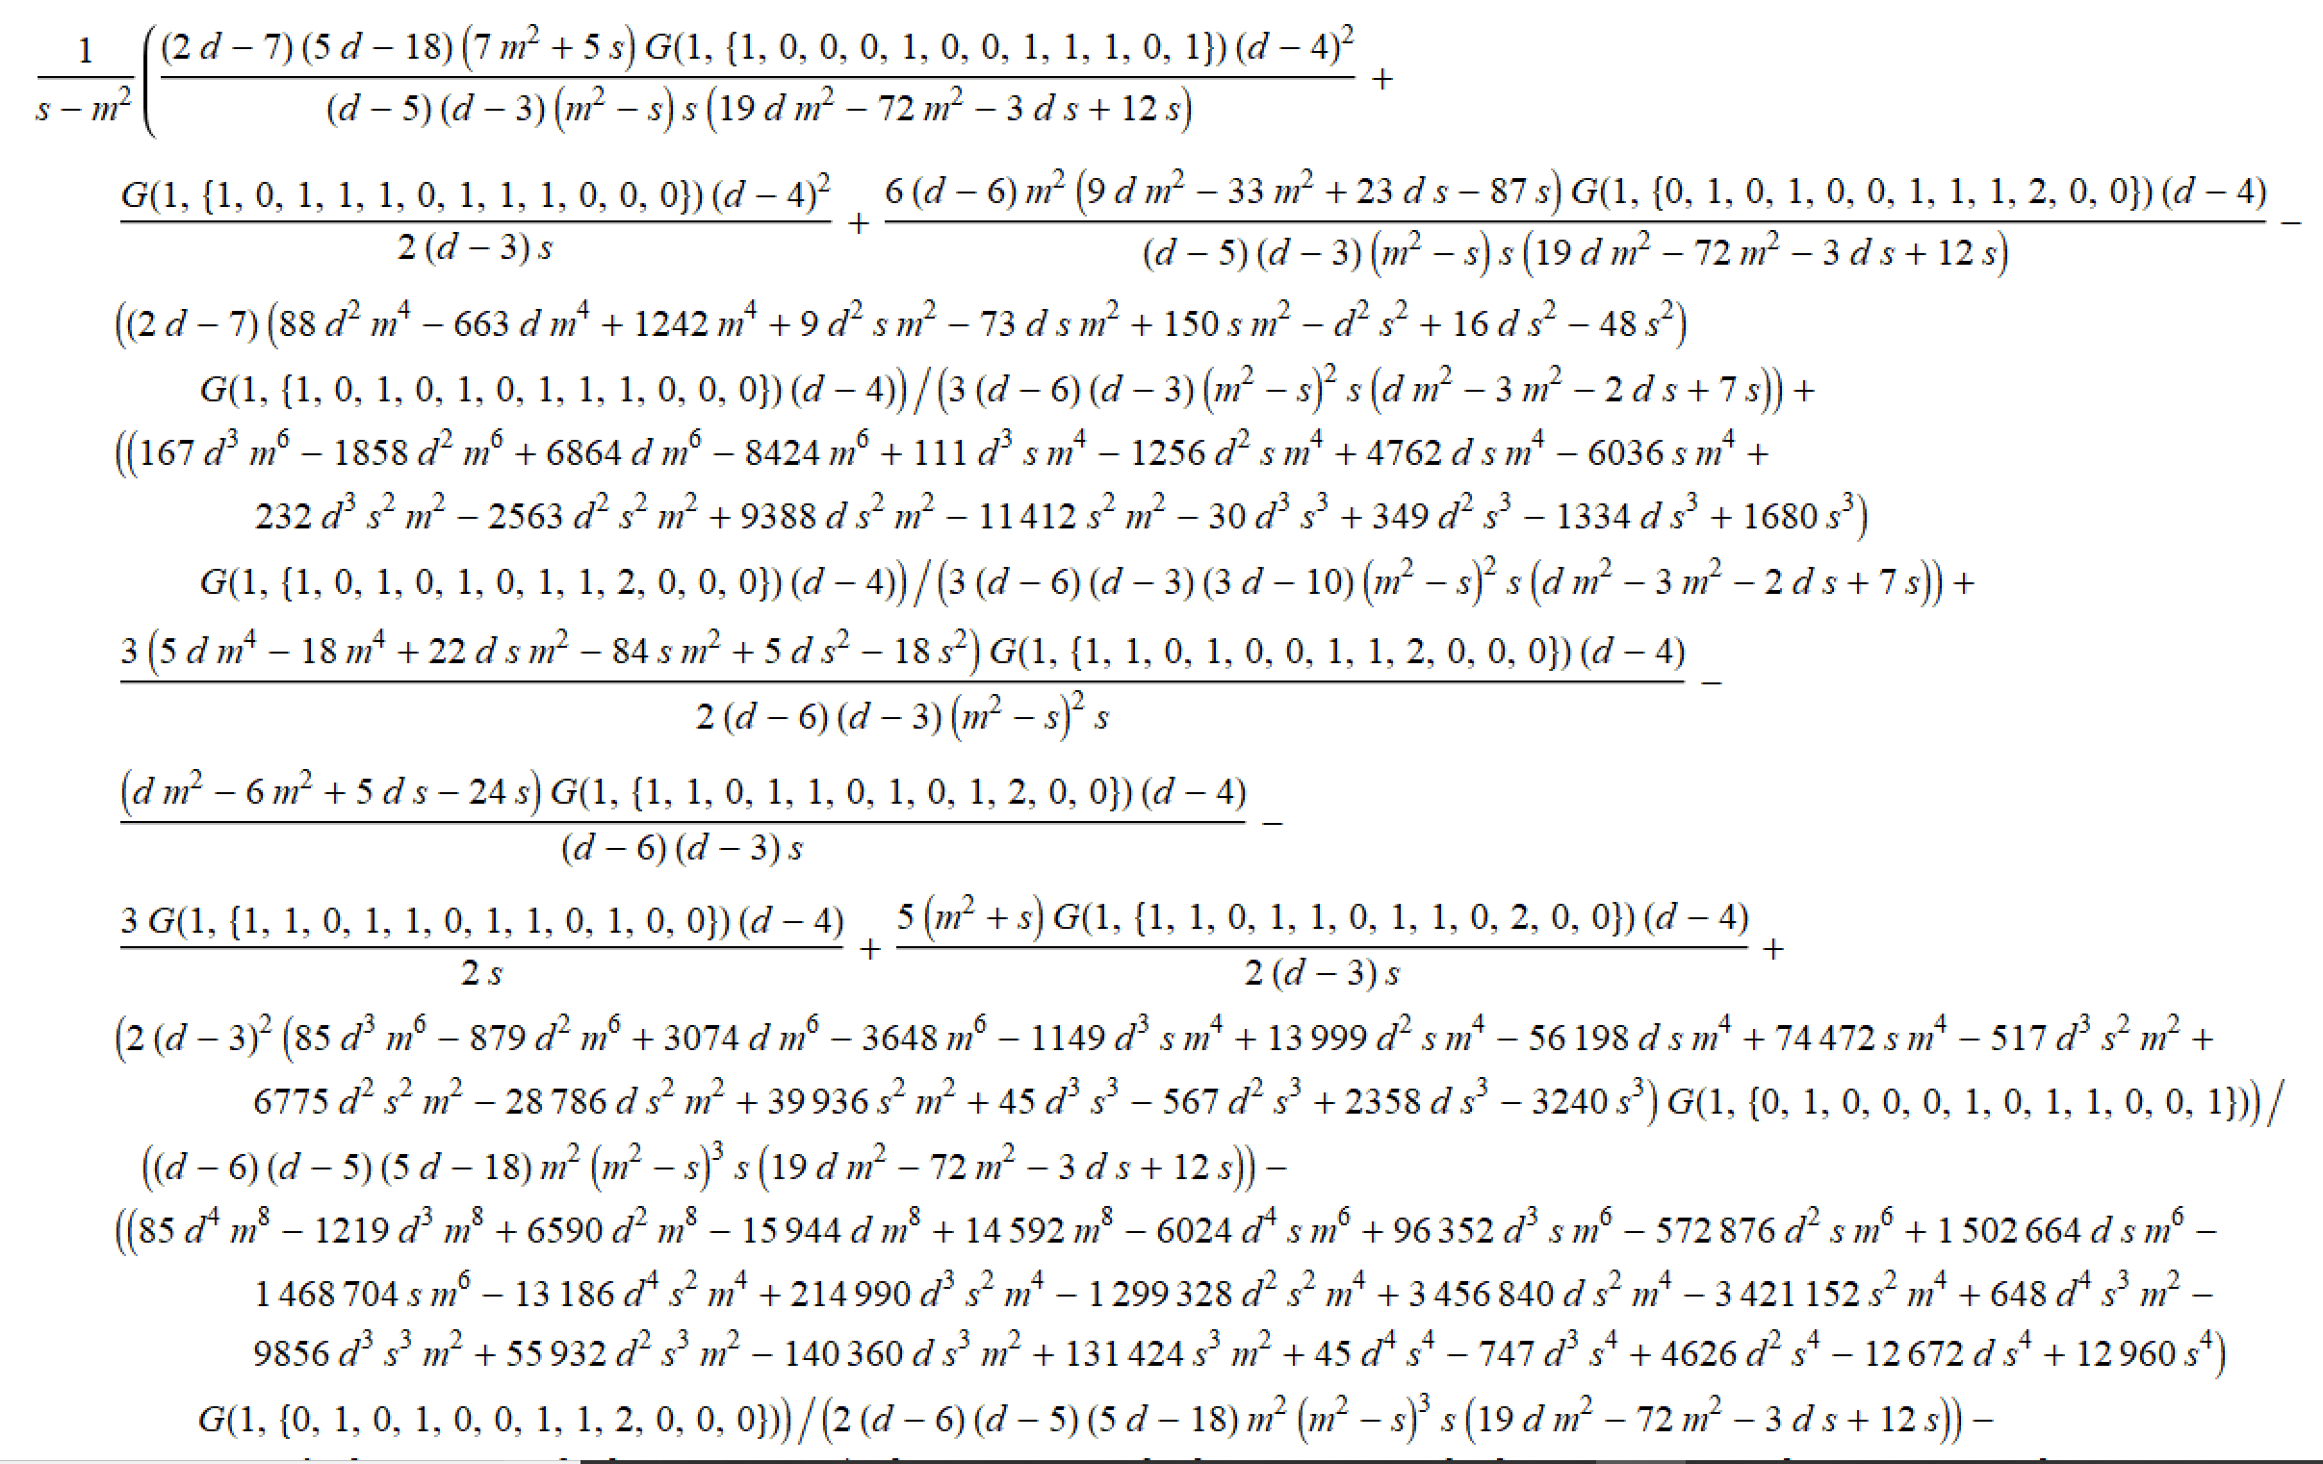
DE for non-canonical basis

Slide 24
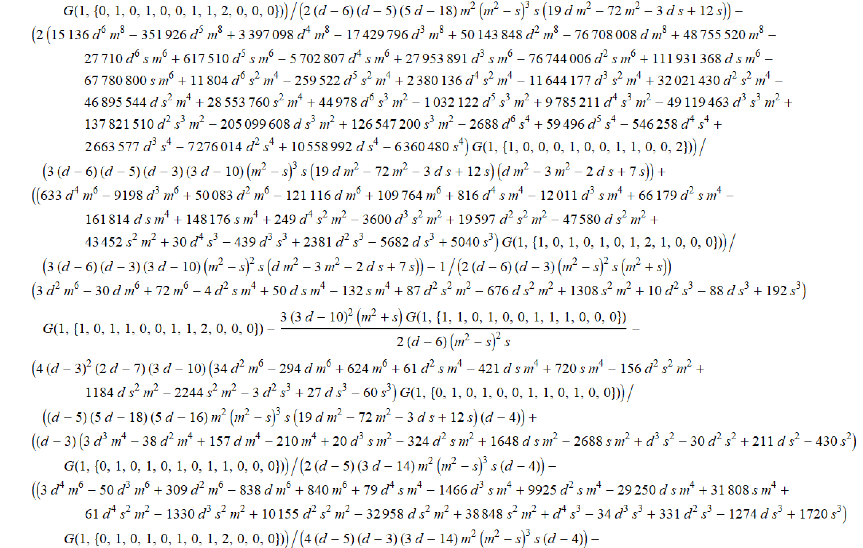

Slide 25
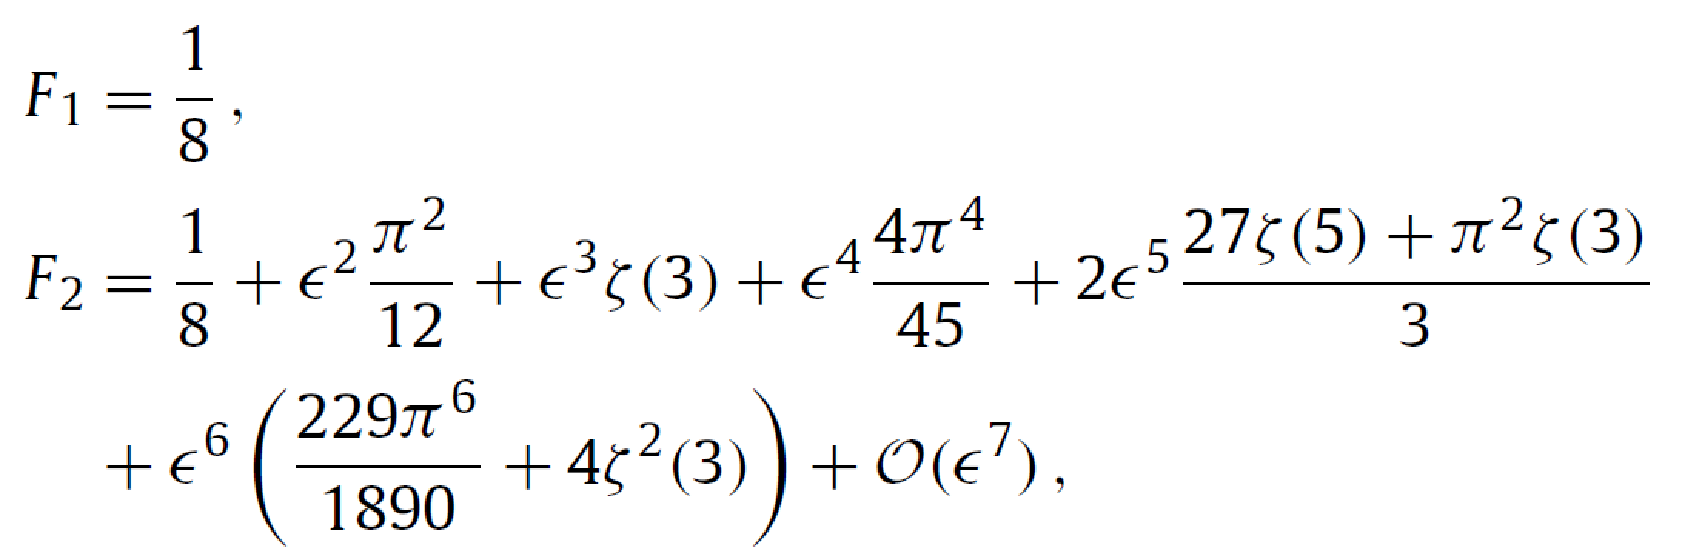

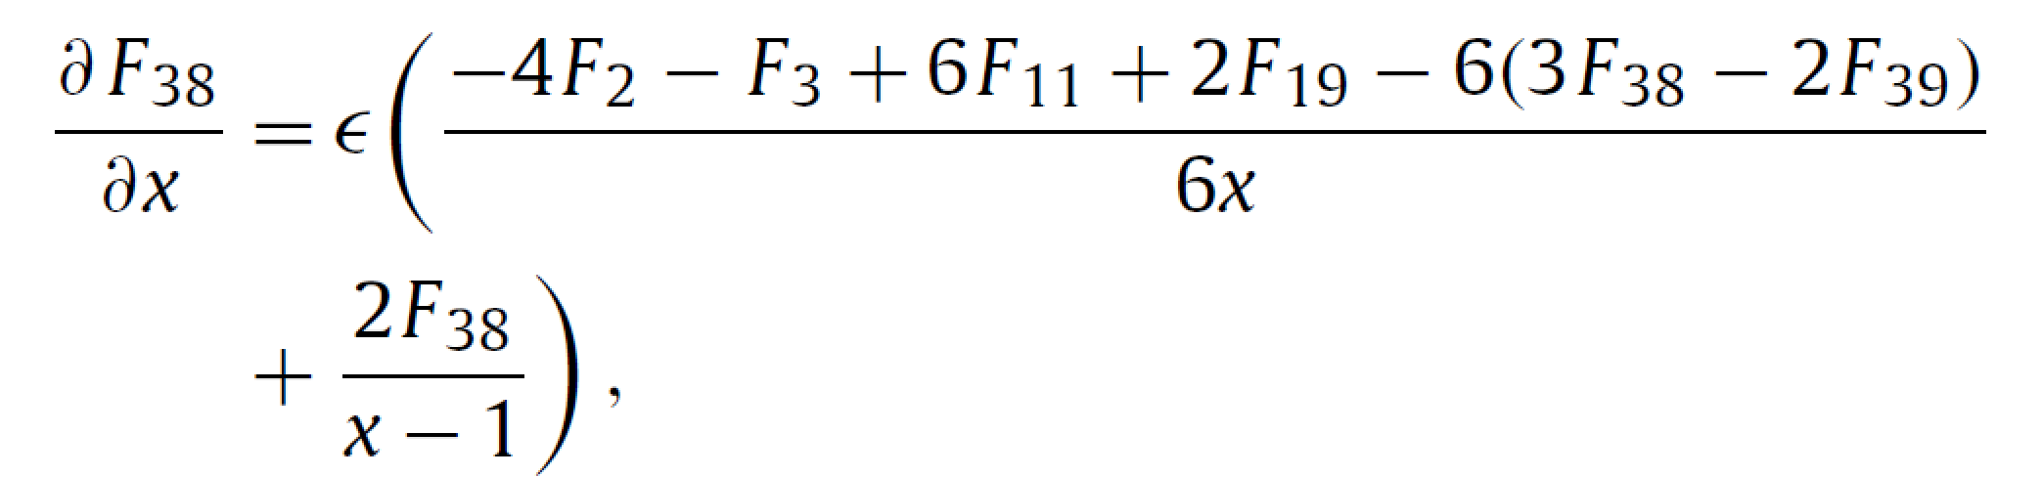
Boundary Conditions
Known
Regular at x=0

Slide 26
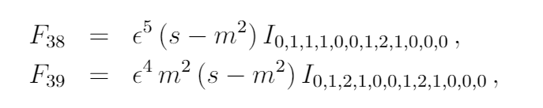
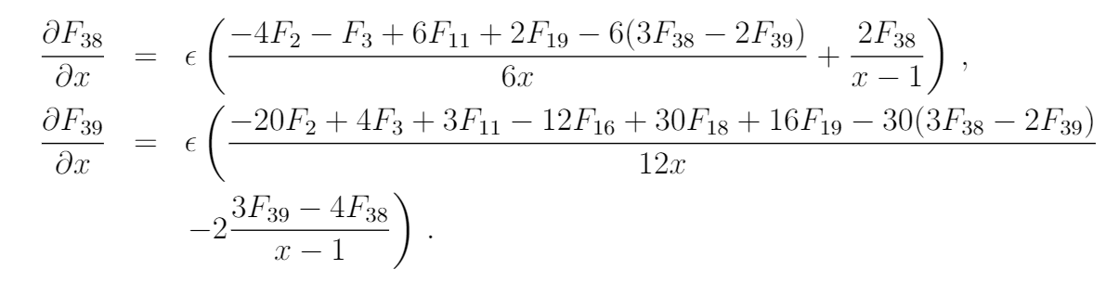
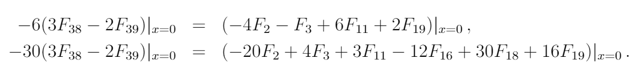

Slide 27
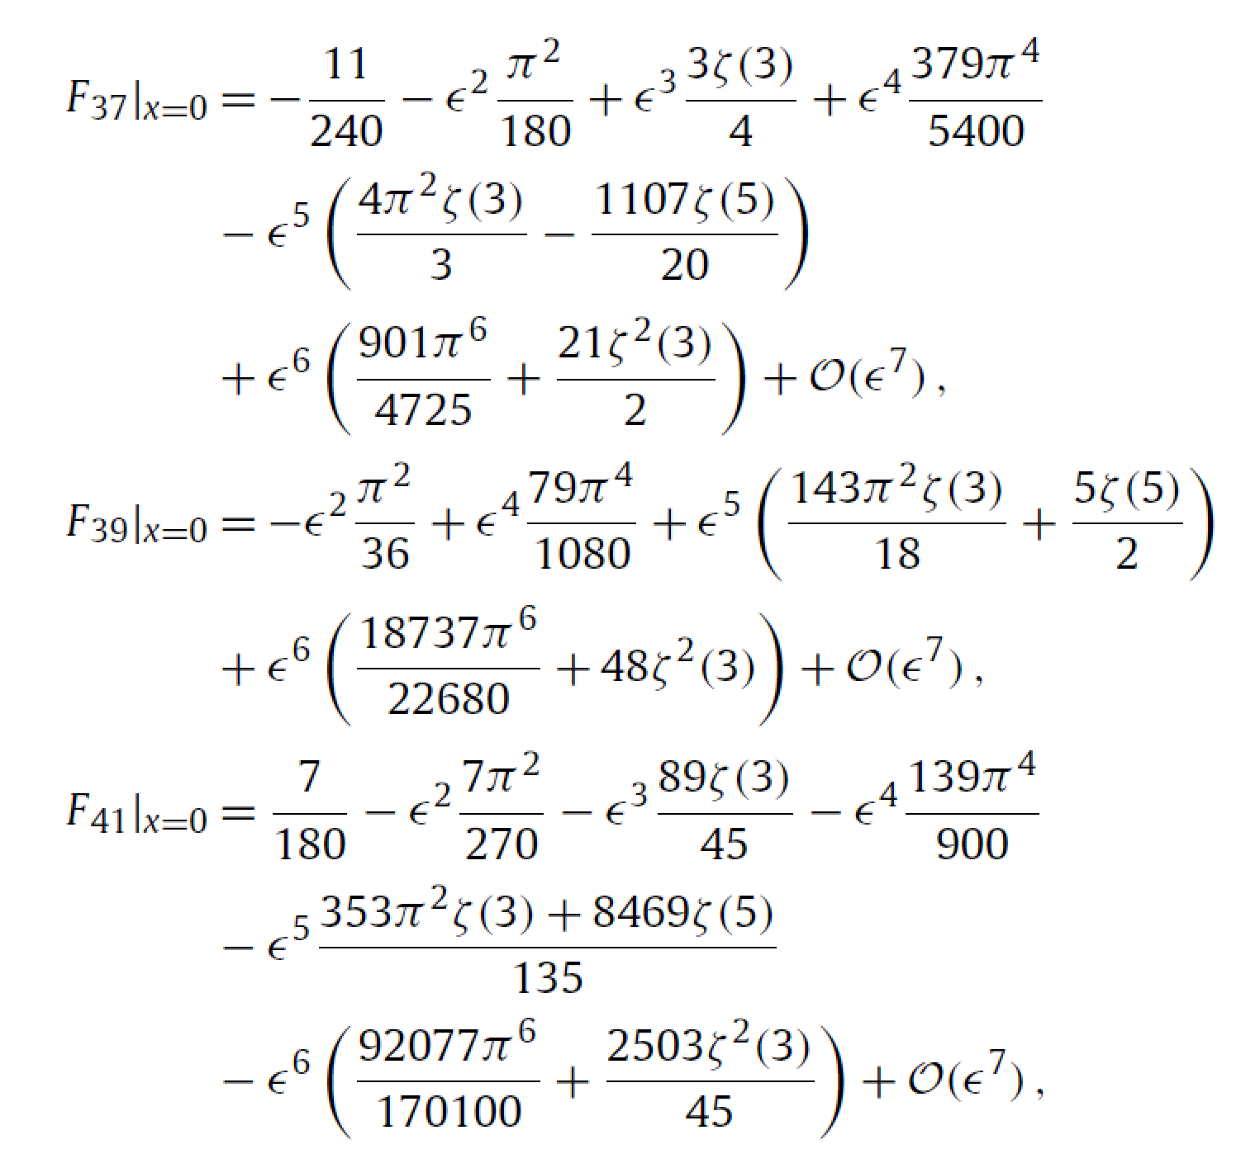
Results of Boundary conditions are expressed in terms of zeta functions.

Slide 28
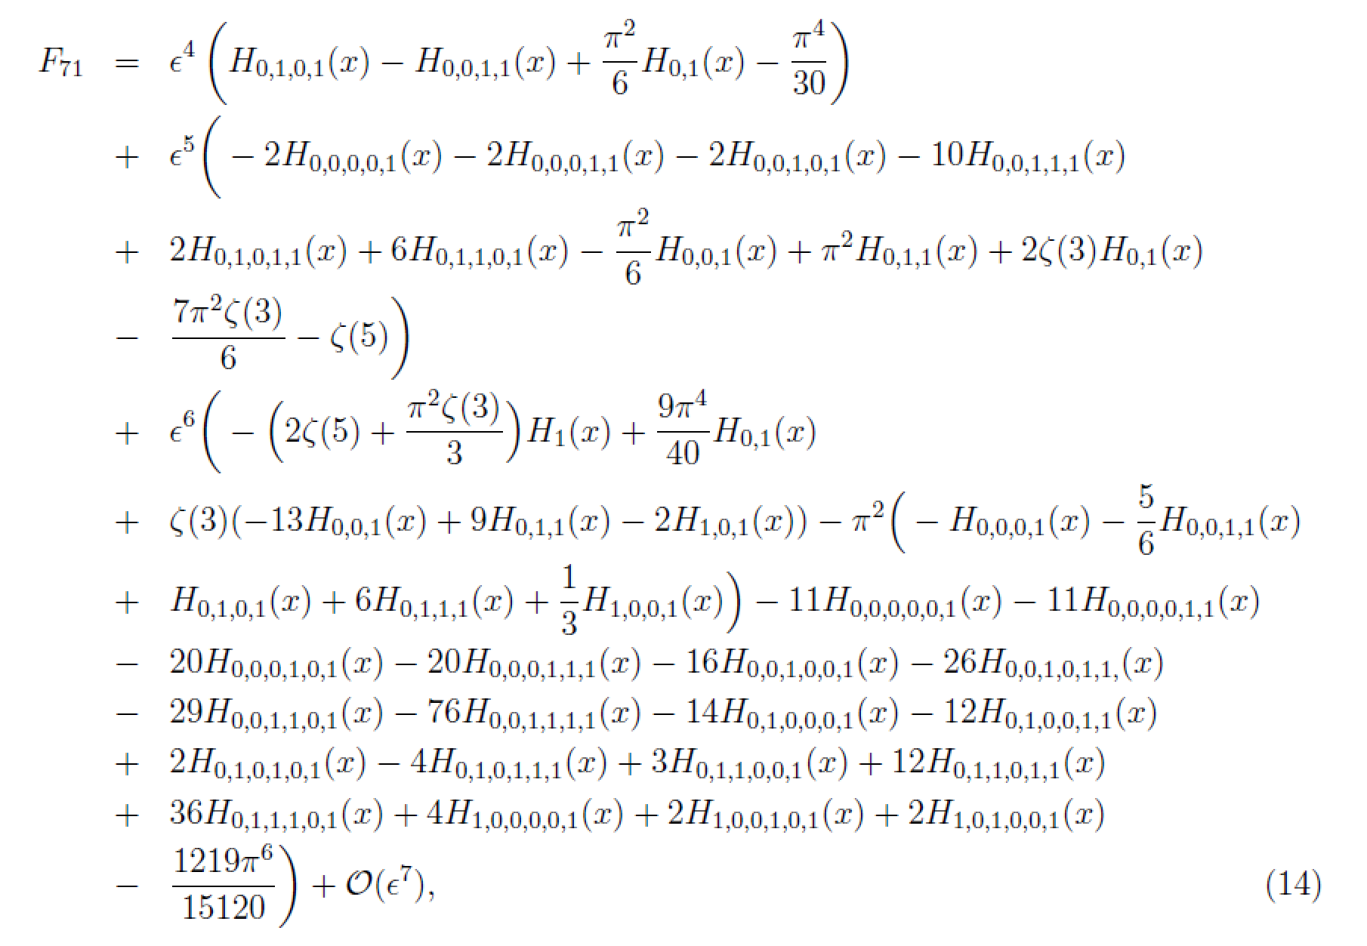
H are Harmonic Polylogarithms

Slide 29
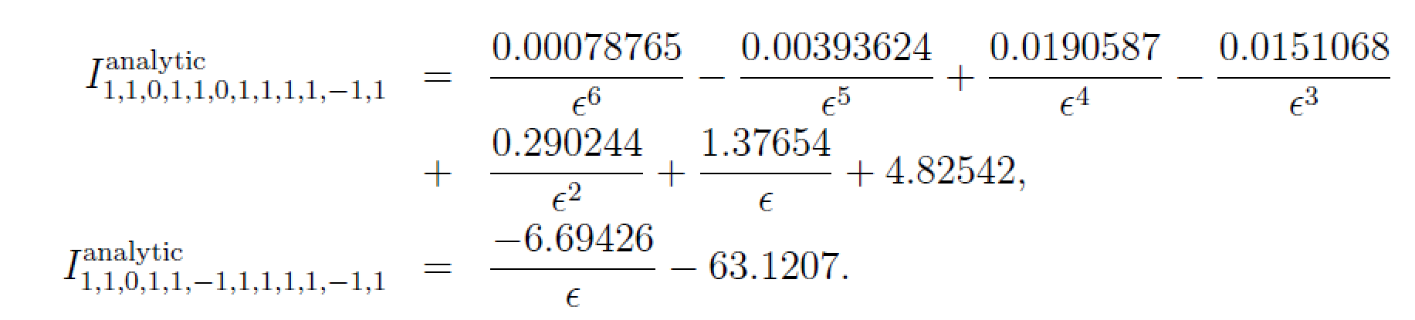
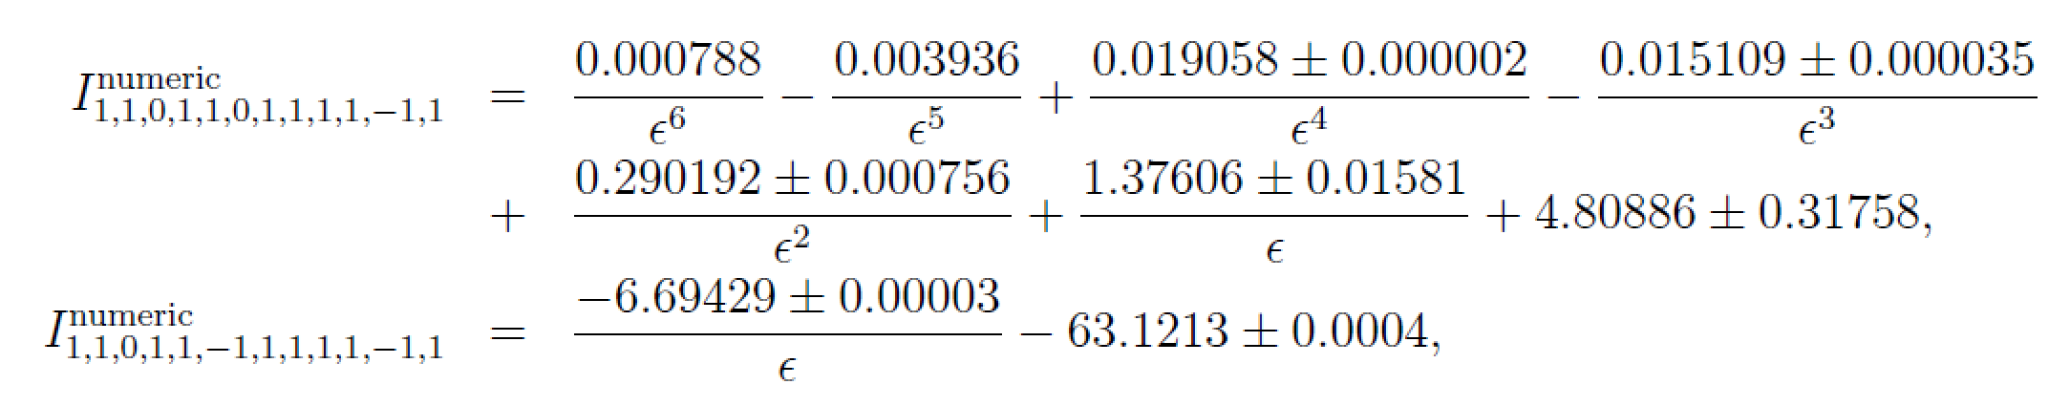
Check:（s=-1.3,m=1.0）
FIESTA packages

Slide 30
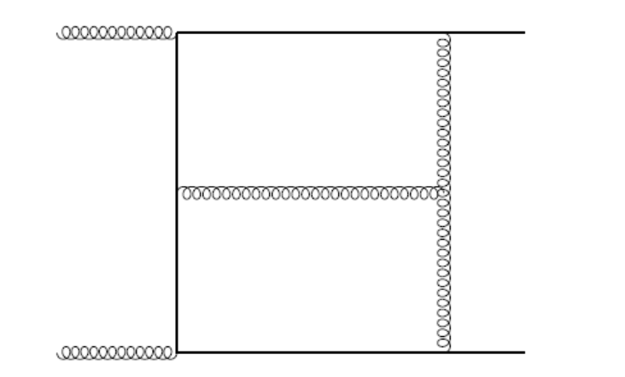
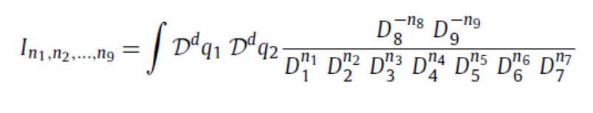
3. Master integrals of a planar double-box family for top-quark pair production
Planar master integrals for top quark pairs hardron productions

Slide 31
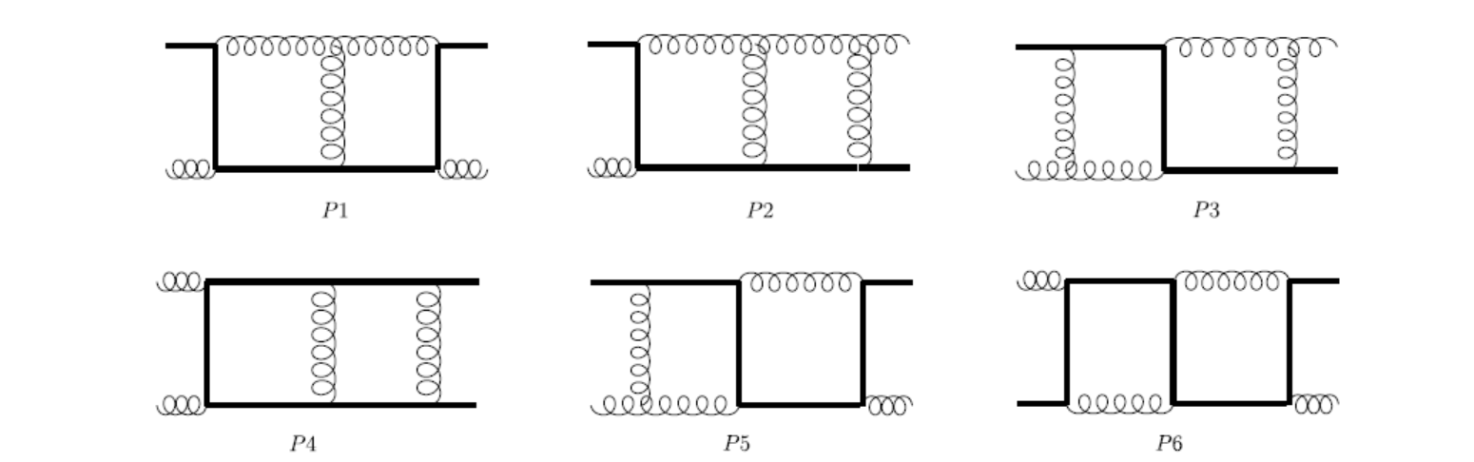
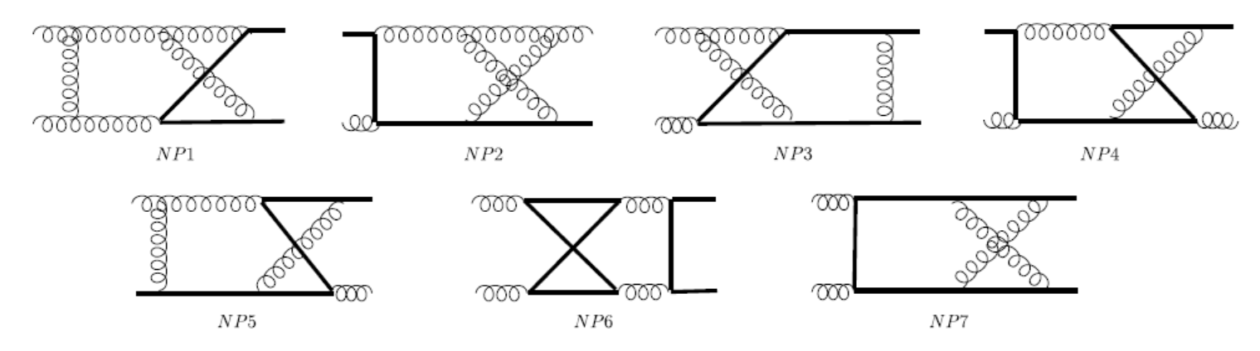
Two-loop Master integrals whose analytic results are unknown (gg->t tbar)
Planar
Non-Planar

Slide 32
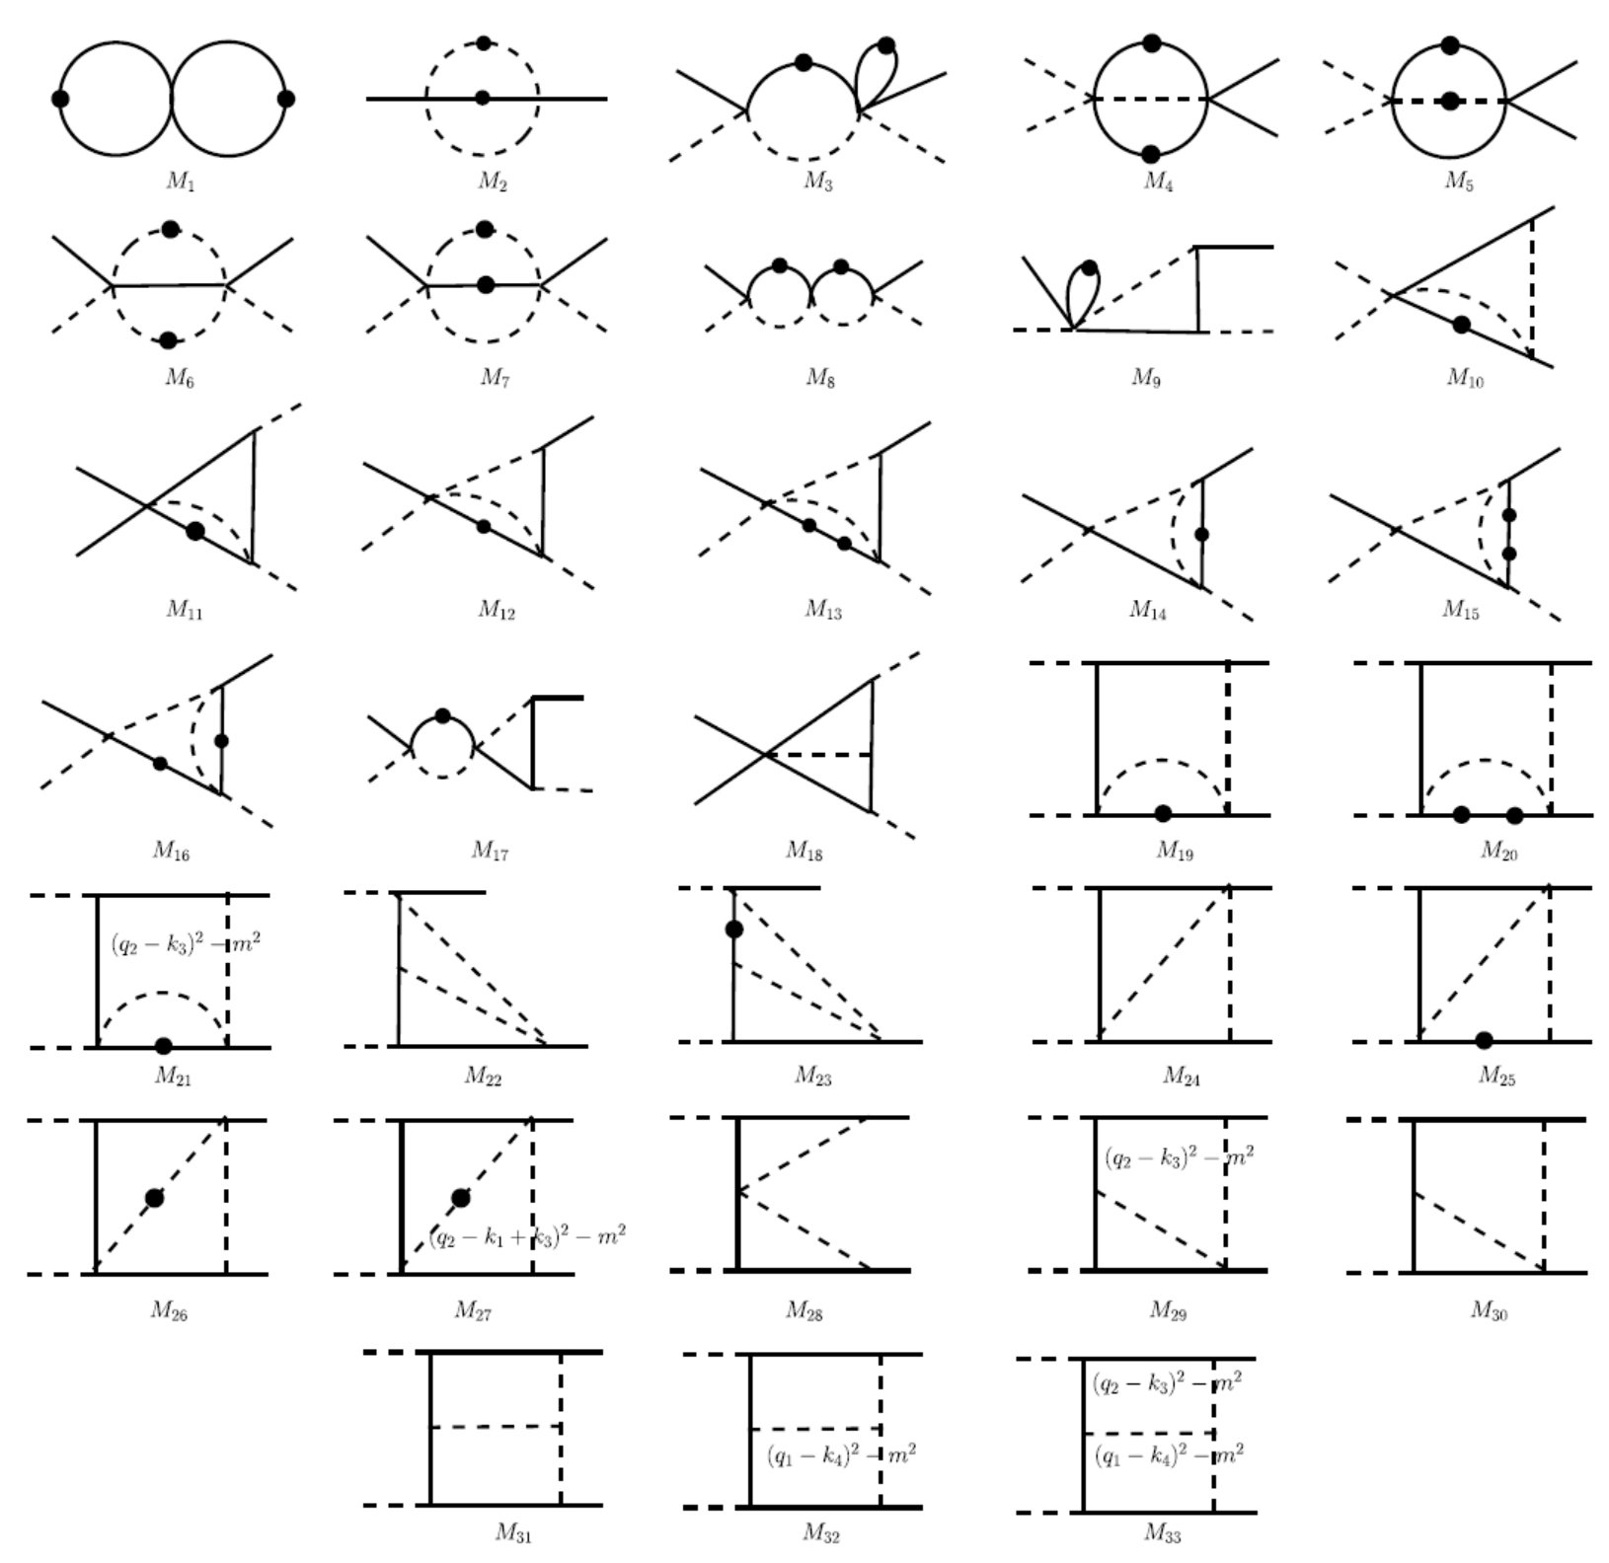


Slide 33
Thanks!

