Slide 1
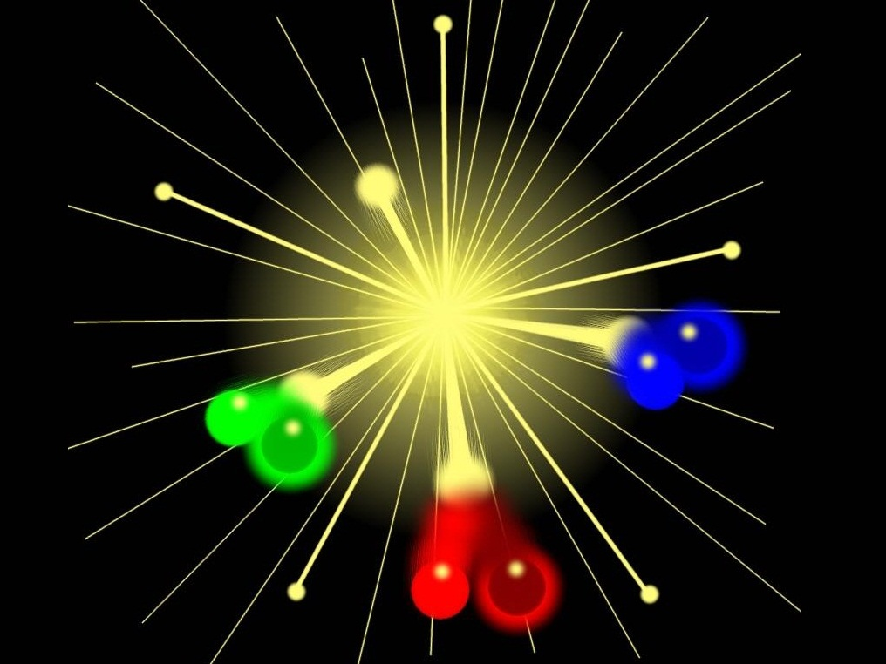

Matter-antimatter asymmetry generation due to time-varying background field
Seishi Enomoto (SYSU)
Based on:
Int. Jour. Mod. Phys. A 33 (2018) 1850146 (arXiv:1707.05310 [hep-ph])
Notes:
Here is outline.
First of all, I’ll explain about this particle production effect, briefly.
Next I’ll mention about our study,
and finally, I’ll summarize.
OK, let’s move to introduction.

Slide 2
Introduction
Notes:
Now, it is known that particle production from vacuum happens if a background is changing.

Slide 3

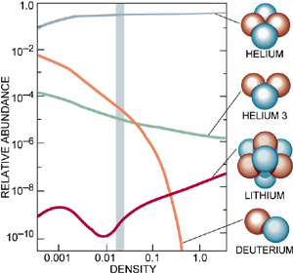
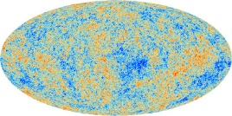










      - Introduction -
History of the Universe
Mandatory!
Mandatory!
…
Inflation
Reheating
(Baryogenesis)
EW
BBN
Recombination
time
${10}^{−43}$ s
${10}^{−12}$ s
$1$ s
${10}^{13}$ s
$$T>a few MeV$$
1. Slow roll [Inflation]
$$V$$
Inflaton $φ$ :
))
))
3. Decay [Reheating]
))
$$T_{R}∼0.2\sqrt{Γ_{φ}M_{P}}$$
$$φ$$
$$∼M_{P}$$
2. Oscillation [Preheating]
Notes:
So, even if beta is zero, particle production can be happened due to interaction effect.

Slide 4
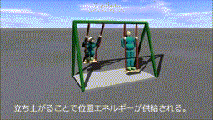
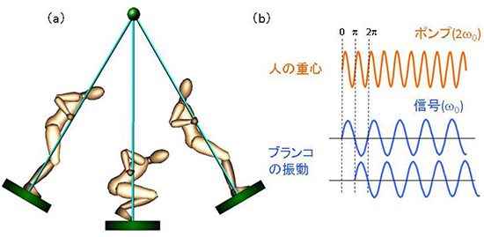
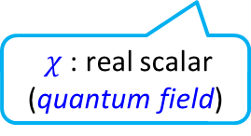


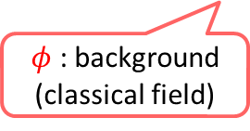






      - Introduction -
Preheating (without spatial expanding)
  Parametric resonance
    Equation of motion for $χ$
    → “Mathieu equation” … motion of a swing with pumping person
      [J. H. Traschen and R. H. Brandenberger (1990), L. Kofman, A. D. Linde, A. A. Starobinsky (1994, 1997)]
$$V=\frac{1}{2}m_{φ}^{2}{\left\langle φ(t)\right\rangle }^{2}+\frac{1}{2}g^{2}{\left\langle φ(t)\right\rangle }^{2}χ^{2}$$
( http://www.nicovideo.jp/watch/sm14518057 )
$φ$ : background
(classical field)
$χ$ : real scalar (quantum field)
$$V$$
[ http://www.riken.jp/pr/press/2014/20140725_1/ ]
$$∼\left\langle φ\right\rangle$$
Center of Mass
$$\left\langle φ\right\rangle$$
Amp of Swing
$$\left\langle φ(t)\right\rangle ∼\left\langle φ_{0}\right\rangle {cos m}_{φ}t$$
$$∼χ_{k}$$
$$0=∂_{t}^{2}χ_{k}+\left(k^{2}+{\left\langle φ_{0}\right\rangle }^{2}{\cos^{2} m}_{φ}t\right)χ_{k}$$
$χ\left(t,x\right)=\sum_{k}{\left[e^{ik⋅x}χ_{k}\left(t\right)a_{k}+\left(h.c.\right)\right]}$

Slide 5




      - Introduction -
Preheating (without spatial expanding)
  Parametric resonance
    Particle production happens
      exponentially (bosonic effect)
      around massless point ($\left\langle φ\right\rangle ∼0$)
      [J. H. Traschen and R. H. Brandenberger (1990), L. Kofman, A. D. Linde, A. A. Starobinsky (1994, 1997)]
$$−ℒ_{int}=\frac{1}{2}m_{φ}^{2}{\left\langle φ(t)\right\rangle }^{2}+\frac{1}{2}g^{2}{\left\langle φ(t)\right\rangle }^{2}χ^{2}$$
Exponential growth!
(wave func.)
$φ$ : background
(classical field)
$χ$ : real scalar (quantum field)
$$V$$
))
))
Exponential growth!
$$\left\langle φ\right\rangle$$
(occupation #)
Non-adiabatic region : $\left|{\dot{ω}}_{k}/ω_{k}^{2}\right|>1$
$ω_{k}≡\sqrt{k^{2}+g^{2}{\left\langle φ\right\rangle }^{2}}$ : frequency of $χ$

Slide 6









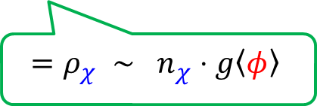
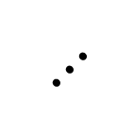
      - Introduction -
  Backreaction
    $$ℋ=\frac{1}{2}{\left\langle \dot{φ}\right\rangle }^{2}+\frac{1}{2}m_{φ}^{2}{\left\langle φ\right\rangle }^{2}+\frac{1}{2}{\dot{χ}}^{2}+\frac{1}{2}{\left(∇χ\right)}^{2}+\frac{1}{2}g^{2}{\left\langle φ\right\rangle }^{2}χ^{2}$$
    Linear potential is established for $φ$!
$$=ρ_{χ} ∼ n_{χ}⋅g\left\langle φ\right\rangle$$
$$V$$
shrink
$$⋯$$
Trapped!
Energy loss
$$V=n_{χ}^{2nd}⋅g\left|\left\langle φ\right\rangle \right|$$
$$⋯$$
$$ΔV∼ρ_{χ}∼n_{χ}⋅g\left\langle φ\right\rangle$$
$$V=n_{χ}⋅g\left|\left\langle φ\right\rangle \right|$$
))
))
))
))
$$φ$$
$χ$ production!
Non-adiabatic region $∼\sqrt{m_{φ}φ_{0}/g}$

Slide 7
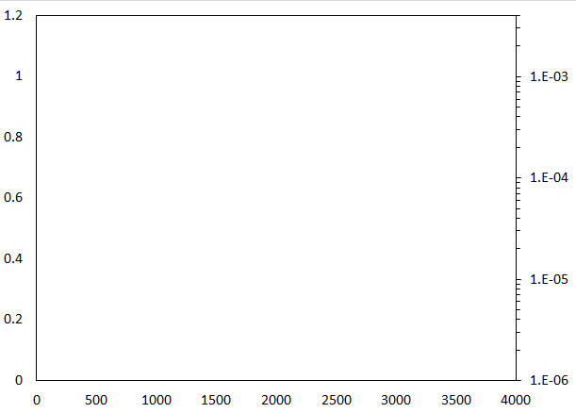
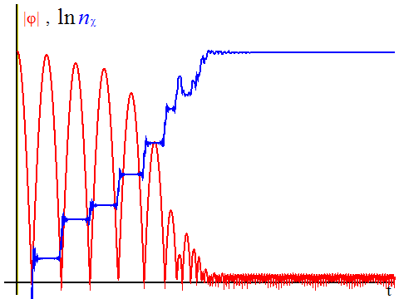
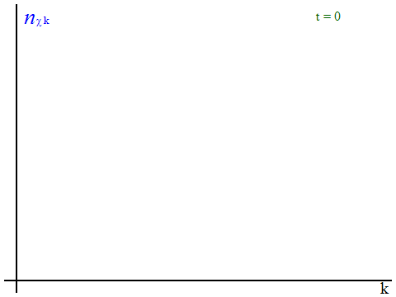











      - Introduction -
Numerical results (${\dot{φ}}_{0}=0, g=1, m_{φ}/φ_{0}=0.01$ )
stop
Shrink
$$V$$
$\tilde{φ}$,
$$χ$$
Exp. growth
Amplitude of $\left|φ\right|/\left|φ_{0}\right|$
Number density $n_{χ}$
))
))
$$\left\langle φ\right\rangle$$
stop
time $φ_{0}t$
10.0
9.0
~ 1700
8.0
7.0
6.0
Distribution $n_{k}$
5.0
4.0
3.0
2.0
1.0
0.05
0.1
0.05
0.1
momentum $\left|\vec{k}\right|/φ_{0}$
momentum $\left|\vec{k}\right|/φ_{0}$
Notes:
So, even if beta is zero, particle production can be happened due to interaction effect.

Slide 8
Asymmetric particle production
Notes:
Now, it is known that particle production from vacuum happens if a background is changing.

Slide 9
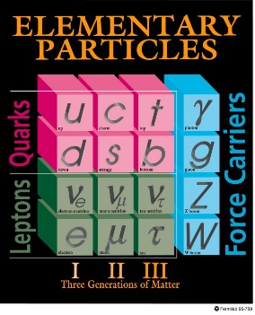








      - 3. Asymmetric particle production -
History of the Universe
Inflation
Reheating
(Baryogenesis)
EW
BBN
Recombination
time
${10}^{−43}$ s
${10}^{−12}$ s
$1$ s
${10}^{13}$ s
2. Oscillation [Preheating]
3. Decay [Reheating]
4. Decay [Baryogenesis]
$$V$$
$$B, C, CP, Eq$$
$$B$$
$$B$$
))
))
$$\overline{B}$$
Asymmetry
$$\left(B,\right) C, CP, Eq$$
))
))
$$\left\langle φ\right\rangle$$
))
$$B, Eq$$
Asymmetry
3. Parametric resonance [Baryogenesis]
( 4. Decay [Reheating] )
Notes:
So, even if beta is zero, particle production can be happened due to interaction effect.

Slide 10

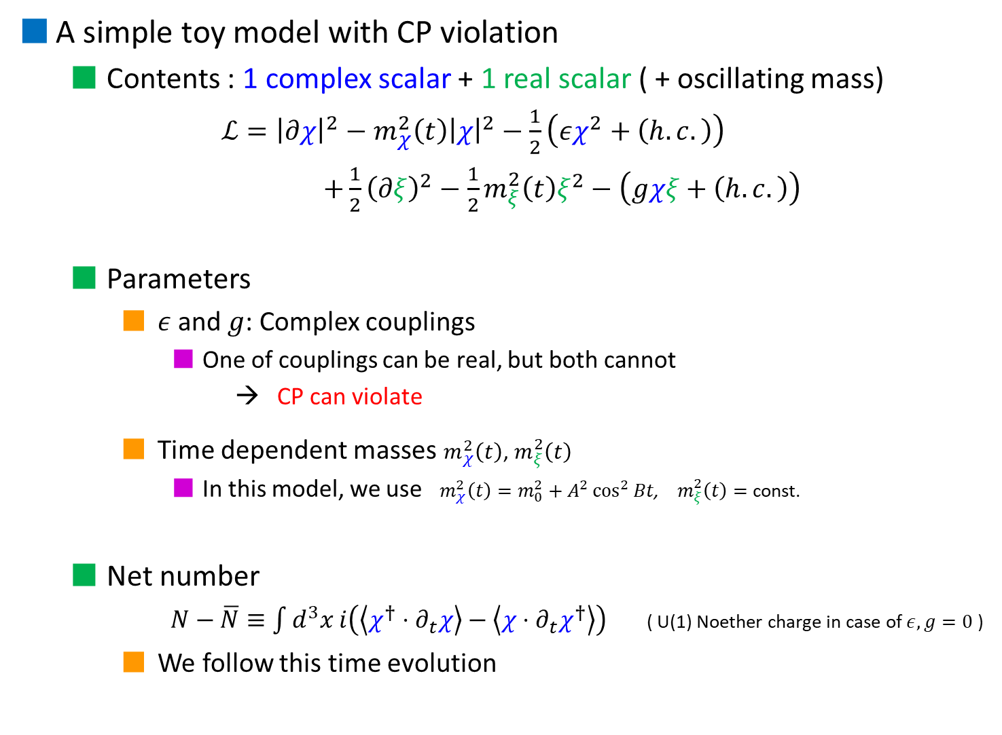





      - 3. Asymmetric particle production -
A simple toy model with CP violation
  Contents : 1 complex scalar + 1 real scalar ( + oscillating mass)
    $ℒ={\left|∂χ\right|}^{2}−m_{χ}^{2}\left(t\right){\left|χ\right|}^{2}−\frac{1}{2}\left(εχ^{2}+\left(h.c.\right)\right)$
    $+\frac{1}{2}{\left(∂ξ\right)}^{2}−\frac{1}{2}m_{ξ}^{2}\left(t\right)ξ^{2}−\left(gχξ+\left(h.c.\right)\right)$
  Parameters
    $ε$and $g$: Complex couplings
      One of couplings can be real, but both cannot
      → CP can violate
    Time dependent masses $m_{χ}^{2}\left(t\right)$, $m_{ξ}^{2}\left(t\right)$
      In this model, we use $m_{χ}^{2}\left(t\right)=m_{0}^{2}+A^{2}\cos^{2}{Bt}$, $m_{ξ}^{2}\left(t\right)=$ const.
  Net number
      $N−\overline{N}≡\int{d^{3}x i\left(\left\langle χ^{†}⋅∂_{t}χ\right\rangle −\left\langle χ⋅∂_{t}χ^{†}\right\rangle \right)}$ ( U(1) Noether charge in case of $ε, g=0$ )
    We follow this time evolution
      [SE, T. Matsuda (2017)]
$χ$,
$\overline{χ}$,
( $ξ$ )
$$V$$
))
))
$$\left\langle φ\right\rangle$$
Original mass
Background oscillation $∼{\left\langle φ\left(t\right)\right\rangle }^{2}$

Slide 11
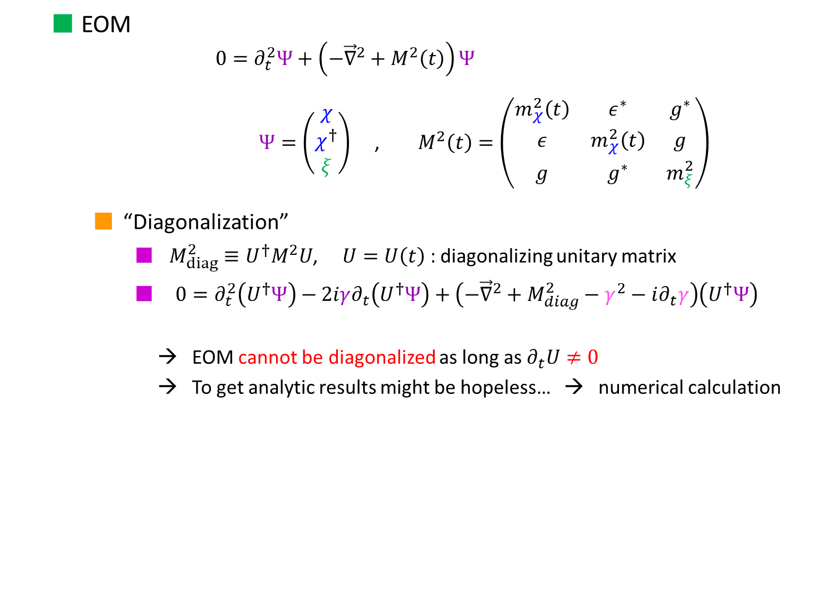
      - 3. Asymmetric particle production -
  EOM
      $$0=∂_{t}^{2}Ψ+\left(−{\vec{∇}}^{2}+M^{2}\left(t\right)\right)Ψ$$
      $Ψ=\left(\begin{aligned}\begin{aligned}χ \\ χ^{†}\end{aligned} \\ ξ\end{aligned}\right)$ , $M^{2}\left(t\right)=\left(\begin{matrix}m_{χ}^{2}\left(t\right) & ε^{∗} & g^{∗} \\ ε & m_{χ}^{2}\left(t\right) & g \\ g & g^{∗} & m_{ξ}^{2}\end{matrix}\right)$
    “Diagonalization”
      $M_{diag}^{2}≡U^{†}M^{2}U$, $U=U\left(t\right)$ : diagonalizing unitary matrix
      $0=∂_{t}^{2}\left(U^{†}Ψ\right)−2iγ∂_{t}\left(U^{†}Ψ\right)+\left(−{\vec{∇}}^{2}+M_{diag}^{2}−γ^{2}−i∂_{t}γ\right)\left(U^{†}Ψ\right)$
      → EOM cannot be diagonalized as long as $∂_{t}U≠0$
      → To get analytic results might be hopeless… → numerical calculation
where $γ≡iU^{†}∂_{t}U$ : Hermite, non-diagonal
Notes:
So, even if beta is zero, particle production can be happened due to interaction effect.

Slide 12

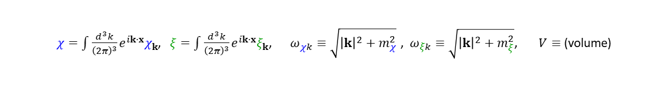













      - 3. Asymmetric particle production -
  Required differential equations
$χ=\int{\frac{d^{3}k}{{\left(2π\right)}^{3}}e^{ik⋅x}χ_{k}}$, $ξ=\int{\frac{d^{3}k}{{\left(2π\right)}^{3}}e^{ik⋅x}ξ_{k}}$, $ω_{χk}≡\sqrt{{\left|k\right|}^{2}+m_{χ}^{2}}$ , $ω_{ξk}≡\sqrt{{\left|k\right|}^{2}+m_{ξ}^{2}}$, $V≡$(volume)
$$∂_{t}\left\langle χ_{k}^{†}χ_{k}\right\rangle =2Re\left\langle χ_{k}^{†}⋅∂_{t}χ_{k}\right\rangle$$
$χ_{k}$-> $χ_{k}$type
$$∂_{t}\left\langle χ_{k}^{†}⋅∂_{t}χ_{k}\right\rangle =\left\langle ∂_{t}χ_{k}^{†}⋅∂_{t}χ_{k}\right\rangle −ω_{χk}^{2}\left\langle χ_{k}^{†}χ_{k}\right\rangle −{\left[ε\left\langle χ_{−k}χ_{k}\right\rangle \right]}^{∗}−g^{∗}\left\langle χ_{k}^{†}ξ_{k}\right\rangle$$
$$∂_{t}$$
$$×$$
$$∂_{t}\left\langle ∂_{t}χ_{k}^{†}⋅∂_{t}χ_{k}\right\rangle =−2ω_{χk}^{2}Re\left\langle χ_{k}^{†}⋅∂_{t}χ_{k}\right\rangle −2Re\left[ε\left\langle χ_{−k}⋅∂_{t}χ_{k}\right\rangle \right]−2Re\left[g^{∗}\left\langle ∂_{t}χ_{k}^{†}⋅ξ_{k}\right\rangle \right]$$
$$∂_{t}\left\langle χ_{−k}χ_{k}\right\rangle =2\left\langle χ_{−k}⋅∂_{t}χ_{k}\right\rangle$$
$$∂_{t}\left\langle χ_{−k}⋅∂_{t}χ_{k}\right\rangle =\left\langle ∂_{t}χ_{−k}⋅∂_{t}χ_{k}\right\rangle −ω_{χk}^{2}\left\langle χ_{−k}χ_{k}\right\rangle −ε^{∗}\left\langle χ_{k}^{†}χ_{k}\right\rangle −{\left[g\left\langle χ_{k}^{†}ξ_{k}\right\rangle \right]}^{∗}$$
$χ_{k}$-> ${\overline{χ}}_{k}$type
$$∂_{t}\left\langle ∂_{t}χ_{−k}⋅∂_{t}χ_{k}\right\rangle =−{2ω}_{χk}^{2}\left\langle χ_{−k}⋅∂_{t}χ_{k}\right\rangle −ε^{∗}\left[2\left\langle χ_{k}^{†}⋅∂_{t}χ_{k}\right\rangle −iV\right]−2{\left[g\left\langle ∂_{t}χ_{k}^{†}⋅ξ_{k}\right\rangle \right]}^{∗}$$
$$∂_{t}$$
$$×$$
$$∂_{t}\left\langle ξ_{k}^{†}ξ_{k}\right\rangle =2Re\left\langle ξ_{k}^{†}⋅∂_{t}ξ_{k}\right\rangle$$
$$∂_{t}Re\left\langle ξ_{k}^{†}⋅∂_{t}ξ_{k}\right\rangle =\left\langle ∂_{t}ξ_{k}^{†}⋅∂_{t}ξ_{k}\right\rangle −ω_{ξk}^{2}\left\langle ξ_{k}^{†}ξ_{k}\right\rangle −2Re\left[g^{∗}\left\langle χ_{k}^{†}ξ_{k}\right\rangle \right]$$
$ξ_{k}$-> $ξ_{k}$type
$$∂_{t}\left\langle ∂_{t}ξ_{k}^{†}⋅∂_{t}ξ_{k}\right\rangle =−2ω_{ξk}^{2}Re\left\langle ξ_{k}^{†}⋅∂_{t}ξ_{k}\right\rangle −4Re\left[g^{∗}\left\langle χ_{k}^{†}⋅∂_{t}ξ_{k}\right\rangle \right]$$
$$∂_{t}$$
$$×$$
$$∂_{t}\left\langle χ_{k}^{†}ξ_{k}\right\rangle =\left\langle χ_{k}^{†}⋅∂_{t}ξ_{k}\right\rangle +\left\langle ∂_{t}χ_{k}^{†}⋅ξ_{k}\right\rangle$$
$ξ_{k}$-> $χ_{k}$type
$$∂_{t}\left\langle χ_{k}^{†}⋅∂_{t}ξ_{k}\right\rangle =\left\langle ∂_{t}χ_{k}^{†}⋅∂_{t}ξ_{k}\right\rangle −ω_{ξk}^{2}\left\langle χ_{k}^{†}ξ_{k}\right\rangle −g{\left\langle χ_{k}^{†}ξ_{k}\right\rangle }^{∗}−{\left[g\left\langle χ_{−k}χ_{k}\right\rangle \right]}^{∗}$$
$$∂_{t}$$
$$×$$
$$∂_{t}\left\langle ∂_{t}χ_{k}^{†}⋅ξ_{k}\right\rangle =\left\langle ∂_{t}χ_{k}^{†}⋅∂_{t}ξ_{k}\right\rangle −ω_{χk}^{2}\left\langle χ_{k}^{†}ξ_{k}\right\rangle −ε{\left\langle χ_{k}^{†}ξ_{k}\right\rangle }^{∗}−g\left\langle χ_{k}^{†}χ_{k}\right\rangle$$
$$∂_{t}\left\langle ∂_{t}χ_{k}^{†}⋅∂_{t}ξ_{k}\right\rangle =−ω_{χk}^{2}Re\left\langle χ_{k}^{†}⋅∂_{t}ξ_{k}\right\rangle −ω_{ξk}^{2}Re\left\langle ∂_{t}χ_{k}^{†}⋅ξ_{k}\right\rangle −ε{\left\langle χ_{k}^{†}⋅∂_{t}ξ_{k}\right\rangle }^{∗}−g\left[{\left\langle χ_{k}^{†}⋅∂_{t}χ_{k}\right\rangle }^{∗}+\left\langle ξ_{k}^{†}⋅∂_{t}ξ_{k}\right\rangle \right]−{\left[g\left\langle χ_{−k}⋅∂_{t}χ_{k}\right\rangle \right]}^{∗}$$
Notes:
So, even if beta is zero, particle production can be happened due to interaction effect.

Slide 13






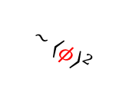







      - 3. Asymmetric particle production -
  Numerical results 1
$m_{χ}^{2}={0.15}^{2}+4\cos^{2}0.03t$, $m_{ξ}^{2}={0.1}^{2}$, $ε={10}^{−4}$
$$∼{\left\langle φ\right\rangle }^{2}$$
(background oscillation)
$$g=0.01i$$
$n_{χ}$ (matter)
${\overline{n}}_{χ}$ (antimatter)
Number densities
$n_{χ}−{\overline{n}}_{χ}$ (net density)
$$t$$
$g=0.01$ (no phase)
$n_{χ}$ (matter)
${\overline{n}}_{χ}$ (antimatter)
$χ$,
$\overline{χ}$,
( $ξ$ )
$$V$$
Number densities
))
))
$$\left\langle φ\right\rangle$$
$$t$$
Notes:
So, even if beta is zero, particle production can be happened due to interaction effect.

Slide 14




      - 3. Asymmetric particle production -
  Numerical results 2
    While the growth of each number densities are exponential, the asymmetry $A_{χ}≡\frac{n_{χ}−{\overline{n}}_{χ}}{n_{χ}+{\overline{n}}_{χ}}$ seems not to grow (nearly constant)
      The asymmetry generation almost completes
      at 1st particle production
    Still we do not have analytic results,
    more detail analysis should be needed
$m_{χ}^{2}={0.15}^{2}+4\cos^{2}0.03t$, $m_{ξ}^{2}={0.1}^{2}$, $ε={10}^{−4}$
$$∼{\left\langle φ\right\rangle }^{2}$$
(background oscillation)
$$g=0.01i$$
Asymmetry $A_{χ}≡\frac{n_{χ}−{\overline{n}}_{χ}}{n_{χ}+{\overline{n}}_{χ}}$
$\frac{n_{χ}−{\overline{n}}_{χ}}{n_{χ}+{\overline{n}}_{χ}}$ (asymmetry)
$$t$$
$χ$,
$\overline{χ}$,
( $ξ$ )
$$V$$
))
))
$$\left\langle φ\right\rangle$$
Notes:
So, even if beta is zero, particle production can be happened due to interaction effect.

Slide 15
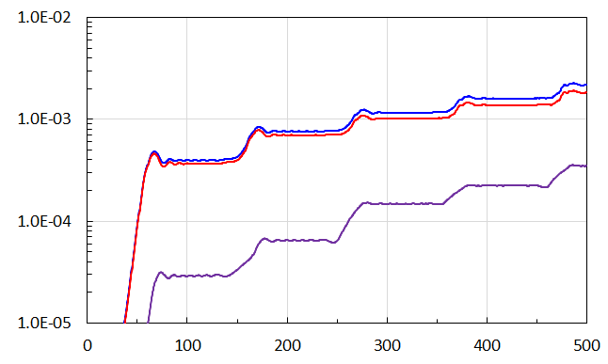

Summary
Parametric resonance
$$V$$
  After inflation, non-perturbative particle production and parametric resonance are caused due to oscillating inflation field (Preheating)
  Such mechanism can be applicable to matter-antimatter asymmetry generation
    Baryogenesis also can be possible at preheating era without decay or scattering
    The analytic results still have not obtained
    → progress in future
    It is interesting to investigate this mechanism by other CP violating model (work in progress)
))
))
$$\left\langle φ\right\rangle$$
Asymmetric particle production

Slide 16
back up

Slide 17

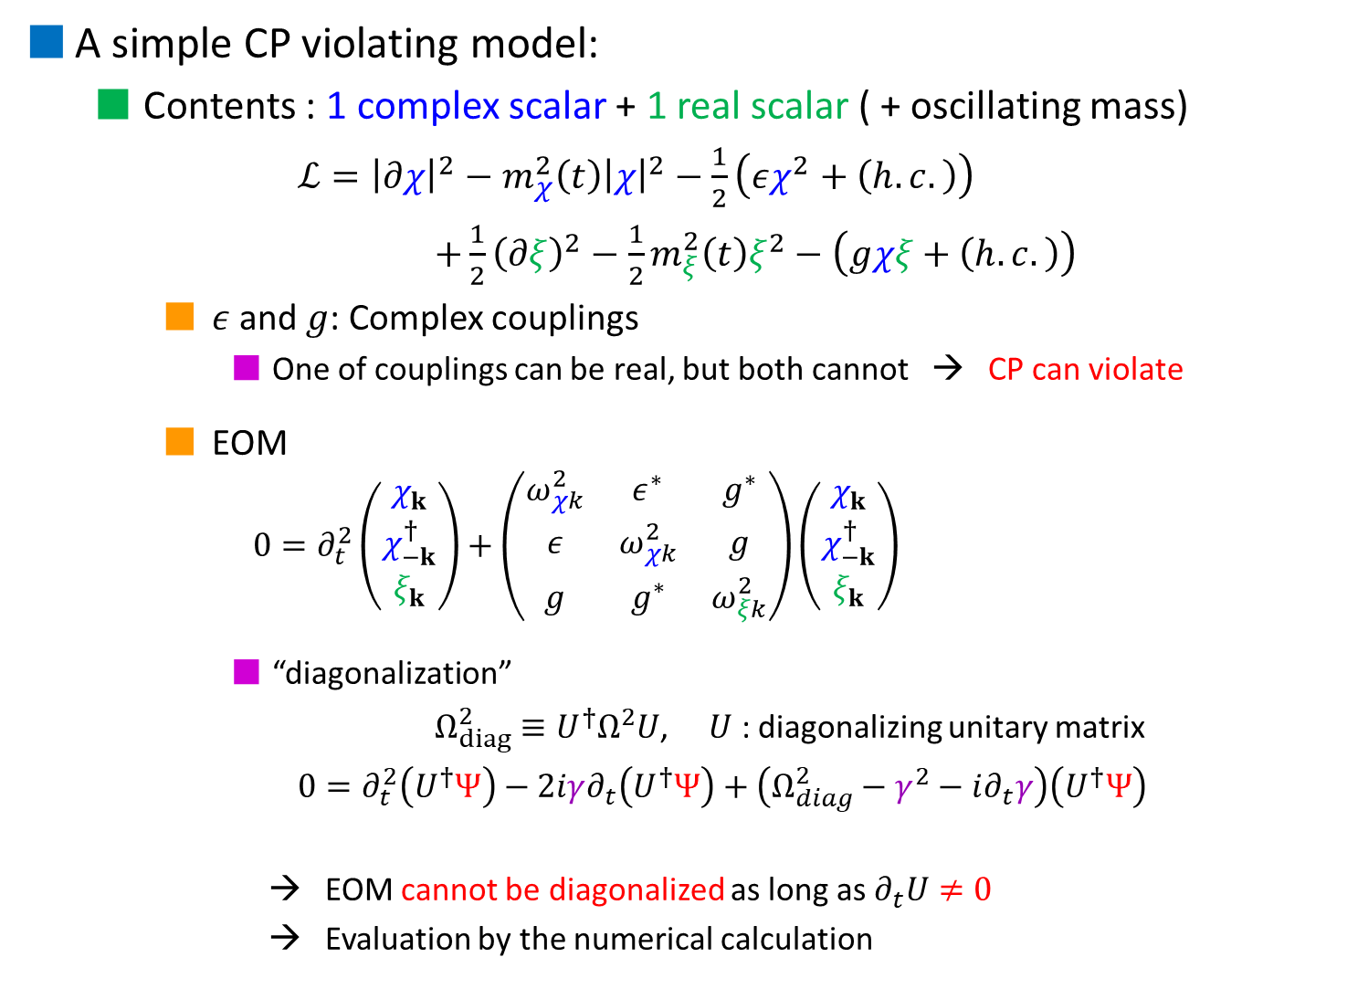
      - 3. Asymmetric particle production -
A simple CP violating model:
  Contents : 1 complex scalar + 1 real scalar ( + oscillating mass)
    $ℒ={\left|∂χ\right|}^{2}−m_{χ}^{2}\left(t\right){\left|χ\right|}^{2}−\frac{1}{2}\left(εχ^{2}+\left(h.c.\right)\right)$
    $+\frac{1}{2}{\left(∂ξ\right)}^{2}−\frac{1}{2}m_{ξ}^{2}\left(t\right)ξ^{2}−\left(gχξ+\left(h.c.\right)\right)$
    $ε$and $g$: Complex couplings
      One of couplings can be real, but both cannot → CP can violate
    EOM
      $$0=∂_{t}^{2}\left(\begin{aligned}\begin{aligned}χ_{k} \\ χ_{−k}^{†}\end{aligned} \\ ξ_{k}\end{aligned}\right)+\left(\begin{matrix}ω_{χk}^{2} & ε^{∗} & g^{∗} \\ ε & ω_{χk}^{2} & g \\ g & g^{∗} & ω_{ξk}^{2}\end{matrix}\right)\left(\begin{aligned}\begin{aligned}χ_{k} \\ χ_{−k}^{†}\end{aligned} \\ ξ_{k}\end{aligned}\right)$$
      “diagonalization”
      $Ω_{diag}^{2}≡U^{†}Ω^{2}U$, $U$ : diagonalizing unitary matrix
      $0=∂_{t}^{2}\left(U^{†}Ψ\right)−2iγ∂_{t}\left(U^{†}Ψ\right)+\left(Ω_{diag}^{2}−γ^{2}−i∂_{t}γ\right)\left(U^{†}Ψ\right)$
      → EOM cannot be diagonalized as long as $∂_{t}U≠0$
      → Evaluation by the numerical calculation
      [SE, T. Matsuda (2017)]
$χ_{k}\left(t\right)≡∫d^{3}xe^{−ik⋅x}χ\left(t,x\right)$,
$ω_{χk}\left(t\right)=\sqrt{k^{2}+m_{χ}^{2}\left(t\right)}$
$ξ_{k}\left(t\right)≡∫d^{3}xe^{−ik⋅x}ξ\left(t,x\right)$,
$ω_{ξk}\left(t\right)=\sqrt{k^{2}+m_{ξ}^{2}\left(t\right)}$
where $γ≡iU^{†}∂_{t}U$ : Hermite, non-diagonal
Notes:
So, even if beta is zero, particle production can be happened due to interaction effect.

Slide 18
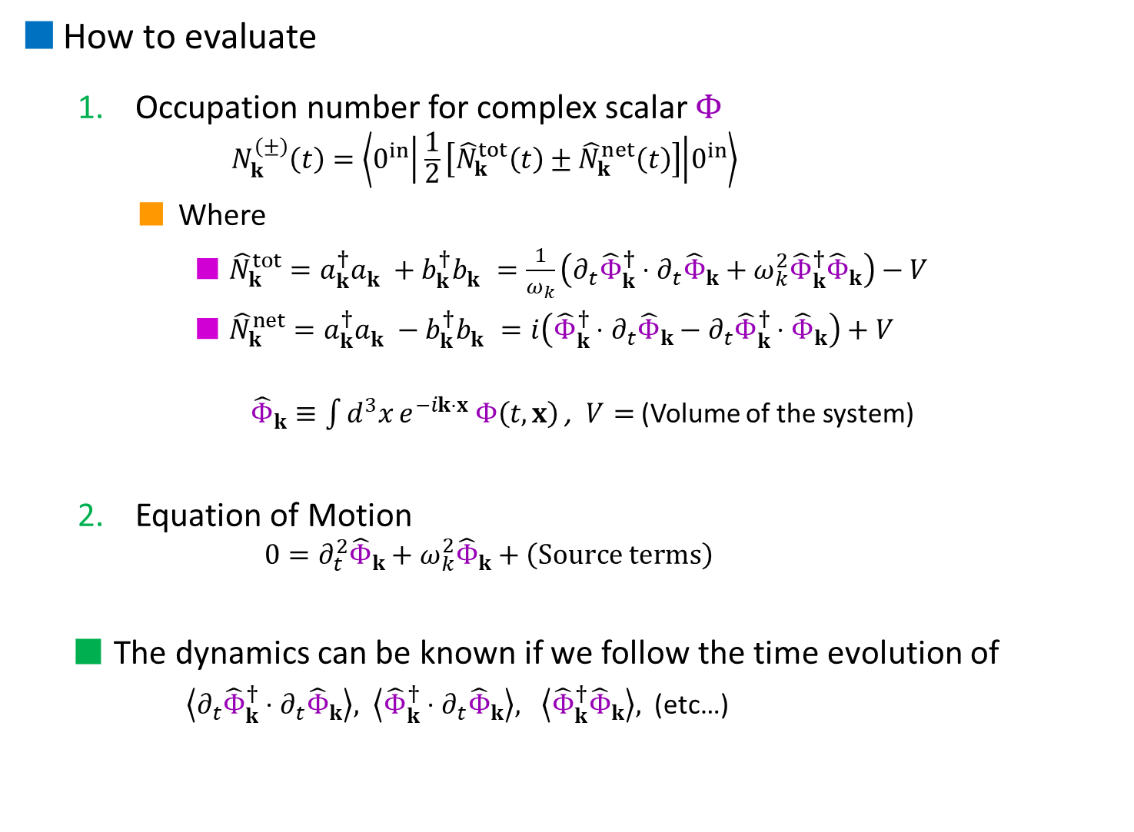

How to evaluate
  Occupation number for complex scalar $Φ$
      $$N_{k}^{\left(±\right)}\left(t\right)=\left\langle 0^{in} | \frac{1}{2}\left[{\hat{N}}_{k}^{tot}\left(t\right)±{\hat{N}}_{k}^{net}\left(t\right)\right] | 0^{in}\right\rangle$$
    Where
      ${\hat{N}}_{k}^{tot}=a_{k}^{†}a_{k}^{}+b_{k}^{†}b_{k}^{}=\frac{1}{ω_{k}}\left({∂_{t}\hat{Φ}}_{k}^{†}⋅∂_{t}{\hat{Φ}}_{k}+ω_{k}^{2}{\hat{Φ}}_{k}^{†}{\hat{Φ}}_{k}\right)−V$
      ${\hat{N}}_{k}^{net}=a_{k}^{†}a_{k}^{}−b_{k}^{†}b_{k}^{}=i\left({\hat{Φ}}_{k}^{†}⋅∂_{t}{\hat{Φ}}_{k}−{∂_{t}\hat{Φ}}_{k}^{†}⋅{\hat{Φ}}_{k}\right)+V$
        ${\hat{Φ}}_{k}≡\int{d^{3}x}e^{−ik⋅x} Φ\left(t,x\right)$ , $V=$ (Volume of the system)
  Equation of Motion
      $$0=∂_{t}^{2}{\hat{Φ}}_{k}+ω_{k}^{2}{\hat{Φ}}_{k}+\left(Source terms\right)$$
  The dynamics can be known if we follow the time evolution of
      $\left\langle {∂_{t}\hat{Φ}}_{k}^{†}⋅∂_{t}{\hat{Φ}}_{k}\right\rangle , \left\langle {\hat{Φ}}_{k}^{†}⋅∂_{t}{\hat{Φ}}_{k}\right\rangle , \left\langle {\hat{Φ}}_{k}^{†}{\hat{Φ}}_{k}\right\rangle ,$ (etc…)
(kinetic energy)
(1 particle energy)
( total # )
( net # )
U(1) Noether charge
$$ω_{k}^{}≡\sqrt{k^{2}+M_{Φ}^{2}}$$
Notes:
So, even if beta is zero, particle production can be happened due to interaction effect.

Slide 19







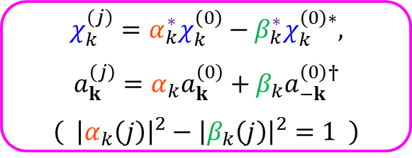

Evaluation of the particle number : Bogoliubov transformation
  The (free) field operator can be expanded with wave function and creation/annihilation operators
      $χ(t,x)=\int{\frac{d^{3}k}{{\left(2π\right)}^{3}}e^{ik∙x}\left(χ_{k}^{\left(0\right)}\left(t\right)a_{k}^{(0)}+χ_{k}^{\left(0\right)∗}(t)a_{−k}^{(0)†}\right)}$
      $=\int{\frac{d^{3}k}{{\left(2π\right)}^{3}}e^{ik∙x}\left(χ_{k}^{(j)}a_{k}^{(j)}+χ_{k}^{(j)∗}a_{−k}^{(j)†}\right)}$
      $\left( 0=∂_{t}^{2}χ_{k}^{(j)}+ω_{k}^{2}χ_{k}^{(j)} , ω_{k}=\sqrt{{\left|k\right|}^{2}+g^{2}{\left\langle φ\right\rangle }^{2}} \right)$
  Bogoliubov transformation law
  Produced number (occupation number)
      $n_{k}^{(j)}≡\left\langle 0^{\left(0\right)} | a_{k}^{\left(j\right)†}a_{k}^{\left(j\right)} | 0^{\left(0\right)}\right\rangle =V⋅{\left|β_{k}\left(j\right)\right|}^{2}$
$$a_{k}^{(0)}\left|\left.0^{(0)}\right\rangle \right.=0$$
plane wave
wave func.
cre./ann. op.
$$a_{k}^{(j)}\left|\left.0^{(j)}\right\rangle \right.=0$$
$$χ_{k}^{(j)}=α_{k}^{∗}χ_{k}^{\left(0\right)}−β_{k}^{∗}χ_{k}^{\left(0\right)∗},$$
$$a_{k}^{\left(j\right)}=α_{k}a_{k}^{\left(0\right)}+β_{k}a_{−k}^{\left(0\right)†}$$
$$\left( {\left|α_{k}\left(j\right)\right|}^{2}−{\left|β_{k}\left(j\right)\right|}^{2}=1 \right)$$
$$V$$
$0$-th
$j$-th
$$φ$$
Non-adiabatic region : $\left|{\dot{ω}}_{k}/ω_{k}^{2}\right|>1$
How calculate?

Slide 20
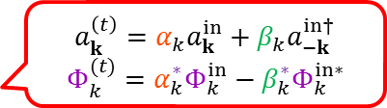
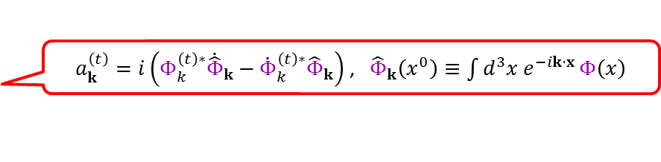

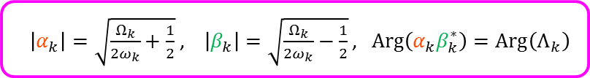
  Bogoliubov transformation
      $Φ(x)=\int{\frac{d^{3}k}{{\left(2π\right)}^{3}}e^{ik∙x}\left(Φ_{k}^{in}\left(x^{0}\right)a_{k}^{in}+Φ_{k}^{in∗}(x^{0})a_{−k}^{in†}\right)}$
      $=\int{\frac{d^{3}k}{{\left(2π\right)}^{3}}e^{ik∙x}\left(Φ_{k}^{\left(t\right)}\left(x^{0}\right)a_{k}^{\left(t\right)}+Φ_{k}^{\left(t\right)∗}(x^{0})a_{−k}^{\left(t\right)†}\right)}$
  Hamiltonian with BT
      $$H=\int{\frac{d^{3}k}{{\left(2π\right)}^{3}}\frac{1}{2}ω_{k}\left(a_{k}^{\left(t\right)†}a_{k}^{\left(t\right)}+a_{−k}^{\left(t\right) }a_{−k}^{\left(t\right)†}\right)}$$
  Particle number (distribution)
      $$n_{k}\left(t\right)≡\frac{\left\langle 0^{in} | a_{k}^{\left(t\right)†}a_{k}^{\left(t\right)} | 0^{in}\right\rangle }{\left(Volume\right)}={\left|β_{k}\left(t\right)\right|}^{2}=\frac{Ω_{k}\left(t\right)}{2ω_{k}\left(t\right)}−\frac{1}{2}$$
    If (mass) = cosnt., $Ω_{k}=ω_{k}$
    Then ${\left|β_{k}\right|}^{2}=0$
$Φ_{k}^{(t)}=α_{k}^{∗}Φ_{k}^{in}−β_{k}^{∗}Φ_{k}^{in∗}$ , $a_{k}^{\left(t\right)}=α_{k}a_{k}^{\left(0\right)}+β_{k}a_{−k}^{\left(0\right)†}$
$$\left( {\left|α_{k}\right|}^{2}−{\left|β_{k}\right|}^{2}=1 \right)$$
$$a_{k}^{(t)}\left|\left.0^{(t)}\right\rangle \right.=0$$
w/ $\left|α_{k}\right|=\sqrt{\frac{Ω_{k}}{2ω_{k}}+\frac{1}{2}}$ , $\left|β_{k}\right|=\sqrt{\frac{Ω_{k}}{2ω_{k}}−\frac{1}{2}}$ , $Arg\left(α_{k}β_{k}^{∗}\right)=Arg\left(Λ_{k}\right)$
(total energy) – (0-point energy)
(1 particle energy)
(distribution) =

Slide 21
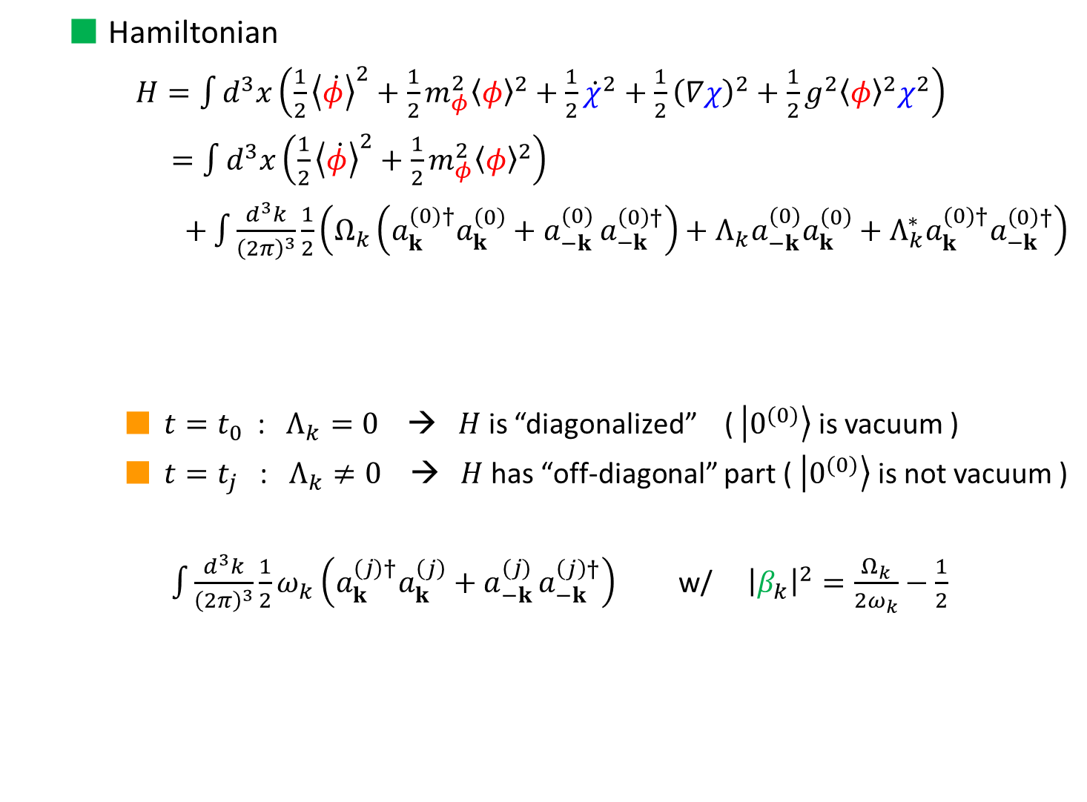

  Hamiltonian
    $H=\int{d^{3}x\left(\frac{1}{2}{\left\langle \dot{φ}\right\rangle }^{2}+\frac{1}{2}m_{φ}^{2}{\left\langle φ\right\rangle }^{2}+\frac{1}{2}{\dot{χ}}^{2}+\frac{1}{2}{\left(∇χ\right)}^{2}+\frac{1}{2}g^{2}{\left\langle φ\right\rangle }^{2}χ^{2}\right)}$
    $=\int{d^{3}x\left(\frac{1}{2}{\left\langle \dot{φ}\right\rangle }^{2}+\frac{1}{2}m_{φ}^{2}{\left\langle φ\right\rangle }^{2}\right)}$
    $+\int{\frac{d^{3}k}{{\left(2π\right)}^{3}}\frac{1}{2}\left(Ω_{k}\left(a_{k}^{(0)†}a_{k}^{\left(0\right)}+a_{−k}^{(0) }a_{−k}^{\left(0\right)†}\right)+Λ_{k}a_{−k}^{(0)}a_{k}^{\left(0\right)}+Λ_{k}^{∗}a_{k}^{(0)†}a_{−k}^{\left(0\right)†}\right)}$
    $t=t_{0}$ : $Λ_{k}=0$ → $H$ is “diagonalized” ( $\left|\left.0^{(0)}\right\rangle \right.$ is vacuum )
    $t=t_{j}$ : $Λ_{k}≠0$ → $H$ has “off-diagonal” part ( $\left|\left.0^{(0)}\right\rangle \right.$ is not vacuum )
    $\int{\frac{d^{3}k}{{\left(2π\right)}^{3}}\frac{1}{2}ω_{k}\left(a_{k}^{(j)†}a_{k}^{\left(j\right)}+a_{−k}^{(j) }a_{−k}^{\left(j\right)†}\right)}$ w/ ${\left|β_{k}\right|}^{2}=\frac{Ω_{k}}{2ω_{k}}−\frac{1}{2}$
$$a_{k}^{\left(j\right)}=α_{k}a_{k}^{\left(0\right)}+β_{k}a_{−k}^{\left(0\right)†}$$
$Ω_{k}≡{\left|χ_{k}^{\left(0\right)}\right|}^{2}+ω_{k}^{2}{\left|χ_{k}^{\left(0\right)}\right|}^{2}$, $Λ_{k}≡{\left({\dot{χ}}_{k}^{\left(0\right)}\right)}^{2}+ω_{k}^{2}{\left(χ_{k}^{\left(0\right)}\right)}^{2}$
Bogoliubov transformation

Slide 22
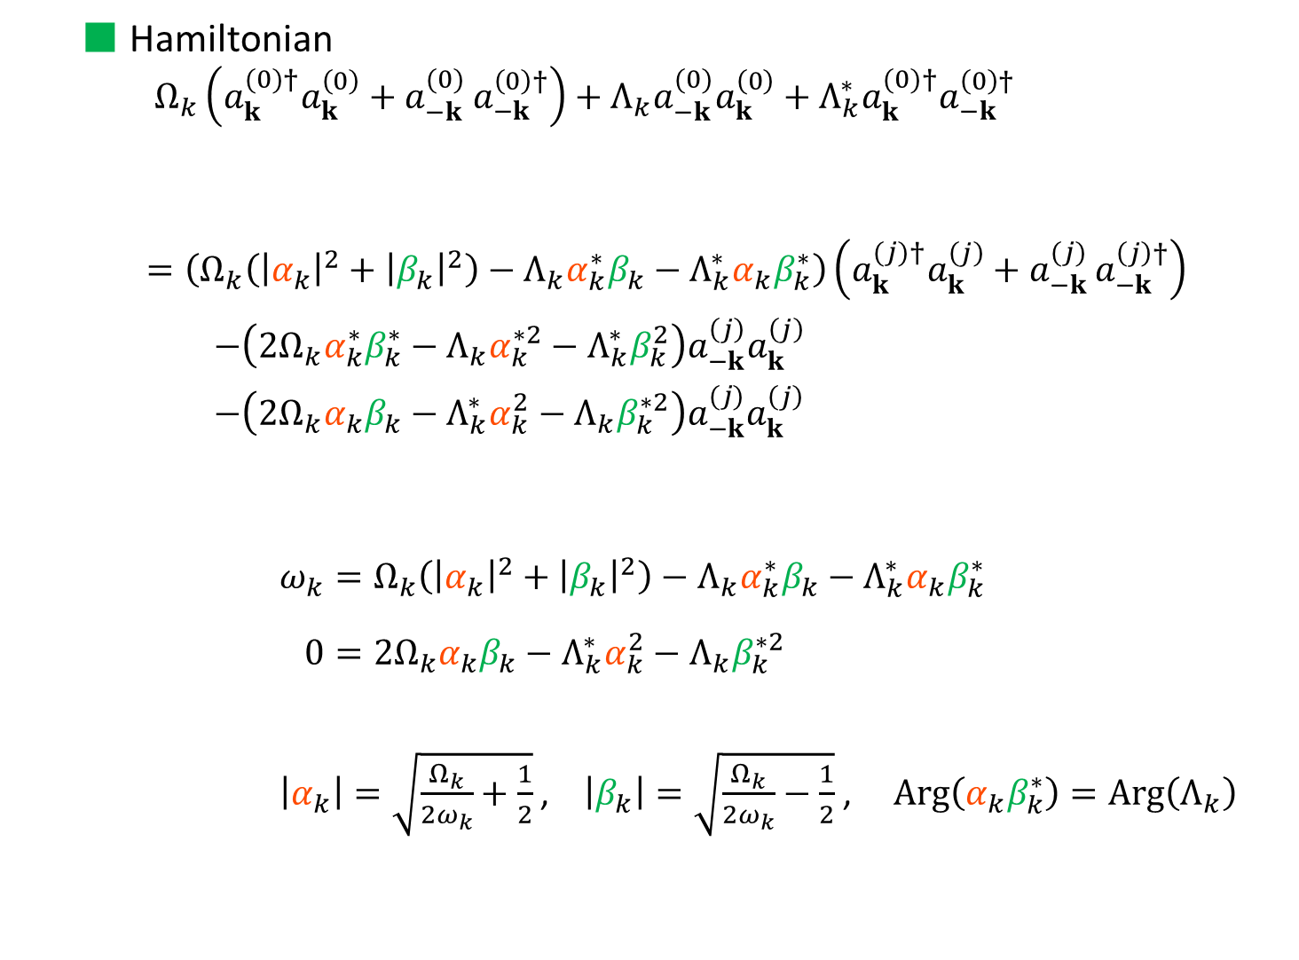
  Hamiltonian
    $$Ω_{k}\left(a_{k}^{(0)†}a_{k}^{\left(0\right)}+a_{−k}^{(0) }a_{−k}^{\left(0\right)†}\right)+Λ_{k}a_{−k}^{(0)}a_{k}^{\left(0\right)}+Λ_{k}^{∗}a_{k}^{(0)†}a_{−k}^{\left(0\right)†}$$
    $$=\left(Ω_{k}\left({\left|α_{k}\right|}^{2}+{\left|β_{k}\right|}^{2}\right)−Λ_{k}α_{k}^{∗}β_{k}−Λ_{k}^{∗}α_{k}β_{k}^{∗}\right)\left(a_{k}^{(j)†}a_{k}^{\left(j\right)}+a_{−k}^{(j) }a_{−k}^{\left(j\right)†}\right)$$
    $−\left(2Ω_{k}α_{k}^{∗}β_{k}^{∗}−Λ_{k}α_{k}^{∗2}−Λ_{k}^{∗}β_{k}^{2}\right)a_{−k}^{\left(j\right)}a_{k}^{\left(j\right)}$
    $−\left(2Ω_{k}α_{k}β_{k}−{Λ_{k}^{∗}α}_{k}^{2}−Λ_{k}β_{k}^{∗2}\right)a_{−k}^{(j)}a_{k}^{\left(j\right)}$
    $ω_{k}=Ω_{k}\left({\left|α_{k}\right|}^{2}+{\left|β_{k}\right|}^{2}\right)−Λ_{k}α_{k}^{∗}β_{k}−Λ_{k}^{∗}α_{k}β_{k}^{∗}$
    $0=2Ω_{k}α_{k}β_{k}−{Λ_{k}^{∗}α}_{k}^{2}−Λ_{k}β_{k}^{∗2}$
    $\left|α_{k}\right|=\sqrt{\frac{Ω_{k}}{2ω_{k}}+\frac{1}{2}}$ , $\left|β_{k}\right|=\sqrt{\frac{Ω_{k}}{2ω_{k}}−\frac{1}{2}}$ , $Arg\left(α_{k}β_{k}^{∗}\right)=Arg\left(Λ_{k}\right)$
Bogoliubov trf.

Slide 23
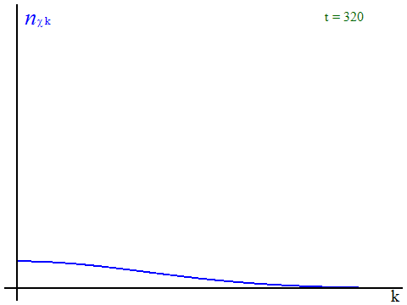




      - Introduction -
Numerical results (${\dot{φ}}_{0}=0, g=1, m_{φ}/φ_{0}=0.01$ )
stop
$$V$$
$\tilde{φ}$,
$$χ$$
Shrink
))
))
Exp. growth
Amplitude of $\left|φ\right|/\left|φ_{0}\right|$
Number density $n_{χ}$
$$\left\langle φ\right\rangle$$
stop
Distribution @ 1st P.P.:
$$n_{k}=e^{−k^{2}/gm_{φ}\left|φ_{0}\right|}$$
time $φ_{0}t$
10.0
9.0
~ 1700
8.0
7.0
6.0
Distribution $n_{k}$
5.0
4.0
3.0
2.0
1.0
0.05
0.1
0.05
0.1
momentum $\left|\vec{k}\right|/φ_{0}$
momentum $\left|\vec{k}\right|/φ_{0}$
Notes:
So, even if beta is zero, particle production can be happened due to interaction effect.

Slide 24
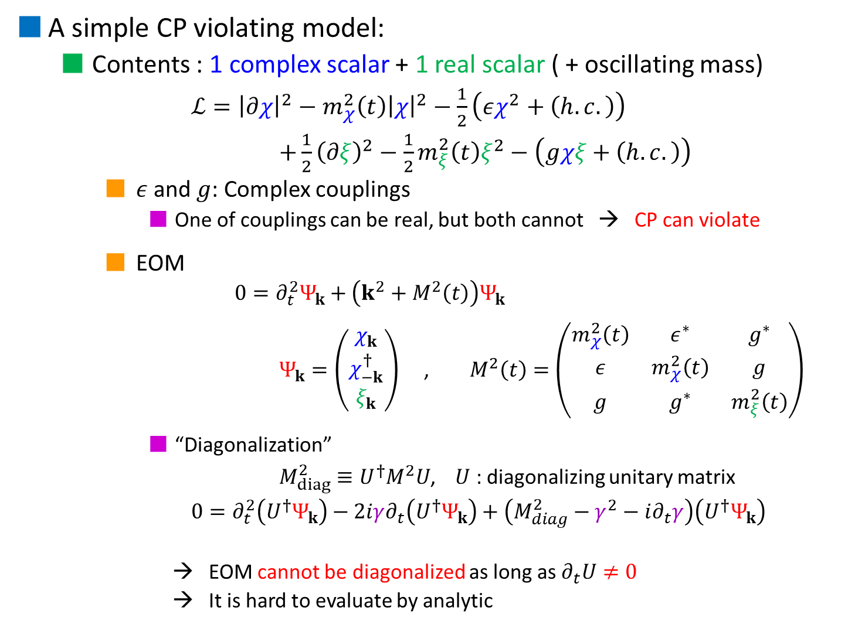
      - 3. Asymmetric particle production -
A simple CP violating model:
  Contents : 1 complex scalar + 1 real scalar ( + oscillating mass)
    $ℒ={\left|∂χ\right|}^{2}−m_{χ}^{2}\left(t\right){\left|χ\right|}^{2}−\frac{1}{2}\left(εχ^{2}+\left(h.c.\right)\right)$
    $+\frac{1}{2}{\left(∂ξ\right)}^{2}−\frac{1}{2}m_{ξ}^{2}\left(t\right)ξ^{2}−\left(gχξ+\left(h.c.\right)\right)$
    $ε$and $g$: Complex couplings
      One of couplings can be real, but both cannot → CP can violate
    EOM
      $$0=∂_{t}^{2}Ψ_{k}+\left(k^{2}+M^{2}\left(t\right)\right)Ψ_{k}$$
      $Ψ_{k}=\left(\begin{aligned}\begin{aligned}χ_{k} \\ χ_{−k}^{†}\end{aligned} \\ ξ_{k}\end{aligned}\right)$ , $M^{2}\left(t\right)=\left(\begin{matrix}m_{χ}^{2}\left(t\right) & ε^{∗} & g^{∗} \\ ε & m_{χ}^{2}\left(t\right) & g \\ g & g^{∗} & m_{ξ}^{2}\left(t\right)\end{matrix}\right)$
      “Diagonalization”
      $M_{diag}^{2}≡U^{†}M^{2}U$, $U$ : diagonalizing unitary matrix
      $0=∂_{t}^{2}\left(U^{†}Ψ_{k}\right)−2iγ∂_{t}\left(U^{†}Ψ_{k}\right)+\left(M_{diag}^{2}−γ^{2}−i∂_{t}γ\right)\left(U^{†}Ψ_{k}\right)$
      → EOM cannot be diagonalized as long as $∂_{t}U≠0$
      → It is hard to evaluate by analytic
      [SE, T. Matsuda (2017)]
where $γ≡iU^{†}∂_{t}U$ : Hermite, non-diagonal

