Slide 1
Recent results and status of PandaX DM experiments
Yong Yang, Shanghai Jiao Tong University
on behalf of PandaX collaboration
2019/07/22, FLASY 2019

Slide 2
Outline
Introduction
  PandaX
  China JinPing underground Lab(CJPL)
Recent results on PandaX-II DM experiment
  Spin-independent
  Light-mediator DM models
  Effective Field Theory interpretations
Status and Future

Slide 3

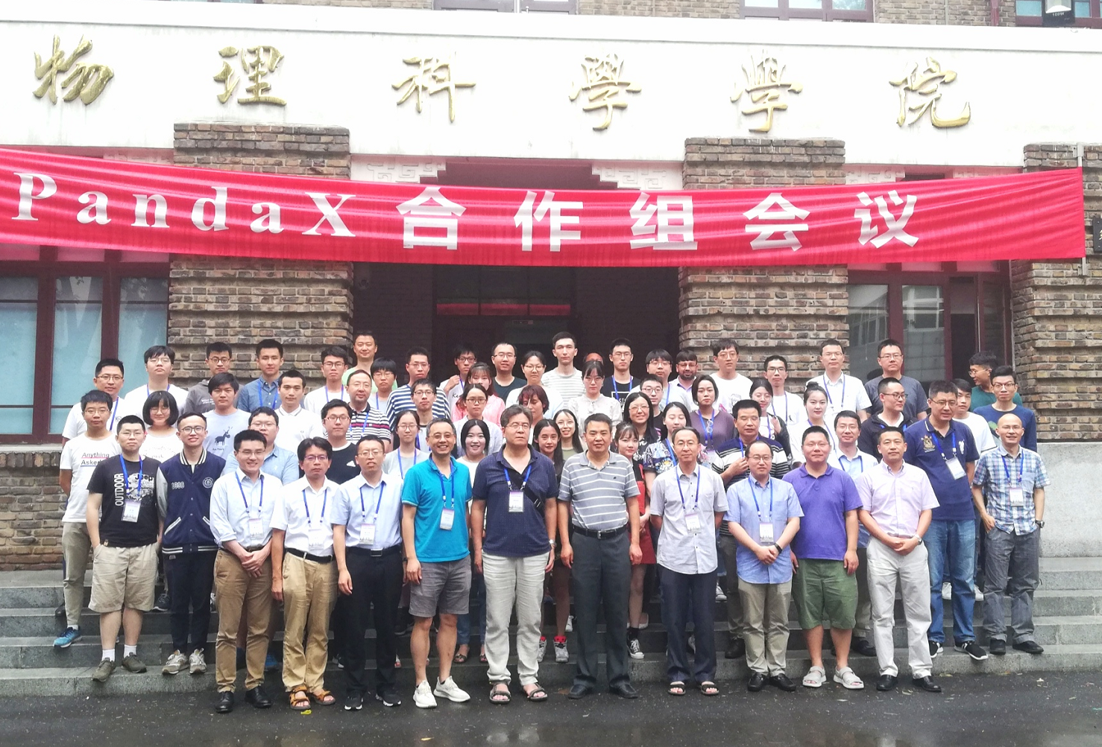





PandaX Collaboration
Particle and Astrophysical Xenon Experiments
  Formed in 2009, ~50 people
Shanghai Jiao Tong University
Peking University
Shandong University
Nankai University
Shanghai Institute of Applied Physics
Yalong Hydropower Company
University of Science & Technology of China
China Institute of Atomic Energy
Sun Yat-Sen University
Beihang University
Fudan University
Shanghai University of Science and Technology
Lawrence Berkeley National Lab
University of Maryland
Alternative Energies & Atomic Energy Commission
University of Zaragoza
Suranaree University of Technology

Slide 4
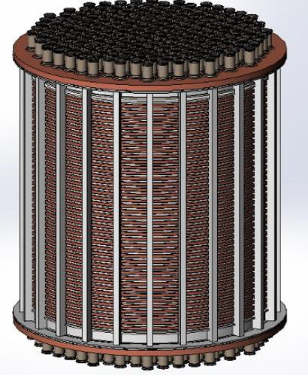
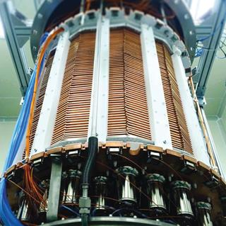
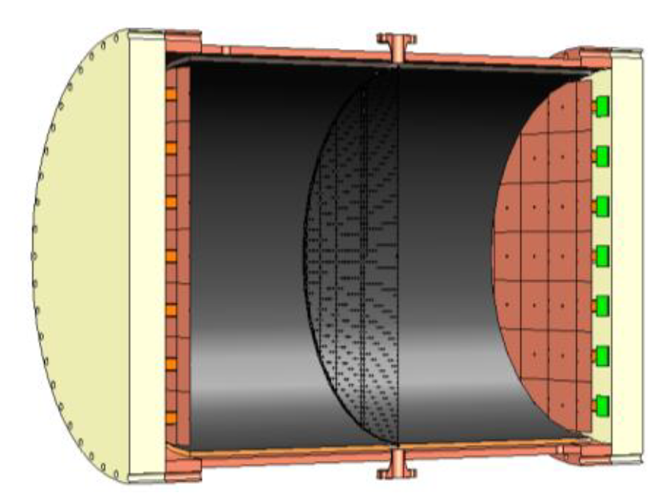
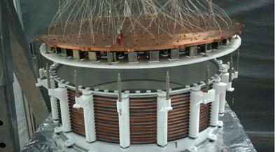
PandaX experiments
series of experiments base on xenon, searching for
  Dark matter with dual-phase time project chamber (TPC)
  0ν2β decays with high pressure ¹³⁶Xe TPC
PandaX-I:
120kg Liquid xenon
(2009-2014)
PandaX-II:
580kg LXe
（2014-2019.6）
PandaX-xT:
Next step, 4ton LXe
（future）
PandaX-III: 200kg-1ton High pressure gaseous xenon
(future)

Slide 5
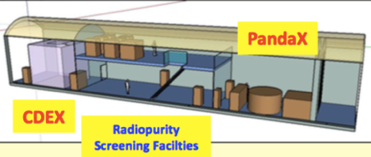
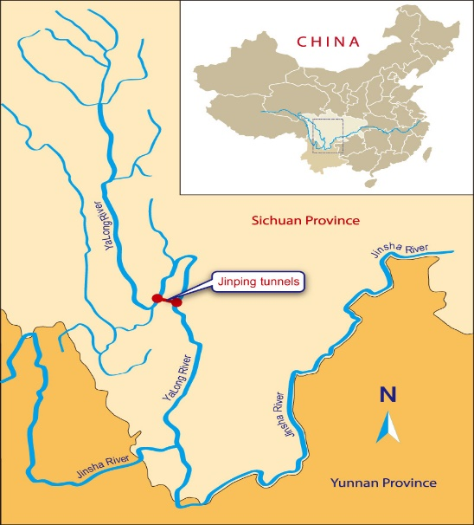
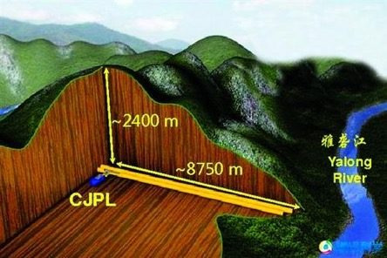
China JinPing Underground Lab
2009-2010 Tsinghua University and Yalong Hydropower company constructed world’ deepest underground lab (2400m)
Two DM experiment operated since then:
  PandaX (for high-mass(>5GeV) WIMPs)
  CDEX( for lighter masses, 1-5 GeV)

Slide 6
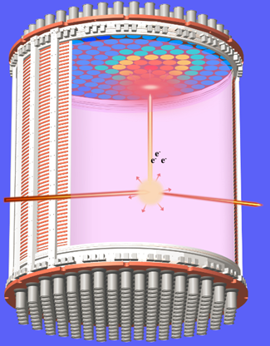
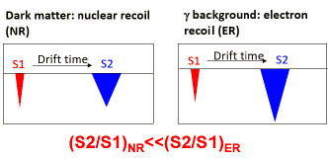
Dual-phase Xenon Time Projection Chamber
Detection principle
Advantages :
  Xenon has no long-lived radioactive isotopes
  Large A: large cross section
  High Z: self-shielding
  Excellent discrimination between nuclear and electron recoils and 3D fiducialization
  Scalability
  9% ¹³⁶Xe for 0ν2β
S2
S1

Slide 7
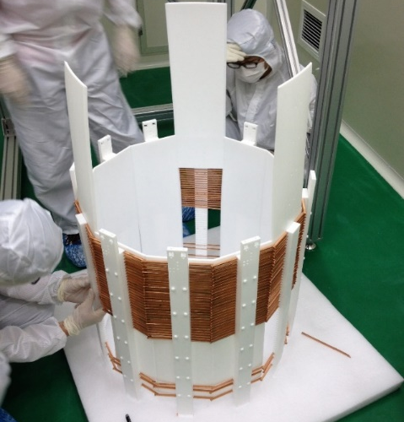
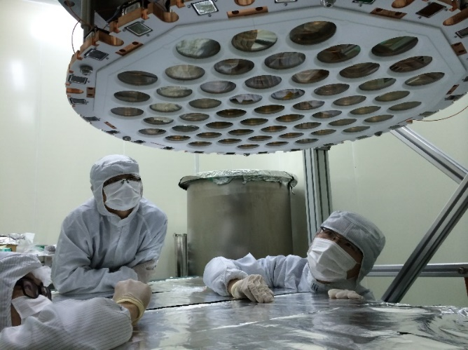
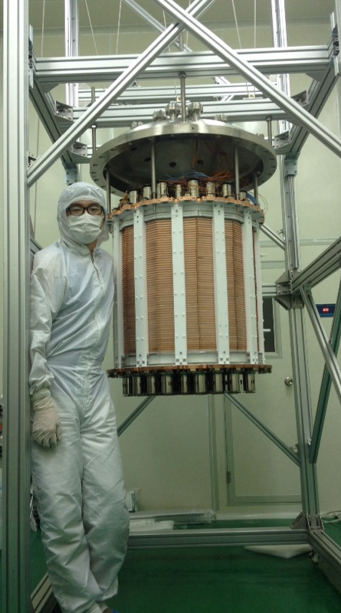
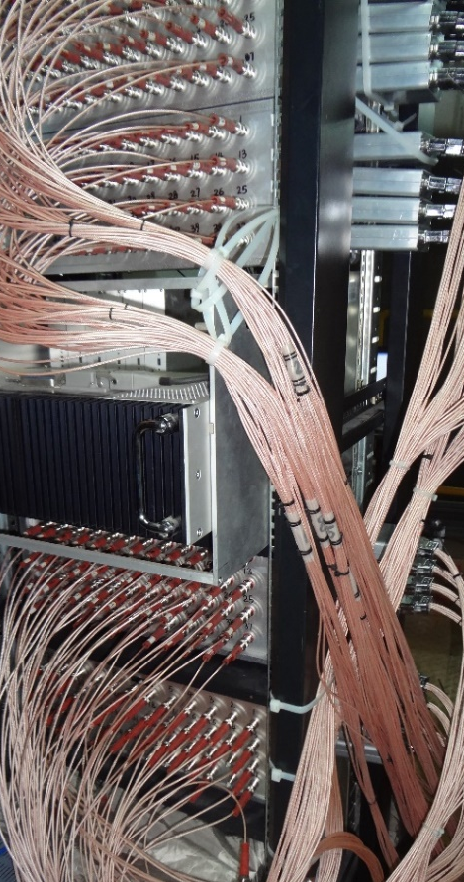
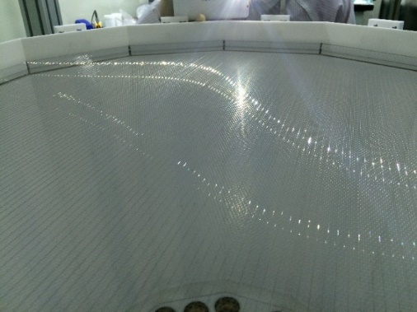
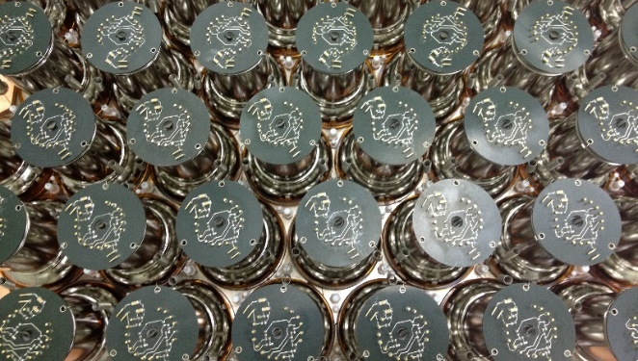
Assembling the detector

Slide 8
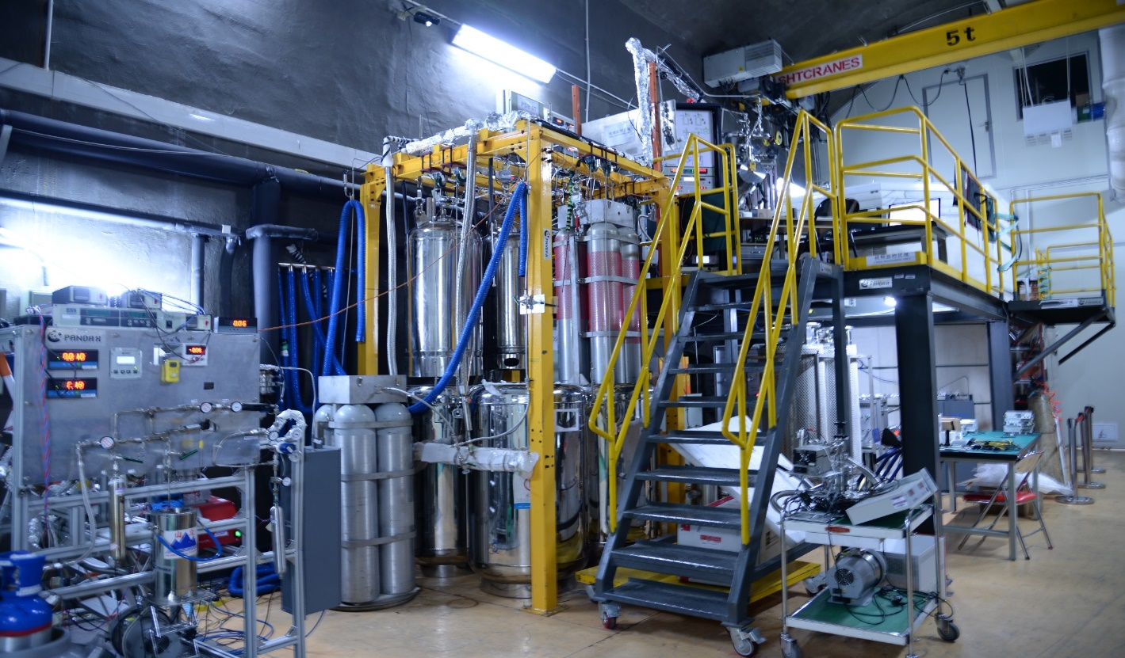
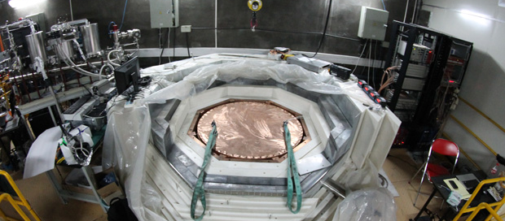
The CJPL-I PandaX Lab

Slide 9
PandaX-II Run history
Run9 =79.6 days, exposure: 26.2 ton-day
Run10 = 77.1 days, exposure: 27.9 ton-day
Run11 ~ 254 days, exposure ~ 92 ton-day
Jul. 2017- June 2019, a few months calibration, followed by DM data taking (Run11), and R&D runs for PandaX-4T
Mar. 9 – June 30, low background with 10-fold reduction of Kr (Run9, 79.6 days)
Nov. 2016 – Mar. 2017, 2nd distillation campaign and recommissioning
2015
2016
2017
2018/2019
Nov. 22 – Dec. 14, Physics commission (Run8, 19.1 days, stopped due to high Krypton background)
Jul – Oct, ER calibration & tritium removal
Apr.22 – July15, dark matter data taking (Run10, 77.1 days)

Slide 10
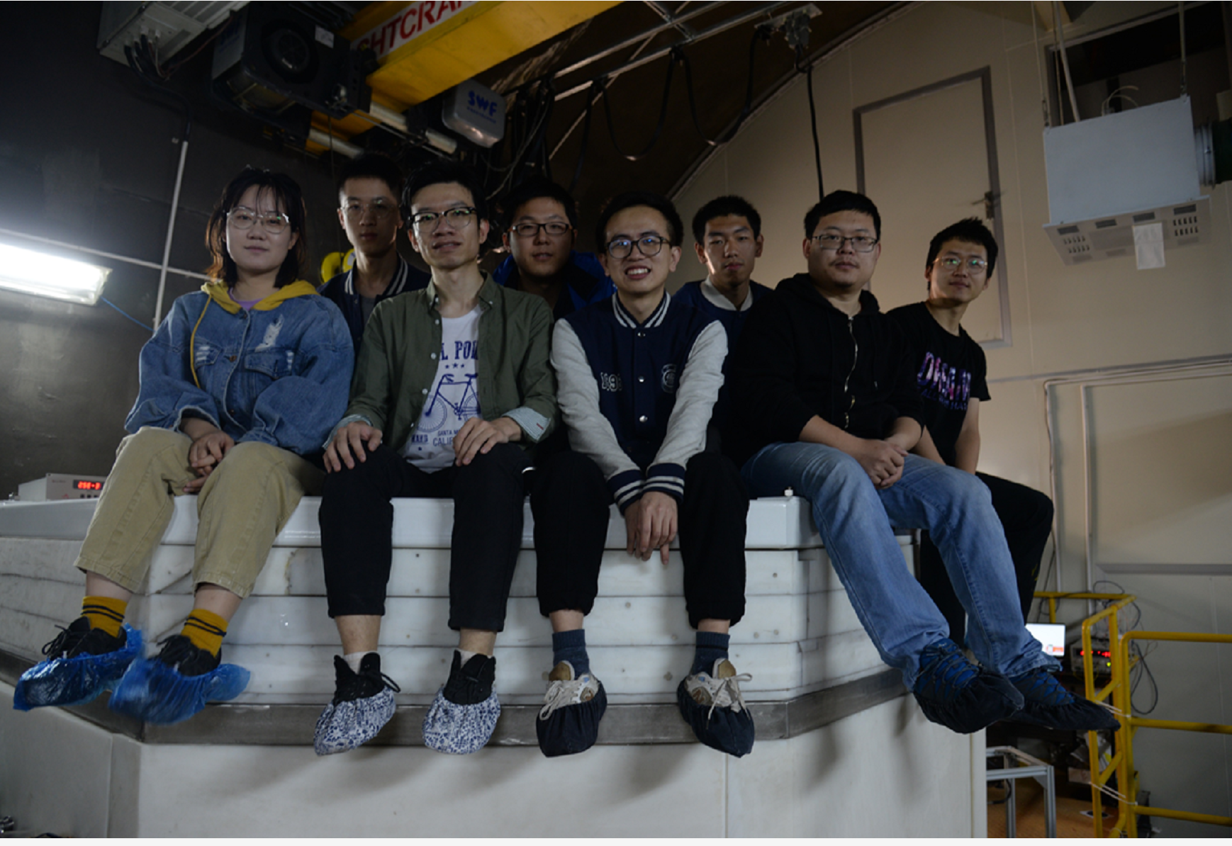
PandaX-II “end-of-run” completed
2019/6, On-site crew preparing for recuperating Xenon
1.16 Ton of Xenon has been recuperated.

Slide 11
PandaX-II DM search results
Dark matter models | Exposure (Ton-day) | Publications
WIMP-nucleon Spin-Independent | 33 | PRL 117, 121303 (2016)
WIMP-nucleon Spin-dependent | 33 | PRL 118, 071301 (2017)
Inelastic scattering | 27 | PRD 96, 102007 (2017)
Axion and ALP | 27 | PRL 119, 181806 (2017)
WIMP-nucleon SI | 54 | PRL 119, 181302 (2017)
DM models with a light mediator, self-interacting DM (*) | 54 | PRL 121, 021304 (2018)
EFT models and SD (*) | 54 | PLB 792, 193–198 (2019)
(*) collaborating with theorists: Hai-bo Yu (UCI) and
Wick C. Haxton (UCB&LBNL)

Slide 12
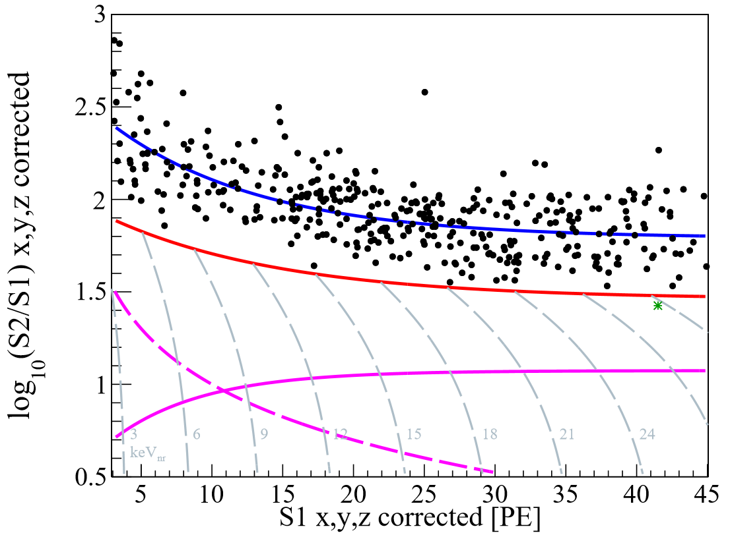
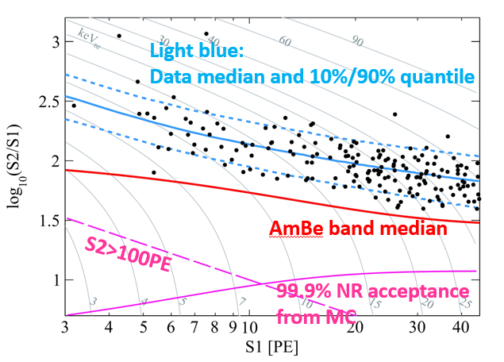
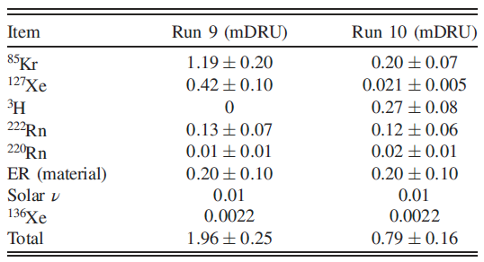
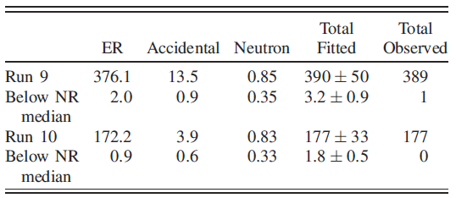
PandaX-II 54 ton-day DM data distribution
RUN9 RUN10
ER median
NR median
mDRU=10⁻³ events/kg/day/keV

Slide 13
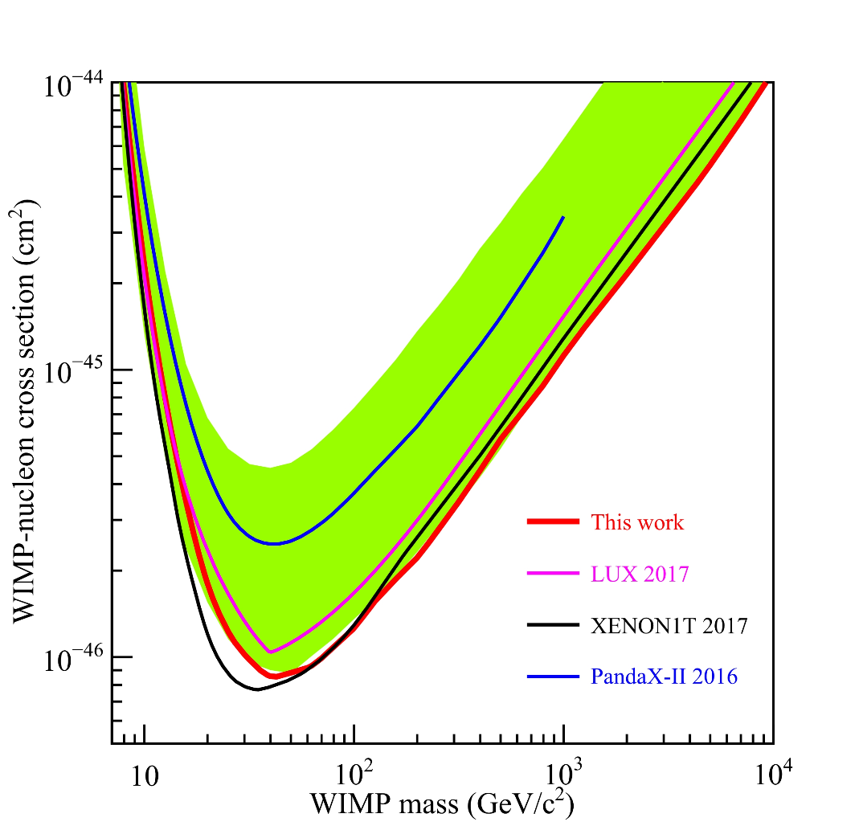
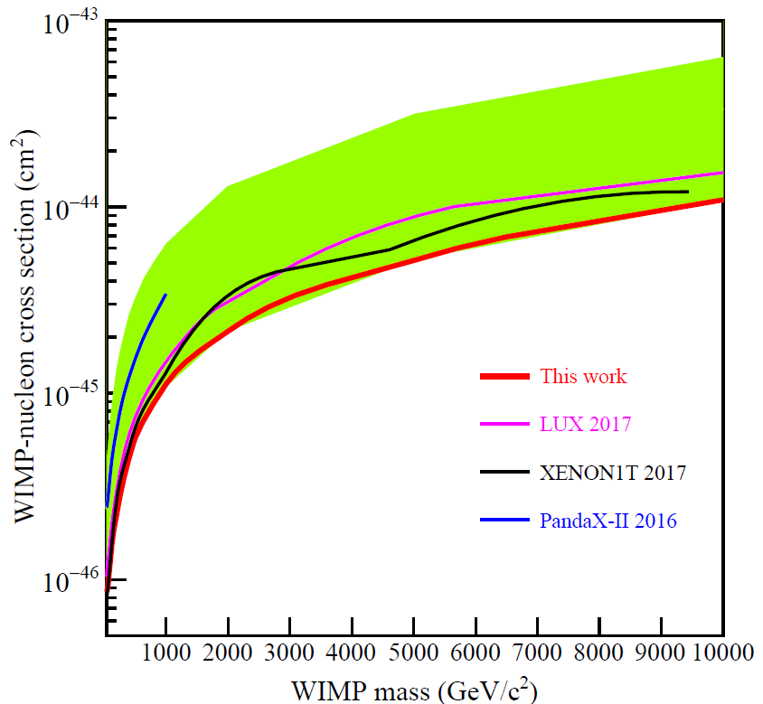
WIMP-nucleon SI cross section limits
PandaX-II 54 ton-day
PRL 119, 181302 (2017)
Improved from PandaX-II 2016 limit about 2.5 time at high masses
  Lowest exclusion at 8.6×10⁻⁴⁷cm² at 40 GeV, most stringent for m_{χ} > 40 GeV
  when published

Slide 14
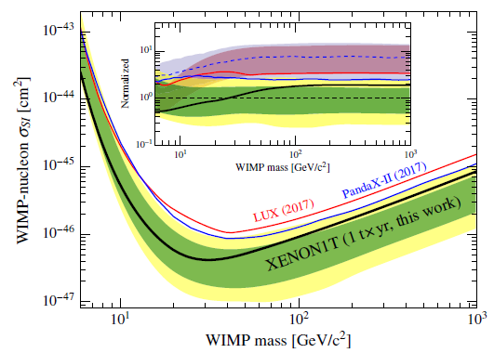
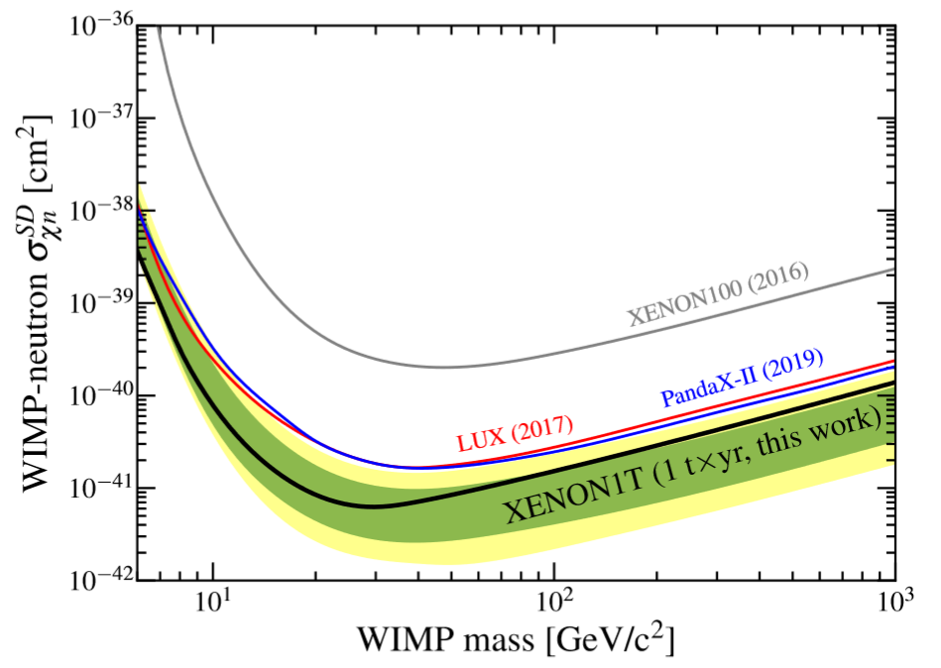
WIMP-nucleon SI and SD cross section limits
XENON1T published DM search results in 1ton-year of data, no DM observed,
Spin-independent:
LUX, PRL 118, 021303 (2017)
PandaX-II, PRL 119, 181302 (2017)
XENON1T, PRL 121, 111302 (2018)
Spin-dependent:
LUX, PRL118, 251302 (2017)
PandaX-II, PLB 792, 193–198 (2019)
XENON1T, PRL 122, 141301 (2019)

Slide 15
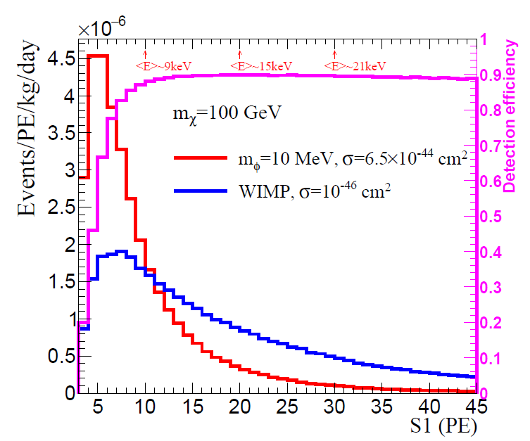
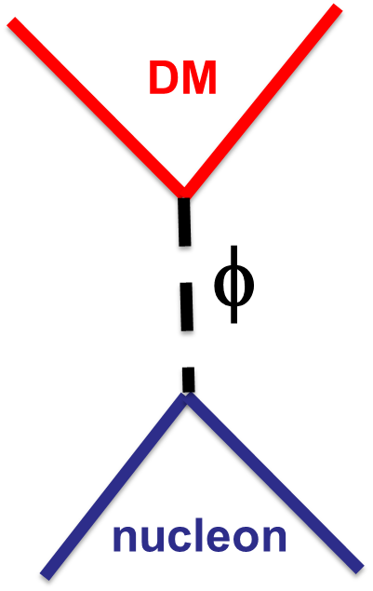

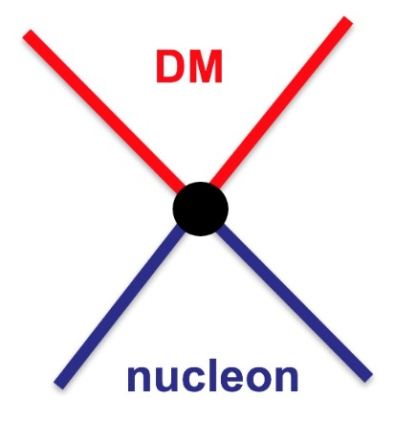
Exploring light-mediator DM models using same data
Heavy mediator ➔ EFT contact interaction
  Foundation of “main” SI/SD results in direct detection
Light mediator: mediator m_{φ} is compared to or smaller than q
  Signal spectrum more peaked towards to low-energy
  q can not be simply ignored

Slide 16
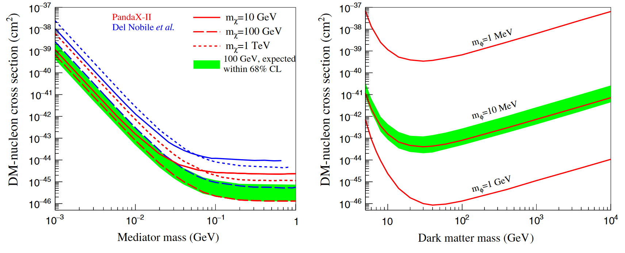
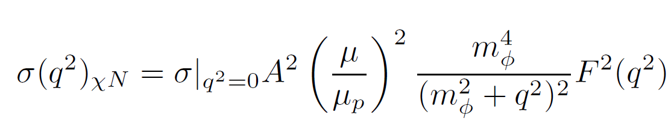
Constraining DM-nucleon cross section with a mediator
PandaX-II 54 ton-day
PRL 121, 021304 (2018)
agree with SI limits
Our Limits
For light-mediator
(scalar/vector) DM models

Slide 17
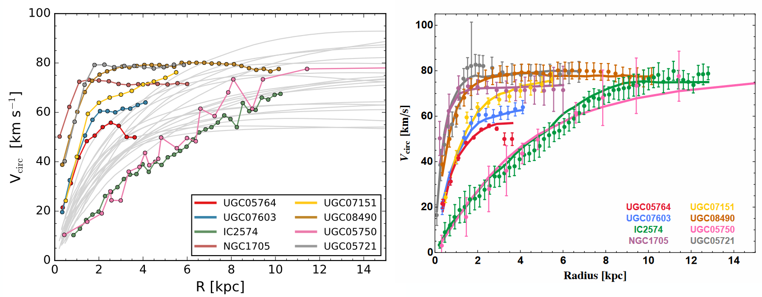
Self-Interacting DM with a light mediator
State-of-art hydrodynamical
CDM simulations
From our collaborator, Hai-Bo Yu (PBSM-2018)
Points : Observed galaxy rotation curves
Gray lines : CDM Simulation
Solid color lines:
SIDM Fits

Slide 18
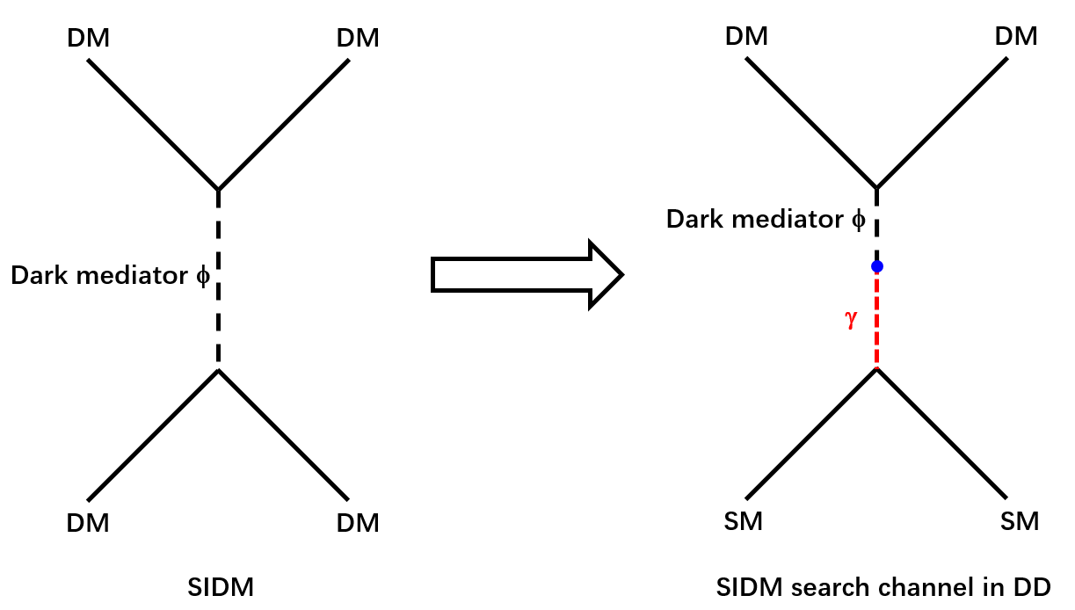
Detecting SIDM in direct detection experiments
If the mediator mixes with SM particles (through g/Z/H mixing ), SIDM
could be detected at direct detection experiments.
Two previous pheno studies directly comparable to our study:
  “Direct Detection Portals for Self-interacting Dark Matter”,
  M. Kaplingha et. al, PRD 89,035009(2014)
  “Direct Detection Signatures of Self-Interacting Dark Matter with a Light Mediator”,
  E. Del. Nobile, JCAP1510, 055 (2015)

Slide 19
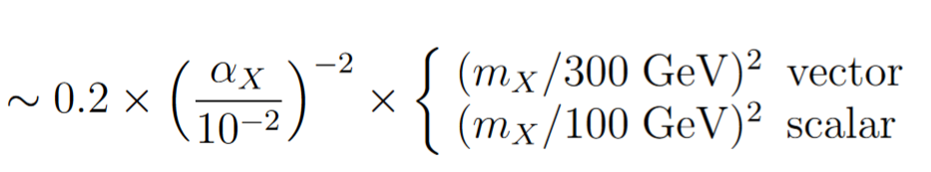


SIDM particle-physics model at direct detections
  M. Kaplingha et. al, PRD 89,035009(2014)
New Parameter | Description
ε_{γ} | Mixing parameter between mediator and photon
α_{χ} | Fine structure in DM sector
α_{χ}
For Symmetric SIDM models, where DM and anti-DM are equally populated in early Universe, α_{χ} can be fixed by the observed DM relic density.
ε_{γ}
, γ/Z mixing
, H mixing
For Asymmetric SIDM models, α_{χ} = 0.01 is assumed

Slide 20
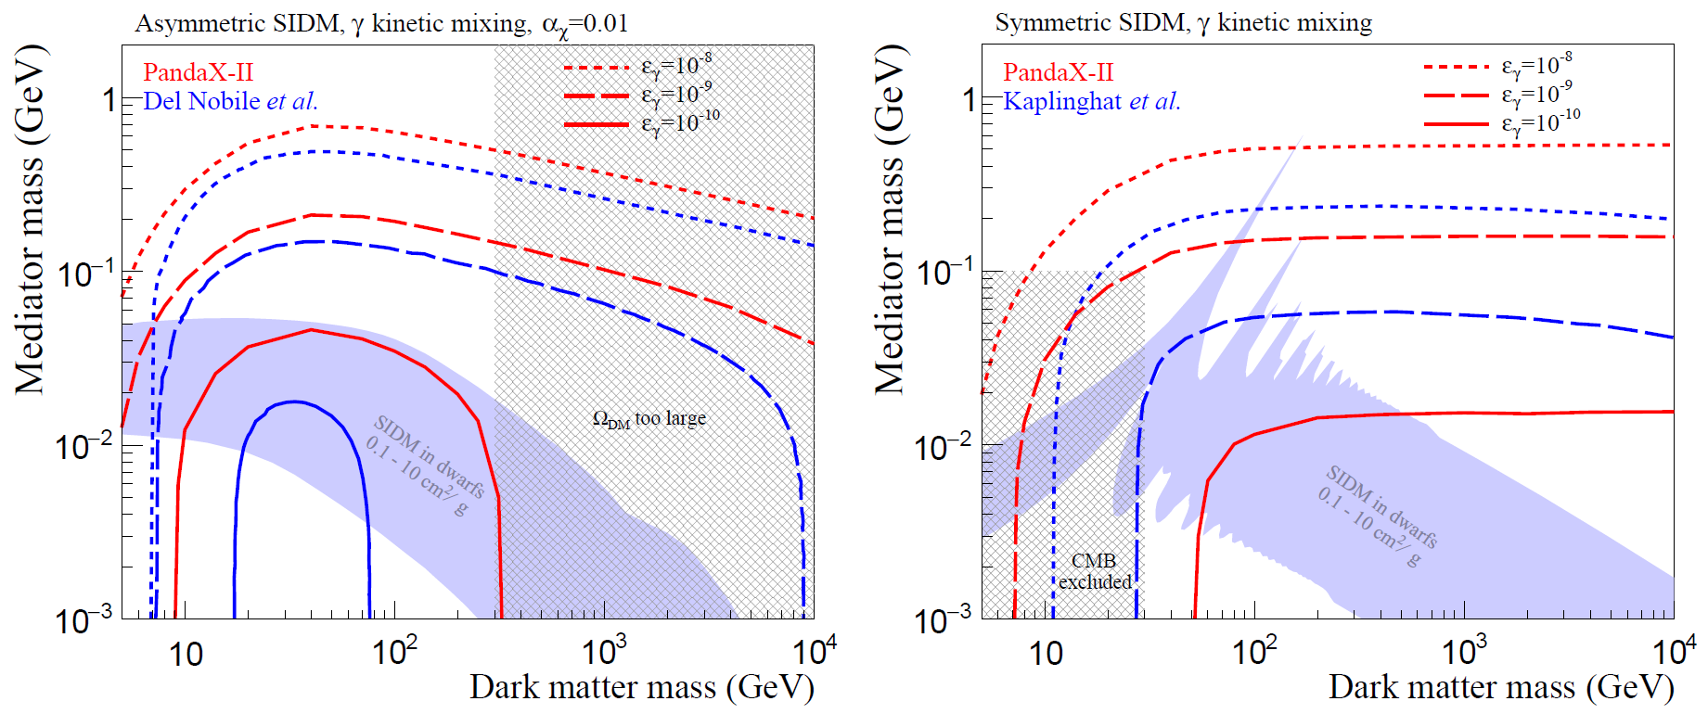
Constraining Self-interacting DM
Lower limits on mediator mass vs DM mass for Asymmetric (left) and Symmetric SIDM with photon kinetic mixing.
In the favored SIDM parameter space, PandaX-II is sensitive for as small as 10⁻¹⁰ mixing parameter

Slide 21
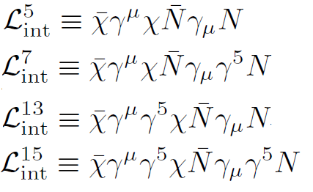
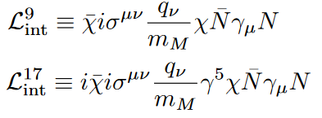
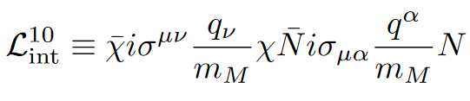
General EFT DM-SM interaction
7 typical relativistic operators studied, complete list in
Phys. Rev. C89, 065501 (2014)
Dimension | Operator | Interactions
4 |  | vector/axial- vector interactions (L5/15: standard SI/SD)
5 |  | coupling the WIMP magnetic moment or electric dipole moment with the nucleon’s vector current
6 |  | coupling WIMP and nucleon magnetic moments
A unit dimensionless coupling is assumed here,
this will be constrained by PandaX-II data.

Slide 22
Energy spectra for EFT operators
7 typical relativistic operator, leading to dramatically different spectra
  q and v dependence
  Isospin scalar (coupling to proton and neutron with same sign)
  isospin vector (p,n opposite sign)

Slide 23
Upper limits on coupling
PLB 792, 193–198 (2019)
Constraints strongly depending on the operator/isospin

Slide 24
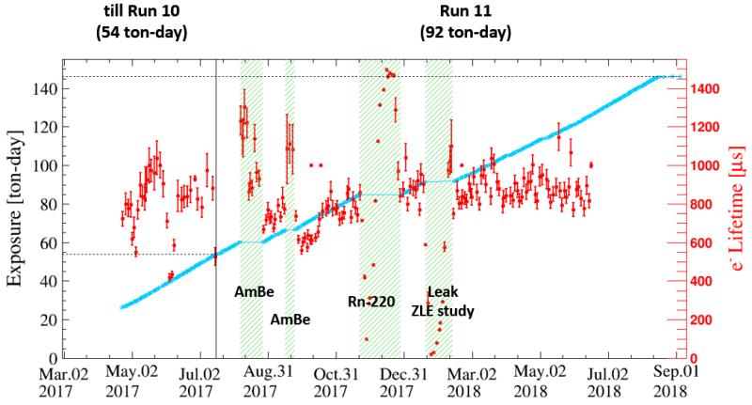
Updated DM data exposure in PandaX-II
A factor of ~2 more DM data to be unblinded.
Analysis is ongoing, tentatively releasing new results
at next TAUP conference (2019/09)

Slide 25
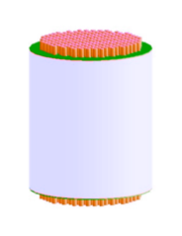
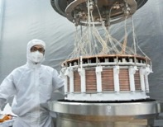
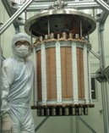
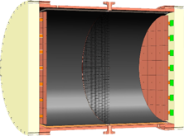
PandaX Future
PandaX-xT for DM search
PandaX-III for 0vbb search
PandaX-I: 120 kg DM experiment
2009-2014
PandaX-II: 500 kg DM experiment
2014-2018
PandaX-xT:
Next stage: 4-ton DM experiment
Future
PandaX-III: 200 kg to 1 ton HP gas ¹³⁶Xe 0vDBD experiment
Future
CJPL-I
CJPL-II
Ke Han’s talk this afternoon
For 0NDBD

Slide 26
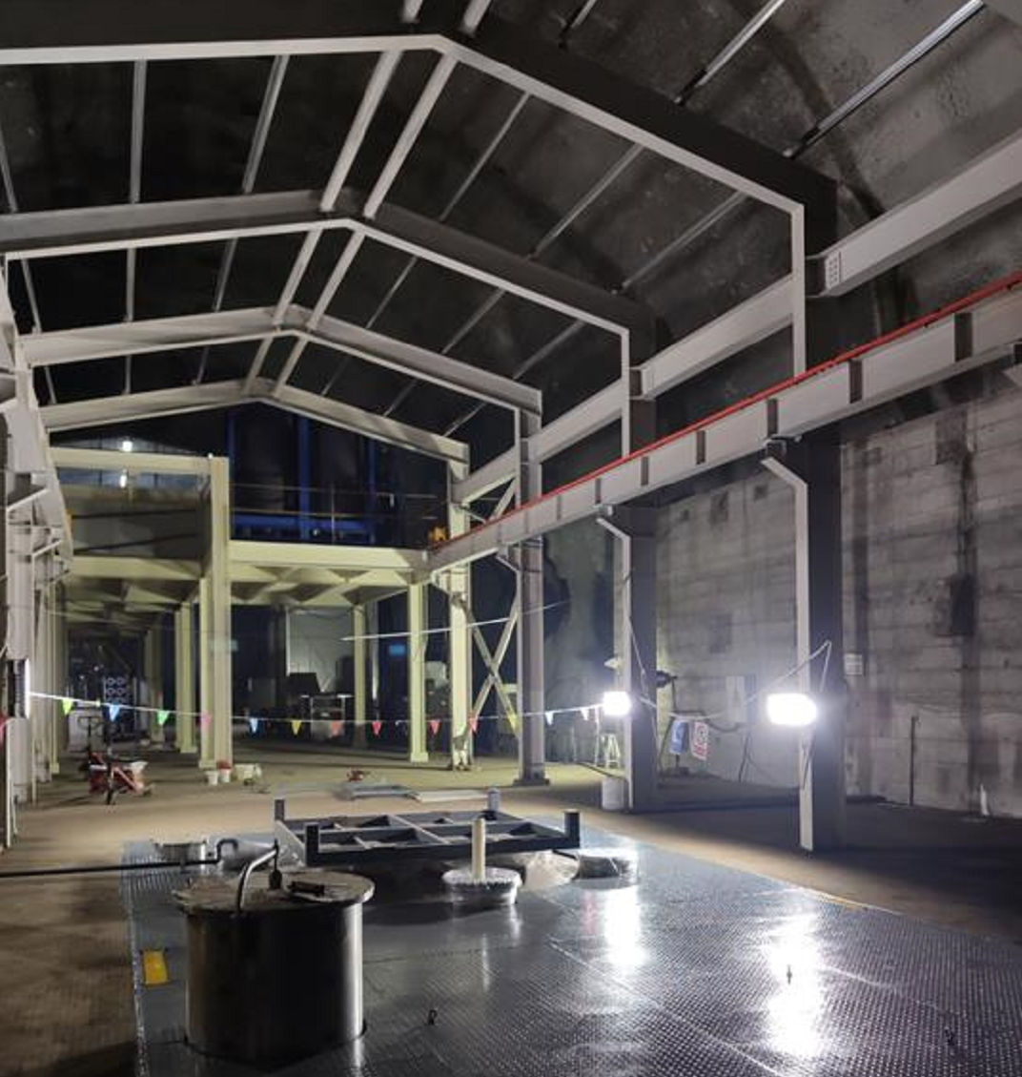
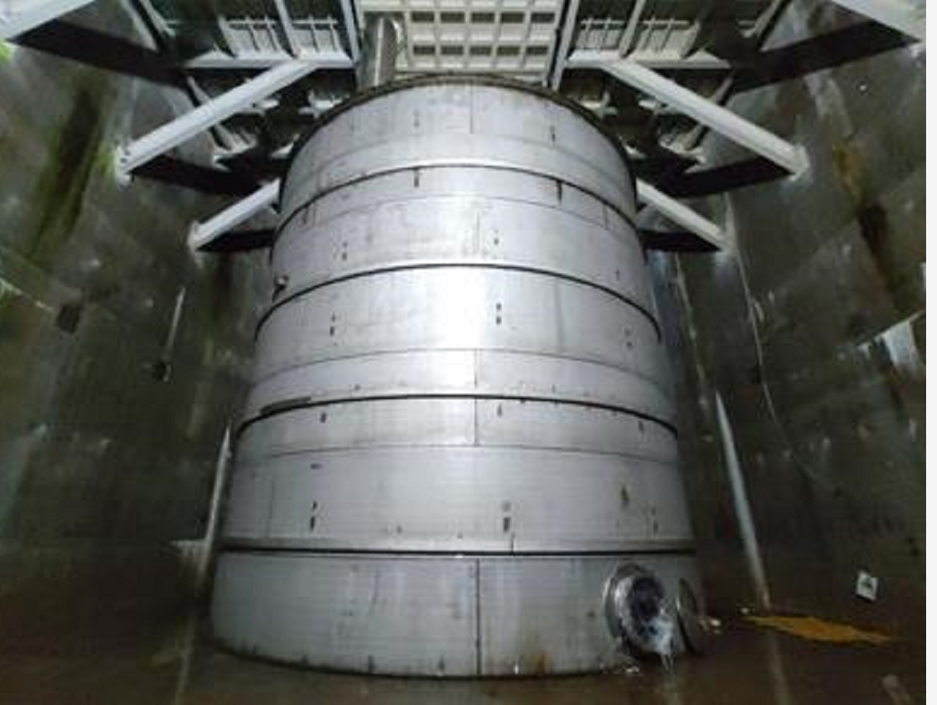
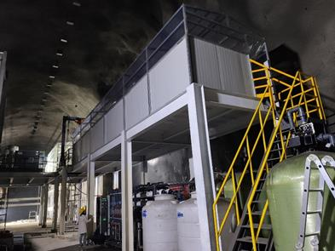
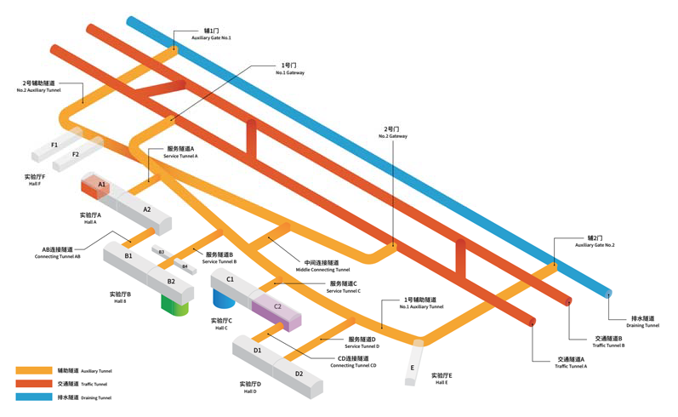
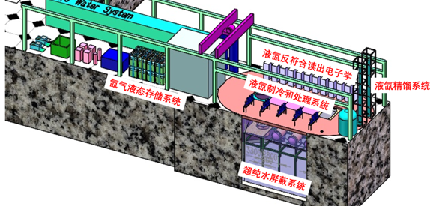
New experiment hall at CJPL-II
B2 Hall
14m(H)x14m(W)x65m(L)
Water Shielding
  5000 Ton pure water
  U/Th <10⁻¹⁴ g/g

Slide 27
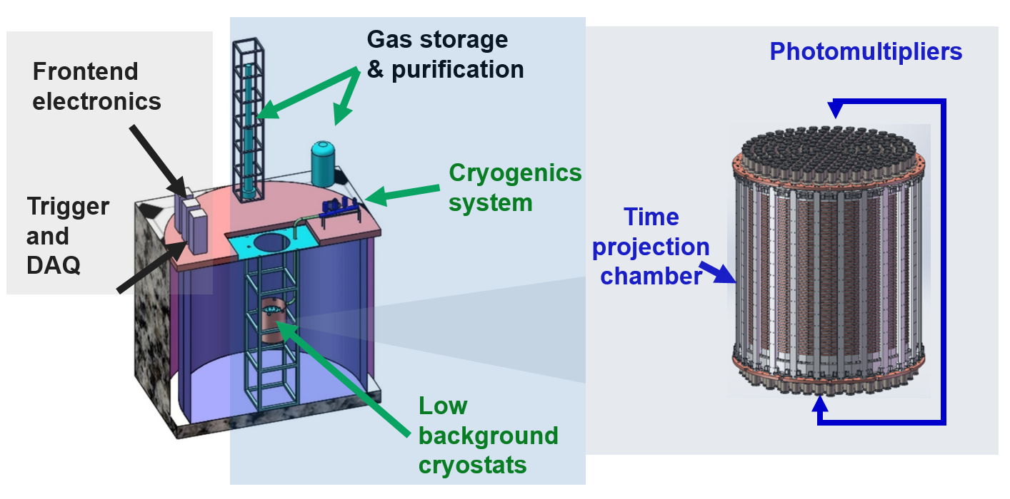
PandaX-xT facilities
512 PMTs
  Drift region:
  Ф~1.2m,
  H~1.2m
Intermediate stage:
  PandaX-4T (4-ton in sensitive region) with SI sensitivity ~10⁻⁴⁷ cm²
  On-site assembly and commissioning: 2019-2020

Slide 28







PandaX-4T in preparation
2019-2020: assembly and commissioning
Cooling bus
Inner vessel
Krypton measurement
TPC prototype
PMT test
DAQ board

Slide 29


PandaX-4T sensitivity study
Simulated ER and NR events
  Detector materials
  Radioactivity in xenon: ⁸⁵Kr, ²²²Rn, ¹³⁶Xe
  Neutrino
Background in signal region
  Total ER background: 0.05 mDRU (0.8 in PandaX-II)
  Total NR background: 1 event/(ton-year)
With two-year exposure, SI DM-nucleon
cross section sensitivity to 10⁻⁴⁷ cm²
Sci. China-Phys. Mech. Astron. 62 3 (2019)

Slide 30
Summary
Recent results from PandaX-II are presented
  WIMP SI analysis
  Interpretations with Light-mediator and SIDM models
  Generic EFT and SD analysis
PandaX-4T and PandaX-III under preparation
  For PandaX-4T, expect 10x improvement on sensitivity over PandaX-II. For SI interaction could reach 10⁻⁴⁷ cm², detector assembly and commissioning is scheduled in late 2019 to 2020
  PandaX-III and 0NDBD, please attend Ke Han’s talk this afternoon

Slide 31
Thanks for your attention!
And many thanks to the particle-physics community
for the support to PandaX in last 10 years!

