Slide 1

Prospects of Charm Physics at τ-c Facility
Hai-ping Peng
penghp@ustc.edu.cn
State Key Laboratory of Particle Detection and Electronics (SKLPE)
University of Science and Technology of China (USTC)
8th workshop on Flavor Symmetries and Consequences in Accelerator and Cosmology
Jul. 22-27, 2019, SJTU/USTC

Slide 2
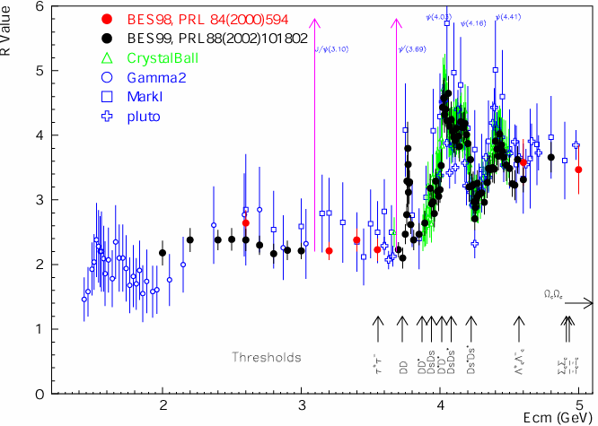
Broad Physics at τ-c Energy Region
R=s(e⁺e⁻→hadron)/
s(e⁺e⁻→m⁺m⁻)
Hadron form factors
Y(2175) resonance
Mutltiquark states with s quark, Zs
MLLA/LPHD and QCD sum rule predictions
Light hadron spectroscopy
Gluonic and exotic states
Process of LFV and CPV
Rare and forbidden decays
Physics with τ lepton
XYZ particles
Physics with D mesons
f_{D} and f_{Ds}
D₀-D₀ mixing
Charm baryons
Unique features ：Rich of resonance, Threshold characteristics, Quantum Correlation
Abundant physics
Notes:
Abundant physics topic are expected in the tau-charm energy region.
For example, in 2-3GeV, it is ideal region to study the hadron form factors,
Study the properties of Y(2175) and search for the mulitquaks states with s quark,
It also can be used to test QC sum rule predictions.
In the charmonium energy region, which can collect very very last data samples, and
It can be used to study the light hadron spectroscopy And gluonic and exotis states.
It also can be used to search for the LFV process, CPV process and rare and forbidden decays preocss.
Of course tau physics can be one of landmark in this region.
Above the 4GeV region, It is ideal place to study XYZ particle, Physics with D meason
And D-D0 mixing charm bayrons.
Of course, the R scane in the whole energy region will definenalyy improve the presision
Of delta Alpha QDQ, charm quark mass extraction. Estpcaiilly in the range from 5-7 GeV,
There are very rare experiment data to day.
The data can also be use for the hadron from factor study.

Slide 3
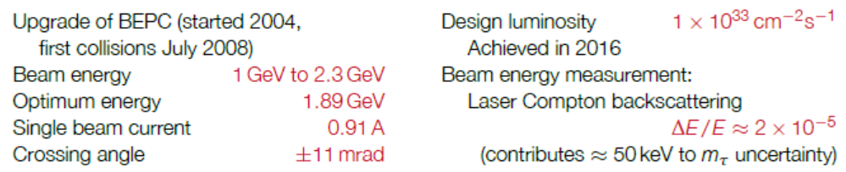
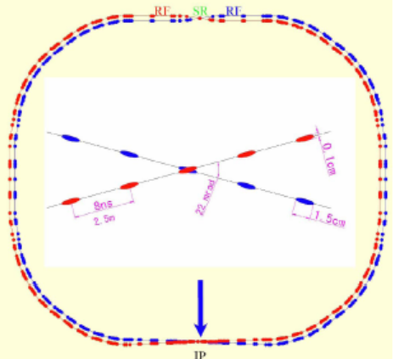
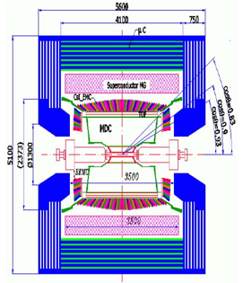
BEPCII

Slide 4
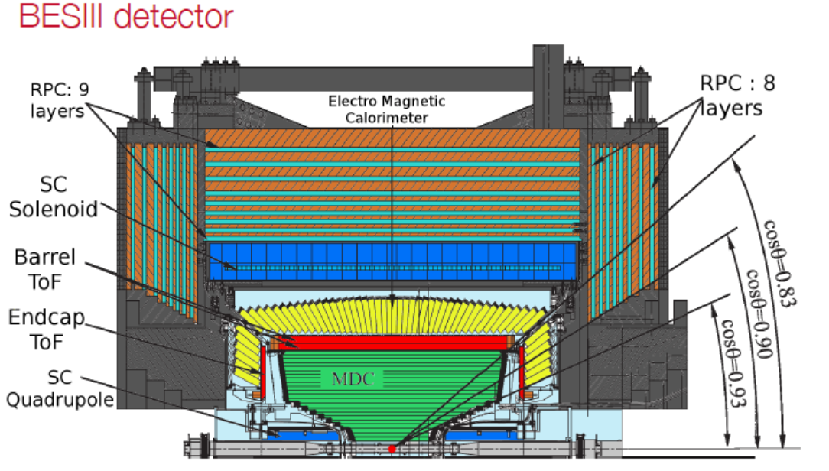
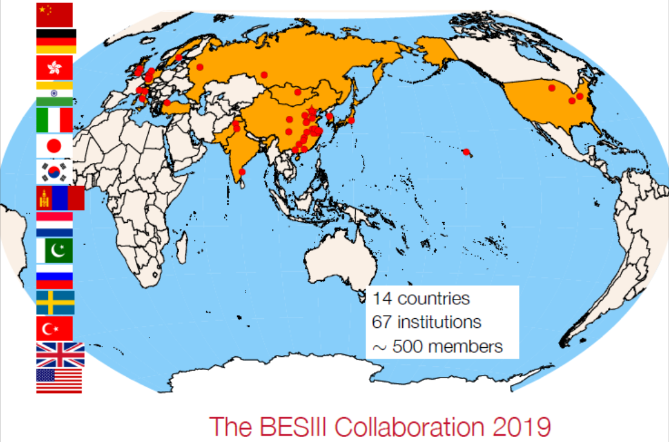
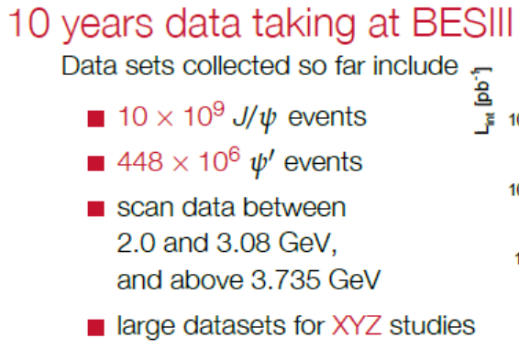
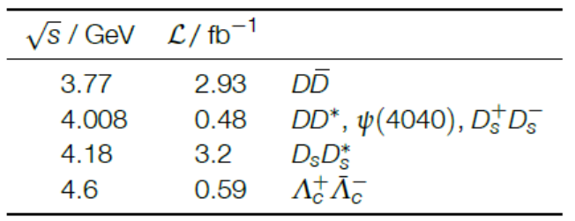
BESIII Experiment

Slide 5
Limitation for BEPCII/BESIII
BEPCII/BESIII have run 10 years, and are playing a leading role in tau-charm physics area.
Limited by length of storage ring, no space and potential for the upgrade.
Physics study limited by the Statistics (luminosity), CME ……
Challenged by Belle II
BEPCII/BESIII will end her mission in 5 - 8 years (?)
A Super τ-charm Facility is the nature extension and a viable option for a post-BEPCII HEP project in China

Slide 6
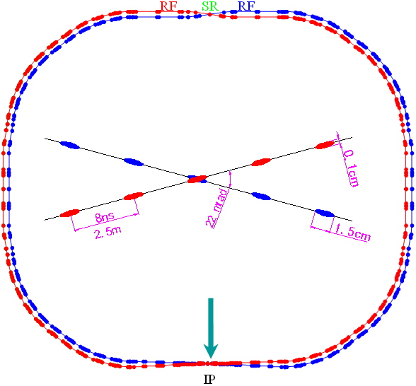
BEPCII vs STCF in China
BEPCII
Peak luminosity 0.6-1×10³³ cm⁻²s⁻¹ at 3.773 GeV
Energy range E_{cm} = 2 − 4.6 GeV
No Polarization
Designed STCF
Peak luminosity 0.5-1×10³⁵ cm⁻²s⁻¹ at 4 GeV
Energy range E_{cm} = 2−7 GeV
Potential to increase luminosity and realize beam polarization
1 ab⁻¹ data is expected per years
Notes:
BEPCII/BESIII will end her mission around 2020,
Led by the high energy Physics association of China, we are exploring possible
Future collider proejct post BEPCII and BESIII
High intensity Electron Positron accelerator (HIEPA) is one of the options.
HIEPA facility can be serviced as a collider machine,
Which provide peak lumin…..
The energy range from 2-7Gev, polarization available on one beam
And the symmertic machine with low currents and crabbed saist solution for the interation….
It also can

Slide 7
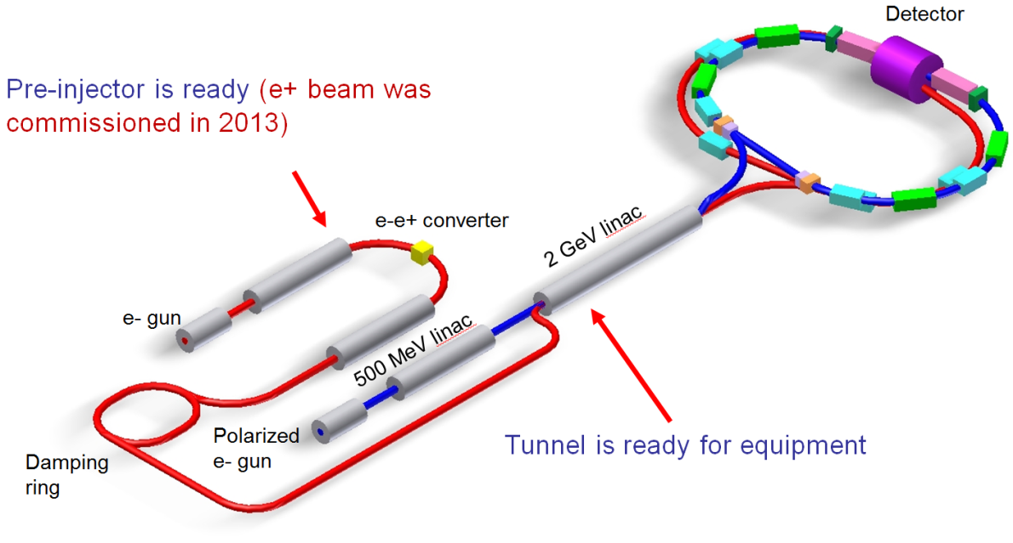
International Collaboration
Super Charm-Tau at Novosibirsk, RUSSIA, Budker Institute of Nuclear Physics Long history…..
Pre-Agreement of Joint effort on R&D, details are under negotiation
Joint workshop between China, Russia, and Europe
2018 UCAS (March), Novosibirsk (May), Orsay (December)
2019 Moscow(September)

Slide 8
Strategy& Activities of STCF at China
CDR → TDR → project application → construction → commissioning
Strategy: focus on CDR (3 years) and TDR (6 years) depend on the available resources. the construction site open.
Webpage: http://wcm.ustc.edu.cn/pub/CICPI2011/futureplans/
Domestic Workshops (2011, 12, 13, 14, 16)
International Workshops (2015, 18)
2015 Fragrance Hill-Science Conference (No. 533)
Report to USTC Scientific Committee and USTC presidents
Report to local government
Form the Organization (including project manager, physics/detector/accelerator work groups ….)
Regular weekly meetings for Accelerator/Detector/physics !

Slide 9
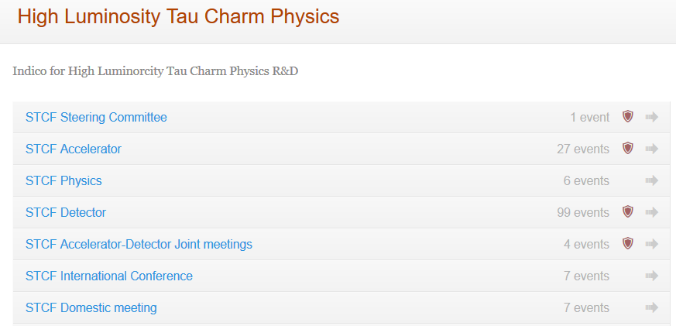
Activities
27
99

Slide 10
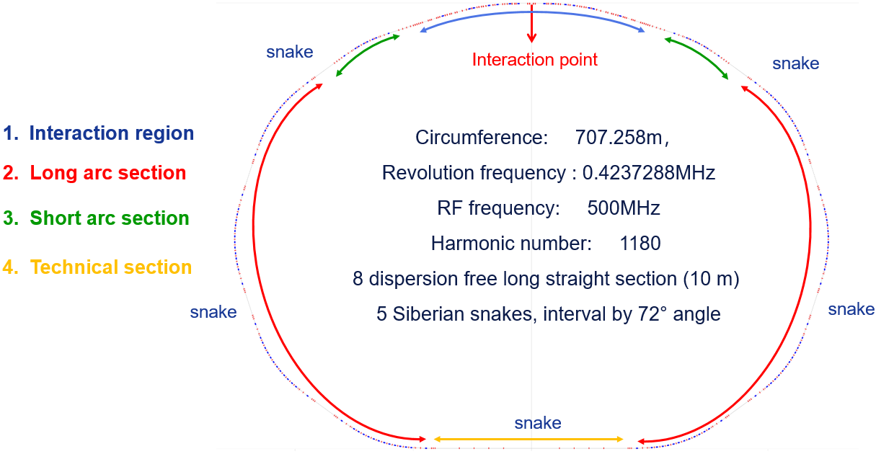
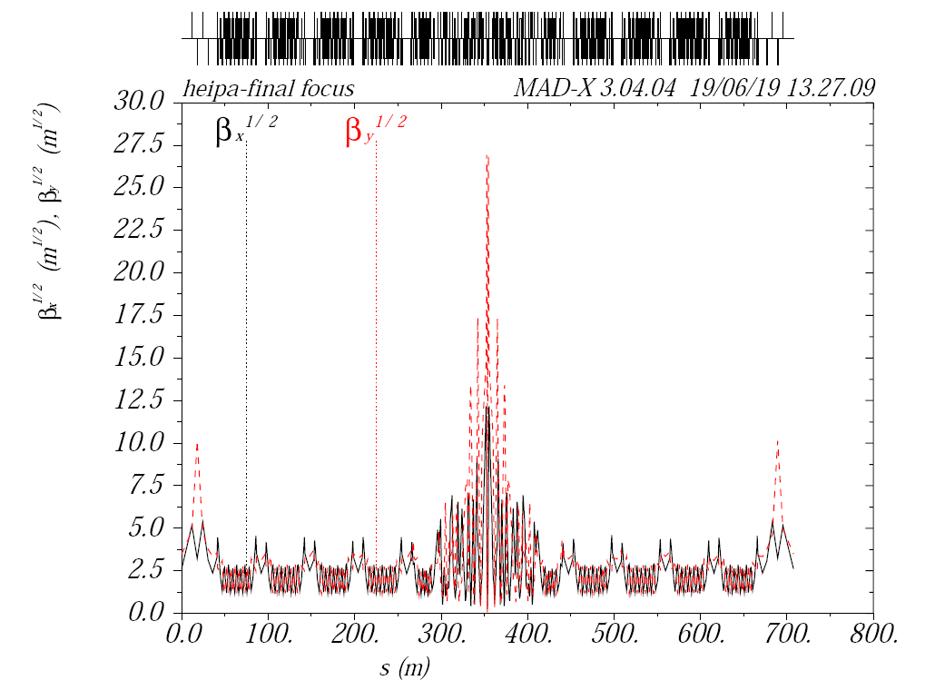
Lattice with FODO-Like Arc
Ring β function
Ring Dispersion function

Slide 11
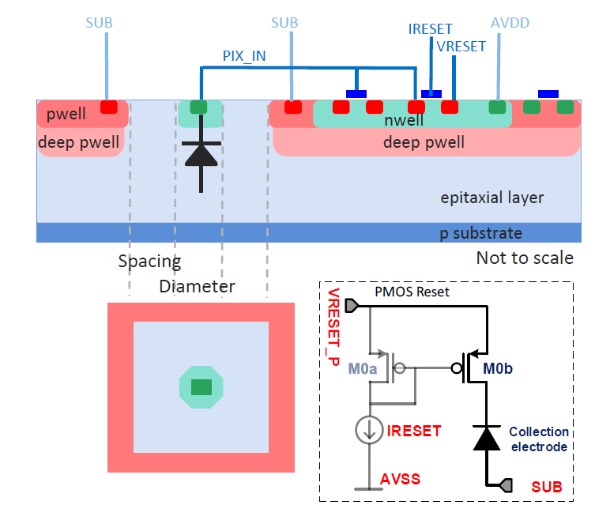
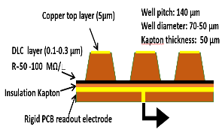
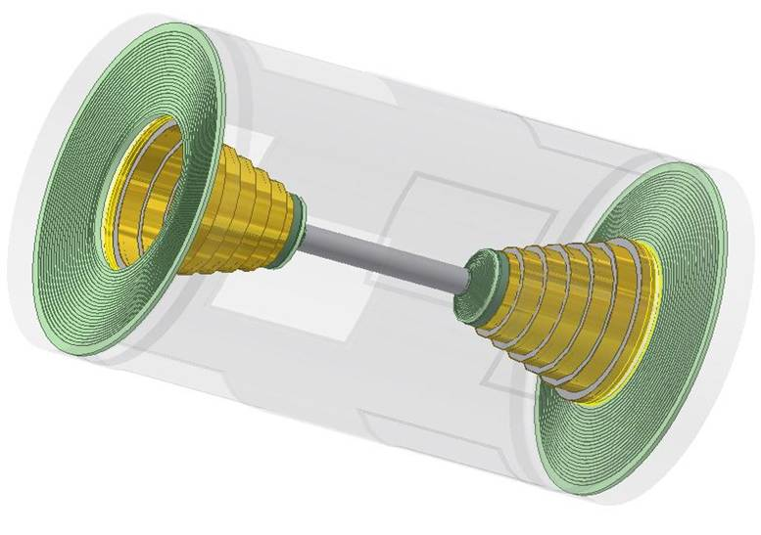
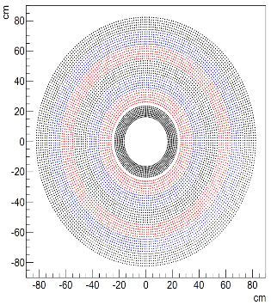
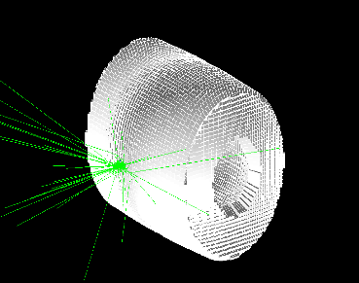
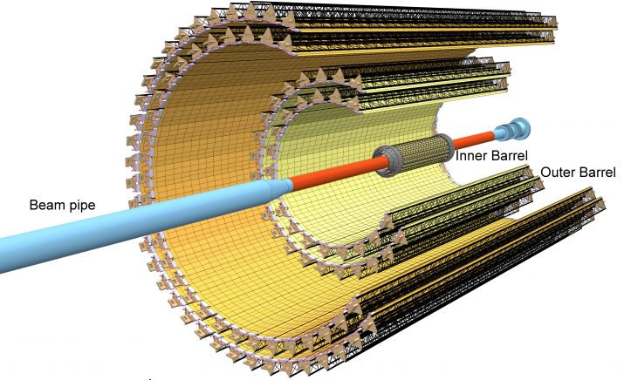
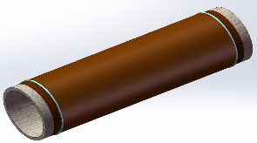
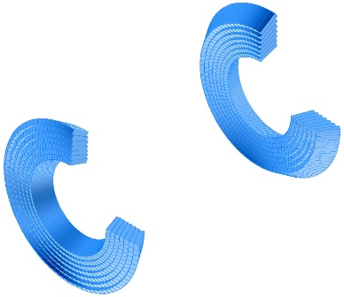
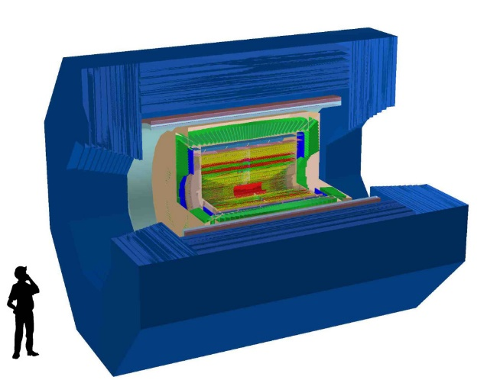
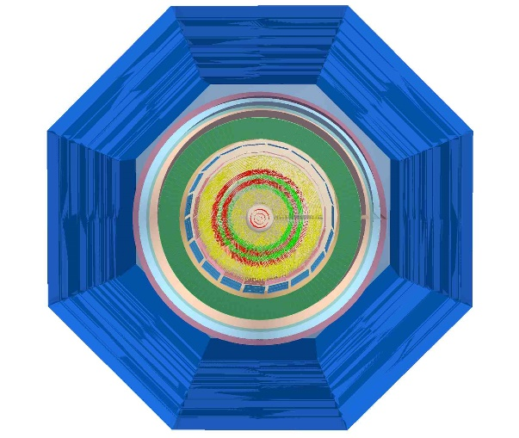
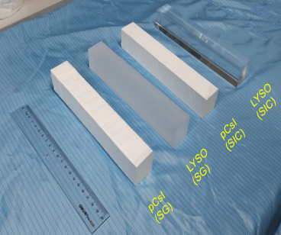

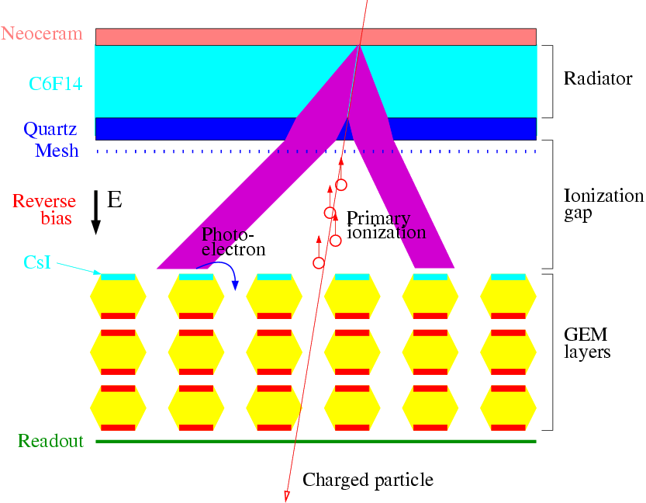
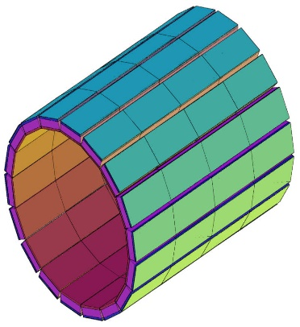
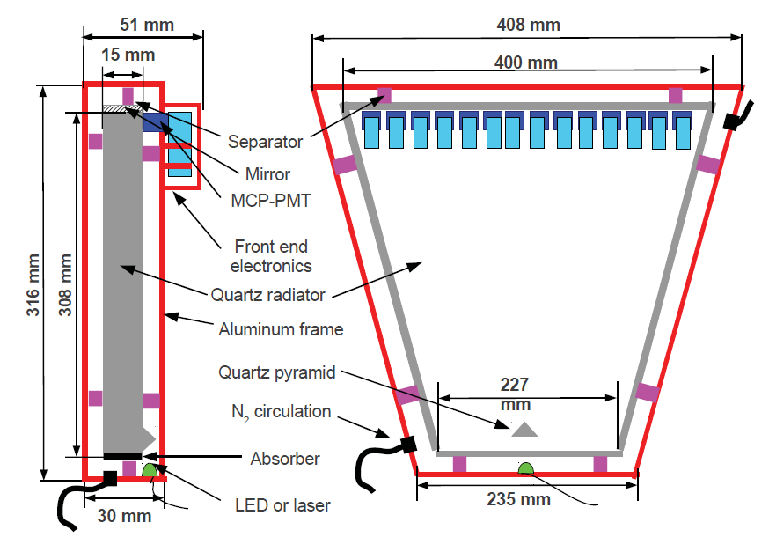
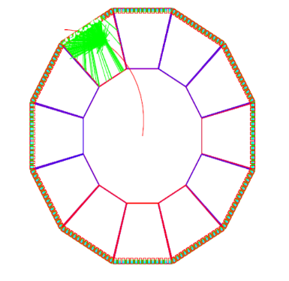
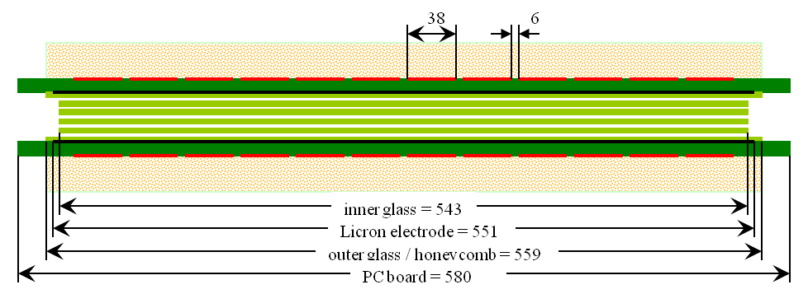
Spectrometer
DMAPs
MPGD
MDC
Conceptual design almost done,
some components (PID，Ecal) enter technological design
BCAL
pCsI
ECAL
LYSO
RICH
MUC
MRPC+RPC+Scintilator
DIRC
11

Slide 12
Facilities for Charm Study
LHCb: Hadron collider, huge cross, energy boost
9 fb⁻¹ until now, 50 fb⁻¹ upgrade I,
World′s largest sample of c-hadron decay in charged modes
B-factories (Belle(-II), BaBar): e⁺e⁻ collider
~ 1 ab⁻¹ Belle, 50 ab⁻¹ Belle-II (2024)
more kinematic constrains, clean environment,
~100% trigger efficiency
τ-charm factories (BESIII, STCF): e⁺e⁻ collider
Pair production and double tag technique
Low backgrounds and high efficiency,
Quantum correlations (J^{PC}=1⁻⁻ for DD, J^{PC}=0⁺⁺ for γDD)
and CP-tagging are unique

Slide 13
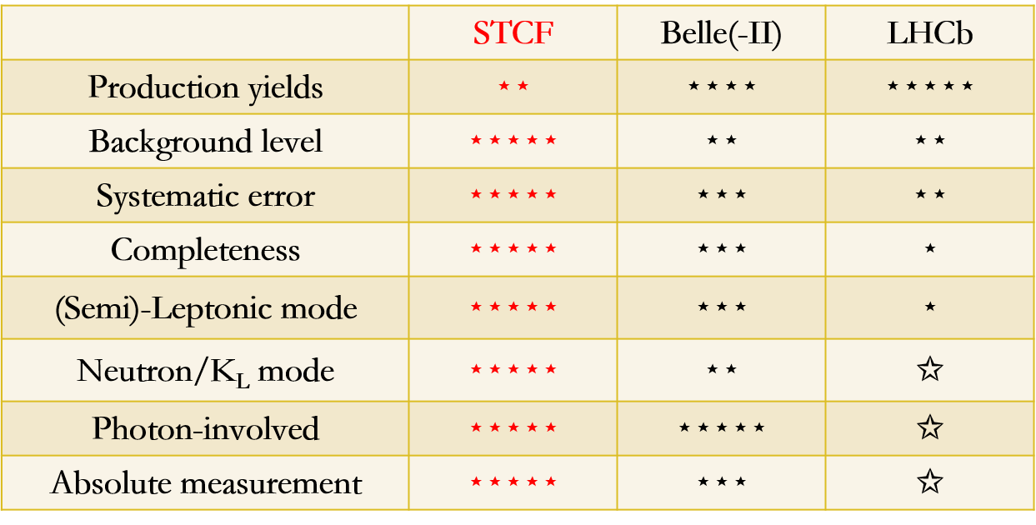
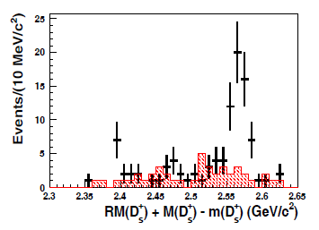
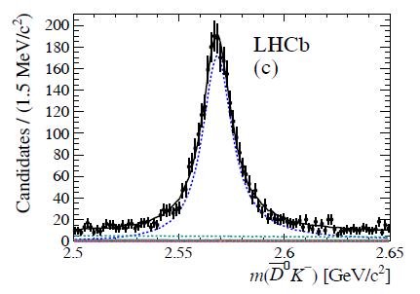
Features for Charm Study
0.5fb⁻¹ ∼ 80Events
1.0ab⁻¹∼ 160000 Events
Most are precision measurements, which are mostly dominant by the systematic uncertainty STCF has overall advantages in several studies
D_{J2}
3.0 fb⁻¹∼ 4000Events
60.0fb⁻¹∼ 80000 Events
Belle II (50 ab⁻¹) has ~20 times more statistics in production comparing to STCF 1 ab⁻¹
STCF is expected to have higher detection efficiency. It's double tag yields expected to be ~20 times more than Belle II
STCF has low backgrounds for productions at threshold

Slide 14
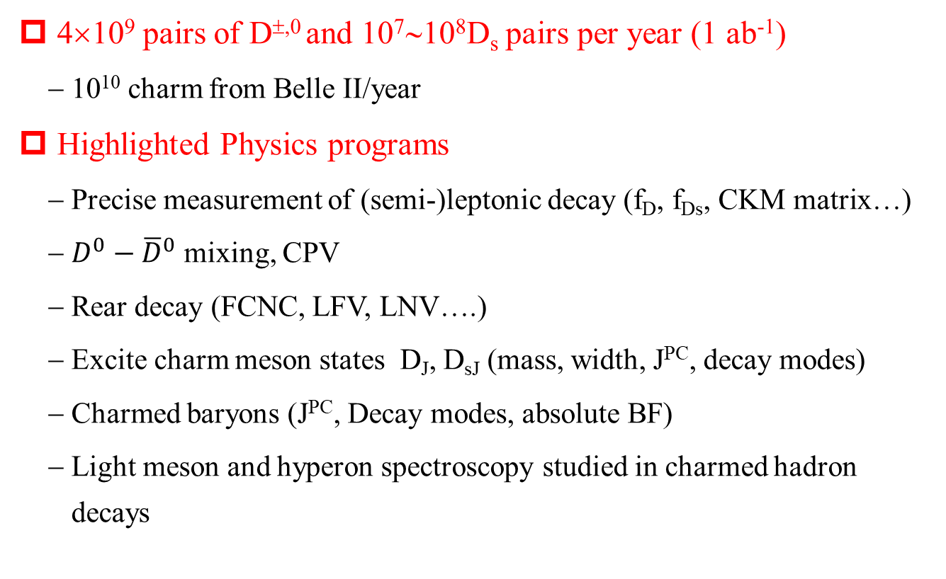
STCF for Charm Study
4×10⁹ pairs of D^{±,0} and 10⁷∼10⁸D_{s} pairs per year (1 ab⁻¹)
10¹⁰ charm from Belle II/year
Highlighted Physics programs
Precise measurement of (semi-)leptonic decay (f_{D}, f_{Ds}, CKM matrix…)
$D^{0}−{\overline{D}}^{0}$ mixing, CPV
Rear decay (FCNC, LFV, LNV….)
Excite charm meson states D_{J}, D_{sJ} (mass, width, J^{PC}, decay modes)
Charmed baryons (J^{PC}, Decay modes, absolute BF)
Light meson and hyperon spectroscopy studied in charmed hadron decays

Slide 15
Precision measurement of CKM elements
CKM matrix elements are fundamental SM parameters that describe the mixing of quark fields due to weak interaction.
A precise test of EW theory
New physics beyond SM?
BESIII + B factories + LQCD
Three generations of quark?
Unitary matrix?
BESIII + B factories + LHCb + LQCD
Expected precision < 2% at BESIII
A direct measurement of V_{cd(s)} is one of the most important task in charm physics

Slide 16
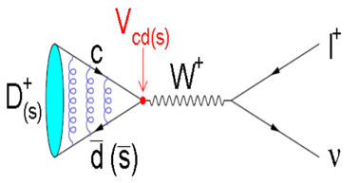
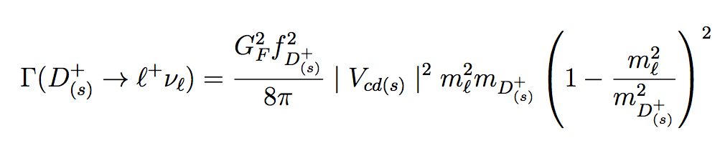
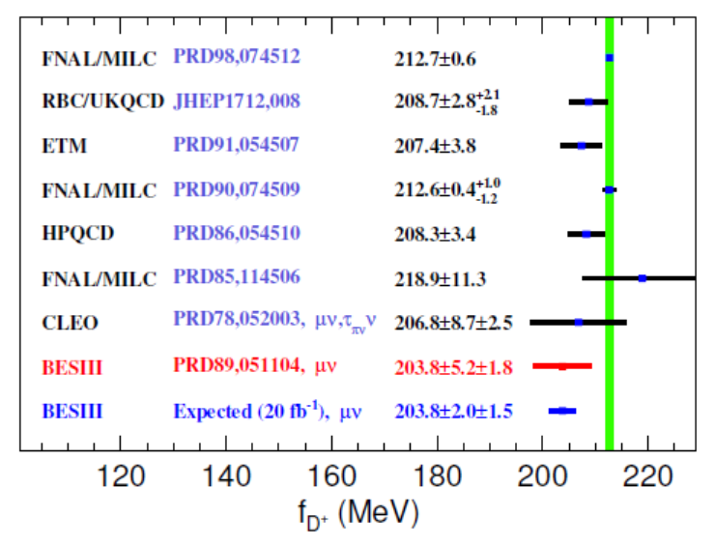
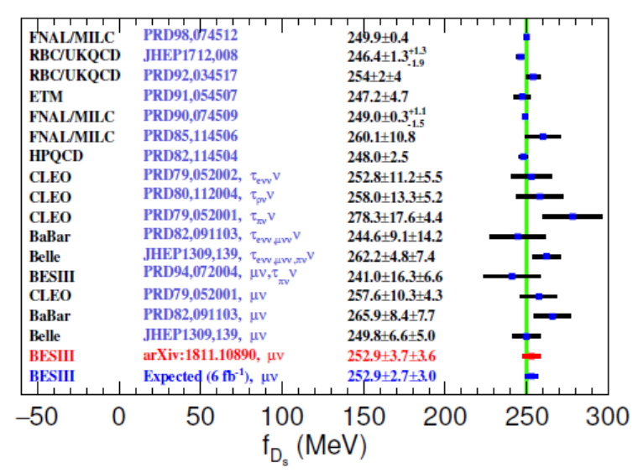
D_{(s)} Leptonic decay
Extract decay constant f_{D(s)} incorporates the strong interaction effects
To validate Lattice QCD calculation of f_{B(s)} and provide constrain of CKM-unitarity
Directly measurement : |V_{cd(s)}| x f_{D(s)}
Input f_{D(s)} from LQCD ⇒ |V_{cd(s)}| , or Input |V_{cd(s)}| from a global fit ⇒ f_{D(s)}
0.3%
<0.2%
2.7%
1.2%
2.0%
1.3%

Slide 17
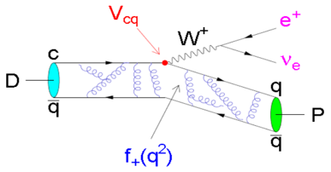
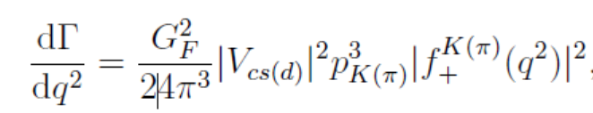
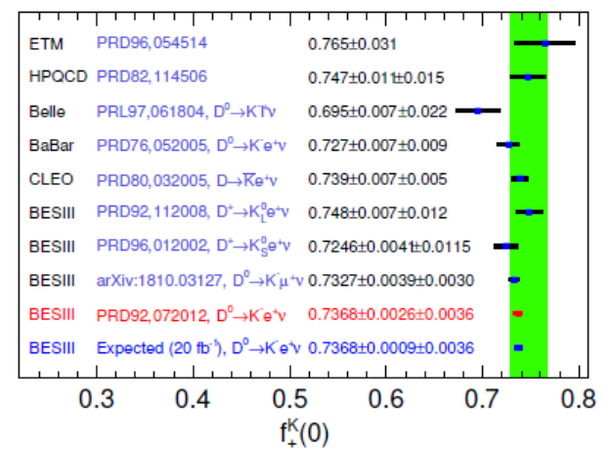
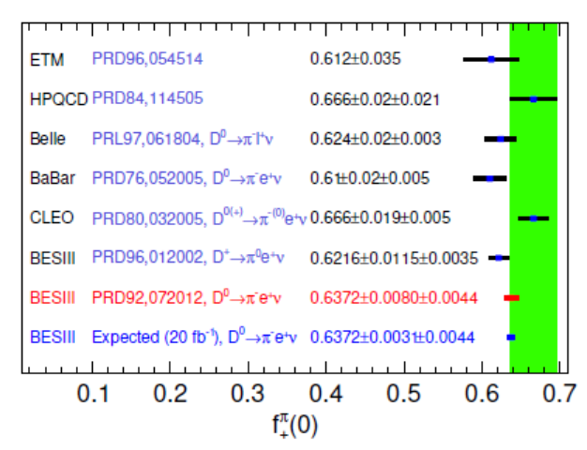
D_{(s)} Semi-Leptonic decay
Directly measurement : |V_{cd(s)}| x f^{k(π)}(0)
Input f^{k(π)}(0) from LQCD ⇒ |V_{cd(s)}|, or Input |V_{cd(s)}| from a global fit ⇒ f^{k(π)}(0)
2.4%
4.5%
0.7%
1.9%
0.6%
1.4%
0.5%
0.8%

Slide 18
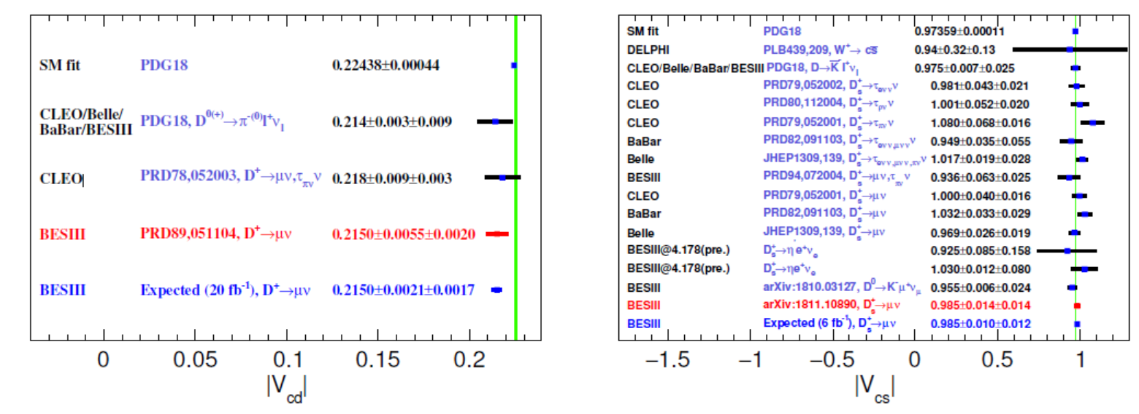
V_{cd(s)} Measurement
2.7%
1.3%
2.0%
1.6%
The best approach to measure |V_{cd(s)}| from pure leptonic decays from BESIII
Semi-leptonic decay suffer large uncertainty of FF from LQCD calculation

Slide 19
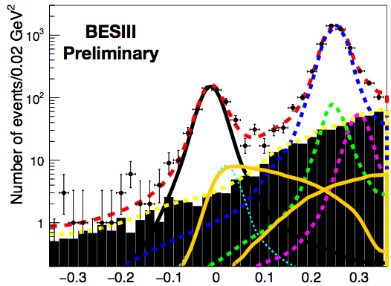
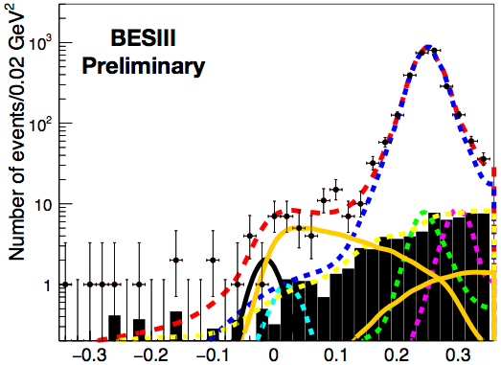

$$D_{(S)}^{+}_{τ} Decay$$
EEMC ≤ 300 MeV
EEMC > 300 MeV
D⁺➝τ⁺ν
D⁺➝μ⁺ν
D⁺➝π⁺π⁰
D⁺➝π⁺KL
D⁺➝π⁺η
D⁺➝π⁺KS
The rest
137±27 D⁺ ➝ τ⁺(➝ π⁺ ν̅τ)ντ events.
> 4σ statistical significance. First evidence!
BF(D⁺ ➝ τ⁺ντ) = [1.20±0.24(stat.)]×10⁻³.
Expected to have comparable sensitivity with $D_{\left(S\right)→μν_{μ} }^{+}$ by combining different τ lepton decay modes

Slide 20
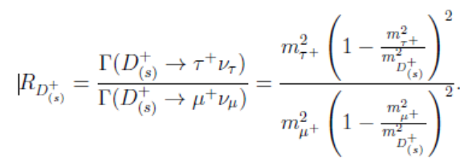
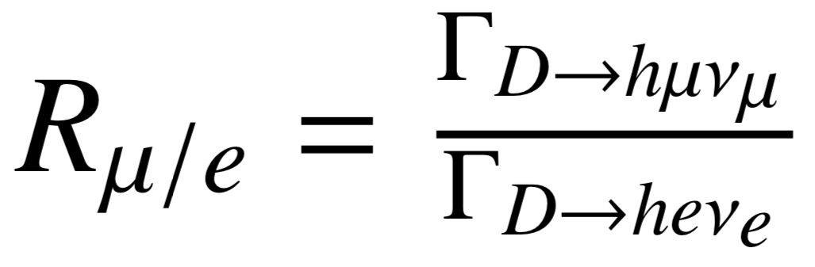
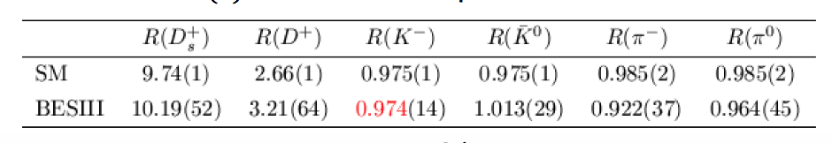
Lepton Flavor universality
LFU is critical to test the SM and search for new physics beyond SM
Purely Leptonic:
Semi-Leptonic:
BESIII preliminary
1σ difference
BESIII publication
∼2σ difference
Large uncertainty from BESIII, dominant by statistically limited

Slide 21
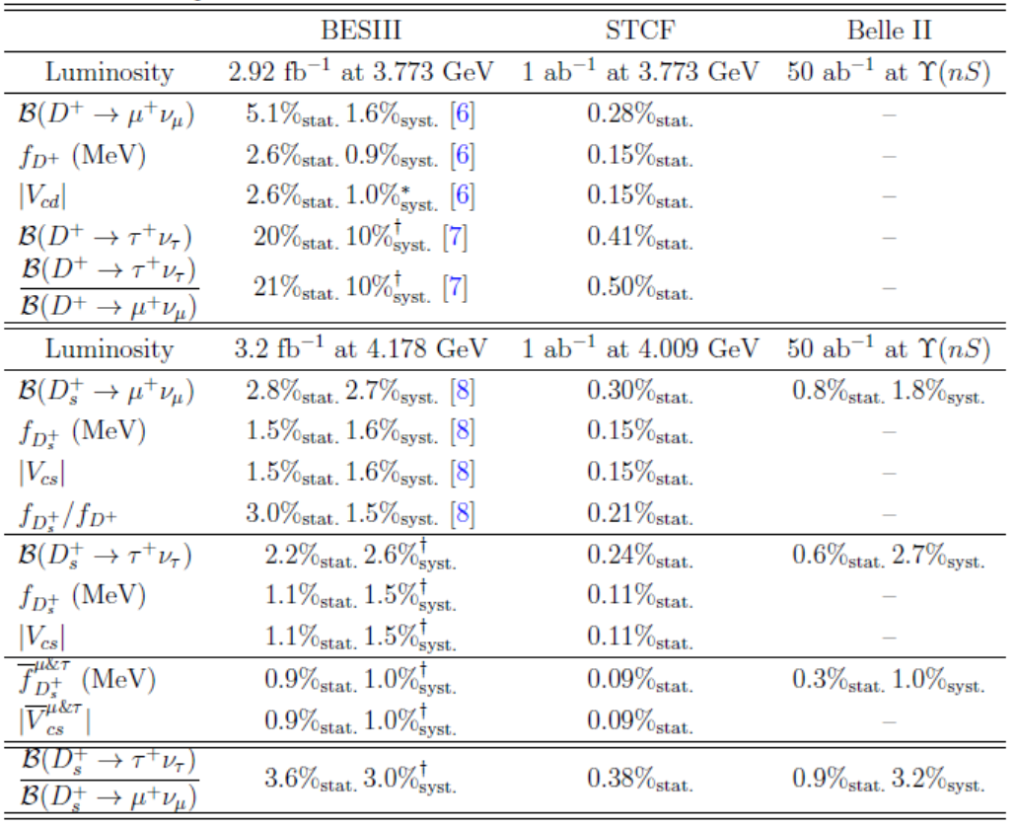
D_{(s)} Leptonic decay
Theory : 0.2%(0.1% expected)
Stat. uncertainty is closed to theory precision
Sys. is challenging
Theory : 0.2%(0.1% expected)
Theory : 0.2%(0.1% expected)
* Assume f_{D(s)} with 0.2% uncertainty; + preliminary results; assume Belle II improved systematics by a factor 2

Slide 22
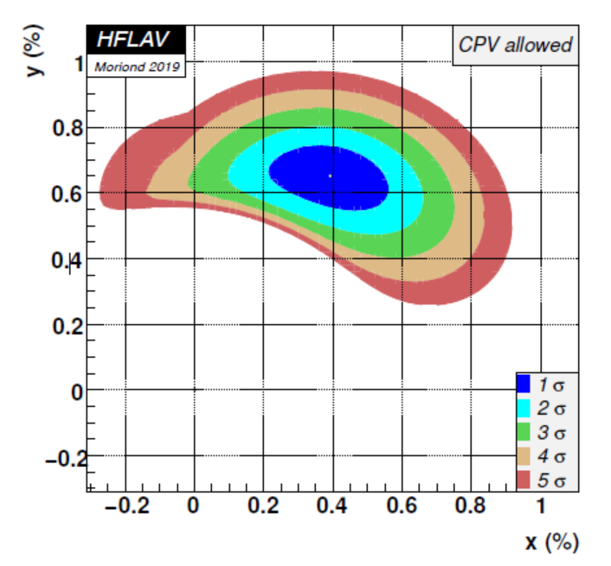


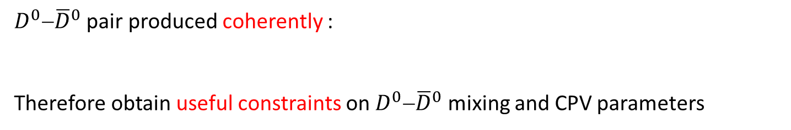


$D^{0}−{\overline{D}}^{0}$ Mixing and CPV
$D^{0}−{\overline{D}}^{0}$ pair produced coherently :
Therefore obtain useful constraints on $D^{0}−{\overline{D}}^{0}$ mixing and CPV parameters
Global fit of the measurement :
-
- their CP conjugate proceses
- the coherent decays : $(3770)→D^{0}{\overline{D}}^{0}→f_{1}f_{2}$
Obtained 95% confidence-level :
Consistent with the theoretical estimation

Slide 23
$D^{0}−{\overline{D}}^{0}$ Mixing and CPV

Slide 24



$D^{0}$-$\overline{D}$⁰ mixing and CPV
Mixing rate $R_{M }=\frac{x^{2}+y^{2}}{2} \sim {10}^{−5}$ with 1 ab⁻¹ data at 3.773 GeV via same charged final states $\left(K^{±}π^{∓}\right)\left(K^{±}π^{∓}\right)$ or $\left(K^{±}l^{∓}v\right)\left(K^{±}l^{∓}v\right)$
Mixing parameter $\left(x,y\right)\sim 0.05\%$ with 1 ab⁻¹ data at 4.040 by $e^{+}e^{−}→γD^{0}{\overline{D}}^{0}$
$∆A_{CP}\sim {10}^{−3}$ for KK and ππ channels
The accurate values might not help much to clarify to the long distance effects in on $D^{0}−{\overline{D}}^{0}$ mixing, but will help a lot to probe the presumably small effects of CPV in neutral charmed decays
Notes:
+ even number or odd number

Slide 25




Determination of γ⁄φ₃ angle
The cleanest way to extract γ is from B→DK decays:
Interference between tree-level decays; theoretically clean
current uncertainty σ(γ) ~5⁰
however, theoretical relative error ~10⁻⁷ (very small!)
Information of D decay strong phase is needed
Best way is to employ quantum coherence of DD production at threshold

Slide 26

Determination of γ⁄φ₃ angle
BESIII 20/fb:
σ(γ) ~0.4º
STCF is needed!
Three methods for exploiting interference (choice of D⁰ decay modes):
Gronau, London, Wyler (GLW): Use CP eigenstates of D^{(*)0} decay,
e.g. D⁰ → K_{s}π⁰, D⁰ → π⁺ π ⁻
Atwood, Dunietz, Soni (ADS): Use doubly Cabibbo-suppressed decays, e.g. D⁰ → K⁺π –
  With 1 ab⁻¹ @ STCF : σ(cosδ_{Kπ}) ∼0.007; σ(δ_{Kπ}) ∼2º ➔ σ(γ) <0.5º
Giri, Grossman, Soffer, Zupan (GGSZ): Use Dalitz plot analysis of 3-body D⁰ decays, e.g. K_{s} π⁺ π⁻ ; high statistics; need precise Dalitz model
STCF would provide important constraints to reduces the contribution of D Dalitz model to a level of ~0.1º
Notes:
In the future, the statistical uncertainties of these measurements will be greatly reduced by using the large B meson samples recorded by LHCb and Belle II. Hence, limited knowledge of the strong phases of the D decays will systematically restrict the overall sensitivity. A 20 fb􀀀1 of data set at 3.773 GeV at BESIII would lead to a systematic uncertainty of 0.4 for the measurement. Hence, to match the future statistical uncertainty of less than 0:4 in the future LHCb upgrade II (as shown in Table 2), STCF would provide important constraints to reduce the systematic uncertainty from D strong-phase to be less than 0.1 and allow detailed comparisons of the results
from dierent decay modes.

Slide 27


Scenario beyond 2035
STCF will provide complementary information on the strong phase and allow detailed comparison of the γ results from different decay modes

Slide 28


Charmed Rare Decays
high luminosity, clean environment and excellent detector performance
Great potential to search for rare and forbidden charmed decays
May serve as a useful tool for probing new physics beyond the SM
FCNC, suppressed by GIM mechanism, only occurred via the loop diagrams :
  Short distance : interested, computable by pQCD, directly test SM
  Long distance effect can enhance the rate to 10⁻⁶ ~10⁻⁷, dominantly.
  Some typical FCNC channel :
  ${Br(D}^{0}) <8.5{10}^{−7}$ (SM $1{10}^{−8}$)
  ${Br(D}^{0}μ^{+}μ^{−})<6.2{10}^{−9}$ (SM $3{10}^{−13}$)
  ${Br(D}^{0}π^{+}π^{−}μ^{+}μ^{−})=(9.61.2){10}^{−7}$
  ${Br(D}^{0}→K^{+}K^{−}μ^{+}μ^{−})=\left(1.54±0.32\right)×{10}^{−7}$
  ${Br(D}^{0}π^{+}K^{−}μ^{+}μ^{−})=(4.20.4){10}^{−6}$
  1ab⁻¹ @ STCF can achieve the sensitivity to 10⁻⁸∼10⁻⁹, tested SM strictly
  Allow with sizeable decay rate in NP, discriminate NP from SM by measuring :
    $D→Vl^{+}l^{−}$: AFB asymmetry
    $D→Pl^{+}l^{−}$ : line shape of dilepton mass, to reveal the interference effect between long-distance and FCNC weak amplitude (NP amplitude);
  Best constrain on rare decays with invisible particles ($D→π^{0}/γν\overline{ν}$)
Non-trivial contribution from long distance effects

Slide 29
Charmed Rare Decays
LFV, LNV and BNV are forbidden in the SM, NP allow at sizable levels.
  No evidence has been found so far
  Typical experimental bounds on LFV are at level 10⁻⁶ to 10⁻⁵
  STCF: 10⁻⁸~10⁻⁹ ➔ stringent constrains to NP models

Slide 30




Charmed Meson Spectroscopy
D_{s}
D
Status :
All 1S and 1P states have been observed, but almost missing for other quantum states
Many excited open-charm states observed, but controversial in their nature
Narrow $D_{sJ}^{∗}\left(2632\right)$ Observed by SELEX, but not in CLEO, BaBar and FOCUS
The unexpected low masses of $D_{s0}^{∗}\left(2317\right)$ and $D_{s1}^{∗}\left(2460\right)$ ⇒ D^{(*)}K molecule
STCF:
Excited states D** can be produced via $e^{+}e^{−}→D^{∗∗}{\overline{D}}^{\left(∗\right)}\left(π\right)$in CME 4.1∼6 GeV
Higher mass D** hadronic or radiative decays to lower open-charm states
Systematic study on D** spectra provide important data to explore the non pQCD dynamics

Slide 31



Charmed Baryon ($B_{c}^{+}$)
Systematic study the charmed baryon spectroscopy and precisely measure the transition widths provide an excellent ground for studying the dynamics of light quarks in the environment of a heavy quark

Slide 32






A theoretical Framework for charmed Hadrons
Topological diagrams + Symmetries + Experimental inputs
⇒ to understand the decaying dynamics, predicting double-charm baryon decays, CPV, etc. (predictive power)
  $Λ_{c}^{+}$ decays used for global analysis
  ⇒ $Ξ_{cc}^{++}→Λ_{c}^{+}K^{−}π^{+}π^{+}$ and $Ξ_{c}^{+}π^{+}$ are large enough for observation.
$Br(Λ_{c}^{+}→pφ)/|V_{us}|^{2}$ = 2 %
$Br\left(Ξ_{cc}^{++}→Σ_{c}^{++}{\overline{K}}^{∗0}\right)$= O(%)
$$Ξ_{cc}^{++}→Λ_{c}^{+}{π^{+}K}^{−}π^{+}$$
$Λ_{c}^{+}$ decays ⇒ Stronger predictive power

Slide 33











Lots of activities on $☹_{c}^{+}$ decays
$$Λ_{c}^{±}$$
EPJC77, 895
PRL113, 042002
Observation of DCS decay
HFLAV 2016 (%)
PRL 117, 011801(2016)
JHEP03, 043(2018)
PRL 115, 221805 (2015)
PLB 767, 42 (2017)
PRD97, 091101(R) (2018)
Events /0.010 (GeV)
U_{miss} (GeV)
Γ[Λ_{c}⁺→Λμ⁺ν_{μ}]/Γ[Λ_{c}⁺→Λe⁺ν_{e}]= 0.96±0.16±0.04
STCF: reduced the uncerntaity by two orders of magnitudes
➔ provides stringent LFU test
LHCb, JHEP 03, 182 (2018)

Slide 34








Single Charmed baryon in PDG
Absolute branching fractions measurement at threshold production will be important
$Ξ_{c}^{+}$: relative to $Ξ^{−}2π^{+}$
$Ξ_{c}^{0}$: relative to $Ξ^{−}π^{+}$
$Ω_{c}^{0}$: relative to $Ω^{−}π^{+}$
First measurement of absolute BF of $Ξ_{c}^{0}$ at Belle [arxiv:1811.09738]

Slide 35

Precision study of the B_{c} decay
Era of precision study of the charmed baryon ($Λ_{c}$, $Ξ_{c}$ and $Ω_{c}$) decays
to help developing more reliable QCD-derived models in charm sector
  Hadronic decays:
  to explore as-yet-unmeasured channels and understand full picture of intermediate structures in B_{c} decays, esp., those with neutron/$Σ/Ξ$ particles
  Semi-leptonic decays:
  to test LQCD calculations and LFU
  CPV in charmed baryon: BP and BV two-body decay asymmetry, charge-dependent rate of SCS
  Charmed Baryons Spectroscopy : (63 P wave states from QM, 16 observed!)
  Rare decays: LFV, BNV, FCNC
STCF will provide very precise measurements of their overall decays, up to the unprecedented level of 10⁻⁶ ~10⁻⁷

Slide 36
Summary
τ-c facilities have rich of physics program, play unique role in charmed physics, and is one of the crucial precision frontier.
The R&D program of a Super τ-c Factory (STCF) is underway in China:
double ring with circumference around 600∼1000 m
e⁺e⁻ collision with E_{cm} = 2 – 7 GeV, L = 1 × 10³⁵ cm⁻²s⁻¹
Welcome to join the efforts of STCF R&D program

Slide 37
Summary
Super τ-c Factory (STCF):
double ring with circumference around 600∼1000 m
e⁺e⁻ collision with E_{cm} = 2 – 7 GeV, L = 1 × 10³⁵ cm⁻²s⁻¹
STCF is one of the crucial precision frontier
rich of physics program
unique for physics with c quark and τ leptons,
important playground for study of QCD, exotic hadrons and search for new physics.
We initialized 10 M CNY (2018), 10-20M CNY(2019) for start R&D.
Project organization is setup, a working group is toward for CDR/TDR
An International collaboration is essential for promoting the project.

Slide 38

Welcome to join the effort

Slide 39




The threshold production of baryon pair
PRD97,032013(2018)
Form factor reflects spatial distributions of electric charge and current inside the nucleon
STCF: 100 more statistics will much enhance the understandings of these 'unexpected' threshold enhancement! (Study e⁺e⁻  $p\overline{p},n\overline{n},Λ\overline{Λ},Σ\overline{Σ},Ξ\overline{Ξ},Ω{\overline{Ω},Λ}_{c}\overline{Λ_{c}},Σ_{c}\overline{Σ_{c}}$ $,Ξ_{c}\overline{Ξ_{c}},Ω_{c}\overline{Ω_{c}}$ … @threshold)

