Slide 1
Direct CP violation in charmed meson decays
Hai-Yang Cheng
Academia Sinica, Taipei
Diagrammatical approach
SU(3) breaking
CP violation at tree and loop levels
FLASY2019
Hefei, July 24, 2019

Slide 2
Experiment
Time-dependent CP asymmetry
Time-integrated asymmetry
LHCb: (11/14/2011) 0.92 fb⁻¹ based on 60% of 2011 data
ΔA_{CP} ≡ A_{CP}(D⁰→ K⁺K⁻) - A_{CP}(D⁰→ π⁺π⁻) = - (0.82±0.21±0.11)%
3.5σ effect: first evidence of CPV in charm sector
CDF: (2/29/2012) 9.7 fb⁻¹
ΔA_{CP}= - (2.33±0.14)% - (-1.71±0.15)%
= - (0.62±0.21±0.10)% 2.7σ effect
Belle: (ICHEP2012) 540 fb⁻¹
ΔA_{CP} = - (0.87±0.41±0.06)% 2.1σ effect

Slide 3
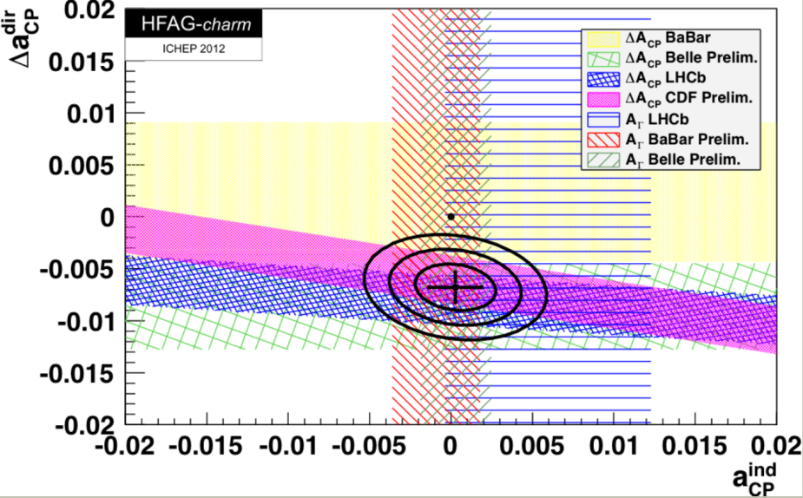
World averages of LHCb + CDF + BaBar + Belle
Δa_{CP}^{dir} = -(0.678±0.147)%, 4.6σ effect
a_{CP}^{ind} = -(0.027±0.163)%
3

Slide 4
Fermilab Today, Dec 13, 2012:
“Another charm revolution?”
The discovery of the charm quark is known in physicists' lingo as the "November revolution" . (1974)
This measurement (of CP violating asymmetry parameter) puts much pressure on the need for revising and improving the prediction techniques to make a clear distinction between the contributions expected from Standard Model physics and those from possible new interaction forces.
Ideas for new precision measurements are likely to turn out as well. Our hope is that this is the beginning of a second revolution in charm physics.
Another November revolution?

Slide 5
Isidori, Kamenik, Ligeti, Perez [1111.4987]
Brod, Kagan, Zupan [1111.5000]
Wang, Zhu [1111.5196]
Rozanov, Vysotsky [1111.6949]
Hochberg, Nir [1112.5268]
Pirtskhalava, Uttayarat [1112.5451]
Cheng, Chiang [1201.0785]
Bhattacharya, Gronau, Rosner [1201.2351]
Chang, Du, Liu, Lu, Yang [1201.2565]
Giudice, Isidori, Paradisi [1201.6204]
Altmannshofer, Primulando, C. Yu, F. Yu [1202.2866]
Chen, Geng, Wang [1202.3300]
Feldmann, Nandi, Soni [1202.3795]
Li, Lu, Yu [1203.3120]
Franco, Mishima, Silvestrini [1203.3131]
Brod, Grossman, Kagan, Zupan [1203.6659]
Hiller, Hochberg, Nir [1204.1046]
Grossman, Kagan, Zupan [1204.3557]
Cheng, Chiang [1205.0580]
Chen, Geng, Wang [1206.5158]
Delaunay, Kamenik, Perez, Randall [1207.0474]
Da Rold, Delaunay, Grojean, Perez [1208.1499]
Lyon, Zwicky [1210.6546]
Atwood, Soni [1211.1026]
Hiller, Jung, Schacht [1211.3734]
Delepine, Faisel, Ramirez [1212.6281]
Muller, Nierste, Schacht [1506.04121]
Nierste, Schacht [1508.00074]
Buccella, Paul, Santorelli [1902.05564]
5

Slide 6
Attempts for SM interpretation
Golden, Grinstein (’89): hadronic matrix elements enhanced as in ΔI=1/2 rule.
However, D→ ππ data do not show large ΔI=1/2 enhancement over ΔI=3/2 one.
Moreover, |A₀/A₂|=2.5 in D decays is dominated by tree amplitudes.
Brod, Kagan, Zupan: PE and PA amplitudes considered
Pirtskhalava, Uttayarat : SU(3) breaking with hadronic m.e. enhanced
Bhattacharya, Gronau, Rosner : P_{b} enhanced by unforeseen QCD effects
Feldmann, Nandi, Soni : U-spin breaking with hadronic m.e. enhanced
Brod, Grossman, Kagan, Zupan: penguin enhanced
Franco, Mishima, Silvestrini: marginally accommodated

Slide 7
New Physics interpretation
Model-independent analysis of NP effects Isidori, Kamenik, Ligeti, Perez
Tree level (applied to some of SCS modes)
In SM, Δa_{CP}^{dir} = 0 at tree level
FCNC Z
FCNC Z’ (a leptophobic massive gauge boson)
2 Higgs-doublet model: charged Higgs
Left-right mixing
Color-singlet scalar
Color-sextet scalar (diquark scalar)
Color-octet scalar
4th generation
Giudice, Isidori, Paradisi; Altmannshofer, Primulando, C. Yu, F. Yu
Wang, Zhu; Altmannshofer et al.
Altmannshofer et al.
Chen, Geng, Wang; Delepine, Faisel, Ramirez
Hochberg, Nir
Altmannshofer et al; Chen, Geng, Wang
Altmannshofer et al.
Rozanov, Vysotsky; Feldmann, Nandi, Soni
NP models are highly constrained from D-D mixing, K-K mixing, ε’/ε,… Tree-level models are either ruled out or in tension with other experiments.

Slide 8
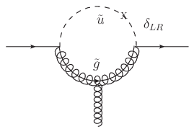
Loop level (applied to all SCS modes)
Large ΔC=1 chromomagnetic operator with large imaginary coefficient
is least constrained by low-energy data and can accommodate large ΔA_{CP.} <PP|O_{8g}|D> is enhanced by O(v/m_{c}). However, D⁰-D⁰ mixing induced by O_{8g} is suppressed by O(m_{c}²/v²). Need NP to enhance c_{8g} by O(v/m_{c})
Giudice, Isidori, Paradisi
It can be realized in SUSY models
gluino-squark loops
new sources of flavor violation from disoriented A terms, split families
trilinear scalar coupling
RS flavor anarchy warped extra dimension models
Grossman, Kagan, Nir
Giudice, Isidori, Paradisi
Hiller, Hochberg, Nir
Delaunay, Kamenik, Perez, Randall

Slide 9
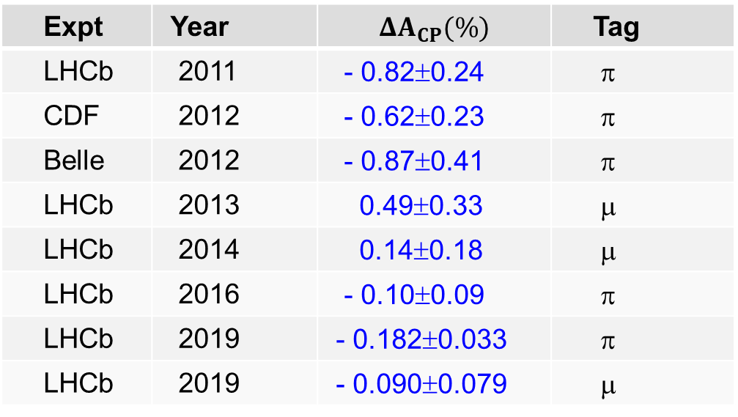
Expt | Year |  | Tag
LHCb | 2011 | - 0.82±0.24 | π
CDF | 2012 | - 0.62±0.23 | π
Belle | 2012 | - 0.87±0.41 | π
LHCb | 2013 | 0.49±0.33 | μ
LHCb | 2014 | 0.14±0.18 | μ
LHCb | 2016 | - 0.10±0.09 | π
LHCb | 2019 | - 0.182±0.033 | π
LHCb | 2019 | - 0.090±0.079 | μ
LHCb (14’+16’+19’) ⇒ ΔA_{CP} = (- 0.154±0.029)% 5.3σ effect
Δa_{CP}^{dir} = (- 0.156±0.029)%
1903.08726
Recall that LHCb (’11) ⇒ Δa_{CP}^{dir} = (- 0.82±0.24)%
Is this consistent with the SM prediction?

Slide 10
A brief history of estimating Δa_{CP} in SM:
We (Cheng-Wei Chiang and HYC) obtained Δa_{CP} ∼ -0.13% in 2012
A few months later, Hsiang-nan Li, Cai-Dian Lu, Fu-Sheng Yu
found Δa_{CP} ∼ -0.10% or (-0.57 ~ -1.87) ×10⁻³
We improved the estimate and obtained two solutions in May, 2012
Δa_{CP}^{dir}= - 0.139±0.004% (I)
- 0.151±0.004% (II)
The 2nd solution agrees almost exactly with LHCb, - 0.156±0.029%.
In 2017, Khodjamirian & Petrov estimated Δa_{CP} using LCSR and obtained an upper bound Δa_{CP}^{dir} ≤ (2.0±0.3)×10⁻⁴
Chala et al. reinforced the notation that this implies new physics!

Slide 11
Why singly Cabibbo-suppressed decays ?
DCPV requires nontrival strong and weak phase difference
In SM, DCPV occurs only in singly Cabibbo-suppressed decays
It is expected to be very small in charm sector within SM
Amp = V*_{cd}V_{ud} (tree + penguin) + V*_{cs}V_{us} (tree’ + penguin)
Tree-induced CP violation depends on strong phases in tree diagrams
DCPV induced by the interference of penguin & tree amplitudes
δ: strong phase
DCPV is expected to be the order of 10⁻³ ∼ 10⁻⁵

Slide 12
Theoretical framework
Effective Hamiltonian approach
pQCD: Li, Tseng (’97); Du, Y. Li, C.D. Lu (’05)
QCDF: Du, H. Gong, J.F. Sun (’01)
X.Y. Wu, X.G. Yin, D.B. Chen, Y.Q. Guo, Y. Zeng (’04)
J.H. Lai, K.C. Yang (’05); D.N. Gao (’06)
Grossman, Kagan, Nir (’07)
X.Y. Wu, B.Z. Zhang, H.B. Li, X.J. Liu, B. Liu, J.W. Li, Y.Q. Gao (’09)
However, it doesn’t make much sense to apply pQCD & QCDF to charm decays due to huge 1/m_{c} power corrections
QCD sum rules: Blok, Shifman (’87); Khodjamirian, Ruckl; Halperin (’95)
Khodjamirian, Petrov (’17)
Lattice QCD: ultimate tool but a formidable task now
Model-independent diagrammatical approach

Slide 13
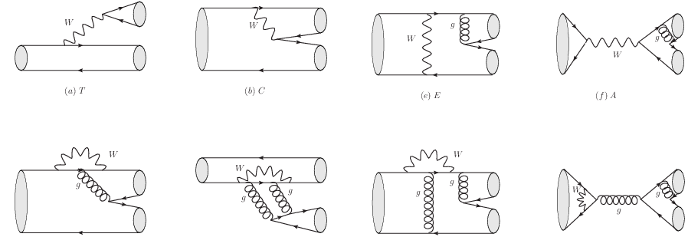
Diagrammatic Approach
All two-body hadronic decays of heavy mesons can be expressed in
terms of several distinct topological diagrams [Chau (’80); Chau, HYC(’86)]
T (tree)
C (color-suppressed)
E (W-exchange)
A (W-annihilation)
HYC, Oh (’11)
P, P^{c}_{EW}
S, P_{EW}
PE, PE_{EW}
PA, PA_{EW}
All quark graphs are topological and meant to have all strong interactions encoded and hence they are not Feynman graphs. And SU(3) flavor symmetry is assumed.
13

Slide 14
Cabibbo-allowed decays
For Cabibbo-allowed D→PP decays (in units of 10⁻⁶ GeV)
T = 3.14 ± 0.01 (taken to be real)
C = (2.66 ± 0.03) exp[i(-152±0.3)º]
E = (1.53 ± 0.04) exp[i(122±0.4)º]
A= (0.44 ± 0.03) exp[i(29⁺⁷-10)º]
Rosner (’99)
Wu, Zhong, Zhou (’04)
Bhattacharya, Rosner (’08,’10)
HYC, Chiang (’10, ’19)
Phase between C & T ~ 150º
W-exchange E is sizable with a large phase ⇒ importance of 1/m_{c} power corrections
W-annihilation A is smaller than E and almost perpendicular to E
E
C
A
T
All topological tree amplitude except T are dominated by nonfactorizable long-distance effects.
The great merit & strong point of this approach ⇒ magnitude and strong phase of each topological tree amplitude are determined
14

Slide 15
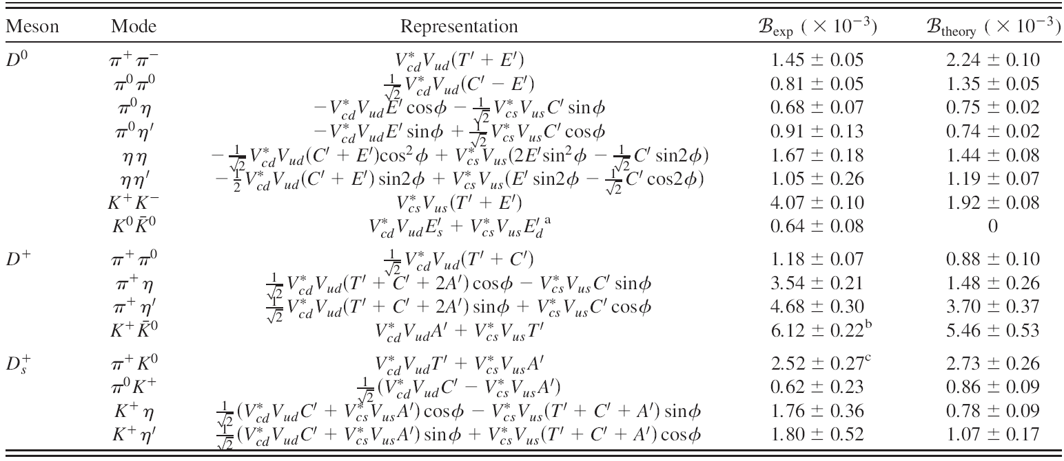
SCS
Sizable SU(3) breaking in some SCS modes
15

Slide 16
SU(3) flavor symmetry breaking
A long standing puzzle: R=Γ(D⁰→ K⁺K⁻)/Γ(D⁰→ π⁺π⁻) ≈ 2.8
expected to be unity in SU(3) limit
λ_{p} =V*_{cp}V_{up}
Possible scenarios for seemingly large SU(3) violation:
Large ΔP
A fit to data yields ΔP=1.54 exp(-i202º) ⇒ |ΔP/T| ∼ 0.5
Brod, Grossman, Kagan, Zupan
Need a large ΔP contributing constructively to K⁺K⁻ & destructively to π⁺π⁻
16
16

Slide 17
Nominal SU(3) breaking in both T & E, while ΔP negligible
SU(3) symmetry must be broken in amplitudes E & PA
A(D⁰→ K⁰K⁰)=λ_{d}(E_{d} + 2PA_{d}) + λ_{s}(E_{s}+ 2PA_{s}) almost vanishes in SU(3) limit
Neglecting ΔP, E_{d} & E_{s} fixed from D⁰→ K⁺K⁻, π⁺π⁻, π⁰π⁰, K⁰K⁰ to be
Accumulation of several small SU(3) breaking effects leads to apparently large SU(3) violation seen in K⁺K⁻ and π⁺π⁻ modes

Slide 18
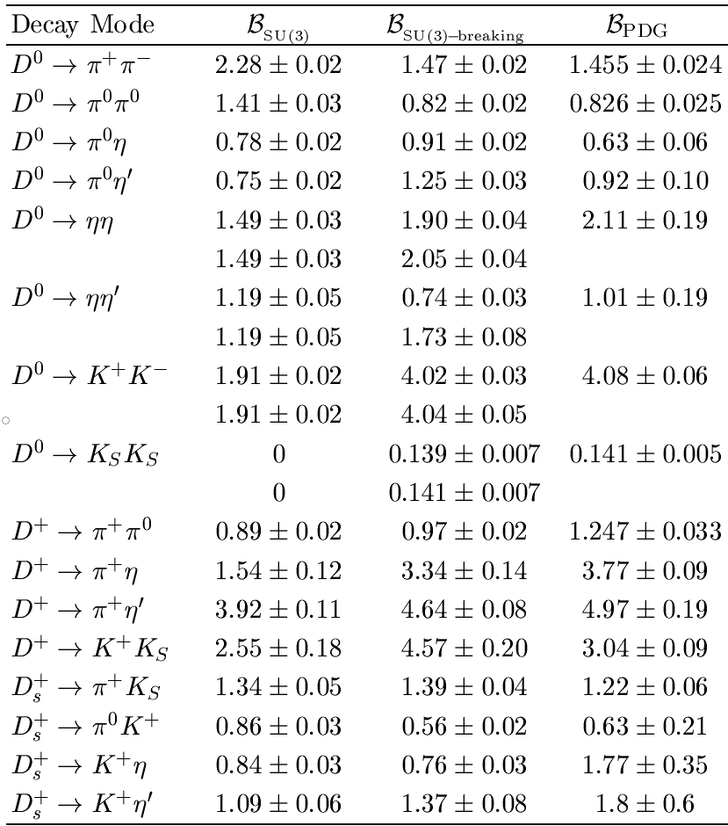
Singly Cabibbo-suppressed D→ PP decays

Slide 19
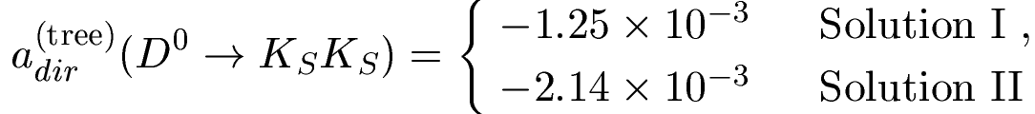
Tree-level direct CP violation
A(D_{s}⁺ → K⁰π⁺) =λ_{d}(T + P_{d} + PE_{d}) + λ_{s}(A + P_{s} + PE_{s}), λ_{p} =V*_{cp}V_{up}
DCPV in D_{s}⁺→ K⁰π⁺ arises from interference between T & A
≈ 10⁻⁴
Larger DCPV at tree level occurs in interference between T & C (e.g. D_{s}⁺→Κ⁺η, −0.80 ×10⁻³) or C & E (e.g. D⁰→ π⁰η, −0.85 ×10⁻³)
A(D⁰→ K⁰K⁰)=λ_{d}(E_{d} + 2PA_{d}) + λ_{s}(E_{s}+ 2PA_{s})
DCPV at tree level can be reliably estimated in diagrammatic approach as magnitude & phase of tree amplitudes can be extracted from data

Slide 20
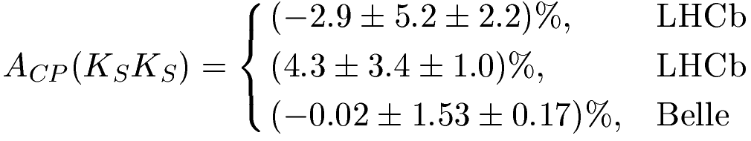

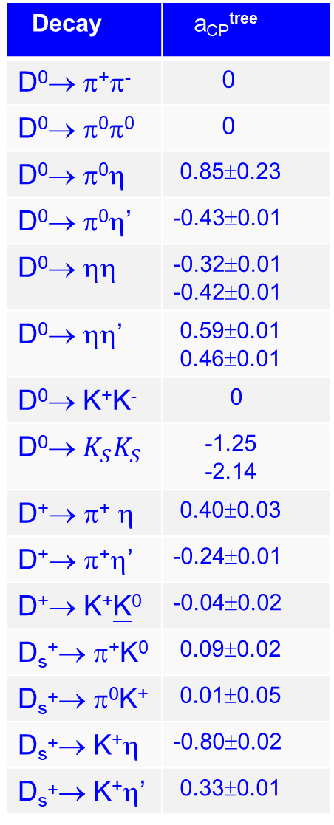
Decay | a_{CP}^{tree}
D⁰→ π⁺π⁻ | 0
D⁰→ π⁰π⁰ | 0
D⁰→ π⁰η | 0.85±0.23
D⁰→ π⁰η’ | -0.43±0.01
D⁰→ ηη | -0.32±0.01 -0.42±0.01
D⁰→ ηη’ | 0.59±0.01 0.46±0.01
D⁰→ K⁺K⁻ | 0
D⁰→ $K_{S}K_{S}$ | -1.25 -2.14
D⁺→ π⁺ η | 0.40±0.03
D⁺→ π⁺η’ | -0.24±0.01
D⁺→ K⁺K⁰ | -0.04±0.02
D_{s}⁺→ π⁺K⁰ | 0.09±0.02
D_{s}⁺→ π⁰K⁺ | 0.01±0.05
D_{s}⁺→ K⁺η | -0.80±0.02
D_{s}⁺→ K⁺η’ | 0.33±0.01
Tree-level DCPV a_{CP}^{(tree)} in units of per mille
10⁻³ > a_{dir}^{(tree)} > 10⁻⁴
Largest tree-level DCPV in D→PP:
D⁰→$K_{S}K_{S}$
a_{dir}^{(tree)} = (-1.25 ~ -2.14)×10⁻³

Slide 21
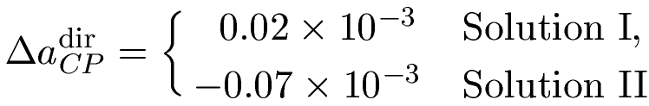
Penguin-induced CP violation
DCPV in D⁰→ π⁺π⁻, K⁺K⁻ arises from interference between tree and penguin
While QCD-penguin amplitudes are estimated to NLO in QCD factorization, PE_{d,s} & PA_{d,s} are subject to end-point divergences beyond control
DCPV from QCD penguin is small for D⁰→ K⁺K⁻ & π⁺π⁻ due to almost trivial strong phase ~ 175º

Slide 22
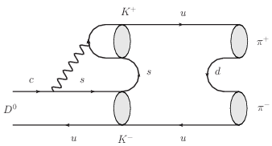
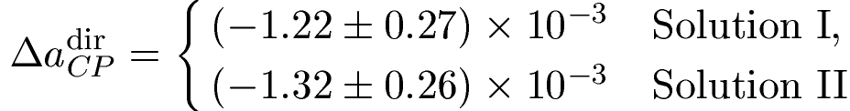
How about power corrections to QCD penguin ?
Large LD contribution to PE can arise from D⁰→ K⁺K⁻ followed by a resonantlike final-state rescattering
HYC, Chiang (’12)
It is reasonable to assume PE ~ E. It should be stressed that PE cannot be larger than T
Δa_{CP} arises mainly from long-distance PE!

Slide 23
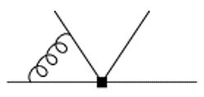
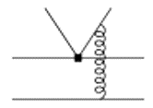
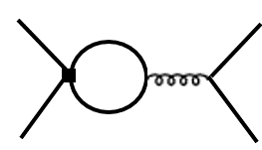
Li, Lu, Yu obtained
⇒ Δa_{CP} ∼ -0.10%
Consider penguin contribution first
vertex hard spectator penguin
corrections interactions contractions

Slide 24
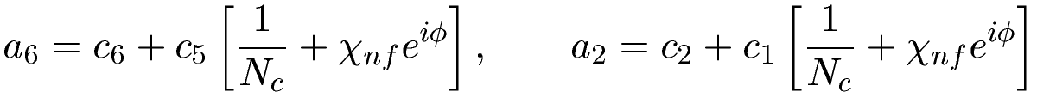
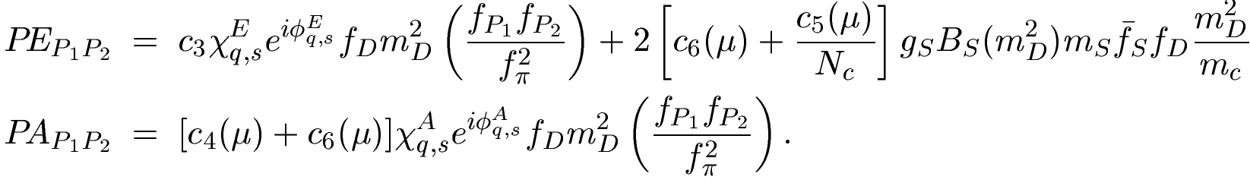


Instead of evaluating vertex, hard spectator and penguin corrections, Li, Lu and Yu parametrized them as $χ_{\begin{aligned}nf \\ \end{aligned}}e^{iφ}$
$$χ_{\begin{aligned}nf \\ \end{aligned}}=−0.59, φ=−0.62$$
Penguin-exchange and penguin annihilation

Slide 25
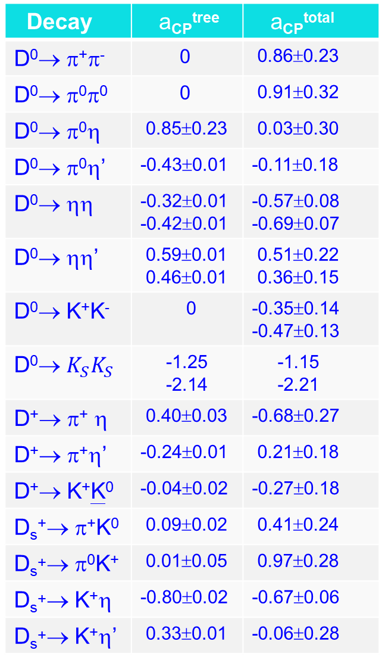
Decay | a_{CP}^{tree} | a_{CP}^{total}
D⁰→ π⁺π⁻ | 0 | 0.86±0.23
D⁰→ π⁰π⁰ | 0 | 0.91±0.32
D⁰→ π⁰η | 0.85±0.23 | 0.03±0.30
D⁰→ π⁰η’ | -0.43±0.01 | -0.11±0.18
D⁰→ ηη | -0.32±0.01 -0.42±0.01 | -0.57±0.08 -0.69±0.07
D⁰→ ηη’ | 0.59±0.01 0.46±0.01 | 0.51±0.22 0.36±0.15
D⁰→ K⁺K⁻ | 0 | -0.35±0.14 -0.47±0.13
D⁰→ $K_{S}K_{S}$ | -1.25 -2.14 | -1.15 -2.21
D⁺→ π⁺ η | 0.40±0.03 | -0.68±0.27
D⁺→ π⁺η’ | -0.24±0.01 | 0.21±0.18
D⁺→ K⁺K⁰ | -0.04±0.02 | -0.27±0.18
D_{s}⁺→ π⁺K⁰ | 0.09±0.02 | 0.41±0.24
D_{s}⁺→ π⁰K⁺ | 0.01±0.05 | 0.97±0.28
D_{s}⁺→ K⁺η | -0.80±0.02 | -0.67±0.06
D_{s}⁺→ K⁺η’ | 0.33±0.01 | -0.06±0.28
a_{CP}^{dir} (10⁻³)
Δa_{CP}^{dir}= -0.122±0.027% (I)
-0.132±0.026% (II)
consistent with LHCb result
Δa_{CP}^{dir} = (- 0.156±0.029)%

Slide 26
The analysis of D→VP modes in the diagrammatic approach is much more involved. The study is near completion.
HYC, Chiang (’19)

Slide 27
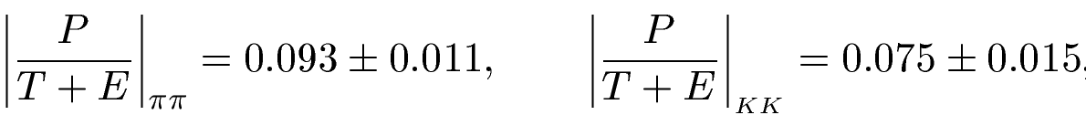
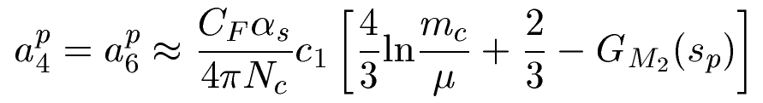

Light-cone sum rules by Khodjamirian, Petrov (’17) lead to
Chala, Lenz, Rusov, Scholtz (’19) considered higher twist corrections
⇒ New Physics
Khodjamirian & Petrov kept only $c_{1}$ and $c_{2}$ and neglected all other Wilson coefficients
Penguin annihilation (PE & PA) and especially LD effects haven’t been considered in LCSR calculations

Slide 28

Conclusions
DCPV measured by LHCb ⇒ importance of penguin effects in the charm sector
The diagrammatical approach is very useful for analyzing hadronic D decays
DCPV in charm decays is studied in the diagrammatic approach. It can be reliably estimated at tree level. Our estimate of Δa_{CP} = (- 0.122±0.027)% or (- 0.132±0.026)% is consistent with LHCb
DCPV in $D^{0}→K_{S}K_{S}$ is predicted to be large and negative

Slide 29
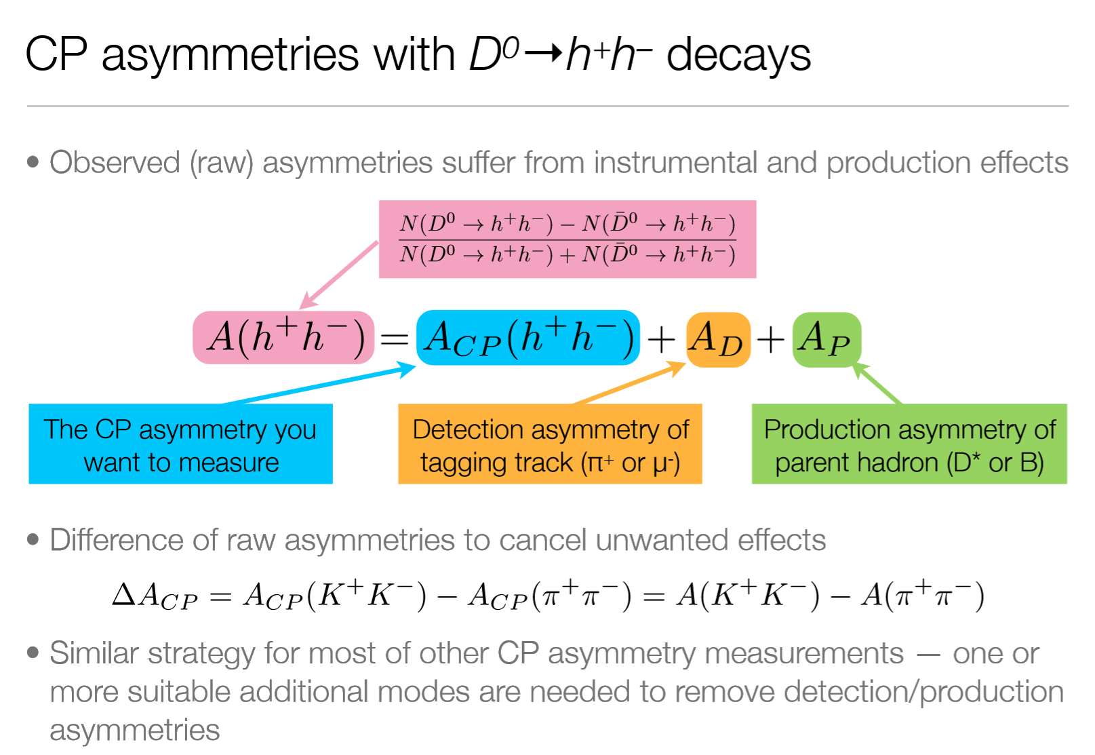
Taken from Angelo Di Canto, talk presented at “Towards the Ultimate Precision in Flavor Physics”, Durham, April, 2019

Slide 30
After LHCb’s new announcement on charm CP violation:
Z. Z. Xing [1903.09566]
Chala, Lenz, Rusov, Scholtz [1903.10490]
H. N. Li, C. D. Lu, F. S. Yu [1903.10638]
Grossman, Schacht [1903.10952]
Soni [1905.00907]

