Slide 1




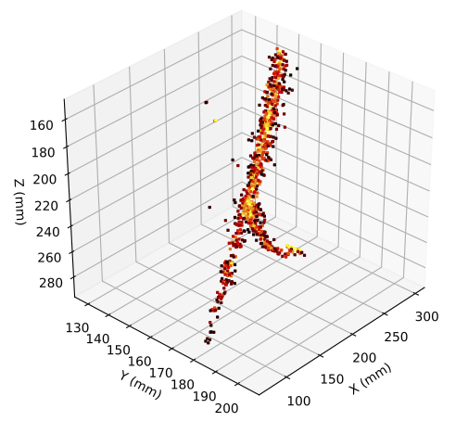
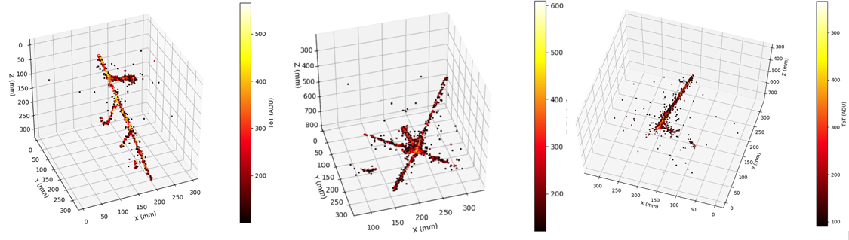
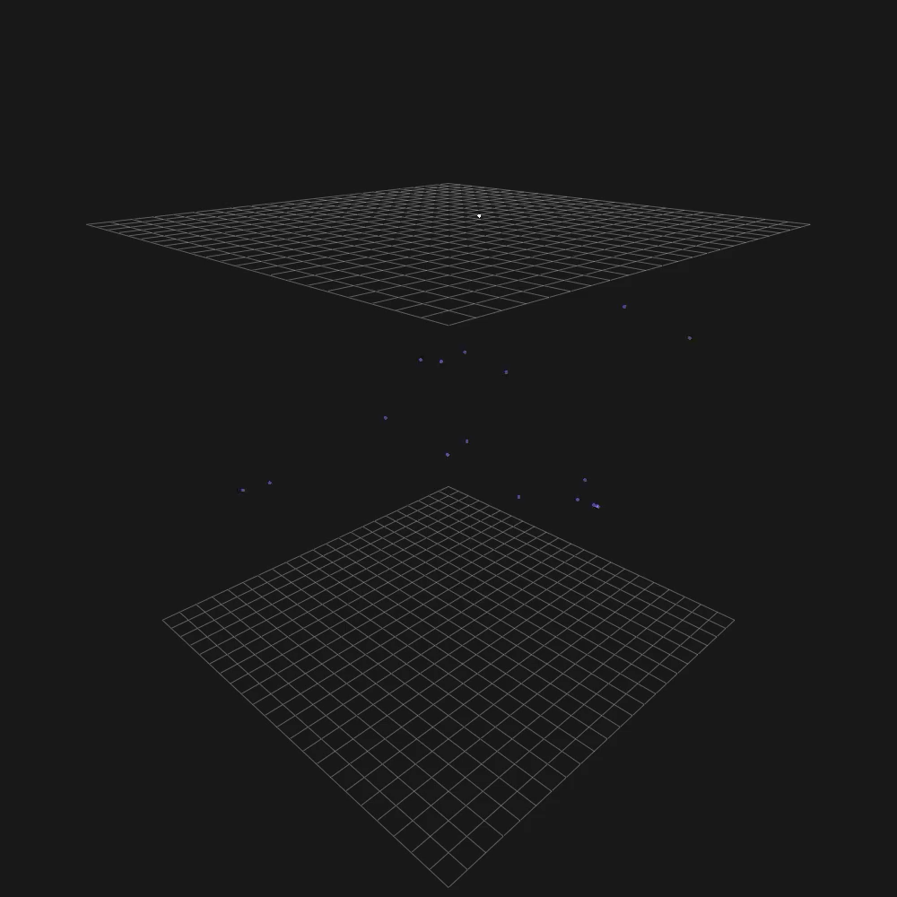

ARIADNE⁺ Results & a Conceptual FLArE TPC
+
http://hep.ph.liv.ac.uk/ariadne
Kostas Mavrokoridis
(on behalf of the ARIADNE+ collaboration)
k.mavrokoridis@liv.ac.uk
BNL meeting Oct 2023

Slide 2
Talk Outline
Background to the ARIADNE program
  TPX3Cam results taken with the ARIADNE 1-ton dual phase LAr detector
ARIADNE⁺: Larger scale demonstration using the CERN “Cold Box” at the Neutrino Platform
  Results and informing next generation designs
Conceptual FLArE TPC design based on TPXCam optical readout

Slide 3
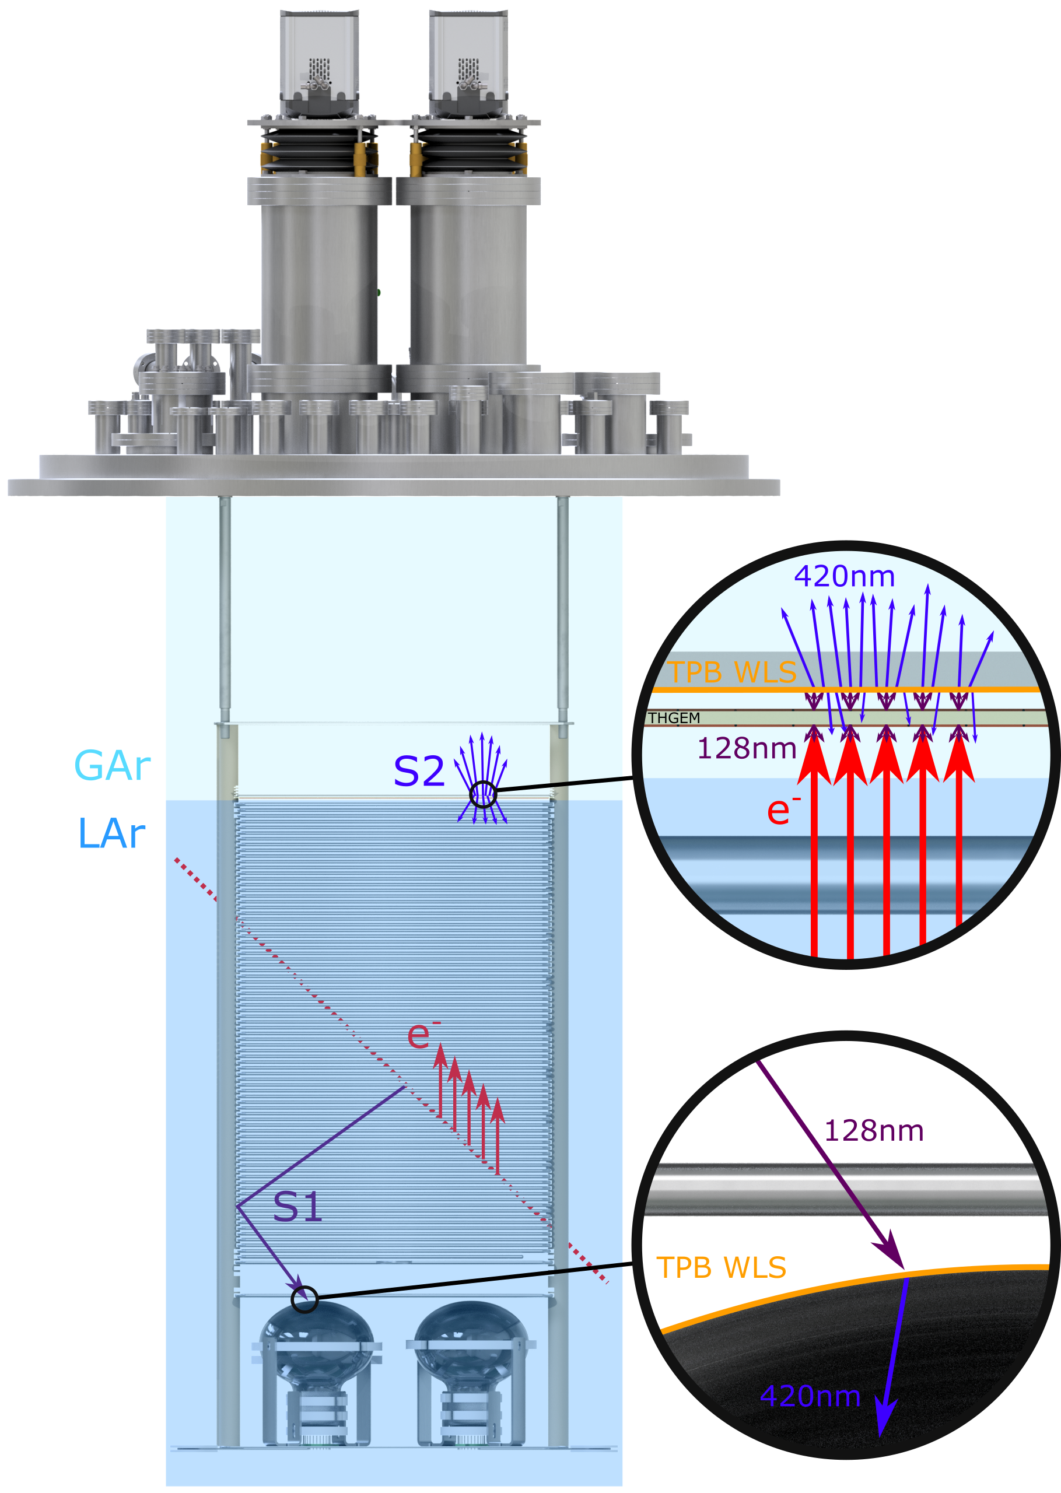
ARIADNE Detection Principle
Cameras
ARIADNE has demonstrated light readout as a viable alternative to charge in dual-phase TPC neutrino experiments
Incoming particles ionise LAr and create prompt scintillation light (S1)
Electrons drift towards the extraction grid situated below the liquid level
A THGEM (THick-Gaseous Electron Multiplier) amplifies drift charge (capable of >30 kV/cm in LAr) generating secondary scintillation light (S2)
WLS (Wavelength Shifting) before imaging with Timepix3 camera
ARIADNE (ARgon ImAging DetectioN chambEr)

Slide 4
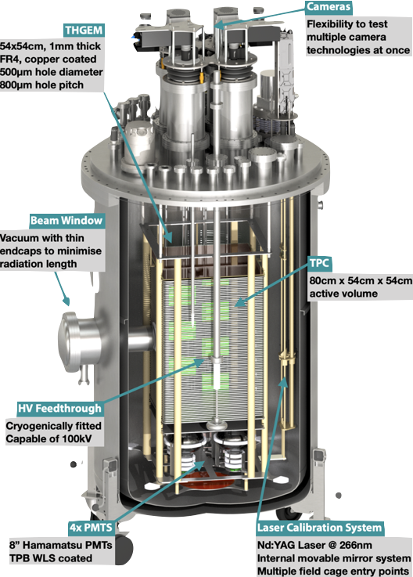
The ARIADNE Advantage - Optical TPCs
    High Resolution: For e.g. TPX3 camera has 256 x 256 pixels, imaging 35 x 35 cm area, as on ARIADNE, gives ≈1 mm resolution
    Sensitivity to low energies: Gain is generated by the THGEM; a THGEM accelerated electron can generate upwards of 100 photons, cameras can be sensitive to single photons
    Very low Noise: Externally mounted cameras are decoupled from TPC electronic noise sources/acoustics
    Ease of Access: Technology can be swapped in and out even with TPC operating
    Cost Efficient: No need for thousands of internal charge TPC readout channels, pre-amps etc.
    Available NOW
  Benefits over previous charge readout methods:
Dual phase TPCs can enable low energy physics hence it is the established technology for direct dark matter detection!
TDR: https://iopscience.iop.org/article/10.1088/1748-0221/15/03/P03003
ARIADNE 1-ton detector

Slide 5
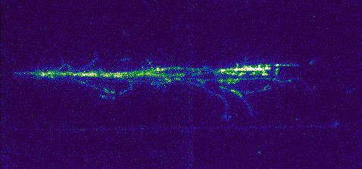
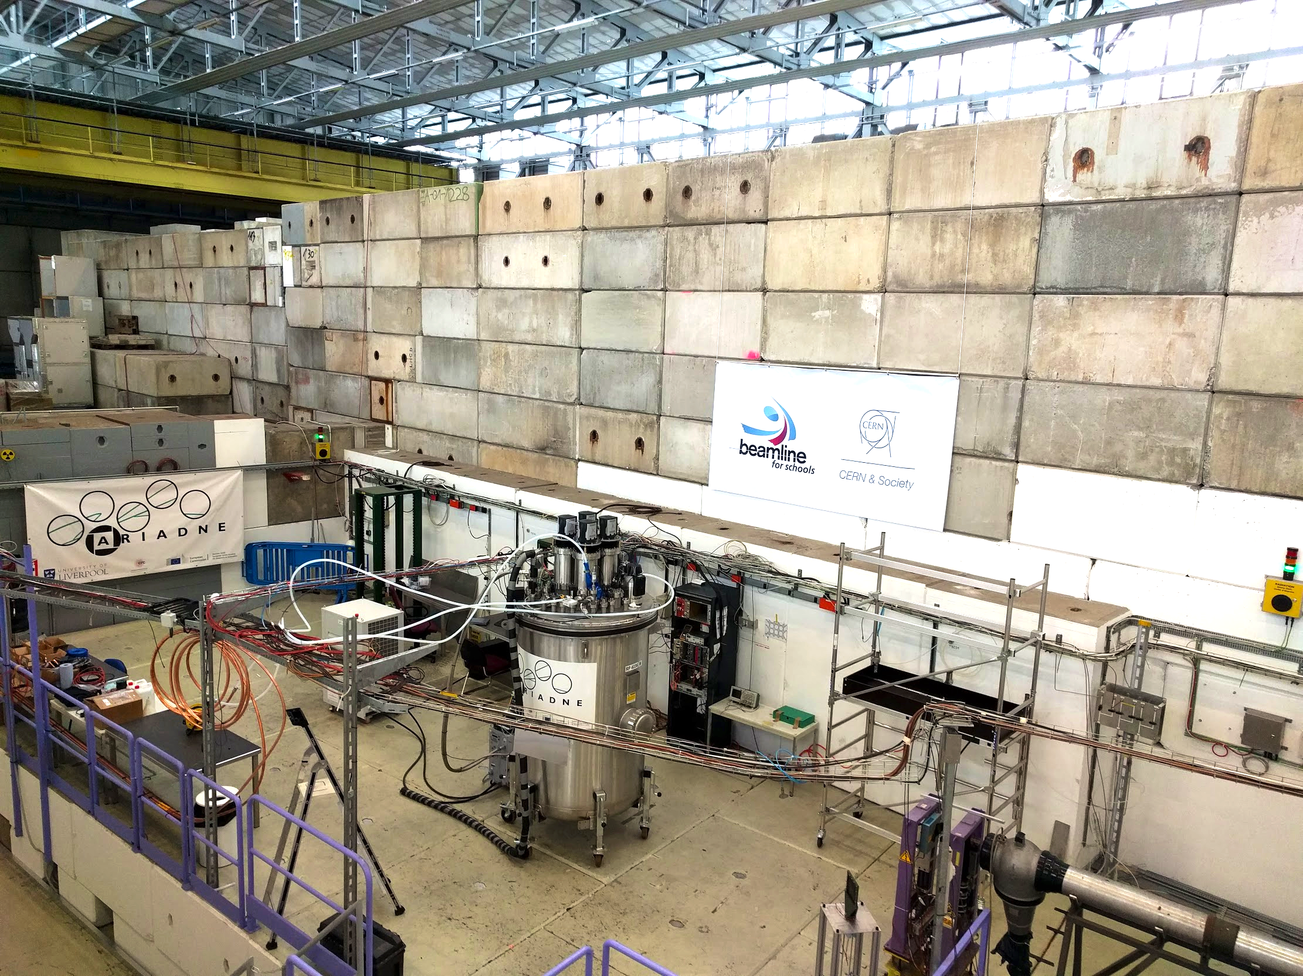
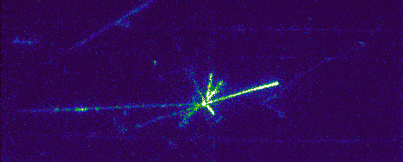
ARIADNE at CERN T9
EMCCD data taking 3 weeks April 2018.
T9 Beamline, East Area, CERN.
Mix of particles: e ±, μ ±, π ±, p±. (0.5 – 8 GeV/c.)
43 cm
35 cm

Slide 6
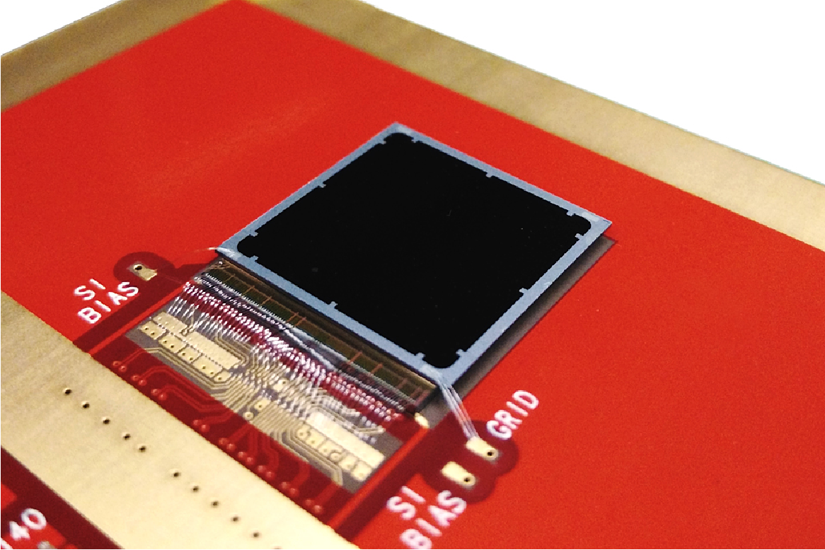
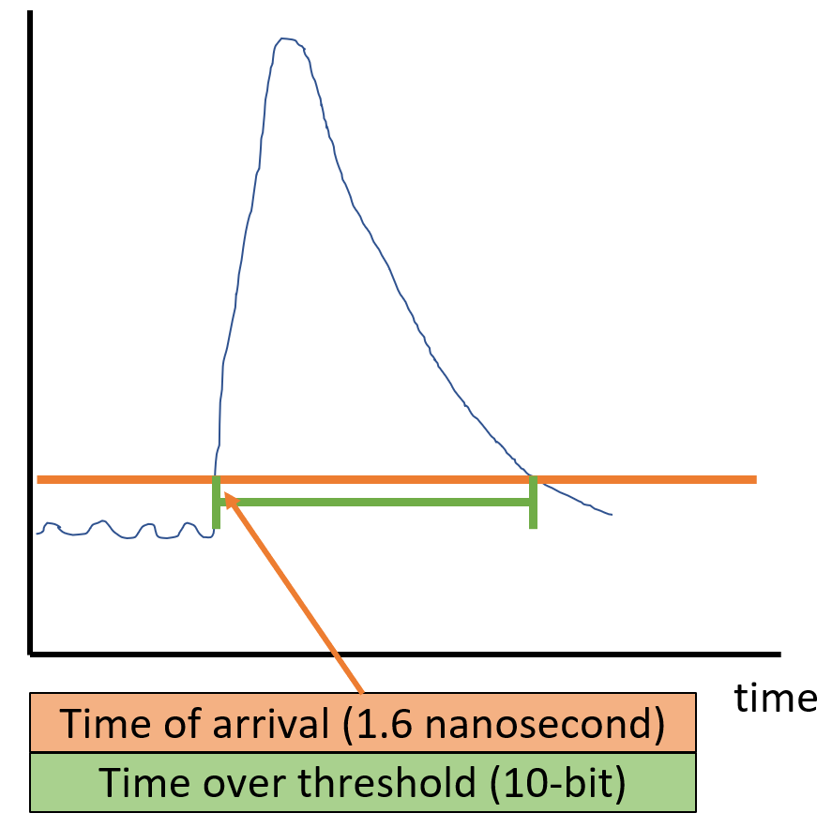
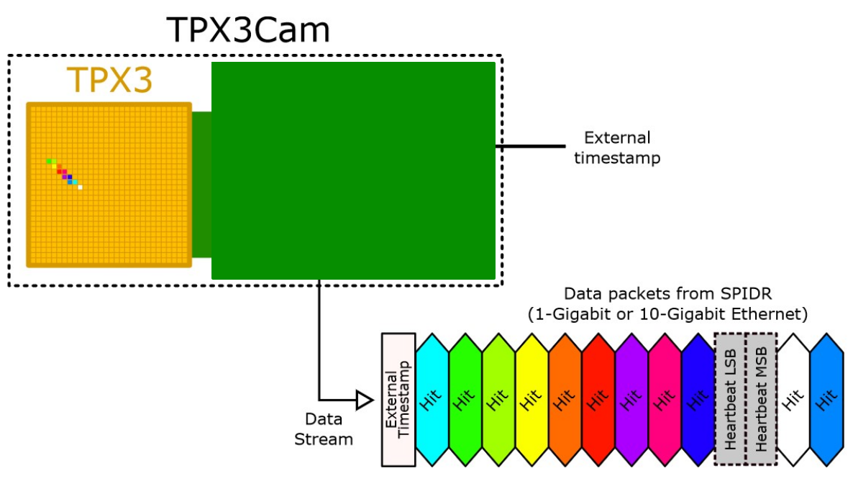
2D-> Full 3D Optical Readout
Silicon pixel readout chip developed by the Medipix collaboration. Very well established technology at CERN.
TPX3 ASIC bonded to optical sensor
TPX3 provides simultaneous time-over-threshold (ToT) and time-of-arrival (ToA). Complete (x,y,z,E) event reconstruction using a single device.
Time over threshold provides intensity / energy measurement ->10-bit resolution.
Time of arrival provides z (drift) axis position information -> 1.6 nanosecond resolution.
Data driven readout -> Event streaming with native zero suppression.
Efficient raw data storage. Triggerless operation.
Sensor resolution | 256x256 pixels
Pixel size | 55µm x 55µm
Max readout rate | 40Mhits•cm⁻² •sec⁻¹
Time resolution | 1.6 ns

Slide 7
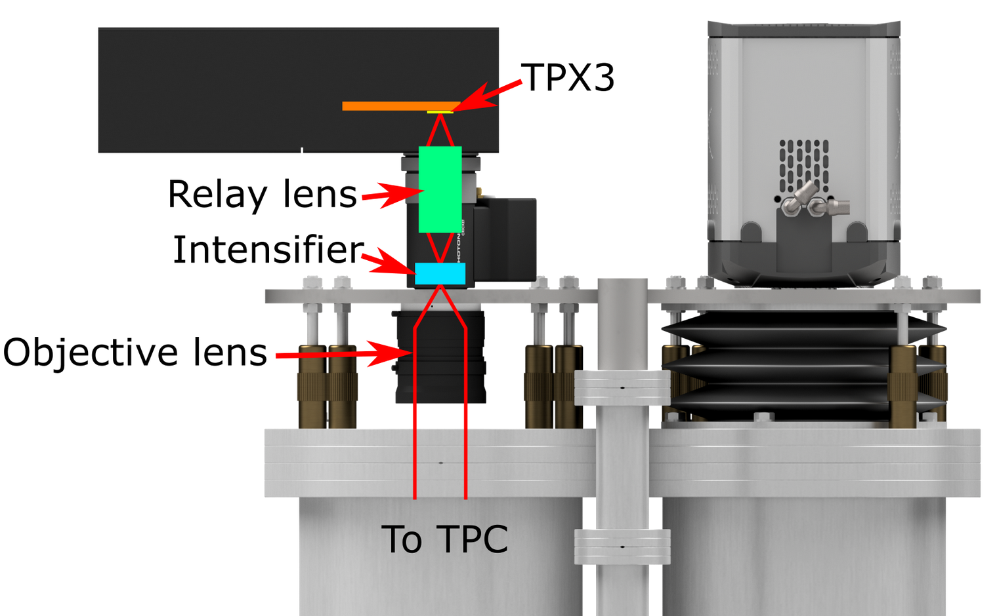
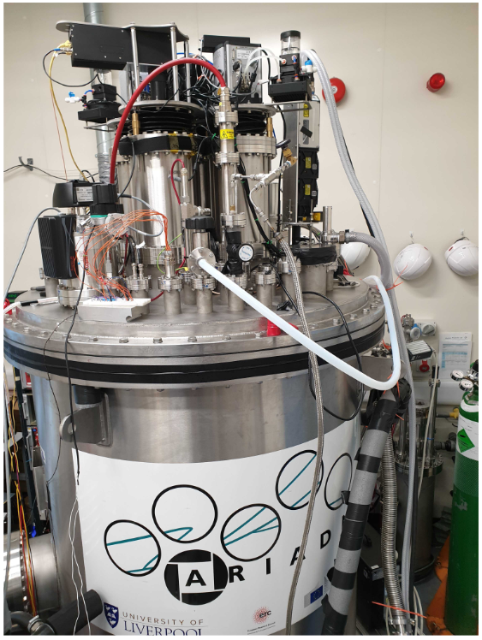
TPX3Cam Optical Readout
Single photon sensitivity when combined with image intensifier.
Intensifier gain ~1E6 photons/photon.
Relay lens couples intensified image onto light sensitive
sensor which is bump bonded onto TPX3 ASIC.
Intensifier provides flexibility -> Many photocathode options are available to customise spectral sensitivity.
– Now also Direct VUV!
Timepix3 camera installed in place of an EMCCD camera.
~ 30cm x 30cm field of view
Photonis Cricket image intensifier with Hi-QE green photocathode.
30% quantum efficiency at 430nm (TPB peak emission)
Coldbox Intensifier
ARIADNE results
TPB emission

Slide 8
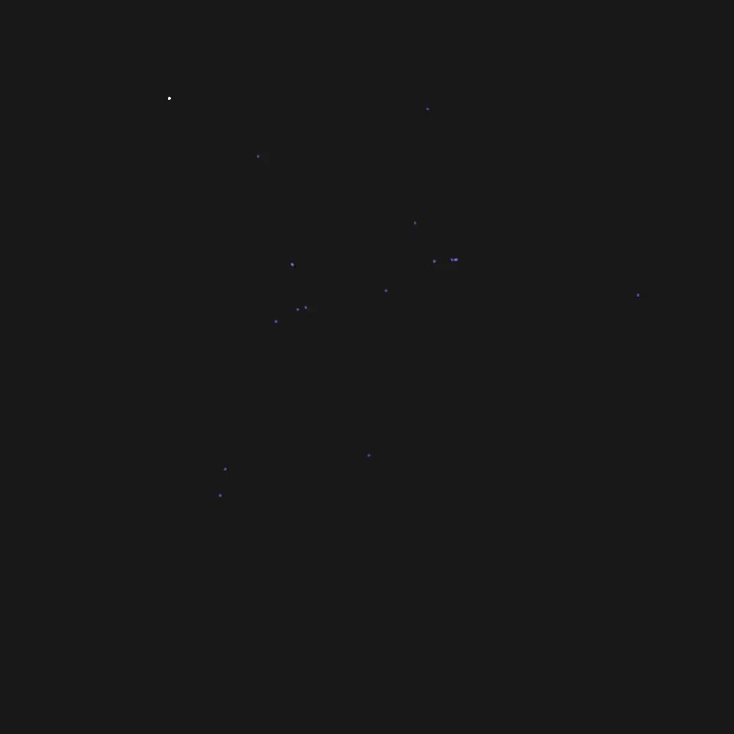
TPX3Cam 3D Cosmics LAr
Continuous streaming, 10 msec slice (playing 1ms jump per frame)
Side View
Top View

Slide 9
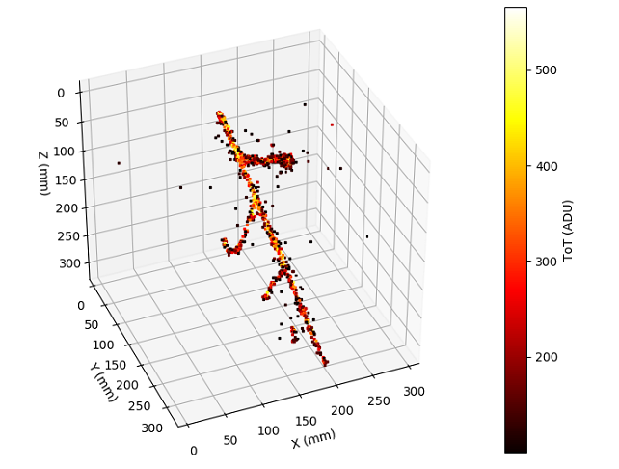
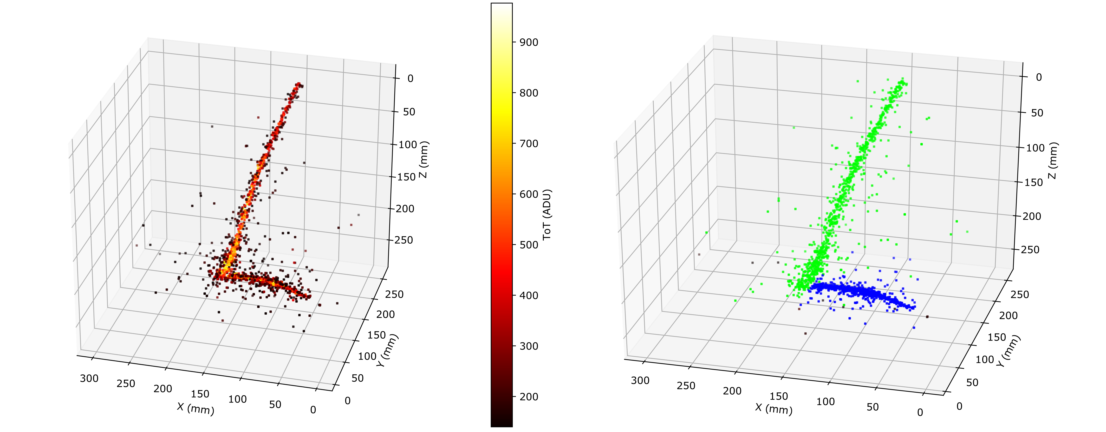
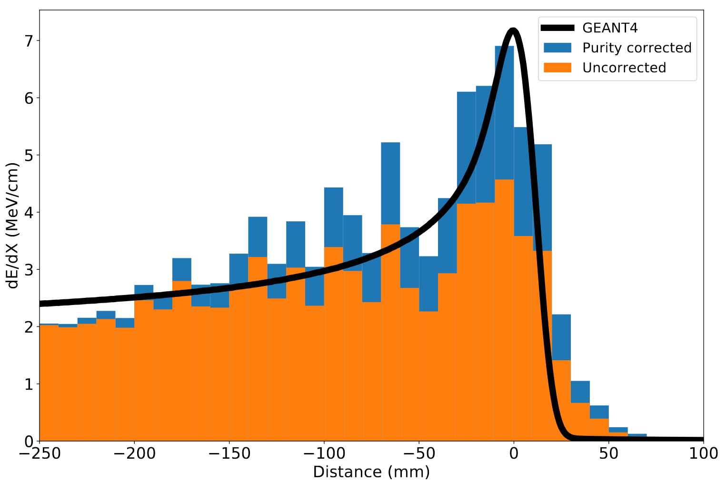
ARIADNE TPX3 Results
https://www.mdpi.com/2410-390X/4/4/35
Stopping Muon
MIP Energy Calibration
ADU (ToT) vs. THGEM Bias
11% energy resolution
Cameras are sensitive to the linear light production regime

Slide 10


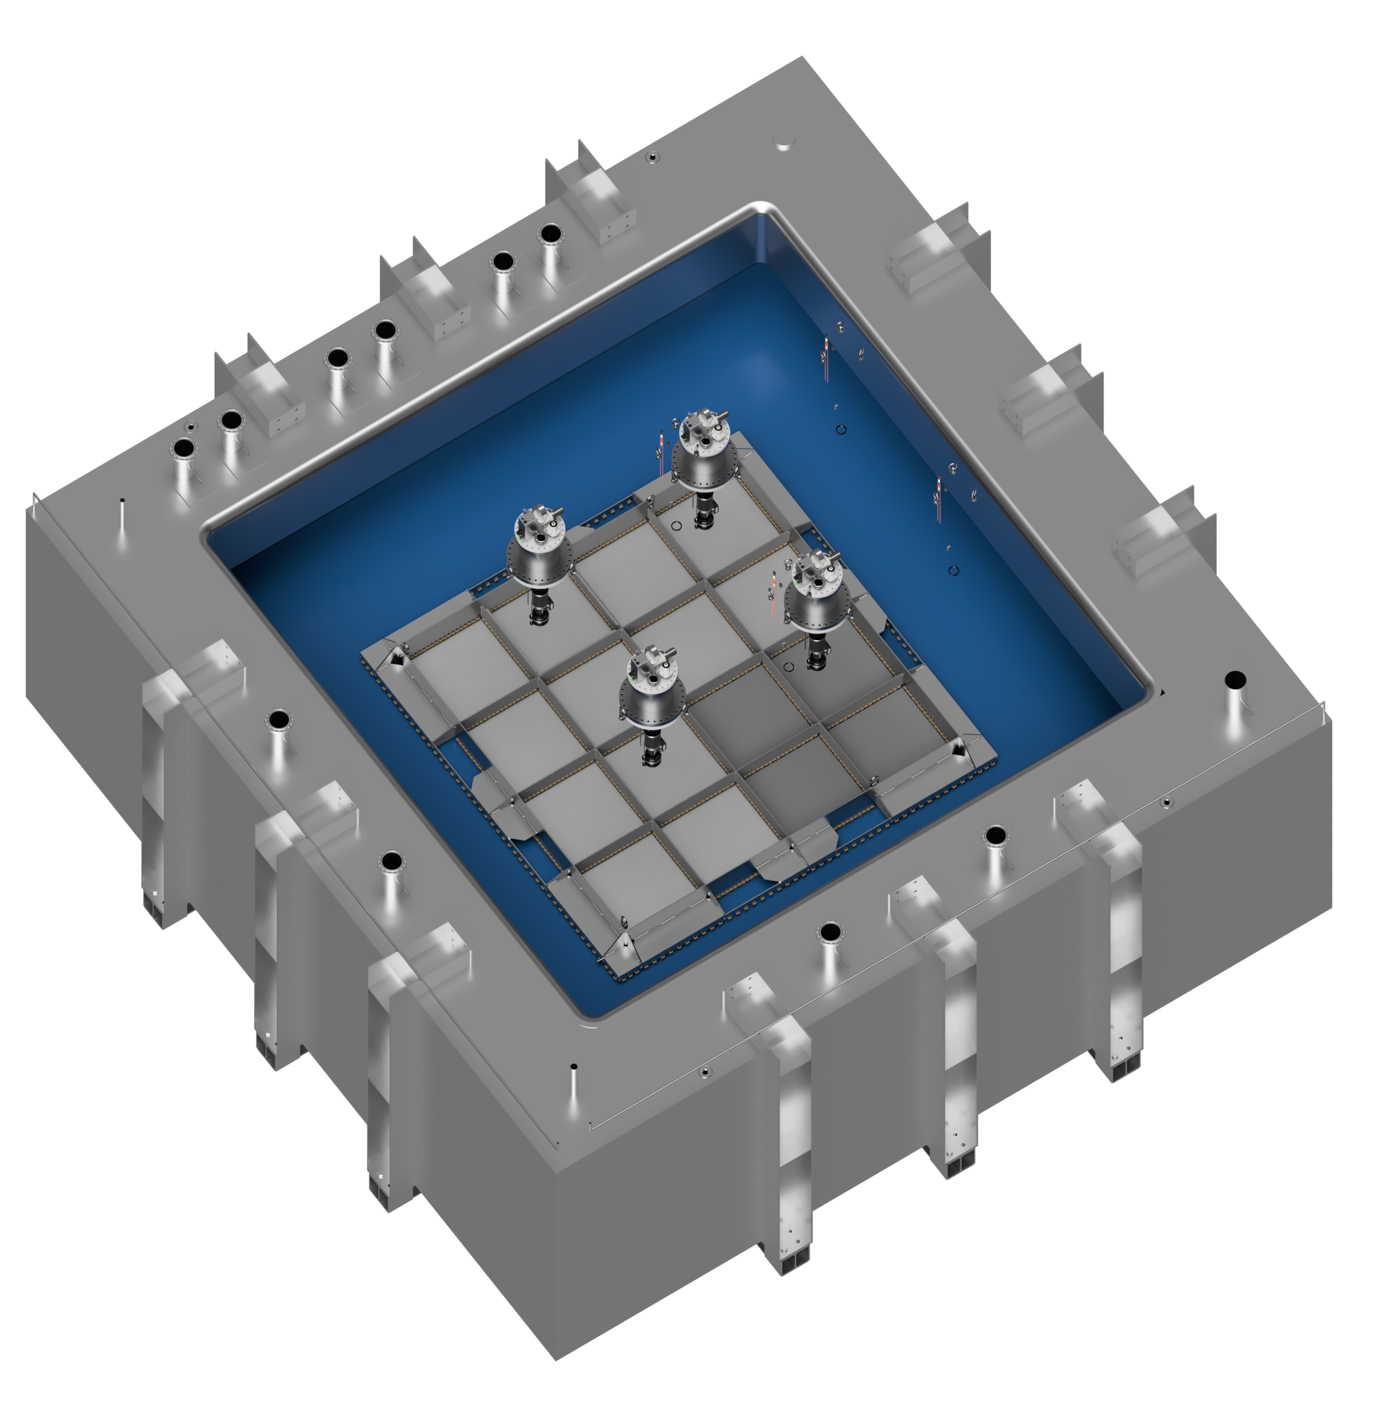
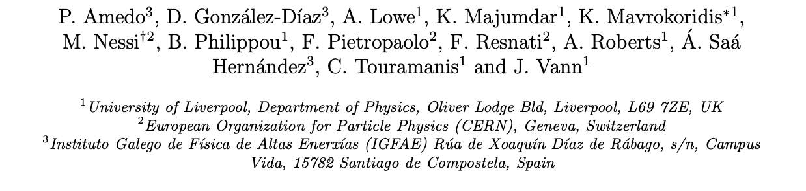
Larger Scale Demonstration at the CERN Neutrino Platform
Operation March/April 2022
Test optical readout on a scale relevant for DUNE using the existing cold box
CERN LOI: https://cds.cern.ch/record/2739360

Slide 11
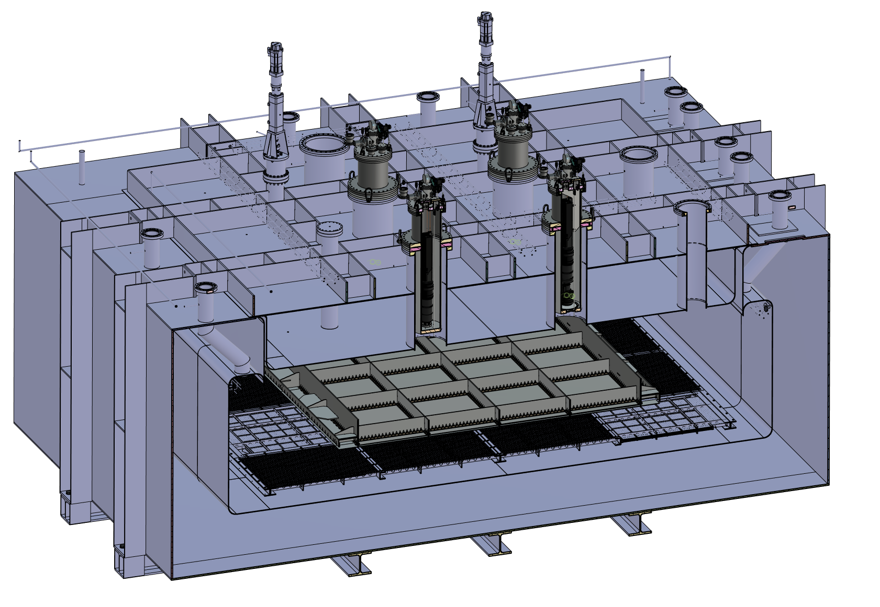
ARIADNE⁺: Cryostat Optical Configuration
TPX3 Camera
Assembly (1 x VUV)
TPX3 Camera
Assembly (3 x visible)
Large scale test of ARIADNE optical readout principle for dual-phase LArTPCs.
Four Timepix3 based cameras, each covering 1m x 1m readout area.
Three cameras detect visible light (wavelength shifter installed above THGEMs)
One camera directly detects VUV.
Light Readout Plane (LRP)
Cathode

Slide 12
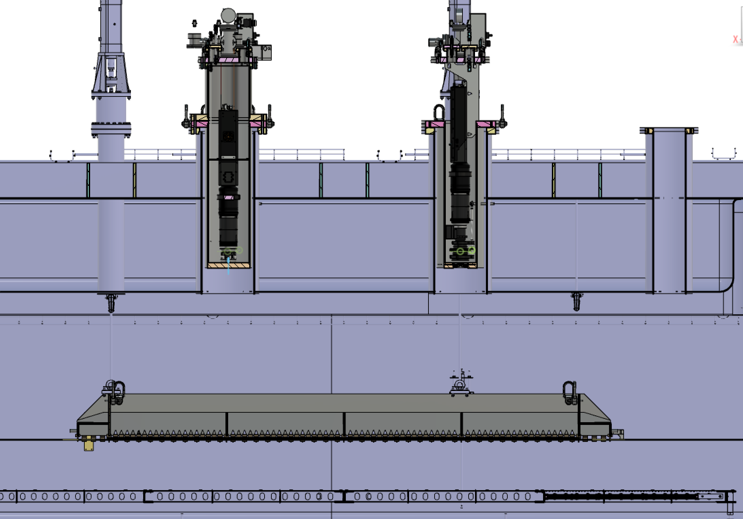
ARIADNE⁺: Cryostat Optical Configuration
Re-entrance viewports, cameras in gas nitrogen
20 cm electron drift

Slide 13
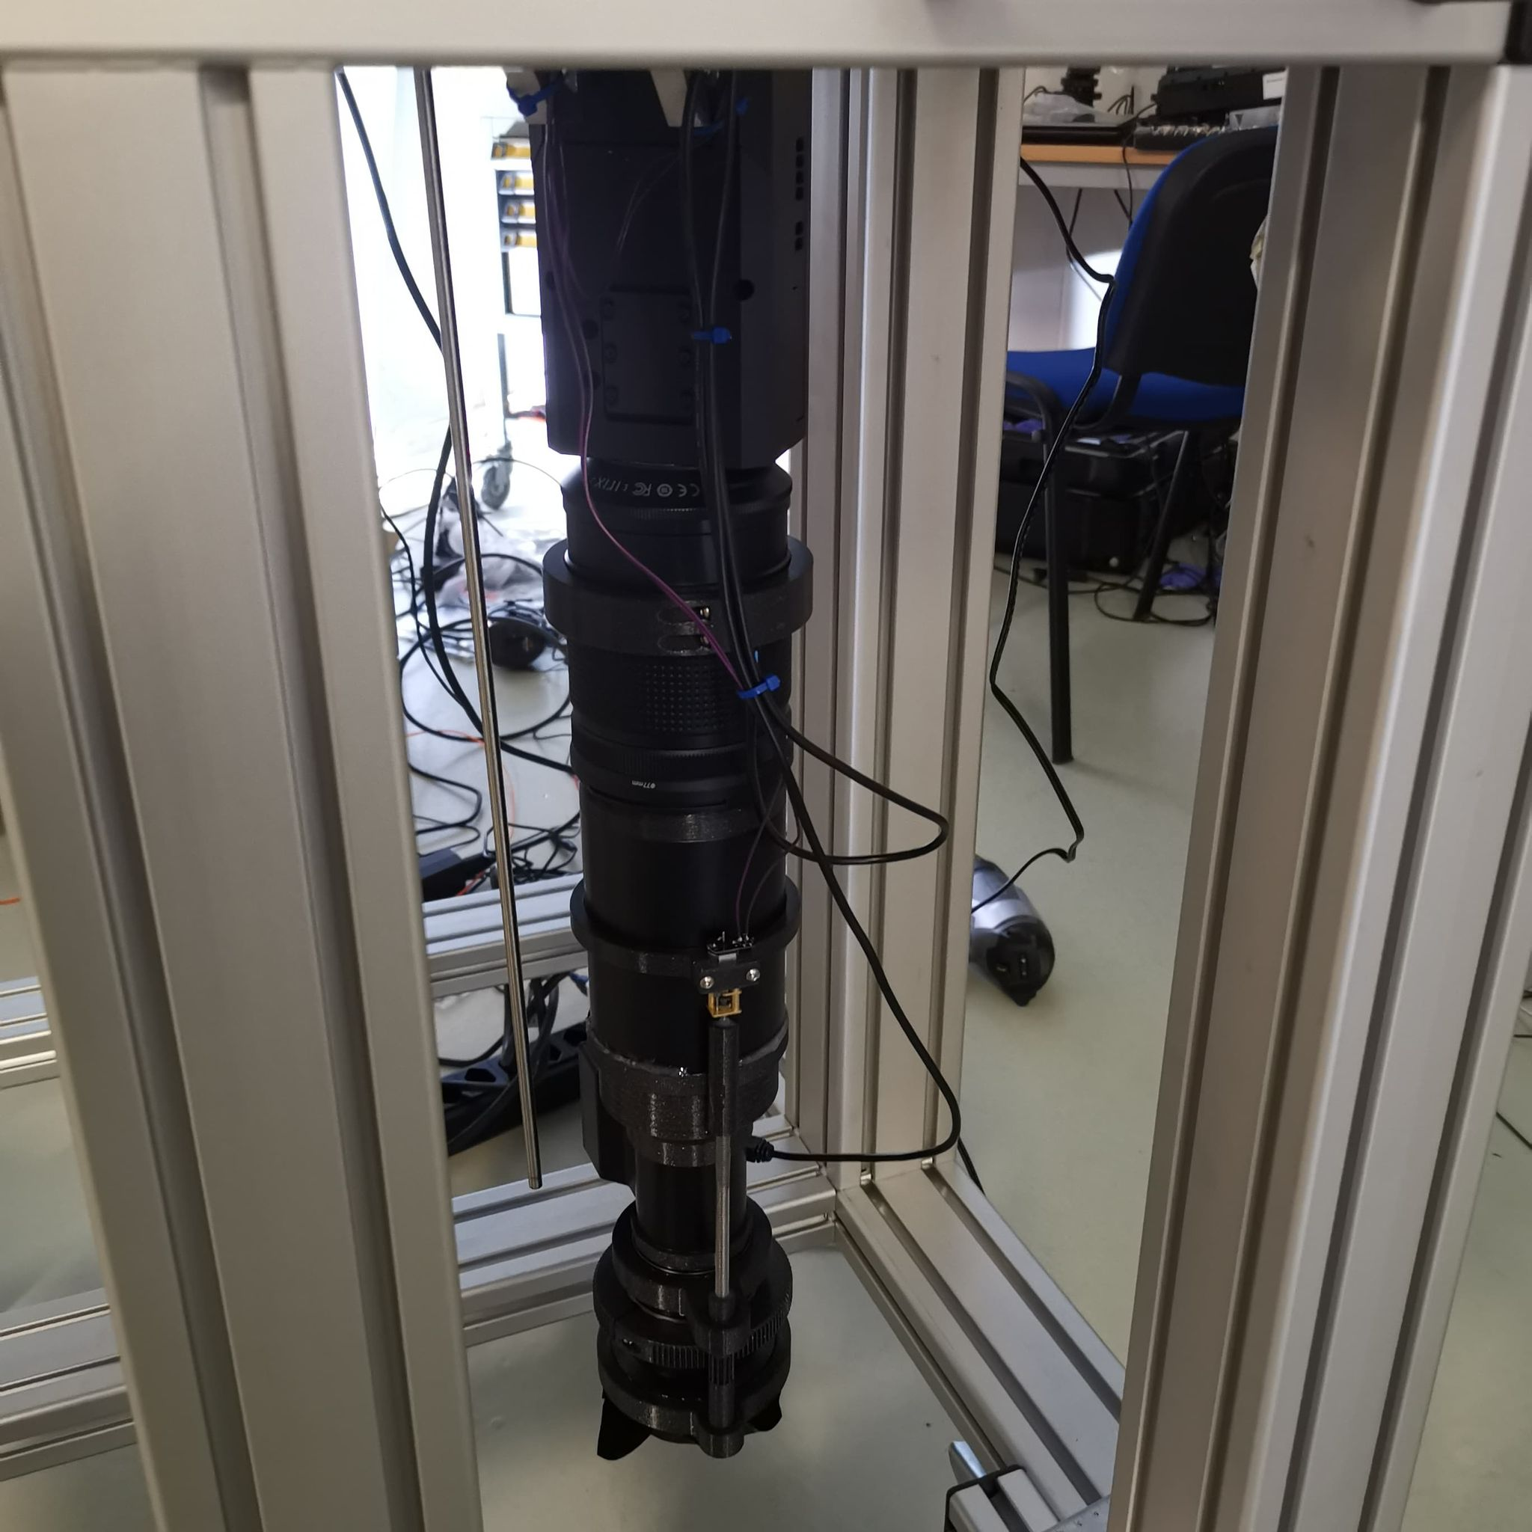
TPX3 Camera System
Timepix 3 Camera
Relay optics
Image intensifier
Objective lens

Slide 14
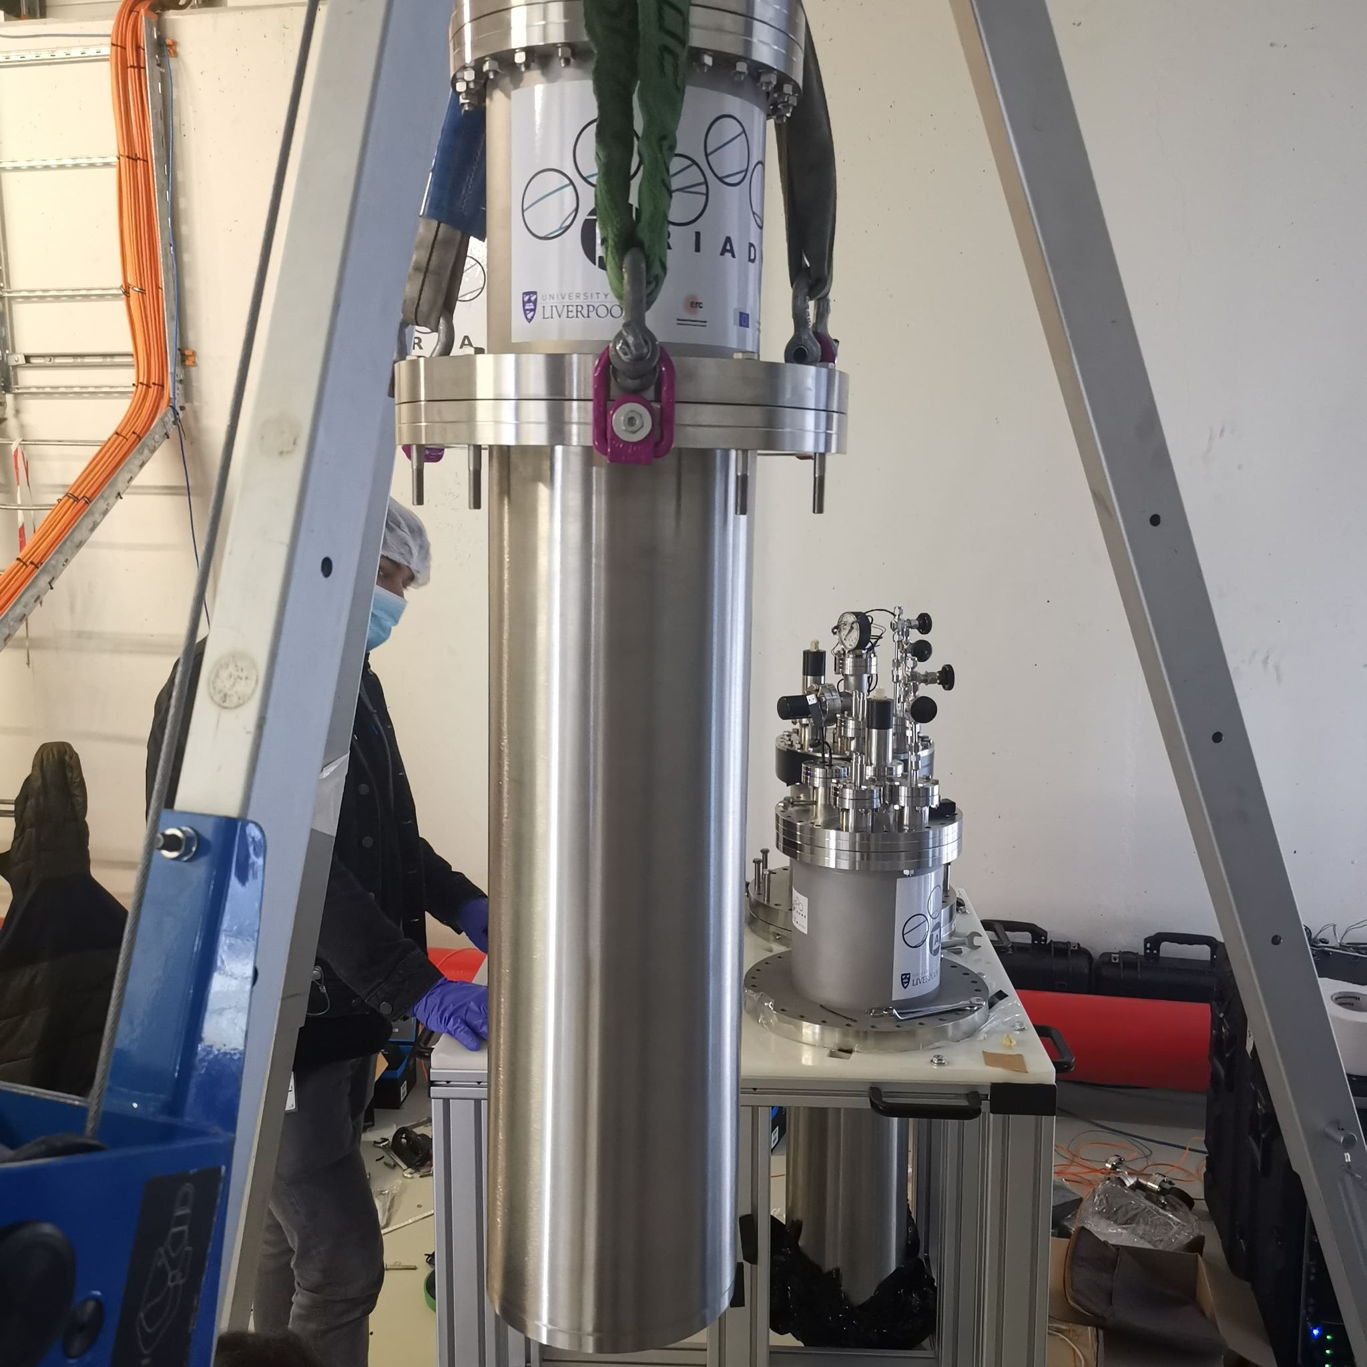
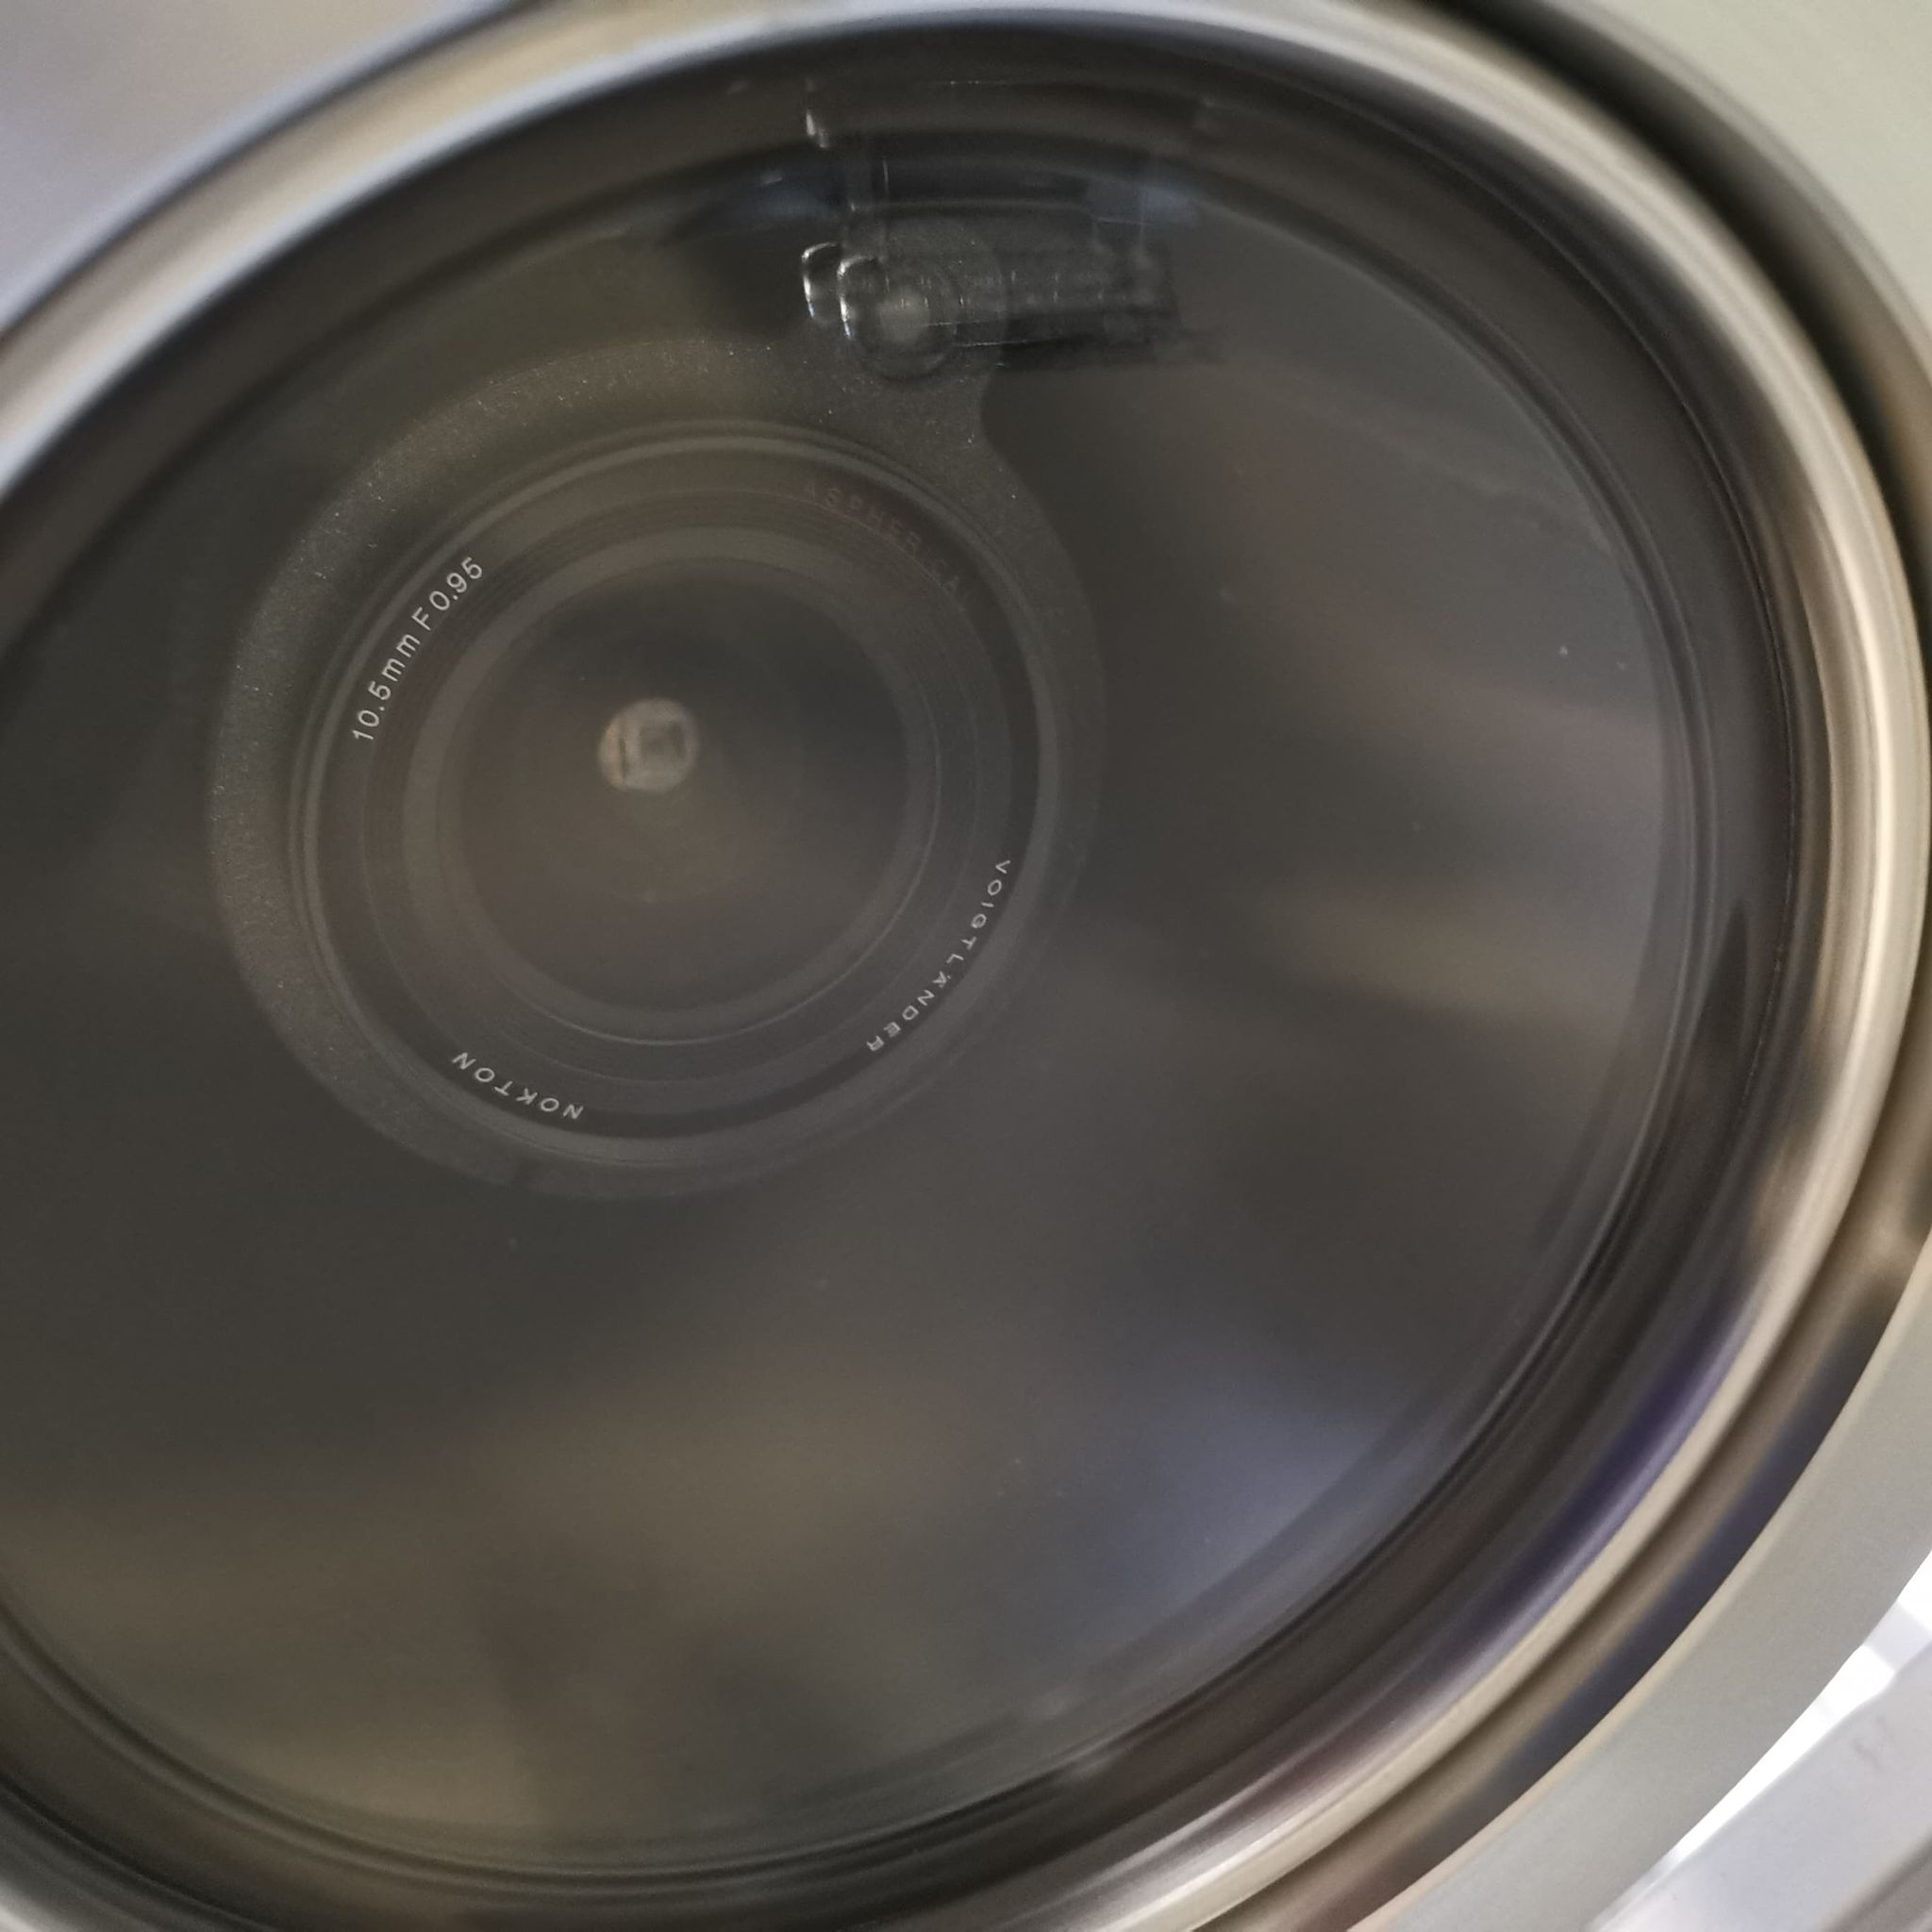
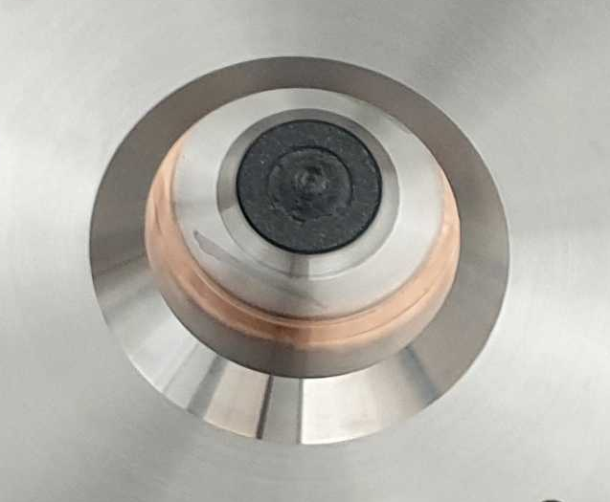
Re-entrance Viewport
Visible lenses (f0.95, 10.5 mm)
Custom made VUV MgF₂ Lens (f3, 11mm, 5mm diameter)

Slide 15
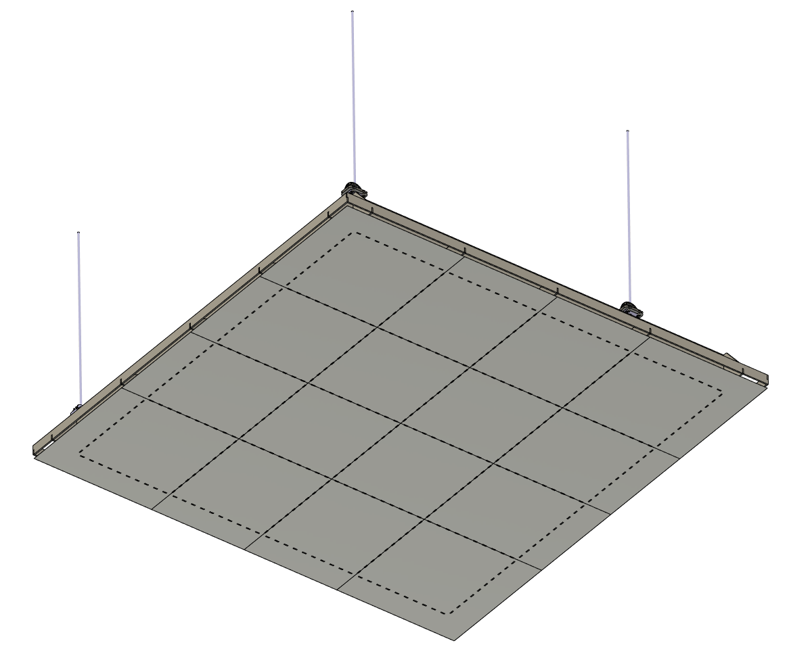
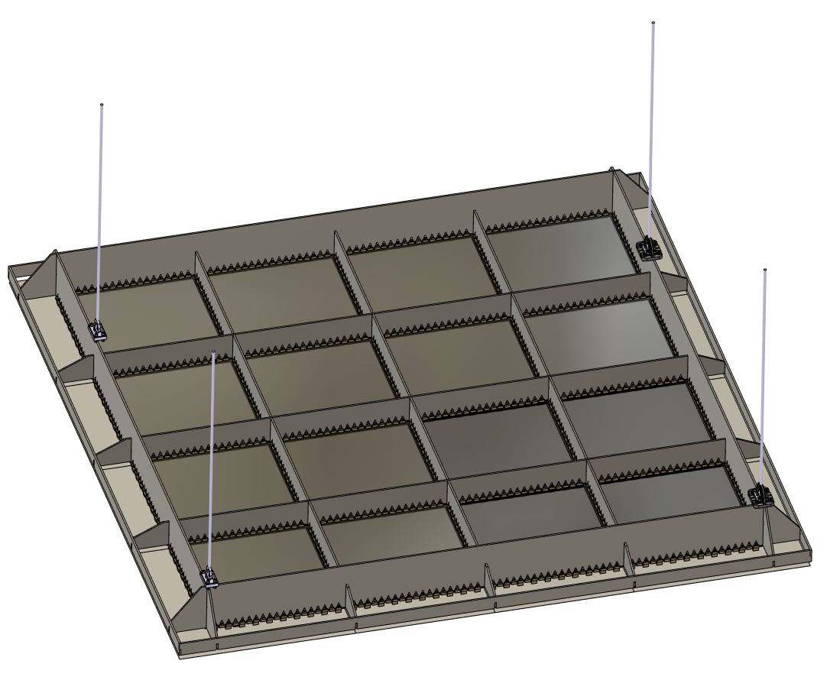
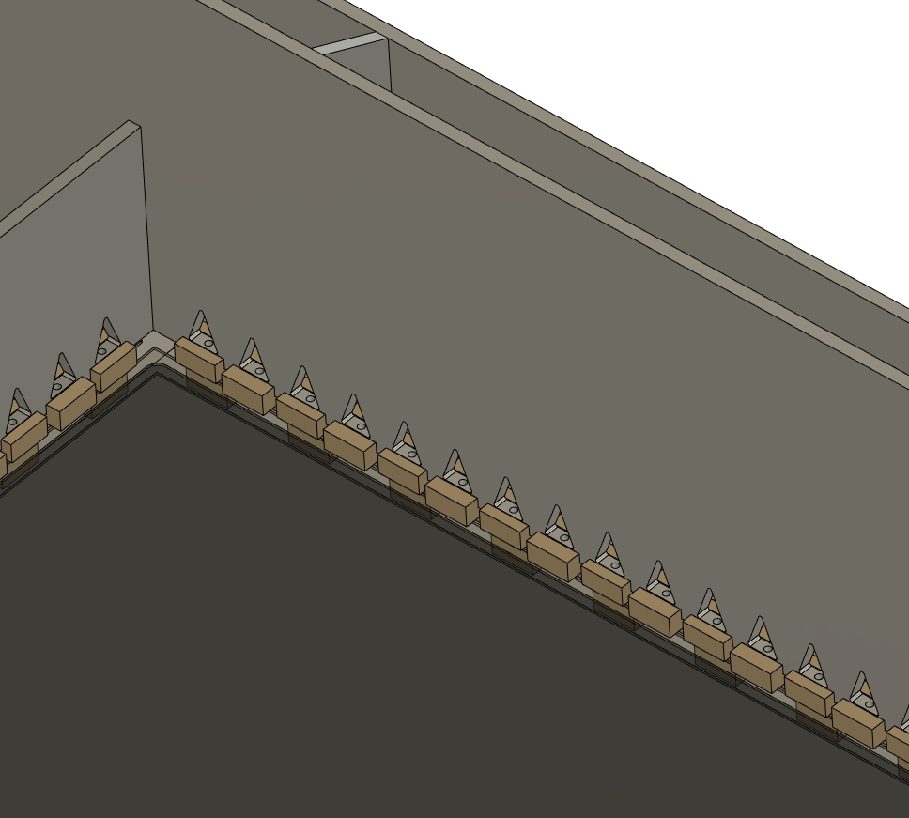
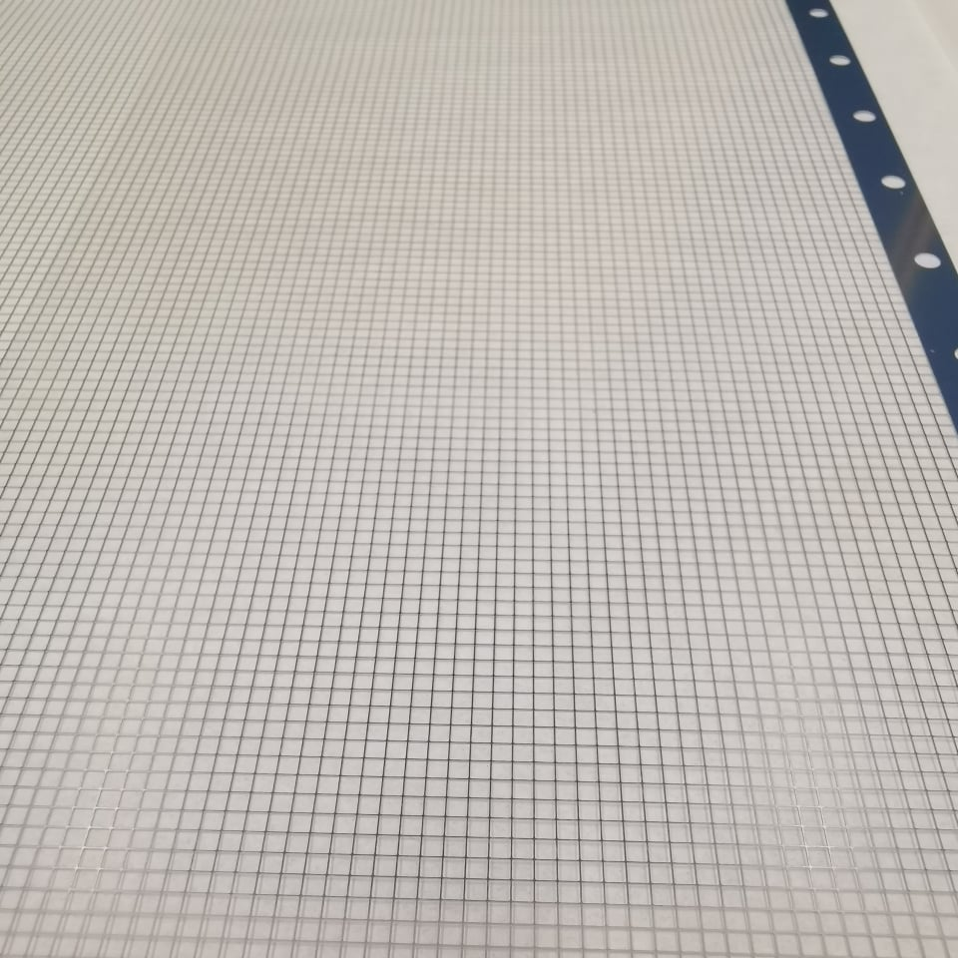
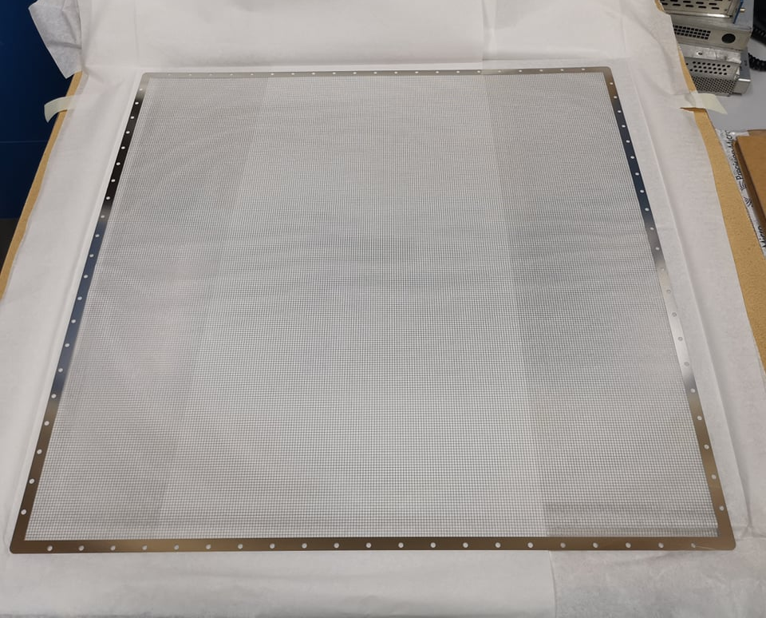
Light Readout Plane (LRP) Design
Modular design and can be applied directly to a DUNE module
Bottom view
Welded Invar structure (Uniquely low coefficient of thermal contraction)
16x 50cm square G-THGEMs
2.3m
Photochemically etched extraction grids
THGEMs/Extraction grids supported by PEEK Spacers

Slide 16
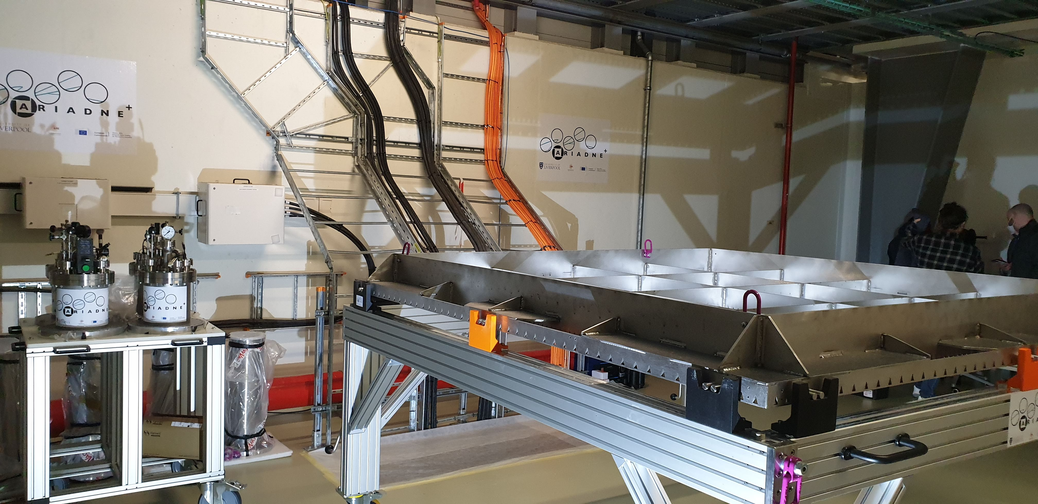
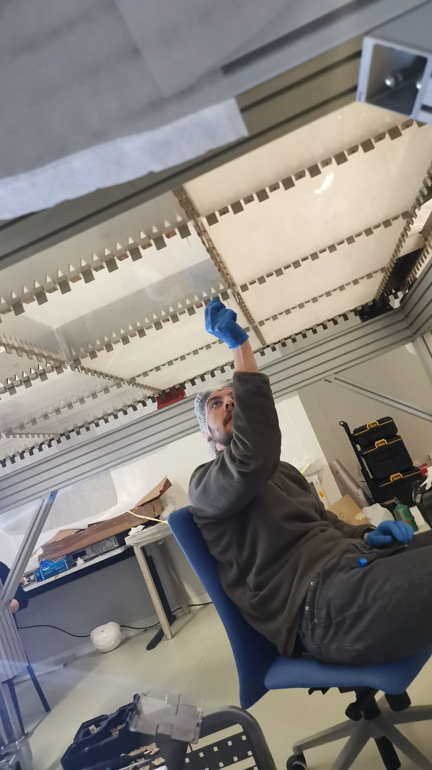
Light Readout Plane (LRP)
LRP assembly at CERN

Slide 17
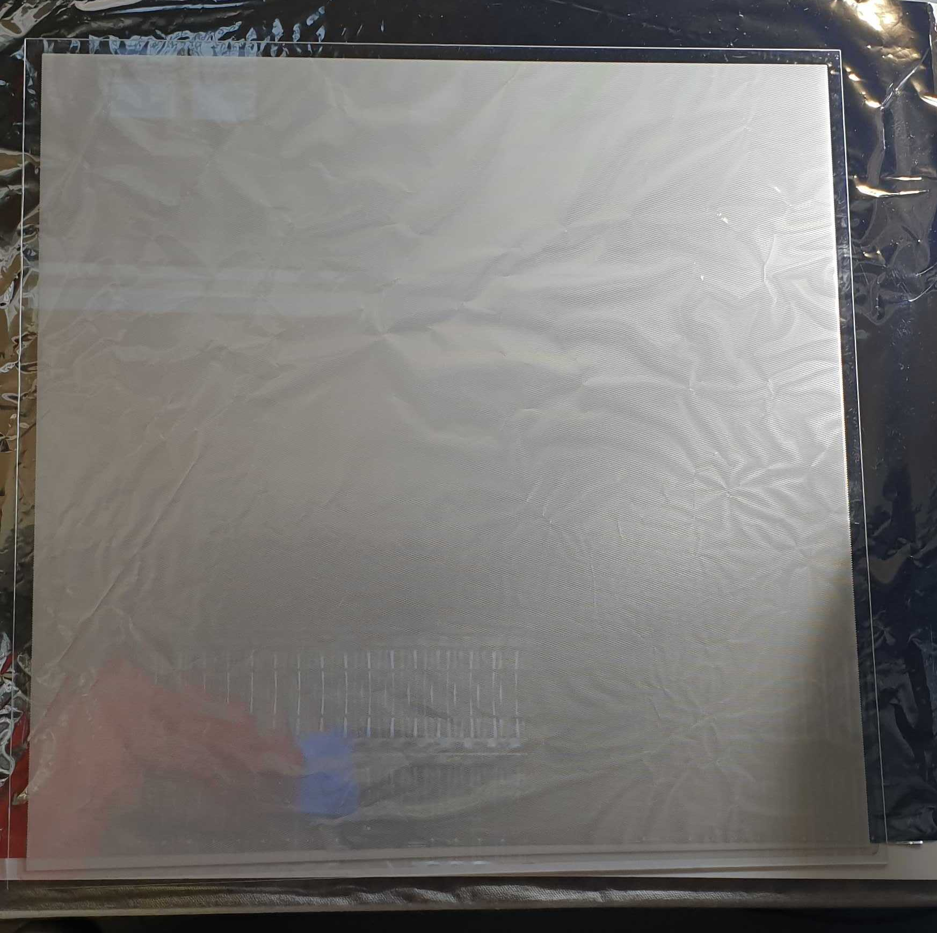
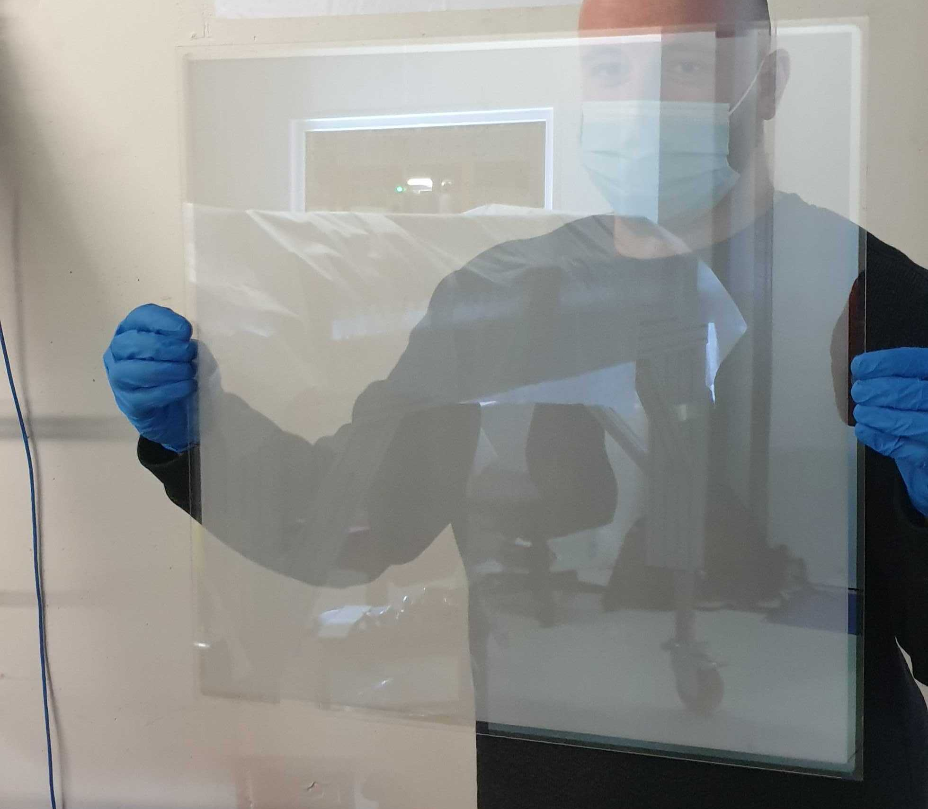
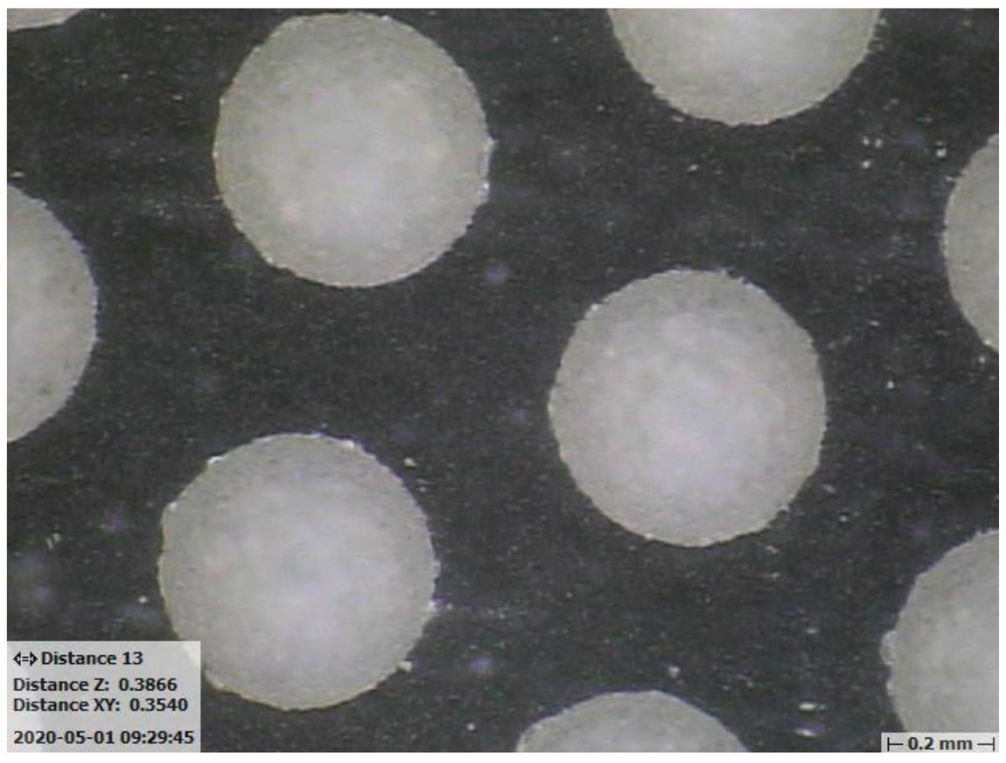
50cm Glass THGEMs
Novel Glass THGEMs developed at Liverpool (Patent accepted GB2019563.2)
Sixteen 50cm x 50cm glass THGEMs
1.1mm thick,
500μm ID holes,
800μm pitch hexagonal array
See for more details:
https://www.mdpi.com/2076-3417/11/20/9450

Slide 18
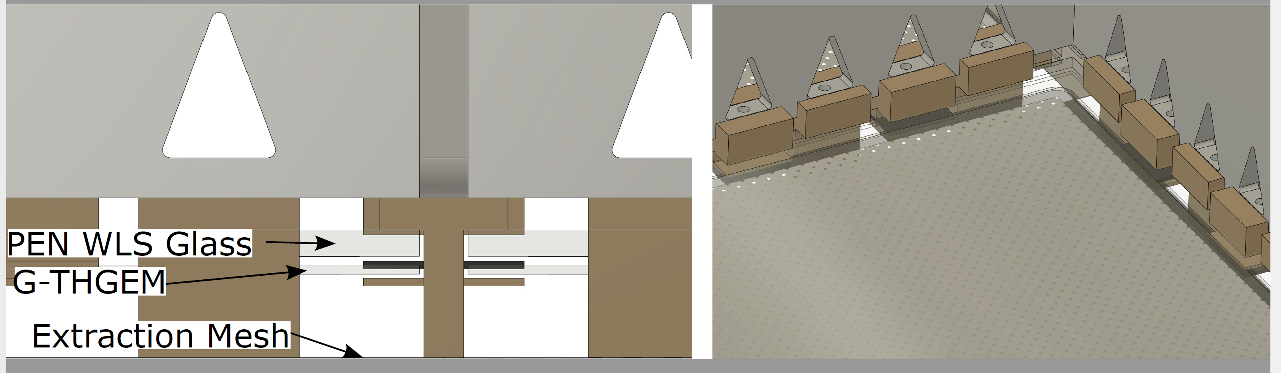
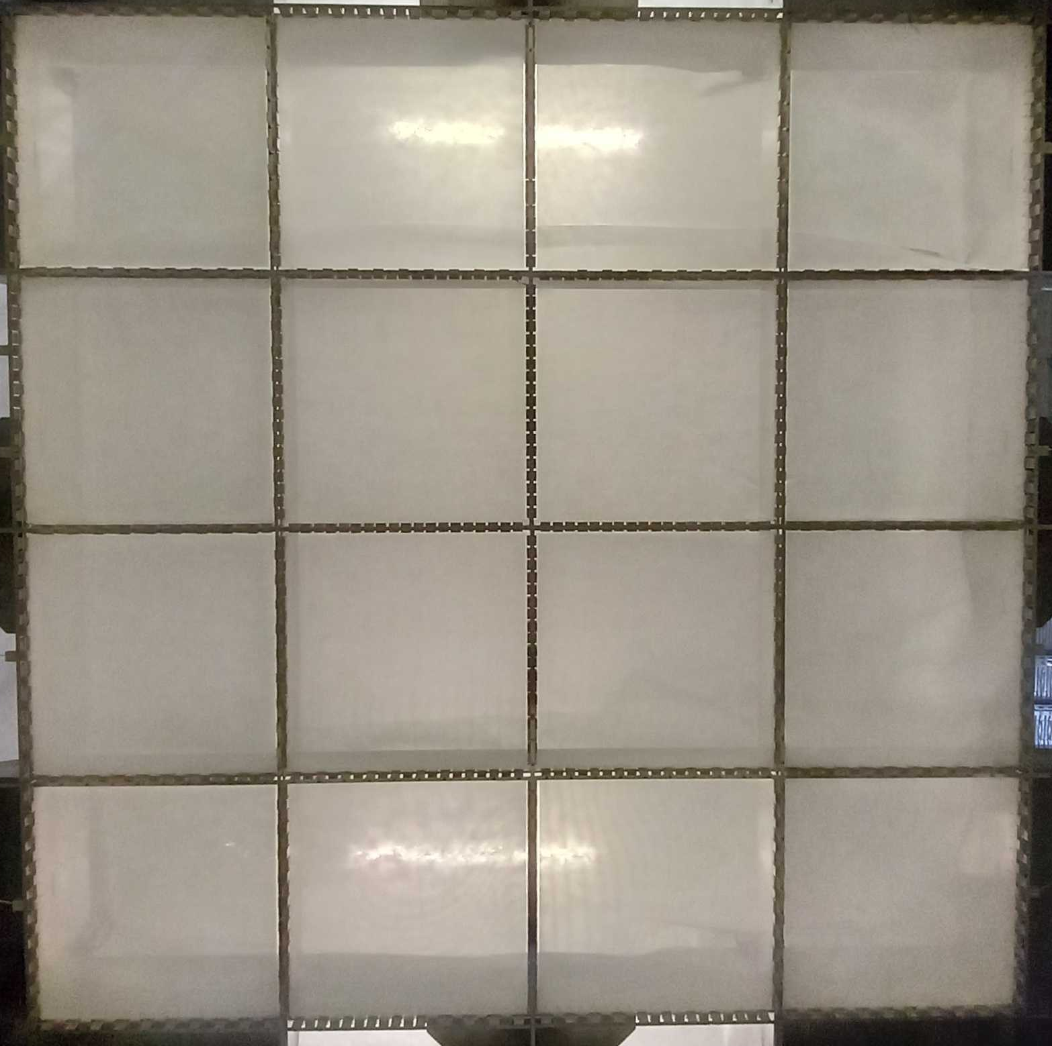
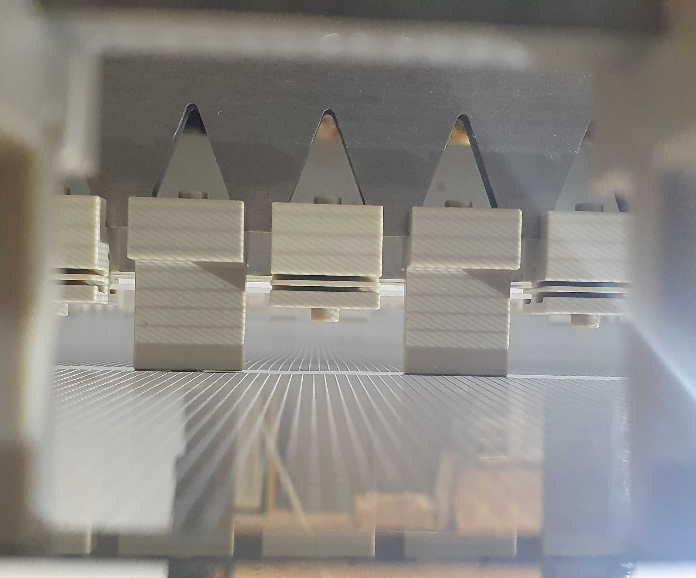
Light Readout Plane
LRP CAD
LRP grids, G-THGEMs and WLS
2x2m LRP G-THGEMs from underneath
The 15mm modular extraction region provided a very stable extraction field!

Slide 19
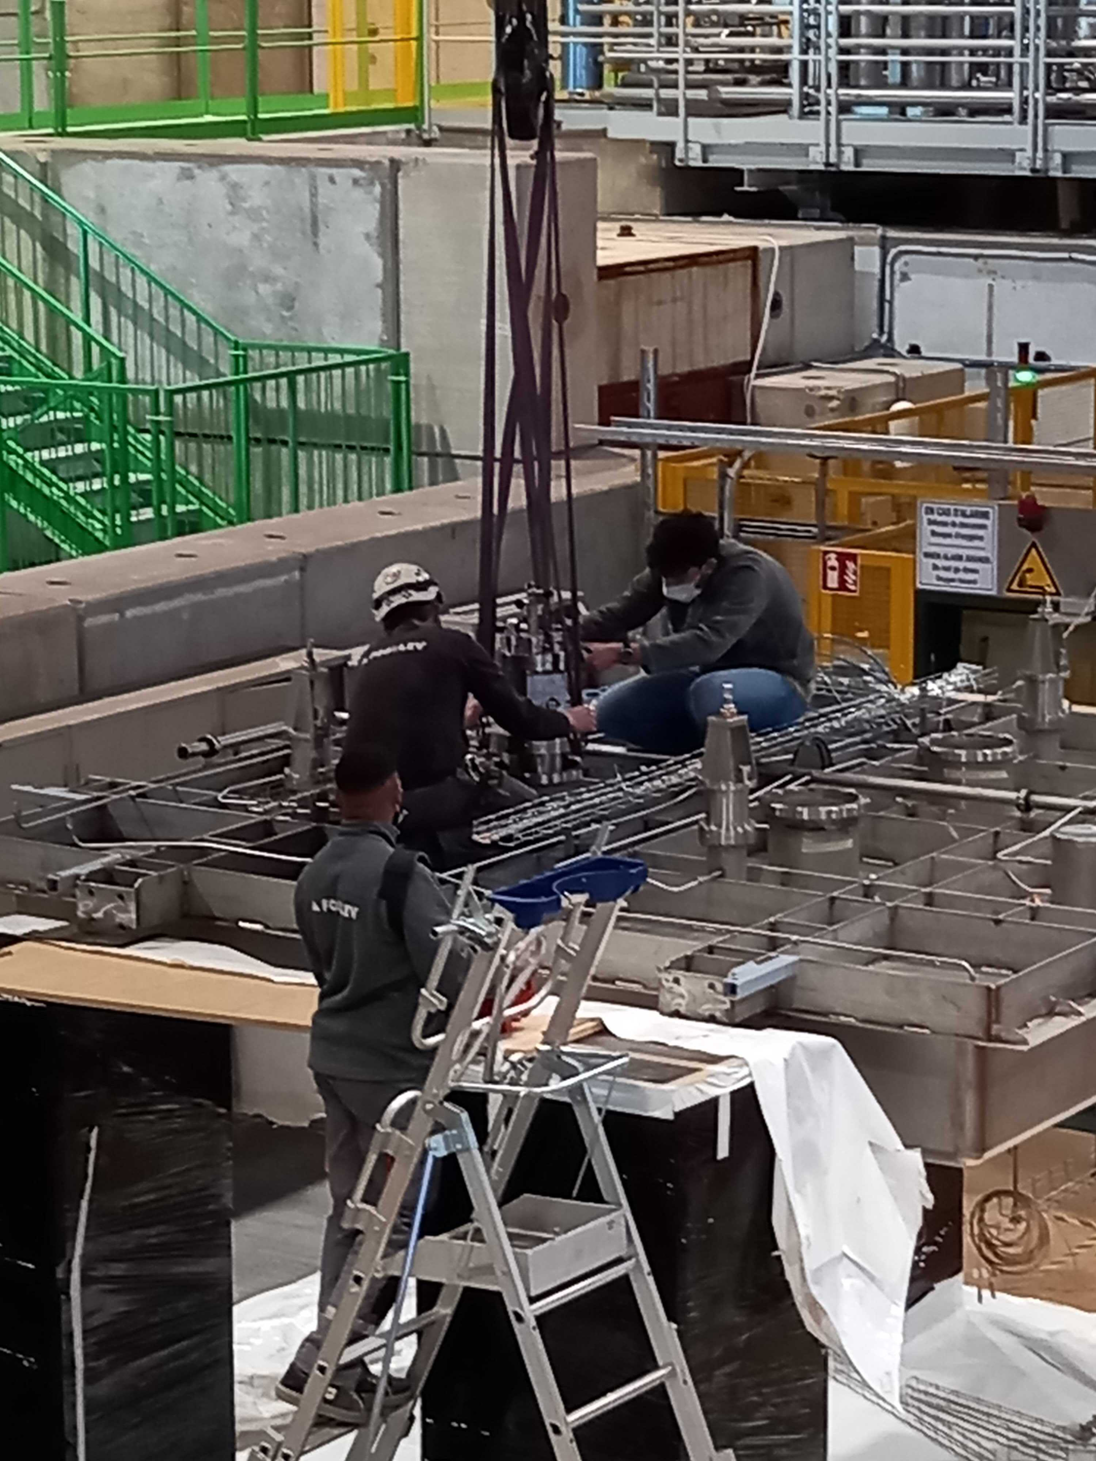
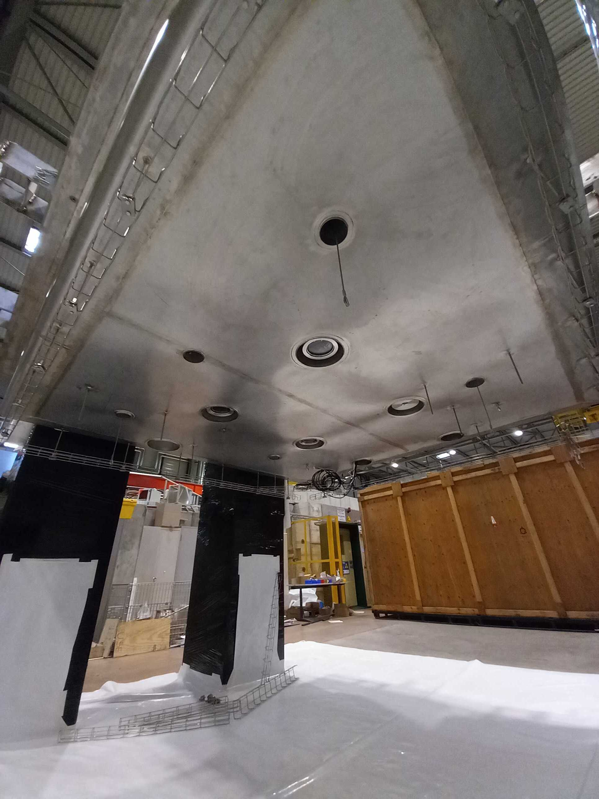
Cold box Integration

Slide 20
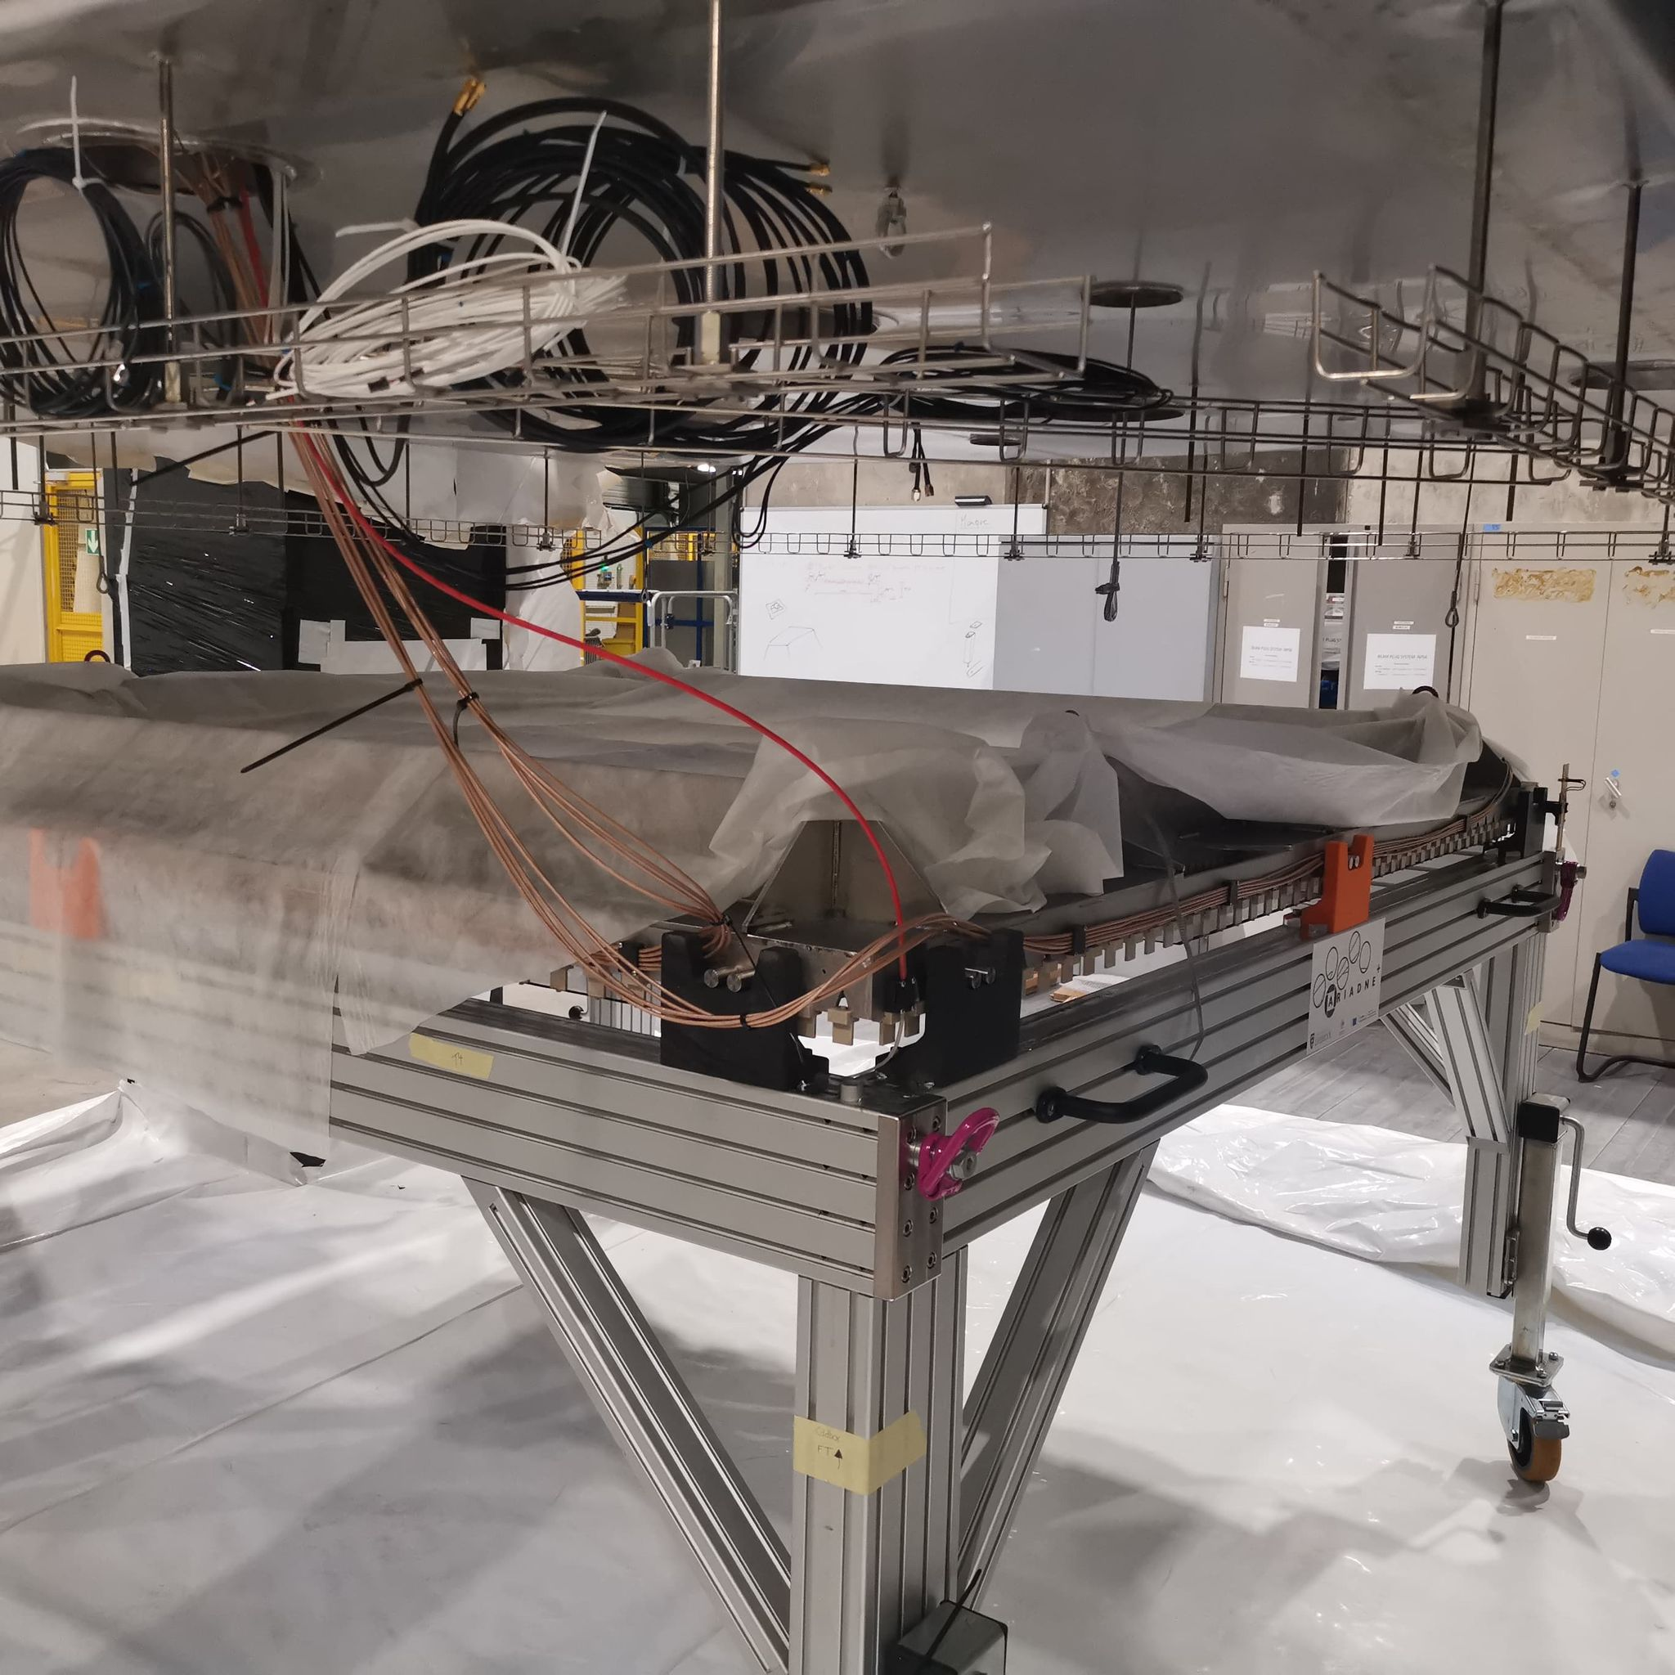
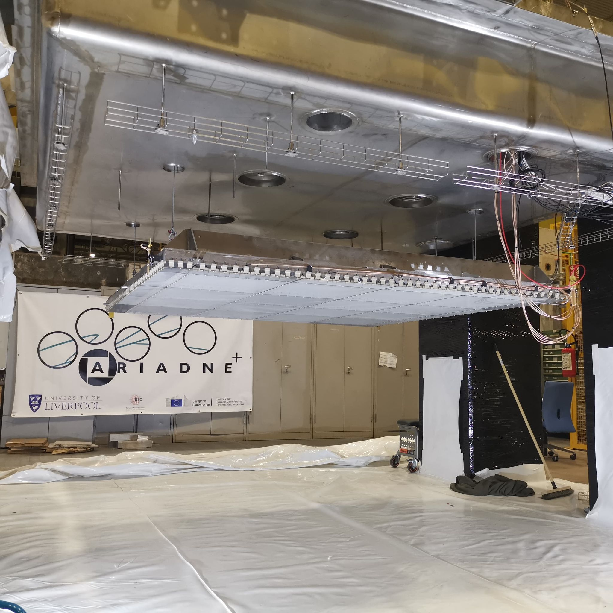
Cold box Integration

Slide 21
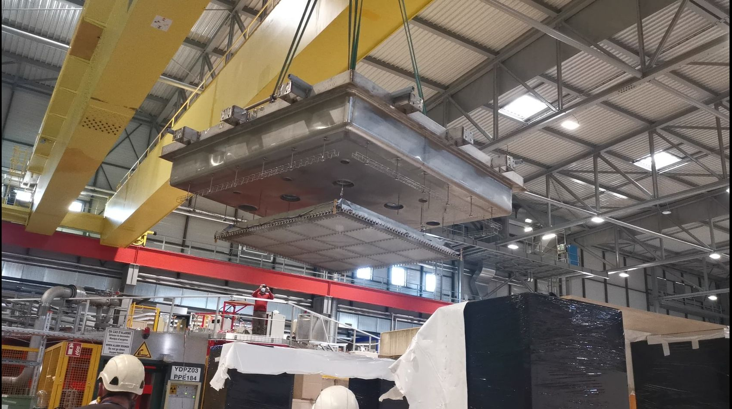
Closing the Detector

Slide 22
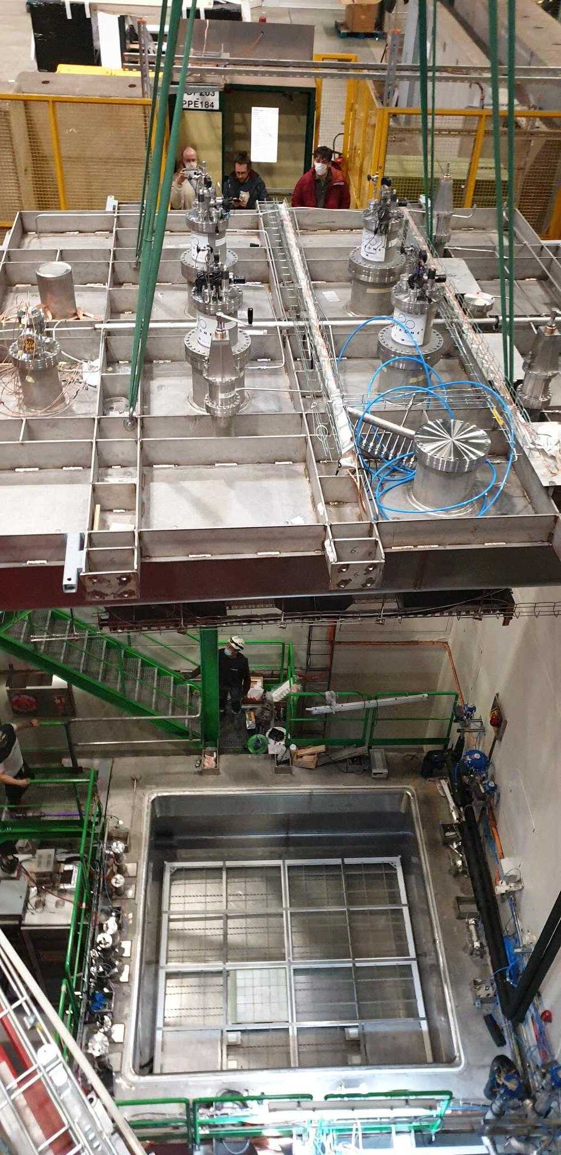
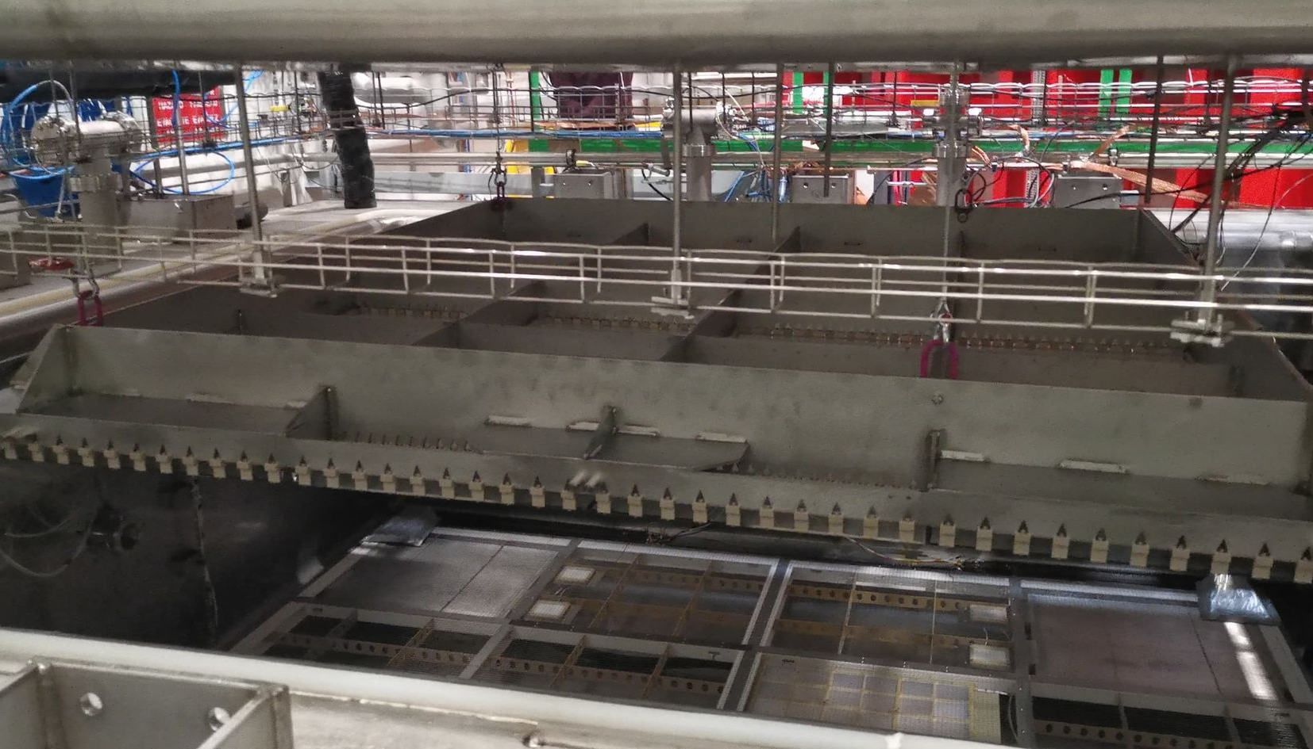
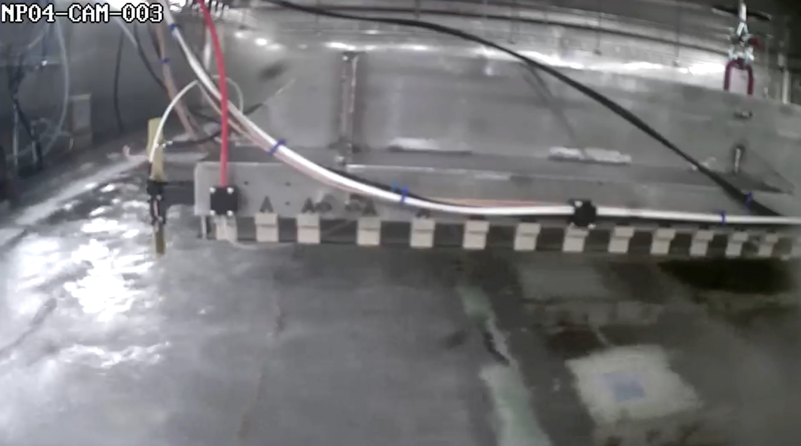
Closing the Detector
X-Arapuca

Slide 23
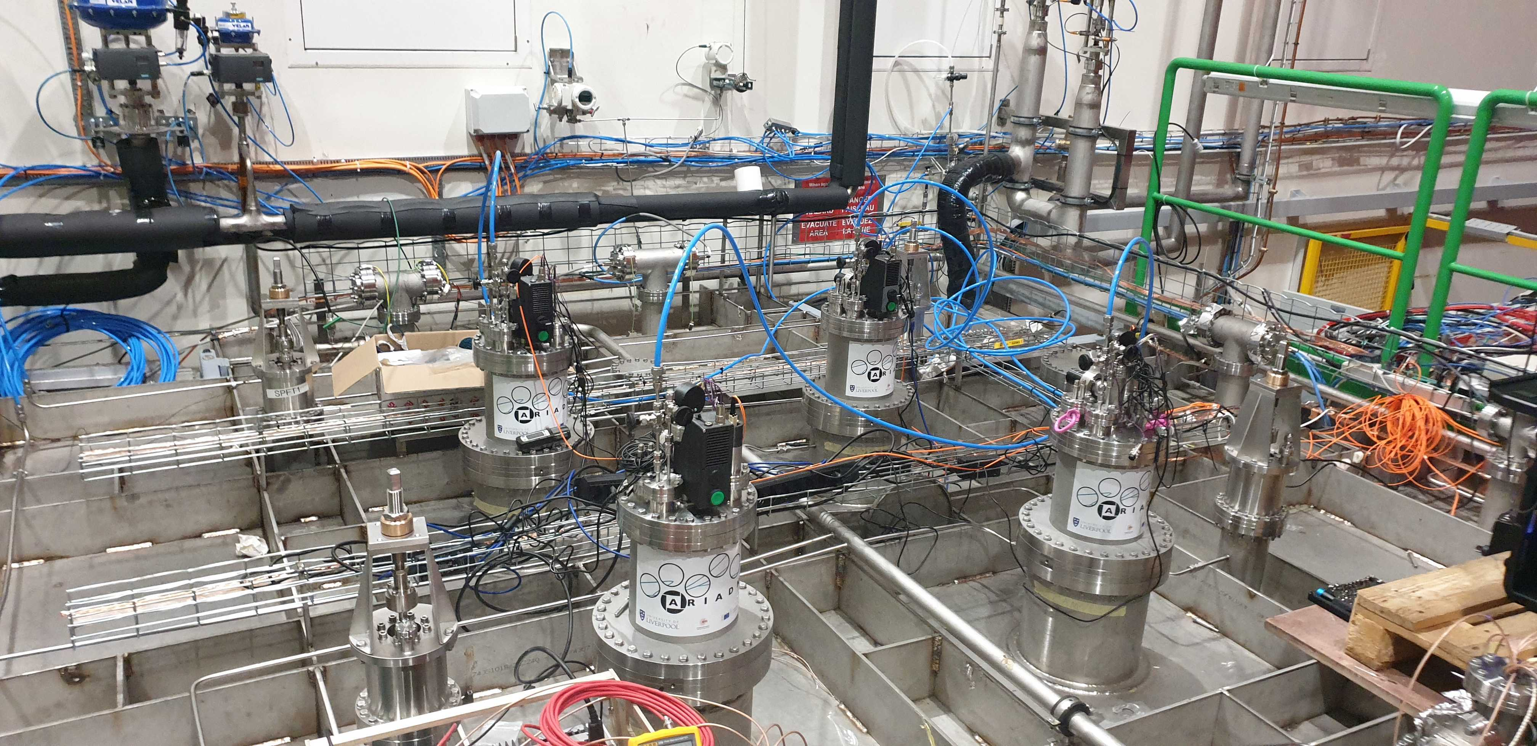
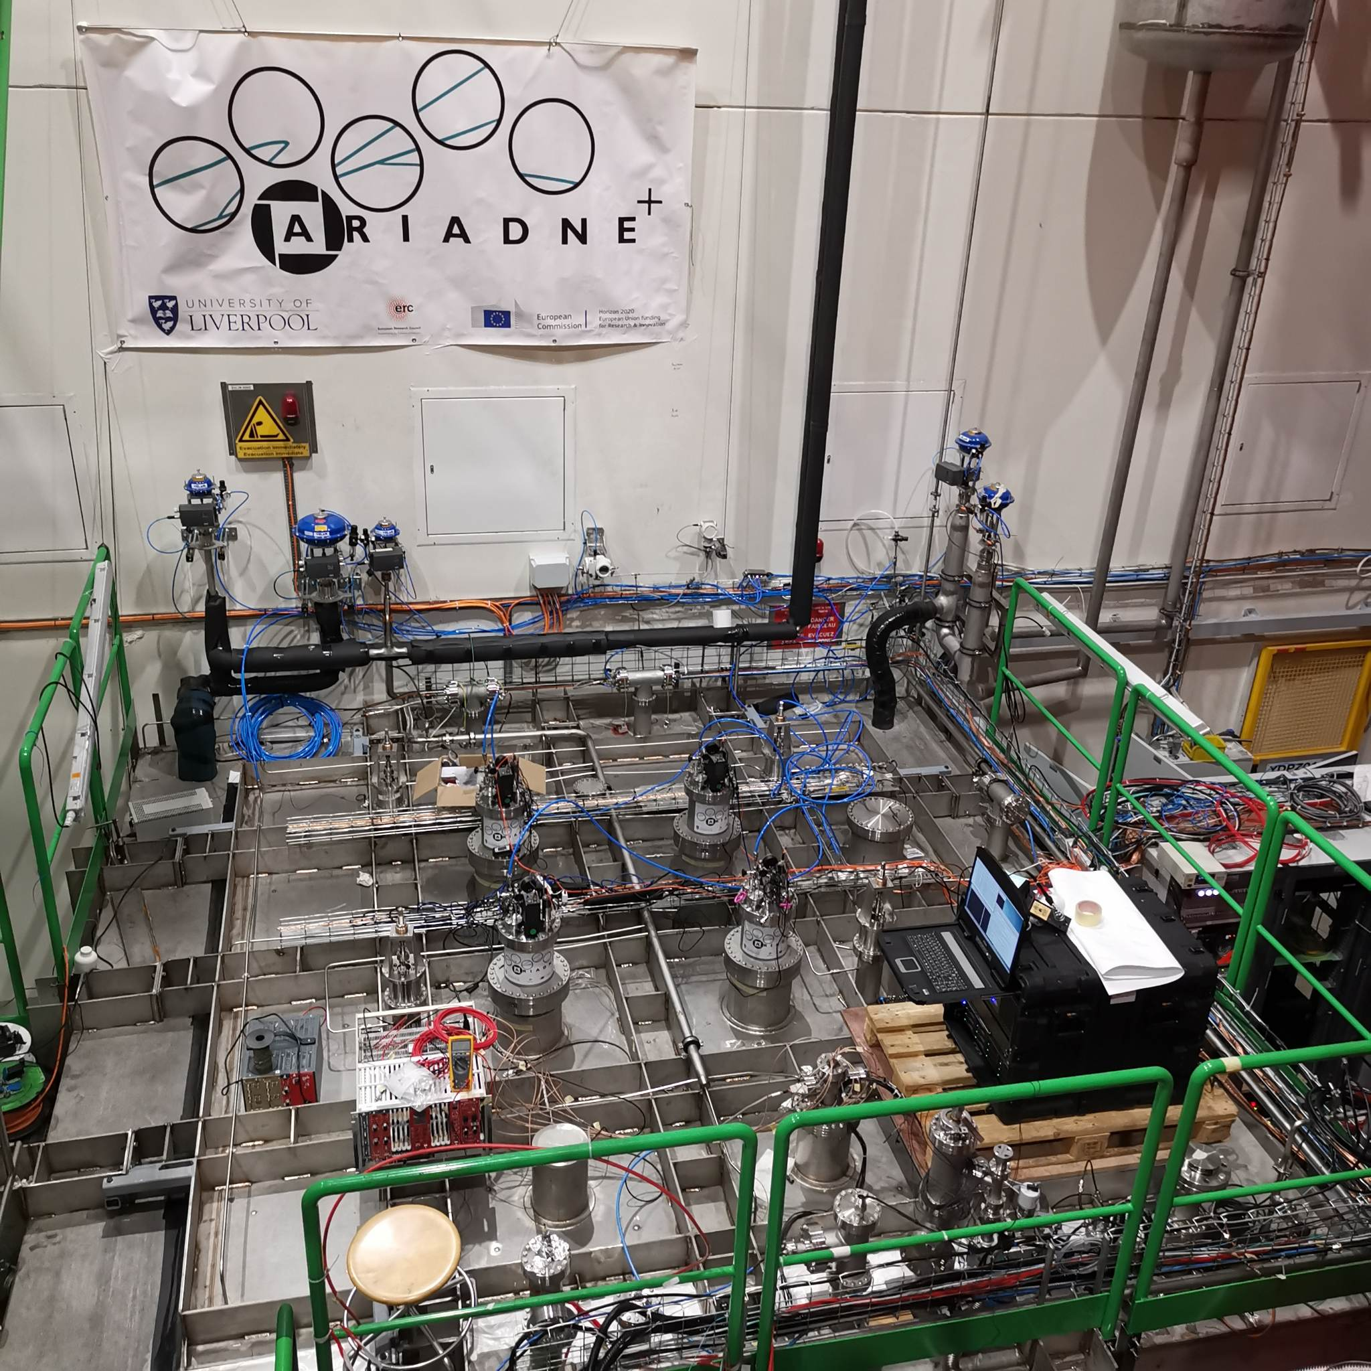
Detector Closed/Running
Very stable cryogenic operation thanks to the CERN team
Argon purity was approximately 0.5 msec
Three weeks of data collection refilled twice

Slide 24
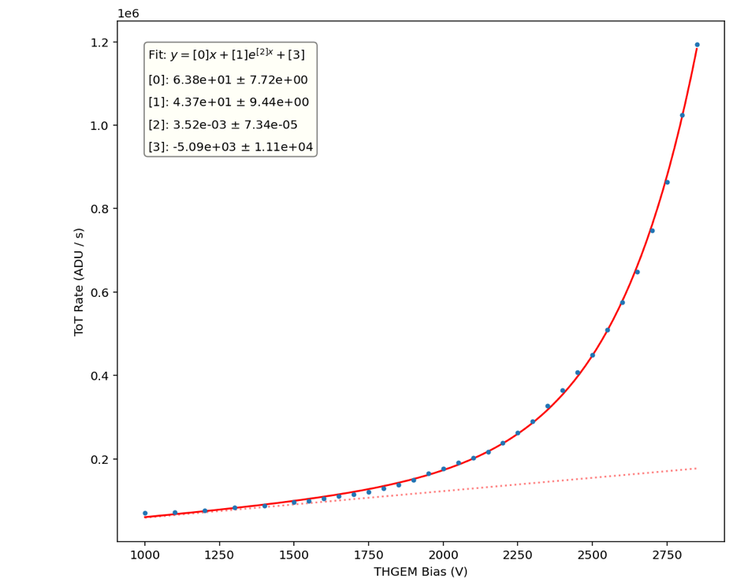
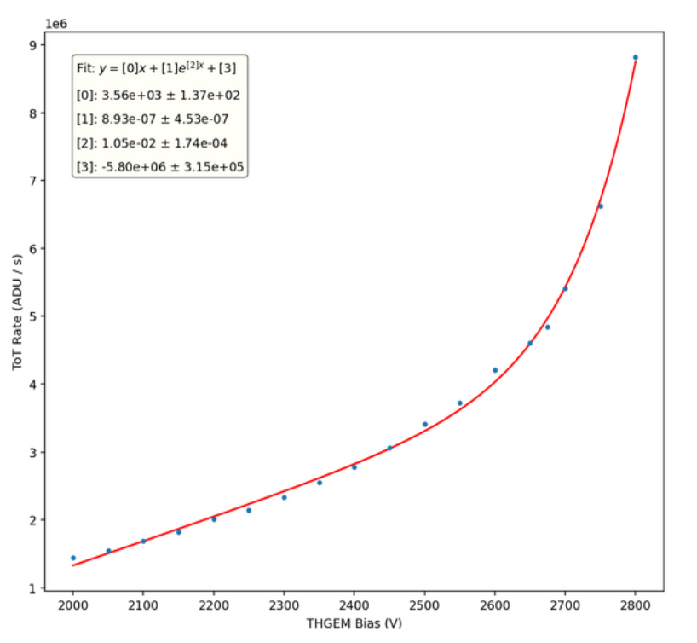
Glass THGEM Light Gain Study
Visible Intensifier
VUV Intensifier

Slide 25


30 Seconds exposure Cosmics
Visible intensifier cosmics
VUV intensifier cosmics
(vignetting effect needs correction)

Slide 26

Energy Calibration and Resolution
Track fitting to through going muons (Through THGEM and greater than 19 cm depth)
Energy conversion : 199.10 ± 1.73 ADU / cm
Energy resolution : 16.73 ± 0.16 %
https://arxiv.org/pdf/2301.02530v2.pdf
Preliminary
Visible image intensifier
VUV image intensifier
Preliminary

Slide 27
ARIADNE+ Conclusions
Optical readout achieved with stable detector conditions has been demonstrated at the same scales as that for vertical drift tests (CERN Neutrino Platform Cold Box)
Dual phase extraction region very stable at large scale!
TPX3 and Glass THGEM technology is ready for deployment now
TPX3Cam TPC Benefits
Raw data is natively 3D
Huge readout rates possible (80 MHits/s)
Zero suppressed readout (approx. few kbytes per event)
Technology | Physics enables | TRL (For DUNE) | Cost (DUNE 12mx60m FD) | R&D plans
TPX3 CAM | Very low energy threshold & excellent tracking | 9 | 7.2M (1 cam/m², 4mm/pix) | Lens and image intensifier testing
LRP (GTHGEM Array) |  | 7-8 | 10M (assumes 14k/m², mass production cost reduction is not included) | Larger scale tests (protoDUNE)
TPX4 CAM | Improved time & energy resolution | 7 | 3.2M (0.6 cam/m², 3mm/pix) | Full characterization
High resolution with approx. 1 mm per pixel
Easy access for swapping in/out technologies
Same readout is possible for dual phase or gas TPCs
Comparatively low cost to other readout methods
Proposal to instrument ProtoDUNE is ongoing

Slide 28
Using ARIADNE optical readout system for FLArE TPC

Slide 29

Simulated TPC & requirements
Detector spatial resolution ~2mm
We presumed 1.8m instrumented LAr width but can change if needed to 1m
Will be good to understand cavern/ cryostat size constraints

Slide 30

Optical FLArE Overview Design
CAD by G.Stavrakis
56 TPX3 Cams in cryostat ports. This will provide 1.8mm/pixel resolution
Two invar LRPs with 56 glass THGEMs, similar to the ARIADNE cold box test
Aluminum profile Field Cage (similar to ProtoDUNE)
Two CPAs (same size as LRPs)
Total instrumented LAr volume 20000 litres/32 tons

Slide 31

TOP view
Each camera is looking a 45x45cm glass THGEM (active area 1.8m x 6.4m, 56 cameras)

Slide 32
TOP view
In red box 1mx1mx6.4m fiducial area and 28 cameras with ~2mm/pixel

Slide 33


LRP Design
CAD by G.Stavrakis
3290mm
One LRP to contain 7x4 Glass THGEMS (similar to ARIADNE LRP)
Made out of Invar
Will hang from 4/6 top cryostat ports and will be able to move up down using levelling motors
The LRP structure will take the weight of the cathode panel

Slide 34
LRP Design
3.4 m
Size of LRP designed in order to fit within the CERN cold box to allow for QA before installation to FLArE

Slide 35

Design Effort -Assembly
Field cage support structure (hangs from cryostat ports)

Slide 36

Design Effort -Assembly
First LRP installation (independently hangs from cryostat ports)

Slide 37

Design Effort -Assembly
Second LRP (hangs also independently)

Slide 38


Design Effort -Assembly
Cathode planes hangs from LRPs
Cathode shown is a welded structure with tube sections

Slide 39

Design Effort -Assembly
Field cage installation

Slide 40

Side view & Bias
For 1.8m e drift
0.5 kV/cm
1 kV/cm
THGEMs 25-30kV/cm
Extraction grid: 5kV
5kV
Cathode: 95kV
185kV
(current successfully operated HV 300kV)

Slide 41



Resolution examples - EMCCD
Changing EMCCD binning
LAr Cosmic interactions collected @0.5kV/cm electron drift
0.5 m
4x4 (1.1mm/pix)
8x8 (2.2 mm/pix)
16x16 (4.4mm/pix)

Slide 42



Ongoing new ARIADNE 1-ton Run
Meanwhile in Liverpool a new ongoing ARIADNE runs to test some of the proposed instrumentation for protoDUNE.
Three TPX cameras installed, with the remaining ¼ of the detector dedicated to Darkside SiPMs.
Measure the response of Darkside SiPMs to varying THGEM bias and determine the correct gain for ProtoDUNE operation (in collaboration with Naples)
Test different types of intensifier - one previously used on ARIADNE and the new intensifier on ARIADNE⁺
Test TPB coated glass for WLS instead of PEN - assessing difference in light quantity
Test imaging S1 tracks with VUV Timepix cameras
Can test image resolution with 1kV/cm e⁻ drift field

Slide 43

Thank you
The A. Team

Slide 44
Extra Slides

Slide 45


TPX3 -> TPX4

Slide 46

TPX3 QUAD
You could have 4 tpx3 ASICs together creating a 512x512 pixels sensor.
Has been done, but not bonded to an optical Si sensor. Will need some R&D
https://inspirehep.net/files/0d645abf22e9e30063b70a74b69b0b6e

Slide 47
Conceptual FLArE TPC dimensions

Slide 48




Novel G-THGEM Production
G-THGEM: https://www.mdpi.com/2076-3417/11/20/9450
FR4 THGEM with Copper electrodes and holes formed by mechanical drilling.
Borofloat 33 substrate G-THGEM
G-THGEM with ITO electrodes and holes formed by abrasive machining.
Abrasive machining vs drilled holes with chemically etched rims.

Slide 49



G-THGEM Characterisation
THGEM charging behaviour
Bi-conical holes lead to “upwards” charging over time.
Straight wall holes lead to “downwards” charging over time
The charging behaviour of fused silica THGEMs results in greater light production for the same applied field.
All circle hole glass THGEMs produced more light than the equivalent FR4 THGEM.
THGEM bias scan
https://www.mdpi.com/2076-3417/11/20/9450

Slide 50


THGEM S2 light production
VUV (126nm) light produced through de-excitation of Argon gas.
TPB Wavelength shifter above THGEM converts to 430nm.
At low field (<2kV/cm), S2 light production is linearly proportional to THGEM field. No charge gain. Very stable operation without discharges. No ion production.
At higher fields, electron multiplication occurs (Townsend avalanche).
Exponentially increasing S2 light production -> Improved sensitivity/threshold
Simulation

Slide 51


PEN WLS
Two grades of TEONEX PEN foil investigated Q51 and Q53.
Thinner PEN consistently found to have a better conversion efficiency than thicker sheets (surface interaction).
Q51 consistently found to have a better conversion efficiency than Q53.
50cmx50cm Q51 25μm PEN film glued on glass panel

Slide 52





Focusing VUV Intensifier using GAr TPC
Alphas from Am-241 in 1100mb pure argon
+1mm
+2mm
Spacer rings
MgF₂ objective lens position is fixed into viewport.
Spacers change focal length position between objective lens and intensifier photocathode.
+2mm found produce sharpest image (in GAr).
+3mm
Intensifier photocathode QE

