Slide 1

Particle Identification at the LHC
Rachid Mazini
Academia Sinica, Taiwan
First International High Energy Physics School
and Workshop in Western China
Lanzhou, China
1-10 August 2018

Slide 2

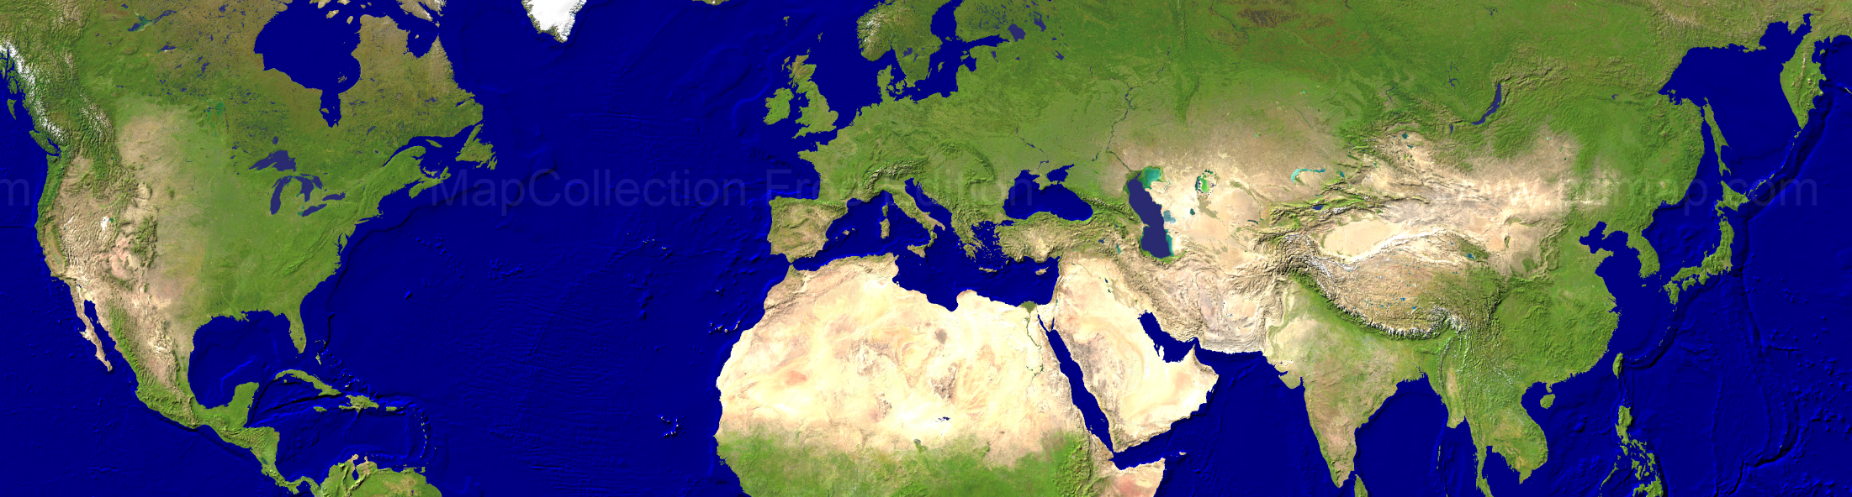
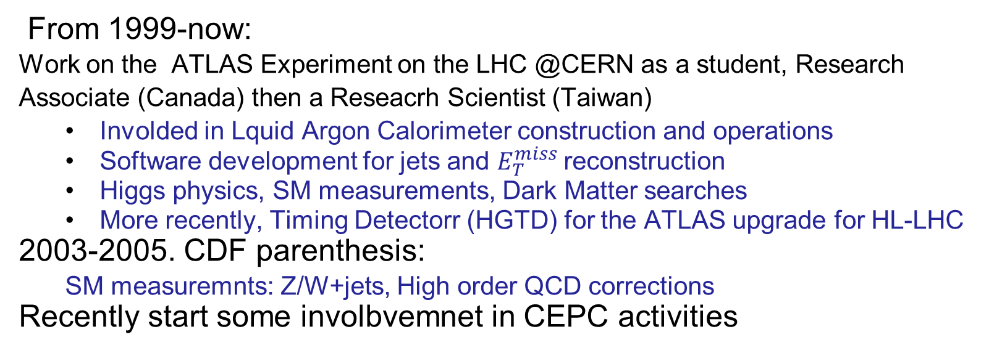
Rachid Mazini
PhD Montreal
Work on ATLAS
@CERN
R. A. Toronto
& FERMILAB
Undegrad in
Morocco&France
Research Scientist
Taiwan
From 1999-now:
Work on the ATLAS Experiment on the LHC @CERN as a student, Research
Associate (Canada) then a Reseacrh Scientist (Taiwan)
  Involded in Lquid Argon Calorimeter construction and operations
  Software development for jets and $E_{T}^{miss}$reconstruction
  Higgs physics, SM measurements, Dark Matter searches
  More recently, Timing Detectorr (HGTD) for the ATLAS upgrade for HL-LHC
2003-2005. CDF parenthesis:
  SM measuremnts: Z/W+jets, High order QCD corrections
Recently start some involbvemnet in CEPC activities

Slide 3

Outline
Particle Identification is a very broad topic
Limited time → need to be selective
I will focus on the basic aspects of reconstruction and identification of elementary
particles as they are produced in primary physics processes.
I will also discuss techniques to measure the performance of the reconstruction and
identification algorithms using the data
I will restrict myself to the multi-purpose experiments ATLAS and CMS at the Large
Hadron Collider (LHC)
Outline of this lecture:
Other identification techniques for single particles (hadrons!) like dE/dx,
Cherenkov radiation etc. not covered here → some information in Backup
Vertex reconstruction → some information in Backup
Lecture 1:
  Introduction to LHC
  Some basics in particles-matter interaction
  Track reconstruction
  Calorimeter energy
Lecture 2:
  Muons
  Electrons and photons
  Tau hadronic decay
Lecture 3:
  b-quark jets
  Jets, $E_{T}^{miss}$

Slide 4
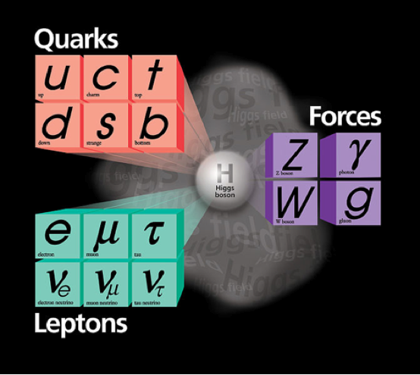
Elementary Particles of the Standard Model
Unstable: t → bW
Unstable: identify via
decay products
Hadronisation → Jets
b jets:
dedicated
identification
techniques
Stable!
Hadronisation → Jets
( (quasi-)stable
hadrons:
π±, K±, K⁰_{L}, p, n)
Stable!
(μ not really, but
as seen by a detector)
No interaction
with detector
→ Missing (transverse)
energy/momentum
Unstable: identify via
decay products

Slide 5





The Large Hadron Collider: LHC
Proton-Proton (Heavy Ion) Accelerator
Circumference: 27 km
Energy: √s = 7 TeV (2010/2011)
√s = 8 TeV (2012)
√s = 13 TeV (2015-2018) Run 2
protons
protons

Slide 6
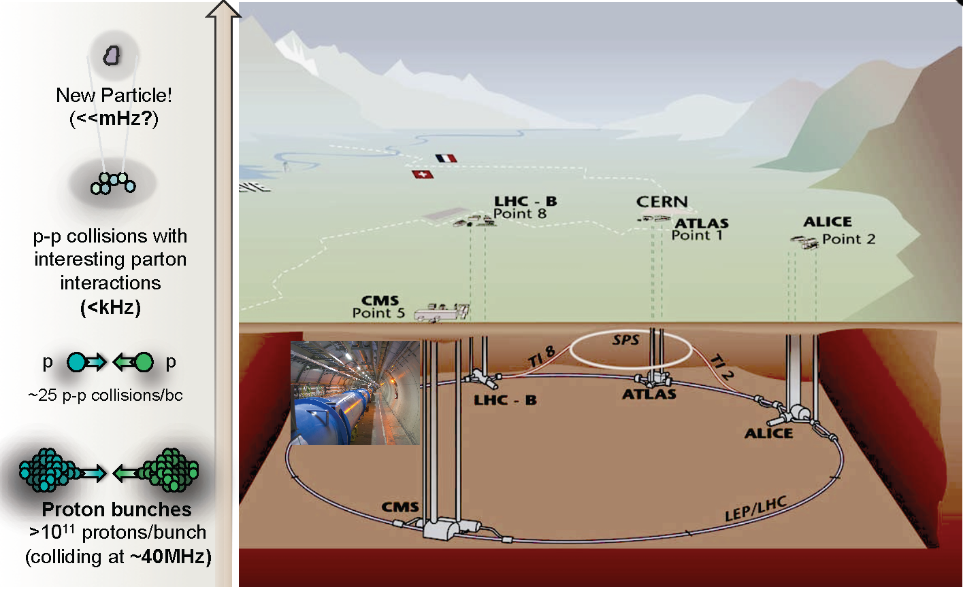
The Large Hadron Collider

Slide 7

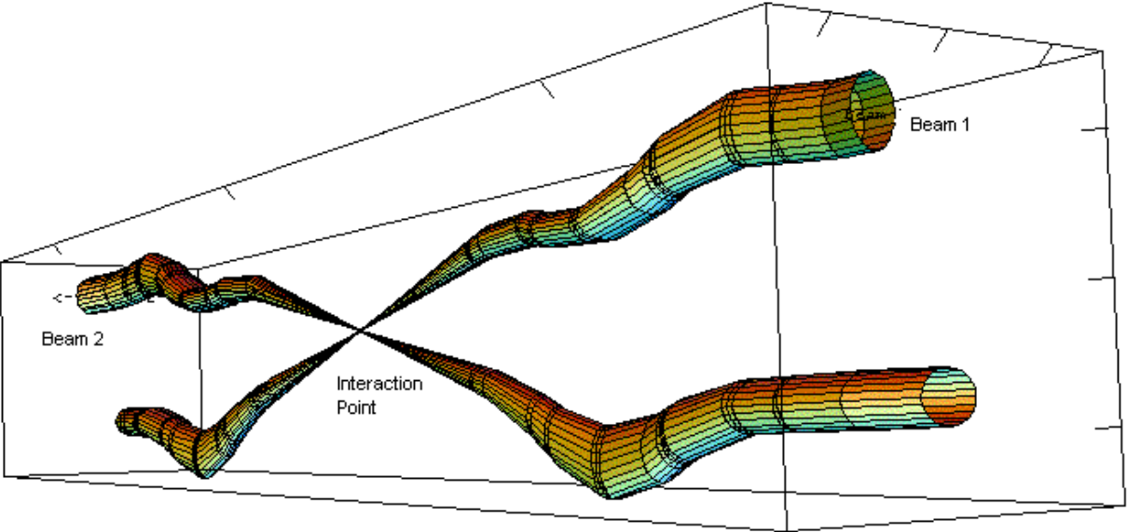
Proton-proton collisions at the LHC
Proton bunches >10¹¹ protons/bunch
colliding at 13TeV and at 40MHz in Run-2
collided at 7/8TeV and at 20MHz in Run-1
LHC beam profiles at the interaction point

Slide 8
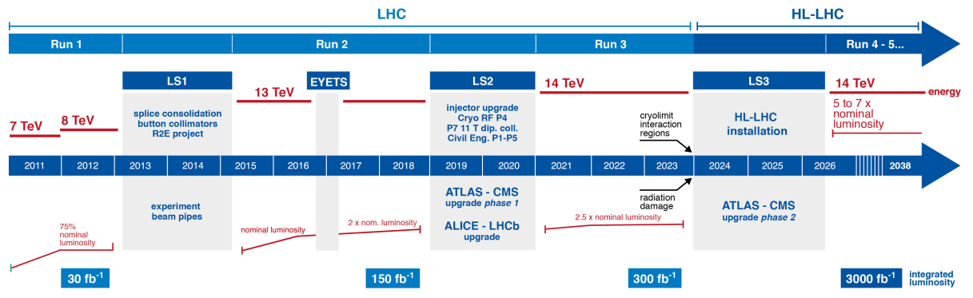
The HL-LHC: The future
_{<μ>20~40} <µ>60~80 <µ>~200
Run 1 | Magnet | Run 2 at | Phase I | Run 3 at | Phase II | HL-LHC:
 | splice | ~full design | upgrades | original | upgrades | ten times
 | update | energy | (injectors) | design lumi | (final focus) | design lumi
HL-LHC mode | Peak Luminosity (cm⁻² s⁻¹) | Mean number of interactions per bunch-crossing <_{PU}> | Integrated luminosity (fb⁻¹)
Baseline | 5x10³⁴ | 140 | 3000
Ultimate | 7.5x10³⁴ | 200 | 4000

Slide 9
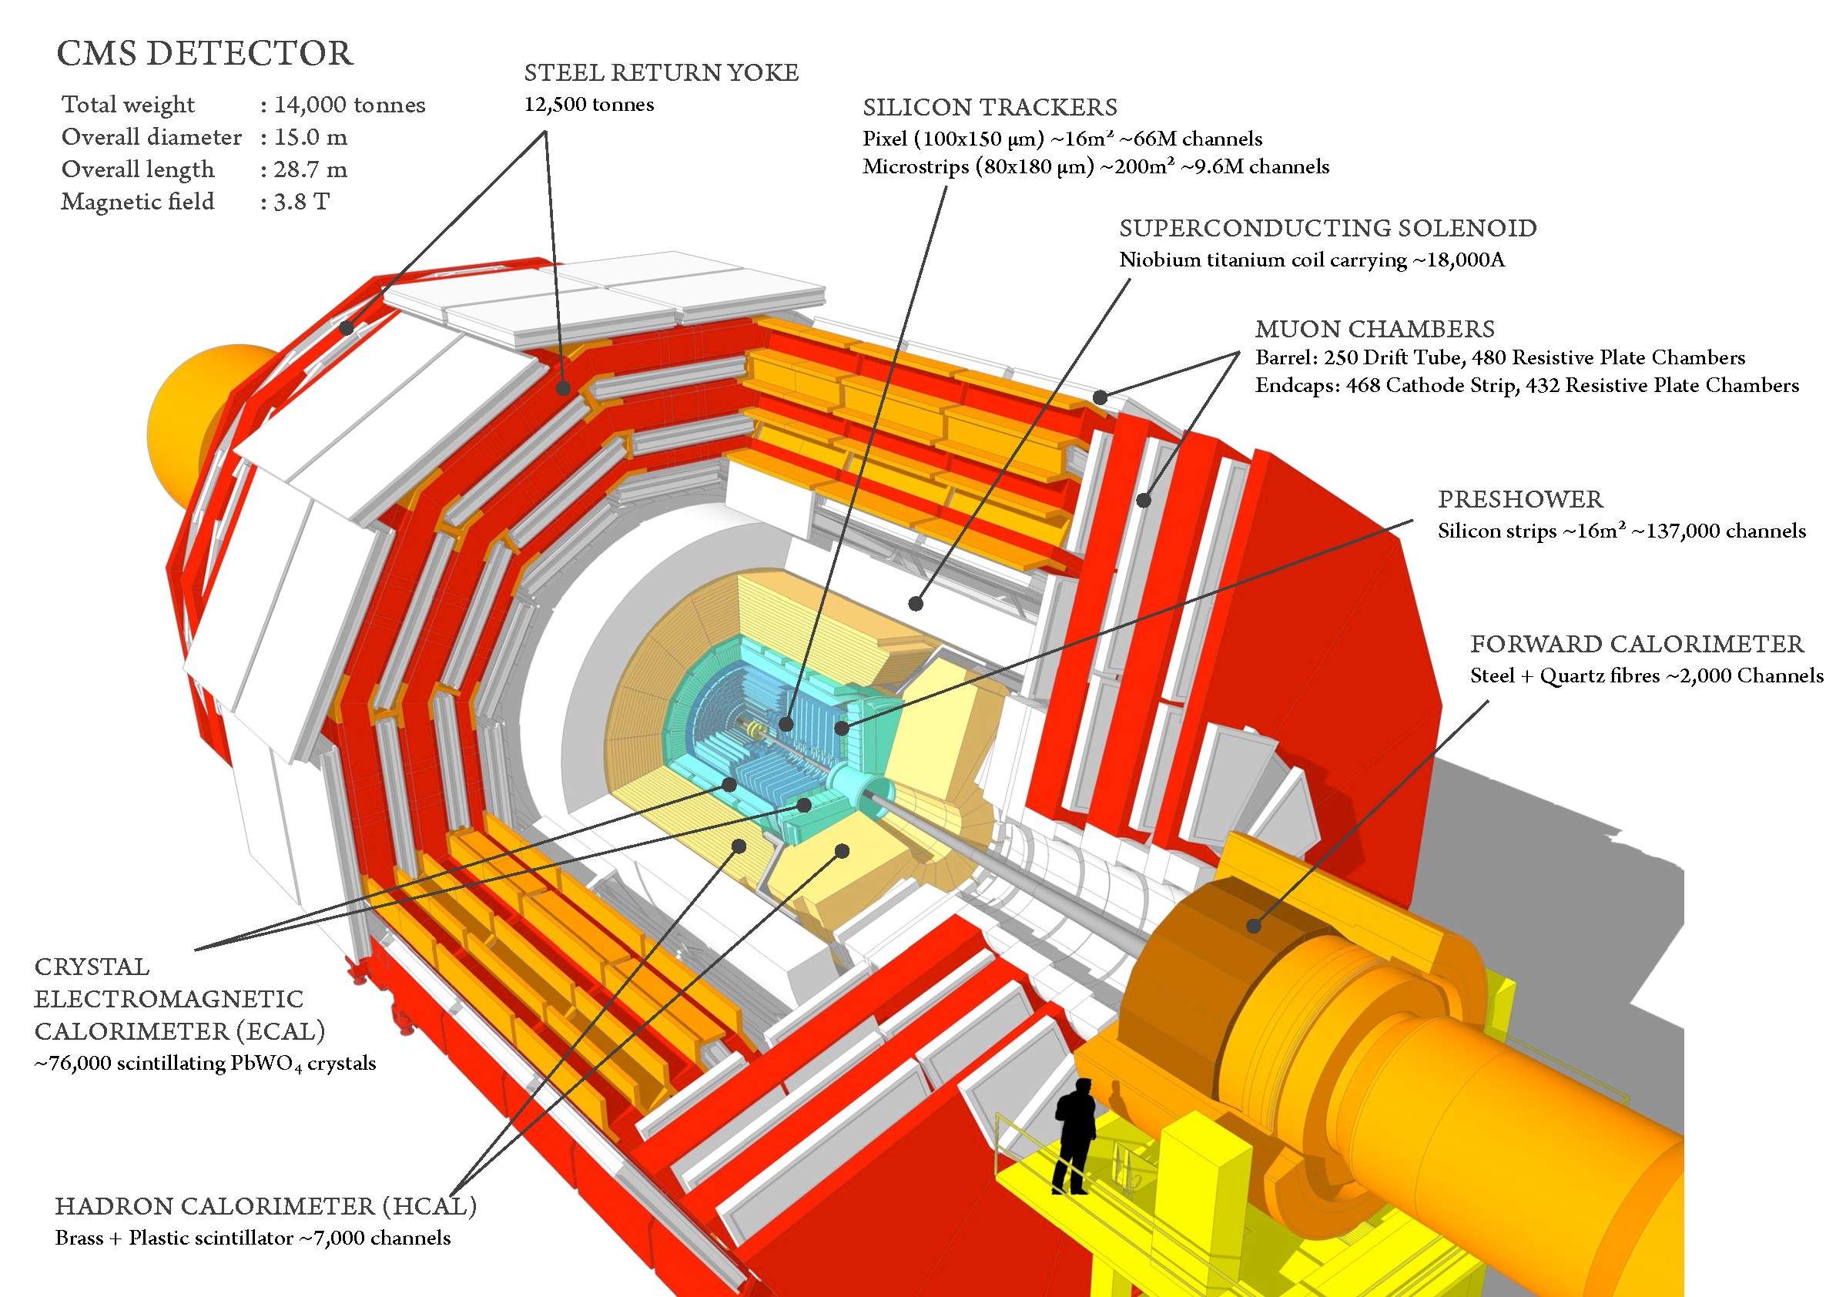
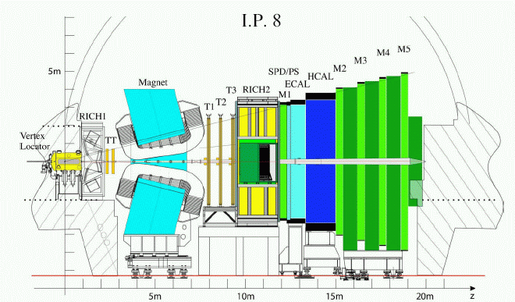
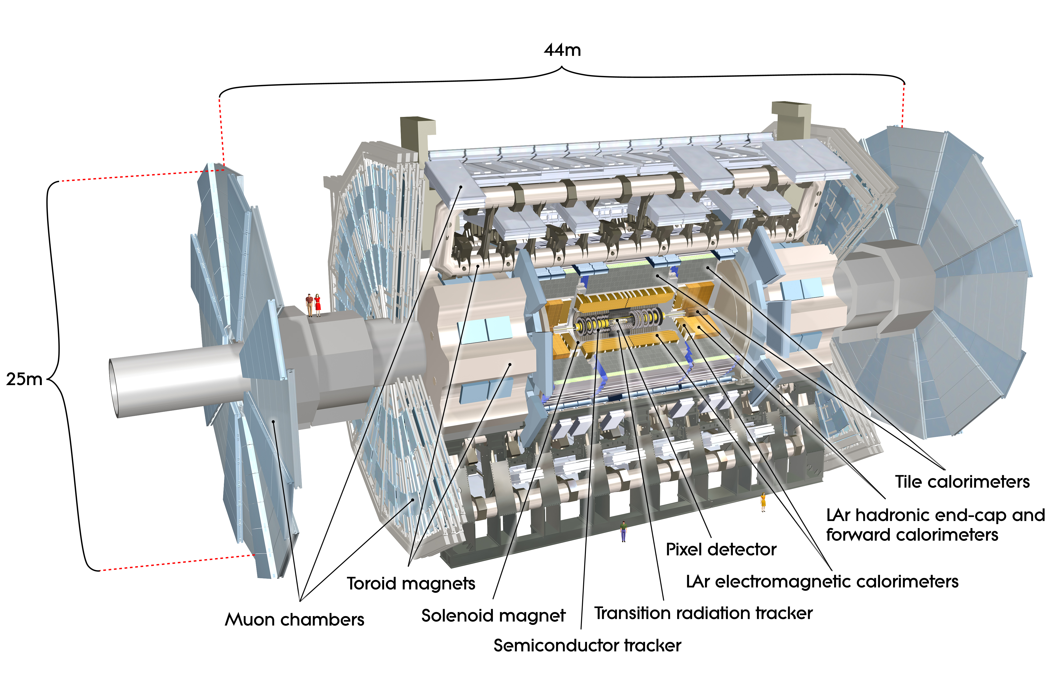
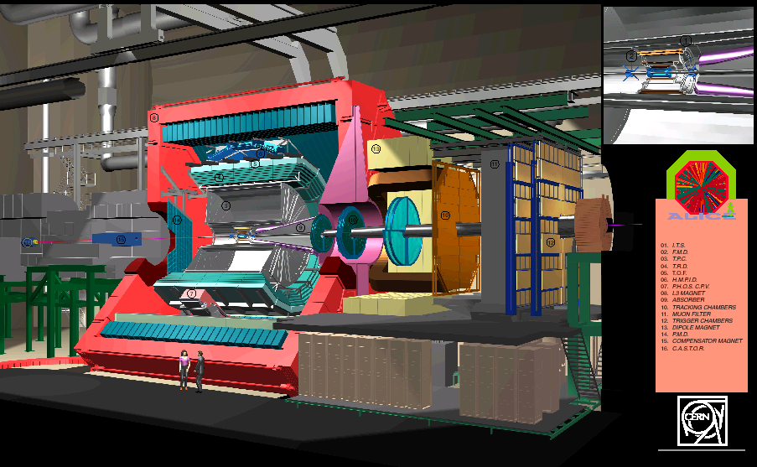
LHC Detectors
CMS: Compact Muon Solenoid
LHCb (b-physics)
ATLAS: A Toroidal LHC ApparatuS
protons
ALICE: A Large Ion Collider Experiment

Slide 10
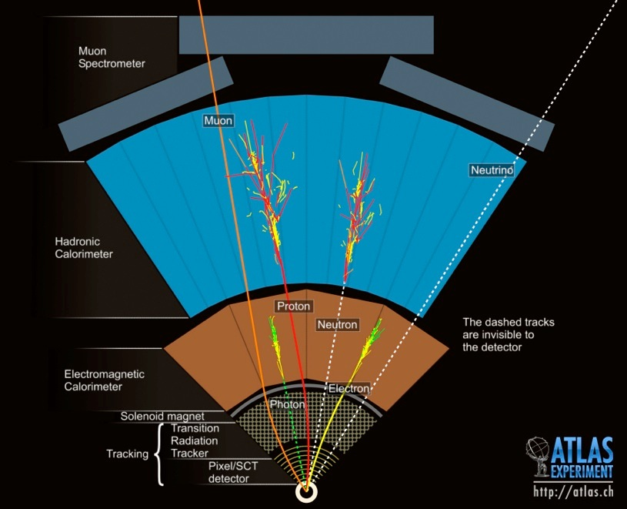
Principal Detector Layout
Typical HEP detector
Layout:
- Tracking detectors
to reconstruct
charged particles
(embedded in
(solenoid) magnet)
- Electromagnetic
calorimeter to measure
energies of electrons
and photons (+ jets)
- Hadronic calorimeter
to measure energies of
hadrons (jets)
- Muon spectrometer to
detect and measure
muons penetrating
through the detector

Slide 11
Brief Recap of Some Basics
The interaction of particles with matter allows the detection of particles ….
…. but also causes effects like energy loss and deflections which are a
nuisance to measurements
I’ll very briefly recap some basics as relevant for what follows in this lecture:
  Ionisation (dE/dx)
  Bremsstrahlung
  Multiple scattering
  Pair creation (photons)
}
Charged particles
Some information on other effects which can be also used for the identification
of individual particles (Cherenkov radiation, transition radiation) can be found
in the backup slides

Slide 12
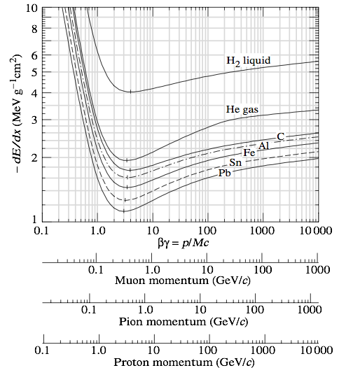


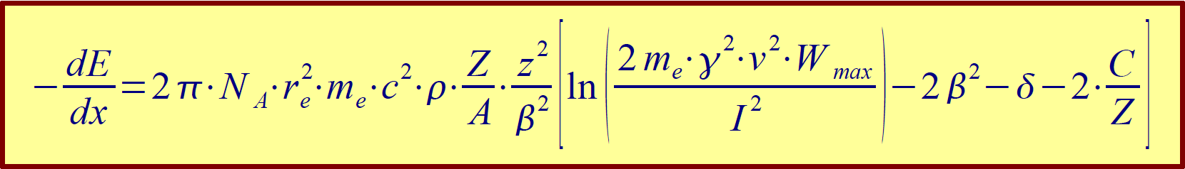
Ionisation, Bethe-Bloch Formula
Energy loss by ionisation: the basic process to
create signals in many detector components
primary ionisation
primary + secondary
ionisation
charged particle
identification!
Described by the Bethe-Bloch formula
(→ backup for definition of all parameters,
see also lecture of N. Wermes)
independent of mass of incident particle
~z², squared charge of particle
~1/β² up to minimum, followed by logarithmic relativistic rise
~Z/A → similar over wide range of materials
minimum at around βγ ≈ 3.5 (MIP: Minimum Ionising Particle)
not valid for electrons

Slide 13
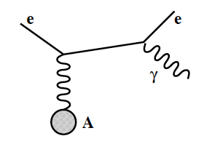
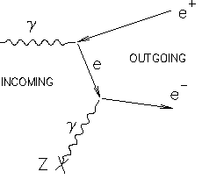
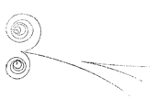
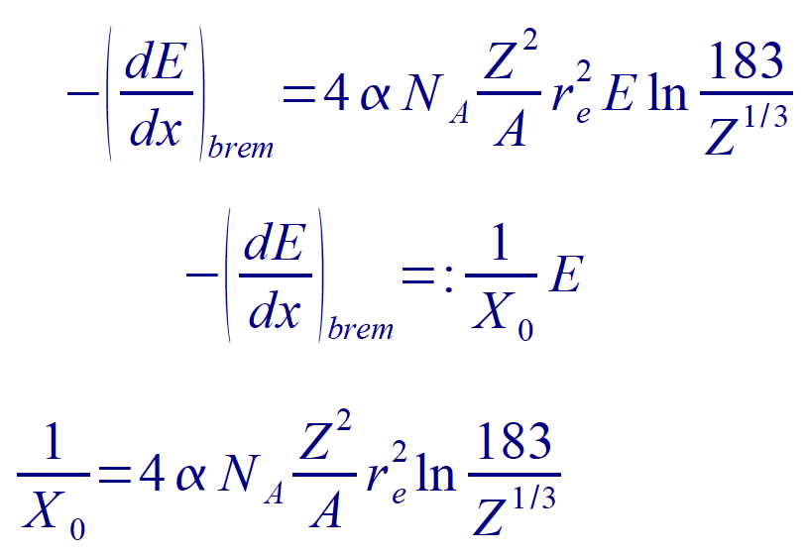
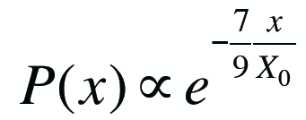
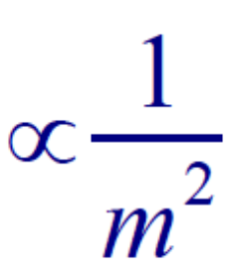
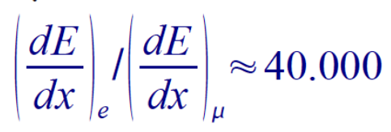
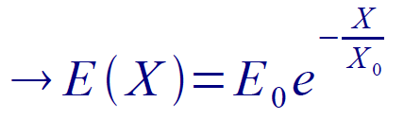
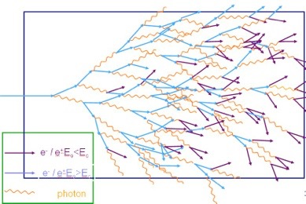
Bremsstrahlung and Pair Production
Bremsstrahlung in the
Coulomb field of the nucleus
γ → ee conversion in the
field of nucleus:
ϒ→e⁺e⁻
Probability not to have
undergone a conversion:
→ mean free path for pair production is 9/7 X₀
X₀: Radiation
length
Simulation of electromagnetic shower
Average electron energy reduced to 1/e after
having passed one radiation length
material | X₀ [cm]
Be | 35.3
Si | 9.4
PbWO₄ | 0.9
Pb | 0.6
Beam pipe
CMS ECAL crystals
Bremsstrahlung and pair production are wanted
features in electromagnetic calorimeters,
but a nuisance otherwise!
ATLAS LAr absorber

Slide 14
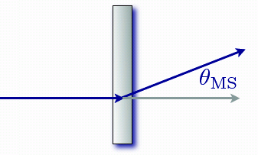
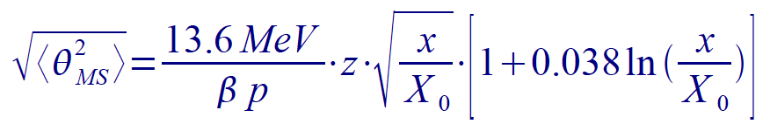
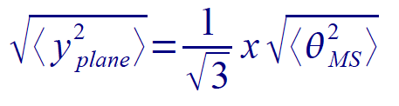
Multiple Scattering
Rutherford scattering of incoming particles on the nuclei of the matter
→ Many small random changes of direction of flight
x
Distribution of scattering angle nearly Gaussian
(many independent scatters; for central ≈ 98%) with:
}
Displacement:
Average scattering angle and displacement are zero!
→ Does not systematically change the track parameters but increases uncertainties of track parameters.
Examples:
300 μm Si: RMS = 0.9 mrad / βp (~ silicon module)
1 mm Be: RMS = 0.8 mrad / βp (~ beam pipe)
→ Limiting factor for reconstructing low momentum particles
Multiple scattering is a nuisance for reconstruction of particles (with lower energies)!

Slide 15
Charged Particles Track Reconstruction
(Quasi-stable) charged Particles
in the detector: e, μ, p, π±, K±
Tracker to
- reconstruct their trajectory with
high efficiency and purity
- determine kinematic properties
Tracks are basis for many subsequent algorithms
Important role in particle identification:
- matching to calorimeter
clusters for e/γ identification,
to muon spectrometer tracks
for μ identification
- reconstruct secondary decay
vertices of b hadrons, τ leptons
- …..
Only tracking detectors offer the spatial resolution needed for (many of) these tasks!

Slide 16
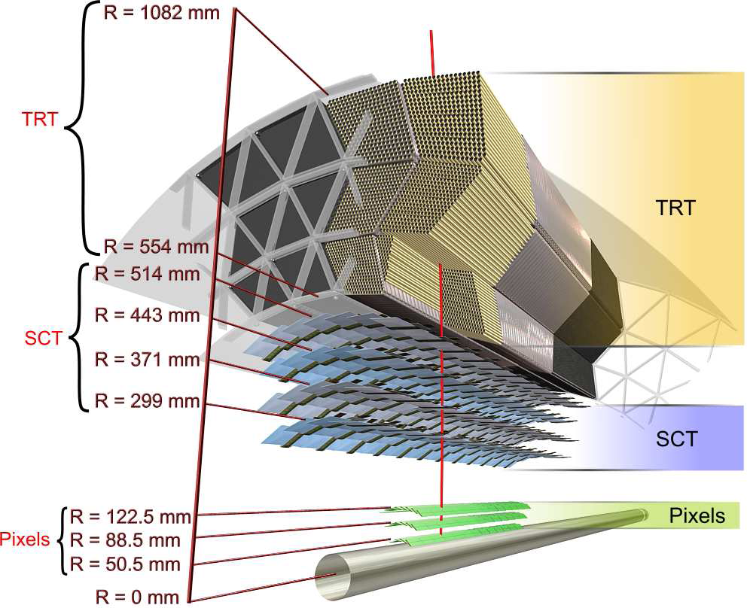
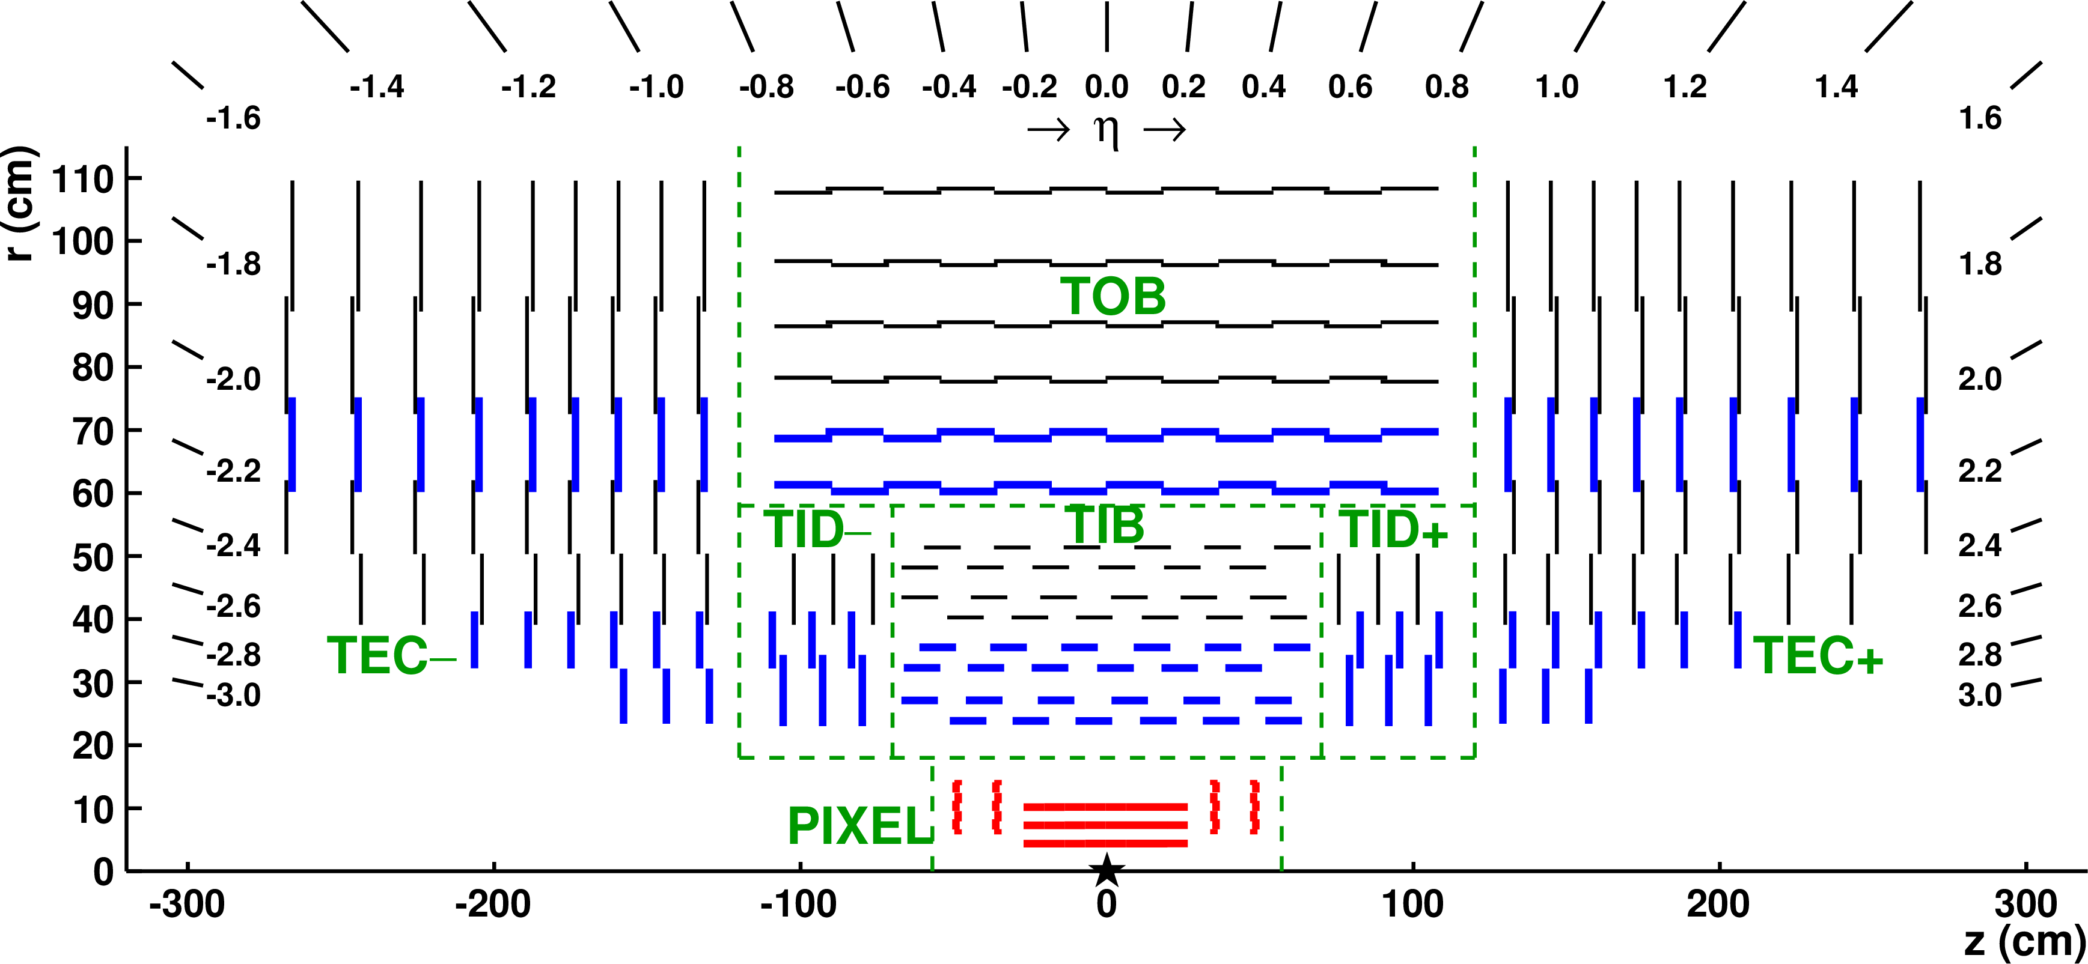
ATLAS and CMS Tracking Detectors
ATLAS: Silicon tracker (pixels and strips) +
straw tube detector (Transition Radiation
Tracker)
CMS: All-silicon tracker (pixels and strips)
Embedded in solenoid magnets
with B ≈ 2 T (ATLAS)
≈ 3.8 T (CMS)

Slide 17
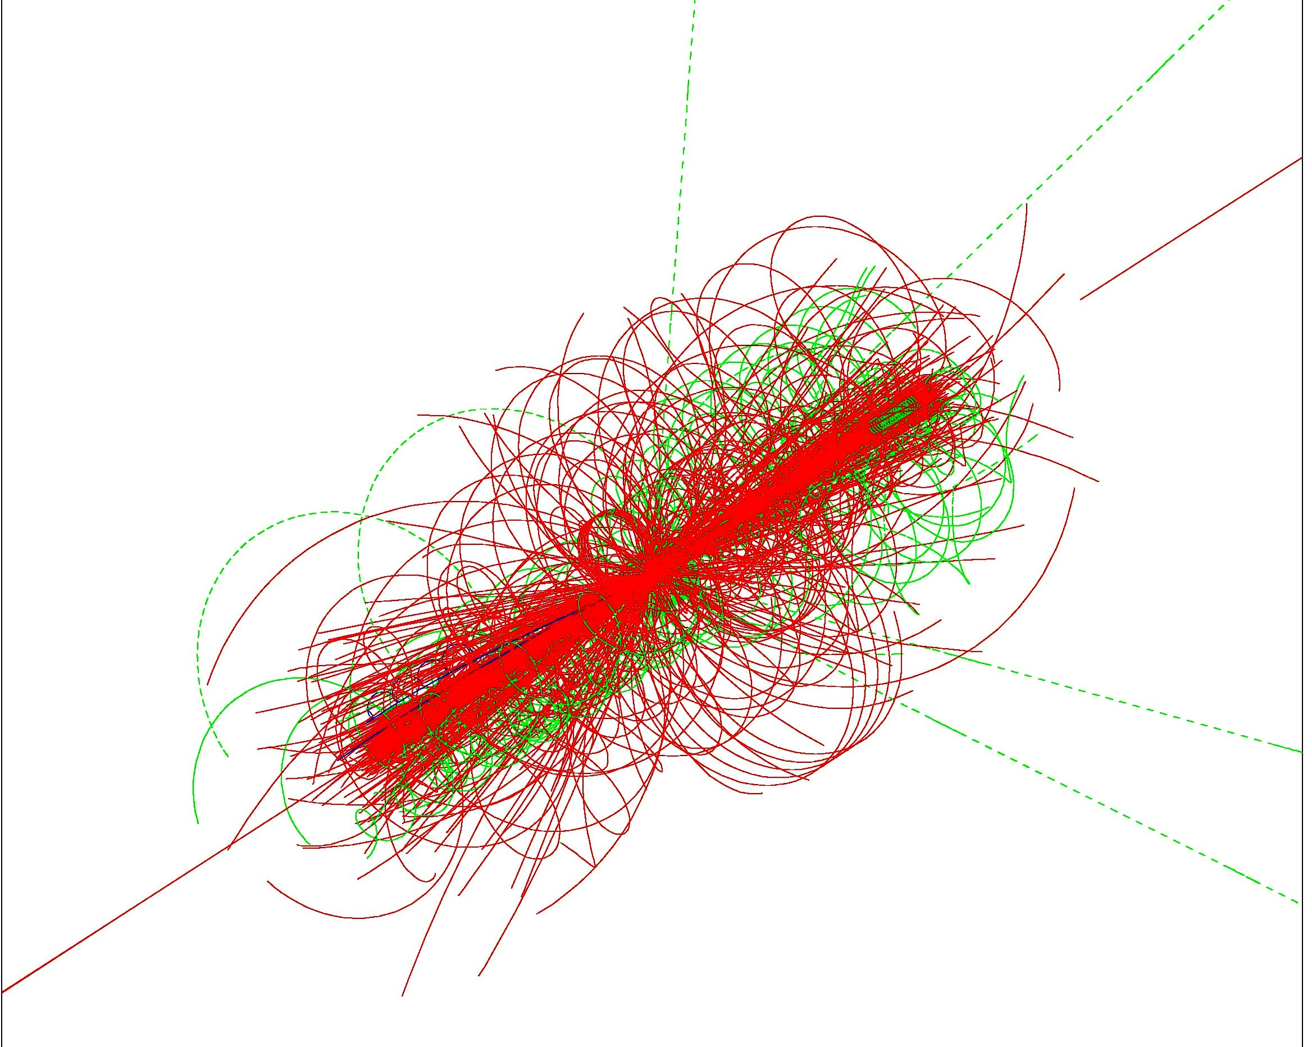
Requirements
Experimental environment at the LHC:
Bunch crossing every 50 ns ( → 25 ns)
High instantaneous luminosity (design: 10³⁴ cm⁻²s⁻¹) → Pileup
→ ~1000 charged particles every 50 (25) ns in the detector
(even higher number of tracks in heavy ion collisions)
Need high granularity to reduce occupancy
→ large number of electronics channels and heat load
→ more material in the tracker
Fast response, otherwise integrate over several bunch crossings.
Challenging readout electronics
Radiation hard:
Design for 10¹⁵ neq (neutron equivalent) for innermost layers (10 year lifetime)
Precise: Momentum Measurement
Spatial precision, especially close to Interaction Point
→ Impact Parameter

Slide 18
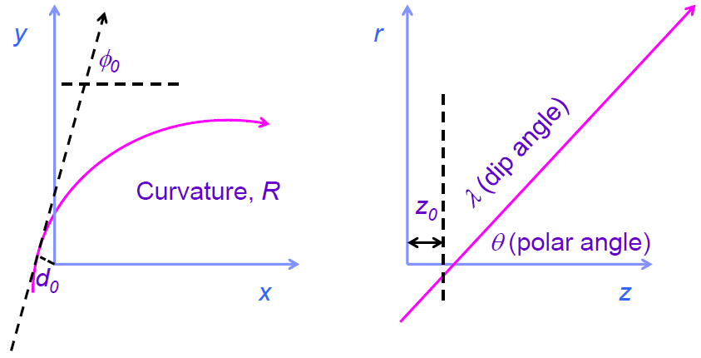
Track Parameters
The trajectory of a charged particle in a magnetic field can be parametrized through
five parameters*:
- Two variables for localisation wrt. reference point/surface
- Three variables for momentum representation, e.g. two angles and curvature/momentum
Perigee Parameters: - d₀, z₀: distance to reference point (e.g. 0/0/0) at point of closest
approach (in transverse plane)
- Φ, θ, q/p
(for cylindrical geometries,
different for fixed-target
geometry)
+ their uncertainties
→ 5x5 covariance matrix
*: 3d position + 3d momentum = 6
-1 because any point on
trajectory can be chosen

Slide 19
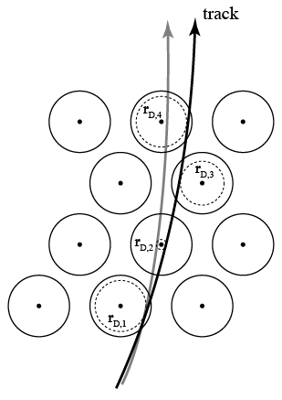
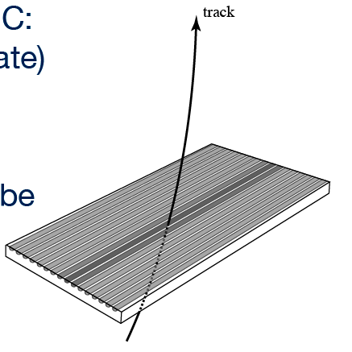
Tracking Input
Main tracking detector types used at the LHC:
- Solid state (silicon) detectors, planar
- Gaseous drift detectors:
Tubes (muon chambers, Straws, …)
TPC (ALICE)
Inputs to track reconstruction are
hits, drift circles, …
May need to combine 2D measurements into space points first
(e.g. silicon strip detectors with stereo angles)

Slide 20
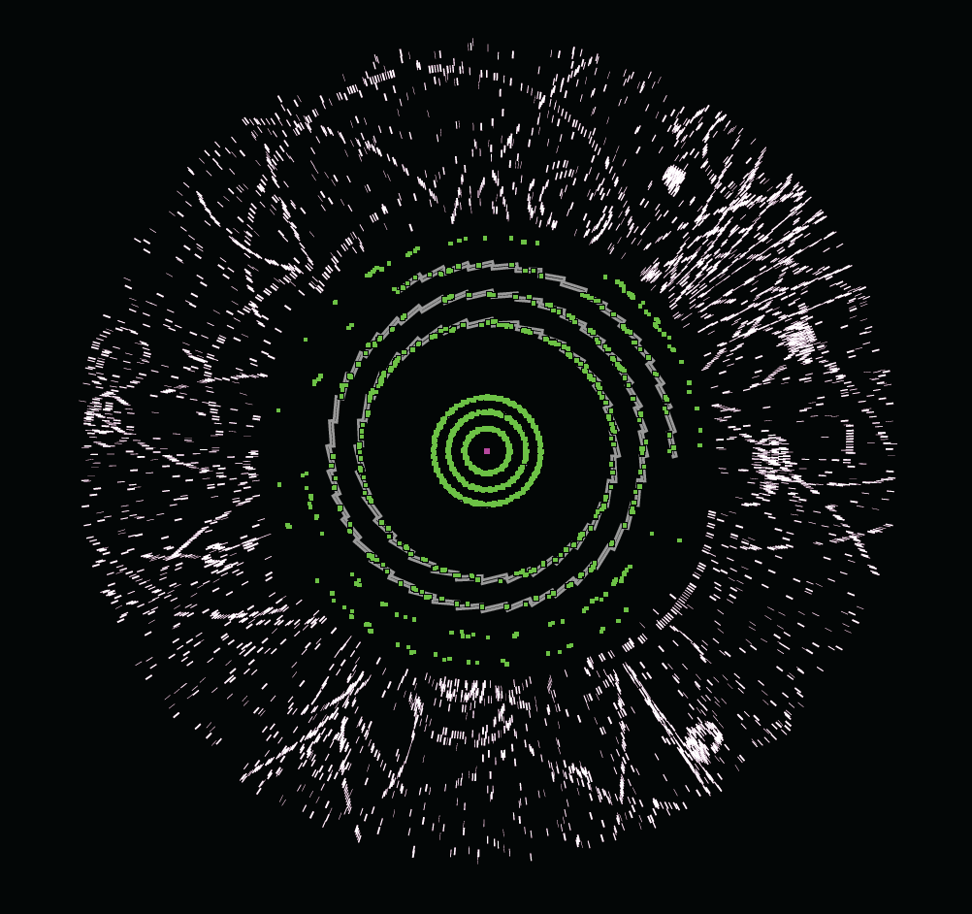
Track Reconstruction (Tracking)
The tracker sees a
cloud of hits (with spatial
coordinates and
their uncertainties)

Slide 21
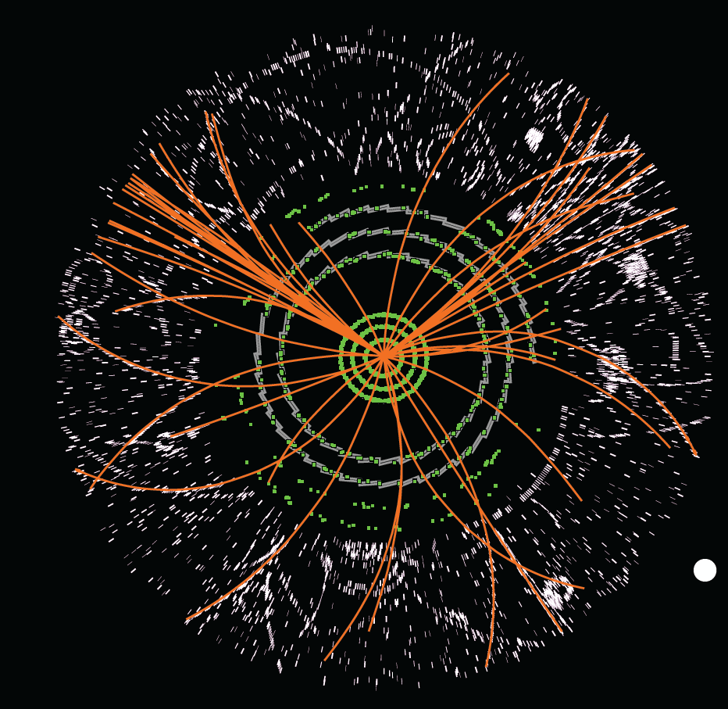
Track Reconstruction (Tracking)
The track reconstruction
algorithms need to
reconstruct particle
trajectories from these
hits and determine the
kinematic properties
(momenta, angles, …)
Trajectory: five track parameters
e.g. Perigee Parameters:
- d₀, z₀:
distance to reference point at
point of closest approach
(in the transverse plane)
- Φ, θ, q/p
+ 5 x 5 covariance matrix

Slide 22
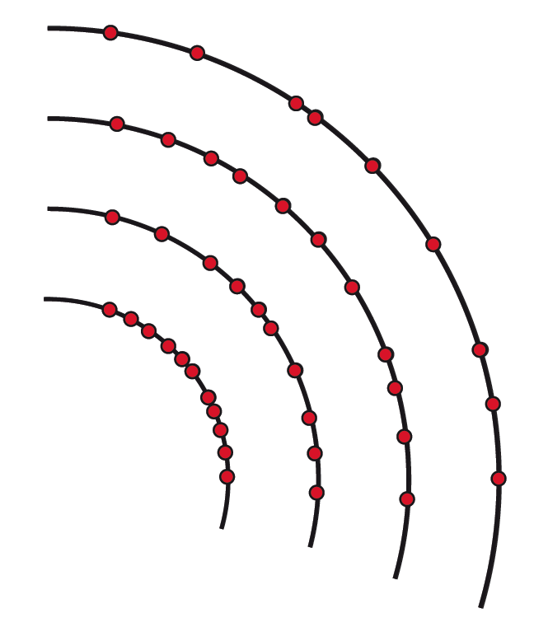
Track Reconstruction Steps
Start from hits

Slide 23
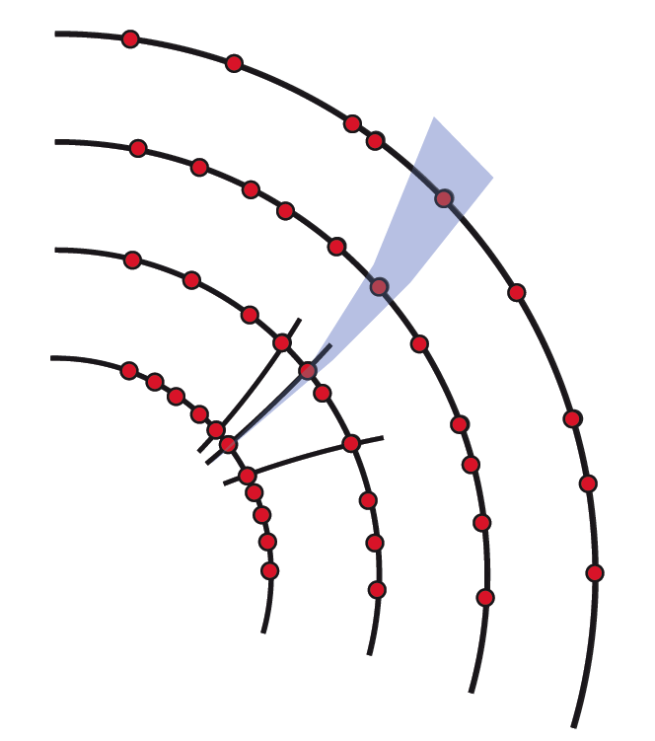
Track Reconstruction Steps
Start from hits
Find track seeds (typically from 3 hits),
determine their parameters
Track Seeding

Slide 24
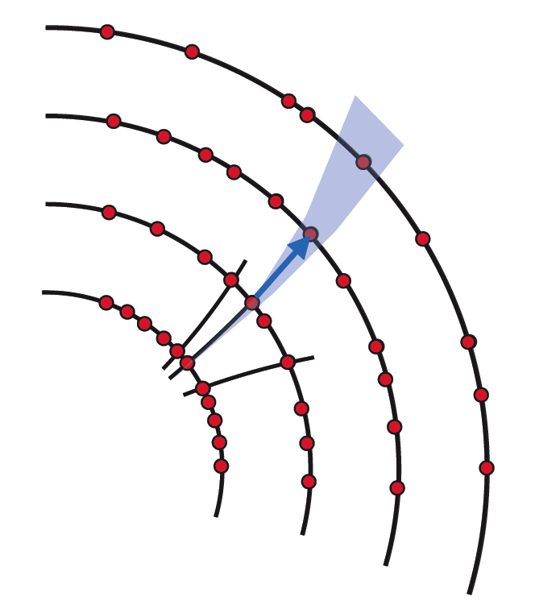
Track Reconstruction Steps
Start from hits
Find track seeds (typically from 3 hits),
determine their parameters
Extrapolate track candidate to next measurement
layer and look for compatible hits
Track Finding

Slide 25
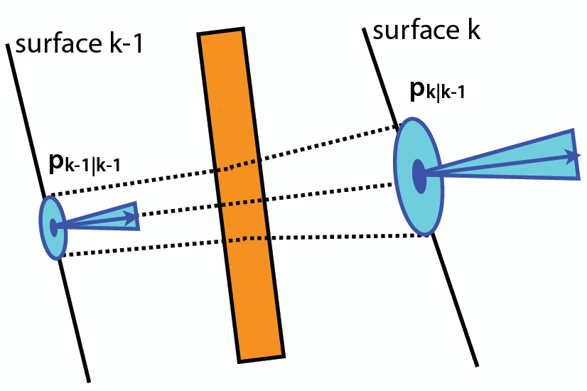
Track Reconstruction Steps
Start from hits
Find track seeds (typically from 3 hits),
determine their parameters
Extrapolate track candidate to next measurement
layer and look for compatible hits
Track propagation:
Involves the track model, e.g. for solenoidal
magnetic field and no material: helix
Take into account material effects:
- energy loss
→ track parameters and uncertainties
- multiple scattering
→ inflation of uncertainties

Slide 26
Track Reconstruction Steps
Start from hits
Find track seeds (typically from 3 hits),
determine their parameters
Extrapolate track candidate to next measurement
layer and look for compatible hits
Add hit and update parameters of the trajectory
Track Fitting

Slide 27
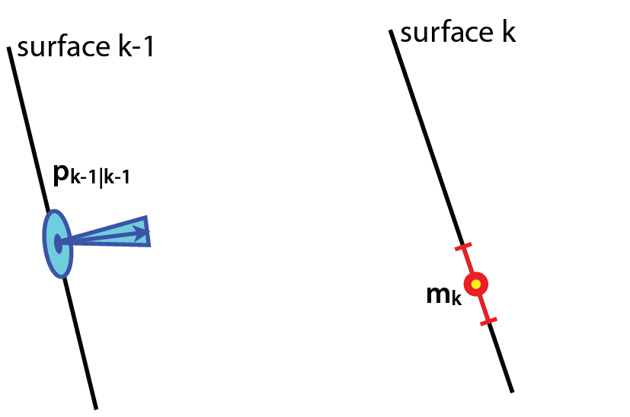
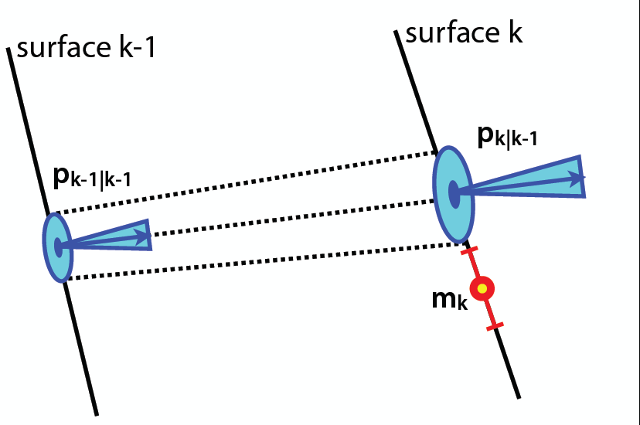
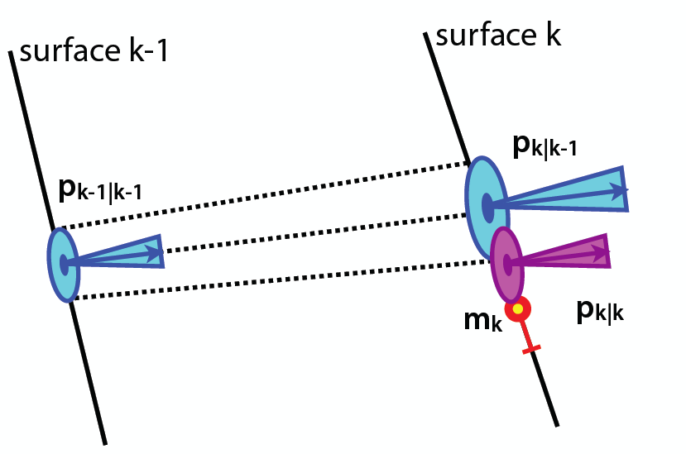
Track Reconstruction Steps
Start from hits
Find track seeds (typically from 3 hits),
determine their parameters
Extrapolate track candidate to next measurement
layer and look for compatible hits
Add hit and update parameters of the trajectory
Kalman filter:
combine predicted state at surface where track has been propagated to
and new measurement (hit) → progressive way of a χ² fit

Slide 28
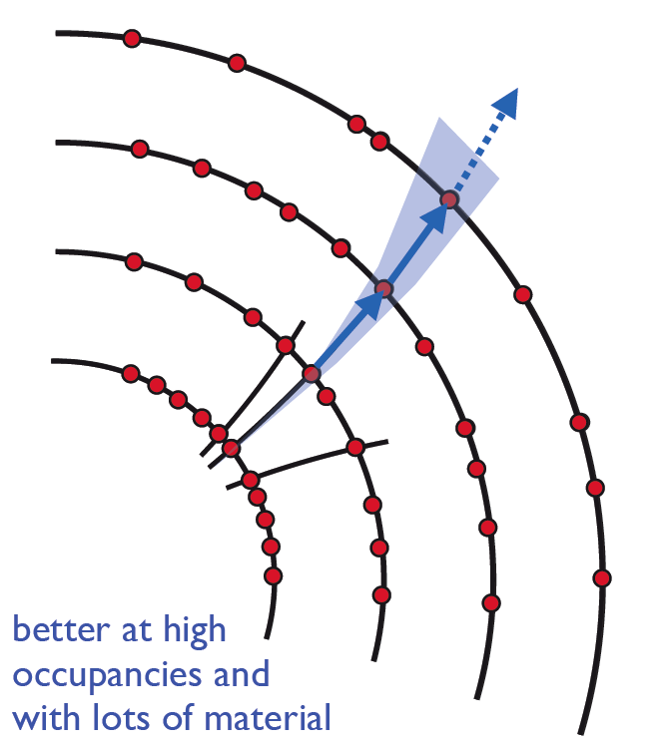
Track Reconstruction Steps
Start from hits
Find track seeds (typically from 3 hits),
determine their parameters
Extrapolate track candidate to next measurement
layer and look for compatible hits
Add hit and update parameters of the trajectory
Continue to next layer and repeat until end of tracker is reached
(or no more hits found). Final determination of track parameters
(χ² fit or Kalman smoother).
This was a simplified view (had to be because of available time and the complexity).
In practice, different strategies are used, often in an iterative way, e.g.:
- Inside-out: seeds from innermost layers (pixel detectors → low occupancy, 3D hits)
- Outside-in: seeds from outermost layers; propagate inwards
→ recover tracks from particles not stemming from the interaction point
Adding hits to track candidates is not unambiguous → need to be resolved
Might misassociate wrong hits to tracks → define quality criteria tracks have to pass

Slide 29
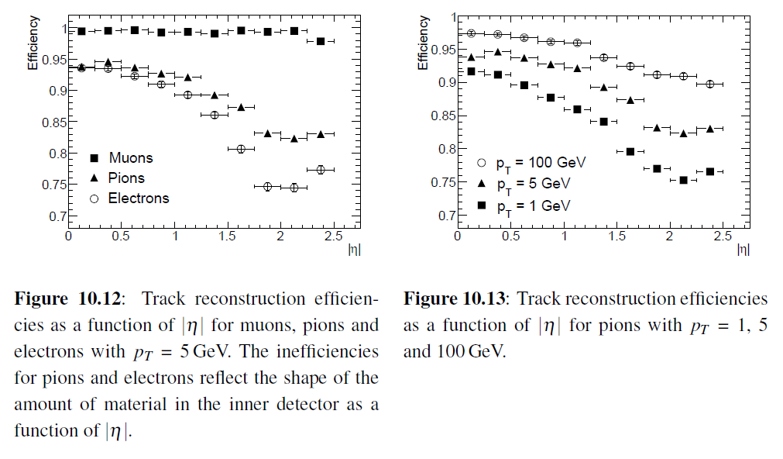
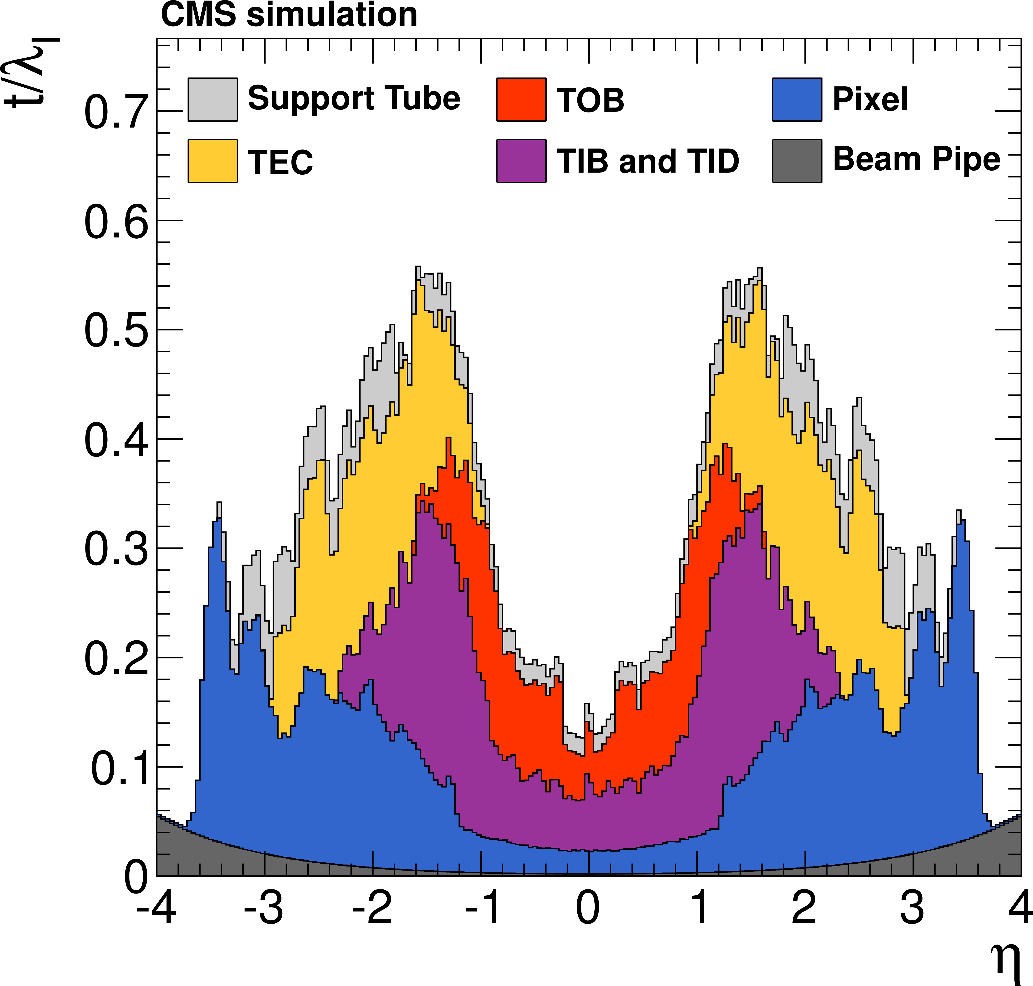
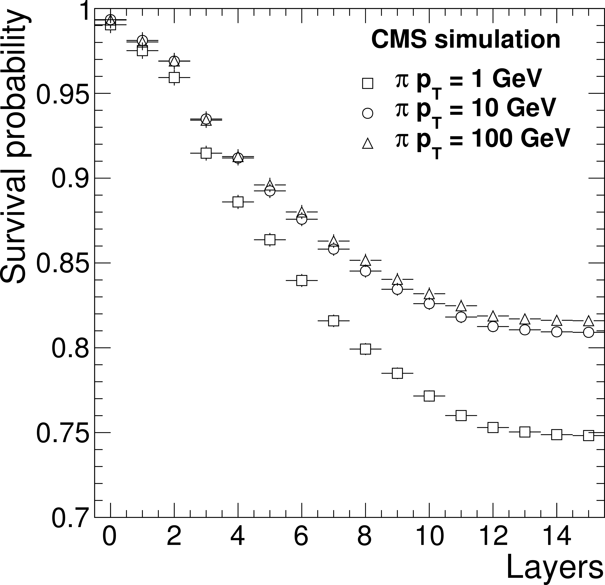
Track Reconstruction Efficiencies
ATLAS
Tracker material in
units of nuclear
interaction lengths
p_{T} = 5 GeV
Muons are 'easy’:
- no hadronic interactions, no
significant bremsstrahlung
→ Reconstruction efficiency close to 100%
Electrons: bremsstrahlung!
(→ see later for dedicated algorithms)
Hadrons (mainly pions): hadronic interactions

Slide 30
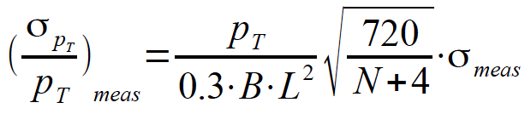
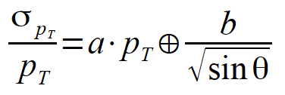
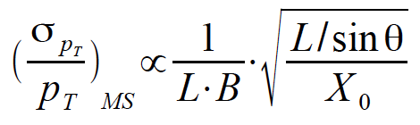
Tracking Precision
Precision of trackers affected by:
Intrinsic space point resolution
(technology: silicon strips, pixels; gas detectors ....)
Dimension of the tracking volume
Multiple Scattering
Material budget (also affects measurements in calorimeters!!)
Magnetic field
Strength, knowledge!
Alignment
Knowledge of detector components positions
→ See backup material of this lecture for some basics: Gluckstern formulae

Slide 31
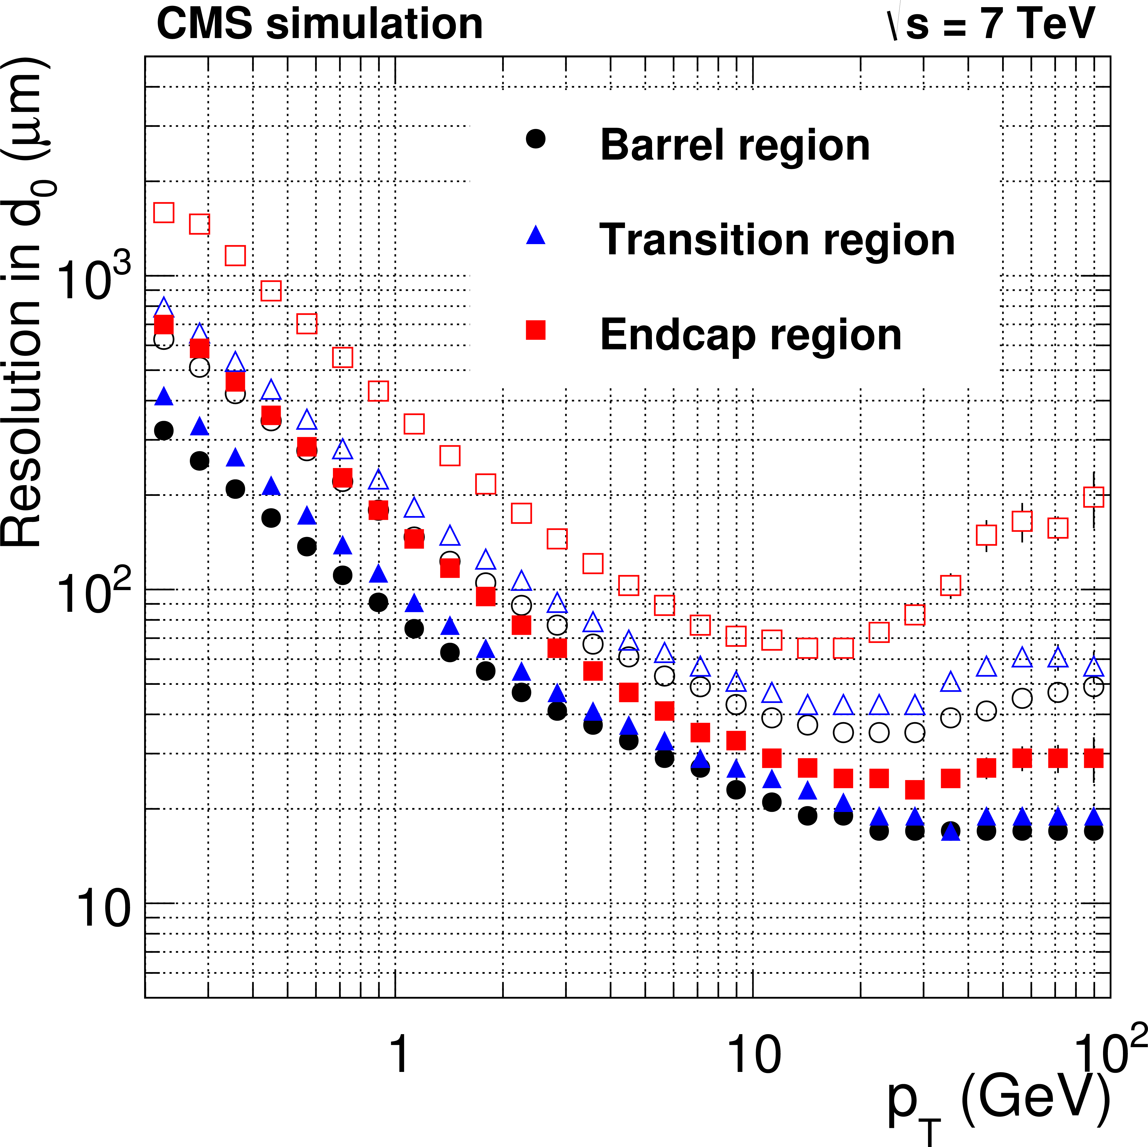
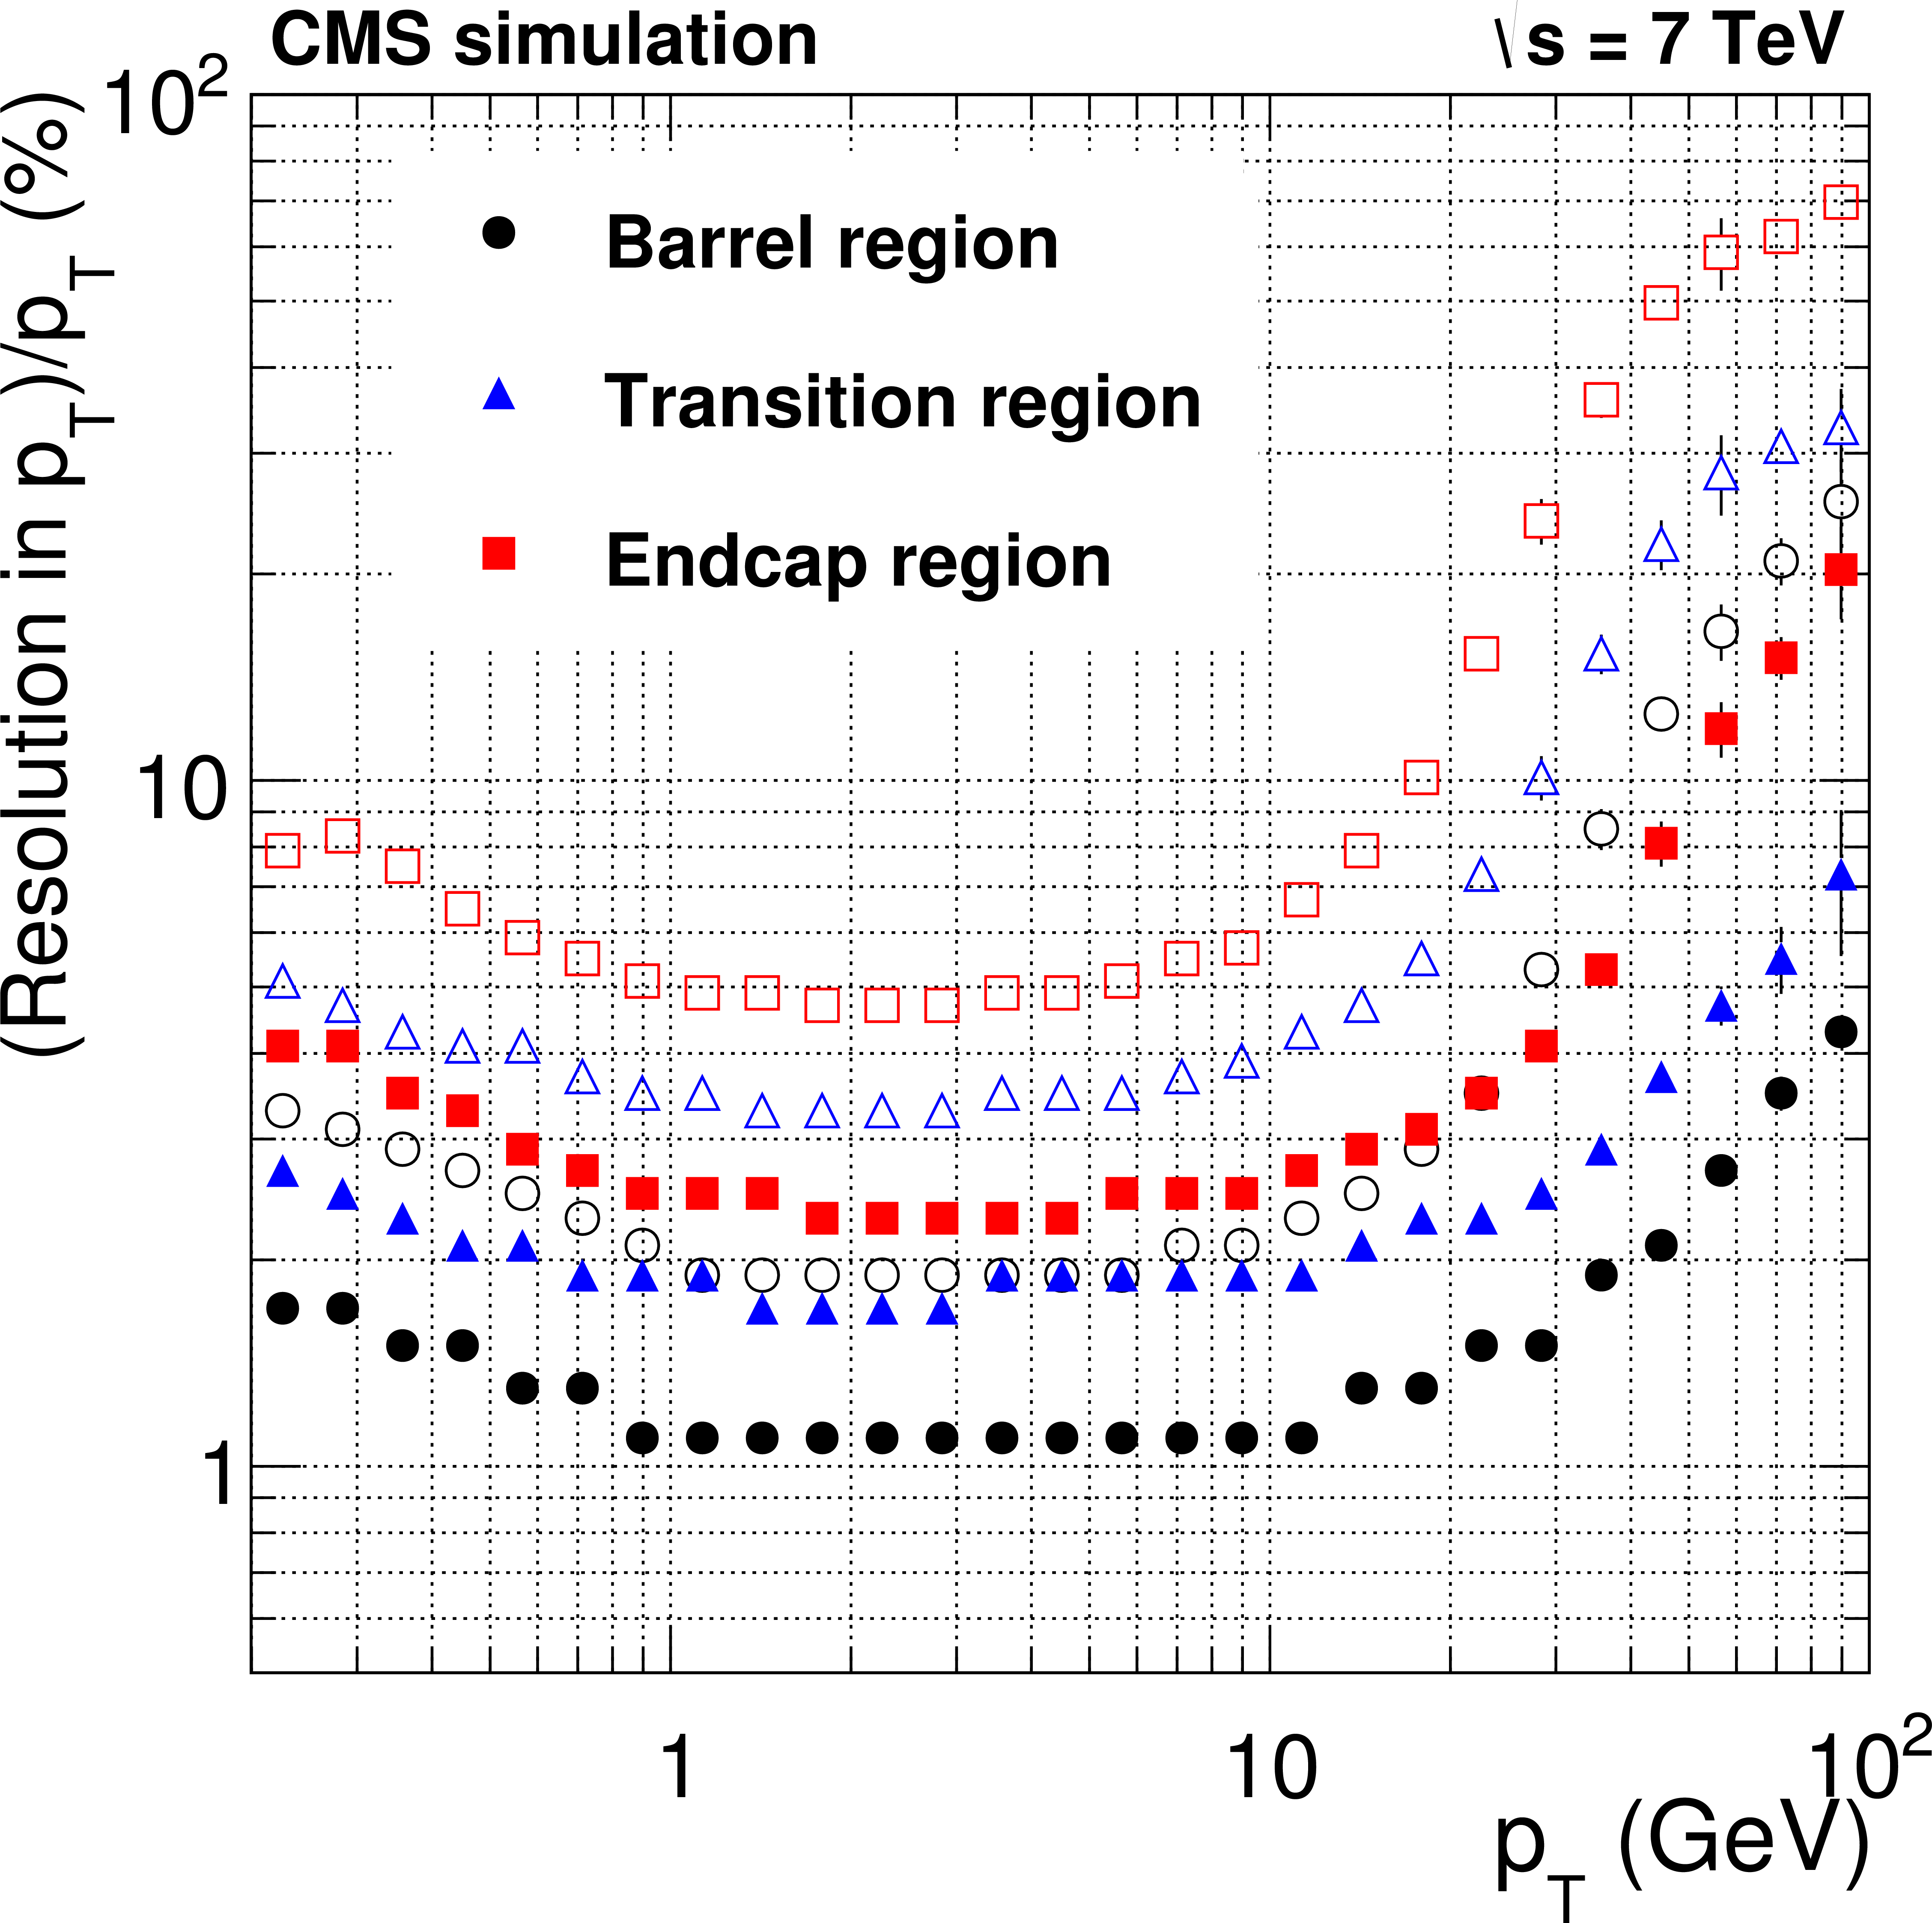

Track Parameter Resolutions
Impact parameters:
Main measure for spatial resolutions
Transverse momentum resolution
Solid/open:
half widths of the 68/90% intervals
- Multiple scattering limiting factor for low p_{T}
- Clear dependence on pseudorapidity
intrinsic
multiple scattering

Slide 32




Calorimeters
ATLAS
CMS
PbWO₄ scintillating crystals
(~ 75000 in total):
ρ = 8.28 g/cm³, X₀ = 0.89 cm
Molière radius = 2.3 cm,
A ~ 22 x 22 mm, l ~ 230 mm
→ Very compact calorimeter
+ Excellent energy resolution
Lead/Liquid-Argon (LAr) sampling calorimeter
with accordion geometry arranged in 3 layers
Fine segmentation
+ precise reconstruction of shower shapes
direction measurements for photons!
→ vertex determination e.g. for γγ final states

Slide 33


Cluster Reconstruction
ATLAS
CMS
sliding
window
Start with seed clusters:
ATLAS: based on calorimeter towers with Δη x Δφ = 0.025 x 0.025 from sliding-window
algorithm (3 x 5 towers)
CMS: extend seed crystals (E ≥ 1 GeV) by arrays of 5 x 1 in η x φ
Extend/adjust size of clusters to account for origin of cluster
ATLAS: based on track and (conversion) vertex reconstruction, classify clusters are as
unconverted photon, converted photon or electron candidate.
CMS: add in both directions of seed crystal up to 17 crystals in φ if certain threshold
exceeded to account for Bremsstrahlung and conversions (spread in φ)
→ Supercluster
Compute corrected cluster energies (MVA regression techniques)

Slide 34

Cluster Reconstruction
e without radiation,
γ without conversion
almost fully contained
in 5 x 5 crystals
radiation, conversion
→ spread in φ direction
CMS
Energy w.r.t. true energy
for 5 x 5 crystals and supercluster
→ significant fraction of energy
out of 5 x 5 cells area

Slide 35

Cluster Reconstruction
Ratio of energies
within 3x3 cluster
and supercluster
energy for
(un)converted photons
Seed clusters based on calorimeter towers
with Δη x Δφ = 0.025 x 0.025 from
sliding-window algorithm (3 x 5 towers)
Based on track and (conversion) vertex
reconstruction, clusters are classified
- unconverted photon
- converted photon
- electron
and their size is adjusted
Cluster energy corrected for energy loss,
leakage etc. (MVA, ….)
Energy wrt.
true energy
for 5x5 crystals
and supercluster
Supercluster energies corrected for leakage,
Shower shape etc. → MVA regression
Clusters also used for track seeding!

Slide 36



Calorimeter cluster energy
Clusters of energy in a calorimeter are due to the original particles
  Clustering algorithm groups individual channel energies
  Don’t want to miss any; don’t want to pick up fakes
Careful tuning of thresholds needed
  needs usually learning phase
  adapt to noise conditions
  too low : pick up too much unwanted energy
  too high : loose too much of “real” energy. Corrections/Calibrations will be larger
Projection
high threshold,
for seed finding
low threshold,
against noise

Slide 37



Cluster Energy calibration
Need to apply calibrations to the cell and cluster energies
  Correct for energy lost before the calorimeter and for energy leaking out the back
  Equalize the response across the detector (different parts of the detector can have different responses because of the way they are built etc..)
The purpose of the calibrations are to correct the measured energy to give as close as possible to the true energy of the incident particle
Calibration constants can be complex functions of the position and energy of the
cluster
  E^{CALIB} = f(E^{MEASURED} , η, ϕ, …) , f includes various calibration constants
Calibration very important to get the best energy resolution
Electron energy resolution from simulation

Slide 38
Pile-up: the high luminosity dilema
10¹¹ protons
10¹¹ protons
beam 1
beam 2
When the LHC collides bunches of protons we can get more than one p-p interaction – this is called pileup
The number of pileup interactions depends on the LHC parameters
  How many protons per bunch
  How small the bunches have been squeezed
Over Run 2 we have on average ~40 interactions per bench crossing, with frequent peaks around 60-70
These pileup interactions give lots of low momentum tracks as well as extra energy deposit in calorimeter cells
We can usually identify which tracks are from which interactions by combining tracks that come from the same vertex
Pileup can cause difficulties for some physics analyses
  Also causes reconstruction to need more computing power
But allows us to get more luminosity

Slide 39

Pile-up
Vertex =
Space point of
common origin of
(charged) particles
Primary event vertex in
beam-beam collisions or
fixed target experiment:
interested in THIS
vertex (has two high
p_{T} muons)
Example for
inclusive vertex
recontruction

Slide 40

Reconstructing tracks in high pile-up
Z->μμ event in ATLAS.
With 11 reconstructed vertices.
Tracks with transverse momentum p_{T}>0.5GeV are shown
How can we do physics analysis with such a huge number of tracks in the detector?

Slide 41

Reconstructing tracks in high pile-up
Z->μμ event in ATLAS.
With 11 reconstructed vertices.
Tracks with transverse momentum p_{T}>2GeV are shown
How can we do physics analysis with such a huge number of tracks in the detector?

Slide 42

Reconstructing tracks in high pile-up
Z->μμ event in ATLAS.
With 11 reconstructed vertices.
Tracks with transverse momentum p_{T}>10GeV are shown
How can we do physics analysis with such a huge number of tracks in the detector?
Selecting high pT tracks, makes the event cleaner, hence easier to analyze.
BUT. It might also reduce its physics content.

Slide 43
Summary
Reconstruction and identification of (elementary) particles play crucial roles in
the physics programs of high p_{T} physics at the experiments at the LHC
Requires excellent performance of several different detector components
The reconstruction of charged particles in the inner tracking detectors is the basis
for the reconstruction and identification of charged (but also neutral) particles
Calorimeter energy at the cell and cluster level need to be well measured
→ Clusterization techniques well developed
From the detectors we have Tracks, Calorimeter Cluster energy, and some timing information
That is s all what we need for full Particle identification and properties measurements

Slide 44
BACKUP Introduction

Slide 45
Final State Particles
Most hadrons are unstable:
Decays into hadrons, leptons or photons:
E.g.: Δ⁺⁺ -> pπ⁺ : p stable
π⁺ → μ+ ν_{μ} : τ_{π} = 2.6 * 10⁻⁸ s → cτ_{π} = 7.8 m
→ most π⁺⁻ traverse detector
also: K⁺⁻, n, K⁰_{L}
(+ weakly decaying hadrons which typically decay inside the detector)
In high p_{T} physics often relevant: Jets created from hadrons
Leptons:
- e: stable
- μ: τ_{μ} = 2.2 * 10⁻⁶ s → quasi-stable
- τ: Decay to hadrons or leptons
- ν_{μ,e,τ}: only weakly interacting → leave detector without detectable interaction
→ Via missing (transverse) energy/momentum
Gauge bosons:
- W/Z: Decay to hadrons or leptons;
- Photon (γ): stable

Slide 46
The CMS Detector
Compact Muon Solenoid

Slide 47

The ATLAS-Detector
A Toroidal LHC ApparatuS
Muon-
Detectors
Electromagnetic
Calorimeter
7000 Tons
Solenoid
25m
Inner Tracking
Detector
Toroids
Hadron Calorimeter
44m

Slide 48
BACKUP Basics

Slide 49
The Bethe-Bloch Formula
(valid for heavy incident particles m>>m_{e}!)
r_{e}: classical electron radius = 2.817 x 10⁻¹³ cm
m_{e}: electron mass
N_{a}: Avogadro's number = 6.022 x 10²³ / mol
I : mean excitation potential
Z,A : atomic number & weight of absorbing material
ρ : density of absorbing material
z : charge of incident particle in units of e
β,γ : v/c, 1/√(1-β²) of incident particle
δ : density correction
C : shell correction
W_{max}: maximum energy transfer in a single collision
often:
use surface density
or mass thickness
ε = ρ x
dE/dε has units
MeV cm² /g

Slide 50
Properties of Bethe-Bloch
does not depend on mass of incident particle
is proportional to squared charge of particle
is inverse proportional to squared velocity of particle (up to minimum)
dE/dx relatively independent of absorber (Z/A similar over wide range of materials)
has its minimum at around βγ ≈ 3.5
→ MIP: Minimum Ionising Particle
dE/dε (min) ≈ 1.5 MeV cm² / g
Density correction (δ):
Shielding of electric field through polarisation of medium
Shell correction (C):
Slow incident particles: atomic electrons no longer stationary

Slide 51
Relativistic rise
Minimum stable
over wide range of
materials (Z, A)!
Bethe-Bloch
brakes down
for very low
energies
(dE/dx drops!)
Different momentum
for different particle
masses
→ Particle ID!

Slide 52

dE/dx for Particle Identification
dE/dx depends on βγ=p/E x E/M = p/m, universal for different particles
→ spread in particle mass M if plotted versus momentum
→ measuring momentum and dE/dx allows particle identification
BABAR
K
μ
p
π
e

Slide 53



Bremsstrahlung
Critical Energy:
Approximation for electrons
and heavy elements:
E_{c} ~ 550MeV/Z
For muons in iron:
E_{c} ~ 900 GeV
Relativistic limit:
Radiated energy contained
in cone with

Slide 54

Multiple Scattering
Examples:
(typical for silicon
wafers and beam pipe)
X₀ (Si) = 9.36 cm
X₀ (Be) = 35.28 cm
Multiple scattering limits the accuracy:
Silicon tracking detector (300 μm)
Distance between detector layers s = 3 cm
X₀ (Si) = 9.36 cm → 300 μm corresponds to 0.3% of a radiation length
→ <d> = (0.9 mrad) / (βp) x s = 27 μm / p (β ≈ 1)
→ for p = 1 / 5 / 10 / 100 GeV
<d> = 27 / 5 / 3 / 0.3 μm
→ significantly larger than typical intrinsic resolutions for low momenta!!

Slide 55
BACKUP Tracking

Slide 56

Magnet Systems
ATLAS
CMS
Small solenoid (2T) for the Tracker
Toroids for the muon system
Big solenoid (4T)
Calorimeters inside solenoid

Slide 57


ATLAS Tracking Detectors
► Pixels close to Interaction Point
Pixel Size 50 x 400 μm
first “b-layer” at r ≈ 5 cm
σ_{rΦ} ≈ 10 μm; σ_{z} ≈ 115 μm
Essential for identification of b-quarks!
► Silicon-Strip-Detectors
Pitch: 80 μm (central part)
Strip length: 12 cm (barrel)
All layers double sided
(Stereo angle 40 mrad)
σ_{rΦ} ≈ 17 μm; σ_{z} ≈ 580 μm

Slide 58

Track Reconstruction
Some more details:
Allow for (certain number of) missing hits, e.g. because of detector inefficiencies
(especially if known that a certain module is dead)
Allow for more than one compatible hit to be added
→ Several track candidates may
evolve from one seed
→ This needs ambiguity solving:
Based on quality of tracks
(scoring scheme),
track length etc.

Slide 59

Track Reconstruction Efficiencies
Measured in Z → μμ events
Hadrons: Hadronic interactions
Muons are 'easy’
- no hadronic interactions, no
significant Bremsstrahlung
→ Reconstruction efficiency close to 100%

Slide 60

Tracking Precisions

Slide 61

Tracking Precisions

Slide 62

Tracking Precisions
however, not very practical ….

Slide 63

Tracking Precisions

Slide 64

Tracking Precisions

Slide 65

Note: Tracking detectors and calorimeters have opposite behaviour!
σ(E)/E (Hcal)
σ(E)/E (%)
σ(p_{T})/p_{T} (Tracker)
Resolutions from CMS Physics TDR
σ(E)/E (Ecal)
August 20-23, 2010

Slide 66
Track Parameter Resolution Measurements
How to determine track parameter resolutions?
- Detailed simulation of the detector → expected resolutions
However, simulation is not always perfect ....
→ Measure in the data (and compare to simulation):
Need additional information sensitive to track parameters, e.g. from:
- Cosmics Data: 1 track reconstructed as 2 tracks
→ compare track parameters of these two tracks
- Reconstruction in a (independent) tracking system → Muon tracking system
- Reconstruction of (well known) resonances: mass and width sensitive to tracking
(J/Ψ, Z, K⁰_{s}, ....)

Slide 67


Track Parameter Resolutions
Impact parameters: Main measure for spatial resolutions
Measured in data (needs to be deconvoluted from primary vertex resolution!)
Low p_{T} range
multiple scattering dominant
→ good material description
High p_{T} range
→ hit resolution
residual misalignment

Slide 68


Impact Parameter Resolution
Impact Parameter resolution largely defined by
distance of first measurement point to primary
event vertex and spatial resolution of this point:
→ Place detectors with excellent position
resolution close to interaction point
track direction wo. material
material
→ multiple scattering
measured track
→ Minimize amount of material in front of first measurement layer
→ thin beampipes, detector layers

Slide 69


Alignment
Position of detector elements needs to be known with a precision good enough not to
significantly dilute the measurement precision as can be expected from intrinsic spatial
resolutions
Survey when constructing detector
Ultimate precision with track based alignment
Basic Principle: Minimize Track-Hit Residuals

Slide 70
Vertex Reconstruction

Slide 71
Introduction
Vertex = Space point of
common origin of (charged) particles
Decays of long-lived
particles, e.g. b-hadrons:
Example for
exclusive vertex
recontruction

Slide 72
Inclusive/Exclusive Vertex Reconstruction
Inclusive:
The tracks (and even not their number) forming the vertex are a-priori not known
→ Need a pattern recognition stage first
(often no clear boundary between vertex finding and fitting)
Typical examples:
- Primary Event Vertex (or multiple vertices in case of Pile-Up)
- Decay vertice in b- and/or c-jets
- Hadronic interaction vertices in the detector material
Exclusive:
Number of tracks and track candidates known a-priori
→ Only need vertex fit
(of course, might reject hypthesis based on fit result)
Typical examples:
- Reconstruction of exclusive decays of c- and b-hadrons, e.g.
D^{*+} → D⁰ π⁺ → K⁻ π⁺ π⁺ , B_{s} → μμ
- Exclusive decays of very long-lived particles, K⁰_{s}, Λ⁰
- Photon Conversions in the detector material

Slide 73

Inclusive Vertex Reconstruction
Typical use case:
Find secondary decay vertex
Doesn't look so difficult .......

Slide 74

Inclusive Vertex Reconstruction
Typical use case:
Find secondary decay vertex
Doesn't look so difficult .......
But: Tracks from primary vertex can be
compatible with secondary vertex
and vice versa!

Slide 75
Vertex Reconstruction Input
Input to vertex reconstruction:
Tracks with their track parameters and uncertainties
+ specific input depending on the use case, e.g. the beamspot
profile for primary vertex reconstruction when applying
a beamspot constraint
Now: Reconstruct vertex with a given set of input tracks

Slide 76

Vertex Reconstruction
Minimise χ² of quadratical distances of tracks to vertex:
vertex
position
Projection of the 5x5
covariance matrix of
track parameters on
3D space
parameter to
describe
position along
the track
position of
track at PCA
to vertex
can e.g. be solved numerically in a global χ² minimisation

Slide 77

Vertex Reconstruction
Faster Methods I: The Billoir Method
P. Billoir, S. Qian
NIM A311(1992)
Rewrite χ² in 5D track parameter space:
track parameters
of track if it
would pass through
vertex
track
parameters
Track Parameter
Covariance Matrix
3 → 5 projection
→ introduce track momenta at vertex as additional parameters
(d₀, z₀ = 0 wrt. vertex at vertex; vertex position and momentum fully defines
track parameters)

Slide 78

Vertex Reconstruction
Faster Methods I: The Billoir Method
P. Billoir, S. Qian
NIM A311(1992)
Rewrite χ² in 5D track parameter space:
track parameters
of track if it
would pass through
vertex
track
parameters
Track Parameter
Covariance Matrix
3 → 5 projection
→ introduce track momenta at vertex as additional parameters
(d₀, z₀ = 0 wrt. vertex at vertex; vertex position and momentum fully defines
track parameters)

Slide 79

Vertex Reconstruction Performance
Primary Vertex reconstruction
Precision depends strongly on number of
tracks and the topology of the event
(~ p_{T} of the) tracks

Slide 80
Vertex Finding
A Vertex finding algorithm (apart from applying a basic track selection) has to deal with the following problem:
  Decide what tracks belong or not to a certain vertex:
    a χ² fit is quadratically dependent on the residuals, so:
      the presence of outliers (e.g. track from secondary interactions) can consistently bias the fit result
      decrease of vertex resolution!
    Methods to avoid this:
      fit a first vertex and iteratively remove the most incompatible tracks (Prob(χ²)>cut)
      Start with e.g. two-track vertices and add compatible tracks
      rely on a “robust” vertex fitter, where the “outlying” tracks are downweighted dynamically by the fitter itself

Slide 81
Adaptive Methods
Methods discussed so far provide efficient and unbiased estimator if tracks are
Gaussian distributed around their true position and the hypothesis of a common
origin is correct.
However, Outliers can bias the fit
- Badly reconstructed tracks, e.g. because of wrong hits assigned
- Tracks not originating from the vertex to be reconstructed
as well as under- or overestimated track uncertainties
→ Robust Methods to decrease sensitivity to such outliers
Deal with this during finding or fitting stage

Slide 82



Adaptive Vertex Fitting
Modify χ² function to be minimized by adding a track-by-track weighting factor
(for simplicity of notation off-diagonal terms of covariance matrix dropped):
Measure for compatibility with last estimated vertex position
Frequent choice:
Annealing scheme:
- Decrease temparature during iterations
- T → 0: soft to hard assignment

Slide 83
Multi-Vertex Finding
Often has to reconstruct several vertices and associate tracks to them.
Especially challenging when vertices have distances comparable to experimental
resolution, e.g. for Pile-Up at the LHC (vertex uncertainties inflated for better visibility):
A-priori, even the number of vertices to be reconstructed is not known.
Often, Seed finders, are used to get an initial list of vertices
(can e.g. be based on simple clustering methods in case of PV reconstruction)

Slide 84
Other Techniques
(Other) Techniques to identify (single) charged particles
Cherenkov radiation
Transition radiation

Slide 85



Cherenkov Radiation
A charged particle moving in a medium with v > c/n
(i.e. a velocity above the speed of light in this medium)
emits so-called Cherenkov radiation
1934: P. Cherenkov: Experimental doscovery
1937: Frank & Tamm: Theoretical explanation
Energy loss caused by Cherenkov radiation small
compared to ionisation (percent level).
Dispersion relation:
Emission preferred
in blue to UV.
n=√ε
Cherenkov radiation in
a nuclear reactor,
Advanced Test Reactor,
Idaho Nat. Labs

Slide 86


Cherenkov Radiation
Threshold behaviour: cos θ < 1 ↔ > β > 1/n
→ Lighter particles emit Cherenkov radiation at
lower momenta
β = 1/n → cos θ_{min} = 1 → θ_{min} = 0
β = 1 → cos θ_{max} = 1/n → θ_{max} = arccos(1/n)
Separation of different
particles when plotting
versus momentum
→ Particle Identification
β=v/c

Slide 87


Cherenkov Radiation
Application: Particle Identification
Measure momentum in tracking
detector, velocity in dedicated
Cherenkov detectors
LHCb

Slide 88

Cherenkov Radiation
Application: Particle Identification
Measure momentum in tracking
detector, velocity in dedicated
Cherenkov detectors
LHCb

Slide 89


Cherenkov Radiation
Many applications also in e.g.
astroparticle physics,
neutrino physics, ...

Slide 90


Transition Radiation
When crossing boundaries of two media with different dielectron constants , a
charged particles emits electromagnetic radiation, transition radiation
Reason: adaptation of the electric fields (ε₁, ε₂)
1946 Discovery and explanation by Ginsburg and Frank
(for a theoretical description, see e.g. Jackson, Classical Electrodynamics)
The total emitted energy in form of transition radiation is proportional to the
Lorentz factor γ
important for the identification of particles in the high momentum /
energy range (where β ≈ 1)
Formation of transition radiation occurs
in a small region, at the boundary,
Formation length: D ≈ γ 10⁻⁶ cm

Slide 91


Transition Radiation
Mainly for the identification of electrons:
Their γ factor is much bigger for the same momentum: γ_{e} / γ_{h} = m_{h} / m_{e}
e.g. for pions: γ_{e} / γ_{h} ≈ 270
For a γ value of 10³ (e with p=0.5 GeV, π± with p ≈ 140 GeV) about half of
the radiated energy is found in the Röntgen energy range (2 – 20 keV γ radiation)
These γ quanta have to be detected, use absorber material with high Z
value (absorption via photoelectric effect, e.g. Xenon gas)
Application e.g. in ATLAS
Transition Radiation Tracker

