Slide 1

Particle Identification at the LHC
II
Rachid Mazini
Academia Sinica, Taiwan
First International High Energy Physics School
and Workshop in Western China
Lanzhou, China
1-10 August 2018

Slide 2
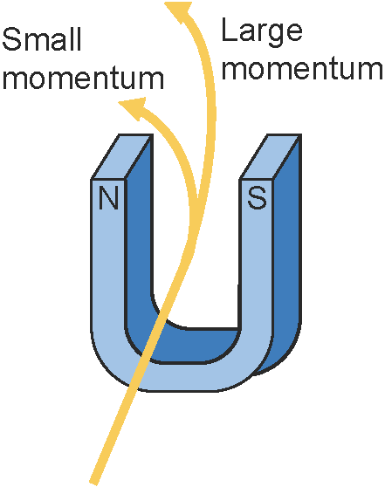
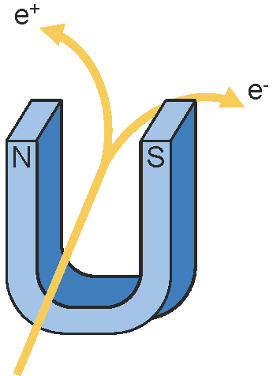
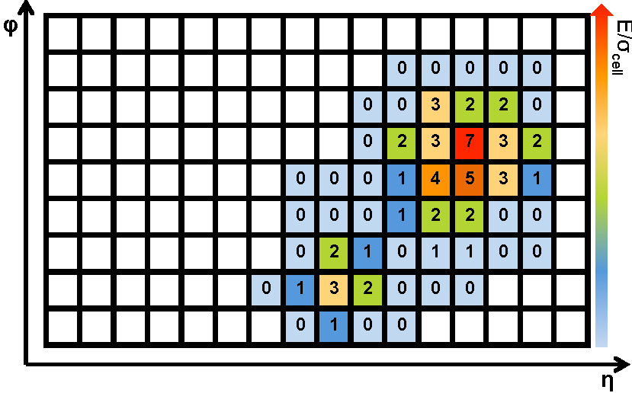
Detector measurements
Tracks: charges, momentum, special parameters, Time-of-flight…
Energy deposit in Calorimeter: clusters

Slide 3
What de we nead to Identify?
... All particles and decays produced in the collisions
Some important physics channels at the LHC with
  Electrons and muons (“easy“ to identify)
    Many Standard model measurements such as W/Z, top, di-bosons ...
    Searches for Higgs, Susy, exotics, e.g. H→4l, Z‘→2l
  Photons
    Direct photons, H→γγ, G →γγ...
  Taus
    Z →ττ, H →ττ, A→ττ
  Jets
    Jet cross-section, jet multiplicies, many Susy channels
  Missing transverse momentum
    W→lν precision measurements, many Susy channels, indirect Dark Matter searches, Extra dimensions...

Slide 4
How particles are reconstructed?
Final state SM particles: e, μ, τ, ν, γ, Hadrons
Each of these particles interact with the detector in a different way:
  e, μ, τ are theoretically similar, however:
    e leaves a track and its energy mostly in the EM calorimeter
    μ leaves a track, passes through all calorimeters into the muons chambers
    τ, in its hadronic decay channel, looks like a jet
      Decays within the Inner detector
      Leaves many tracks (1-3), EM and Hadronic energy
EM energy without a track EM energy with a track | Photon Electron
Hadronic energy without a track Hadronic energy with a track Hadronic energy with many tracks | Neutral Hadron Charged Hadron Collimated hadrons (jet, tau)
ID and muon chambers track | Muon
Missing transverse energy Missing longitudinal energy Displaced secondary vertex | Neutrino Beam remnants In-flight decay, B-mesons

Slide 5
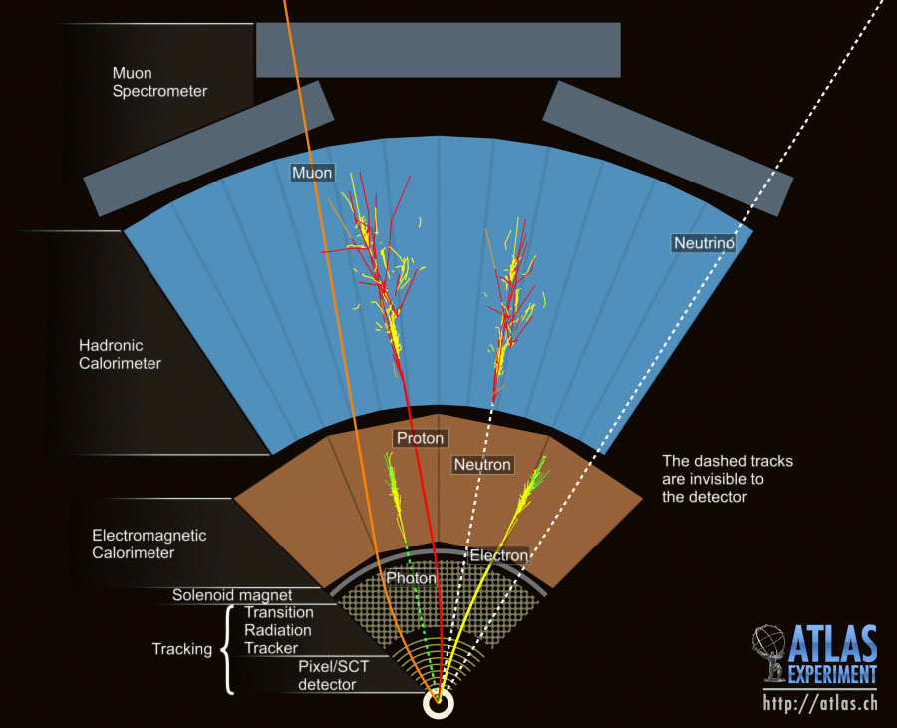
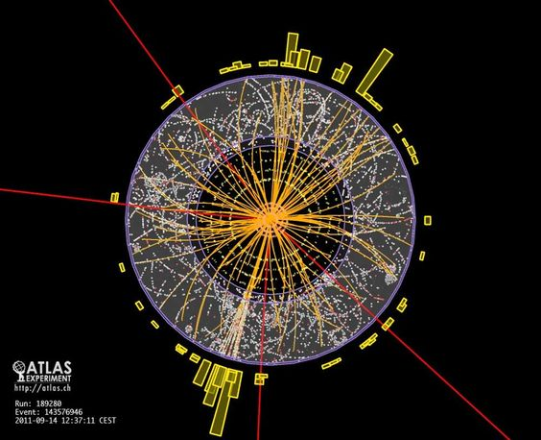
Physics objects reconstruction

Slide 6
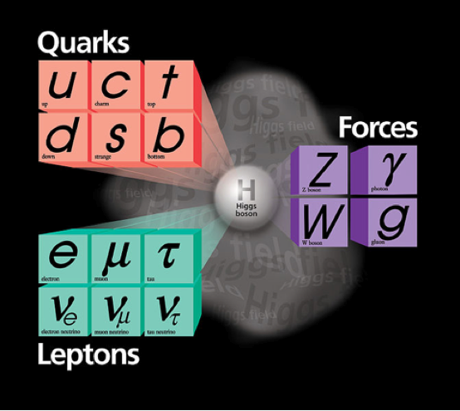
Today lecture
Unstable: t → bW
Unstable: identify via
decay products
Hadronisation → Jets
b jets:
dedicated
identification
techniques
Stable!
Hadronisation → Jets
( (quasi-)stable
hadrons:
π±, K±, K⁰_{L}, p, n)
Stable!
(μ not really, but
as seen by a detector)
No interaction
with detector
→ Missing (transverse)
energy/momentum
Unstable: identify via
decay products

Slide 7
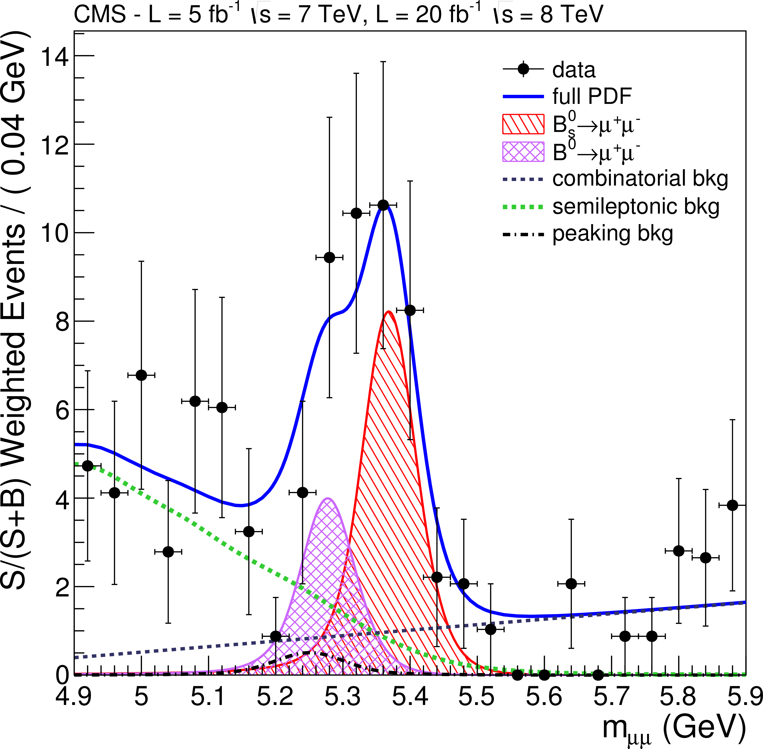
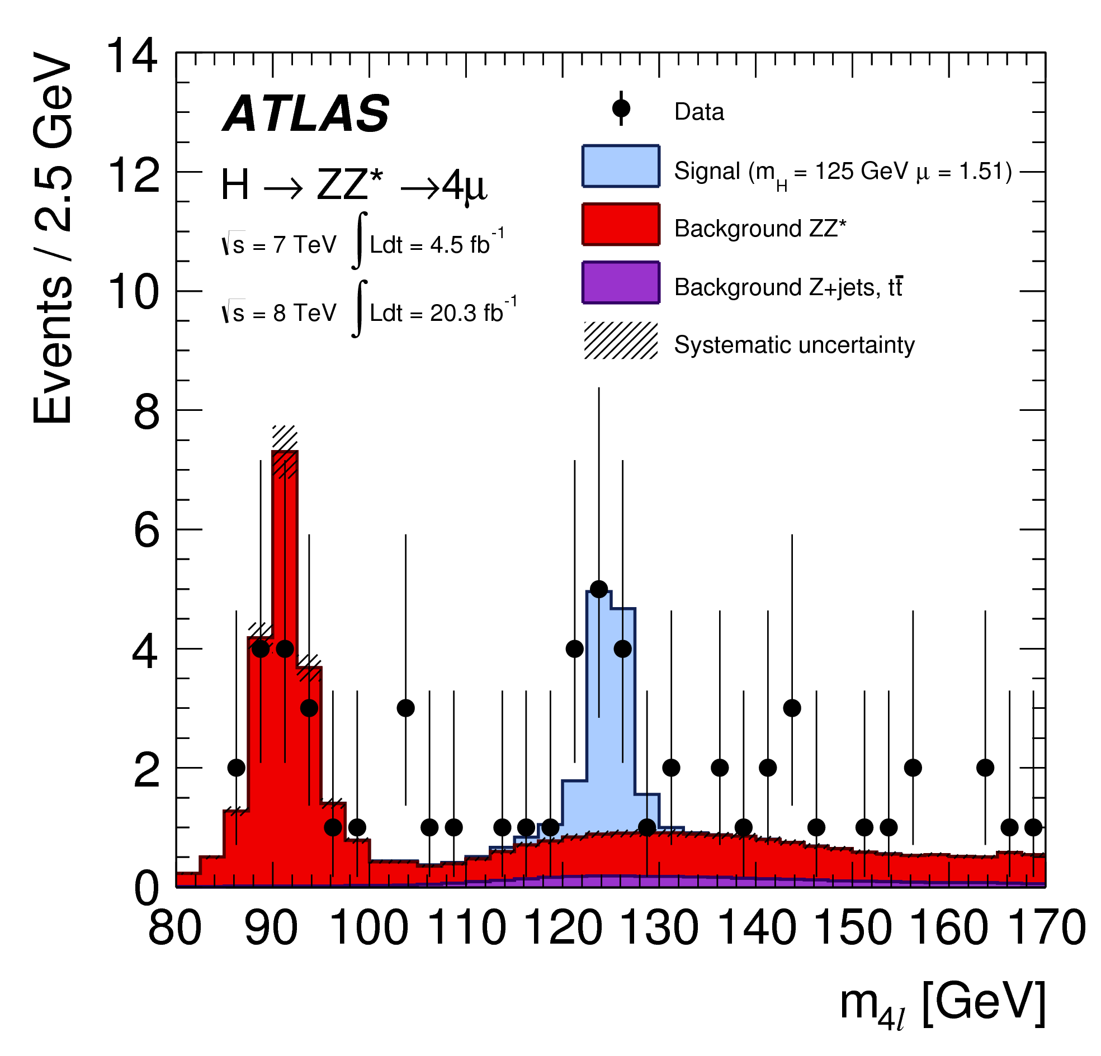
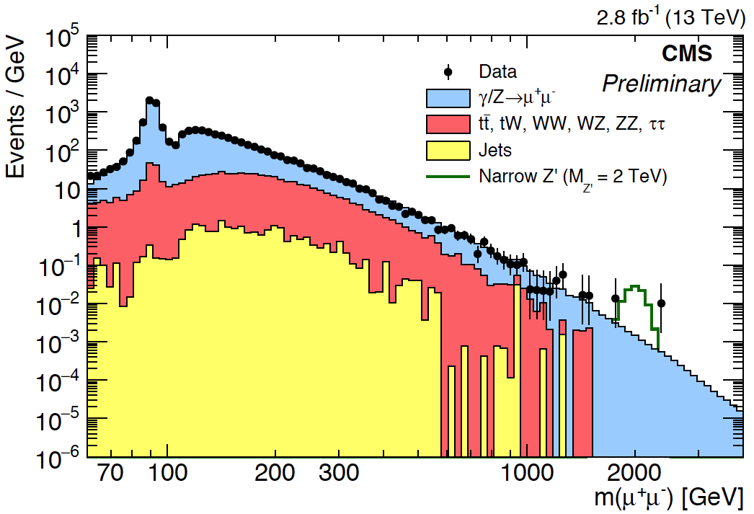
Muon Reconstruction
Why reconstruct and identify muons?
- leptons: distinct signature at hadron collider
→ get signal out of huge background, good S/B
- elementary, (quasi-)stable particle, no big bremsstrahlung
→ easy to identify (muon detectors)
→ precise determination of kinematic properties
H → ZZ* → ℓℓℓℓ (4μ):
Golden Channel
Searches for heavy resonances
of BSM physics, e.g. Z’ → μμ
B_{s} → μ⁺μ⁻
→ Muons over a wide momentum range up to ~ TeV
goal: momentum resolution ~ 10% at 1 TeV (remember: σ_{PT}/p_{T} ~ p_{T})

Slide 8
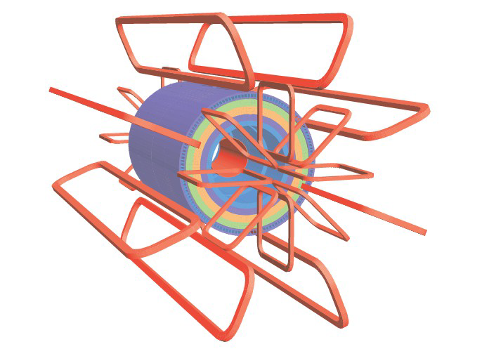
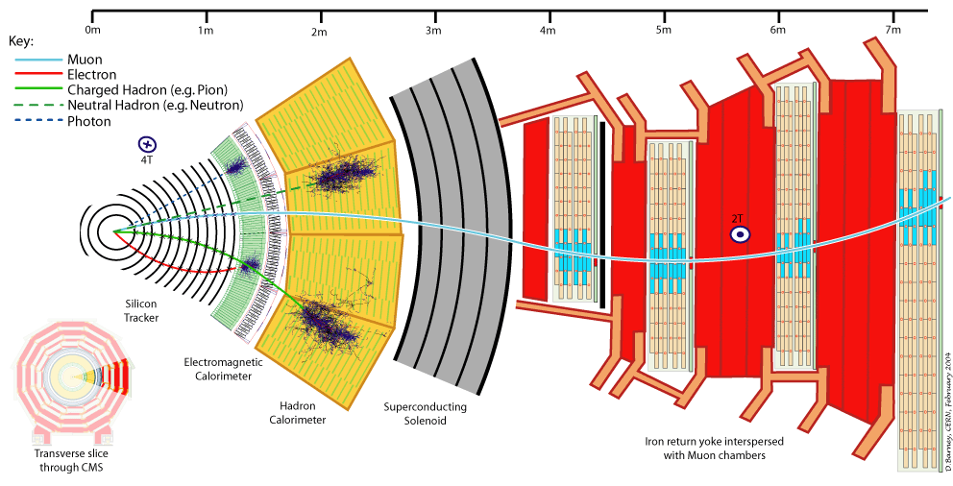
Magnet Systems
ATLAS
CMS
Solenoid for inner tracking system
(bending in rφ plane)
Large air-core toroid systems for
barrel and endcap regions
for precise stand-alone muon tracking
Bending plane perpendicular to rφ
Relatively small B-field (~0.5 T)
but large dimensions
→ for good momentum resolution
Bending through return yoke of solenoid
Larger B-field (~ 2 T) but multiple scattering!
Momentum resolution over wide range
dominated by silicon tracker (B ~ 3.8 T),
improve for large transverse momenta
including muon system

Slide 9
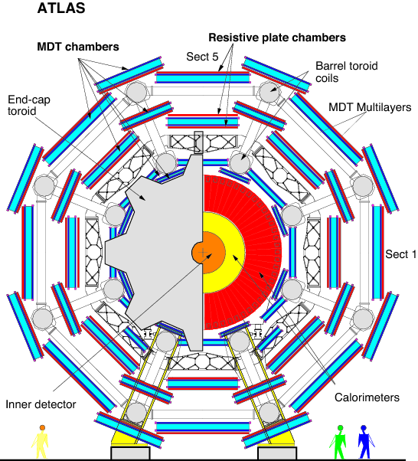
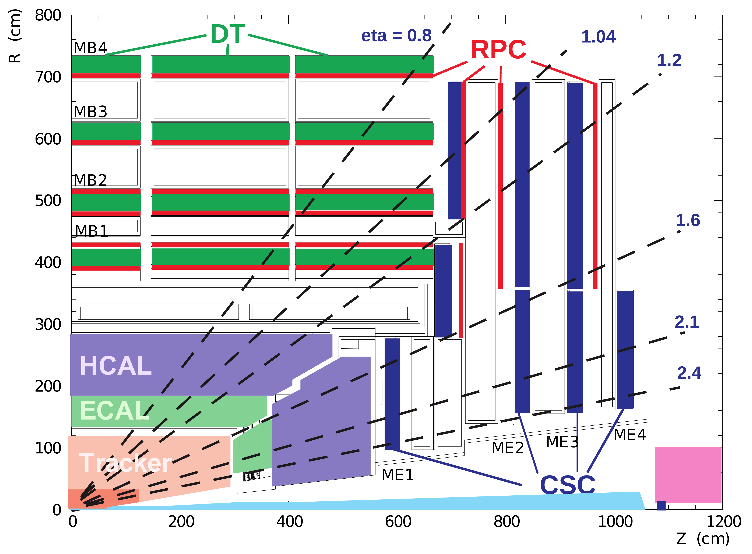
Muon Systems
ATLAS
CMS
Different technologies of gas-ionisation detectors:
Drift Tubes (MDT)
Cathode Strip Chambers (CSC)
Resistive Plate Chambers (RPC)
Thin Gap Chambers (TGC)
}
precision measurements
}
triggering

Slide 10
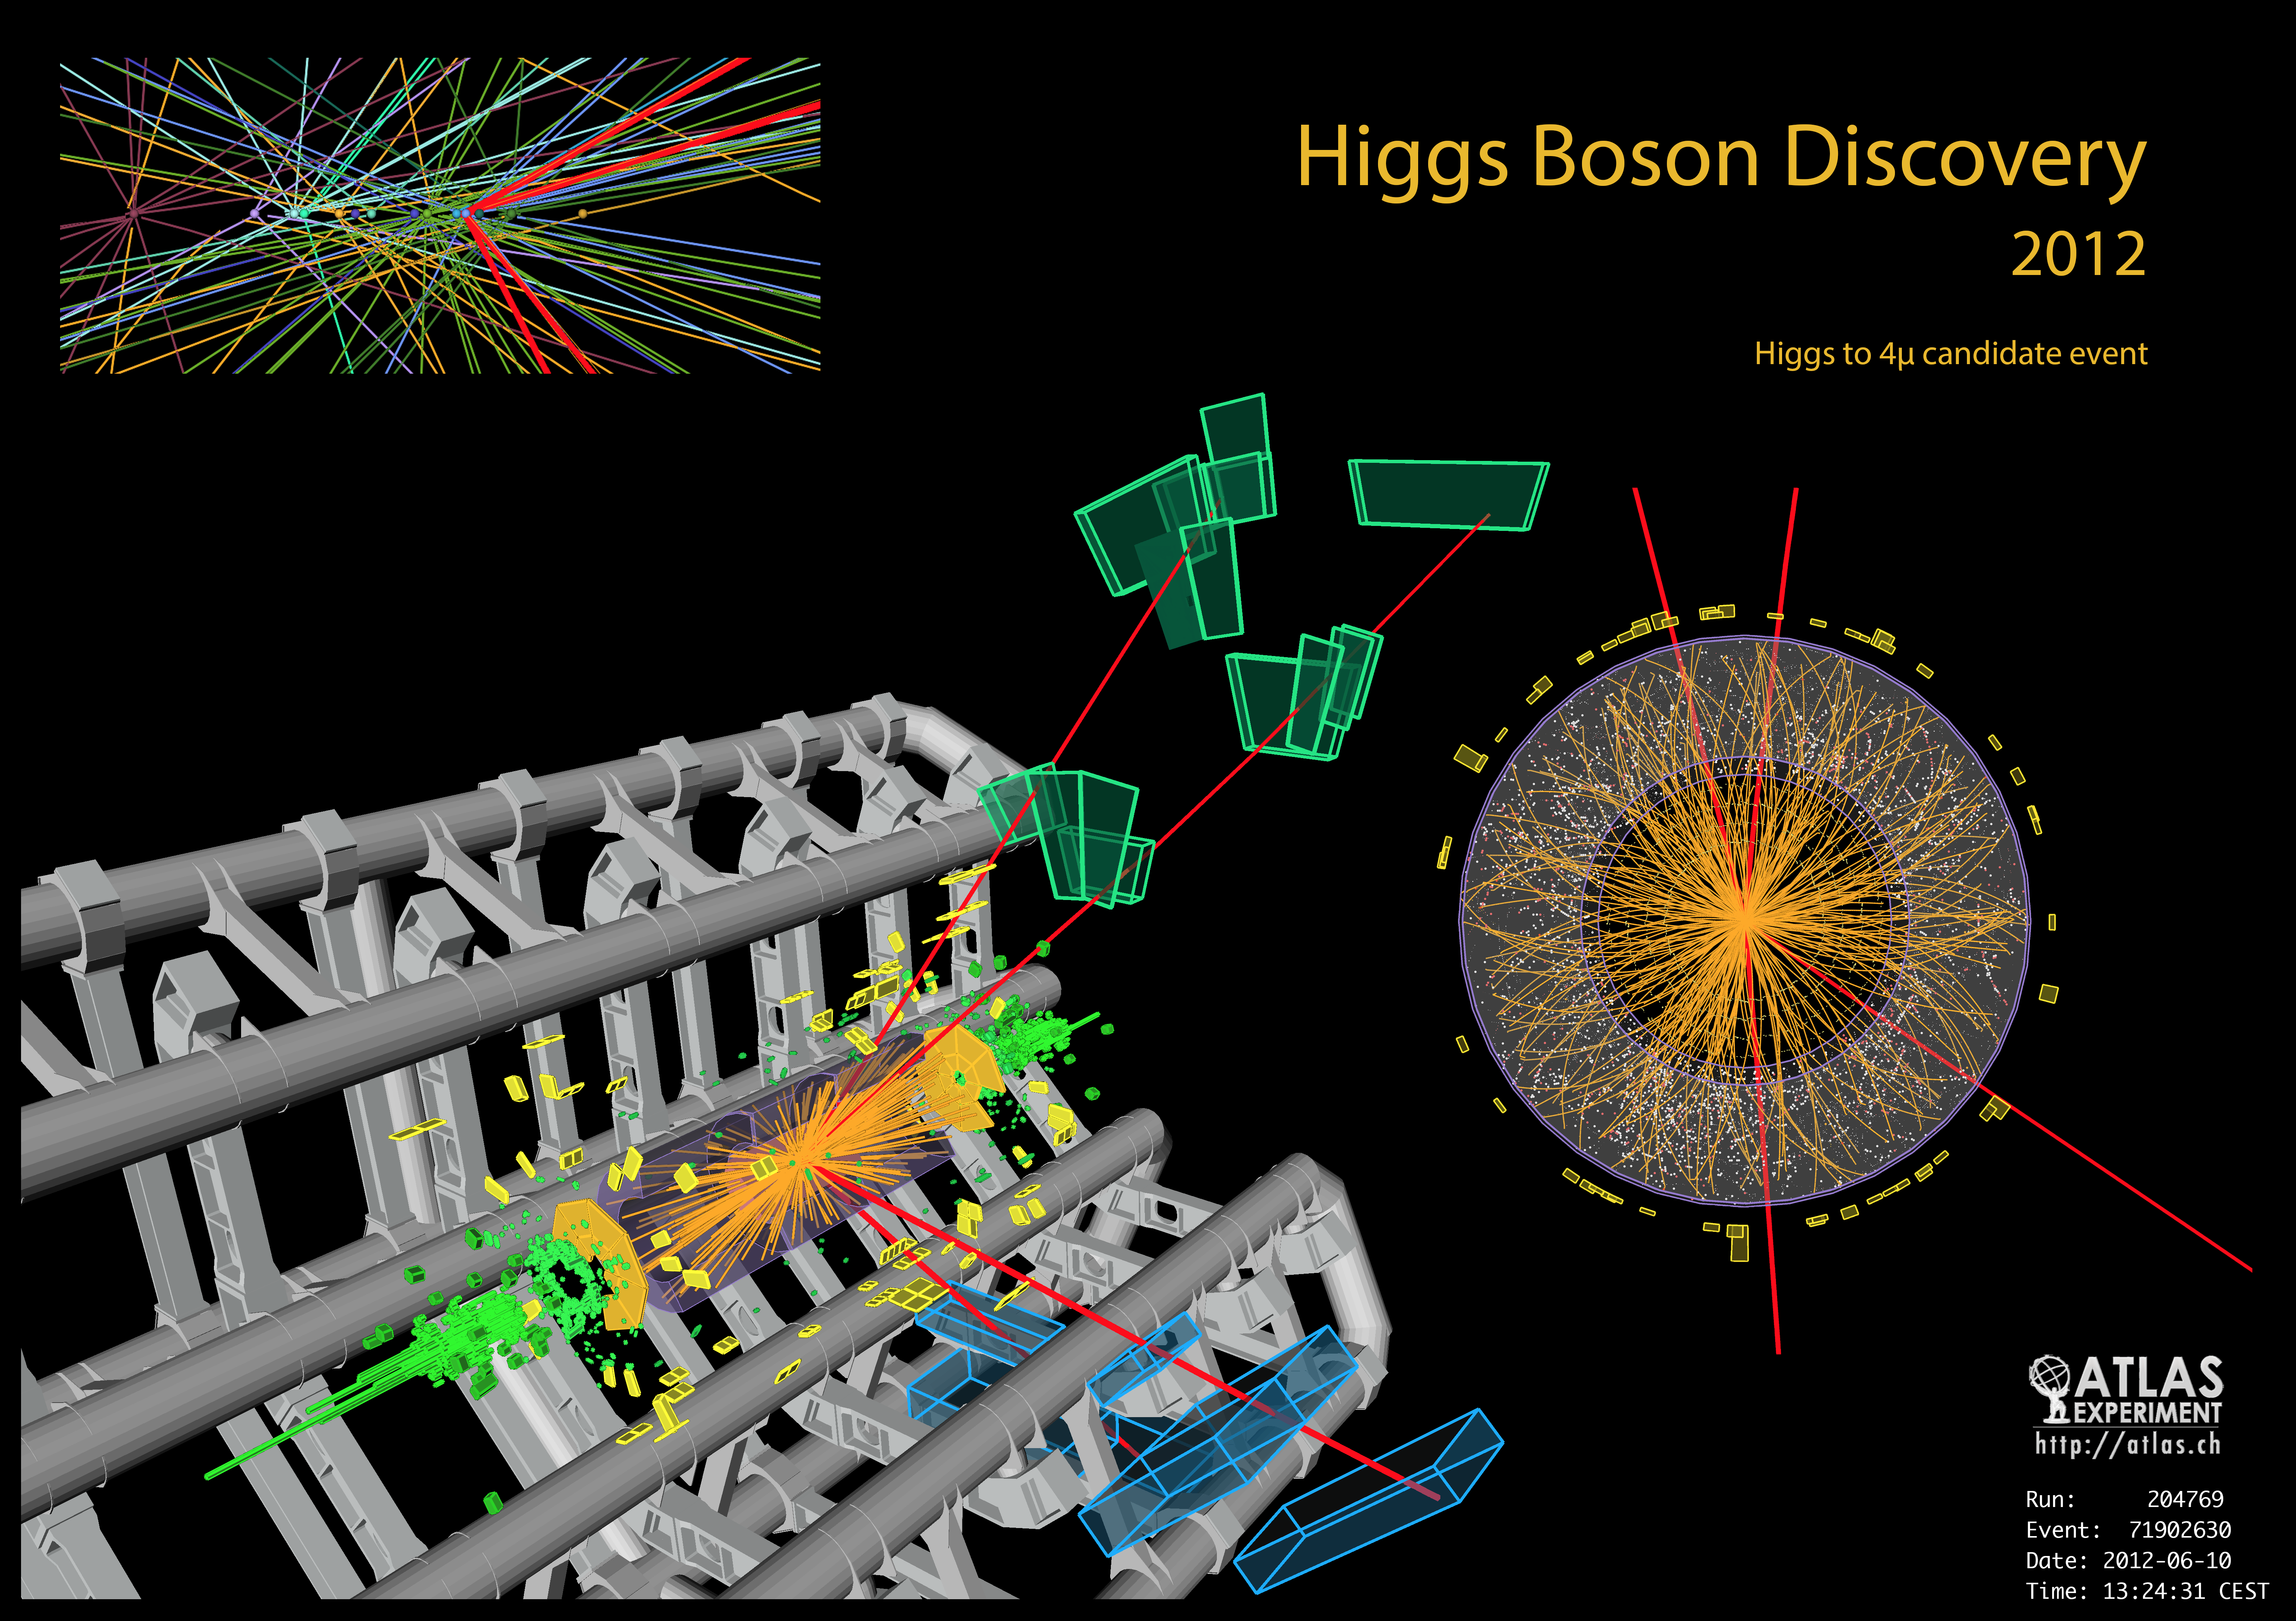
H → 4μ Candidate

Slide 11
Basic Principle
- Reconstruct track in inner tracking detector (ID; as any other charged particle)
- Reconstruct track (or segments) in muon spectrometer (MS)
- Match these and define different categories of reconstructed muons

Slide 12
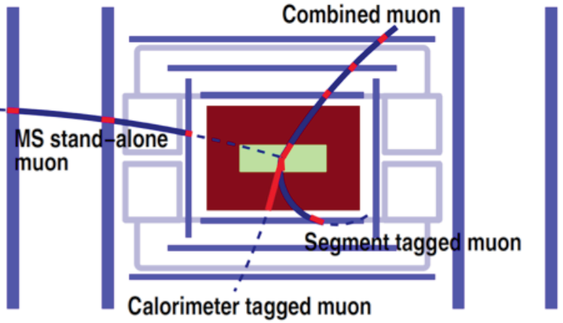
Muon Reconstruction
Global combined muons:
Match tracks fully reconstructed in the ID and the MS. Combined fit using all hits.
→ Best class of muons
ID track + MS segment:
Extrapolate fully reconstructed ID track to MS; add track segments reconstructed in MS
→ Recover efficiency for muons with lower transverse momenta (p_{T} ≤~ 5 GeV) or areas
of reduced MS acceptance
ID track + calorimeters (~ MIP),
no MS requirements:
→ Recover efficiency where MS only
partially instrumented
Track only in MS:
→ Extend acceptance beyond
ID acceptance
Apply identification criteria to suppress background from e.g. K±/π± → μν decays, punch-through.
Define identification levels (e.g. tight, medium, loose) with different efficiencies and purities
→ Analyses to choose according to their needs (S/B; e.g. H → 4l needs high efficiency).

Slide 13
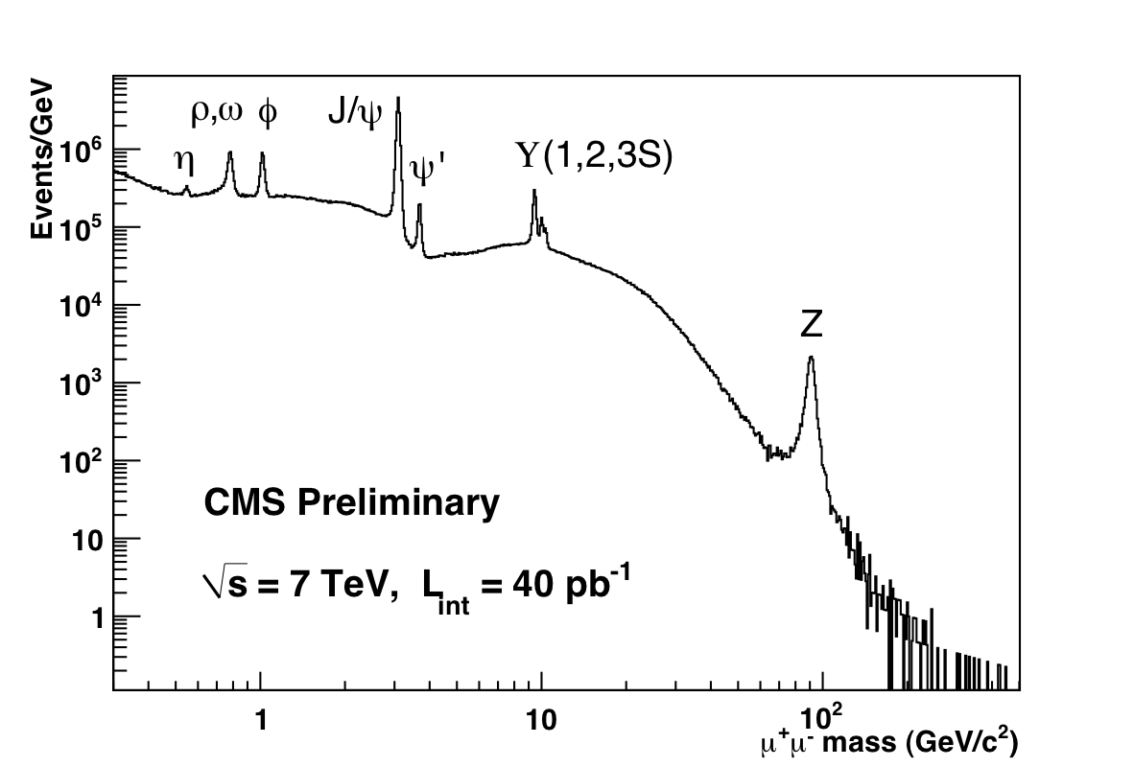
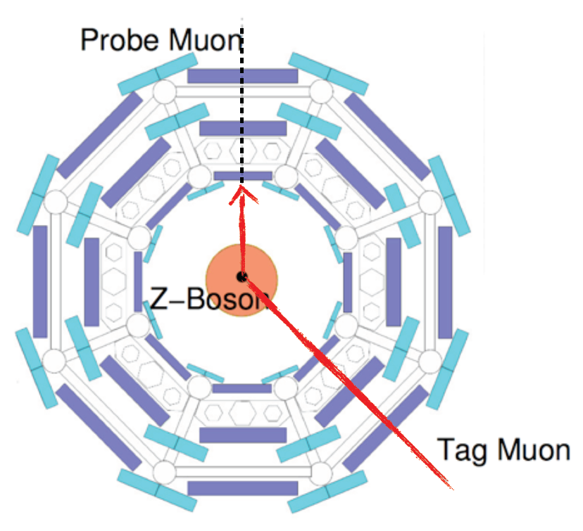
Measuring Efficiencies in Data
Use resonance decays in a pair of
muons, e.g.
J/Ψ → μ⁺μ⁻ (~ low p_{T}) and
Z → μ⁺μ⁻ (medium-high p_{T})
Can be cleanly identified without making
use of complete identification information!
Tag-and-Probe Method:
- identification of one μ: Tag
- study properties of other μ not used for reconstruction: Probe
- ask for a reconstructed track as probe
→ test reconstruction and identification as muon
w.r.t. track in a nearly unbiased way
- ask for MS muon as probe → test reconstruction in ID

Slide 14
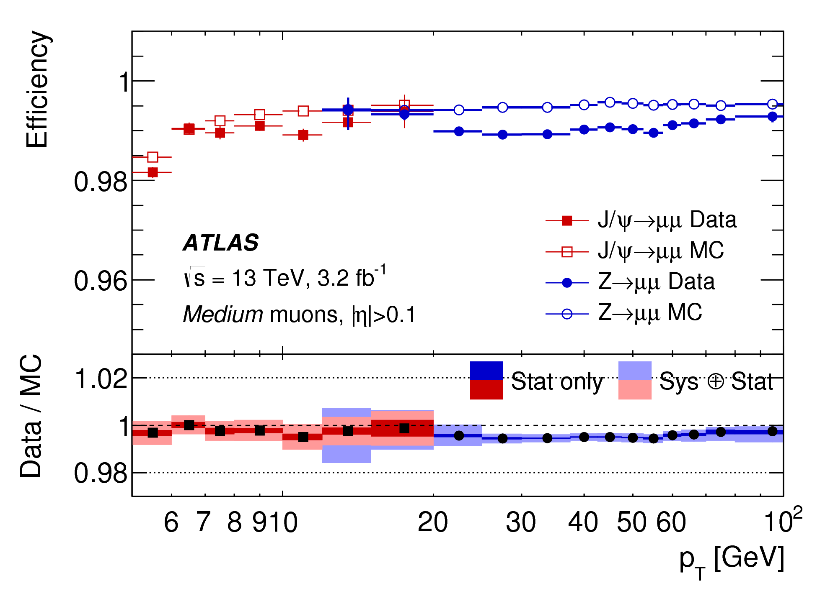
Measuring Efficiencies in Data
Use resonance decays in a pair of
muons, e.g.
J/Ψ → μ⁺μ⁻ (~ low p_{T}) and
Z → μ⁺μ⁻ (medium-high p_{T})
Can be cleanly identified without making
use of complete identification information!
Very high reconstruction efficiencies!
Tag-and-Probe Method:
- identification of one μ: Tag
- study properties of other μ not used for reconstruction: Probe
- ask for a reconstructed track as probe
→ test reconstruction and identification as muon
w.r.t. track in a nearly unbiased way
- ask for MS muon as probe → test reconstruction in ID

Slide 15
Momentum Resolution
CMS: MS improves overall momentum resolution for p_{T} > 200 GeV
ATLAS: excellent p_{T} determination from MS alone for p_{T} > 100 GeV

Slide 16
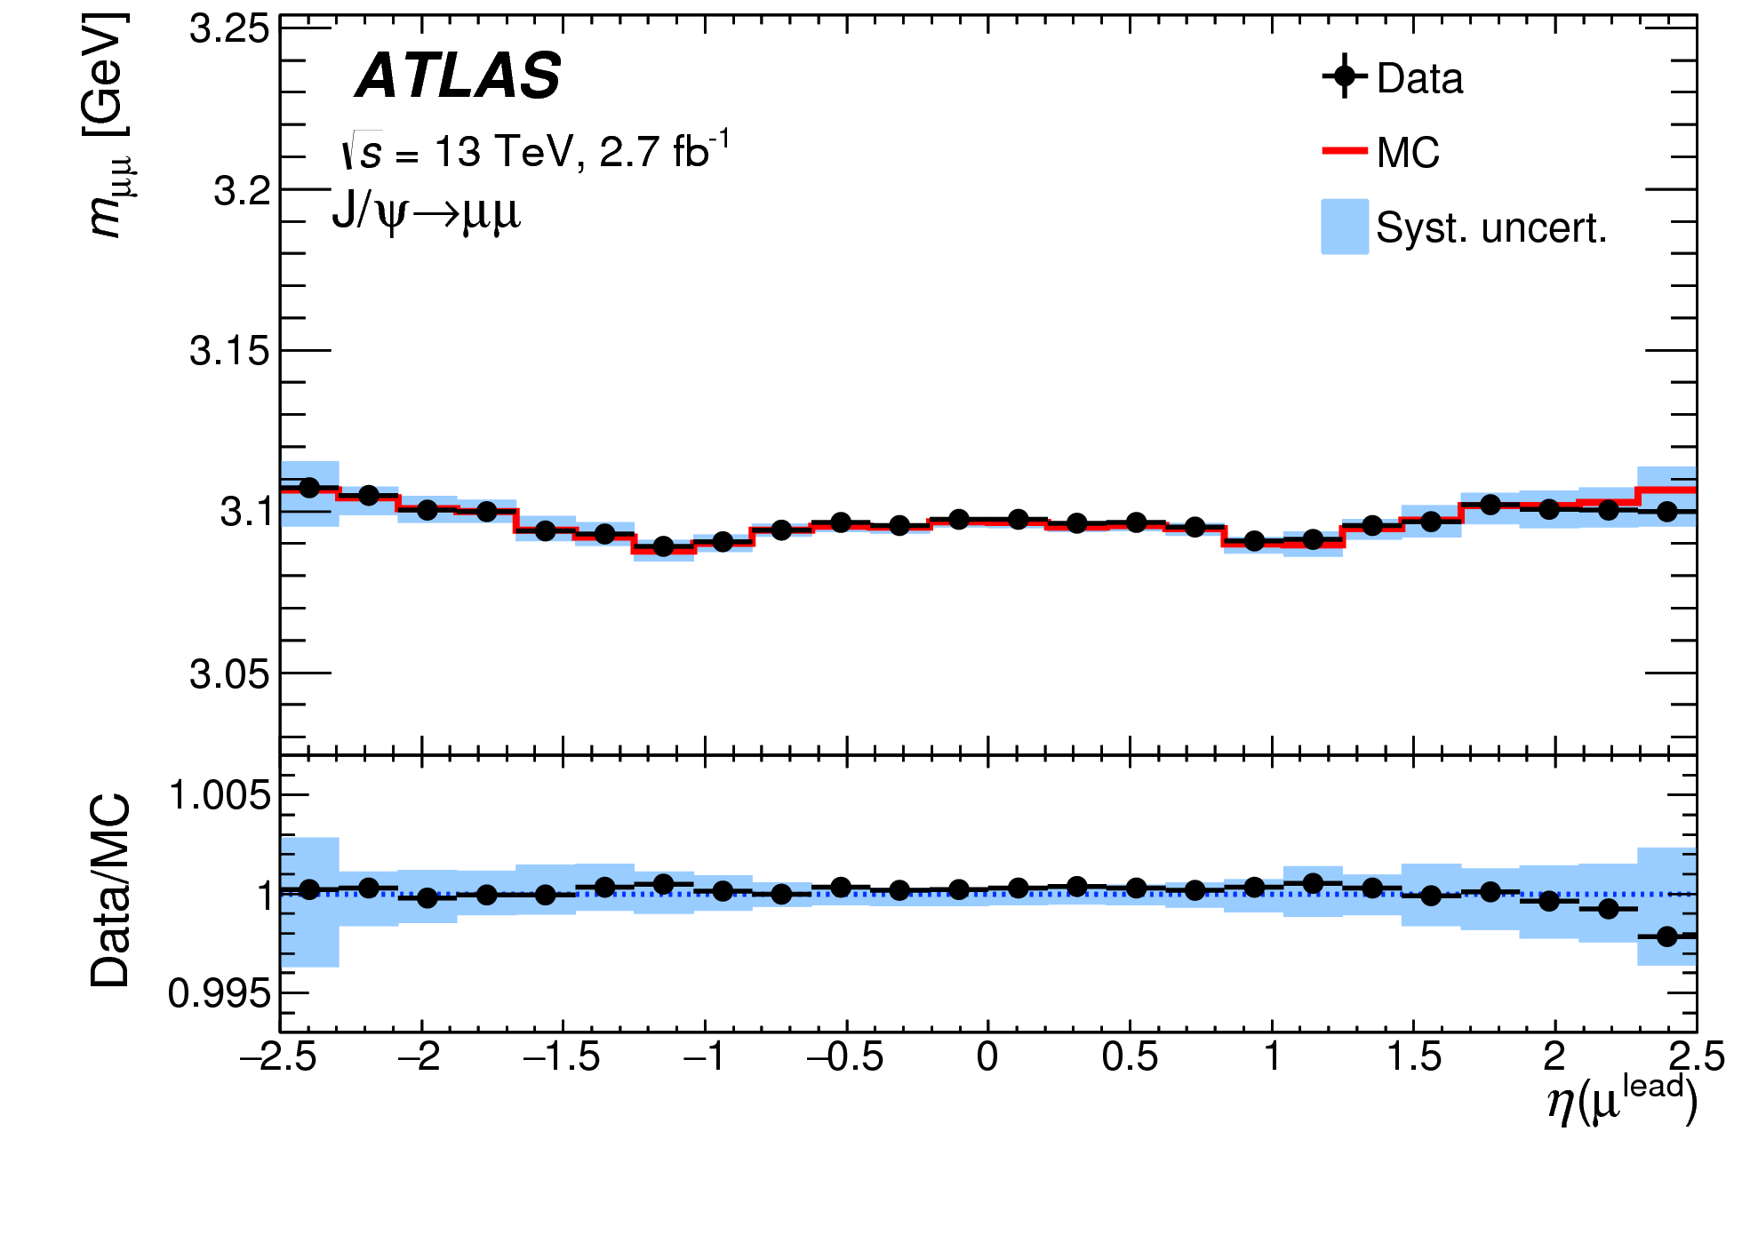
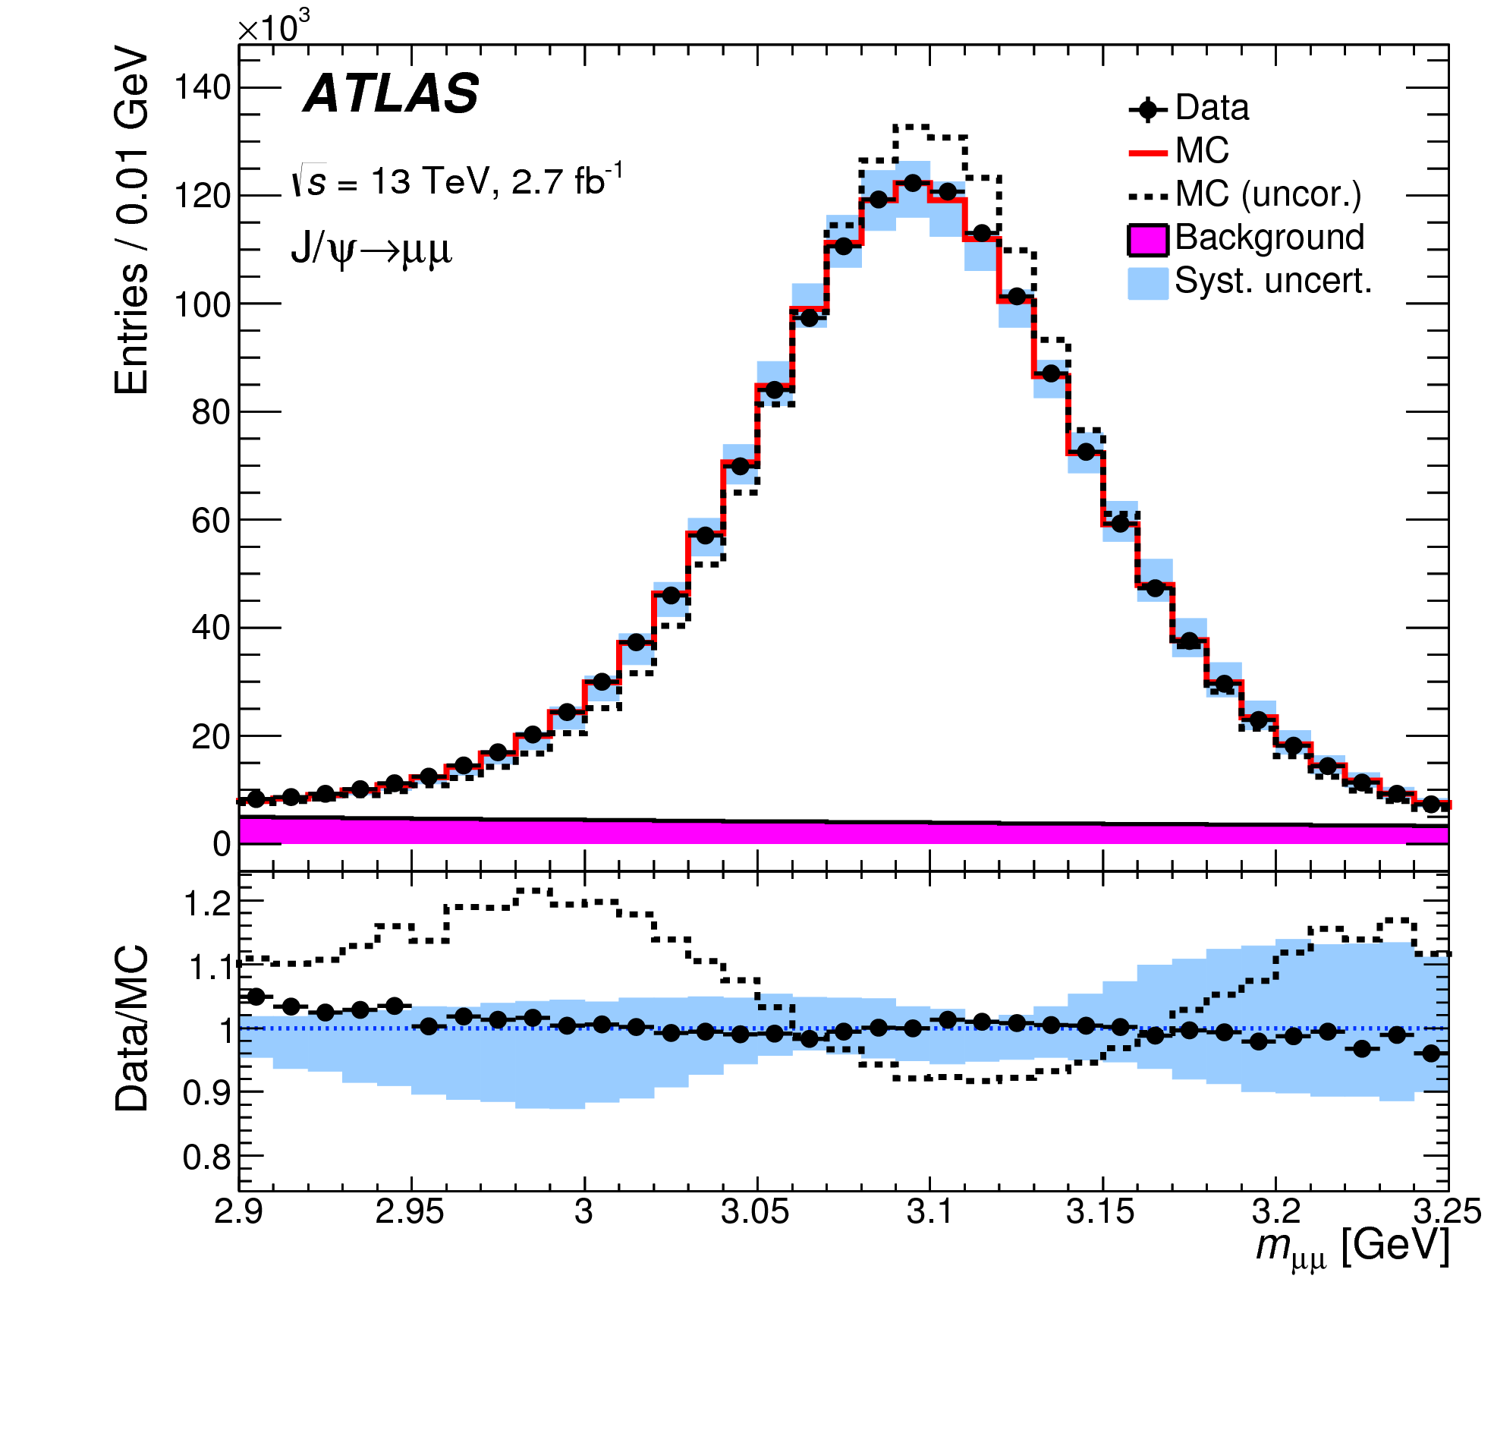
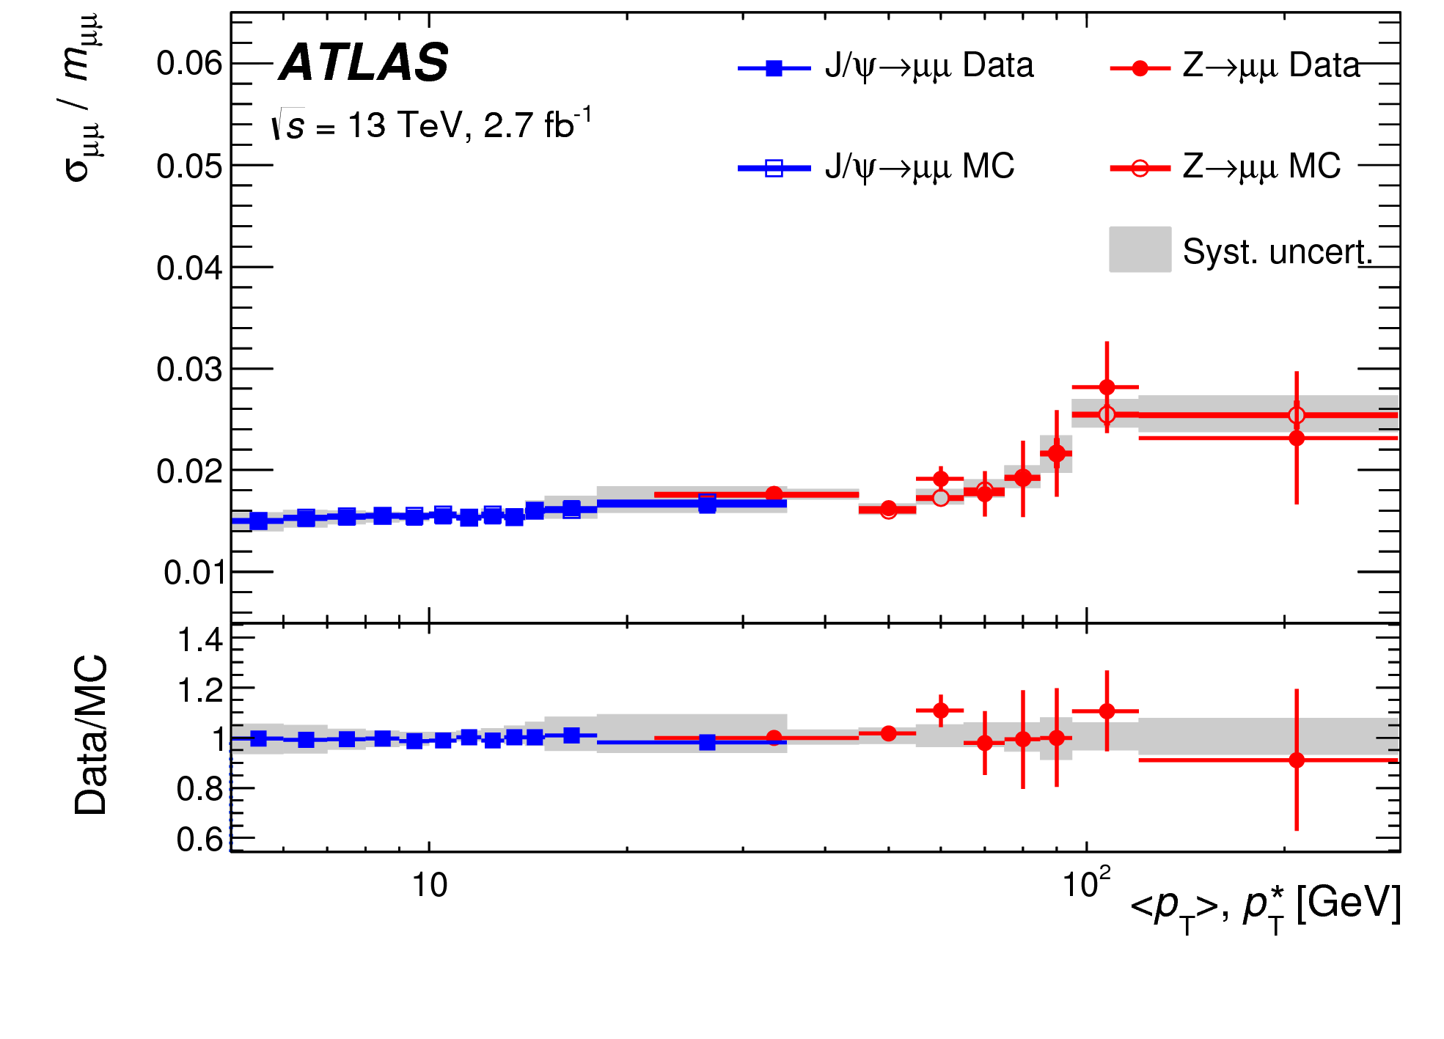
Momentum Scale and Resolution
Data: Derive corrections from mass distributions of
J/Ψ → μ⁺μ⁻ (~ low p_{T}) and
Z → μ⁺μ⁻ decays
to be applied to the simulation
(also: cosmic muons for very high p_{T})
Mass: momentum scale
Width: momentum
resolution
Knowledge crucial for precision measurements,
e.g. Higgs boson mass in H → ZZ* → 4l !

Slide 17
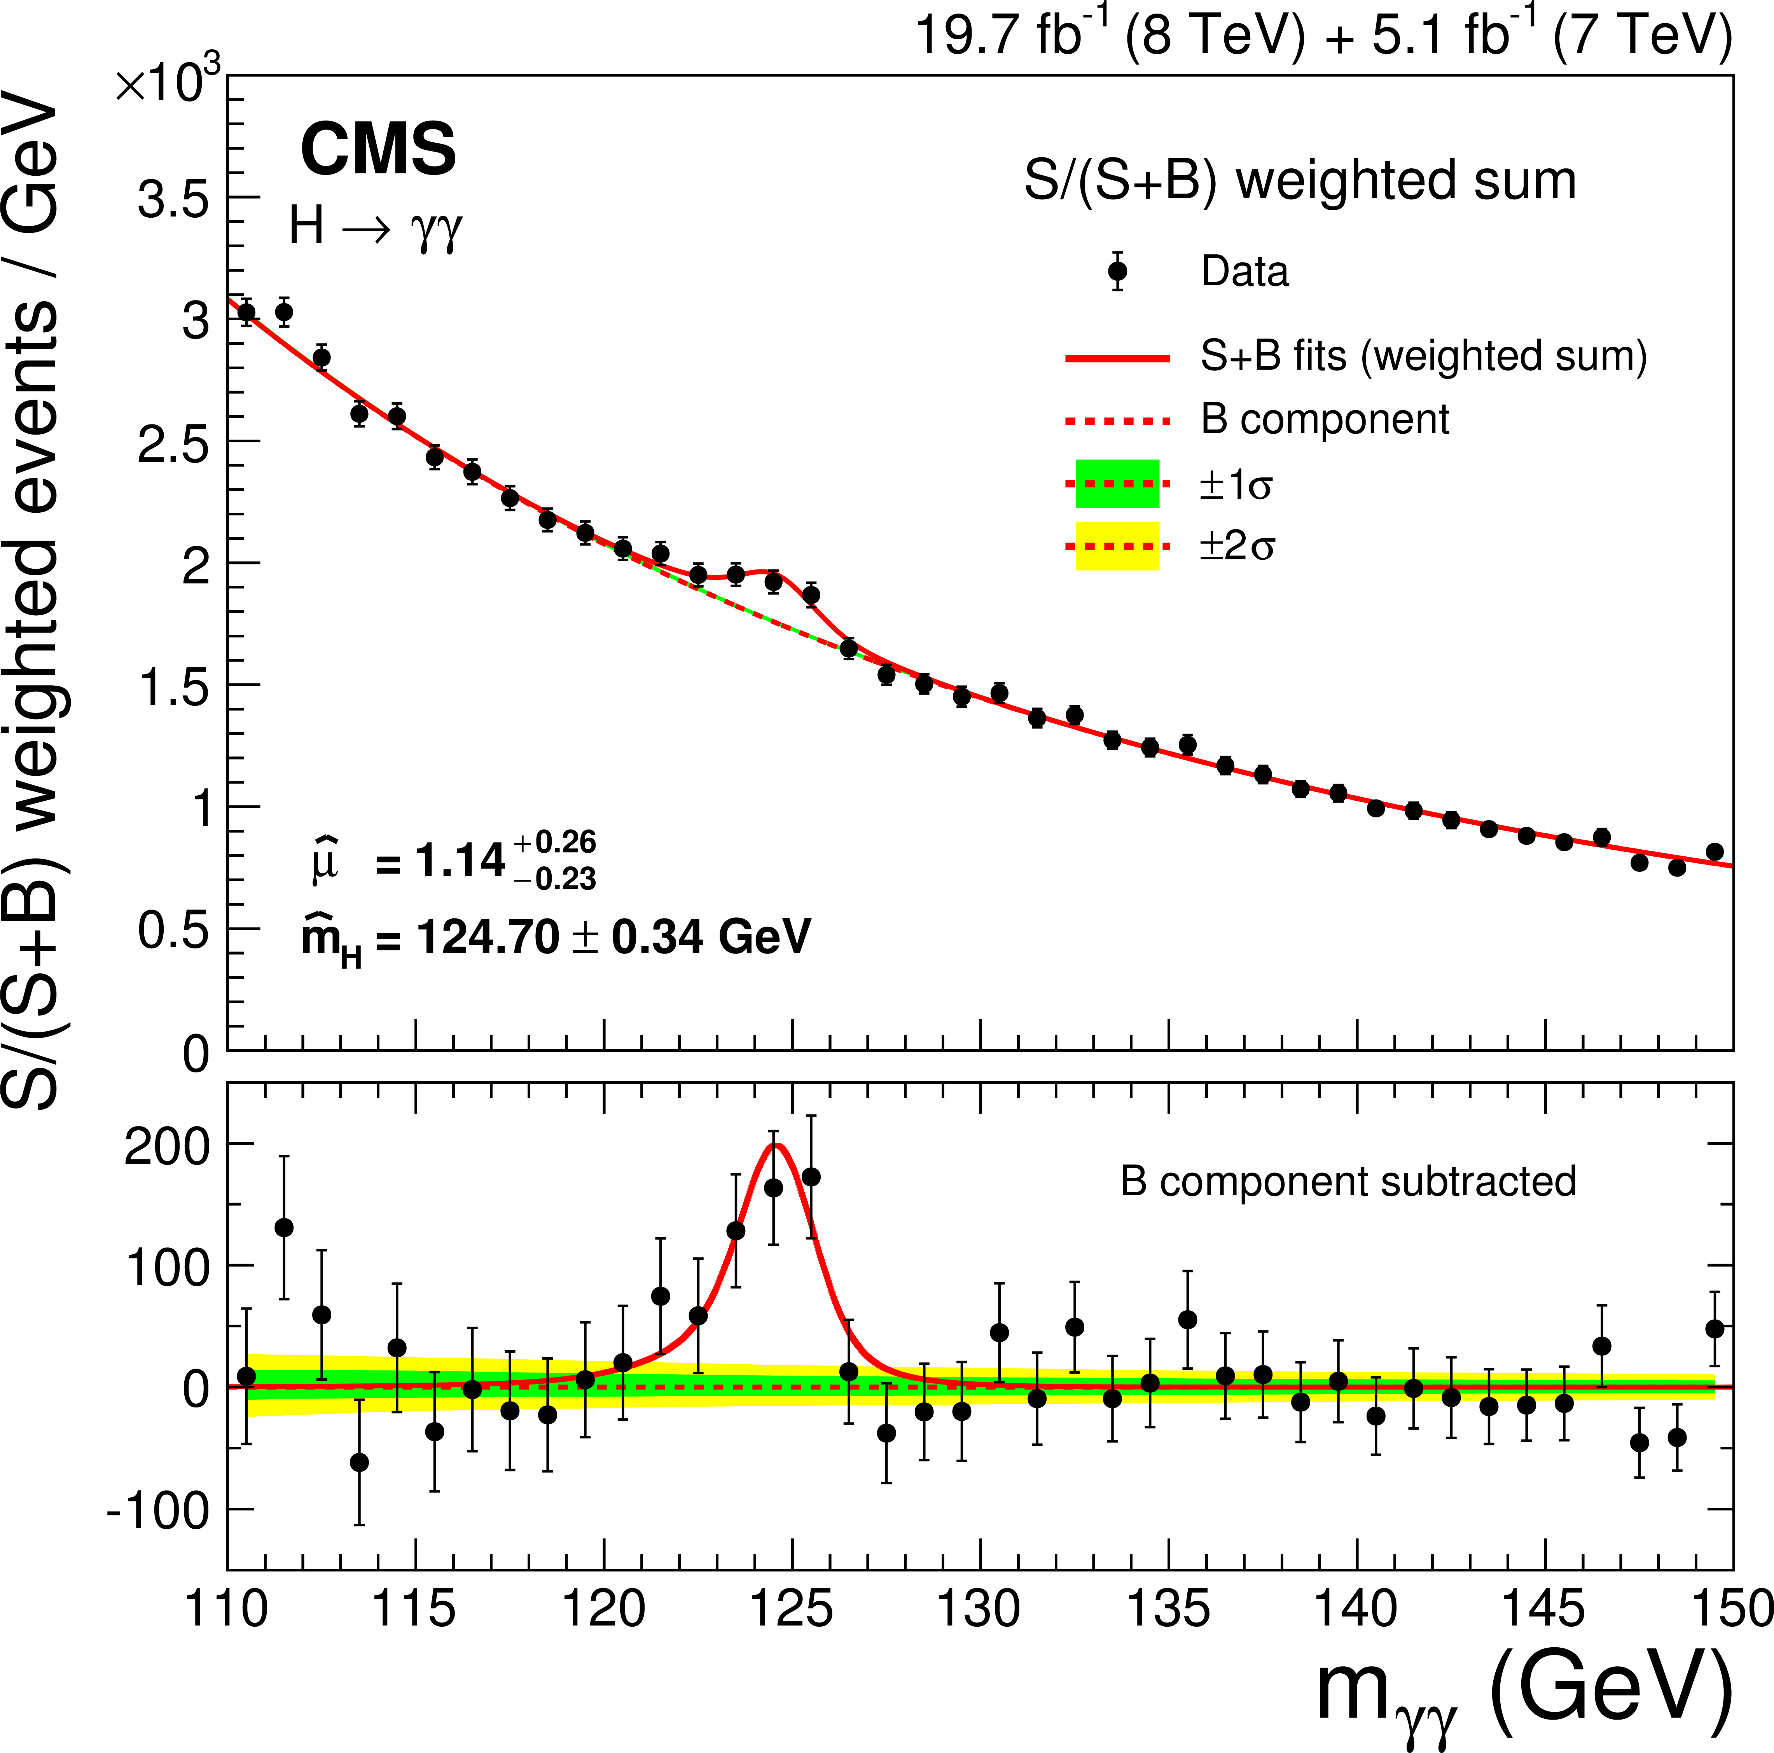
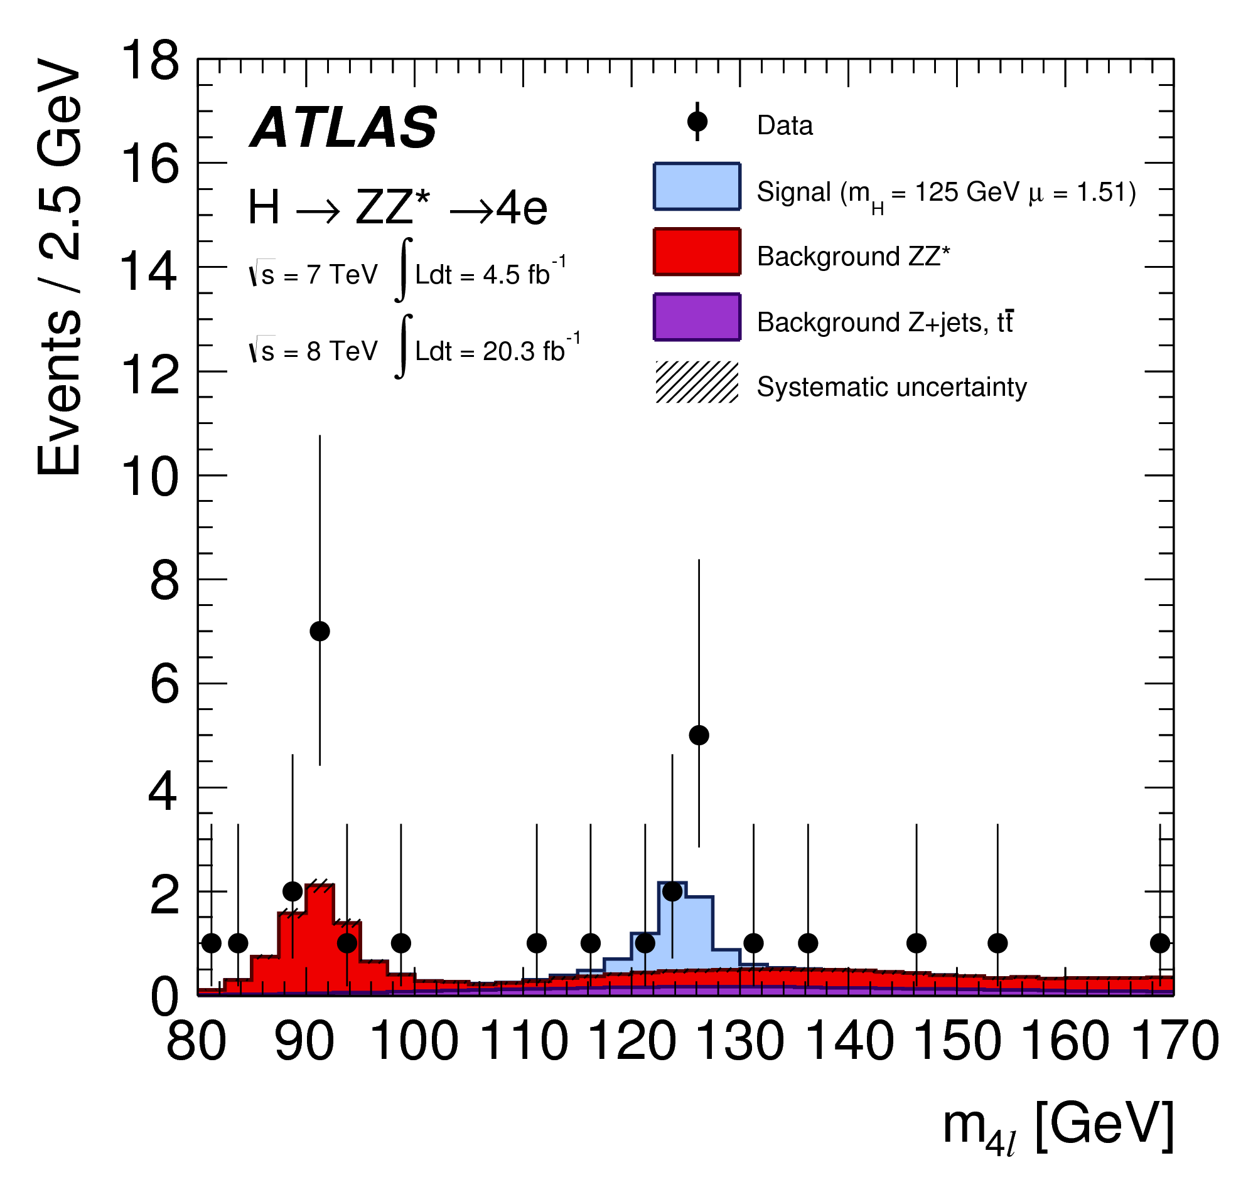
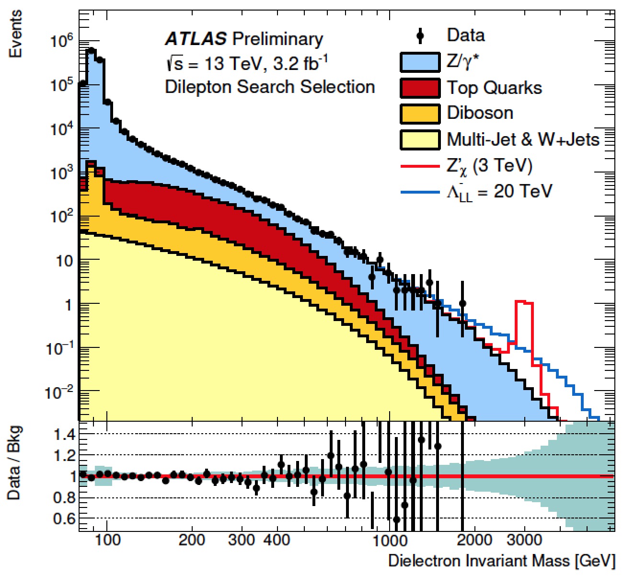
Electron/Photon Reconstruction
Why reconstruct and identify electrons and photons?
- e (lepton), γ → distinct signature at hadron collider
→ get signal out of huge background, good S/B
- photon is the only vector boson that can be directly detected!
- elementary, stable particles
→ allows precise determination of kinematic properties (calorimeters: σ_{E}/E ~ 1/√E !)
H → γγ
Searches for heavy resonances
of BSM physics, e.g. Z’ → ee
H → ZZ* → ℓℓℓℓ (4e):
Golden Channel
→ Need excellent identification and energy resolution over a wide energy range!

Slide 18
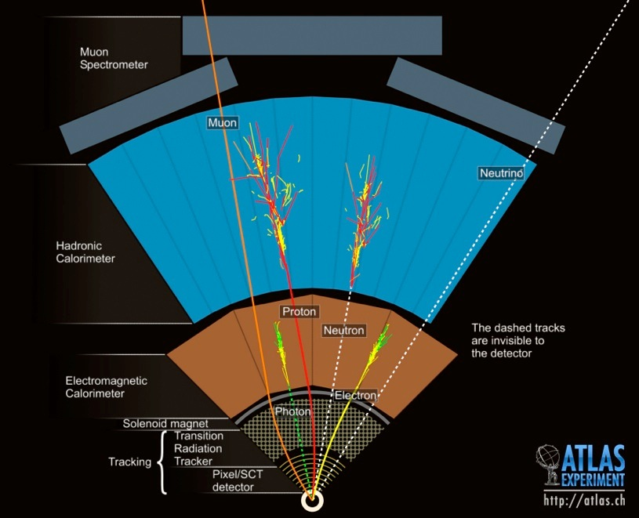
Reconstructing e, γ
Showers in the electromagnetic calorimeter
Electron: e
- charged particle in the
tracker
Photon: γ
- no charged particle in
the tracker (ideally ….)

Slide 19
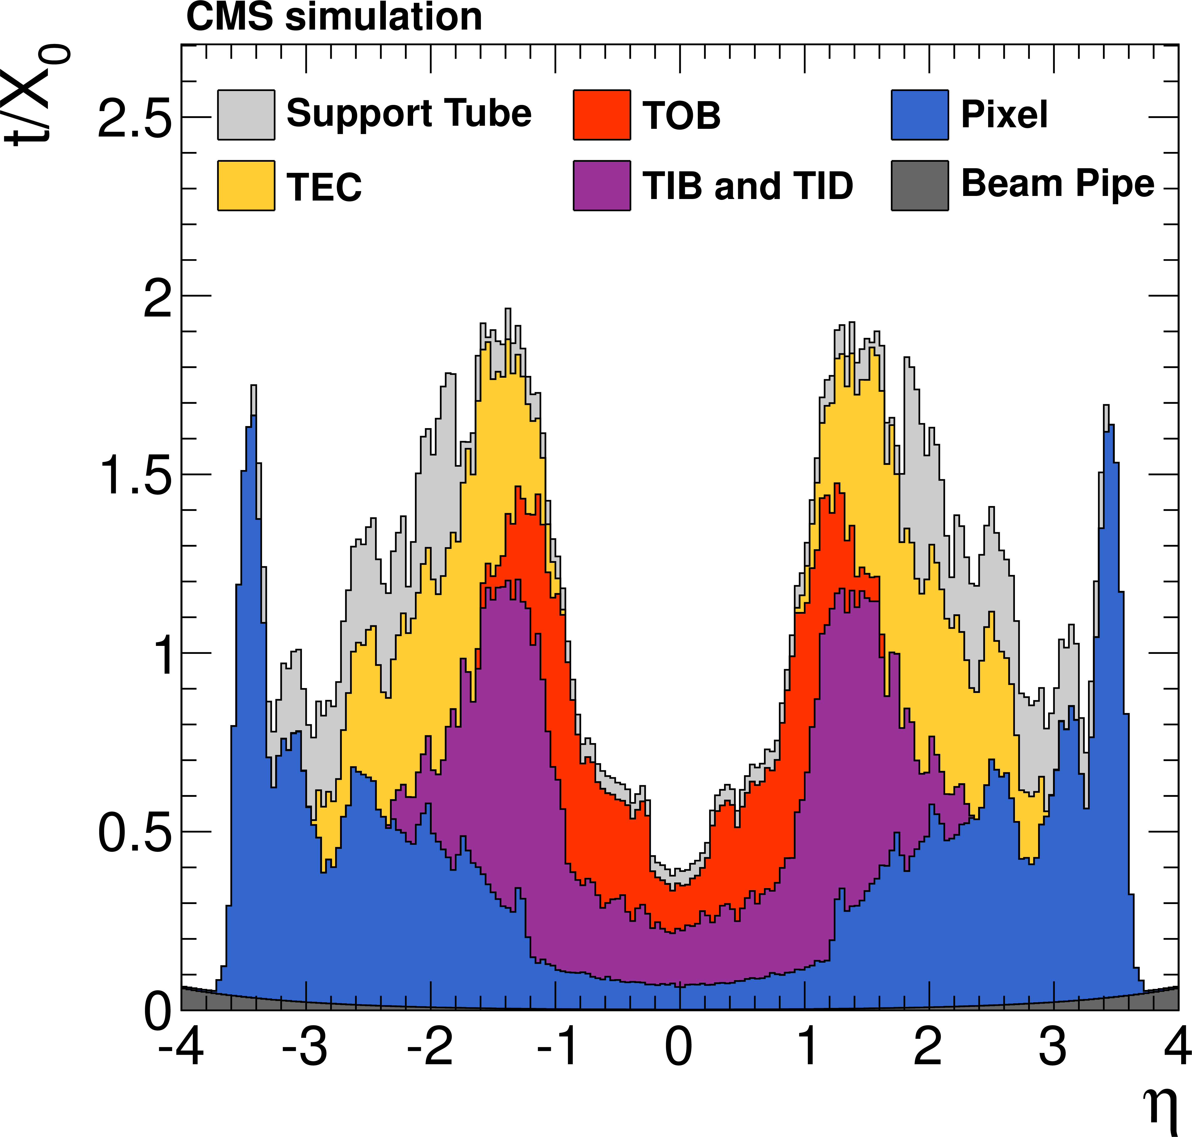
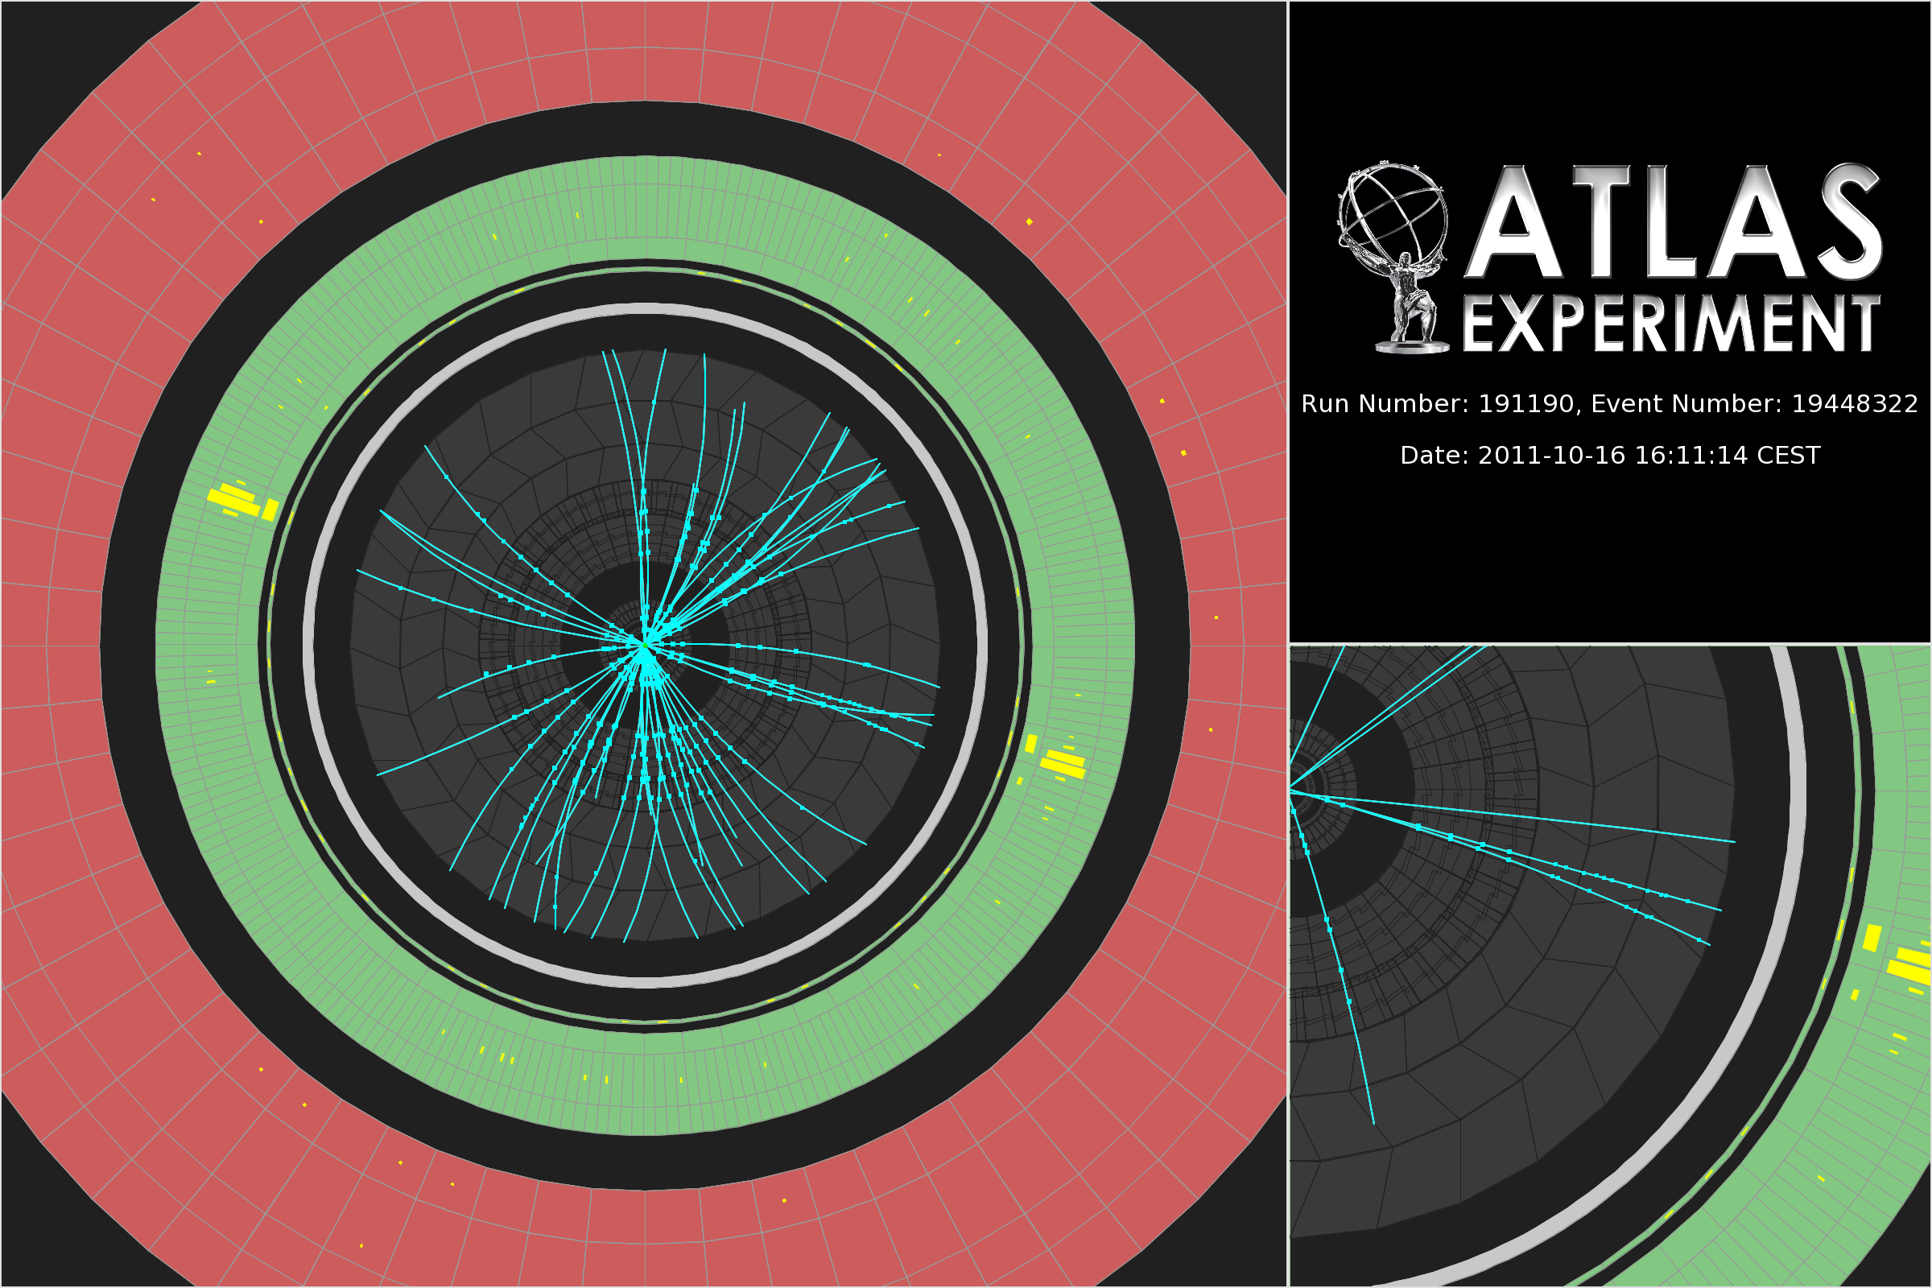
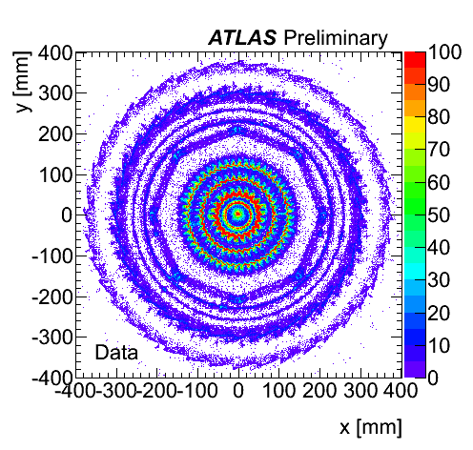
Tracker Material
The reality is far from ideal: There is a huge amount of material in front of the calorimeters!
Bremsstrahlung of electrons: e.g. CMS:
electrons radiate 33% of their energy at |η| = 0
86% |η| = 1.4
before reaching the electromagnetic calorimeter!
Conversion of photons!
→ Often, not pure electrons (→ eγ) and photons (→ ee) reach
the calorimeters
→ Take this into account in the reconstruction algorithms!
H → γγ candidate
unconverted
photon
converted
photon

Slide 20
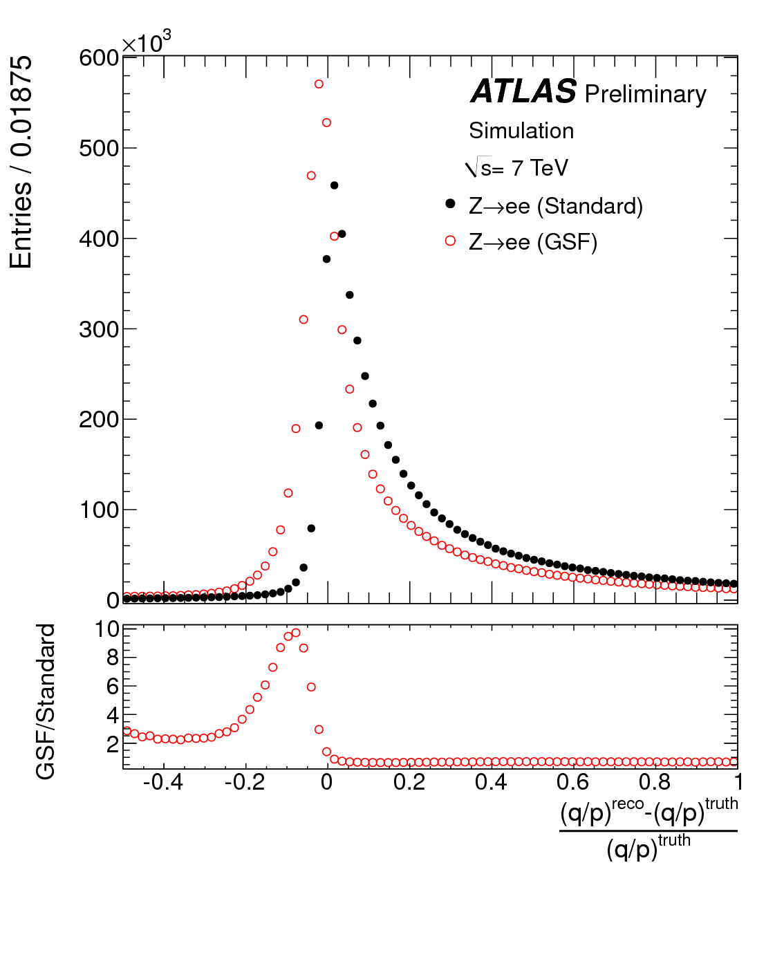
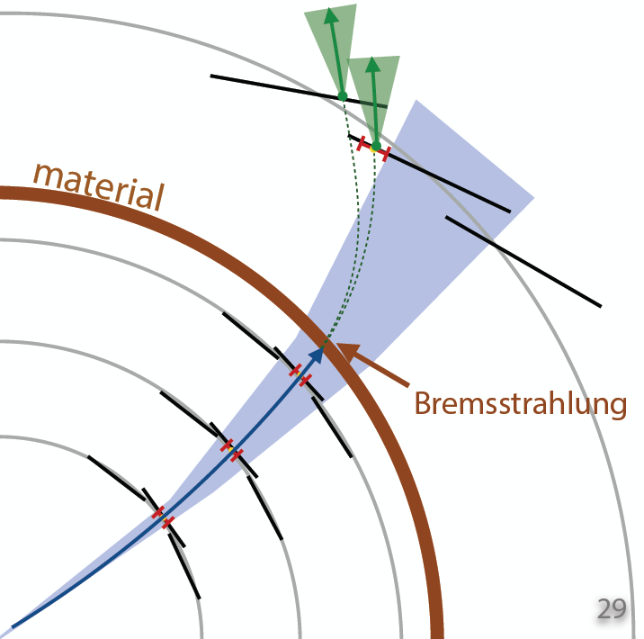
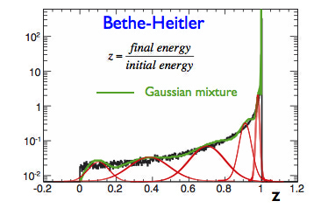
Electron Tracking: Gaussian Sum Filter
Potentially large, non-Gaussian energy
loss through Bremsstrahlung
→ significant change of curvature:
loss of hits etc.
→ lower efficiency, degraded track parameters
Gaussian Sum Filter (GSF):
- approximate Bethe-Heitler energy loss by
sum of Gaussians
- run several Kalman Filter in parallel

Slide 21
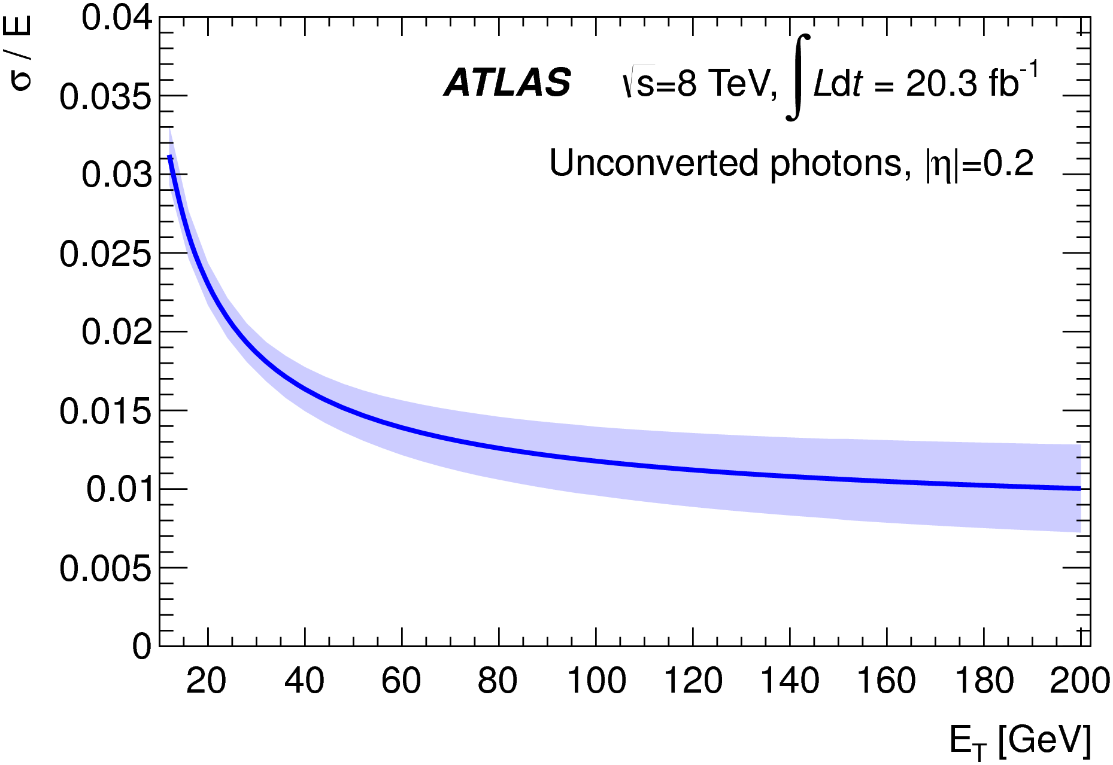
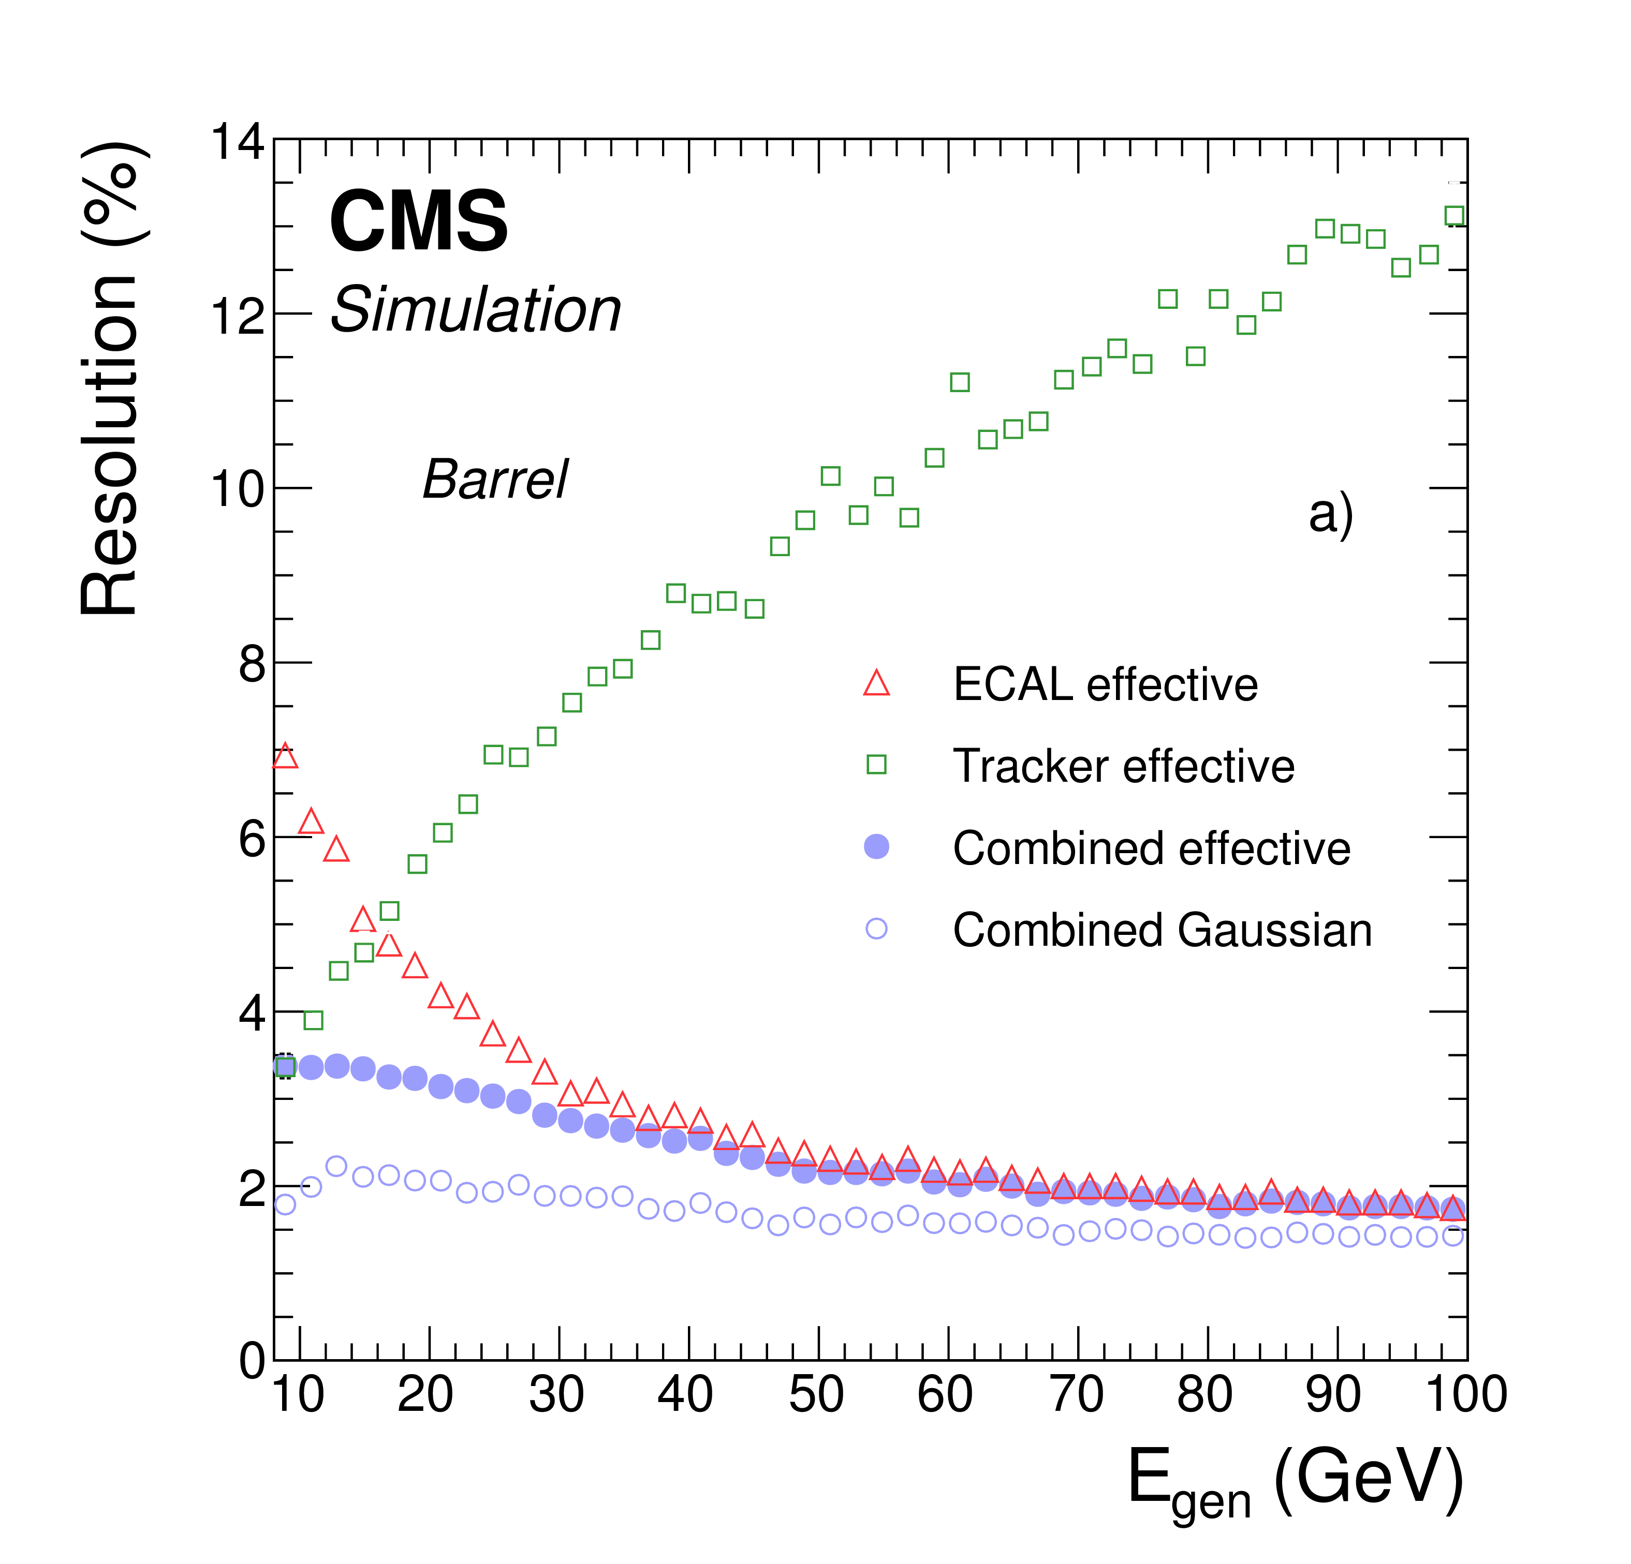
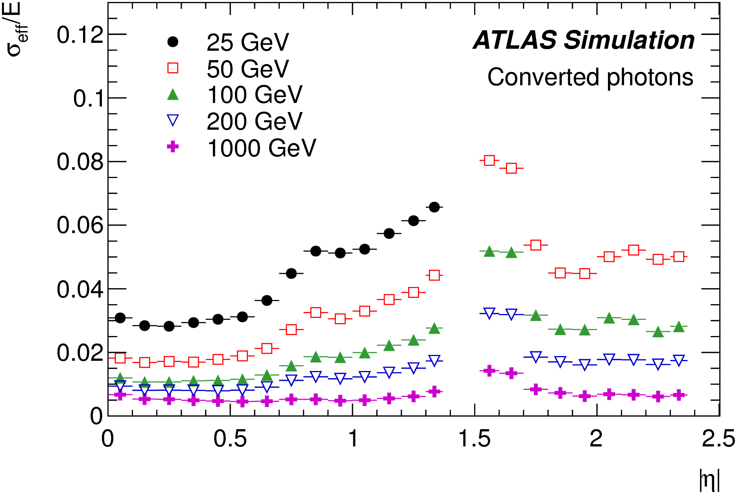
Energy/Momentum
Photons: from calibrated and corrected (super)clusters;
apply MVA techniques
Electrons:
ATLAS: energy of cluster, direction from track
CMS: combines cluster and tracker measurements
using MVA regression:
e
Tracker
contribution
at low E

Slide 22
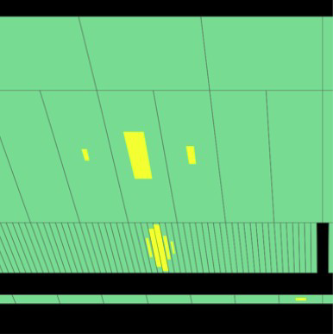
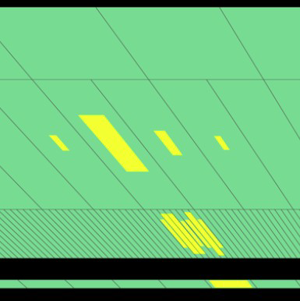
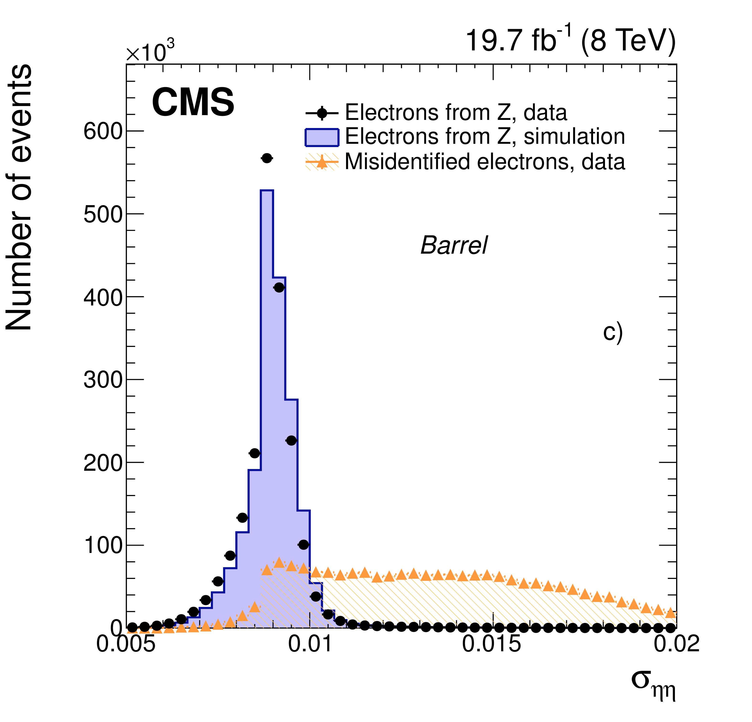
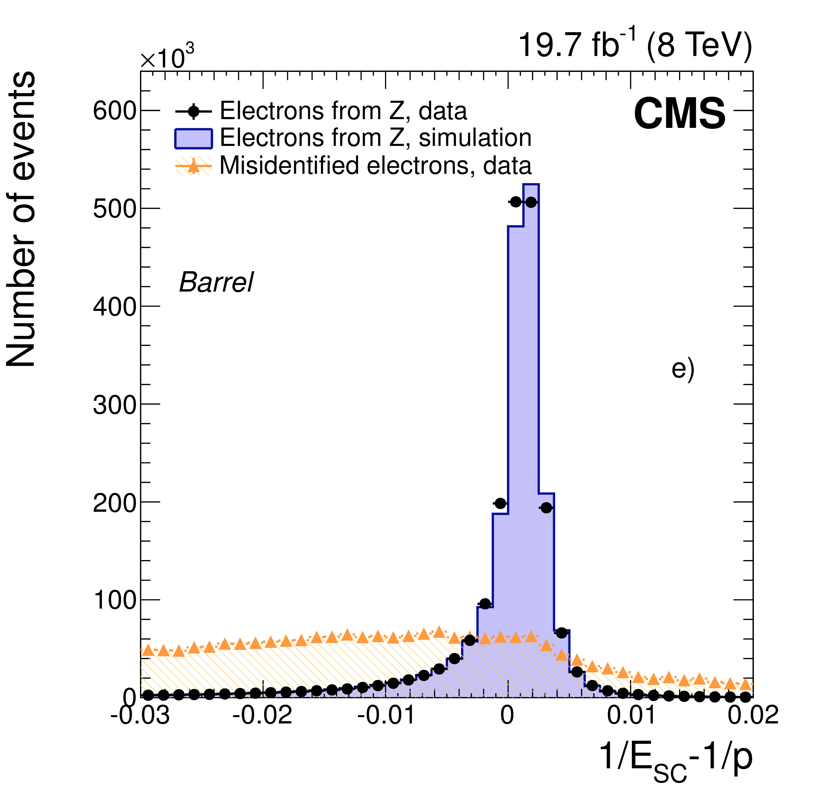
Identification
Apply criteria to efficiently suppress backgrounds from other processes/objects
Main backgrounds (to isolated electrons/photons):
e: jets, (real!) electrons from γ conversions,
decays of hadrons
γ: hadron decays into photons, mainly
π⁰ → γγ, with hard fragmentation
General Method:
exploit variables discriminating between e/γ
and background (sequential cuts or MVA):
- shower shape variables in the calorimeter,
hadronic leakage, …..
- variables for matching tracks and clusters
- track properties
(ATLAS: Transition radiation → Backup)
γ
π⁰ → γγ
~ lateral shower width
energy of supercluster
and momentum of track

Slide 23
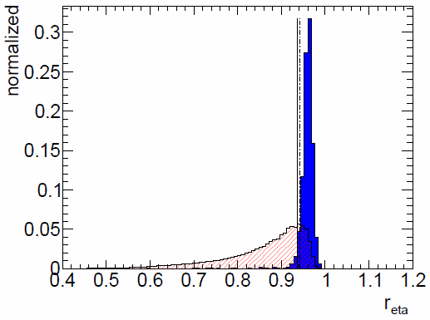
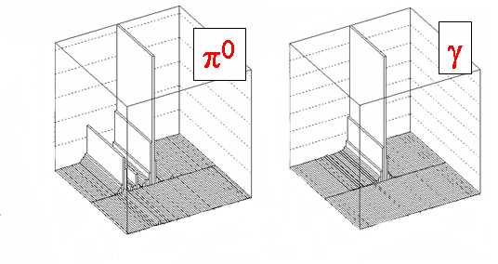
e/jet and γ/jet separation
Leakage into 1st layer of hadronic calorimeter
Analyse shape of the cluster in the different layers of the EM calo
  “narrow“ e/γ shape vs “broad“ one from mainly jets
Look for sub-structures within one cluster
  Preshower in CMS, 1st EM layer with very fine granularity in ATLAS
  Very useful for π⁰→γγ / γ separation, 2 photons from π⁰ tend to end up in the same cluster at LHC energies
Transverse shower shape in 2nd EM layer (ATLAS)
Electron or photon
cut
jet
ATLAS

Slide 24
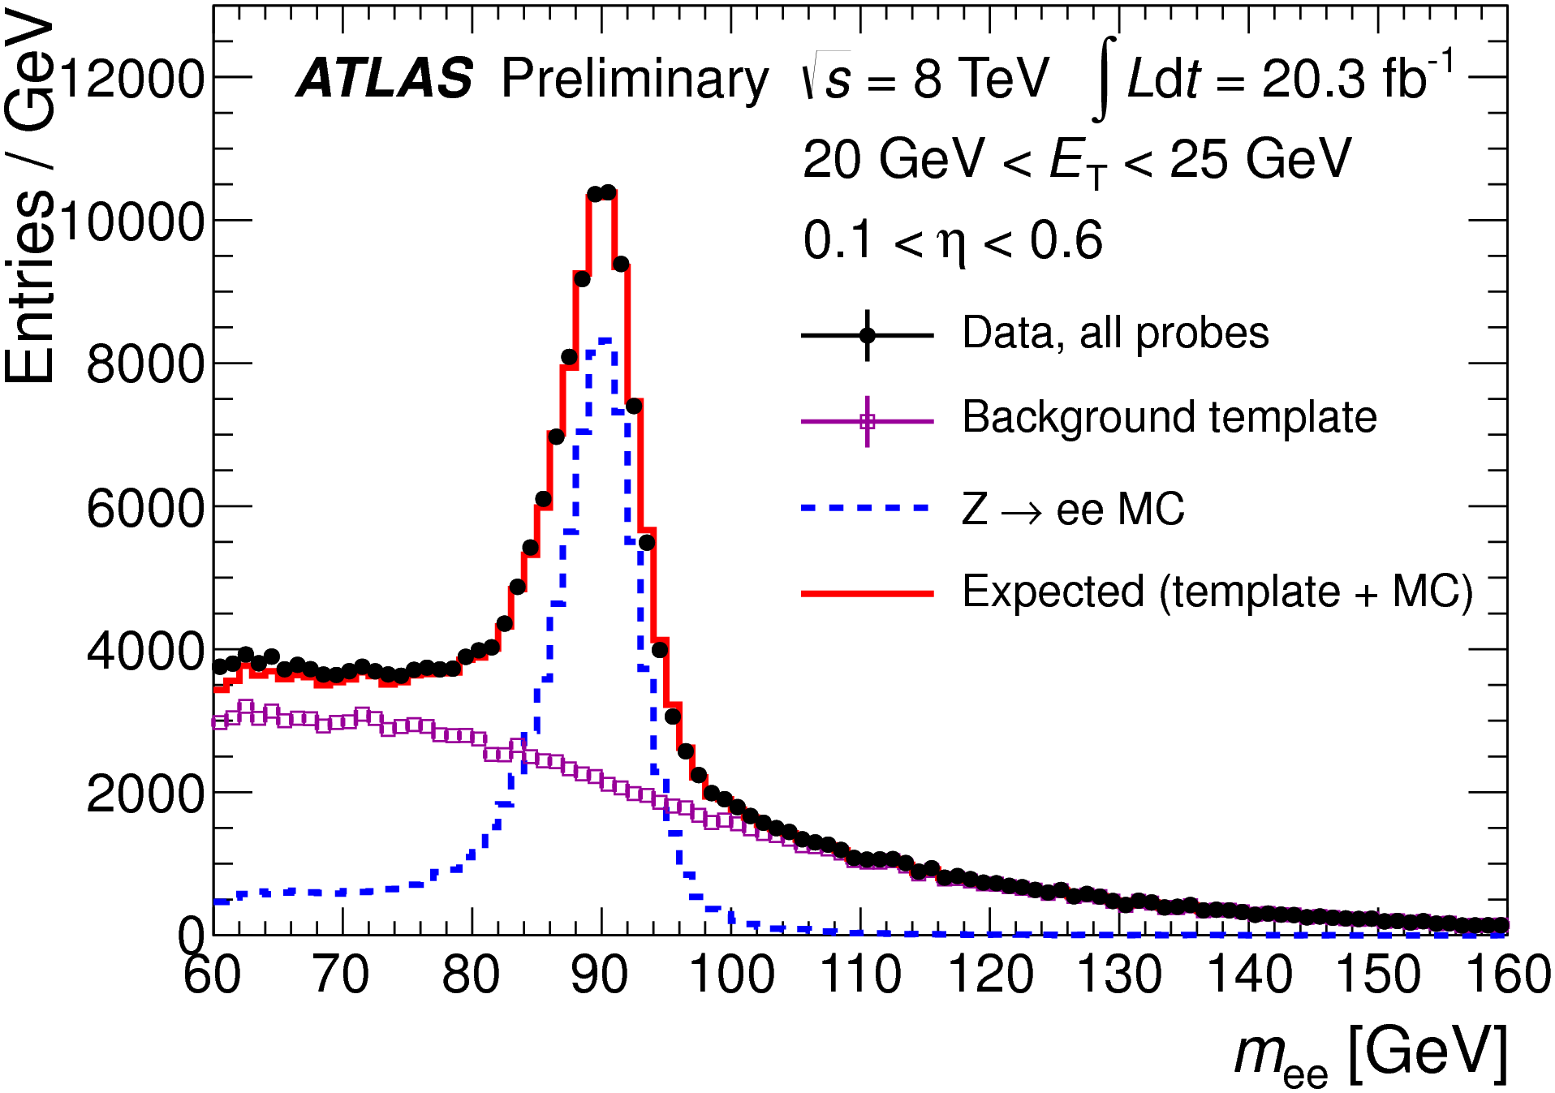
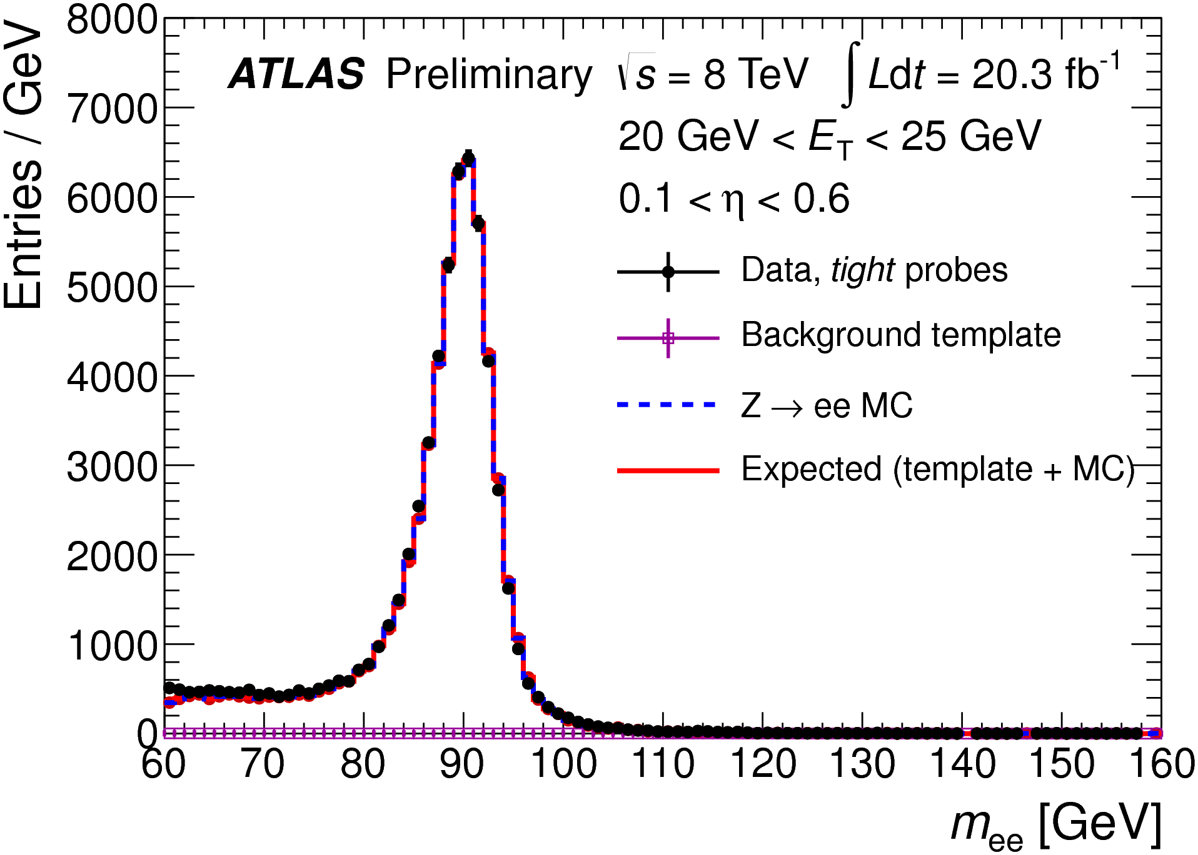
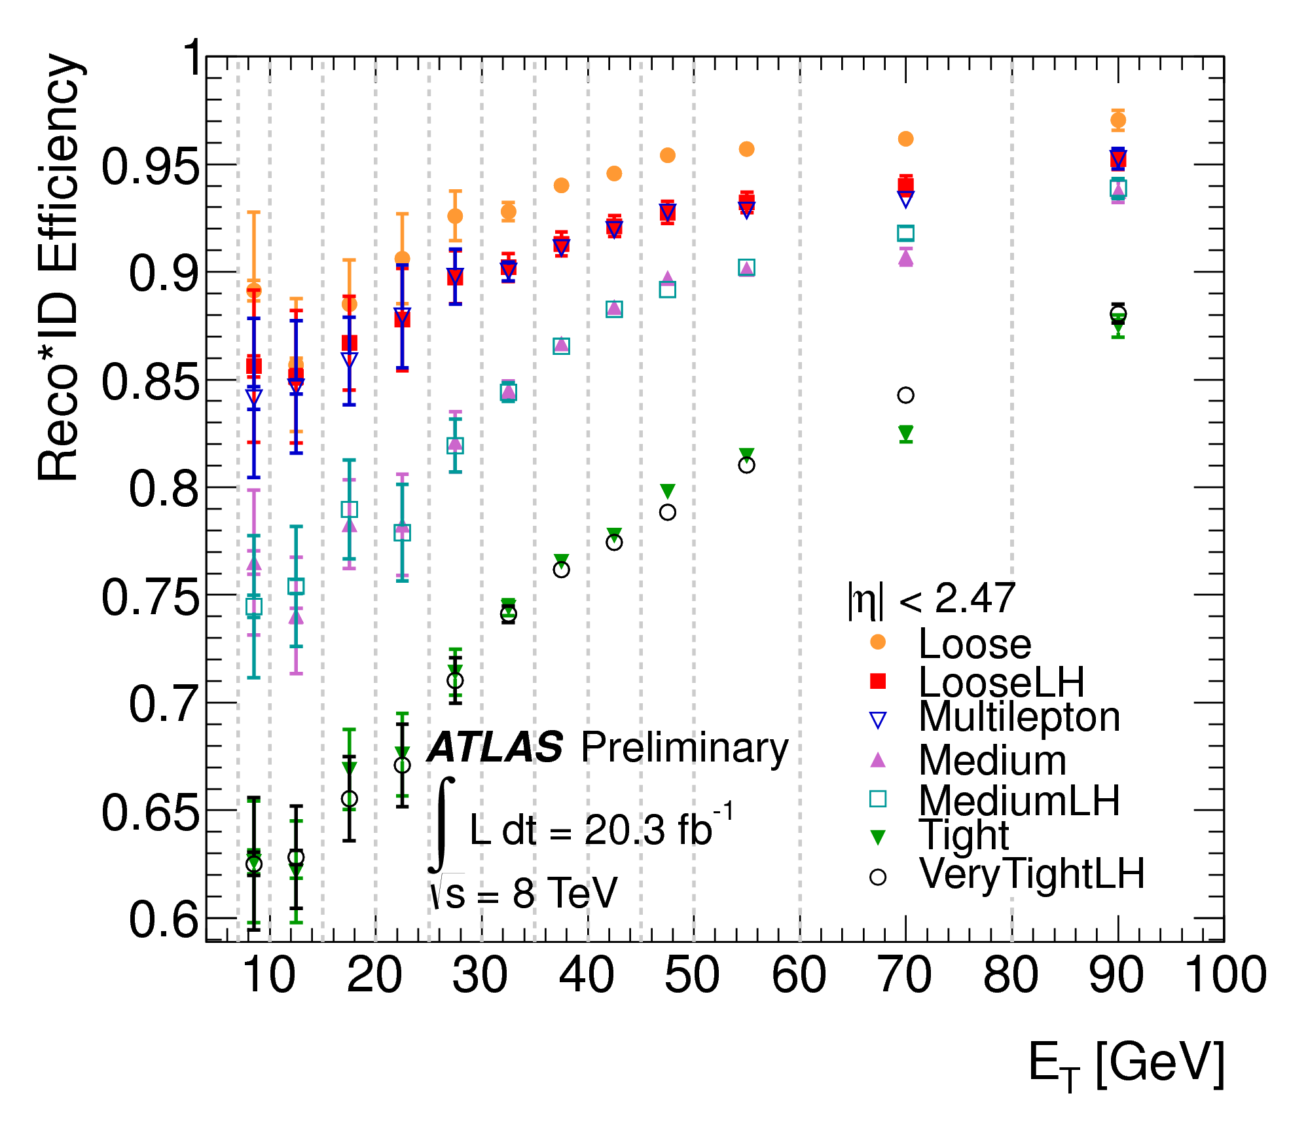
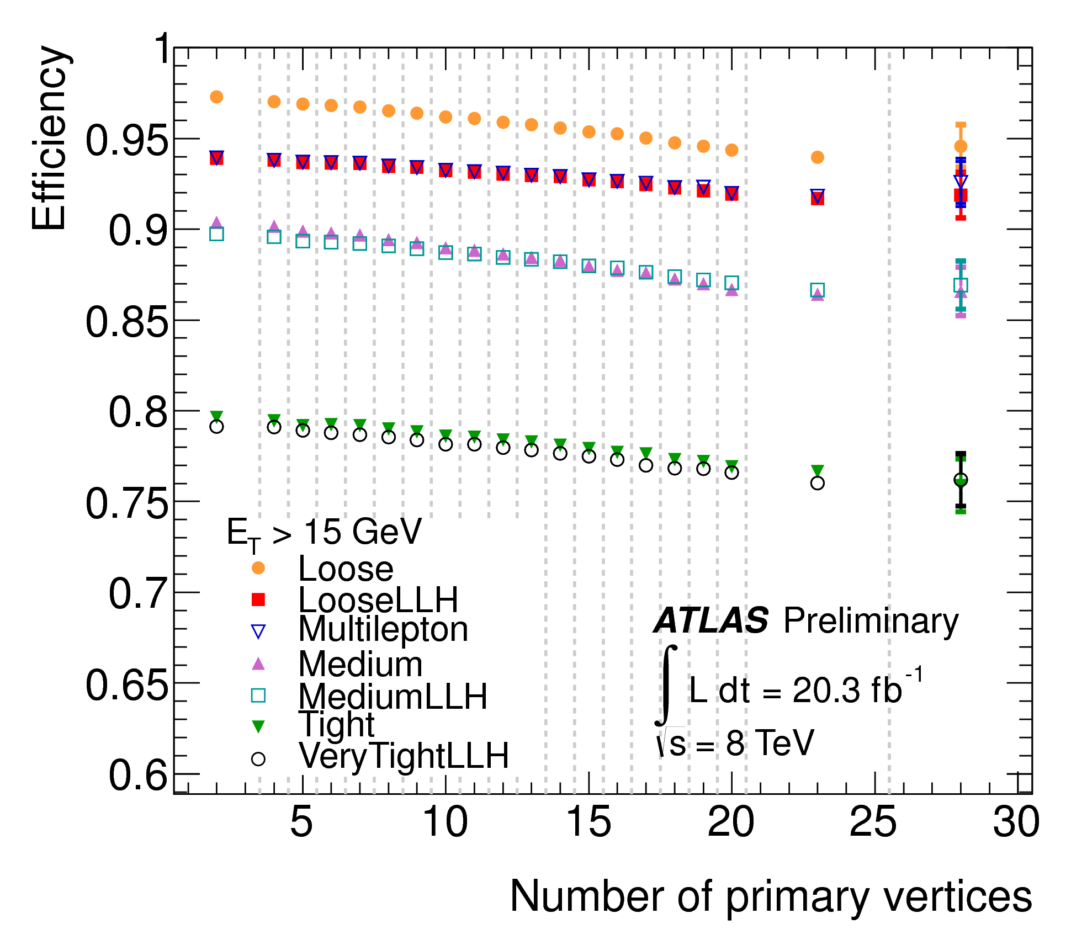
Measurements in Data
Mainly based on Tag-and-Probe Method in Z → ee (and J/Ψ → ee)
(for photons also e.g. radiative decays Z → llγ). Decompose into e.g.
Combined
reconstruction
and identification
efficiency
(wrt. reconstructed
em clusters):
Identification
efficiency
vs. pileup:

Slide 25
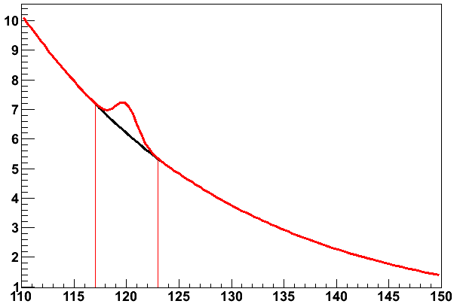
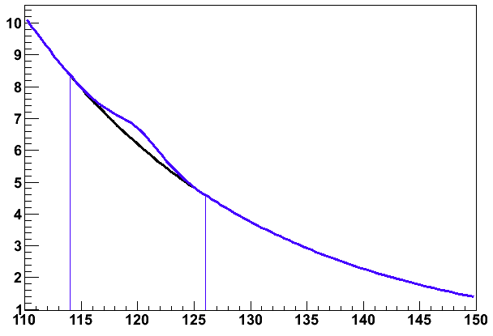
Importance of energy resolution
H→γγ Toy example: Signal peak on exponential background.
2 different signal resolutions. Same number of signal events in each peak
Would discover the left hand signal much quicker!
Mass resolution 1 GeV
Signal over background in cut range ~10%
Mass resolution 2 GeV
Signal over background in cut range ~5%
Mγγ [GeV]
Mγγ [GeV]
Very important to build the detector to give you the best resolution.
But also to optimize the reconstruction algorithms and calibrations to give the best resolution possible for that detector.

Slide 26
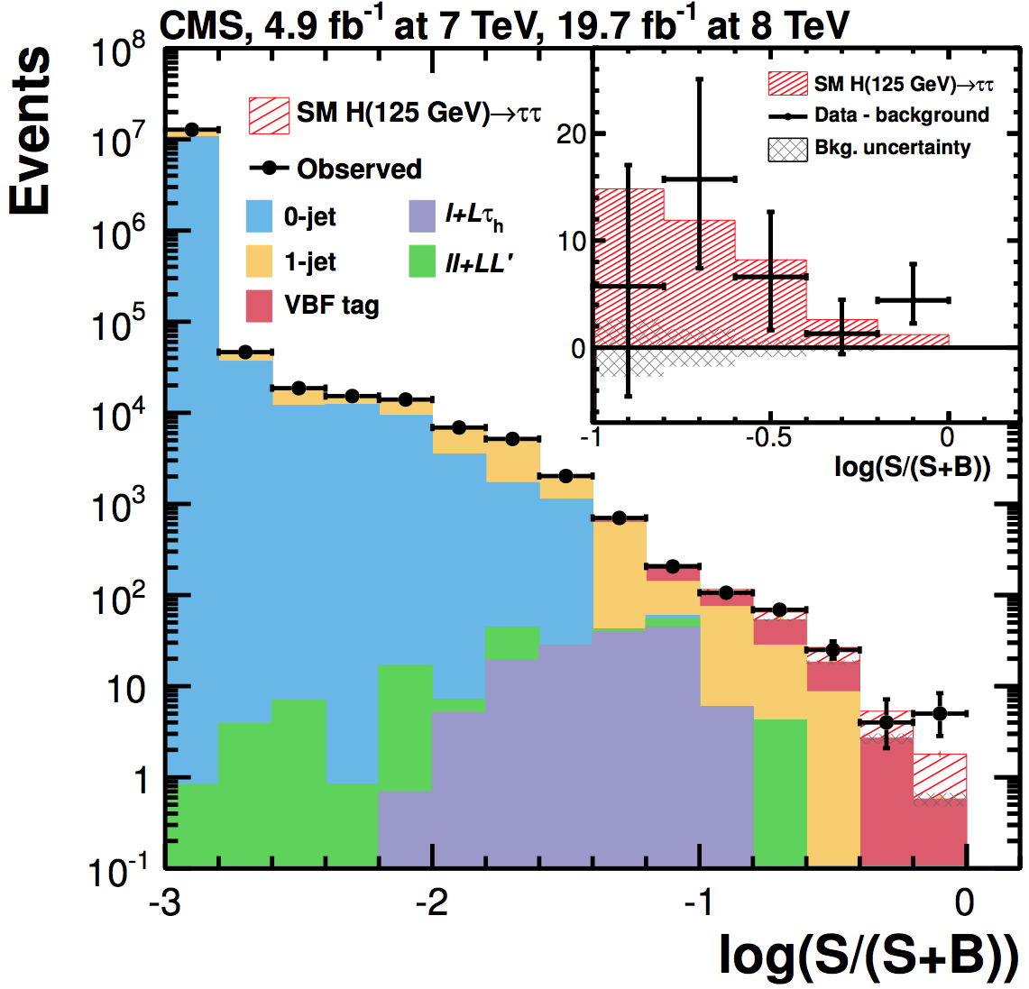
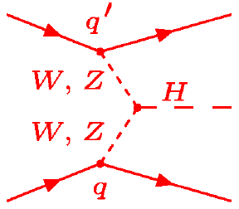
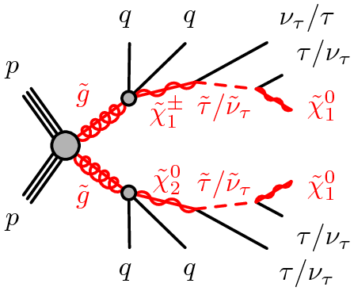
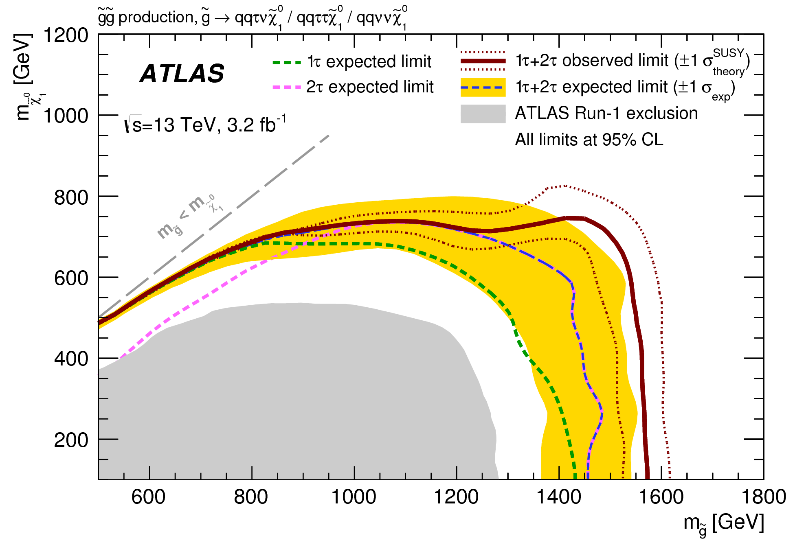
Tau Reconstruction
Motivation:
The τ lepton is the heaviest lepton
→ well suited to probe Yukawa couplings
to fermions (leptons)
It’s a 3rd generation lepton → of specific interest in some models of physics beyond the
Standard Model
τ
τ

Slide 27


Properties of τ Leptons
The heaviest lepton: m_{τ} = 1.78 GeV; unstable: cτ ~ 87 μm
Decays into leptons:
or hadrons with either one or three
charged particles (mainly π±) in the
final state: one-prong / three-prong decays
} ~ 35%
} ~ 50%
} ~ 15%
Final states for pairwise production:
τ_{had}τ_{had} ~ 42%
τ_{lep}τ_{lep} ~ 12%
τ_{lep}τ_{had} ~ 46%
d
_
u
For decays into leptons, the corresponding reconstruction and identification algorithms are used
(and triggers! → no time to discuss this here).
In the following, the reconstruction and identification of hadronically decaying
τ leptons is discussed.

Slide 28

H → ττ Candidate

Slide 29



τ Reconstruction
Hadronically decaying τ leptons look like very narrow jets (large fraction of the energy
contained within a small cone) with either 1 or 3 charged particles.
Signal cone ΔR ~ 0.2
Isolation cone 0.2 < ΔR < 0.4
  τ reconstruction seeded by reconstructed jets
+ attempt to reconstruct π⁰ to exploit knowledge of decay topology
+ associate tracks to τ candidates (multiplicity, lifetime information)
Identification
variables to
discriminate
against jets:
Fraction of energy within ΔR < 0.1
w.r.t. energy within ΔR < 0.2
Number of tracks in
isolation cone

Slide 30






τ Reconstruction
MultiVariate Analysis for optimal combination
of variables:
Calibration in data using Z → ττ Tag-and-Probe ……
…. and e.g. W+jet
events for BG studies.

Slide 31



Identification of b-Quark Jets: B-Tagging
Top quarks:
V_{tb} ≈ 1 → BR(t→bW) ≈ 1
(also to veto top where it’s
a background)
LHC HIGGS XS WG 2013
t
t
Higgs:
SM: for m_{H} ≈ 125 GeV:
BR(H → bb) ≈ 57.5%
t
t
SUSY:
many topologies with b-quark
final states (e.g. 3rd generation
sbottom/stop quarks may be
light)
Because of their properties, the underlying quark flavour of
jets can be best identified for b jets!

Slide 32

B-Tagging
b-quark
→ Fragmentation
→ Jet
Jet
PV

Slide 33


B-Tagging
B-mesons
b-baryons
b-quark
→ Fragmentation
→ Jet
→ b-hadron:
weak decay
Jet
b-Hadron
m(B) ≈ 5 GeV; τ ≈ 1.5 ps
e.g. E(B)= 50 GeV
→ <l> = <βγcτ> ≈ 5 mm
Secondary decay vertex with
high mass of associated tracks,
multiplicity and energy fraction
PV
Weak decay:
W⁺
-
-
b
c
d
d

Slide 34
B-Tagging
m(B) ≈ 5 GeV; τ ≈ 1.5 ps
e.g. E(B)= 50 GeV
→ <l> = <βγcτ> ≈ 5 mm
Secondary decay vertex with
high mass of associated tracks,
multiplicity and energy fraction
Tracks with large
Impact-Parameter IP
Jet
IP
b-Hadron
PV
Weak decay:
W⁺
-
-
b
c
d
d

Slide 35
B-Tagging
m(B) ≈ 5 GeV; τ ≈ 1.5 ps
e.g. E(B)= 50 GeV
→ <l> = <βγcτ> ≈ 5 mm
Secondary decay vertex with
high mass of associated tracks,
multiplicity and energy fraction
Tracks with large
Impact-Parameter IP
Tertiary c-hadron
decay vertex
Jet
b-Hadron
c-Hadron
PV
Weak decay:
W⁺
W⁻
-
b
-
-
c
s
d
d
d

Slide 36
B-Tagging
m(B) ≈ 5 GeV; τ ≈ 1.5 ps
e.g. E(B)= 50 GeV
→ <l> = <βγcτ> ≈ 5 mm
Secondary decay vertex with
high mass of associated tracks,
multiplicity and energy fraction
Tracks with large
Impact-Parameter IP
Tertiary c-hadron
decay vertex
Muons or electrons from
semileptonic decay
Jet
b-Hadron
μ,e
PV
BR(b→l+X) ≈ 11%
BR(b→c→l) ≈ 10%
-
W⁺
W⁻
b
-
-
c
s
d
d
d

Slide 37

A B-Tagged Jet

Slide 38
Non-b Jets
Tracks from
fragmentation
Hadronic interactions
Primary
Interaction
Vertex
K_{s},Λ decays
Light-quark (gluon) jets:
γ → e⁺e⁻
Pixel Layers
Most tracks directly from fragmentation process and thus originating from primary vertex
But can have real displaced vertex due to:
  Hadronic interactions and photon conversions in the detector material
  Long lived particles: K_{s} / Λ (cτ ∼ Ο(cm))
Badly measured tracks (resolution, multiple scattering, nuclear interactions,...) and tracks with shared hits in the pixel layers can also lead to mistags
Charm-quark jets: c-hadrons also have high mass and lifetime, e.g. the most abundantly
produced D⁺ and D⁰ mesons:
D⁺: m ~ 1.9 GeV, τ ≈ 1.06 ps
D⁰: m ~ 1.9 GeV, τ ≈ 0.42 ps
→ similar topology, much more difficult to distinguish from b-quark jets

Slide 39





Algorithms Input: Impact Parameters
- Distance to primary vertex at
point of closest approach
- IP significance:
- For b-tagging a lifetime sign is used:
decay in jet direction (+) or
opposite (-) wrt. PV
>0
IP<0
Combine information
of all tracks within a jet,
e.g. using a Likelihood
ratio method

Slide 40




Secondary Vertex Reconstruction
Classical secondary vertex reconstruction: Reconstruct inclusive geometrical vertex
Properties of secondary
vertices discriminating
between jet flavours :

Slide 41



JetFitter
Pioneered by SLD
for b physics,
ATLAS for b tagging
Drawbacks of “conventional” methods:
- Hypothesis of a single geometrical vertex not correct
- Some topologies (e.g. 1-1) difficult to access
b and c vertices approximately on
same line of flight
→ intersect b-hadron flight direction
with tracks
→ allows to exploit topological
information
Vertices w.
1 track
Vertices w.
≥ 2 tracks

Slide 42



Performance
→ combine information from different algorithms using multivariate
methods (Neural Networks or Boosted Decision Trees)
b versus light jets
b versus c jets

Slide 43

Performance
Dependence on kinematics
b versus light jets
Multiple scattering, ....
- (Fragmentation) track multiplicity
→ combinatorics
- dense jet → pattern recognition, ….

Slide 44



Calibrating B-Tagging Algorithms
Many aspects to describe B-Tagging performance:
Physics : Modelling of b-hadron production and decays, …..
Instrumental: track resolutions, alignment, …..
→ Cannot rely on simulations
→ need to calibrate the algorithms using real data
Strategy: Measure the b-tag efficiency and mistag rate in data and derive data-to-MC scale factors to correct the performance in MC to data.
Top pair events: expect 2 b jets per event → use for calibration

Slide 45
Summary
Electrons, photons and muons as (quasi-)stable particles can be reconstructed
with high efficiency and excellent energy/momentum resolution
→ the key to identifying vector bosons
→ crucial role in the discovery of the Higgs boson!
The τ lepton has a special role as unstable 3rd generation lepton
→ dedicated reconstruction algorithms to reconstruct τ jets!
Identifying the flavour of jets is particularly challenging, b-quark jets are best suited
→ B-Tagging
Dedicated methods have been developed to measure the performance of the
reconstruction and identification algorithms using data (e.g. Tag-and-Probe, …)

Slide 46
BACKUP Introduction

Slide 47
Final State Particles
Most hadrons are unstable:
Decays into hadrons, leptons or photons:
E.g.: Δ⁺⁺ -> pπ⁺ : p stable
π⁺ → μ+ ν_{μ} : τ_{π} = 2.6 * 10⁻⁸ s → cτ_{π} = 7.8 m
→ most π⁺⁻ traverse detector
also: K⁺⁻, n, K⁰_{L}
(+ weakly decaying hadrons which typically decay inside the detector)
In high p_{T} physics often relevant: Jets created from hadrons
Leptons:
- e: stable
- μ: τ_{μ} = 2.2 * 10⁻⁶ s → quasi-stable
- τ: Decay to hadrons or leptons
- ν_{μ,e,τ}: only weakly interacting → leave detector without detectable interaction
→ Via missing (transverse) energy/momentum
Gauge bosons:
- W/Z: Decay to hadrons or leptons;
- Photon (γ): stable

Slide 48
BACKUP Muons

Slide 49
Reconstructing Particles
Muon: μ
- charged particle in
the tracker
- charged particle in the
muon spectrometer
- very little energy in
calorimeters

Slide 50


Muon Identification
Backgrounds:
K±/π± → μν decays,
punch-through, …
→ apply criteria to reconstructed muon
candidates to suppress those.
E.g. to suppress K±/π± → μν :
→ kink topology: momentum imbalance of ID and MS tracks
Define identification selections with different efficiencies/purities
(loose/medium/tight/high p_{T} in ATLAS; soft/tight/particle flow in CMS), analyses choose
according to their needs (e.g. H → 4l needs high efficiency).
Typical numbers for reconstruction and identification efficiencies:

Slide 51




Measuring Efficiencies in Data
Medium
Tight
Tight
Soft

Slide 52
Momentum Determination

Slide 53


Misidentification
Use hadron decays like K⁰_{s} → ππ, Λ → pπ, Φ → KK to measure probability to
misidentify hadrons as muons
Soft π → μ
Soft p → μ
(decays in flight)
(punch-through, random match)

Slide 54


Isolation
In high p_{T} physics are mainly interested in isolated prompt muons, NOT within a jet
→ Define isolation variables, typically the energy of tracks or calorimeter clusters
around the muon

Slide 55
BACKUP Electron/Photon

Slide 56



Cluster Reconstruction
Ratio of energies
within 3x3 cluster
and supercluster
energy for
(un)converted photons
Seed clusters based on calorimeter towers
with Δη x Δφ = 0.025 x 0.025 from
sliding-window algorithm (3 x 5 towers)
Based on track and (conversion) vertex
reconstruction, clusters are classified
- unconverted photon
- converted photon
- electron
and their size is adjusted
Cluster energy corrected for energy loss,
leakage etc. (MVA, ….)
Energy wrt.
true energy
for 5x5 crystals
and supercluster
Supercluster energies corrected for leakage,
Shower shape etc. → MVA regression
Clusters also used for track seeding!

Slide 57


Electron Tracking: Gaussian Sum Filter
Potentially large, non-gaussian energy
loss through Bremsstrahlung
→ significant change of curvature:
loss of hits etc.
→ lower efficiency, degraded track parameters
non-e
e
Bremsstrahlung loss
Gaussian Sum Filter (GSF):
- approximate Bethe-Heitler energy loss by
mixture of Gaussians
- Run several Kalman Filter in parallel

Slide 58




Energy/Momentum
Photons: from calibrated and corrected (super)clusters; apply MVA techniques
Electrons:
ATLAS: energy from calibrated and corrected calorimeter clusters; direction from track
CMS: combines cluster and tracker measurements in a weighted average using
MVA regression → tracker contribution mainly at low/medium energy

Slide 59

Energy/Momentum

Slide 60

Isolation
Mainly interested in e/γ not within jets → apply isolation criteria based on nearby
- energy deposits in the calorimeter
- tracks
within a certain cone around the e/γ candidate (typically ΔR ~ 0.3 – 0.4)

Slide 61
BACKUP Tau

Slide 62



Performance
Also: dedicated variables to discriminate
against electrons (and muons):
μ misidentification
rate
e misidentification rate

Slide 63
BACKUP B-Tagging

Slide 64


Performance
b versus light jets

Slide 65





Calibrating B-Tagging Algorithms
More difficult for non-b jets:
- c-jets: use jets with an (exclusively) reconstructed D* meson
or jets with a muon from a semileptonic c-hadron decay
→ Need to extrapolate to an inclusive samples b-tagging is
typically applied to
→ additional uncertainties
- Light quark jets: Lifetime-sign inverted tagging algorithms

Slide 66



Run II
ATLAS: From Run 1 → Run 2
- New Insertable B Layer (IBL): additional pixel layer close to beam pipe
- Algorithms Improvements
Significant improvement of b-tagging performance!

