Slide 1

Particle Identification at the LHC
III
Rachid Mazini
Academia Sinica, Taiwan
First International High Energy Physics
School and Workshop in Wsetern China
Lanzhou, China
1-10 August 2018

Slide 2
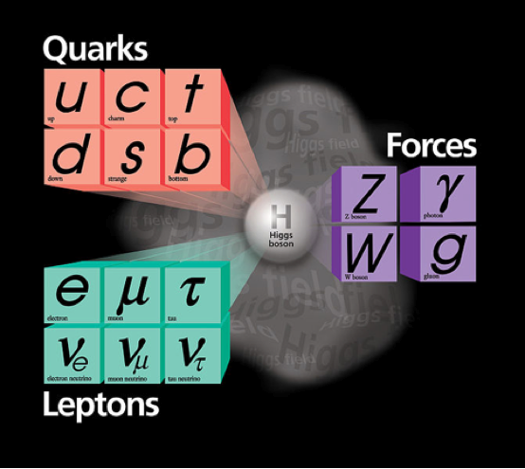
Today Lecture
Unstable: t → bW
Unstable: identify via
decay products
Hadronisation → Jets
b jets:
dedicated
identification
techniques
Stable!
Hadronisation → Jets
( (quasi-)stable
hadrons:
π±, K±, K⁰_{L}, p, n)
Stable!
(μ not really, but
as seen by a detector)
No interaction
with detector
→ Missing (transverse)
energy/momentum
Unstable: identify via
decay products

Slide 3
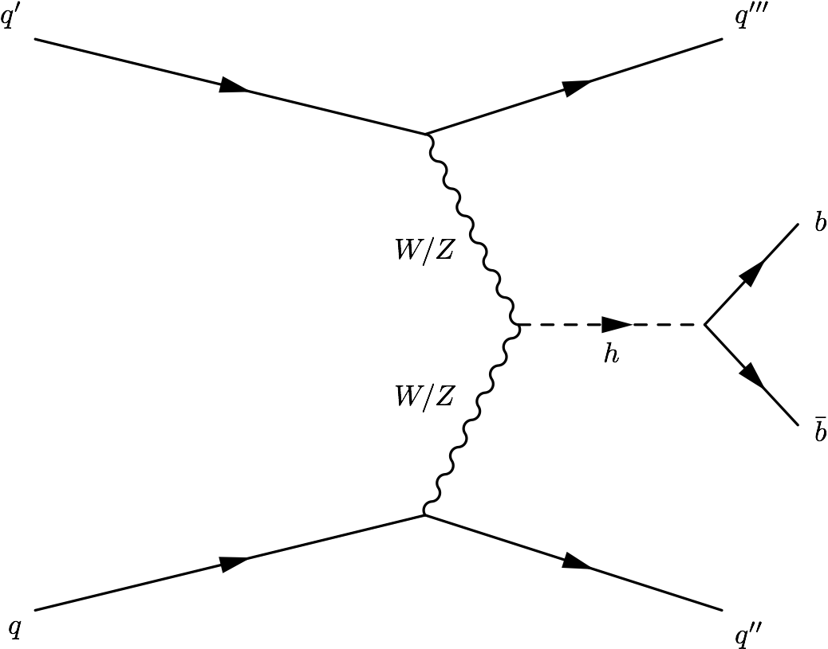
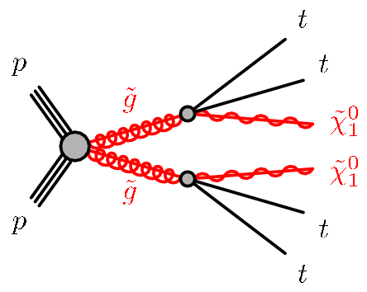
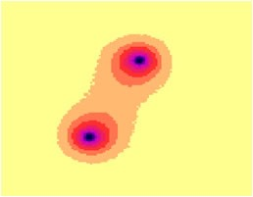
Jets at the LHC
Jets are one of the most prominent physics signatures at hadronic high energy colliders
Individual jets are proxies for quark and gluons
Combinations of jets are used to identify heavy electroweak particles (W,Z,H bosons and the top quark)
o crucial signatures for searches of new phenomena and precision measurements
Jets have internal structure: quantum properties

Slide 4
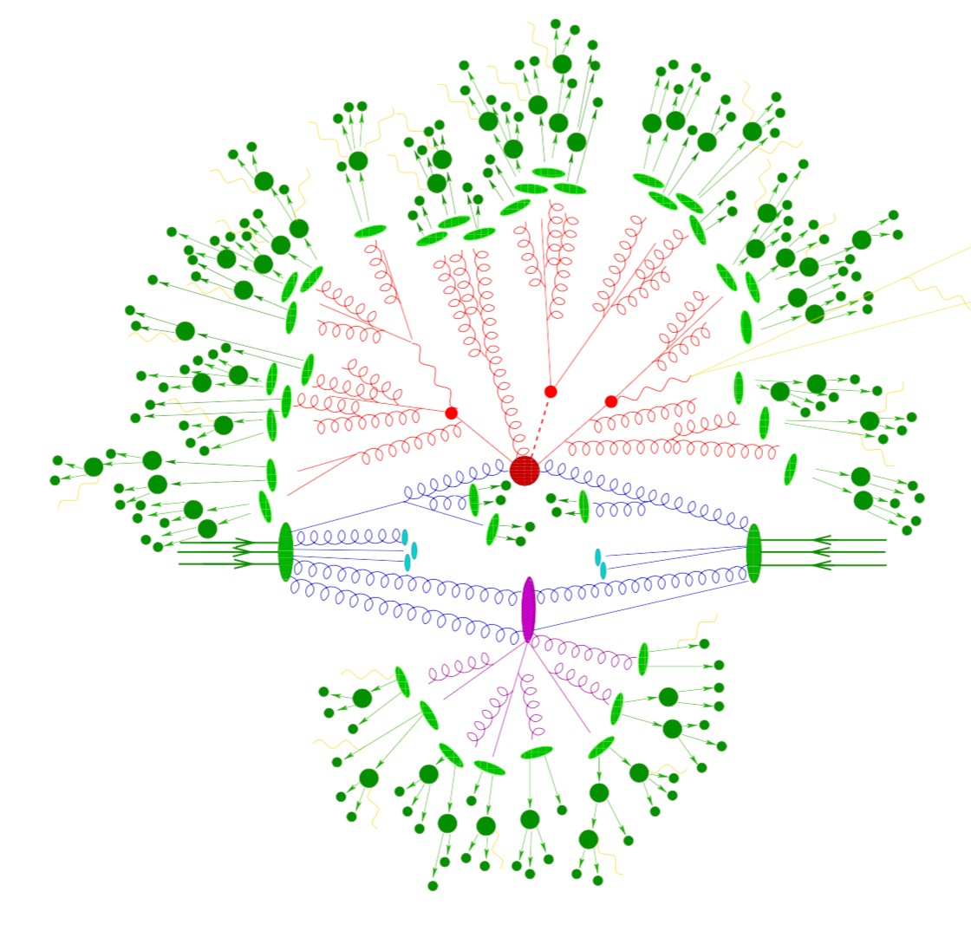
Jets and jet algorithms (I)
Quark and gluons (partons) produced at short distances (hard process)
As they propagate they radiate more partons (parton shower)
Form uncolored hadrons (hadronization)

Slide 5

Jets and jet algorithms (I)
Quark and gluons (partons) produced at short distances (hard process)
As they propagate they radiate more partons (parton shower)
Form uncolored hadrons (hadronization)

Slide 6

Jets and jet algorithms (I)
Quark and gluons (partons) produced at short distances (hard process)
As they propagate they radiate more partons (parton shower)
Form uncolored hadrons (hadronization)

Slide 7

Jets and jet algorithms (I)
Quark and gluons (partons) produced at short distances (hard process)
As they propagate they radiate more partons (parton shower)
Form uncolored hadrons (hadronization)

Slide 8
Jets and jet algorithms (I)
Quark and gluons (partons) produced at short distances (hard process)
As they propagate they radiate more partons (parton shower)
•
Form uncolored hadrons (hadronization)
Jets: tools to organize the event
7
•

Slide 9
Jets and jet algorithms (I)
Quark and gluons (partons) produced at short distances (hard process)
As they propagate they radiate more partons (parton shower)
•
Form uncolored hadrons (hadronization)
Jets: tools to organize the event
8
•

Slide 10
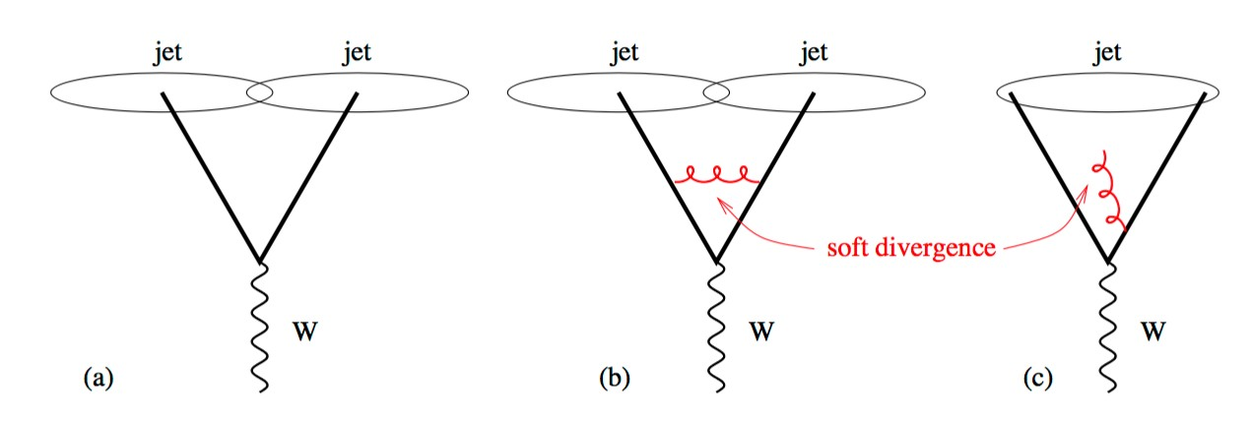
Jets and jet algorithms (II)
Jet algorithms: set of rules to group particles together and to assign a momentum to the resulting jet
Infrared and collinear safe
LHC uses sequential recombination jet algorithms
o K_{t}, C/A, anti-k_{t}
9

Slide 11
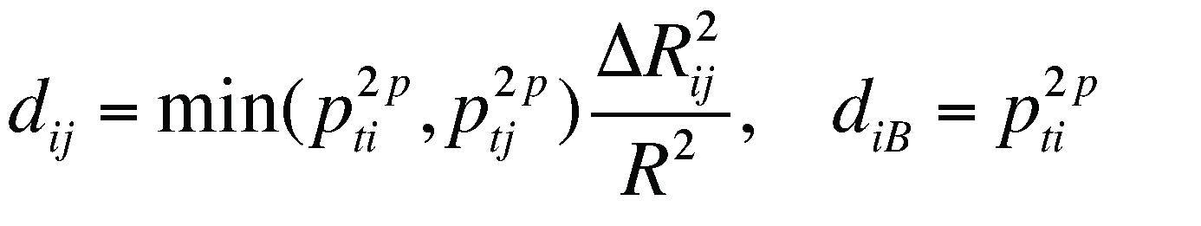
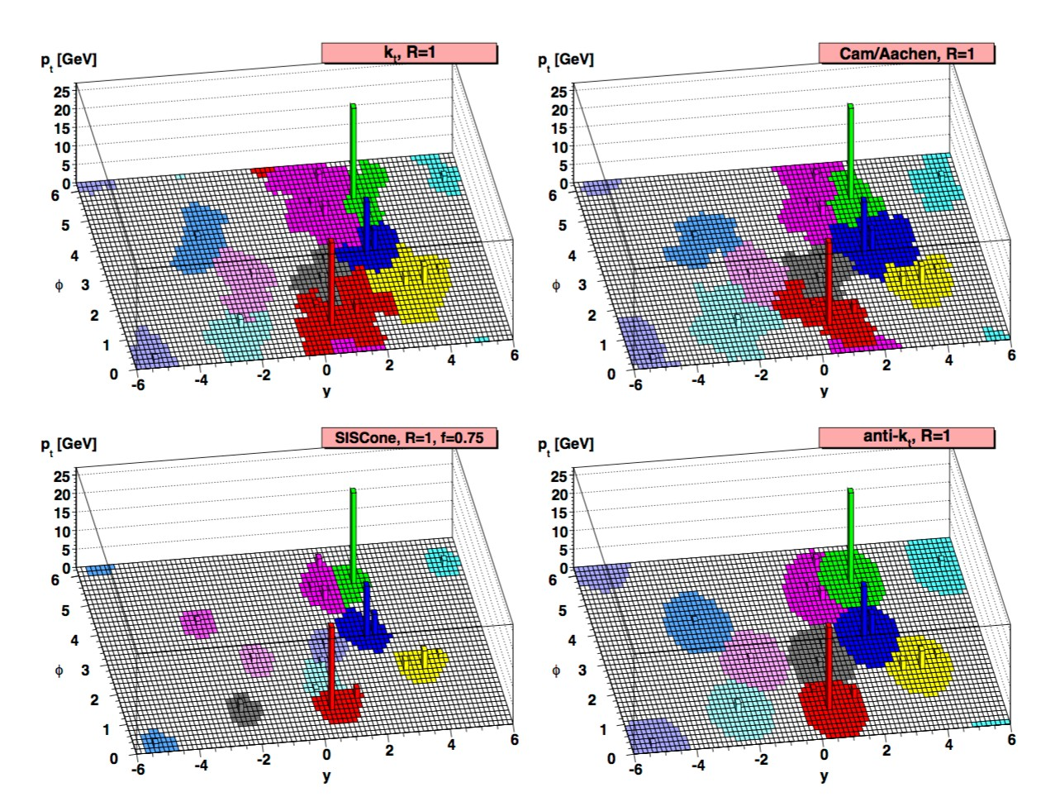
Jets and jet algorithms (III)
10

Slide 12
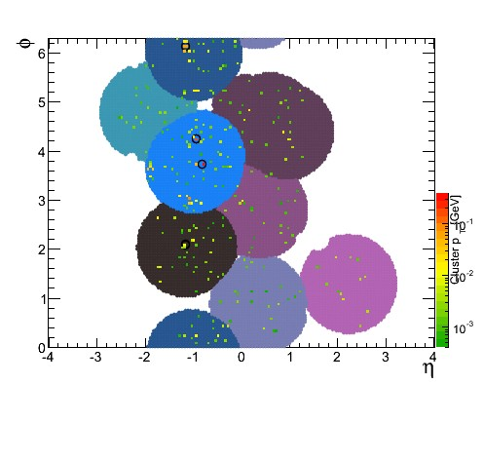
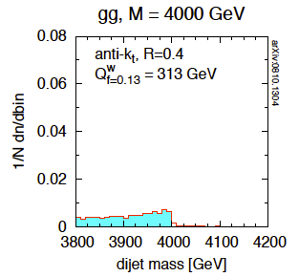
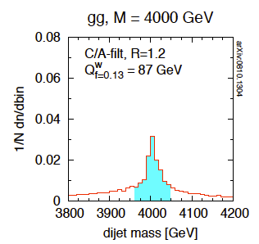
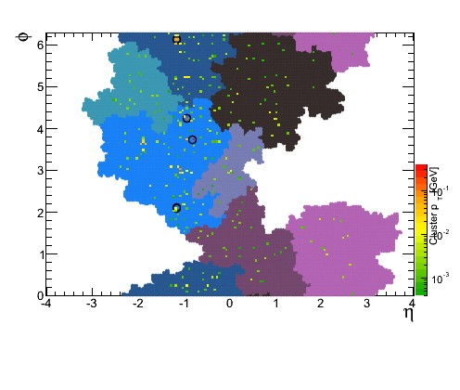
Jets and Missing ET
Jets are tools to organize and interpret events
Multiple interpretation of events
anti-k_{t}
C/A
G. Salam

Slide 13
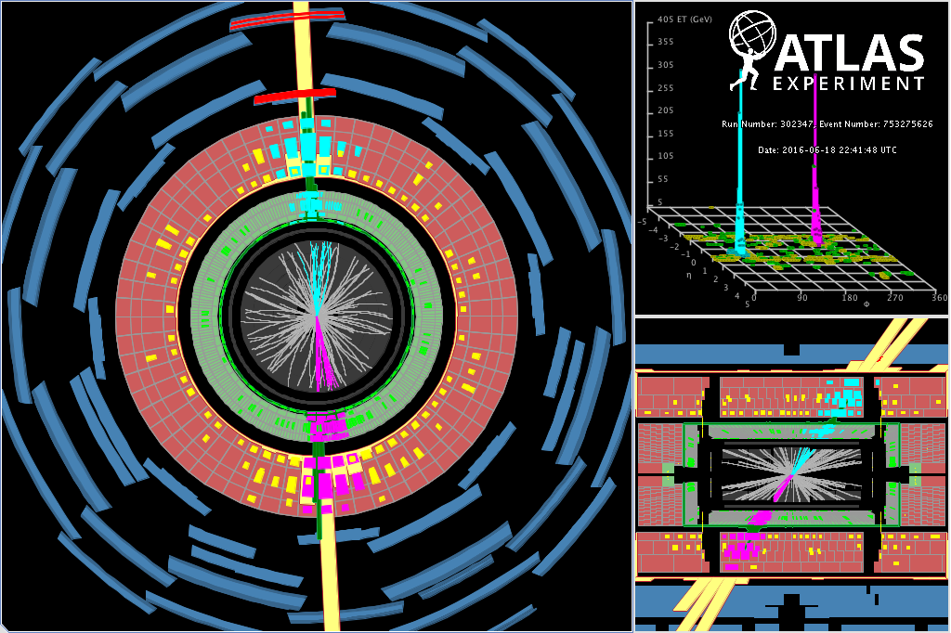
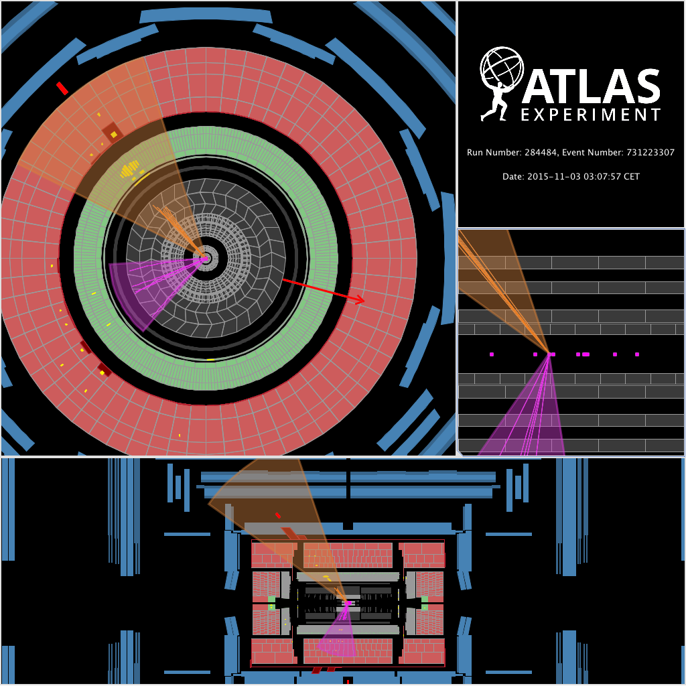
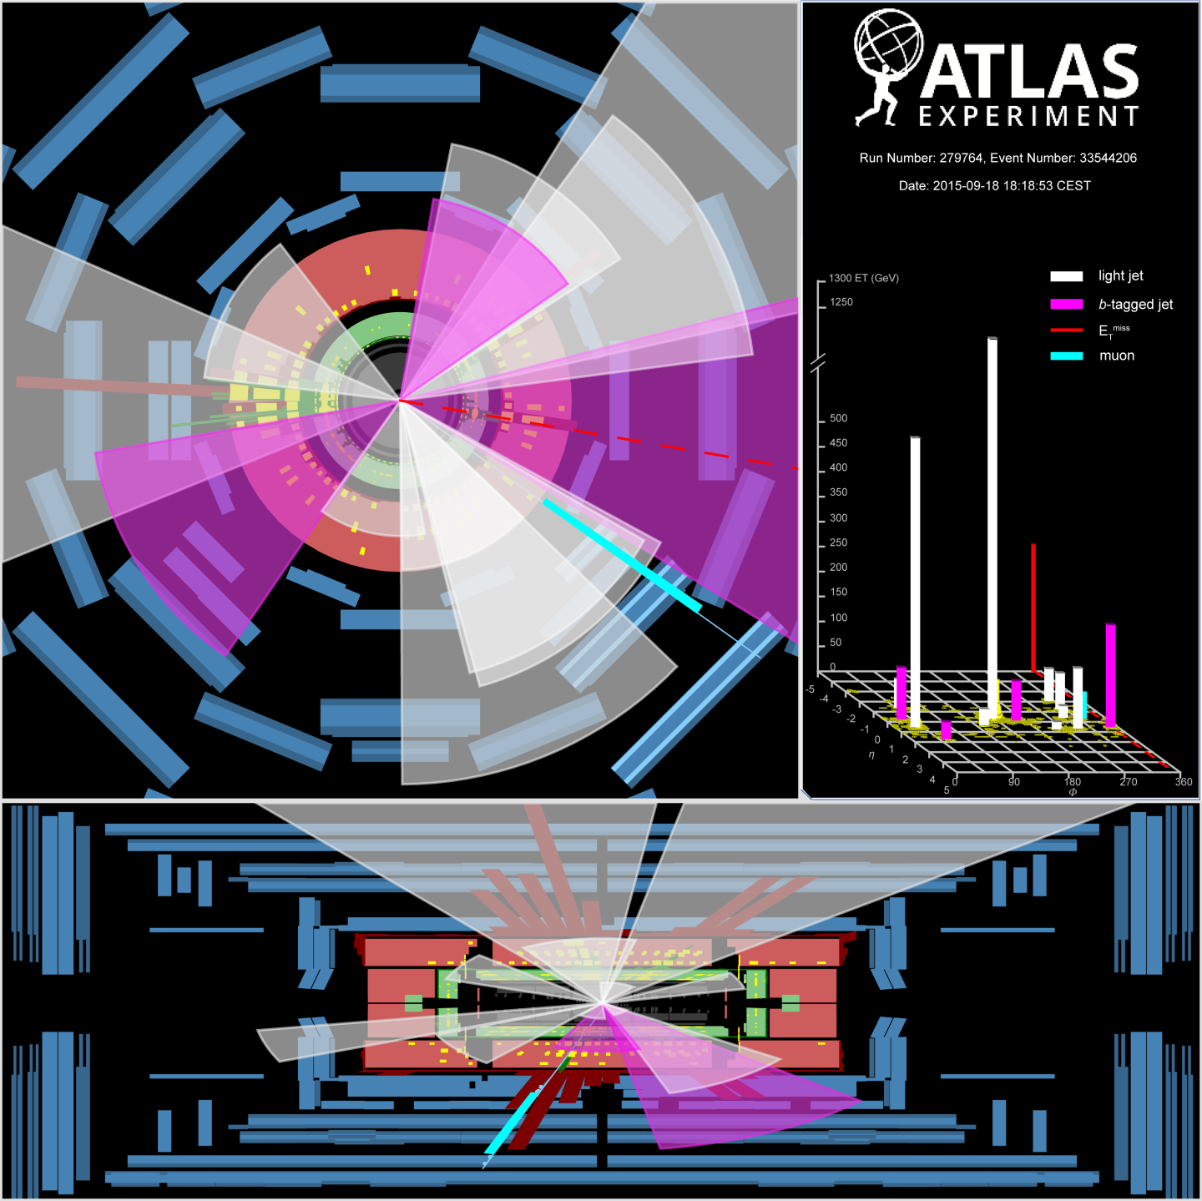
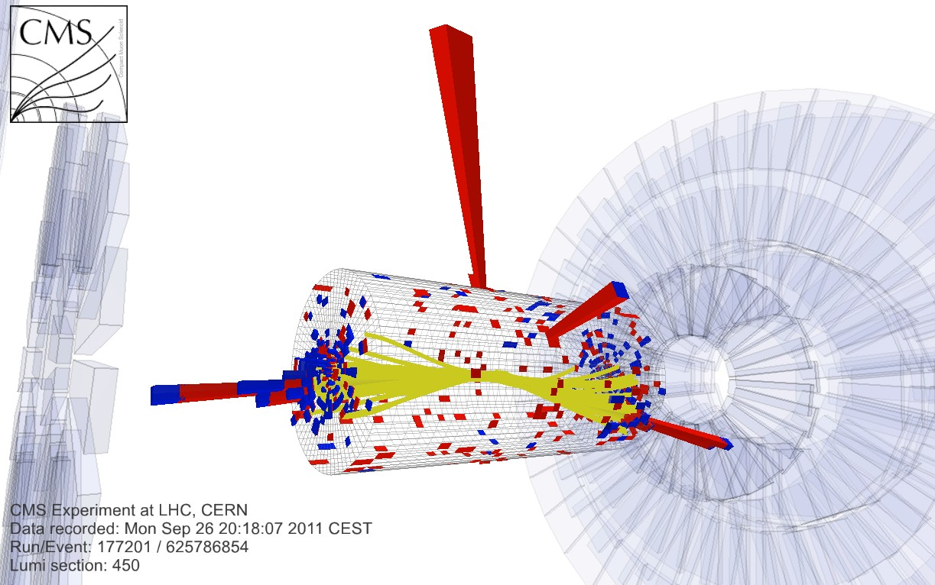
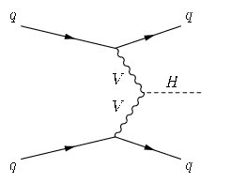
Hàbb + missing E_{T}
M_{JJ} = 7.5 TeV
4 top candidate
VBF Hàγγ

Slide 14
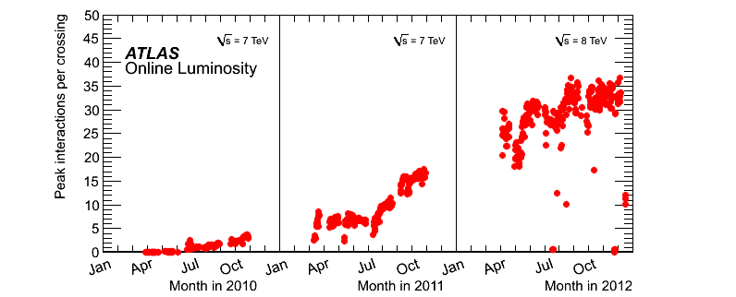
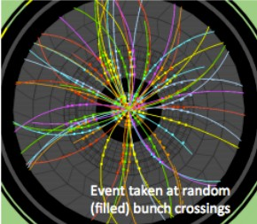
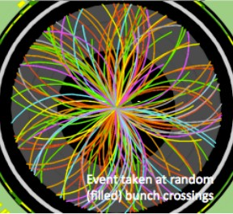
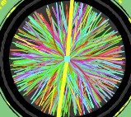
Pile-up in Run 1
<PU>=9.1 <PU>=20.7
HL-LHC
<PU>~200!
2010
2011
2012

Slide 15
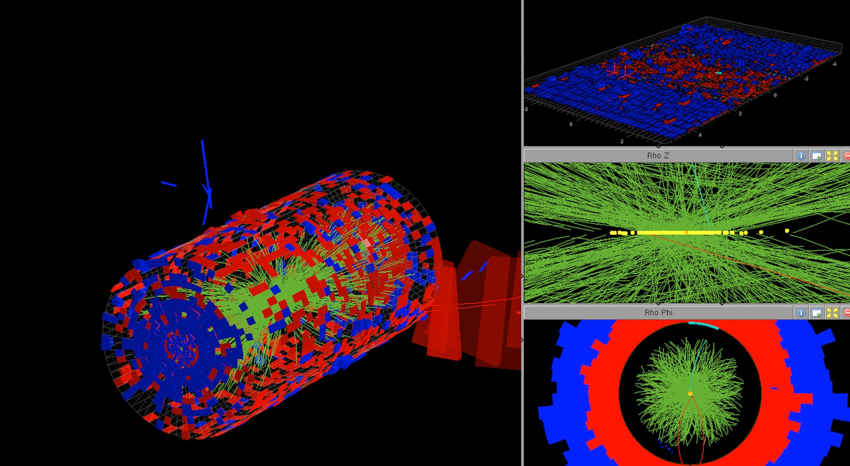
High pile-up (Run 2)
78 pile-up vertices!
CMS high pile-up run 198609

Slide 16
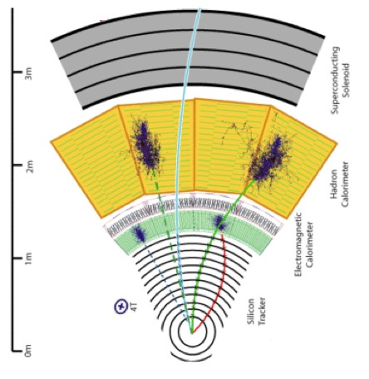
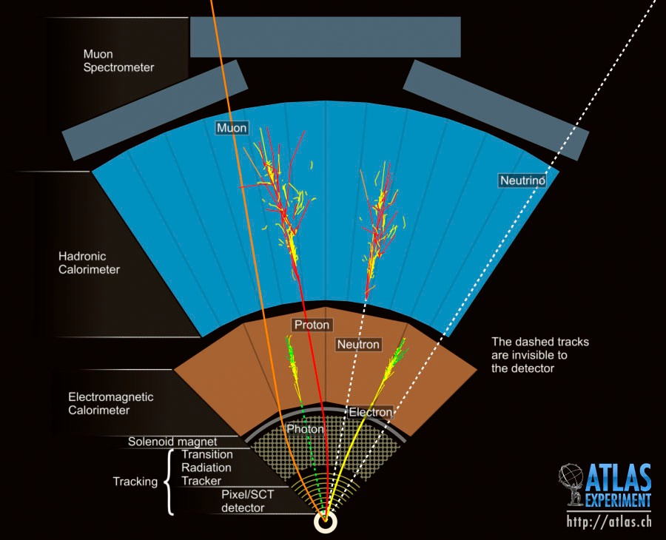

ATLAS and CMS Detectors
Solenoid outside calorimeter
3 longitudinal HAD layers
LAr cryostat
Highly segmented ECAL
3 longitudinal EM layers
B=2T
Solenoid before calorimeter
B=4T
B=2T

Slide 17
ATLAS and CMS Detectors
Excellent hadron energy resolution Longitudinal EM/HAD segmentation Fine transverse segmentation
High magnetic field
Very fine transverse EM granularity
Low p_{T} tracking
Good separation between photons and pion showers
Low p_{T} charged particles do not reach the calorimeter à need to integrate tracking with calorimeter information
Can use shower shape information and 3-dimensional clustering to identify and calibrate EM/HAD energy depositions à More handles for calorimeter-based jet reconstruction and calibration

Slide 18
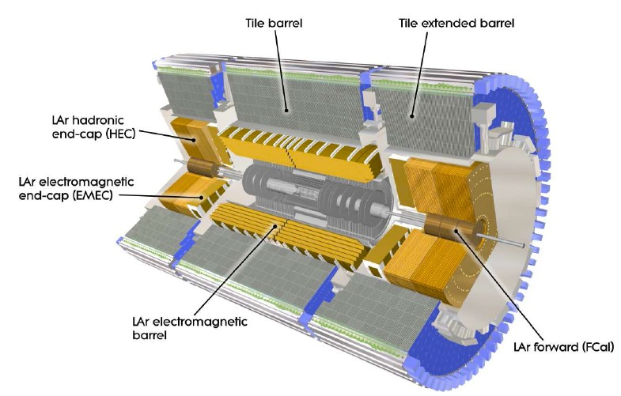



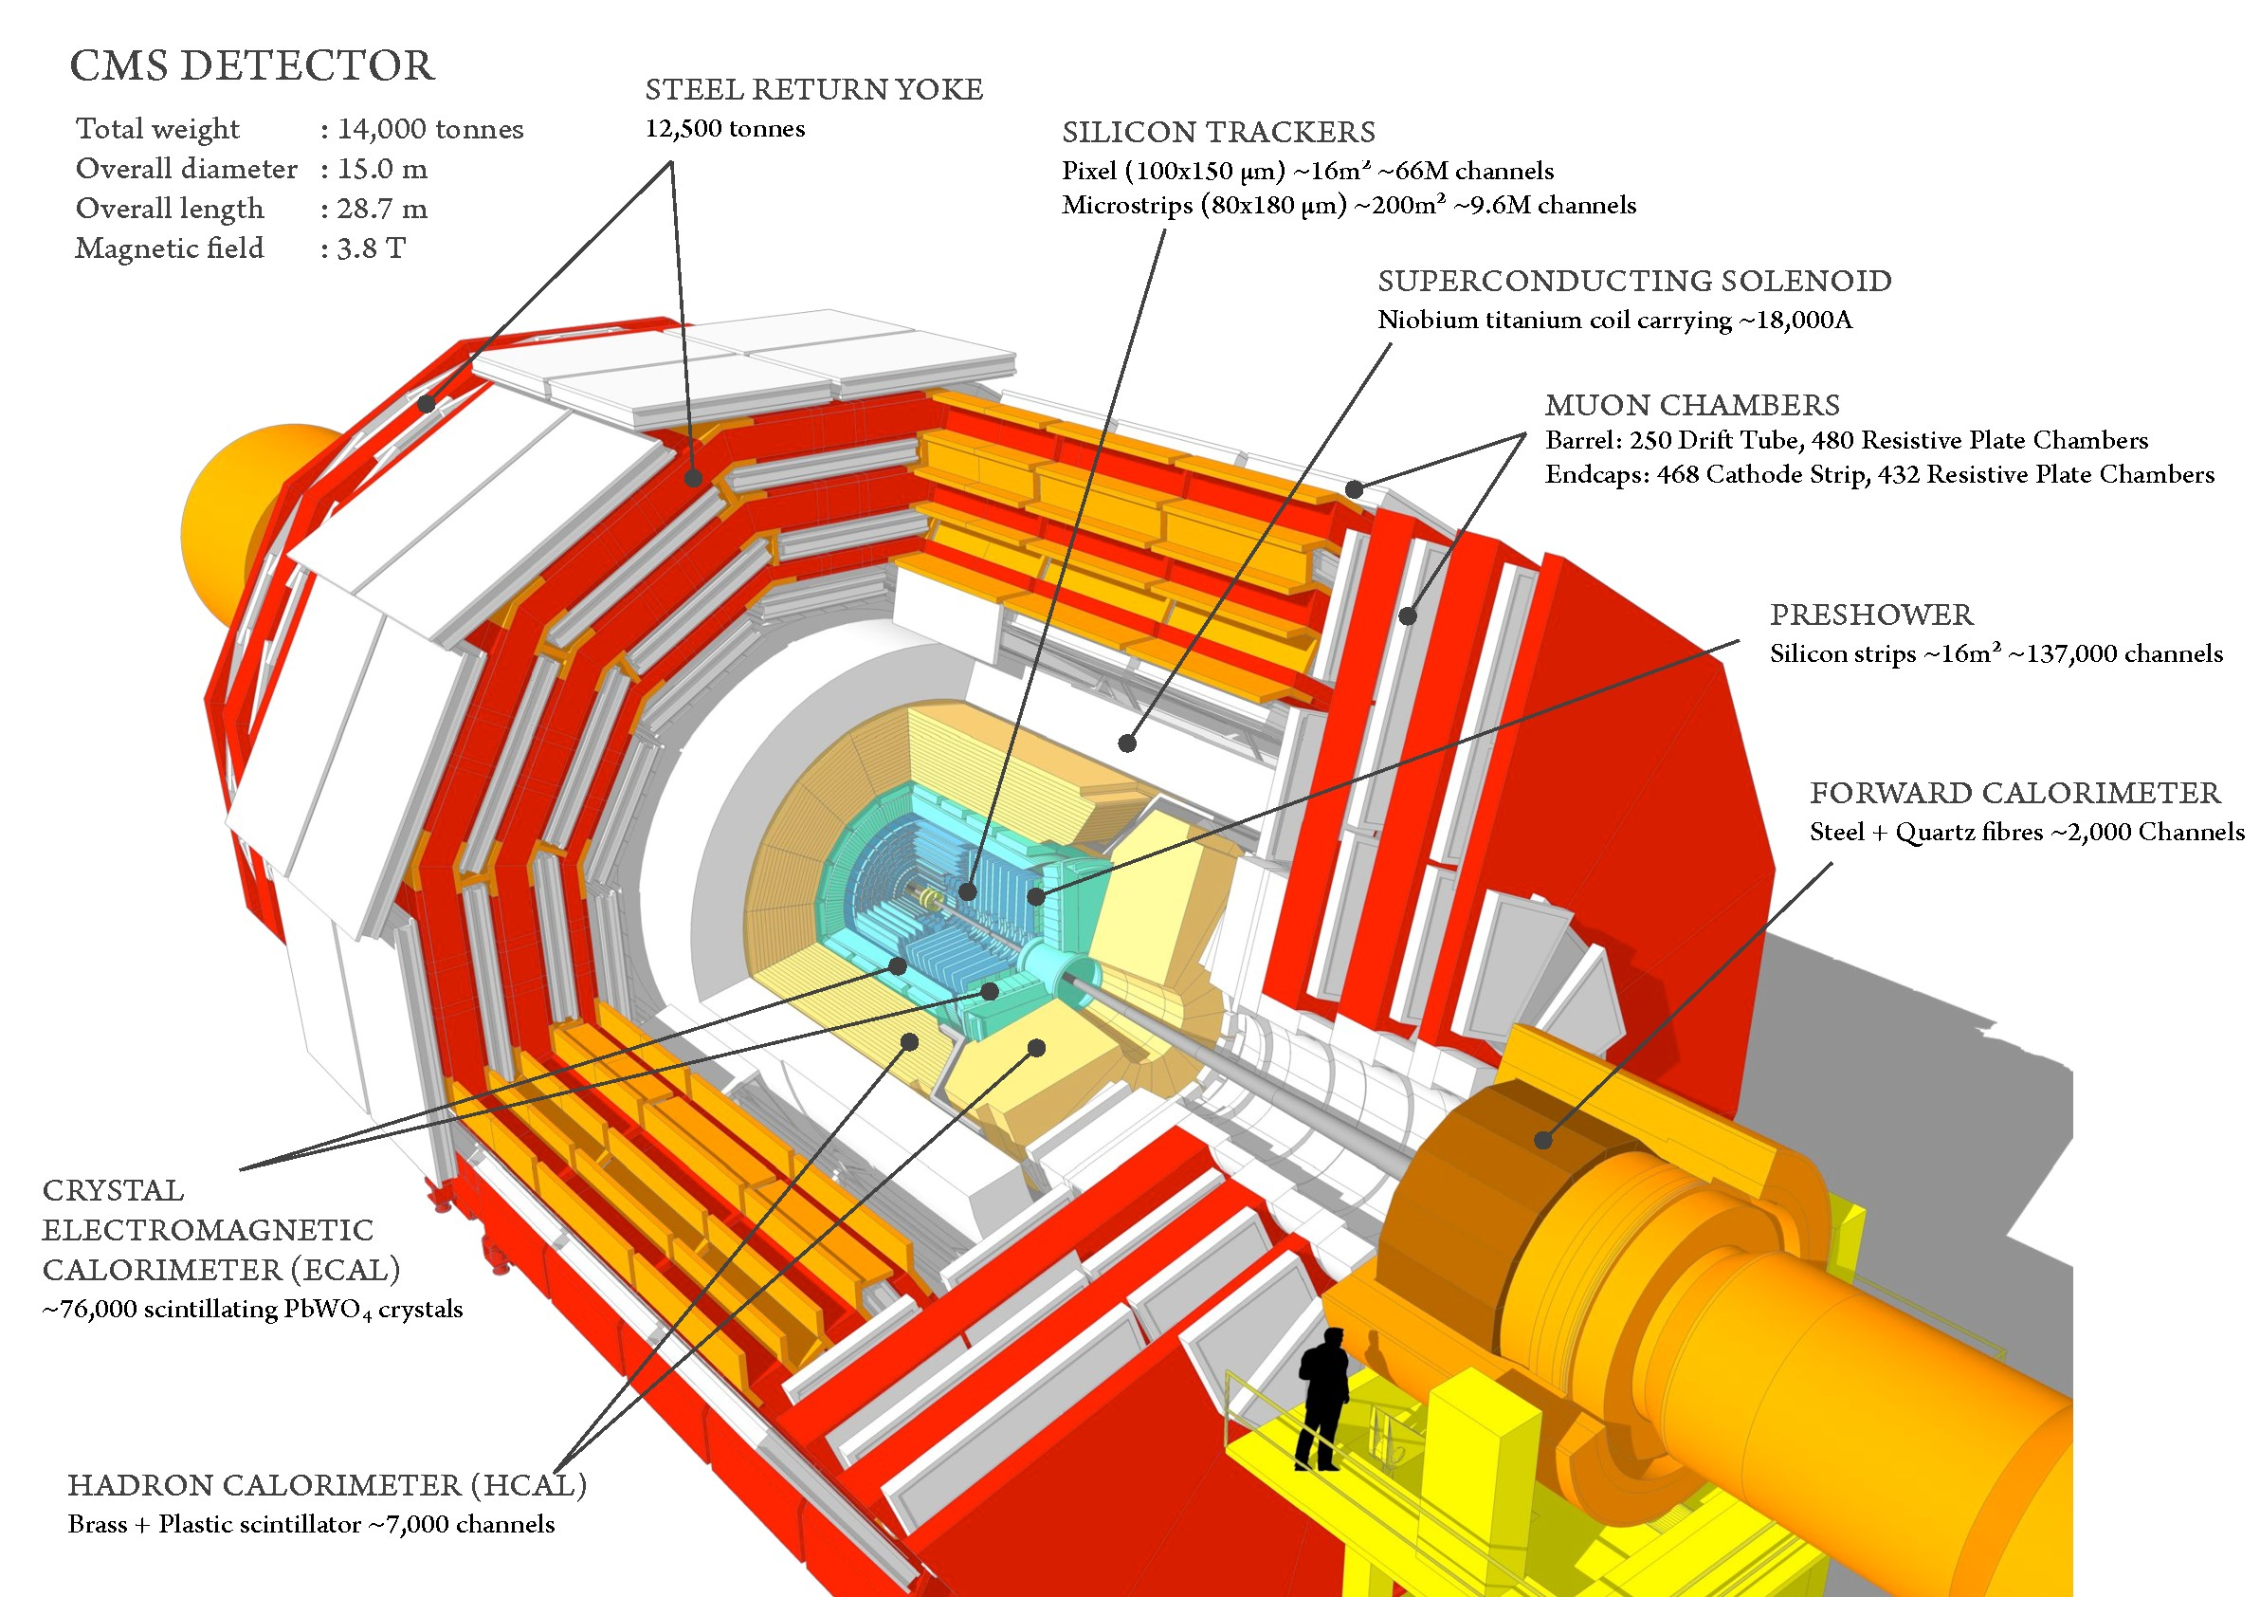



Jet reconstruction overview
Calorimeter Topo-clusters
jets
Track corrections
ATLAS
Calorimeter clusters + tracks
Particle flow objects
jets
CMS

Slide 19



Jet reconstruction at ATLAS
Topological clustering
o Three-dimensional clustering algorithm at the level of individual calorimeter cells
Noise suppression
limit the formation and grow of clusters from electronic and pileup noise
Local calibration
EM/HAD classification and calibration
Improves the linearity of the jet energy response and the energy resolution
Reduce pile-up contributions before jet ﬁnding
20

Slide 20
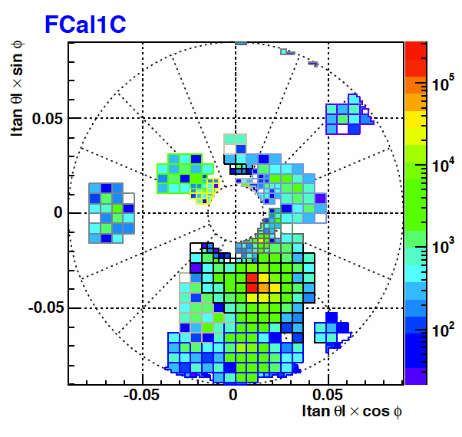
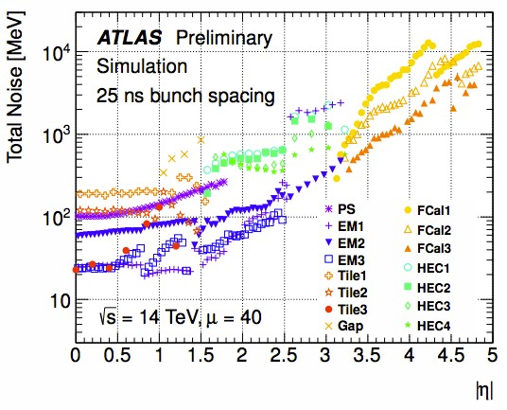
Jet reconstruction at ATLAS
Topological clusters:
o 3D nearest-neighbor algorithm that clusters calorimeter cells with energy significance (|E_{cell}|/σ) >4 for the seed, >2 for neighbors, and >0 at the
boundary
Sigma noise (σ): electronic + pileup noise
o Adjusted with μ for pileup noise suppression
2010: σ(μ=0)
2011: σ(μ=8)
2012: σ(μ=30)
μ=40

Slide 21
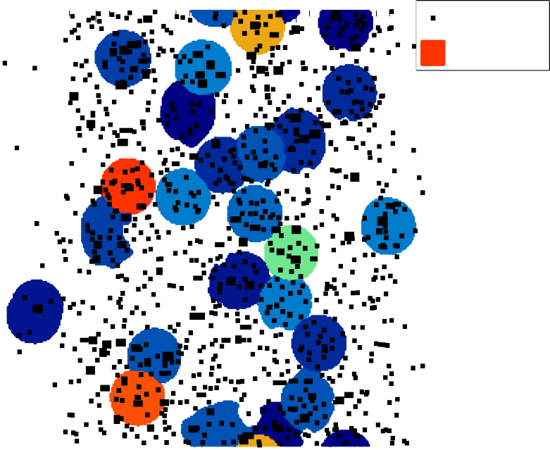
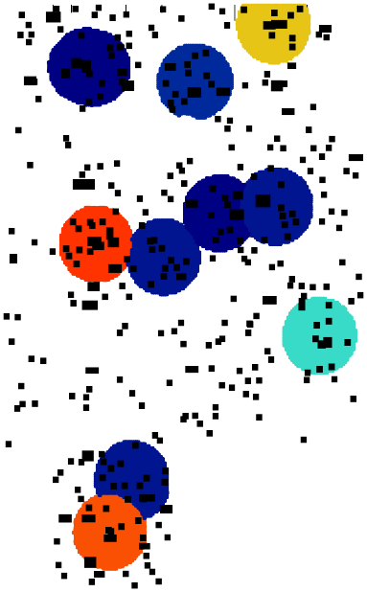



Topoclustering
pile-up suppression
mu=80
mu=80
φ [radians]
6
ATLAS
Clusters
φ [radians]
6
ATLAS
Clusters
Preliminary Simulation
anti-k_{t} (R=0.4)
Preliminary Simulation
anti-k_{t} (R=0.4)
5
5
p [GeV]
p [GeV]
4
4
T
T
3
3
2
2
10²
10²
QCD Jets
QCD Jets
¹ <μ> = 80
¹ <μ> = 80
pileup
pileup
σ_{noise} (μ = 40)
σ_{noise} (μ = 80)
0
0
-4
-3 -2
-1
0
1
2
3 _{y}4
-4
-3 -2
-1
0 1 2
3 _{y}4
pileup
(μ = 40) σ
pileup noise
(μ = 80)
noise
Sigma noise provides particle (cluster) level pile-up suppression

Slide 22
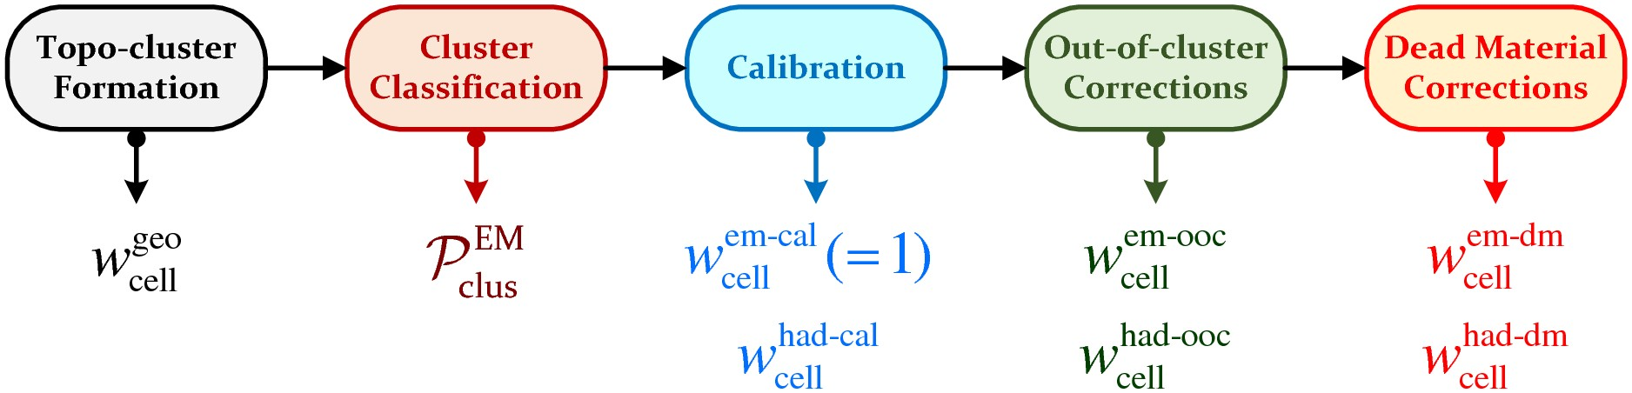
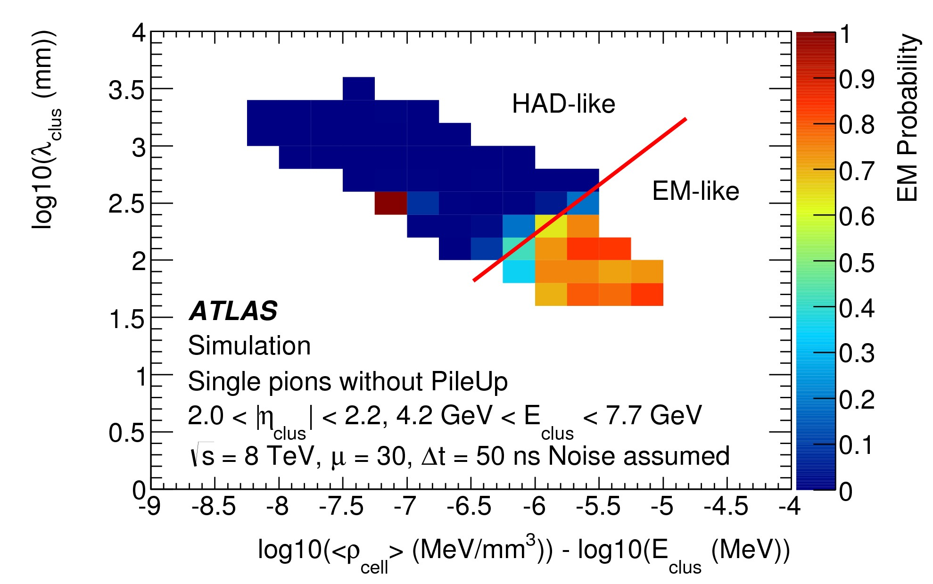
Local cluster calibration
Use local cluster shape information to classify and calibrate EM/ HAD clusters. Calibrations derived using single pion Monte Carlo
Cluster depth
Average cell signal density

Slide 23
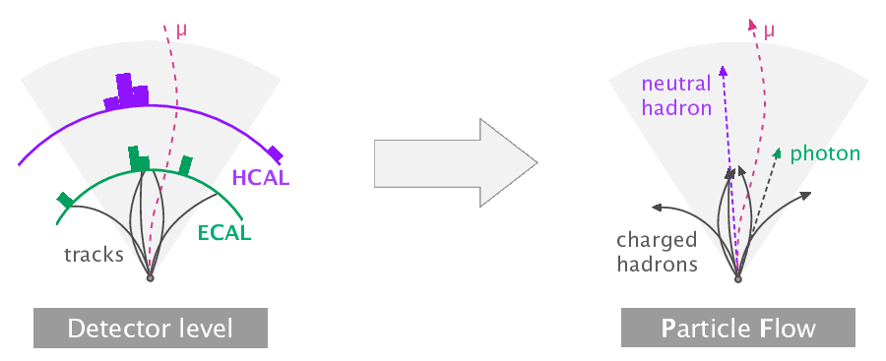
CMS Particle Flow
Reconstruct individually each particle combining tracking and calorimeter information:
o Relies on high granularity and resolution of ECAL and high magnetic field
to separate individual showers
65% charged hadrons → Tracker 25% photons → ECAL
10% neutral hadrons → HCAL
Picture from
24
h>p://bartosik.pp.ua/hep_sketches/cms_particle_ﬂow

Slide 24
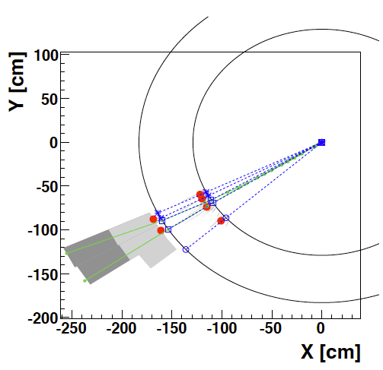
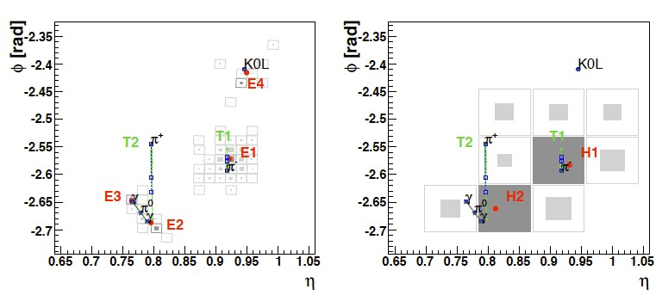
Particle Flow
ECAL
Tracks
HCAL
65% charged hadrons → Tracker 25% photons → ECAL
10% neutral hadrons → HCAL
Performance limited by confusion: ability to separate individual particle showers)
o Need High granularity, B field
Average (large fluctuations)

Slide 25





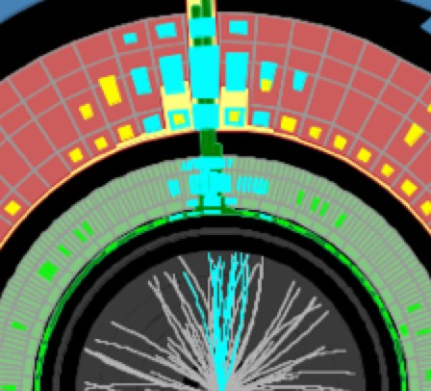
Jet calibration overview
Input signals:
jets Calibration
Topo-clusters PFlow objects
Jet energy response:
E
reco
Reconstructed jet
R(E,η) =
_{E}truth
Calorimeter non-compensation
•
•
•
•
•
Calibration
Inactive regions of the detector
Energy deposits below thresholds
Particles not included in the jets
Particle (truth) jet
Pile-up
Data / Monte Carlo scale

Slide 26
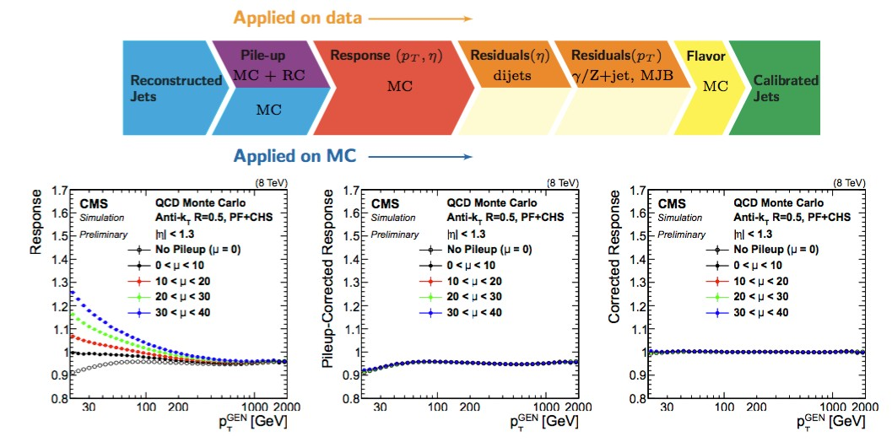
Jet calibration overview

Slide 27
Jet calibration overview

Slide 28
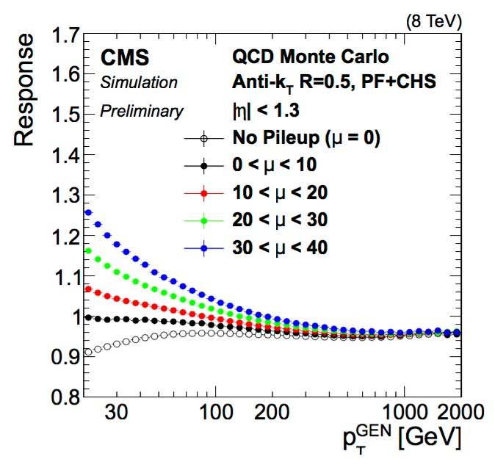
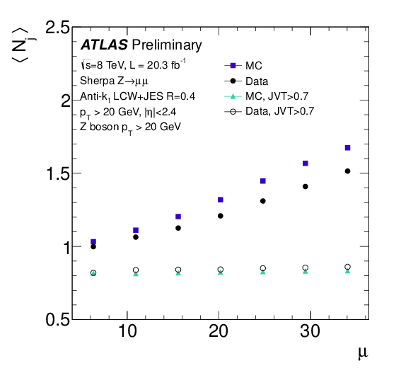
The challenge of pile-up
One the most difficult challenges at the LHC
Hard scatter jet
QCD pileup
jet
“Stochastic” pileup jet
More energy
pileup
Number of jets
Additional energy (offset) Fluctuations:
Reduce accuracy of the jet energy and mass determination
Additional fake pileup jets
More jets
pileup
Average PU ₂₉

Slide 29







Pileup mitigation:
four key ideas
Constituent level pile-up suppression
Topo-clustering(ATLAS Charged Hadron Subtraction and PUPPI (CMS)
Jet-Vertex Tagging
Use of tracking information to reject jets from pileup
Area-Median Subtraction
jet,corr jet
jet
p_{T} = p − ρ × A
T
T
Grooming
Reduce local fluctuations of pileup (Large-R jets)

Slide 30
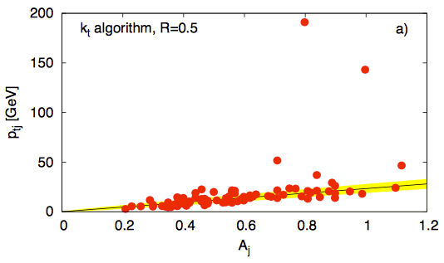
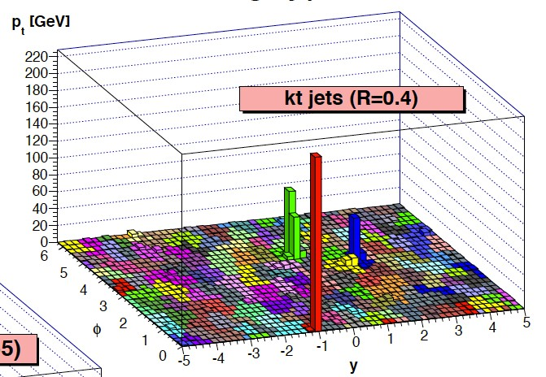
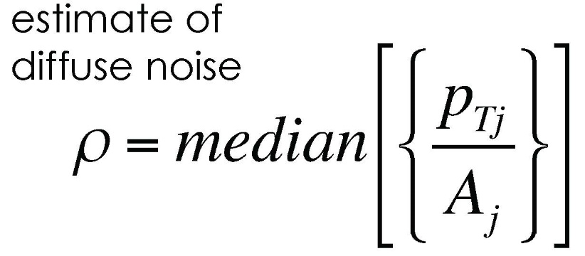
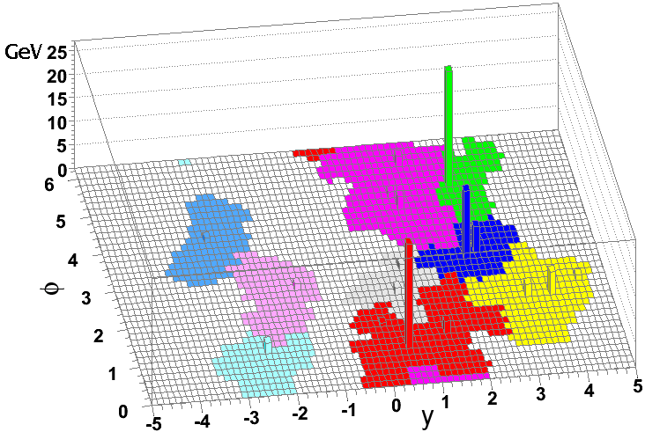
Pileup subtraction (I)
arXiv:0707.1378 [hep-ph]
jet,corr
jet
jet
Jet Area:
susceptibility to diffuse noise contamination
p_{T} = p_{T} − ρ × A_{T}
Event-by-event

Slide 31
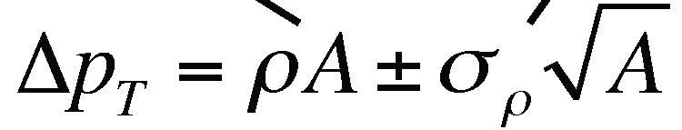
Pileup subtraction (II)
arXiv:0707.1378 [hep-ph]
band
line
jet,corr
jet
jet
Geometrical contamination
Fluctuations in the noise from point to point in the event
p_{T} = p_{T} − ρ × A_{T}

Slide 32
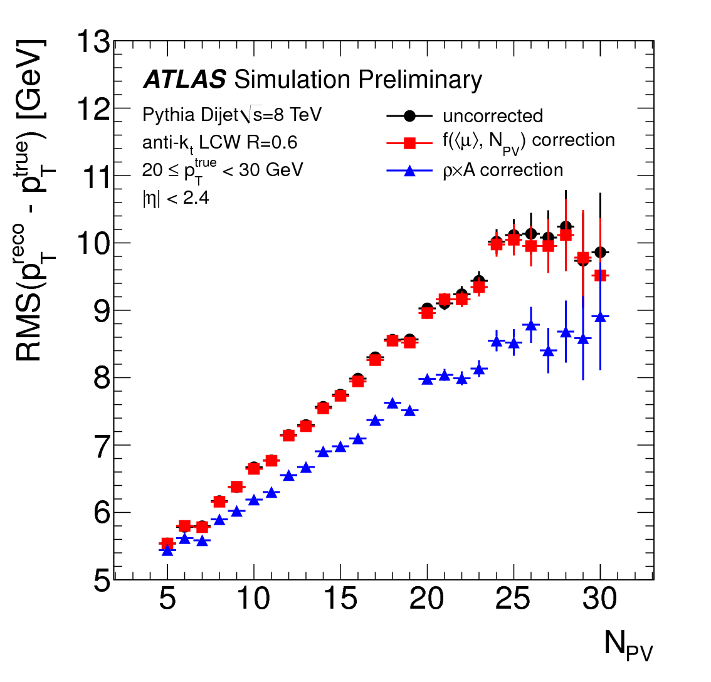
Pileup subtraction
Residual correction
/∂N [GeV]
_{T} PV
1
ATLAS Simulation Pythia Dijets 2012 anti-k _{t} LCW R=0.4
offset
0.8
0.6
∂p
0.4
Jet energy resolution
Improvement
0.2
0
Improvement
-0.2
Before any correction After ρ×A subtraction After residual correction
0 0.5 1 1.5 2 2.5
-0.4
3 3.5 4
|η|
Significant improvement of the jet p_{T} resolution
10-20% reduction in jet-by-jet pileup fluctuations
33

Slide 33
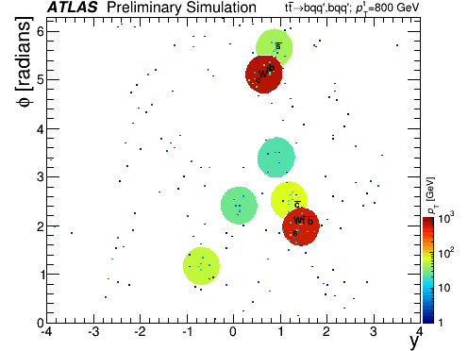
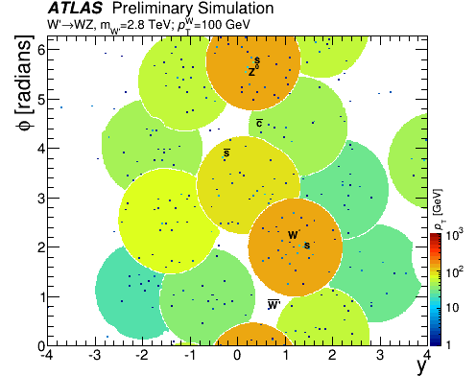
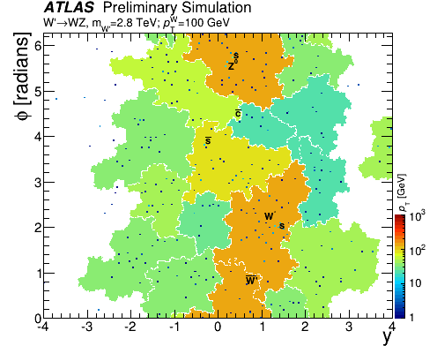
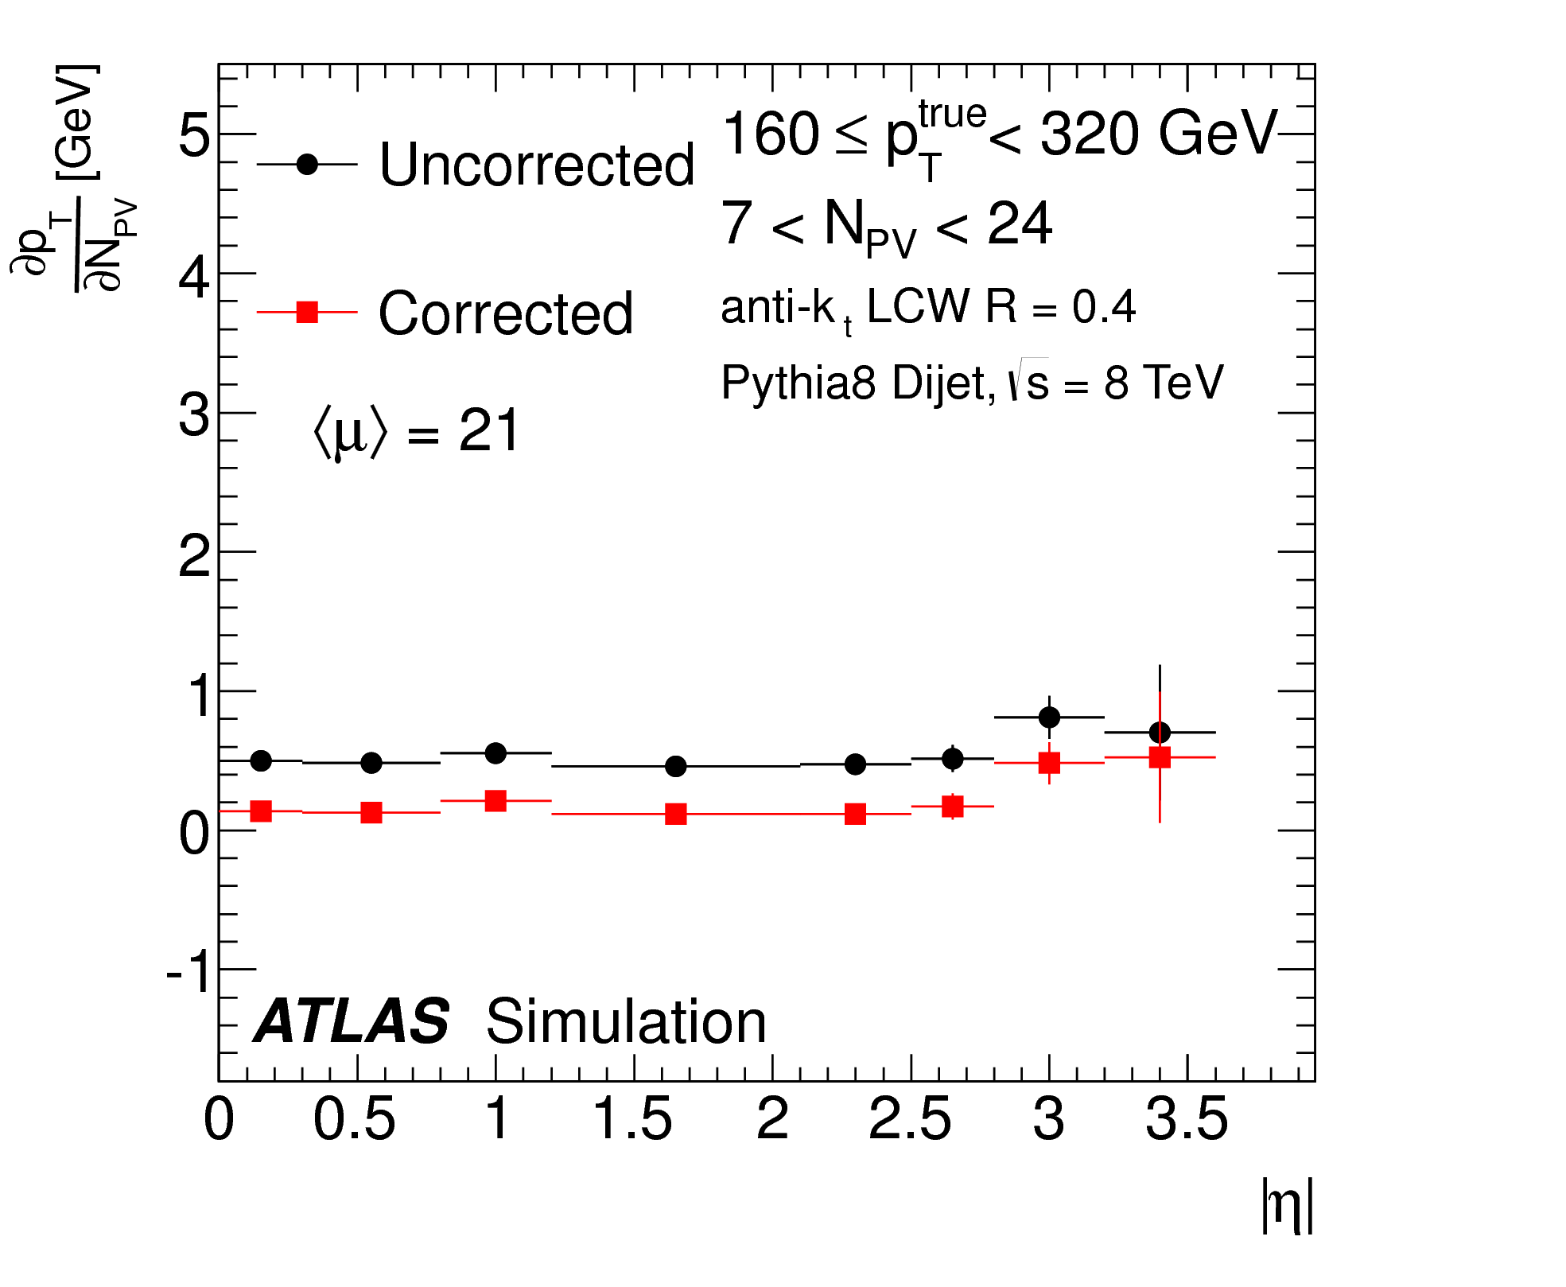
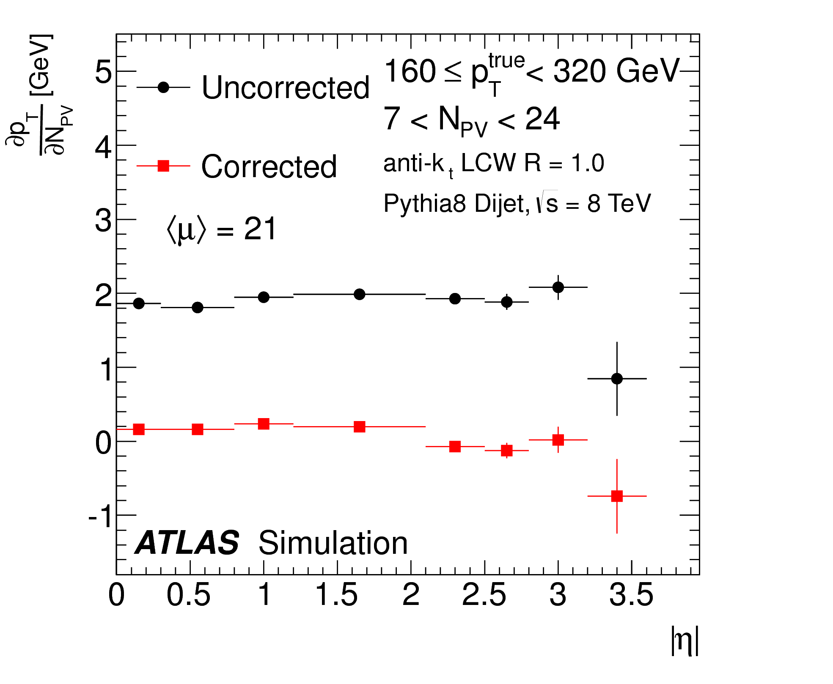

anti-k_{t} R=0.4
anti-k_{t} R=1.0
C/A large-R
R=1.0
R=1.2
34

Slide 34
Local pile-up ﬂuctuations
Area subtraction
band
line
Local fluctuations
Geometrical contamination
Fluctuations in the noise from point to point in the event: local fluctuations
jet,corr
jet
jet
p_{T} = p_{T} − ρ × A_{T}
35

Slide 35


CMS Charged Hadron
Subtraction
HS
PU
Remove charged pile-up tracks
Improvement

Slide 36


Rejecting jets from pileup
Pileup can create pileup jets:
  QCD jets originating from a pileup vertex
  Random combination of particles from multiple pileup interactions (“stochastic pileup jets”)
More jets
pileup

Slide 37


Jet Vertex Tagging / JetID
Jet vertex fraction algorithm (JVF)
o Tag and reject pileup jets using tracking and vertexing information
HS jets
trk
Σp_{T} (PV )
JVF =
0
_{Σp}trk _{(PV} trk
_{T 0} ) + Σp_{T} (PU_{n} )
ATLAS-CONF-2013-083
CMS PU Jet ID: CMS PAS JME-13-005
PU jets
Jets with no tracks

Slide 38

JVF pileup jet suppression
JVF restores the N_{jet} distribution as a function of pileup
Improves the data/MC agreement
JVF
improvement

Slide 39
Jet calibration overview
40

Slide 40

Jet energy scale correction
Multiplicative factor (JES) derived as a function of jet p_{T} (E) and η in di-jet Monte Carlo events: JES = 1 / R(E, η)
Rec jet
 |  | JES
cle (tr
onstructed
Parti
uth) jet
E
reco
R(E,η) =
_{E}truth
Jet |η|
41

Slide 41

Reducing ﬂuctuations (I)
In non-compensating (e/h>1) calorimeters, the energy resolution is driven by the large fluctuations in the EM shower fraction
ATLAS uses a method inspired by dual-readout calorimetry to improve the jet energy resolution
42

Slide 42

Reducing ﬂuctuations (II)
Higher than average response
Average response
Lower than average response
43

Slide 43










Global Sequential Calibration
Use jet-by-jet information to correct the response of each jet individually after the average JES correction
o Reduce fluctuations in the jet energy response
due to detector effects
o Reduce the difference in response between
Muon variables
quark and gluon initiated jets
Number of muon segments
Sensitive to leakage
Calorimeter variables
Tracking variables
Tile layer 0 energy fraction
Number of tracks
Jet (track)
EM layer 3 energy fraction
width
Sensitive to quark/gluon differences
Sensitive to LAr cryostat energy loss
44

Slide 44


Global Sequential Calibration
Quark/Gluon response difference
Jet energy resolution
Improvement from tracking variables
Improvement from calorimeter variables at high p_{T}
Improvement from tracking variables at low p_{T}

Slide 45
Jet calibration overview
CMS DP -2016/020
Residual in situ jet energy scale correction:
JETM-2016-002
Brings the energy response of jets in data and MC to agreement, reducing a major source of systematic uncertainty
jet ref
p_{T} / p_{T}
_{JES}insitu ₌
MC
Reference objects: Z, γ, jets
_{p} jet _{/ p}ref
T T
DATA
Jet energy scale uncertainty determined by the uncertainty on the measurement of the jet response in data

Slide 46






In situ jet energy calibration
Relative η inter-calibration
Absolute p_{T} calibration
Multi-jet events
Z/γ+ jet
Di-jet events
47
γ+ jet
multijet
Z+ jet

Slide 47

Systematic uncertainties

Slide 48

Jet quantum properties
Exploit the internal jet (and event) substructure to measure jet quantum properties:
  Electric charge
  Color charge
    Quark vs. gluons
    Color connections between jets
Tools to enhance precision measurements (Higgs, VBF final states) and to characterize new physics

Slide 49


Jet charge (I)
Weighted sum over track charges is an experimental handle on the electric charge of jets (Field, Feynman, 1978)
1
Q =
∑
i∈tracks
i κ
q × ( p )
j
( p
₎κ
i T
T_{j}
50

Slide 50



Jet charge (II)
ATLAS-CONF-2013-086 CMS PAS SMP-15-003
1
Q_{j} =
∑
i∈tracks
i κ
q × ( p )
( p_{T} )
κ
i T
j
51

Slide 51


Color ﬂow: jet pull (I)
Observable designed to be sensitive to the color connections between the hard-scatter partons initiating the jets
o Multiple physics applications (QCD, Higgs, new particle searches…)
Higgsàbb
gluonàbb
θ_{P} ~ 0
θ_{P} ~ π / 2
Jet Superstructure (Schwartz and Gallicchio) arXiv:1001.5027
52
i
p_{T} r_{i}
!
Jet Pull Vector∑
r_{i}
J
p_{T}
i∈J
θ_{p}(J1,J2) = angle between J₁ pull vector and the vector connecting J₁ and J₂
ATLAS-CONF-2014-048

Slide 52


Color ﬂow: jet pull (II)
Study jet pull in data using jets from hadronic W’s in ttbar events
CMS-PAS-JME-14-002 ATLAS-CONF-2014-048

Slide 53

Quark-gluon jet tagging
Distinguish quark from gluon initiated jets using jet properties that result from the different color charge between quark (C_{F}=4/3) and gluon (C_{A}=3) partons
N_{g}
₌ C_{A =} 9
N_{q} C_{F} 4
Gluons are expected to have more particles, be wider, and have a softer particle spectrum
Eur. Phys. J. C (2014) 74: 3023 CMS-PAS-JME-13-002

Slide 54


Quark-gluon jet tagging
Gluon-like
Quark-like

Slide 55


Boosted EW objects
Due to the large hierarchy of scales at the LHC (√s>>M_{EW}), heavy electroweak particles can be highly boosted
_{R ~} 2m
p_{T}
R=0.4 Jet
R=0.4 Jet
b
DR
b
b
b
^{G}KK
H
^{G}KK
H
H
H
b
b
M(G) = 500 GeV DR(bb) ~ 1.0
b
M(G) = 2 TeV DR(bb) ~ 0.25
b
Boosted regime: EW decay products are collimated and merged within a single jet

Slide 56

Boosted top pair candidate event
q q W
top

Slide 57
Jet substructure
Single large-R jet
Use large radius jets + internal jet structure:
Large-R jets from the decay of a massive particle have different
W
q
q,g
characteristics than jets originating from quarks and gluons (soft divergences in QCD)
q
2-prong structure
Soft emission
Jet mass
N-prong structure
Radiation pattern
Two main challenges:
  Very large QCD background
  High pileup
    Contamination proportional to the area of the jet:
o x6 increase from R=0.4 to R=1.0

Slide 58


Jet substructure
Two major ideas:
Grooming
Tagging
Reduce contamination from pile-up
Identify the internal structure of jets
Reduce QCD background
Improve the signal mass resolution
Many techniques!
trimming, filtering, pruning, mass drop, soft drop, HEPTopTagger, Shower Deconstruction, N-subjettiness, planar flow, energy correlations, template method, jet images,…

Slide 59

Jet trimming (1/4)
Pythia di-jet event (QCD background)
60

Slide 60

Jet trimming (2/4)
Anti-k_{t} (R=1.0) jet built from topo-clusters (p_{T}>20 GeV)
61

Slide 61

Jet trimming (3/4)
Re-cluster jet constituents with the k_{t} R=0.3 jet algorithm: subjets
62

Slide 62

Jet trimming (4/4)
subjet
jet
Remove soft subjets if
p_{T} < f_{cut} . p_{T}

Slide 63



Jet trimming (QCD)
φ [radians]
ATLAS Preliminary Simulation
Pythia di-jet
p fraction
T
6
1
5
₁₀-1
4
3
₁₀-2
p [GeV]
T
2
10³
10²
1
10
0
1
-4
-3
-2
-1
0
1
2
3 _{y}4
Grooming effectively reduces the area of jet, reducing the jet sensitivity to pileup fluctuations

Slide 64


Jet trimming (W/Z)
Grooming retains the hard n-prong structure of boosted electroweak objects

Slide 65

Trimming performance
JHEP09 (2013) 076
Signal: Zàqq, Background: QCD jets
Improved mass resolution (sharpens the mass peak)
Trimmed jet mass
Raw
jet mass
Reduced QCD background (improved S/B)

Slide 66


Top quark mass with 300 PU
SIGNAL: Z’(2 TeV)àtt BACKGROUND: QCD
grooming
SIGNAL:
Z’(2 TeV)àtt
BACKGROUND: QCD

Slide 67

W jet tagging
65 GeV < m < 95 GeV
j
n-subjettiness:
o Measures the n-prong structure of jets
0.08
W jets QCD jets
0.07
Relative occurence
0.06
Thaler &
0.05
Van Tilburg
2.2
Boosted W Jet, R = 0.6
5.8
Boosted QCD Jet, R = 0.6
0.04
W jet
5.6
QCD jet
2
0.03
1.8
5.4
φ
1.6
φ
5.2
0.02
1.4
5
1.2
ΔR
4.8
0.01
1
4.6
0
−0.2
0
0.2 0.4 0.6 0.8
η
1
−1.2
−1 −0.8 −0.6 −0.4 −0.2
η
0
0.2
0.4
0.6
0.8
1
/τ of jet
τ₂
1

Slide 68
W jet tagging
13 TeV
^{ε}bkg
1
C₂ β=1 C₂ β=1.5
CMS
Simulation Preliminary
0.8
C₂ β=2
QGL
Subjet 2 QGL
0.6
^{Γ}Qjet
τ₁
τ₂
0.4
τ₂/ τ₁
AK R = 0.8
475 < p < 600 GeV
T
0 < N < 40
0.2
PU
|η| < 2.5
N-subjettiness
0
0
0.2
0.4
0.6
0.8
1
^{ε}sig
CMS-PAS-JME-14-002
69

Slide 69

W jet tagging (Run 1)
C/A R=0.8 jets
CMS-PAS-JME-15-002
70

Slide 70


Higgs tagging
Use small-R (R=0.2) track-jets to resolve b-hadrons at small angular distances
Associate b-tagged track-jets to un-groomed large-R jets
Double b-tagging provides most of the discrimination power
ATLAS-PHYS-PUB-2015-035

Slide 71

Very high p_{T} jets
At very high boost, the decay products of EW objects can merge into single cells
Track-assisted mass:
p
calo
track
T
m = m ×
Measure
track
p_{T}
substructure with tracks
Measure p_{T} with calorimeter
Low p_{T}: Calorimeter better
High p_{T}:
TA-mass better
ATLAS-CONF-2016-035

Slide 72


Jets and machine learning
Jet tagging as a computer vision problem
Utilize state-of-the art image processing/classification to analyze jets in new ways

Slide 73




Deep learning W Tagging
New data representation: the jet-image
o Calorimeter towers à pixels in a camera
Use all available calorimeter information
Enable the use of cutting-edge computer vision image classification algorithms (deep neural networks)
Convolved
Convolutions
Feature Layers
Max-Pooling
W’→ WZ event
arXiv:1511.05190
Repeat
74

Slide 74

Deep learning W Tagging
Pythia 8, s = 13 TeV
250 < p /GeV < 300 GeV, 65 < mass/GeV < 95
T
Pythia 8, W'→ WZ, s = 13 TeV
240 < p /GeV < 260 GeV, 0.19 < τ < 0.21, 79 < mass/GeV < 81
1/(Background Efficiency)
[Translated] Azimuthal Angle (φ)
T
21
Pearson Correlation Coefficient
150
1
0.19 <τ₂₁< 0.21
signal-like
background-like
0.6
mass
^{τ}21
ΔR
Fisher Maxout Convnet
Random
x3 better rejection than n-subjettiness
0.4
0.5
0.2
100
0
0
-0.5
-0.2
-0.4
50
-1
-0.6
-1
-0.5
0 0.5 1
[Translated] Pseudorapidity (η)
Deep correlation jet-image: Pearson Correlation coefficient of pixels intensity with the network output:
how discriminating information is contained within the network
0
0.2
0.4
0.6
0.8
Signal Efficiency
Large performance gains beyond jet substructure observables
Visualization of the discriminant adds a new capability to understand the physics within jets
75

Slide 75



Fuzzy jets
arXiv:1509.02216
View jet clustering as an
unsupervised learning task
For state-of-the-art clustering, every clustered object belongs to exactly one jet
Fuzzy jets: incorporate probabilistic membership, in order to learn new features of the jet structure
Modified Gaussian Mixture Model (IRC safe)
Algorithm learns the jet shape
Improved top tagging performance

Slide 76

Missing ET
One of the most important observables in searches for new physics (SUSY, dark matter) and precision measurements (H, W, top)
Transverse momentum imbalance of the event
o Relies on the reconstruction (and calibration) of all high p_{T} objects in
the event, as well as the “un-clustered energy”
o Pile-up is a major challenge
Track Soft Term (ATLAS)
PV-tracks outside hard objects
PUPPI (CMS)
miss
HARD
x ( y)
SOFT
x ( y)
^{E}x ( y)
= E
E
Scale the 4-momentum of
pflow objects based on a local pile-up probability
Jets, e,μ,τ
“unclustered” E_{T}

Slide 77


Missing ET Performance
Measured in Z+jet events
ATLAS-PHYS-PUB-2015-027
CMS-PAS-JME-16-004

Slide 78

Missing ET Signiﬁcance
CMS-PAS-JME-16-004
Estimate the probability distribution for
ME_{T} due to resolution fluctuations
event-by-event
jet
L(ε = ME_{T} )
S = 2 ln
ME_{T}
L(ε = 0)
jet
Low ME_{T} significance
jet
ME_{T}
jet
High ME_{T} significance

Slide 79
Summary
Jets and missing ET are key signatures for the analysis of LHC data
  Quark, gluons, heavy electroweak particles
  Quantum properties
ATLAS and CMS developed sophisticated techniques for the reconstruction and calibration of jets combining calorimeter and tracking information
  Different approaches motivated by the different detector strengths and capabilities
Many different jet algorithms and jet substructure techniques have enabled a rich toolkit for the analysis and interpretation of events at the energy frontier

Slide 80

Backup

Slide 81

Reducing ﬂuctuations (III)
Higher than average response
Average response
Lower than average response

Slide 82




Forward pile-up jets
?
Challenge: how to associate the vertex origin of forward jets, outside the inner tracker detector

Slide 83


Forward pile-up jet tagging
Use tracks in the central region to indirectly tag forward pileup jets: Exploit angular correlations of QCD jets produced in pile-up interactions
Back-to-back QCD pile-up in the central region

Slide 84

Forward pile-up jet tagging
improvement
ATLAS-PHYS-PUB-2015-034

Slide 85


Expanding the use of jets
Many motivations to use jets with different R parameters
Angular size of jets produced by a massive particle scales as 2m/p_{T}
Pileup contamination scales as R²
Major experimental limitation:
jet calibrations and uncertainties need to be derived for every jet collection
Jet mass calibration
Colors: jet E
86

Slide 86

Jet re-clustering
Build jets from jets
•
•
JHEP 02 (2015) 075
Introduce a new angular scale r < R at which jets are calibrated Cluster radius r jets into radius R jets
o Large-R jet calibrations (and uncertainties!) propagate from r to R
Allows for unprecedented flexibility to optimize the R jet parameter in the context of specific physics analyses
o Improve the discovery potential to new physics
87

Slide 87


Reclustered grooming
Discard small radius r jets i re-clustered into large-R jet J if:
^{p}T ,i ^{< f}cut ^{. p}T
J
Top jets
W jets
W jets
Enables a natural transition between large-R and small-R jets

Slide 88


JVF pileup jet suppression
improvement
improvement
JVF restores the N_{jet} distribution as a function of pileup
Improves the data/MC agreement
JVF makes the jet veto efficiency stable with pileup without the need to raise the jet p_{T} threshold

Slide 89
Jet calibration overview
Two main goals:
  Reduce fluctuations (improve resolution)
    Event-by-event pileup subtraction
    Jet-by-jet corrections
  Reduce data/MC differences (improve uncertainty)
    Jet energy calibration determined from data (in-situ)
    Jet-by-jet techniques to reduce effects not well modeled
      Pile-up jets: Jet Vertex Fraction
      Flavor dependence of the response: Global Sequential Calibration
90

Slide 90




Experimental challenges
Non-linear jet response
Pile-up
Eta-dependent response
Flavor dependence

Slide 91
Pileup subtraction
arXiv:0707.1378 [hep-ph]
band
line
Determine the median p_{T}
Δp_{T} = ρA ± σ_{ρ} A
density (ρ) per unit of area of each event, and the jet area (A)
Geometrical contamination
Fluctuations in the noise from point to point in the event
_{p} jet,corr _{= p} jet _{− ρ × A} jet T T T

Slide 92
VBF H →ZZ →llll
gg
improvement
JVF makes the jet veto efficiency stable with pileup without the need to raise the jet p_{T} threshold
ATLAS-CONF-2014-018
93

Slide 93

Pattern recognition and machine learning in jet physics

Slide 94



Computer vision: jet images
JHEP 02 (2015) 118
Fisher discriminant

Slide 95


Jet-image W tagging
Improvement
Connection between jets and images enabled the use of computer vision algorithms to jet tagging for the first time
Improved performance with respect to state-of-the art methods
Visualization of the discriminant adds a new capability to understand the physics within jets and design more powerful jet
tagging methods
96

Slide 96

Topoclustering pileup suppression
Linear behavior of rho up to high mu for fixed sigma noise values
Higher pileup sigma noise values lead to partial suppression of pileup
Optimization of topoclustering sigma noise is key to reconstruct jets at high luminosity
Effect of sigma noise
Jet Area(R=0.4) ~ 0.5
à Jet p_{T} offset ~ <ρ>/2
97

Slide 97



New jet-vertex tagging variables
Correct JVF for its pileup
Use pileup-corrected
dependence:
observables:
trk
Σp_{T} (PV )
trk
CorrJVF =
0
Σp_{T} (PV₀ )
trk
^{R}pT
=
trk
Σp_{T} (PU_{n} )
Σp_{T} (PV₀ ) +
p_{T}
jet
_{k n}trk
10²
PU
10²
Normalized Entries
ATLAS Simulation Preliminary
Normalized Entries
ATLAS Simulation Preliminary
Pythia8 dijets
PU jets HS jets
10
Pythia8 dijets
PU jets HS jets
10 Anti-k LCW+JES R=0.4
Anti-k LCW+JES R=0.4
t
t
|η| < 2.4, 20 < p < 30 GeV
|η| < 2.4, 20 < p < 30 GeV
0 ≤ N_{Vtx} ≤ 30
T
0 ≤ N_{Vtx} ≤ 30
T
1
1
₁₀-1
₁₀-1
₁₀-2
₁₀-2
₁₀-3
₁₀-3
₁₀-4
-1 -0.5 0
ATLAS-CONF-2014-018
0.5
1
corrJVF
₁₀-4
0
0.5
1
1.5
^{R}pT
98

Slide 98



Jet Vertex Tagger (JVT)
Normalized Entries
10²
ATLAS Simulation Preliminary
Fake Rate
Pythia8 dijets
PU jets HS jets
ATLAS Simulation Preliminary
₁₀ Anti-k_{t} LCW+JES R=0.4
|η| < 2.4, 20 < p < 30 GeV
0 ≤ N_{Vtx} ≤ 30
T
Pythia8 dijets
Anti-k_{t} LCW+JES R=0.4
|η| < 2.4
JVF
corrJVF ^{R}pT JVT
1
₁₀-1
20 < p < 50 GeV
₁₀-1
T
JVF = 0.5
₁₀-2
JVF = 0.25
₁₀-3
0
0.5
1
JVT
JVF
CorrJVF
Efficiency
ATLAS Simulation Preliminary
_{1.2} Pythia8 dijets
JVF>0.5
JVF>0.6
JVT>0.6
JVT>0.85
JVT
Anti-k_{t} LCW+JES R=0.4
₁₀-2
|η| < 2.4
R
Target signal efficiency = 0.9
pT
solid markers: 20 < p < 30 GeV
T
open markers: 30 < p < 40 GeV
1
T
improvement
0.8 0.85 0.9
JVT
0.8
0.95
Efficiency
JVF
Reduced pileup dependence
New ATLAS pileup suppression algorithm for Run 2
0.6
10 20
30
N
Vtx
99

Slide 99




High multiplicity searches using jet mass
Search for events with four large-R jets and use the total-jet-mass event-level observable to separate signal from background:
4
Σ
∑
p_{T} >100GeV
η <2.5
jet
M_{J} =
m
Large-R jets in high multiplicity events have a multi-prong structure from the accidental
merging of partons resulting in large jet masses
o Jet masses do not correspond to a parent’s
particle’s mass
A. Hook, E. Izaguirre, J. Wacker, et. al. (arXiv:1202.0558)
Two assumptions:
  Jet rich environment
  Large-R Jet masses uncorrelated
100

Slide 100



Total-jet-mass
Signal event (gluino mass = 1 TeV)
Background event
Σ
Σ
M_{J} = 705 GeV
M_{J} = 260 GeV

Slide 101


Total-jet-mass
Total jet mass sensitive to gluino mass and mass splitting:
m − m
⌢
⌢
0
g
χ₁

Slide 102










Jet calibration
Jet energy scale
inputs
Topo-clusters (pileup
noise threshold)
Local cluster weighting (LCW)
Event-by-event pileup subtraction
Residual oﬀset (out-of-time, occupancy)
Jet Energy Scale
Pileup noise:
σ(µ)
calib
EM/HAD
classification
p_{T} = (p_{T} − ρA − α(N_{PV} −1) − β μ )× JES
Average JES correction
2
ATLAS simulation
0.3 ≤ |η| < 0.8
2.1≤ |η| < 2.8
3.6 ≤ |η| < 4.4
HAD-like
1.8
1.6
longitudinal depth
1.4
1.2
1
Anti-k_{t} R = 0.6, EM+JES
20 30
10² 2×10²
10³ 2×10³
EM-like
p^{jet} [GeV]
T
Energy density
Insitu JES

Slide 103

Topo-clustering at high luminosity
Adjust σ pileup noise for each μ configuration
Optimization of local calibration for EM/HAD cluster classification for each pileup noise value
o Derived from single pion simulation with μ=0 and σ(μ>0)
μ=40
μ=140

Slide 104




Jet Vertex Tagging performance
Efficiency
1.1
ATLAS Preliminary
s = 8 TeV, L = 20.3 fb⁻¹
Sherpa Z→μμ
jet veto efficiency
1.5
Total Uncertainty MC
Data
ATLAS Simulation Preliminary
1
Anti-k LCW+JES R=0.4
qq’ → Hqq’, H→ZZ→ 4l
p > 20 GeV
T
t
Anti-k LCW+JES R=0.4
p > 30 GeV
T
20 < p < 50 GeV, |η| < 2.4
t
solid markers: inclusive
open markers: JVT>0.7
T
JVT > 0.2
0.9
1
JVT>0.2
efficiency
0.8
0.5
0.7
20
30
40
50
60 [GeV]
improvement
_{p}ref
VBF Hà4l
T
Data / MC
1.04
0
0 10
ATLAS-CONF-2014-018
1.02
20
30
^{N}Vtx
1
0.98
0.96
20
30
40
50
60

Slide 105




Jet charge in boosted W jets
ATLAS-CONF-2013-086
Different ways to define jet charge in a boosted W jet
  Using the sum of leading subjet charges leads to worse separation
Optimal definition makes use of all associated tracks
  Grooming has not impact
106

Slide 106




Jet trimming
Jet contamination from pileup,
Recluster jet constituents into k_{t} subjets with small R
Discard subjets with:
underlying event, and initial state radiation is softer than hard- scatter partons and final state radiation:
Remove soft components of the jet
Reduce the area of the jet
p_{T} < f_{cut} . p_{T}
ATLAS Preliminary Simulation
jet
φ [radians]
ATLAS Preliminary Simulation
Pythia di-jet
p fraction
T
φ [radians]
Pythia di-jet
p fraction
T
6
6
1
1
5
5
₁₀-1
₁₀-1
4
4
3
₁₀-2
3
₁₀-2
p [GeV]
T
p [GeV]
T
k_{t} R = 0.3
2
10³
f = 0.05
2
10³
10²
cut
10²
1
1
10
10
0
1
0
1
-4
-3
-2
-1
0
1
2
3 _{y}4
-4
-3
-2
-1
0
1
2
3 _{y}4

Slide 107


Multijet event (R=0.4)

Slide 108

Multijet event (R=1.0)

Slide 109


Multijet event (Trimming)
110

