Slide 1
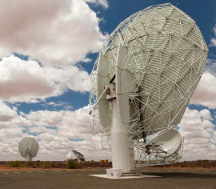
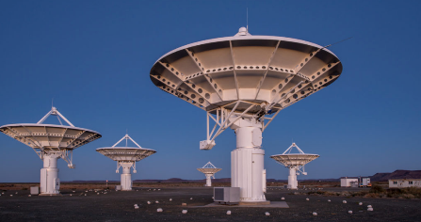
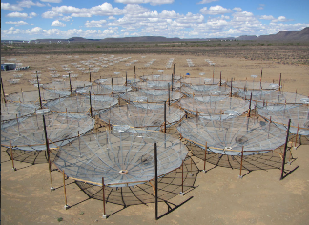
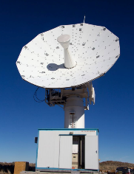
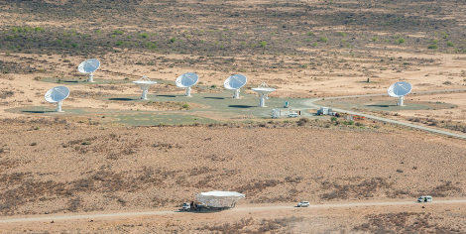
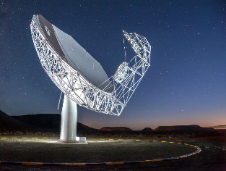
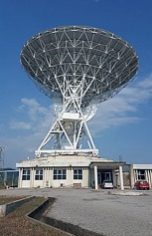

SKA Steerco
Project Cash Update
MTEF 2024/25
10 DECEMBER 2024
www.sarao.ac.za

Slide 2
SKAO Payment Schedule MTEF 2024/25 to 2026/27
RSA Observatory Funding Commitments:
  Cash contributions over the next 2.5 years (105,7m Euro) – indexation based on actual Inflationary adjustments can change this. Exchange rate risk to be mitigated by FEC contracts, we reviewing options based on engagements with bankers.
  Payments for 2024/25 = R451m (29 Nov 2024) Actual Payment
  Payments for 2025/26 = R786m (May 2025 and Nov 2025) aligned to MTEF
  Payments for 2026/27 = R868m (May 2026 and Nov 2026) aligned to MTEF

Slide 3
SARAO Cash Requirements Projected 2024/25 & 2025/26

Slide 4
Funding 24/25 & MTEF Next Year
Current Year 24/25
  DSI Finance confirmed balance to be received from BFI funding as per award letter R418m (2024/25)
Funding beyond 24/25 – Next MTEF
  Changes – such as INAF Revenue contract (included), updated cash flow for Buildings EOC Tenders, for SPC & SOC & Fencing Tender – cash flow to commence in next financial year
  SARAO applied for R4,5bn from BFI:
  R3,57bn for SKAO Membership Fees (4 years 2025-2028 – so includes Current year Payments + MTEF)
  R430m Buildings shortfall
  R300m SRC
  R200m Science Exploratorium and Other Projects

Slide 5
Update: BFI Submission
Funding submission for R4.5bn not approved by BFI
  Range of issues raised, although primary reason is 100% funding requirement
  Formal response submitted by SARAO on 29th October, with supplementary information – only acknowledgement of receipt was given
Following site visit with members of BFI Technical Evaluation Committee
  Technical lead at Infrastructure SA was tasked to prepare presentation to Minister for Public Works for, what appears to be, the design of a special funding mechanism or instrument for SKA
  Further information was provided, and we await outcome (December/January)
  Technical lead strongly recommended a follow-up meeting with DG’s of National Treasury, Public Works and DSTI

