Slide 1
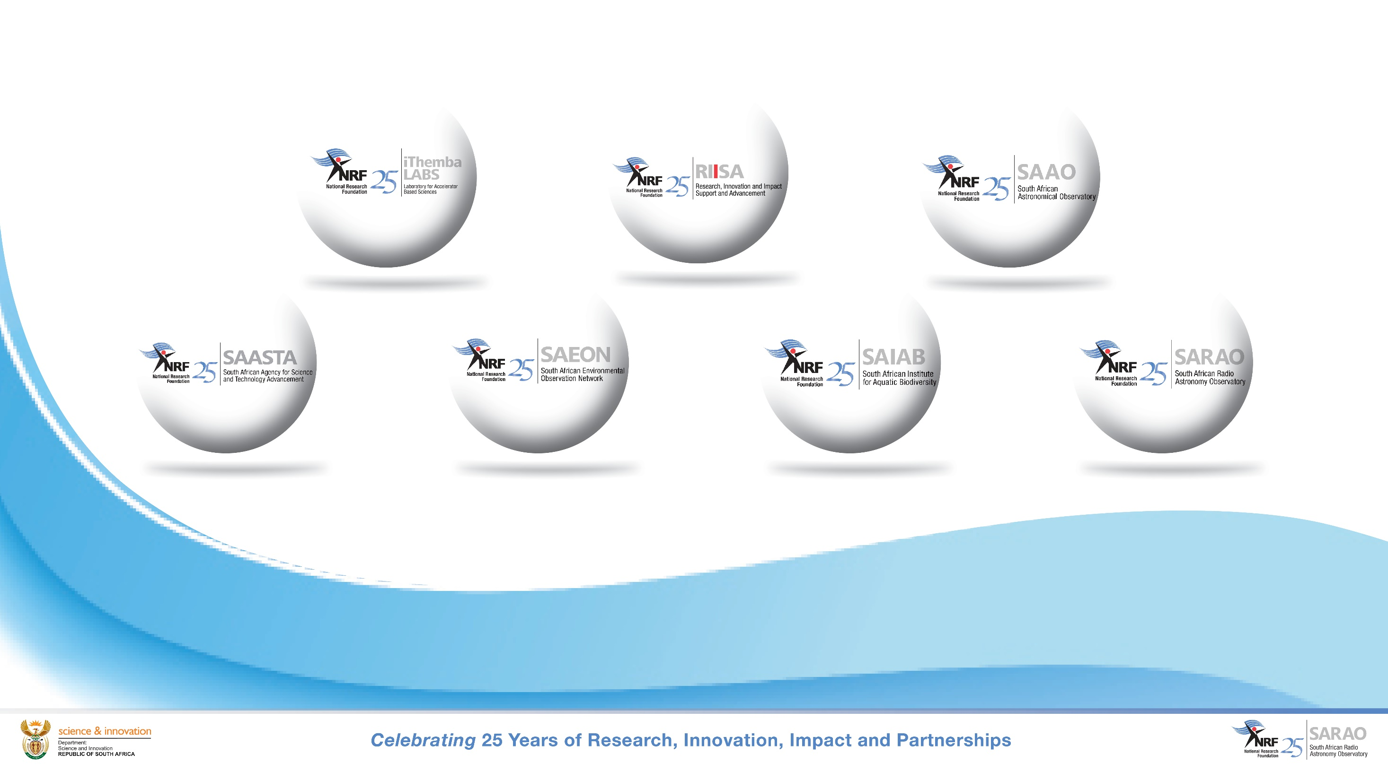
Ghana Radio Telescope: Status, Way Forward & Exit Strategy
SASSC Meeting, December 2024

Slide 2
Background
Agreement to establish Ghana Radio Astronomy Observatory signed in March 2013, subsequently renewed 6 times (expires December 2024)
R160 million cost thus far (including R10 million incurred by SARAO directly following exhaustion of African Renaissance Funding
  R150 million originally received through African Renaissance Fund
  Funding depleted circa 2020/21, after which costs absorbed into SARAO baseline – including current 2nd engineering phase

Slide 3
Status: Engineering, Science
Engineering (< 12 months)
  Four activities outstanding that are due for completion in 2024/25, which enables handover for science commissioning
Science
  Science commissioning could take 1-2 years after completion of engineering phase
    Subject to available science commissioning resources
  Possible science program post-commissioning includes VLBI as part of EVN, and single dish science
    Critical success factors
      Engaged scientists
      Concrete scientific proposal that can be carried out

Slide 4
Status: Operations
Despite range of interventions at institutional and political level, Ghana has failed to deliver against majority of its responsibilities and has made little progress in establishing a sustainable and resourced institution to take over and operate the radio telescope
  RSA has provided financial support (R1.5 million annually) for operations at GRAO since 2013
  Support personnel concept document developed by SARAO and presented to MESTI in 2017
    Ensured operational self-sustainability
  High level interventions with GAEC/GSSTI and MESTI to support operationalization, all of which failed due to following
    Moratorium on creation of new positions within GAEC/GSSTI
    No budget allocated within GAEC/GSSTI to support long term sustainable operations
  Since earlier interventions, some staff have been appointed linked to Kuntunse, including lead scientist Dr Proven Emmanuel

Slide 5
Situational Analysis
Engineering activities largely time bound (<1 year), using of existing resources
  Not completing would make it very difficult for GSSTI to initiate operations at any stage
Science commissioning could be undertaken (1-2 years duration) following engineering handover
  Subject to science commissioning resources being available (currently none)
  Process enables significant learning opportunities for operational institution (GSSTI)
  Could be supported through international collaboration and partnership (ie. EVN partners)
Significant concern regarding long term sustainability of Kuntunse
  Currently no operational entity ready to take over operations, with very little funding from MESTI

Slide 6
Recommended Exit Strategy
Noting that
  GSSTI will require 12 months to put in place operational structures necessary to initiate ops and maintenance activities (assume additional 6 months contingency), subject to funding
  GSSTI can collaborate with various EVN partners to support science commissioning
  GSSTI requires staff to support science commissioning, operations and maintenance
The following Exit Strategy is recommended, starting from January 2025
  Months 1-12: SARAO completes remaining engineering activities, which will enable commencement of science commissioning, operations and maintenance activities
  Month 18: SARAO hands over dish to GSSTI (assuming completion of engineering activities), under one of the following two scenarios:
    If GSSTI has established necessary capacity: SARAO collaborates with GSSTI on best effort basis to do science commissioning, led by GSSTI and supported by EVN partners
    If GSSTI has not established the necessary capacity: SARAO remains available to advise and collaborate on science commissioning once the necessary capacity has been put in place by GSSTI
  DSI to lead engagements with respective MESTI officials

Slide 7
Cost of Exit Strategy
Scenario 1: Completion of engineering phase, continued operations support, and science commissioning support assuming GSSTI has established internal capacity
  Human resources – ~R8 million
  Financial resources – R3 million
Scenario 2: Completion of engineering phase ONLY, and continued operations support until handover after 18 months
  Human resources – ~R5 million
  Financial resources – R3 million

