Slide 1

Africa Radio Astronomy Program: Update
SASSC Meeting, December 2024

Slide 2
Background
Recognising resourcing and other constraints, South African SKA Steering Committee (SASSC) requested update of Africa Strategy and Budget
  Presented to, and supported by, SASSC February 2022 and accepted by the APC Meeting June 2023
Key takeaways
  Countries
    Ghana - Continued support for operations in Ghana until such a time that an exit strategy can be agreed and executed
    Zambia and Madagascar - Infrastructure refurbishment not feasible
    Namibia - focus on Africa Millimetre Telescope partnership with a hope to incorporate VLBI operations
    Botswana – Prospect of MPG dish being deployed to be explored, superceding previous understanding of South African deployment
  Africa
    Two dish interferometer training telescopes (TAI) are to be rolled out to the APCs
    TART instruments are to be rolled out to all the APCs
    HIRAX potential deployment of outrigger telescopes in up to four partner countries, starting with Botswana
    Each partner country to develop a 10-year implementation plan in collaboration with SARAO

Slide 3
Africa Strategy & Objectives
Vision: The sustainable establishment of African science and technology networks and skills, and growth of science and technology capacity in the SKA Africa Partner Countries
ARAP broad objective to institutionalise radio astronomy in the African Partner Countries the following strategic interventions
  Implementation of programmes to ensure long-term site and programme sustainability in the Africa Partner Countries
  Provide support to the successful implementation of radio astronomy programmes in the Africa Partner Countries
  Actively exploit and support initiatives and programmes to further establish human capital in the Africa Partner Countries
  Develop Cyberinfrastructure and Big Data capabilities
  Facilitate implementation of co-located industry partnerships in the Africa Partner Countries
  Support collaborative programmes to deploy research infrastructure across the Africa Partner Countries
Specific actions and outcomes flowing from these strategic interventions are described in accompanying documents

Slide 4
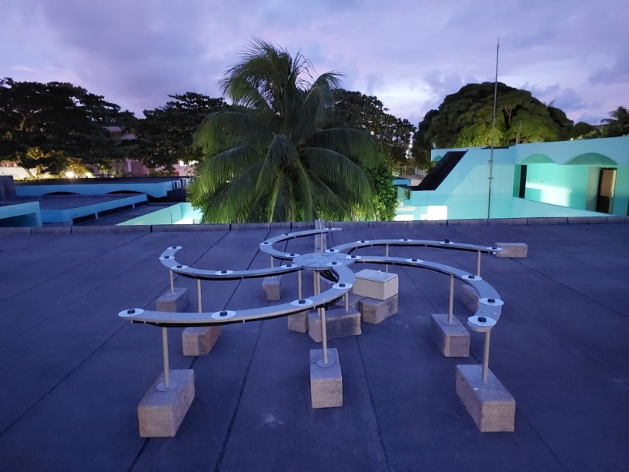
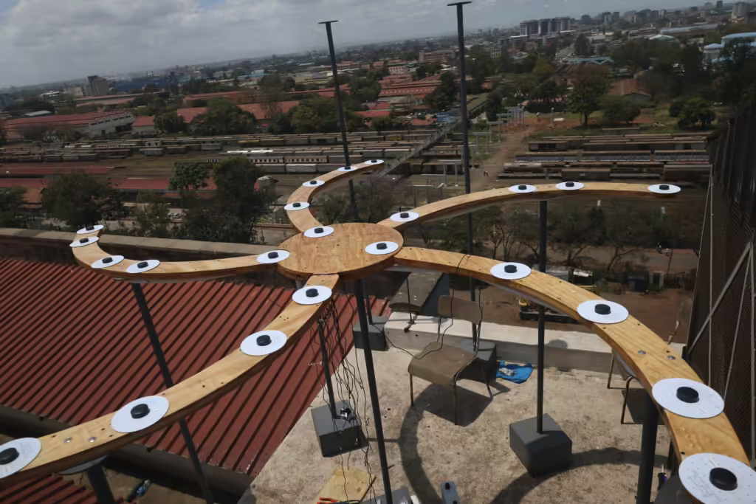
Milestones
Past 6 Months
Successful TART installations
  Mauritius and Kenya
Next 6 Months
TART installations
  Zambia (Jan)
  Mozambique (Mar)
In-house development, in collaboration with industry, for 2-dish interferometer (TAI)
  Next six to be done in-house in collaboration with industry
DARA Phase 3 Training at HartRAO (already completed)
Africa FIRST Pilot Rollout

Slide 5
Proposed Actions and Budget going Forward
Leveraged investments into broader Africa Program ~ R300 million
Country Specific Actions
  Ghana
    Complete engineering work
    Develop exit strategy
    Support ongoing operations until successful execution of exit strategy
  Botswana
    HIRAX – obtain letter of instruction from DSI, and conclude agreement with UKZN. Provide ongoing technical support at current level in South Africa
    MPG Dish – Meeting with Micheal Kramer indicated that MPG will retain ownership of dish and fund to operational level and 3 year maintenance for components supplied by MPG, no expectation for SARAO’s involvement.
      SARAO to meet with BIUST-MPG to clarify expectations and agree on level of participation. SARAO options for consideration (to be expanded prior to meeting)
      Technical training for dish maintenance to BIUST from South Africa
      Development of equipment within SARAO existing skills capacity and resources (depends on MPG plans as they own the dish)
General Actions
  Continue to exploit collaborative HCD opportunities
  Deploy two dish interferometer training telescope system in African Partner Countries, whilst identifying opportunities for local industrial involvement and international collaboration
  Deploy TART in African Partner Countries
ACTIVITY | 2024/2025 | 2025/2026 | 2026/2027 | To Completion
Strategic Intervention 2:
GHANA TELESCOPE
· Completion of the engineering work and technical set-up on the Ghana telescope - Ongoing operations until such time as a SARAO Exit Strategy is approved (see accompanying document: Status and Strategy for the Ghana Radio Telescope) | 1 500 000 | 1 500 000 | 1 500 000
Strategic Intervention 3:
TWO DISH INTERFEROMETER TRAINING TELESCOPE (TAI)
· In-House Development of 2-dish training telescope for each of the 8 partner countries, and local training |  | 6 000 000 | 6 406 000 | 7 000 000
Strategic Intervention 6:
TART TELESCOPE
· Installing TART telescope in 8 partner countries, and associated training | 1 050 000
HIRAX OUTRIGGER
· Transfer of DSI funding to enable installation of the HIRAX outrigger station in Botswana | 6 250 000 | 2 886 802
BOTSWANA DISH
· The extent of SARAO’s participation is not yet concluded and is to be confirmed |  | TBC | TBC
Annual Total (excl. Botswana Dish) | 8 800 000 | 10 386 802 | 7 906 000 | 7 000 000
Notes:
BIUST HIRAX funding subject to appropriate agreement and letter of instruction from DSI
BIUST MPG Dish involvement subject to further discussion with BIUST and MPG

Slide 6
Resource Requirements on Current Path
ACTIVITY | 2024/2025 | 2025/2026 | 2026/2027
Strategic Intervention 2:
GHANA TELESCOPE
· Completion of the engineering work and technical set-up on the Ghana telescope | 1 500 000 | 1 500 000 | 1 500 000
- Ongoing operations until such time as a SARAO Exit Strategy is executed
- Resources | 2 FTE | 8 FTE
 | 2 000 000 | 8 000 000
Strategic Intervention 3:
TWO DISH INTERFEROMETER TRAINING TELESCOPE (TAI)
·-In-House Development of 2-dish training telescope for each of the 8 partner countries, and local training | 0 | 6 000 000 | 6 406 000
- Resources | 0.6 FTE | 12 FTE
 | 600 000 | 12 000 000
Strategic Intervention 6:
TART TELESCOPE
· Installing TART telescope in 8 partner countries, and associated training | 1 050 000 | 0 | 0
- Resources | 1.1 FTE
 | 1 100 000
HIRAX & HIRAX OUTRIGGER
· Transfer of DSI funding to enable installation of the HIRAX outrigger station in Botswana, subject to DSI letter of instruction and funding transfer | 6 250 000 | 2 886 802 | 0
- Resources | 0.1 FTE | 1 FTE
 | 100 000 | 1 000 000
Annual Total (excl. Human Resources) | 8 800 000 | 10 386 802 | 7 906 000
Annual Total (incl. Human Resources) | 12 600 000 | 20 886 802 | 18 406 000
Resource requirements calculated to completion of projects
Average salary costs assumed
Cost over 2024/25 – 2026/27
  R27.1M (+R7M) excl. human resources
  R51.9M (+R7M) incl. human resources
  Note: Above costs exclude BIUST-MPG dish, which requires resolution

Slide 7
Recommendation
SASSC to discuss the proposed Africa implementation plan

Slide 8
Additional Information: APC Activities to Date
Mauritius
TART Installed
Training
HPC delivered
20 HCD grants
Madagascar
Institute being established
Site assessment
HPC delivered
Training
41 HCD grants
Kenya
Site assessment conducted (Longonot)
HPC delivered
Training
TART Installation August 2024
28 HCD grants
Ghana
GRAO launched
Kuntunse Dish conversion
HPC delivered
Colocation Pilot
Training
14 HCD grants
Namibia
Two HPC installations
Training
1 site assessed (HESS)
Exploring the AMT partnership
7 HCD grants
Botswana
HPC installation
Identified sites, 5 assessed
2 dish interferometer installed
HIRAX Outrigger
MPI dish 2025
Training
27 HCD grants
Zambia
Conversion site secured, mast challenge
SKA2 Site secured
HPC installation
Training
15 HCD grants
Mozambique
20 PC lab delivered
Training
8 HCD grants

