Slide 1




Experimental Study of Fission and Capture Reaction Rates over the Volume of Massive Uranium Target under Relativistic p, D and ¹²C Irradiation
A.A. Zhadan¹, A.A. Baldin², K.V. Gusak³,V.V. Sotnikov¹, S.I. Tyutyunnikov²,
V.A. Voronko¹, P. Zhivkov⁴, I.V. Zhuk³
¹NSC Kharkov Institute of Physics and Technology, Kharkov, Ukraine
²Joint Institute for Nuclear Research, Dubna, Russia
³Joint Institute for Power and Nuclear Research, Minsk, Belarus
⁴Institute of Nuclear Research and Nuclear Energy, Sofia, Bulgaria
The XIV-th International School-Conference «The Actual Problems of Microworld Physics»

Slide 2
Objectives
In the period of 2011 - 2016 the nuclear physical characteristics of deep-subcritical uranium target assembly Quinta (mass of natural uranium 512 kg) under relativistic protons, deuterons and carbon ions irradiation have been studied within the framework of the international project "Energy and Transmutation of RAW".
The Quinta assembly was irradiated with 0.66 GeV protons, 1, 2, 4 and 8 GeV deuterons and 24, 48 GeV carbon ions from the Phasotron and Nuclotron accelerators at the Joint Institute for Nuclear Research (JINR), Dubna.
One of the main collaboration objectives is to study of dependence of neutron generation in the uranium target on primary beam energy and accelerated particles type.
The experiments carried out by Kharkov team were mainly connected with the measurement of the spatial distributions of capture reaction 238U(n,γ) and natU fission reaction rates, as well as determination of the integral numbers of capture and fission reactions in the volume of uranium target, using the activation technique.
The XIV-th International School-Conference «The Actual Problems of Microworld Physics»

Slide 3
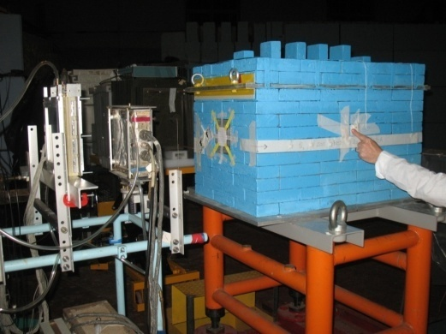
Quinta subcritical assembly
The parameters of uranium assembly:
length - 65 cm;
lateral dimensions ~ 30 cm;
U mass - 512 kg;
Quinta is a deeply subcritical nuclear assembly with
𝑘_{eff} of 0.22.
d
The XIV-th International School-Conference «The Actual Problems of Microworld Physics»
Notes:
the effective neutron multiplication factor k, also denoted by K_{eff}

Slide 4
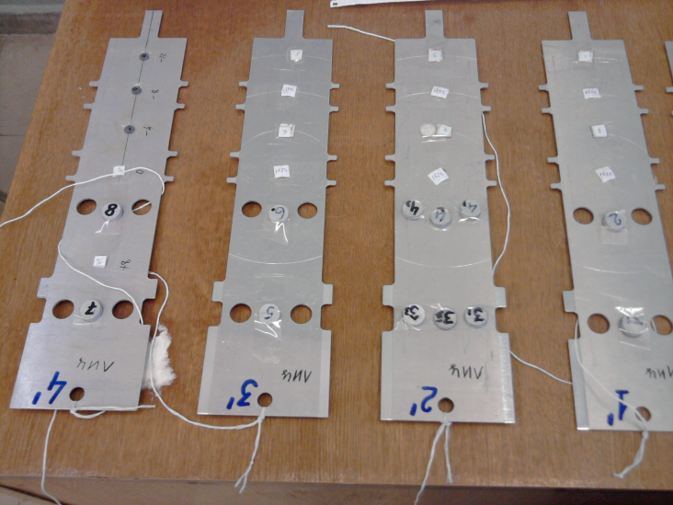
Location of uranium activation detectors on the detector plates
Section № 1
Sections № 2,3,4,5
Detector plates
5
5
1
2
2
3
3
4
4
For ²³⁸U(n,γ) and ^{nat}U(n,f) reaction rate measurements the activation detectors from natural metallic uranium (diameter 8 mm, thickness 1 mm, mass ~ 0.9 g) were used (29 activation detectors in each irradiation).
5 R = -80 mm
1 R = 0
2 R = 40 mm
3 R = 80 mm
4 R = 120 mm
The XIV-th International School-Conference «The Actual Problems of Microworld Physics»

Slide 5
Beam parameters
Total intensity of primary beams
Monitoring of deuteron, proton and ¹²C nuclei beams was carried out by activation of aluminum and copper foils in the reactions
²⁷Al(d,x)²⁴Na, ²⁷Al(p,x)²⁴Na ²⁷Al(¹²C,x)²⁴Na,
⁶⁴Cu(d,x)²⁴Na and ⁶⁴Cu(¹²C,x)²⁴Na.
Next cross sections were used:
 | Energy GeV | CS (Al) mb | CS (Cu) mb
p | 0.66 | 10.8 | 0.31
d | 1 | 16.8 | -
 | 2 | 15.4 | 3.8
 | 4 | 14.6 | 6.0
 | 8 | 14.0 | 6.3
¹²C | 24 | 19.4 | 9.5
 | 48 | 19.0 | 9.5
Cross sections of these reactions for given beam energy were chosen by averaging and interpolation of known experimental values
Total intensities were 10¹² - 10¹⁴ beam particles in different RUNs
The XIV-th International School-Conference «The Actual Problems of Microworld Physics»

Slide 6
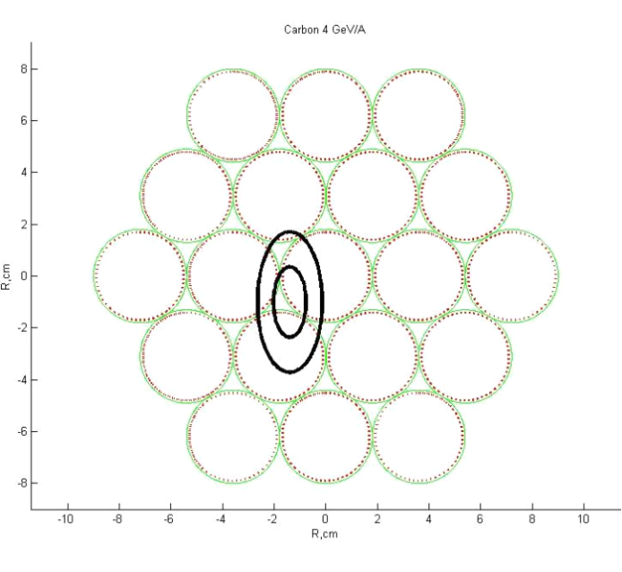
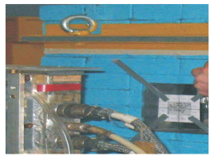
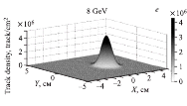
Beam parameters
Beam shape and position at the front end of the target
(I. Zhuk team from Belarus)
The beam positioning and beam shape were found using an array of fission track detectors measuring beam induced natPb(d, f) fission track densities.
These were placed directly on the front of the targets along the X and Y axes of the Quinta assembly. The track densities from ^{nat}Pb(d, f) reactions were fitted to a Gaussian distribution function to obtain the beam profile.
These values used for compare measured reaction rates in different irradiation runs, for interpolation of the integral numbers of reactions and for simulate experiments by
Codes.
The XIV-th International School-Conference «The Actual Problems of Microworld Physics»

Slide 7
Determination of the capture reaction rates (accumulated plutonium)
The number of ²³⁸U neutron radiative capture reactions corresponds to the number of ²³⁹Pu nuclei, which are formed by the chain of ²³⁹U β-decay:
²³⁸U(n,γ)²³⁹U β⁻ (23,54 min) →²³⁹Np β⁻ (2,36 d) →²³⁹Pu
After the irradiation of uranium assembly γ-spectra of irradiated uranium foils were measured using HPGe detectors. Before measurement uranium foils were exposure for more than 4 hours to reach 99.9% of the decays of ²³⁹U. The reaction rate of neutron capture of uranium-238 was determined by measuring the activity of the ²³⁹Np nuclide.
The XIV-th International School-Conference «The Actual Problems of Microworld Physics»

Slide 8
Determination of the fission reaction rates
Fissions reaction rates were determined by yield of gamma-lines
743.36 keV, 364.49 keV, 529.9 keV, and 293.3 keV
of fission fragments
⁹⁷Zr, ¹³¹I, ¹³³I and ¹⁴³Ce
Cumulative yields (CY) of these fragments remain approximately constant in a wide range of neutron energies from the fission-spectrum neutrons to neutrons with energy 60 MeV. We used the next values of CY (average evaluated data for fission-spectrum and 14 MeV)
⁹⁷Zr -5.7%, ¹³¹I -3.6%, ¹³³I -6.3%, ¹⁴³Ce -4.3%.
Fission rates obtained for 97Zr, 131I, 133I and 143Ce then averaged.
The XIV-th International School-Conference «The Actual Problems of Microworld Physics»

Slide 9
Axial distribution of reaction rates
The experimental axial distribution of ^{nat}U fission and capture reaction rates for deuteron and ¹²C ion primary beams with various energy.
Value of reaction rates normalized per one gram of ^{nat}U, per one incident particle and per 1 GeV particle energy. For this normalization, the distributions of reaction rates of one type of primary particles is close together for all beam energies.
But one can see that with increasing beam energy, a relative decrease in the number of reactions at the first half of the target is observed in the axial distributions of uranium fission events, and a slight increase in these quantities is observed at the same time at the second half of the target along the direction of the primary beam.
The XIV-th International School-Conference «The Actual Problems of Microworld Physics»

Slide 10
Radial distribution of reaction rates
(example for deuteron beams)
Capture
Fission
Spectral index
With the increase of primary deuteron energy the density of number of uranium fission and number of produced ²³⁹Pu nuclei is reduced in the near field to the deuteron beam input at the target and at the same time there is an increase in the number of uranium fission and number of produced ²³⁹Pu to the periphery of the target. Spectral index (the ratio between the average cross sections of neutron capture and uranium fission) is most suitable for comparison with the results of calculations as it does not contain errors of deuteron flux definition. The spectral indices change from the axis of the deuteron beam to the periphery of the uranium target from about 0.4 to 2, indicating a softening of the neutron spectrum, and do not depend on the energy of the beam in the range of 1…8 GeV.
The XIV-th International School-Conference «The Actual Problems of Microworld Physics»

Slide 11
Total number of reactions in the uranium target
The total number of fission and capture in the volume of uranium target was determined by numerical integration of the measured uranium fission rate spatial distributions in the approximation of a cylindrical target with radius R = 143 mm (the vertical size of the uranium target sections).
The determination of the integral values was carried out taking into account:
the radial volumes for each point,
the effective density of uranium in each section (the mass of the uranium section divided by the geometric volume of the section) and
the beam position on the target (recalculation of the foil distances from the beam axis).
The XIV-th International School-Conference «The Actual Problems of Microworld Physics»

Slide 12
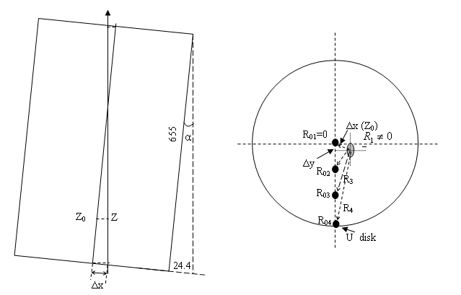
Actual radial distance
The actual position of the uranium detectors relative to the axis of the primary beam
where,
ΔX, ΔY - the primary beam centre coordinates at the front end of QUINTA (SSNTD beam parameters)
The XIV-th International School-Conference «The Actual Problems of Microworld Physics»

Slide 13
Total number of reactions in the uranium target
The total numbers of fission and capture reaction obtained for the TA Quinta are shown in Table per one accelerated particle and, per beam power. Errors in this values obtained for deuteron beams are given in the table without taking into account the systematic error (10%) in the reference cross-section of the Al(d, x)24Na reaction used for determining the total intensity of the deuteron beams.
Beam, GeV | N_{f} /ion | N_{f}/ion/GeV
p(0.66) | 4.1 ± 0.3 | 6.2 ± 0.5
D(1) | 8.9 ± 0.6 | 8.9 ± 0.6
D(2) | 19 ± 1 | 9.7 ± 0.6
D(4) | 37 ± 2 | 9.2 ± 0.5
D(8) | 71 ± 4 | 8.9 ± 0.5
¹²C(24) | 160±20 | 6.7±0.9
¹²C(48) | 340±40 | 7.1±0.8
Beam, GeV | N_{c}/ion | N_{c}/ion/GeV
p(0.66) | 5.7 ± 0.5 | 8.6 ± 0.7
D(1) | 11.2 ± 0.6 | 11.2 ± 0.6
D(2) | 25±2 | 12.7±0.8
D(4) | 45± 3 | 11.3 ± 0.5
D(8) | 84 ± 4 | 10.5 ± 0.5
¹²C(24) | 210±25 | 8.6±0.8
¹²C(48) | 384±45 | 8.0±0.8
It should be noted that total number of the fission reaction (per beam power) in the volume of the uranium target Quinta for deuteron beams with energies from 1 to 8 GeV is independent of the beam energy within the limits of statistical errors (up to 7- 10%).
The total number of fission for deuterons is in 1.4 to 1.5 times greater than for protons with energy of 660 MeV at the same beam power. In the case of ¹²C ions, the total number of fission is noticeably lower than in case of deuteron irradiation.
For the integral number of capture reactions we have seen a small max at 2 GeV deuteron energy
The XIV-th International School-Conference «The Actual Problems of Microworld Physics»

Slide 14
Integral numbers of fission reaction
The XIV-th International School-Conference «The Actual Problems of Microworld Physics»

Slide 15
Simulation
(Piter Zhivkov,Bulgaria)
The irradiation of the Quinta assembly was simulated using MCNPX 2.7 code. The INCL4 intra-nuclear cascade model, the ABLA fission-evaporation model and LAQGSM (for carbon beams) code were used. Neutron transport cross section libraries from the ENDF/B-VII evaluation and the INCL4-ABLA physics model were used.
The neutron and charge particle spectrum at the location of irradiated samples was calculated and then the convolution with cross-sections from ENDF/B-VII evaluation was performed.
In the simulation the detailed geometric model of the target QUINTA and experimental data about beam shape and position on the target were employed.
The XIV-th International School-Conference «The Actual Problems of Microworld Physics»

Slide 16
Comparison of experimental results with model predictions
Experimental values with the overall uncertainties ~ 14%
MCNPX code simulation of integral number of fissions and capture reactions is in agreement with the experimental data in the range of 20%.
In case of carbon beam we have 35% deviation
The XIV-th International School-Conference «The Actual Problems of Microworld Physics»

Slide 17
Comparison of experimental results with model predictions
Axial distributions of the fission events
Figure shows the axial distribution of natU fission rates for uranium samples at R = 8 cm. As can be seen in the case of the 2 GeV deuteron beam there is a good agreement between the calculation and experiment. But with increasing beam energy there is an increasing discrepancy between the experimental and calculated data only for the first three detector plates (Z = 0, 123 and 254 mm).
Such a discrepancy in backward direction from beam path in target is also observed for samples at R = 4 cm and 12 cm.
The XIV-th International School-Conference «The Actual Problems of Microworld Physics»

Slide 18
Conclusions
The integral number of fissions reactions in the volume of uranium target of QUINTA, that was defined by activation method, remains approximately constant within our statistical errors for 1, 2, 4 and 8 GeV deuteron beams and for 24 and 48 GeV carbon beams (per a beam particle and per 1 GeV energy)
For the integral number of capture reactions we have seen a small maximum at 2 GeV deuteron energy
The integral number of fissions reactions for deuteron beams more than ~1.46 times for 660 MeV proton beam (per 1 GeV)
The integral number of fission and capture reactions for carbon beams is smaller than for deuteron beams by 25% - 30% at the same beam power and for beam energy 2 - 4 AGeV
MCNPX code simulation of integral number of fissions and capture reactions is in agreement with the experimental data in the range of 20%. In case of carbon beam we have 35% deviation between experimental and simulated data
For spatial distribution of reaction rates in case of 4 and 8 GeV deuteron beams we have seen a large discrepancy between the experimental and calculated values in backward direction (for the first three detector plates Z = 0, 123 and 254 mm).
The XIV-th International School-Conference «The Actual Problems of Microworld Physics»

Slide 19
THANK YOU FOR YOUR ATTENTION

