Slide 1
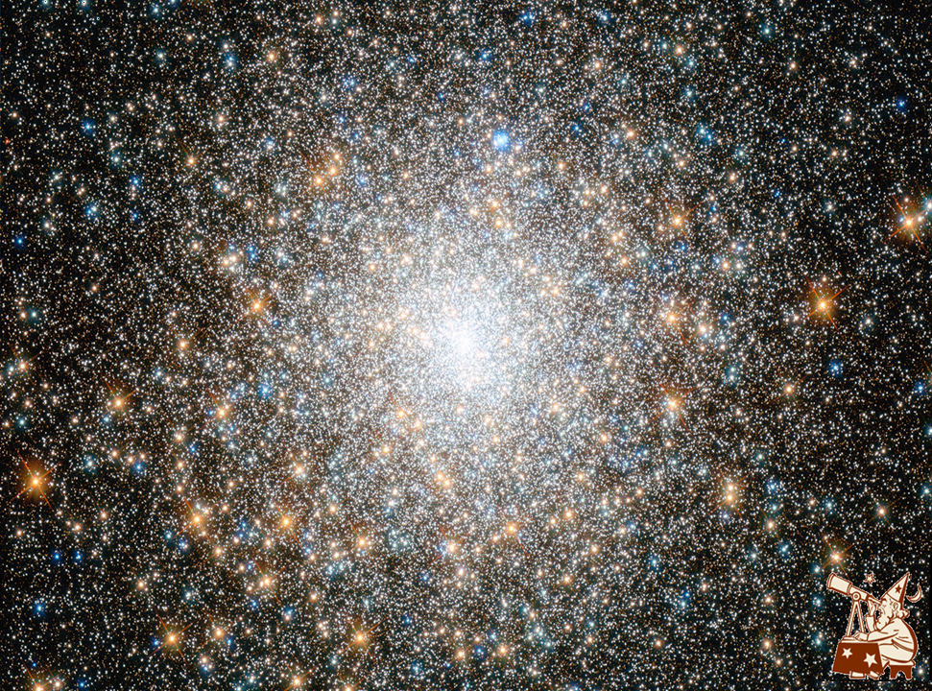

Slide 2


Notes:
2

Slide 3
M. A. SERDYUKOVA, A. N. SERDYUKOV
Frantsysk Skaryna State University, Gomel, Belarus
How Far Can One Get with a Linear Field Theory of Gravitation
in Flat Space-Time?
Notes:
3

Slide 4
1
GRAVITATION IN FLAT
SPACE-TIME: MOTIVATIONS
Notes:
4
4

Slide 5

Hubble’s Gravitational Background and the Cyclic Dynamics of a Quiet Universe
The Einstein’s idea of a dynamic generalization of Newtonian law of gravitation on the base of strong principle of equivalence lead to the metric approach in gravity [1].
Its persistent success contributed to the common certainty that Riemannian geometry is the best language that enables us to adequately describe and truly interpret the relativistic dynamics of the gravitational field.
847.
Notes:
5
5

Slide 6
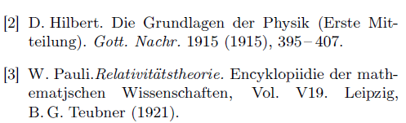
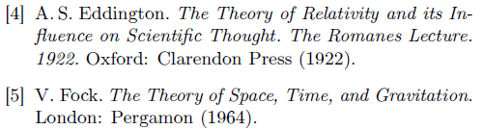
Hubble’s Gravitational Background and the Cyclic Dynamics of a Quiet Universe
Several generations of scientists who contributed to the development or popularization of general relativ­ity, like the first of them, David Hilbert [2], Wolfgang Pauli [3], and Arthur Eddington [4], noted the heuristic power of the Einstein's version of equivalence princi­ple and admired the beauty inherent in general relativity. Almost all of them did not doubt, like Vladimir Fock, that Einstein's field equations "represent one of the greatest achievements of human genius" [5] (p. 396).
Notes:
6
6

Slide 7

Hubble’s Gravitational Background and the Cyclic Dynamics of a Quiet Universe
‘‘…a theory with beauty and elegance of Einstein’s theory has to be substantially correct.’’
Notes:
7
7

Slide 8

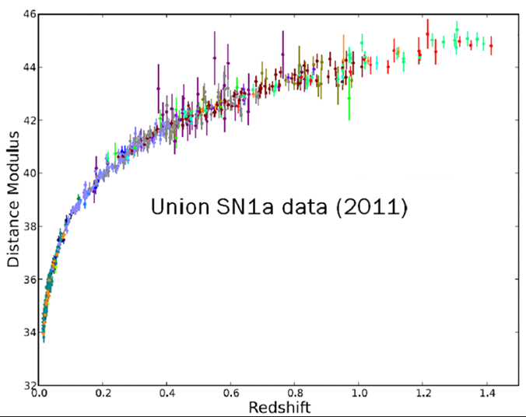
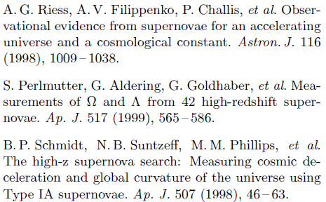
Hubble’s Gravitational Background and the Cyclic Dynamics of a Quiet Universe
1.1 Unanswered cosmological challenge to general relativity
Notes:
8
8

Slide 9
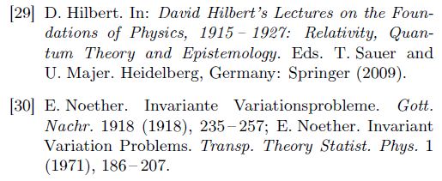
Hubble’s Gravitational Background and the Cyclic Dynamics of a Quiet Universe
1.2 Unresolved problems of general relativity: Troubles with conservation laws
The principal impossibility of a mathematically rig­orous formulation of the energy conservation law in gen­eral relativity was first noted by David Hilbert as a characteristic feature of this theory right after its ad­vent [29] (pp. 16-17). The proof of Hilbert's conjecture about the failure of this law in the newfound theory was immediately obtained by Emmy Noether in her famous article [30] as a special case along with the loss of other conservation laws in this theory of gravitation.
Notes:
9
9

Slide 10
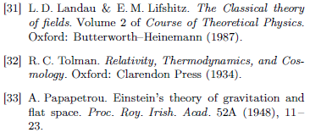
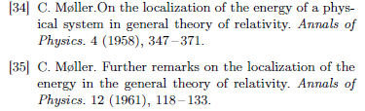

Hubble’s Gravitational Background and the Cyclic Dynamics of a Quiet Universe
Initially Einstein [1] and then his numerous followers, in particular, [31], [32], [33], [34], [35], [36], based on the derived in [1] field equations of gravitation and using a technique similar to the one developed in electrodynamics, attempted to construct the local form of the equation of conservation of energy-momentum for the gravitational field. But this program proved to be impracticable, as it should be by virtue of the Noether’s theorem, so that the solutions to the raised problem that were offered at different times have turned out to be illusory. All these unavoidable failures simply led in another way to a clear understanding of the absence in general relativity of a whole series of fundamental conservation laws, which form an integral part of the special theory of relativity.
Notes:
10
10

Slide 11

Hubble’s Gravitational Background and the Cyclic Dynamics of a Quiet Universe
We believe unacceptable the erosion of these clear physical concepts even for the sake of the exciting idea that the geometry of space-time in general relativity is not given a priori, but is determined by the distri­bution of matter, and this fact is considered as a re­markable achievement of this theory in a philosophical sense (for example, see [53] or [3] (p. 149)). We must not forget that on the other side of the scales lies the outstanding achievement of a higher philosophical reso­nance - this is the emergence of conservation laws from the undistorted symmetry of Minkowskian space-time that is established by Noether's theorem. For this rea­son we cannot agree with the obviously physically unac­ceptable assertion that "the conservation of energy and momentum is only approximate" [54] (p. 45) and “ "total mass-energy" is a limited concept, useful only when one adopts a limited viewpoint that ignores cosmology“ [42] (p. 463).
Notes:
11
11

Slide 12
Hubble’s Gravitational Background and the Cyclic Dynamics of a Quiet Universe
Fortunately, the quoted statement, as we shall see, is not a proven scientific truth, but only a point of view of the authors of the book in question, who them­selves developed the theory of gravitation very actively. Of course, it was also the point of view of a whole gen­eration of physicists who were quite satisfied with the status quo of energy in the theory of the gravitational field in the happy 1970s-1980s, not yet overshadowed by the upcoming discoveries in astronomy that would be called "dark".
Notes:
12
12

Slide 13
Hubble’s Gravitational Background and the Cyclic Dynamics of a Quiet Universe
In summary, we must recognize that Einstein's gen­eralization of the empirical law of the proportionality of inertial and gravitational masses in the form of strong principle of equivalence is fatal for funda­mental special-relativistic laws of conservation for en­ergy, momentum, angular momentum, and center-of-mass motion. Of course, the most appreciable unwanted circumstances for the cosmology based on general rel­ativity arise in connection with the loss of the law of energy conservation. A lot of time and effort, expended by researchers in numerous but invariably unconvincing attempts to solve the problem of the nature of dark en­ergy, convinces us that an understanding of the essence of gravity, where "Anybody who looks for a magic formula for "local gravitational energy-momentum" is looking for the right answer to the wrong question" [42] (p. 467), is a useless toy for repelling the present chal­lenges of observational cosmology.
Notes:
13
13

Slide 14
Hubble’s Gravitational Background and the Cyclic Dynamics of a Quiet Universe
UNSOLVED PROBLEMS OF GRAVITY:
POSITIVITY OF ENERGY DENSITY
When searching, instead of a metric one, the really field approach to the problem of gravity, a direct electro­magnetic analogy may seem promising for constructing a dynamic theory of the gravitational field, taking into account the obvious similarity between the Coulomb and Newtonian static fields. James Clerk Maxwell was the first to try to construct such a theory, taking ad­vantage of this circumstance.
Notes:
14
14

Slide 15
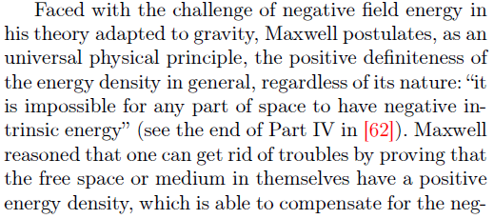
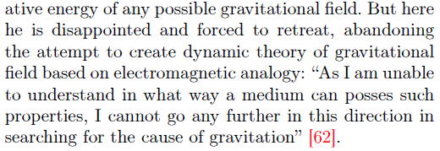
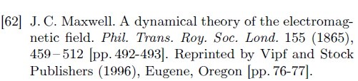
Hubble’s Gravitational Background and the Cyclic Dynamics of a Quiet Universe
1.2 Unsolved problem with gravity: Maxwell principle
Notes:
15
15

Slide 16



Hubble’s Gravitational Background and the Cyclic Dynamics of a Quiet Universe
The negative expression
is widely known in general relativity as the energy density of static gravitational field in Newtonian approximation. It can de found, for example, in books (list is very far of completeness)
Notes:
16
16

Slide 17
Hubble’s Gravitational Background and the Cyclic Dynamics of a Quiet Universe
It should not be inferred from our discussion that the violation of the principle of positive definiteness of the energy density is a sign only of the vector model of gravity. Actually, this is a well-known conceptual chal­lenge of the gravitational interaction facing theoretical physics in general. This unsolved problem has a long history, but it seems that its existence in limbo does not bother anyone today.
Having penetrated into cosmology along with grav­ity, the negative energy density is now not considered as something that can cause a protest, but this illegal phenomenon is even deliberately introduced, for exam­ple, together with hypothetical fields with the negative density of the kinetic energy, creating wrong scenar­ios of the universe evolution and problem of its insta­bility. The absolute profanation of the science of the universe, resulting from the negative energy density of the gravitational field, are, of course, the zero-energy universe and the miracle of the multiple creation of universes from nothing in grandiose vacuum fluctua­tions [72].
Notes:
17
17

Slide 18
2
MINIMAL RELATIVISTIC EXTENSION OF NEWTONIAN GRAVITY
Notes:
18
18

Slide 19

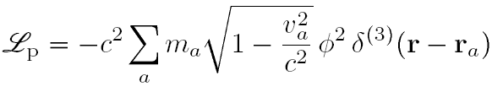
Hubble’s Gravitational Background and the Cyclic Dynamics of a Quiet Universe
2.1 Scale-invariance one of the forms of gauge invariance
Notes:
19
19

Slide 20



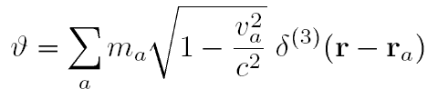

Hubble’s Gravitational Background and the Cyclic Dynamics of a Quiet Universe
2.2 Nordstroem mechanics and spin-0 field equations
Notes:
20
20

Slide 21
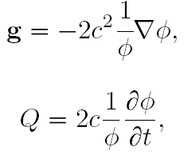

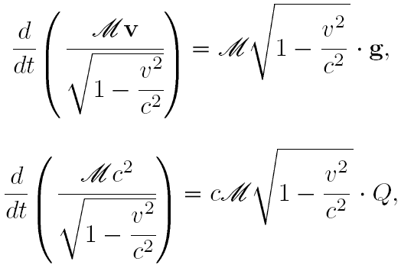

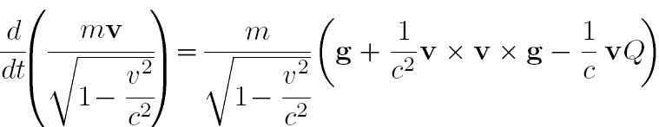
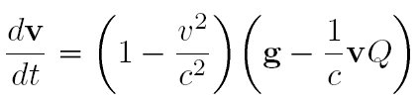
Hubble’s Gravitational Background and the Cyclic Dynamics of a Quiet Universe
Notes:
21
21

Slide 22




Hubble’s Gravitational Background and the Cyclic Dynamics of a Quiet Universe
Notes:
22
22

Slide 23


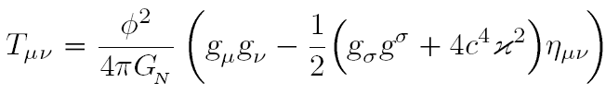



Hubble’s Gravitational Background and the Cyclic Dynamics of a Quiet Universe
Notes:
23
23

Slide 24
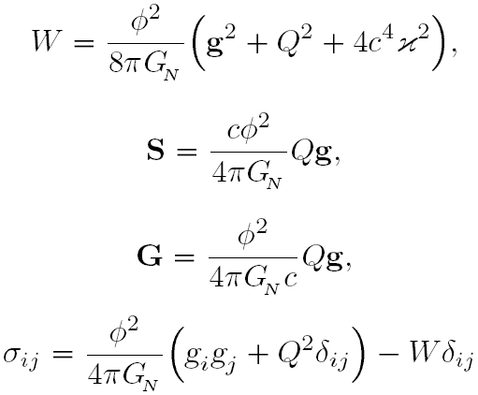
Hubble’s Gravitational Background and the Cyclic Dynamics of a Quiet Universe
Notes:
24
24

Slide 25
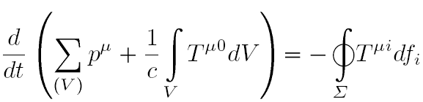

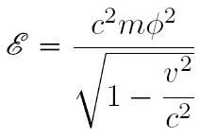
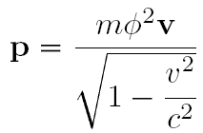

Hubble’s Gravitational Background and the Cyclic Dynamics of a Quiet Universe
Notes:
25
25

Slide 26
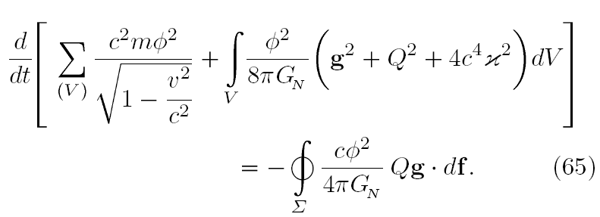

Hubble’s Gravitational Background and the Cyclic Dynamics of a Quiet Universe
Notes:
26
26

Slide 27
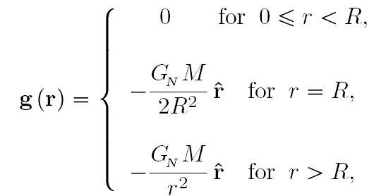
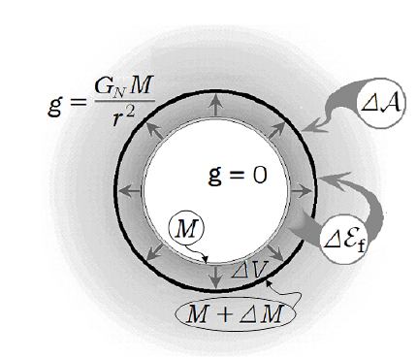



Hubble’s Gravitational Background and the Cyclic Dynamics of a Quiet Universe
Notes:
27
27

Slide 28
M. A. SERDYUKOVA, A. N. SERDYUKOV
Frantsysk Skaryna State University, Gomel, Belarus
Hubble’s Gravitational Background
and the Cyclic Dynamics
of a Quiet Universe
Notes:
28

Slide 29
М. А. СЕРДЮКОВА, А.Н. СЕРДЮКОВ
Гомельский госуниверситет им. Ф. Скорины, Гомель, Беларусь
Хаббловский гравитационный фон
и циклическая динамика
спокойной Вселенной
Notes:
29

Slide 30
3
CYCLIC DYNAMICS
OF GRAVITATING UNIVERSE
Notes:
30
30

Slide 31
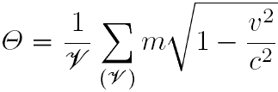

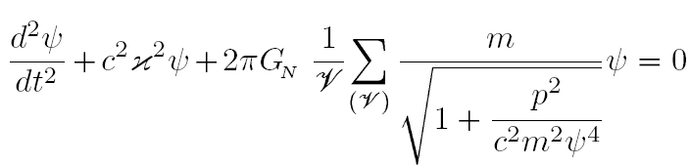
Hubble’s Gravitational Background and the Cyclic Dynamics of a Quiet Universe
Notes:
31
31

Slide 32
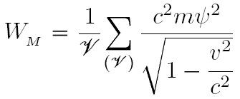
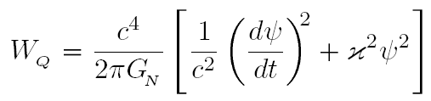

Hubble’s Gravitational Background and the Cyclic Dynamics of a Quiet Universe
Notes:
32
32

Slide 33

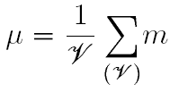



Hubble’s Gravitational Background and the Cyclic Dynamics of a Quiet Universe
Notes:
33
33

Slide 34






Hubble’s Gravitational Background and the Cyclic Dynamics of a Quiet Universe
Notes:
34
34

Slide 35
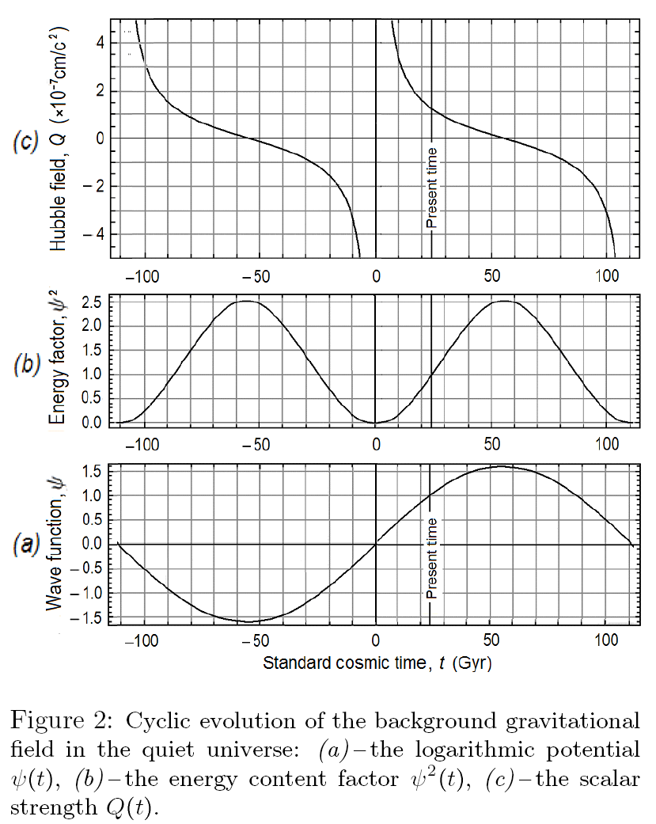
Hubble’s Gravitational Background and the Cyclic Dynamics of a Quiet Universe
Notes:
35
35

Slide 36
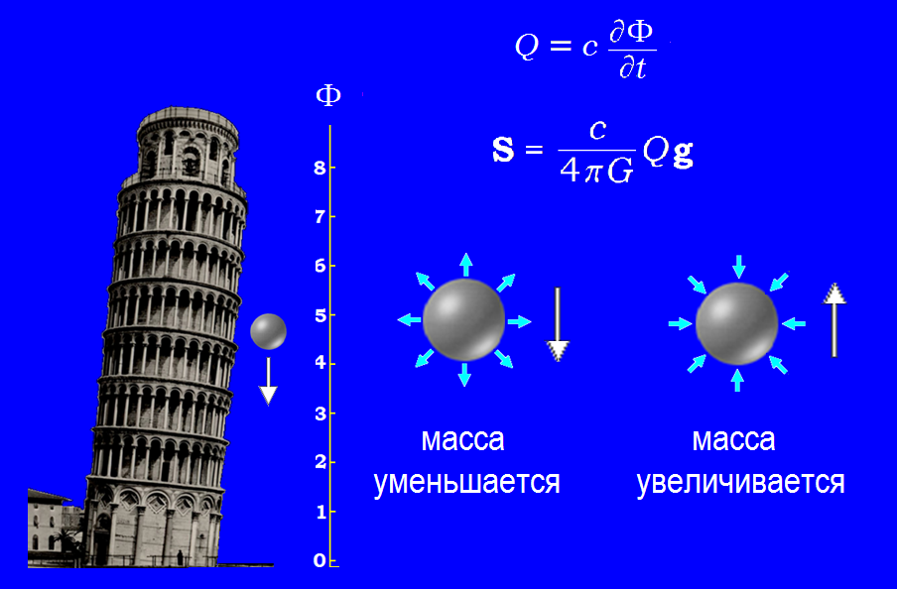




Hubble’s Gravitational Background and the Cyclic Dynamics of a Quiet Universe
Gravitational origin of inertial mass
Notes:
36
36

Slide 37




Hubble’s Gravitational Background and the Cyclic Dynamics of a Quiet Universe
Gravitational origin of inertial mass
Mach’s principle
Notes:
37
37

Slide 38

Hubble’s Gravitational Background and the Cyclic Dynamics of a Quiet Universe
Notes:
38
38

Slide 39

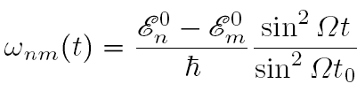


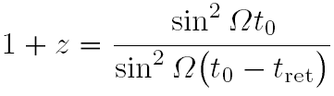
Hubble’s Gravitational Background and the Cyclic Dynamics of a Quiet Universe
Notes:
39
39

Slide 40









Hubble’s Gravitational Background and the Cyclic Dynamics of a Quiet Universe
Notes:
40
40

Slide 41

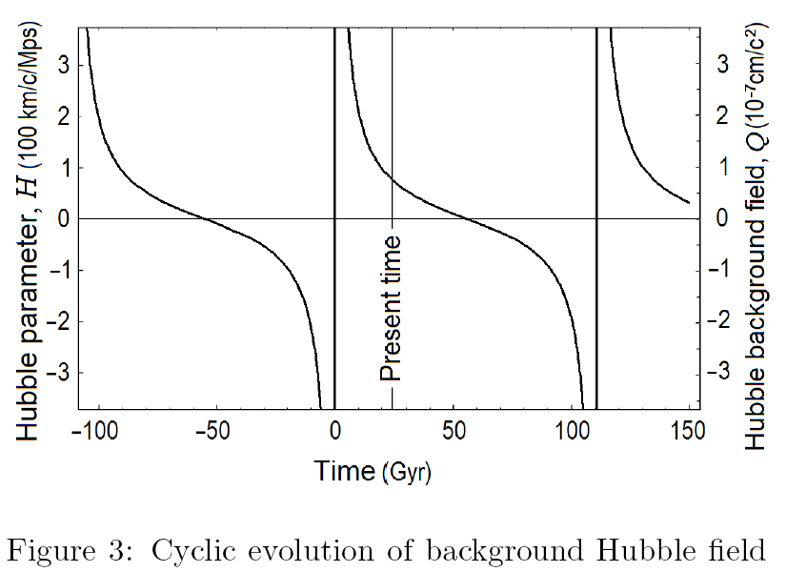
Hubble’s Gravitational Background and the Cyclic Dynamics of a Quiet Universe
Notes:
41
41

Slide 42
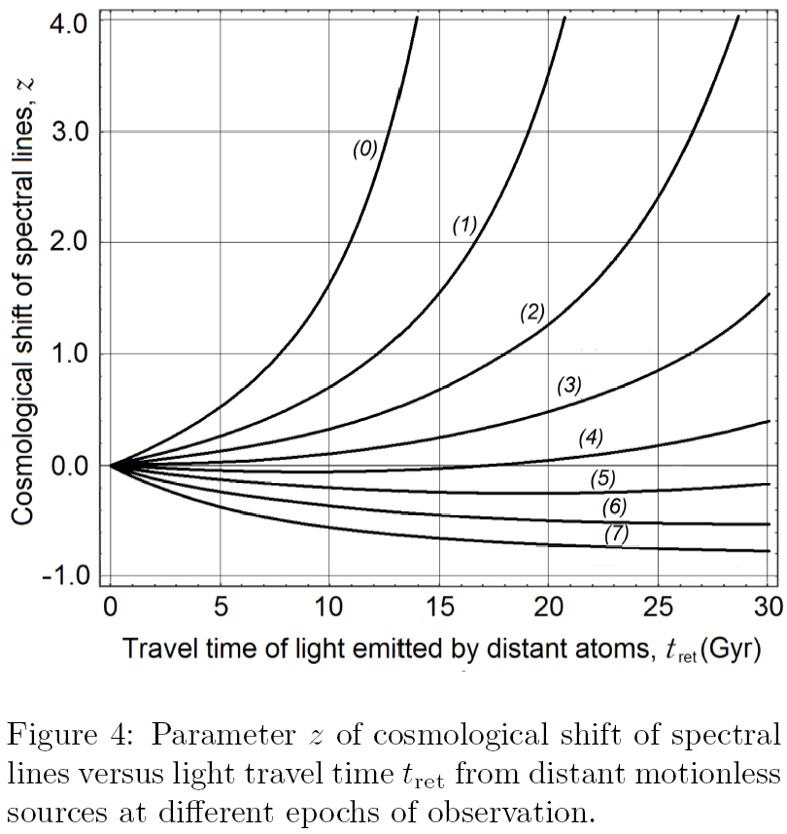
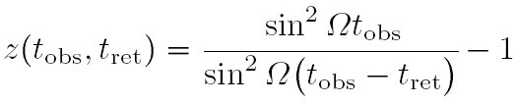
Hubble’s Gravitational Background and the Cyclic Dynamics of a Quiet Universe
Notes:
42
42

Slide 43
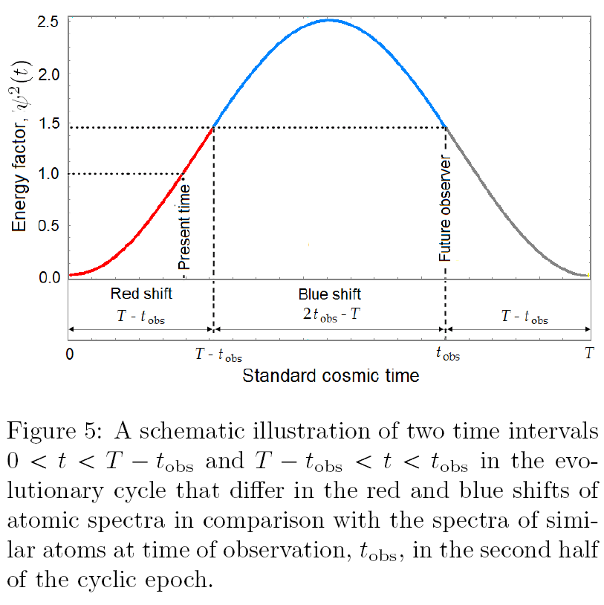
Hubble’s Gravitational Background and the Cyclic Dynamics of a Quiet Universe
Notes:
43
43

Slide 44


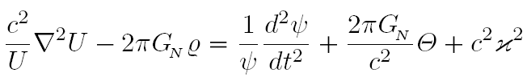





Hubble’s Gravitational Background and the Cyclic Dynamics of a Quiet Universe
Notes:
44
44

Slide 45
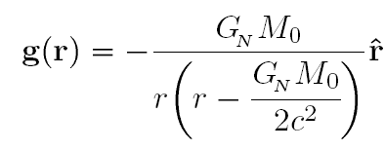
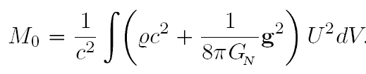
Hubble’s Gravitational Background and the Cyclic Dynamics of a Quiet Universe
Notes:
45
45

Slide 46







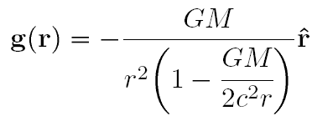
Hubble’s Gravitational Background and the Cyclic Dynamics of a Quiet Universe
Notes:
46
46

Slide 47
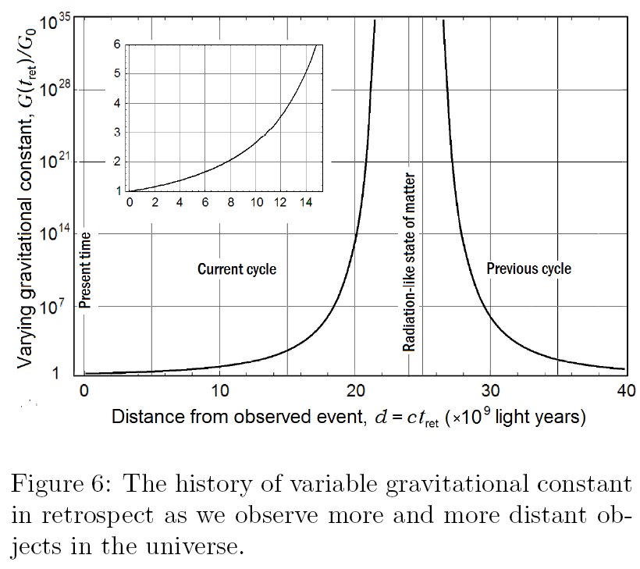
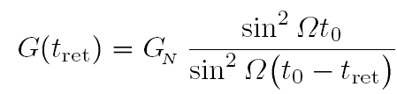

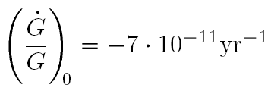
Hubble’s Gravitational Background and the Cyclic Dynamics of a Quiet Universe
Notes:
47
47

Slide 48
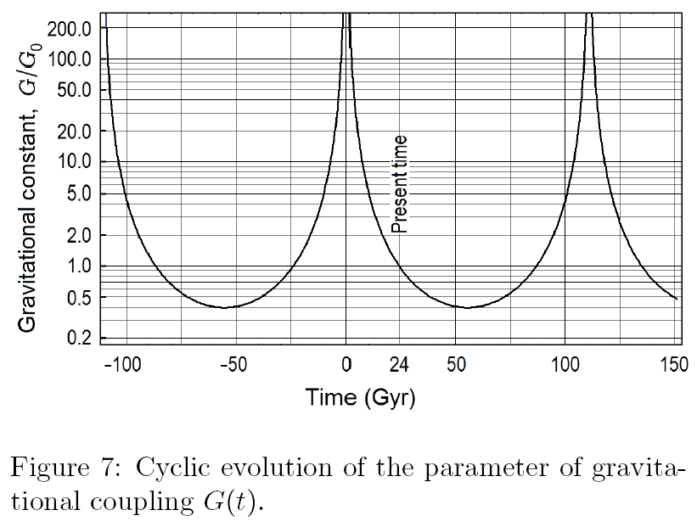
Hubble’s Gravitational Background and the Cyclic Dynamics of a Quiet Universe
Notes:
48
48

Slide 49









Hubble’s Gravitational Background and the Cyclic Dynamics of a Quiet Universe
Notes:
49
49

Slide 50



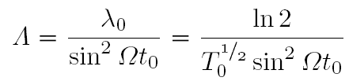


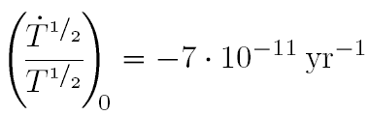
Hubble’s Gravitational Background and the Cyclic Dynamics of a Quiet Universe
Notes:
50
50

Slide 51




Hubble’s Gravitational Background and the Cyclic Dynamics of a Quiet Universe
Notes:
51
51

Slide 52
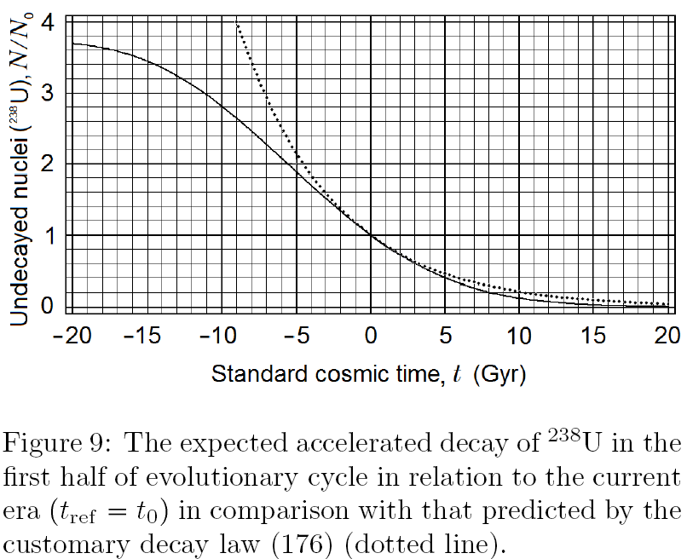
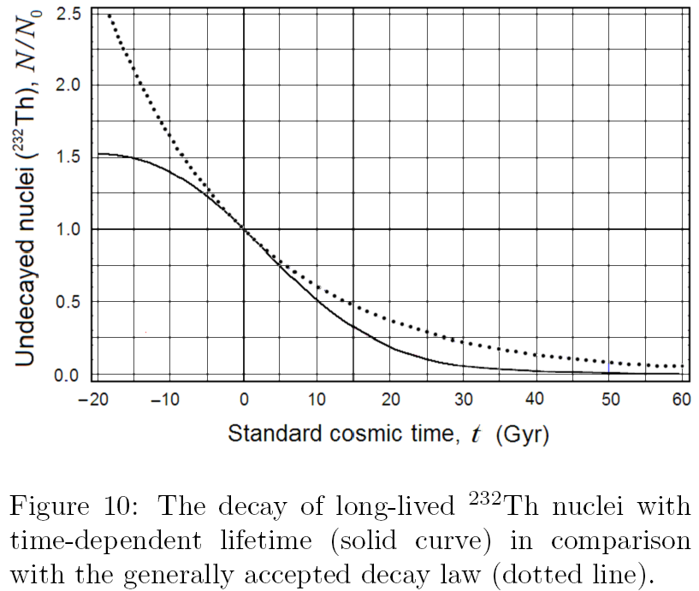
Hubble’s Gravitational Background and the Cyclic Dynamics of a Quiet Universe
Notes:
52
52

Slide 53


Hubble’s Gravitational Background and the Cyclic Dynamics of a Quiet Universe
Notes:
53
53

Slide 54

Hubble’s Gravitational Background and the Cyclic Dynamics of a Quiet Universe
Notes:
54
54

Slide 55



Hubble’s Gravitational Background and the Cyclic Dynamics of a Quiet Universe
Notes:
55
55

Slide 56


Hubble’s Gravitational Background and the Cyclic Dynamics of a Quiet Universe
Notes:
56
56

Slide 57



Hubble’s Gravitational Background and the Cyclic Dynamics of a Quiet Universe
Notes:
57
57

Slide 58
Notes:
58
58

Slide 59


Hubble’s Gravitational Background and the Cyclic Dynamics of a Quiet Universe
Notes:
59
59

Slide 60

Notes:
60
60

Slide 61


Hubble’s Gravitational Background and the Cyclic Dynamics of a Quiet Universe
Notes:
61
61

Slide 62


Hubble’s Gravitational Background and the Cyclic Dynamics of a Quiet Universe
C. L¨ammerzahl, O. Preuss & H. Dittus. Is the physics within the Solar system really understood? : Lasers, Clocks and Drag-Free Control: Exploration of Relativistic Gravity in Space. Eds: H. Dittus
Notes:
62
62

Slide 63


Hubble’s Gravitational Background and the Cyclic Dynamics of a Quiet Universe
Notes:
63
63

Slide 64




Hubble’s Gravitational Background and the Cyclic Dynamics of a Quiet Universe
Notes:
64
64

Slide 65




Hubble’s Gravitational Background and the Cyclic Dynamics of a Quiet Universe
Notes:
65
65

Slide 66
СПАСИБО
ЗА ВНИМАНИЕ!
Notes:
66
66

Slide 67

Hubble’s Gravitational Background and the Cyclic Dynamics of a Quiet Universe
Notes:
67
67

Slide 68
Hubble’s Gravitational Background and the Cyclic Dynamics of a Quiet Universe

Slide 69


Hubble’s Gravitational Background and the Cyclic Dynamics of a Quiet Universe
Notes:
69
69

Slide 70

Hubble’s Gravitational Background and the Cyclic Dynamics of a Quiet Universe
Notes:
70
70

Slide 71

Hubble’s Gravitational Background and the Cyclic Dynamics of a Quiet Universe
Notes:
71
71

Slide 72

Hubble’s Gravitational Background and the Cyclic Dynamics of a Quiet Universe
Notes:
72
72

Slide 73

Hubble’s Gravitational Background and the Cyclic Dynamics of a Quiet Universe
Notes:
73
73

Slide 74


Hubble’s Gravitational Background and the Cyclic Dynamics of a Quiet Universe
Notes:
74
74

Slide 75

A. SERDYUKOV

