Slide 1
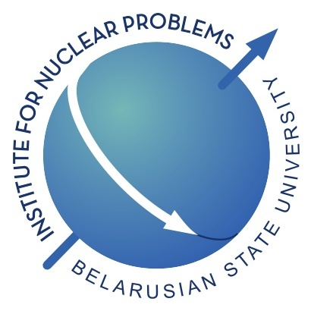

Parametric x-rays in crystals: prospects for research and applications
Alexander Lobko
INP BSU-Minsk
XIV Intl School-Conference
August 22, 2018 – Belarus, Grodno, Ozerny

Slide 2
PARAMETRIC X-RAYS
BASIC PROPERTIES
PROSPECTS FOR BIOMEDICAL APPLICATIONS
TOPICS FOR RESEARCH
PRECISE SPECTROSCOPY
CONCLUSIONS
BOOK V.G. Baryshevsky, I.D. Feranchuk, A.P. Ulyanenkov, Parametric X-Ray Radiation
in Crystals: Theory, Experiment and Applications, vol. 213, Springer-Verlag,
Berlin Heidelberg, 2005.
REVIEW V.G. Baryshevsky Spontaneous and induced radiation by electrons/positrons in natural and photonic crystals. Volume free electron lasers (VFELs): From microwave
and optical to X-ray range // Nuclear Instruments and Methods B 355 (2015) 17–23

Slide 3
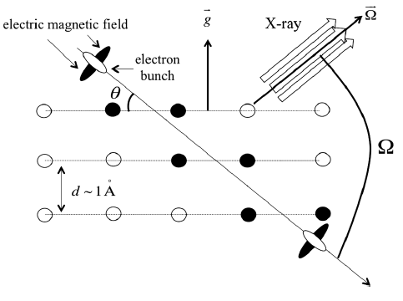
PXR visual presentation - 1
Polarized and coherent x-rays
Electromagnetic field

Slide 4
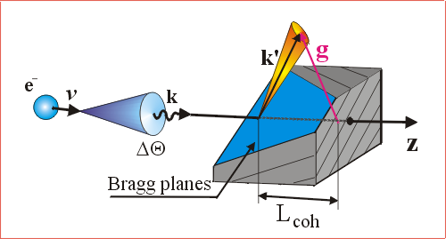
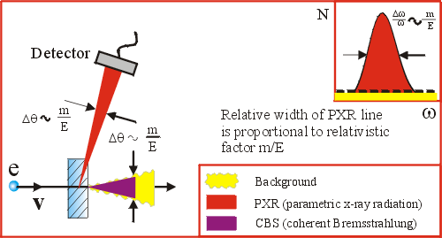
PXR Visual Presentation - 2
Relativistic electrons: the background radiation
caused by effects other than PXR, e.g., coherent
and incoherent Bremsstrahlung, is concentrated
within the narrow cone along the direction of
particle beam

Slide 5
Motivation for application –
PXR properties
PXR are quasi-monochromatic x-rays;
PXR energy can be changed continuously by crystal rotation;
PXR are directed, and polarized, and partially coherent x-rays;
PXR energy does not depend on energy of incident charged particles but only on their Lorenz factor;
PXR radiation angle can be as large as 180 degrees;
PXR has no theoretical limits for charged particle energy, i.e. this radiation mechanism exists at any, low or high as possible, beam energy.

Slide 6
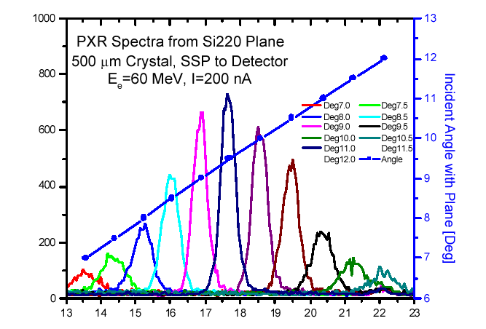
PXR frequency tunability
About 40% tunability around 17.7 keV Bragg condition
B. Sones et al.
ANS Transactions, v. 88
(2003), RPI Linac, USA
Rensselaer Polytechnical Institute

Slide 7
Comparison of some x-ray generation processes at accelerators
Type of radiation | Yield, photon/e | Е, MeV
BR | 1.2*(-8) | 500
CBR | 1.7*(-7) | 0.2
SR | 1.2*(-5) | 3 *(+3)
TR | 1.0*(-9) | 125
RR | 1.6*(-7) | 50
PXR | 1.3*(-5) | 50
V.G. Baryshevsky, I.D. Feranchuk // NIM 228 (1985) 490

Slide 8
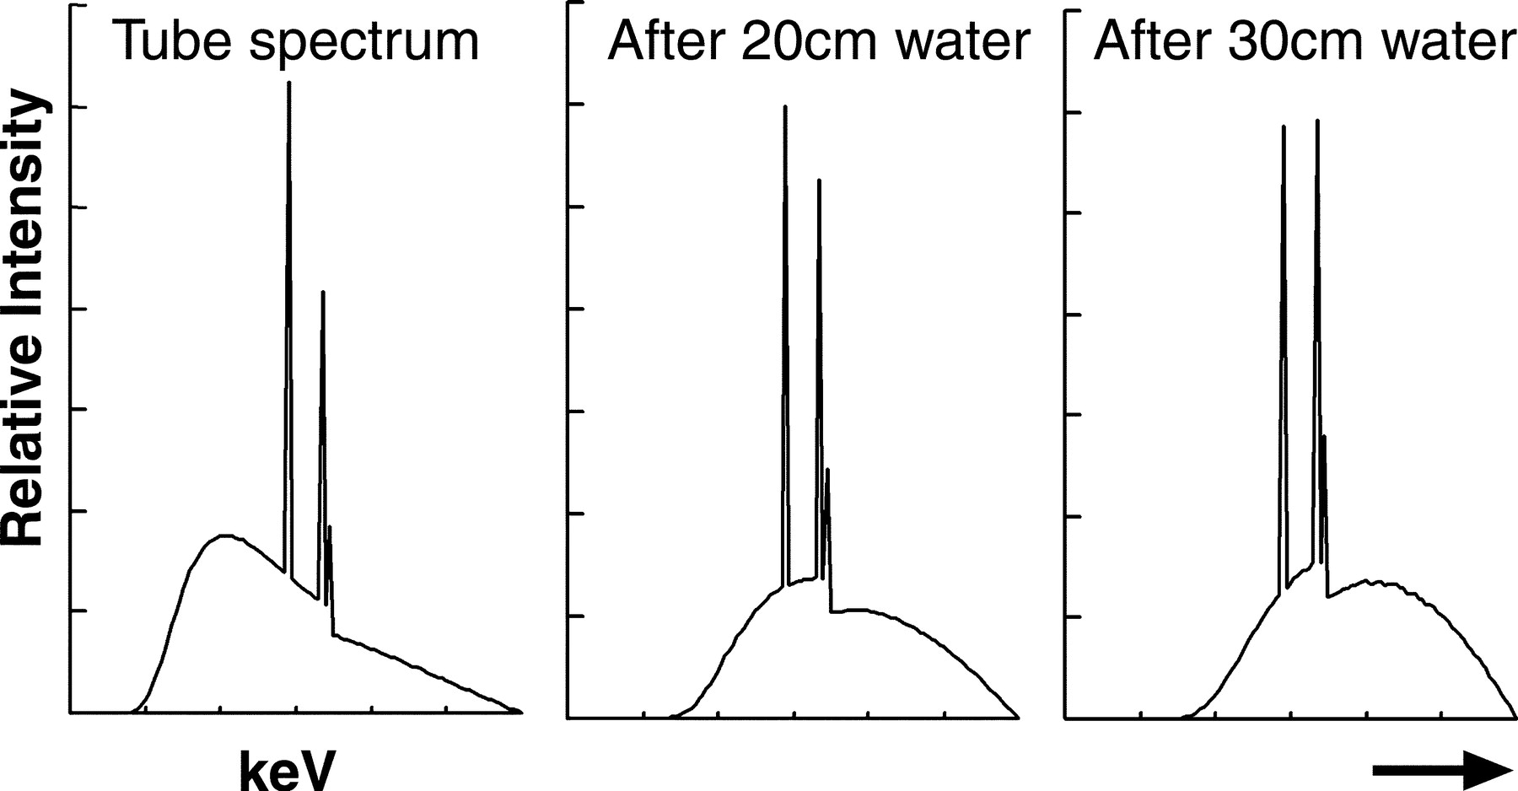
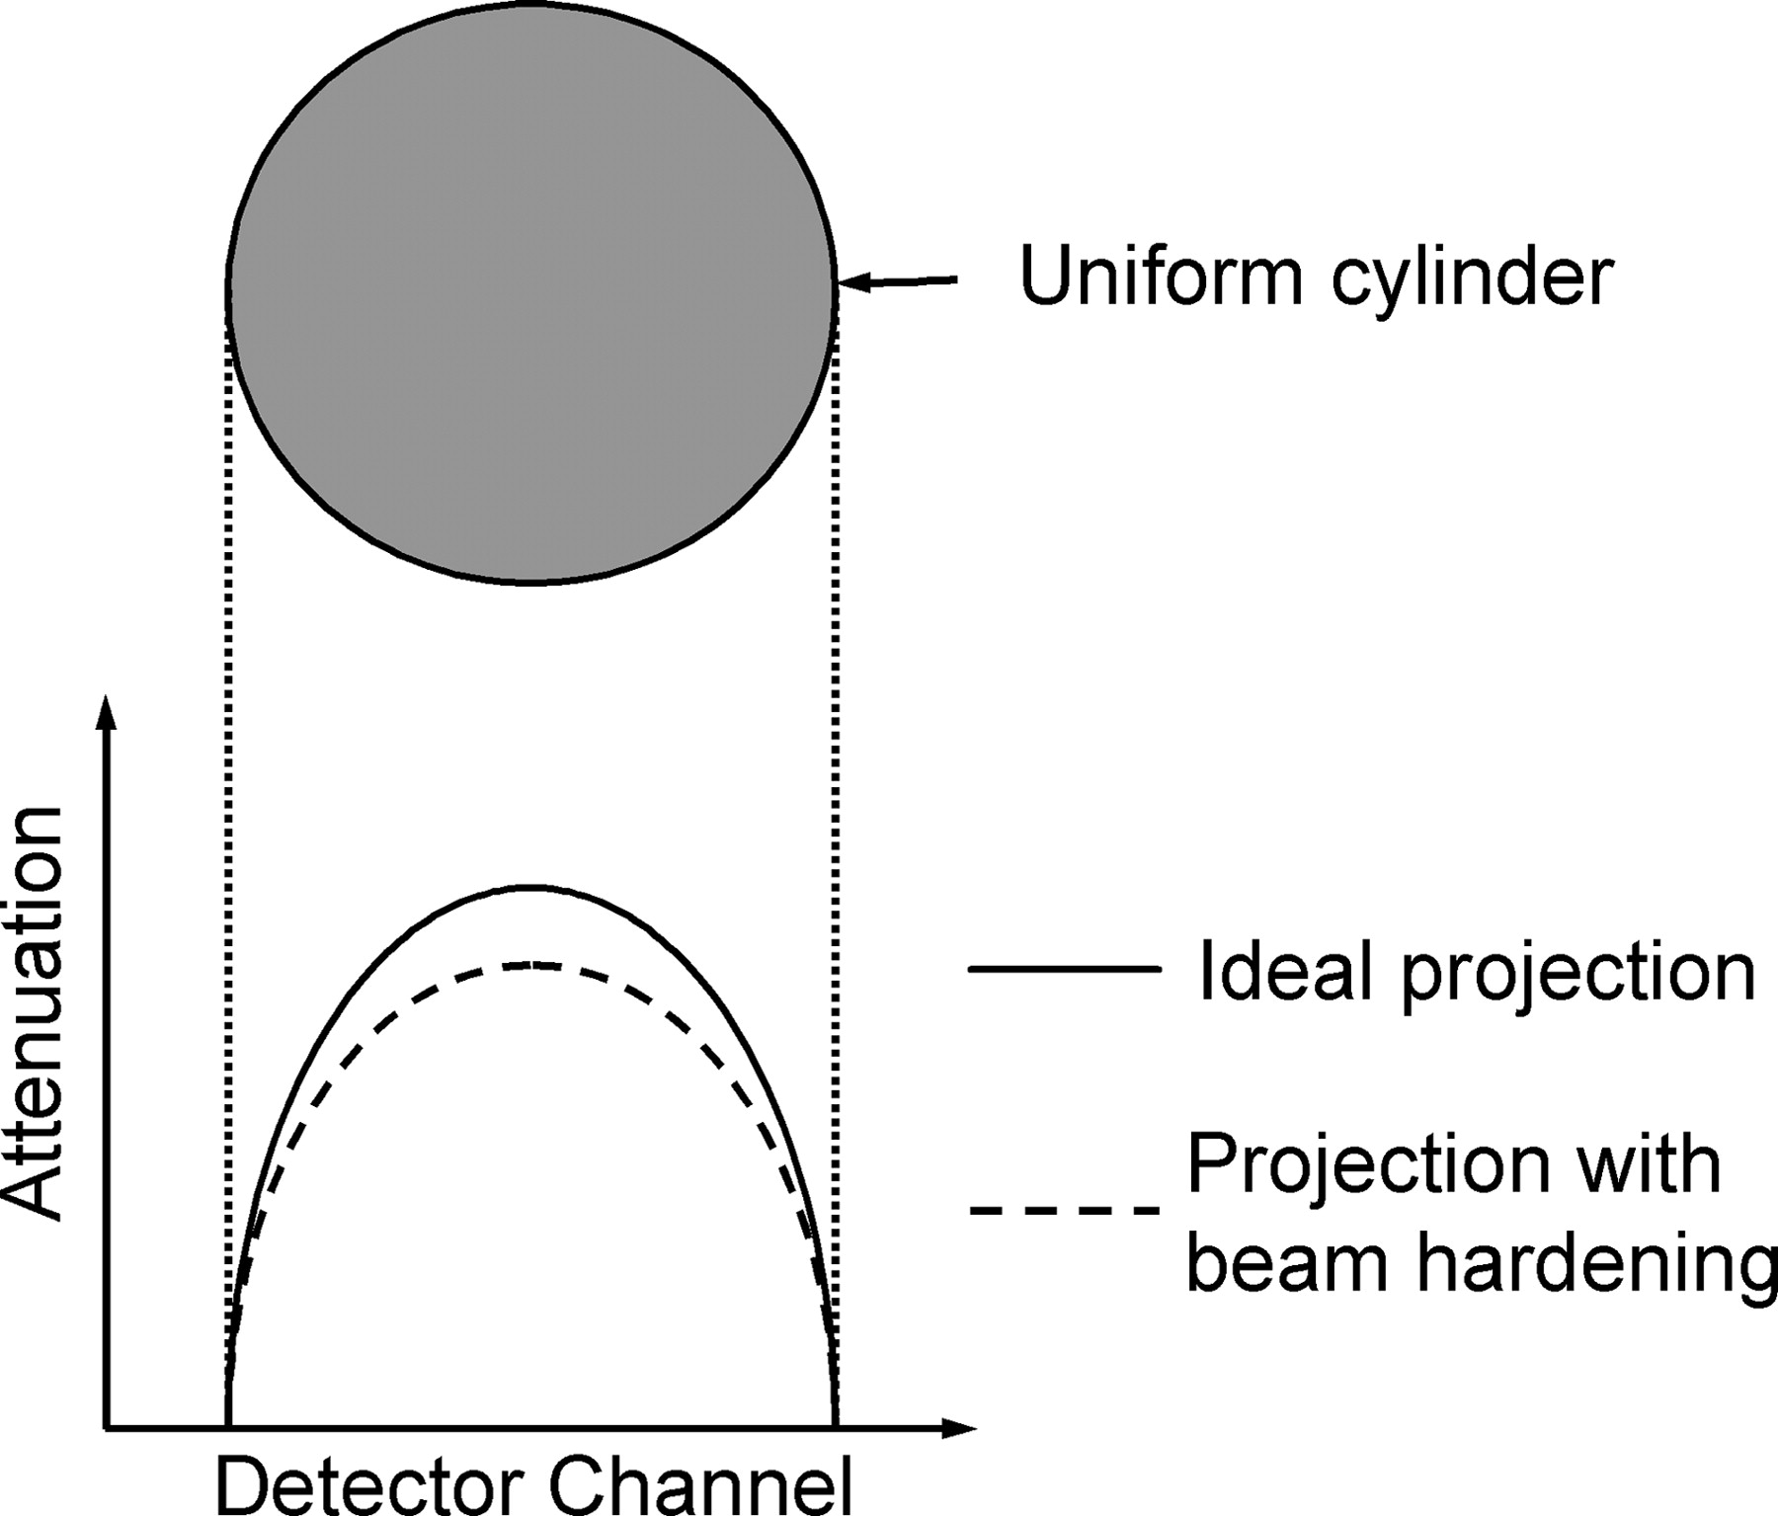
Ideal case: Monochromatic source tunable for the particular imaging situation
Requirements:
- high contrast
- low patient dose
- maximum SNR
- no beam hardening artefacts
Variants:
→ use a synchrotron X-ray source (100 m)
→ improving of X-ray tubes (10 cm) based technology
→ search for alternatives (table-top): parametric X-rays, channeling X-rays, etc…..

Slide 9
Biomedical Applications
An x-ray source with a narrow frequency range, ideally at a single frequency, would be advantageous because it would allow x-rays only at the desired frequency to be produced.
By eliminating x-ray frequencies outside of the range required for a specific application, the dose may be significantly reduced. It has been estimated that mammographic examinations performed with near mono-energetic x-rays will deliver a dose to the patient that will be from one-tenth to one-fiftieth of the dose delivered by a conventional x-ray system. This estimate is similarly applicable to angiography and other radiography studies.

Slide 10
Optimal X-Ray Energies for Medical Imaging
mammography, soft tissues - 15-25 keV;
radiography of chest,
extremities and head - 40-50 keV;
abdomen and pelvis
radiography - 50-70 keV;
digital angiography - ~33 keV.

Slide 11
X-Ray Flow Evaluation
The Physics of Medical Imaging / S. Webb (ed), Bristol: Hilger, 1978.
t
x
Number of x-ray quanta needful to visualize
1.0 mm³ of biological tissue at 1% contrast is
2.6x10¹³ quanta/m².

Slide 12
What do we need for in vivo quality X-RAY imaging?
Evaluating radiological examination in general context, number of x-ray quanta needed to visualize 1.0 mm³ of biological tissue at 1% contrast is
~10⁶ photons/mm² in the case of digital detection

Slide 13
What do we exactly need for in vivo quality X-RAY imaging?
Due to heart beat and breathing, above mentioned photon flux must be provided within ~1 second.
Photons must penetrate considerable field of vision,
say 10x10 cm.
Thus, we need, at least
~10⁶ mm⁻² * 100x100 mm² / 1.0 s =
~10¹⁰ photons/s
with tunable x-ray energy in 10-70 keV range.
Mono-chromaticity could be of ~10⁻² and less for a patient’s dose reduction.
Radiation background should be low.
All these conditions together can be met today only at SRS

Slide 14
Number of the PXR photons regarding to parameters of a realistic electron accelerator
1 A = 6*10^18 electrons/s
PXR photons/s = 10^-5 per electron/s
Thus,
10^10 PXR photons can be generated by ~some mA beam

Slide 15
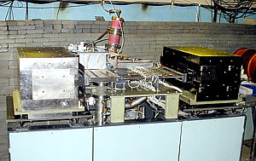
Electron Beam Laboratory
SINP, Moscow, Russia
Parameters of a pulsed racetrack microtron
Injection energy: 48 keV
Energy gain: 4.8 MeV / orbit
Orbits: 14
Output energy: 14.8 - 68.3 MeV
Output current at 68.3 MeV: 10 mA
Orbit circumference increase: 1l/orbit
Operating frequency: 2,856 MHz
Klystron power pulsed: 6 MW
End magnet field induction: 0.963 T
RTM dimensions: 2.2x1.8x0.9 m3
http://vserv.sinp.msu.ru/ebl/

Slide 16
Limitations of medical x-ray imaging
The quality of the x-ray images is ultimately limited by two opposing factors, one is that increased image spatial and contrast resolution requires an increased number of detected x-ray photons per image resolution unit, and the second is the direct dependence between the increased dose deposited by x-rays and the increased risk of tissue damage and further cancer development.
Some ways of optimization:
Monochromatic x-rays instead of Bremsstrahlung
Utilization of x-ray refractive index – phase sensitive imaging

Slide 17
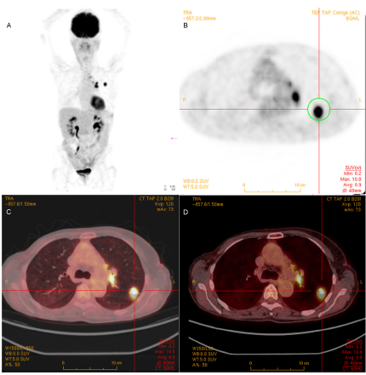
Multi-modality imaging
PET/CT images of glucose metabolism.
(A) Maximum intensity projection image representing the whole-body bio-distribution of FDG. (B) shows an axial PET slice positioned on a lung lesion highlighted by the circled region. (C,D) show two fusion images obtained with two different HU windows.

Slide 18
The market has reached a plateau in terms of number of CT slices due to patient dose, image quality and cost considerations

Slide 19
D. Panetta Advances in X-ray detectors for clinical and preclinical Computed Tomography // NIM A809 (2016) 2–12
As the slice war has come to an end by some years, manufacturers seems now following a different direction for next generation of CT scanners for which the number of energy bin is to be increased instead of the number of slices. Extending the capability of CT scanners beyond the physical limitation posed by energy integrating detectors (EID) offers several advantages. Bremsstrahlung spectra generated by Xray tubes are such that all images obtained by energy integrating detectors are unavoidably affected by beam hardening artifacts (besides several more or less fancy software techniques for artifact reduction); hence, objects with same composition and density can have different reconstructed CT numbers (expressed in Hounsfield Units, or HU) depending on the depth and composition of surrounding materials. This limitation prevents material differentiation and quantitative imaging, unless (i) the incident Xray spectrum is narrowed enough to be considered quasimonochromatic, or (ii) the attenuation data is selectively recorded in different data bins as a function of the photon energy.

Slide 20
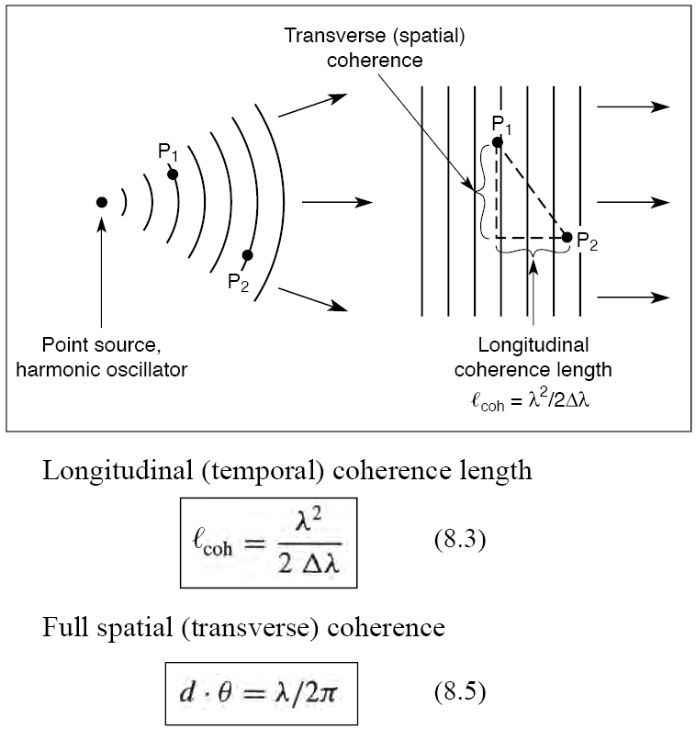
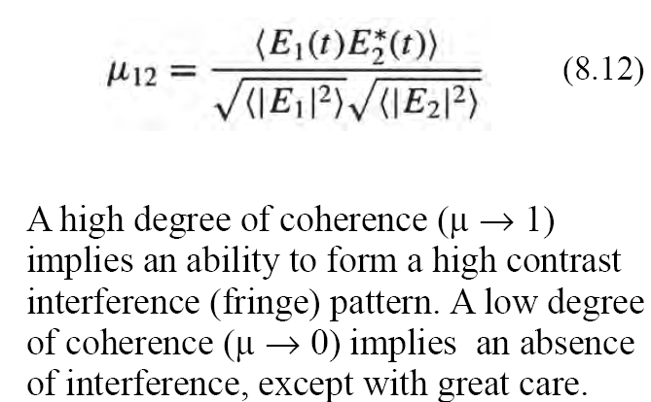
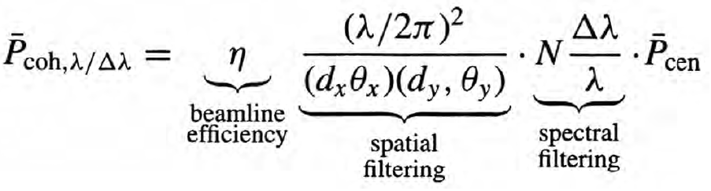
Phase sensitive imaging requires coherent x-rays
In general, radiation is partially coherent
D. Attwood http://www.coe.berkeley.edu/AST/srms

Slide 21
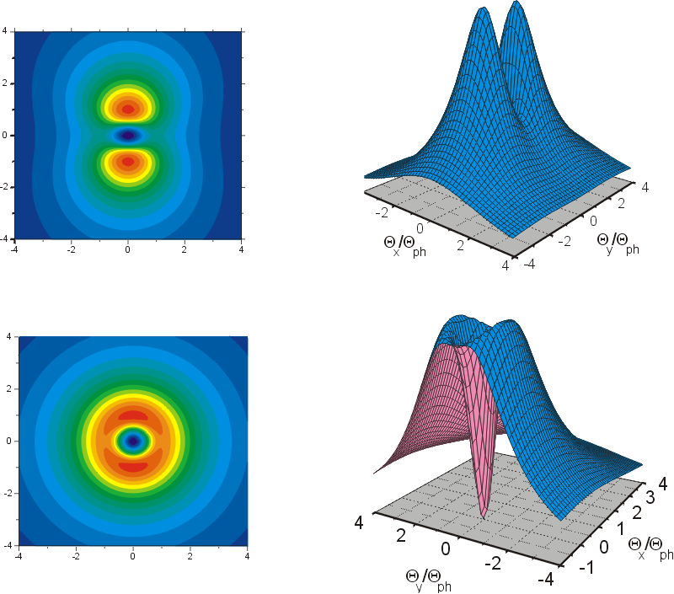
Coherence of PXR
PXR may provide combination of monochromatic absorption imaging and phase contrast imaging. Parametric x-rays are coherent to a considerable extent. That is its intrinsic property.
Shape of PXR angular distribution strongly depends on the Bragg angle and on the quantity of diffracted transition radiation and Bremsstrahlung.
Proportion between coherent and partly coherent components depends on generation geometry, i.e. Bragg, or Laue, or extremely asymmetric diffraction.
When crystal target is rotating to tune PXR frequency, proportion between coherent (pure PXR) and partly coherent components (diffracted radiations), as well as shape of the “source” changes considerably.
Thus, PXR spatial (and temporal) coherence is the value, highly variable with crystal target rotation.
PXR angular distributions at Bragg angles
of 45 and 9 arc deg.

Slide 22
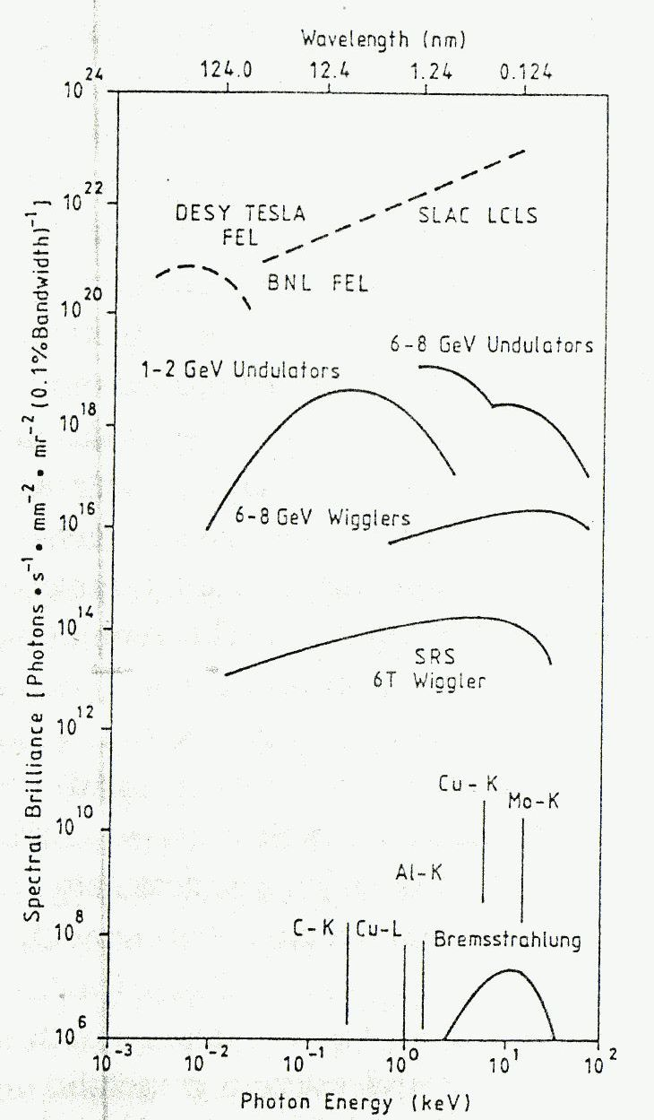
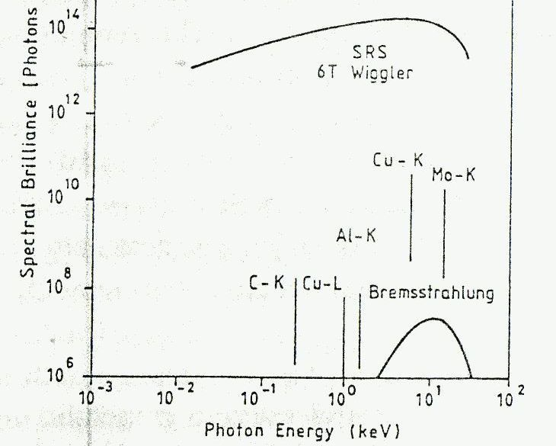
Spectral brilliance of x-ray sources
PXR sources
PXR spectral brilliance comparable with that of bending magnet, but its flux is coherent on a great extent

Slide 23
Prospects
PXR is the prospective source of coherent hard x-rays obtainable at a relatively low energy electron accelerator
Application of PXR for bio-med imaging can provide combination of monochromatic and phase sensitive images, thus reducing dose while improving contrast (First PXR-DEI image was taken at LEBRA-PXR source)
Coherence properties of a real PXR beams are the matter of further research, both theoretically and experimentally
It is important to develop techniques of PXR coherence metrology and/or in-line monitoring

Slide 24
Spectroscopy
Mössbauer spectroscopy is a powerful and well established method employed for conducting research in various fields such as physical, chemical, biological, earth, and fundamental physical sciences.
Mössbauer spectroscopy provides element-specific information on surrounding electronic states and magnetism, which is required in modern materials science and in complex systems such as biological substances.
Mössbauer spectroscopy probes tiny changes in the energy levels of an atomic nucleus in response to its environment. Typically, three types of nuclear interaction may be observed: an isomer (chemical) shift; quadrupole splitting; and magnetic or hyperfine splitting (Zeeman effect).
Due to the high energy and extremely narrow line widths of gamma rays, Mössbauer spectroscopy is one of the most sensitive techniques in terms of energy (and hence frequency) resolution, capable of detecting change in just a few parts per 10¹¹.

Slide 25
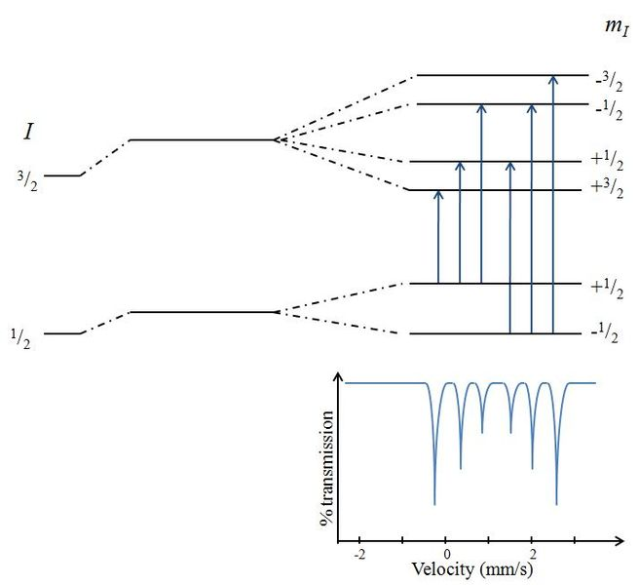
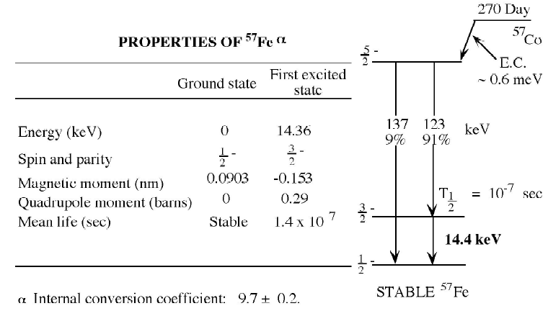
Mössbauer effect
In 1957, Rudolf Mössbauer discovered that, in some circumstances, if the nucleus is bound in a crystal lattice, the whole crystal recoils rather than the individual nucleus. Due to the much greater mass involved in recoil the energy of the emitted ray is very close to that of the difference in energy between the nuclear energy levels, and resonant absorption is possible.
Mössbauer spectroscopy is limited by the need for a suitable gamma-ray source. And samples must be solid (frozen)
Magnetic splitting of the nuclear energy levels and the corresponding Mössbauer spectrum

Slide 26
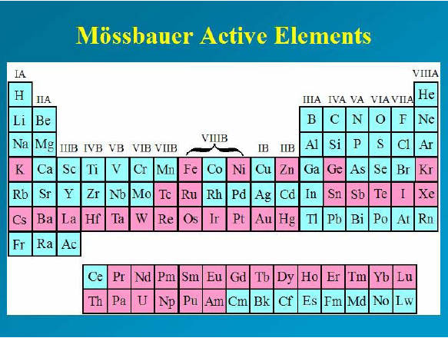
Mössbauer effect
pink

Slide 27
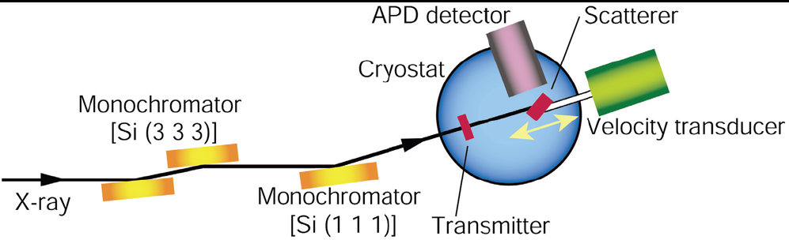
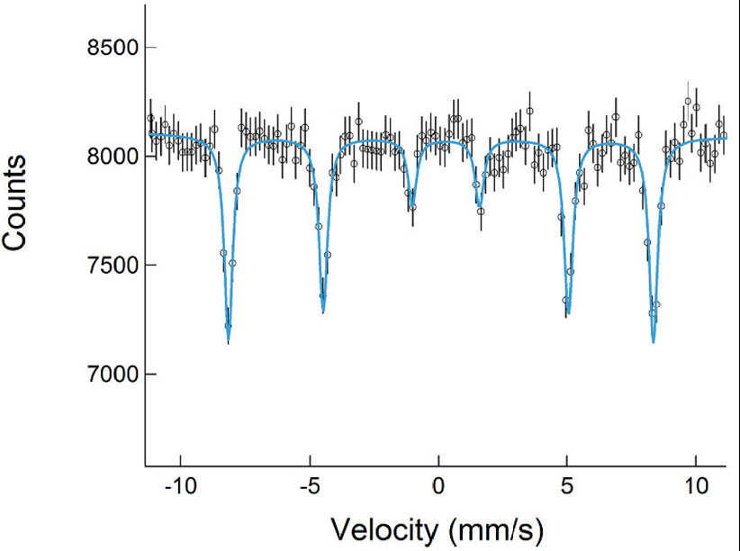
Synchrotron-Radiation-Based
Mossbauer Spectroscopy
The applicability
of SR-based Mossbauer spectroscopy increasing.
M. Seto at al. PRL 102, 217602 (2009)

Slide 28
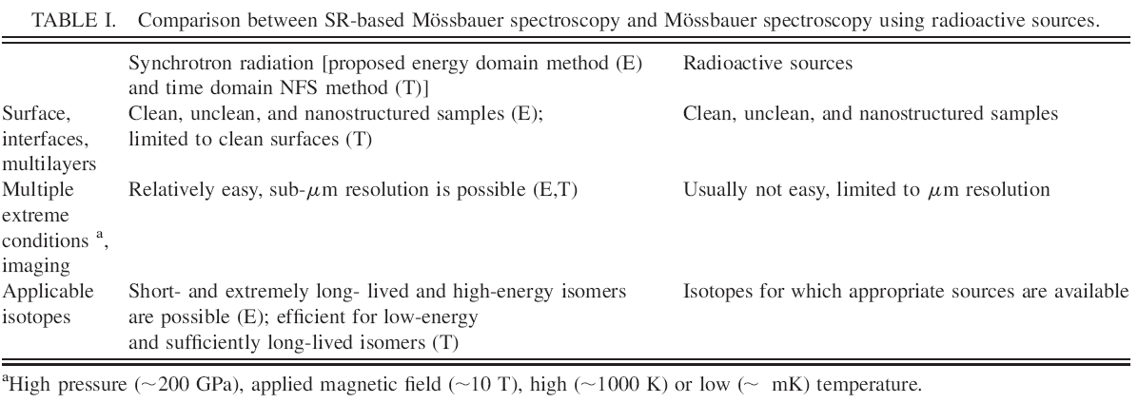
Synchrotron-Radiation-Based
Mossbauer Spectroscopy
The spectral density of PXR in the peaks exceeds the analogous value for the SR to one electron. It is also important that the PXR frequencies are defined solely by the crystal parameters and do not depend on the electron energy. It allows generate hard X-rays from electrons with essentially less energy than in the case of SR.

Slide 29
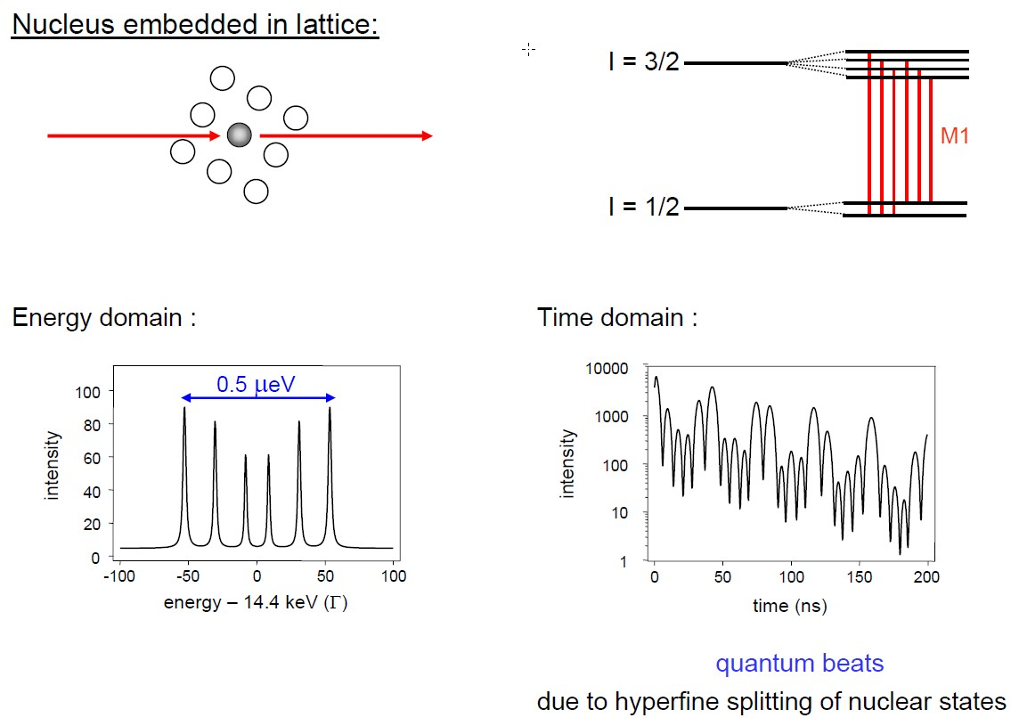
Mossbauer spectra in energy and time domains

Slide 30
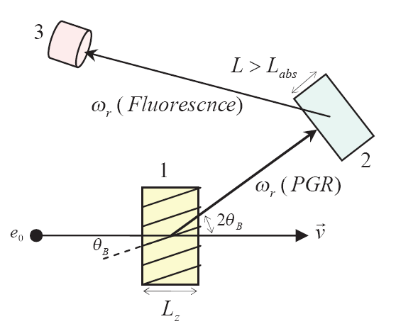
EXPERIMENTAL SETUP FOR PGR OBSERVATION
Sketch of the experimental setup for the observation of PGR:
Mossbauer crystal-radiator; 2) Mossbauer absorber;
3) detector-counter of the fluorescence photons from the absorber

Slide 31
PROSPECTS
Mossbauer spectroscopy can probe the hyperfine fields, measuring local properties of materials (structural and magnetic)
Hyperfine interactions: interactions between a nucleus and its environment (isomer shift, quadrupole splitting, magnetic splitting)
Conversion electron Mossbauer spectroscopy allows to study magnetic properties of mono-layer thick nanostructures
Accelerator-based Mossbauer spectroscopy can provide spectra in time domain to addition of energy domain (standard MS)
Accelerator-based Mossbauer spectroscopy can provide polarized photons necessary for magnetic measurements
Accelerator-based Mossbauer spectroscopy can deal with non-conventional Mossbauer isotopes

Slide 32
Diffracted Radiation of Relativistic Oscillator (DRO)
DRO is the coherent process of x-ray photon emission by the relativistic oscillator (e.g. electron channeling in a crystal) and its diffraction within the single crystal target. It sometimes called diffracted channeling radiation – DCO.
DRO formation was firstly considered in [Baryshevsky V.G., Dubovskaya I.Ya. // Doklady Akad. Nauk SSSR, 231 (1976) 1336, (in Russian) ] and detailed review and references may be found in [Baryshevsky V.G., Dubovskaya I.Ya. Diffraction phenomena in spontaneous and stimulated radiation by relativistic particles in crystals, Lawrence Berkeley Laboratory, LBL-31695 (1991) 122 p.].

Slide 33
Diffracted channeling radiation
For example, for Si target this ratio is estimated as R~5 for electrons of 34 MeV energy channeled between (100) planes and radiation diffracted by (220) planes.

Slide 34
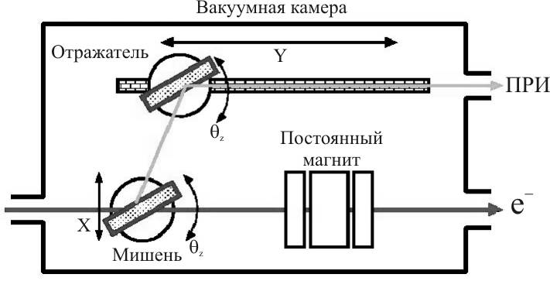
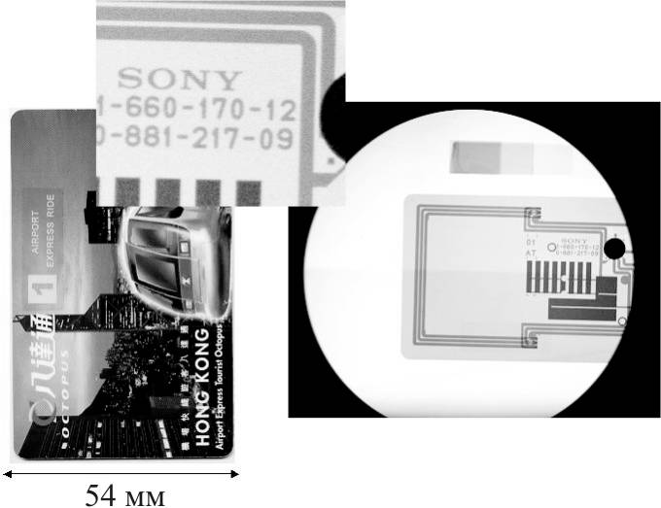
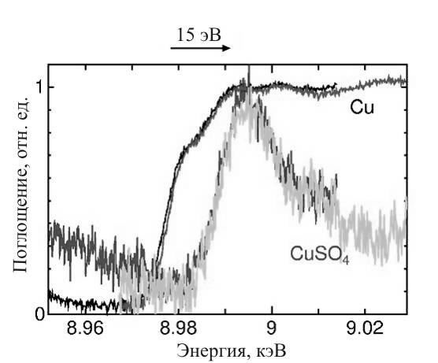
Practical examples of PXR applications
Nihon University, Japan
enhanced contrast images
EXAFS
Rensselaer Polytechnic Institute, NY, USA

Slide 35
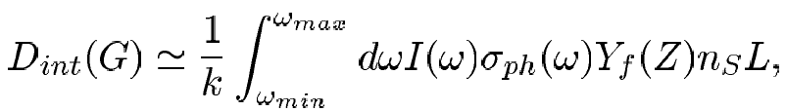
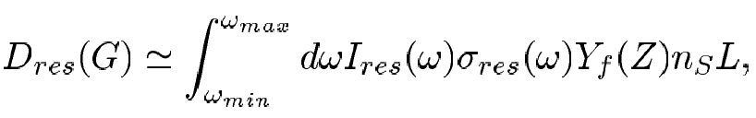
Dose reduction
Possibility to reduce absorbed dose by PXR use:
Choice of the PXR frequency within “water window”
Selective action on the specific molecular bonds

Slide 36
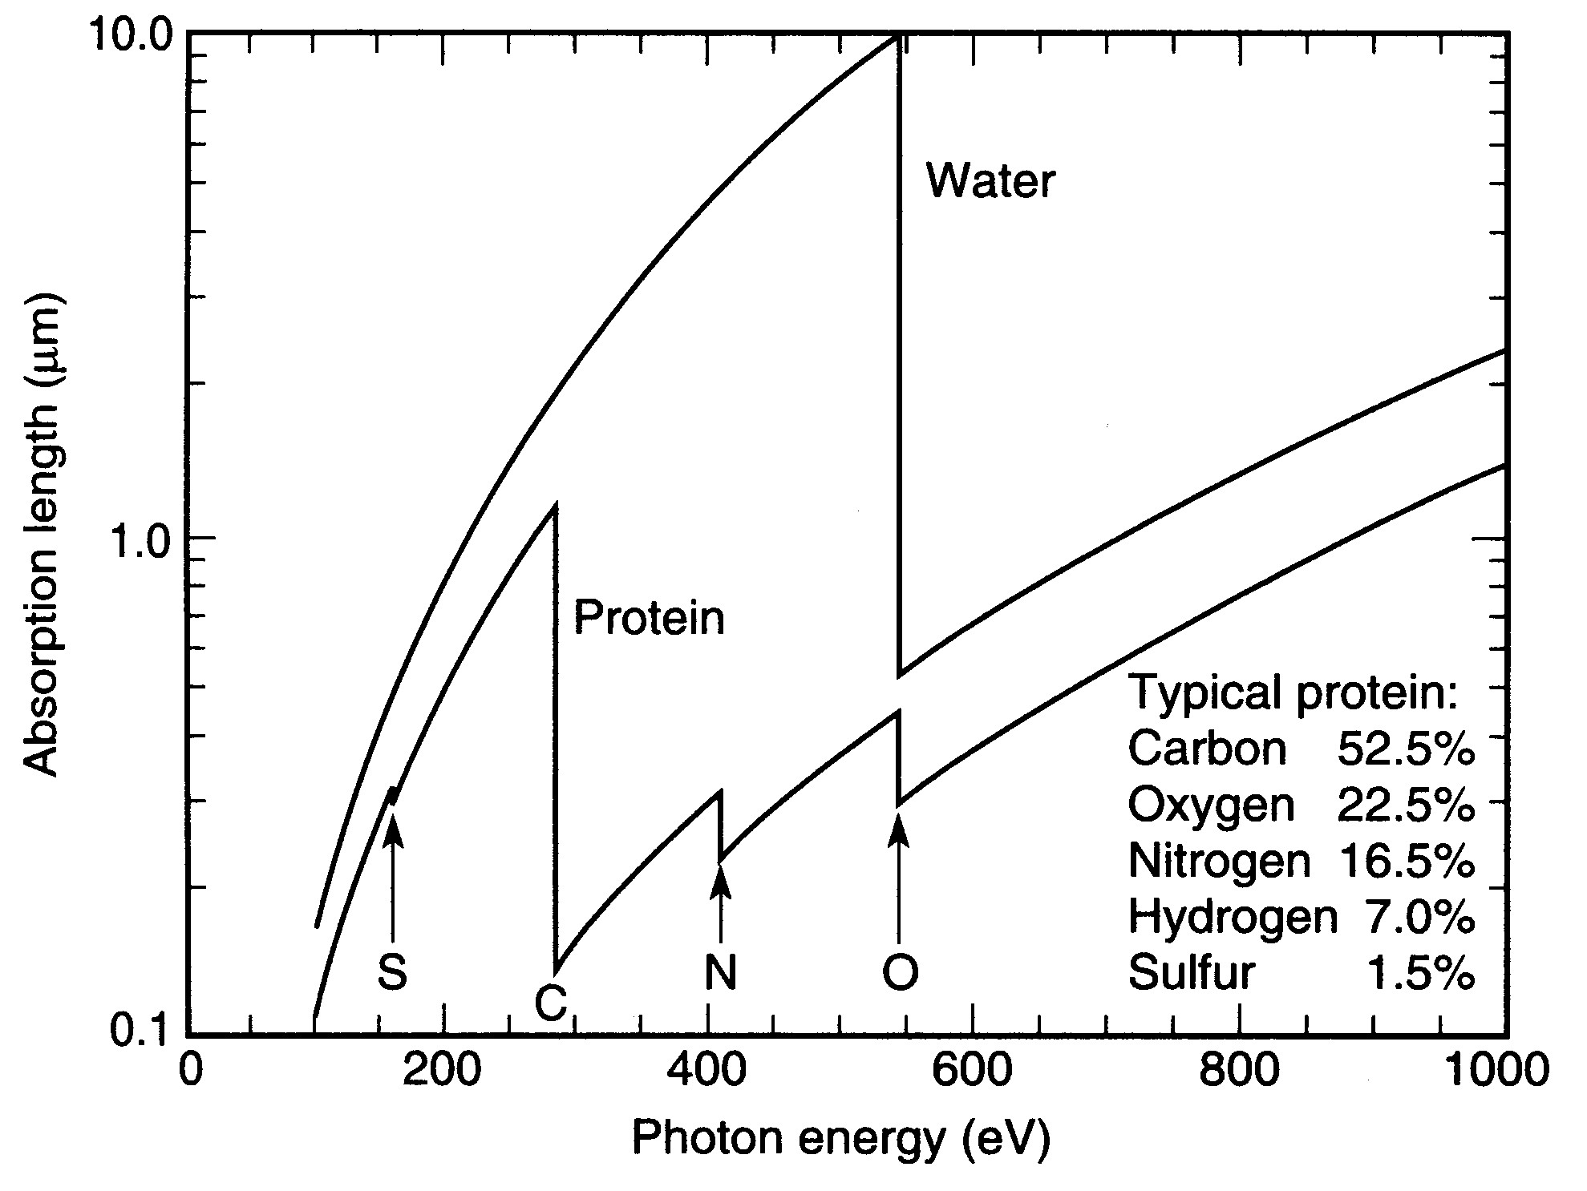
Soft x-ray water window

Slide 37
Photon activation therapy
www.mpsd.de/irt

Slide 38
PXR effect on protein molecule
Deactivation of cysteine enzyme (ionization of the sulfur bridge) results in destruction of some molecules in cancer cells
Cysteine is sulfur-containing enzyme, which determines bonds and activity of many bio-active molecules
Use of resonant radiation from PXR source could provide eight times reduction of total radiation dose for getting the equivalent radiation effect
For some cancer tumors number of sulfur atoms 3 times exceeds this number for normal cells

Slide 39
Soft X-Ray Imaging
Methods: Soft x-ray imaging, photoelectron emission microscopy (PEEM), scanning transmission x-ray microscopy (STXM), full-field microscopy, x-ray diffraction imaging (XDI), x-ray tomography, computer-aided tomography (CAT).
Problems:
Cell biology
Nano-magnetism
Environmental science
Soft matter, polymers
The tunability of radiation is absolutely essential for the creation of contrast mechanisms.

Slide 40
Soft X-Ray Spectroscopy
Methods: Soft x-ray absorption spectroscopy (XAS), near-edge x-ray absorption fine structure (NEXAFS) spectroscopy, soft x-ray emission spectroscopy (SXES), resonant inelastic x-ray scattering (RIXS), x-ray magnetic circular dichroism (XMCD), x-ray photo-emission spectroscopy (XPS), Auger spectroscopy.
Problems:
Complex materials
Magnetic materials
Environmental science
Catalysis
The photon energy tunability and its brilliance for some above listed applications are essential.

Slide 41
Soft X-Ray Scattering
Methods: Soft x-ray emission spectroscopy (SXES), inelastic x-ray scattering (IXS), resonant x-ray inelastic scattering (RIXS), speckle patterns, small-angle x-ray scattering (SAXS).
Problems:
Strongly correlated materials
Magnetic materials
Environmental science
Catalysis
The tunability of radiation and its brilliance for some above listed applications are essential.

Slide 42
Applications to the life sciences
Potential to form high spatial resolution images in hydrated bio-material
Ability to identify atomic elements by the coincidence between photon energy and atomic resonances of the constituents of organic materials
Concern
Radiation-induced damage: photon energy deposited per unit mass (dose) can cause observable changes in structure

Slide 43
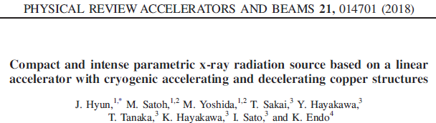
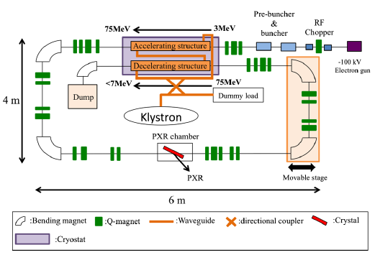
CONCEPT OF PXR SOURCE

Slide 44
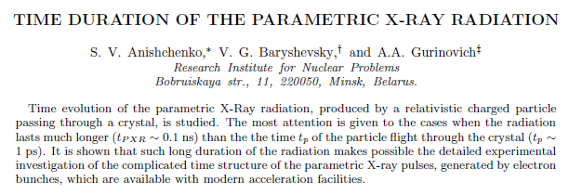
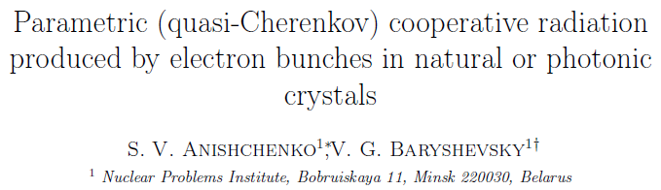

Slide 45
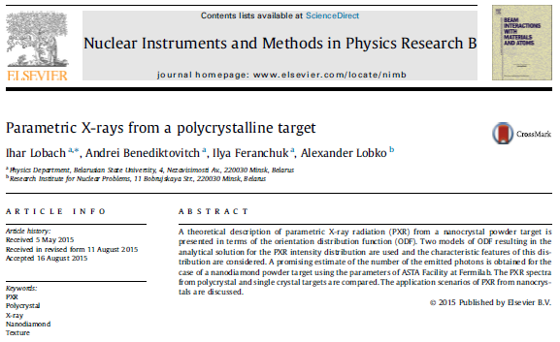
New targets

Slide 46
PROSPECTS
We have fabricated homogeneous 500 nm-thick films made of single crystal HPTP nano-diamonds which demonstrated good x-ray diffraction patterns. Next step is to develop methods to produce sandwich-type ND targets of thickness suitable for the accelerator x-ray experiments, i.e. tens of microns.
We consider that targets made of nanodiamonds may provide good prospects in generating crystal-assisted radiations by the relativistic charged particles, such as PXR, diffracted transition radiation, diffracted Bremsstrahlung, etc.

Slide 47
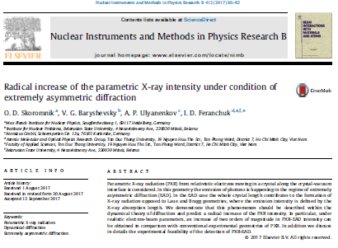
New Geometries

Slide 48
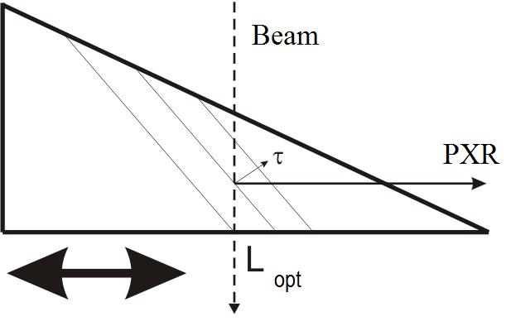
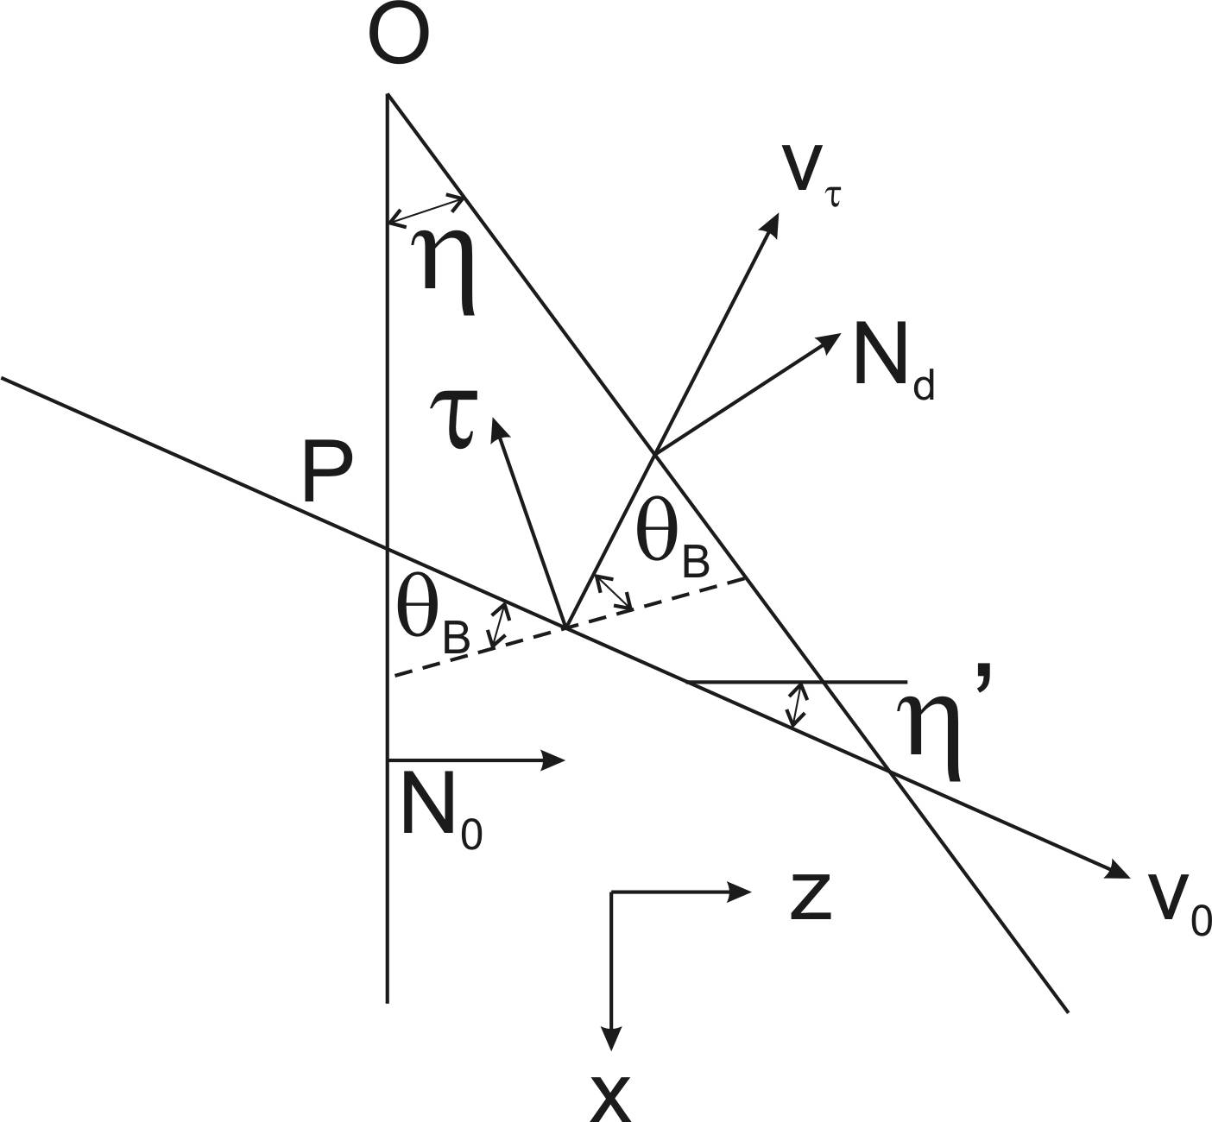
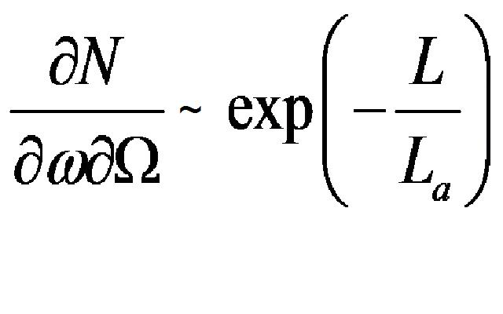
Optimal PXR shape of crystal target - wedge
To calculate optimal asymmetric geometries and wedge configurations – dynamical theory required

Slide 49
Ideas for the future research
PXR Yield optimization (target material, Laue and Bragg, symmetric/asymmetric, wedge-shaped, X ray energy range, polarization, angular distribution, etc.) on the base of exact dynamical theory
Analysis of experimental data
Account of coherent Bremsstrahlung and PXR interference
Development of dedicated targets
Calculations of heat deposit and its dependence on PXR properties

Slide 50
Ideas for the future research
Theory and simulations of PXR generation in bent crystals
X ray optics (conventional, poly-capillary, bent crystals)
Possibilities of biomedical applications
Application of photonic crystals for radiation generation in THz, UV and soft X ray ranges
Feasibility study of PXR collective generation

