Slide 1


Analytical model of a many-electron atom
BELARUSIAN
STATE
UNIVERSITY
Aliaksandr Leonau
Belarusian State University, Minsk (Belarus)
Actual Problems of Microworld Physics, 17.08.2018
Belarus, Grodno region

Slide 2
Contents
Motivation
Description of the effective charge model
Second-order corrections
Some of the possible applications
Conclusions

Slide 3
Contents
Motivation
Description of the effective charge model
Second-order corrections
Some of the possible applications
Conclusions

Slide 4


Accuracy vs Simplicity
Single-electron wave function (SEWF) is the key point of the initial approximation for both density functional theory and the solution of the Schrödinger equation.
High accuracy algorithms: HF, MCHF, post-HF and other.
Disadvantage: complexity of numerical simulations
There are many applications where there is no need for extremely high accuracy, but a simple algorithm of repeated calculations of atomic characteristics is required:
computational plasma
X-ray physics
crystallography
semiconductor physics
strong laser-matter interactions
Models used: Thomas-Fermi, multi-parametric screening hydrogen, etc.
Can one introduce something new ?
2 (17)

Slide 5
Main features of our approach
Effective Charge Model (ECM) utilizes basis set of fully analytical SEWF – hydrogen-like wave functions with a single free parameter (identical for all SEWF).
complete and orthonormal basis is automatically provided !
transition into secondary-quantized representation becomes possible
various closed-form expressions can be implemented
Main goals of ECM:
  sufficiently accurate analytical zeroth-order approximation
  possibility to construct regular perturbation theory for higher order corrections
3 (17)

Slide 6
Contents
Motivation
Description of the effective charge model
Second-order corrections
Some of the possible applications
Conclusions

Slide 7
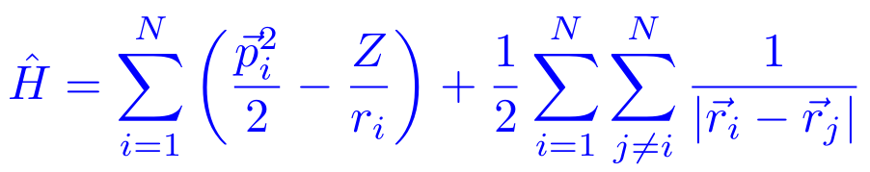
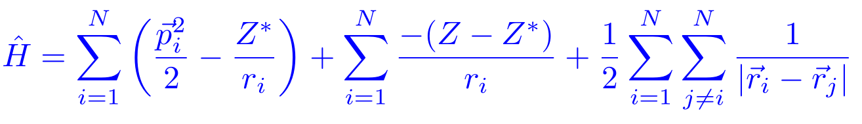


Hamiltonian of the atomic system
Non-relativistic Hamiltonian of the atomic system (in atomic units)
can be re-written in the form as follows:
describes a set of non-interacting electrons in a hydrogen-like atom with nucleus charge Z* and total number of electrons N
can be considered as a “perturbation” operator
4 (17)

Slide 8

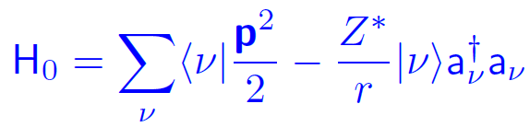





Hamiltonian of the atomic system
Transition to the secondary-quantized representation
(discrete states)
Greek letters represent the collective quantum number:
(continuous spectrum)
Simple hydrogen-like wave-functions are used:
Note: only one free parameter is used for all SEWF of the current atom (ion) !
5 (17)

Slide 9

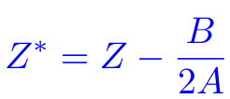


How to calculate Z* ?
The knowledge of the effective charge Z* fully defines the Hamiltonian of the zeroth-order approximation H₀ .
For this puprose we perform the variational calculation
with trial state vector
depends on the set
of occupation numbers
All calculations can be done analytically, and finally
we obtain:
both values are analytically calculated and DO NOT depend on Z*
Here we utilized the variable change
zeroth-order energies and SEWF
are well-defined !
6 (17)

Slide 10
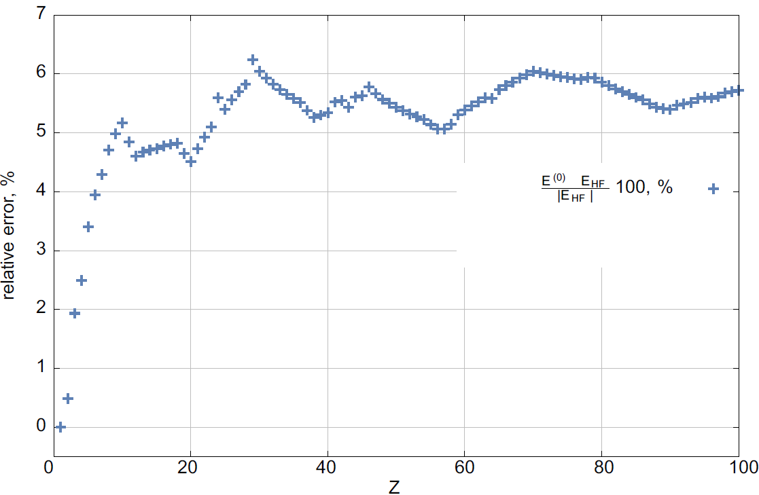
Zeroth-order results
Relative error of the total atomic energy as a function of nucleus’ charge Z
7 (17)

Slide 11
Contents
Motivation
Description of the effective charge model
Second-order corrections
Some of the possible applications
Conclusions

Slide 12

Perturbation theory over W-operator
Now it is possible to construct perturbation theory due to the operator W (eigenstates of the zeroth-order Hamiltonian H₀ are utilized):
1-st order correction:
1st order correction vanishes !
8 (17)

Slide 13
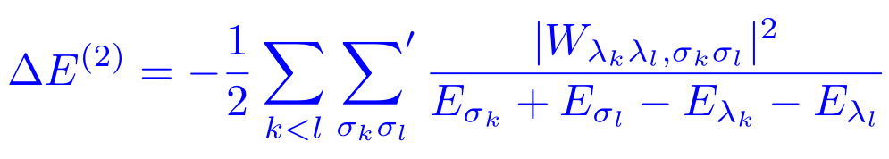
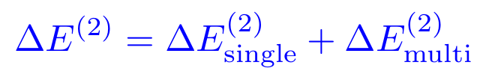
Calculating 2nd order corrections
2nd order perturbation theory due to the W operator:
where
only one electron goes into an
intermediate state
two electrons undergo the transition into
intermediates states
9 (17)

Slide 14
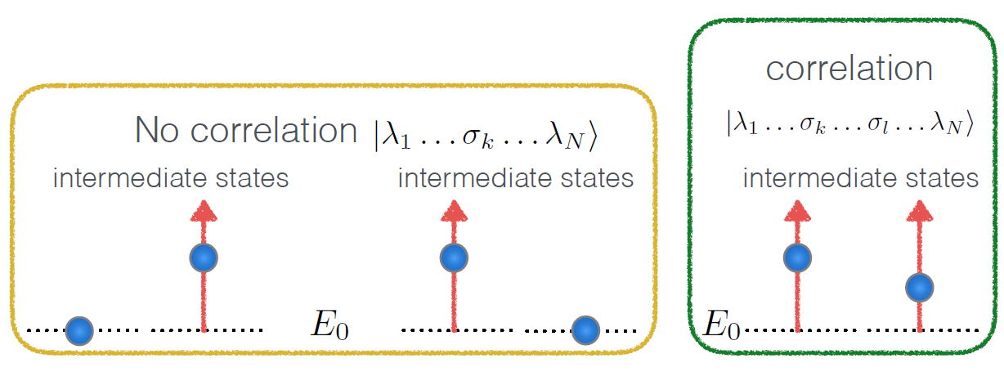
Calculating 2nd order corrections
only one electron goes into an
intermediate state
two electrons undergo the transition into
intermediates states
9 (17)

Slide 15
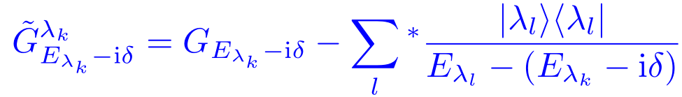
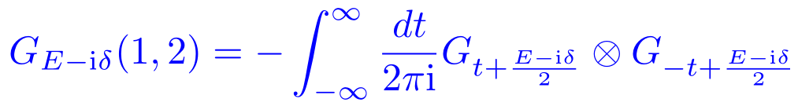
Calculating 2nd order corrections
The largest advantage of ECM – using a hydrogen-like basis the required summations can be done in a closed form through the single-particle Coulomb Green functions.
Taking into account the Pauli exclusion principle and that not all states are present, the reduced Coulomb Green function is utilized:
for mutli-electron excitations we need to obtain a two-particle Coulomb Green function that can be represented as a convolution of two single particle ones:
10 (17)

Slide 16
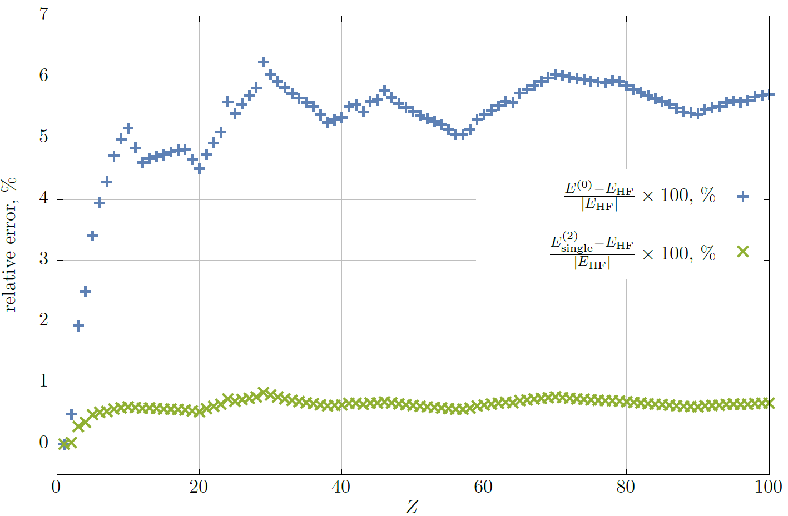
2nd order PT: single electron excitations
Relative error of the total atomic energy as a function of nucleus’ charge Z
11 (17)

Slide 17
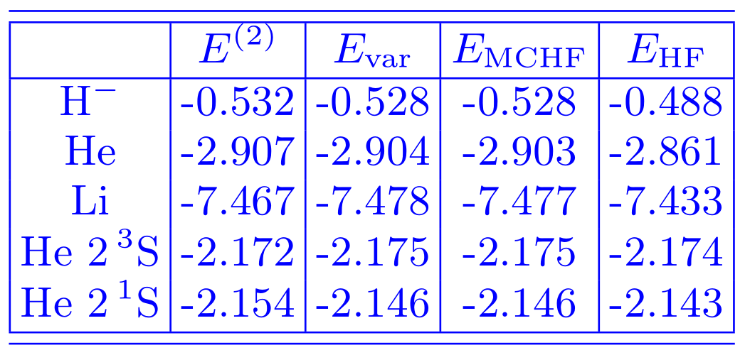

2nd order PT: single + multi electron excitations
12 (17)

Slide 18
Contents
Motivation
Description of the effective charge model
Second-order corrections
Some of the possible applications
Conclusions

Slide 19
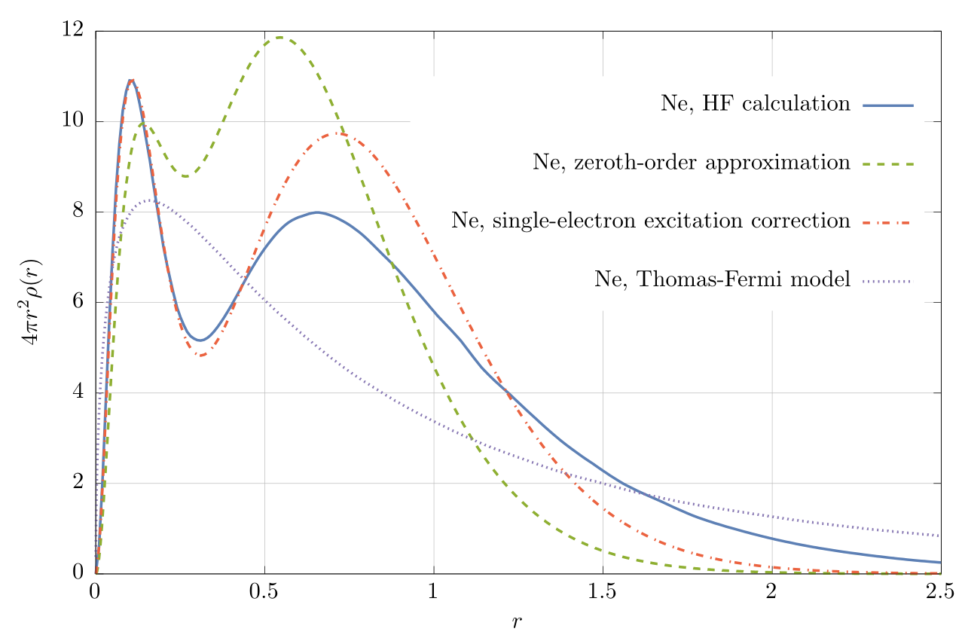
Radial densities: Ne
13 (17)

Slide 20
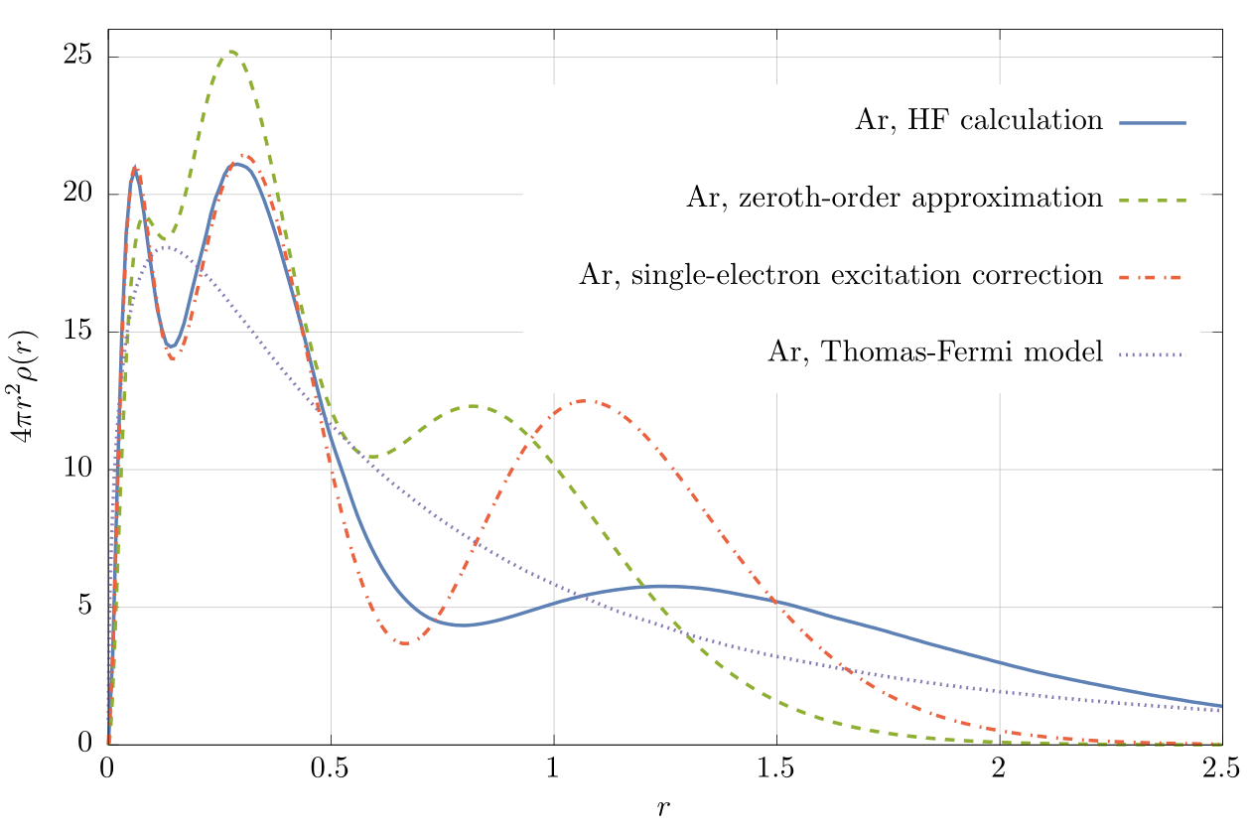
Radial densities: Ar
14 (17)

Slide 21
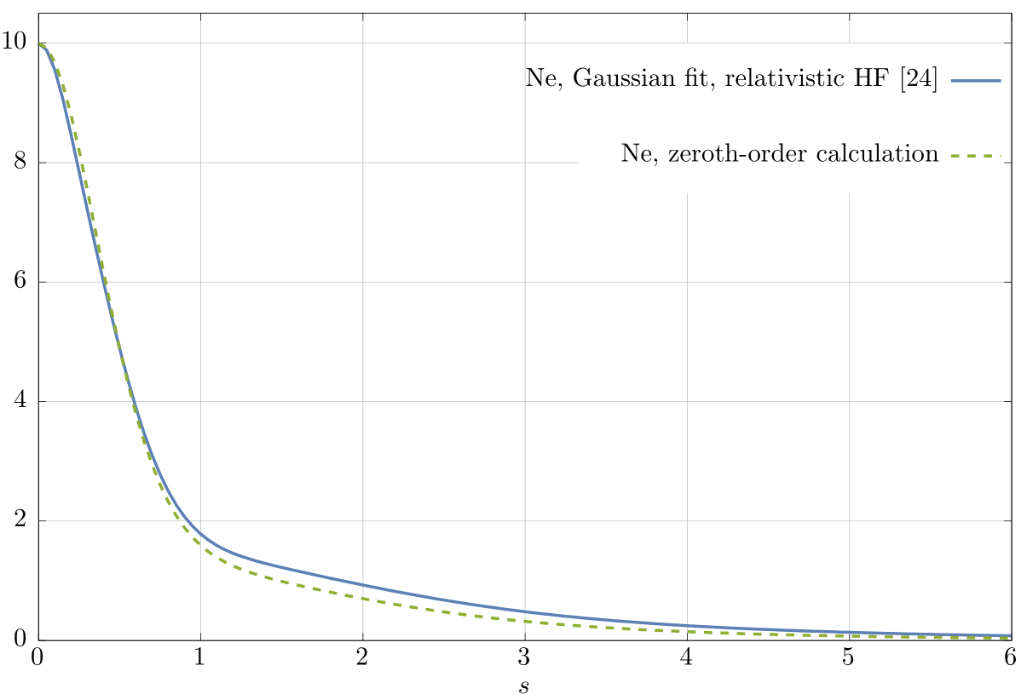
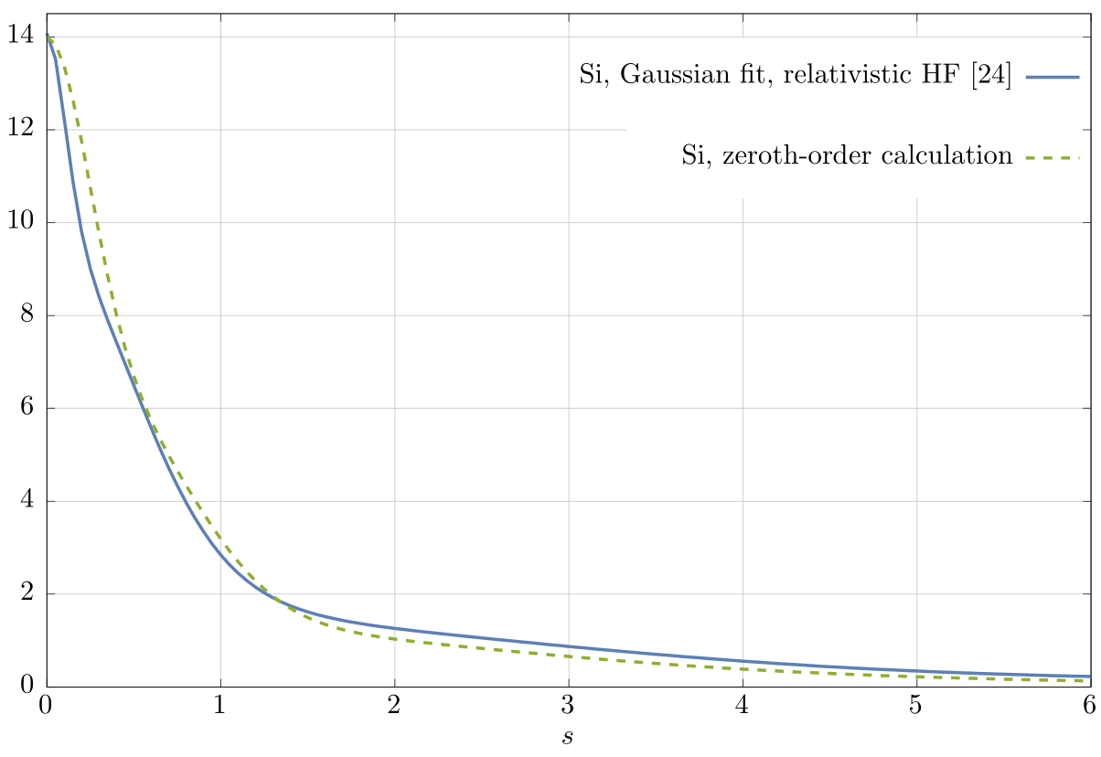
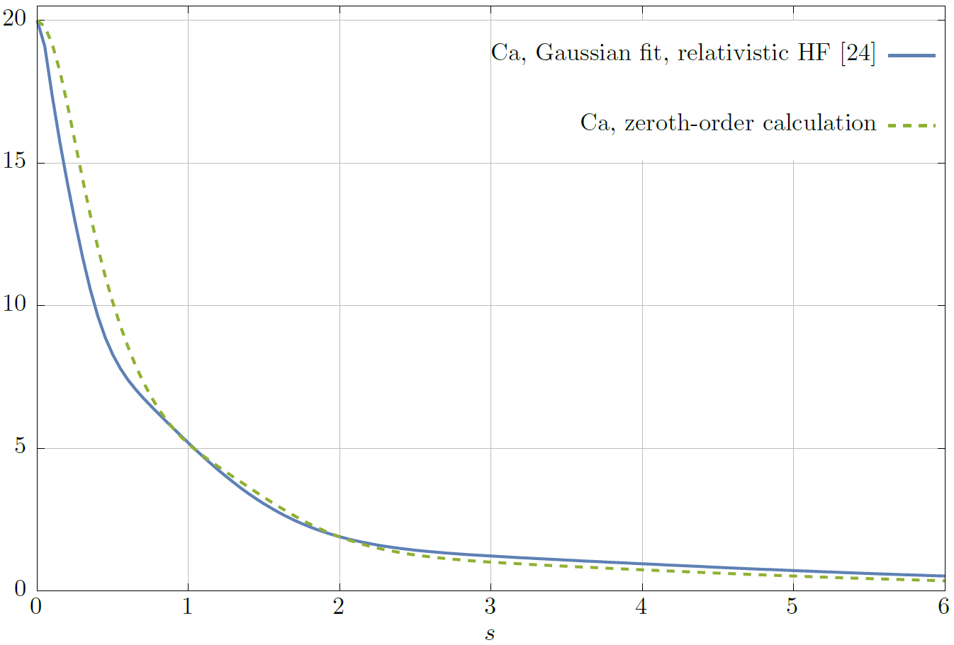
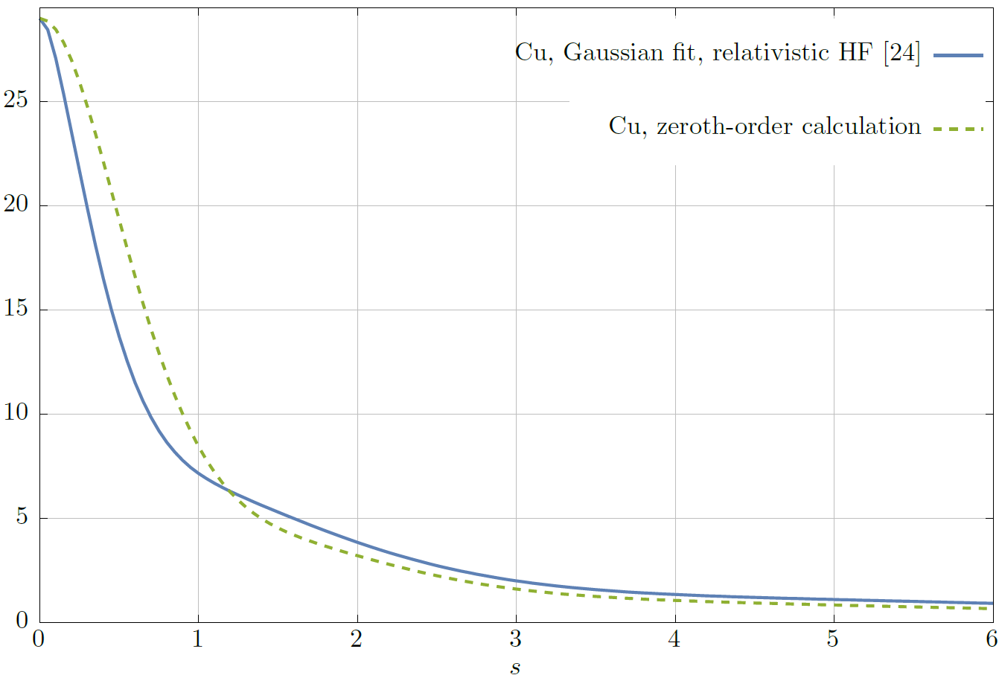
Atomic scattering factors
Ne
Si
Ca
Cu
15 (17)

Slide 22
Contents
Motivation
Description of the effective charge model
Second-order corrections
Some of the possible applications
Conclusions

Slide 23
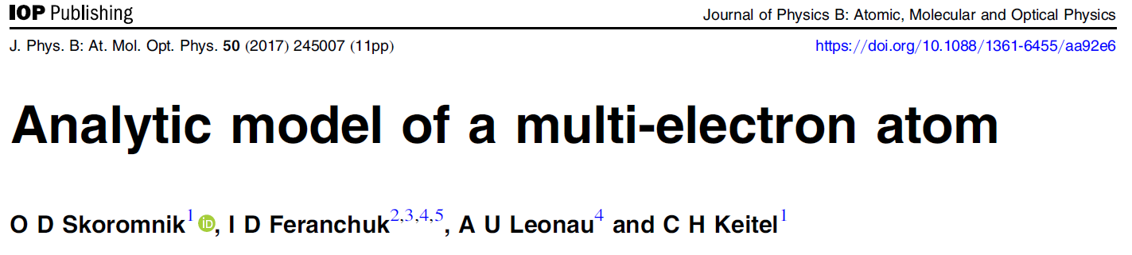
Conclusions
A fully analytical approximation for the observable characteristics of many-electron atoms and ions is developed
Both qualitative and quantitative estimations can be done
Straightforward calculation of subsequent corrections and direct generalization for the relativistic calculations is possible
SOFTWARE AVAILABLE:
https://github.com/tupos/effz
16 (17)

Slide 24

Acknowledgements
Belarusian State University
(Minsk, Belarus)
MPI for Nuclear Physics
(Heidelberg, Germany)
Prof. Dr. Ilya Feranchuk
Dr. Oleg Skoromnik
Prof. Dr. Christoph Keitel
17 (17)

Slide 25
THANK YOU
FOR YOUR ATTENTION !

