Slide 1
The XIV-th International School-Conference The Actual Problems of Microworld Physics
In Memory of Professor Nikolai Shumeiko
Modular testing system
for detectors and front-end electronics
Institute for Nuclear Problems, Belarusian State University
Vadim Bayev
Konstantin Afanaciev

Slide 2
THE AIM:
to create the modular testing system in Minsk
1. System for testing new type gas detectors (GEMs in particular) developed by JINR, INP BSU and Institute of Physics of the NAS of Belarus jointly.
2. System for testing front-end electronics developed by INP BSU for HEP experiments at JINR, CERN, DESY etc.
3. Verification of results obtained with testing facility in JINR.
Notes:
2016-2017 – development of modified GEM detectors for MPD experiment at NICA

Slide 3
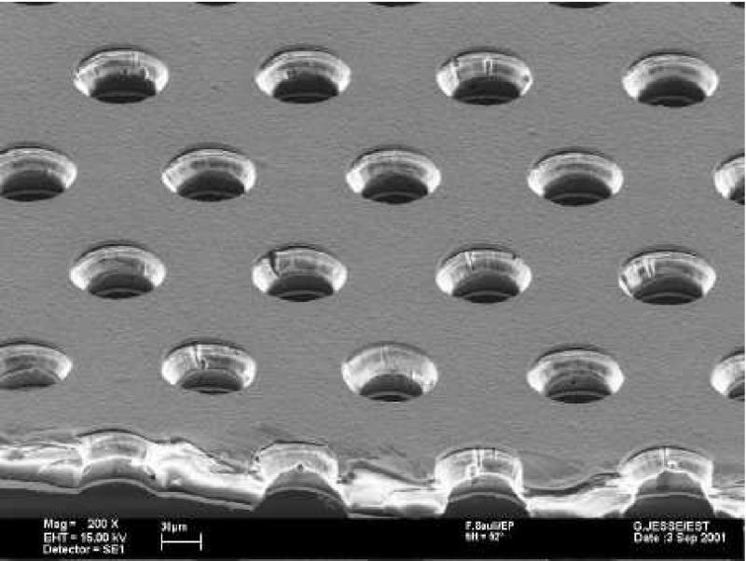
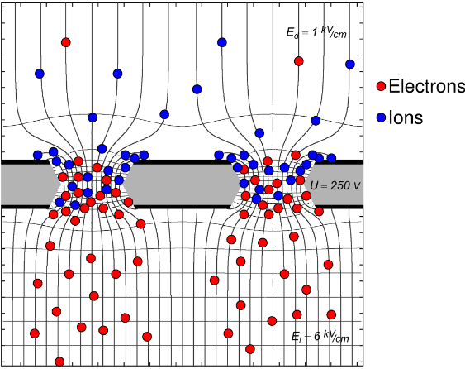
Gas electron multiplier (GEM) detectors are one of the class of
Micropattern gas detectors including such types as MicroMegas,
MicroStrip Gas Chamber, Micro Pattern Gas Detectors and other
GEMs were invented in 1997 in the Gas Detector Development Group at CERN by physicist Fabio Sauli.
cathode
X-ray
10 kV/cm
anode
Electron microscope picture of a GEM surface (from CERN GDD group).
Sketch of the working principle of a GEM.
Notes:
The intrinsic ion back-drift suppression is one of the main advantages of the GEMs and makes a gating grid unnecessary. In this way, a detector can be read out continuously using GEMs without the dead time during the gating.
Another advantage of the GEM amplification is the fast signal: the electron signal is measured directly on the pad plane, which leads to a better time (respectively z-) resolution. Furthermore, the GEMs do require less mounting structures as proportional wires do.
The GEM signal on the pad plane is narrower than in the case of proportional wires. This is an advantage in the two-track separation, but poses new problems in the rφ resolution. The pads have to be smaller, so that a narrow signal still hits enough pads for a good reconstruction in the rφ plane. However, the number of pads is limited by the feasible number of readout channels and the signal height (smaller pads result in a smaller signal per pad), so a compromise has to be found.
Overall, GEMs are a very promising technique for the gas amplification in a TPC and many of their advantages already have been confirmed experimentally.

Slide 4
Scheme of modular testing system
Fe⁵⁵ X-Ray Source
can be varied
Oscilloscope
High Voltage
4 channels
Up to ± 8 kV
Test Box
(device under test)
can be varied
Charge Sensitive Amplifier
can be varied
Gas System (Ar+CO₂)
can be varied
Data Acquisition
(DRS4 evaluation board
DT5725 CAEN digitizer)

Slide 5
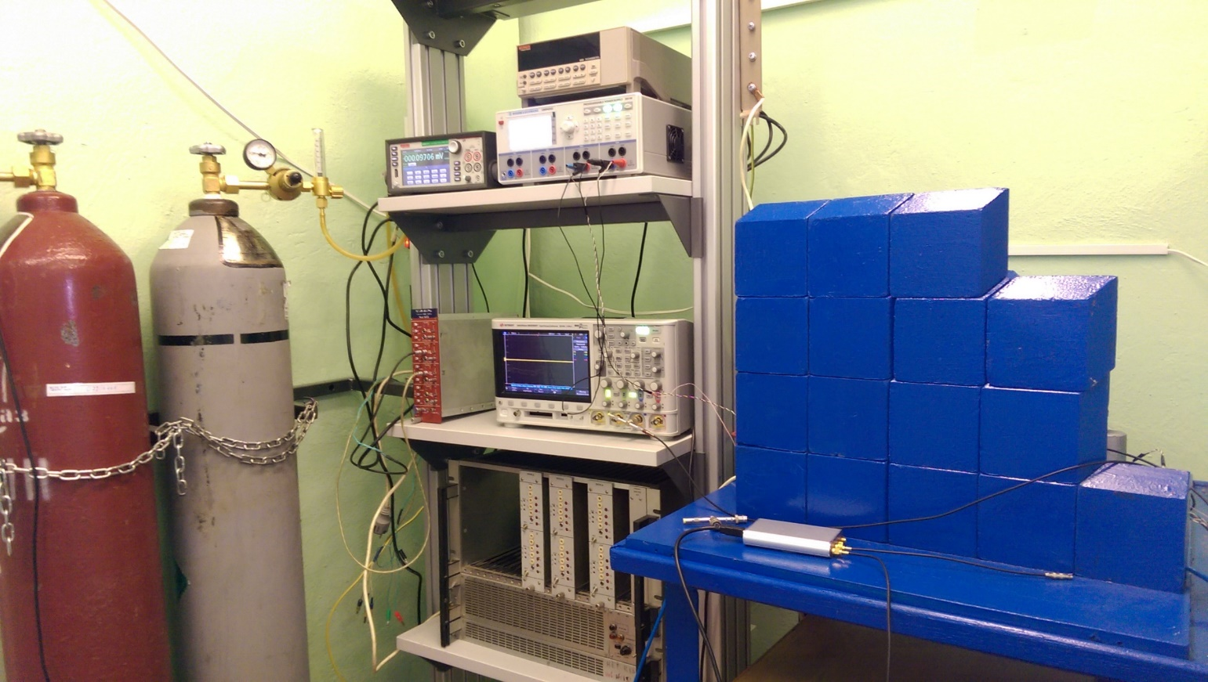
Setup for gas detectors study
GEM
Gas tubes
Wire chamber
Straw tube
Charge sensitive amplifiers
2-ch MH1XAA010
8-ch MH2XAA020 (KT-N)

Slide 6
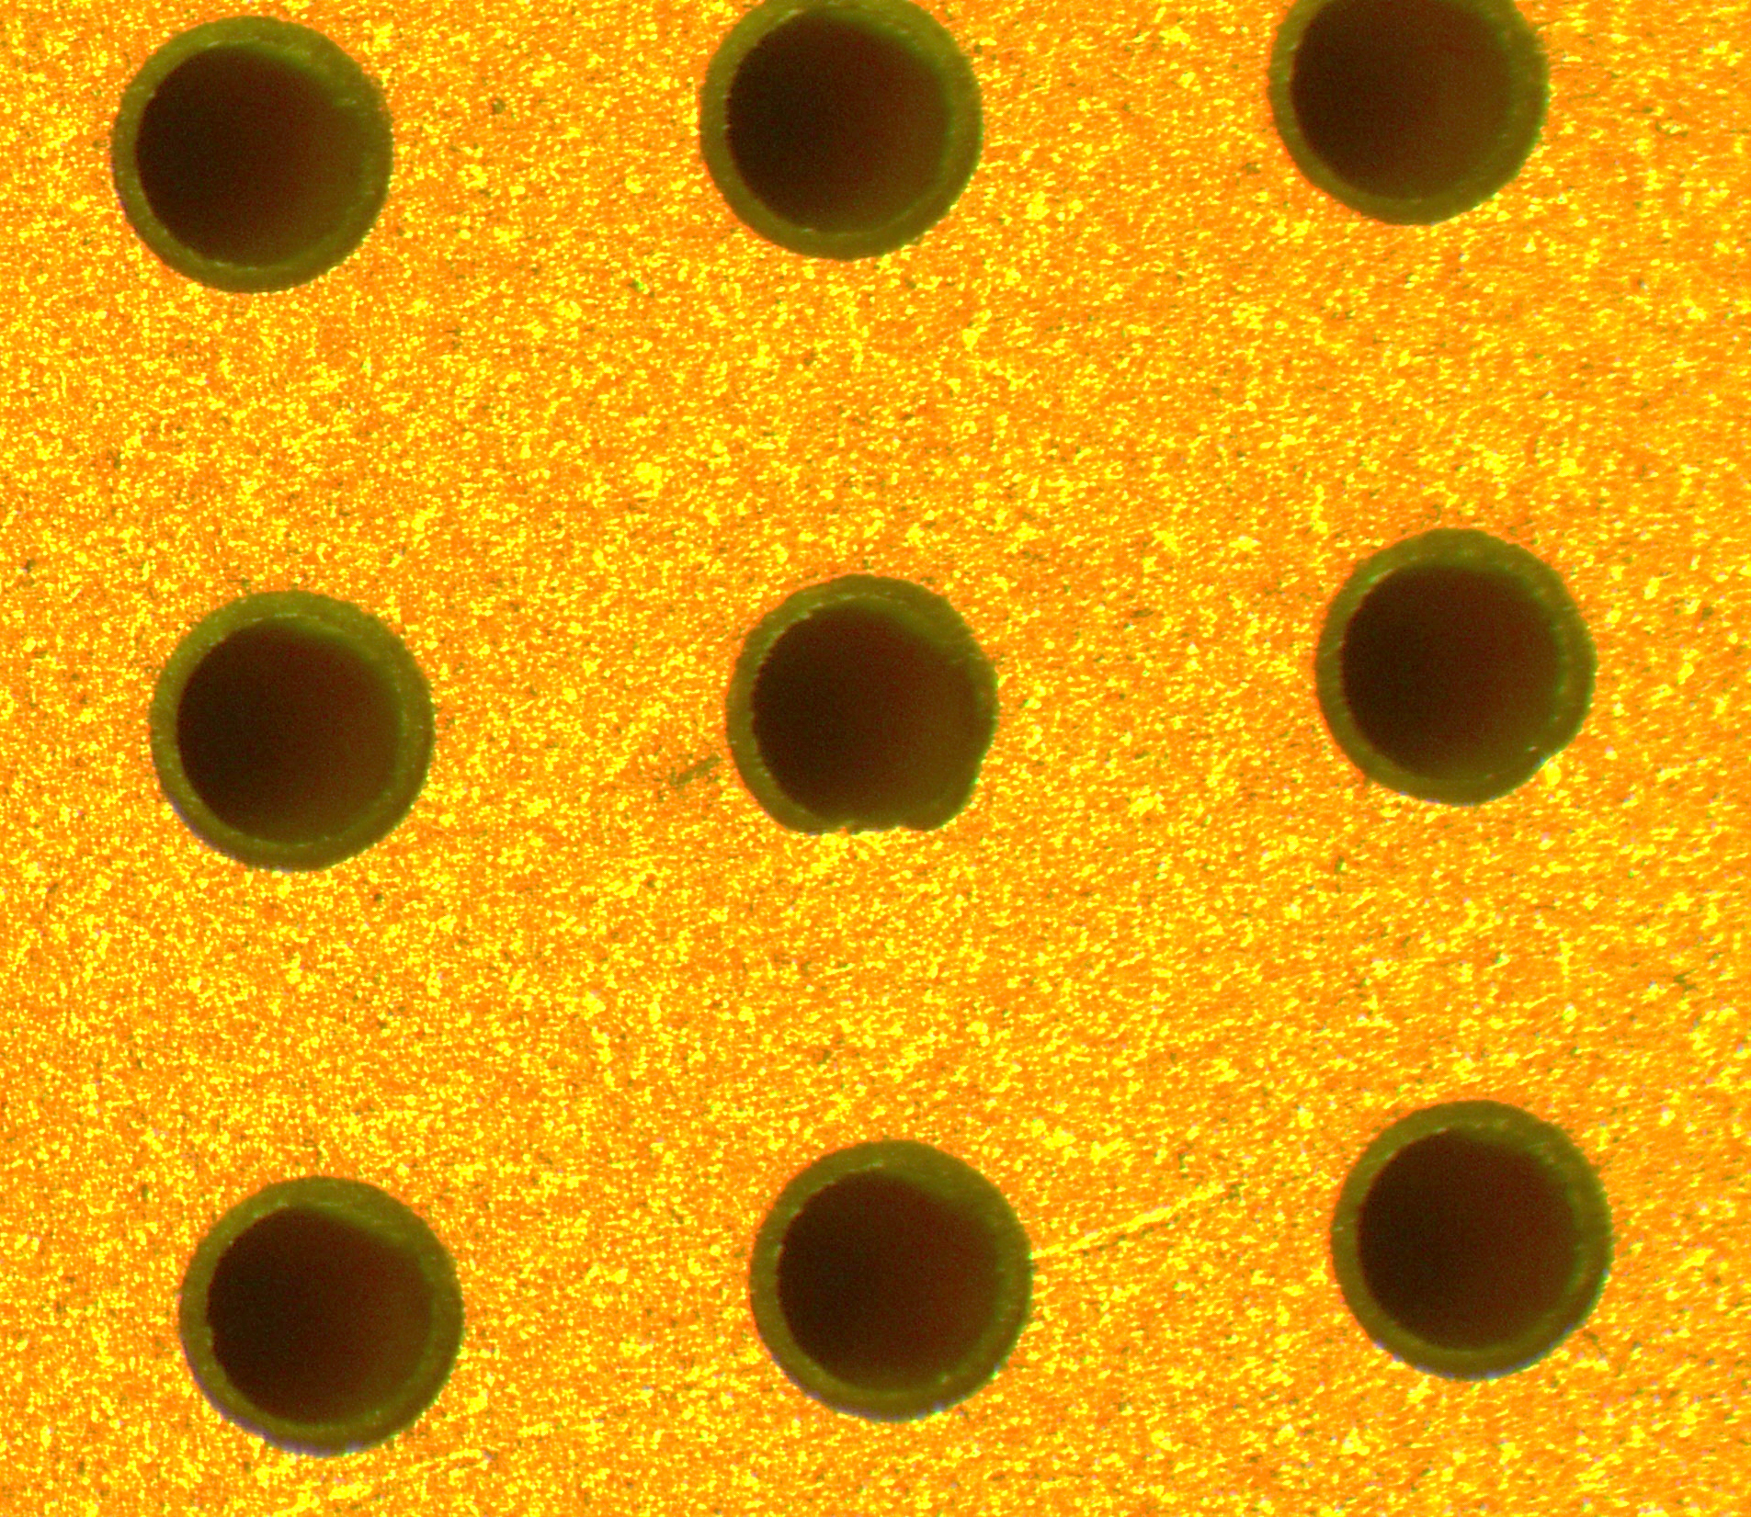

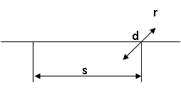
Thick Gas Electron Multiplier (THGEM)
Produced by Svyaz Engineering (Dubna, Russia), 15 pcs tested
Thickness of fiberglass is 0.5 mm
Thickness of copper metallization after etching is 12 μm
Diameter of holes d = 0.2 mm
Distance between holes s= 0.5 mm
Width of rims is 15 μm
Area of THGEM is 10х10 mm²
Breakdown Voltage Test:
for Ar 90% + CO₂ 10% ~1450 V
for Ar 70% + CO₂ 30% ~3100 V

Slide 7
THGEM detector scheme with anode readout

Slide 8
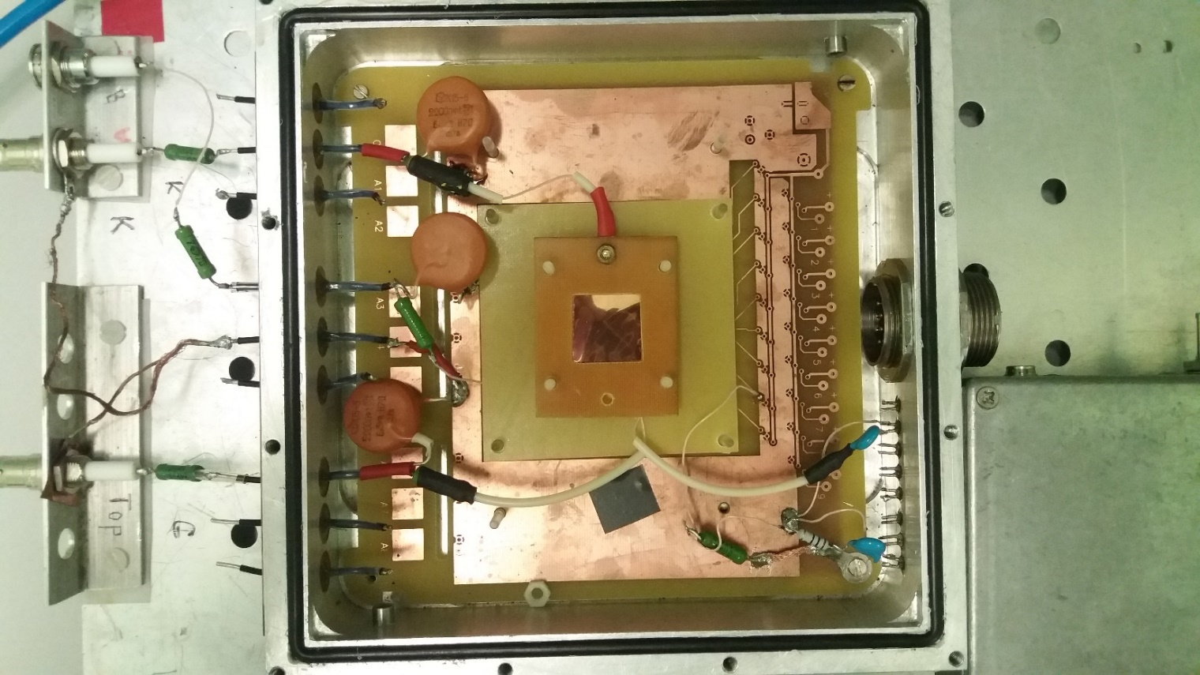
Test module for THGEM detector characterization with readout anode
Cathode
Gas mixture in
THGEM
HV
Charge Sensitive Amplifier
8-ch MH2XAA020 (KT-N)
Gas mixture out

Slide 9
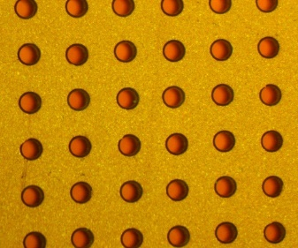
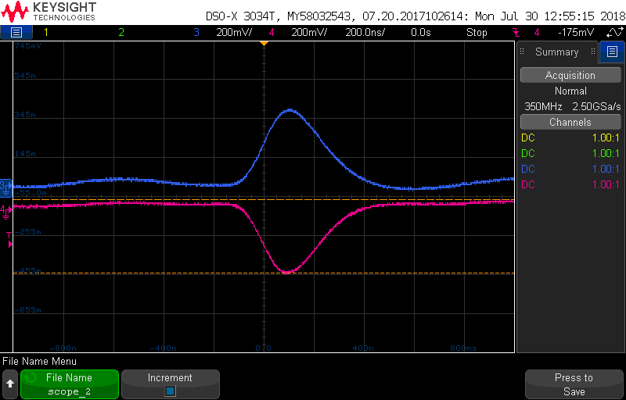
Spectroscopy results (Fe⁵⁵)
Fe⁵⁵ X-ray source used for testing
5.9 keV main peak
2.9 keV escape peak in Ar

Slide 10
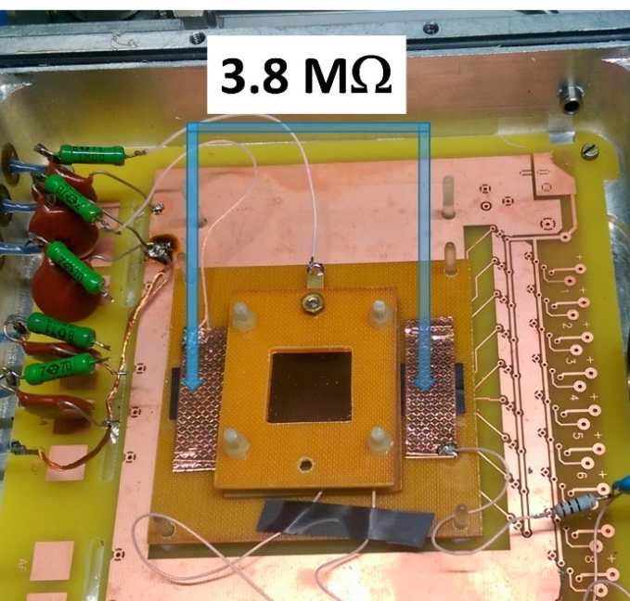
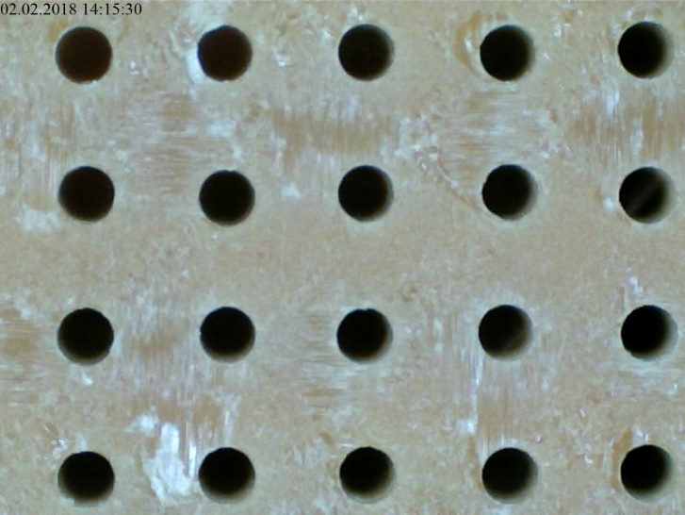
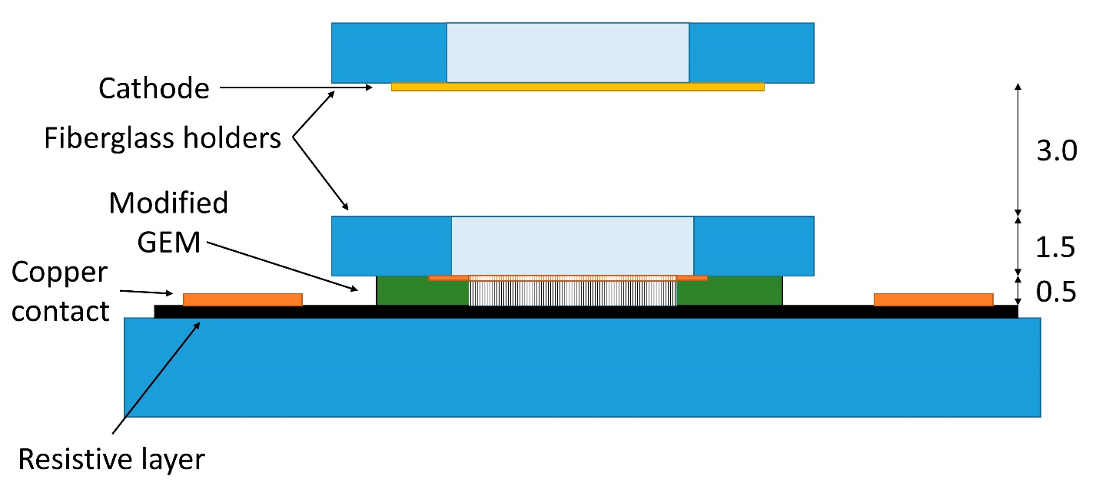
μRWELL dector
Bottom metallization
removed
Resistive Kapton used
for signal registration

Slide 11
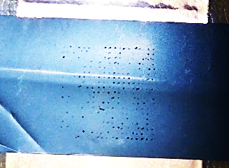
Spectroscopy results (Fe⁵⁵)
The signals from μRWELL detector example were obtained but the resolution and Gain were much worse than expected.
Also resistive Kapton was damaged after some time of detector operation.
We plan to use DLC coating instead of resistive Kapton.

Slide 12
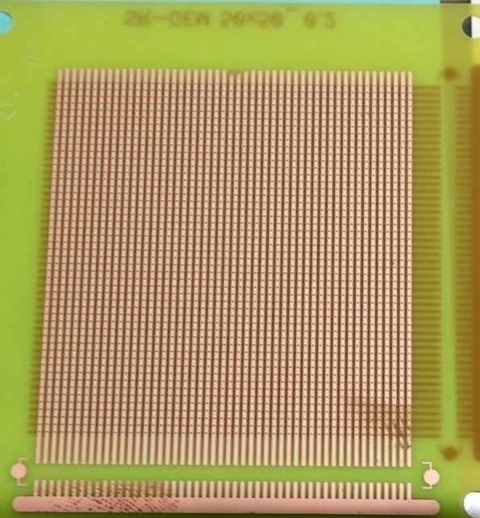
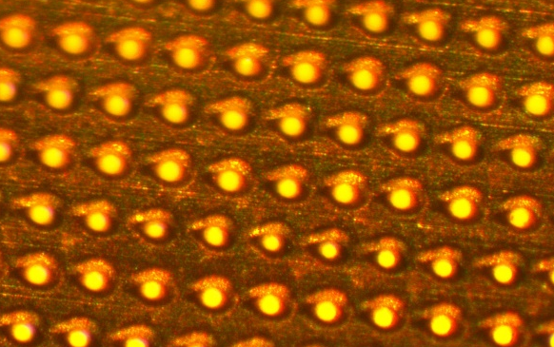
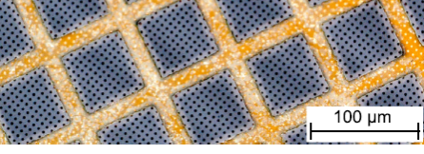
Plans for the near future
detector μRWELL with DLC coating
SSR THGEM (strip readout)
GEM and μRWELL with holes formed by laser beam in collaboration with Institute of Physics of the NAS of Belarus
GEM with graphene coating to prevent ion back flow
Straw tubes with segmented cathode for Z-coordinate
SSR THGEM
Cu foil
d =20 μm
pitch 40 μm
Graphene
at Cu mesh
d = 50 μm

Slide 13
Conclusions
The modular system for detectors and front-end electronics testing was developed in INP BSU
The characterization of Thick Gas Electron Multiplier (produced by Svyaz Engineering in Dubna) was performed
It was shown that the developed modular testing system allows to measure the main characteristics of GEM detectors
Main characteristics of THGEM detectors measured in Minsk fully correlate with those obtained in Dubna

