Slide 1




The Actual Problems of Microworld Physics
Grodno, Belarus, August 12 - August 24, 2018
The area of high radiation technologies on the basis of the accelerator complex NICA
(suggestions for implementation)
S.Tyutyunnikov
Joint Institute for Nuclear Research, Dubna, Russia

Slide 2
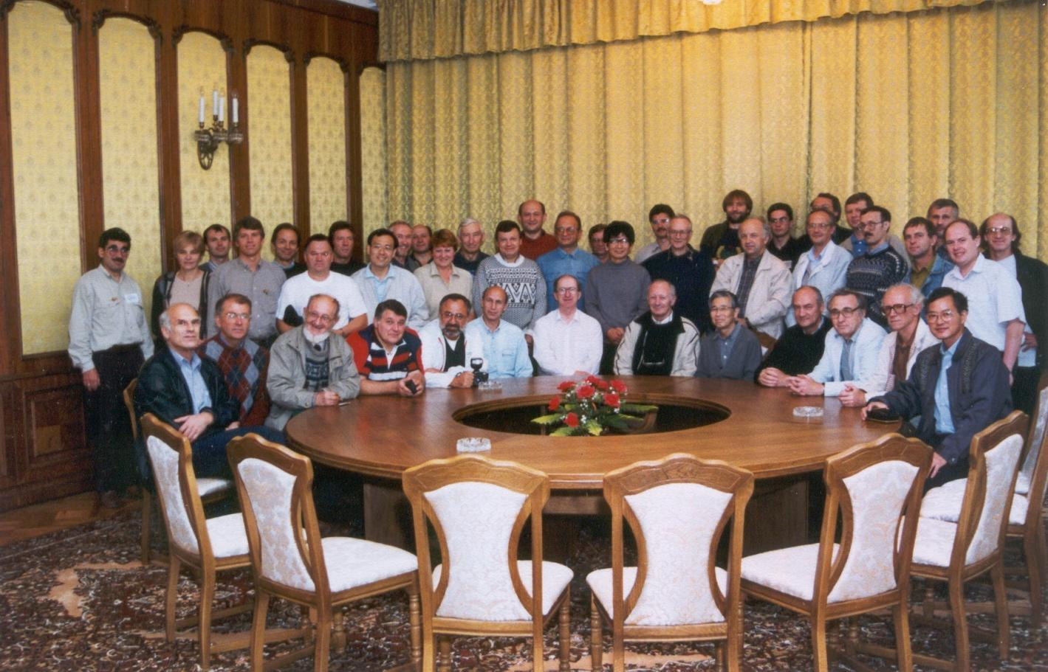
1997, Belovezhskaya Pushcha

Slide 3
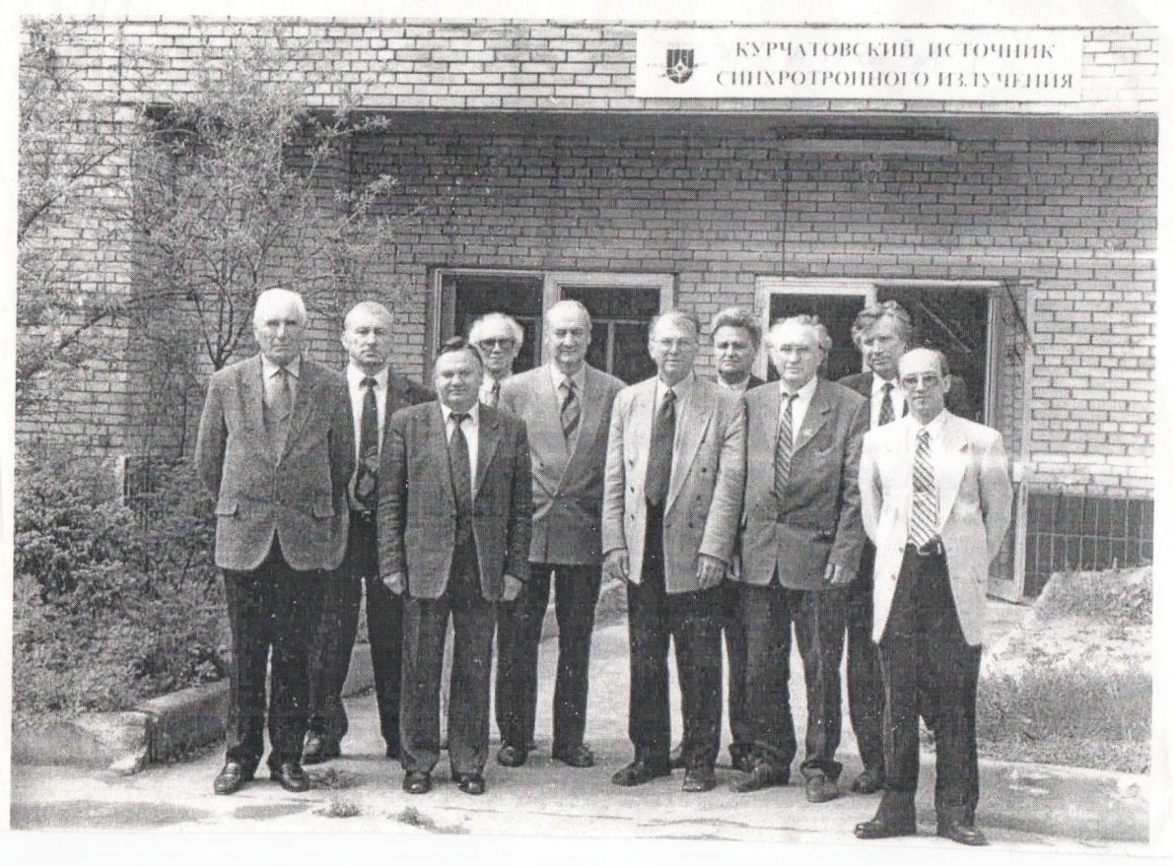
Kurchatov synchrotron radiation source, 1999

Slide 4
Contents:
Modern Center for Radiation Research (FEARA, BIMAX, KEK)
The main directions of applied research with relativistic particles beams in the world.
NICA accelerator complex in JINR. The main parameters of the beams.
Investigations at the Nuclotron in relativistic nuclear technology (NRT).
Researches of structural changes in condensed matter with heavy ions.
Creating the basic units of the prototype of the carbon therapy complex.
Creating a solid nanostructured systems with beams of relativistic nuclei.
Scientific infrastructure for radiation effects research.

Slide 5
Various Applications of the KEK AIA
Warm Dense Matter Science
Nanostructure Fabrication (Ion Track, Nanowire)
Ion-tuning to Make Intelligent Material & Surface Improvement
Hybrid Cancer Therapy with H, C and Fe
Mutation Breeding
Micro-beam for Biological Science
SEU Experiments for Microprocessor, Semiconductor & Power Transistor

Slide 6
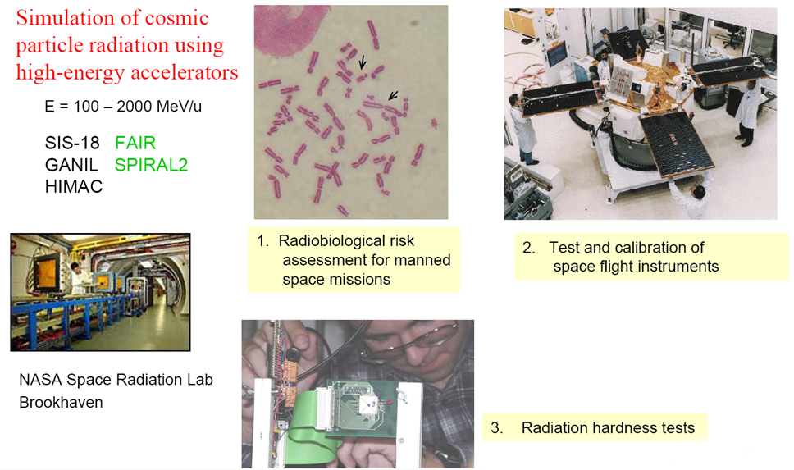
High-energy ion beams for space research

Slide 7
High-Energy Irradiation Facility for High-Energy Irradiation Facility for Biophysics and Material Research -
BIOMAT
Research program: Space radiation effects
- heavy ion induced modifications of soliids under extremely high pressure
- analysis of material modifications induced by relativistic heavy ions
Radiation hardness of materials
Equipments:
- Magnetic scanner system
- Flexible irradiation set-ups
- Instrumentation for in-situ diagnostics of irradiated samples

Slide 8
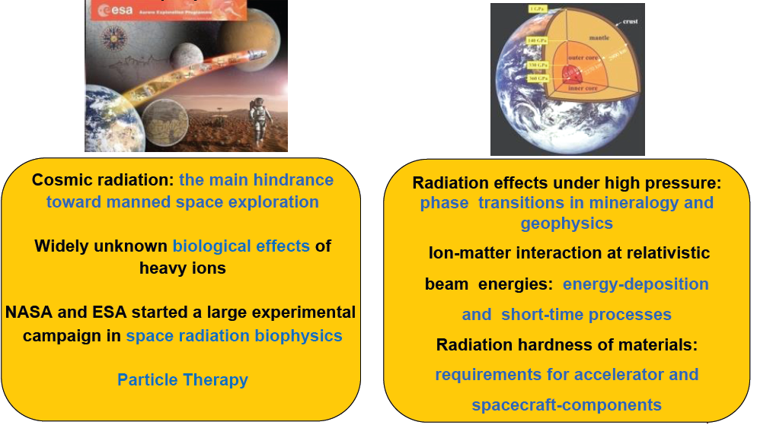
BIOMAT Research Fields
Biophysics
Materials Research

Slide 9
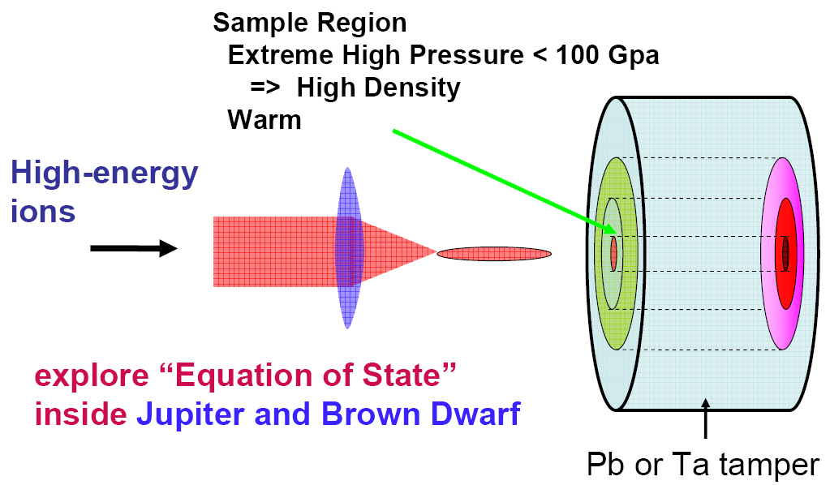
Warm Dense Matter Science and Material Creation

Slide 10
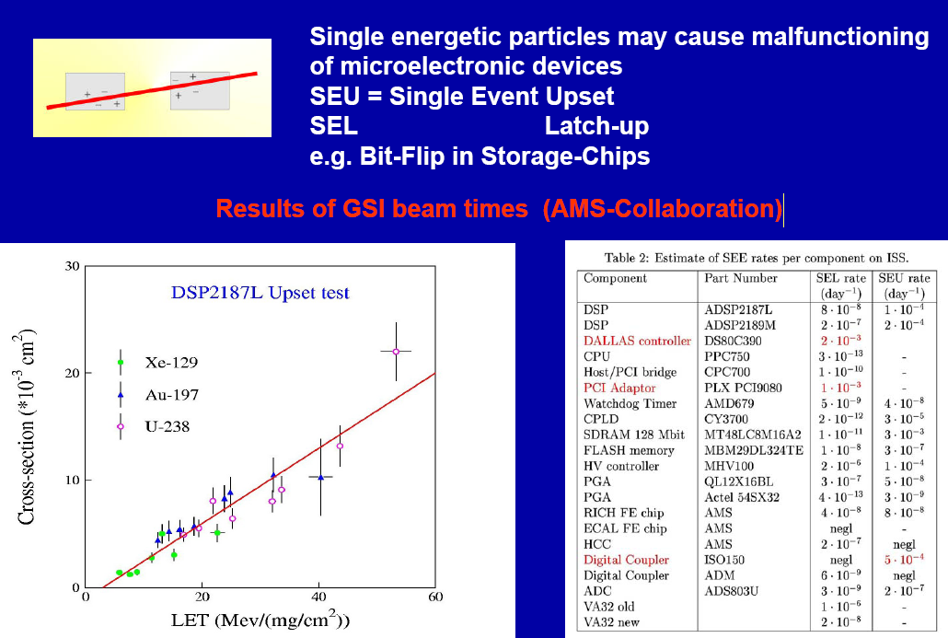
Radiation damage of electronic components

Slide 11
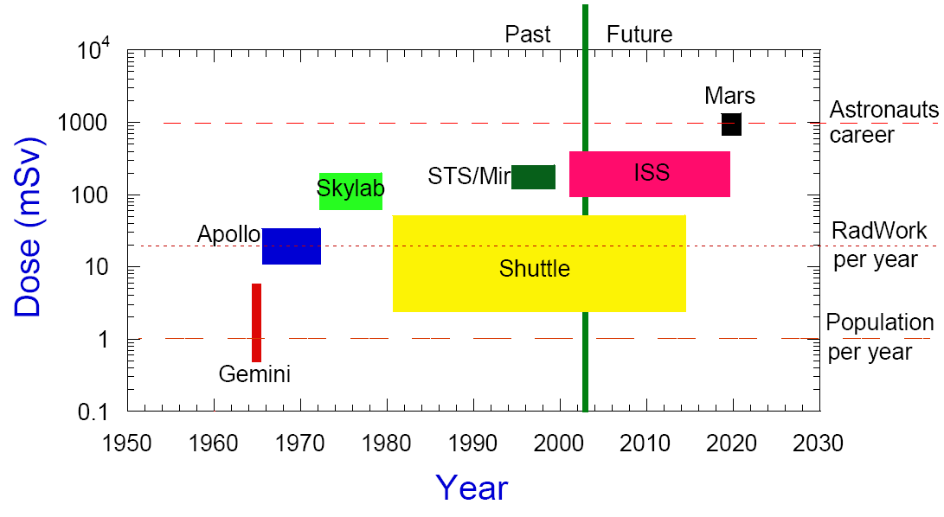
Radiation load for space flights

Slide 12
The damage induced by heavy ions

Slide 13
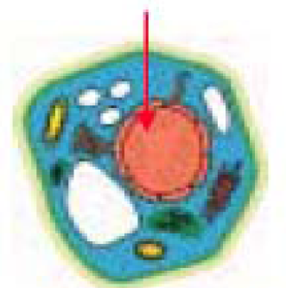
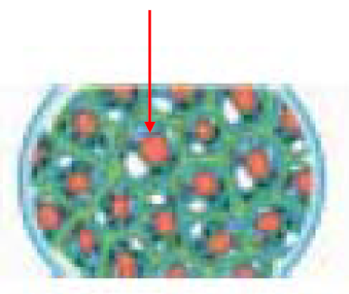
Microbeam irradiation for biological and medical science
Aiming at part of
Chromosome in cell
Aiming at one cell in cell
block

Slide 14
The main directions of scientific-methodical and innovative work on the beams of relativistic nuclei
Radiocarbon Therapy: A prototype of the complex for radiocarbon therapy
Creation of complex equipment for radiobiological studies to simulating galactic radiation
Radiation Materials science :
  Radiation damage of micro electronics
  Technology for creating electronic structures in the tracks of relativistic ions

Slide 15
Microbeams of heavy ions for research of local damage in cells
In the near future it is planned to lead the development of the channel to create micro beams of nuclei for biological studies at the Nuclotron beam nuclei (for example, GSI, Germany). Mikrobeam of GeV-energy ion scan enable cell and determine the degree of radiation damage.

Slide 16
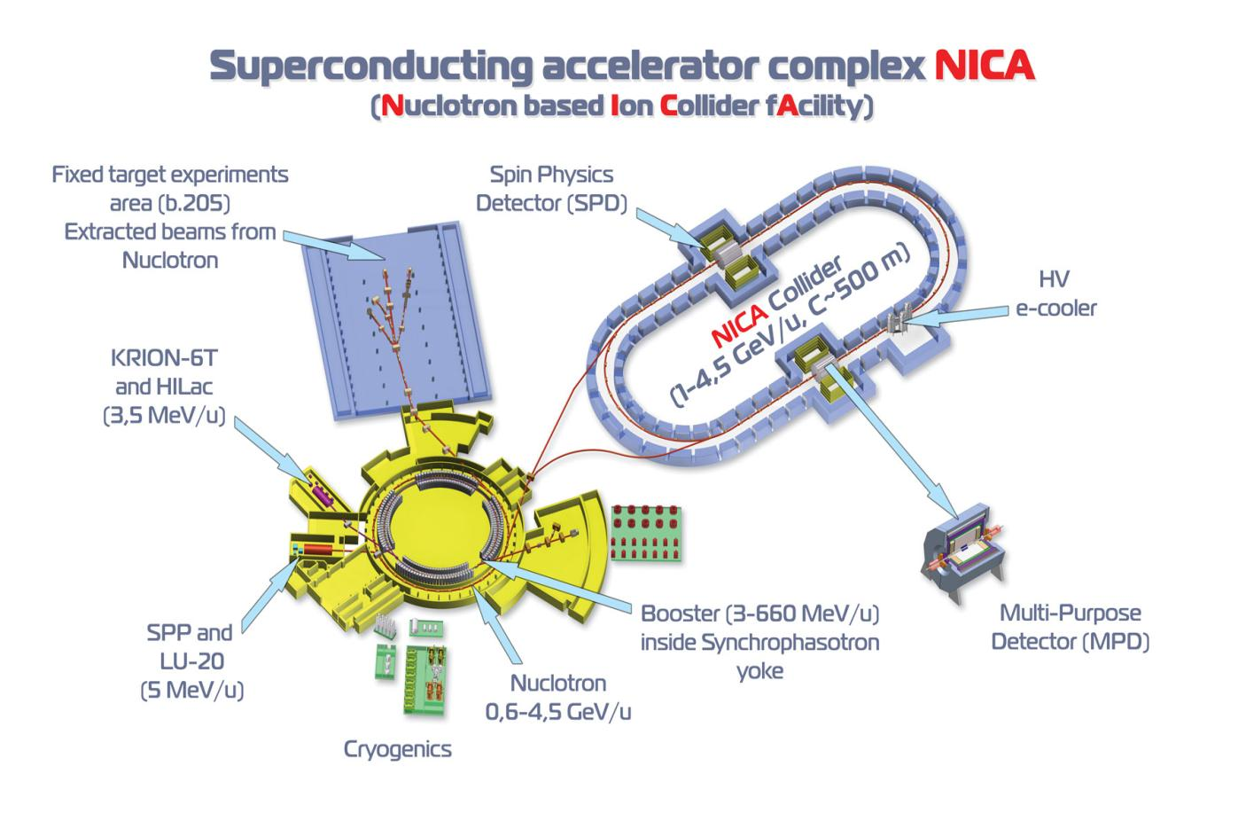

Slide 17
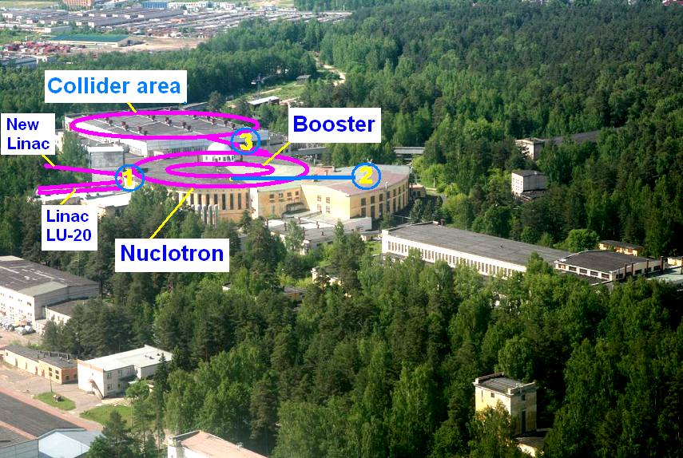

Slide 18
NICA scheme
area-1
beams of low-energy
Injector: 2×10⁹ ions/pulse of ²³⁸U³⁰⁺ at energy 5 MeV/u
Booster (30 Tm)
5 single-turn injections,
storage of 8×10⁹
at electron cooling bunching & acceleration
up to 590 MeV/u
Collider (37 ⇒ 45 Tm)
Storage of
20 bunches × 2.5⋅10⁹ ions per ring
at 3.5 GeV/u max.,
electron and/or stochastic cooling
Stripping (eff. 40%) ²³⁸U^{32+ ⇒ 238}U⁹²⁺
area-2
medium-energy beams
Nuclotron (45) Tm)
injection of one bunch
of 3×10⁹ ions,
acceleration up to
3.5 GeV/u max.
IP-1
Two collider rings
IP-2
2x20 injection cycles
area-3
beams of high-energy

Slide 19
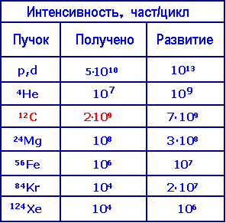
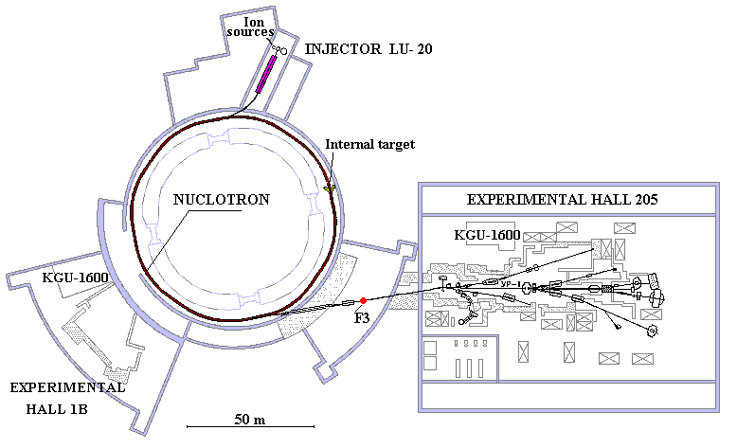
The existing accelerator complex VBLHEP
Intensity nucl/cycl
beam
recd
future

Slide 20
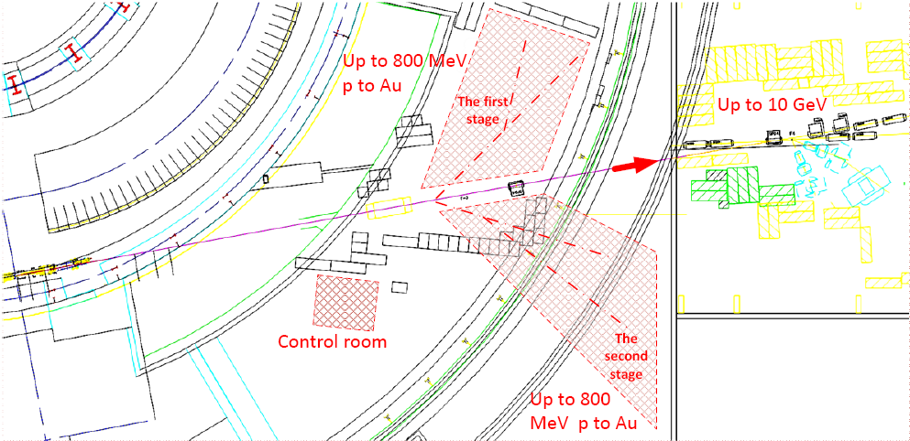
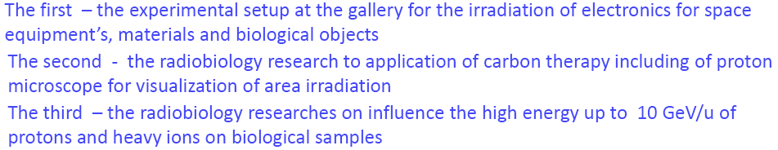
Experimental areas for BIOMAT research

Slide 21
Using beams of the NICA

Slide 22
Projects under the theme of 1107 for the 2017-2019 years.
Energy &Transmutation
Setup Quinta - Nuclotron extracted beam (205 VBLHEP building);
Simulation of hybrid nuclear reactor on the basis of a deep subcritical assembly of natural uranium, excited by a beam of high-energy ions. Research possibility of transmutation of radioactive waste under the influence of radiation.
Setup “Big uranium target" - extracted beam from Phazotron (LNP);
Studying the effects of coherent electromagnetic radiation in the beta decay of long-lived isotopes (IR laser, FEM millimeter range - 42 VBLHEP building). The interested member country - Poland, the Russian Federation.
Radiated Materials Science
Studying of influence of powerful beam of particles and electromagnetic radiation on semiconductor and superconducting materials
Radiation resistance of classic and high-temperature superconductors - extracted beam from LNP Phasotron;
Effect of large doses of high-energy ions (Nuclotron extracted beam, BM & N channel), high energy electrons and hard X-rays (LIA-3000, 42 build. VBLHEP) on Semiconducting micro-devices (customer - Zelenograd).
The development of physical methods of nuclear medicine
Methods of destruction of cancerous tumors under the influence of light ions beams and coherent electromagnetic radiation in conditions of tissue saturation by nanoscale absorbers of radiation
A prototype of oxygen therapy channel with the additional influence of microwave radiation (booster VBLHEP extracted beam);
Study of the possibilities of proton therapy with the additional influence of microwave radiation (medical channel of LNP Phasotron);
The impact of coherent electromagnetic radiation on cancer cells in the tissue saturation conditions by nanoscale absorbers (IR laser, FEM millimeter range - 42 VBLHEP building). The interested member country – Belarus.

Slide 23
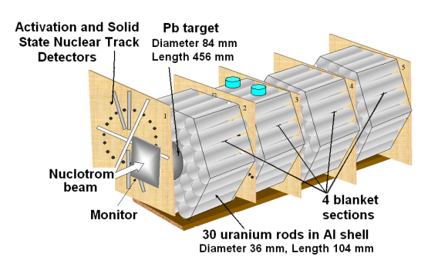
Study of irradiation of sub-critical uranium assembly + lead target. International collaboration “Energy+Transmutation” at Nuclotron
Getting new basic nuclear-physics data with relativistic proton, deutron and light ion beams (1 - 4.5 GeV/n)
for modeling and design of the active core of the prototype for close-to-industrial setup of the radioactive waste processing

Slide 24
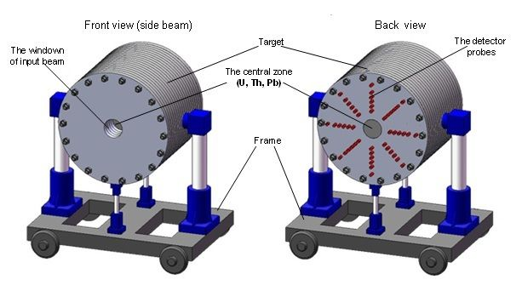
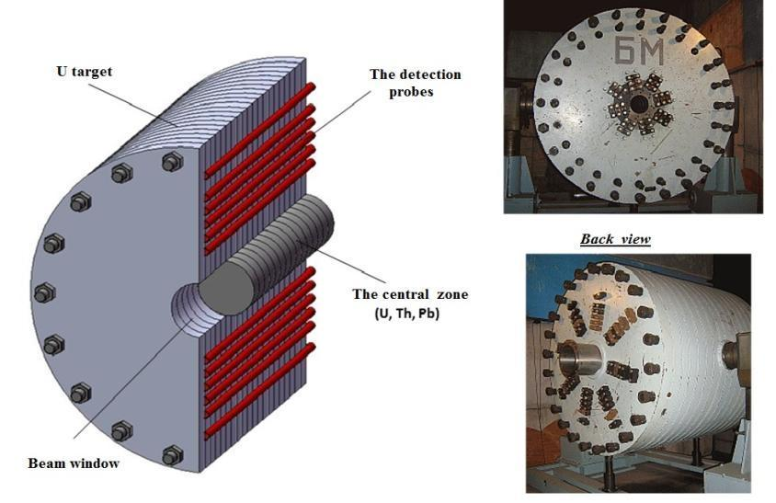
Mass of uranium – 19.5 т. Materials of central zone – U, Th, Pb.
Diameter – 1,2 м. Diameter of central zone – 0,2 м.
Length – 1 м.
General view of the target setup BURAN at the transport-fixing platform.
The scheme of longitudinal section of the TS BURAN with the mounted central zone (top-left) and general view photo (right).

Slide 25
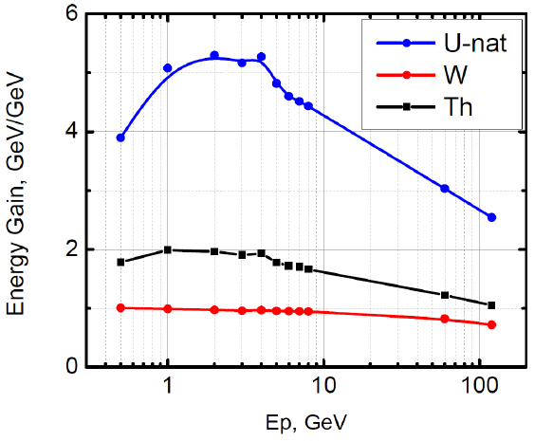

Energy multiplication in the target

Slide 26
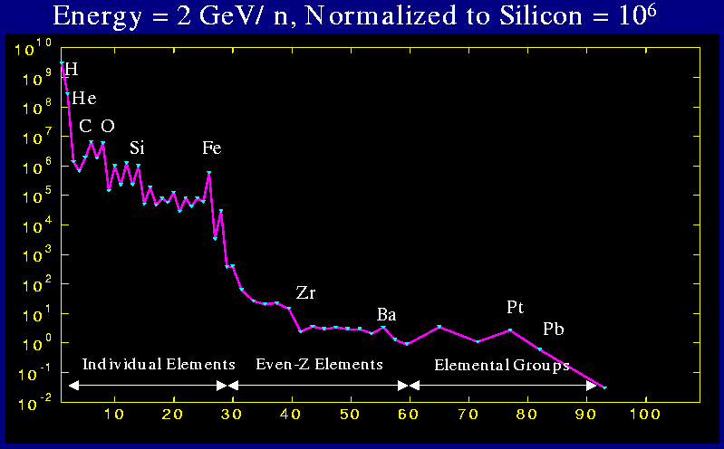
Cosmic Ray Composition and Spectra
ISO 15390 standard: Galactic Cosmic Ray model (Nymmik, MSU) e.g. in CREME-96

Slide 27
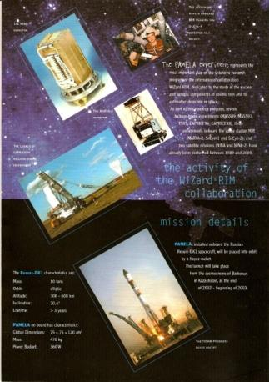
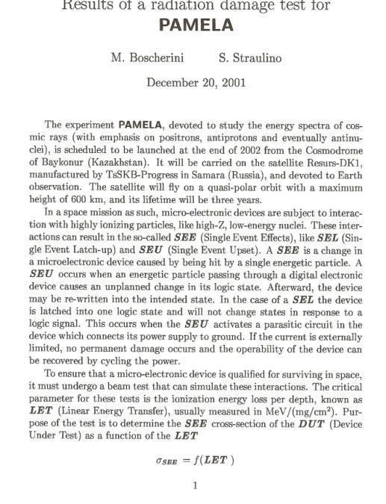
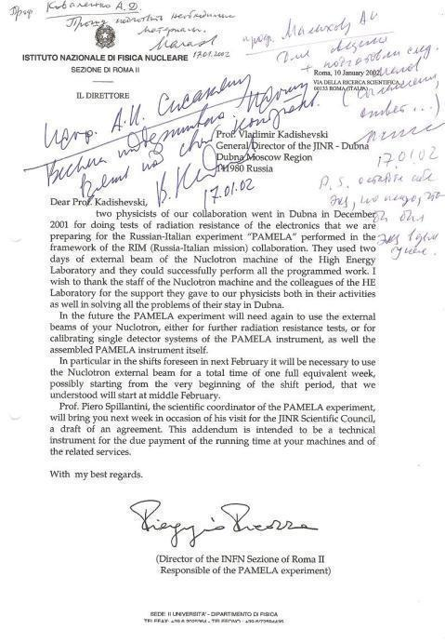
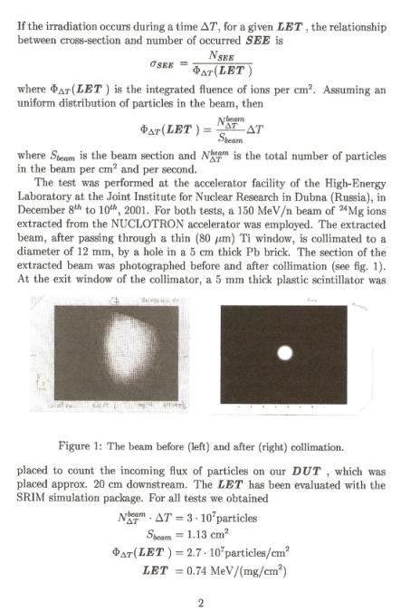
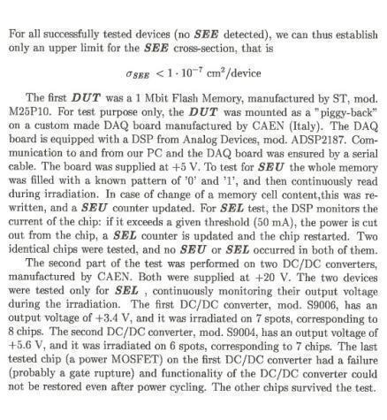
Radiation damage of electronic components. Experiments at the Nuclotron.
Heavy ion beams of the Nuclotron-M of relativistic energies are an unique tool for validation of microelectronic devices for the space program

Slide 28
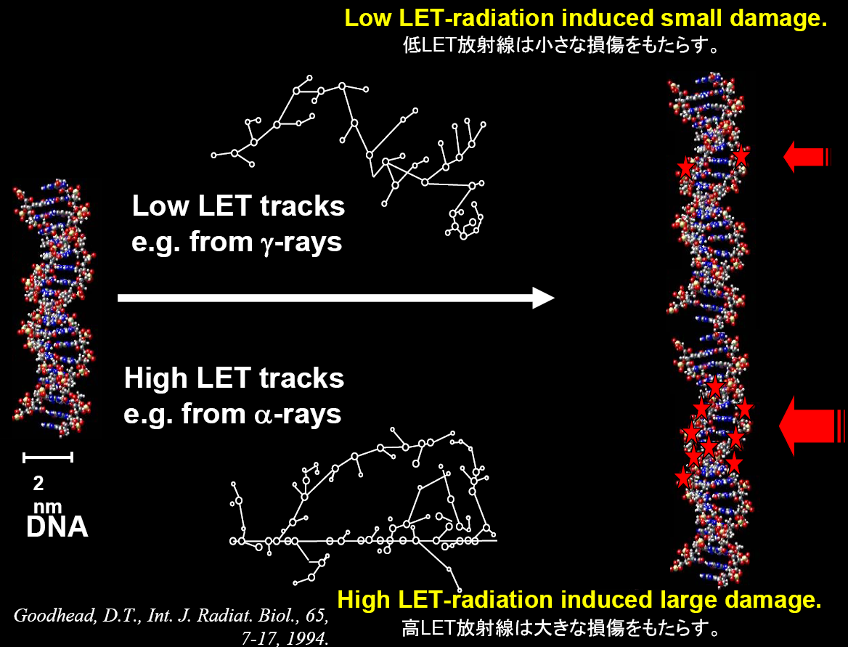

Slide 29
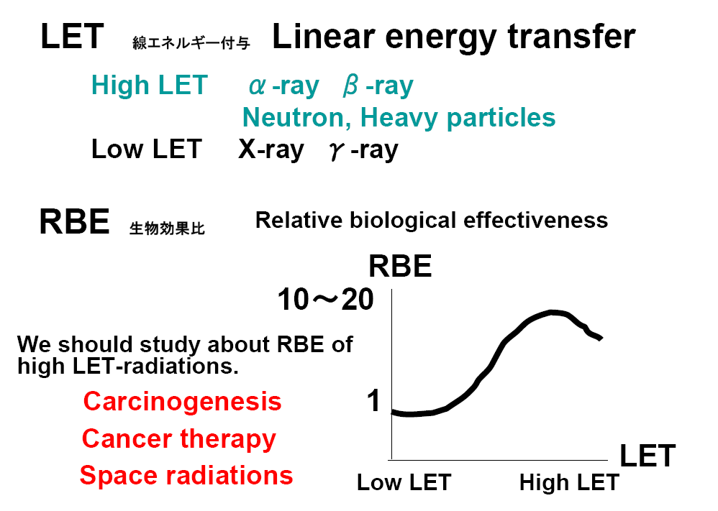

Slide 30
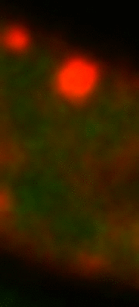
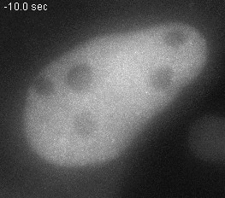
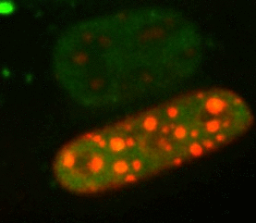
Live cell imaging of heavy ion traversals in euchromatin and heterochromatin
GFP-NSBS1
Jakob et al., Proc. Natl. Acad. Sci. USA 2009; Nucl. Acids Res. 2011

Slide 31
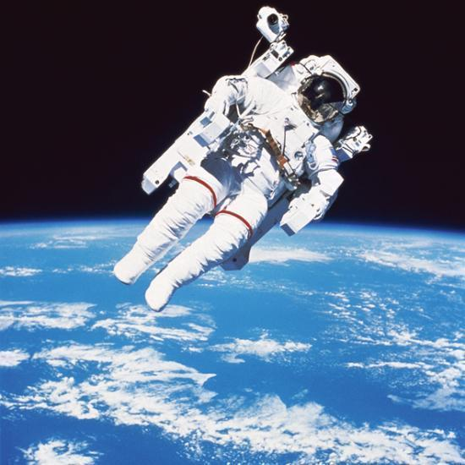
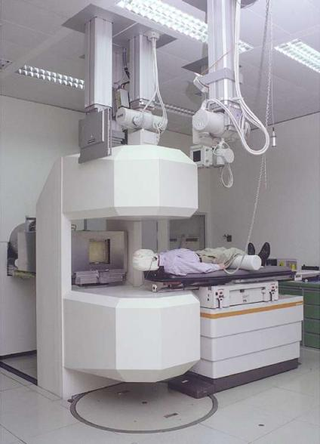
Why are we interested in energetic heavy ions?
¹H to ⁵⁶Fe
100-10000 MeV/n
¹H to ²⁰Ne
70-400 MeV/n
Heavy ion radiation is not present naturally on Earth

Slide 32
PHYSICAL SUPPORT OF RADIOBIOLOGICAL EXPERIMENTS AT NUCLOTRON
The spatial distribu-tions of X and Y wires currents measured by the multiwire propor-tional chamber (● − X; ▲−Y) and TLD readings distribution (○ −X; Δ − Y) in the formed field of 1 GeV protons. The dashed lines are the borders of the irradia-tion area
The quasiuniform particle field is formed in biological patterns area
Data of MPC and TLD (orb. units)
X, Y position data, mm
Multiwire
rorortional
chamber
Activation detectors
Blood pattern
The dosimetric ionization chamber calibration at the Nuclotron beams by the activation detectors
Magnetic lenses
F3′
Nuclei | p | He | C | C | Mg | Ar | Fe
Energy GeV/n | 1 | 0.5 | 1 | 0.5 | 0.5 | 1 | 1.25
LET in blood keV/μm | 0.233 | 1.157 | 8.40 | 10.65 | 39.62 | 75.5 | 151.4
Vacuum pipe
Dosimetric
chamber
TLD matrix
The experimental arrangement at radiobiological exposures at the Nuclotron
List of radiobiological experiments at the Nuclotron

Slide 33
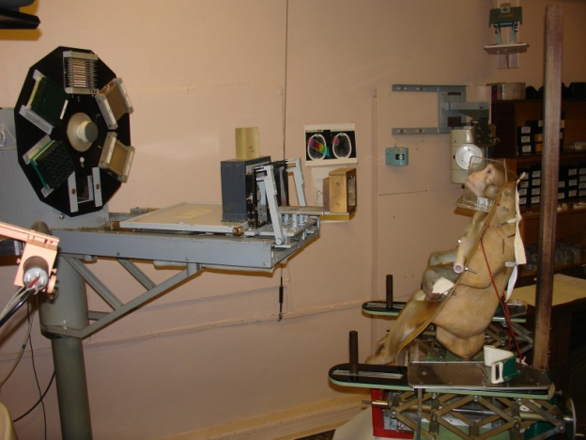
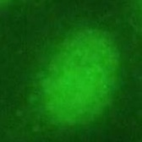
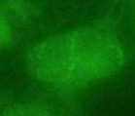
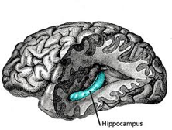
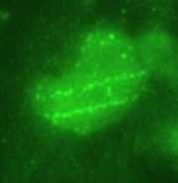
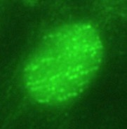
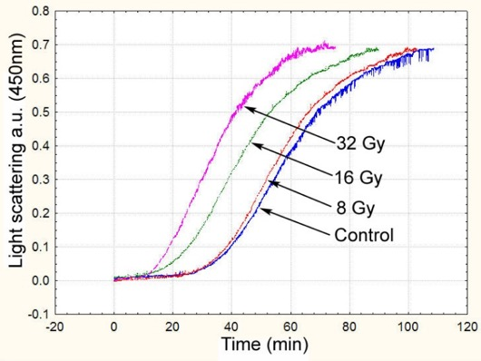
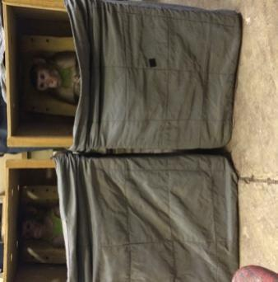
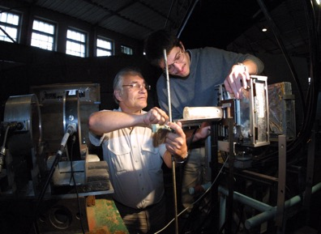

Beam channel at Nuclotron for research in radiobiology. Well-controlled ion beam (from protons and deutrons to Carbon, Fe, Xe) with energy from 300 to 1000 MeV/u allows cell scanning and to define the degree of radiation damage.
Damages of the higher nervous activity centers
Tracks of iron ions are well visualized with markers of double-strands of RNA (γH2AX)
Experiments with monkeys (JINR – IMBP RAS).
Protons 170 MeV, C6+ nuclei 500 MeV/u
0 sGr
50 sGr
100 sGr
200 sGr
hyppocampus
Action of B¹¹ ions
Cataractogenic and damage of the retina

Slide 34
Development of the prototype units Complex of Carbon Radiotherapy

Slide 35
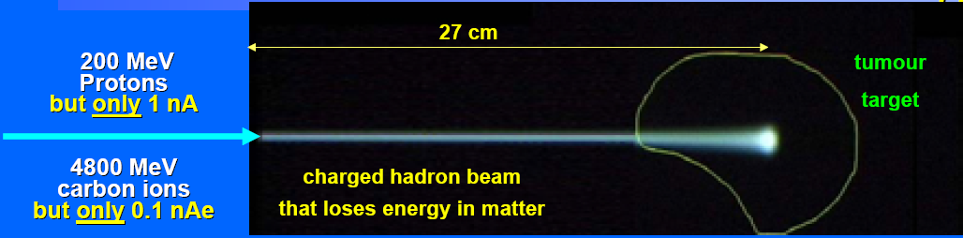
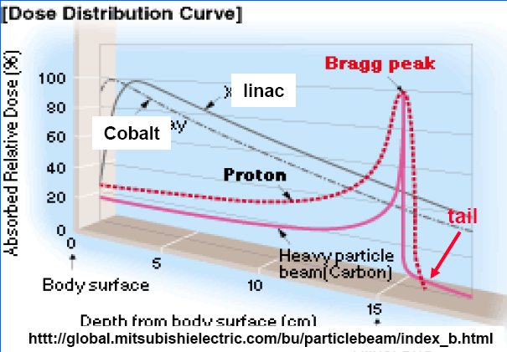
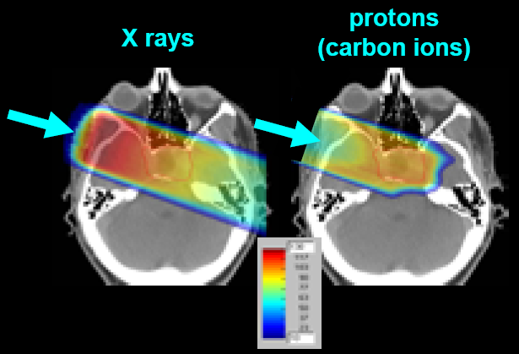
The foundations of hadrontherapy

Slide 36
Block diagram of the experimental setup of the prototype on a carbon nuclei beam of the Nuclotron-M
The results obtained by measuring the stability, intensity and size of the ion beam from the Nuclotron and fully comply with the requirements of radiocarbon therapy.
Currently, the main components of the prototype experimental setup for ion beam Nuclotron-M are developing.

Slide 37
A set of detectors and electronics for complex of Carbon therapy is shown below.

Slide 38
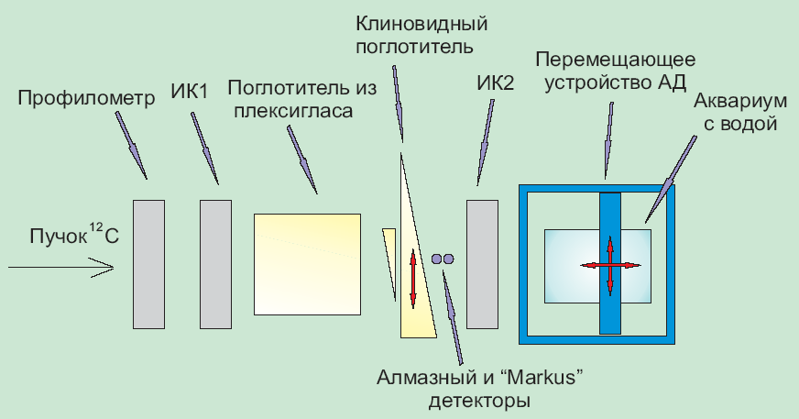
The experimental setup "Med-Nuclotron"

Slide 39
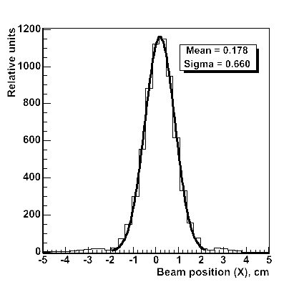
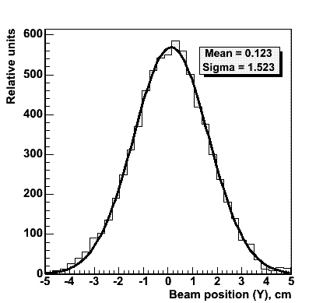
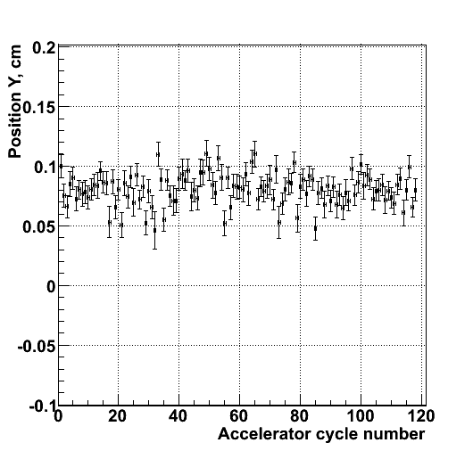
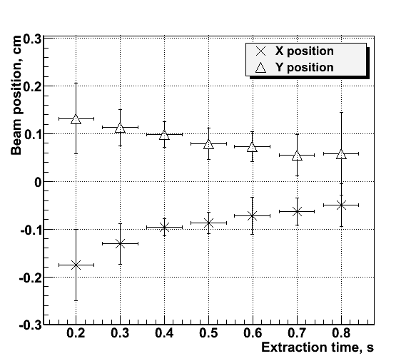
Profiles of the beam of accelerated ions 12C were measured using an multi wire chambers with 32 horizontal and 32 vertical wires with a 3 mm.
horizontal profile
vertical profile
Beam position during the one irradiation run.
Beam position during the extraction
The beam profile of carbon ions

Slide 40
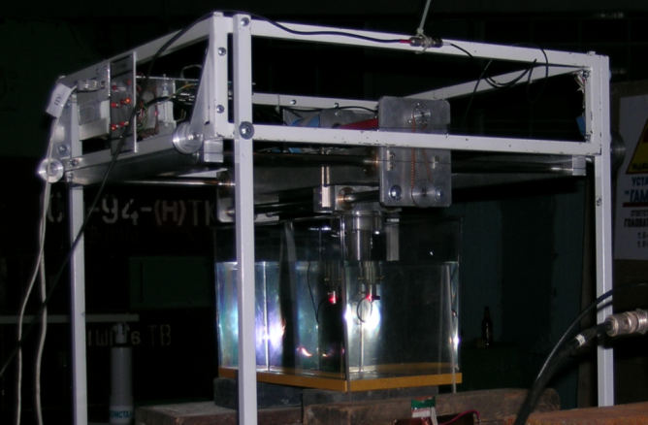

Diamond detector can be moved along and across the beam move the device with 1 mm increments. The photo shows a detector moving in the aquarium with water.
Bragg peak while moving along the beam axis diamond detector in water phantom.
Measurement of the Bragg peak in water phantom

Slide 41
Device structures tracks of heavy ions, filled with nanoparticles

Slide 42
Electrodeposition of nanoparticles
The method provides high selectivity (local) deposition.
Using the low (room) temperature in the electrochemical deposition of multilayer semiconductor structures can reduce the likelihood of mutual diffusion of the various components of the semiconductor heterojunction.
The method may hold a combination of electrochemical and chemical steps
Electrochemical method provides a complex chemical composition of substances - solid solutions chalcogenides, alloys of several metals (not only the equilibrium, but also the composition of the non-equilibrium), complex oxides, the metal chalcogenide systems and others.
A new direction in the field of nanotechnology is devoted to creation of nanostructures within a track that creates a heavy ion in the silicon wafer, and can be implemented composite structure - ferromagnetic, paramagnetic.

Slide 43
Extent filling of the pores with Ni nanoparticles is controlled by deposition time
On the basis of silicon created a structure with magnetic nanoclusters Ni.

Slide 44

Giant magnetic resistance n-Si / SiO2 / Ni nanostructures
Fedotov A., Ivanou D., Ivanova Yu., Mazanik A., Svito I., Streltsov E.,
1 Belarusian State University, Independence av. 4, 220030 Minsk, Belarus
Tyutyunnikov S.
2 Joint Institute for Nuclear Research, Dubna, Russia
R – resistance at field 8 T
R₀ – resistance at B = 0
For the first time in these composite structures are obtained the material properties with a giant magnetic resistance (a prototype spintronic structure).
The dependence of giant magnetic resistance on temperature

Slide 45
Experimental infrastructure at the VBLHEP of JINR
for research in the field of radiation material science and radiobiology

Slide 46


Kurchatov synchrotron radiation source

Slide 47






Kurchatov synchrotron radiation source
(different installation)

Slide 48

SYNCHROTRON RADIATION

Slide 49
Basic scientific directions
Nanodiagnostics and Materials (atomic structure, macromolecular structures, nanofilms, heterostructures, superlattices, nanoclusters, fine (fine dispersed) environment, quantum dots, radiation defects, carbon nanostructures and nanocomposites, etc.).
Nanotechnology (molecular-beam epitaxy, a technique Langmuir-Blodgett films, etc.).
Biotechnology (protein crystallography, organic film on the surface of the liquid, etc.).
Microsystems technology (LIGA - technology)
Fundamental research (materials at ultrahigh pressures, "space" crystals, X-ray optics, etc.).
Living systems and nuclear medicine (new methods of medical diagnostics, supramolecular structure of biological tissues and fluids, etc.).
Dual-use technologies (non-destructive testing responsible products, forensics, etc.).
Metrological support of nanotechnology (Spectroradiometry, metrology layered structures, etc.).

Slide 50
Development of EXAFS spectroscopy methods on SR beams

Slide 51
The main scientific problems which can be solved by using ED EXAFS
The investigations of state matter in extreme condition P ≤ 40 GPa, T=2000 ÷ 3000 ⁰C
The investigation of kinetics passing chemical reactions in heterogeneous systems with time resolution ≤ 10 ^{– 3} sec
The investigation of magnetic properties of nanostructure composite films with using magnetic dichroism
The structure investigation with femtometer resolution
The investigation of phase transition under external actions (magnetic and electric field, radiation).

Slide 52

The basic units of the station "Energy dispersive EXAFS spectrometer"
General view of the spectrometer inside the hutch.
Notes:
52
52

Slide 53

XASX-Ray Absorption Spectroscopy

Slide 54


Fourier transform of the EXAFS spectra at the CoK-edge for the La₁xSrxCoO₃
XANES spectra at the Co K-edge for the La₁xSrxCoO₃
(x0.00.5). Inset: the pre-edge region

Slide 55
Debye-Scherrer diffraction geometry "reverse" on the scattering of the Kurchatov source SI

Slide 56
Debye-Scherrer diffraction with registration in the opposite hemisphere
The advantages
1. Very high sensitivity to the relative change in the interplanar distances - two - three orders of magnitude higher than the scattering of the "forward"
Disadvantages
1. Investigated only a thin surface layer – hundreds Microns.
2. The sample must be flat and smooth (for maximum sensitivity)
3. In the study on line stretching occurs along one axis, and the measurement - at a different (Poisson's ratio)

Slide 57

Diffraction in the opposite hemisphere based on equipment of EXAFS – D spectrometer

Slide 58


Debye-Scherrer diffraction in the opposite hemisphere
The interplanar distance of the heat-treated sample is less than control. d/d =5.7*10⁻⁴
Profile ring heat-treated sample is wider than control ring in 3.6 times.
steel 10Х9К3В2МФБР
(1040°С-30min, 760°С-3 hours)
steel 10Х9К3В2МФБР (control)

Slide 59


Debye-Scherrer diffraction in the forward hemisphere. Corundum. (Reference Model)
Experiment.
Debye-Scherrer diffraction in the backward hemisphere. Steel body of Balakovo NPP. Experiment.

Slide 60



Raman scattering is the interaction of photons and intrinsic molecular bonds
^{Raman Chandrasekhara Venkata} 7.11.1888, Tiruchchirappalli, — 21.11.1970, Bengaluru
Molecular vibration in sample
Incident light
Scattered light
Excited state
The Indian physicist, awarded the Nobel Prize on the physicist 1930 for opening of combinational dispersion of light (Raman effect).
Wavelength
Boltzmann distribution

Slide 61
Raman and CARS-microscopy.
(a) Spontaneous Raman energy diagram based on inelastic scattering of incident radiation resulting in a red-shifted (ω_{s}, Stokes) emission.
(b) CARS energy diagram in which the vibrational oscillators are actively driven at ω_{p}-ω_{s}. Upon further interaction, a blue-shifted (ω_{as}, anti-Stokes) photon is emitted.
(c) Raman spectrum of dried HeLa cells showing the wealth of molecular information contained in the vibrational spectrum.
(d) Basic layout of CARS microscope with a collinear excitation geometry. Either the sample or the beams are scanned.
Signal is detected simul-taneously in the forward
(F-CARS)and the backward (E-CARS) direction, yielding different contrast mechanisms.
F-CARS signals are strong and are accompanied by a nonresonant background from the medium while E-CARS signals are weak and the background is sup-pressed.
This is illustrated by the images of a 0.2 μm polystyrene bead in agarose taken at the 3,050 cm⁻¹ aromatic CH vibration of polystyrene.

Slide 62

Scanning Confocal Microscope
Ø Sub-μm spot Scanning Spectroscopic Microscope
Ø Laser Confocal Microscope
3-D tomography by confocal laser microscope based on cross-section spectroscopy at 0.2 μm spot
Raman, fluorescence and lifetime analysis of compounds, contaminants; defects and stress in semiconductor;
films, liquid crystal, biological saline…

Slide 63

Basis of the piezospectroscopic effect
the applied stress strains the lattice and alters the energy of transitions between electronic states
R-lines shift :
Δν = Π_{ij}×σ_{ij}
Π_{ij} – piezospectroscopic coefficients
For hydrostatic stresses:
σ_{h} (GPa) ≈ Δν₂(cm⁻¹) / 7.61
For nonhydrostatic stresses:
σ11 = (Δν₂ - 2,16σ₃₃) / 5,46
σ22 = σ33 = (Δν₂ - 0,83Δν₁) / 0,88
D. Clarke et. al. Non-Contact Methods of Measuring Stresses in High Temperature Materials

Slide 64


Depth-resolved R-lines spectra on Al₂O₃Cr virgin and irradiated by 250 MeV Kr ions.
Ion flux Φ=1×10¹⁴ cm⁻²
R_{p}=12.2 μm

Slide 65

Tests of nonlinear laser microscope (CARS) in Minsk before being sent to the JINR, December 2009

Slide 66

Study of apoptosis in cells with CARS microscope
The distribution of proteins, lipids, DNA, and RNA in dividing and apoptotic HeLa cells visualized by multimodal CARS/TPEF imaging. During the imaging live cells were maintained at the physiological conditions.
Proteins and lipids were observed in the CARS mode at their characteristic vibrations of 2930 cm−1 and 2840 cm−1, respectively. Nucleic acids, stained by acridine orange, were acquired in the red (RNA) and green (DNA) fluorescence channels in TPEF mode. In the right panels, schematics of the macromolecular organization of cells are represented. The CARS signal from proteins is represented in the left panels. The panels in the middle represent merger signals of the proteins (red), RNA (green), DNA (blue), and lipids (gray). The white-outlined areas in the protein channel are enlarged below. (A) Nontreated cells. The signal from proteins is accumulated in the nucleolus (Inset, arrowhead) and the nuclear lamina (arrows). In the
rest of the nuclear volume, the intensity of the protein signal is nearly uni-
form. (B–F) Representative cells at the subsequent stages of the apoptotic
development. (B) 30 minutes following the initiation of apoptosis, the
distribution of proteins is altered in the nucleolus (Inset, arrowheads) and
the novel structure, apoptotic nuclear protein granules (ANPG), emerged
in the nucleoplasm. In the cytoplasm, cytoskeleton fibers begin to lose their
structural polarization. (C) The pattern of proteins becomes increasingly ir-
regular, and ANPG become prominent (Inset, arrowheads). (D) The nucleolar
proteins are forming a complex meshwork (Inset). The apoptotic membrane
blebs are seen (D and E merged panels, arrows), ANPG disintegrate. (E and F)
Proteins abandon the nucleolus and demonstrate a highly irregular distribution in the nucleoplasm; the genomic DNA is condensing to chromatin bodies and partially segregates from the proteins.

Slide 67

Thank you for attention
Grodno, Belarus, August 12 - August 24, 2018

Slide 68
Результаты испытаний МОП транзисторов на воздействие релятивистских частиц

Slide 69


Методика экспериментов
Эксперименты проводились на мощных вертикальных полевых транзисторах со структурой металл-окисел-полупроводник, изготовленных в серийном технологическом процессе по технологии двойной диффузии (ДМОП ПТ). Исследовались приборы в пластмассовых корпусах TO-3P (U_{СИ макс}=200 В, I_{С}=30 А, R_{СИ откр}=0,085 Ом), TО-220 (U_{СИ макс}=60 В, I_{С}=50 А, R_{СИ откр}=0,028 Ом) и металлокерамическом корпусе КТ97С (ТО-258).
При проведении экспериментов приборы располагались в зоне пучка частиц так, чтобы плоскость полупроводникового кристалла, в которой сформирована активная область прибора, была ориентирована перпендикулярно направлению движения частиц. Схема ориентации активной области прибора относительно направления пучка частиц показана на рисунке 1. В процессе экспериментов частицы (дейтроны) попадали на прибор со стороны теплоотвода. Активная область прибора в процессе экспериментов подвергается воздействию, как пучка дейтронов, так и продуктов ядерных реакций, происходящих в окружающей среде при участии дейтронов.
Затвор
Исток
Подзатворный диэлектрик (оксид кремния)
р
n⁺
Эпитаксиальный слой n−типа
Подложка
n⁺−типа
Основание корпуса (теплоотвод) - медь
Сток
Схема ориентации активной области прибора относительно направления пучка частиц
Пучок частиц

Slide 70
Результаты по наработке радиоактивных изотопов при облучении транзистора дейтронами
с энергией 4 ГэВ (2 ГэВ/нук) приведены в таблице 1 и на рис. а,б,в.
Облучение было начато 13.03.13 в 16-17, закончено 14.03.13 в 01-00.
Наработка радиоактивных изотопов
Изотоп | Тип распада | Период полураспада | Число ядер, наработанное за время облучения | Активность на конец облучения, Бк
Co-57 | %EC=100 | 271.79 d | 3.17E+09 | 94
Ni-57 | %EC+%B+=100 | 35.60 h | 3.68E+08 | 1990
Sc-47 | %B-=100 | 3.3492 d | 3.63E+08 | 869
Sc-48 | %B-=100 | 43.67 h | 1.07E+08 | 472
V-48 | %EC+%B+=100 | 15.9735 d | 1.50E+09 | 754
Co-56 | %EC+%B+=100 | 77.27 d | 1.12E+09 | 116
Sc-44m | %IT=98.80, %EC+%B+=1.20 | 58.6 h | 7.06E+08 | 2320
Sc-44 | %EC+%B+=100 | 3.927 h | 1.13E+08 | 5540
Cr-48 | %EC+%B+=100 | 21.56 h | 2.28E+08 | 2036
Cr-51 | %EC=100 | 27.7025 d | 2.84E+09 | 823
K-43 | %B-=100 | 22.3 h | 1.93E+08 | 1666
Y-87 | %EC+%B+=100 | 79.8 h | 1.68E+08 | 405
Mn-52 | %EC+%B+=100 | 5.591 d | 9.23E+08 | 1325
Co-58 | %EC+%B+=100 | 70.86 d | 3.56E+09 | 406
Mn-54 | %EC+%B+=100, %B-<2.9E-4 | 312.3 d | 3.66E+09 | 94
Sc-46 | %B-=100 | 83.79 d | 9.09E+08 | 95
Na-24 | %B-=100 | 14.9590 h | 7.20E+08 | 9267
Au-196 | %EC+%B+=92.80, %B- =7.20 | 6.183 d | 8.27E+07 | 107

Slide 71



Рис. а
Рис. б
Рис. в

Slide 72
Результаты испытаний МОП транзисторов на воздействие пучком дейтронов
№ эксперимента дата | Коли-чество па-кетов импуль-сов | № испытываемого тран-зистора | Кор-пус | Раз-мер крис-талла | Энер-гия нук-лона, ГэВ | Коли-чество нукло-нов, Н | Флюенс нукло-нов, Н/см² | Дли-тель-ность пакета им-пуль-сов, сек | Дли-тель-ность промежутка меж-ду па-кета-ми, сек | Скважность | Суммар-ная энер-гия нук-лонов на крис-талл, ГэВ | I_{cu}, нА | U_{проб} В | U_{пор}, В | Схе-ма испыта ний | Зафик- сиро-ван-ный заряд, пКл
1 13.03. 2013 | 1 | 63 | ТО220 | 4,32× 4,57 | 2 | 1*10¹⁰ | 1,41*10⁹ | 3 | 12 | 4 | 5,5*10⁸ | 5 | 60 | 2,85 | рис.1 U_{пит}= 10В
 | 10 |  |  |  |  | 1*10¹¹ | 1,41*10¹⁰ |  |  |  | 5,4*10⁹ | 5 | 60 | 2,85
 | 100 |  |  |  |  | 1*10¹² | 1,41*10¹¹ |  |  |  | 5,4*10¹⁰ | 5 | 60 | 2,85
 | 150 |  |  |  |  | 1,5*10¹² | 2,12*10¹¹ |  |  |  | 8,1*10¹⁰ | 5 | 60 | 2,85
2 13.03. 2013 | 1 | 51 | ТО218 | 6,53× 6,53 | 2 | 1,4*10¹⁰ | 2,04*10⁹ | 3 | 12 | 4 | 1,74*10⁹ | 5 | 200 | 3,28 | рис.2 U_{пит}= 40В | 9550
 | 10 |  |  |  |  | 1,8*10¹¹ | 2,58*10¹⁰ |  |  |  | 1,75*10¹⁰ | 5 | 200 | 3,28 |  | 7,3*10⁴
 | 114 |  |  |  |  | 1,6*10¹² | 2,3*10¹¹ |  |  |  | 1,96*10¹¹ | 5 | 200 | 3,28 |  | 7,4*10⁵
3 13.03-14.03. 2013 | 1 | 132 | КТ97С | 5,8× 7,7 | 2 | 1,4*10¹⁰ | 2,04*10⁹ | 3 | 12 | 4 | 1.74*10⁹ | 5 | 200 | 3,2 | рис.2 U_{пит}= 40В
 | 10 |  |  |  |  | 1,85*10¹¹ | 2,64*10¹⁰ |  |  |  | 2,25*10¹⁰ | 5 | 200 | 3,2
 | 21 |  |  |  |  | 3,7*10¹¹ | 5,3*10¹⁰ |  |  |  | 4,7*10¹⁰ | 5 | 200 | 3,2
4 16.03-17.03. 2013 | 1 | 2 | КТ97С | 5,8× 7,7 | 4 | 1,82*10⁹ | 2,6*10⁸ | 1 | 12 | 12 | 4,64*10⁸ | 10 | 200 | 3,2 | рис.2 U_{пит}= 95В
 | 1768 |  |  |  |  | 2,07*10¹² | 2,93*10¹¹ |  |  |  | 5,23*10¹¹ | 10 | 200 | 3,2

