Slide 1
Tau lepton couplings to the Z and Higgs bosons
Wolfgang Lohmann,
BTU, CERN, DESY and RWTH

Slide 2
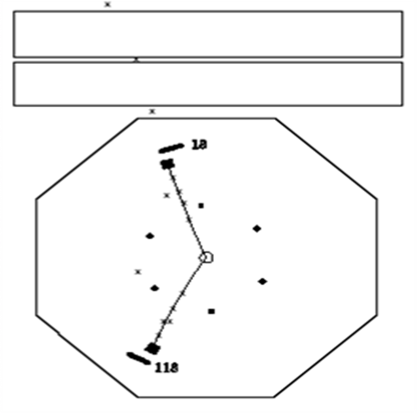
Tau Lepton
The τ lepton was discovered in SLAC in 1975 (Nobel prize for Martin Perl in 1995)
appearance of events with an electron and a muon in the final state
e⁺e⁻ τ⁺ τ⁻
τ⁻ μ⁻νν
τ⁺ e⁺νν
It is the heaviest lepton we know
Mass : 1777 MeV
Lifetime: 290.6 fs (87 μm)

Slide 3

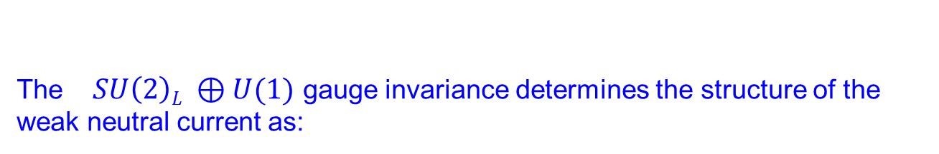






Couplings to the neutral current
The $SU\left(2\right)L ⊕U(1)$ gauge invariance determines the structure of the weak neutral current as:
$vf$
$$af$$
and the vector- and axial-vector couplings and :
with the third component of the weak isospin, the electric charge and the weak mixing angle, a free parameter of the theory
$$vf=T3 −2Qsin2θW$$
$$af=T3$$
$$T3$$
$$Q$$
$$sin2θW$$

Slide 4
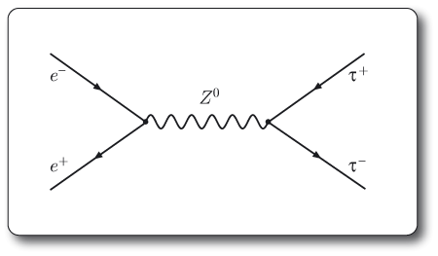
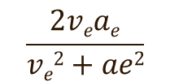
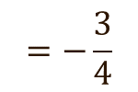
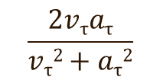


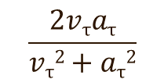
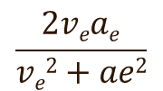
neutral current coupling measurements in e⁺e⁻ annihilations
$$=\frac{3}{4}$$
$$\frac{2veae}{ve2+ae2}$$
$$\frac{2vτaτ}{vτ2+aτ2}$$
$$=−$$
$$\frac{2vτaτ}{vτ2+aτ2}$$
$$=−\frac{3}{4}$$
$$\frac{2veae}{ve2+ae2}$$

Slide 5
Measurements at LEP and SLD
examples

Slide 6
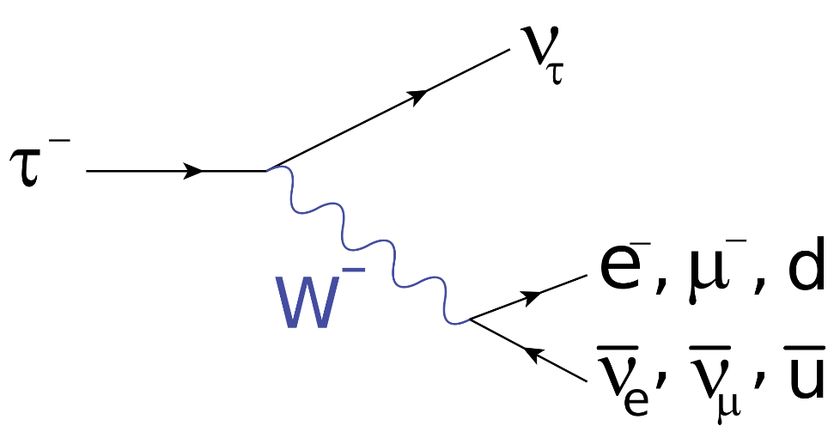
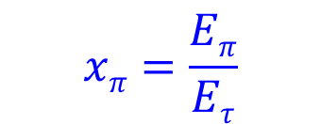
Measurements at LEP and SLD
Assuming (V-A}
$$xπ=\frac{Eπ}{Eτ}$$
In the lab frame

Slide 7











Measurements at LEP and SLD
Analysis of the $τ →a1 ν$ decay
$$ξ$$
$$ξ$$
$$ξ$$
$ξ=ξ (\cos\left(θ\right), β, γ)$
$$ξ$$
$$ξ$$
$$ξ$$
$$ξ$$
$$ξ$$
$$ξ$$

Slide 8


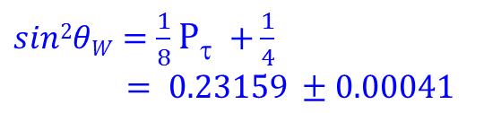




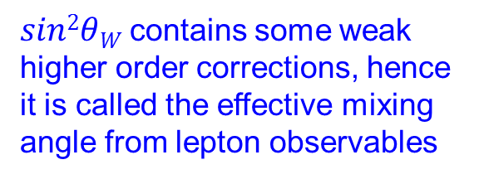


Measurements at LEP and SLD
$$\frac{2veae}{ve2+ae2}$$
$$𝒜e$$
$$=$$
$=$ $0.1498±0.0049$
$𝒜$_{τ}
=$\frac{2vτaτ}{vτ2+aτ2}$
$=$ $0.1439±0.0043$
$=−$P_{τ}
$sin2θW=\frac{1}{8}$ P_{τ} $+\frac{1}{4}$
$= 0.23159 ±0.00041$
$sin2θW$contains some weak higher order corrections, hence it is called the effective mixing angle from lepton observables

Slide 9
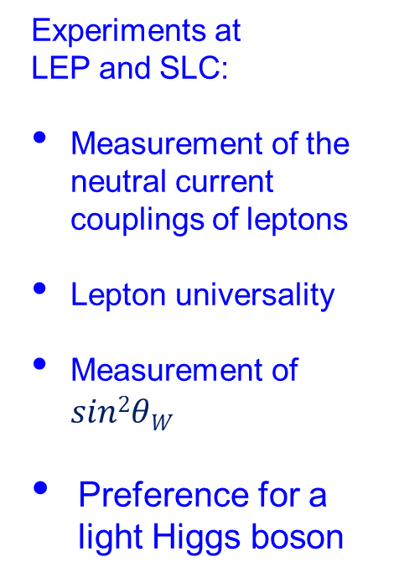


Measurements at LEP and SLD
Experiments at
LEP and SLC:
Measurement of the neutral current couplings of leptons
Lepton universality
Measurement of $sin2θW$
Preference for a light Higgs boson
$vf$
$af$

Slide 10
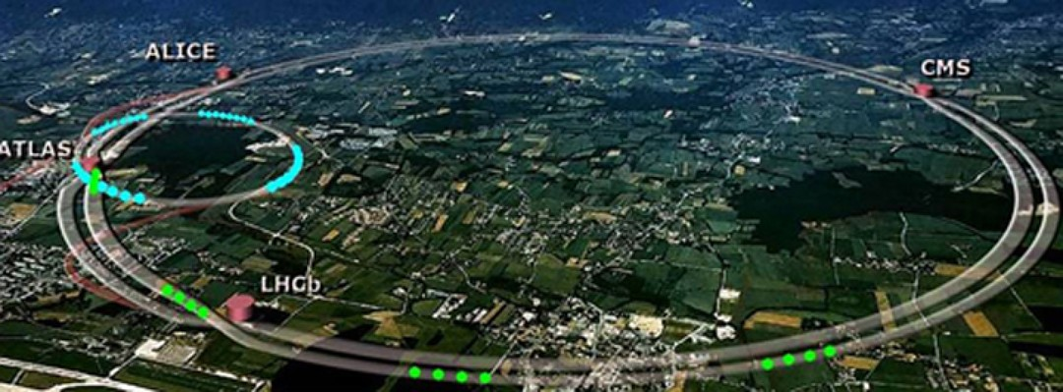
Measurements at LHC
At LHC the luminosity is 10³ times larger
However:
The Z is produced in q q annihilations
the Z is not at rest in the centre-of-mass system (or lab system)
Pile up of many interactions

Slide 11
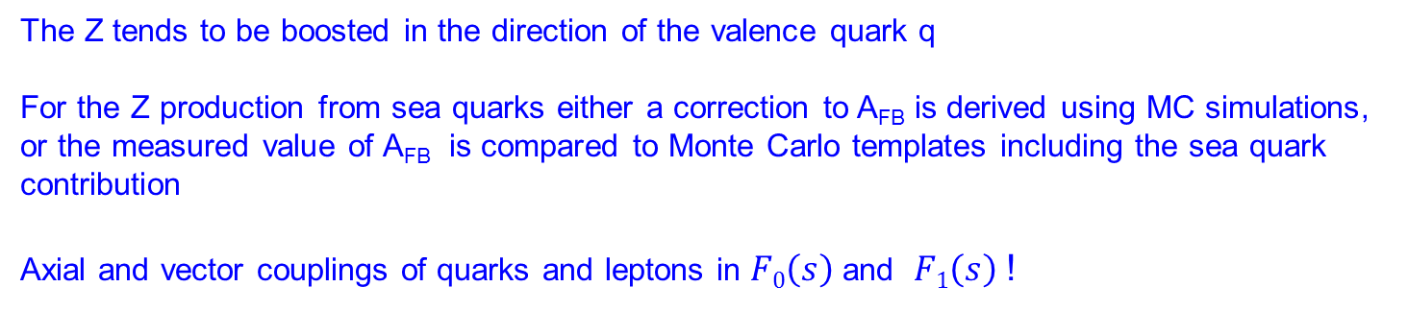

$sin2θW$from A _{FB}
Process: q q Z μ⁺ μ⁻
l
l
l
l
l
l
l
l
l
The Z tends to be boosted in the direction of the valence quark q
For the Z production from sea quarks either a correction to A_{FB} is derived using MC simulations, or the measured value of A_{FB} is compared to Monte Carlo templates including the sea quark contribution
Axial and vector couplings of quarks and leptons in $F0\left(s\right)$ and $F1\left(s\right)$ !

Slide 12
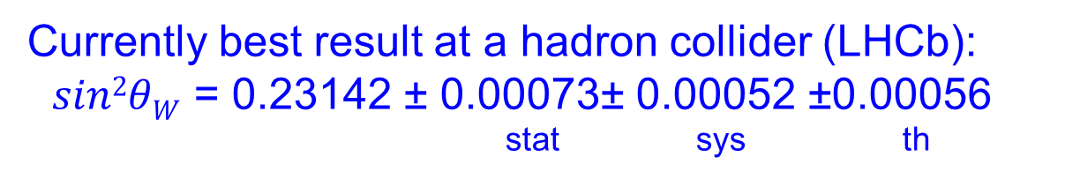
$sin2θW$from A _{FB}
A_{FB} as a function of m(μ⁺μ⁻)
Currently best result at a hadron collider (LHCb):
$sin2θW$ = 0.23142 ± 0.00073± 0.00052 ±0.00056
stat sys th

Slide 13
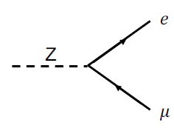
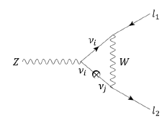
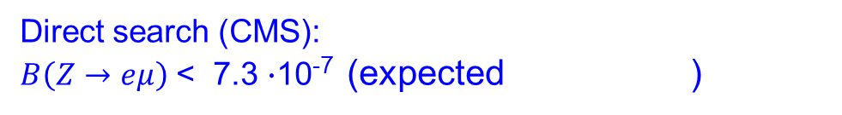
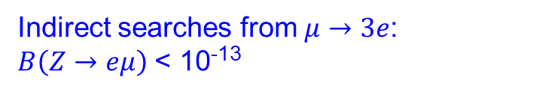
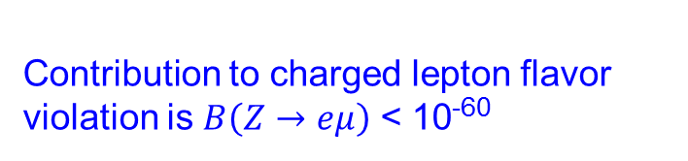

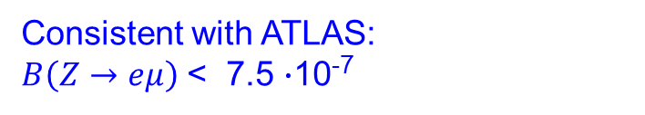
Flavour changing neutral current
Lepton flavor is conserved in the standard model, however there is no underlying symmetry, and it does not hold for neutrinos
Contribution to charged lepton flavor violation is $B\left(Z→eμ\right)$ < 10⁻⁶⁰
Indirect searches from $μ→3e$:
$B\left(Z→eμ\right)$ < 10⁻¹³
Direct search (CMS):
$B\left(Z→eμ\right)$ < 7.3 $∙$10⁻⁷ (expected )
< 6.7 $∙$10⁻⁷
Consistent with ATLAS:
$B\left(Z→eμ\right)$ < 7.5 $∙$10⁻⁷

Slide 14
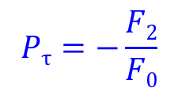
Tau Polarisation at LHC
τ⁻
$$Pτ=−\frac{F2}{F0}$$
since
τ⁺
$⇒$the quark couplings cancel out at the Z pole
Away from the Z pole u and d type quarks give slightly different contributions, and γZ interference matters

Slide 15
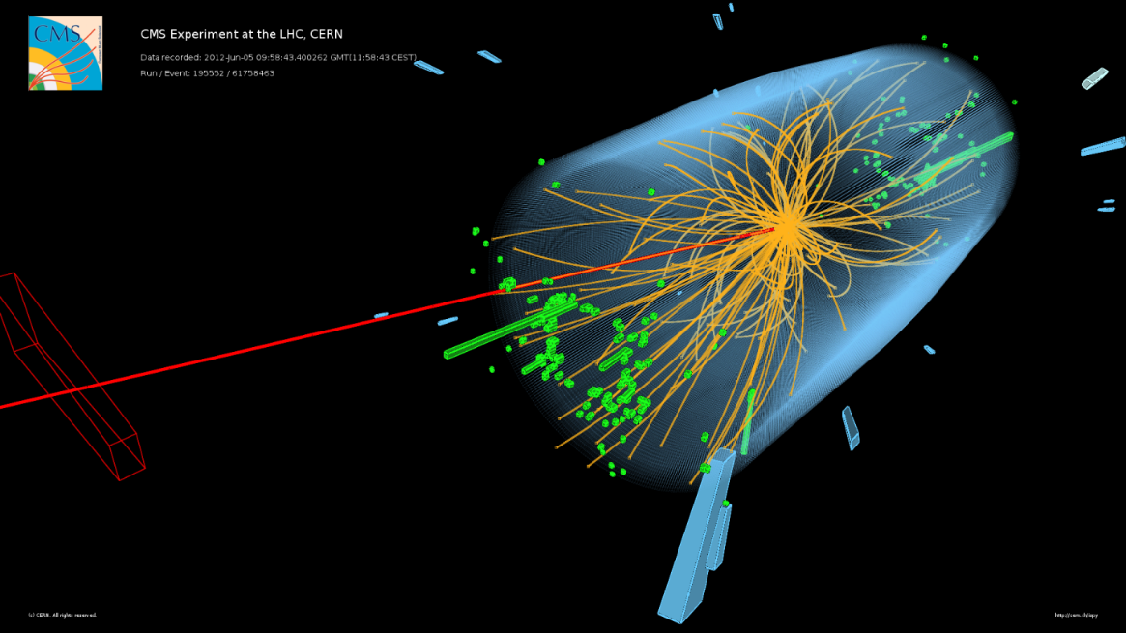
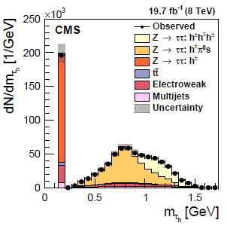



Tau Leptons at LHC
Signatures of τ pairs in an event:
Two electrons
Two muons
One electron and one muon
One electron/muon and a low multiplicity hadronic jet
Two low multiplicity hadronic jets
In all cases missing transverse momentum
$$τ →π ν$$
$$τ →ρν→π±π0ν$$
$$τ →a1 ν→π+π−π±ν$$

Slide 16
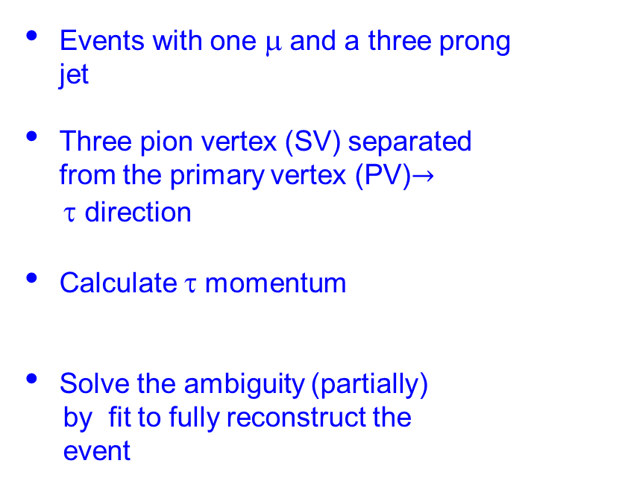
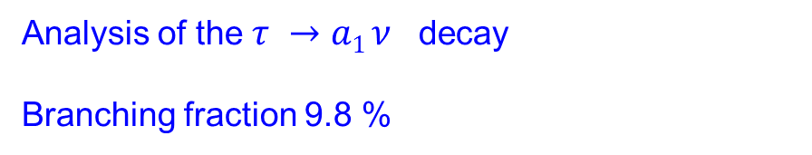
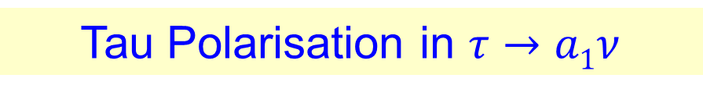

Tau Polarisation in $τ→a1ν$
Analysis of the $τ →a1 ν$ decay
Branching fraction 9.8 %
Events with one μ and a three prong jet
Three pion vertex (SV) separated from the primary vertex (PV)$→$
τ direction
Calculate τ momentum
Solve the ambiguity (partially)
by fit to fully reconstruct the
event
$$pν2=\left(pτ−pa1\right)2=0$$

Slide 17
Tau Polarisation in $τ→a1ν$
Comparison between data and simulated event samples
Visible mass m(a₁μ) 3 π mass

Slide 18


Tau Polarisation in $τ→a1ν$
$$Pτ=−12.6±0.066±0.032±0.017$$
stat(data) stat(MC) sys
This is the polarisation averaged over the Z resonance shape!
Gauge obtained using ZFITTER and proton pdfs
$sin2θW=0.2326±0.0096$0.23
Measured with only small impact of the quark couplings

Slide 19


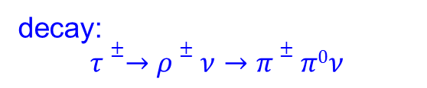
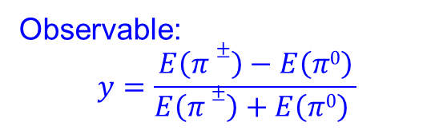
Tau Polarisation in $τ→ρν$
Branching fraction 26 %
decay:
$$τ±→ρ±ν→π±π0ν$$
Observable:
$$y=\frac{E\left(π±\right)−E\left(π0\right)}{E\left(π±\right)+E\left(π0\right) }$$
$$y$$
Results in progress

Slide 20
Couplings to the Higgs boson
Couplings to gauge bosons and quarks manifest in the production cross section
τ
The Yukawa coupling to the tau-lepton is measured in the decay H τ τ
τ

Slide 21
Couplings to the Higgs boson

Slide 22
Lepton flavor violation Z boson decays
number of Z bosons larger than at LEP
challenge: precise estimate of background processes
Best limits so far:

Slide 23
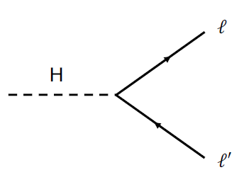
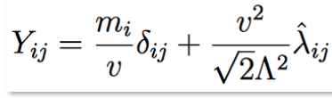
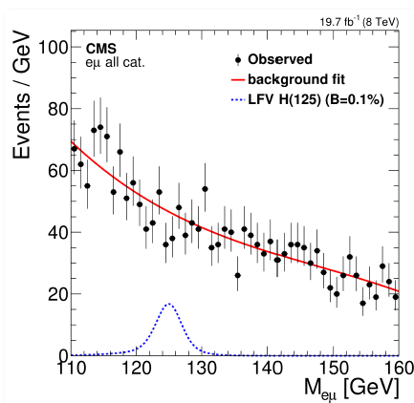
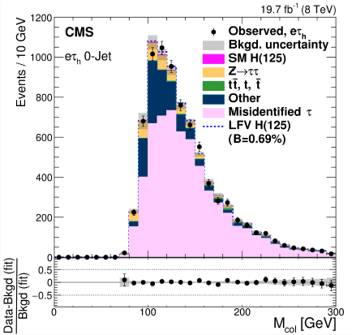


Lepton flavor violation in Higgs boson decays
Extended Yukawa coupling
$B\left(H→eμ\right)$ < $0.035\% (95\% C.L.)$
$B\left(H→eτ\right)$ < $0.69\% (95\% C.L.)$

Slide 24
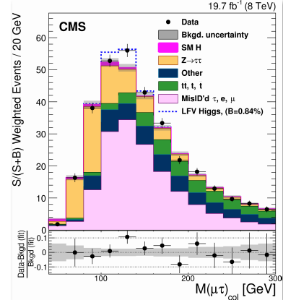

Lepton flavor violation in Higgs boson decays
$$B\left(H→μτ\right)=0.84±0.390.37$$

Slide 25
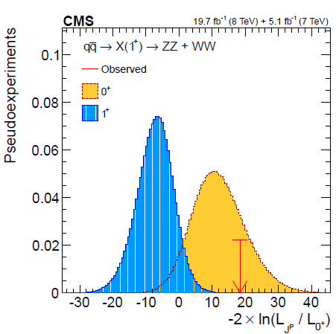
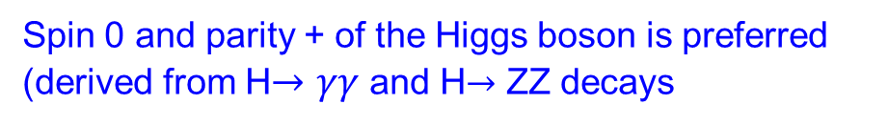
Higgs boson spin and parity
Spin 0 and parity + of the Higgs boson is preferred (derived from H$→γγ$ and H$→$ ZZ decays
What about the CP quantum number ?

Slide 26
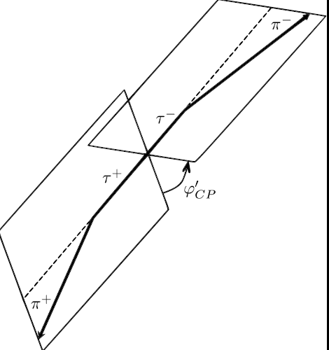


Couplings to the Higgs boson
τ
Extended Yukawa coupling
$φτ$ is the mixing angle between a CP + and CP - state
τ
It can be accessed from the distribution of the angle between the two τ decay planes Φ_{CP}, or, without loss of sensitivity, by the angle of the two impact parrameter planes of the τ decays Φ*_{CP}
$$φτ$$
$$φτ$$

Slide 27
Sensitivity of the method
With the current luminosity the signal is too small,
But:
Luminosity is growing
now > 100 fb⁻¹
Analysis method has room for improvements
Fine tuning of the tracking/vertexing needed

Slide 28


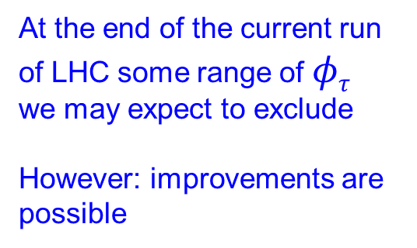

Sensitivity of the method
Defining a likelihood function:
it is estimated at which luminosity we expect sufficient data to obtain sensitivity for
$$φτ$$
At the end of the current run of LHC some range of $φτ$ we may expect to exclude
However: improvements are possible

Slide 29
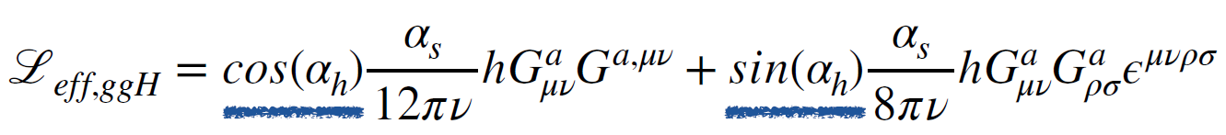
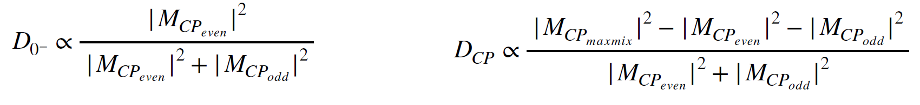
Other Methods
H → ττ decay !
Extended Lagrangian
CP+
CP-
CP sensitive quantites, obtained from MELA (Matrix Element Likelihood Algorithm)

Slide 30
Other Methods
Most sensitive quantity: φ (J1, J2),
azimuthal angle difference
between jets
MELA variables

Slide 31

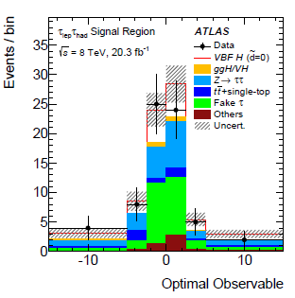

Other methods
CP test in the production, using a CP odd (-) quantity and calculating its average value
For the vector boson fusion Higgs production the matrix element is extended:
Additional couplings HZZ, HWW, HWA
CP odd quantity
An optimal CP odd variable is defined:
And distributed for the events with H$→ττ$decays
˜
$$−0.11<d<0.05 (68\% C.L.)$$

Slide 32
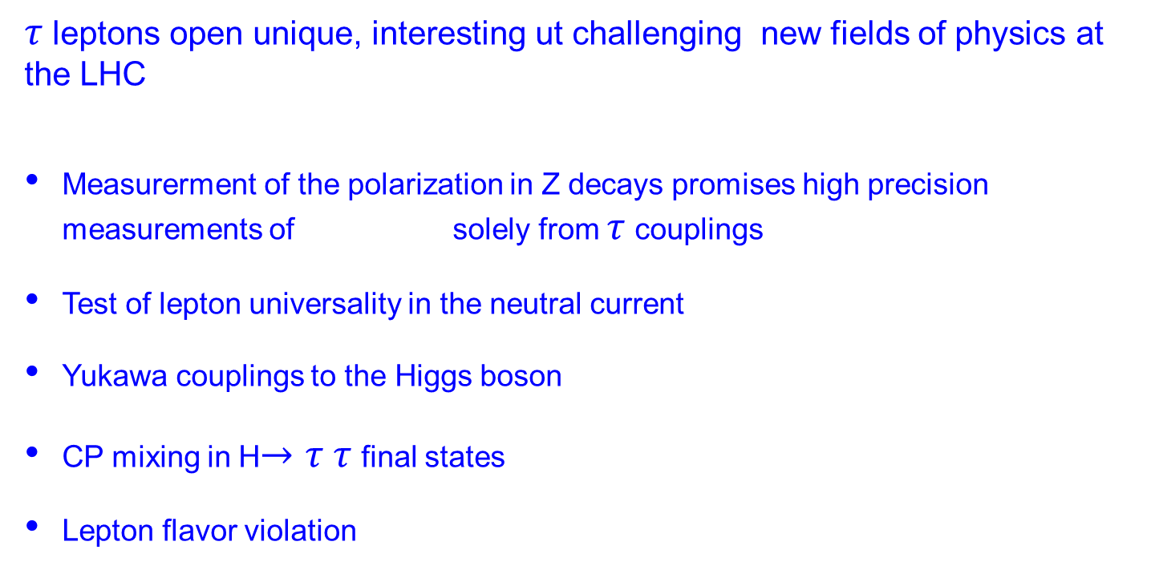

Summary
$τ$leptons open unique, interesting ut challenging new fields of physics at the LHC
Measurerment of the polarization in Z decays promises high precision measurements of solely from $τ$ couplings
Test of lepton universality in the neutral current
Yukawa couplings to the Higgs boson
CP mixing in H$→τ τ$ final states
Lepton flavor violation
$$sin2θW$$
Currently these studies are in most cases still limited by statistics. However, with growing luminosity very interesting and surprising results may appear.
I would like to thank the students of RWTH Aachen who worked with me the last year on many of the topics reported here: Claudia Pistone, Vladimir Cherepanov, Peter Fakeldey, Olena Hlushchenko, Bastian Kargoll, Thomas Müller, Alexander Nehrkorn, Hale Sert and Jann Aschersleben.

