Slide 1
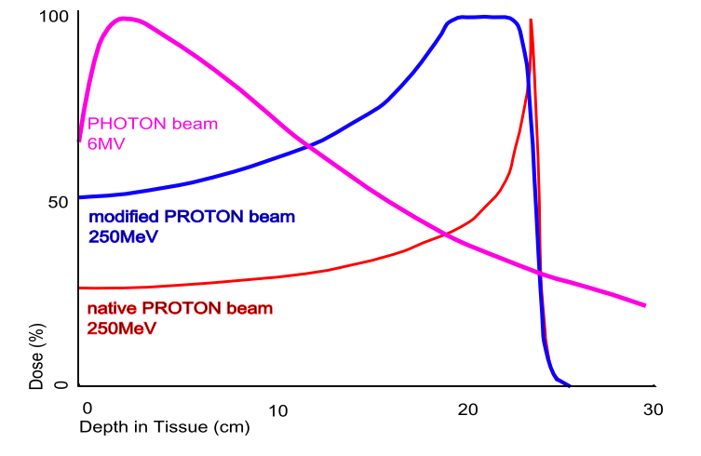
About preparation of the project of the Research Center for Proton Therapy (RCPT) at JINR
Introduction
The Bragg peak is a pronounced peak on the Bragg curve which plots the energy loss of ionizing radiation during its travel through matter. For protons, α-rays, and other ion rays, the peak occurs immediately before the particles come to rest. This is called Bragg peak, after William Henry Bragg who discovered it in 1903.
When a fast charged particle moves through matter, it ionizes atoms of the material and deposits a dose along its path. A peak occurs because the interaction cross section increases as the charged particle's energy decreases. Energy lost by charged particles is inversely proportional to the square of their velocity, which explains the peak occurring just before the particle comes to a complete stop.
The phenomenon is exploited in therapy of cancer, to concentrate the effect of light ion beams on the tumor being treated while minimizing the effect on the surrounding healthy tissue. The blue curve in the figure ("modified proton beam") shows how the originally monoenergetic proton beam with the sharp peak is widened by increasing the range of energies, so that a larger tumor volume can be treated. This can be achieved by using variable thickness attenuators.
N.Russakovich 13.08.2018

Slide 2
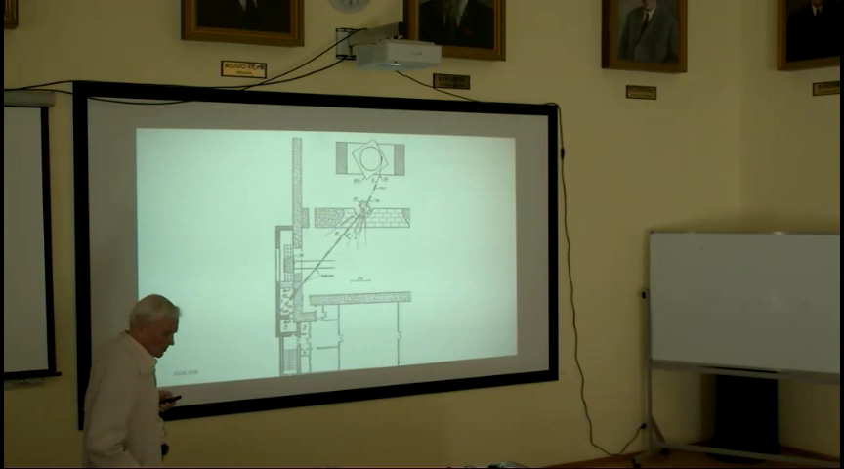
Seminar at DLNP by Prof. Vladimir Komarov
April 2018

Slide 3
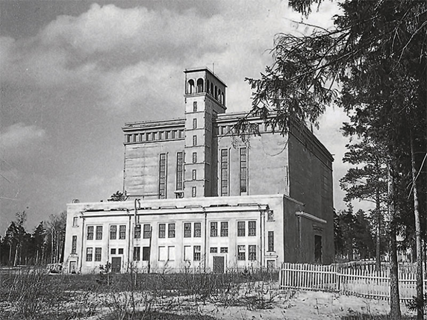
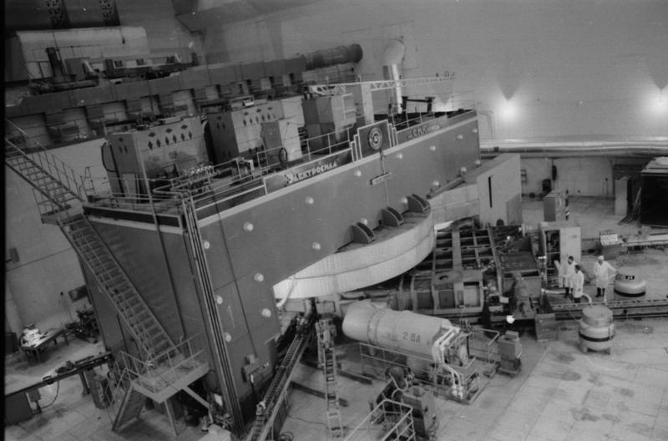
At the Dzhelepov Laboratory of Nuclear Problems, JINR, the Medico-Technical Complex (MTC) was developed on the basis of the 660-MeV proton accelerator (Phasotron), where patients with different tumors are treated using 3D conformal proton beam therapy which allows the dose distribution maximum to be shaped so as to most closely match the shape of the irradiated target. The dose drastically falls off beyond the tumor boundaries, which allows treatment of earlier inaccessible localizations immediately adjacent to a patient’s vital radiosensitive organs.
Over the period of 2000 to 2017 proton treatment with the Phasotron beams was given to more than 1200 patients with various tumors (including residents of JINR Member States other than Russia).

Slide 4
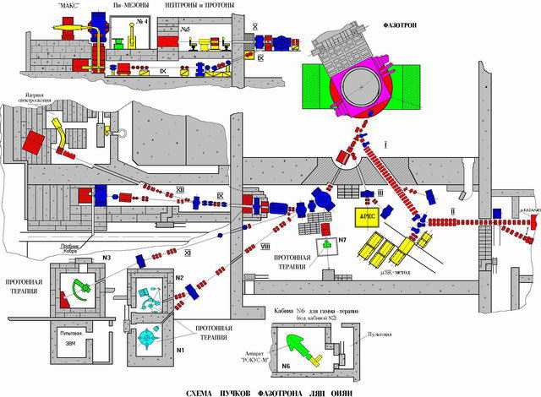
However, medical uses of the Phasotron beams grow low effective for a number of reasons. This accelerator was intended for basic nuclear-physics research, which makes its particle energy about a factor of 3 too high as compared with dedicated proton therapy accelerators. This results in increased power consumption (up to 3 MW), rather sizable personnel (about 50 people), and lower operation reliability. Total annular JINR budget expenditures for Phasotron maintenance and operation are about €1M.
 |  | Resources requested
 |  | 2017 | 2018 | 2019
1. 2. 3. 4. | DLNP Phasotron Materials Equipment Scientific visits | 900 hrs 5,000 $ 10,000 $ 10,000 $ | 900 hrs 5,000 $ 10,000 $ 10,000 $ | 900 hrs 5,000 $ 10,000 $ 10,000 $
 | Total | 25,000 $ | 25,000 $ | 25,000 $

Slide 5
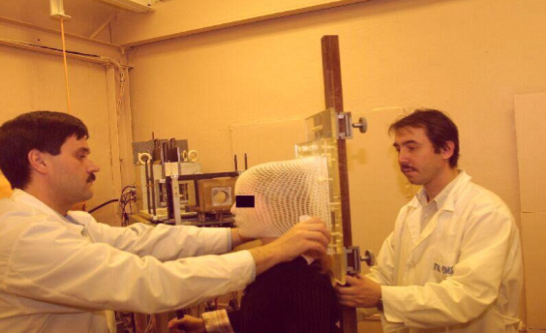
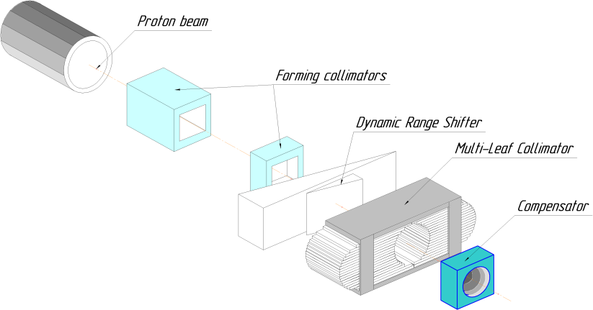
The project “Further Development of Methods, Technologies, Schedule Modes and Delivery of Radiotherapy”
(2017-2019)
1. Clinical trials:
Continuation of clinical trials on proton therapy of various new growths on Phasotron beam in a procedural cabin №1.
Finishing statistical analysis of results of therapy on a proton beam of patients with the diagnosis "hordoma and hondrosarkoma of the basis of a skull". The statistical analysis of results of clinical trials on a proton beam of patients with the diagnosis "gliomas and meningioma of a brain".
2. Development and improvement of techniques of proton therapy:
Development of the equipment for carrying out dynamic conformal radiation by a proton beam of deeply lying targets including computer operated moderator of variable thickness and full-scale option of the Multi-Leaf Collimator.
3. Expansion of functionality of the three-dimensional program of planning of conformal proton radiotherapy developed at MTC and its clinical approbation in radiation sessions.
4. Dosimetry and micro dosimetry of therapeutic hadron beams.

Slide 6
Recommendation of JINR’s Program Advisory Committee about the project (2016):
“The PAC emphasizes the importance of the results achieved both in the field of clinical research on the proton radiotherapy and in radiobiology. In Russia, this medical and technical complex is currently the only centre for proton therapy which is in operation and at the same time has acquired considerable expertise in this field. The PAC notes the significance of the project’s scientific programme aimed at medico-technical and clinical research for the treatment of cancer patients as well as successive diagnostics. The tools and methods of the project are able to resolve the problem; the scientific and technical impact of this research is on the good level. The requested budget is reasonable and meets the purposes and tasks stated. The management plan includes a clear overall responsibility for the activities of partners from JINR and external institutions which expressed an interest to join this project. The research team is well balanced and its expertise is sufficient to accomplish the project. The planned timetable, the balance between time frames and costs, and the benefits for JINR arising from this activity are clearly outlined.”

Slide 7
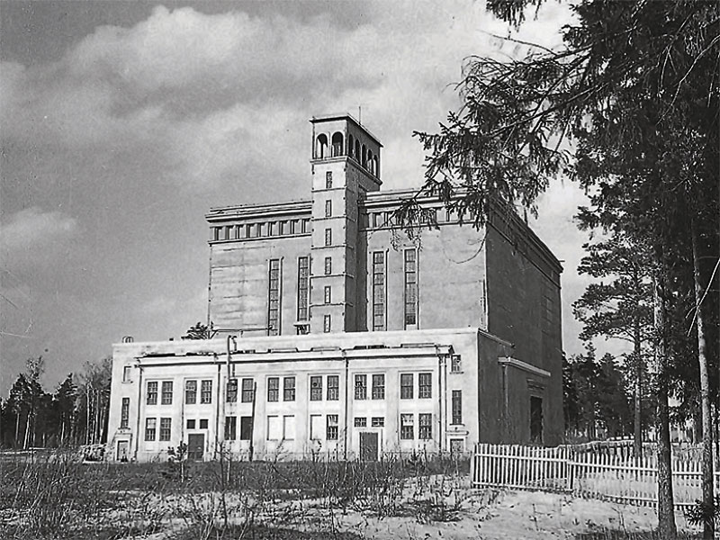
Still in the 90’s the Scientific Council and the Committee of Plenipotentiaries repeatedly indicated to us an inefficiency and high cost of use of the Phasotron for therapy. However, at that time this accelerator was providing beams also for basic research – a muonic catalysis, solid state investigations with muon spin rotation method, and some others.
Today the physical program for the Phasotron is not an actual issue anymore.
The main goal of the project is development and construction of a dedicated proton therapy center on the basis of the SC202 superconducting cyclotron being jointly developed by JINR and ASIPP (Hefei, China).
This compact superconductive accelerator SC202 is expected to be delivered already next year. Inevitably, in the near future there will be a question of its placement.

Slide 8
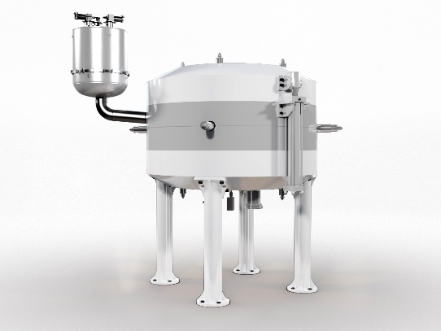
Superconducting cyclotron SC202
Fixed energy, fixed field and fixed RF frequency;
Superconducting coils enclosed in cryostat, all other parts are warm;
Extraction with an electrostatic deflector and passive magnetic channels.
Bending limit W=200 MeV;
Deep-valley concept with RF cavities placed in the valleys;
Acceleration up to ~5-7 mm from pole edge ⇒ to facilitate extraction;
Pole radius = 61 cm;
Outer diameter = 250 cm;
Height = 170 cm;
Hill field = 4.75 Tesla, valley field = 3 Tesla;
Weight is about 55 tons.

Slide 9
Therefore, it seems currently important to construct a new center for medico-biological investigations of interest for almost all JINR Member States on the basis of a new compact dedicated proton accelerator.
Some time ago a similar idea was already considered. It implied placing a compact superconducting accelerator in the DLNP Phasotron hall and using the existing beam transport equipment and treatment rooms.
However, such option is extremely conservative and practically does not provide opportunities for any further development. Considering also that the Phasotron building was constructed about 70 years ago and that requirements of Russian controlling agencies for radiation hazardous installations grow stricter, it seems to be reasonable to construct a dedicated proton therapy center in a free area on the territory of the DLNP site.
This will also provide to the Phasotron – the very first JINR’s accelerator – the honourable role of a museum exhibit.

Slide 10
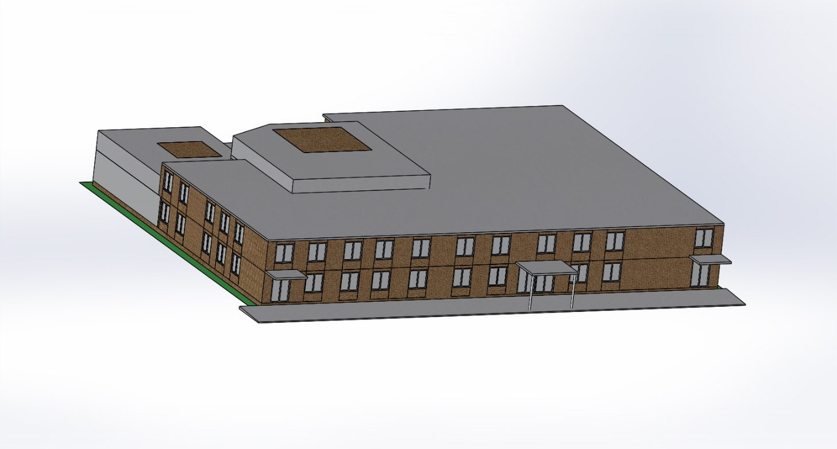
Artist’s view of the Proton Therapy Research Center

Slide 11
The center will be constructed in two stages. At the first stage the room with the fixed horizontal beam and the treatment chair will be equipped. This method is used in MTC treatment room 1 and proved itself to be good over several years of conformal proton beam treatment of head–neck tumors and tumors of other localizations. The equipment of this room can be rather quickly transformed, which allows the break between phasotron-based proton therapy sessions at the MTC to be reduced to a minimum. In this version only the system for shaping and control of the proton therapy beam in the treatment room will be modified.
At the second stage the proton therapy center will be equipped with a gantry capable of scanning the target volume by a narrow proton beam. This method is now considered most promising since it allows more flexible shaping of dose fields and also doing without individual beam-shaping devices (boluses and collimators), which decreases the time of preparation for the course of radiotherapy and the irradiation time.
It is worth noting that development and manufacture of such a sophisticated device as the gantry by the efforts of JINR will take unreasonably long time and require appreciable expenditures. A more practical way is to purchase a commercially produced gantry, e.g., from IBA, with which JINR fruitfully cooperates for a long time.
In addition, the building of the center should be designed and constructed with a view to its housing a dedicated medical electron accelerator for the energy of about 6 MeV for concomitant photon–proton therapy and an X-ray and a magnetic resonance tomography for carrying out the complete cycle of radiotherapy preparation procedures in one place.

Slide 12
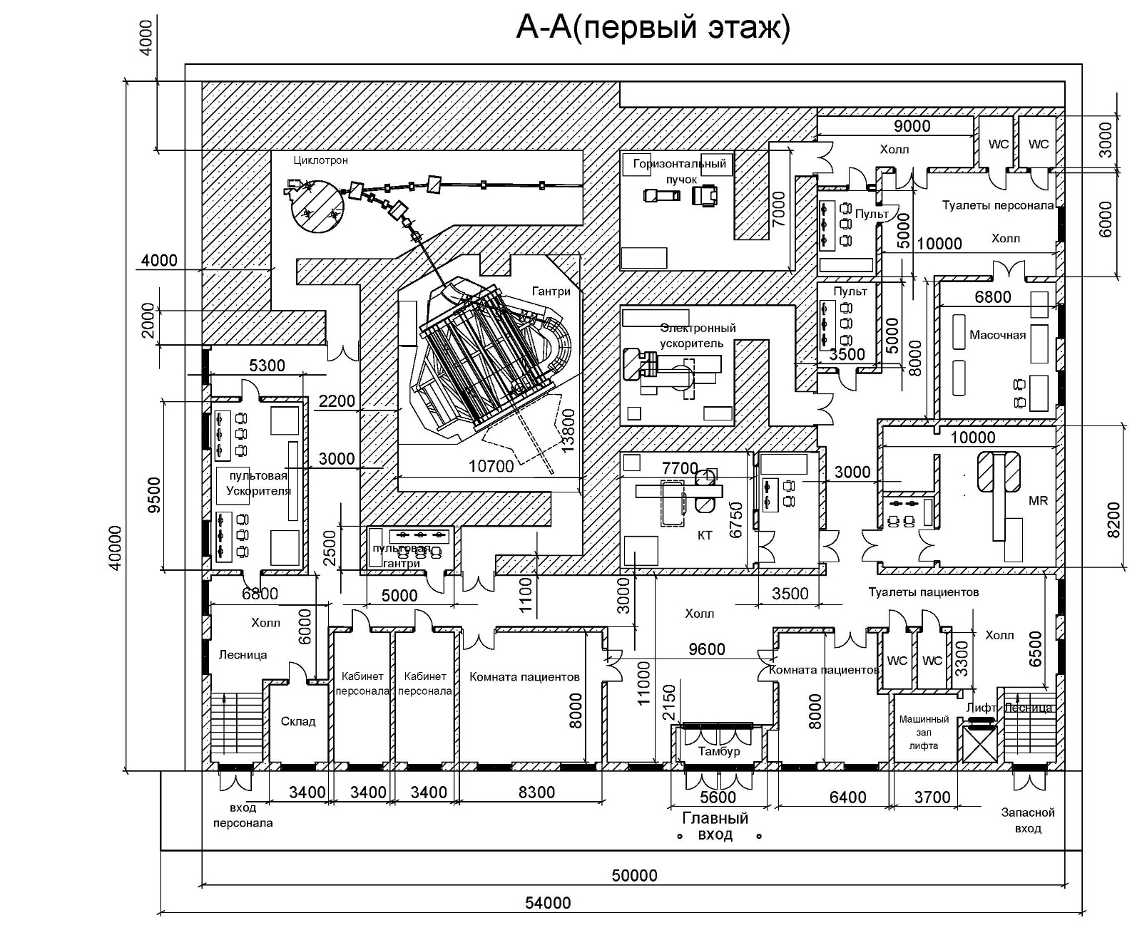
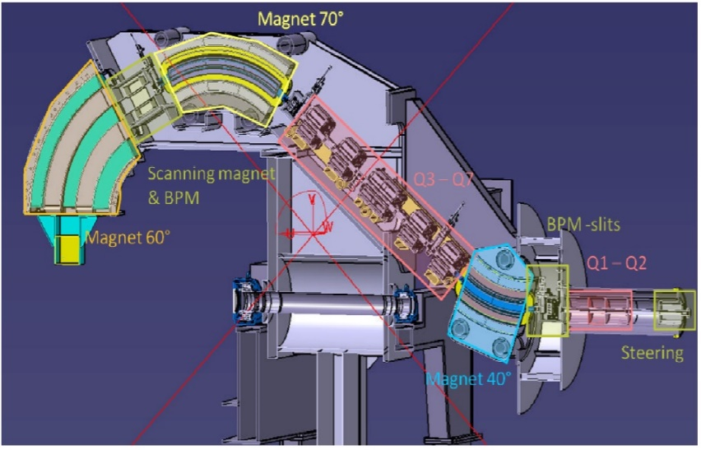
The DLNP Design Office has developed the concept of situating the Proton Therapy Research Center in a two-storied building. The first floor accommodates equipment and rooms for patients.
The IBA Proteus ONE gantry system for a proton therapy center

Slide 13
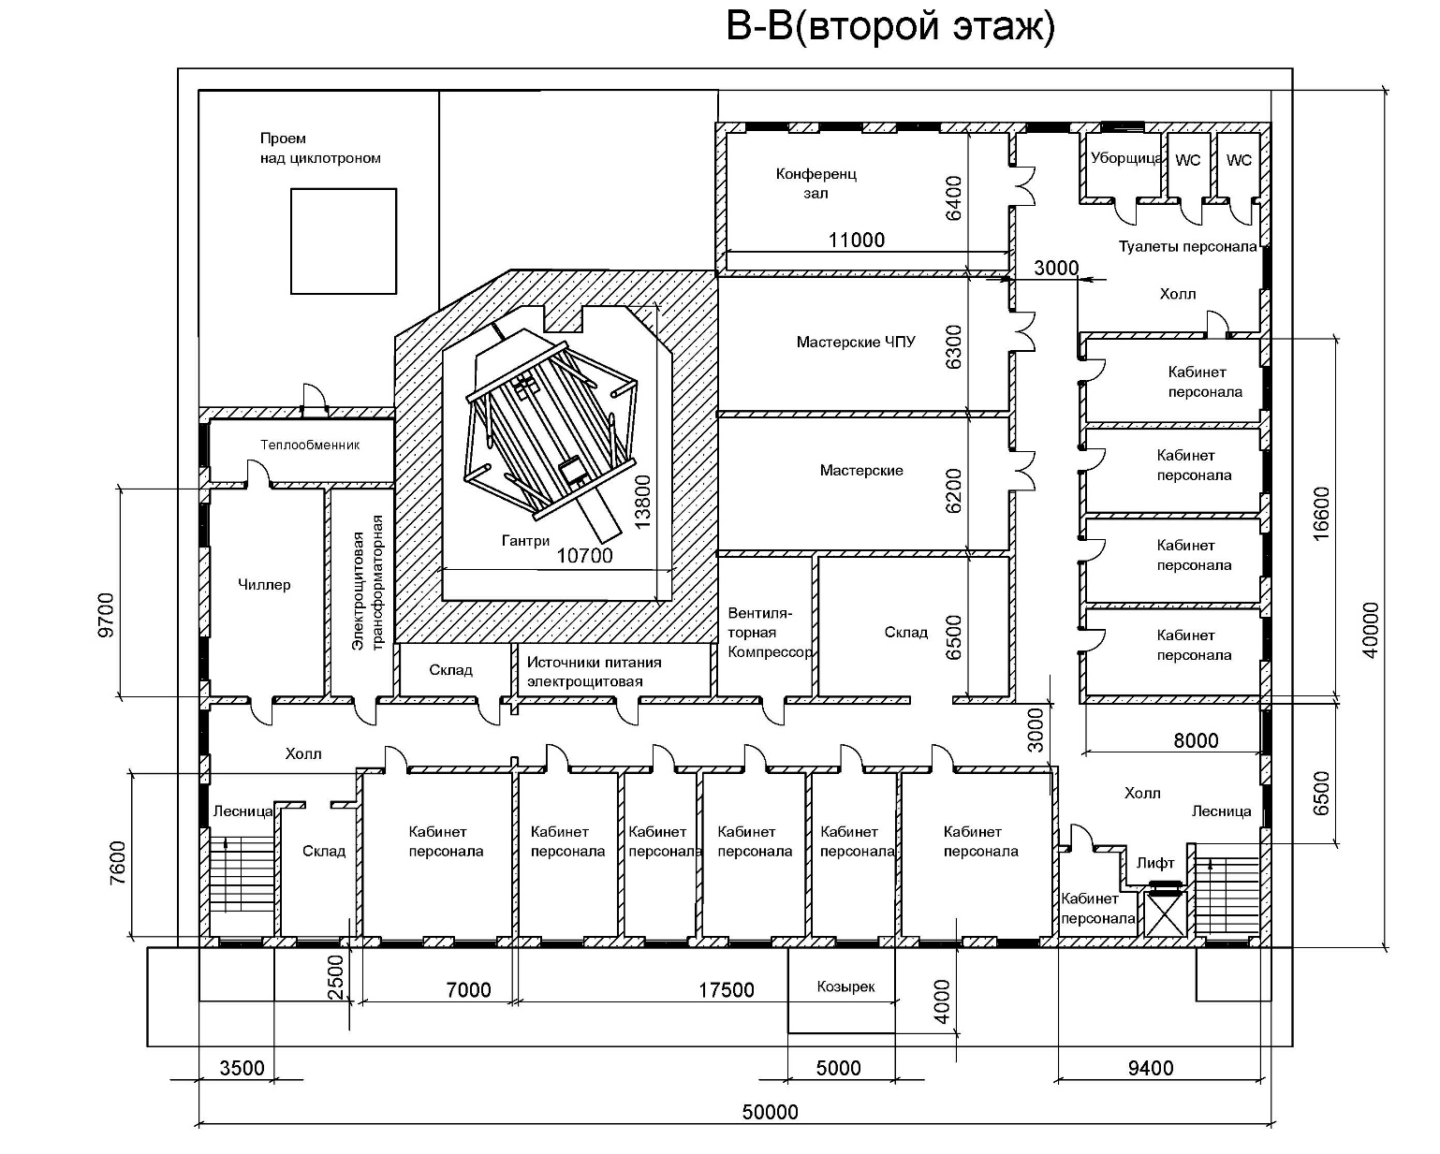
On the second floor there are rooms for the personnel and technical maintenance rooms.

Slide 14
Provisional schedule and resources (2019-2021???)

Slide 15
Implementation of this project allows the following issues to be solved:
To stop using the Phasotron, which is very expensive and low effective in its parameters for medico-biological research.
To provide significantly better working conditions for researches, but also comfortable treatment for patients.
To preserve the possibilities of “in-house” development of techniques, hardware and the software.
To create a modern “demonstration” proton therapy center that can be further replicated for practical medicine purposes of JINR Member States.
In view of recently expanding construction and commissioning of proton therapy centers in Russia and other JINR Member States and considering ample experience of Dubna in this area, it could become a cadre training unit for these centers.

Slide 16
From recommendations of the 48th meeting of JINR’s PAC for Condensed Matter Physics (June2018)
“The PAC took note of the conceptual project of a Research Centre for Proton Therapy at JINR presented by N. Russakovich. The PAC recognizes the importance of further development of instruments and methods for proton therapy at JINR and fully supports the idea of playing a leading role in disseminating the culture of proton therapy in JINR Member States.
Recommendation: Taking into account the real state of the Phasotron and the ongoing work on the construction, together with Chinese colleagues, of the SC202 therapeutic cyclotron, the PAC invites the JINR Directorate to elaborate the project of a new, compact research infrastructure for therapy with proton beams which could serve also as a pilot facility for future use in JINR Member States as well as an educational tool for training specialists in proton therapy.”

Slide 17
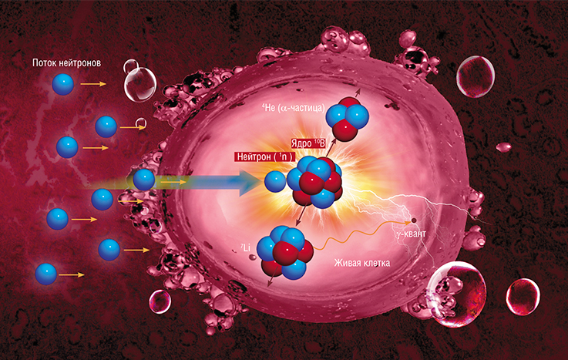
Additional remark 1: Boron-Neutron Capture Therapy (from publications by S. Yu. Taskaev and co-authors)
This two-step process is comprised of a compound containing an injectable, stable isotope of boron-10 that accumulates in tumor cells followed by irradiation of the tumor region with epithermal (0.5eV-10keV) neutrons. Boron-10 nucleus captures neutron in the tumor cell, resulting in a reaction, the energy of which leads to the cell destruction. The use of boron-10 carriers, which are selectively (due to blood-brain barrier) accumulated in tumor cells, allows for specific destruction of tumor cells while sparing normal, unchanged cells. As a result of neutron absorption by boron-10, unstable boron-11 nuclei are formed, which instantaneously decay into alpha-particles and lithium nuclei.
¹⁰B + n → ¹¹B* → α + ⁷Li + 2,31 MeV

Slide 18
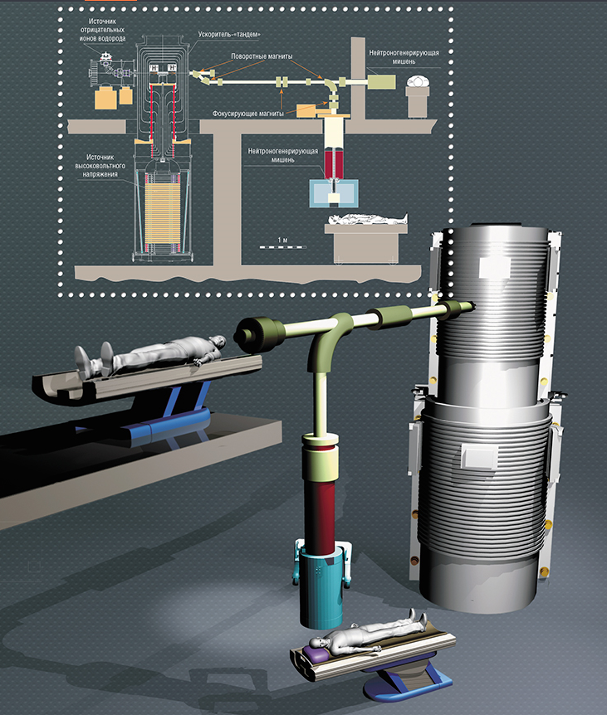
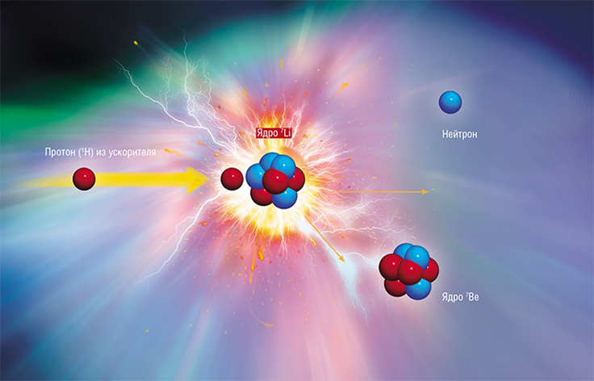

The neutron beams at reactors have been used for clinical investigations in Finland, USA, Netherlands, Sweden, Czech Republic and Japan.
A compact source of epithermal neutrons based on accelerator was built at the Budker Institute of Nuclear Physics of Siberian Branch of Russian Academy of Sciences (Novosibirsk). This source can be placed in a clinic. It is based on the accelerator-tandem with vacuum insulation and a lithium target. A stationary proton beam with energy of 2 MeV and current up to 5 mA is generated. A series of studies were performed in vitro and in vivo.

Slide 19
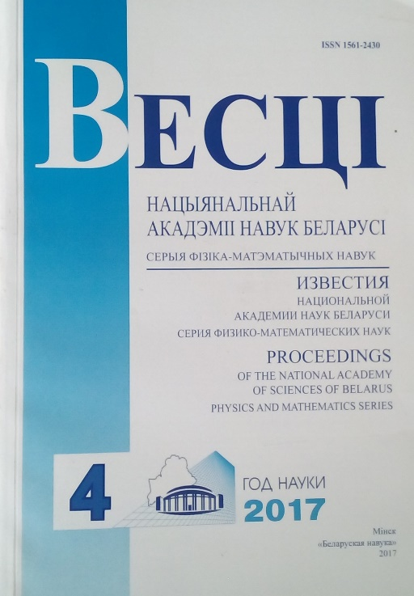

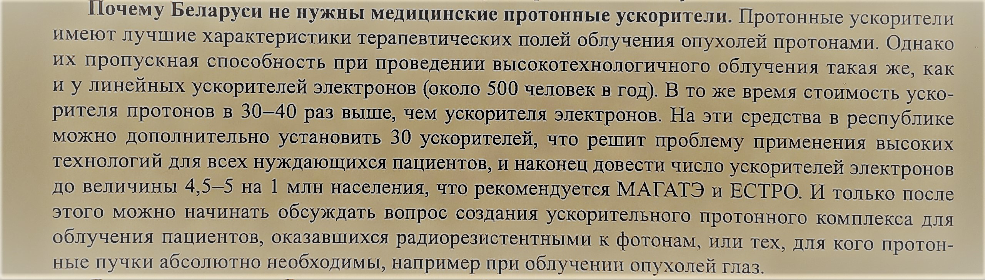
Additional remark 2: on the future of radiotherapy in Belarus
I.G.Tarutin, A.A.Baranovski
“Modern technical state of Radiotherapy and Nuclear Medicine in the Republic of Belarus . Ways of their next evolution”

Slide 20
Thank you!

