Slide 1
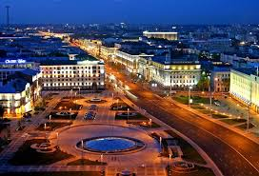

Participation of INP BSU in CMS. Past, Present and Future
Juan Suarez Gonzalez
Institute for Nuclear Problems BSU
Minsk, Belarus
17th January 2017

Slide 2
Outline
Past
Letter of Intent
Nikolai Shumeiko, Michel Della Negra, Peter Jenni
Contribution to the CMS Experiment
Today
Future
Outlook

Slide 3
The Past

Slide 4
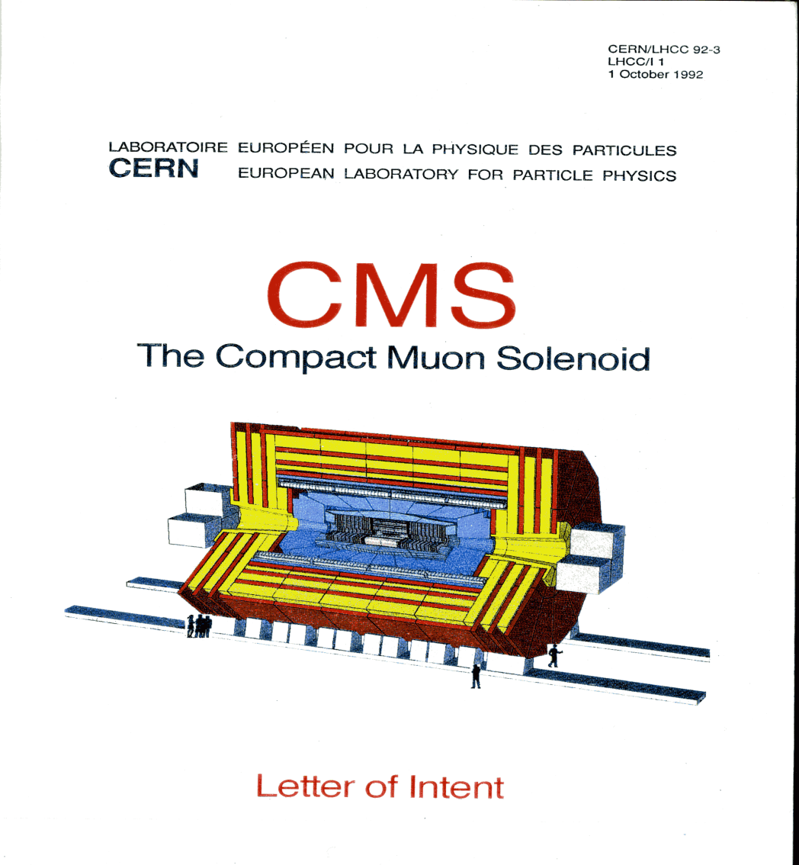
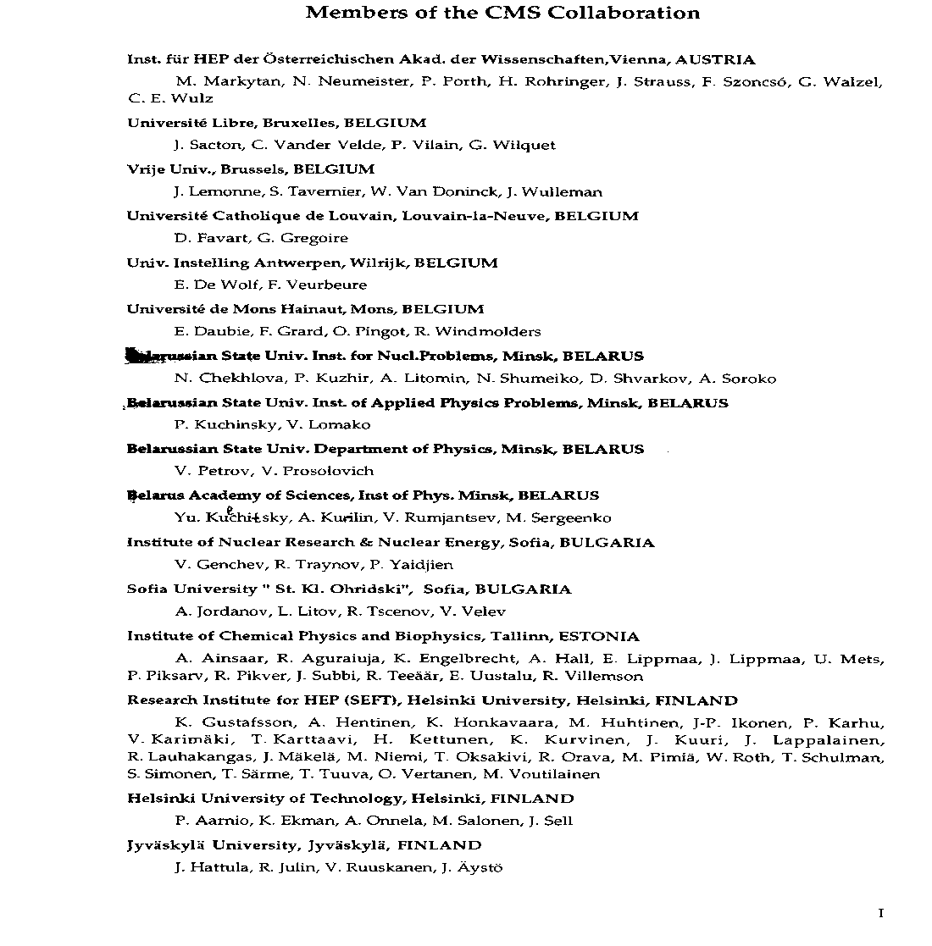
At the very beginning – Letter of Intent

Slide 5
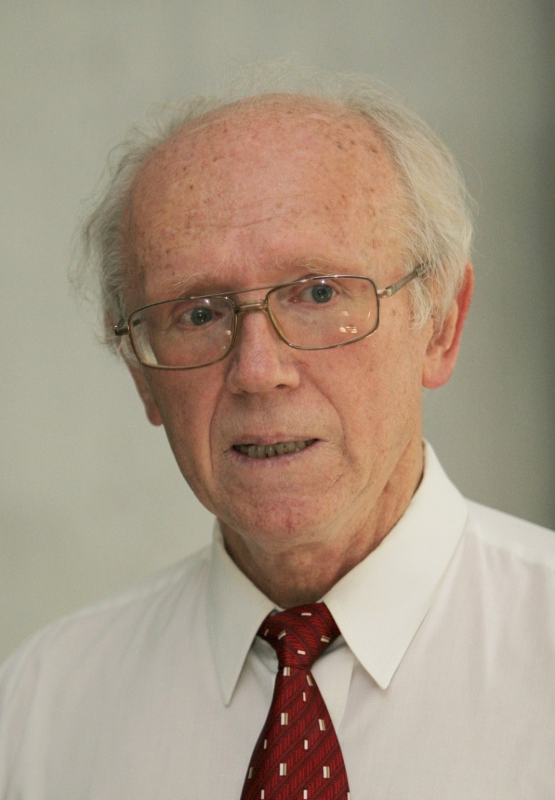
Nikolai Shumeiko
1942-2016

Slide 6
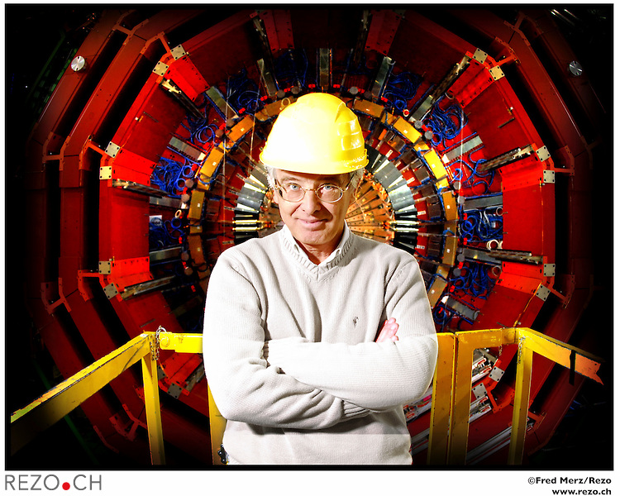
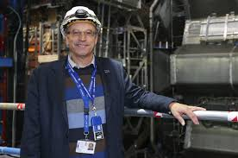
Father Founders of CMS and ATLAS
Michel Della Negra
Peter Jenni

Slide 7
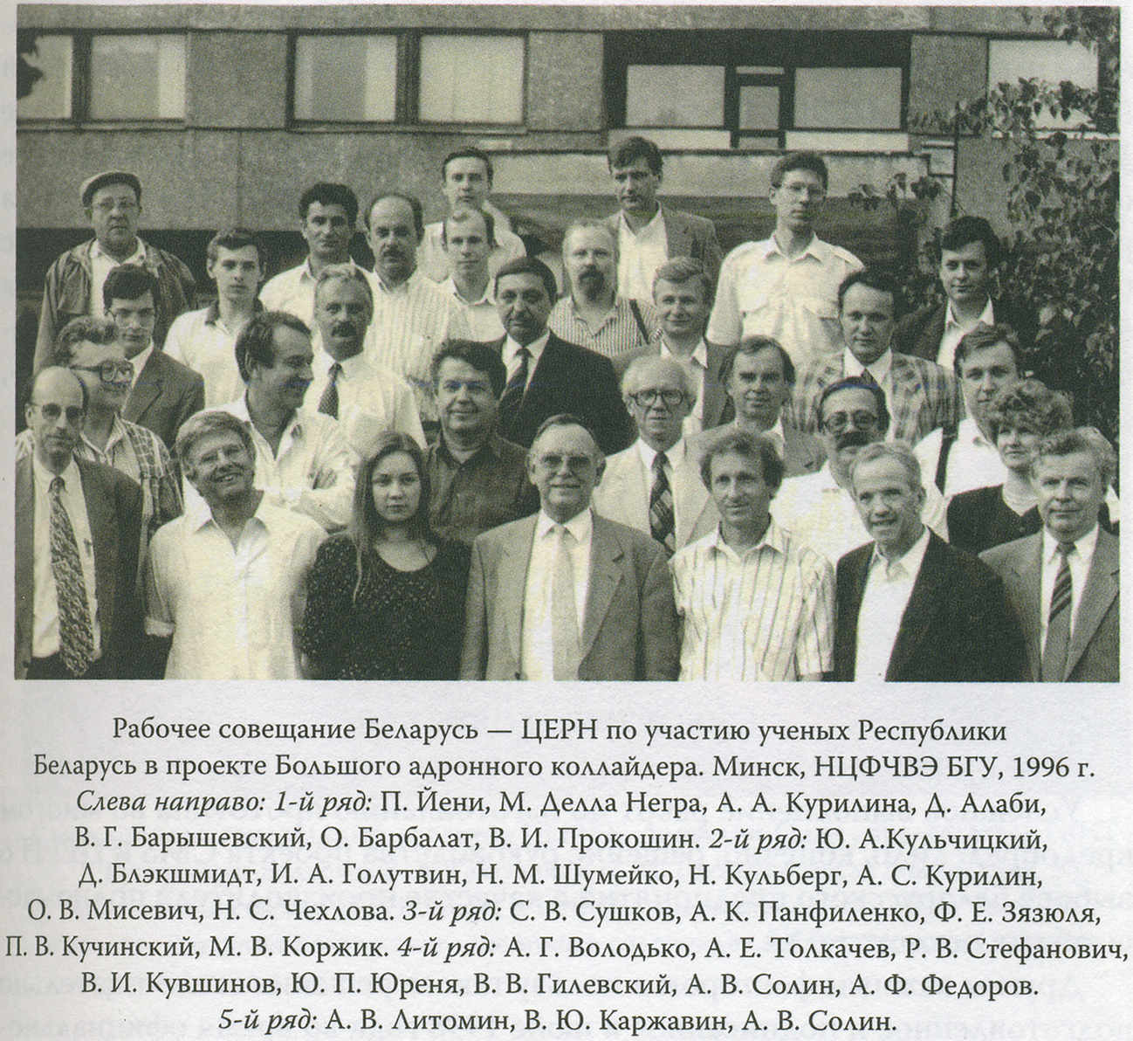
Historical Meeting in Minsk, June 1996

Slide 8
Contribution to Ecal

Slide 9
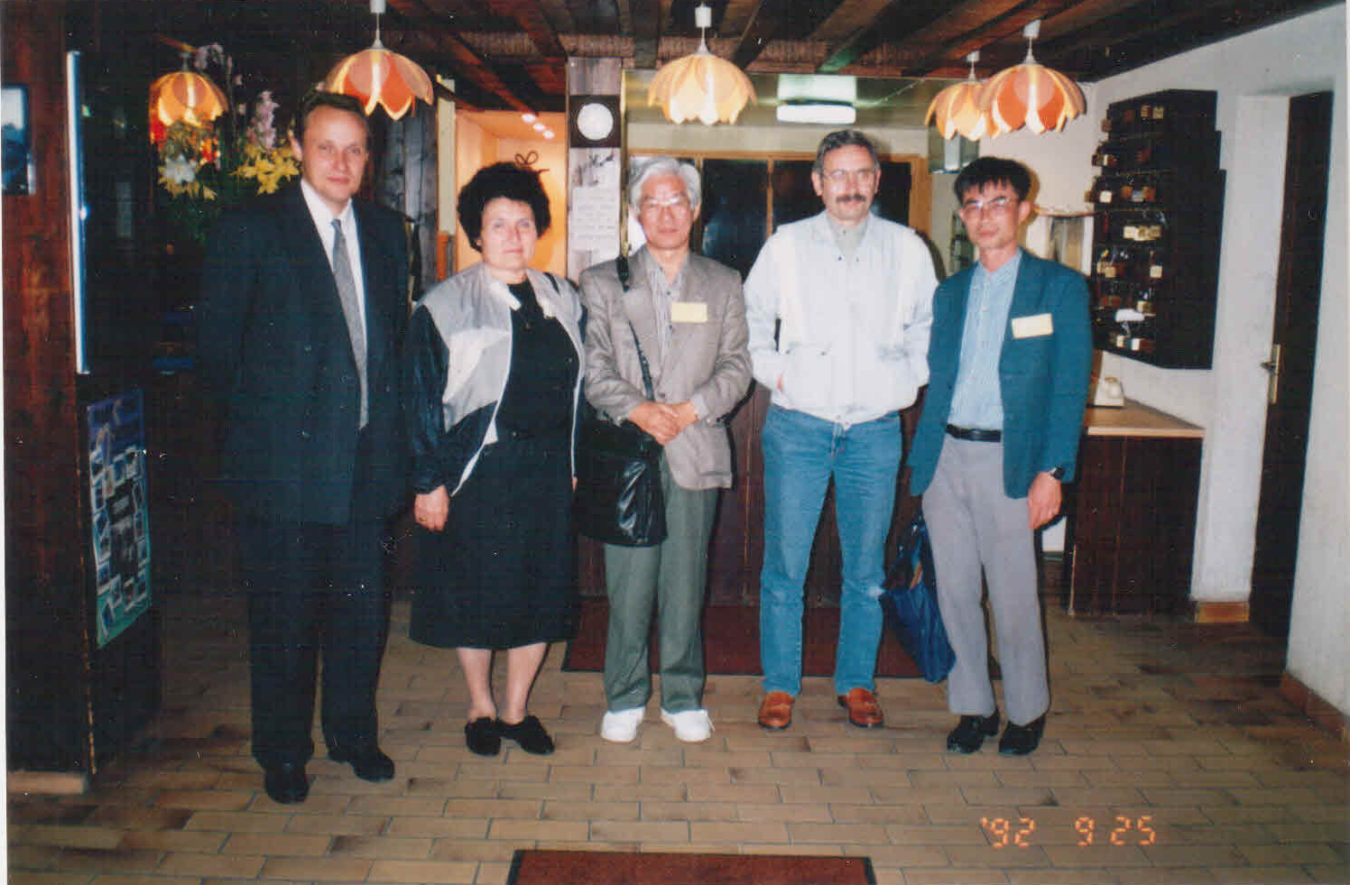
LEAD TUNGSTATE CALORIMERY EPOQUE IN HEP
INSTRUMENTATION
INVENTION OF PbWO4 SCINTILLATION MATERIAL FOR
CALORIMERY
Pioneering article: Barishevsky V.G., Fyodorov A.A., Korzhik M.V., Ka t c h a n o v V.A .,
Moroz V.I. et al. // Nuclear Instruments and Methods in Physics Research. A322. 1992. Р. 231.
The first PWO crystal grown
by ISC (Kharkov) according
to INP (Minsk) request
Participants of the First PWO Workshop, Charmonix, Sept.1992, From left to right:
M.Korjik (INP), L.Nagornaya (ISC), M.Issi (KEK), J.P.Peigneux (LAPP), M.Kobayashi (KEK)

Slide 10
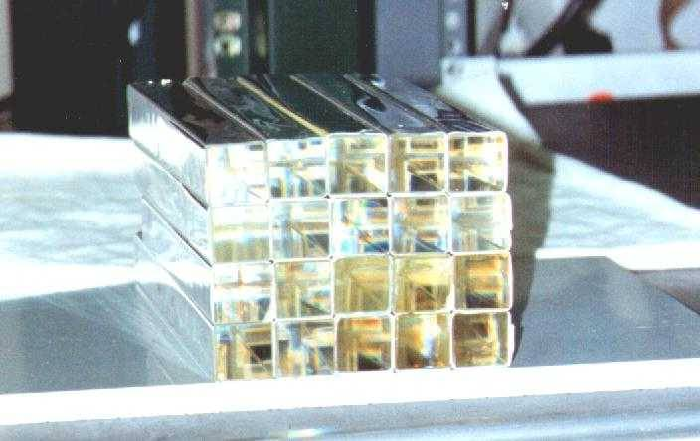
Jointing of RD18 (Crystal Clear Collaboration ) to PWO R&D
performed by IHEP (Protvino) and INP (Minsk)
1994- First joint test at H4 of the 5x5 matrix of 22X0 PWO crystals
1995- P.Lecoq, I.Dafinei, E.Auffray, M.Schneegans, M.V.Korzhik,
O.V.Missevitch, VB Pavlenko, AA Fedorov, AN Annenkov,
VL Kostylev, VD Ligun Lead Tungstate (PbWO4) scintillators for
LHC EM calorimetry, (1995) Nucl Instr Meth Phys Res 365:291-298
2002- Annenkov A, Korzhik M, Lecoq P (2002) Lead tungstate
scintillation material. Nucl Instr Meth Phys Res A490:30‒50
R&D start
R&D Finish
The CMS ALICE experiments at LHC made these Electromagnetic calorimeters on a base of PbWO₄ because of its high density, fast luminescence and reasonable light yield and radiation resistance. CMS ECAL , the world largest crystalline calorimeter, have a total volume of 11m³ and a weight of 90 tons.
INP BSU experts were a driving force to
improve scintillation properties of PbWO4
and made available crystal mass production.
Some PWO crystals produced at BTCP within
the largest ISTC (Moscow, Russia) 1718P
Project

Slide 11
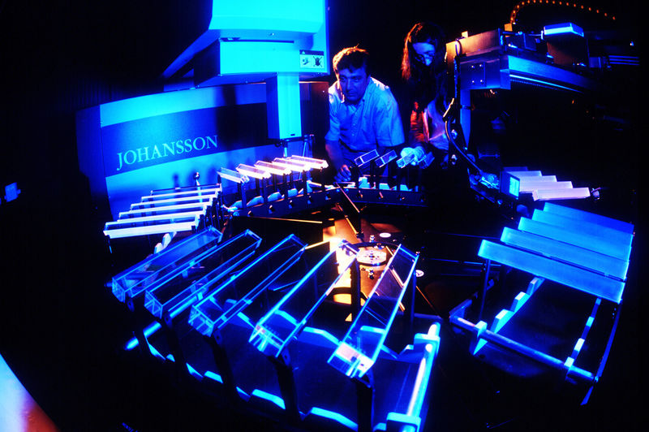
Mass production of PWO crystals for CMS ECAL (2000-2008)
ACCOS at BTCP ACCOS at CERN
INP designed and built Automatic Crystal Control Systems with LAPP , CERN and
ETH for mass certification of CMS scintillation elements for Barrel and End Caps.
CERN ACCOS is still in use to certify PWO elements for PANDA and several
other experiments!

Slide 12

Role of PWO Electromagnetic Calorimeter (ECAL) in the Discovery of the Higgs Boson by the CMS Collaboration at LHC
The γγ, ZZ and WW channels are equally sensitive in the search for a Higgs boson
around 125 GeV and they all are more sensitive than the bb and ττ channels.
The γγ channel is especially important as it allows the mass of the new
particle to be measured with precision. In the γγ channel, the mass is determined from
the energies and directions of two high-energy photons measured by the CMS crystal
electromagnetic calorimeter.
An event recorded with the CMS
detector in 2012 at a proton-proton
center of mass energy of 8 TeV.
The event shows the characteristics
expected from the decay of the SM
Higgs boson into a pair of photons
(dashed yellow lines and green
towers). The event could also be
due to the known standard model
background processes
(courtesy of CMS Collaboration)

Slide 13
Contribution to Hcal

Slide 14
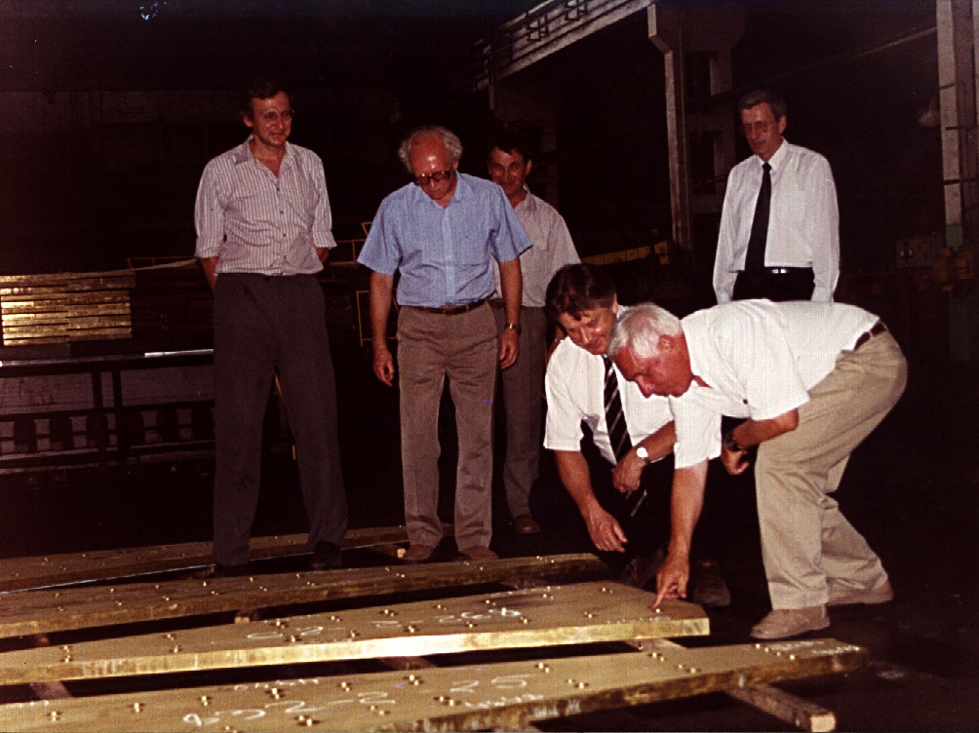
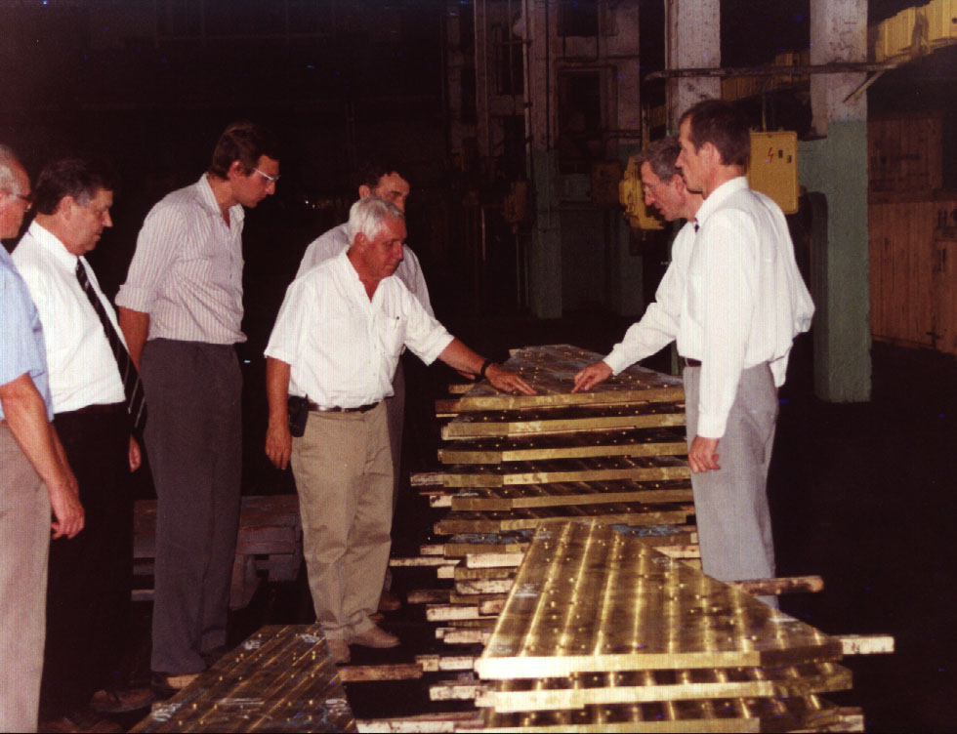
Commissiong of Latium plates for the forward-hadron calorimeter of the CMS experiment at MZOR factory, Minsk by CERN and JINR teams. 2000.

Slide 15
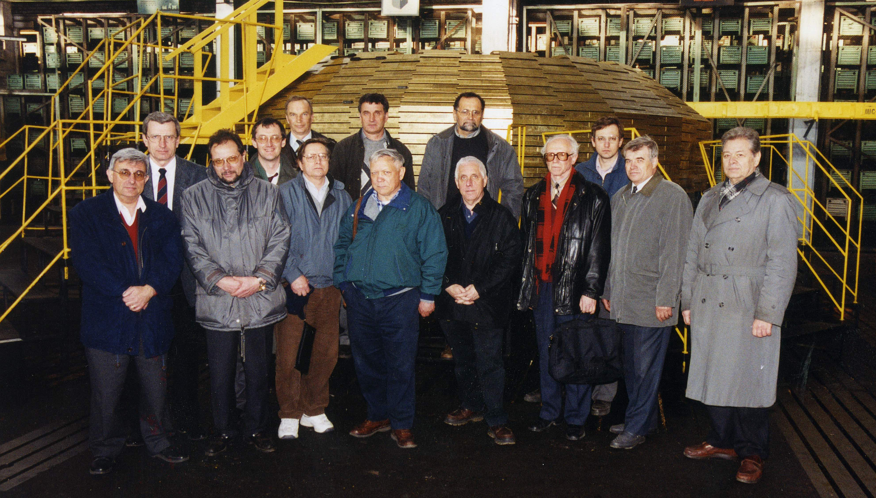
Commissioning of the Latium absorber of the forward-hadron calorimeter of the CMS detector at «MZOR» , Minsk by CERN and JINR teams. 2001

Slide 16
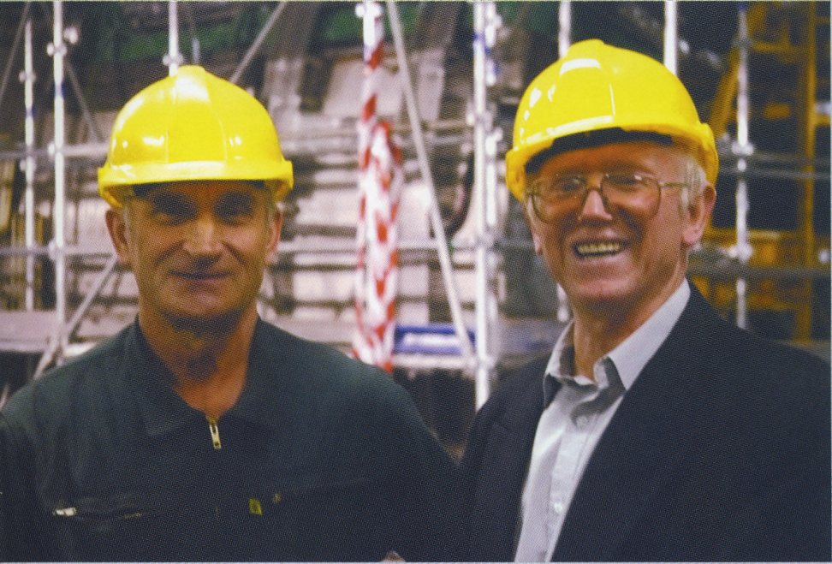
Hcal Installation at P5 CMS
Roman Viktorovich Stefanovich
Engineer of INP BSU playing a fundamental role in the installation of the Hcal and CSC Muon chambers. Now involved in the integration of TOTEM to CMS. 20 years of continue work at CERN point 5.

Slide 17
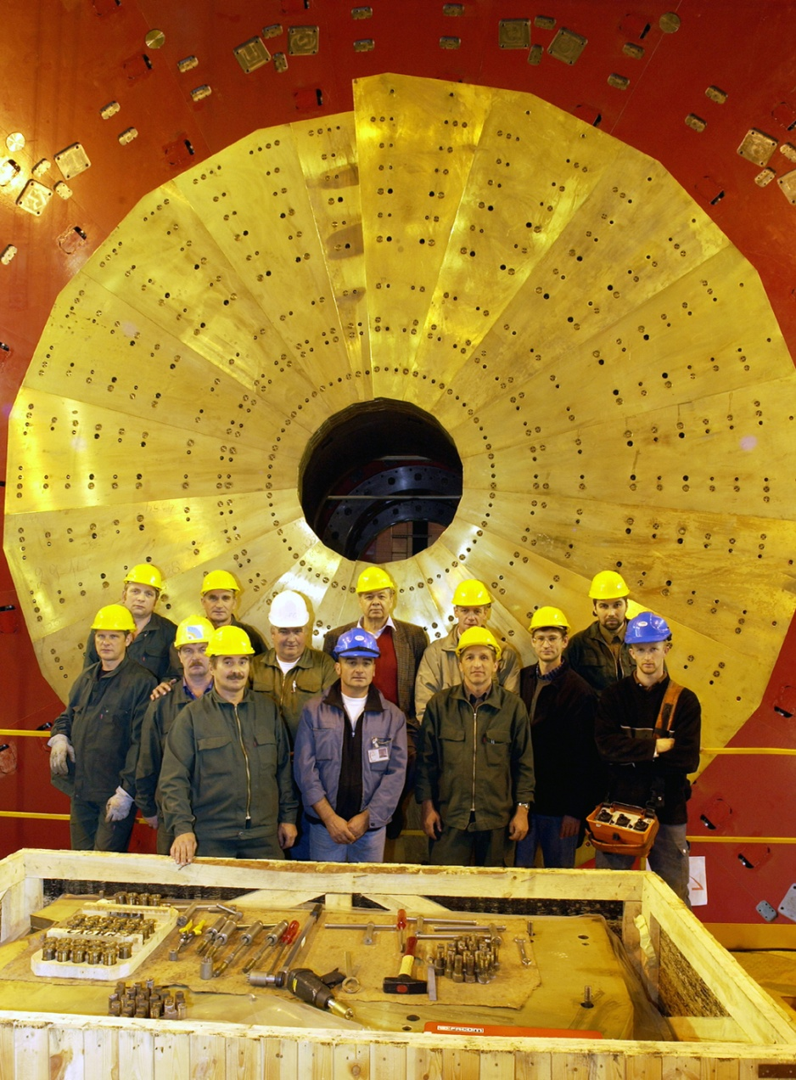
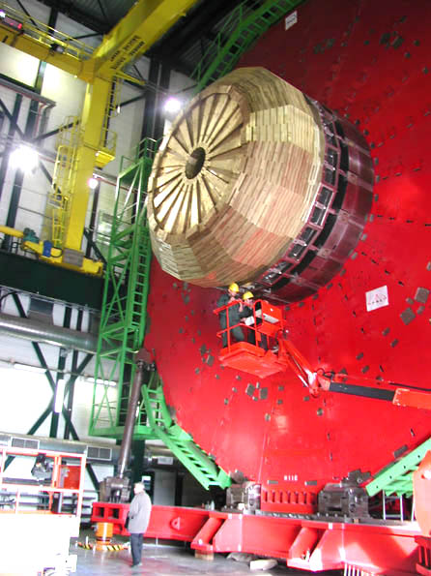
Installation of hadron-forward calorimeter absorber at point 5 CERN
2002, CERN. Installation of CMS end-cap hadron calorimeter absorber

Slide 18
Contribution to CSC Muon System

Slide 19
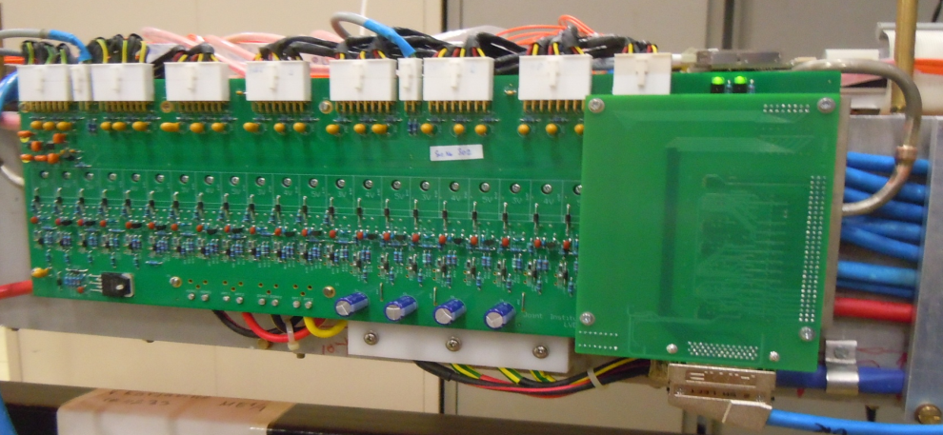
Electronics for CSC
Vladimir Tchekhovski
Development, manufacture support and testing of application-specific analog and mixed-signal IC for nuclear electronics, radio-electronic and electronic measuring equipment
Development of electronic components and assemblies for the experimental equipment used in modern particle physics experiments
Development and prototyping of specialized control and measurement electronics for testing IC and modern element base.
Electronic module for low voltage power supply system
of CMS muon detecror

Slide 20

Higgs boson discovery: 14 co-authors from INP BSU
The Higgs boson discovery publications in journals Science and Physics Letters B

Slide 21
The Present

Slide 22
INP BSU Successful participation in CMS
Author ship of all papers published by CMS Collaboration so far. As today 603 publications send to referee journals.
Fulfilling our obligations on shifts and pledges (see V. Mossolov talk)
Participation in various analysis groups – DY, A_FB, Z’ (see U. Yevarovskaya talk)
Participation in the CMS generators’ group (MC centralized samples)
Creation of the MC generator LPPG and integration to the CMS generator system (see Y. Dydyzhka talk )
Successful operation of the CMS Grid Tier 3 (see V. Yermolchik talk)

Slide 23
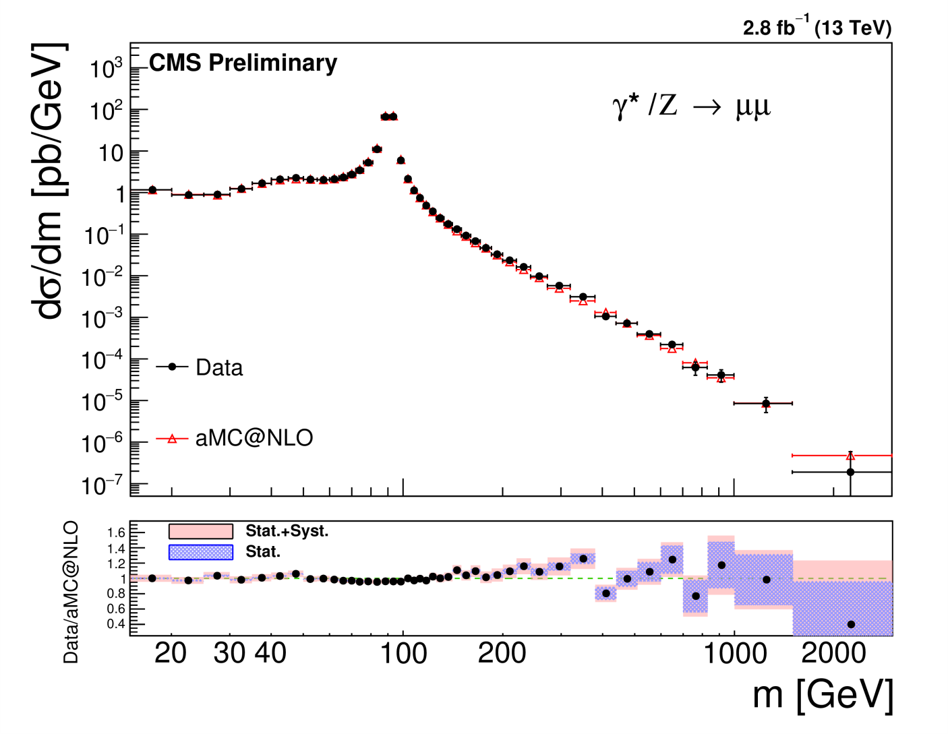
Drell-Yan cross section measurement
2-3% system. Precision; compared NNLO predictions calculated with FEWZ and NLO predictions calculated with aMC@NLO
[CMS-PAS-SMP-16-009]

Slide 24
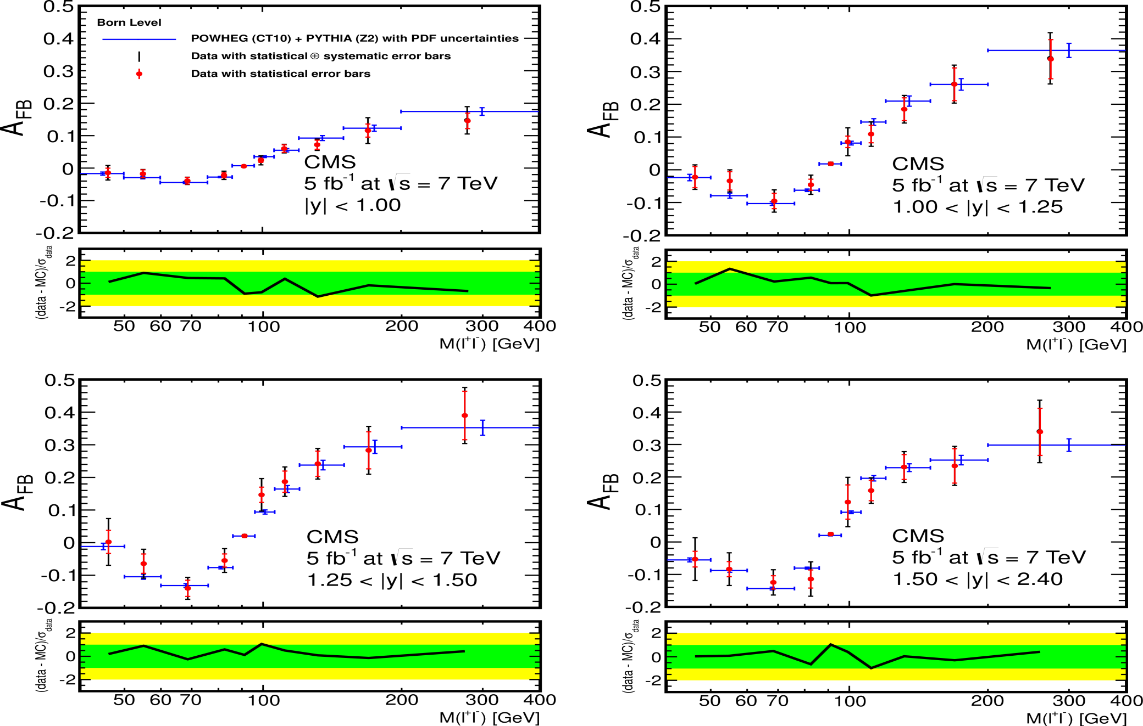
Forward-Backward Asymmetry

Slide 25
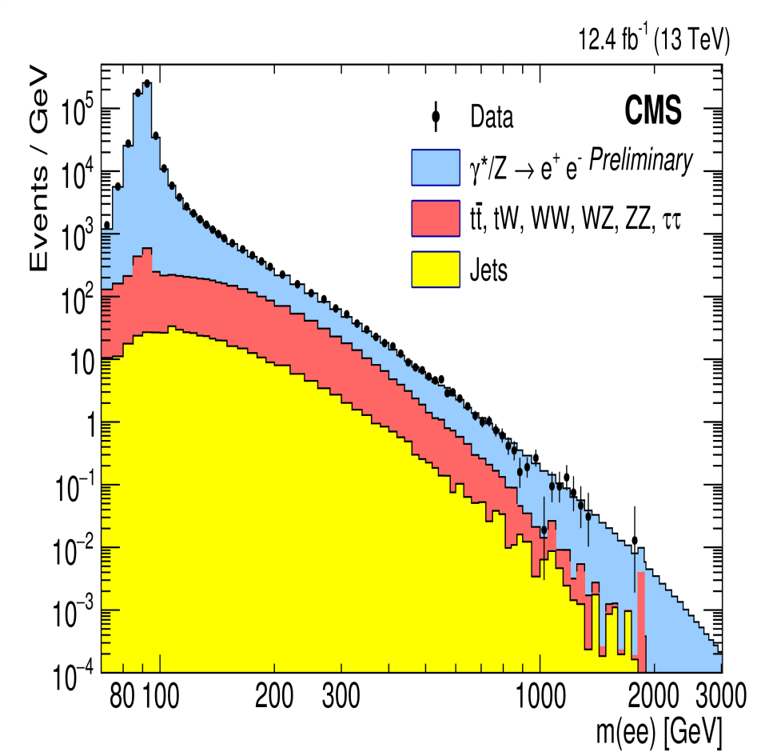
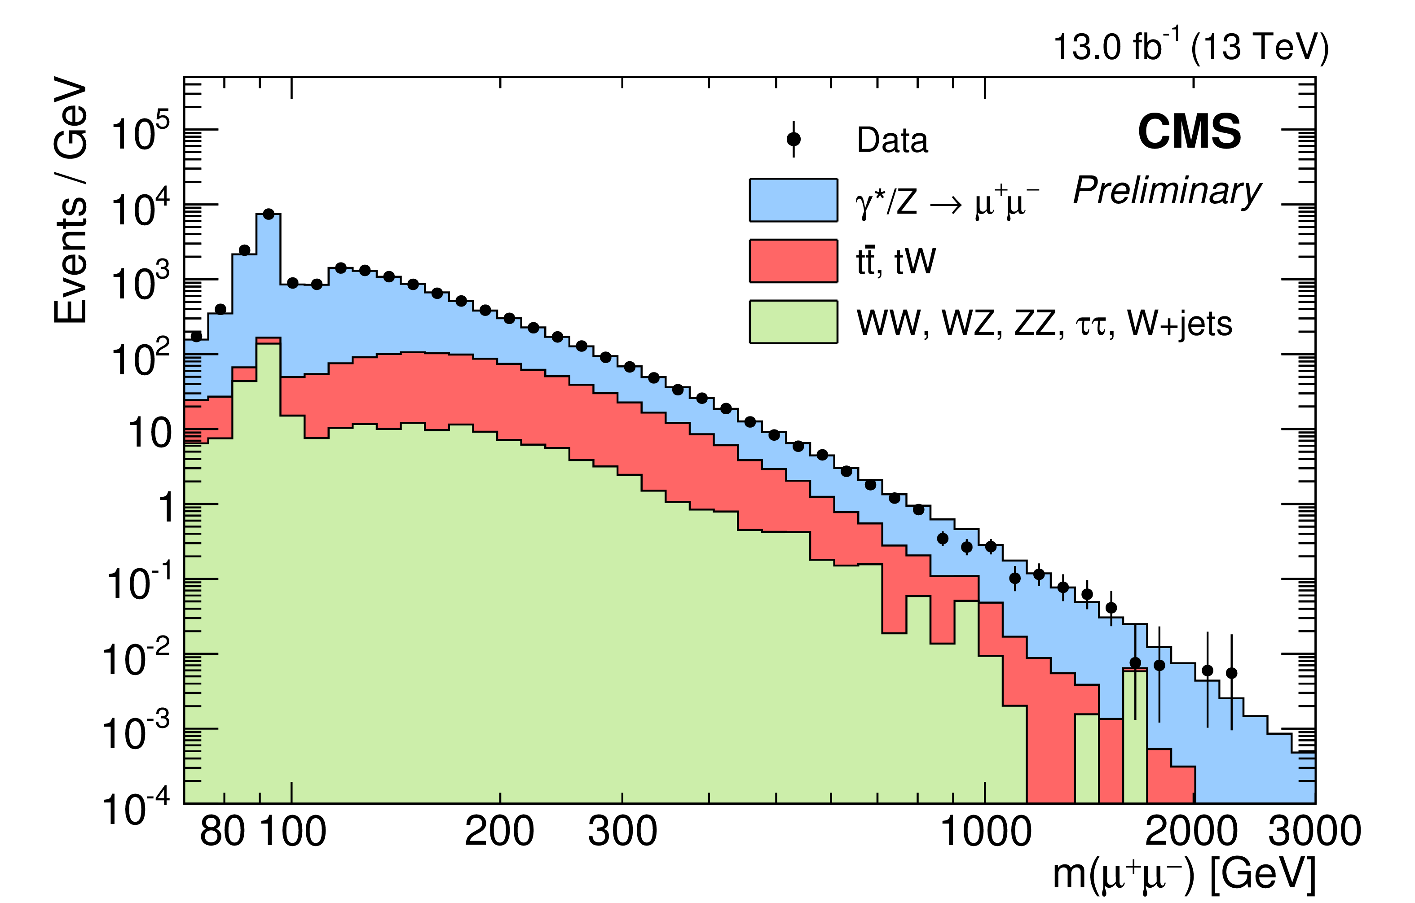
Search for Z’ in e-e+ and μ-μ+ channels
Exclusion limits for: Z’_ssm (3% width)> 4 TeV/c2 (95% CL) and Z’_ψ (0.5% width)> 3.36 TeV/c2 (95% CL) [CMS-PAS-EXO-16-031]

Slide 26
The Future

Slide 27
R&D on PWO still continue!
Newly discovered luminescence properties of PWO crystals
Initial part of PbWO₄ photoluminescence
kinetics at 343 nm excitation (blue line)
and 254 nm excitation with pulse energy of
15 mJ/cm² (red) and 1.5 mJ/cm² (green)
The results show that the fast rise of luminescence in PWO scintillators is short
enough to be exploited for the sub-50-picosecond readout, which is targeted for
the future scintillator detectors at High Luminosity LHC and Future Circular Collider.

Slide 28
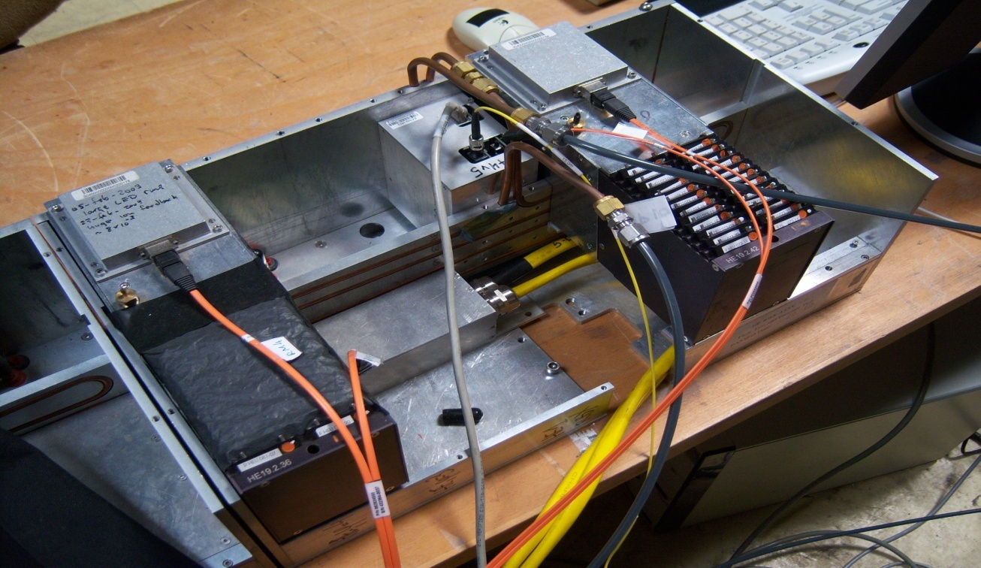
HE Readout Box and Readout Module Boxes
Hcal upgrade project phase I
Big enrolment of Belarus industry in this project

Slide 29
ME CSC electronics upgrade
At present L1A rate and L1A latency CFEBs are fine
At HL-LHC luminosity CFEBs cannot sustain the planned trigger rates and latency
Proposal to replace electronics on the inner chambers 1.6 < |η| < 2.4 (ME2/1, ME3/1,ME4/1 ):
Cathode Front-End Boards (CFEBs) by digital
DCFEBs to eliminate dependency on level 1 latency
Replace DAQ readout electronics (DMB=>ODMB)
to accommodate increased bandwidth
Already replaced on ME1/1 in LS1
Inner chambers
ME2/1, ME3/1, ME4/1
Perform upgrade in 2 steps:
LS2: On chamber electronics + OTMB (in peripheral crates)
LS3: ODMB (in peripheral crates) + FEDs (in USC) + optical links
Notes:
http://cms.web.cern.ch/news/cms-detector-design

Slide 30
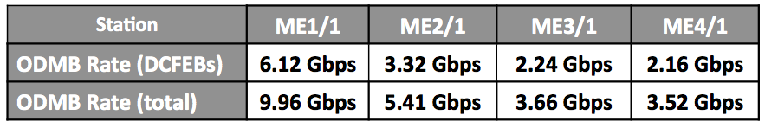
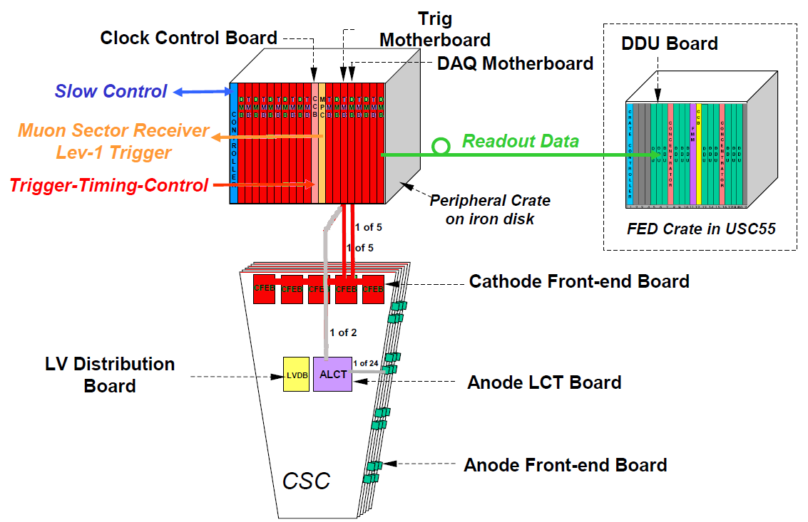
Upgrade of Trigger, DAQ, and FED (Data Bandwidth)
Replacement of CFEBs with DCFEB implies:
Low Voltage Distribution Board (LVDB) -> LVDB5
Trigger MotherBoard (TMB) -> Optical TMB (OTMB)
DAQ MotherBoard (DMB) -> Optical DMB (ODMB)
Increased luminosity at HL-LHC implies:
Increased data bandwidth requirements
Data Rates at 0.75x10³⁵cm⁻²s⁻¹
At present DMB -> DDU links are 1.28 Gbps
ME1/1 ODMBs need to be replaced with high bandwidth version of ODMB (72 needed)
ME2/1, 3/1, 4/1 DMBs need to be replaced
with new ODMB2s (108 needed)
ME2/1, 3/1, 4/1 TMBs need to be replaced with OTMBs
No changes needed; simply produce more (108 needed)
ME2/1, 3/1, 4/1 LVDBs need to be replaced with LVDB5s (108 needed)

Slide 31
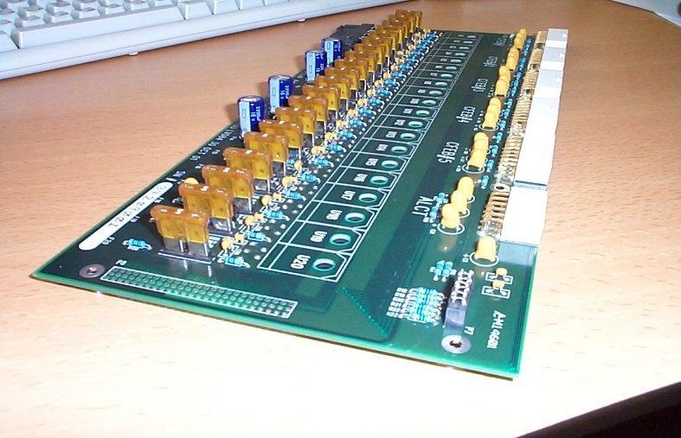
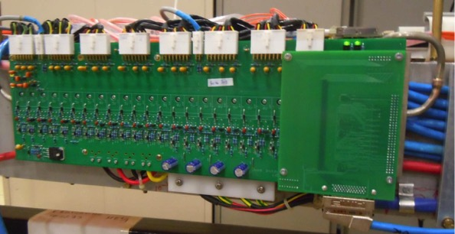
On chamber power distribution
New Low Voltage Distribution Board LVDB 5 will provide 20 output voltage channels:
to supply 5 DCFEBs (6V, 5V, 3.3V per each board)
to supply ALCT(5.5V, 1.8V, 3.3V)
to provide DCFEBs reference voltage power supplies of -5V and +10V
New on-chamber electronics requires ~2x more power then the old one
LVMB
LVDB
LVDB 7
JINR and INP, Minsk take responsibility for design and construction of 120 new Low Voltage Distributions Boards (LVDB5) for 108 Muon Endcap inner rings (MEX/1) detectors.

Slide 32
The CSC Upgrade in Muon Project Upgrade
Armando Lanaro UW-Madison
2015
2016
2017
2018
2019
2020
2021
2022
2023
2024
2025
2026
LS2
LS3
GE1/1 TDR
LS2
LS3
GE1/1 Pre
production
EDR
ESR
GE1/1 Production
Test
GE11 Installation &
Commissioning
Design and Prototyping
MUON TDR
Prototyping
Engineering and Preproduction
EDR
GE2/1 Production
Installation &
Commissioning
GEM
Test
Design and Prototyping
Prototyping
Engineering and Preproduction
EDR
ME0 Production and integration in HBE
Test
RPC
Design and Prototyping
Prototyping
ESR
EDR
RE3/1 and RE4/1 Production
Engineering and Preproduction
Test
DT
Design and Prototyping
Prototyping and demonstrators
ESR
DT Electronics Production
Test
Engineering and Preproduction
BACK-END ESR
Design and Prototyping
On-chamber electronics
production
CSC
Engineering and
pre-production
Engineering design back-end
Off-chamber electronics production
ON-CHAMBER ESR
Test
On-chamber electronics Installation
Test
Off-chamber electronics Installation
Notes:
http://cms.web.cern.ch/news/cms-detector-design

Slide 33
Outlook
Active and successful participation in a variety of crucial tasks (detector R&D, creation and mounting. Theory, analysis, shifting, pledges and Grid cluster maintenance)
Hope to continue playing a decisive role in the upgrade of the CMS detector in physics and services

Slide 34
Thank You for your Attention!!!

Slide 35
Backup

Slide 36
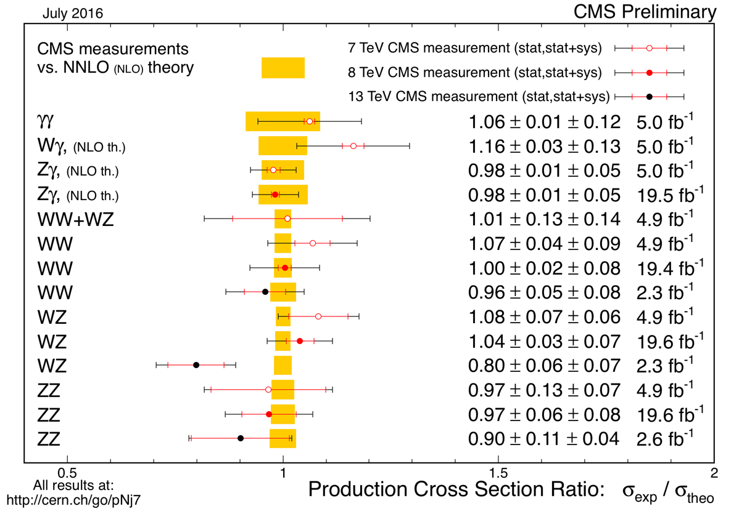
Double-boson Cross section

Slide 37
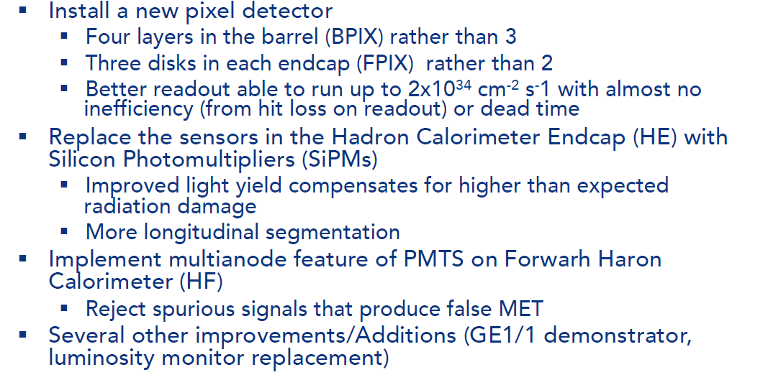
Upcoming ACTIVITIS for Upgrade I

