Slide 1
Frederike Hanisch
Co-Authors: Maya Elspaß, Fritz-Herbert Heinsius, Bertram Kopf, Meike Küßner, Ulrich Wiedner
Hadron Spectroscopy and the New Unexpected Resonances
26.09.2024, Paraty

Slide 2
Outline
Partial Wave Analysis – Status Quo
PAWIAN-Software
Accelerating PWA Fits: Theory and First Results
    Automatic Differentiation (Autodiff)
    Sorting Based Nearest Neighbour Search (SNN)
    Adaptive Moment Estimation Algorithm (ADAM)
Summary and Outlook

Slide 3

Partial Wave Analysis (PWA) – Current Challenges
Era of high statistics
Event based PWA fits use lots of computing resources
Currently fits take up to several weeks, even on hundreds of CPU cores
Even more data in future
Motivation
  More sustainable use of resources
  Faster and more efficient PWA
  Especially problematic in event-based analyses
Fit time depends on:
Numerical
MINUIT2
AUTODIFF
ADAM
Computation of the
Gradient
Number of Iterations
Number of Data Events
SNN

Slide 4
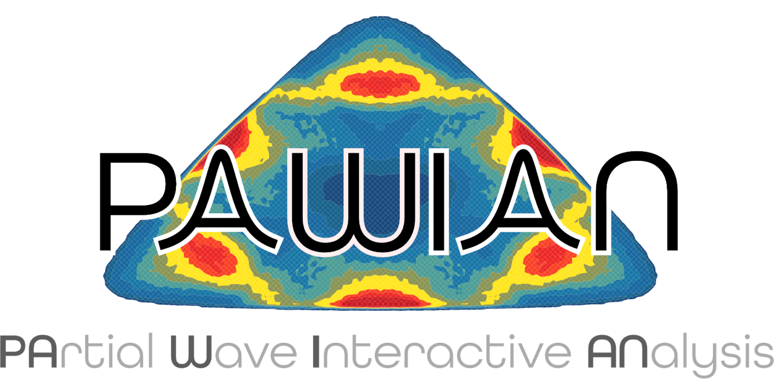
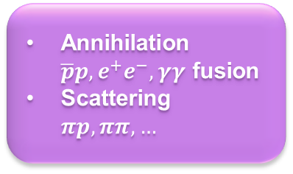
PAWIAN Framework
PArtial Wave Interactive ANalysis Software: https://gitlab.ep1.rub.de/pwa/Pawian
Hypothesis and other settings defined via configuration files
Event based maximum likelihood fit using e.g., MINUIT2
Support for server-client mode and cluster submission
Analysis tools: Extraction of pole positions and residues
Event generation, histograms, efficiency correction, …
Production Mechanism
Dynamical Models
Spin Formalisms
Annihilation $\overline{p}p,e^{+}e^{−},γγ$ fusion
Scattering $πp, ππ, …$
K-Matrix
Two-potential
Tensor
Breit-Wigner
…
Helicity
Canonical amplitudes
…

Slide 5
Automatic Differentiation (AUTODIFF)

Slide 6
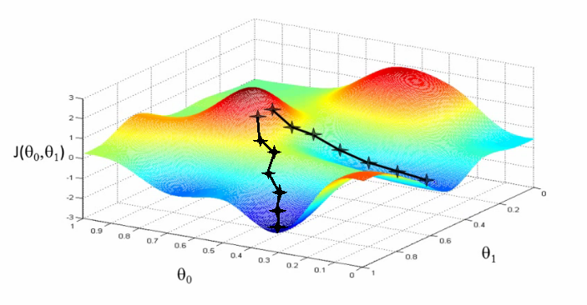
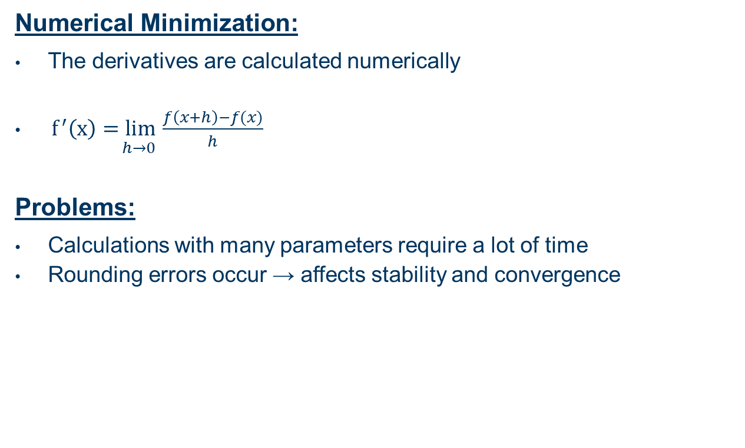
Minimization Tools for PWA – Status Quo
Numerical Minimization:
The derivatives are calculated numerically
$\underset{ h→0 }{f^{′}\left(x\right)=lim}{\frac{f\left(x+h\right)−f(x)}{h}}$
Problems:
  Calculations with many parameters require a lot of time
  Rounding errors occur → affects stability and convergence
https://miro.medium.com/max/1100/1*ZfdJDpJ8prZVJVDb2gaqRA.png

Slide 7
Autodiff - Differentiation Methods
Stable
SYMBOLIC
AUTOMATIC
Slow
Fast
NUMERICAL
ANALYTICAL
In general not possible
Unstable
https://fmin.xyz/docs/methods/Autograd/

Slide 8
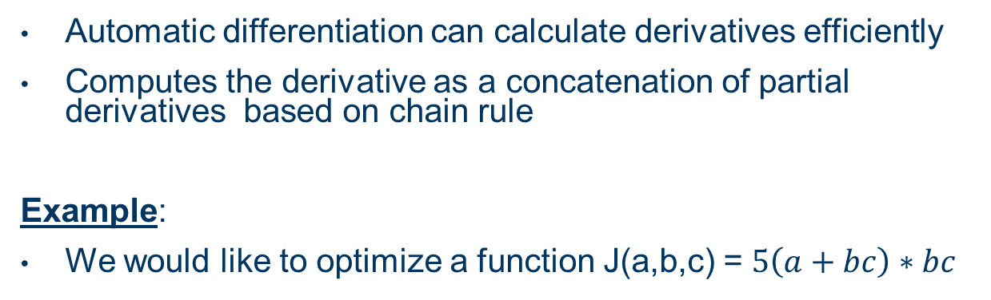
Automatic Differentiation (Autodiff) - Basics
Automatic differentiation can calculate derivatives efficiently
Computes the derivative as a concatenation of partial derivatives based on chain rule
Example:
We would like to optimize a function J(a,b,c) = $5\left(a+bc\right)∗bc$
u
v
a
J
b
v = a + u
J = 5v + u
u = bc
c
Computation Graph

Slide 9
Autodiff - Modes
Forward mode: Calculates the derivative of a function by successively applying the chain rule to the elementary function
Reverse mode: Calculates the derivative of a function by applying the chain rule to the output of the function (backpropagation)
  → Suitable for PWA → a lot of free parameters
a
b
v = a + u
J = 5v + u
u = bc
c
Computation Graph

Slide 10

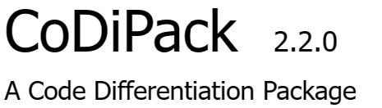
What are we currently working on?
Goal: Implementing Autodiff in PAWIAN
We tested different C++-Packages for Autodiff
  Technical requirements
  Calculation time
  CoDiPack was best suited for our requirements
Major refactorization of the code utilizing templates
CoDiPack (Code Differentiation Package): Tool for gradient evaluation in computer programs developed by TU Kaiserslautern
  Header only
  Forward mode
  Reverse mode
  Different tape implementations
  Higher order derivatives
  Less memory consumption in comparison to other AD packages

Slide 11
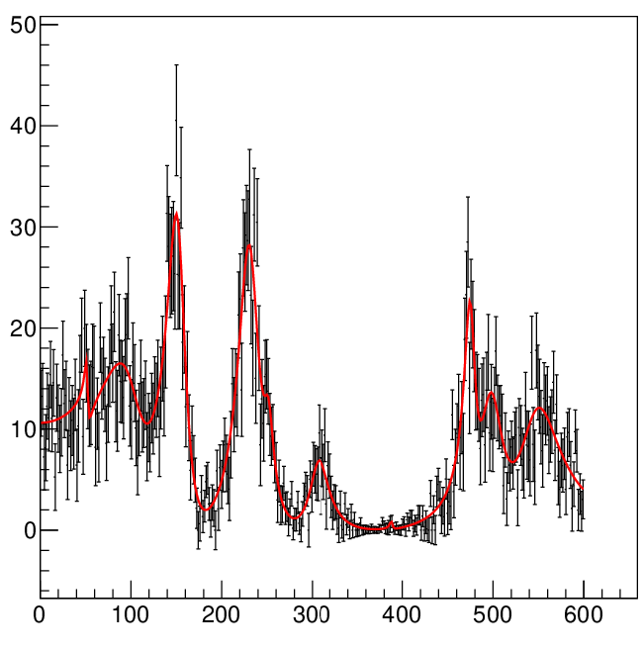
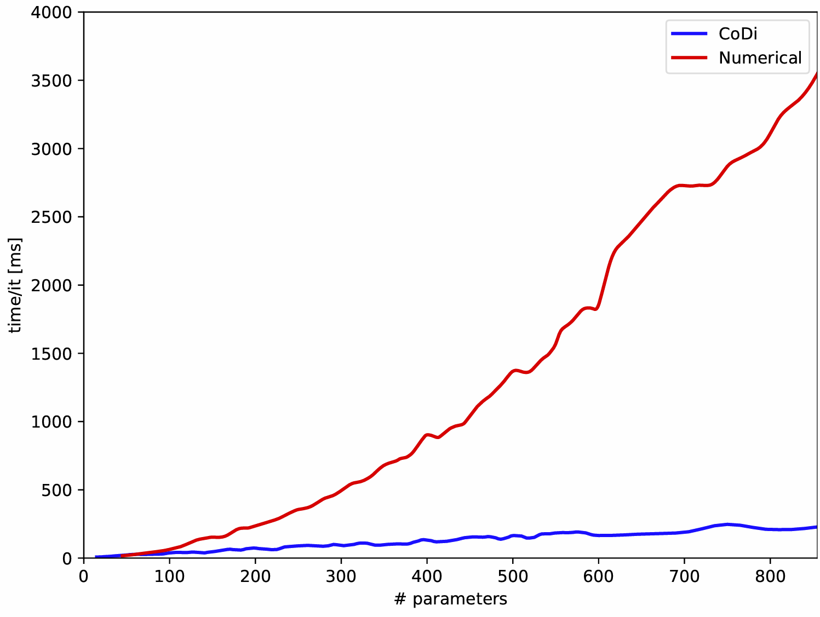
Autodiff: What we have achieved…
PAWIAN test application
  ~100k generated events
  10 – 300 Breit-Wigner functions (30 – 900 parameters)
  Comparison between numerical and automatic differentiation (reverse mode)
  Autodiff is faster (up to 10 times!!!!) and more stable than numerical differentiation with a higher number of parameters!!

Slide 12
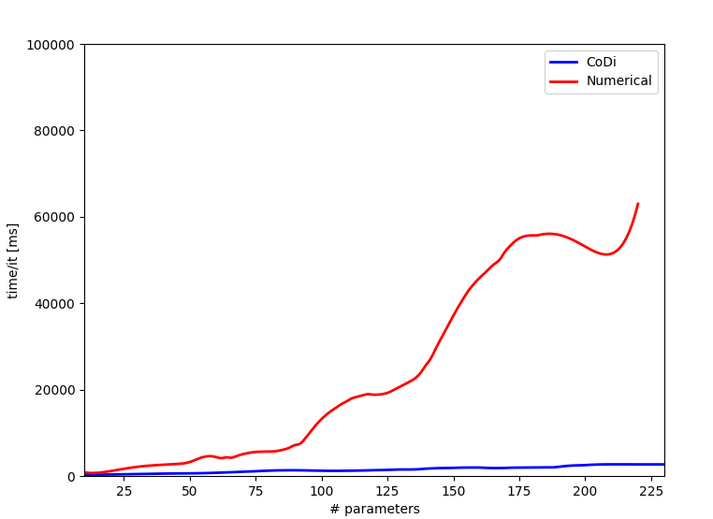
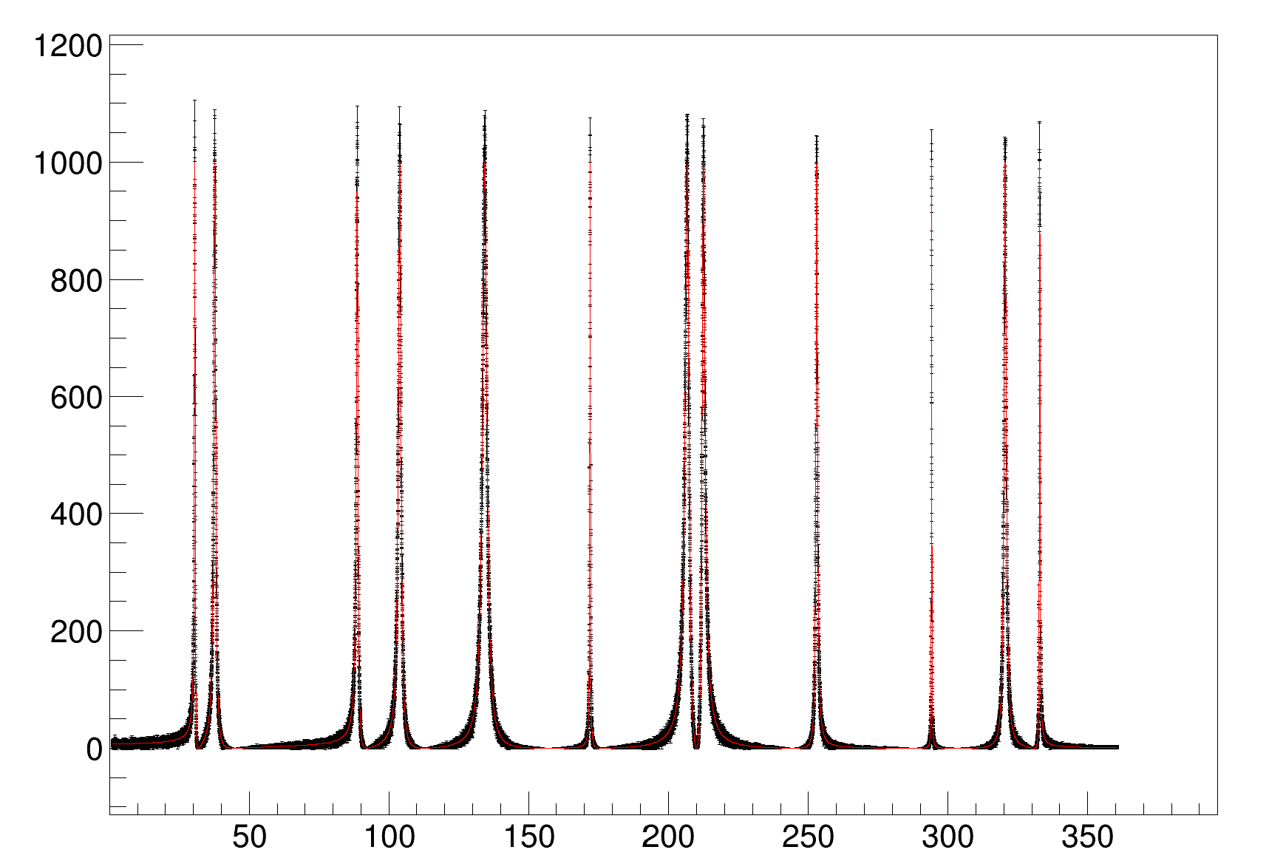
Autodiff: What we have achieved II…
To test the more complex calculations (Inversion of matrices), the T-matrix was integrated into the test application
Instead of a sum of Breit-Wigner functions, a T-Matrix with n-Poles is plotted
Similar results as in the example with the sum of Breit-Wigner functions
Autodiff is faster and more stable, especially by fitting cases with a high number of free parameters

Slide 13
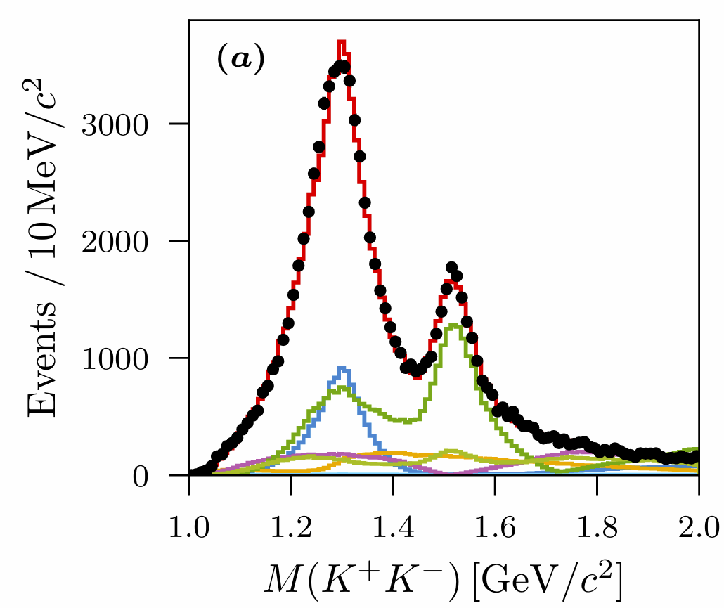
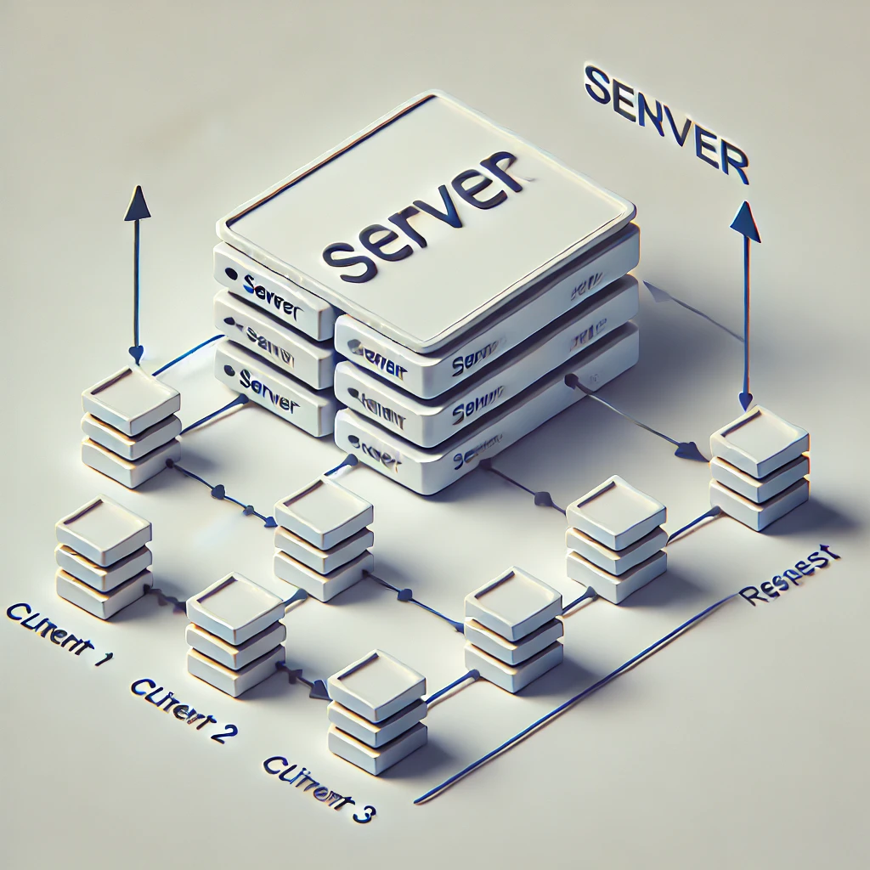
Outlook: Autodiff
  Future Tasks:
  Extending our test application to more complex models
    Coupled channels
  Performance tests with Forward-Mode
  Testing different AD packages
Autodiff in PAWIAN: Sever-Client-Mode
Coupled Channel Partial Wave Analysis of Two-Photon Reactions at BESIII, M. Küßner (Bonn)
Schematic representation of the server-client mode. Generated with ChatGPT

Slide 14
Sorting-Based Nearest Neighbour Search (SNN)

Slide 15
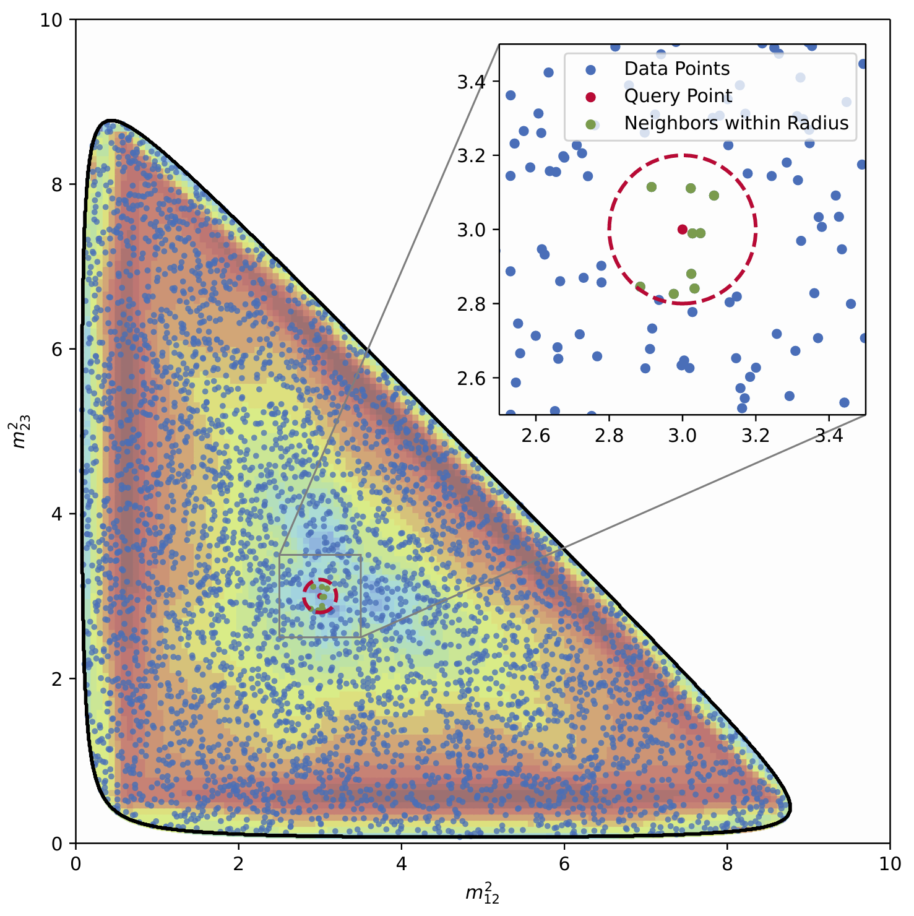
Sorting-Based Nearest Neighbour Search (SNN)
Motivation
In times of high statistic data samples events can become indistinguishable within detector resolution
  Idea: Combine events within the detector resolution without losing information
Generated by Meike Küßner, Bonn
15

Slide 16
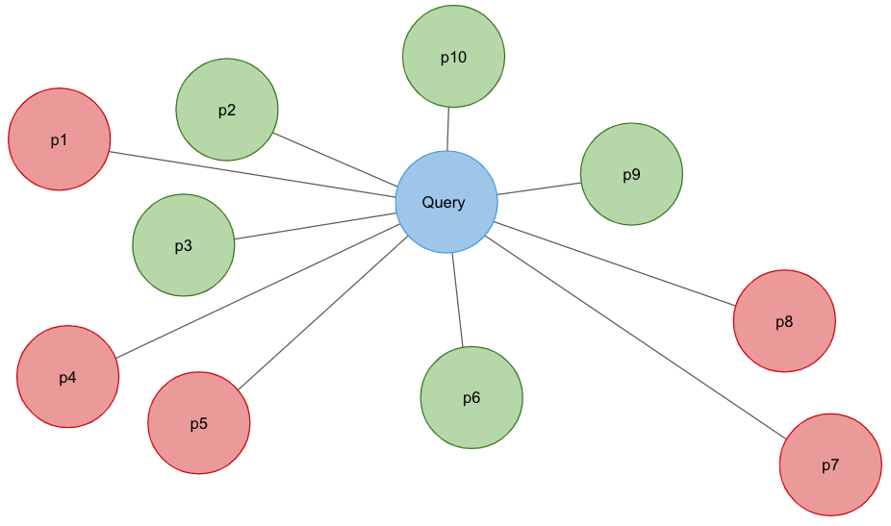
Nearest Neighbour Search – Problems with Traditional Methods
Traditional methods include k-nearest neighbor (k-NN) and fixed-radius near neighbor (FRNN) search
Existing methods face challenges in balancing speed and accuracy, particularly for high-dimensional data
Need for a method that is fast and exact without requiring complex parameter tuning
SNN algorithm based on arXiv:2212.07679v6 solves these problems
Schematic Graph of Nearest Neighbour Search:
Using approximate nearest neighbor search in real world applications | by Lester Solbakken | Towards Data Science

Slide 17
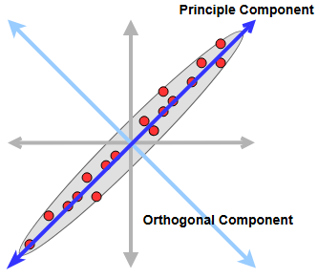
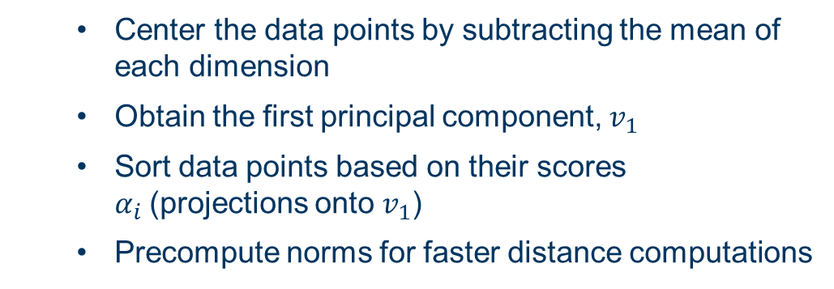
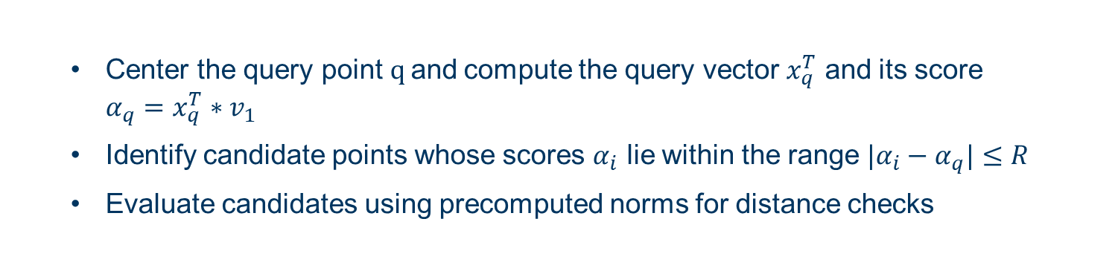

SNN - Methodology
$$v_{1}$$
Indexing Phase
  Center the data points by subtracting the mean of each dimension
  Obtain the first principal component, $v_{1}$
  Sort data points based on their scores $α_{i}$(projections onto $v_{1}$)
  Precompute norms for faster distance computations
Illustration of the first principle component, PCA: Principal Component Analysis | Baeldung on Computer Science
Query Phase
  Center the query point$q$and compute the query vector $x_{q}^{T}$ and its score $α_{q}=x_{q}^{T}∗v_{1}$
  Identify candidate points whose scores $α_{i}$ lie within the range $|α_{i}−α_{q}|≤R$
  Evaluate candidates using precomputed norms for distance checks
17

Slide 18
SNN – Advantages and Requirements
Advantages:
Simplicity: No parameters except the search radius
Exactness: Guarantees all data points within the search radius are found
Speed: Outperforms brute force and tree-based methods
Requirements:
NN search is performed before the fit to prepare the data and reassign event weights
Channel specific information need to be roughly known:
  Detector resolution
  Relevant PHSP dimensions and utilisation of symmetries
It is possible to assign individual radii depending on resolution in the specific PHSP volume

Slide 19

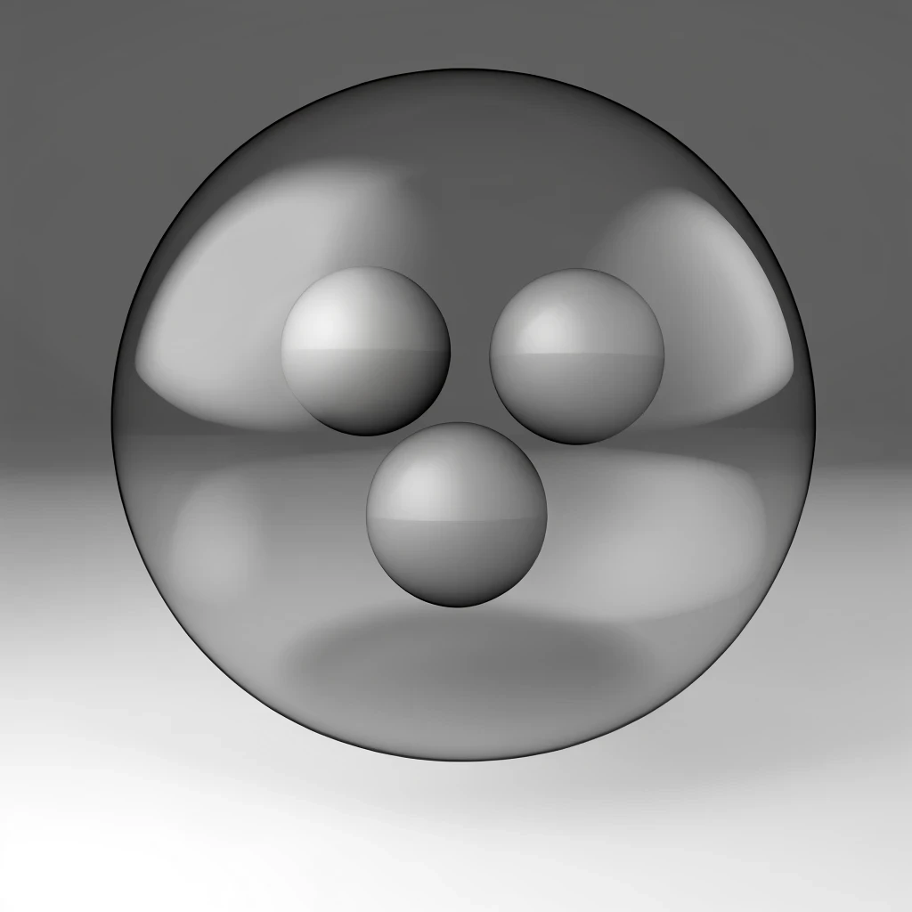
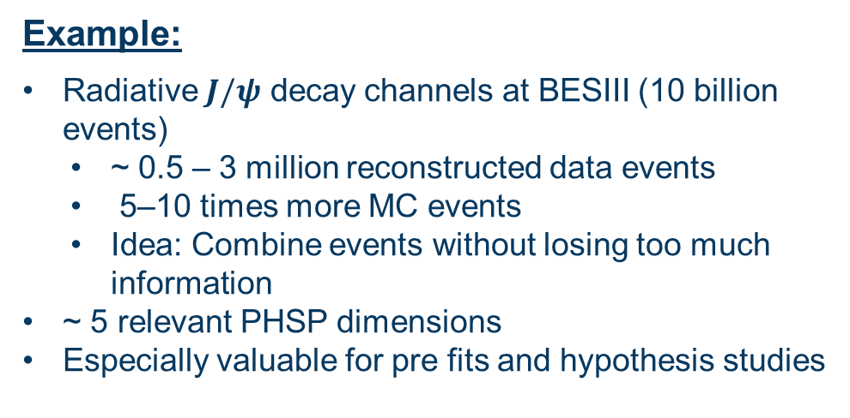
SNN – Example from radiative $J/ψ$ data
Example:
Radiative $J/ψ$ decay channels at BESIII (10 billion events)
  ~ 0.5 – 3 million reconstructed data events
  5–10 times more MC events
  Idea: Combine events without losing too much information
~ 5 relevant PHSP dimensions
Especially valuable for pre fits and hypothesis studies
Preliminary results show:
Compression:
  20% for MC
  10% for data events
  Directly proportional to computing time savings
  Fit results are comparable within precision
Generated with ChatGPT
19

Slide 20
Adaptive Moment Estimation Algorithm (ADAM)

Slide 21
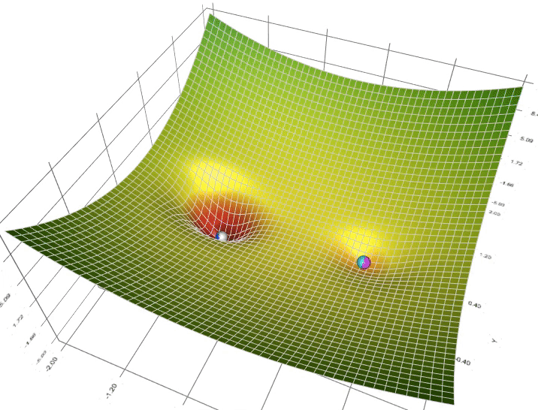
ADAM (Adaptive Moment Estimation Algorithm)
Adam optimisation is a gradient descent method based on adaptive estimation of first-order and second-order moments
Animation of 5 gradient descent methods on a surface: gradient descent (cyan), momentum (magenta), AdaGrad (white), RMSProp (green), Adam (blue).
A Visual Explanation of Gradient Descent Methods (Momentum, AdaGrad, RMSProp, Adam) | by Lili Jiang | Towards Data Science
21

Slide 22
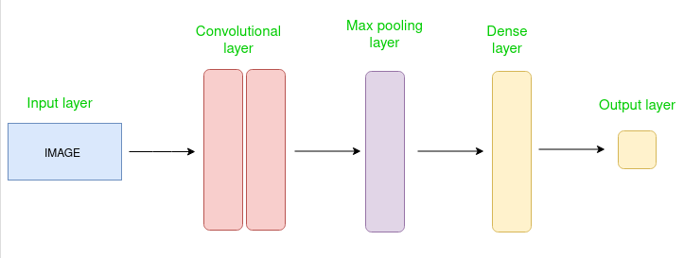
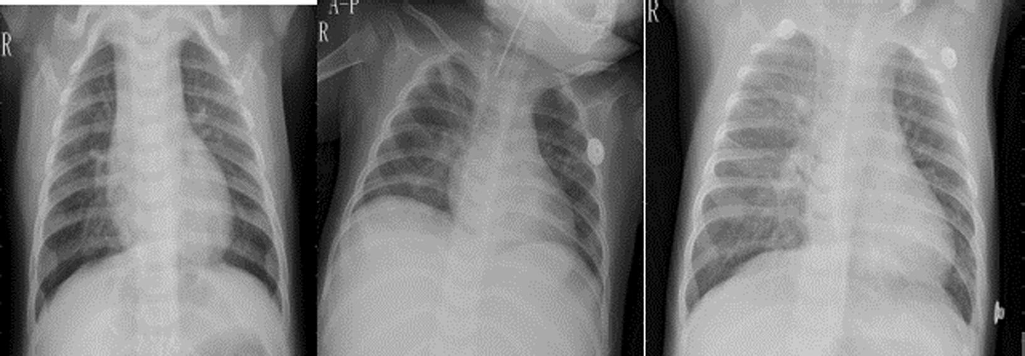

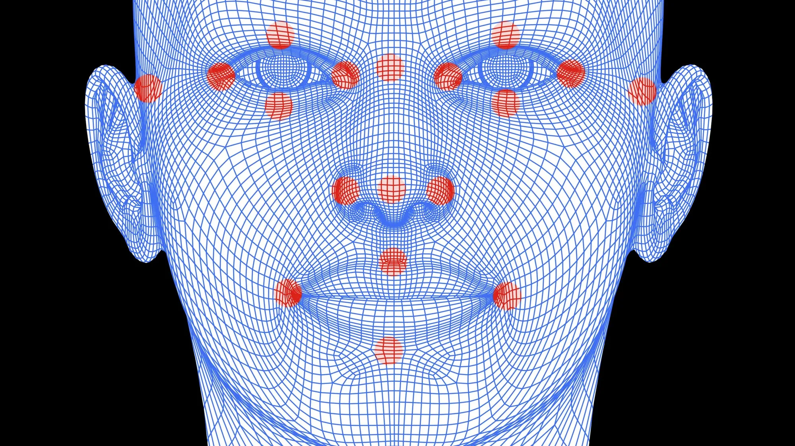

ADAM – Application Areas
ADAM is primarily used in computer science and machine learning, especially for training neural networks
Simple CNN (Convolutional Neural Network) Architecture
Some application areas of ADAM include:
    Neural Networks
    Image Processing
    Natural Language Processing (NLP)
    Game AI and Reinforcement Learning
    …
ADAM is used in medical imaging: https://doi.org/10.1016/j.measurement.2021.109153
ADAM is an essential component of many modern machine learning applications!
    Particle Physics
Facial Recognition Systems – identifying faces in security and smart devices
ADAM is used for NLPs like ChatGPT

Slide 23


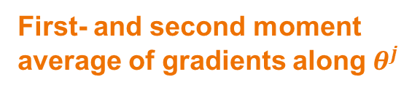

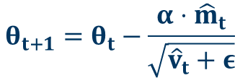


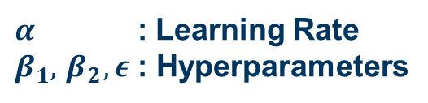
ADAM – Basics
Input
$g_{t}$ : Gradient
$α$ : Learning Rate
$β_{1},{ β}_{2}, ε$: Hyperparameters
$$m_{t}=β_{1}^{t}⋅m_{t−1}+\left(1−β_{1}^{t}\right)⋅g_{t}$$
$${\hat{m}}_{t}=\frac{m_{t}}{1−β_{1}^{t}}$$
$$v_{t}=β_{2}^{t}⋅v_{t−1}+\left(1−β_{2}^{t}\right)⋅g_{t}^{2}$$
$${\hat{v}}_{t}=\frac{v_{t}}{1−β_{2}^{t}}$$
First- and second moment average of gradients along $θ^{j}$
Bias-Correction
$$θ_{t+1}=θ_{t}−\frac{α⋅{\hat{m}}_{t}}{\sqrt{{\hat{v}}_{t}+ε}}$$
t = Iteration
Corrected Parameters
Output
Adam: A Method for Stochastic Optimization (arxiv.org)

Slide 24
ADAM – Evaluation
Advantages:
Adaptive Learning Rates: Individual learning rates for different parameters
Fast and efficient: Performs well for computational efficiency and memory usage
Versatility: Suitable for a wide range of optimization problems
Disadvantages:
Non-Convergence in Some Cases: Slower convergence near minimum
→ Idea: MINUIT2 or L-BFGS https://doi.org/10.48550/arXiv.1802.05374
Tuning of Hyperparameters: Not straight-forward
24

Slide 25

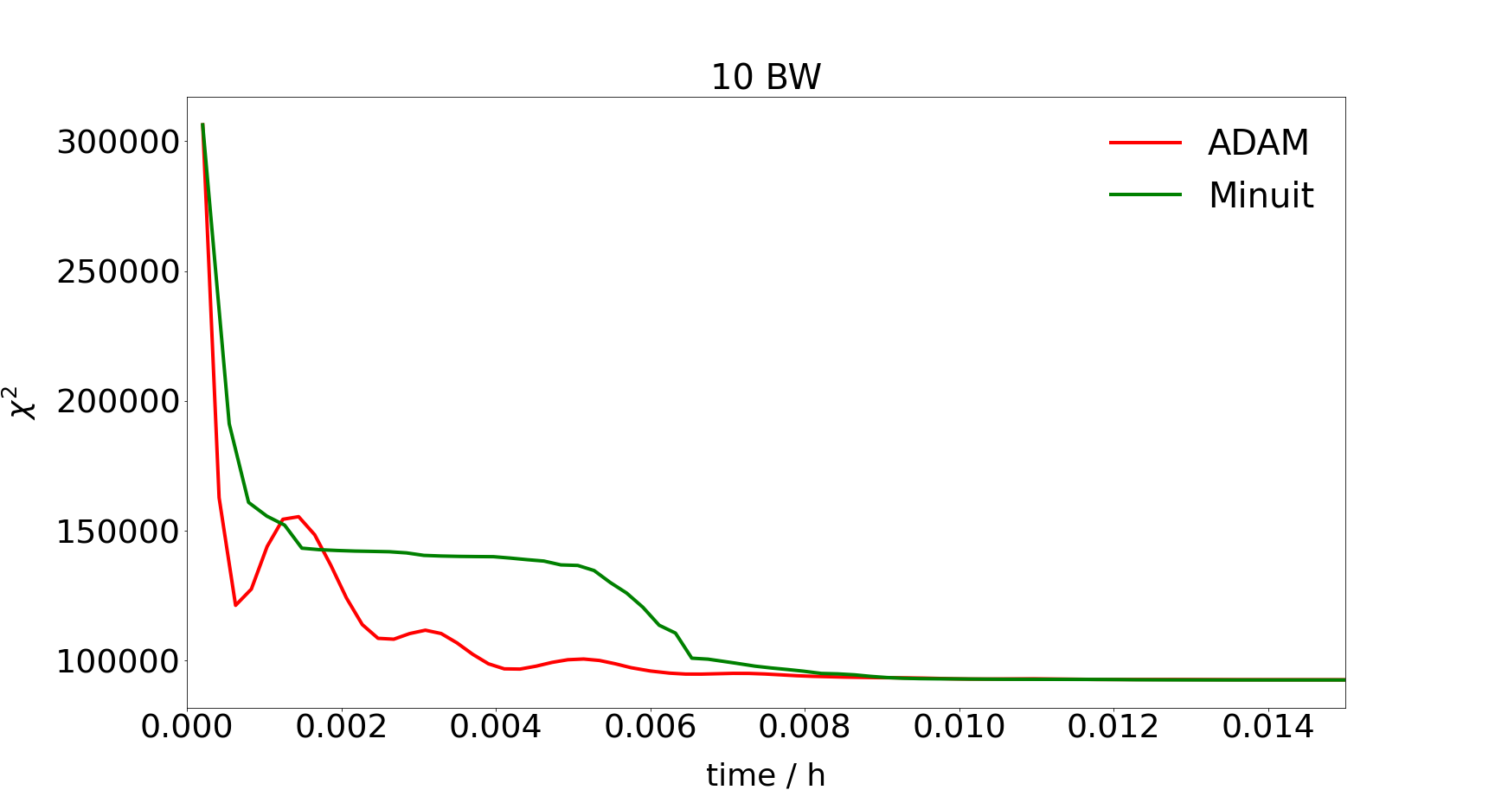
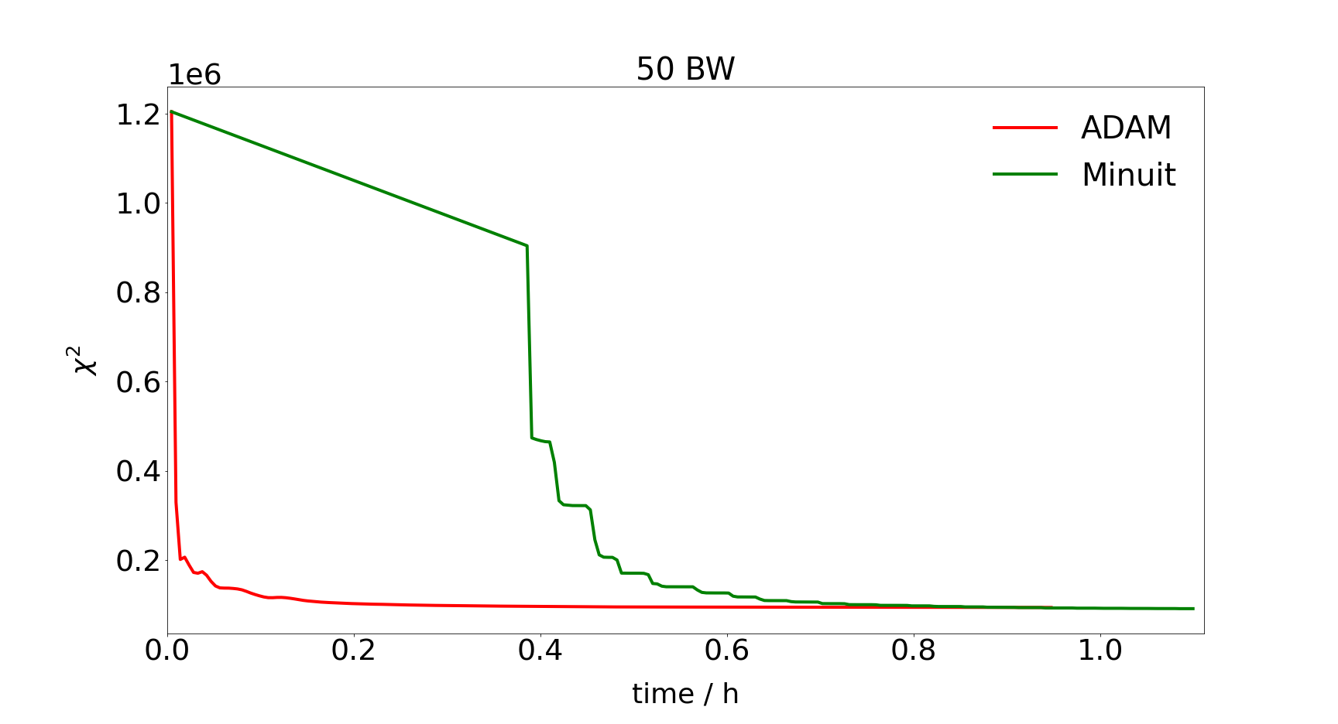
ADAM – First Tests
Development of a test application in PAWIAN
Comparison between MINUIT2 and ADAM for a sum of Breit-Wigner functions
ADAM reaches the vicinity of the minimum much faster than MINUIT2
ADAM is very efficient at the beginning of the minimisation
Use ADAM first, and then switch to MINUIT2 near the minimum

Slide 26
Summary and Outlook
ADAM:
At the beginning of a minimisation, ADAM is faster than MINUIT2
Future Tasks:
  Replacing or connecting MINUIT2 with ADAM
SNN:
Compression of 10% for data and 20% for MC data
Future Tasks:
  Testing various radii and estimate general critical turnover point
Autodiff:
CoDiPack: faster (factor 10) and more stable than the numerical method!!!
Future Tasks:
  Testing CodiPack in Server-Client Mode
  Tests with ADAM and Autodiff
26

Slide 27
Thanks for your Attention!
fhanisch@ep1.rub.de

Slide 28
SNN-Backup
Computational Considerations
Arithmetic complexity is reduced by using precomputed dot products and matrix operations
BLAS (Basic Linear Algebra Subprograms) for fast computation on modern architectures
Handling of floating-point arithmetic ensures high accuracy
Theoretical Analysis
Efficiency of SNN depends on the number of distance computations
Analysis shows that the algorithm is more efficient with increasing query radius
SNN balances between exhaustive search and efficient pruning of search space

